Slide 1
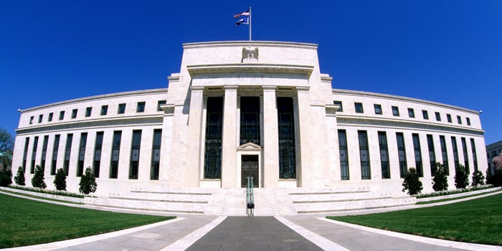
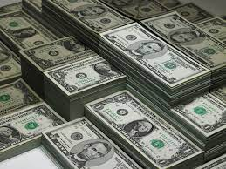
Monetary Policy & The Fed
Money Talks Monthly Seminar
Geoffrey Woglom,
Amherst College, emeritus
National Economic Education Delegation
May 20, 2024
Notes:
Jump to 6

Slide 2
Submitting Questions
There will be a Q&A once the material has been presented.
Slides will be posted at https://needecon.org/delivered_presentations.php.
Access to my Google site:
https://sites.google.com/view/macro-current-issues/monetary-policy

Slide 3
Outline
Facts about the Fed; and its historical performance.
The short-run determinants of inflation and unemployment.
The Fed’s policy tools.
Monetary policy during the recession and the subsequent rise in inflation.
Where does the Fed go from here?

Slide 4
The Evolution of the Fed’s Role in the Macro Economy
Federal Reserve Act of 1913 – “furnish an elastic currency”
Employment Act of 1946
  “Full employment” is a Executive Government Responsibility.
  Council of Economic Advisors.
  Economic Report of the President.
Humphrey Hawkins Act 1978 & the Fed’s “Dual” mandate
  Full employment
  Price stability
Division of Labor between Monetary and Fiscal Policies.

Slide 5
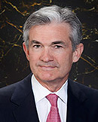
Stabilizer in Chief: the Fed
The Fed’s Dual Mandate:
  “Stable prices” which means 2% rate of inflation in the Personal Consumption Price Index (which corresponds to about 2.5% inflation in the more well-known CPI).
  “Maximum employment” which means the highest level of employment (lowest unemployment rate) consistent with mandate 1.
Monetary policy is made by the Federal Open Market Committee (FOMC), comprised of the 7 Fed Governors and 5 of the 12 Presidents of the Regional Federal Reserve Banks on a rotating basis.
The FOMC has scheduled meetings 8 times a year, but can hold unscheduled meetings at a moments notice (e.g., March of 2020)
Jerome Powell
February 2018
Notes:
Define inflation as the rate of increase in the average level of prices not gasoline price inflation. Exceptions Deep Recesssions. ARP we will talk about later.

Slide 6
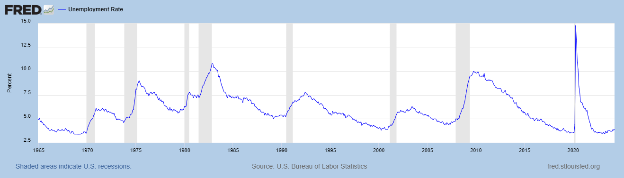
Track Record on Unemployment
Volcker Disinflation
Shaded Bars are Recessions

Slide 7
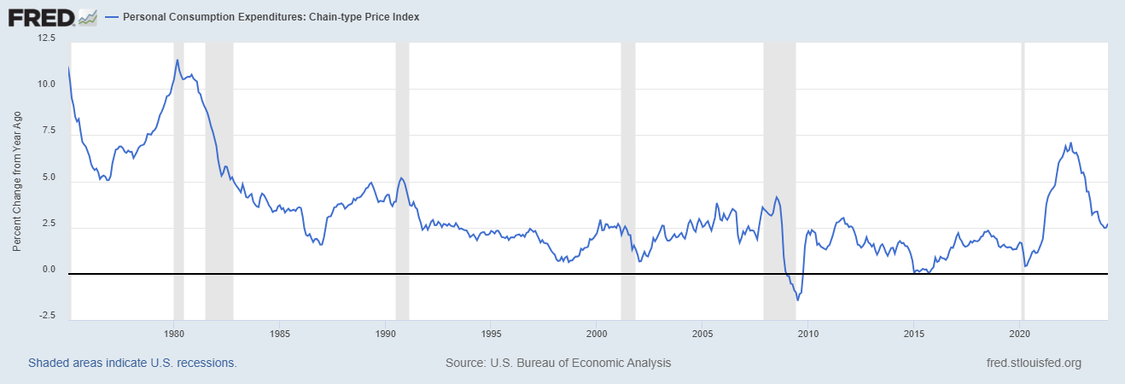
Track Record on “Price Stability”
The Great Moderation
Notes:
Shaded lines are recessions . 1970S THE Great Moderation

Slide 8
Determinants of Unemployment & Inflation
Short run:
Unemployment: The higher the level of total spending the lower the unemployment rate.
Inflation:
  “Too much Spending:” Total spending above the economy’s normal capacity (“potential output”) tends to increase inflation (Vietnam War) .
  Increase in production costs (e.g., “supply chain bottlenecks;” stagflation of the 70s)
  Expectations of high inflation can cause inflation to be high (persistence of high inflation in early 80s).
The Fed can affect 1, influence 3., but has no effect on 2.
Notes:
One sign of too much spending is a very low unemployment rate. Go back to 19 and 20 then to 21

Slide 9
What about the Money Supply?
Notice the absence of the money supply. The Fed does not believe there is a reliable, short-run link between the money supply and total spending or inflation.
The Minutes of the 3/19-20 FOMC Meeting mentions:
  Money Supply, M1, M2 – 0 times
  Federal funds rate – 18 times

Slide 10
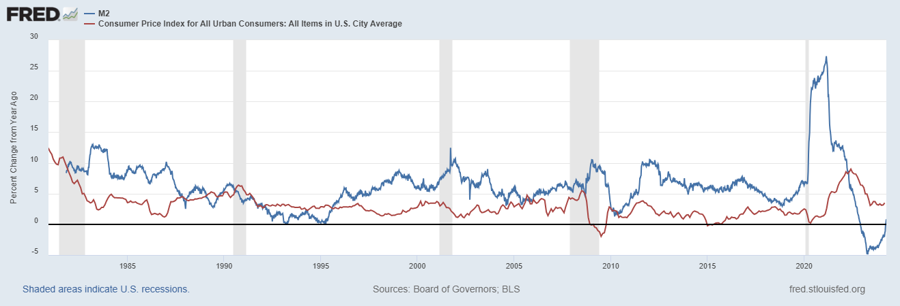
Do You See a Relationship?

Slide 11
The Fed’s Affects the Economy via Interest Rates
Higher Interest rates discourage firms from buying new plant and equipment, households from buying new homes, and tend to lower stock and housing prices (!).
Lower spending tends to raise unemployment and eventually lowers inflation.

Slide 12
Become a Central Banker in One Slide!
If you are more concerned that inflation is too high, raise interest rates to lower total spending below potential output.
If you are more concerned that unemployment is too high, lower interest rates to raise total spending.
Inflation and unemployment just right: keep rates the same.
Sounds Easy! But…

Slide 13
One Big Complication: Lags
Milton Friedman: Monetary Policy affects GDP and Inflation with Long and Variable (Unpredictable) Lags.
Raising interest rates today does nothing to spending today nor to inflation.
But over time spending slows and eventually inflation falls.
Friedman believed that lags led the Fed to “oversteer” the economy consistently.

Slide 14
A Closer Look at Interest Rate Control
Primary Tool: the Fed targets the federal funds rate (or fed funds rate for short), the interest rate on overnight loans between banks.
The Fed adjusts bank reserves so that the federal funds rate is within a target range 25 basis points wide; e.g., 5.5-5.25%
From the bank’s perspective these loans are very close substitutes to other short-term, safe assets such as Treasury Bills.
Therefore, controlling the fed funds rate gives the Fed close control over all safe, short-term interest rates.
Notes:
Target range for the fed funds rate

Slide 15
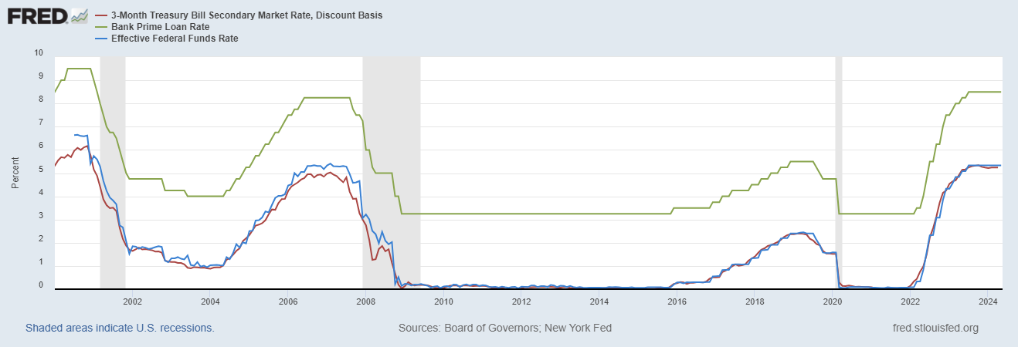
The Fed and Short-term Interest Rates
Blue is the fed funds rate.
Red is the rate on 3 month Treasuries.
Green is the prime bank lending rate
Notes:
Take note over the redline peeking above the others

Slide 16
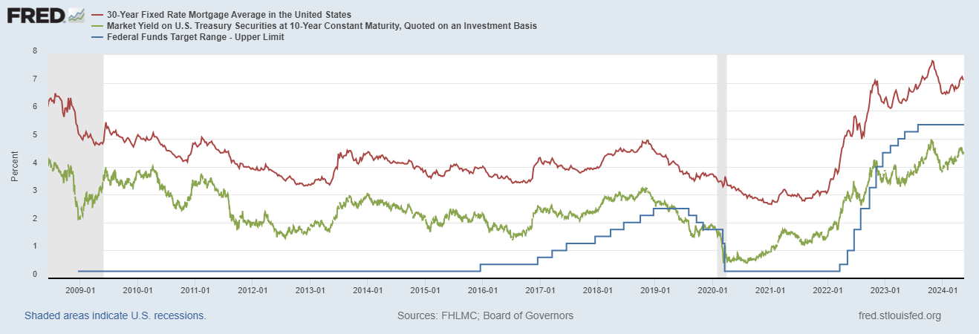
The Importance of Long-Term Interest Rates
Nobody buys a house because of the level overnight interest rates.
Notes:
Red line was 90-day cp, the TBIll line was 1 month rate

Slide 17
Long-Term Interest Rates
Unfortunately, the current fed funds rate has much less influence on long term interest rates.
Instead, long-term interest rates depend on two factors
  The average of expected, future short-term rates over the life of the long-term bond. Friday, US Treasuries: 1-Yr 5.14; 2-Yr 4.83. Why?
  “Risk” premia that reflect the possibility of unexpected changes in interest rates and the possibility of default.
The Secondary Tools are aimed at affecting these factors.
Notes:
Red line was 90-day cp, the TBIll line was 1 month rate

Slide 18
Two Secondary Tools to Affect Interest Rates
Forward Guidance: Communicating the Fed’s intentions for the future path of short-term interest rates.
Long-term Asset Purchases better known as quantitative easing or QE.
Both of these tools also affect interest rates, and thereby aggregate demand. But their effect is on interest rates for longer-term and riskier assets.
Notes:
Forward guidance occurs not just with the FOMC policy statments

Slide 19
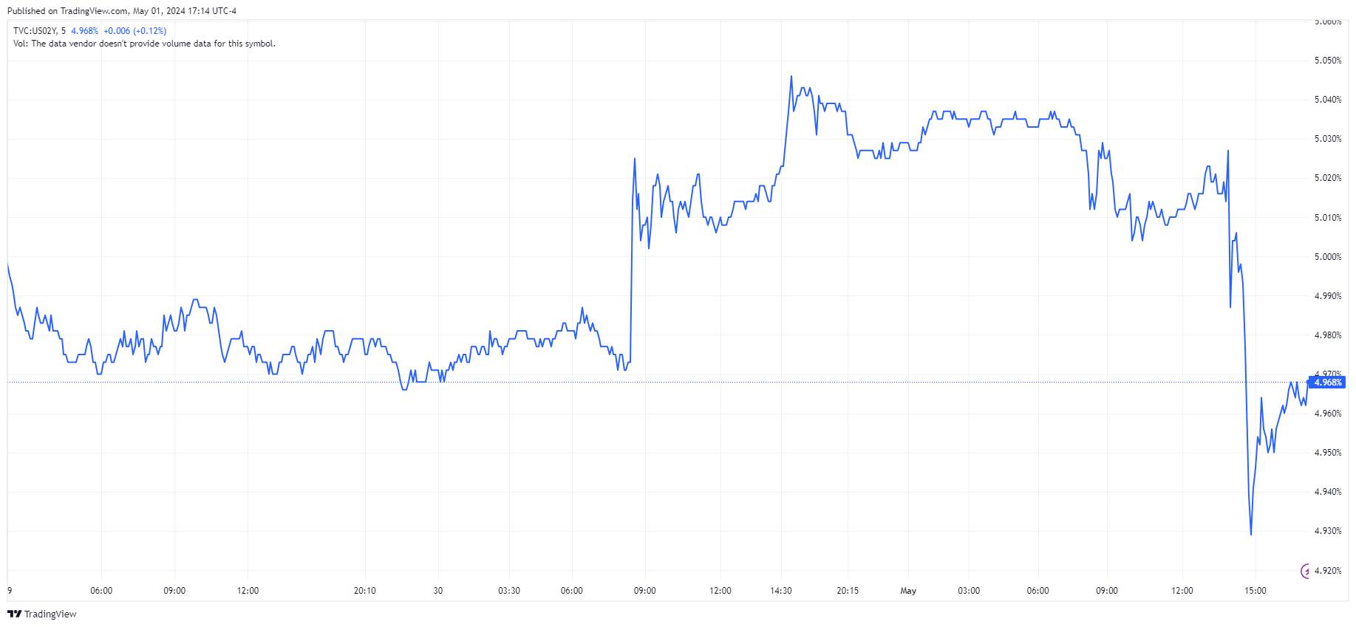
When Jay Powell Talks, People Listen!
Notes:
April 30th Employment Cost Index

Slide 20
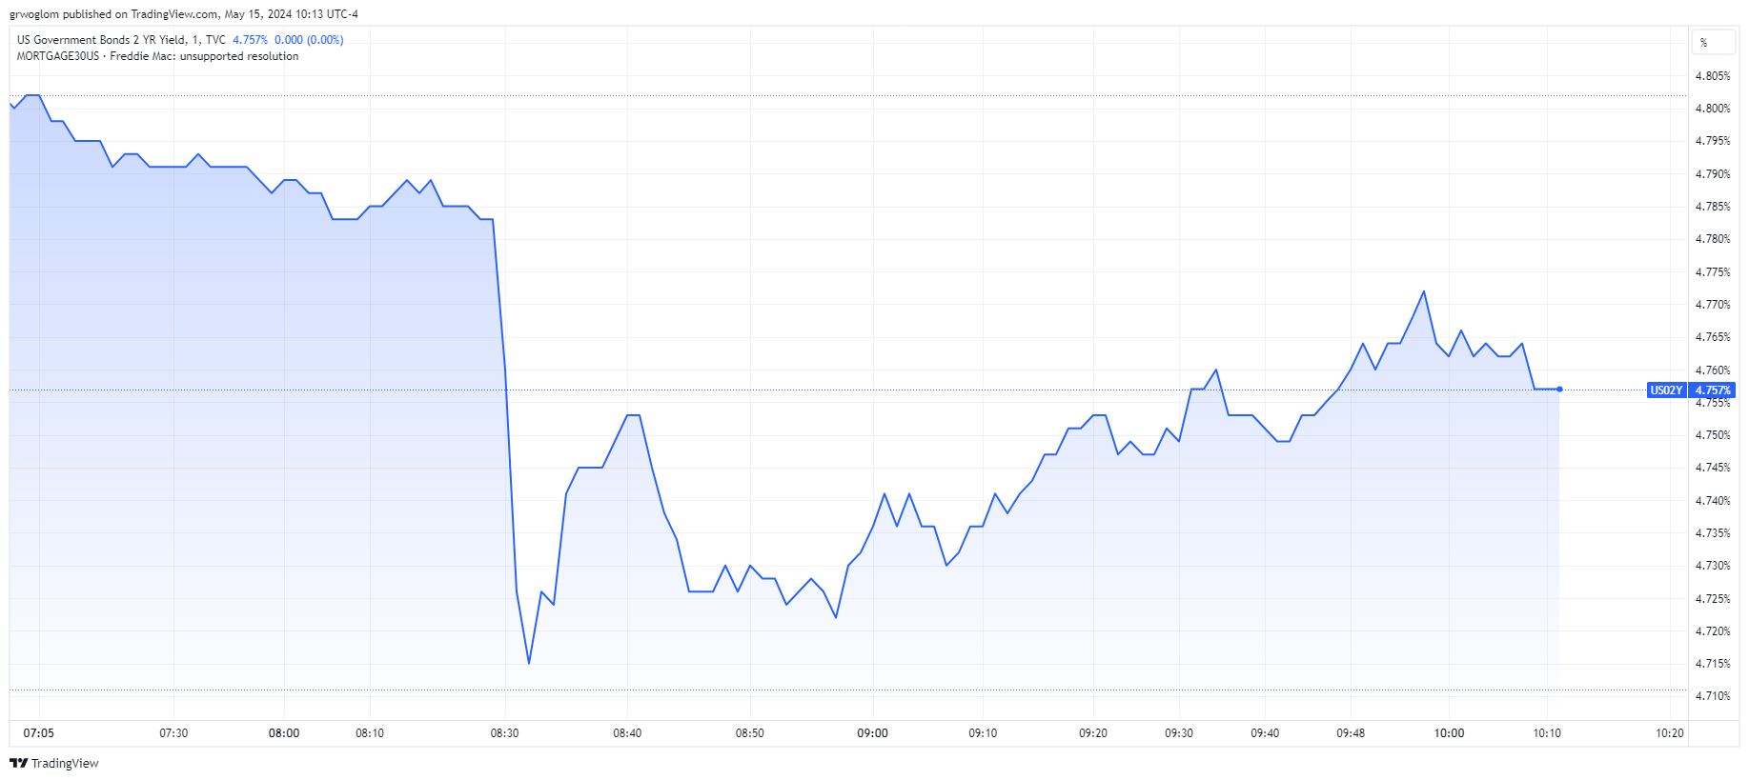
People also Listen to the BLS!

Slide 21
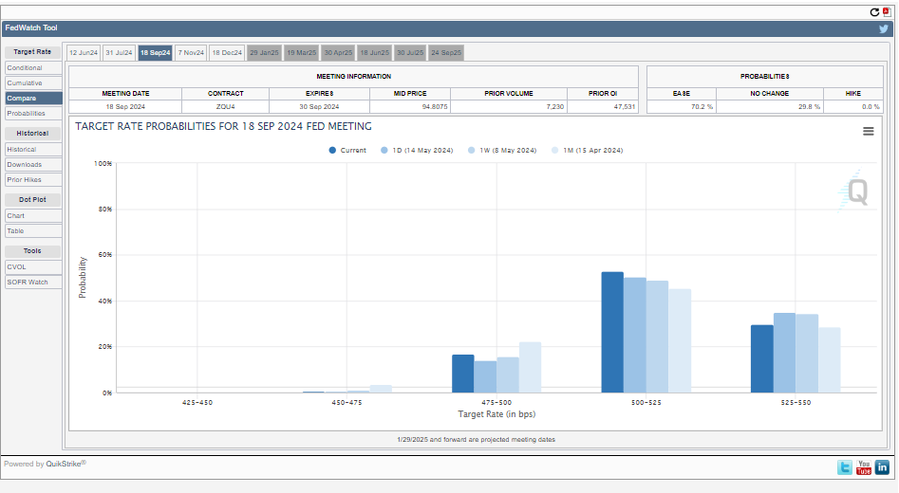
Predicting Future Fed Actions
https://sites.google.com/view/macro-current-issues/monetary-policy

Slide 22
QE And Long-term, Risky Rates
Financial investors require a higher interest rate on risky bonds, than on safe short-term Treasuries.
The lower the supply of risky bonds, the lower the required risk premia needed to get enough private investors to buy them.
QE lowers the supply of long-term bonds held by private investors and thereby lowers to required risk premia and the interest rate on these bonds.

Slide 23
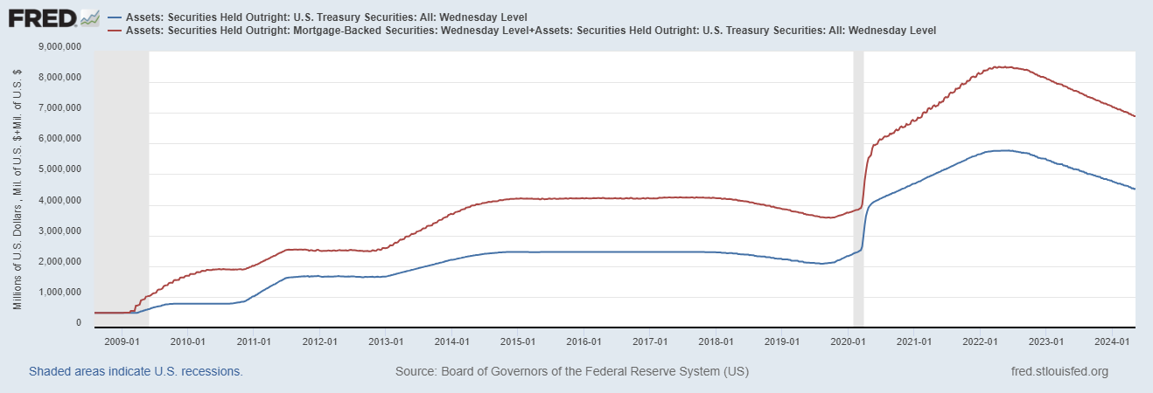
QE Had Been a Big Deal
Quantitative
Tightening!
Source: Federal Reserve Board
Notes:
25% of marketable Federal Debt; 20 percent of household mortgages. Total Fed assets increase by over 1.2 tr in 9 weeks;
Then by over 2.6 tr second time.

Slide 24
A Policy Strategy: Stabilize Expectations of Inflation
Monetary Policy is much easier if the people believe that the Fed will achieve its inflation target.
Ben Bernanke (2007):
”…if inflation expectations respond less than previously to variations in economic activity, then inflation itself will become relatively more insensitive to the level of activity…”
In central bank jargon, stable expectations are “well anchored.”

Slide 25
Anchoring Requires Credibility
Credibility, the public believes that the Fed will achieve its goals.
Requirements for Credibility
  Transparency (Communication)
  Accountability (Performance) BOE Letter?
  Political Independence
Notes:
Communication releases; accountability, Congressional Testimony and 5 year full release. Political independence 14 year terms, but fragile.

Slide 26
The Great Moderation
Volcker paid a price in the early 1980s, but the price paid dividends from 1990 through 2008.
During that period the performance of the US economy was extraordinary and even Milton Friedman gave kudos to the Alan Greenspan.
Has Powell jeopardized Volcker’s legacy?
Notes:
Go back to 16

Slide 27
Policy Changes under Powell
In the Fed’s dual mandate FOMC put more emphasis on the employment goal relative to the inflation goal.
Inflation goal switched from targeting forecasted future inflation to:
“In order to anchor longer-term inflation expectations at this [2 percent], the Committee seeks to achieve inflation that averages 2 percent over time, and therefore judges that, following periods when inflation has been running persistently below 2 percent, appropriate monetary policy will likely aim to achieve inflation moderately above 2 percent for some time.”
Notes:
Description of Policy goals reversed the order of the inflation and employment objectives

Slide 28
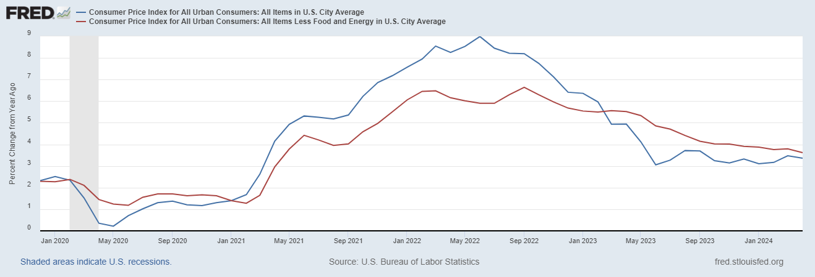
Why Didn’t the Fed Act by April 2021?
Have They Forgotten about Policy Lags!!
But, by March 2022 Things Changed!

Slide 29
Has Powell Learned His Lesson
Letting inflation exceed the target causes lots of problems.
Because of lags you must act in advance of a potential problem.
But, in January of this year the Fed reaffirmed that it was targeting average realized inflation!
But where does the economy go from here?

Slide 30
Fed Economic Projections
3/20/2024
Austin Goolsbee, President of the Chicago Fed. The economy is on a “golden path” and will achieve the “mother of all soft landings.”
Notes:
Survey of Professional Forecasters from early August: GDP and unemployment much like the June Fed forecast. Inflation much like the Fed’s September forecast.

Slide 31
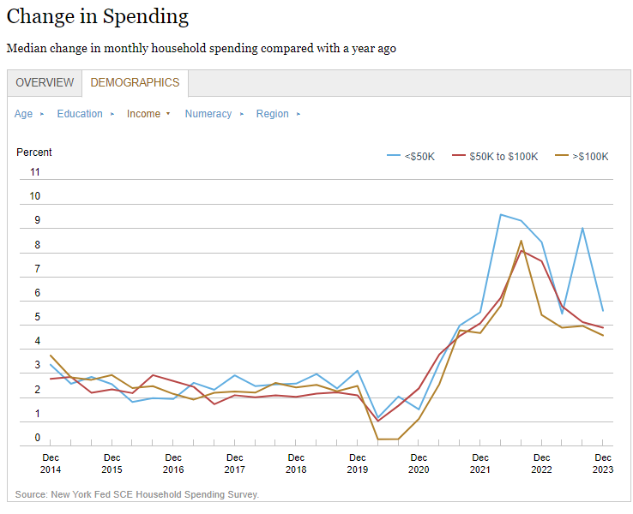
Maybe Not!

Slide 32
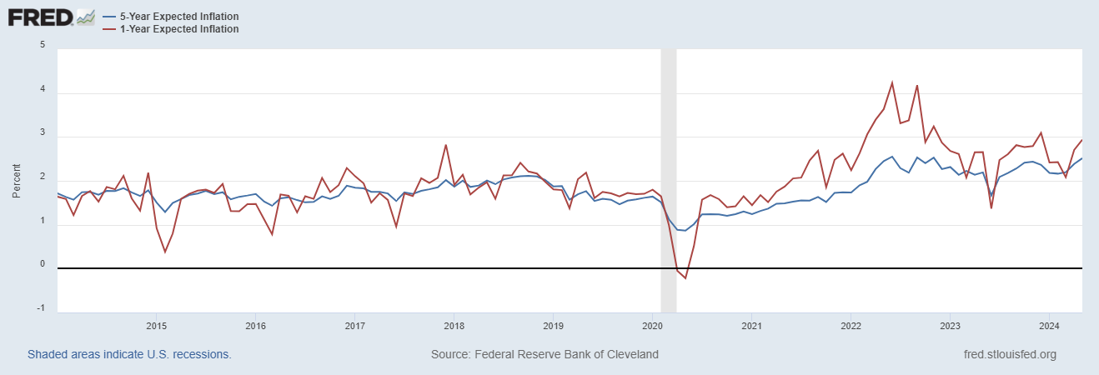
Inflation Expectations: Heating Up?

Slide 33
Above My Pay Grade
To Cut or Not To Cut.
Don’t Forget about Lags.
Political Reaction once Rates Start Coming Down (Unemployment Up)?
Stay Tuned: 5/31, April PCE Inflation (BEA); 7/7 May Employment Report (BLS), 7/12, May CPI Inflation (BLS); 7/12 FOMC Mtg.!
The 2024 election may hinge on what the Fed does and when.

Slide 34
Let’s Hear from You!
Geoffrey Woglom grwoglom@amherst.edu
https://sites.google.com/view/macro-current-issues/monetary-policy
Contact NEED: Info@NEEDEcon.org
Support NEED: www.NEEDEcon.org/donate.php

