Slide 1
Osher Lifelong Learning Institute, Spring 2025
Contemporary Economic Policy
University of Hawaii, Manoa
Host: Geoffrey Woglom
Director, National Economic Education Delegation

Slide 2
Available NEED Topics Include:
US Economy
Healthcare Economics
Climate Change
Economic Inequality
Economic Mobility
Trade and Globalization
Minimum Wages
Immigration Economics
Housing Policy
Federal Budgets
Federal Debt
Black-White Wealth Gap
Autonomous Vehicles
US Social Policy

Slide 3
Course Outline
Contemporary Economic Policy
  Week 1 (6/2): Economic Update (Geoffrey Woglom, Amherst College)
  Week 2 (6/09): Climate Change Economics (Sarah Jacobson, Williams College)
  Week 3 (6/16): Economic Mobility (Jon Haveman, Exec Director, NEED)
  Week 4 (6/23): Health Economics (Robert Rebelein, Vassar College)
  Week 5 (6/30): Cryptocurrencies (Joan Nix Queens College (CUNY)

Slide 4
Submitting Questions
Submit questions in the chat or by raising your digital hand.
  I will try to handle them as they come up.
We will do a verbal Q&A once the material has been presented.
Slides will be available from the NEED website tomorrow (https://www.needecon.org/delivered_presentations.php)

Slide 5



Economic mobility
Jon Haveman
NEED
June 16, 2025
<location/audience>
<date>
Notes:
M

Slide 6
Credits and Disclaimer
This slide deck was authored by:
  Oana Tocoian, UCSD
  Kathryn Wilson, Kent State University
  Jon Haveman, NEED
Disclaimer
  NEED presentations are designed to be nonpartisan.
  It is, however, inevitable that the presenter will be asked for and will provide their own views.
  Such views are those of the presenter and not necessarily those of the National Economic Education Delegation (NEED).

Slide 7
Outline
I. What do we mean by economic mobility?
II. Empirical patterns of economic mobility
III. What is the desired level of economic mobility?
IV. Exploring channels/barriers to upward mobility and policy options.

Slide 8
I. What do we mean by economic mobility?
Definition and motivation

Slide 9
Economic Mobility – Defined
Economic Mobility – Our working definition:
  Ability to advance beyond the status of your parents.
Variety of measures:
  Income
  Wealth
  Education level
  Occupation
  Home ownership
More Broadly:
The ability to improve your socioeconomic status.
We will consider intergenerational mobility in INCOME.

Slide 10

Absolute and Relative Mobility
Absolute mobility: the difference in income from one’s parent.
    You’re higher on the escalator than your parents were at the same age.
    It is possible for everyone to experience upward absolute mobility, especially if the escalator is going up.
Relative mobility: the change in income rank from one’s parent.
    You have fewer people above you on the escalator than your parents did.
    Increased relative mobility requires both upward and downward movement.

Slide 11
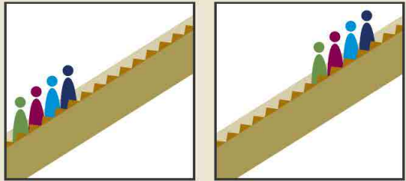
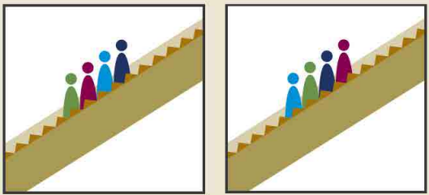
More on Absolute vs Relative Mobility
Can there be absolute mobility with NO relative mobility?
  Yes: if everybody experiences the same increase in income, there will be no relative mobility.
Can there be relative mobility with NO absolute mobility?
  Yes: There can be a dramatic reshuffling of the distribution even if there is no increase in average income.
Parents Kids
Parents Kids
+2
-1
+1
-2

Slide 12
Economic Growth and Mobility
Economic growth should drive absolute mobility
  It has the potential to raise all incomes.
  But the extent of mobility that results depends on how income is distributed.
Economic growth and relative mobility are unrelated
  Growth does not have implications for whether kids are more or less likely to rise above their parent’s position in the income distribution.

Slide 13
II. Empirical patterns of Economic Mobility
What are the facts?

Slide 14
Mobility – Big Picture for Absolute Mobility
Decline in absolute mobility in the United States:
  90% of those born in the early 1940s could expect to earn more than their parents in real terms.
  For millennials, the fraction is closer to 50%.
  Below-median earnings have not increased in real terms since the 1970s.

Slide 15
9 out of 10 of those born in the early 1940s could expect to earn more than their parents.
  1 in 2 Millennials (born after 1980) earn more than their parents.
Year of Birth

Slide 16
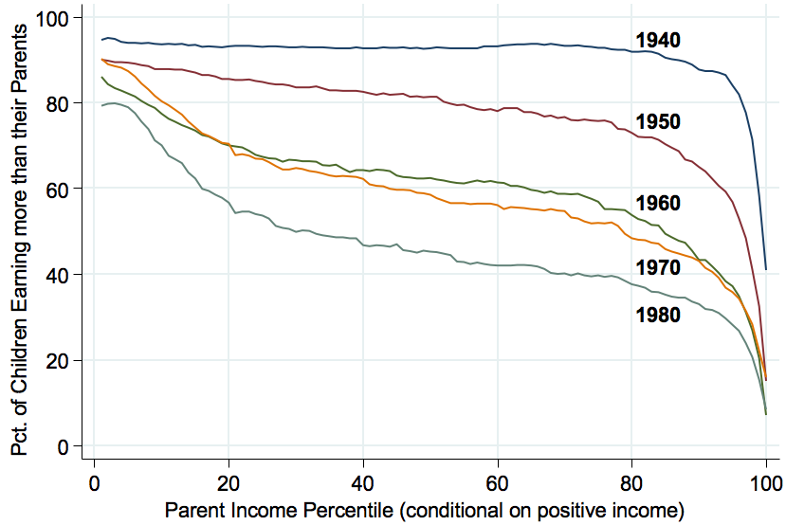
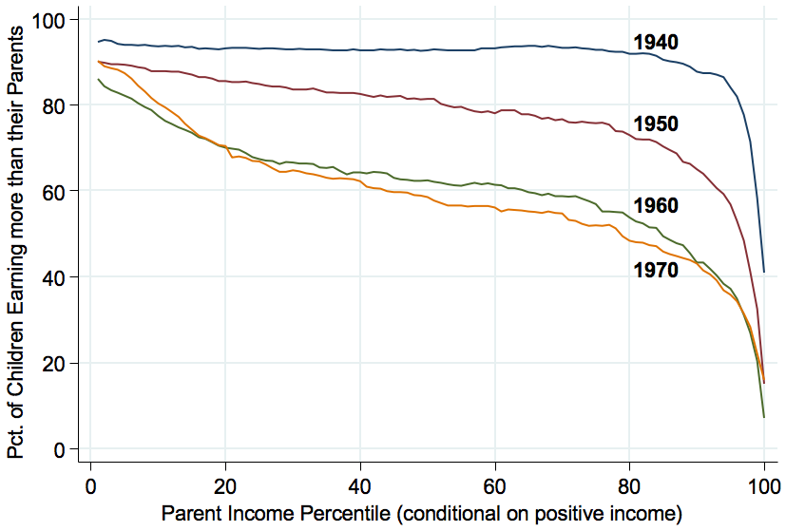
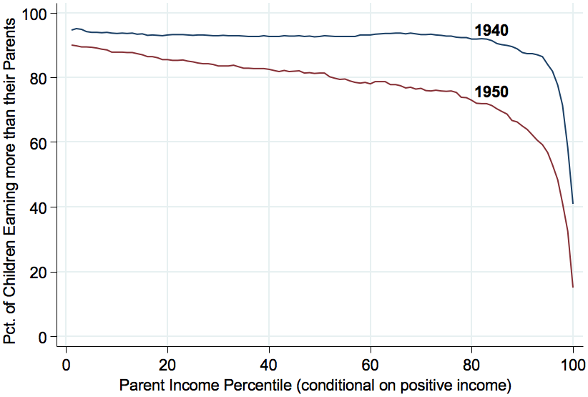
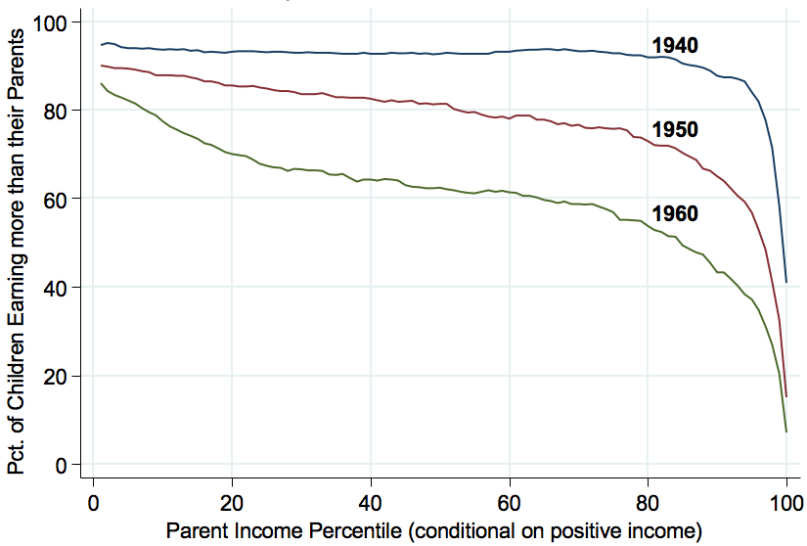
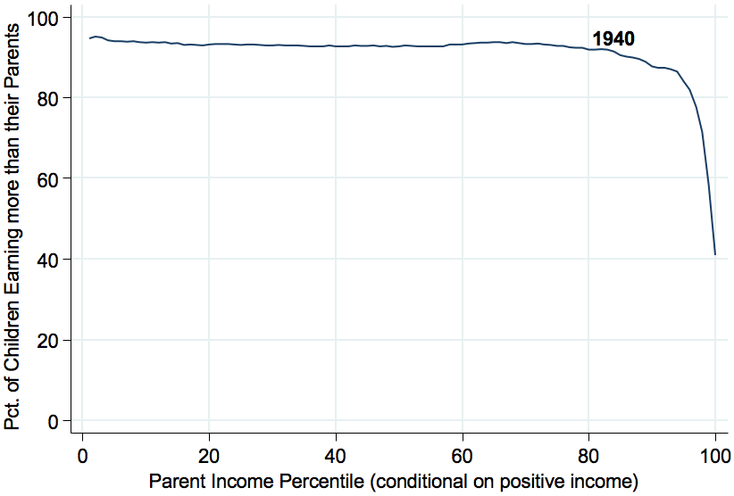
Absolute Mobility by Birth Cohort
94%
93%
88%
70%
45%
33%

Slide 17
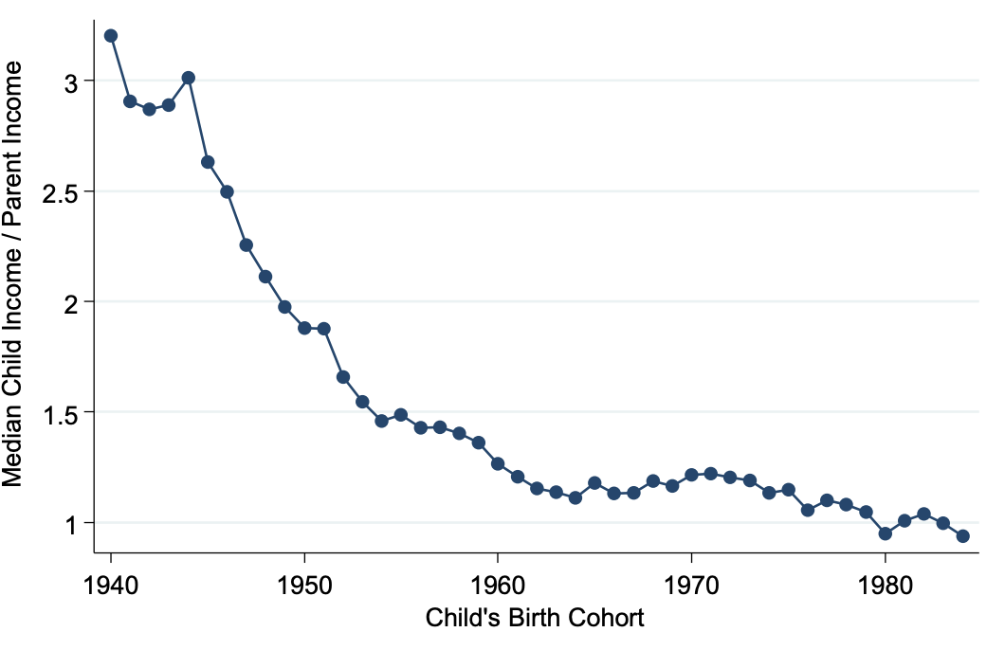
Ratio of Child to Parent Income by Birth Cohort
3
1
Source: https://opportunityinsights.org/wp-content/uploads/2018/03/abs_mobility_paper.pdf

Slide 18
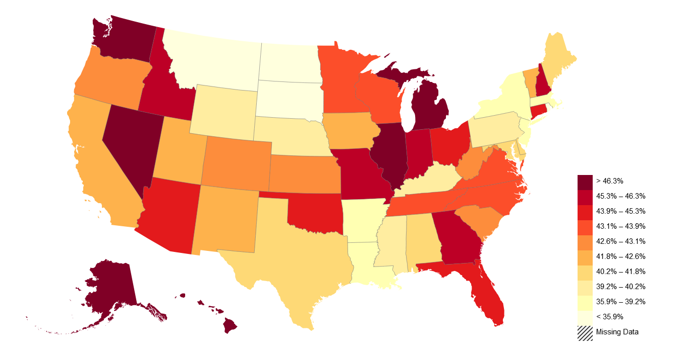
American Dream: Geography Matters
Trends in Absolute Mobility by State: Change from 1940-1980
Decline in Abs. Mob. from 1940-80
Source: https://opportunityinsights.org/paper/the-fading-american-dream/

Slide 19
Measuring Relative Mobility
Reminder: Relative mobility is the change in income RANK from one’s parents.
Transition Probabilities: Likelihood that an individual ends up in a different income quintile than their parents.
Perfect Mobility: For each of the parental income quintiles, 20% of their offspring end up in each income quintile as adults.
Quintile | Bottom (below 20%) | Lower (20% to 40%) | Middle (40% to 60%) | Upper (60%-80%) | Top (above 80%)
Income | Below $27,000 | $27,000-$52,000 | $52,000-$85,000 | $85,000-$141,000 | Above $141,000

Slide 20
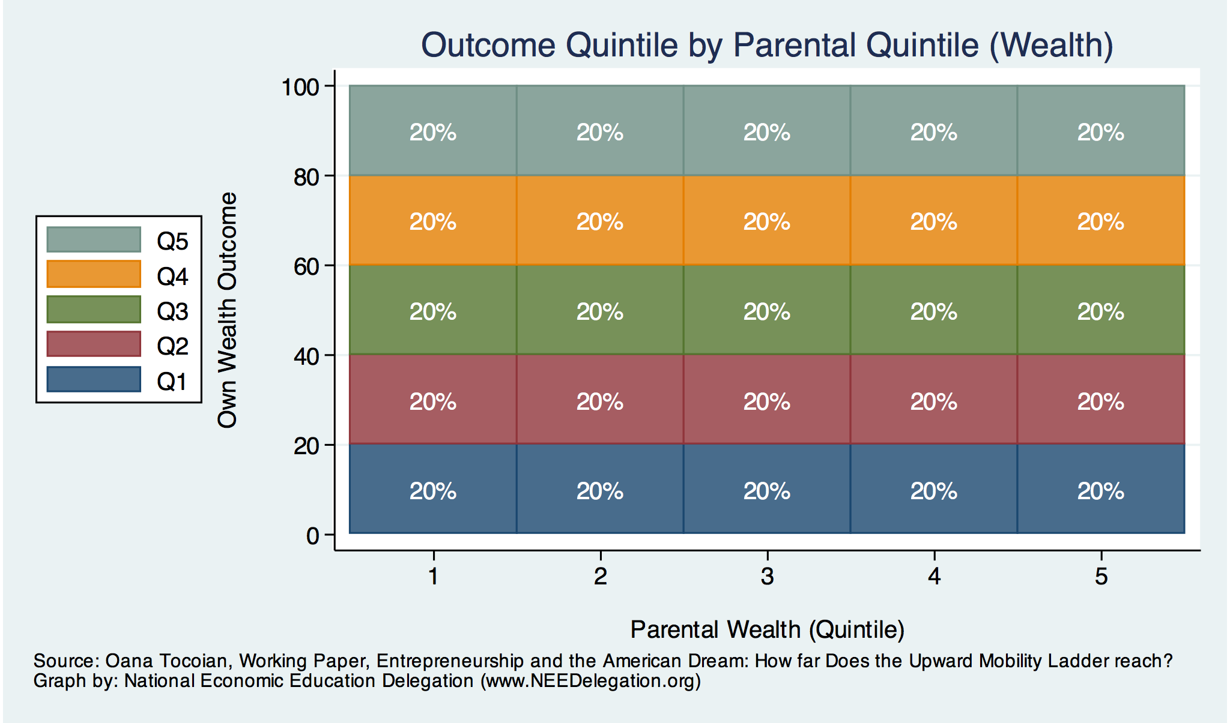
Wealth Mobility – Perfect Mobility

Slide 21
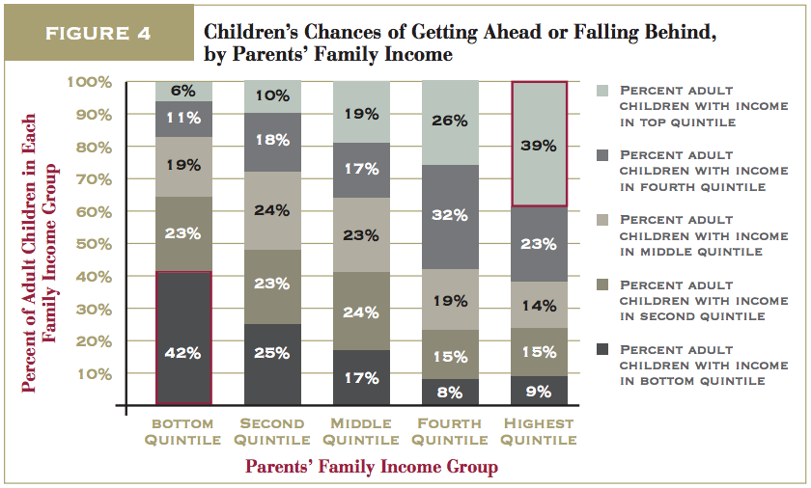
Transition Probabilities in the United States
https://www.brookings.edu/wp-content/uploads/2016/06/11_generations_isaacs.pdf

Slide 22
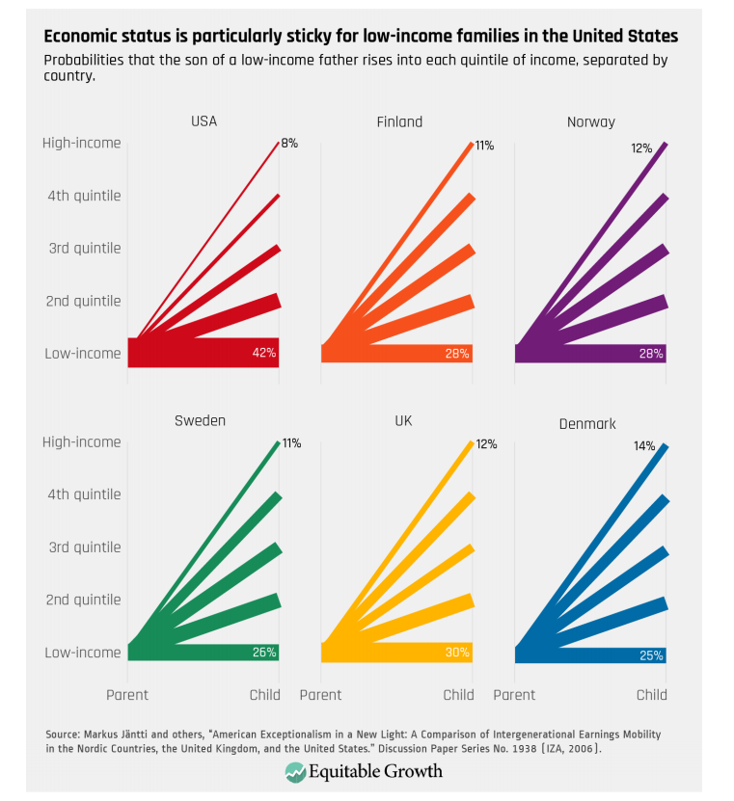
Transitions: International Comparisons
Source: : https://equitablegrowth.org/research-paper/are-todays-inequalities-limiting-tomorrows-opportunities

Slide 23
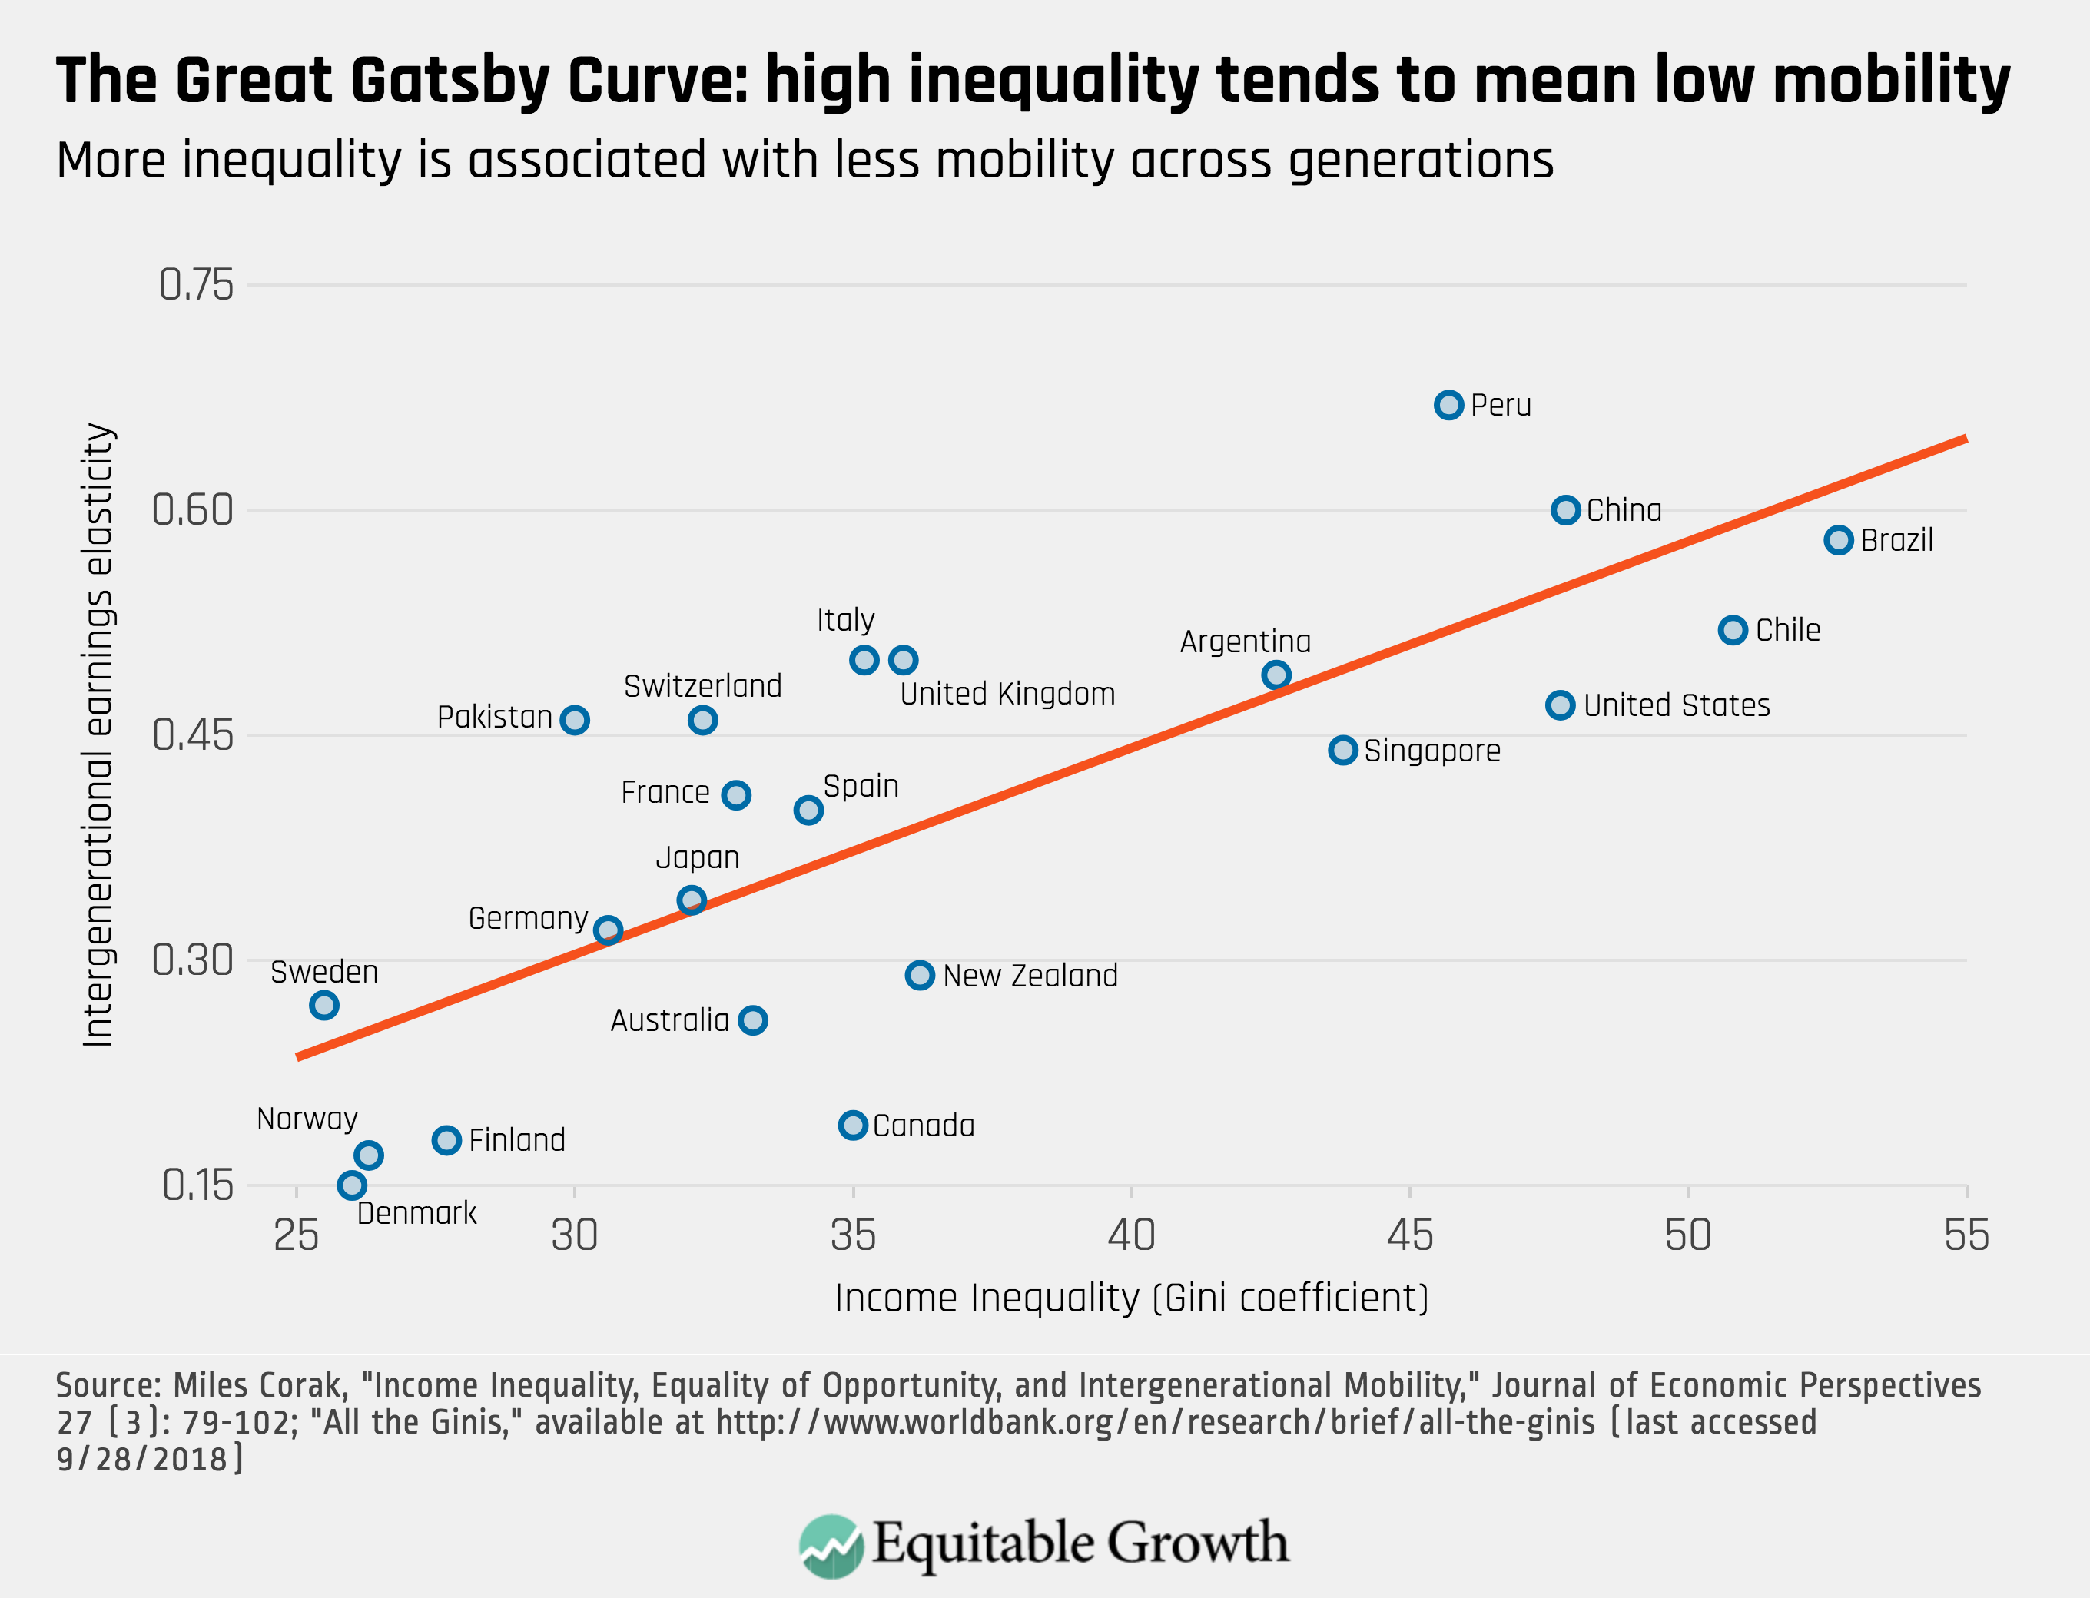
Peru
China
Brazil
Less Economic Mobility
Germany
U.S.
Canada
https://equitablegrowth.org/research-paper/are-todays-inequalities-limiting-tomorrows-opportunities

Slide 24
American Dream: Geography Matters
More Relative Upward Mobility
https://www.brookings.edu/blog/social-mobility-memos/2018/01/11/raj-chetty-in-14-charts-big-findings-on-opportunity-and-mobility-we-should-know/

Slide 25
Summary of Empirical Patterns
Absolute economic mobility in the United States has been in decline since the 1940s.
  Half of people born in the mid-1980s have not outperformed their parents in terms of income.
Relative mobility is lower in the United States than many developed countries.
  Income is especially “sticky” at the bottom and the top of the income distribution.
Geography matters – there is tremendous variation in mobility within the United States.

Slide 26
III. What is the desired level of economic mobility?
Economically what is optimal? What do people think is optimal?
Mobility and Inequality

Slide 27
Absolute or Relative Mobility?
Upward absolute mobility of the whole population is unambiguously desirable (it’s hard to defend not wanting everyone to be better off!).
    The fact that half the population is treading water should worry us.
But, relative mobility is a zero-sum game: for some people to rank higher than their parents did, others have to rank lower.

Slide 28
The “Right” Level of Relative Mobility
Efficiency
  Want to provide incentives in order to get economic growth.
Equity
  Want a system that is “fair”.
What is the optimal level of relative mobility?
  This is a hard question, one which we may not be able to answer or agree on.
Is current relative mobility too low (or too high)?
  The answer would suggest the best incremental steps to take towards a better outcome, and policy changes are best done in incremental steps in any case.

Slide 29
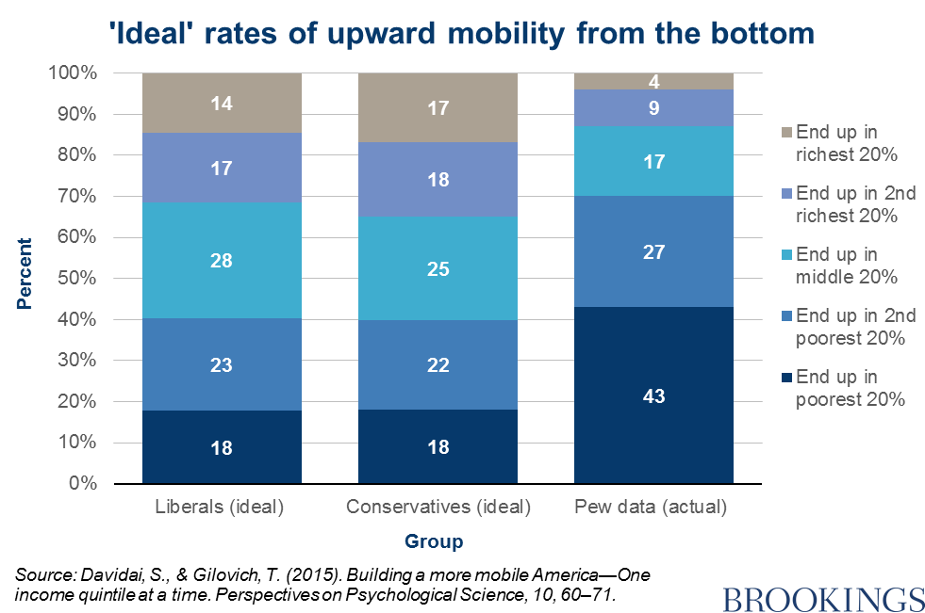
“Survey Says” on Upward Mobility from the BOTTOM

Slide 30
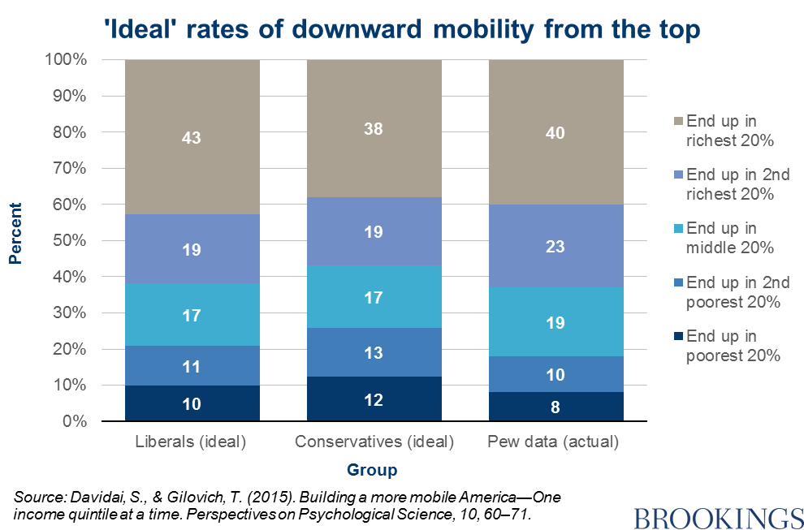
“Survey Says” on Downward Mobility from the TOP

Slide 31
Preferences hit Awkward Truth: Math
Again: relative mobility is a zero-sum game.
  There are only so many spots in the top quintile (only 20% of population can be there)
    Preferences want:
      43% of them for kids born into the top
      16% for those born into the bottom
      Leaves about 14% for each of the other 3 quintiles
    Preferences are inconsistent
      Greater upward mobility for the bottom than the middle?
Results are intuitive:
  Stickiness at the top
  Mobility from the bottom
…but inconsistent:
  What about the middle?

Slide 32
Public Perception and Sentiment
Perception: “American Dream” vs “Old World”
  General belief is that the U.S. has greater mobility than elsewhere.
    Fewer explicit barriers – no nobility titles.
    More meritocratic – “rags to riches”, Heratio Alger
    The American Dream plays a significant part in national identity.
Reality: Overestimate of actual mobility
  Common perception is incorrect.

Slide 33
Intergenerational Elasticity – of Income
Most common measure of relative mobility (IGE):
  Q: What is the relationship between the family income of parents and the family income of their child?
    A lower IGE implies more economic mobility.
Problems with IGE:
  Strongly influenced by income inequality.
  Strongly affected by data used:
    Age range
    Can’t include people with zero earnings.
    Etc.

Slide 34
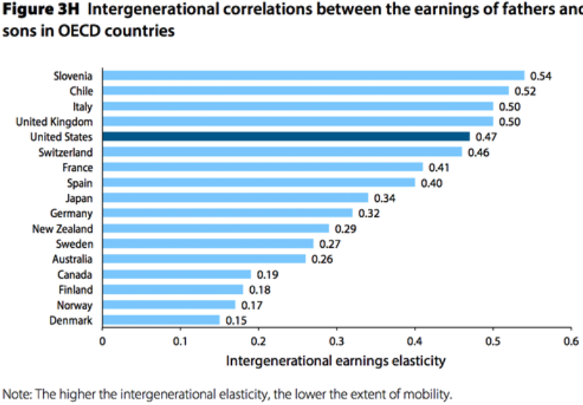
IGE: U.S. in International Comparison
Less
Mobility
More
Mobility
https://www.epi.org/publication/usa-lags-peer-countries-mobility/

Slide 35
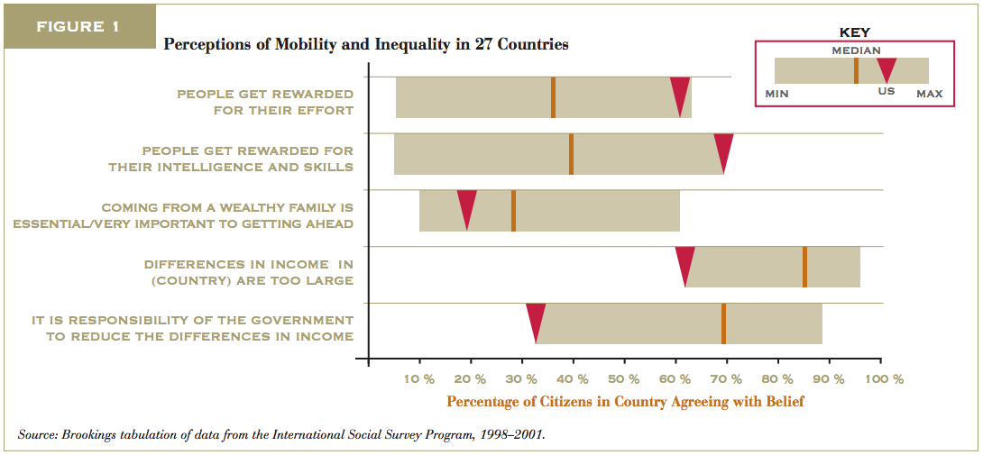
The “American Dream” Shapes Perceptions
https://www.brookings.edu/wp-content/uploads/2016/06/02_economic_mobility_sawhill.pdf

Slide 36
IV. Exploring channels/barriers to upward mobility and policy options
Focus on Education and Career Opportunities

Slide 37
Barriers to Upward Mobility
Key Question:
What are the factors that might prevent someone born
in a low-income household from doing as well as their
richer counterpart?
Answers:
  Birth Lottery
  Structural barriers

Slide 38
Barriers to Upward Mobility – Birth Lottery
Early advantages
  Innate (genetic) advantages:
    Inherited ability, medical conditions, psychological traits
  Environmental factors:
    In utero: pre-natal care, mother’s nutrition, exposure to abuse or stress.
    Home environment which promotes healthy development, transmission of family values.
    Availability of role models, mentors, neighborhood effects.
    Availability of good educators, facilities, peers.

Slide 39
Barriers to Upward Mobility – Structural
Selective access to quality higher education.
  Preferential admission for legacy and donor families.
  Expectation of extra-curricular activities, AP classes, etc.
Effective access to family planning (sex ed, contraceptives, abortion).
  Teen births reduce outcomes for both mother and child.
Access to lucrative employment.
  Reliance on personal connections, homophily, racism, sexism...
Access to entrepreneurship and invention.
  Initial capital and insurance against negative shocks, social networks.
Direct transmission of income-earning assets.

Slide 40
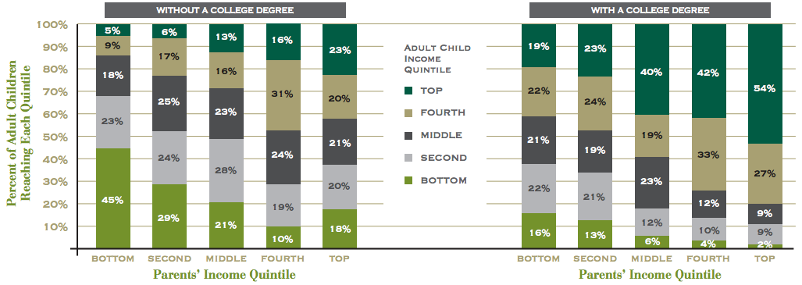
Education: an Avenue and Barrier to Mobility
https://www.brookings.edu/wp-content/uploads/2016/06/02_economic_mobility_sawhill.pdf

Slide 41
College Attendance Rates – by Parent’s Income
100%
80%
60%
Percent in College at 19
84-87 Slope = 0.745
40%
(0.008)
20%
0
20
40
60
80
100
Parent Income Rank
https://opportunityinsights.org/paper/recentintergenerationalmobility/

Slide 42
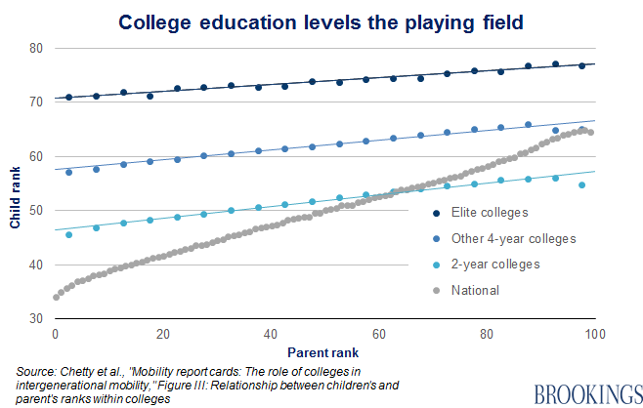
College: The Great Equalizer

Slide 43
Career Opportunities: an Avenue and Barrier to Mobility
Business Ownership
Inventions
Job Networks

Slide 44
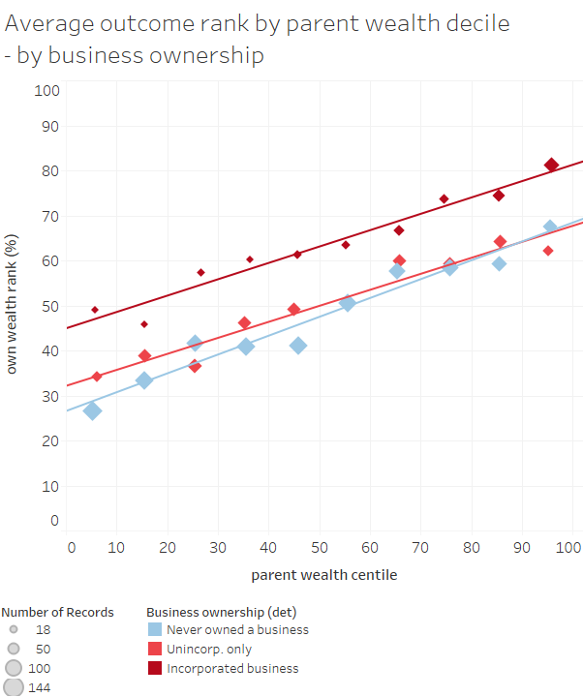
Career Opportunities – Business Incorporation
Ownership of a business is a big indicator of wealth accumulation.
Children from a wealthy family are more likely to incorporate a business.
Graph from Sarada and Tocoian (2018)

Slide 45
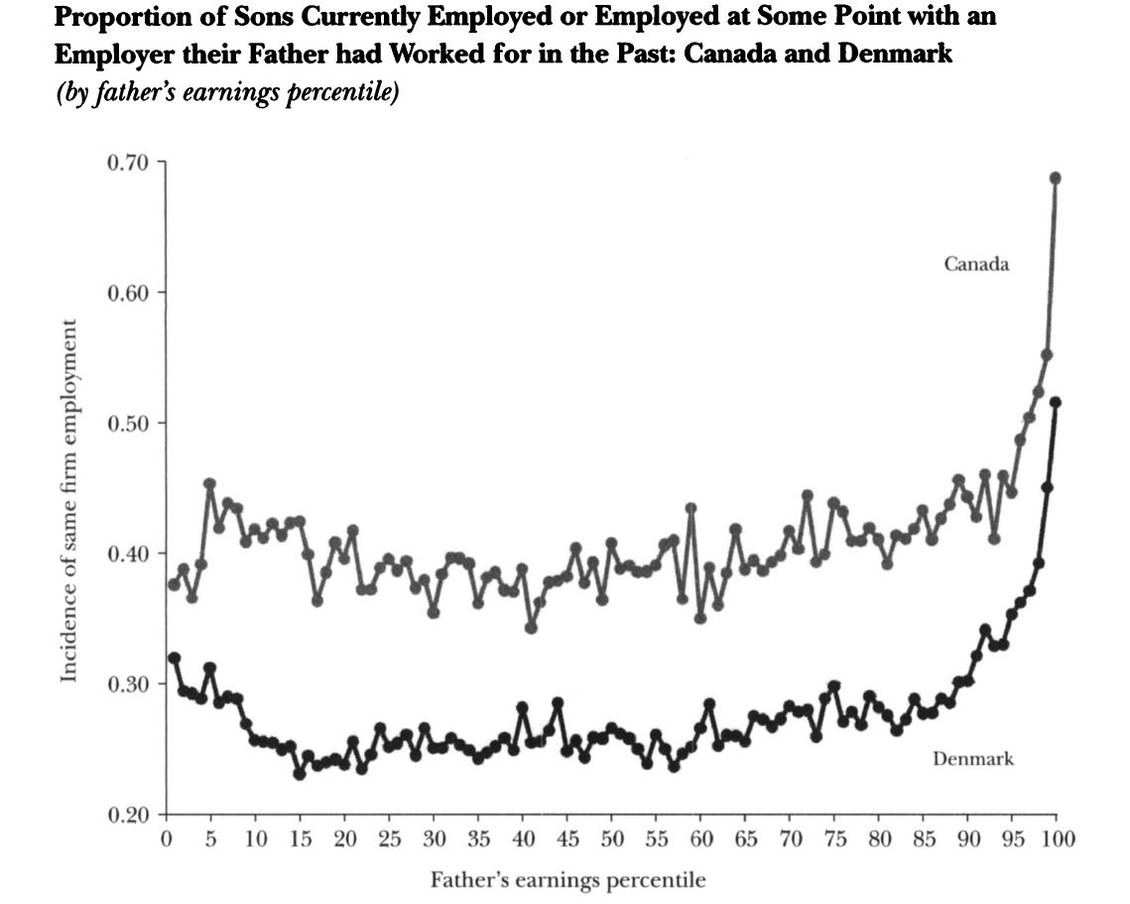
Career Opportunities – employment networks
2 out of 3 sons of the top earners in Canada get access to their father’s employer.
Much less access at lower levels of parental earnings.

Slide 46
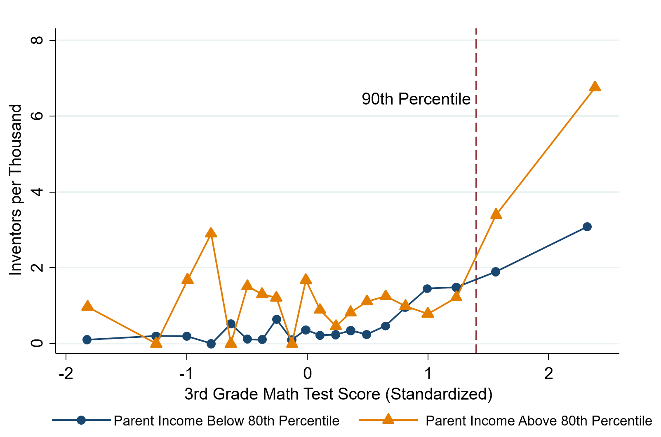
Career Opportunities – Inventions
High math-ability 3rd graders go on to become inventors if their family is well-off.
(Also if they grow up in high-innovation areas.)
Graph from Bell et al (2018)

Slide 47
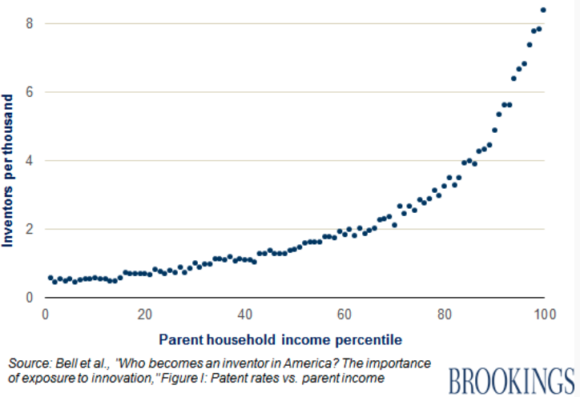
Inventors Are From Rich Families

Slide 48
Policy Options
Investments in education
  Make preparedness for college more universally available.
Entrepreneurship
  Introduce children to it at an early age and seek to reduce barriers to starting a business.
Housing vouchers, public housing, zoning laws
  Help underprivileged children grow up in neighborhoods conducive to mobility.
Implement policies to reduce inequality.

Slide 49
Summary: Economic Mobility
I. What do we mean by economic mobility?
  Absolute vs Relative Mobility
II. Empirical patterns of economic mobility
  Absolute mobility is in decline
  Relative mobility is much lower in the U.S. than elsewhere.
    Brings into question the notion of the “American dream”.
III. What is the desirable level of economic mobility?
  Absolute: concern that 50% of kids are treading water or falling behind.
  Relative: not as much as people seem to think there is.
IV. Exploring channels/barriers to upward mobility and policy options
  Often what is an avenue to mobility at the individual level may be a barrier at the societal level due to structural factors (i.e., Education and Career Opportunities)
  There are plenty of levers to pull to increase mobility.

Slide 50
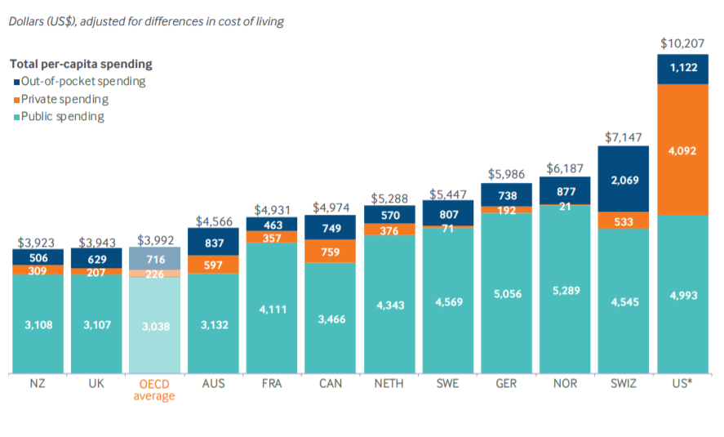
Next Week: International Per Capita Spending
US spends more than twice the OECD average
Source: Roosa Tikkanen and Melinda K. Abrams, U.S. Health Care from a Global Perspective, 2019: Higher Spending, Worse Outcomes (Commonwealth Fund, Jan. 2020).
Notes:
Some good resources:
https://www.commonwealthfund.org/publications/issue-briefs/2020/jan/us-health-care-global-perspective-2019
A bit older report: https://www.commonwealthfund.org/publications/issue-briefs/2015/oct/us-health-care-global-perspective
https://www.healthsystemtracker.org/chart-collection/quality-u-s-healthcare-system-compare-countries/#item-overall-age-specific-potential-years-of-life-lost-per-100000-population-1990-2017
https://axenehp.com/international-healthcare-systems-us-versus-world/

Slide 51
Thank you!
Any Questions?
www.NEEDEcon.org
Jon Haveman, Ph.D.
Jon@NEEDEcon.org
Contact NEED: info@NEEDEcon.org
Submit a testimonial: www.NEEDEcon.org/testimonials.php
Become a Friend of NEED: www.NEEDEcon.org/friend.php

Slide 52
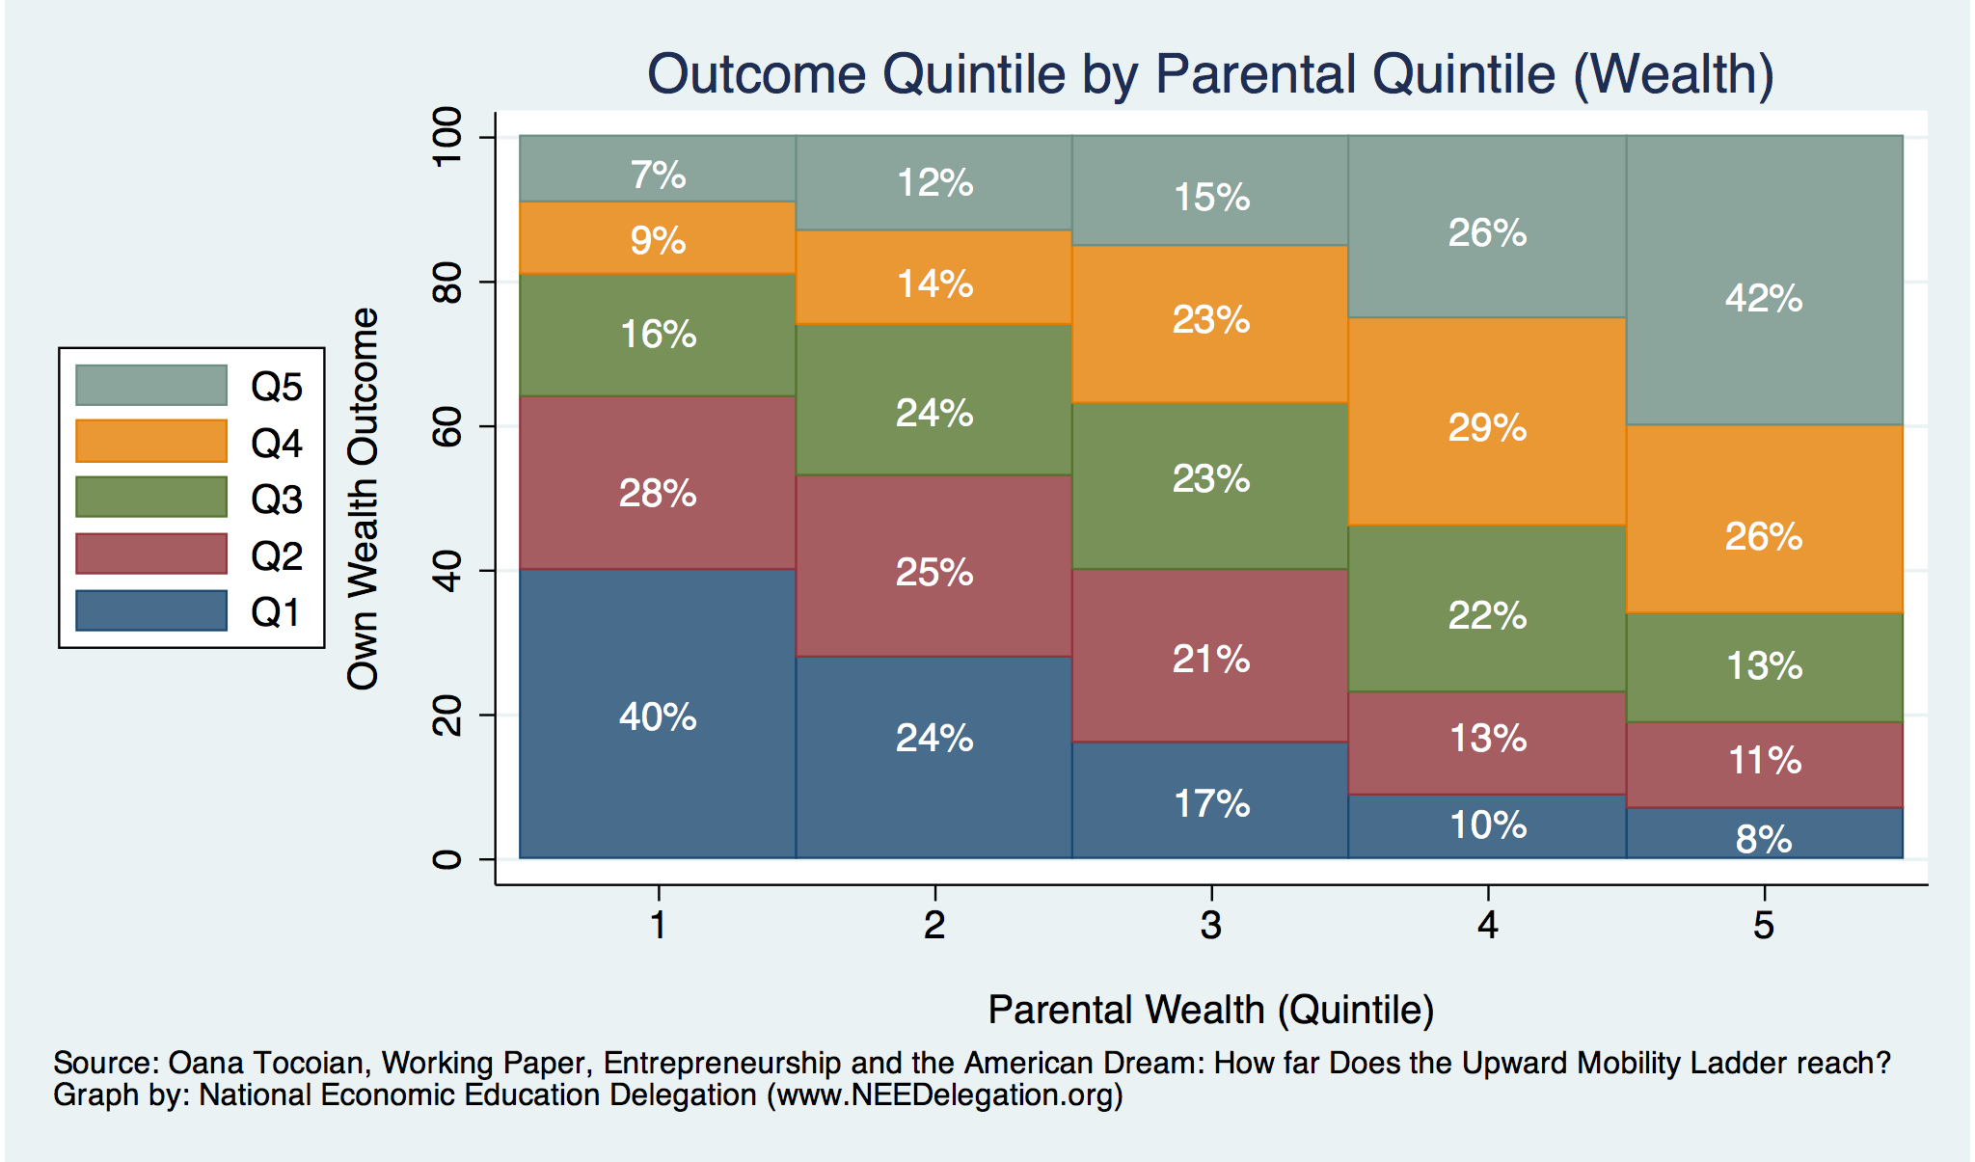
Wealth Mobility - Actual

