Slide 1
Osher Lifelong Learning Institute, Summer 2022
Contemporary Economic Policy
Rochester Institute of Technology
July-Aug, 2022
Host: Jon Haveman, Ph.D.
National Economic Education Delegation

Slide 2
Available NEED Topics Include:
Healthcare Economics
US Economy
Climate Change
Economic Inequality
Economic Mobility
Trade and Globalization
Minimum Wages
Immigration Economics
Housing Policy
Federal Budgets
Federal Debt
Black-White Wealth Gap
Autonomous Vehicles
Healthcare Economics

Slide 3
Course Outline
Contemporary Economic Policy
Week 1 (7/11): Economic Update (Jon Haveman, NEED)
Week 2 (7/18): Economic Inequality (Christopher Herrington VCU)
Week 3 (7/25): Trade and Globalization (Alan Deardorff, University of Michigan)
Week 4 (8/1): The Black-White Wealth Gap (Mike Shor, UConn)
Week 5 (8/8): Economic Mobility (Jon Haveman, NEED)
Week 6 (8/15): Climate Change Economics (Jon Haveman, NEED)
Week 7 (8/22): Autonomous Vehicles (Jon Haveman, NEED)

Slide 4
Submitting Questions
Please submit questions of clarification in the chat.
I will try to handle them as they come up.
We will do a verbal Q&A once the material has been presented.
Slides will be available on Need website( www.NEEDelegation.org)

Slide 5
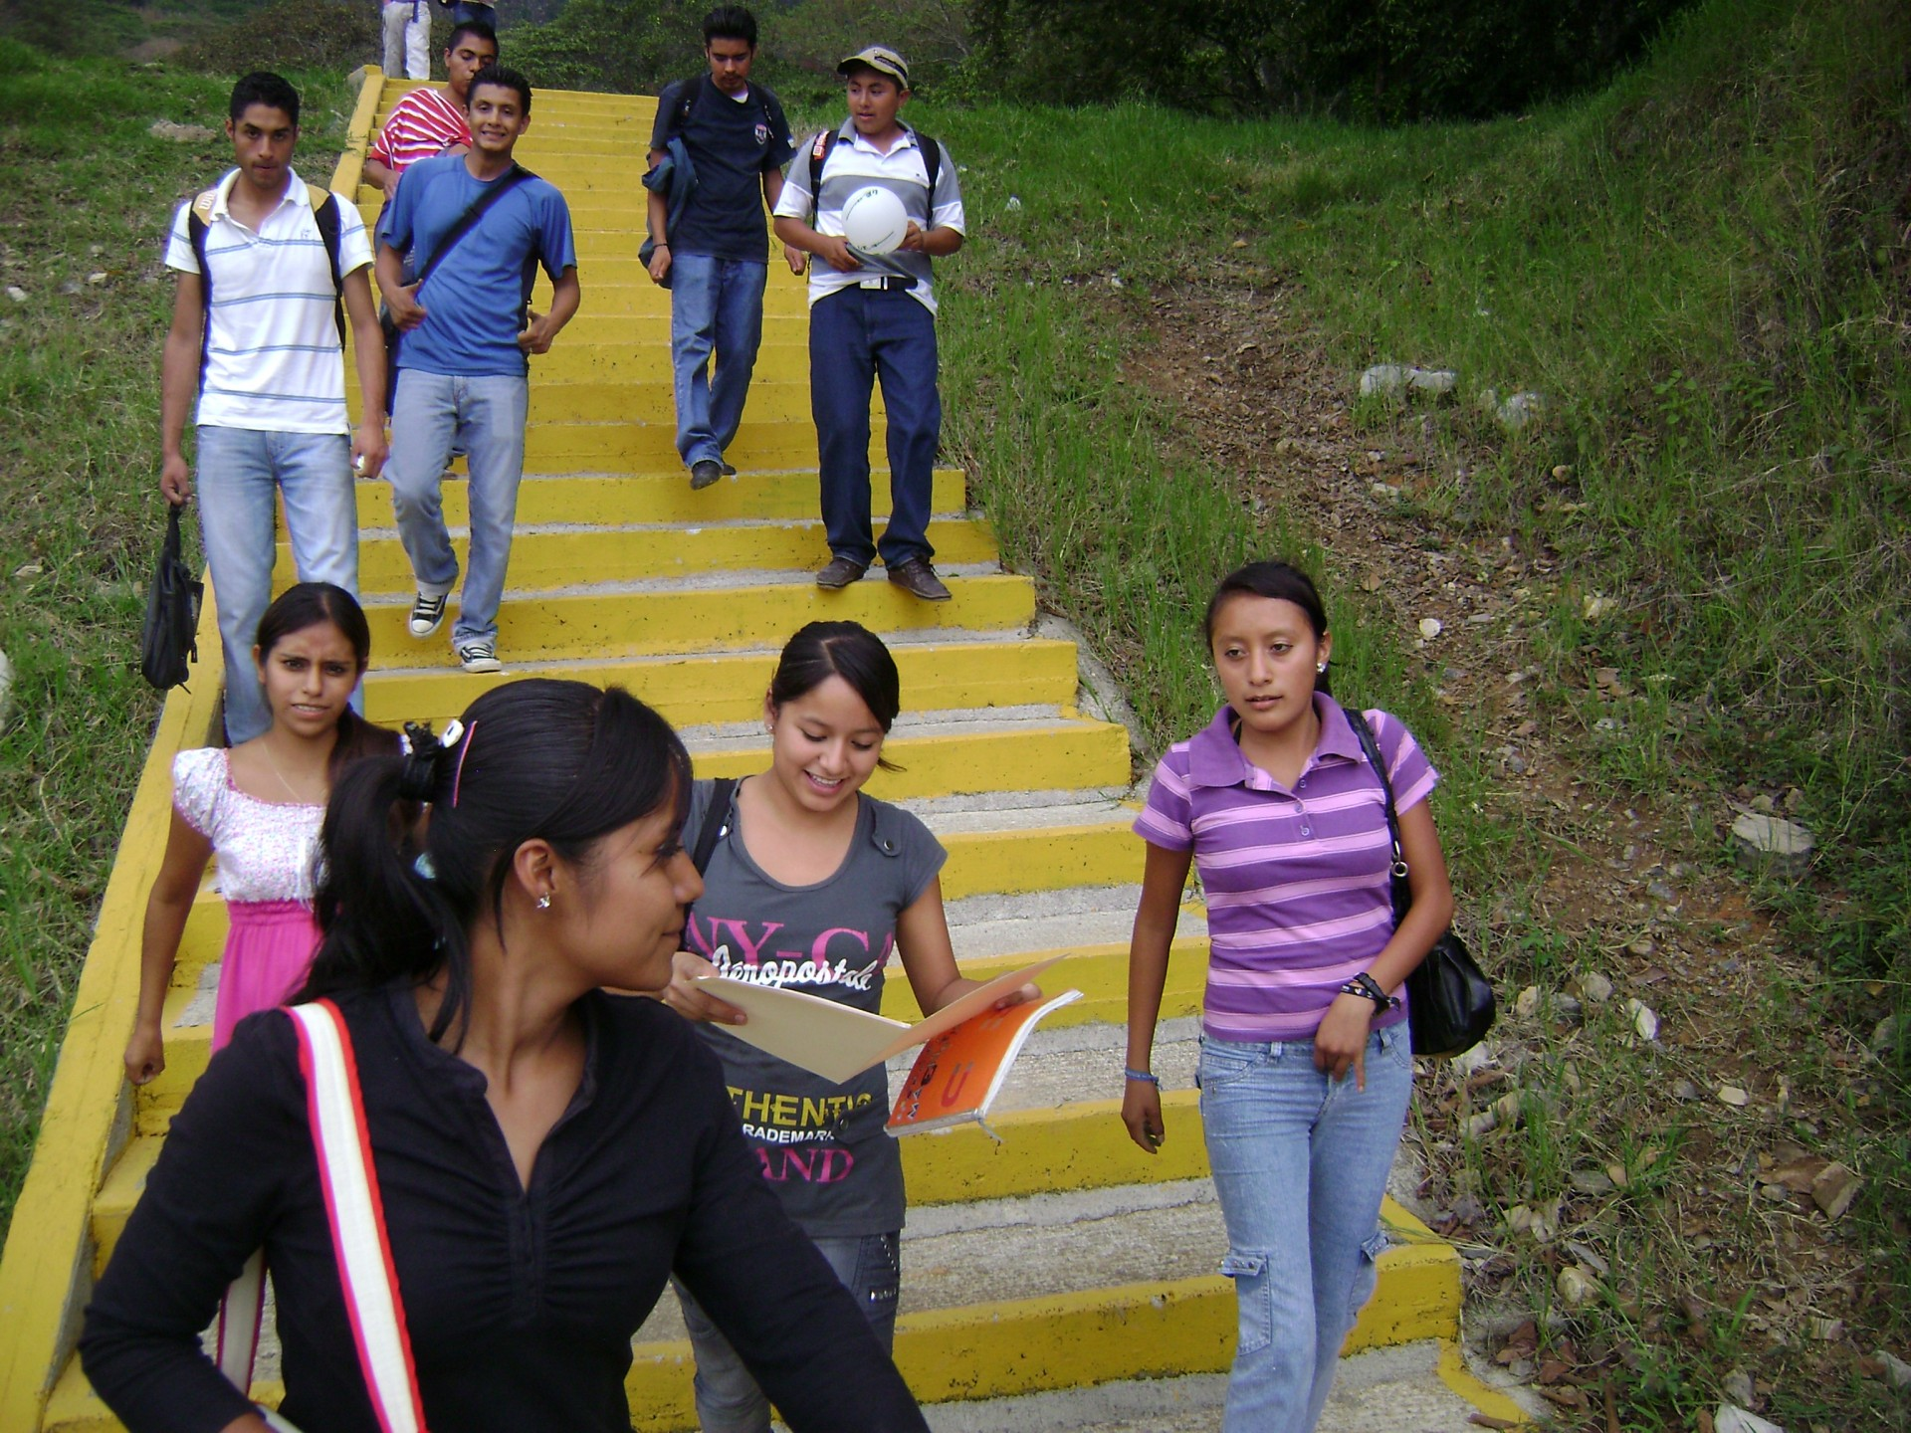
Economic Mobility
Jon Haveman, Ph.D.
NEED
Aug 8, 2022
<location/audience>
<date>
Notes:
M

Slide 6
Credits and Disclaimer
This slide deck was authored by:
Oana Tocoian, UCSD
Kathryn Wilson, Kent State University
Jon Haveman, NEED
Disclaimer
NEED presentations are designed to be nonpartisan.
It is, however, inevitable that the presenter will be asked for and will provide their own views.
Such views are those of the presenter and not necessarily those of the National Economic Education Delegation (NEED).

Slide 7
Outline
I. What do we mean by economic mobility?
II. Empirical patterns of economic mobility
III. What is the desirable level of economic mobility?
IV. Exploring channels/barriers to upward mobility and policy options

Slide 8
I. What do we mean by economic mobility?
Definition and motivation

Slide 9
Economic Mobility – Defined
I. What do we mean by economic mobility?
Economic Mobility – Our working definition:
Ability to advance beyond the status of your parents.
Variety of measures:
Income
Wealth
Education level
Occupation
Home ownership
More Broadly:
The ability to improve your socioeconomic class.
We will consider intergenerational mobility in INCOME.

Slide 10
Absolute and Relative Mobility
I. What do we mean by economic mobility?
Absolute mobility: the difference in income from one’s parents.
You’re higher on the escalator than your parents were.
It is possible for everyone to experience upward absolute mobility, especially if the escalator is going up.
Relative mobility: the change in income rank from one’s parent.
You have fewer people above you on the escalator than your parents did.
Increased relative mobility requires both upward and downward movement.

Slide 11
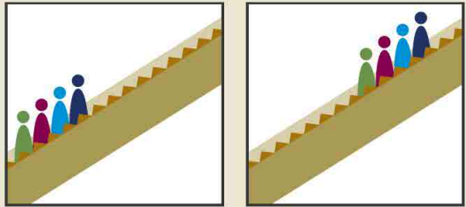
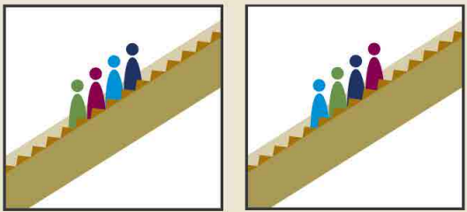
More on Absolute vs Relative Mobility
I. What do we mean by economic mobility?
Can there be relative mobility with NO absolute mobility?
Yes: There can be a dramatic reshuffling of the distribution even if there is no increase in average income.
Can there be absolute mobility with NO relative mobility?
Yes: if everybody experiences the same increase in income, there will be no change in relative income.
Parents Kids
Parents Kids
+2
-1
+1
-2

Slide 12
Economic Growth and Mobility
I. What do we mean by economic mobility?
Economic growth should drive absolute mobility.
It has the potential to raise all incomes.
But the extent of mobility that results depends on how income is distributed.
Economic growth and relative mobility are unrelated.
Growth does not have implications for whether kids are more or less likely to rise above their parent’s position in the income distribution.

Slide 13
II. Empirical patterns of Economic Mobility
What are the facts?

Slide 14
Mobility – Big Picture for Absolute Mobility
II. Empirical Patterns of Economic Mobility
Decline in absolute mobility in the United States:
90% of those born in the early 1940s could expect to earn more than their parents in real terms. For millennials, the fraction is closer to 50%.
Below-median earnings have not increased in real terms since the 1970s.

Slide 15
II. Empirical Patterns of Economic Mobility
9 out of 10 of those born in the early 1940s could expect to earn more than their parents
1 in 2 Millennials (born after 1980) earn more than their parents.

Slide 16
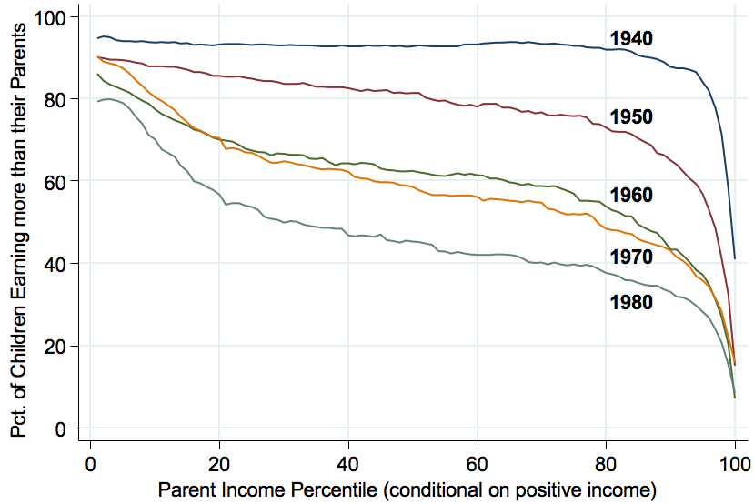
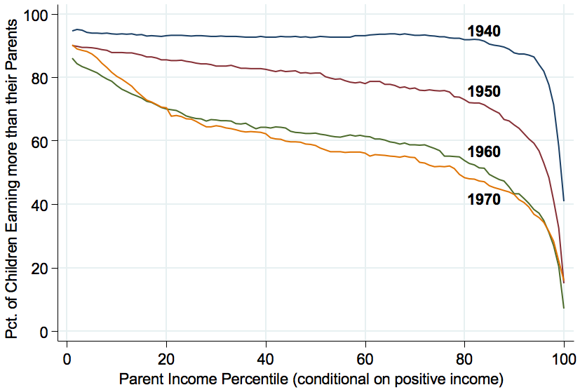
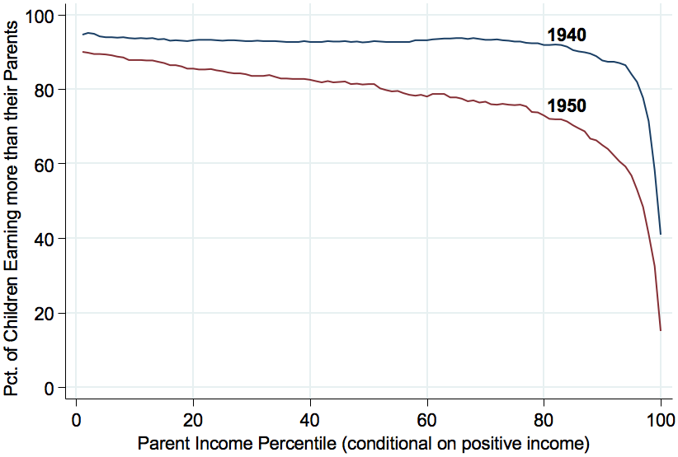
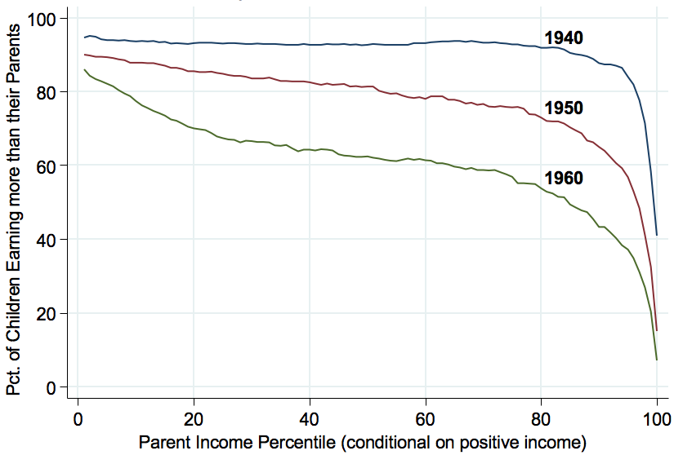
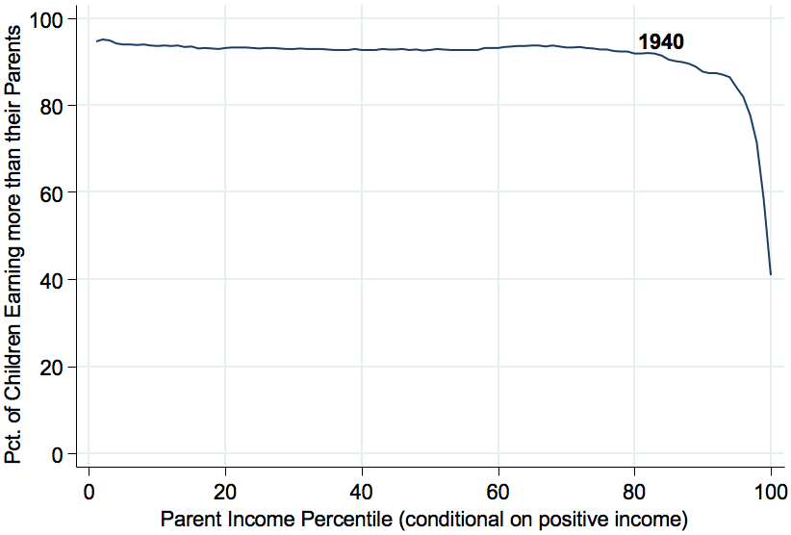
Absolute Mobility by Birth Cohort
II. Empirical Patterns of Economic Mobility
94%
93%
88%
70%
45%
33%

Slide 17
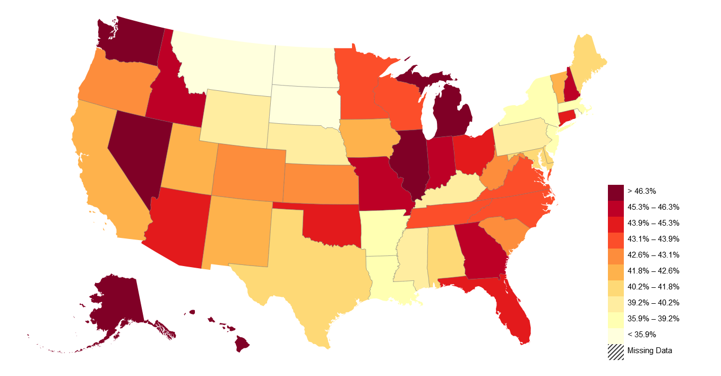
American Dream: Geography Matters
II. Empirical Patterns of Economic Mobility
Trends in Absolute Mobility by State: Change from 1940-1980
Decline in Abs. Mob. from 1940-80
https://opportunityinsights.org/paper/the-fading-american-dream/

Slide 18
Why? Increasing Income Inequality
Stock Market Crash
WWII
Housing Bubble
Dot-com Bubble

Slide 19
Absolute Mobility: Race
II. Empirical Patterns of Economic Mobility

Slide 20
Absolute Mobility: Gender
II. Empirical Patterns of Economic Mobility

Slide 21
Measuring Relative Mobility
II. Empirical Patterns of Economic Mobility
Reminder: Relative mobility is the change in income rank from one’s parent.
Transition Probabilities: Likelihood that an individual ends up in a different income quintile than their parents.
Perfect Equality: For each of the parental income quintiles, 20% of their offspring end up in each income quintile as adults.

Slide 22
Perfect Mobility/Equality

Slide 23
Transition Probabilities in the United States
II. Empirical Patterns of Economic Mobility
https://www.brookings.edu/wp-content/uploads/2016/06/11_generations_isaacs.pdf

Slide 24
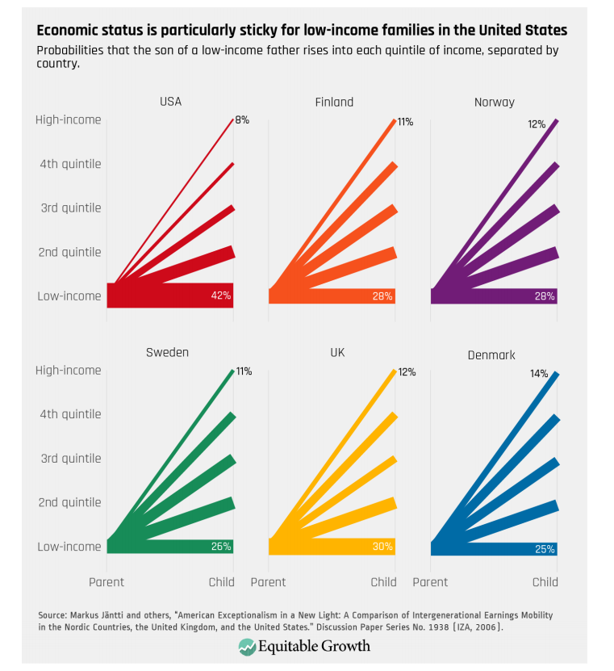
Transitions: International Comparisons
II. Empirical Patterns of Economic Mobility
Source: : https://equitablegrowth.org/research-paper/are-todays-inequalities-limiting-tomorrows-opportunities

Slide 25
American Dream: Geography Matters
II. Empirical Patterns of Economic Mobility
https://www.brookings.edu/blog/social-mobility-memos/2018/01/11/raj-chetty-in-14-charts-big-findings-on-opportunity-and-mobility-we-should-know/

Slide 26
Relative Mobility: Race
II. Empirical Patterns of Economic Mobility

Slide 27
Relative Mobility: Gender
II. Empirical Patterns of Economic Mobility

Slide 28
Summary of Empirical Patterns
II. Empirical Patterns of Economic Mobility
Absolute economic mobility in the United States has been in decline since the 1940s.
Half of people born in the mid-1980s have not outperformed their parents in terms of income.
Relative mobility is lower in the United States than many developed countries.
Income is especially “sticky” at the bottom and the top of the income distribution.
Geography matters – there is tremendous variation in mobility within the United States.
There are racial differences (large) and gender differences (smaller) in absolute and relative mobility.

Slide 29
III. What is the desirable level of economic mobility?
Economically what is optimal? What do people think is optimal? Mobility and Inequality

Slide 30
Absolute or Relative Mobility?
III. What is the Desirable Level of Economic Mobility
Upward absolute mobility of the whole population is unambiguously desirable (it’s hard to defend not wanting everyone to be better off!)
The fact that half the population is treading water should worry us.
But, relative mobility is a zero-sum game: for some people to rank higher than their parents did, others have to rank lower.

Slide 31
The “Right” Level of Relative Mobility
III. What is the Desirable Level of Economic Mobility
Equity
Want a system that is “fair”.
Efficiency
Want to provide incentives in order to get economic growth.
What is the optimal level of relative mobility?
This is a hard question, one which we may not be able to answer or agree on.
Is current relative mobility too low (or too high)?
The answer would suggest the best (incremental) policy steps to take towards a better outcome.

Slide 32
How is the Mobility Porridge?
III. What is the Desirable Level of Economic Mobility
How might we answer the second question: Is mobility too low or too high?
Common sense judgement.
E.g., is it plausible that – due to merit alone – a child from the top 1% would be 77 times as likely to attend an Ivy League school than a child from the bottom quintile?
What if the likelihood was 5-fold?
Forget merit is it WISE for a society to exclude large segments of the population from the circles of its future leaders?
Examination of the channels through which relative mobility can occur, howe they relate to family resources and how they respond to investigative changes (see next section).

Slide 33
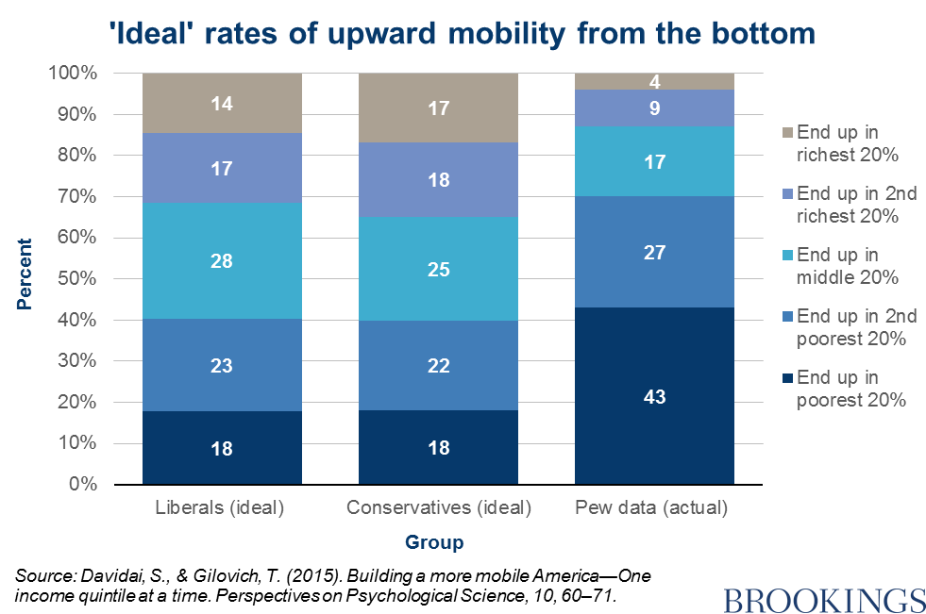
Survey Says on Upward Mobility from the BOTTOM
III. What is the Desirable Level of Economic Mobility

Slide 34
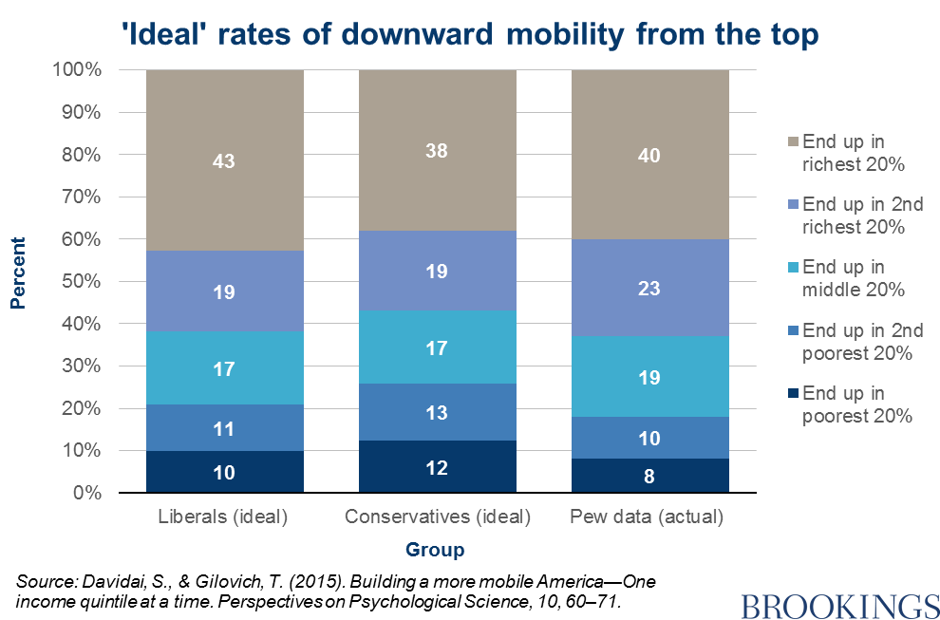
Survey Says on Downward Mobility from the TOP
III. What is the Desirable Level of Economic Mobility

Slide 35
Preferences hit Awkward Truth: Math
III. What is the Desirable Level of Economic Mobility
Again: relative mobility is a zero-sum game
There are only so many spots in the top quintile (only 20% of population can be there)
Preferences want:
43% of them for kids born into the top
16% for those born into the bottom
Leaves about 14% for each of the other 3 quintiles
Preferences are inconsistent
Greater upward mobility for the bottom than the middle?
Results are intuitive:
Stickiness at the top
Mobility from the bottom
…but inconsistent:
What about the middle?

Slide 36
Public Perception and Sentiment
III. What is the Desirable Level of Economic Mobility
Perception: “American Dream” vs “Old World”
General belief is that the U.S. has greater mobility than elsewhere.
Fewer explicit barriers – no nobility titles.
More meritocratic – “rags to riches”, Heratio Alger
The American Dream plays a significant part in national identity.
Reality: Overestimate of actual mobility
Common perception is incorrect.

Slide 37
The “American Dream” Shapes Perceptions
III. What is the Desirable Level of Economic Mobility
https://www.brookings.edu/wp-content/uploads/2016/06/02_economic_mobility_sawhill.pdf

Slide 38
Mobility and Inequality
III. What is the Desirable Level of Economic Mobility
Lower mobility may have implications for the desired level of inequality.
More inequality makes both absolute and relative mobility more difficult.
Absolute: more of the gains go to the top.
Relative: the top is further away from the bottom.

Slide 39
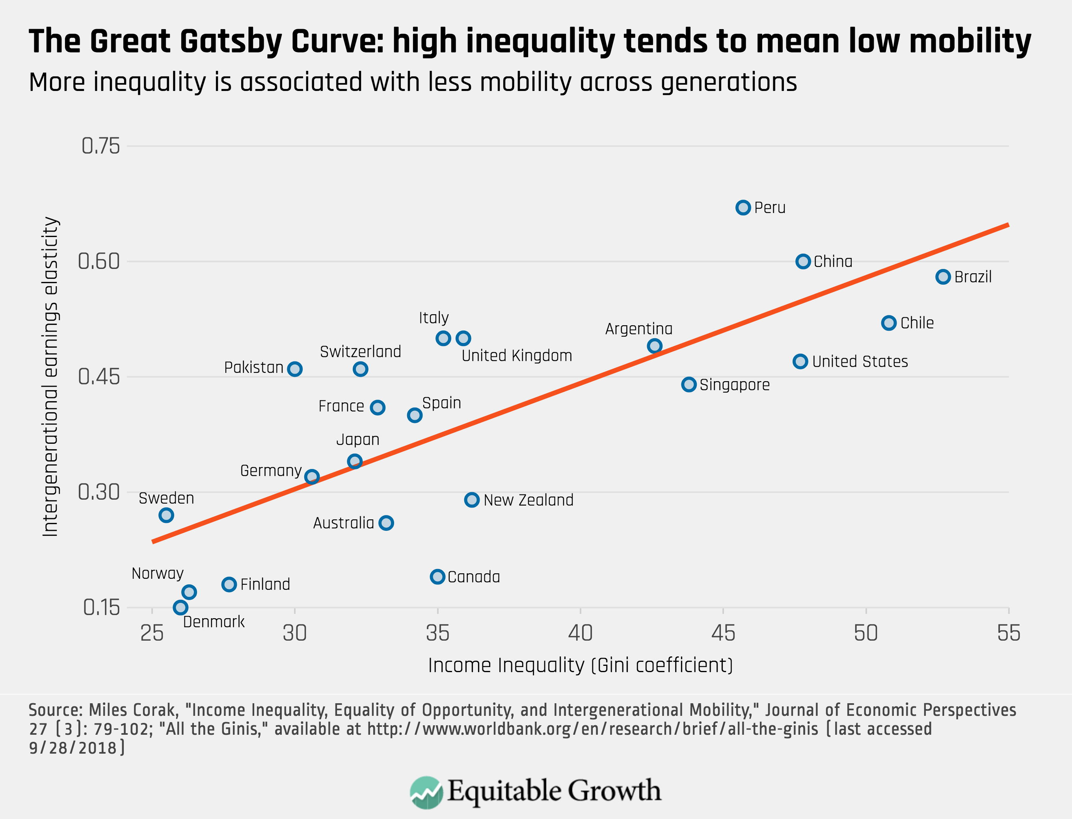
Peru
China
Brazil
More Mobility Less Mobility
Germany
U.S.
Canada
https://equitablegrowth.org/research-paper/are-todays-inequalities-limiting-tomorrows-opportunities

Slide 40
IV. Exploring channels/barriers to upward mobility and policy options
Focus on Education and Career Opportunities

Slide 41
Barriers to Upward Mobility
IV. Exploring Channels/Barriers to Upward Mobility and Policy Options
Key Question:
What are the factors that might prevent someone born
in a low-income household from doing as well as their
richer counterpart?
Answers:
Birth Lottery
Structural barriers

Slide 42
Barriers to Upward Mobility – Birth Lottery
IV. Exploring Channels/Barriers to Upward Mobility and Policy Options
Early advantages
Innate (genetic) advantages:
Inherited ability, medical conditions, psychological traits.
Environmental factors:
In utero: pre-natal care, mother’s nutrition, exposure to abuse or stress.
Home environment which promotes healthy development, transmission of family values.
Availability of role models, mentors, neighborhood effects.
Availability of good educators, facilities, peers.

Slide 43
Barriers to Upward Mobility – Structural
IV. Exploring Channels/Barriers to Upward Mobility and Policy Options
Selective access to quality higher education
Preferential admission for legacy and donor families.
Expectation of extra-curricular activities, AP classes, etc.
Effective access to family planning (sex ed, contraceptives, abortion)
Teen births reduce outcomes for both mother and child.
Access to lucrative employment
Reliance on personal connections, homophily, racism, sexism...
Access to entrepreneurship and invention
initial capital and insurance against negative shocks, social networks.
Direct transmission of income-earning assets

Slide 44
Education: an Avenue and Barrier to Mobility
IV. Exploring Channels/Barriers to Upward Mobility and Policy Options
https://www.brookings.edu/wp-content/uploads/2016/06/02_economic_mobility_sawhill.pdf

Slide 45
College Attendance Rates – by Parent’s Income
IV. Exploring Channels/Barriers to Upward Mobility and Policy Options
100%
80%
60%
Percent in College at 19
84-87 Slope = 0.745
40%
(0.008)
20%
0
20
40
60
80
100
Parent Income Rank
https://opportunityinsights.org/paper/recentintergenerationalmobility/

Slide 46
College Quality Rank – by Parent’s Income
IV. Exploring Channels/Barriers to Upward Mobility and Policy Options
80
70
60
Mean College Quality Rank
50
40
84-87 Coll. Qual Gradient (P75-P25) = 0.191
88-90 Coll. Qual Gradient (P75-P25) = 0.192
30
91-93 Coll. Qual Gradient (P75-P25) = 0.181
0
20
40
60
80
100
Parent Income Rank
1984-87
1988-90
1991-93
https://opportunityinsights.org/paper/recentintergenerationalmobility/

Slide 47
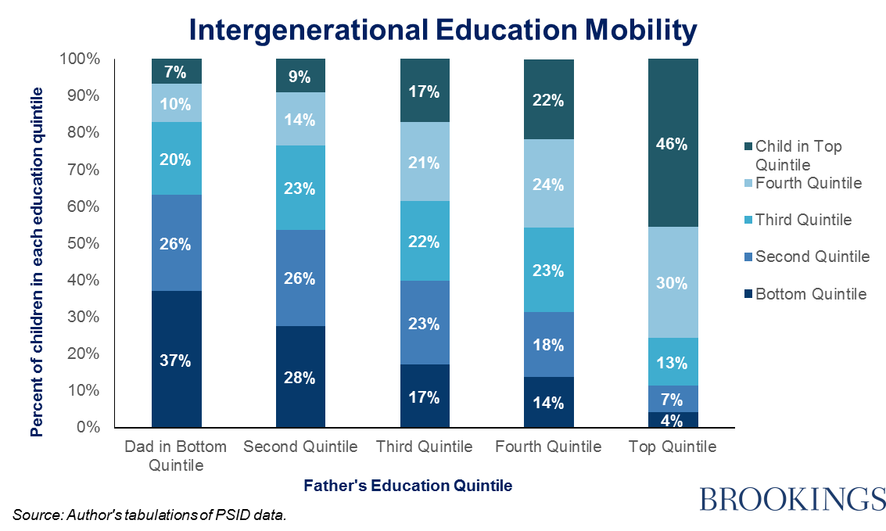
Educational Mobility
IV. Exploring Channels/Barriers to Upward Mobility and Policy Options
https://www.brookings.edu/blog/social-mobility-memos/2014/10/27/the-inheritance-of-education/

Slide 48
Career Opportunities: an Avenue and Barrier to Mobility
IV. Exploring Channels/Barriers to Upward Mobility and Policy Options
Business Ownership
Inventions
Job Networks

Slide 49
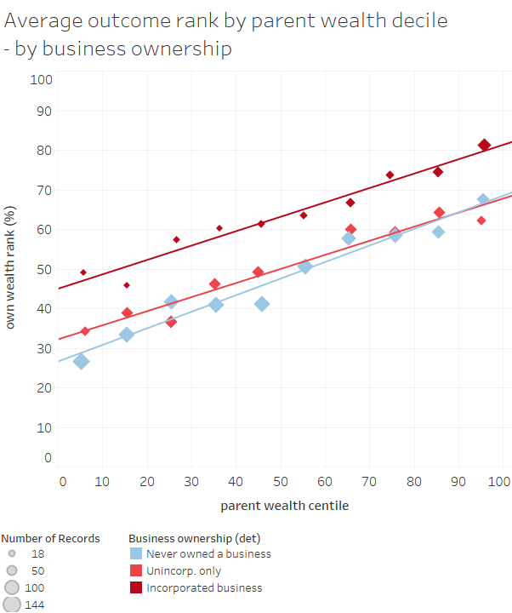
Career Opportunities – Business Incorporation
IV. Exploring Channels/Barriers to Upward Mobility and Policy Options
Ownership of a business is a big indicator of wealth accumulation.
Children from a wealthy family are more likely to incorporate a business.
Graph from Sarada and Tocoian (2018)

Slide 50
Career Opportunities – Employment Networks
IV. Exploring Channels/Barriers to Upward Mobility and Policy Options
2 out of 3 sons of the top earners in Canada get access to their father’s employer.
Much less access at lower levels of parental earnings.

Slide 51
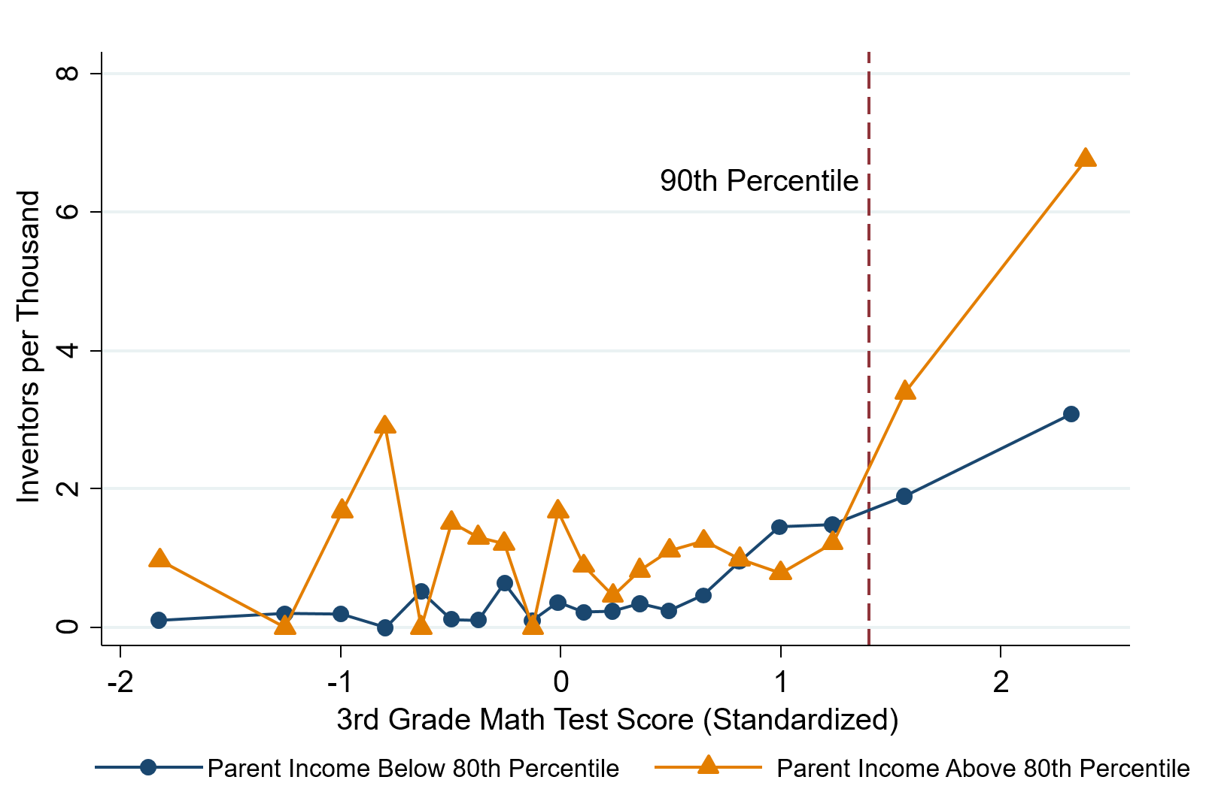
Career Opportunities – Inventions
IV. Exploring Channels/Barriers to Upward Mobility and Policy Options
High math-ability 3rd graders go on to become inventors if their family is well-off.
(Also if they grow up in high-innovation areas.)
Graph from Bell et al (2018)

Slide 52
Policy Options
IV. Exploring Channels/Barriers to Upward Mobility and Policy Options
Investments in education
Make preparedness for college more universally available.
Entrepreneurship
Introduce children to it at an early age and seek to reduce barriers to starting a business.
Housing vouchers, public housing, zoning laws
Help underprivileged children grow up in neighborhoods conducive to mobility.
Implement policies to reduce inequality.

Slide 53
Summary: Economic Mobility
I. What do we mean by economic mobility?
Absolute vs Relative Mobility
II. Empirical patterns of economic mobility
Absolute mobility is in decline
Relative mobility is much lower in the U.S. than elsewhere.
Brings into question the notion of the “American dream”.
III. What is the desirable level of economic mobility?
Absolute: concern that 50% of kids are treading water or falling behind.
Relative: not as much as people seem to think there is.
IV. Exploring channels/barriers to upward mobility and policy options
Often what is an avenue to mobility at the individual level may be a barrier at the societal level due to structural factors (i.e., Education and Career Opportunities)
There are plenty of levers to pull to increase mobility.

Slide 54
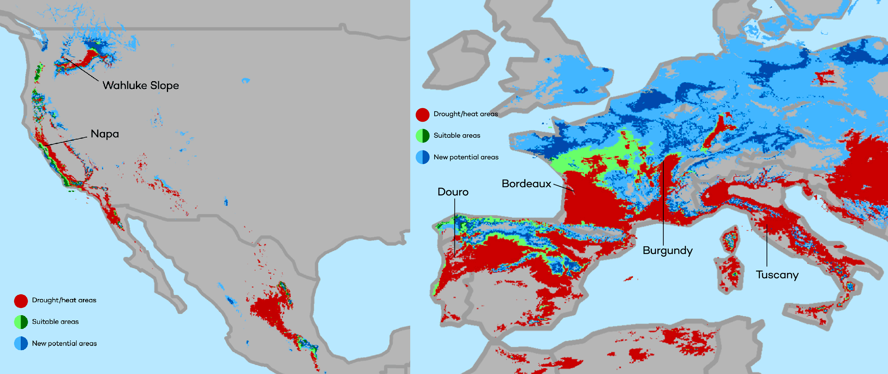
Climate Change Economics
The changing map of the world’s wine-growing regions.

Slide 55
Thank you!
Any Questions?
www.NEEDelegation.org
Jon D. Haveman
Jon@NEEDelegation.org
Contact NEED: info@NEEDelegation.org
Submit a testimonial: www.NEEDelegation.org/testimonials.php
Become a Friend of NEED: www.NEEDelegation.org/friend.php

