Slide 1
Osher Lifelong Learning Institute, Winter 2022
Contemporary Economic Policy
American University
March-May, 2022
Host: Jon Haveman, Ph.D.
National Economic Education Delegation

Slide 2
Available NEED Topics Include:
Coronavirus Economics
US Economy
Climate Change
Economic Inequality
Economic Mobility
Trade and Globalization
Minimum Wages
Immigration Economics
Housing Policy
Federal Budgets
Federal Debt
Black-White Wealth Gap
Autonomous Vehicles
US Social Policy

Slide 3
Course Outline
Contemporary Economic Policy
Week 1 (3/11): US Economy & Coronavirus Economics
Week 2 (3/18): Federal Debt (Brian Peterson, Central College)
Week 3 (3/25): Trade and Globalization (Alan Deardorff, Univ. of Michigan)
Week 4 (4/1): Healthcare Economics (Veronika Dolar, SUNY-Old Westbury)
Week 5 (4/8): Economics of Immigration (Jennifer Alix-Garcia, Oregon St. Univ.)
Week 6 (4/15): Economic Inequality (Kyle Montanio, Colorado University - Denver)
Week 7 (4/22): Economic Mobility (Kathryn Wilson, Kent State University)
Week 8 (4/29): Discrimination in US Policy History (Jon Haveman, NEED)
Week 9 (5/6): The Black-White Wealth Gap (Mike Shor, Univ. of Connecticut)
Week 10 (5/13): The Gender Wage Gap (Mallika Pung, Univ. of New Mexico)

Slide 4
Submitting Questions
Please submit questions of clarification in the chat.
I will try to handle them as they come up.
We will do a verbal Q&A once the material has been presented.
OLLI allowing, we can stay beyond the end of class to have further discussion.
Slides will be available from the NEED website tomorrow (https://needelegation.org/delivered_presentations.php)

Slide 5
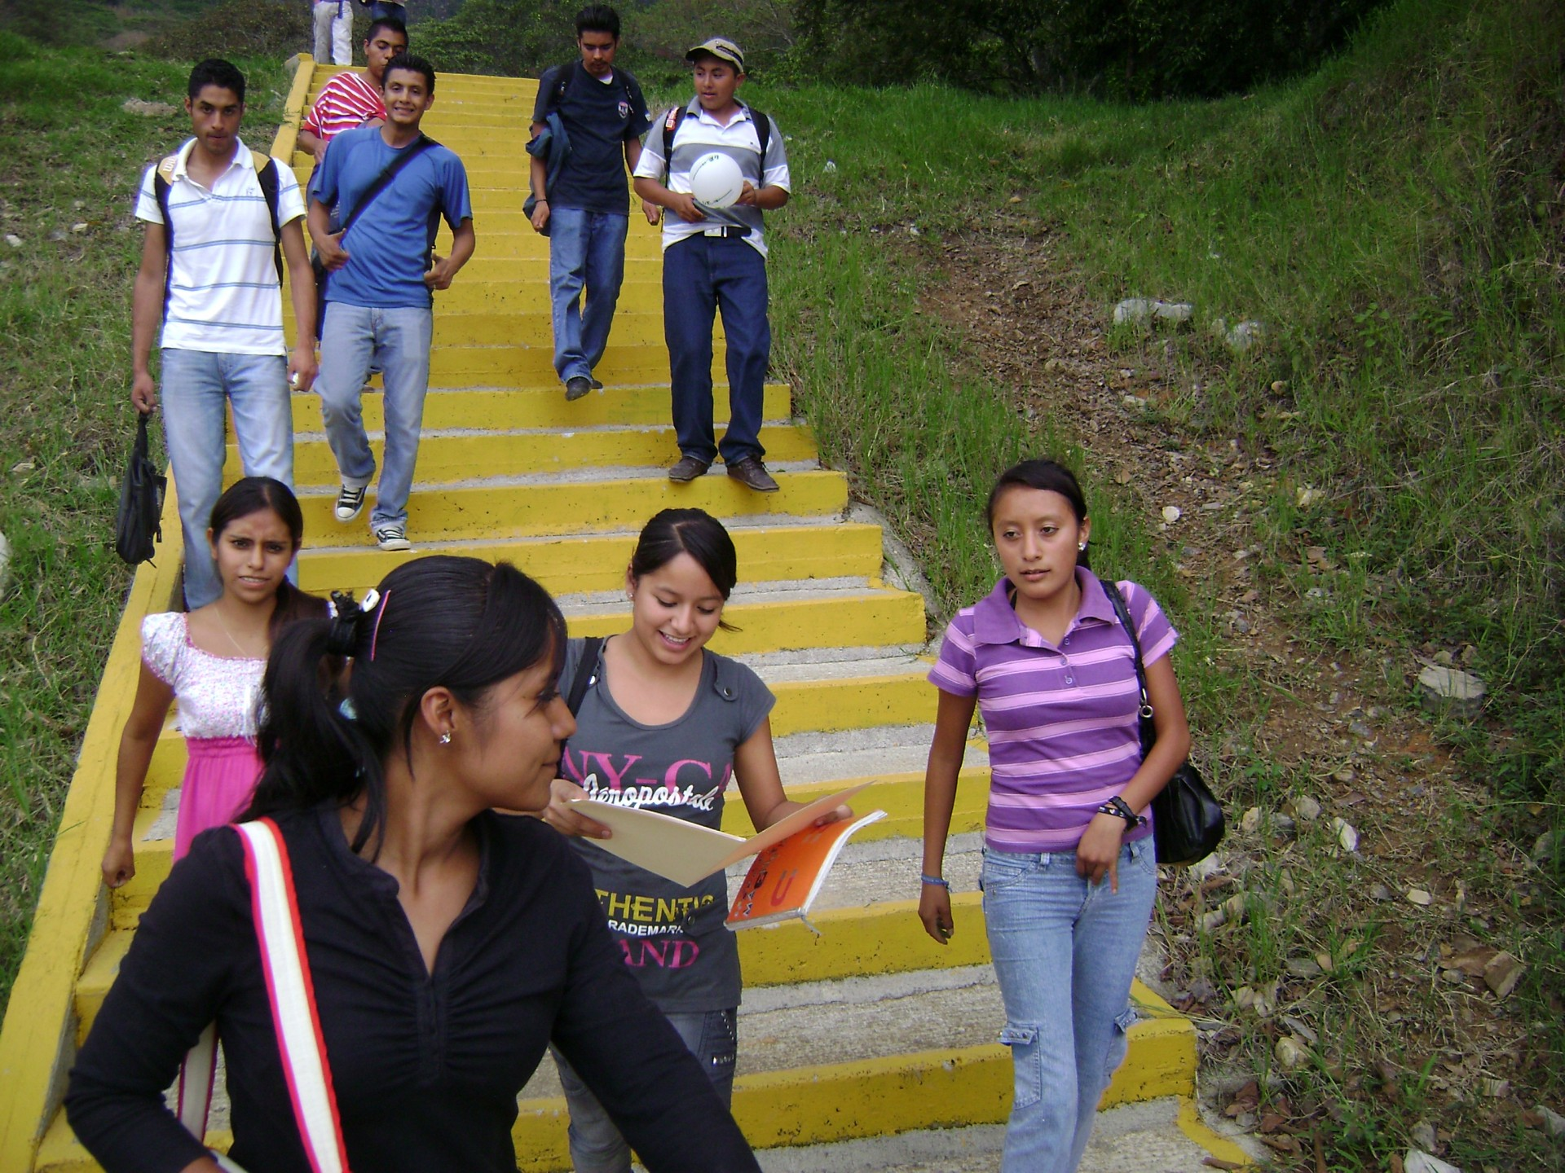
Economic mobility
Kathryn Wilson, Ph.D.
American University
April 22, 2022
<location/audience>
<date>

Slide 6
Credits and Disclaimer
This slide deck was authored by:
Oana Tocoian, UCSD
Jon Haveman, NEED
Disclaimer
NEED presentations are designed to be nonpartisan.
It is, however, inevitable that the presenter will be asked for and will provide their own views.
Such views are those of the presenter and not necessarily those of the National Economic Education Delegation (NEED).

Slide 7
Outline
I. What do we mean by economic mobility and why does it matter?
II. What are the facts? Empirical patterns and cultural context
III. What can we make of these patterns?
IV. Exploring different barriers to upward mobility
V. Summary

Slide 8
I. What do we mean by economic mobility?
Definition and motivation

Slide 9
Economic Mobility – Defined
Economic Mobility – Our working definition:
Ability to advance beyond the status of your parents.
More broadly:
The ability to improve your socioeconomic class.
Variety of measures:
Income
Wealth
Education level
Occupation
Home ownership

Slide 10
Absolute and Relative Mobility
Consider intergenerational mobility in INCOME.
There are basic concepts:
Absolute mobility: the difference in income from one’s parent.
It is possible for everyone to experience upward absolute mobility.
Relative mobility: the change in income rank from one’s parent.
Increased relative mobility requires both upward and downward movement.

Slide 11
Absolute vs Relative: Escalator Analogy
Absolute Mobility
You’re moving up the escalator.
Relative Mobility
You’re moving up the escalator and passing other people.

Slide 12
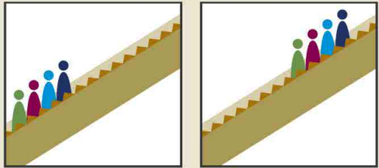
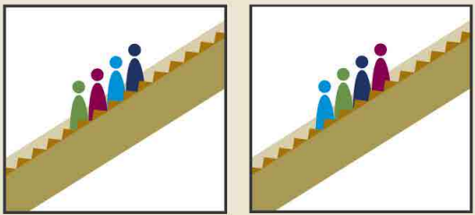
More on Absolute vs Relative Mobility
Can there be absolute mobility with NO relative mobility?
Yes: if everybody experiences the same increase in income, there will be no relative income.
Can there be relative mobility with NO absolute mobility?
Yes: There can be a dramatic reshuffling of the distribution even if there is no increase in average income.
Parents Kids
Parents Kids
+2
-1
+1
-2

Slide 13
Economic Growth and Mobility
Economic growth should drive absolute mobility
It has the potential to raise all incomes.
But the extent of mobility that results depends on how income is distributed.
Economic growth and relative mobility are unrelated
Growth does not have implications whether kids are more or less likely to rise above their parent’s position in the income distribution.

Slide 14
II. Empirical Patterns
What are observed levels of mobility?

Slide 15
Mobility – Empirical Patterns
Decline in absolute mobility in the United States:
90% of those born in the early 1940s could expect to earn more than their parents in real terms. For millennials, the fraction is closer to 50%
Below-median earnings have not increased in real terms since the 1970s.

Slide 16
9 out of 10 of those born in the early 1940s could expect to earn more than their parents
1 in 2 Millennials (born after 1980) earn more than their parents.

Slide 17
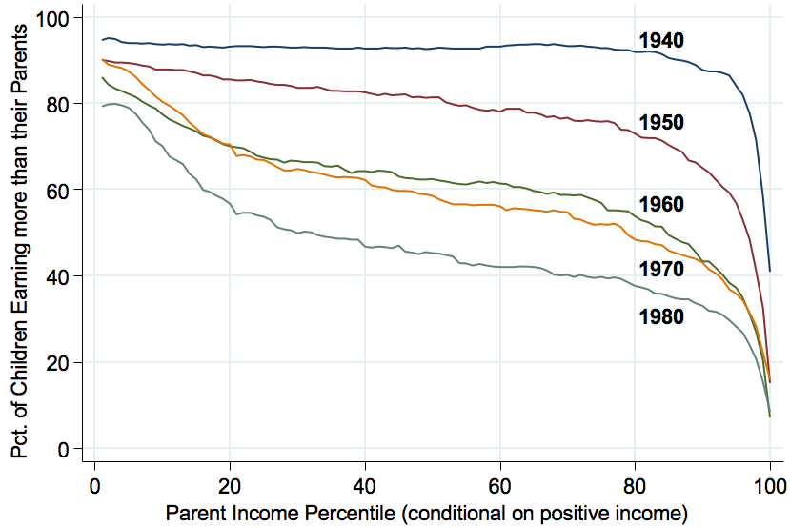
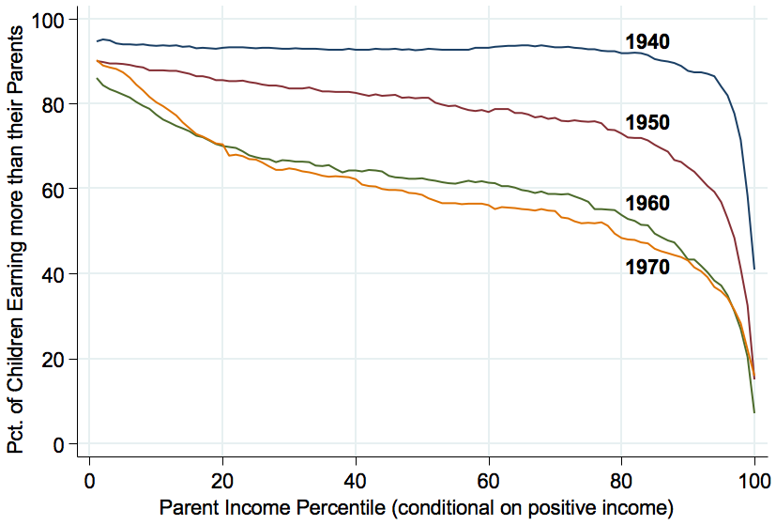
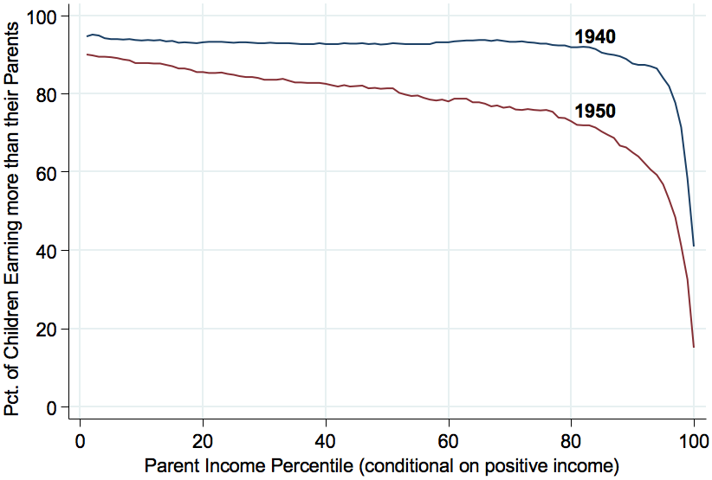
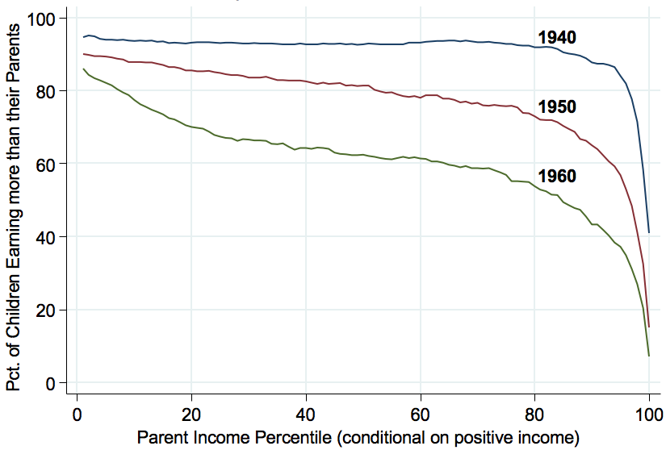
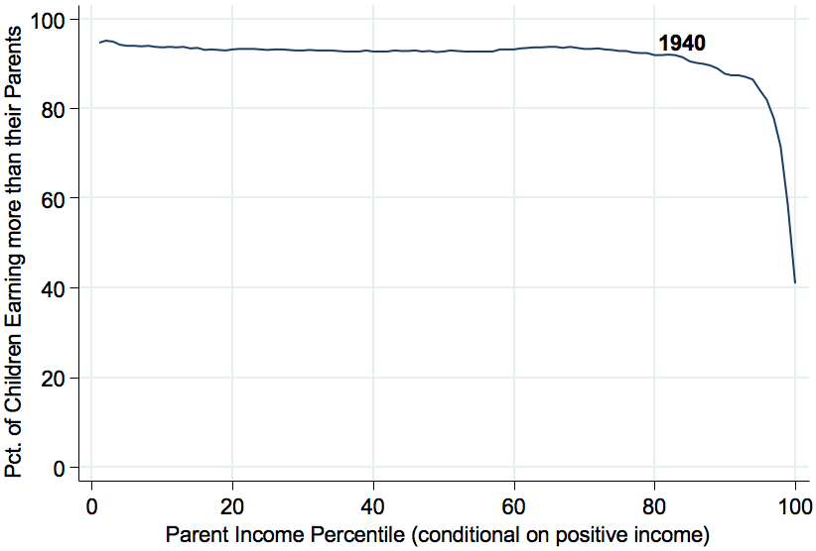
Absolute Mobility by Birth Cohort
94%
93%
88%
70%
45%
33%

Slide 18
American Dream: Geography Matters
https://www.brookings.edu/blog/social-mobility-memos/2018/01/11/raj-chetty-in-14-charts-big-findings-on-opportunity-and-mobility-we-should-know/

Slide 19
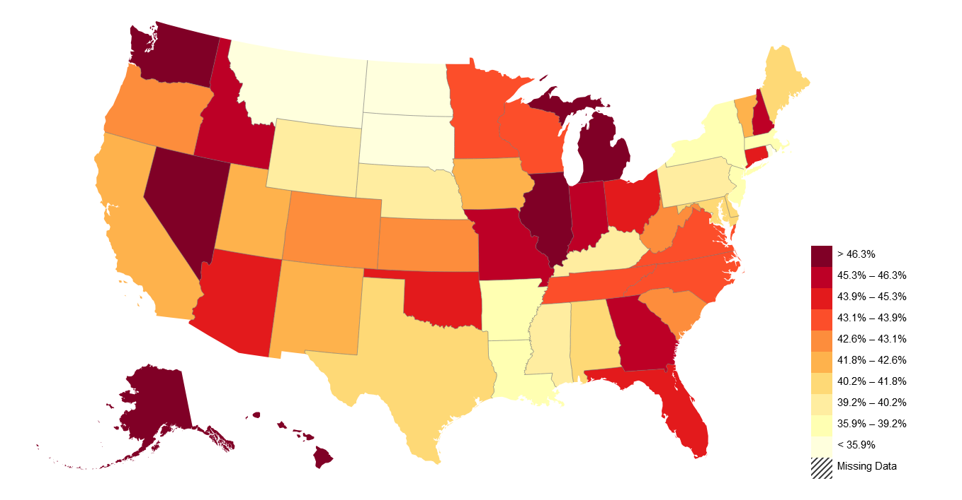
American Dream: Geography Matters
Trends in Absolute Mobility by State: Change from 1940-1980
Decline in Abs. Mob. from 1940-80
https://opportunityinsights.org/paper/the-fading-american-dream/

Slide 20
Relative Mobility
Multiple ways to measure changes in relative mobility:
Movement across quintiles in the income distribution.
Rank correlation of parent and child’s incomes.

Slide 21
Mobility Example: Perfect Relative Mobility
20%
Child’s Quintile
20%
20%
20%
20%
Parent’s Quintile
https://www.demos.org/blog/absolute-and-relative-mobility-short-primer

Slide 22
Transition Probabilities in the United States
https://www.brookings.edu/wp-content/uploads/2016/06/11_generations_isaacs.pdf

Slide 23
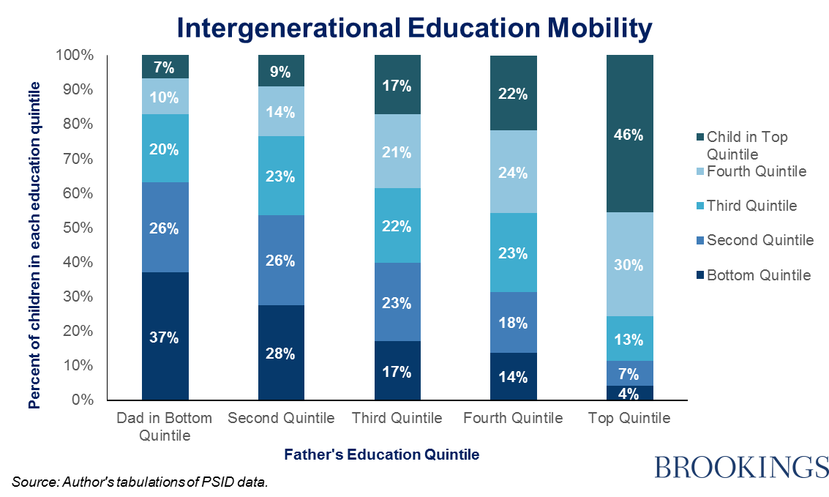
Educational Mobility
https://www.brookings.edu/blog/social-mobility-memos/2014/10/27/the-inheritance-of-education/

Slide 24
Education Does Matter – at All Income Levels
https://www.brookings.edu/wp-content/uploads/2016/06/02_economic_mobility_sawhill.pdf

Slide 25
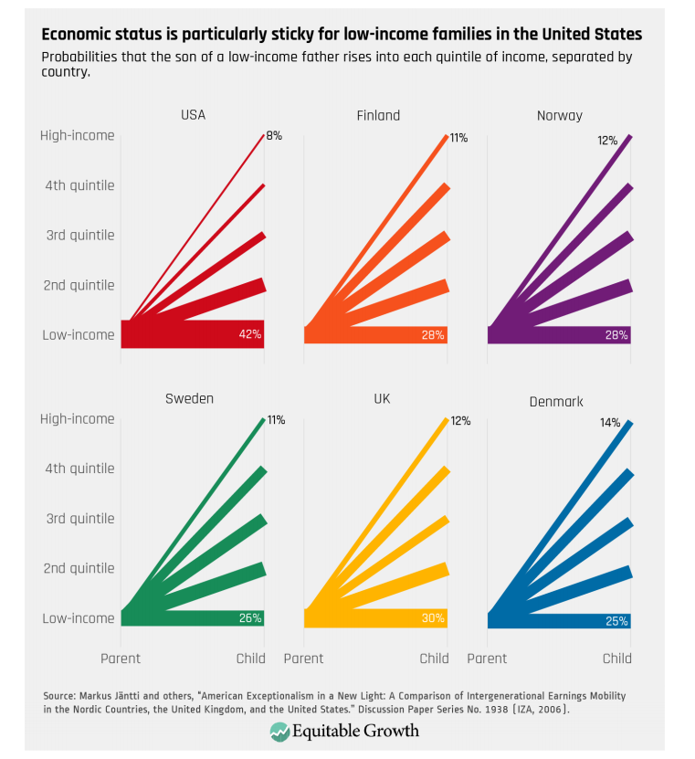
Transitions: International Comparisons
Source: : https://equitablegrowth.org/research-paper/are-todays-inequalities-limiting-tomorrows-opportunities

Slide 26
Reflections on the American Dream
https://www.brookings.edu/blog/social-mobility-memos/2018/01/11/raj-chetty-in-14-charts-big-findings-on-opportunity-and-mobility-we-should-know/

Slide 27
Relative Mobility – Rank Correlation
Rank-based correlation
What are the ranks?
Rank children based on their incomes relative to other children in the same birth cohort
Rank parents of these children based on their incomes relative to other parents
Ask: How correlated are these measures?
Answer: How much does a child’s income rank in adulthood depend on their parent’s income rank when they were growing up?

Slide 28
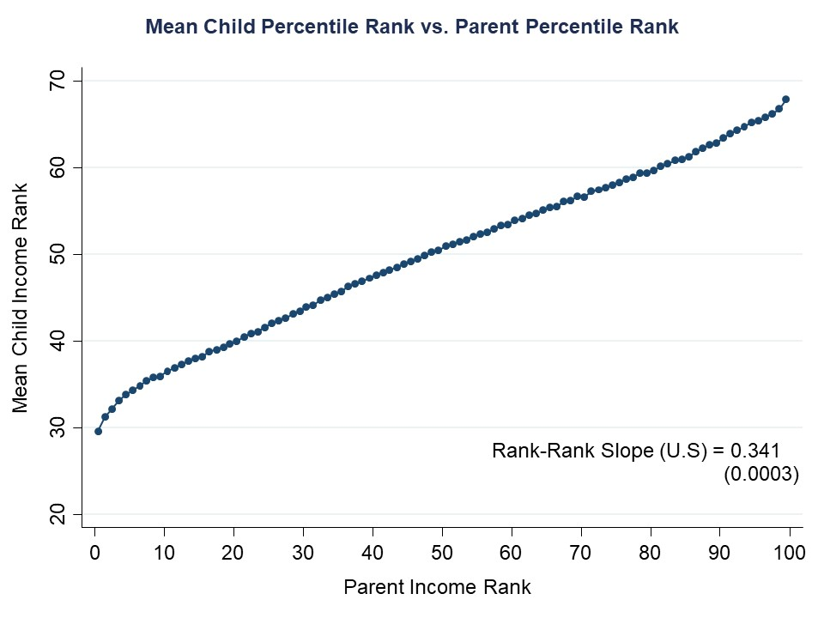
68th percentile for child if
parent in 99th percentile
30th percentile child if
parent in 1st percentile
Graph from Chetty et al (2014)
Notes:
Slide taken directly from Chetty, Hendren, etc. – “Is the United States still the land of opportunity. …” (2014)

Slide 29
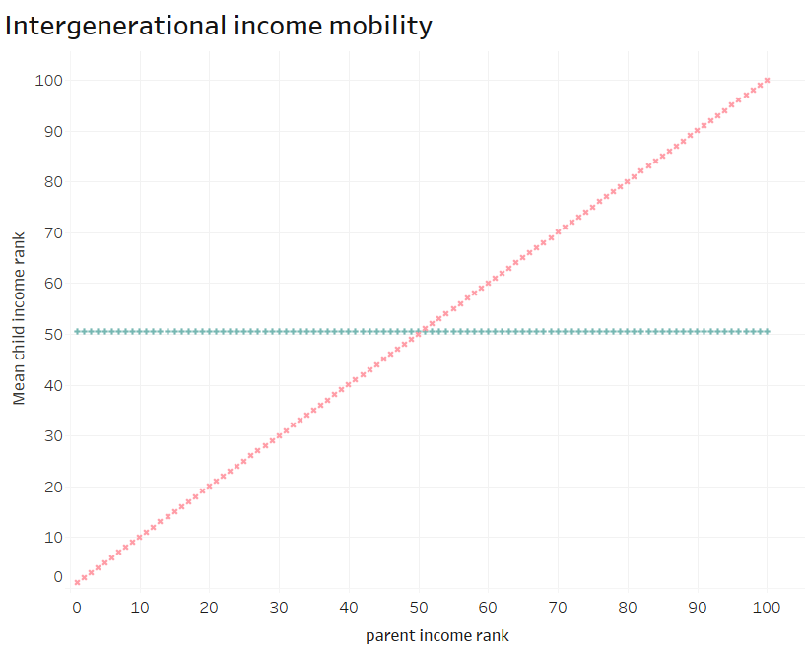
Intergenerational Mobility – The Abstract
no mobility
Extreme cases:
perfect mobility

Slide 30
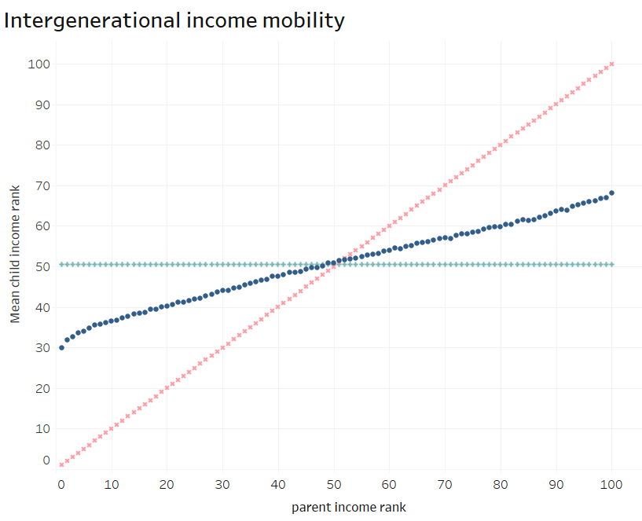
Intergenerational Mobility – The Abstract
no mobility
slope=1
actual mobility
slope=0.34
Note that any imprecision in the data will make mobility appear closer to perfect than it is.
perfect mobility
slope=0

Slide 31
An International Comparison
https://scholar.harvard.edu/files/hendren/files/geo_slides.pdf

Slide 32
Mobility – What’s the Right Amount?
Rank-based correlation, cont’d
Is 0.34 too high or is it reasonable?
This number has not changed significantly in the past 50 years. But inequality (the spread of the distribution) has increased, meaning that which family one is born into has greater consequences for one’s quality of life.
Notes:
Most empirical patterns taken from: http://www.equality-of-opportunity.org/documents/
Papers used in this section:
“Is the United States Still a Land of Opportunity? Recent Trends in Intergenerational Mobility” – Chetty, Hendren, Kline, Saez, Turner 2014
“The Fading American Dream: Trends in Absolute Income Mobility Since 1940” – Chetty, Grusky, Hell, Hendren, Manduca, Narang; Science 2017

Slide 33
College Attendance Rates – by Parent’s Income
100%
80%
60%
Percent in College at 19
84-87 Slope = 0.745
40%
(0.008)
20%
0
20
40
60
80
100
Parent Income Rank
https://opportunityinsights.org/paper/recentintergenerationalmobility/

Slide 34
College Quality Rank – by Parent’s Income
80
70
60
Mean College Quality Rank
50
40
84-87 Coll. Qual Gradient (P75-P25) = 0.191
88-90 Coll. Qual Gradient (P75-P25) = 0.192
30
91-93 Coll. Qual Gradient (P75-P25) = 0.181
0
20
40
60
80
100
Parent Income Rank
1984-87
1988-90
1991-93
https://opportunityinsights.org/paper/recentintergenerationalmobility/

Slide 35
Public Perception and Sentiment
Perception: “American Dream” vs “Old World”
General belief is that the U.S. has greater mobility than elsewhere.
Fewer explicit barriers – no nobility titles.
More meritocratic – “rags to riches”, Heratio Alger
The American Dream plays a significant part in national identity.
Reality: Overestimate of actual mobility
Common perception is incorrect.

Slide 36
Intergenerational Elasticity – of Income
Most common measure of relative mobility (IGE):
Q: What is the relationship between the family income of parents and the family income of their child?
A lower IGE implies more economic mobility
Problems with IGE:
Strongly influenced by income inequality.
Strongly affected by data used:
Age range
Can’t include people with zero earnings
Etc.

Slide 37
IGE: U.S. in International Comparison
Less
Mobility
More
Mobility
https://www.epi.org/publication/usa-lags-peer-countries-mobility/

Slide 38
The “American Dream” Shapes Perceptions
https://www.brookings.edu/wp-content/uploads/2016/06/02_economic_mobility_sawhill.pdf

Slide 39
Mobility – Important Relationships
Mobility and Growth
What is the relationship between the two?
Growth drives absolute mobility.
Mobility drives growth.
Primarily through individual actions: investments in productive capacity and effort.
Mobility and Inequality
What is the relationship between the two?
Makes both absolute and relative mobility more difficult.

Slide 40
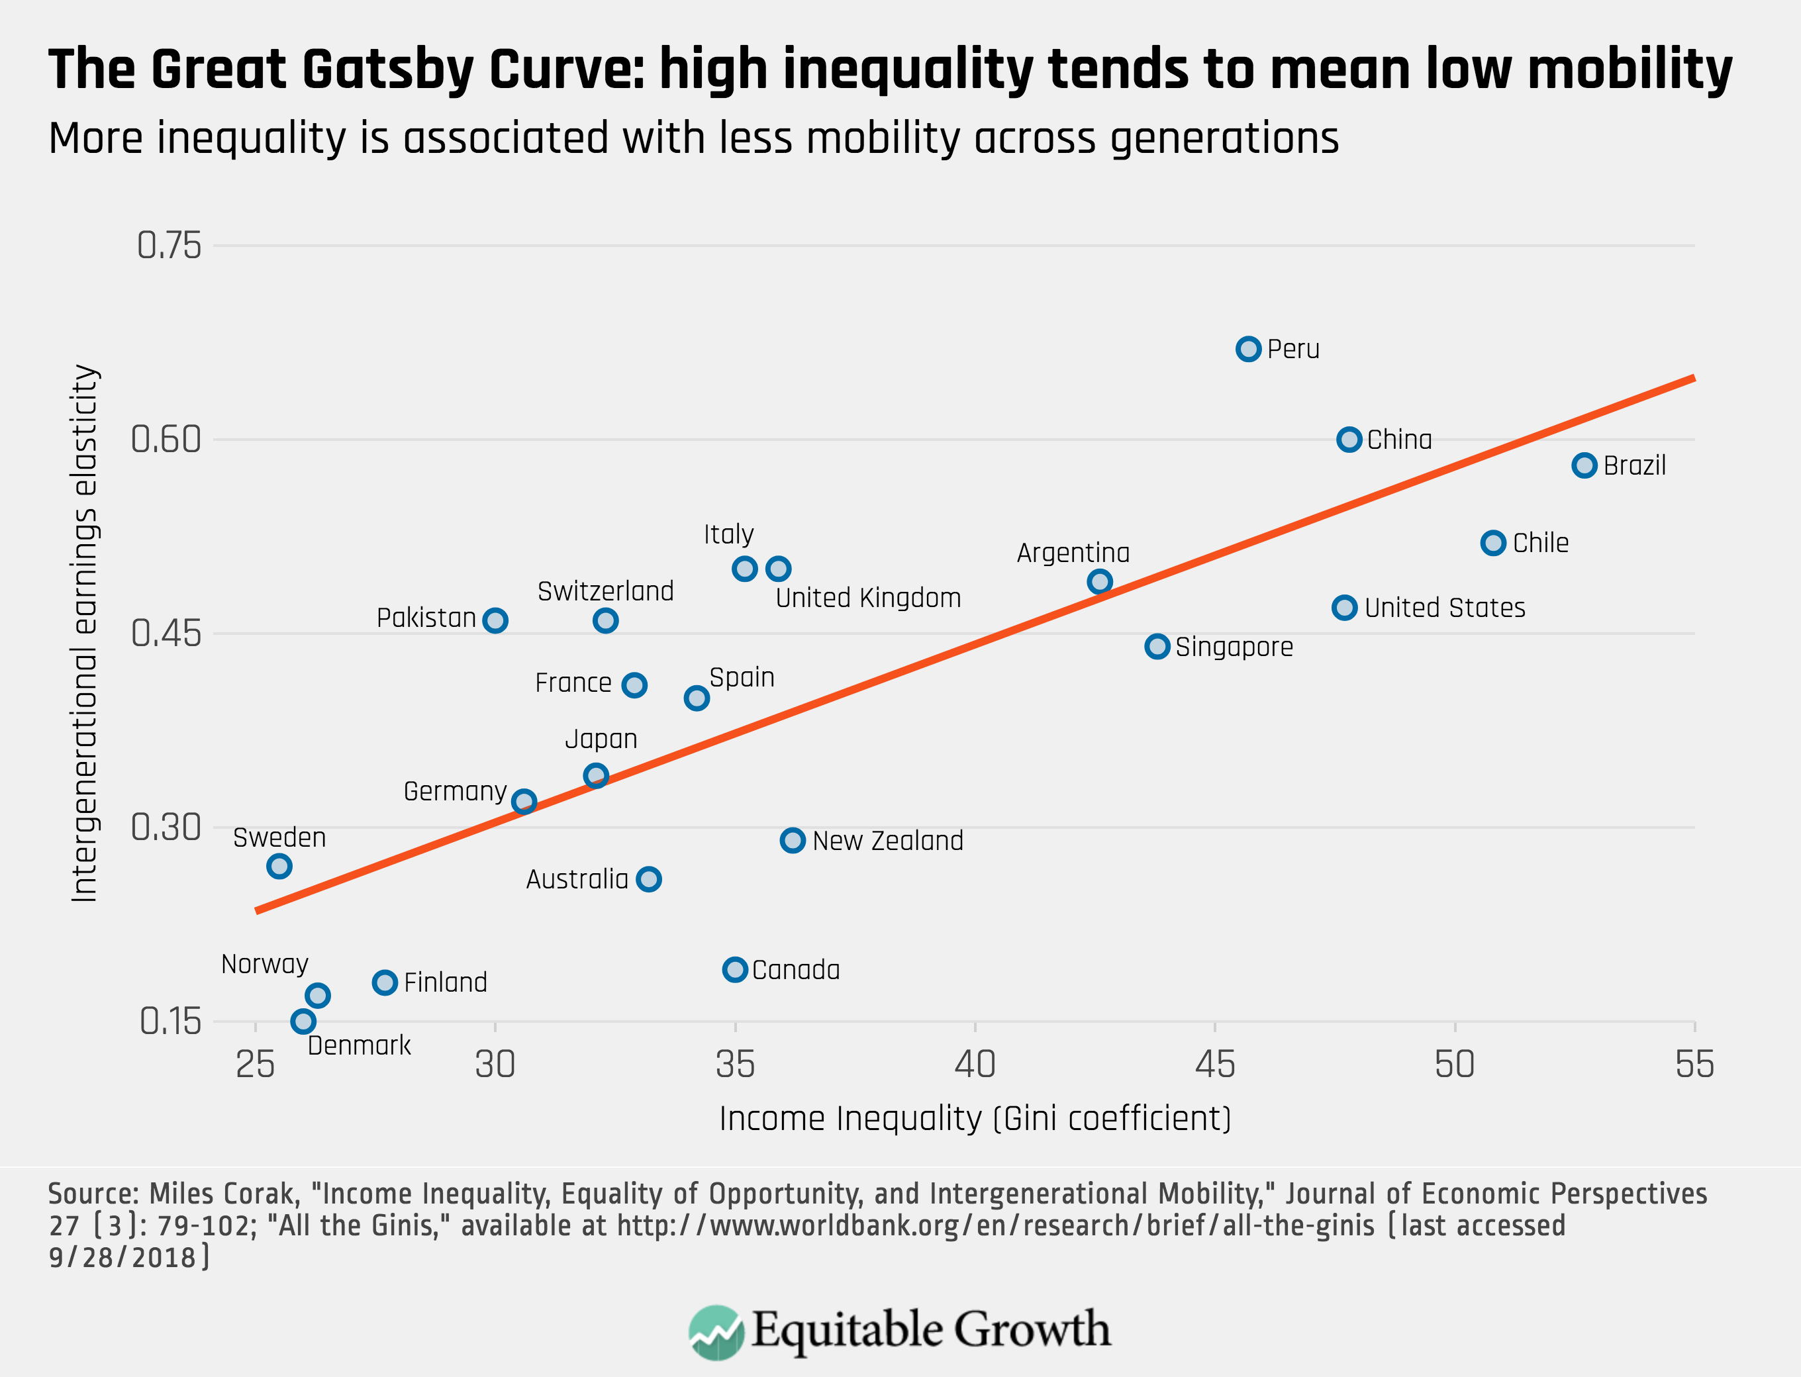
Peru
China
Brazil
Germany
U.S.
Canada
https://equitablegrowth.org/research-paper/are-todays-inequalities-limiting-tomorrows-opportunities

Slide 41
Absolute Mobility: Race

Slide 42
Relative Mobility: Race

Slide 43
Absolute Mobility: Gender

Slide 44
Relative Mobility: Gender

Slide 45
III. What can we make of this?
What does the data tell us, and what is to be done?

Slide 46
Why Should We Care?
Efficiency
Does mobility affect economic growth?
Equity
Is there a sense of fairness that is in play here?
Would greater equity provide societal benefits?
Is there a tradeoff or are these concerns reinforcing?

Slide 47
Private Issue with Public Consequences?
The “left-behind” and low-to-middle-class malaise
Evidence that absolute mobility has dropped the most in the Industrial Midwest, and for men relative to their fathers
These are the groups which revolted against traditional political candidates in 2016 and voted for Trump.
Not a uniquely American phenomenon
See Brexit and the rise of populist candidates throughout developed countries.

Slide 48
Absolute or Relative Mobility?
Upward absolute mobility of the whole population is unambiguously desirable (it’s hard to defend not wanting everyone to be better off!)
The fact that half the population is treading water should worry us.
But, relative mobility is a zero-sum game: for some people to rank higher than their parents did, others have to rank lower.
Why is social churn desirable? (Is it?!)
Are people not merely being petty when, after getting a raise, they are displeased to find out that a coworker got a bigger raise?

Slide 49
Is PERFECT Relative Mobility Desirable?
There are persuasive arguments why perfect relative mobility is sub-optimal: (i.e. we shouldn’t expect children’s outcomes to be entirely uncorrelated with their parents’):
Fairness argument: highly skilled parents earn higher incomes, and they also have--on average--more highly-skilled children, who thus deserve higher earnings.
What’s more, it is better for everyone if talent is recognized, so that resources can be put to the most efficient use

Slide 50
Is ZERO Relative Mobility Desirable?
Similarly, there are arguments why zero relative mobility is sub-optimal:
Fairness: it is highly unlikely that zero relative mobility is ever fair, since two extreme conditions would have to be met:
Parental generation outcomes would have had to be perfectly fair
Abilities, traits, and effort would have to be perfectly correlated across generations
Instrumental: a perfectly rigid society is one where people feel powerless.
They think the game is “rigged”, and from this follows civic disengagement, slow economic growth, social unrest, etc.

Slide 51
How Much Relative Mobility is Desirable?
If perfect mobility is too much and zero is too little, it seems reasonable to ask:
What is the optimal level of relative mobility?
This is a hard question, one which we may not be able to answer.
Luckily, it’s almost as useful to ask a less ambitious question:
Is current relative mobility too low (or too high)?
The answer would suggest the best incremental steps to take towards a better outcome, and policy changes are best done in incremental steps in any case.

Slide 52
How is the Mobility Porridge?
How might we answer the second question (is mobility too low/ too high)?
Common sense judgement
E.g. is it plausible that – due to merit alone – a child from the top 1% would be 77 times as likely to attend an Ivy League school than a child from the bottom quintile?
What if the likelihood was 5-fold?
Forget merit: is it wise for a society to exclude large segments of the population from the circles of its future leaders?
Examination of the channels through which relative mobility can occur, how they relate to family resources and how they respond to investigative changes (see next section)
Notes:
Chetty et al (2017) – “Mobility Report Cards: The Role of Colleges in Intergenerational Mobility”

Slide 53
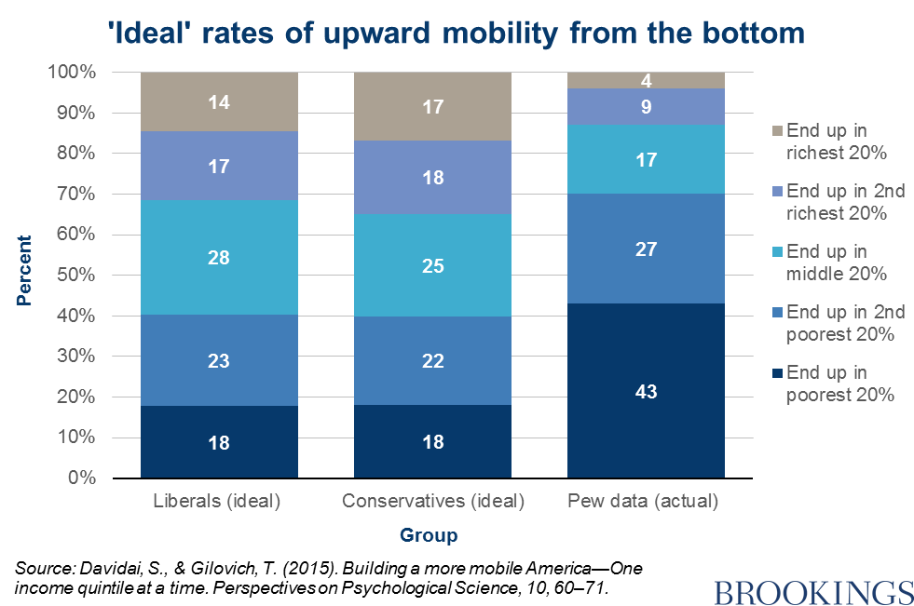
Survey Says on Upward Mobility from the BOTTOM

Slide 54
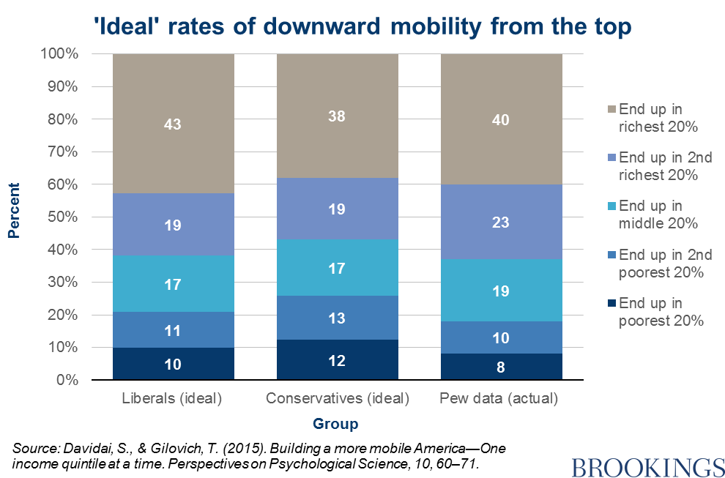
Survey Says on Downward Mobility from the TOP

Slide 55
Preferences hit Awkward Truth: Math
Again: relative mobility is a zero-sum game
There are only so many spots in the top quintile
Preferences want:
43% of them for kids born into the top
16% for those born into the bottom
Leaves about 14% for each of the other 3 quintiles
Preferences are inconsistent
Greater upward mobility for the bottom than the middle?
Results are intuitive:
Stickiness at the top
Mobility from the bottom
…but inconsistent:
What about the middle?

Slide 56
IV. Exploring different barriers to upward mobility – empirical evidence
Findings and suggested policy interventions

Slide 57
Barriers to Upward Mobility
Key Question:
What are the factors that might prevent someone born
in a low-income household from doing as well as their
richer counterpart?
Answers:
Birth Lottery
Structural barriers

Slide 58
Barriers to Upward Mobility – Birth Lottery
Early advantages
Innate (genetic) advantages:
Inherited ability, medical conditions, psychological traits
Environmental factors:
In utero: pre-natal care, mother’s nutrition, exposure to abuse or stress.
Home environment which promotes healthy development, transmission of family values
Availability of role models, mentors, neighborhood effects.
Availability of good educators, facilities, peers

Slide 59
Structural Barriers to Upward Mobility
Selective access to quality higher education
Preferential admission for legacy and donor families.
Expectation of extra-curricular activities, AP classes, etc.
Effective access to family planning (sex ed, contraceptives, abortion)
Teen births reduce outcomes for both mother and child.
Access to lucrative employment:
Reliance on personal connections, homophily, racism, sexism...

Slide 60
Structural Barriers to Upward Mobility (2)
Exposure and access to avenues of wealth creation:
e.g. tax-deferred education accounts (529), investment strategies, also tax avoidance loopholes, etc.
Access to entrepreneurship:
initial capital and insurance against negative shocks, social networks.
Direct transmission of income-earning assets.

Slide 61
Barriers to Upward Mobility – Drilling Down
These and other channels each play a role.
We will review and discuss some of them, keeping the following questions in mind:
What is the magnitude of the effect?
Is it fair to benefit from an advantage along this dimension?
Are there plausible public interventions that would increase fairness and efficiency?

Slide 62
Barriers: Findings
Role of elite universities and selective admission
Only a minority of top universities are engines for social mobility.
Ivy league is successful, but small numbers of low income students.
Second tier state schools are less successful, but larger numbers.
Propensity to be an inventor
Exposure to innovative activity encourages own innovation.
Importance of role models and exposure to an activity.
Rates of business ownership
Children from wealthy families are far more likely to own a business.
Location of birth
Where one grows up matters
Socio-economic segregation across neighborhoods.

Slide 63
Channels of Upward Mobility – Business Ownership vs. Higher Education
Households that own a business amass significantly more wealth.
But, households with little initial wealth have low odds of starting a successful business.
Availability of capital, ability to absorb risk.
Propensity to innovate:
evidence that much of the difference in patenting rates is due to exposure effects, both from parents and from the neighborhood.
Children who graduate from elite colleges and come from poor backgrounds do almost as well as their richer classmates.
But, low income students are dramatically UNDER-represented at elite colleges.

Slide 64
Mobility: Business Ownership vs. College
Business ownership and higher education play similar roles:
Both facilitate wealth accumulation for all.
Incorporating the business and graduating from a prestigious university, respectively, is where most of the gains come from.
Even if only few benefit, is selection meritocratic?
Controlling for parental wealth, access to education is more meritocratic (i.e. positively linked to ability) than access to business ownership.

Slide 65
Channels of upward mobility – employment networks
2 out of 3 sons of the top earners in Canada get access to their father’s employer.
Much less access at lower levels of parental earnings.

Slide 66
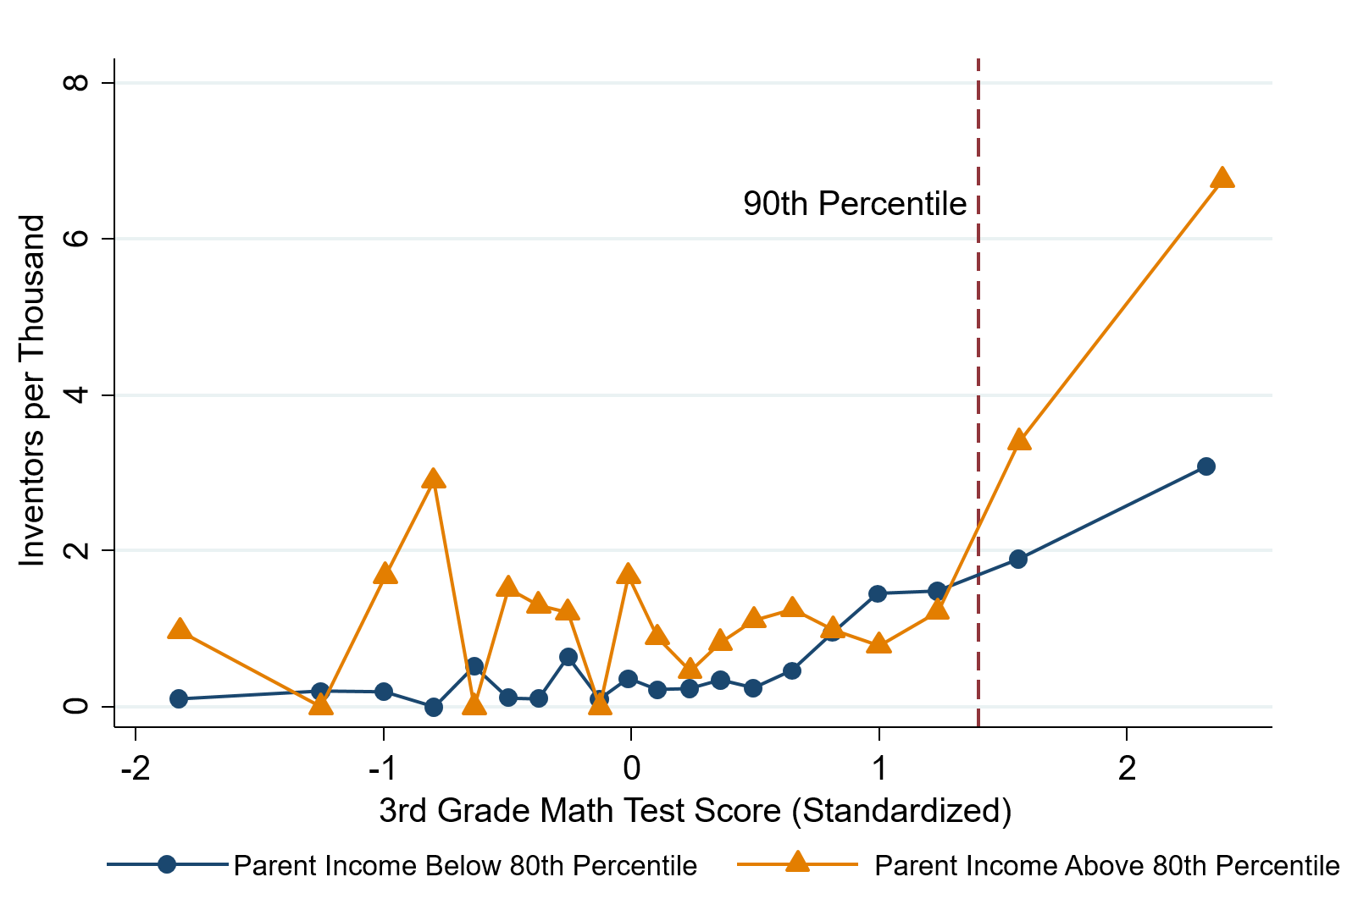
Channels of upward mobility – inventions
High math-ability 3rd graders go on to become inventors if their family is well-off.
(Also if they grow up in high-innovation areas)
Graph from Bell et al (2018)

Slide 67
Summary: Policy Options
Housing vouchers, public housing, zoning laws
Help underprivileged children grow up in neighborhoods conducive to mobility.
Investments in education
Make preparedness for college more universally available.
Entrepreneurship
Introduce children to it at an early age.
Implement policies to reduce inequality.

Slide 68
Summary: Economic Mobility
Definitions:
Absolute vs Relative Mobility
Levels:
Absolute mobility is in decline
Relative mobility is much lower in the U.S. than elsewhere.
Brings into question the notion of the “American dream”.
Enough mobility? Hard to say.
Absolute: concern that 50% of kids are treading water or falling behind.
Relative: not as much as people seem to think there is.
Policy options?
There are plenty of levers to pull to increase mobility.

Slide 69
Discrimination in Policy History: Jon Haveman
Slave trade
The first deprivation.
Slavery
40 acres (and a mule)
The second deprivation.
Discriminatory distribution of land.
Freedmen’s Bank
Lax oversite and dissolution.
Jim Crow Laws & Economic Policy
Convict leasing, debt peonage, chain-gang, sharecropping, and lynching.
Homestead Act
Discriminatory distribution of land.
Land theft and destruction
E.g., Black Wall Street – Tulsa, 1921.
GI Bill
Discriminatory access – Levittown
Federal Housing Authority
Redlining
And many more.

Slide 70
Thank you!
Any Questions?
www.NEEDelegation.org
Dr. Kathryn Wilson
kwilson3@kent.edu
Contact NEED: Info@NEEDelegation.org
Submit a testimonial: www.NEEDelegation.org/testimonials.php
Get NEED Updates: www.NEEDelegation.org/friends.php

