Slide 1
Economic Inequality
Volodymyr Lugovskyy
Associate Professor of Economics, Indiana University
Rotary Club of Mission San Rafael
Jan 14, 2021

Slide 2
National Economic Education Delegation
Vision
One day, the public discussion of policy issues will be grounded in an accurate perception of the underlying economic principles and data.
Mission
NEED unites the skills and knowledge of a vast network of professional economists to promote understanding of the economics of policy issues in the United States.
NEED Presentations
Are nonpartisan and intended to reflect the consensus of the economics profession.

Slide 3
Who Are We?
Honorary Board: 48 members
2 Fed Chairs: Janet Yellen, Ben Bernanke
6 Chairs Council of Economic Advisers
Furman (D), Rosen (R), Bernanke (R), Yellen (D), Tyson (D), Goolsbee (D)
3 Nobel Prize Winners
Akerlof, Smith, Maskin
Delegates: 500+ members
At all levels of academia and some in government service
All have a Ph.D. in economics
Crowdsource slide decks
Give presentations
Global Partners: 45 Ph.D. Economists
Aid in slide deck development

Slide 4
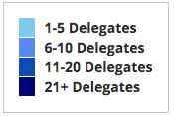
Where Are We?

Slide 5
Credits and Disclaimer
This slide deck was authored by:
Jon Haveman, Executive Director of NEED
This slide deck was reviewed by:
Timothy Smeeding, University of Wisconsin
Robert Wright, Augustana University
Disclaimer
NEED presentations are designed to be nonpartisan
It is, however, inevitable that the presenter will be asked for and will provide their own views
Such views are those of the presenter and not necessarily those of the National Economic Education Delegation (NEED)

Slide 6
National Income Inequality: Share of Top 10%
Stock Market Crash
WWII
Housing Bubble
Dot-com Bubble

Slide 7
The Abrupt Increase in Inequality
Source: Chad Stone, Danilo Trisi, Arloc Sherman, and Roderick Taylor, “A Guide to Statistics on Historical Trends in Income Inequality,”
Center on Budget and Policy Priorities, Policy Futures, Dec. 11, 2018.
Notes:
Slide taken from page 10, Chad Stone, Danilo Trisi, Arloc Sherman, and Roderick Taylor, “A Guide to Statistics on Historical Trends in Income Inequality,” May 15, 2018

Slide 8
Most of the Action Is at the Top: Pre-Tax
Projected 2021
CBO: Projected Changes in the Distribution of Household Income, 2016 to 2021

Slide 9
Where Does Inequality Come From?
Labor Characteristics
Demographics
Age distribution
Personal Choices
Educational attainment
Effort
Priorities
Household composition
Immigration
Market Forces
Technology
Changing demand patterns
Competition for labor
Government Policy
Market influence
Redistribution

Slide 10
The Rich Really do Pay Lower Taxes
1950
Top 400
Lower Income
Higher Income

Slide 11
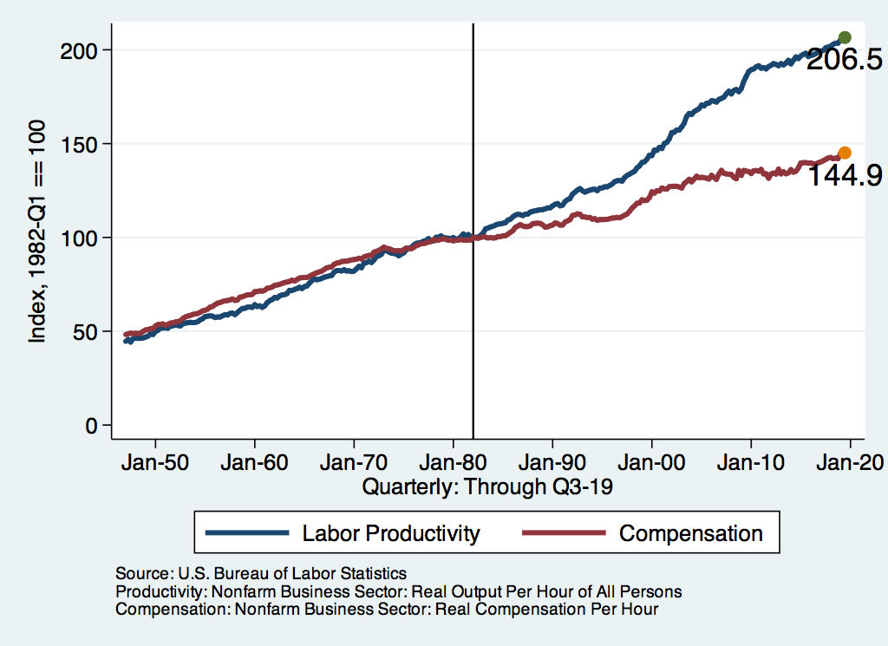
Labor Income is Unhinged from Productivity
Why?
Declining unionization
Globalization
Immigration
Competition policy
Cheap technology

Slide 12
Declining Unionization
Unionization Rates
1983: 20.1%
2019: 10.3%
Unionization Rates
Public: 33.6%
Private: 6.2%
Source: Jason Furman, ”Forms and sources of inequality in the United States”, VOX, March 17, 2016, Figure 4.
Notes:
https://voxeu.org/article/forms-and-sources-inequality-united-states

Slide 13
Competition in the Economy
Return on invested capital excluding goodwill –
US publicly-traded nonfinancial firms, 1965-2014
Source: Jason Furman, ”Forms and sources of inequality in the United States”, VOX, March 17, 2016, Figure 6.
Notes:
Note: The return on invested capital definition is based on Koller et al (2015), and the data presented here are updated and augmented versions of the figures presented in Chapter 6 of that volume. The McKinsey data includes McKinsey analysis of Standard & Poor’s data and exclude financial firms from the analysis because of the practical complexities of computing returns on invested capital for such firms. ​ Source: Koller et al. (2015); McKinsey & Company; Furman and Orszag (2015). , by way of https://voxeu.org/article/forms-and-sources-inequality-united-states
Furman, J and P Orszag (2015), “A Firm-Level Perspective on the Role of Rents in the Rise in Inequality”, Presentation at “A Just Society” Centennial Event in Honor of Joseph Stiglitz Columbia University, October 16, 2015.

Slide 14
CEO Pay Has Been Growing Rapidly

Slide 15
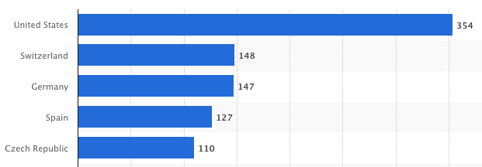
CEO Pay Has Been Growing Rapidly

Slide 16
Immigration and Inequality
Source: Ping Xu, James C. Garand, and Ling Zhu, “How immigration makes income inequality worse in the U.S.”, October, 2015, Figure 1.

Slide 17
Technology Benefits Ownership over Labor

Slide 18
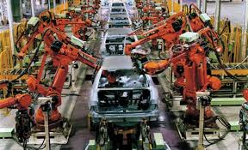
Technology can Hurt Low Income Workers
Early on, technology was good to low income workers
Until it was bad for them….

Slide 19
A Modern Example: Uber & Lyft
Technology:
Facilitates market power for owners.
Reduces bargaining power for labor.
Shifts costs of doing business onto labor.
Modern day Robber Barons?
Ruthlessly absorbing as much income as they can.
Lack of regard for labor.

Slide 20
Sources of Inequality Through Late 1990s

Slide 21
Why Does Inequality Matter?
Too little inequality can:
Reduce individual motivation
Slow economic growth
Too much inequality can:
Reduce individual motivation
Slow economic growth
Too much inequality may also:
Divide society
Distort political environment
Reduce political participation
Reduce investments in public goods
Education
Environmental protections

Slide 22
An International Perspective
Source: Data taken from the 2014 CIA World Factbook.

Slide 23
Addressing Inequality: Is It A Problem?
Why it might be a problem.
Economic issues (Efficiency)
There is evidence that at some level, increased inequality slows economic growth.
Or, inequality concentrates resources among investors.
Noneconomic issues (Equity)
Values, ethics and morals will drive individual evaluations of the level of inequality.
E.g., inequality is primarily a function of market outcomes, so should be left alone.
Or, a solid middle class is important for maintaining a civil society, which runs contrary to a high degree of inequality.
Suppose you think it’s a problem. How might it be addressed?

Slide 24
Addressing Inequality: Immediately Available Policy Solutions (1/2)
RE-distribution
Tax and transfer programs
PRE-distribution
Strengthen labor unions
Collective bargaining
Other policies that favor labor over business owners
Minimum wages

Slide 25
Addressing Inequality: Long Term
It’s all about access to resources:
Education, in particular
Improve public education
Reduce disparities in quality of public education
Improve counseling in low-income schools
With respect to college – paths to success and funding
Investments are needed in early education, not later
Universal pre-K
Upgrade quality of elementary schools in low-income areas

Slide 26
Tension in Policy Solutions
Is it possible to increase growth at the same time that you reduce income inequality?
Common refrain among some that government intervention in the economy is always and everywhere bad for growth.
Possibly: expanding equality of access promotes the full utilization of resources.
Expanding equality of access requires resources likely from the well-to-do.

