Slide 1
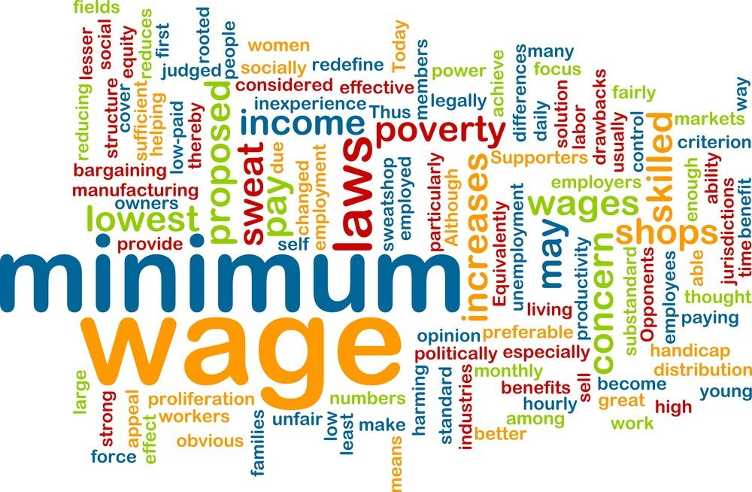
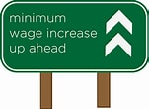
Minimum Wage
ExtraFood.org
Jon D. Haveman, Ph.D.
Executive Director, NEED
November 2, 2021

Slide 2
National Economic Education Delegation
Vision
One day, the public discussion of policy issues will be grounded in an accurate perception of the underlying economic principles and data.
Mission
NEED unites the skills and knowledge of a vast network of professional economists to promote understanding of the economics of policy issues in the United States.
NEED Presentations
Are nonpartisan and intended to reflect the consensus of the economics profession.

Slide 3
Who Are We?
Honorary Board: 54 members
2 Fed Chairs: Janet Yellen, Ben Bernanke
6 Chairs Council of Economic Advisers
Furman (D), Rosen (R), Bernanke (R), Yellen (D), Tyson (D), Goolsbee (D)
3 Nobel Prize Winners
Akerlof, Smith, Maskin
Delegates: 600+ members
At all levels of academia and some in government service
All have a Ph.D. in economics
Crowdsource slide decks
Give presentations
Global Partners: 44 Ph.D. Economists
Aid in slide deck development

Slide 4
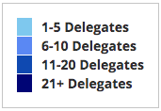
Where Are We?

Slide 5
Available NEED Topics Include:
Coronavirus Economics
US Economy
Climate Change
Economic Inequality
Economic Mobility
Trade and Globalization
Healthcare Economics
Immigration Economics
Housing Policy
Federal Budgets
Federal Debt
Black-White Wealth Gap
Autonomous Vehicles
US Social Policy

Slide 6
Credits and Disclaimer
This slide deck was authored by:
Jon Haveman, NEED
Veronika Dolar, SUNY at Old Westbury
This slide deck was reviewed by:
Jeffrey Clemens, UC– San Diego
David Neumark, UC - Irvine
Disclaimer
NEED presentations are designed to be nonpartisan.
It is, however, inevitable that the presenter will be asked for and will provide their own views.
Such views are those of the presenter and not necessarily those of the National Economic Education Delegation (NEED).

Slide 7
Outline
What is the Federal minimum wage?
Origin story
Limitations
Effects of increasing
Economist’s perspective

Slide 8
What Is The Minimum Wage?
The minimum wage sets a wage floor.
It is unlawful for businesses in covered industries to pay a wage below the minimum.
The Federal minimum wage is currently $7.25.
This is the highest that it has ever been.
Adjusting for inflation:
It is no higher than it was in the late 1950s.
It is nearly $5.00 lower than it was in the late 1960s.

Slide 9
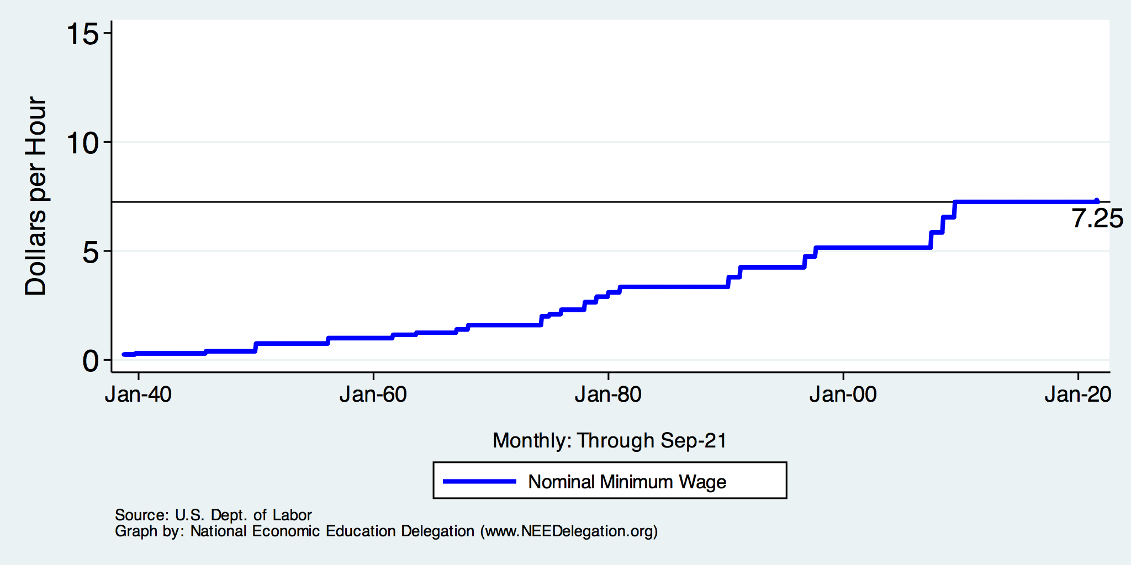
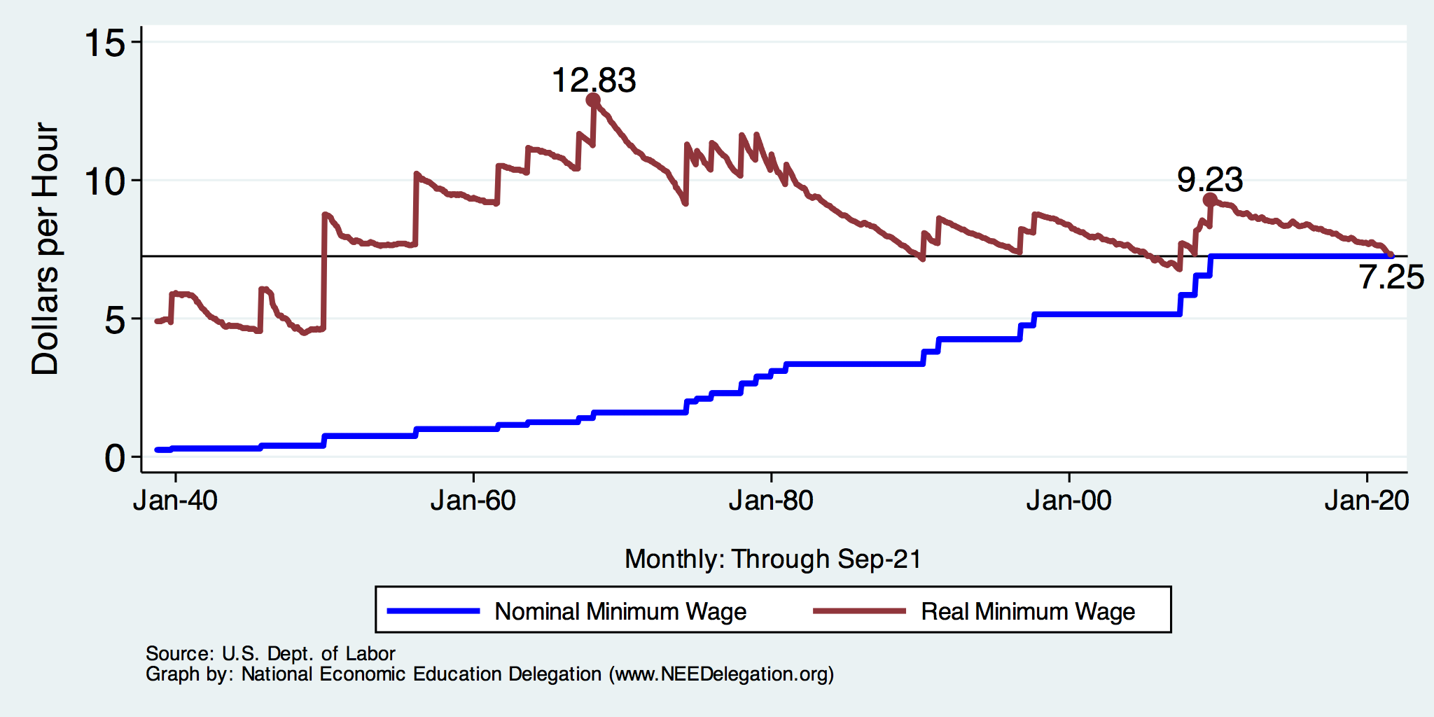
History of the Federal Minimum Wage

Slide 10
From Hourly to Approx. Annual Minimum Wage
Real Annual Minimum Wage in 1968 was
$12.80 x 40 hours per week x 52 weeks = $26,624
Real Annual Minimum Wage today is
$7.25 x 40 hours per week x 52 weeks = $15,080

Slide 11
How Many are Paid At or Below Min. Wage?
1980: 15%
1991: 8.4%
2010: 6%
2019: 1.9%

Slide 12
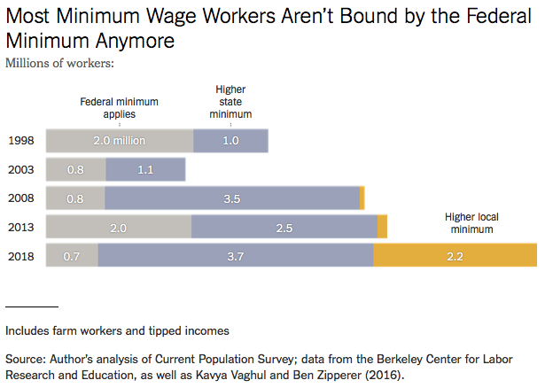
Notes:
https://www.nytimes.com/2019/04/24/upshot/why-america-may-already-have-its-highest-minimum-wage.html?action=click&module=RelatedLinks&pgtype=Article

Slide 13
Many States Have A Higher Min Wage
NY: $12.50/hour
States with Higher
Minimum Wage
than Federal
CA: $14/hour
States with Same
Minimum Wage
as Federal
States with no Minimum Wage
As of Jan 1, 2021
Source: U.S. Department of Labor

Slide 14
Example: Minimum Wage in California
California’s minimum wage rate is currently is $14.00/hour.
Significant increases imposed beginning in 2017.
Employers must use the following hourly minimum wage schedule for ALL employees:
Date | Firms with <= 25 Employees | Firms with > 25 Employees
January 1, 2017 | $10.00/hour | $10.50/hour
January 1, 2018 | $10.50/hour | $11.00/hour
January 1, 2019 | $11.00/hour | $12.00/hour
January 1, 2020 | $12.00/hour | $13.00/hour
January 1, 2021 | $13.00/hour | $14.00/hour
January 1, 2022 | $14.00/hour | $15.00/hour
January 1, 2023 | $15.00/hour

Slide 15
Important Questions:
What is the purpose of a minimum wage?
What is the purpose of a FEDERAL minimum wage?
Why do we have one?
What are the implications of having one?
Should we have one?
How high should it be?

Slide 16
Minimum Wage: Purpose
International Labor Organization:
The purpose of minimum wages is to protect workers against unduly low pay. They help ensure a just and equitable share of the fruits of progress to all, and a minimum living wage to all who are employed and in need of such protection.
Minimum wages can also be one element of a policy to overcome poverty and reduce inequality, including those between men and women, by promoting the right to equal remuneration for work of equal value.

Slide 17
Origin Story: The New Deal
Minimum wages
Social Security
Unemployment

Slide 18
Fair Labor Standards Act of 1938
Minimum wage: $0.25 – raised 22 times
“Covered” only about 23% of workers at the time.
The law did not apply universally.
11 million out of 48 million gainful workers were covered.
The provisions of the Act affect employees who are engaged in (interstate) commerce or the production of goods for (interstate) commerce.
Not covered were:
Farm labor, retail trade, domestic and personal service, governmental service, or the self-employed.
Source: Daugherty, The Economic Coverage of the Fair Labor Standards Act

Slide 19
Should There be A Federal Minimum Wage?
Abolish a FEDERAL minimum wage?
Argument in favor of abolishing:
Cost of living differs across states.
Arguments against abolishing:
Could result in very different living standards across states.
Racial differences are a particular concern.
30% of labor force will already be under a $15 min wage by 2025.
California, Connecticut, Illinois, Maryland, Massachusetts, New Jersey, New York

Slide 20
States and Local Gov’ts are Raising Min Wages
Notes:
https://www.nytimes.com/2019/04/24/upshot/why-america-may-already-have-its-highest-minimum-wage.html?action=click&module=RelatedLinks&pgtype=Article

Slide 21
Common View of Minimum Wage
Wages go up.
Labor costs go up.
Employment falls and Unemployment increases.
Bottom line: are the increased wages worth the drop in employment?
This is a very SIMPLE view of the minimum wage.
Economics is complicated.

Slide 22
Simple Views are Incomplete
A minimum wage need not reduce employment.
An increase in the minimum wage can hurt its intended beneficiaries - even with no employment effect.
This incompleteness comes from potential firm responses:
Output prices
Nonwage compensation
Other job attributes:
Effort requirements, safety measures, quality of working environment.
Because business settings vary, the responses across these areas will differ across industries and between firms within an industry.
No single answer is possible.

Slide 23
Responses by Employer
Reduce employment of low wage workers.
Produce less.
Reduce dependence on low skilled labor
Using more capital or more of labor with higher skills.
Raise prices to consumers.
Offsets the increase in labor costs, blunting the drop in employment.
However, it also erodes the income gains of min wage increase.
Reduce nonwage compensation.
Health care, paid leave, etc.
Alter other job attributes.
Effort requirements, safety, general quality of the work environment, flexibility of schedules.
Offshore production.
Experience lower profits.
Close down.

Slide 24
Responses by Employee
Increase their supply of labor.
Growing the labor force.
Value the job more highly.
Increased effort.
Reduced job search.
Use the increased income to:
Better the lives of their family.
Invest in training and education.

Slide 25
Arguments FOR a Minimum Wage
Basic:
It raises the standard of living for minimum wage workers.
In 2019, CBO projected increases for 17 million people with an increase to $15/hour by 2025.
Secondary - Less consensus:
Improved employee morale.
Less turnover, greater productivity.
Economic growth potential.
Increased purchasing power among low wage workers may increase aggregate demand.
Reduce gender disparities in wages.
A greater proportion of female workers are paid the minimum wage.
Proportions across race and ethnicity do not differ significantly.
Source: https://www.investopedia.com/articles/markets-economy/090516/what-are-pros-and-cons-raising-minimum-wage.asp

Slide 26
Arguments AGAINST a Minimum Wage Hike
Basic:
Increased labor costs lowers employment among low wage workers.
Particular effect on:
Small businesses.
Labor intensive industries.
Secondary:
Increases the cost of living – inflation.
Producers may raise prices to offset the increase in labor costs.
May change the nature of the workplace environment.
Source: https://www.investopedia.com/articles/markets-economy/090516/what-are-pros-and-cons-raising-minimum-wage.asp

Slide 27
Who Wins? No Clear Answer
Minimum wage is more likely to be beneficial at lower wages and with smallish changes.
The spillover effects of an increase in the minimum wage are not well understood:
Increased effort and employee retention.
Increase in prices/inflation.
Reduction of nonmonetary compensation.
Less attractive work environment.
E.g., more variable work schedules, fewer safety measures.
“Conservative/Liberal” divide in the profession
Conservatives – emphasize job losses
Liberals – minimize job losses
Both are incomplete…..

Slide 28
Consensus of Employment Effects?
Short answer: No!
Longer answer:
Trend in the literature is toward finding progressively smaller NEGATIVE employment effects.
Most analyses indicate negative employment effects.
Some confirmation that the negative implications for employment, or hours, translates into negative implications for compensation.

Slide 29
Raise the Wage Act 2021 (RWA)
Raise the federal minimum wage from $7.25 to $15 by 2025;
Index the federal minimum wage to median wage growth;
Eliminate multiple minimum wages:
End tipped workers lower minimum wage;
End teen worker lower minimum wage;
End subminimum wage certificates for workers with disabilities.

Slide 30
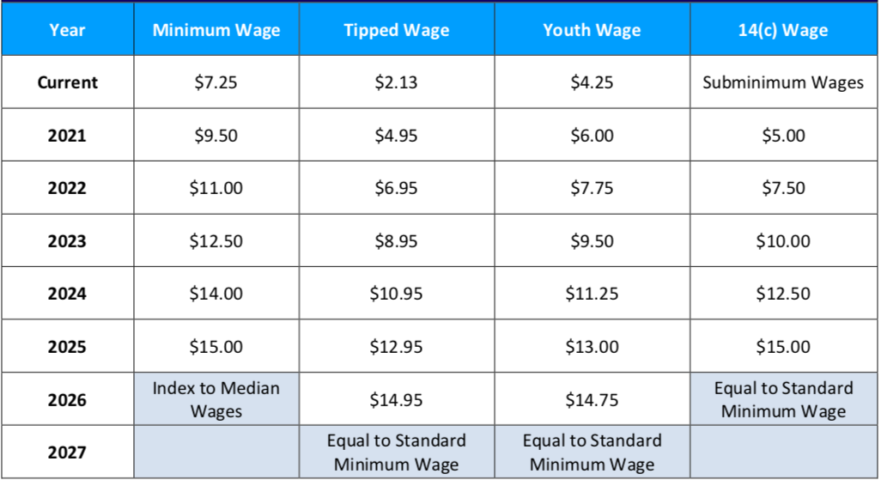
Scheduled Min Wage Increases Under RWA

Slide 31
Economic Consensus on $15/hour? NO
Increases are well outside the range of previous experience.
Ambiguous impact on affected worker’s living standards:
Negative: unemployment, lower on the job amenities, inflation
Positive: higher wages
Likely NOT an improvement for business owners.
Unless it induces implausibly high levels of increased worker effort.
Implications for broader society are unclear.
But the minimum wage is implemented as an efficiency tradeoff for equity.
It is a policy that reflects society’s values regarding the welfare of workers.

Slide 32
CBO Analysis
Effects of increase to $15 – summary:
Increased wages for 27 million people in 2025.
17 million who would be below $15/hour.
10 million who would have earned just above $15/hour.
Increased labor compensation of $333 billion between 2021 and 2031.
$509B in increased pay.
$175B less because of job losses.
Put 1.4 million out of work (0.9% of workers).
Primarily young, less educated workers.
Lift 900,000 out of poverty.
2019: 34 million people lived in poverty.
https://www.cbo.gov/system/files/2021-02/56975-Minimum-Wage.pdf

Slide 33
What to make of the CBO results?
Primary Results
Increased wages for 27 million people.
1.4 million fewer low wage jobs.
900,000 lifted out of poverty.
Reasonable people can, and do, disagree about whether or not the tradeoff is worth it.
Important question: Is there a better policy instrument?
Up for consideration: expanding the Earned Income Tax Credit.
Also raises the incomes of low wage workers, but puts taxpayers on the hook instead of businesses.
Again, reasonable people can, and do disagree about whether this is better.
Up for consideration: Can trade unions do a better job in wage negotiation?

Slide 34
Other Options?
Why Federal MW and not simply State or Local?
Why not rely more on the use of collective bargaining agreements and unions
Earned Income Tax Credit (EITC): provides an income subsidy (in the form of a tax credit) to low-income working families. The tax credit benefits are phased out slowly so that workers are not penalized as they earn more income.

Slide 35
EITC superior on many grounds
MW
May costs some jobs (or hours worked).
Does not target benefits on the poor.
Does not redistribute from the richest.
EITC
Targets the poor effectively.
Encourages work.
Better long-term effects.
Financed by taxes (hence can decrease inequality).
We can make it more generous.
Notes:
Redistribution through government policy is, in my view, an appropriate response to rising inequality.
Touch on Israel tax data work.

Slide 36
But Both Might Be Better Together
EITC – encourages more people to work, lowering wages.
Reduces the amount of the EITC that goes to workers. Some goes to employers.
Minimum wage – can reduce the extent to which wages fall with the EITC.
Minimum wage shifts EITC back to workers and away from employers.
Minimum wage can dilute the wage reducing effects of the EITC.
Workers keep more of their EITC payments.

Slide 37
Summary
The minimum wage has been around since 1938.
The comprehensiveness of its coverage has steadily increased.
The Federal minimum wage is currently $7.25/hour.
It’s level has fluctuated, both up and down in inflation adjusted terms.
It is currently 41% below it’s peak in the 1960s.
There are perfectly valid arguments for and against it.
Economics is not currently able to provide a definitive answer.
Depends on the tradeoff between higher wages and employment.
The textbook exposition (price up -> quantity down) is a gross simplification.
The reality of its evaluation is much more complicated.
The FEDERAL minimum wage is waning in importance.
States take up the mantel.
Economists do not have a clear position or anything like consensus on the issue.
But the research is trending in the direction toward benefits (improved living standards) and away from direct costs (unemployment).

Slide 38
Most Important Point: It’s Complicated
Minimum wage helps some (many?) workers, but has negative consequences.
Little or no evidence of net benefits for low-income families.
There are winners and losers from a higher minimum wage.
Policymakers and the public then have to decide if enough of the gains are going to those they want to help, to offset the losses for others.
There are other policies that likely work better.

Slide 39
Thank you!
Any Questions?
www.NEEDelegation.org
<presenter name>
<presenter email>
Contact NEED: info@needelegation.org
Submit a testimonial: www.NEEDelegation.org/testimonials.php
Become a Friend of NEED: www.NEEDelegation.org/friend.php

