Slide 1
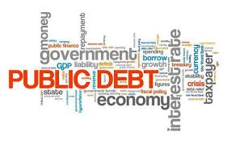
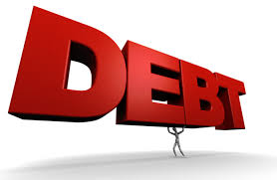
The US Federal Debt
Lifeguard Wealth
April 6, 2023
Jon Haveman, Ph.D.
NEED

Slide 2
National Economic Education Delegation
Vision
Someday, the public discussion of policy issues will be grounded in an accurate perception of the underlying economic principles and data.
Mission
NEED unites the skills and knowledge of a vast network of professional economists to promote understanding of the economics of policy issues in the United States.
NEED Presentations
Are nonpartisan and intended to reflect the consensus of the economics profession.

Slide 3
Who Are We?
Honorary Board: 48 members
2 Fed chairs: Janet Yellen, Ben Bernanke
6 chairs of the Council of Economic Advisers
Furman (D), Rosen (R), Bernanke (R), Yellen (D), Tyson (D), Goolsbee (D)
3 Nobel Prize-winners
Akerlof, Smith, Maskin
Delegates: 650+ members
At all levels of academia and government service
All have a PhD in economics
Crowdsource slide decks
Give presentations
Global Partners: 45 PhD Economists
Aid in slide deck development

Slide 4
Credits and Disclaimer
This slide deck was created by:
Jon Haveman, Executive Director, NEED
Geoffrey Woglom, Amherst College, Emeritus
Disclaimer
NEED presentations are designed to be nonpartisan.
It is, however, inevitable that presenters will be asked for and offer their own views.
Such views are those of the presenters and not necessarily those of the National Economic Education Delegation (NEED).

Slide 5
First: A Budget Primer

Slide 6
What Does the US Govt. Budget Look Like?
2022 Budget Summary (in billions)
Revenue |  |  | Outlays
Income Taxes | $2,632 |  | Mandatory | $4,134
Payroll Taxes | $1,484 |  | Discretionary | $1,661
Corporate Taxes | $425 |  | Interest | $475
Other | $356
Total | $4,897 |  | Total | $6,270
Budget Deficit: $1,373 Billion
https://www.cbo.gov/publication/58888
Notes:
https://www.cbo.gov/publication/53627
https://www.cbo.gov/publication/53624

Slide 7
But There is More to The Budget!
Source: https://www.cbo.gov/system/files/2023-02/58848-Outlook.pdf

Slide 8
What Are Tax Expenditures?
Source: https://www.pgpf.org/Chart-Archive/0199_distribution_tax_expenditures

Slide 9
And Now: The Debt

Slide 10
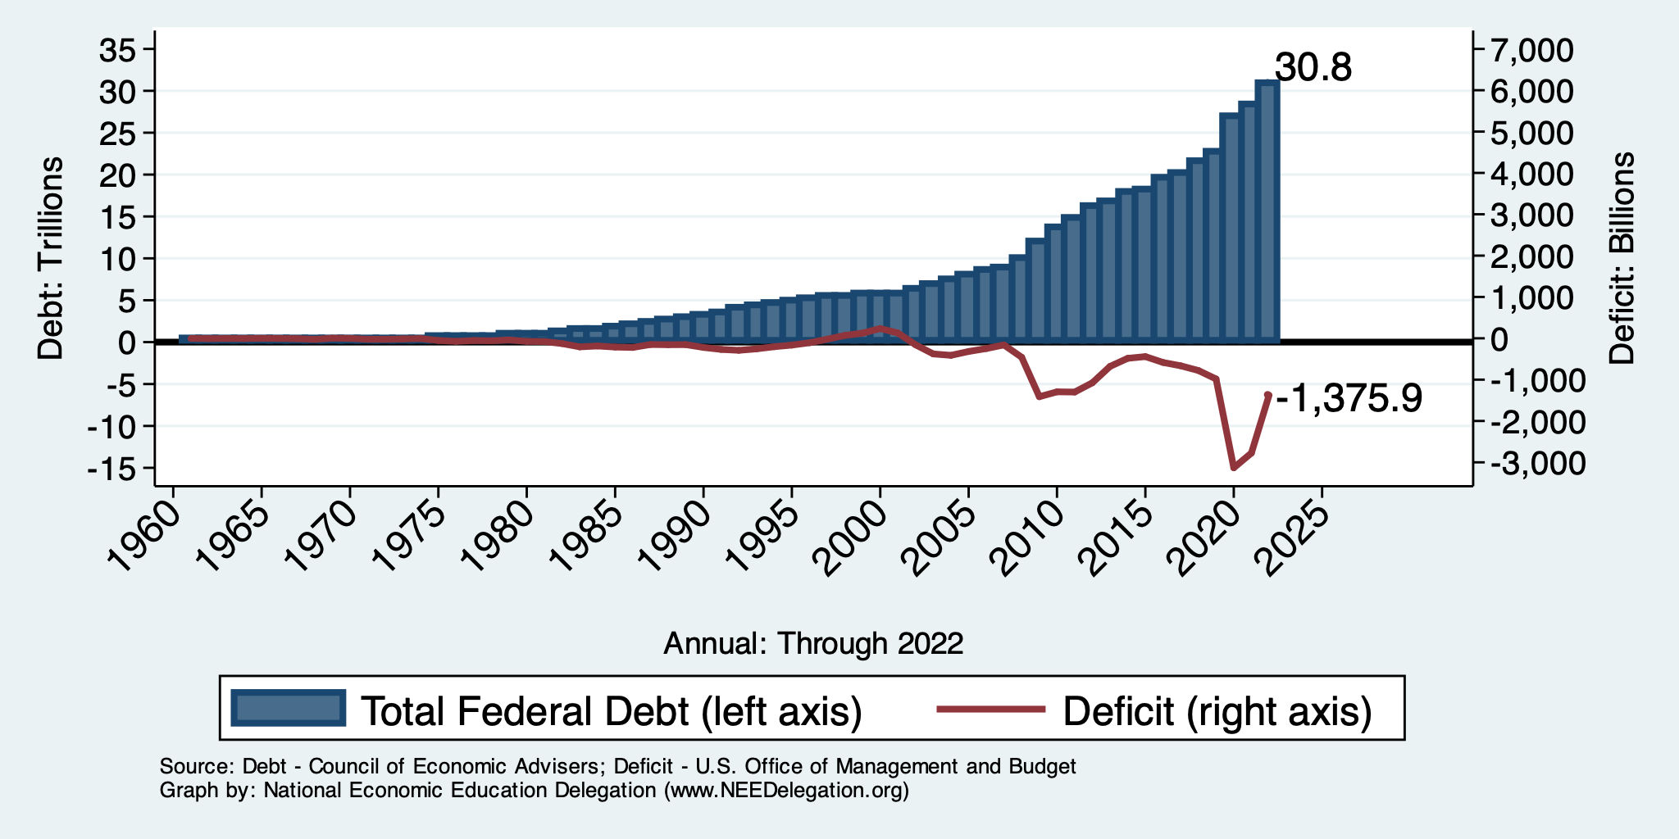
Debt vs. Deficit
Debt = The Sum of All Past Deficits Less Surpluses
Notes:
Debt2deficit.png

Slide 11
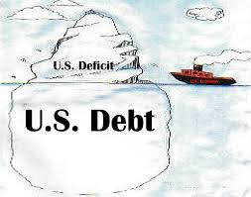
Of Debt, Deficits, and Surpluses
FLOW
Deficit: The excess of outlays over revenues in a year.
Surplus: The excess of revenues over outlays in a year.
STOCK
Debt: The accumulation of debt over time.
The sum of all past deficits and surpluses.

Slide 12
How Does the US Government Borrow?
It issues debt.
Treasury marketable securities:
Treasury bills, notes, and bonds
TIPS: Treasury inflation-protected securities
Savings bonds
Who buys the debt?
Other federal agencies
Individuals and businesses
State and local governments
Foreign government and individuals
Federal Reserve

Slide 13
A Breakdown of Total Federal Debt, 2020
https://www.gao.gov/americas_fiscal_future?t=federal_debt

Slide 14
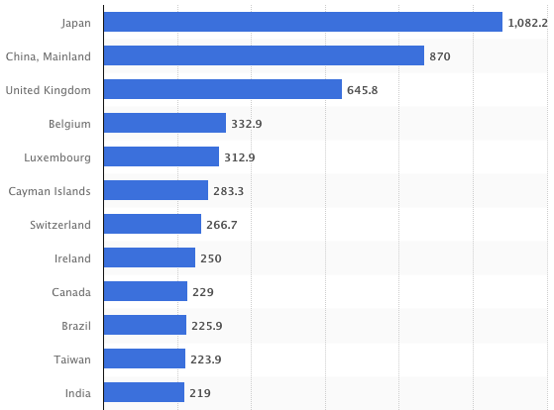
Who Holds Debt to Foreigners, 11/22
Foreign ownership is relatively recent – in 1990 foreign ownership was less than 20%
Billions of U.S. Dollars
Source: https://www.statista.com/statistics/246420/major-foreign-holders-of-us-treasury-debt/

Slide 15
Why Do Foreign Investors Buy US Treasuries?
Market for Treasuries is the deepest, most liquid capital market in the world.
The US economy has a history of political and economic stability.
The dollar is the largest international reserve currency.
Most trade transactions (e.g., oil) are quoted in dollars.
With some exceptions, foreign citizens borrow in dollars.

Slide 17
Trends in US Debt Over Time
2022, Q4: Other Domestic: 46.0%
Federal Reserve: 24.2%
Foreign: 29.8%

Slide 18
Not All Debt Is Created Equal
Some debt can reduce the availability of investment funds to other borrowers.
Often referred to as “crowding out” private investment.
Intragovernmental debt is (important) bookkeeping.
This debt DOES NOT crowd out private investment.
Debt held by the public.
This debt MIGHT crowd out private investment.
Most analyses of debt focus on federal debt held by the public.

Slide 19
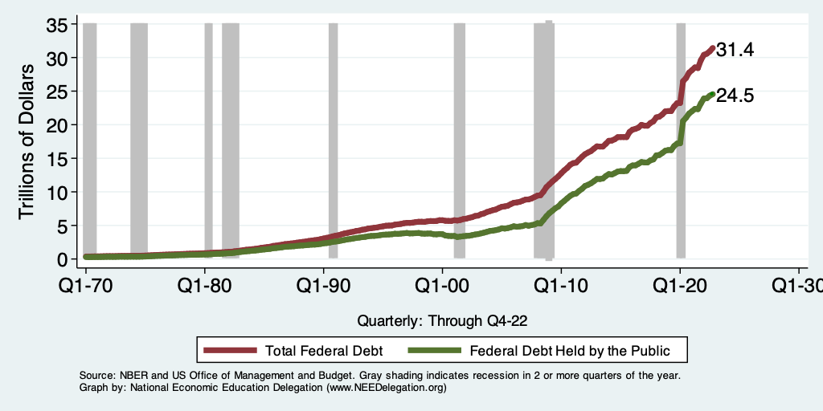
Two Measures of the Debt

Slide 20
The All-Important Relative Debt
CBO analyzes the debt relative to GDP because:
To the extent that debt and deficits have burdens, these burdens depend on the size of the debt relative to the size of the economy.
 | Total Public Debt | Relative Debt Debt/GDP
United States | $31.4 Trillion | 120%
Greece | $0.20 Trillion | 252%

Slide 21
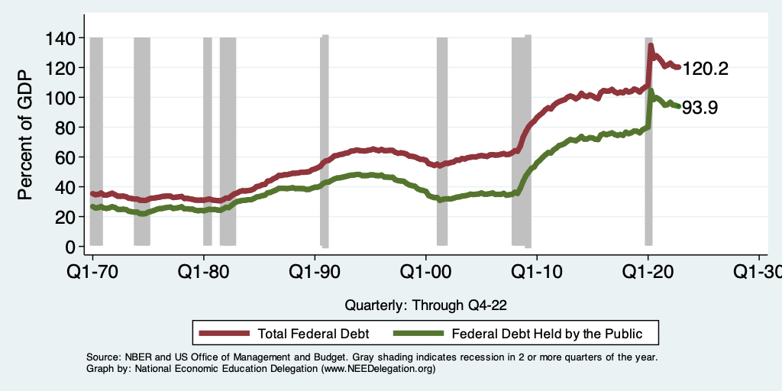
Two Measures of RELATIVE Debt

Slide 22
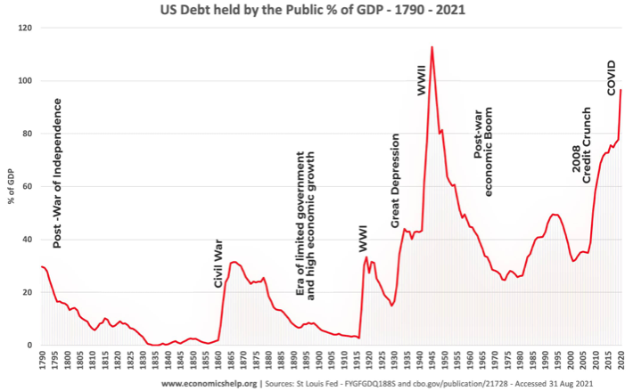
Key Points About US Relative Debt
1983
Prior to 1983, relative debt rose purposefully (wars and recessions) and then fell.
Relative debt peaked during World War II, followed by a long decline.
Relative debt has been and is expected to rise for the next 30 years w/o a strategic purpose.

Slide 23
Debt Dynamics
Surprising (?) Facts
From 1945 to 1979, relative debt fell from 100% of GDP to 25% of GDP.
During this period, the federal budget was in surplus only 8/35 years!
Relative debt is a fraction: Debt/GDP; fractions fall if:
The numerator falls (budget surplus)
The denominator rises (nominal GDP growth)
The denominator grows faster than the numerator
GDP growth is greater than the interest rate on borrowing.
CAN still run deficits and reduce the relative debt.

Slide 24
An Almost Free Lunch
If the interest rate is less than the growth rate of GDP, then the contribution from the primary budget can be positive, hence…
Debt to GDP can be stabilized with a (small) primary deficit.

Slide 25
Evidence? Does This Happen?

Slide 26
Is Stabilizing Relative Debt Good Enough?
This means that the absolute level of the debt would continue to increase.
Yes, it is probably good enough.
It is a reflection of the economy’s ability to support the debt.
Stability will avoid bond market scares.
More on this later.

Slide 27
But Let’s Think About Today

Slide 28
Why Has the Federal Debt Risen So Much?
Expenditures UP:
Social Security
Health-care costs
Economic stimulus
In particular, during the Great Recession & COVID.
Military engagements overseas
Revenues DOWN:
Declining income tax revenues
Stagnant wages
Tax cuts
Social security
Declining revenues

Slide 29
Tax Cuts Have Driven The Debt Increases
Trump Tax Cuts: 6% of GDP
Bush Tax Cuts: 32% of GDP
Great Recession & COVID: 26% of GDP
The rest: 34% of GDP
Up from 31% in 2001

Slide 30
Now Let’s Think About Today and the Future

Slide 31
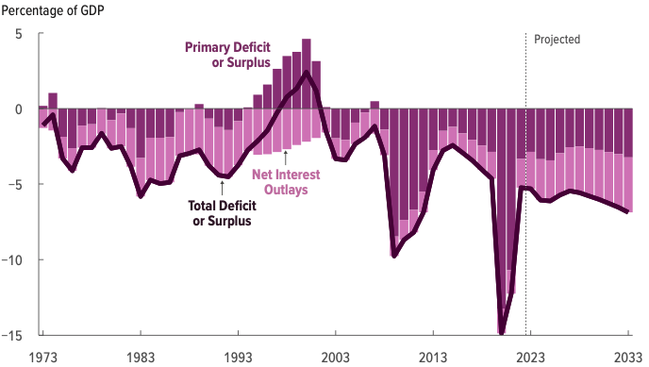
Rising Debt Levels Due to a Future of Deficits
Source: Congressional Budget Office, The Budget and Economic Outlook: 2023 to 2033

Slide 32
Spending to Grow Much Faster Than Revenue
Interest, too!

Slide 33
Two Measures of the Deficit
(1) Primary deficit = current programmatic outlays – revenues
(2) Total deficit = primary deficit + interest
Interest on the debt is
The part of the total deficit that is due to past deficits.
This distinction becomes important for understanding:
The future course of relative debt.
The costs borne by future generations because of the debt.

Slide 34
Interest Will Grow as a Share of the Deficit
Primary
Interest
Source: https://www.cbo.gov/system/files/2023-02/58848-Outlook.pdf

Slide 35
What Are the Primary Drivers Going Forward?
Social Security
And Medicare

Slide 36
How to Think About the Debt

Slide 37
Perspectives on Increased Debt
Does debt impose a burden on future generations?
Does it inevitably have to be paid off?
Government borrowing crowds out private capital and investments.
Weakened by the ability to borrow from other countries.
In time, debt service might crowd out other government spending.
Diminishing policy priorities in the budget.
Is it reasonable to borrow at low interest rates for investment?
For example, for infrastructure.

Slide 38
Is The Debt a Problem Today?
Federal government borrows each month with little difficulty.
Very little evidence of ”crowding out.”
Interest rates are low, but rising – this is becoming a concern.
So, no, other than the debt ceiling, it’s not a problem today.

Slide 39
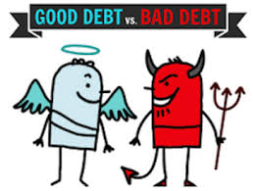
Not All Borrowing Is Bad!
Two good reasons to borrow:
During a temporary crisis
Recession
War
Pandemic
Productive public investment
Infrastructure
Education
These deficits did not and do not permanently increase relative debt.
Great Depression, WWII
Public investment expands GDP and tax revenue

Slide 40
So, Why Worry About it?
If debt become too high:
Investors might start questioning the creditworthiness of the US government.
Problem: Nobody knows how high is too high.
It becomes more difficult to borrow in times of crisis.
War, severe recession
“Fiscal space”
Impossible to measure how much we have.
Clearly, we have less now than in 2007.
Could start to crowd out investment by consumers and businesses.
Not currently a problem. No idea if/when it might become one.
Could be inflationary.

Slide 41
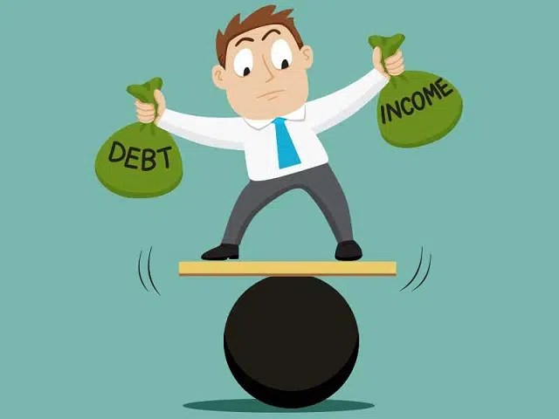
So, Why Worry About It?
If debt continues to grow:
Interest payments will grow with it.
8% of spending in 2018.
22% of spending in 2048.
Less room for using the budget for policy priorities.
40% of payments go to other countries.
The longer we wait to address it, the harder and more disruptive addressing it will be.
Interest rates are increasing.

Slide 42
Growth in Relative Debt
Can be scary to….
International investors
Bond markets

Slide 43
Fiscal Crisis, or a Run on the Dollar
With an exploding relative debt, what happens if foreigners lose confidence in the stability of the dollar?
CBO (Federal Debt: A Primer, March 2020):
because the United States currently benefits from the dollar’s position as the world’s reserve currency and because the federal government borrows in dollars, a financial crisis—similar to those that befell Argentina, Greece, or Ireland—is less likely in the United States.
Although no one can predict whether or when a fiscal crisis might occur or how it would unfold, the risk is almost certainly increased by high and rising federal debt.
Crises of confidence, in addition to being unpredictable, happen very quickly.

Slide 44
What Is a Fiscal Crisis?
Increased perception of risk in government debt.
Potential manifestations:
Sudden significant increase in interest rates
Plunging exchange rates
Why?
Increased expectation of default
Potential results:
Dramatic budget reforms may be quickly necessary to stave off actual default.
Recession from declines in:
investment (interest rates)
consumption (interest rates)
Government spending
Higher interest bill on existing debt

Slide 45
The Key: Stabilization of Relative Debt
Stabilization of relative debt might forestall the consequences of chronic deficits.
Problem: The US federal debt is in no way stable.
W/o stability, interest rates might rise, causing crowding out of:
policy priorities
domestic investment
Budget surpluses are not necessary, but budget control is.

Slide 46
Shall we manufacture our own fiscal crisis?

Slide 47
Existential Threat: Coming This Summer!

Slide 48
5 Things to Know about the Debt Ceiling
The debt limit has been raised continually for more than a century.
Raising the debt limit is not about new spending; it is about paying for previous choices policymakers legislated.
The uselessness of a debt limit is exhibited by the fact that only one other advanced country—Denmark—has a separate debt limit rule like ours.
If debt hits the ceiling, the Treasury Department uses several accounting gimmicks to postpone the day of reckoning, but these typically last only a few months.
The economic consequences of a large-scale, intentional default are unknown, but predictions range from bad to catastrophic.
Souce: https://www.brookings.edu/2023/01/19/7-things-to-know-about-the-debt-limit/

Slide 49
Lessons from 2011 & 1979
2011: Government shutdown was very costly:
Stock markets plunged (17%).
Employment growth stuttered.
Treasuries – downgraded credit ratings.
Borrowing costs rose.
The Debt Ceiling may be a very effective bargaining tool, but…
It is costly.
It is unnecessary.
Accidental partial default in 1979:
increased borrowing costs by $40 Billion!

Slide 50
Bottom Line: We Need to Worry about the Debt
Interest rates are rising.
A fiscal crisis should be avoided at all costs.
Stabilizing relative debt would substantially reduce the possibility of a crisis.
The good news is we might be able to stabilize relative debt without a primary surplus.
But we must substantially reduce primary deficits.
We MUST MUST MUST raise the debt ceiling.

Slide 51
Bottom-Line Takeaways
Relative debt must be stabilized, so it is imperative to reduce primary deficits after the virus has been defeated.
Given the fiscal challenges of an aging population and climate change, it is better to do this sooner rather than later.
But high debt levels should not deter:
Productive infrastructure investment.
Fiscal responses to crises:
When the house is on fire, you don’t worry about being in a drought; you just put it out.
Debt ceiling – what is it good for?

Slide 52
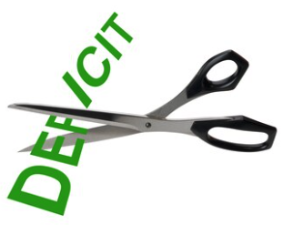
Bottom Line
Question is not WHETHER the US will have to act…
but WHEN.
Some combination of the following WILL be necessary:
Raising taxes
Cutting spending
Reining in health-care costs

Slide 53
Thank you!
Any Questions?
www.NEEDelegation.org
Jon Haveman, Ph.D.
Jon@NEEDelegation.org
Contact NEED: info@needelegation.org
Submit a testimonial: www.NEEDelegation.org/testimonials.php
Become a Friend of NEED: www.NEEDelegation.org/friend.php

Slide 54
Economists’ Views on the Debt Evolve

Slide 55
Traditional View: A Non-Issue
The analogy between household and government debt is inaccurate.
The government does not have to pay back the debt.
Retirees cash in maturing bonds, which are financed with new bond issues sold to younger people.
Interest on the debt is essentially paid by the young to their parents.
When the young are old, their young will do the same for them.

Slide 56
Reagan’s Experiment in Supply-Side Economics
Tax cuts were supposed to be “investments.”
Lower marginal tax rates, and people will work more/harder and save.
Higher GDP will raise tax revenue to pay for the deficit.
Sadly, in 1981-89, debt rises from 25% to 40%.
For the first time, relative debt rises during a non-recessionary peacetime.
Reignites concern about debt and deficits.
Failed experiment?

Slide 57
Traditional View: Four True Costs
Crowding out:
The Treasury’s borrowing needs compete with private borrowers, so debt and deficits raise interest rates.
Higher interest rates lead to foreign capital inflows or foreign borrowing.
With foreign borrowing, some of the interest on the debt goes to foreign countries.
Larger primary surpluses are needed to stabilize the relative debt.
The larger the relative debt, the bigger the needed primary surplus.
Thus higher taxes or programmatic outlays must be reduced.
Government bias toward higher inflation
GDP grows if either prices rise or real output rises.
Source: CBO, Federal Debt: A Primer, March 2020 pp.24-5

Slide 58
What the Traditional View Got Wrong
Stabilizing relative debt, debt/GDP, requires that the growth rate in debt equal the growth rate of GDP.
The growth rate in debt has two parts:
The growth rate in interest on the debt, or just the interest rate.
A contribution due to the primary surplus (–) or deficit (+).
The traditional view assumes that the interest rate on debt is greater than the growth rate of GDP
So, 2 must be negative to offset excess of 1.
i.e., debt stabilization requires a primary surplus.

Slide 59
Maybe Debt Isn’t a Problem After All: MMT
Modern monetary theory
US Treasury borrows in its own currency and therefore cannot default.
As opposed to countries, such as Greece, which borrow in euros.
Example: How did we ”find the money” for the recent increase in the deficit of about $1.9 trillion?
Answer: The Fed purchased $1.7 trillion = 89% of financing
More generally, MMT argues that we can always find the money to increase federal spending.

Slide 60
MMT’s Free Lunch
The only limit on deficit spending is when it leads to too much spending, thereby increasing current inflation.
Recognizing this fact, “could free policymakers not only to act boldly amid crises but also to invest boldly in times of more stability.”
First part, acting boldly, is important and likely true.
Second part, invest boldly, is suspect.

Slide 61
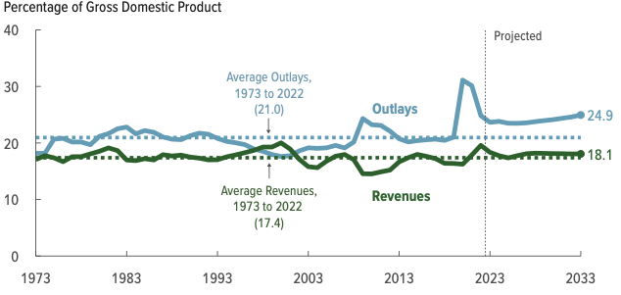
Why Has the Federal Debt Risen So Much?

Slide 62
Why Has the Federal Debt Risen So Much?
Expenditures:
Social Security
Health-care costs
Economic stimulus
In particular, during the Great Recession & COVID.
Military engagements overseas
Revenues
Declining income tax revenues
Stagnant wages
Tax cuts
Social security
Declining revenues

Slide 63
Growth in Outlays Exceeds Revenue

Slide 64
Bottom-Line Takeaways
Herb Stein, an expert on fiscal policy and the chairman of the Council of Economic Advisors under Richard Nixon, is famous for observing: “If something cannot go on forever, it will stop.” A rising and accelerating ratio of debt to GDP cannot go on forever.
We have a choice largely between:
Fiscal crisis.
Reductions in the primary deficit.

Slide 65
OK: Relative Debt Cannot Grow Forever, But
Does it matter at what level we stabilize relative debt?
Relative debt stops growing:
when the growth of debt is less the growth in GDP (on average).
Arithmetic: growth rate of the debt equals the interest rate plus the effect of the primary surplus or deficit.
The bigger the relative debt, the smaller the effect of the primary surplus or deficit.

Slide 66
Other Countries Have Higher Debt Levels

Slide 67
Takeways (Continued)
After the virus is defeated, some combination of spending cuts and tax increases must be enacted.
The particular combination of spending cuts and revenue increases is a political question.
But high debt levels should not deter:
Productive infrastructure investment.
Fiscal responses to crises.
Given the fiscal challenges of an aging population and climate change, it is better to do this sooner rather than later.

Slide 68
Bottom Line
Question is not WHETHER the US will have to act…
but WHEN.
Some combination of the following WILL be necessary:
Raising taxes
Cutting spending
Reining in health-care costs

Slide 69
Are There Reasons to Wait?
Very little evidence of:
Crowding out
Inflationary impact
Uncertainty about the future
Economic growth might render action today unnecessary.
There are a great many investments to be made by the govt.
Infrastructure
Education
Much, much more …

Slide 70
What Are the Primary Drivers Going Forward?

Slide 71
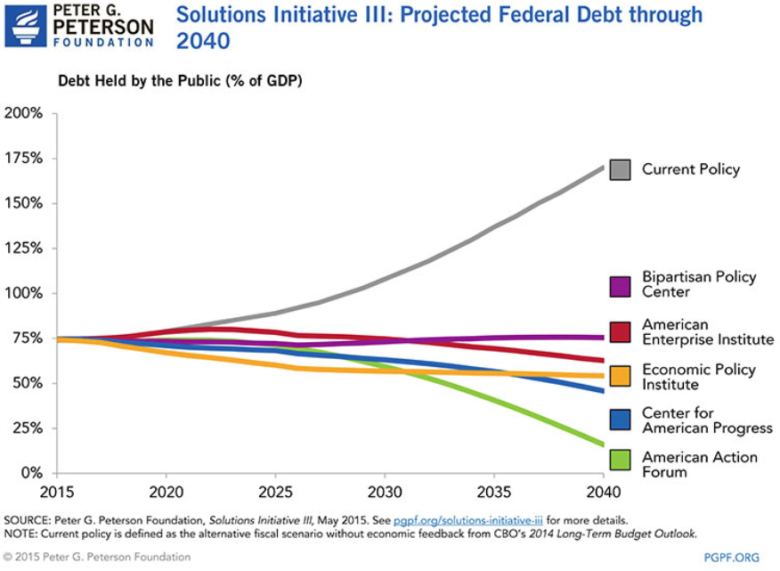

Slide 72
There Are Other (Bad/Costly) Solutions
Financial repression
Using regulation to force down interest rates.
Paying the interest by printing money.
Risks inflation, hyper or otherwise.
Or defaulting on the debt.
This will forever raise the cost of government borrowing.

Slide 73
Summary: The Debt
The jury is out (sort of) on the debt.
Conventional wisdom is being challenged:
Previously: inflationary and crowd out private investment
New assertion: these things don’t matter for a country that can borrow in its own currency.
Upshot?
This is a policy choice.
The cautious approach is to rein in the debt.
The cautious approach may lead to slower economic growth.

Slide 74
Traditional View: Cost 1
Rising debt reduces investment.
Deficits and debt raise aggregate demand.
Direct government spending.
Lower taxes lead households to spend more.
To offset this increase in demand, the Fed has to raise interest rates, reducing investment and future GDP.
By causing interest rates to rise:
debt and deficits “crowd out” investment.

Slide 75
The International Appetite for US Treasuries

Slide 76
2005: The International Dimension to Debt
Interest on foreign-held debt reduces US residents’ welfare.
Interest payments go to other countries.
When the Fed raises interest rates, the exchange rate of the dollar rises, causing:
Increases in the trade deficit
Foreign borrowing.
Sharp increases in interest rates and the cost of imports raises the possibility of a fiscal crisis or a “run on the dollar.”

Slide 77
General Agreement Among Economists

Slide 78
Trade and Investment Flows Balance Out

Slide 79
Costs 1–2: The Dog That Didn’t Bark

Slide 80
Traditional View: Cost 3
Rising debt reduces budgetary options.
More debt means higher interest costs.
Therefore, greater relative debt:
requires a bigger primary surplus to stabilize the relative debt.
Larger primary surplus means either higher tax rates or less government spending:
“crowding out” of outlays and/or tax cuts.

Slide 81
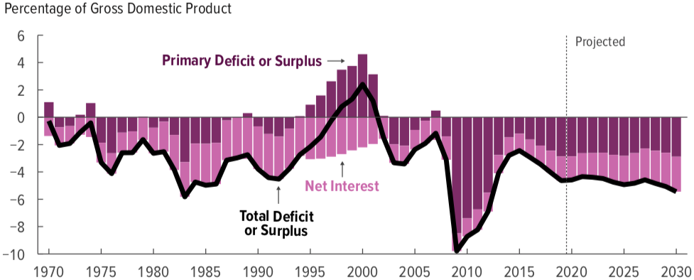
Cost 3: No Primary Surplus Since 2007!
This graph was done before Covid-19
Source: Congressional Budget Office, The Budget and Economic Outlook: 2020 to 2030

Slide 82
Cost 4: Anybody See Any Inflation?

