Slide 1

Rotary of Campbellsville
U.S. Economic Outlook
National Economic Education Delegation
Scott Baier Ph.D.
Professor and Department Chair, Clemson University
January 26, 2022
https://needelegation.org/

Slide 2
National Economic Education Delegation (NEED)
Vision
  One day, the public discussion of policy issues will be grounded in an accurate perception of the underlying economic principles and data.
Mission
  NEED unites the skills and knowledge of a vast network of professional economists to promote understanding of the economics of policy issues in the United States.
NEED Presentations
  Are nonpartisan and are intended to reflect the consensus of the economics profession.

Slide 3
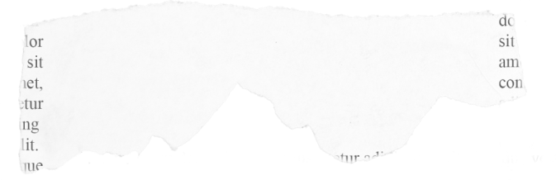







CLEMSON WINS BOWL GAME
GDP GROWTH
SLOWS IN Q3
EMPLOYMENT NUMBERS
DISAPPOINT
OMICRON VARIANT SURGING
CONSUMER SPENDING UP
UNEMPLOYMENT RATE
FALLS TO 3.9%
INFLATION HITS
39 YEAR HIGH
SUPPLY CHAINS ISSUES PERSIST

Slide 4
COVID-19 Cases US

Slide 5
COVID-19 Cases US

Slide 6
US GDP Level and GDP Trend

Slide 7
US GDP Growth Annual Growth: 1990-2020

Slide 8
US GDP Growth Quarterly Growth: 1990-2019
Consumption accounts
For about 2/3 of GDP growth
Investment in plants machines in equipment is the most volatile

Slide 9
US GDP Growth Quarterly Growth: 2010-2021

Slide 10
Personal Consumption Expenditures

Slide 11
Real Personal Disosable Income
2.5%
2.8%

Slide 12
Personal Savings as a Fraction of Disposable Income

Slide 13
Durable Goods and Service Consumption
Consumption of durable goods is about 35% higher than its pre-pandemic levels
Consumption of services is almost back to pre-pandemic levels.
Note: PC Expenditures Services are nearly 6.5 times greater than PC expenditures on Durables

Slide 14
Employment
Unemployment
Employment Growth
Employment by Sector

Slide 15
Unemployment Rate

Slide 16
Employment Changes: Nonfarm Payroll
1990-2019
From 1990 -2007, average gain in employment each month averaged about 131,000

Slide 17
Employment Changes
In March and April of 2020, the US economy lost more than 22 million jobs.
Since that time, the economy has recovered about 18.8 million jobs.
Still roughly 3.5 million jobs below where we were in 2/2020

Slide 18
Nonfarm Payroll: Job Losses March -April 2020
Roughly 22 million Jobs lost in March and April of 2020
Source: BLS

Slide 19
Nonfarm Payroll: Employment Gains 5/20-12/21
In most of sectors approximately 80-90 percent of employment returned compared to the losses in March and April 2020

Slide 20
Employment Dynamics
Job Openings
Job Hires

Slide 21
Employment Dynamics: Quits and Layoffs
QUITS

Slide 22
Pre-COVID Quit Rates by Industry

Slide 23
Pre & Post COVID Quit Rates by Industry

Slide 24
Employment Dynamics: Wage Growth

Slide 25
Inflation

Slide 26
What is Driving Inflation?
Profiteering / Greed: President Biden and Senator Elizabeth Warren.
Supply Chains Disruptions:
  the pandemic has impacted the ability to get parts and supplies.
  Labor shortages and rising wages have raised costs and help push up prices.
Increased Demand:
  During the pandemic there has been an increase in demand for goods. For many of these goods, it is not easy to ramp up production.
  The fiscal and monetary authorities have provided lots of stimulus.

Slide 27
ISM Survey Delivery Delays

Slide 28
Money Growth: M2 (Transactions Money)
6.1%

Slide 29
Annualized Money Growth
Growth Rate of Money Stock (percent per year) | Beginning of Period | End of Period
6.1 | January 2000 | March 2020
46.3 | April 2020 | June 2020
12.3 | July 2020 | November 2021

Slide 30
Real Personal Disosable Income
2.5%
2.8%

Slide 31
Personal Savings as a Fraction of Disposable Income

Slide 32
Durable Goods and Service Consumption
Consumption of durable goods is about 35% higher than its pre-pandemic levels
Consumption of services is almost back to pre-pandemic levels.
Note: PC Expenditures Services are nearly 6.5 times greater than PC expenditures on Durables

Slide 33
PCE Inflation: Goods and Services

Slide 34
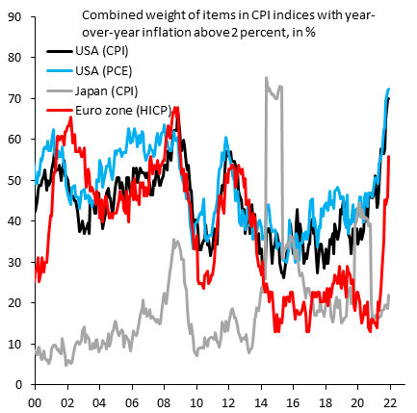
Is Inflation Occurring in Just a Few Categories?

Slide 35
Monetary Policy
Fed does not control M2
What generally determines the growth of M2?
  Expected inflation
Recent increase is something different
  Federal government transfers to checking accounts
  Helicopter drop
Generally, faster growth of M2 associated with higher inflation
  Here?

Slide 36
Inflation Over the Next Few Years
Reasonable to expect prices continue to rise
What will happen to expected inflation?
  Stay at Federal Reserve target rate of 2 percent per year?
  Increase to quite a bit more?
What will happen to inflation given the current monetary policy framework?
  Inflation will be about two percent
  Inflation will increase quite a bit, say 5 to 10 percent per year

Slide 37
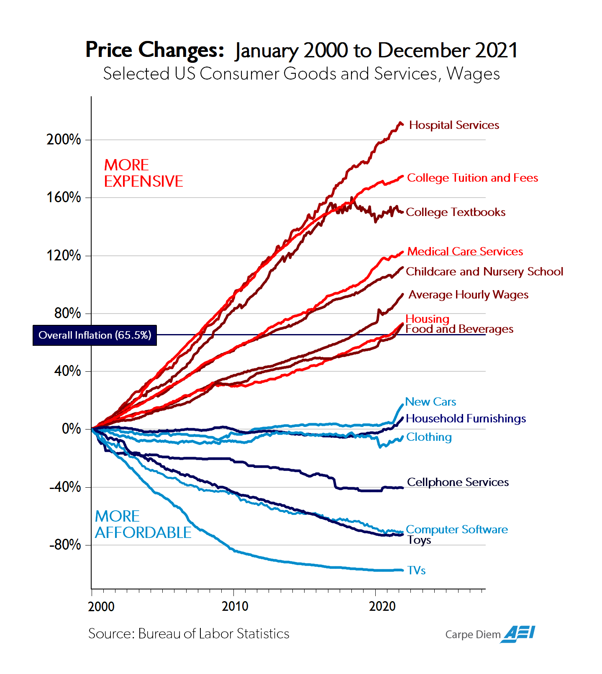

Slide 38
Path of the Debt
Peter G. Petersen Foundation
Source: Congressional Budget Office, Additional Information About the Budget Outlook: 2021 to 2031

Slide 39
Path of the Debt: Spending and Revenues
Peter G. Petersen Foundation
Source: Congressional Budget Office, Additional Information About the Budget Outlook: 2021 to 2031

Slide 40
Path of the Debt: Spending and Revenues
Peter G. Petersen Foundation

Slide 41
Conclusion
The economy continues to recover from the pandemic.
Until there is clarity on the health side, I would not anticipate the labor market to fully recover.
The actions that the government took helped the recovery, but may have also planted the seeds for higher inflation.
The increased deficit and debt is not expected to be permanent, but …

Slide 42
Thinking About Infrastructure Package
Key components are:
  Efficiency: Is the government spending (infrastructure) undertaken efficiently?
  Multiplier: Does the government spending raise the productivity of the private sector (human capital and physical capital)?
    Think of this like a multiplier .
    Depends on the nature of private capital: Complements or Substitutes
  Resource Use: Does the spending pull use “idle” resources or is their crowding out.
    If the infrastructure pulls workers and capital from other uses the net effect on GDP is likely to be smaller.
  Funding Distortions DWL: Effect of Infrastructure depends on how the funds are raised.
    If raised by taxes, what private sector activities are reduced because of the taxes.
    If the infrastructure package is financed by borrowing will there be crowding out through higher interest rates.
    If it is financed by printing money (MMT) will this be inflationary

Slide 43
Thinking About Infrastructure Package
Key components are:
  Efficiency: Is the government spending (infrastructure) undertaken efficiently?
  Multiplier: Does the government spending raise the productivity of the private sector (human capital and physical capital)?
    Think of this like a multiplier .
    Depends on the nature of private capital: Complements or Substitutes
  Resource Use: Does the spending pull use “idle” resources or is their crowding out.
    If the infrastructure pulls workers and capital from other uses the net effect on GDP is likely to be smaller.
  Funding Distortions DWL: Effect of Infrastructure depends on how the funds are raised.
    If raised by taxes, what private sector activities are reduced because of the taxes.
    If the infrastructure package is financed by borrowing will there be crowding out through higher interest rates.
    If it is financed by printing money (MMT) will this be inflationary

