Slide 1
Osher Lifelong Learning Institute, Fall 2023
Contemporary Economic Policy
American University
Fall, 2023
Jon Haveman, Ph.D.
National Economic Education Delegation

Slide 2
Course Outline
Contemporary Economic Policy
Week 1 (9/28): US Federal Budget (Jon Haveman, NEED)
Week 2 (10/5): Trade and Globalization (Arkadiusz Mironko, Indiana Univ. East)
Week 3 (10/12): International Institutions (Alan Deardorff U of Michigan)
Week 4 (10/19): Economic Update (Geoffrey Woglom Amherst College)
Week 5 (10/26): Monetary Policy (Geoffrey Woglom)
Week 6 (11/02): Intro to Financial Economics(Geoffrey Woglom)

Slide 3
International Economic Institutions
Alan V. Deardorff
University of Michigan
Presentation to American University
October 12, 2023

Slide 4
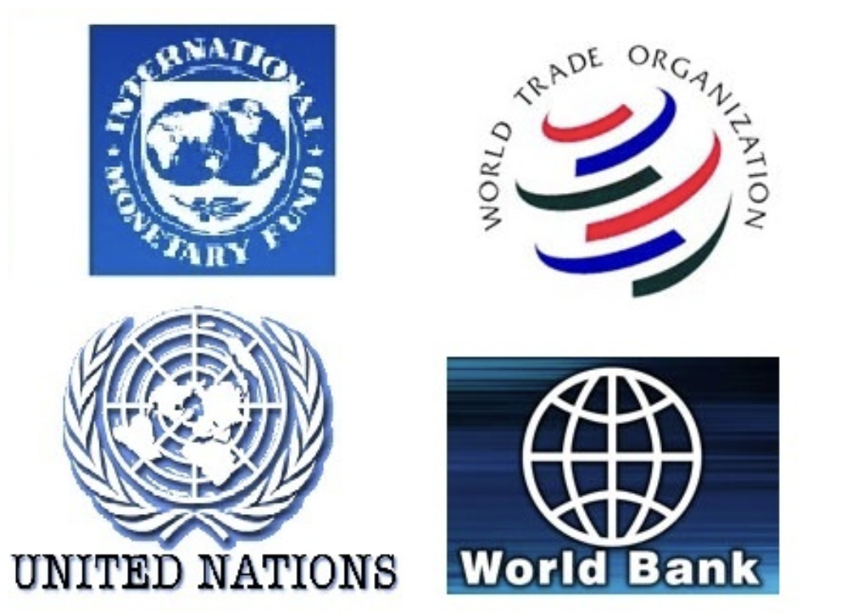
Main Economic Institutions
Notes:
https://sbhshgovapmacro.wordpress.com/2011/06/02/international-institutions/

Slide 5
Views
Economists like myself tend to view all these institutions as
Valuable, but
Flawed
The public and specialists in things other than economics often see them as
Ineffective
Harmful
Examples…

Slide 6
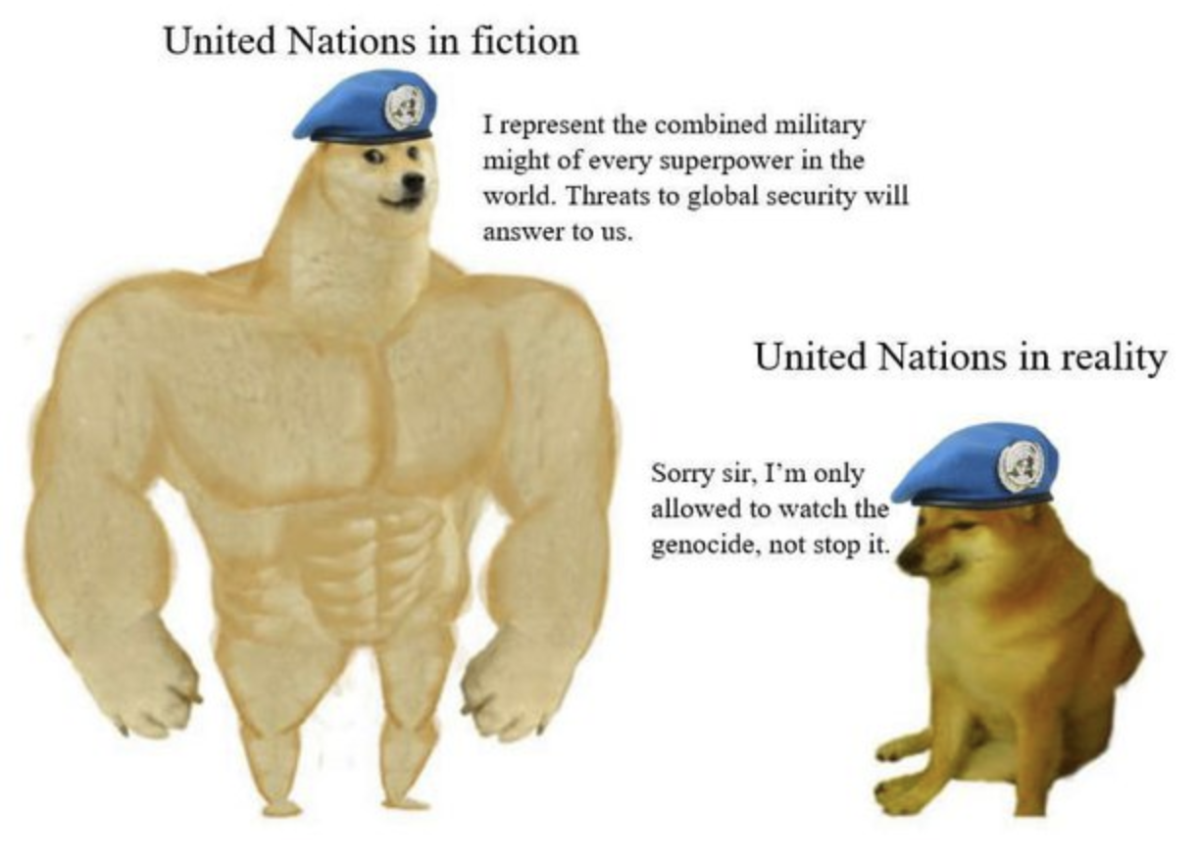
UN
Notes:
https://www.quora.com/When-has-the-United-Nations-been-less-than-effective

Slide 7
UN
Notes:
https://www.nytimes.com/2016/03/20/opinion/sunday/i-love-the-un-but-it-is-failing.html

Slide 8
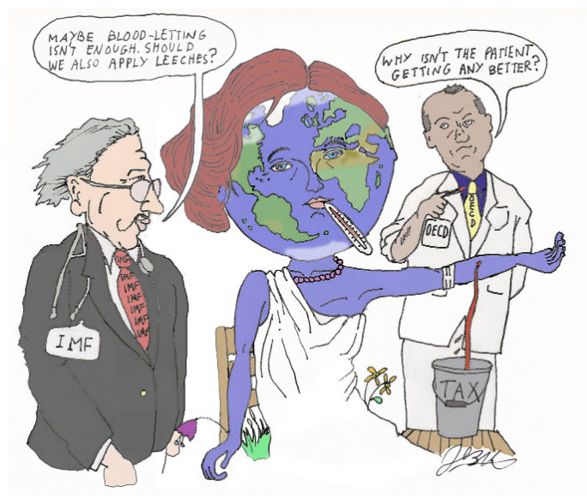
IMF
Notes:
https://www.cato.org/blog/international-monetary-fund-accidentally-provides-strong-evidence-laffer-curve

Slide 9
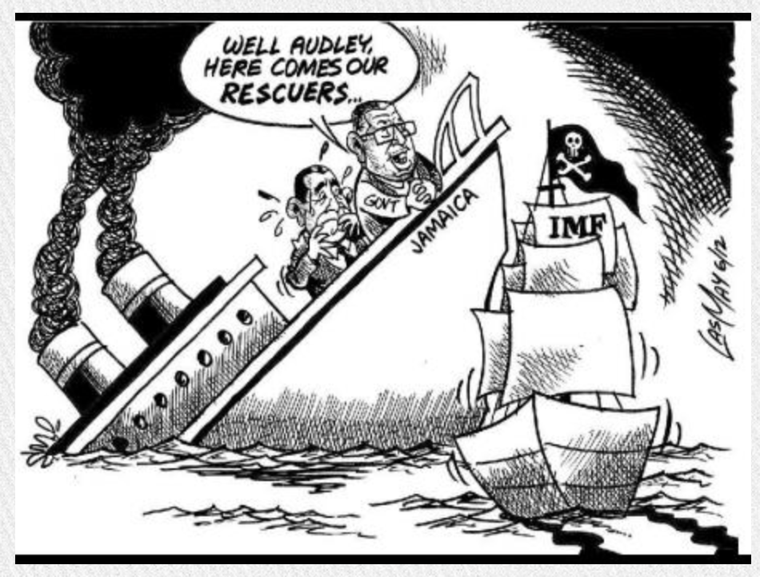
IMF
Notes:
https://jamaica-gleaner.com/gleaner/20120930/focus/focus1.html

Slide 10
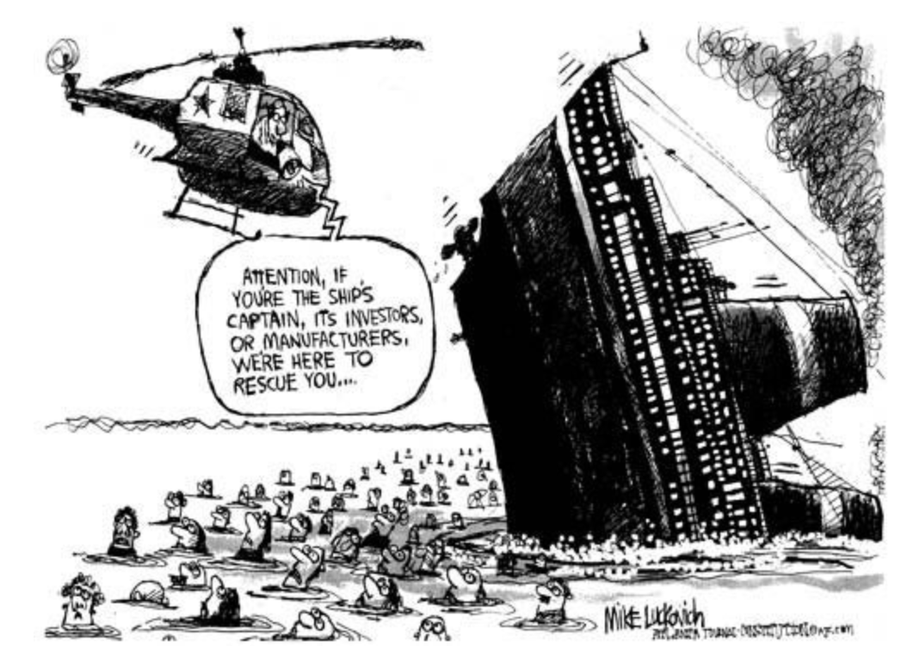
IMF
Notes:
https://www.pbp.ie/eu-imf-shock-therapy-will-make-a-bad-situation-worse-remove-last-semblance-of-democracy/

Slide 11
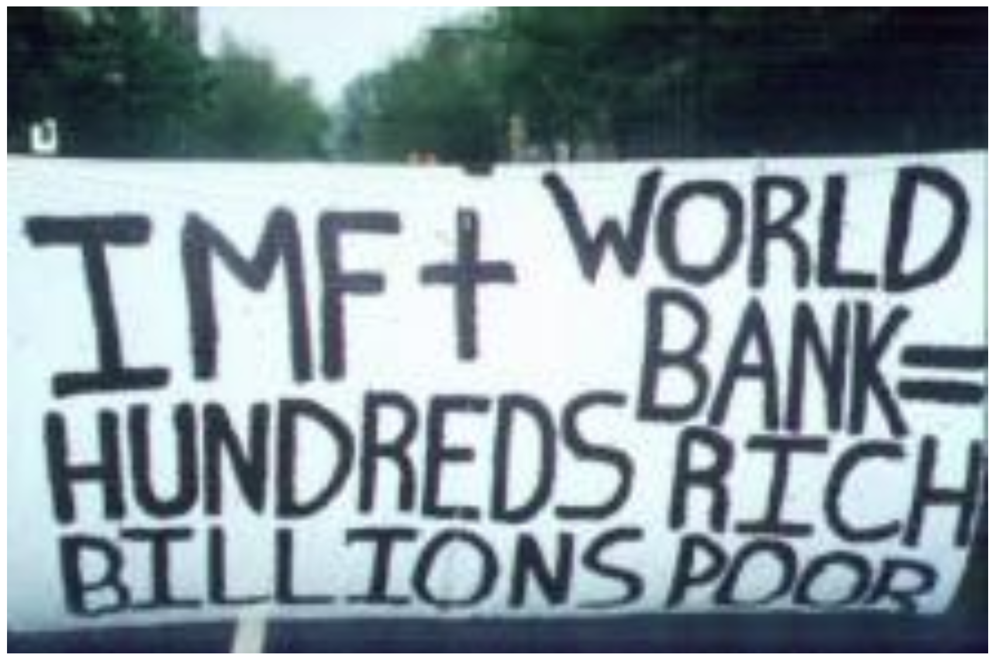
IMF & World Bank
Notes:
https://libcom.org/article/more-bad-news-world-bank

Slide 12
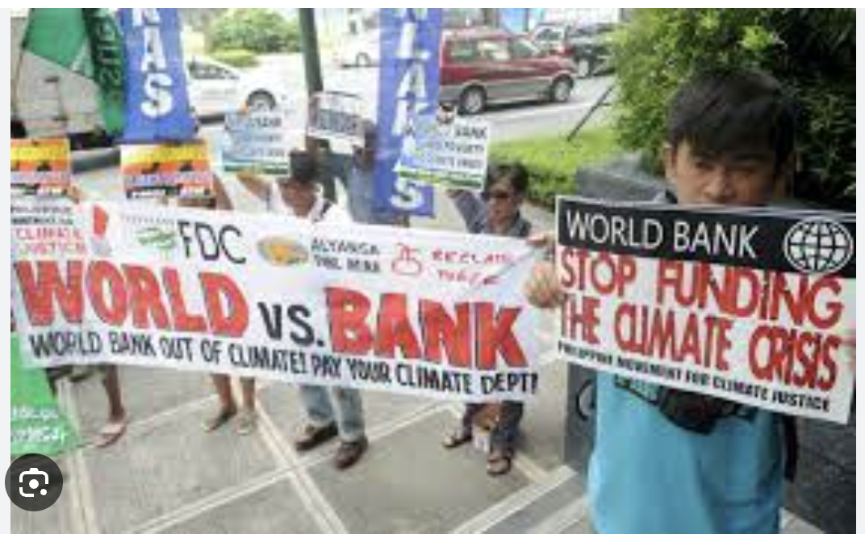
World Bank
Notes:
http://america.aljazeera.com/opinions/2015/7/the-world-bank-has-an-accountability-problem.html

Slide 13
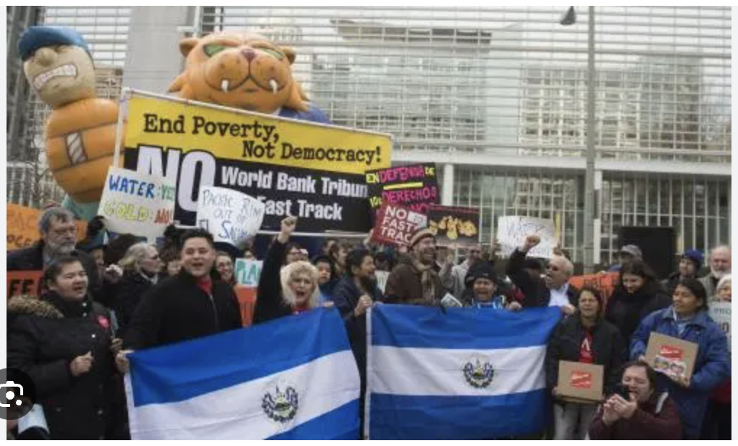
World Bank
Notes:
https://www.google.com/search?q=world+bank+bad&tbm=isch&ved=2ahUKEwj_56CJxL6BAxUIJtAFHWb2DkgQ2-cCegQIABAA&oq=world+bank+bad&gs_lcp=CgNpbWcQAzIHCAAQGBCABDoFCAAQgAQ6BggAEAcQHjoICAAQCBAHEB5QvghY7jhgmUdoAHAAeACAAX6IAZ4IkgEDOC4zmAEAoAEBqgELZ3dzLXdpei1pbWfAAQE&sclient=img&ei=g7INZb-aI4jMwN4P5uy7wAQ&bih=652&biw=1398&rlz=1C5GCEM_enUS993US993#imgrc=b0LR28pjgCP12M

Slide 14
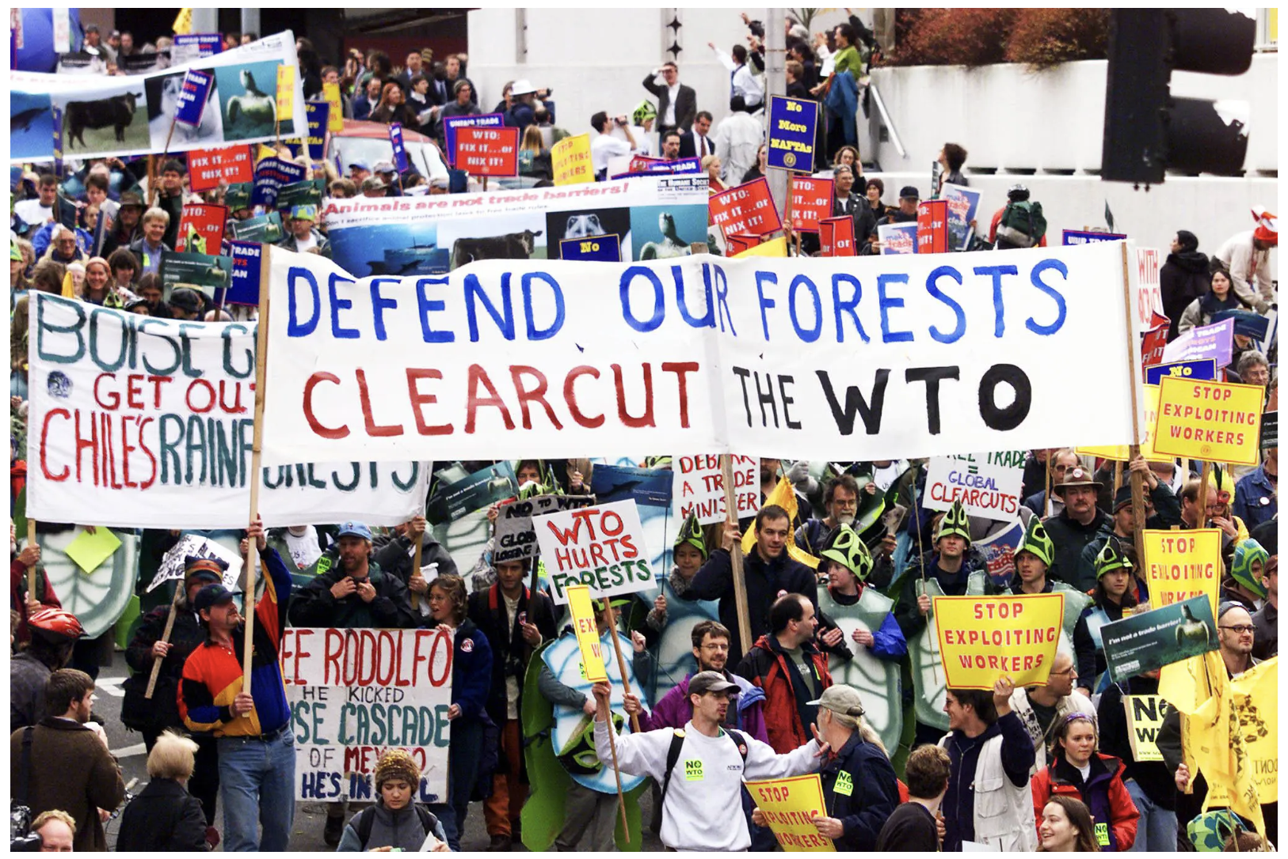
WTO
Notes:
https://www.nytimes.com/2019/11/28/opinion/seattle-world-trade-organization.html

Slide 15
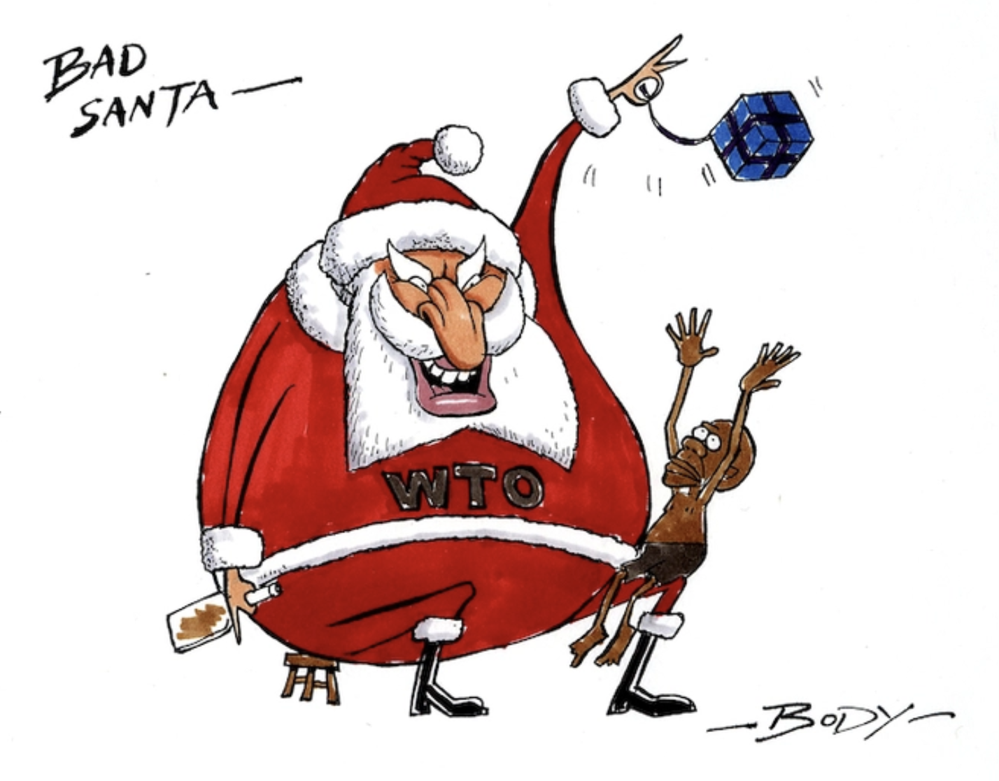
WTO
Notes:
https://natlib.govt.nz/records/23054047?search%5Bi%5D%5Bsubject_authority_id%5D=-64352&search%5Bpath%5D=items

Slide 16
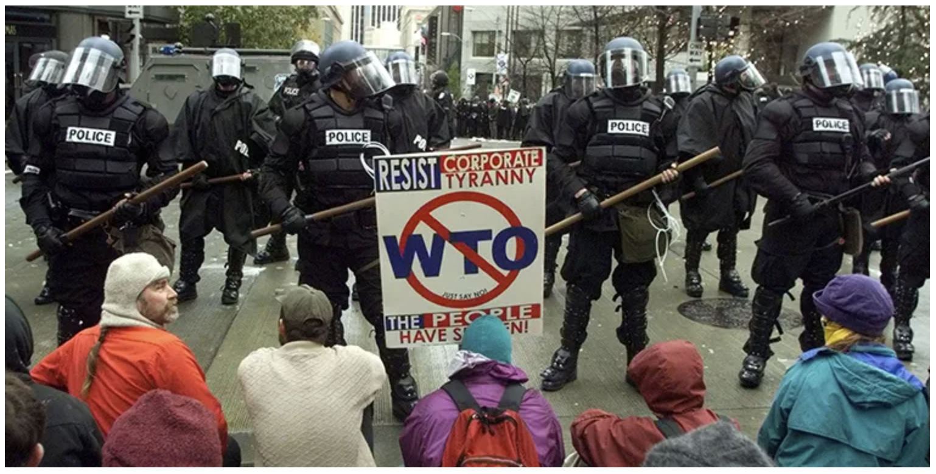
WTO
Notes:
https://world101.cfr.org/understanding-international-system/global-governance/what-world-trade-organization

Slide 17
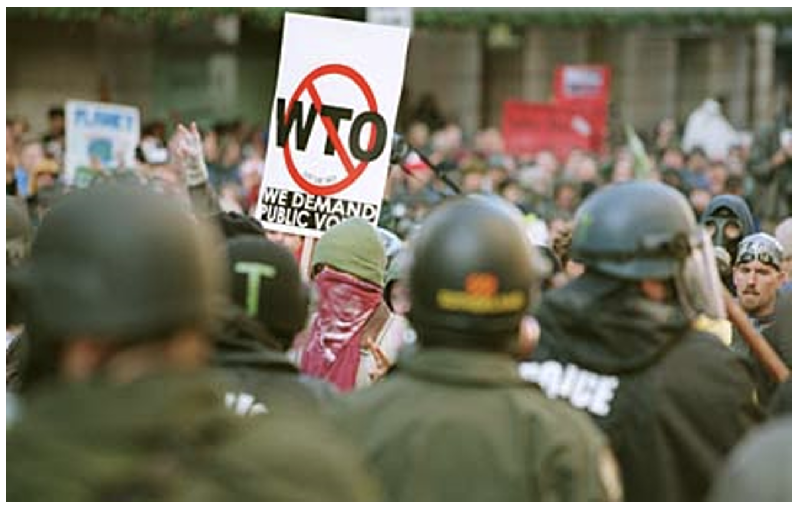
WTO
Notes:
From course slides. Don’t know where i

Slide 18
Outline
The Four Main Institutions
Compared
Individually
United Nations
International Monetary Fund
World Bank
World Trade Organization
Other Institutions
Economic Groupings of Countries
Free Trade Agreements and Customs Unions
Other

Slide 19
Institutions Compared
Major Economic Institutions Compared
 | Members | Budget $ mil |  | Employees |  | from Countries
UN | 193 | 3,400 |  | 125,436
IMF | 190 | 1,411 |  | 2,400 |  | Over 190
World Bank | 189 | 2,851 |  | 18,946 |  | Over 170
WTO | 164 | 217 |  | Over 600 |  | Around 80

Slide 20
United Nations

Slide 21
United Nations
United Nations
Created after World War II (replacing League of Nations from post-WWI)
Major organs:
General Assembly
Security Council
Economic and Social Council
Trusteeship Council
Secretariat
International Court of Justice, The Hague, Netherlands.
Also has many other organizations affiliated with it, some of which existed prior to the UN
Based at UN Headquarters in New York

Slide 22
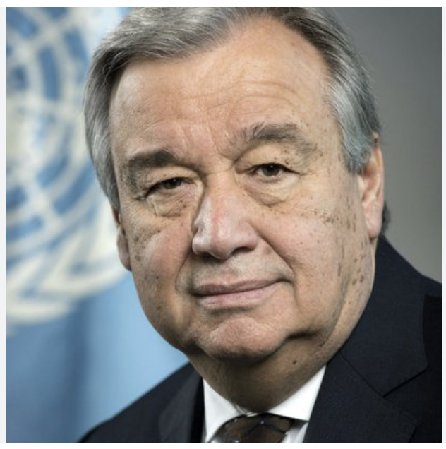
United Nations
Director General: António Manuel de Oliveira Guterres
Portuguese
Prime Minister of Portugal 1995-2002

Slide 23
United Nations
Security Council has the power
15 members, each with one vote
5 Permanent members, each with veto
China, France, Russia, UK, US
10 elected members with 2-year terms (ending date)
(2023) Albania, Brazil, Gabon, Ghana, UAE
(2024) Ecuador, Japan, Malta, Mozambique, Switzerland
Presidency cycles through members each month (Oct 2023 is Brazil)
All 193 UN members ”are obligated to comply with Council decisions.”
General Assembly votes to express opinions but has no power
Notes:
https://www.un.org/securitycouncil/content/security-council-members
https://www.un.org/securitycouncil/content/presidency

Slide 24
United Nations
Major UN Organizations are
UNICEF = United Nations Children's Fund
(Originally United Nations International Children's Emergency Fund)
Humanitarian and developmental aid to children
UNHCR = United Nations High Commissioner for Refugees
Aids and protects refugees
WFP = World Food Programme
Provides food assistance worldwide
WHO = World Health Organization
Responsible for international public health
UNDP = United Nations Development Programme
Helps countries eliminate poverty and achieve sustainable economic growth and human development.

Slide 25
United Nations
UN Economic Organizations are
ILO = International Labour Organization
Founded 1919 under League of Nations
Sets international labor standards
Has no enforcement power
WIPO = World Intellectual Property Organization
Founded 1967
Forum for intellectual property policy (patents, trademarks, copyrights, etc.)
Has no enforcement power
FAO = Food and Agriculture Organization
Aims to defeat hunger and improve nutrition and food security.
IOM = International Organization for Migration
Services and advice concerning migration

Slide 26
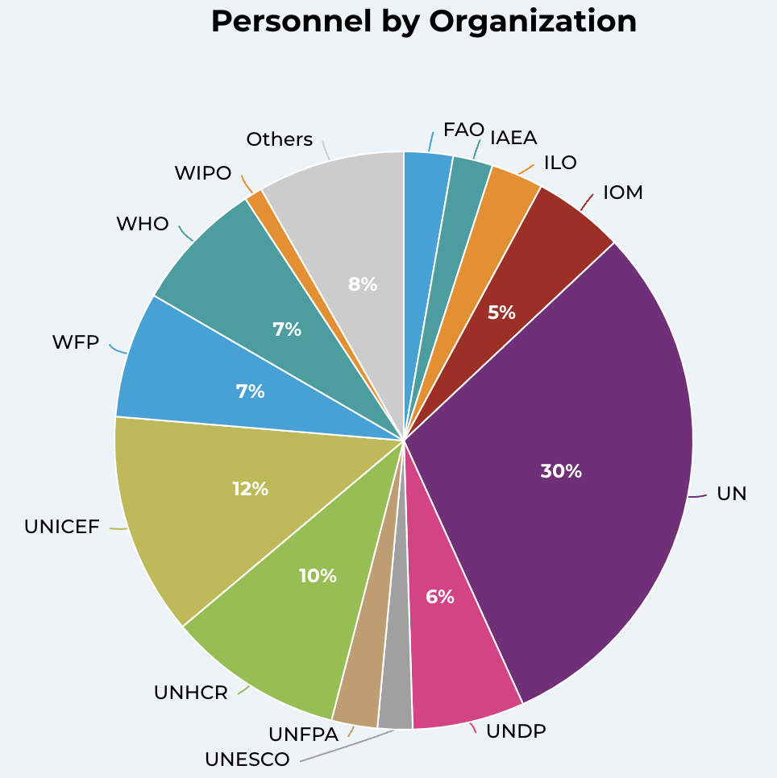
UN Personnel
Notes:
https://unsceb.org/hr-organization

Slide 27
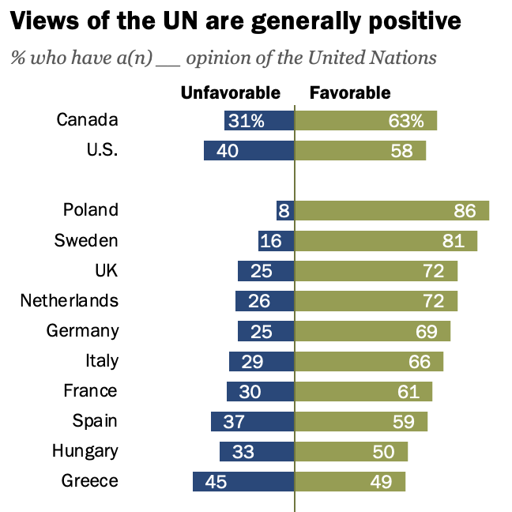
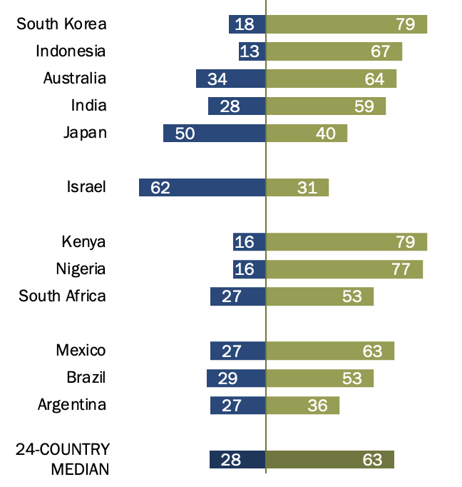
UN Views
Source: Pew Research Center, Aug 31, 2023
Notes:
Fagan, Moira, “People across 24 countries continue to view UN favorably,” Pew Research Center, August 31, 2023.
https://www.pewresearch.org/short-reads/2023/08/31/people-across-24-countries-continue-to-view-un-favorably/

Slide 28
UN Budget
UN has two budgets, plus voluntary contributions
Regular budget
Country contributions based on “capacity to pay”
Decided every three years
Formula uses shares of gross national income with adjustments for debt, population, and level of development
Peacekeeping budget
Decided by Permanent Members of Security Council
Contributions from same formula, with additional adjustment for
Contributing troops
Voluntary contributions
Fund a large part of disaster relief, development work and agencies such as UNICEF.
Notes:
https://betterworldcampaign.org/us-funding-for-the-un/un-budget-formula#:~:text=There%20are%20two%20main%20budgets,of%20global%20gross%20national%20income.

Slide 29
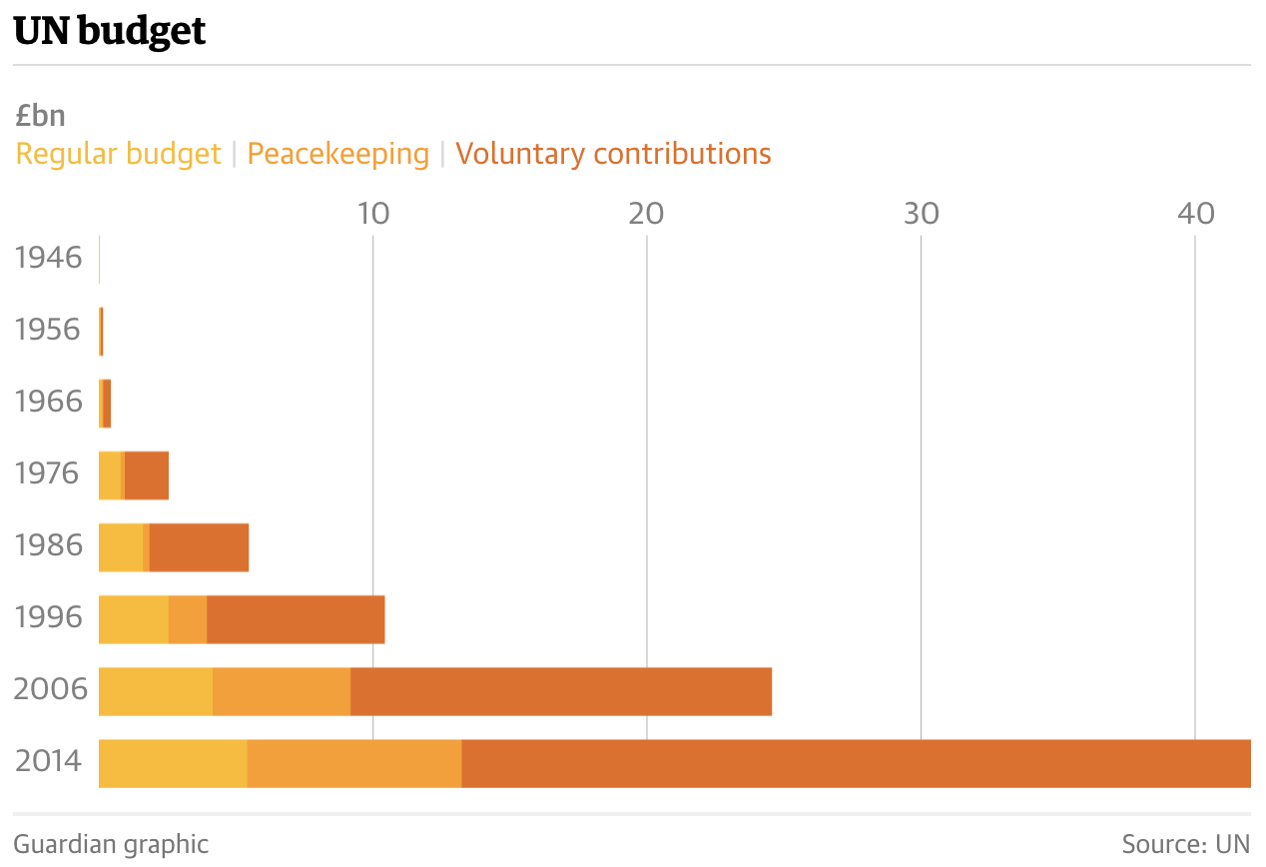
UN Budget
(Apparently in 2015 currency)
Looks big. But “still only about half of New York City’s $75bn budget.”
Source: Reed, “70 years and half a trillion dollars later: what has the UN achieved?” The Guardian, 2015.
Notes:
https://www.theguardian.com/world/2015/sep/07/what-has-the-un-achieved-united-nations
These data seem to be adjusted for inflations, as article says “Even accounting for inflation, annual UN expenditure is 40 times higher than it was in the early 1950s.”

Slide 30
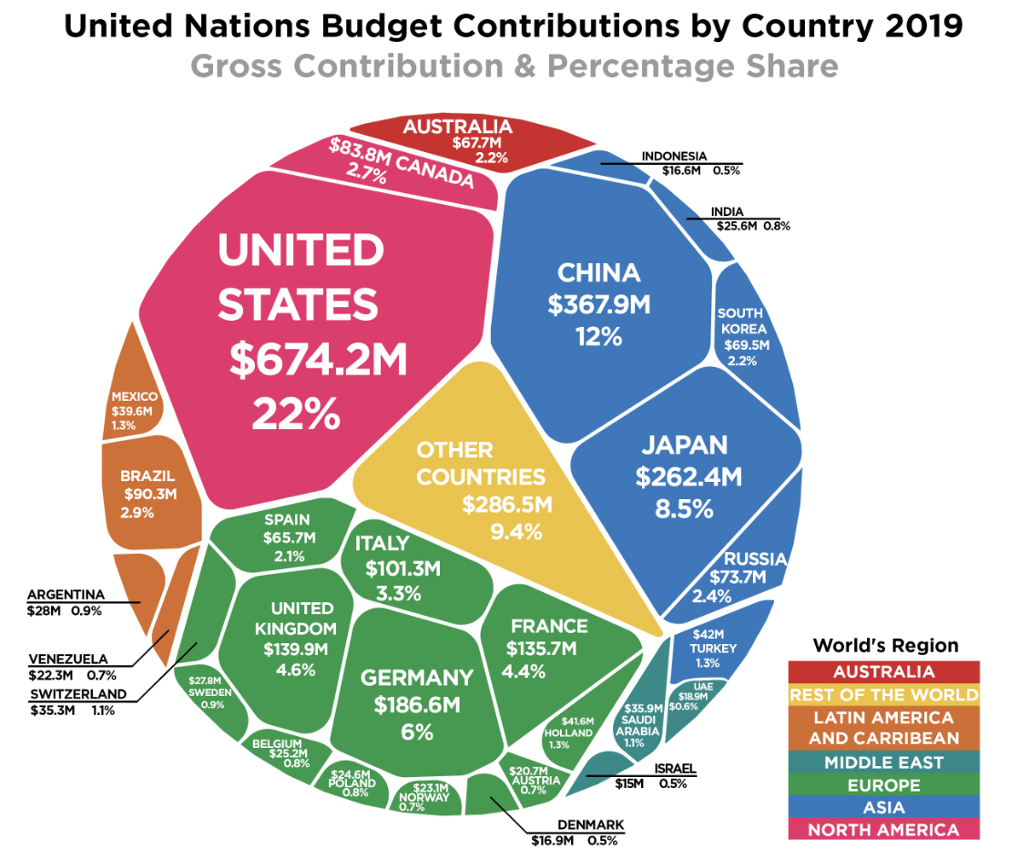
UN Budget
Notes:
https://howmuch.net/articles/united-nations-budget-contributions-by-country-2019

Slide 31
IMF

Slide 32
IMF
International Monetary Fund
Created at Bretton Woods 1944
Original purpose
To prevent international financial crises by
Overseeing exchange rates pegged to the US dollar
Providing resources to central banks to assist in exchange-rate management
Current purpose
Major countries longer have pegged exchange rates
“Promote financial stability and monetary cooperation”
“Lender of last resort and global standard-setter”
Notes:
https://www.ft.com/content/ab44dccf-e613-485d-a901-2b19badc9705

Slide 33
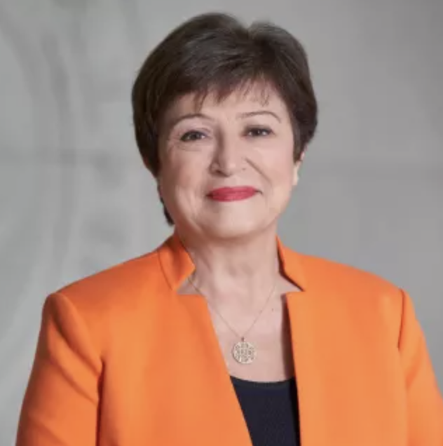
IMF
Managing Director: Kristalina Georgieva
Bulgarian economist

Slide 34
IMF
Things the IMF does
Policy advice
Loans to countries in financial distress
Conditional on agreeing to “undertake certain policy actions” (“Policy conditionality”)
Ceilings on external debt, government wage bill
Improve tax administration, fiscal transparency, anti-corruption
Charges interest rate based on the SDR interest rate (see below) plus a margin that is currently 100 basis points (one percentage point)
Capacity development assistance and training
Notes:
https://www.imf.org/en/About

Slide 35
Aside on SDRs
SDR = “Special Drawing Rights”
History is interesting but not important
Sort of international money
Created by IMF
Used only by central banks with each other
Valued is basket of major currencies, used for IMF bookkeeping and transactions
Dollar, euro, renminbi, yen, pound
Interest rate posted by IMF each week is based on interest rates in component currencies
Notes:
https://www.imf.org/external/np/fin/data/sdr_ir.aspx

Slide 36
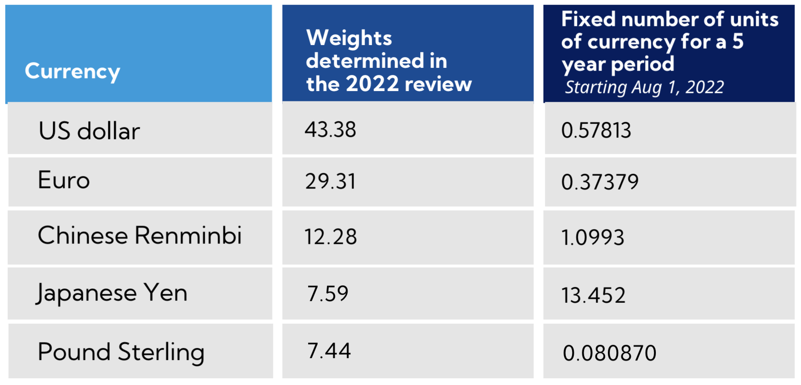
Aside on SDRs
Notes:
https://www.imf.org/external/np/fin/data/sdr_ir.aspx

Slide 37
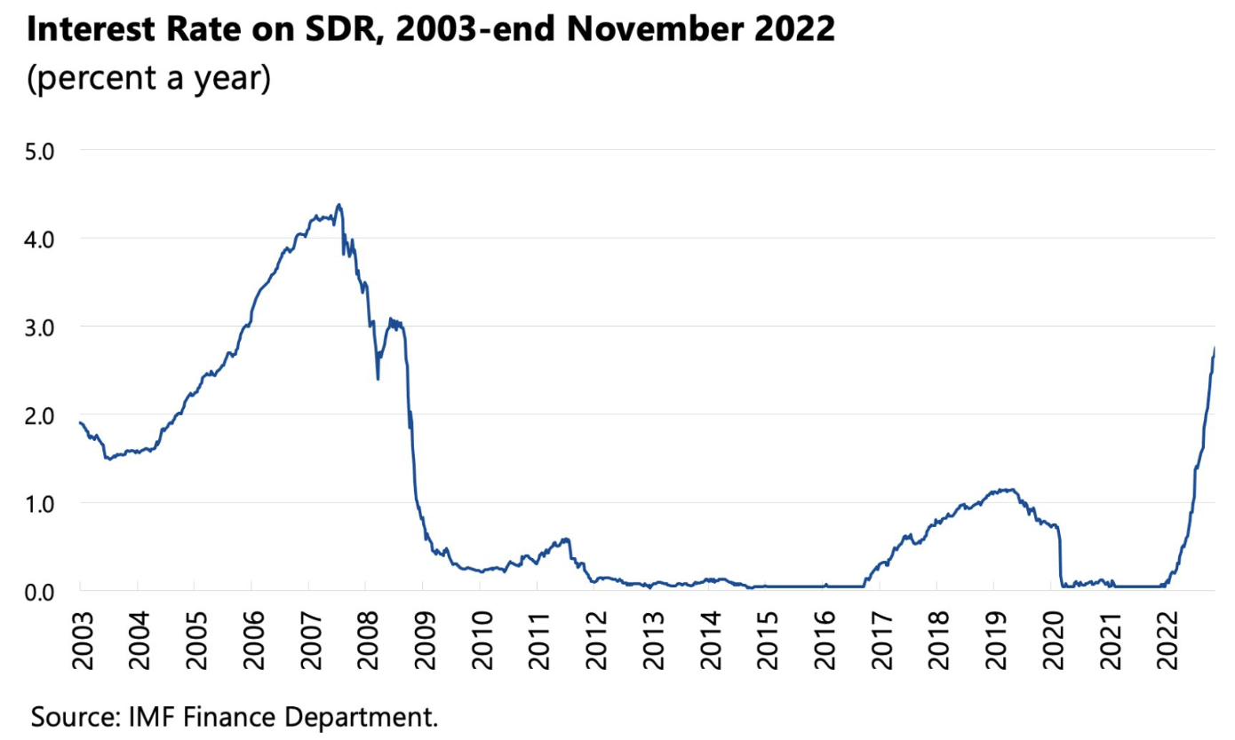
Aside on SDRs
Notes:
https://www.imf.org/external/np/fin/data/sdr_ir.aspx

Slide 38
IMF Funding
IMF Funding comes from 3 courses
Member quotas
Assigned based “broadly on its relative position in the world economy”
Reviewed every 3 years
Last increased 2010 for effect 2016
Current review due mid-December 2023
New Arrangements to Borrow
Bilateral Borrowing Agreements
Notes:
https://www.imf.org/en/About/Factsheets/Where-the-IMF-Gets-Its-Money

Slide 39
IMF Funding
Notes:
https://www.imf.org/en/About/Factsheets/Where-the-IMF-Gets-Its-Money

Slide 40
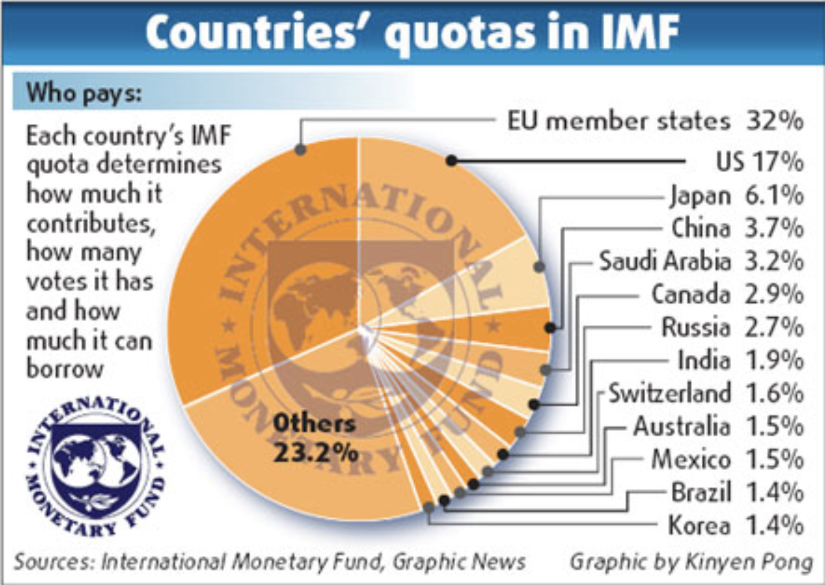
IMF Funding
Source: China Daily, 2009
Notes:
https://www.chinadaily.com.cn/bizchina/2009-05/14/content_7775618.htm

Slide 41
IMF Funding
IMF Quotas and Voting
Countries’ voting shares are similar to their quotas
Today, US quota share is 17.43% and its voting share is 16.50%
That gives US a veto on all major decisions
These quotas
Have not been increased since 2010, limiting the IMF’s ability to operate
It has expanded borrowing to compensate
They are to be discussed for revision at annual meeting
October 9-15, 2023
Notes:
https://www.ft.com/content/ab44dccf-e613-485d-a901-2b19badc9705

Slide 42
World Bank

Slide 43
World Bank
World Bank Group
Created at Bretton Woods 1944
Original purpose
To assist war-destroyed countries to recover from WWII
Current purpose
To assist developing countries with
Loans
Policy advice
Assistance

Slide 44
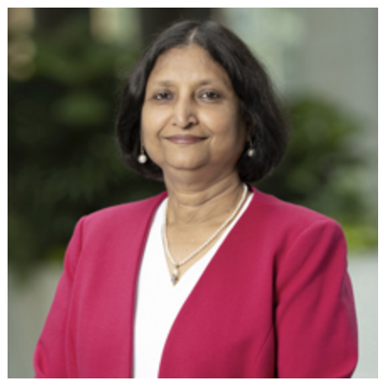
World Bank
Managing Director: Anshula Kant
Former CFO of State Bank of India

Slide 45
World Bank
World Bank Institutions:
International Bank for Reconstruction and Development
International Development Association
International Finance Corporation
Multilateral Investment Guarantee Agency
International Centre for Settlement of Investment Disputes

Slide 46
World Bank
Est. 1945
Est. 1960
Est. 1956
Est. 1988
Est. 1966
Notes:
https://www.developmentaid.org/news-stream/post/124249/doing-business-with-the-world-bank-2
http://www.globalislander.com/2012/10/the-world-bank-group.html

Slide 47
World Bank Lending
World Bank borrows all the money that it lends
It borrows from all over the world at very low interest rates
It lends
To middle-income countries at rates below commercial banks
To the poorest countries at no interest
Borrowers must
Cover part of any project from other sources (own funds or commercial loans)
Pay back their loans
Notes:
https://www.worldbank.org/en/news/feature/2012/07/26/getting_to_know_theworldbank

Slide 48
World Bank Lending
Projects help countries to
Supply safe drinking water
Build schools and train teachers
Increase agricultural productivity
Manage forests and other natural resources
Build and maintain roads, railways, and ports
Extend telecommunications networks
Generate and distribute energy
Expand health care
Modernize
Notes:
https://www.worldbank.org/en/news/feature/2012/07/26/getting_to_know_theworldbank

Slide 49
World Trade Organization

Slide 50
WTO
World Trade Organization
Created 1995 by Uruguay Round Ministerial of the GATT
Purposes
Operate a system of rules on international trade policies
Serve as forum for negotiating trade agreements
Settle trade disputes between countries
Notes:
https://www.wto.org/english/thewto_e/thewto_e.htm

Slide 51
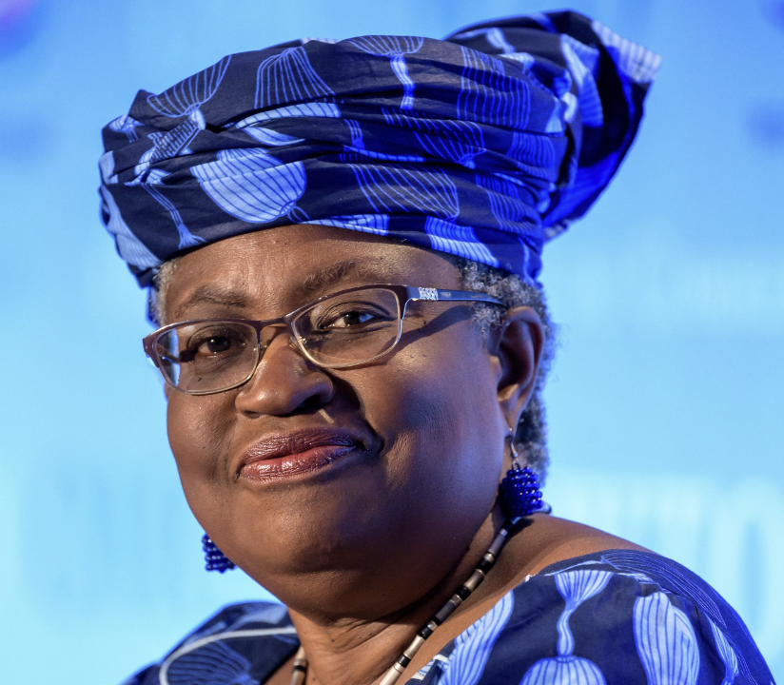
WTO
Director-General: Ngozi Okonjo-Iweala
Nigerian-American economist
Previously Minister of Finance, Nigeria

Slide 52
WTO
Three parts:
GATT = General Agreement on Tariffs and Trade
GATS = General Agreement on Trade in Services
TRIPs = Trade-Related Aspects of Intellectual Property Rights
Functions (see below)

Slide 53
WTO Functions
Functional Outline of the World Trade Organization
Communication
Constraints
Exceptions
Dispute Settlement

Slide 54
WTO Functions
Communication | Ministerials
 | Negotiating Rounds
 | Working Groups
 | Trade Policy Review Mechanism
 | Councils and Committees
Trade Ministers (USTR, etc.) Meet “Every” Two Years
Tariff Reductions; Changes in Rules

Slide 55
WTO Functions
National Treatment for Service Firms (only in some industries)
Constraints | Tariff Bindings
 | Customs Valuation
 | Product Regulations
 | Quantitative Restrictions
 | Subsidies
 | Foreign Direct Investment (TRIMS)
 | Services (GATS)
 | Intellectual Property (TRIPs)
Countries negotiate and commit to maximum tariffs
Enforce Patents, Copyrights, Trademarks
55

Slide 56
WTO Functions
Most commonly used
Exceptions | Anti-Dumping
 | Countervailing Duties
 | Safeguards
 | Balance of Payments Protection
 | Preferential Trade Agreements
Permitted; not required
Allows NAFTA, EU, etc.

Slide 57
WTO Functions
Standing Committee that reviews most cases
Dispute Settlement | Consultation
 | Panel Recommendation
 | Appellate Body
 | Remedy | Implementation
 |  | Compensation
 |  | Retaliation
3-person Panel Decides Case
The Ultimate Remedy: Permit Tariffs

Slide 58
WTO Disputes
Trump and the WTO
Oct 25, 2017, on Fox interview with Lou Dobbs:
“The WTO, World Trade Organization, was set up for the benefit for everybody but us.”
“we lose the lawsuits, almost all of the lawsuits … within the WTO”
In fact, like other countries, US
Wins most of the cases it brings
Loses most the cases brought against it
Since 1995, in all cases, complainant has won 90%
As complainant, US has won 91%
As respondent, US has lost 89%

Slide 59
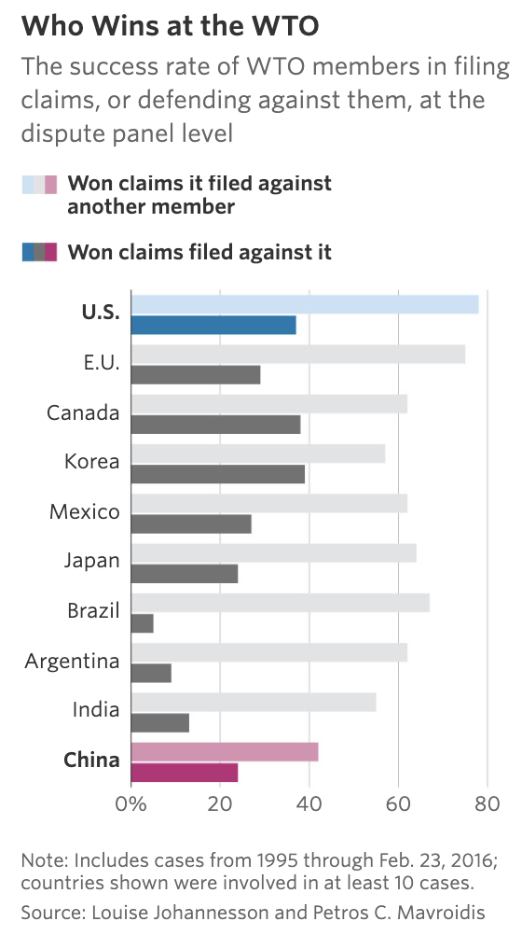
WTO Disputes
Source: WSJ, 2017
Notes:
Schlesinger, Jacob M., “How China Swallowed the WTO,” Wall Street Journal, November 2, 2017.
https://www.wsj.com/articles/how-china-swallowed-the-wto-1509551308

Slide 60
WTO and the United States
National-Security Tariffs (on steel, aluminum)
Cases brought by EU and many others
EU, Canada, & Mexico cases settled by negotiation
Other cases status: panel composed
How did WTO rule?
Panel report in December 2022 found against the US
Said action was not “in time of war or other international emergency”
US appealed (but has blocked the Appellate Body)
WTO provision:
Article XXI: “[n]othing in this Agreement shall be construed . . . to prevent any contracting party from taking any action which it considers necessary for the protection of its essential security interests . . . taken in time of war or other emergency in international relations[.]”

Slide 61
WTO and the United States
Dispute Settlement Body (DSB)
Lacks a quorum since Dec 11, 2019
Trump blocked all new appointments
Biden has not changed this
Without DSB no case can finish if it is appealed (which all are)
Other countries formed an alternative mechanism, not including US

Slide 62
WTO and the United States
Trade war with China
Tariffs levied under US Section 301 not consistent with GATT/WTO
WTO panel ruled against US Sep 15, 2020
Panel: “Trump’s tariffs violated several global rules” (NYT)
US appealed but case cannot be completed
Even without that, would WTO permission for China to levy tariffs be meaningful?

Slide 63
Other Institutions
Other Institutions
OECD
G-7, G-20
UN Organizations
UNCTAD
ILO
WIPO
Regional Commissions for Economic and Social Development
International Development Banks

Slide 64
OECD

Slide 65
OECD
OECD = Organization for Economic Cooperation and Development
38 member countries
Economist calls it a “rich-country think tank”
“provides governments a setting in which to discuss, develop and perfect economic and social policy”
Most recently, OECD agreed on a “global treaty” to tax digital technology giants in the countries where they do business
143 countries took in the negotiations
It still needs to be signed and ratified by “enough countries”.
Some important ones (e.g., US) may not
Notes:
https://www.ft.com/content/2219e65d-19a6-4da3-a5d0-192300775e64

Slide 66
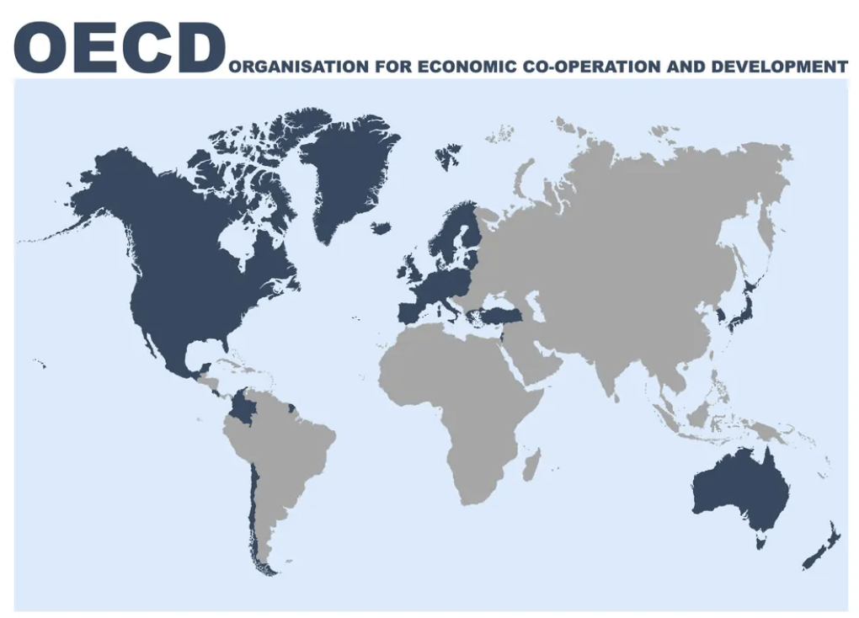
OECD

Slide 67
G-20

Slide 68
G-20
G-7: US, Canada, Japan, Britain, France, Germany, and Italy (plus the EU)
Began annual meetings of heads of state in 1976
G-20: G7 plus 13 others, both major developed and developing countries
Founded 1999 with only finance ministers
Began head-of-state meetings after financial crisis of 2008
“Summit on Financial Markets and the World Economy”
Today, G7 deals more with politics, G20 with economics
G-20 met in India September 9-10, 2023
Launched India-Middle East-Europe Economic Corridor

Slide 69
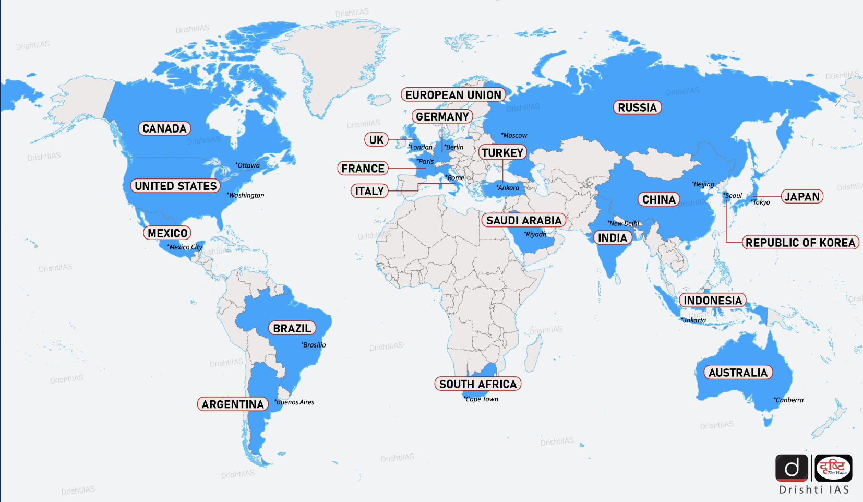
G-20
Notes:
https://www.drishtiias.com/daily-updates/daily-news-analysis/g20-map

Slide 70
UNCTAD

Slide 71
UNCTAD
UNCTAD = United Nations Conference on Trade and Development
Supports “developing countries to access the benefits of a globalized economy more fairly and effectively.”
> 193 members of UN
Notes:
https://unctad.org/about

Slide 72
ILO

Slide 73
ILO
ILO = International Labor Organization
Created 1919 by Treaty of Versailles
Tripartite: governments, employers and workers
Sets labor standards, develops policies, and devises programs promoting decent work
Has no power to enforce, but only shame

Slide 74
ILO
Fundamental ILO Conventions
Freedom of Association
Right to Organize (157)
Right to Collective Bargaining (168)
Abolition of Forced Labor
Forced Labor (180)
Abolition of Forced Labor (178*)
Equality
Discrimination (174)
Equal Remuneration (175)
Elimination of Child Labor
Minimum Age (175)
Worst Forms of Child Labor (187*)
(# countries ratifying)
* USA ratified

Slide 75
WIPO

Slide 76
WIPO
WIPO = World Intellectual Property Organization
Global forum for intellectual property policy, services, information and cooperation.
IP includes
Patents
Copyrights
Trademarks
Trade secrets
Has no power to enforce

Slide 77
Regional Commissions for Economic and Social Development

Slide 78
Regional Commissions for Economic and Social Development
Economic Commission for Africa (ECA), Addis Ababa, Ethiopia
Economic Commission for Europe (ECE), Geneva, Switzerland
Economic Commission for Latin America and the Caribbean (ECLAC), Santiago, Chile
Economic and Social Commission for Asia and the Pacific (ESCAP), Bangkok, Thailand
Economic and Social Commission for Western Asia (ESCWA), Beirut, Lebanon

Slide 79
Regional Commissions for Economic and Social Development
What Regional Commissions for Economic and Social Development do:
They “promote economic development and cooperation in their respective regions”
They normally meet once a year
They enable member States to maintain contact with one another and with the Secretariat between sessions of the General Assembly, to which they submit their proposals and convey their concerns.
Each maintains offices and staff in their region to undertake programs of work

Slide 80
International Development Banks
…

Slide 81
International Development Banks
There is a long list of International (or Multilateral) Development Banks. The largest are
The African Development Bank Group
The Asian Development Bank
The European Bank for Reconstruction and Development
The Inter-American Development Bank
The World Bank Group
My Glossary lists 14 more and is surely incomplete

Slide 82
International Development Banks
Purpose: “to provide medium- and long-term capital for productive investment, often accompanied by technical assistance, in poor countries.”
They “may be publicly or privately owned and operated, but governments frequently make substantial contributions to the private ones.”
Concerns:
Bad investments
Imposing policies that destabilize countries
Moral hazard: encouraging irresponsible policies
Source: Britannica. Money
Notes:
https://www.britannica.com/money/development-bank

Slide 83
Economic Groupings of Countries
Free Trade Agreements and Customs Unions
European Union
USMCA
CPTPP
RCEP
MERCOSUR
Other
G-20 Developing
Cairns Group

Slide 84
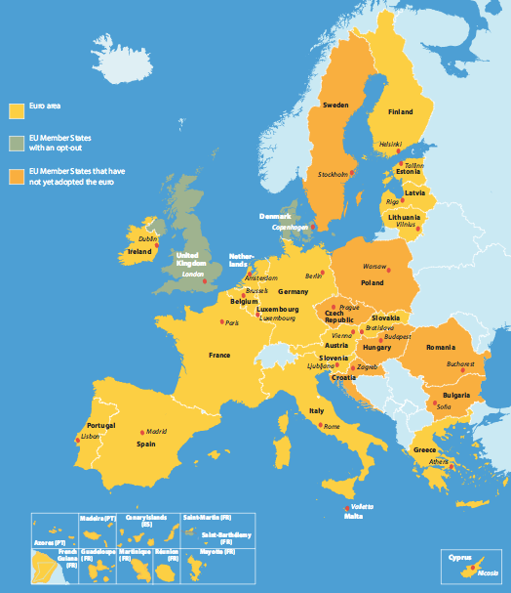
Economic Groupings of Countries
European Union
Notes:
http://europa.eu/european-union/about-eu/money/euro_en

Slide 85
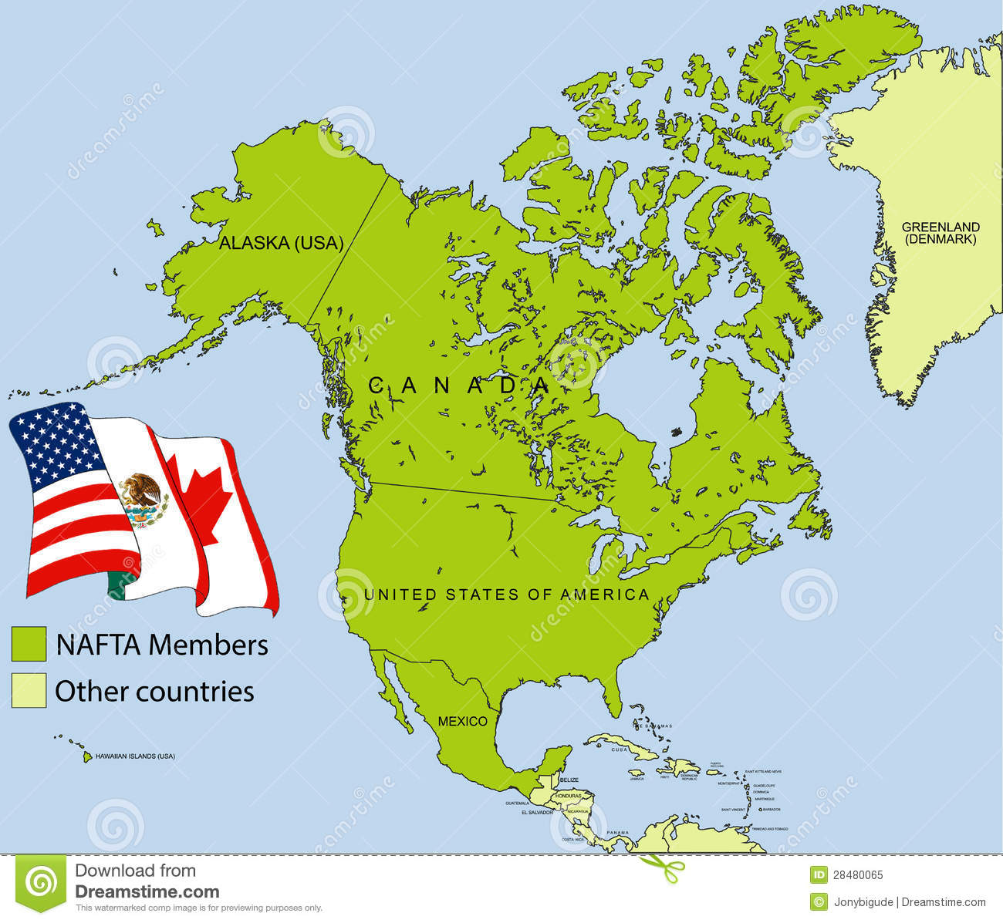
Economic Groupings of Countries
NAFTA (now USMCA)
Notes:
https://maproom.net/shop/eu-map/

Slide 86
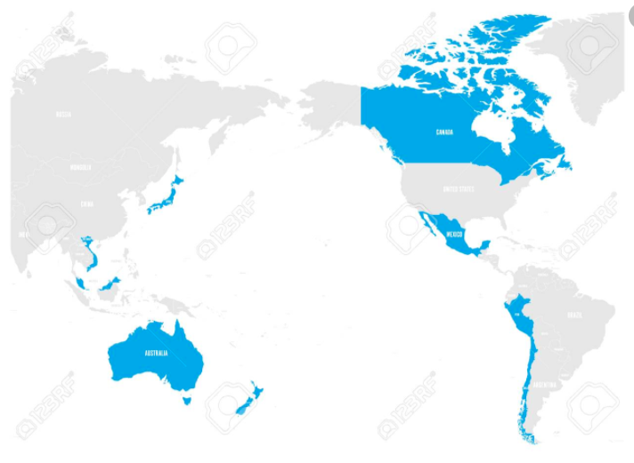
Economic Groupings of Countries
CPTPP = Trans-Pacific Partnership minus US
Notes:
https://maproom.net/shop/eu-map/

Slide 87
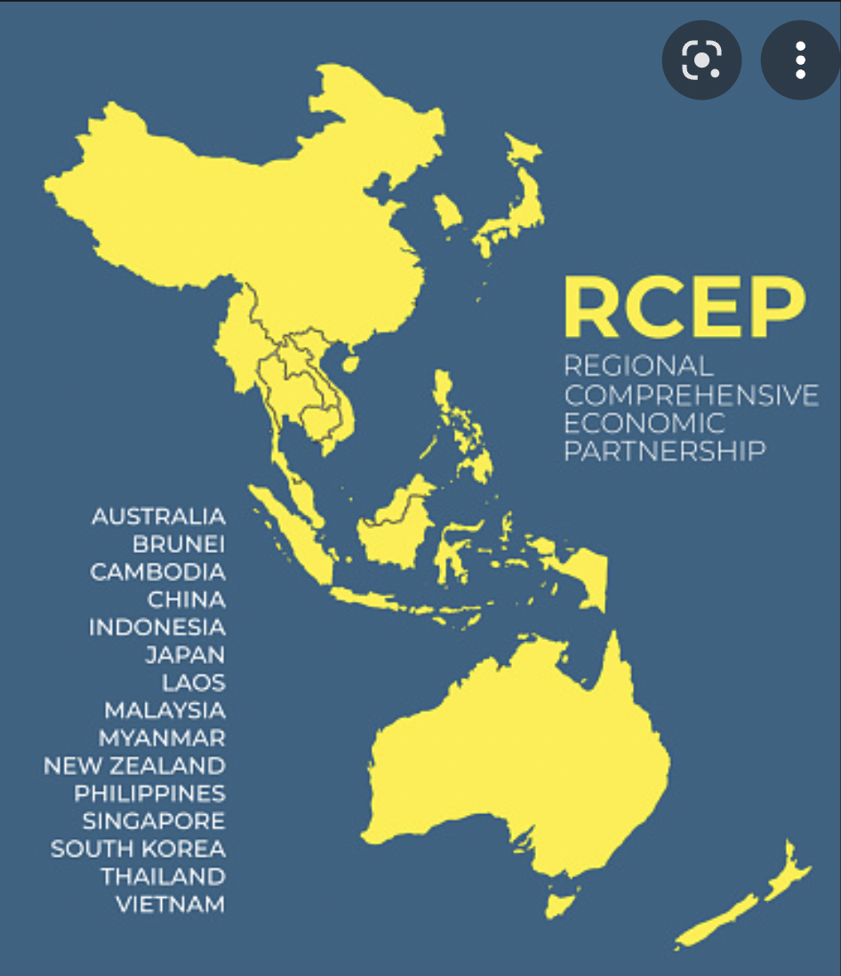
Economic Groupings of Countries
RCEP = Regional Comprehensive Economic Partnership
Notes:
https://maproom.net/shop/eu-map/

Slide 88
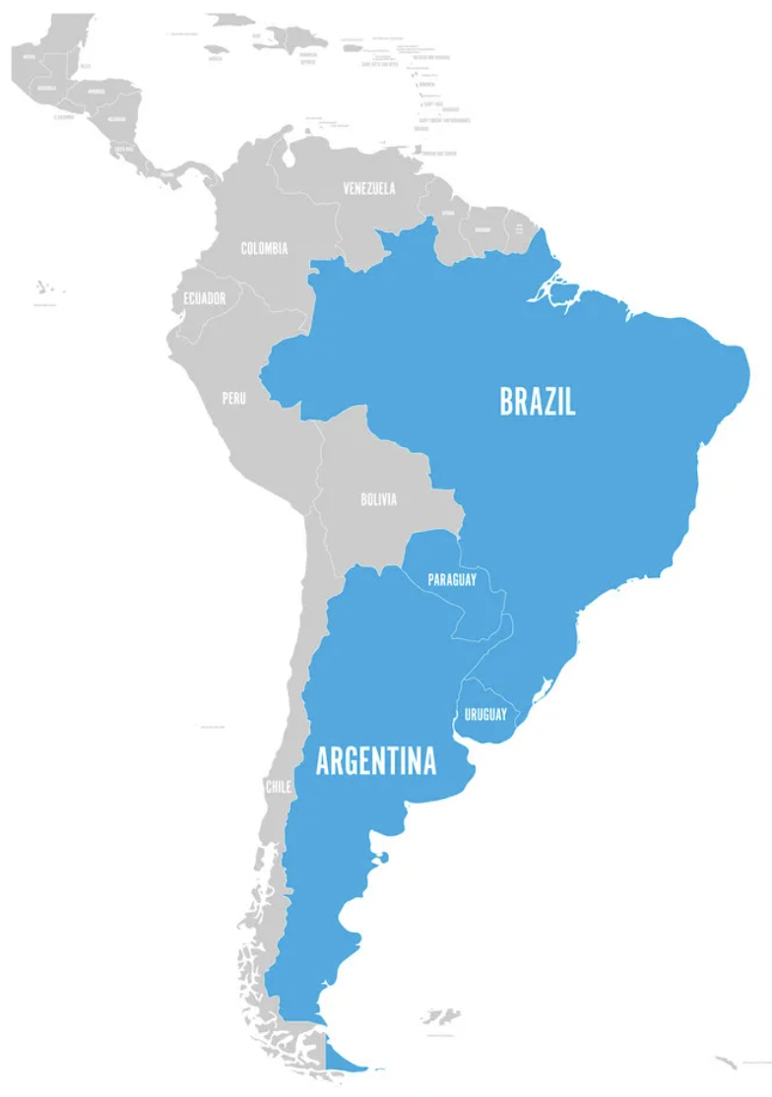
Economic Groupings of Countries
MERCOSUR
Notes:
https://maproom.net/shop/eu-map/

Slide 89
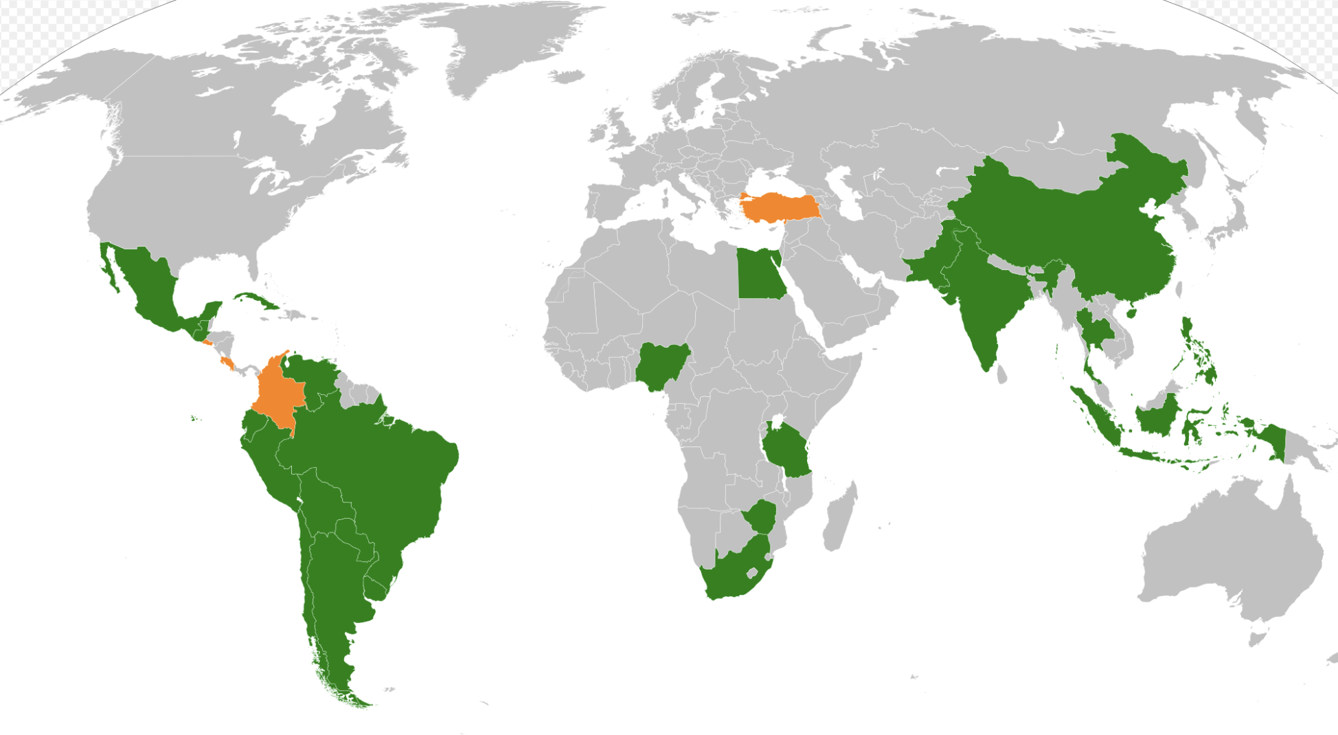
Economic Groupings of Countries
G20 Developing Countries
Notes:
https://maproom.net/shop/eu-map/

Slide 90
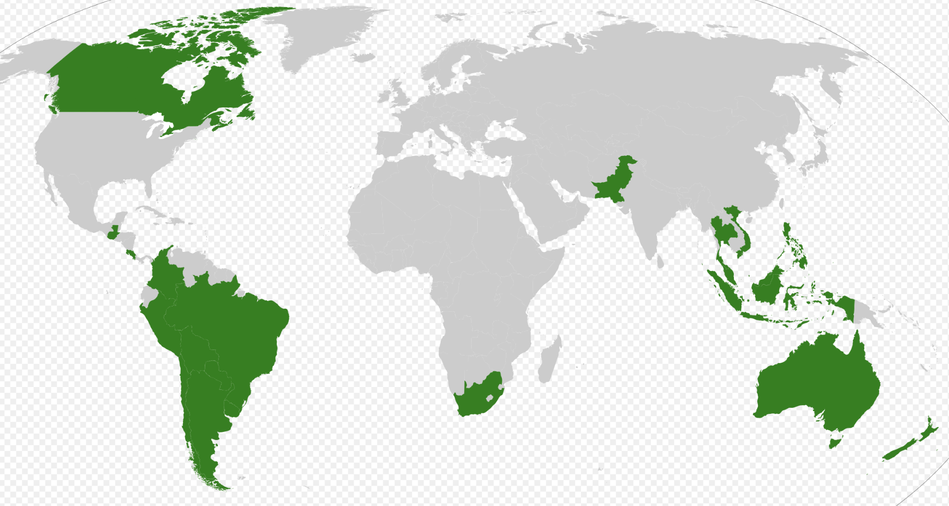
Economic Groupings of Countries
Cairns Group
Notes:
https://maproom.net/shop/eu-map/

Slide 91
Next Week
Economic Update
Geoffrey Woglom
Amherst College

Slide 92
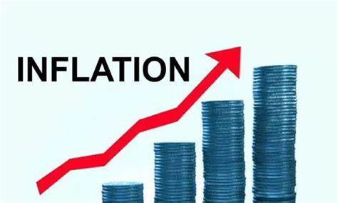
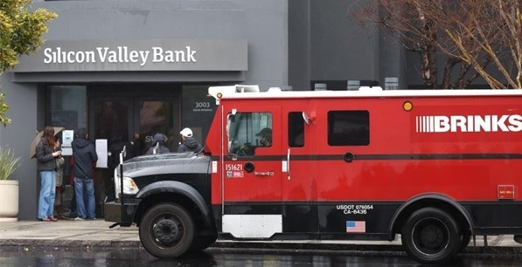
US Economy: Update
Geoffrey Woglom,
Professor of Economics
Amherst College, emeritus
October 19, 2023

Slide 93
Thank you!
Any Questions?
www.NEEDEcon.org
Alan Deardorff
alandear@umich.edu
Contact NEED: info@NEEDEcon.org
Submit a testimonial: www.NEEDEcon.org/testimonials.php
Become a Friend of NEED: www.NEEDEcon.org/friend.php

