Slide 1
Osher Lifelong Learning Institute, Winter 2022
Contemporary Economic Policy
Oklahoma State University
February-March, 2022
Jon Haveman, Ph.D.
National Economic Education Delegation

Slide 2
Available NEED Topics Include:
Coronavirus Economics
US Economy
Climate Change
Economic Inequality
Economic Mobility
Trade and Globalization
Minimum Wages
Immigration Economics
Housing Policy
Federal Budgets
Federal Debt
Black-White Wealth Gap
Autonomous Vehicles
US Social Policy

Slide 3
Course Outline
Contemporary Economic Policy
Week 2 (2/15): US Economy & Coronavirus Economics
Week 3 (2/22): Climate Change Economics (Simone Wegge, CUNY)
Week 4 (3/1): Immigration Economics (Roger White, Whittier College)
Week 5 (3/8): Infrastructure Economics (Mallika Pung, Univ. of New Mexico)
Week 5 (3/15): Trade and Globalization (Alan Deardorff, Univ. of Michigan)
Week 6 (3/22): The Black-White Wealth Gap (Me)

Slide 4
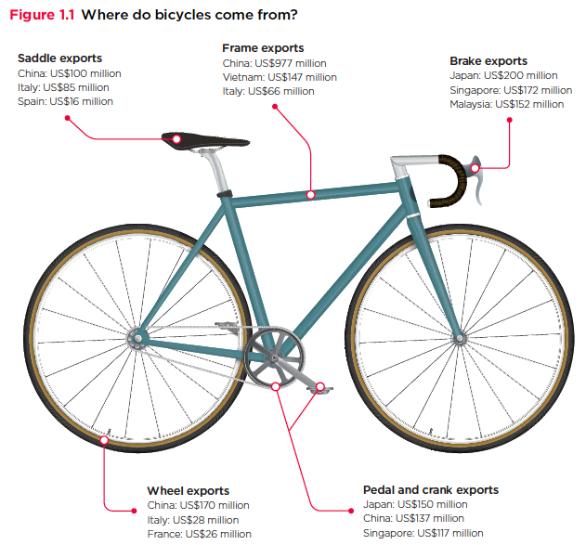
Trade: w/Alan Deardorff
Source: World Development Report 2020

Slide 5
Infrastructure Economics
Mallika Pung, Ph.D.
University of New Mexico

Slide 6
Submitting Questions
Please submit questions in the chat.
We will do a verbal Q&A once the material has been presented.
And the questions in the chat have been addressed.

Slide 7
Credits and Disclaimer
This slide deck was authored by:
Mallika Pung, Rice University
Jon Haveman, NEED
Disclaimer
NEED presentations are designed to be nonpartisan.
It is, however, inevitable that the presenter will be asked for and will provide their own views.
Such views are those of the presenter and not necessarily those of the National Economic Education Delegation (NEED).

Slide 8
Outline
What do we mean by infrastructure?
Current state of infrastructure in the US
Infrastructure in economic models
Why should we invest in infrastructure?
Policy options to fund infrastructure investments

Slide 9
What is a Useful Definition of Infrastructure?
Infra- means "below;"
So, the infrastructure is the "underlying structure" of a country and its economy.
Miriam-Webster definition of Infrastructure:
the system of public works of a country, state, or region
also: the resources (such as personnel, buildings, or equipment) required for an activity
the underlying foundation or basic framework (as of a system or organization)
the permanent installations required for military purposes

Slide 10
Different Kinds of Infrastructure
Provide basic services
Improve the performance of the economy
Make people’s lives better
Example: Electricity, water, broadband, roads, bridges, airports, seaports

Slide 11
Another Categorization
Tangible
Traffic systems: streets, railways, other transportation
Utilities and disposal: energy, water, and communication networks
Intangible
Human capital
Education, research facilities
Health systems, social services
Institutional
Legal, economic, and social system
Culture, traditions
The Economics of Infrastructure Provisioning, MIT Press, 2015, pg.10

Slide 12
Infrastructure – Is it:
Traditional:
Roads, bridges, tunnels, airports, seaports, dams, water, electrical, and telephone systems?
Additional:
Broadband
What about:
R&D? Human capital? Institutions?
What definition of “infrastructure” makes it most useful today?
Caregiving?

Slide 13
What is Infrastructure? – A Recap
Economic infrastructure:
Basic services that represent a foundational tool for the economy.
Can be:
Physical structures
Systems
Institutions
Services
Facilities
We will focus on physical structures, systems, and facilities.

Slide 14
Categories of Physical Infrastructure
Transportation
Highways, roads, bridges
Mass transit
Airports, seaports
Water
Supply
Distribution
Waste management
Trash, recycling, and wastewater
Energy
Generation
Transmission
Communications
Telephone
Internet

Slide 15
Current State of Infrastructure in the US
Source: https://www.infrastructurereportcard.org/

Slide 16
Current State of Transportation Infrastructure
Roads
Over 4 million miles of roads.
In 2018: 3.3 trillion VMT (Vehicle Miles Traveled).
40%+ of America’s urban interstates are congested.
In 2017, 8.8 billion hours of traffic delay.
Costing the country $166 billion in wasted time and fuel.
“The average auto commuter spends 54 hours in congestion and wastes 21 gallons of fuel due to congestion at a cost of $1,080 in wasted time and fuel.”
-- 2019 Urban Mobility Report, Texas A&M Transportation Institute
42,060 motor vehicle fatalities in 2020 (8% increase over 2019).

Slide 17
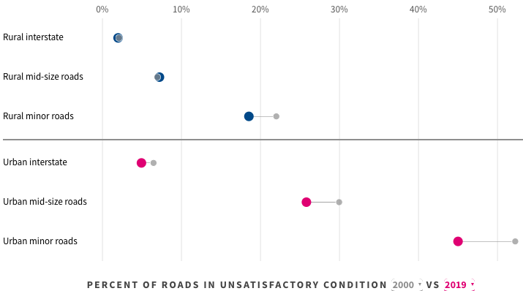
But it is Getting Better
Improvement
Source: usafacts.org

Slide 18
Current State of Transportation Infrastructure
Mass Transit
~ 6,800 organizations in the U.S. that provide transit services.
Transit ridership: peaked at 10.7 billion in 2014.
COVID-19 pandemic caused major disruptions across all transit agencies.
45% of Americans have no access to transit.
50% of passenger trips by bus.
10% of fleets NOT in “state of good repair”.
33+% by heavy rail (subway/metro)
3% of fleets NOT in “state of good repair”.
Transit users face increased delays due to service interruptions, and agencies are grappling with growing maintenance and vehicle procurement costs.

Slide 19
Current State of Transportation Infrastructure
Aviation
In 2019, 10 million+ commercial flights
Flying ~3 million passengers daily
National Plan of Integrated Airport Systems (NPIAS)
identifies over 3,300 airports in the U.S. aviation network
Contributed 5.1% to US GDP
Generated 10.6 million jobs
In 2019, 79% of flights were on-time. Delays were caused by
late-arriving aircrafts,
air carriers,
weather, and
diverted flights.

Slide 20
Current State of Transportation Infrastructure
Ports
99% of US overseas trade pass through ports
Los Angeles and Long Beach – busiest ports in the US
Top 10 U.S. ports account for 3/4th of U.S. trade
Congestion decreased port productivity by over 25% over the past decade
COVID-19 pandemic exacerbated the congestion related issues
Port infrastructure upgrades needed to accommodate new, larger ships with deeper navigation channels
Waterways
More than 600 million tons of cargo
14% of annual domestic freight
Beyond their 50-year design life
50% vessels experience delays due to maintenance shut downs

Slide 21
Current State of Water Infrastructure
Drinking Water
150,000+ public drinking water systems
1 billion+ glasses of drinking water consumed daily
80% from surface waters such as rivers, lakes, oceans, reservoirs
20% from groundwater aquifers
Delivered via 2.2 million miles of pipes
Majority laid in mid-20th century and are aging
estimated 240,000 water main breaks occur each year
6 billion gallons of treated drinking water lost daily due to leaking pipes
could support 15 million households

Slide 22
Current State of Water Infrastructure
Wastewater
16,000+ wastewater treatment plants
1.3 million miles of public and private lateral sewers
Used by 80% of Americans
Likely to serve 56 million more people by 2032
Structural failure, blockages, and overflows cause at least 23,000 to 75,000 sanitary sewer overflow events each year

Slide 23
Current State of Water Infrastructure
Dams
There are over 91,000 dams in the US providing:
drinking water,
irrigation,
hydropower,
flood control, and
recreation
Most are privately owned
Average age – 57 years
By 2025, 7 out of every 10 dams will be over 50 years old
In 2019, there were 15,600 high-hazard potential dams

Slide 24
Current State of Water Infrastructure
Levees
A network of 30,000 miles of levees
Levees in the U.S. Army Corps of Engineers Levee Safety Program protect
over 300 colleges and universities,
30 professional sports venues,
100 breweries, and
an estimated $1.3 trillion in property
Built in the mid-20th century with an average age of 50 years, aging fast
Levees are crucial with majority of the U.S. population living within 50 miles of a coast

Slide 25
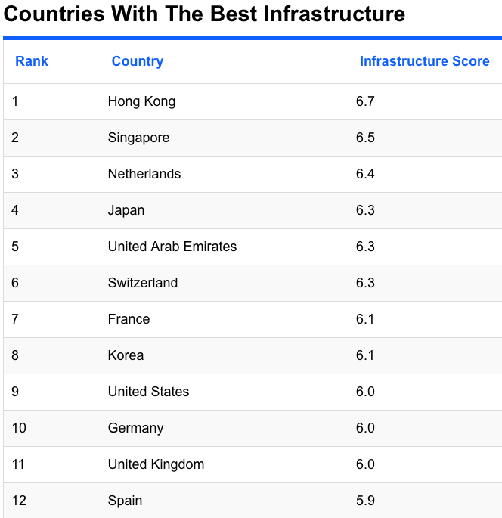
How Do We Compare?
We’re #9!
Source: World Economic Forum, [i]The Global Competitiveness Report 2017–2018[i]

Slide 26
The 2021 Infrastructure Package

Slide 27
What is in it?
Transportation
Other
Roads, bridges, major projects | $110 Billion
Passenger and freight rail | $66 Billion
Public transit | $39 Billion
Airports | $25 Billion
Port infrastructure | $17 Billion
Transportation safety programs | $11 Billion
Electric vehicles | $7.5 Billion
Zero and low-emission buses and ferries | $7.5 Billion
Revitalization of communities | $1 Billion
Broadband | $65 Billion
Power infrastructure | $73 Billion
Clean drinking water | $55 Billion
Resilience and Wester water storage | $50 Billion
Removal of pollution from water and soil | $21 Billion

Slide 28
How is it paid for?
Unspent emergency relief funds
Strengthening tax enforcement – crypto currencies
Revenue generated from higher economic growth
Increased federal budget deficit

Slide 29
Infrastructure Benefits

Slide 30
Why Should we Invest in Infrastructure?
Vital ingredient to economic growth
Facilitates economies of scale, raises productivity A 10% rise in infrastructure assets directly increases Real GDP per capita by 0.7 – 1%.
Assuming increases in spending translate 1-1 to the stock of assets:
~$50 billion will raise GDP per capita in the US by ~$300 -$450.
$100 to $150 billion in increased GDP.
Productivity growth raises standards of living

Slide 31
Why Should we Invest in Infrastructure?
Vital ingredient to economic growth
Reduces trade costs by improving access to markets
Port capacity improvement
Reducing traffic congestion
Reduces effective distances, facilitates trade and agglomeration
Advances public health by providing clean water and effective sewage systems

Slide 32
Case for Spending More on Infrastructure Maintenance
Rundown infrastructure increases costs
Longer travel time → higher costs for businesses
Wear on cars → more spending on car repairs → faster car depreciation
Vehicle deterioration → Additional fuel consumption
“The average motorist in the U.S. is losing $523 annually -- $112 billion nationally -- in additional vehicle operating costs as a result of driving on roads in need of repair.”
-- November 2016 Urban roads TRIP report
Deferred maintenance is a debt burden on the future generations.

Slide 33
Infrastructure in economic models
Vast macroeconomic literature on relation between infrastructure and economic growth
Neoclassical growth model aka the Ramsey Model
Endogenous growth model
Variants
Wide variation in the magnitude of economic effects of infrastructure spending on growth or productivity

Slide 34
Econometric issues that make the task difficult
Direction of causality
Between infrastructure investment and productivity
Between infrastructure investment and output
Spurious correlation
Non stationary data
Ignoring unobserved factors that might affect both infrastructure investment and output
Heterogenous Effects

Slide 35
Public or Private Infrastructure Investment?
Nonrival consumption
Non-excludable use
➔Social benefits might exceed expected financial return.
Private sector likely to underprovide key types of infrastructure.
Economic case for public provision of infrastructure assets.

Slide 36
Public or Private Infrastructure Investment?
A few arguments for public provision:
Provision of public infrastructure increases productivity of private infrastructure
Incentivizes private capital investment,
Increases labor productivity,
Indirectly increases employment and wages.

Slide 37
Public or Private Infrastructure Investment?
A few more arguments for public provision:
Provides short-term stimulus to the economy by creating jobs
Promotes trade and commerce
Promotes equity
Pays prevailing wages
More demographically inclusive
Encompasses all congressional districts
Promotes public health and well-being
Improves public safety
Affects not just the present but the future generations also
Some of these are more debatable than others

Slide 38
Empirical Evidence on Effect of Gov’t Spending
In studies from 80s, early 90s:
A 1% increase in the stock of public capital raised GDP by 0.39%
In more recent studies
by only 0.08% in the short run, 0.12% long run
In terms of multiplier, most short-term estimates are less than 1
Due to negative effects of tax/interest rate increases on private C and I
Longer term multiplier
OECD panel data – 1.6
US interstate highway system – 1.8

Slide 39
Empirical Evidence on Effect of Gov’t Spending
Estimates from the 2009 American Recovery and Reinvestment Act
Each $100,000 spent led to 0.8 job-years created
Highway construction employment unaffected in 2009-10
fell sharply afterwards
Significant “crowd-in” of state and local highway spending
For each $1 of federal grant and additional $2.30 in state spending

Slide 40
A CBO study on effects of Gov’t Spending on Infrastructure on Real GDP
Two scenarios to finance $500 billion over 10 years:
Reducing gov’t noninvestment purchases
Reduces net cost by 1/3rd
Real GDP increase averages 0.09% between 2022-51
Increasing federal borrowing
Increases net cost by 1/4th
Real GDP increase averages 0.04% between 2022-51

Slide 41
Infrastructure Investment in the US
Transportation, drinking water, and wastewater infrastructure
mainly funded by the public sector
Publicly owned transportation infrastructure
Highways - Mass transit
Aviation - Water transportation
Rail
Publicly owned water infrastructure
Water utilities - Water resources
In 2017, Federal, State and Local governments spent
$441 billion on infrastructure
2.3% of gross domestic product

Slide 42
Government Spending on Infrastructure, 2017
Source: Congressional Budget Office

Slide 43
Spending on Infrastructure as Share of GDP
Source: Congressional Budget Office

Slide 44
Infrastructure Spending by Levels of Government
2003
Source: Congressional Budget Office

Slide 45
Infrastructure Spending by Category
2003
Source: Congressional Budget Office

Slide 46
Spending by Category and Level of Gov’t
Source: Congressional Budget Office

Slide 47
Federal vs. State and Local Gov’t Roles in Infrastructure Investment
Mode | Typical Maximum Federal Share of Total Spending | Decision making roles of Federal, State and Local Gov’ts
Highways | 80% of capital | State and local gov’ts choose projects, following federal rules and conditions
Mass Transit | 80% of capital, 50% of operations | State and local gov’ts choose projects, following federal rules and conditions
Rail | Not applicable | Regulatory
Aviation | 75%-90% of capital | State and local gov’ts choose projects, following federal rules and conditions; Federal gov’t designs the national aviation system
Water Transportation | 40%-100% of construction, 50%-100% of operations | Federal gov’t chooses water projects with Congressional approval

Slide 48
Federal Support for State and Local Infrastructure
Federal government provides to state and local governments
major financial support for highways, mass transit, aviation, and water utilities.
relatively little financial support for water infrastructure

Slide 49
Funding vs. Financing Infrastructure Investment
Funding
Spending current resources
Financing
Issue bonds to be repaid in future
Attractive option if government doesn’t have funds now
Limits future availability of funds
1/3rd of public investment between 2007-16 involved federally supported financing.

Slide 50
Sources of Federal Infrastructure Financing
Discretionary spending
subject to appropriation
capitalization grants for state banks and
fund the net subsidy costs of direct federal credit programs
Direct spending
authorization of mandatory spending
2009-10 Build America Bonds program for transportation and water projects
future programs of tax credit bonds
Federal tax exemption for the interest paid on various bonds

Slide 51
Federal Financing of State and Local Infrastructure
50%+ state and local infrastructure spending financed through
bonds that provide federal tax preferences or
federally supported loan programs
Examples:
Tax exempt bonds ← Most widely used
State revolving funds and infrastructure banks (or state banks)
Direct Loans -- loans made using banks’ capital funds
Leveraged Loans -- using the proceeds of bank issued tax-exempt bonds
Tax credit bonds
Direct federal credit programs

Slide 52
Fiscal Substitution of Federal Infrastructure Investment
A $1 increase in federal highway grants, reduces state and local spending by 20- 80 cents.
The effect will vary depending on
fiscal condition of state and local governments,
whether federal spending change is permanent or temporary,
magnitude of the spending change,
direction of the change

Slide 53
What About Private Sector Investment?
State and local governments own almost all of the nation’s transportation and water infrastructure.
Most of the private-sector investment in these occurs through public-private partnerships for publicly owned infrastructure.

Slide 54
What Is a Public-Private Partnership?
Per Engel et al. (2011)
“an agreement by which the government contracts a private company to build or improve infrastructure works and to subsequently maintain and operate them for an extended period (for example, 30 years) in exchange for a stream of revenues during the life of the contract”
New federal investment tends to favor new construction
Traditional procurement separates design, construction and maintenance aspects
Contractors involved in new construction not incentivized to build to minimize long term maintenance costs
PPP helps correct this incentive problem.

Slide 55
Types of PPP contracts
PPP contracts differ based on the amount of risk transferred from the public to the private sector:
Design-Build (DB)
Design-Build-Operate-Maintain (DBOM)
Design-Build-Finance-Operate-Maintain (DBFOM)
Similarly, we can have DBF, DBFM, etc.

Slide 56
Few Public-Private Partnerships in the US
Colorado I-70 Project
Denver FasTracks commuter and light rail project in Colorado,
Goethals Bridge reconstruction project linking New York City and New Jersey
Bayonne Water Joint Venture LLC project, a water and wastewater PPP in New Jersey
Automated People Mover (APM) project at Los Angeles International Airport (LAX)
LaGuardia Airport Terminal B P3 project

Slide 57
Few Public-Private Partnerships in the US
A few unsuccessful P3s in California
Route 91 toll lanes in Orange County
Route 125 toll road in San Diego County
Presidio Parkway project connecting the City of San Francisco to the Golden Gate Bridge

Slide 58
An Alternative Financing Tool – User Fees
Make those who use infrastructure more heavily, pay for it.
User fees help in appropriately rationing assets to the space.
Help in demand management where congestion is an issue

Slide 59
An Alternative Financing Tool – User Fees
Singapore’s congestion pricing model
Singapore -- an island nation with land area of 250 sq. miles
Limited street capacity in the central business area
Heavy congestion
Electronic Road Pricing (ERP) System launched in 1998
variable pricing designed to respond to congestion in real-time
Complementary policies to ERP
Parking fees inside the restriction zone doubled
Buses and bus frequency increased
HOV+4 lanes established
15,000 park-and-ride spaces were established outside the restriction zone

Slide 60
Another Aspect of Infrastructure – Broadband
Talk of a digital divide ubiquitous
especially considering the current pandemic
21 million+ Americans lack meaningful access to the internet
Meaningful access: 25 Mbps download and 3 Mbps upload
14.5 million have no access at all
Lack of access more common among the less educated, low income, living in rural or suburban areas
9 million+ school children lacked internet access for online schoolwork

Slide 61
Broadband Access
Modern-day equivalent of the interstate highway system
Lack of access not just a rural problem
In 2016, 57% of households in Detroit, MI;
49% in Memphis, TN and
48% in Cleveland, OH without fixed broadband
Digital redlining within cities
Where available, service is often limited to a single service provider – natural monopolies
Due to high up-front fixed costs of laying fiber optic lines

Slide 62
Solutions to the Access Problem
2021 Infrastructure Bill
FCC Launched a $20 billion Rural Digital Opportunity Fund in February 2020
$6 million budget
Target census blocks that without 25/3 Mbps broadband
Taking matters into their own hands, cities and communities:
Building municipal infrastructure and cooperatives providing broadband
Despite legal barriers or bans on publicly owned networks in 19 states
850+ communities served by a municipal network or cooperative
Community-owned networks are less expensive and have more transparent pricing than private ISPs – Harvard Study

Slide 63
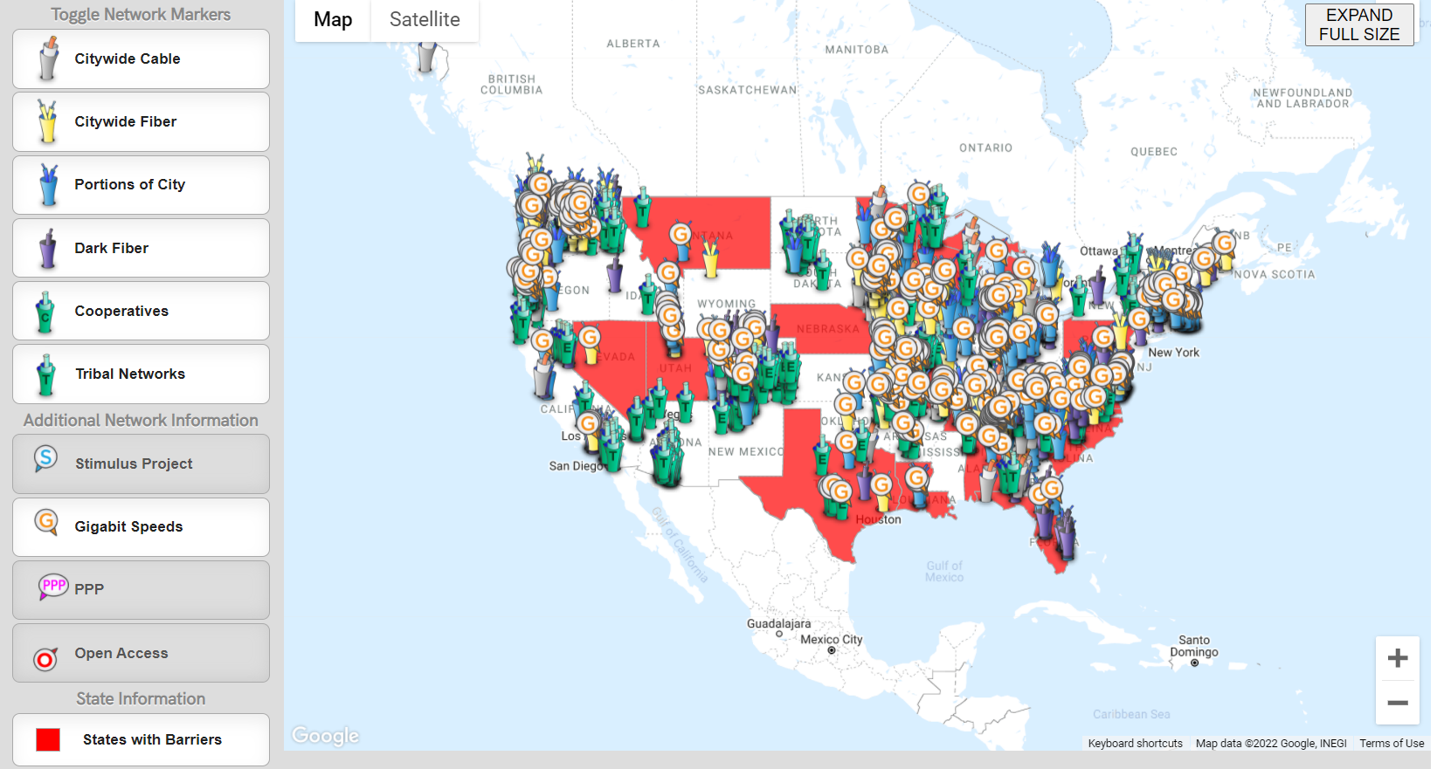
Community Network Map
Source: https://muninetworks.org/communitymap

Slide 64
Technological Advancements of the Future to the Rescue?
Low Earth Orbit (LEO) satellite internet
On June 13, 2020 Elon Musk’s SpaceX launched 58 satellites into low earth orbit as part of the Starlink program.
Aims to provide low-latency (less lag) satellite internet.
Better internet coverage than traditional communications satellites.
Could potentially provide high quality internet to homes and businesses without access to cable, fiber, or reliable cellular internet.

Slide 65
Enormous Economic Benefits to Access
Individual benefits:
Better health and life outcomes.
Access to health and education online.
Job search and development of digital skills.
Higher property values.
Increased population and job growth.
Higher rates of business formation.
Broader economic benefits:
World Bank
10% increase in access yields a 1.2% jump in real incomes.
Indiana
ROI = 300-400%.
Brookings; The Benefits and Costs of Broadband Expansion, Aug 18, 2021

Slide 66
Pace of Investment

Slide 67
Too Much, Too Soon? Too Little, Too Late?
Is the current infrastructure package appropriate?
The United States has enormous needs.
Basic infrastructure – bridges, roads, etc.
Other:
General R&D: 2% of GDP in the 1950s, currently 0.75%.

Slide 68
COVID Borrowing

Slide 69
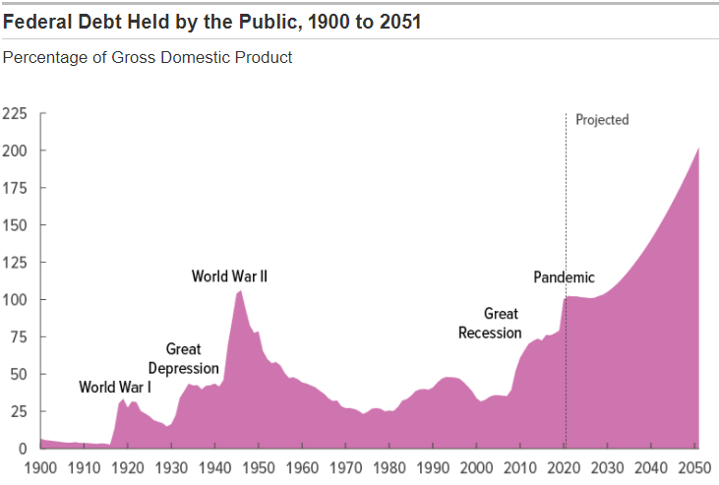
Debt Outlook is Troublesome
Source: Congressional Budget Office

Slide 70
Summary
Infrastructure investment is important
Current state of US infrastructure – leaves a lot to be desired for
Public infrastructure investment can play a vital role in long run growth
Improve mobility
Raise private capital productivity
Improve health
May not be ideal as short term stimulus
Private sector involvement via the market process will promote innovation and efficiency
Local access issues may sometimes be better resolved locally than federally
Reforms needed to make the process less cumbersome

Slide 71
Thank you!
Any Questions?
www.NEEDelegation.org
Mallika Pung, Ph.D.
MallikaPung@gmail.com
Contact NEED: info@NEEDelegation.org
Submit a testimonial: www.NEEDelegation.org/testimonials.php
Become a Friend of NEED: www.NEEDelegation.org/friend.php

