Slide 1
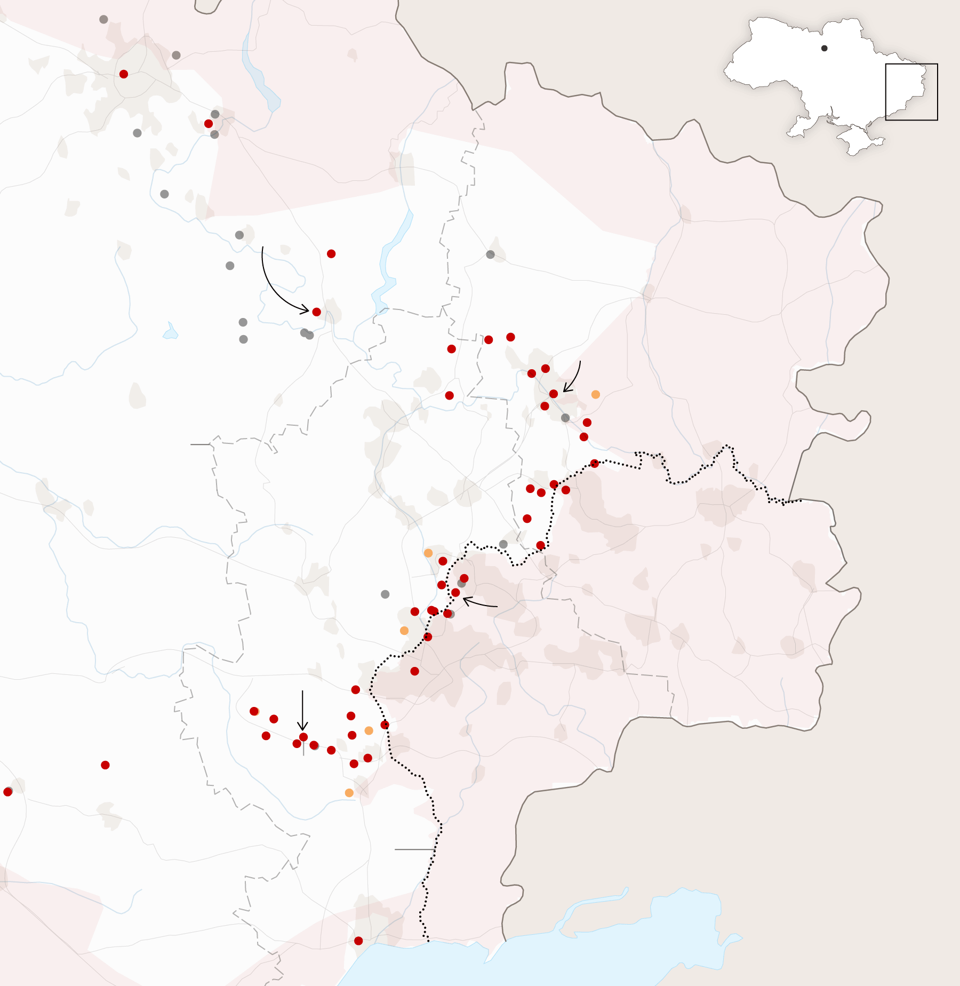
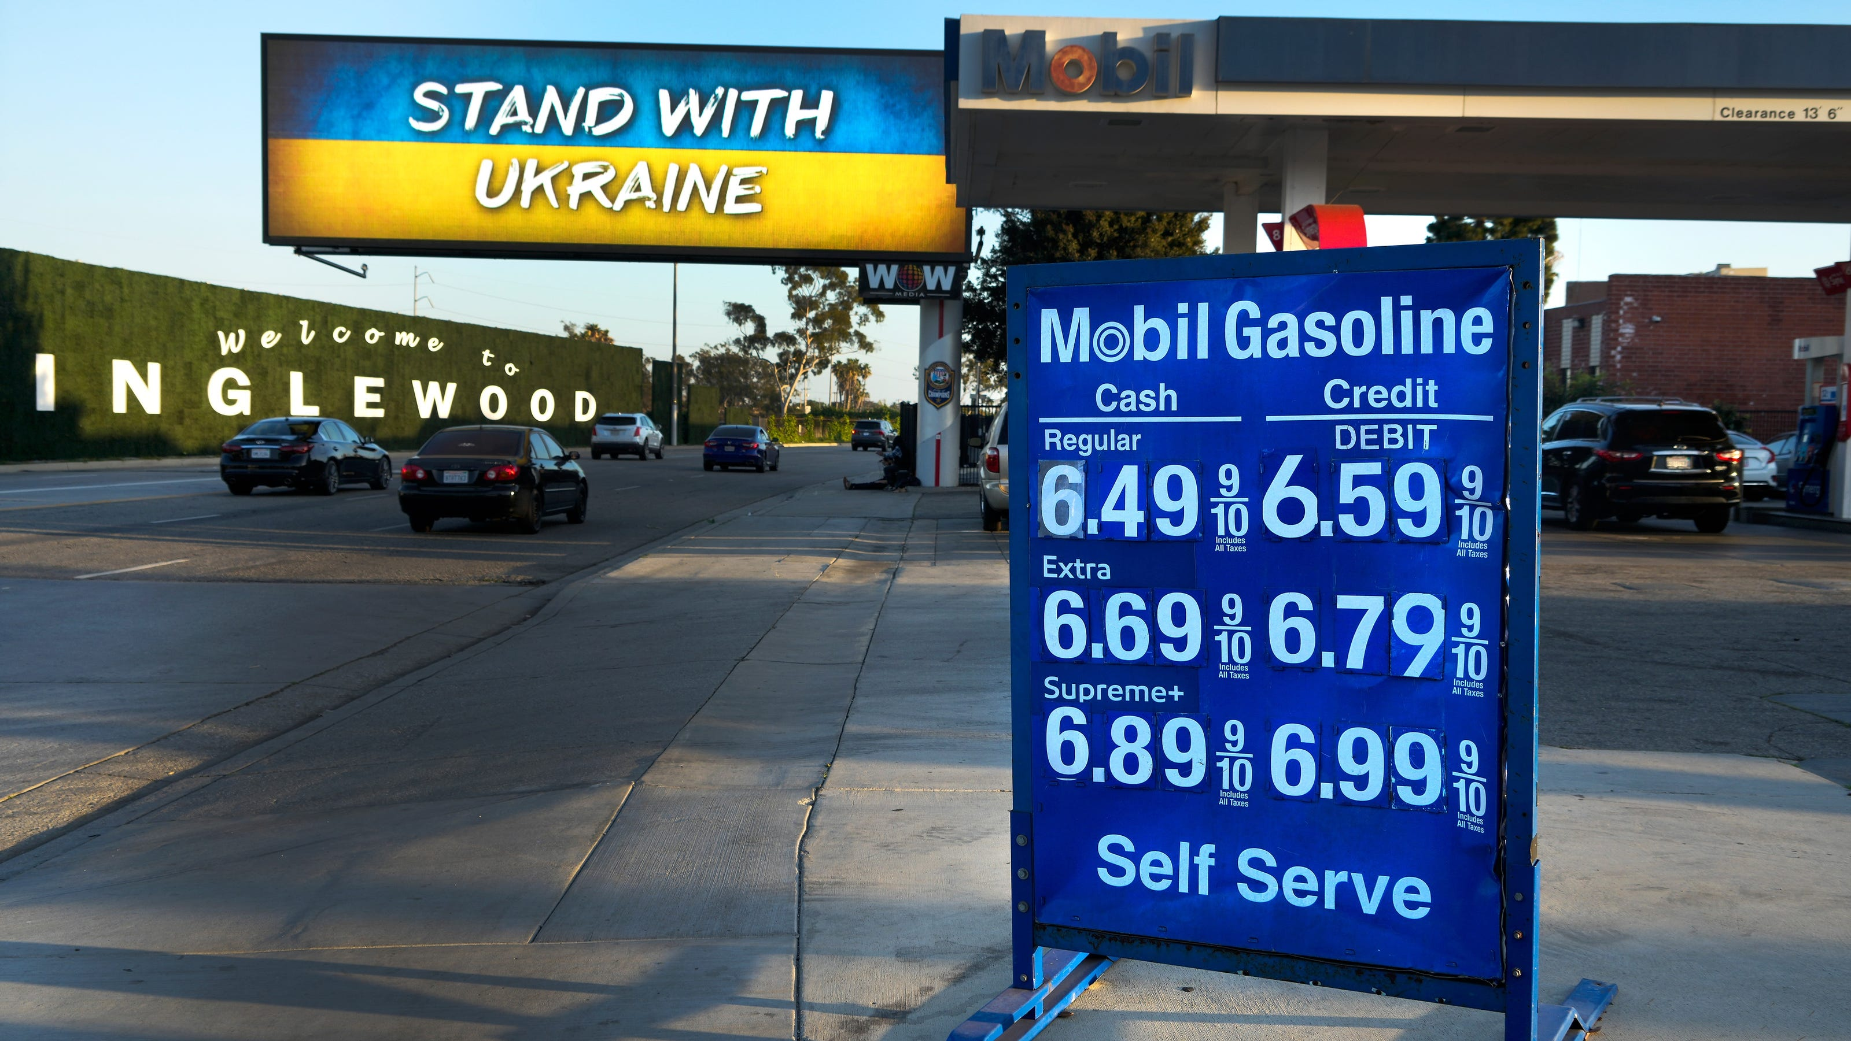
US Economy and
Russia/Ukraine Conflict
Ross Valley Rotary Club
May 11, 2022
Jon Haveman, Ph.D.

Slide 2
National Economic Education Delegation
Vision
One day, the public discussion of policy issues will be grounded in an accurate perception of the underlying economic principles and data.
Mission
NEED unites the skills and knowledge of a vast network of professional economists to promote understanding of the economics of policy issues in the United States.
NEED Presentations
Are nonpartisan and intended to reflect the consensus of the economics profession.

Slide 3
Who Are We?
Honorary Board: 54 members
2 Fed Chairs: Janet Yellen, Ben Bernanke
6 Chairs Council of Economic Advisers
Furman (D), Rosen (R), Bernanke (R), Yellen (D), Tyson (D), Goolsbee (D)
3 Nobel Prize Winners
Akerlof, Smith, Maskin
Delegates: 651+ members
At all levels of academia and some in government service
All have a Ph.D. in economics
Crowdsource slide decks
Give presentations
Global Partners: 49 Ph.D. Economists
Aid in slide deck development

Slide 4
Available NEED Topics Include:
Coronavirus Economics
US Economy
Climate Change
Economic Inequality
Economic Mobility
Trade and Globalization
Minimum Wages
Immigration Economics
Housing Policy
Federal Budgets
Federal Debt
Black-White Wealth Gap
Autonomous Vehicles
US Social Policy

Slide 5
Outline
The U.S. Economy
Inflation
Russia/Ukraine
Housing Markets

Slide 6
The U.S. Economy
The Role of the Pandemic versus Policy Adjustments? And what now?

Slide 7
GDP Trajectory: Pandemic Plunge!
GDP is:
$0.4 Trillion below 2019 forecast.
$0.6 Trillion ABOVE 2019-Q4 level.

Slide 8
GDP Trajectory: Pandemic Plunge!

Slide 9
Monthly Changes in Nonfarm Employment
Notes:
PAYEMS.png

Slide 10
Monthly Changes in Nonfarm Employment
Notes:
PAYEMS.png

Slide 11
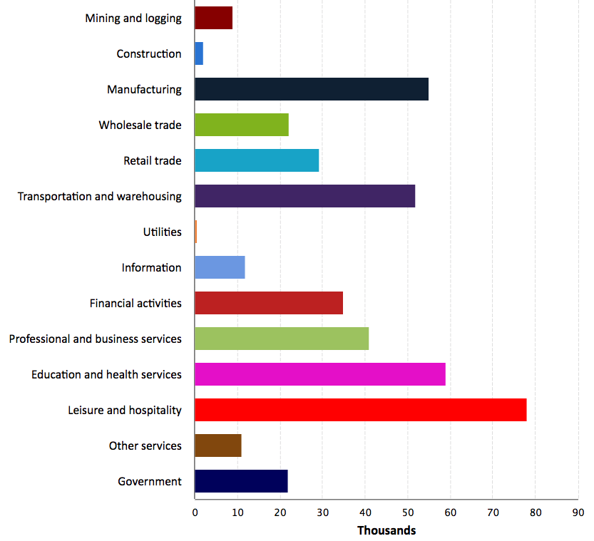
Employment Changes - US
Source: New York Times

Slide 12
Employment Gap
1.2 Million below February, 2020.
6.9 Million below where we should be.
Notes:
payroll_recent.png

Slide 13
Trends in Labor Force Participation
0.6 Million below February, 2020.
3.9 Million below where we should be.
Notes:
CLF16OV.png

Slide 14
Fiscally Driven Recovery

Slide 15
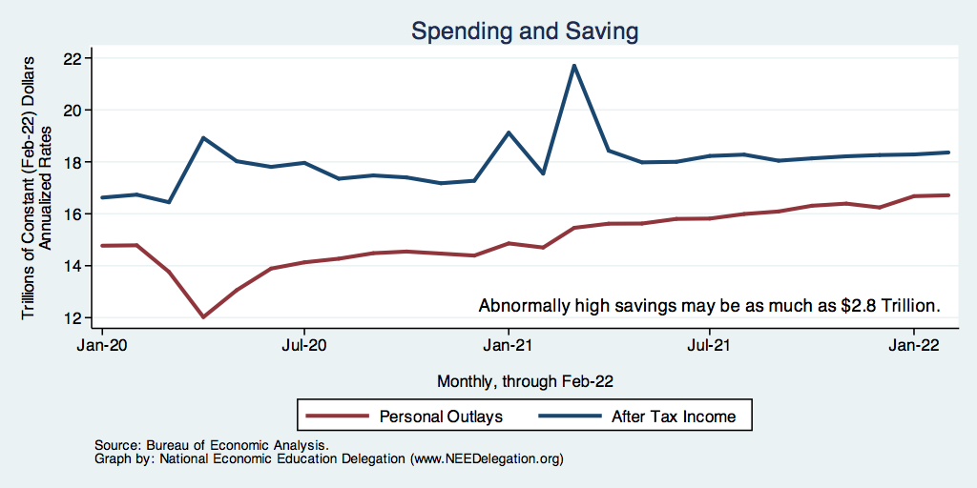
Households Lead the Way
Saving

Slide 16
Overall Households Are Doing Well

Slide 17
K-Shaped Recovery

Slide 18
Stimulus Payments Saved Low Income Families

Slide 19
Inflation

Slide 20
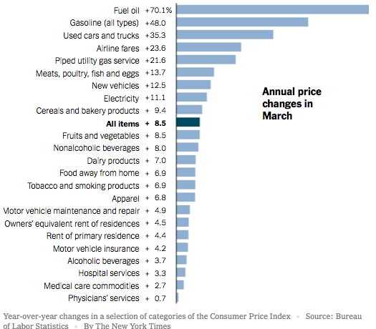
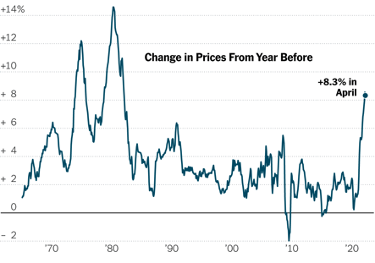
Inflation News
January 2022
Source: New York Times, Wall Street Journal
Notes:
Why CPI overestimates or underestimates inflation – COVID CPI should reflect a change in purchases. Covid CPI 6.54%

Slide 21
Food and Fuel are A Big Part of the Story

Slide 22
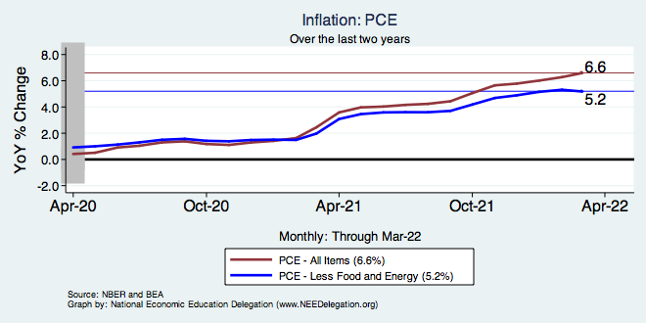
Inflation – The Fed’s Metric! Not Sooo High.
Notes:
Cpi_recent.png

Slide 23
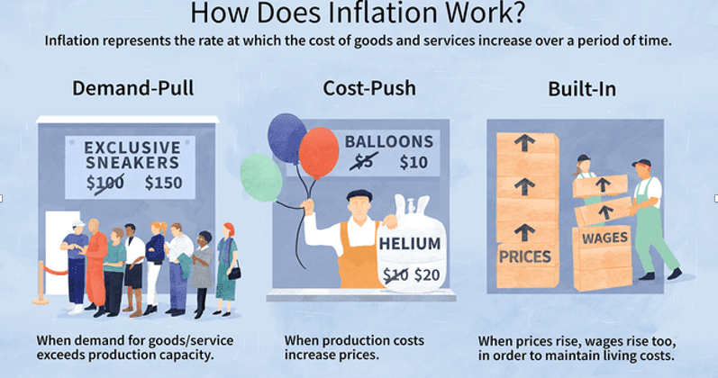
Source: Investopedia

Slide 24
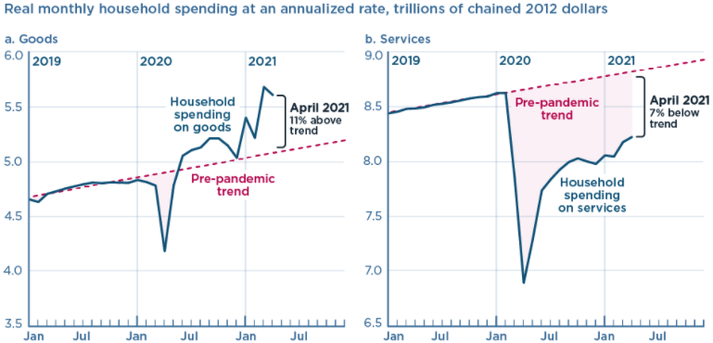
We’re Buying Mostly … Stuff
Demand-Pull
Source: Jason Furman, PIIE

Slide 25
Goods are Driving Inflation

Slide 26
Inflation: Concentrated
Cost-Push

Slide 27
Corporate Profits…Adding to Inflation?

Slide 28
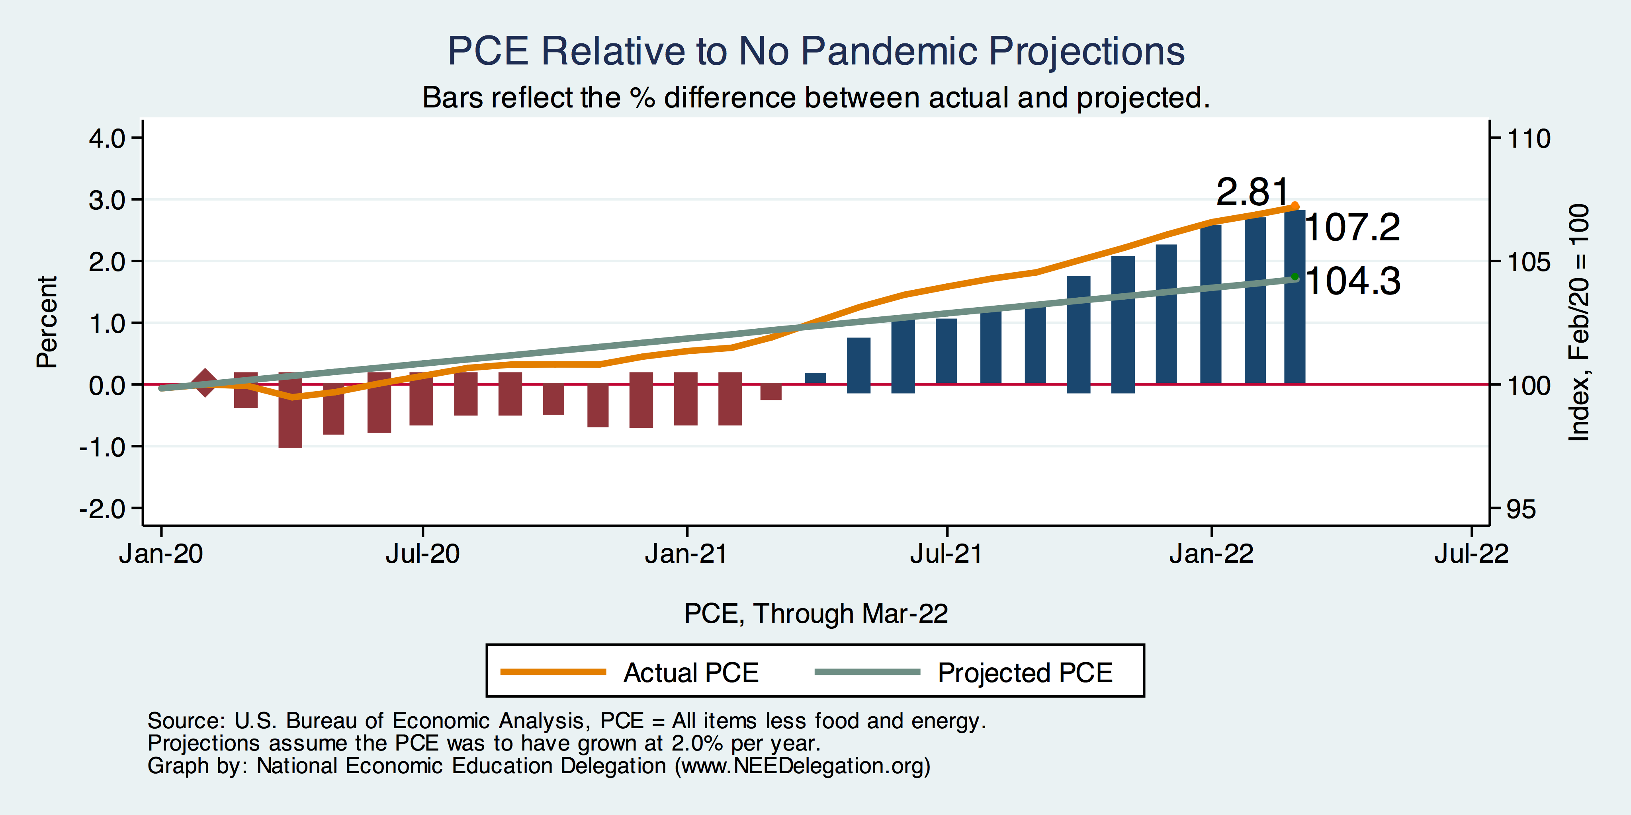
Inflation – PCE and Fed Suggest: I don’t know.
Notes:
Cpi_recent.png

Slide 29
This Inflation is Different!
12-month, percentage price increase, selected items in the CPI
Category: | Weight in CPI, 2022 | December 1981 | March 2022
All Items | 100% | 8.9 | 8.5
Services | 60.6 | 13.0 | 5.4
Commodities | 39.3 | 6.0 | 15.0
Housing | 42.2 | 10.2 | 6.8
Transportation | 18.3 | 11.0 | 23.2
Food | 14.3 | 4.3 | 8.5
Medical Care | 8.4 | 12.5 | 2.9
Energy | 7.5 | 11.9 | 33.3
Used Cars | 4.2 | 20.3 | 31.4
Sources: BLS and Fred data from the St Louis Federal Reserve Bank

Slide 30
My Diagnosis for the Uptick in Inflation
Yes, there were supply chain issues that affected some areas in particular (e.g., computer chips).
But there is too much total spending and in the absence of bold Fed actions is likely to continue.
Fiscal stimulus led households to increase saving over 2021 by more than $2 trillion. Strong retail sales numbers suggest they are prepared to spend it.
Whose to Blame: ARP probably too big, but the Fed could have acted sooner.

Slide 31
Measure of Inflation Expectations
Breakeven Inflation Rate = Difference between
nominal and real 5-year and 10-year Treasury
constant maturity securities.
Market participants expect around 2.8%
of inflation annually over the next 10 years and
3.1% over the next 5 years.
Inflation expectations are calming down.

Slide 32
Russia/Ukraine(/Belarus)

Slide 33
Consequences for the Global Economy
Primarily:
Oil
Wheat
Why?
Major suppliers of each
29% of world wheat production
20-40% of Europe’s oil and gas
Russia part of OPEC+
Russian and Ukranian combined economies are small.
Don’t forget Belarus.

Slide 34
The Conflict in Ukraine and the US Economy
Short run
Uncertainty
Recession?
Increase in cost of food and fuel
Long run
Decrease in globalization

Slide 35
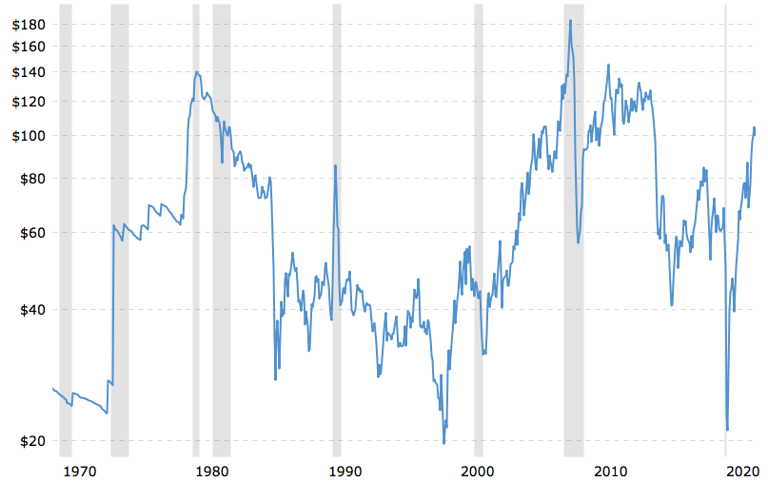
Supply Shocks: Then and Now
Historical Oil Price adjusted for Inflation.
$99.76 on May 10/22
Source: macrotrends.net

Slide 36
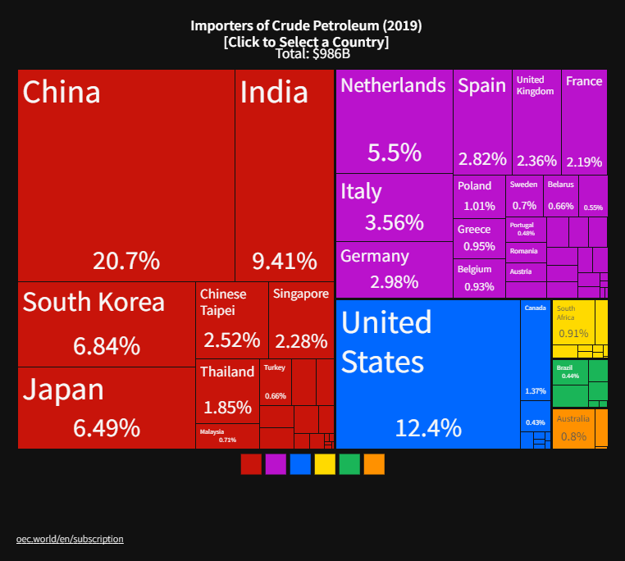
The Price of Oil is Likely to Rise (further)
Winners
Losers
Notes:
Since 2019 US has become a net exporter of oil

Slide 37
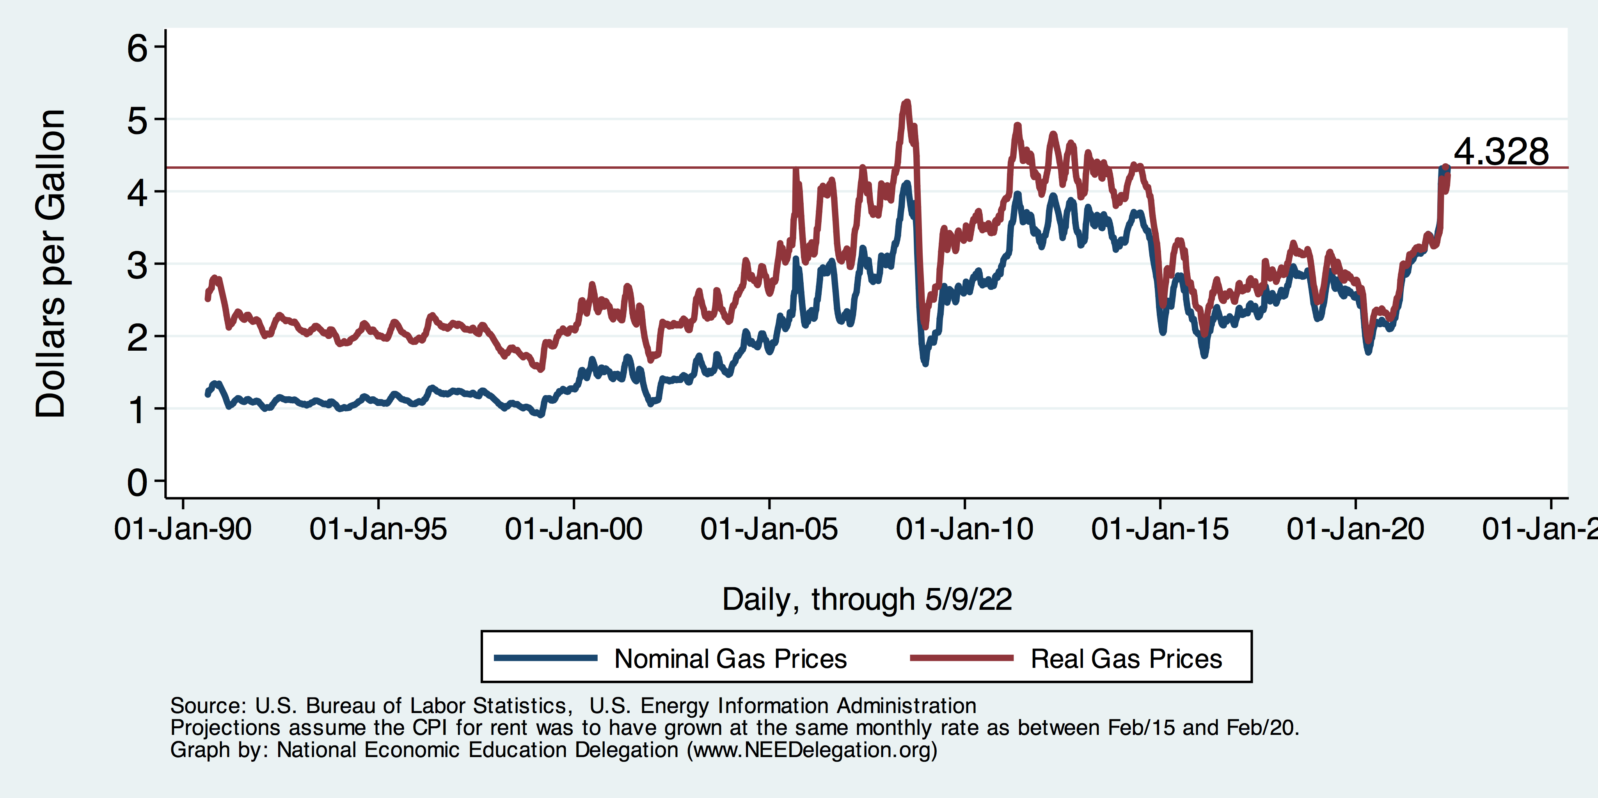
Gas Prices at the Pump

Slide 38
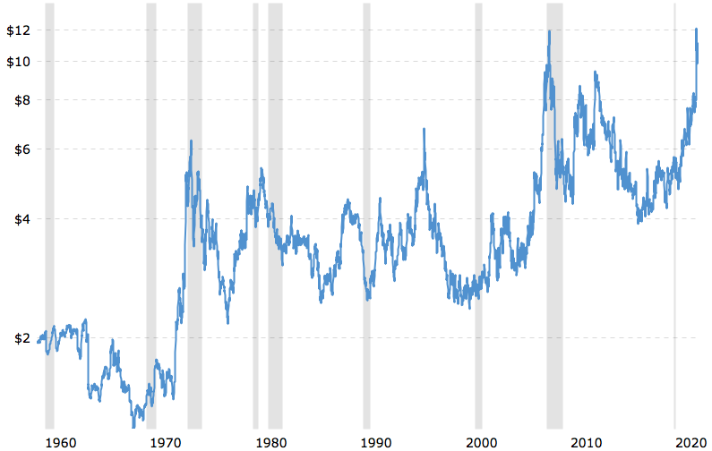
Wheat Prices Also Look Scary
Wheat Futures Prices
NOT Adjusted for inflation.
$10.93 on May 10/22.
Source: macrotrends.net

Slide 39
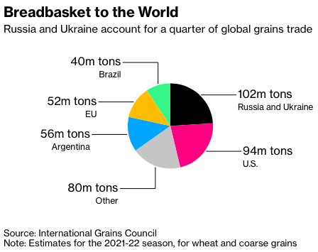
Grains
Notes:
https://www.bloomberg.com/news/articles/2022-03-02/wheat-soars-above-10-as-russia-invasion-stifles-black-sea-trade

Slide 40
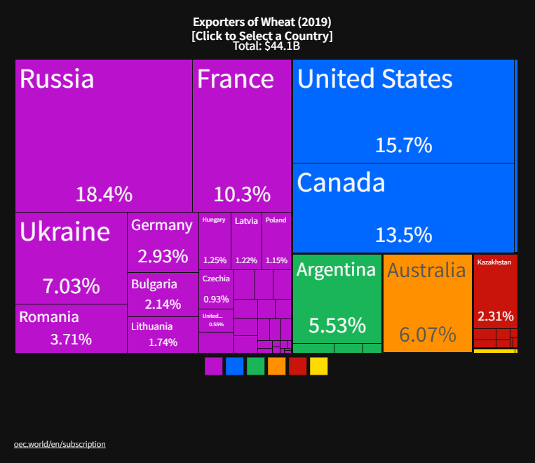
The Price of Wheat: Winners and Losers
Winners
Losers

Slide 41
Oh, and…
40% of the world’s PALLADIUM comes from Russia.
Used in catalytic convertors.
70% of the world’s NEON comes from Ukraine.
Used in production of semiconductors.
Fertilizer: Russia is the world’s largest supplier.
Prices are 3-4x their 2020 levels.
Therefore: more supply chain issues, more inflation, food insecurity.

Slide 42
Real Estate Prices

Slide 43
RE Experiences Differ!

Slide 44
Interest Rates are Rising!

Slide 45
Marin’s Home Price Position

Slide 46
Home Price Appreciation w/in Marin

Slide 47
Employment Situation: Marin County

Slide 48
Employment Situation: Marin County

Slide 49
www.NEEDelegation.org/LocalGraphs
For every state and county in the United States.
Detailed graphs on employment, housing, moves, and other statistics.

Slide 50
Conclusion
GDP will likely expand about 4% in 2022.
Completing the recovery.
Employment is still lagging.
Real estate markets likely to cool.
Physical health determines economic health for the economy.
Variants may slow our progress: Omicron BA.2 (see Europe and China)
Gov’t missteps may also hinder progress.
Biggest problems:
Supply chain bottlenecks.
Labor force participation.
Russian invasion of Ukraine.
There is much uncertainty.

Slide 51
Thank you!
Any Questions?
www.NEEDelegation.org
Jon D. Haveman
Jon@NEEDelegation.org
Contact NEED: info@NEEDelegation.org
Submit a testimonial: www.NEEDelegation.org/testimonials.php
Become a Friend of NEED: www.NEEDelegation.org/friend.php

