Slide 1
Prospects for Inflation
The Kiawah-Seabrook Exchange Club
February 16, 2022
Geoffrey Woglom
Richard S. Volpert Professor of Economics (emeritus)
Amherst College

Slide 2
Outline for the Talk
A little background on the Fed and how it affects the economy.
The importance of “well-anchored” inflationary expectations.
Recent economic performance and my explanation for why the Fed has been slow to react.
Dangers that lie ahead.

Slide 3
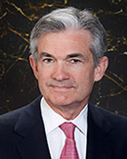
Stabilizer in Chief: the Fed
The Fed’s Dual Mandate:
“Stable prices” which means 2% rate of inflation in the Personal Consumption Price Index (which corresponds to about 2.5% inflation in the more well-known CPI).
“Maximum employment” which means the highest level of employment (lowest unemployment rate) consistent with mandate 1.
Fiscal Policy (taxes and spending, President and the Congress) can affect inflation and unemployment, but it is the Fed’s job to achieve the dual mandate
Jerome Powell
February 2018
Notes:
Define inflation as the rate of increase in the average level of prices not gasoline price inflation. Exceptions Deep Recesssions. ARP we will talk about later.

Slide 4
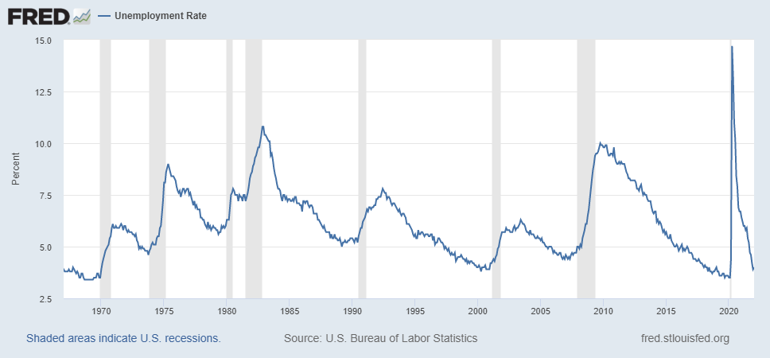
Track Record on Unemployment
Shaded Bars are Recessions
Notes:
Define natural 3 episodes. Great Moderation

Slide 5
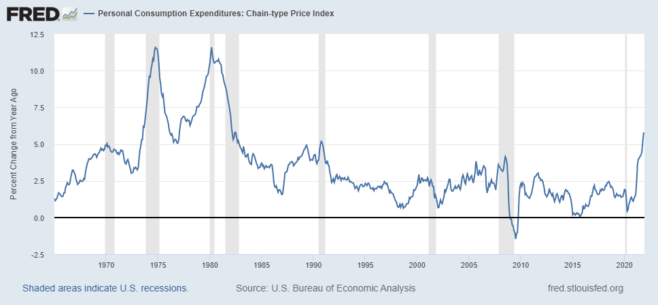
Track Record on “Price Stability”
Notes:
Shaded lines are recessions . 1970S THE Great Moderation

Slide 6
Determinants of Unemployment & Inflation
Unemployment: The higher the level of total spending (“aggregate demand”), the lower the unemployment rate.
Inflation:
Too much spending and inflation rises (Vietnam).
Increase in production costs (e.g., “supply chain bottlenecks.”)
Expectations of high inflation can cause inflation to be high.
Notes:
Slides 4 and 5, then back to 7

Slide 7
The Fed’s Affects the Economy via Interest Rates
Higher Interest rates discourage firms from buying new plant and equipment, households from buying new homes and tend to lower stock and house prices (!).
Reduced spending tends to lower production and employment and eventually lowers inflation.

Slide 8
Become a Central Banker in One Slide!
If you are more concerned that inflation is too high, raise interest rates.
If you are more concerned that unemployment is too high, lower interest rates.
Inflation and unemployment just right: keep rates the same.

Slide 9
One Big Complication: Lags
Milton Friedman: Monetary Policy affects GDP and Inflation with Long and Variable (Unpredictable) Lags.
Raising interest rates today does nothing to spending today nor to inflation.
But over time spending slows and eventually inflation falls.
Friedman believed that lags led to the Fed to “oversteering” the economy consistently.

Slide 10
The Great Moderation
From 1990 until 2008, the performance of the US economy was extraordinary and even Milton Friedman gave kudos to the Alan Greenspan.
We (economist) thought we knew why: Central Bankers finally listened to us on the importance of stabilizing inflationary expectations, starting with Paul Volcker.
Volcker was determined to reduce inflationary expectations.
Notes:
Back to slide 4 and then on to 12

Slide 11
“Anchoring” Inflation Expectations
Forecasts: Philadelphia Fed, “Survey of Professional Forecasters”
Notes:
Livingston Survey. 75-78. Unemployment 7% and 6% inflation. Look at the stability in the post 2001 period and the 2003-2005 period

Slide 12
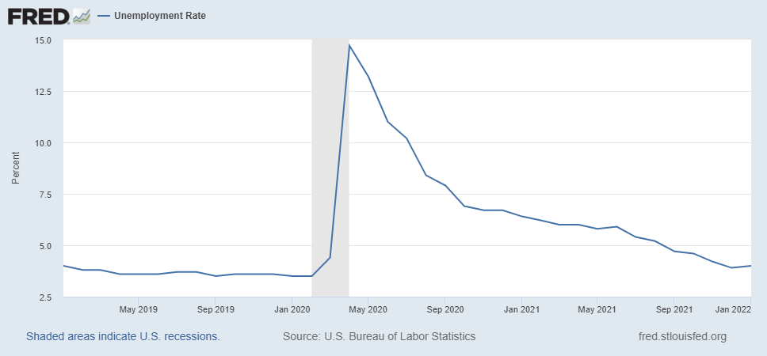
A Closer Look Has the Fed Been Doing Recently?
Unemployment Rate
Notes:
During 2021 the Fed’s measure increased by 5.8%, CPI by 7.5

Slide 13
My Diagnosis for the Uptick in Inflation
Yes, there were supply chain issues that affected some areas in particular (e.g., computer chips).
But there is too much total spending and in the absence of bold Fed actions is likely to continue.
Fiscal stimulus led households to increase saving over 2021 by more than $2 trillion and today’s strong retail sales numbers suggest they are prepared to spend it.
Whose to Blame: ARP probably too big, but the Fed could have acted sooner.

Slide 14
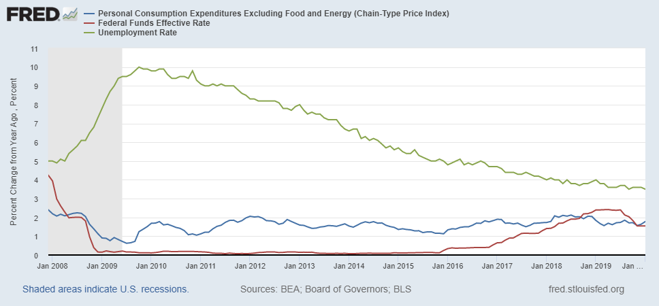
Why Did Powell Do It?
Powell Replaces
Yellen as Chair
Notes:
On average inflation is less than 2% And Fred raises rates before inflation exceeds 2.%. But, very credible. Latest tightening was begun before Powell became Chair. Tightening is very gradual 1.5 pct pts in 2 years.

Slide 15
Policy Changes under Powell
In the Fed’s dual mandate put more emphasis on the employment goal relative to the inflation goal.
Inflation goal switched from targeting forecasted future inflation to trying to achieve average realized inflation of 2%
Have they forgotten about Lags!
Notes:
Description of Policy goals reversed the order of the inflation and employment objectivesw

Slide 16
So Far Inflationary Expectations Look Stable
Professional forecasters, financial markets and the Fed itself think that inflation in 2022 will be in the 2.5-3%, range
Variable: | Median Fed Forecasts from 12/15/21 FOMC Meeting
 | 2022 | 2023 | 2024 | Longer run
Unemployment rate | 3.5 | 3.5 | 3.5 | 4.0
Inflation | 2.6 | 2.3 | 2.1 | 2.0
Interest rate | 0.9 | 1.6 | 2.1 | 2.5

Slide 17
Latest Fed Readings
The Minutes of the FOMC meeting 3 weeks ago were released today at 2PM.
Most participants suggested that a faster pace of increases in the target range for the federal-funds rate than in the post-2015 period would likely be warranted.
Most participants noted that, if inflation does not move down as they expect, it would be appropriate for the Committee to remove policy accommodation at a faster pace than they currently anticipate.

Slide 18
If Expectations Start to Increase
The Fed will have a very difficult choice
Raise interest rates a lot (in an election year) to slow inflation
stalling the recovery.
disrupting financial markets.
Raise interest rates slowly and moderately to cushion the effect on employment
avoids a recession (maybe).
inflationary expectations become unanchored

Slide 19
More Information
Slides will be available the NEED web site tomorrow (www.NEEDelegation.org)
Similar analysis in today’s WSJ, “The Fed Missed Inflation. Can Jay Powell Tame It Without Causing a Recession?” (https://www.wsj.com/articles/behind-the-feds-slow-pivot-to-tackling-inflation-11644930180?page=1)

Slide 20
Who Are We?
Honorary Board: 54 members
2 Fed Chairs: Janet Yellen, Ben Bernanke
6 Chairs Council of Economic Advisers
Furman (D), Rosen (R), Bernanke (R), Yellen (D), Tyson (D), Goolsbee (D)
3 Nobel Prize Winners
Akerlof, Smith, Maskin
Delegates: 649+ members
At all levels of academia and some in government service
All have a Ph.D. in economics
Crowdsource slide decks
Give presentations
Global Partners: 45 Ph.D. Economists
Aid in slide deck development

Slide 21
National Economic Education Delegation
Vision
One day, the public discussion of policy issues will be grounded in an accurate perception of the underlying economic principles and data.
Mission
NEED unites the skills and knowledge of a vast network of professional economists to promote understanding of the economics of policy issues in the United States.
NEED Presentations
Are nonpartisan and intended to reflect the consensus of the economics profession.

Slide 22
Available NEED Topics Include:
Coronavirus Economics
US Economy
Climate Change
Economic Inequality
Economic Mobility
Trade and Globalization
Minimum Wages
Immigration Economics
Housing Policy
Federal Budgets
Federal Debt
Black-White Wealth Gap
Autonomous Vehicles
US Social Policy

Slide 23
Let’s Hear from You!
Geoffrey Woglom
grwoglom@amherst.edu
Contact NEED: Info@NEEDelegation.org
Submit a testimonial: www.NEEDelegation.org/testimonials.php
Support NEED: www.NEEDelegation.org/donate.php

Slide 24
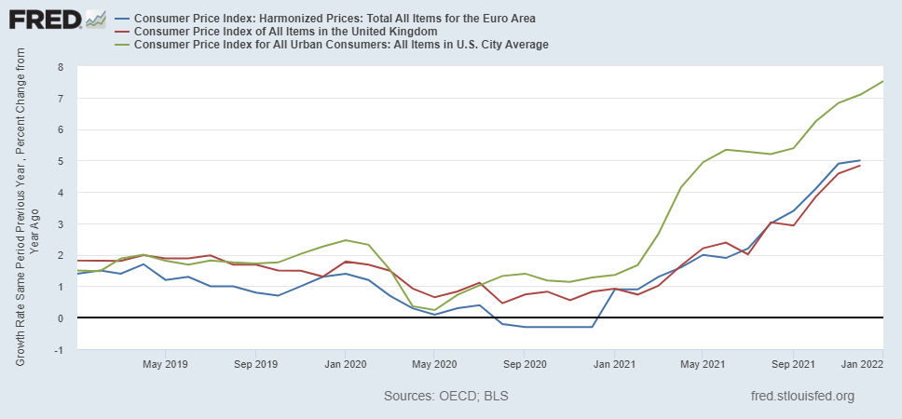
Inflation in 3 Areas

Slide 25
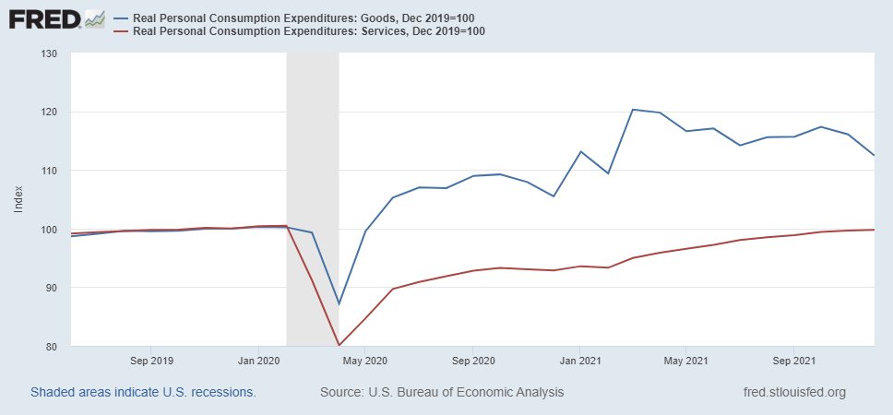
What about Supply Chain Disruptions?
Notes:
Too much spending in the economy.

Slide 26
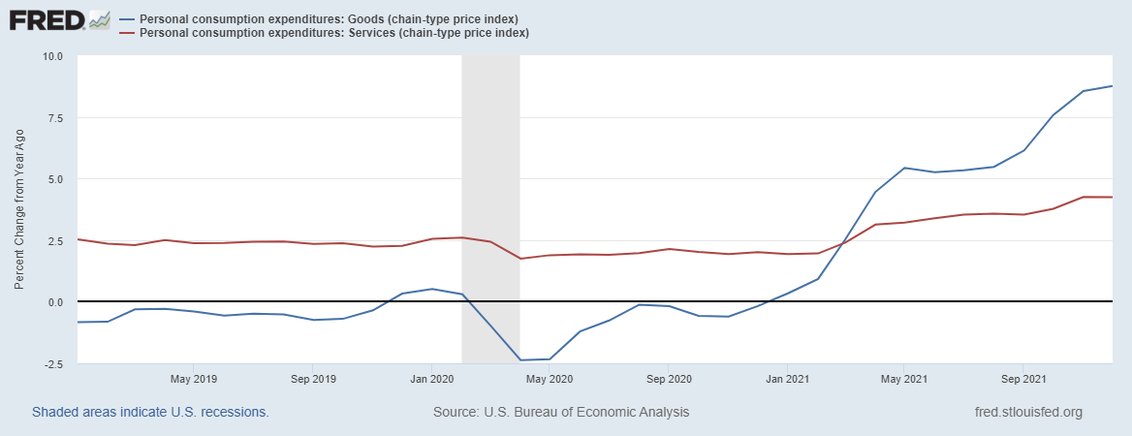
Macro Imbalances & Inflation
Notes:
Explain why economists expects slowing inflation

Slide 27
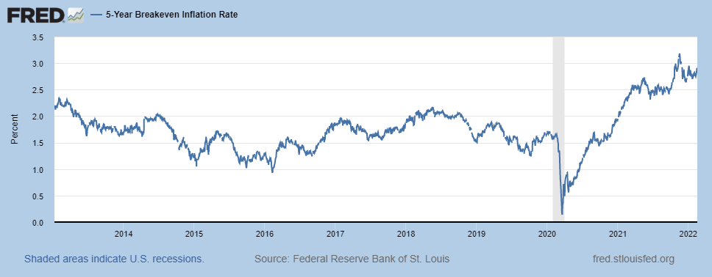
The Bond Market’s Take on Inflation

Slide 28
Consumer Demand is Still Strong

