Slide 1


Economic Inequality
Kiwanis of San Jose
March, 2021
Adina Ardelean, Ph.D.

Slide 2
National Economic Education Delegation
Vision
  One day, the public discussion of policy issues will be grounded in an accurate perception of the underlying economic principles and data.
Mission
  NEED unites the skills and knowledge of a vast network of professional economists to promote understanding of the economics of policy issues in the United States.
NEED Presentations
  Are nonpartisan and intended to reflect the consensus of the economics profession.

Slide 3
Who Are We?
Honorary Board: 53 members
  2 Fed Chairs: Janet Yellen, Ben Bernanke
  6 Chairs Council of Economic Advisers
    Furman (D), Rosen (R), Bernanke (R), Yellen (D), Tyson (D), Goolsbee (D)
  3 Nobel Prize Winners
    Akerlof, Smith, Maskin
Delegates: 585+ members
  At all levels of academia and some in government service
  All have a Ph.D. in economics
  Crowdsource slide decks
  Give presentations
Global Partners: 44 Ph.D. Economists
  Aid in slide deck development

Slide 4
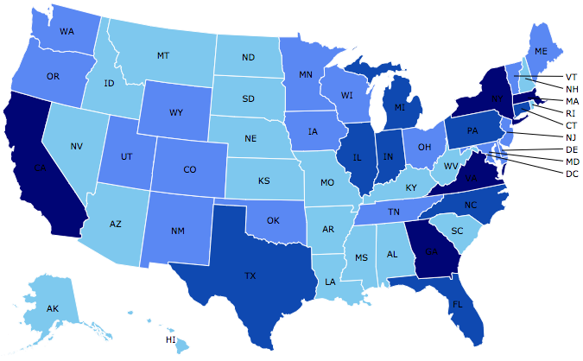
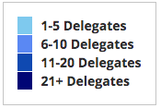
Where Are We?

Slide 5
Credits and Disclaimer
This slide deck was authored by:
  Jon Haveman, Executive Director of NEED
This slide deck was reviewed by:
  Timothy Smeeding, University of Wisconsin
  Robert Wright, Augustana University
Disclaimer
  NEED presentations are designed to be nonpartisan
  It is, however, inevitable that the presenter will be asked for and will provide their own views
  Such views are those of the presenter and not necessarily those of the National Economic Education Delegation (NEED)

Slide 6
Notes:
https://fivethirtyeight.com/features/many-americans-think-economic-inequality-is-a-problem-just-not-the-most-pressing-one/

Slide 7
Outline
Definition
What happened?
Does it matter?
Is it a problem?
What to do about it

Slide 8

Income Inequality
Definition:
  The extent to which the distribution of income deviates from complete equality
  The dispersion of income throughout the economy

Slide 9
Different Ways of Thinking About Inequality
Income Inequality
  Before taxes and transfers
  After taxes and transfers
Wealth Inequality
Consumption Inequality

Slide 10
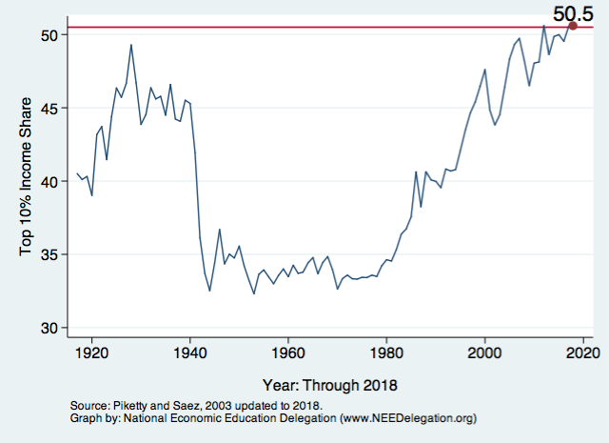
National Income Inequality: Share of Top 10%
Stock Market Crash
WWII
Housing Bubble
Dot-com Bubble

Slide 11

Most of the Action Is at the Top: Pre-Tax
Projected 2021
CBO: Projected Changes in the Distribution of Household Income, 2016 to 2021

Slide 12
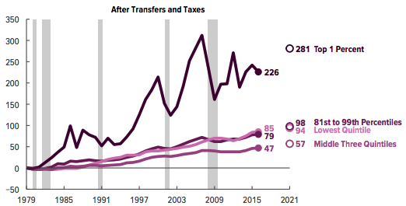
Most of the Action Is at the Top: After-Tax
Projected
CBO: Projected Changes in the Distribution of Household Income, 2016 to 2021

Slide 13
Wealth Inequality Exceeds Income Inequality
Source: Chad Stone, Danilo Trisi, Arloc Sherman, and Roderick Taylor, “A Guide to Statistics on Historical Trends in Income Inequality,”
Center on Budget and Policy Priorities, Policy Futures, May 15, 2018, page 15, Figure 4.

Slide 14
Racial Wealth Inequality
Source: How to fix Economic Inequality?, Peterson Institute of International Economics, 2020

Slide 15
Outline
Definition
What happened?
Does it matter?
Is it a problem?
What to do about it

Slide 16
Where Does Inequality Come From?
Labor Characteristics
  Demographics
    Age distribution
  Personal Choices
    Educational attainment
    Household composition
  Immigration
Market Forces
  Technology
  Globalization
  Competition for labor
Government Policy
  Market influence
  Redistribution

Slide 17
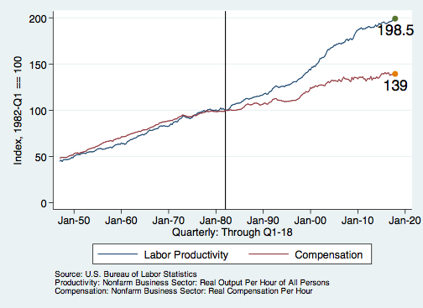
Labor Income is Unhinged from Productivity
Why?
Declining unionization
Globalization
Immigration
Competition policy
Cheap technology

Slide 18
Sources of Inequality Through Late 1990s

Slide 19
Government Policy and Inequality
Market Influence: PRE-distribution
  Characteristics of labor
    Access to education
  Effects on labor demand
    Market regulation
      Competition policy
    Labor regulations
      Minimum wage, overtime, health insurance, etc.
RE-distribution
  Tax Rates
  Income support
    Direct aid
    Food stamps

Slide 20
Tax and Transfer Programs and Inequality
2014
Source: U.S. Congressional Budget Office, “The Distribution of Household Income, 2014”, Average Income Before and After Means-Tested Transfers and
Federal Taxes, by Income Group, 2014.

Slide 21
What About Tax Rates?
400 Taxpayers with highest incomes
1992-2007
+
392%
1992-2014
Average
Tax Rate
+310%
Average
Income
-12%
-
37%
Source: IRS
Source: IRS, Statistics of Income Division, December 2016.

Slide 22

Dramatically Less Progressivity in the Tax Code
1961 to 2011
Source: New York Times, from Thomas Piketty, Emmanuel Saez and Gabriel Zucman, “
Distributional National Accounts: Methods and Estimates for the United States”

Slide 23
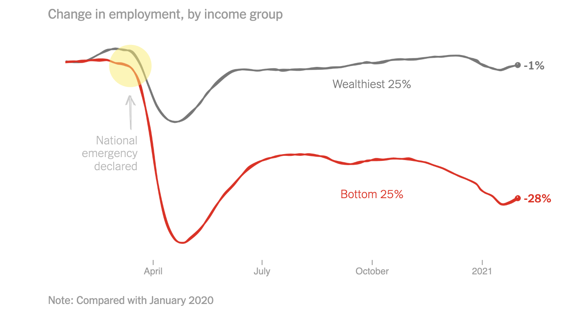
The Coronavirus crisis
400 Taxpayers with highest incomes
1992-2007
+
392%
Average
Tax Rate
Average
Income
-
37%
Source: IRS
Source: The New York Times, March, 2021

Slide 24
Outline
Definition
What happened?
Does it matter?
Is it a problem?
What to do about it

Slide 25

Why Does Inequality Matter?
Too little inequality can:
  Reduce individual motivation
  Slow economic growth
Too much inequality can:
  Slow growth
  Reduce individual motivation
Too much inequality may also:
  Divide society
  Distort political environment
  Reduce political participation
  Reduce investments in public goods
    Education
    Environmental protections

Slide 26
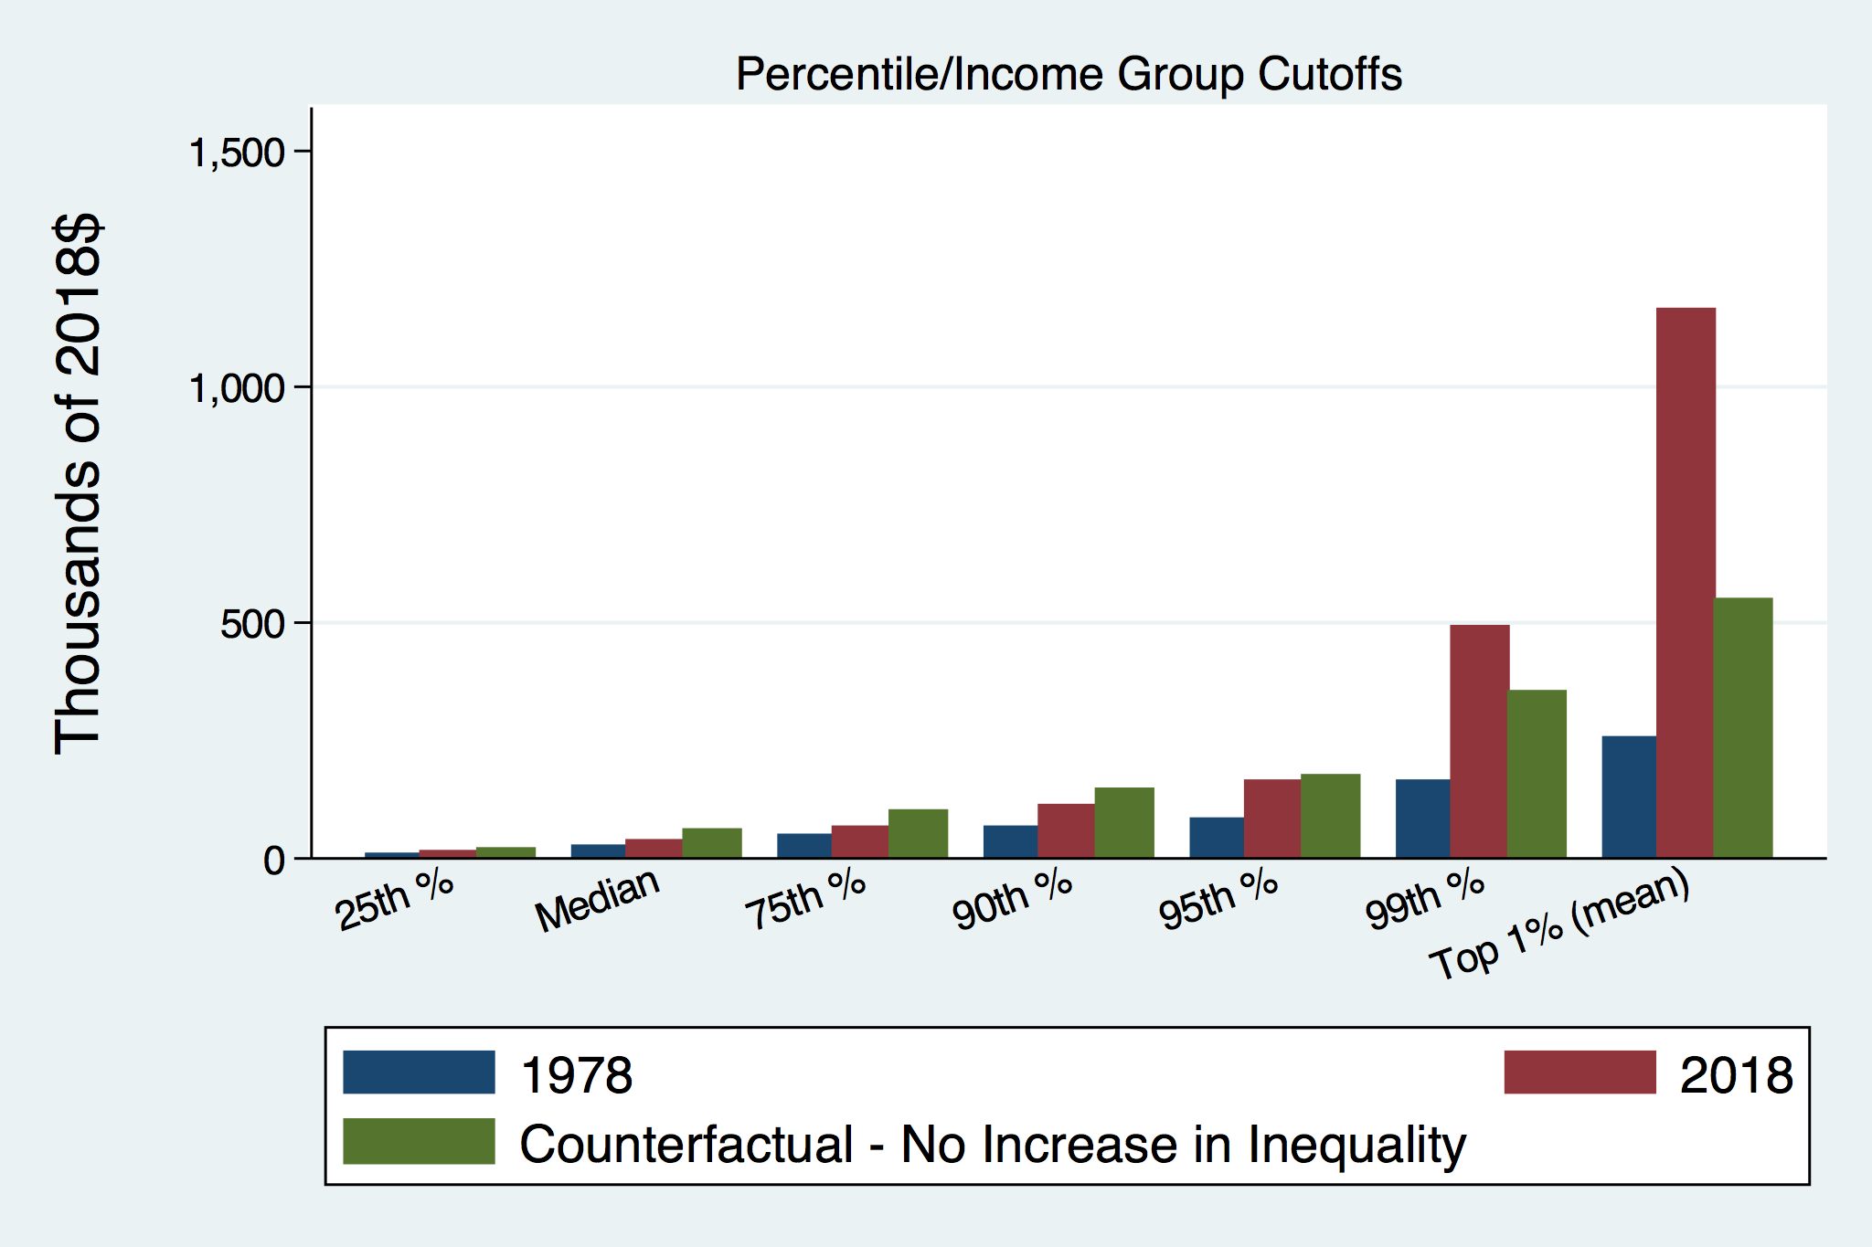
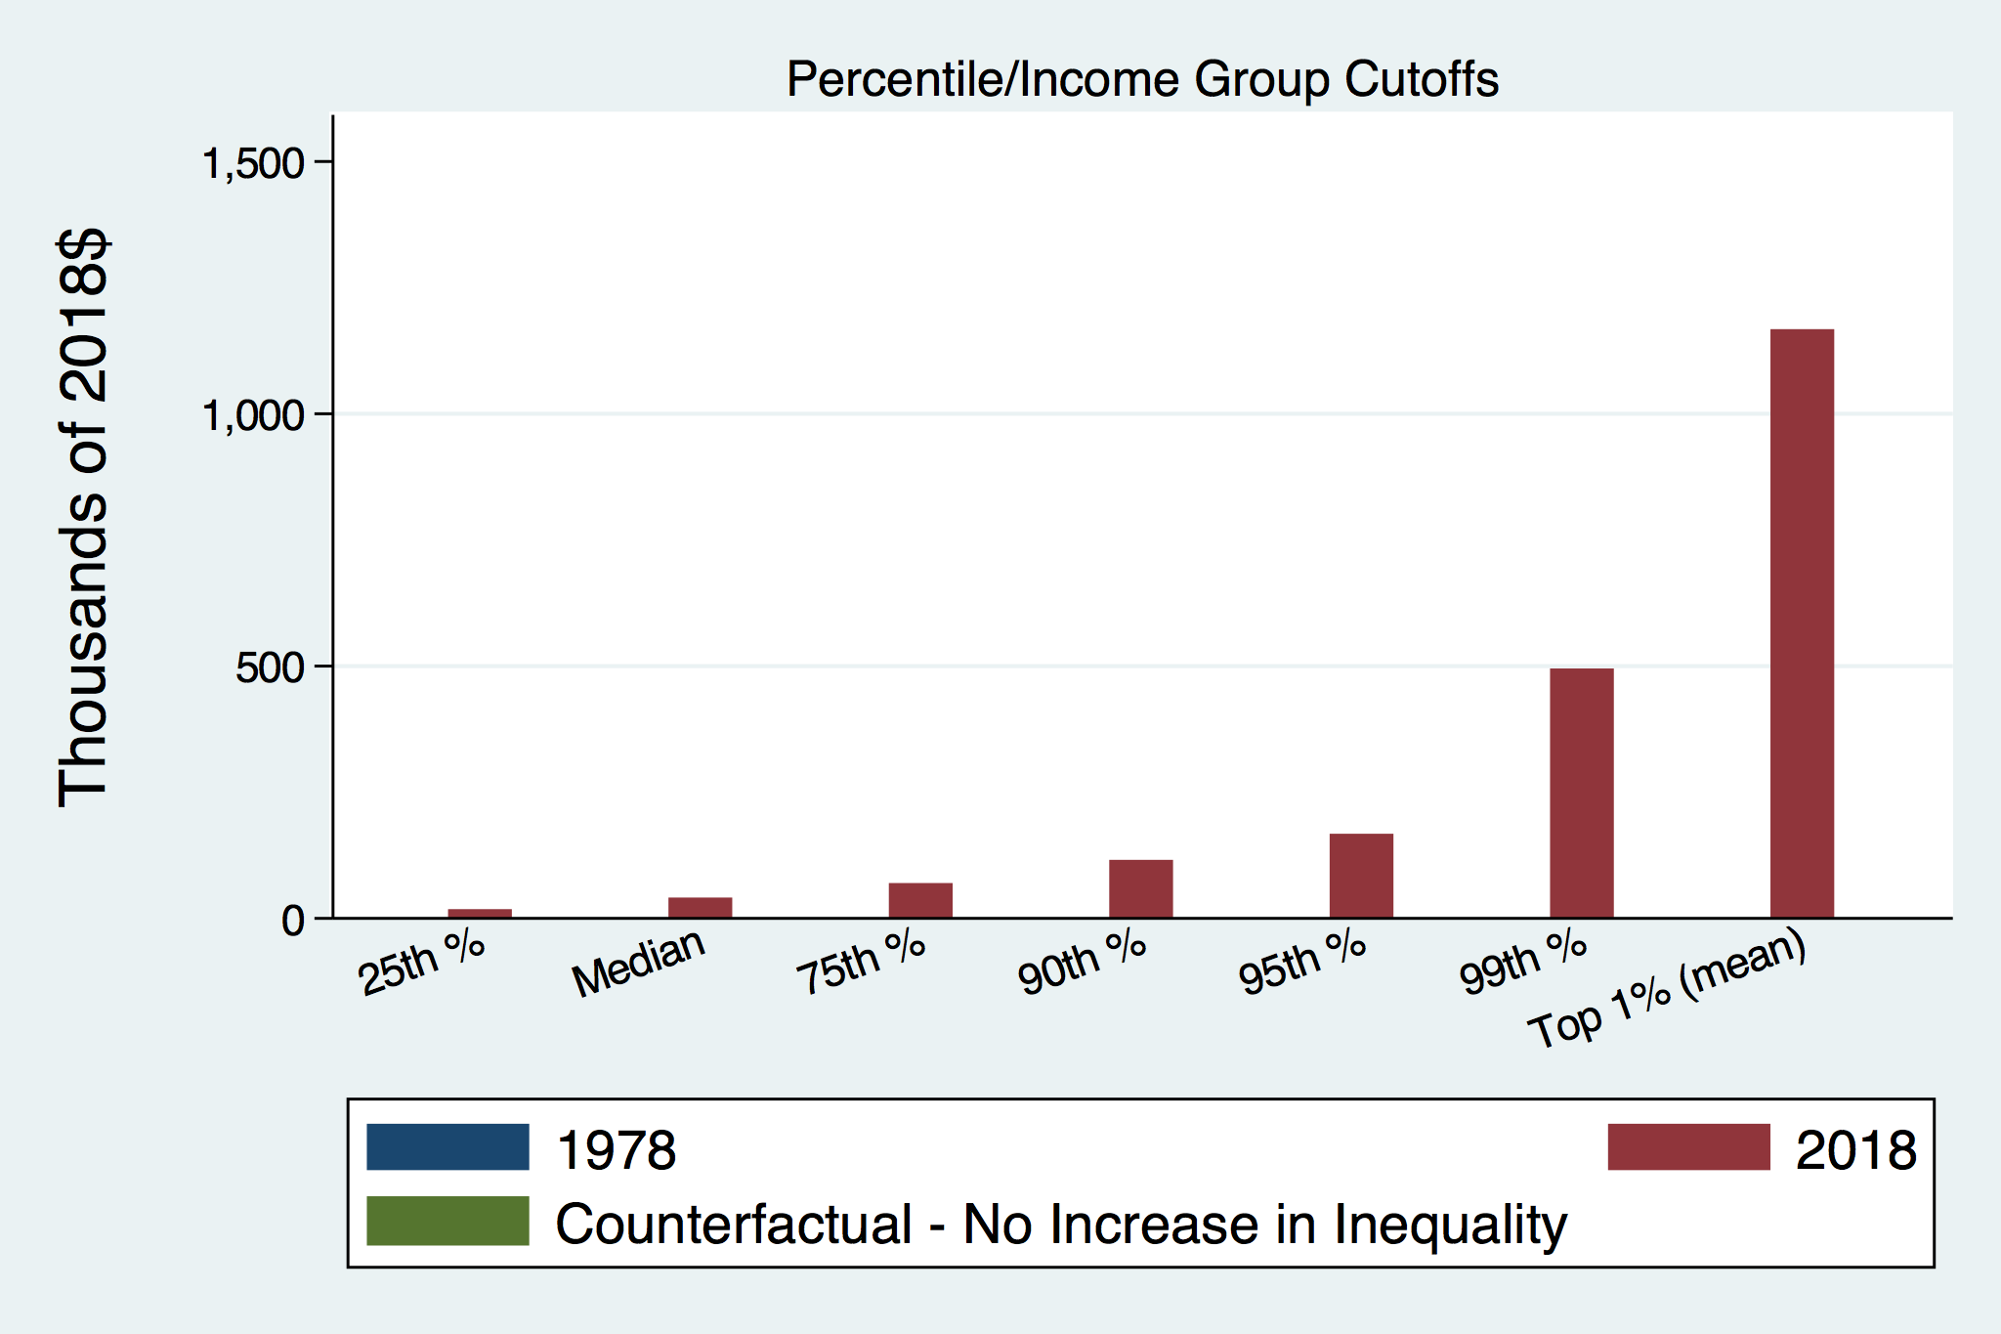
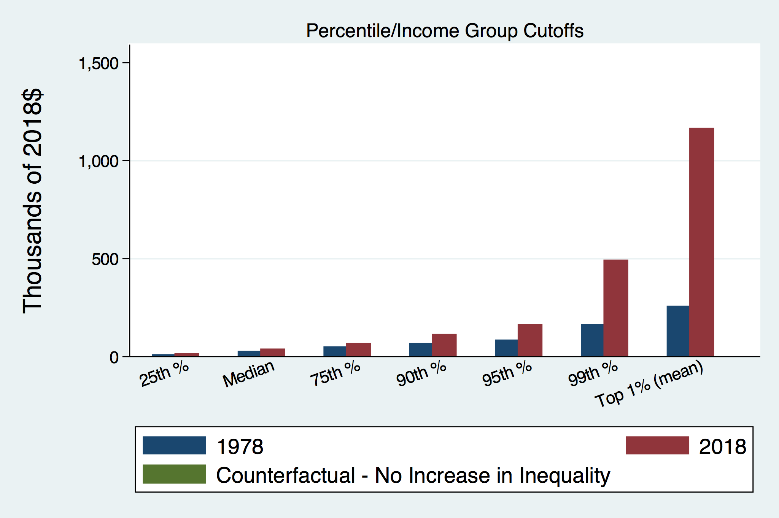
How Has Inequality Influenced Incomes?

Slide 27
The American Dream is fading
Percent of US children earning more than their parents at age 30 by year of birth, 1940-1984
Source: How to fix Economic Inequality?, Peterson Institute of International Economics, 2020

Slide 28
An International Perspective: Comparables

Slide 29
Outline
Definition
What happened?
Does it matter?
Is it a problem?
What to do about it

Slide 30

Addressing Inequality:
Immediately Available Policy Solutions (1/2)
Redistribution (Tax and Social Safety Net Policies)
  Tax and transfer programs
PRE-distribution (Labor Policies)
  Strengthen labor unions
  Minimum wages
  Collective bargaining
  Other policies that favor labor over business owners

Slide 31
Addressing Inequality:
Immediately Available Policy Solutions (2/2)
Corporate Regulation Policies
  Reverse trends in market power
Locally
  Employment services: job training, interview skills, or assistance with day-to-day issues, such as child care
  Cognizance of the potential for technologies to affect worker/employer power dynamics
    Uber, Lyft, etc.
Notes:
Reference your own experience at FTC

Slide 32
Addressing Inequality:
Long Term
It’s all about access to resources:
  Education, in particular
    Improve public education
    Reduce disparities in quality of public education
    Improve counseling in low-income schools
      With respect to college – paths to success and funding
    Investments are needed in early education, not later (e.g. universal pre-k)
  Opportunities for wealth-building
  Housing
Initiatives whose impacts cross neighborhood and class lines and increase upward mobility specifically for black men
  Mentoring programs for black boys, efforts to reduce racial bias among whites, interventions to reduce discrimination in criminal justice, and efforts to facilitate greater interaction across racial groups.

Slide 33
Tension in Policy Solutions
Is it possible to increase growth at the same time that you reduce income inequality?
  Common refrain among some that government intervention in the economy is always and everywhere bad for growth.
Possibly: expanding equality of access promotes the full utilization of resources.
  Expanding equality of access requires resources likely from the well-to-do.

Slide 34
Summary
Income inequality is clearly increasing.
  The economy is clearly favoring owners of productive resources over labor.
The causes appear to be largely driven by:
  The market – technology, competition, and trade
  Changing institutions.
Open questions are:
  To act or not to act?
  If so, how?
The level of inequality is a policy choice.

Slide 35
Thank you!
Any Questions?
www.NEEDelegation.org
Adina Ardelean
atardelean@scu.edu
Contact NEED: info@needelegation.org
Submit a testimonial: www.NEEDelegation.org/testimonials.php
Become a Friend of NEED: www.NEEDelegation.org/friend.php

