Slide 1


Economic Inequality
Jon Haveman, Ph.D.
Executive Director, NEED
Vistages, Santa Rosa, CA
December 15, 2021

Slide 2
National Economic Education Delegation
Vision
  One day, the public discussion of policy issues will be grounded in an accurate perception of the underlying economic principles and data.
Mission
  NEED unites the skills and knowledge of a vast network of professional economists to promote understanding of the economics of policy issues in the United States.
NEED Presentations
  Are nonpartisan and intended to reflect the consensus of the economics profession.

Slide 3
Who Are We?
Honorary Board: 54 members
  2 Fed Chairs: Janet Yellen, Ben Bernanke
  6 Chairs Council of Economic Advisers
    Furman (D), Rosen (R), Bernanke (R), Yellen (D), Tyson (D), Goolsbee (D)
  3 Nobel Prize Winners
    Akerlof, Smith, Maskin
Delegates: 600+ members
  At all levels of academia and some in government service
  All have a Ph.D. in economics
  Crowdsource slide decks
  Give presentations
Global Partners: 44 Ph.D. Economists
  Aid in slide deck development

Slide 4
Credits and Disclaimer
This slide deck was authored by:
  Jon Haveman, Executive Director of NEED
This slide deck was reviewed by:
  Timothy Smeeding, University of Wisconsin
  Robert Wright, Augustana University
Disclaimer
  NEED presentations are designed to be nonpartisan
  It is, however, inevitable that the presenter will be asked for and will provide their own views
  Such views are those of the presenter and not necessarily those of the National Economic Education Delegation (NEED)

Slide 5
Outline
Definition
Measurement
How does it happen?
Does it matter?
Is it a problem?
What to do about it

Slide 6

Economic Inequality: Income
Definition:
  The extent to which the distribution of income deviates from complete equality
  The dispersion of income throughout the economy

Slide 7
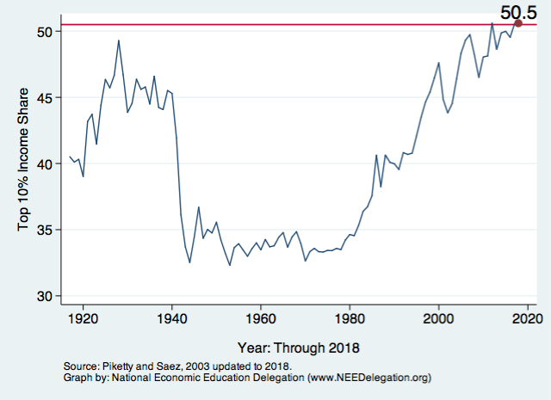
National Income Inequality: Share of Top 10%
Stock Market Crash
WWII
Housing Bubble
Dot-com Bubble

Slide 8

The Abrupt Increase in Inequality
Source: Chad Stone, Danilo Trisi, Arloc Sherman, and Roderick Taylor, “A Guide to Statistics on Historical Trends in Income Inequality,”
Center on Budget and Policy Priorities, Policy Futures, Dec. 11, 2018.
Notes:
Slide taken from page 10, Chad Stone, Danilo Trisi, Arloc Sherman, and Roderick Taylor, “A Guide to Statistics on Historical Trends in Income Inequality,” May 15, 2018

Slide 9
Income Changes from Growing Inequality
Bottom 90%
of Households

Slide 10
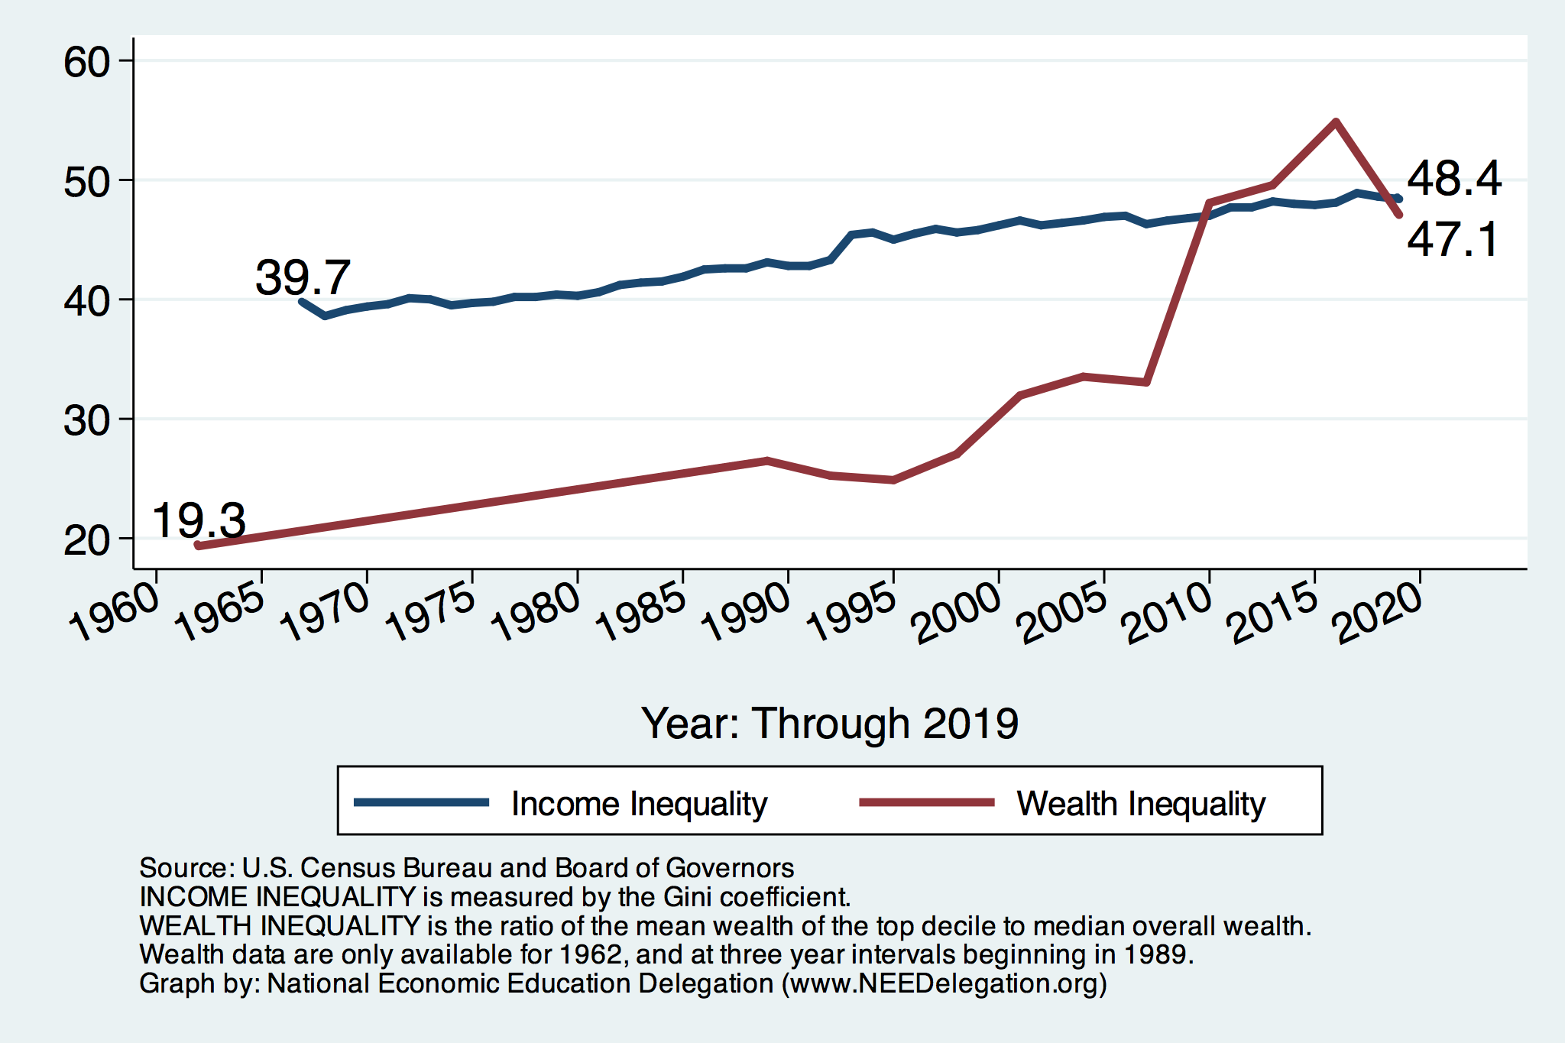
Income and Wealth Inequality
Income Inequality (Gini)
United States: 48.1%
Oregon: 45.0%
Yamhill County: 44.6%

Slide 11
Wealth Inequality Exceeds Income Inequality
Source: Chad Stone, Danilo Trisi, Arloc Sherman, and Roderick Taylor, “A Guide to Statistics on Historical Trends in Income Inequality,”
Center on Budget and Policy Priorities, Policy Futures, Dec. 11, 2018.

Slide 12
Where Does Inequality Come From?
Labor Characteristics
  Demographics
    Age distribution
  Personal Choices
    Educational attainment
    Effort
    Priorities
    Household composition
  Immigration
Market Forces
  Technology
  Changing demand patterns
  Competition for labor
Government Policy
  Market influence
  Redistribution

Slide 13
Government Policy and Inequality
Market Influence: PRE-distribution
  Characteristics of labor
    Access to education
  Effects on labor demand
    Market regulation
      Competition policy
    Labor regulations
      Minimum wage, overtime, health insurance, etc.
RE-distribution
  Tax Rates
  Income support
    Direct aid
    Food stamps

Slide 14
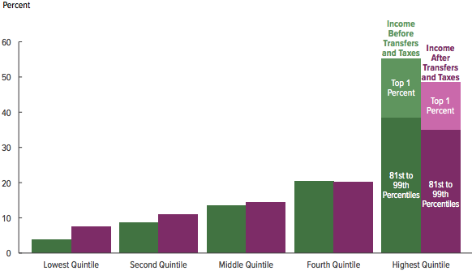
Tax and Transfer Programs: Income Shares
2017
Source: U.S. Congressional Budget Office, “The Distribution of Household Income, 2016”, Average Income Before and After Means-Tested Transfers and
Federal Taxes, by Income Group, 2016.

Slide 15

Dramatically Less Progressivity in the Tax Code
1961 to 2011
Source: New York Times, from Thomas Piketty, Emmanuel Saez and Gabriel Zucman, “
Distributional National Accounts: Methods and Estimates for the United States”

Slide 16
Market Forces and Inequality
Changing demand patterns
  Technology
  Globalization
  Industry composition
    PCs instead of typewriters
    Services instead of goods
    Professional services instead of personal services
Competition in labor markets
  Unionization
  Market concentration

Slide 17

Labor Income is Unhinged from Productivity
Why?
Declining unionization
Globalization
Competition policy
Cheap technology

Slide 18

Declining Unionization
Unionization Rates
1983: 20.1%
2020: 10.8%
Unionization Rates
Public: 34.8%
Private: 6.3%
Source: https://inequality.org/facts/income-inequality/, Bureau of Labor Statistics and Emmanueul Saez, University of Califonria, Berkeley
Notes:
https://voxeu.org/article/forms-and-sources-inequality-united-states

Slide 19

Growing Revenue Concentration
Source: The Hamilton Project, Brookings: The State of Competition and dynamism.

Slide 20


Technology can Hurt Low Income Workers
Early on, technology was good to low income workers
Until it was bad for them….

Slide 21
Globalization
What is globalization?
  Flow of goods, services, capital, and labor across international borders
How does it affect inequality?
  Through a differential impact on low-skilled workers and hence their wages
  For the United States, globalization is thought to lower the wages of low skilled and hence low-wage workers relative to those of high-skilled workers

Slide 22
Sources of Inequality Through Late 1990s

Slide 23

Why Does Inequality Matter?
Too little inequality can:
  Reduce individual motivation
  Slow economic growth
Too much inequality can:
  Reduce individual motivation
  Slow economic growth
Too much inequality may also:
  Divide society
  Distort political environment
  Reduce political participation
  Reduce investments in public goods
    Education
    Environmental protections

Slide 24
An International Perspective: Comparables
U.S.: 17-18
Canada, UK, Germany: 12-13
Italy, France, Japan: 7-9

Slide 25

Addressing Inequality:
Immediately Available Policy Solutions (1/2)
RE-distribution
  Tax and transfer programs
PRE-distribution
  Strengthen labor unions
  Collective bargaining
  Other policies that favor labor over business owners
  Minimum wages

Slide 26
Addressing Inequality:
Immediately Available Policy Solutions (2/2)
Other
  Reverse trends in market power.
Locally
  Employment services: job training, interview skills, or assistance with day-to-day issues, such as child care.
Notes:
Reference your own experience at FTC

Slide 27
Addressing Inequality:
Long Term
It’s all about access to resources:
  Education, in particular
    Improve public education
    Reduce disparities in quality of public education
    Improve counseling in low-income schools
      With respect to college – paths to success and funding
    Investments are needed in early education, not later (e.g. universal pre-k)
  Opportunities for wealth-building
  Housing

Slide 28
Summary
Income inequality is clearly increasing.
  The economy is clearly favoring owners of productive resources over labor.
The causes appear to be largely driven by:
  The market – technology, competition, and trade
  Changing institutions.
Open questions are:
  To act or not to act?
  If so, how?
The level of inequality is a policy choice.

Slide 29
Thank you!
Any Questions?
www.NEEDelegation.org
Jon D. Haveman, Ph.D.
Jon@NEEDelegation.org
Contact NEED: info@needelegation.org
Submit a testimonial: www.NEEDelegation.org/testimonials.php
Become a Friend of NEED: www.NEEDelegation.org/friend.php

Slide 30
Available NEED Topics Include:
Coronavirus Economics
Climate Change
Economic Inequality
Economic Mobility
US Social Policy
Trade and Globalization
Minimum Wages
The U.S. Economy
Immigration Economics
Housing Policy
Federal Budgets
Federal Debt
Black-White Wealth Gap
Autonomous Vehicles

