Slide 1


Economic Inequality
Jon D. Haveman, Ph.D.
Executive Director, NEED
April 14, 2022

Slide 2
Credits and Disclaimer
This slide deck was authored by:
  Jon Haveman, Executive Director of NEED
This slide deck was reviewed by:
  Timothy Smeeding, University of Wisconsin
  Robert Wright, Augustana University
Disclaimer
  NEED presentations are designed to be nonpartisan
  It is, however, inevitable that the presenter will be asked for and will provide their own views
  Such views are those of the presenter and not necessarily those of the National Economic Education Delegation (NEED)

Slide 3
Outline
Measurement
How does it happen?
Does it matter?
Is it a problem?
What to do about it

Slide 4

Economic Inequality: Income
Definition:
  The extent to which the distribution of income deviates from complete equality
  The dispersion of income/wealth throughout the economy

Slide 5
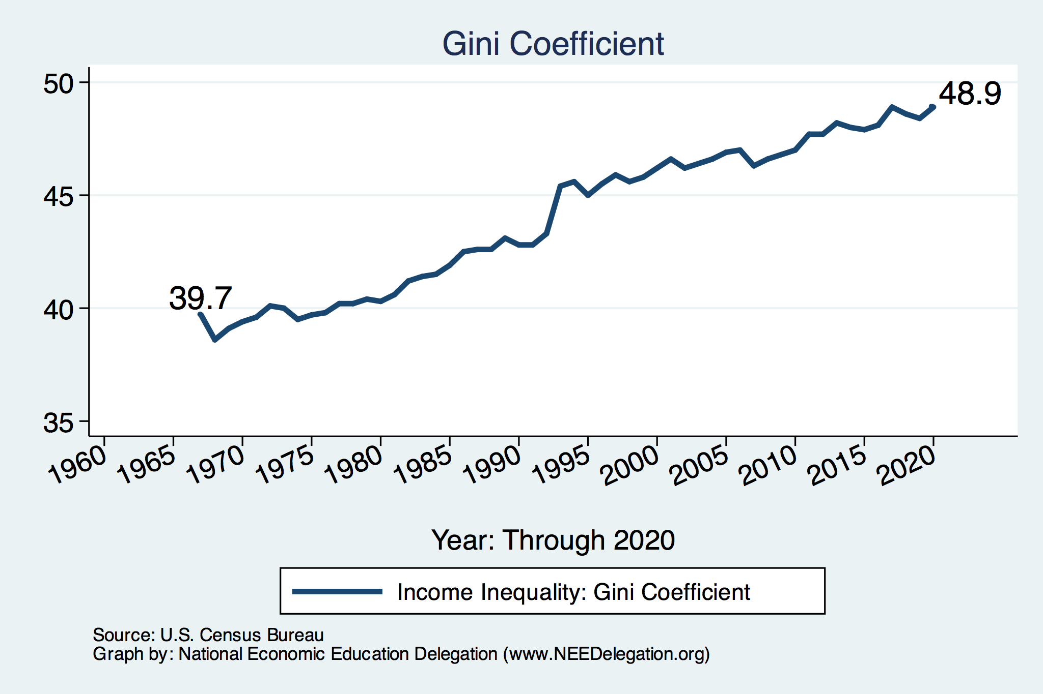
Income Inequality: Measuring Dispersion

Slide 6

Income Inequality: Share of Top 10%
Stock Market Crash
WWII
Housing Bubble
Dot-com Bubble

Slide 7

The Abrupt Increase in Inequality
Source: Chad Stone, Danilo Trisi, Arloc Sherman, and Roderick Taylor, “A Guide to Statistics on Historical Trends in Income Inequality,”
Center on Budget and Policy Priorities, Policy Futures, Dec. 11, 2018.
Notes:
Slide taken from page 10, Chad Stone, Danilo Trisi, Arloc Sherman, and Roderick Taylor, “A Guide to Statistics on Historical Trends in Income Inequality,” May 15, 2018

Slide 8
Where Does Inequality Come From?
Labor Characteristics
  Demographics
    Age distribution
  Personal Choices
    Educational attainment
    Effort
    Priorities
Market Forces
  Technology
  Changing demand patterns
  Competition for labor
Government Policy
  Market influence
  Redistribution

Slide 9
Government Policy and Inequality
Market Influence: PRE-distribution
  Characteristics of labor
    Access to education
  Effects on labor demand
    Market regulation
      Competition policy
    Labor regulations
      Minimum wage, overtime, health insurance, etc.
RE-distribution
  Tax Rates
  Income support
    Direct aid
    Food stamps

Slide 10
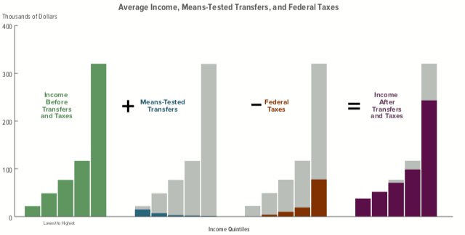
Taxes, Transfers, and Income: 2018
Source: U.S. Congressional Budget Office, “The Distribution of Household Income, 2016”.

Slide 11

Most of the Action Is at the Top: Pre-Tax
Projected 2021
CBO: Projected Changes in the Distribution of Household Income, 2016 to 2021

Slide 12
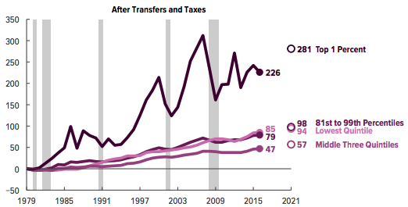
Most of the Action Is at the Top: Post-Tax
Projected
CBO: Projected Changes in the Distribution of Household Income, 2016 to 2021

Slide 13

Dramatically Less Progressivity in the Tax Code
1961 to 2011
Source: New York Times, from Thomas Piketty, Emmanuel Saez and Gabriel Zucman, “
Distributional National Accounts: Methods and Estimates for the United States”

Slide 14
Market Forces and Inequality
Changing demand patterns
  Technology
  Globalization
  Industry composition
    PCs instead of typewriters
    Services instead of goods
    Professional services instead of personal services
Competition in labor markets
  Unionization
  Market concentration

Slide 15
Where Does Inequality Come From? Summary
Labor characteristics
  What do workers bring to the market?
Market forces
  How does the market value the labor characteristics?
Government policies
  PRE-distribution – affecting markets
  Redistribution – affecting incomes

Slide 16
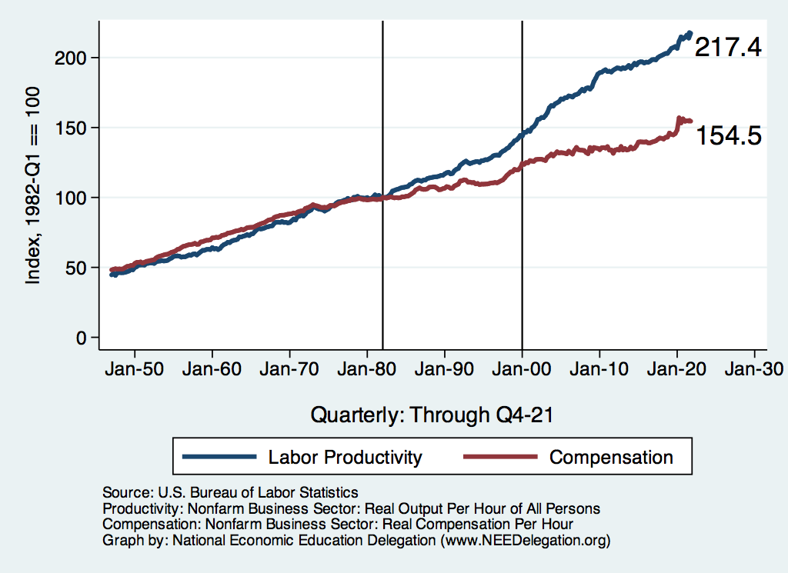
Labor Income is Unhinged from Productivity
Why?
Declining unionization
Globalization
Competition policy
Cheap technology

Slide 17

Declining Unionization
Unionization Rates
1983: 20.1%
2021: 10.3%
Unionization Rates
Public: 33.9%
Private: 6.1%
Source: https://inequality.org/facts/income-inequality/, Bureau of Labor Statistics and Emmanueul Saez, University of Califonria, Berkeley
Notes:
https://voxeu.org/article/forms-and-sources-inequality-united-states

Slide 18
Competition in the Economy
Return on invested capital excluding goodwill –
US publicly-traded nonfinancial firms, 1965-2014
Source: Jason Furman, ”Forms and sources of inequality in the United States”, VOX, March 17, 2016, Figure 6.
Notes:
Note: The return on invested capital definition is based on Koller et al (2015), and the data presented here are updated and augmented versions of the figures presented in Chapter 6 of that volume. The McKinsey data includes McKinsey analysis of Standard & Poor’s data and exclude financial firms from the analysis because of the practical complexities of computing returns on invested capital for such firms. ​
Source: Koller et al. (2015); McKinsey & Company; Furman and Orszag (2015). , by way of https://voxeu.org/article/forms-and-sources-inequality-united-states
Furman, J and P Orszag (2015), “A Firm-Level Perspective on the Role of Rents in the Rise in Inequality”, Presentation at “A Just Society” Centennial Event in Honor of Joseph Stiglitz Columbia University, October 16, 2015.

Slide 19
Technological Change and Inequality
Much of the technology adopted in the last 30 years has eliminated low-skill or low-wage jobs.
  Computers, advanced manufacturing equipment, steel mini-mills, automation
There is a “winner take all” aspect of the technology-driven economy.
  This likely favors a small group of individuals.
Both aspects increase inequality by increasing the rewards to:
  Those with significant labor market skills.
  Owners over workers

Slide 20
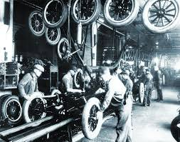

Technology can Hurt Low Income Workers
Early on, technology was good to low income workers
Until it was bad for them….

Slide 21
Globalization
What is globalization?
  Flow of goods, services, capital, and labor across international borders
How does it affect inequality?
  Through a differential impact on low-skilled workers and hence their wages
  For the United States, globalization is thought to lower the wages of low skilled and hence low-wage workers relative to those of high-skilled workers

Slide 22
What is driving increasing inequality?
Primary drivers:
  Technology
  Globalization
  Institutions
    Unions and government policy
These drivers can also influence personal choices in ways that affect measured income inequality.
  For example, educational choices or labor force participation

Slide 23

Why Does Inequality Matter?
Too little inequality can:
  Reduce individual motivation
  Slow economic growth
Too much inequality can:
  Reduce individual motivation
  Slow economic growth
Too much inequality may also:
  Divide society
  Distort political environment
  Reduce political participation
  Reduce investments in public goods
    Education
    Environmental protections

Slide 24
How Much Inequality Is too Much?
Economic
Sweet Spot
?
?
Equity
Efficiency/GDP
Efficiency/GDP
Equity
Efficiency/GDP
Equity
0
100
Z
X
Gini Coefficient

Slide 25
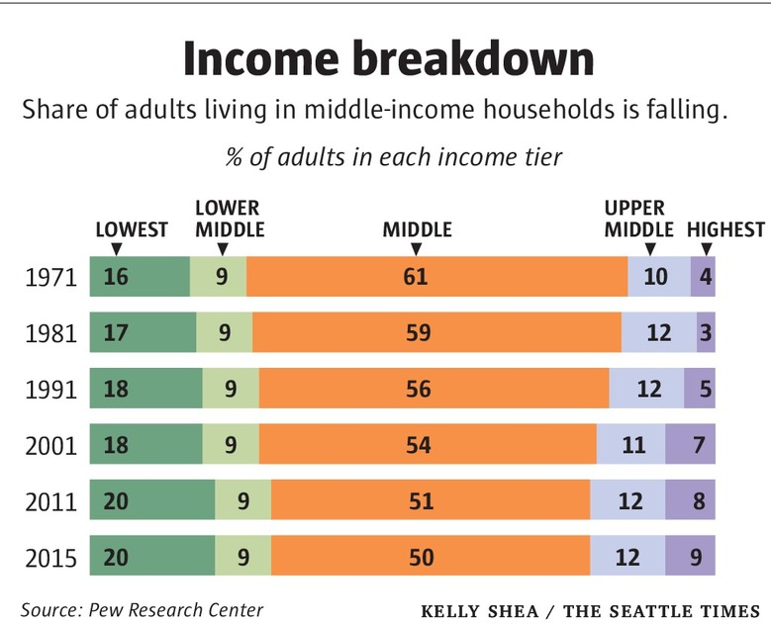
Inequality Can Also Directly Affect GDP
The US Economy is driven by consumption (67% of GDP).
  Middle class are the big consumers.
  They have less money.
  Consumption is lower.
  GDP is lower.

Slide 26

Peru
China
Brazil
LESS Mobility
Germany
U.S.
Canada
MORE Inequality
https://equitablegrowth.org/research-paper/are-todays-inequalities-limiting-tomorrows-opportunities

Slide 27
Too Much Inequality Can:
Reduce work effort, which reduces GDP.
Reduce purchasing power of the middle class, which reduces GDP.
Reduce the ability of people to get ahead, which reduces mobility.
  Puts the American Dream at risk.
Increase the share of the population living on low incomes.
  Offending our sense of equity? Desire for shared prosperity?
Concentrate political power.

Slide 28
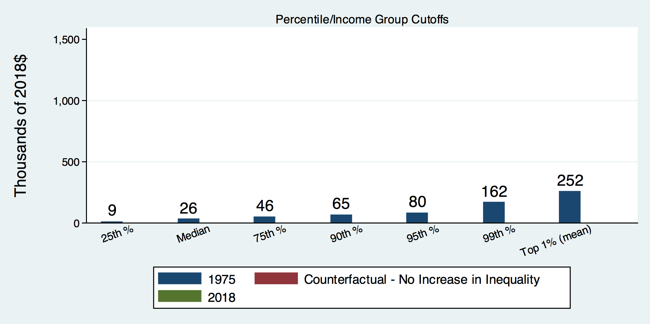
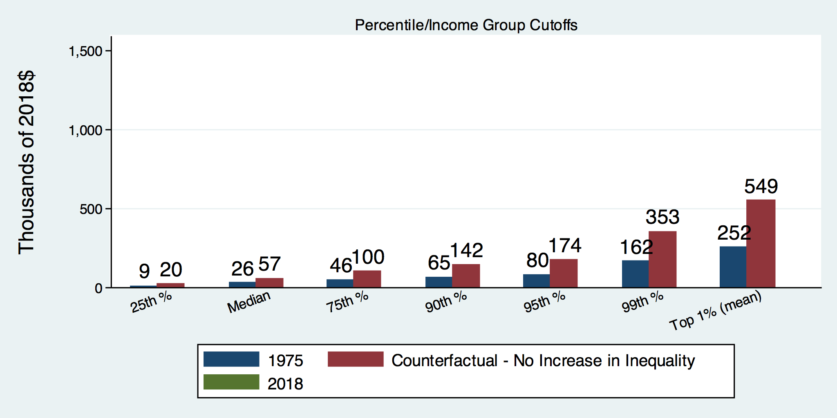
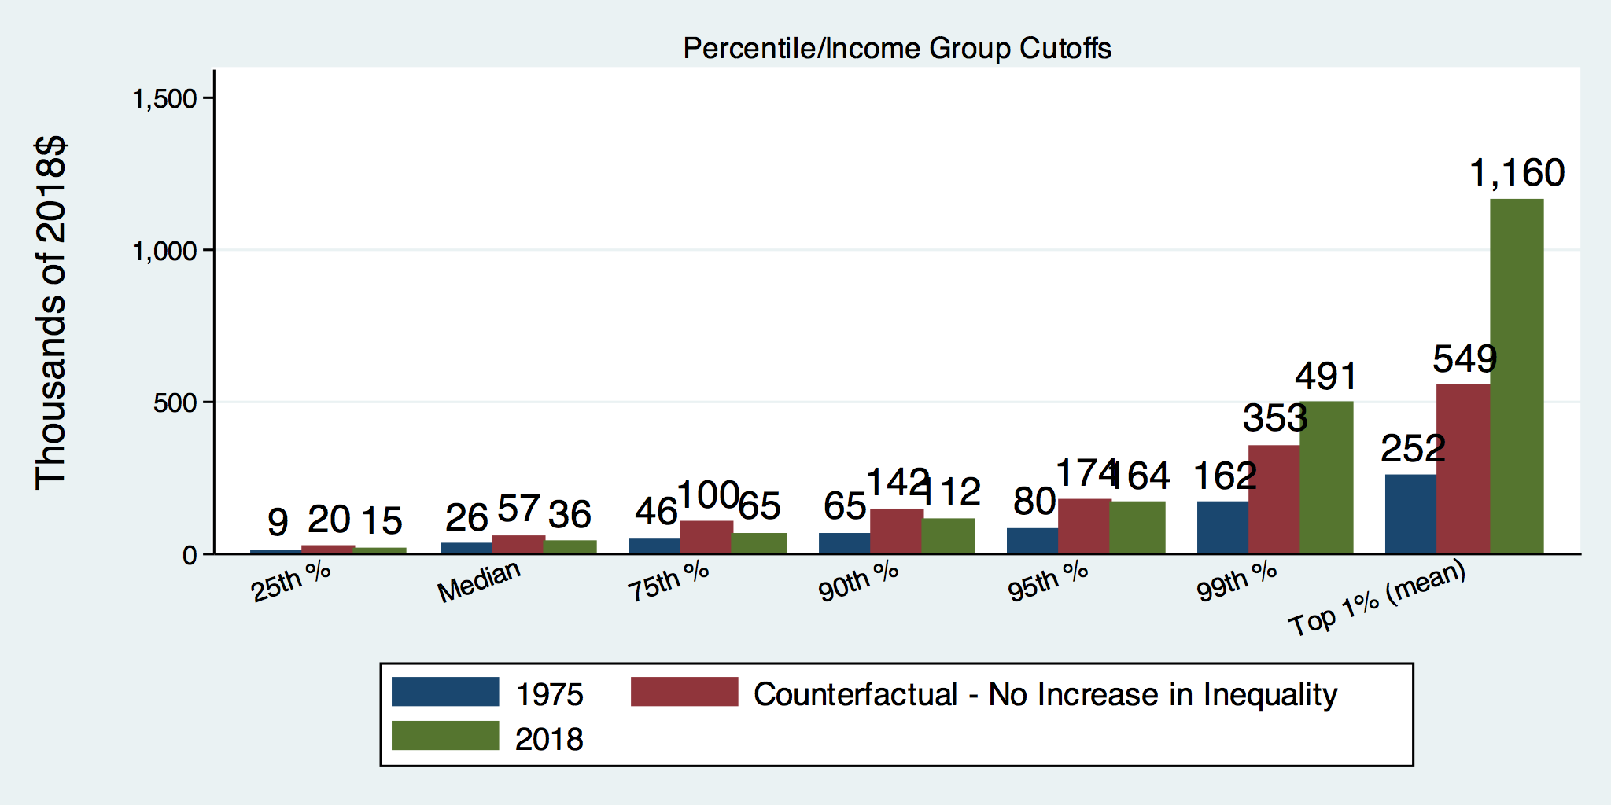
How Has Inequality Influenced Incomes?

Slide 29
Addressing Inequality: Is It A Problem?
Why it might be a problem.
  Economic issues (Efficiency)
    There is evidence that at some level, increased inequality slows economic growth.
  Noneconomic issues (Equity)
    Values, ethics and morals will drive individual evaluations of the level of inequality.
      E.g., inequality is primarily a function of market outcomes, so should be left alone.
      Or, a solid middle class is important for maintaining a civil society, which runs contrary to a high degree of inequality.
Suppose you think it’s a problem. How might it be addressed?

Slide 30

Addressing Inequality:
Immediately Available Policy Solutions (1/2)
RE-distribution
  Tax and transfer programs
PRE-distribution
  Strengthen labor unions
  Collective bargaining
  Other policies that favor labor over business owners
  Minimum wages

Slide 31
Addressing Inequality:
Immediately Available Policy Solutions (2/2)
Other
  Reverse trends in market concentration.
Locally
  Employment services: job training, interview skills, or assistance with day-to-day issues, such as child care
Notes:
Reference your own experience at FTC

Slide 32
Addressing Inequality:
Long Term
It’s all about access to resources:
  Education, in particular
    Improve public education
    Reduce disparities in quality of public education
    Improve counseling in low-income schools
      With respect to college – paths to success and funding
    Investments are needed in early education, not later (e.g. universal pre-k)
  Opportunities for wealth-building
  Housing

Slide 33
Summary
Income inequality is clearly increasing.
  The economy is clearly favoring owners of productive resources over labor.
The causes appear to be largely driven by:
  The market – technology, competition, and trade
  Changing institutions.
Open questions are:
  To act or not to act?
  If so, how?
The level of inequality is a policy choice.

Slide 34
Thank you!
Any Questions?
www.NEEDelegation.org
Jon D. Haveman
Jon@NEEDelegation.org
Contact NEED: info@NEEDelegation.org
Submit a testimonial: www.NEEDelegation.org/testimonials.php
Become a Friend of NEED: www.NEEDelegation.org/friend.php

Slide 35

Growing Revenue Concentration
Source: The Hamilton Project, Brookings: The State of Competition and dynamism.

Slide 36

CEO Pay Has Been Growing Rapidly

Slide 37

CEO Pay Has Been Growing Rapidly

Slide 38
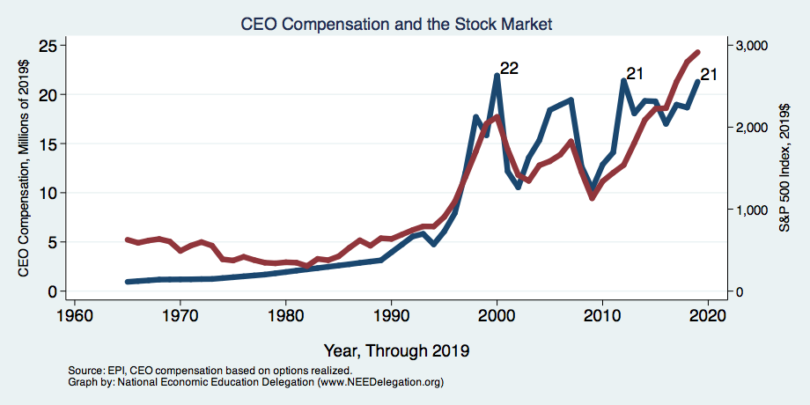
CEO Compensation – Tied to Stock Prices

Slide 39
Immigration and Inequality
Source: Ping Xu, James C. Garand, and Ling Zhu, “How immigration makes income inequality worse in the U.S.”, October, 2015, Figure 1.

Slide 40
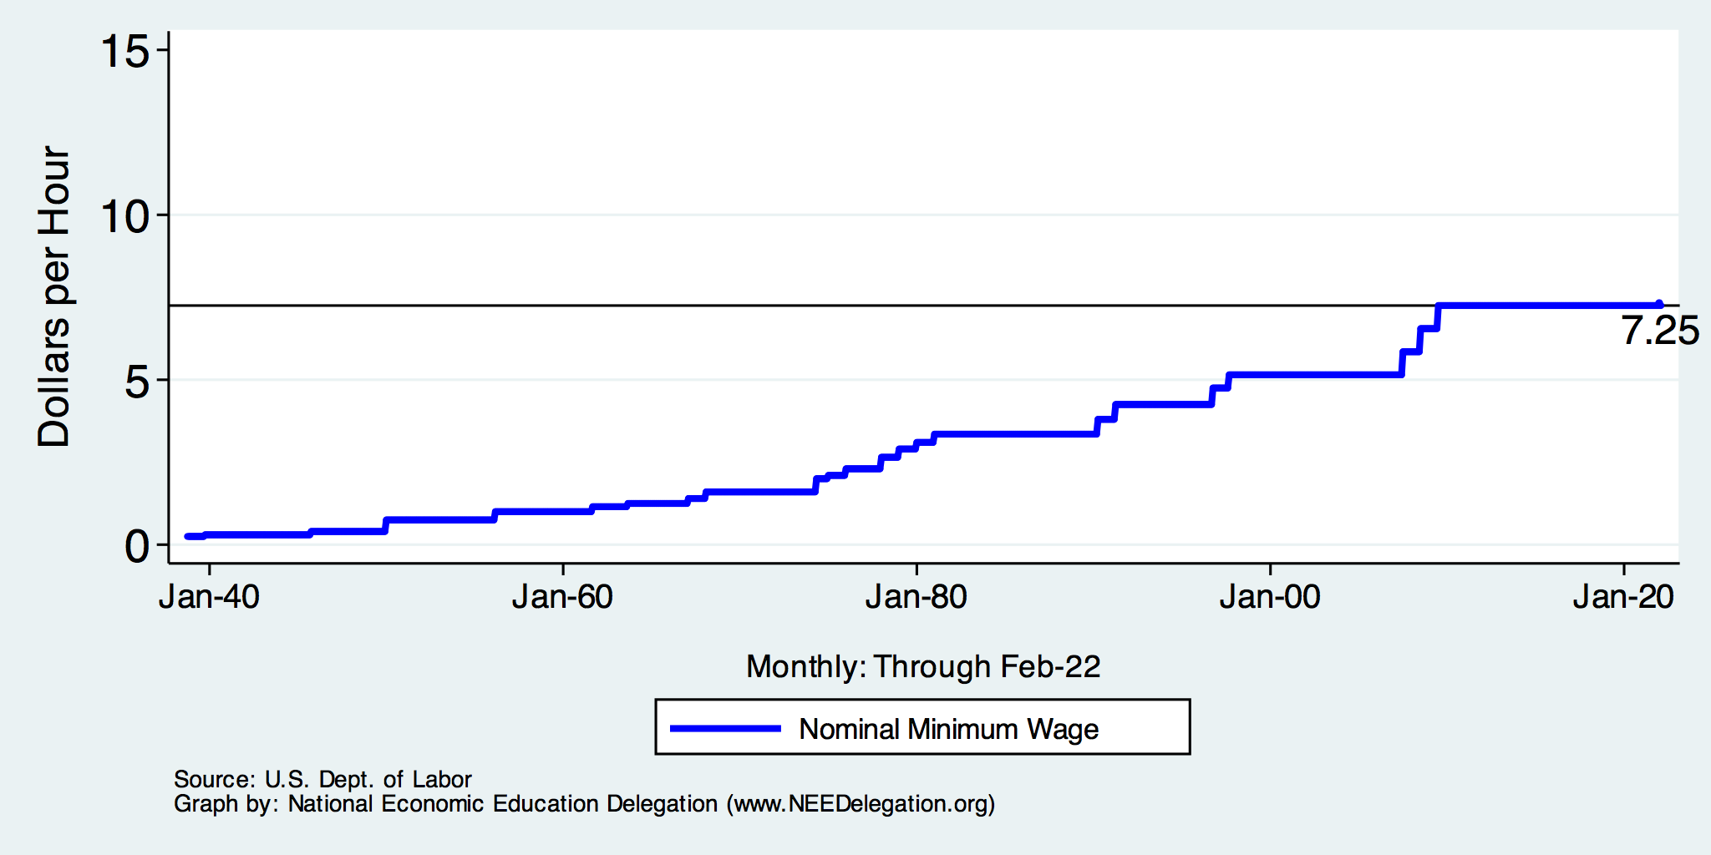
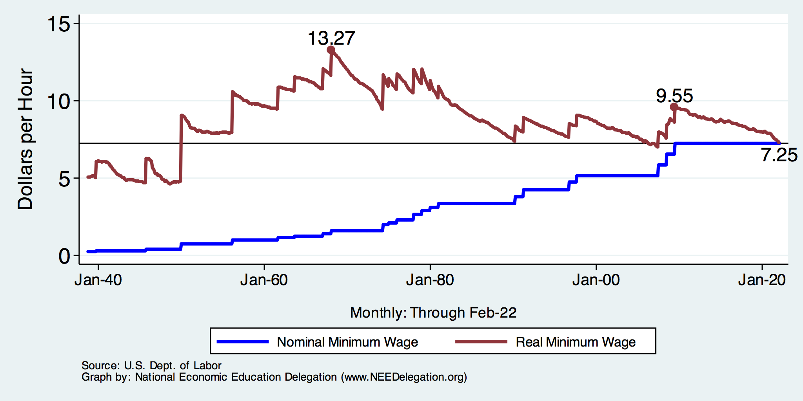
History of the Federal Minimum Wage

Slide 41
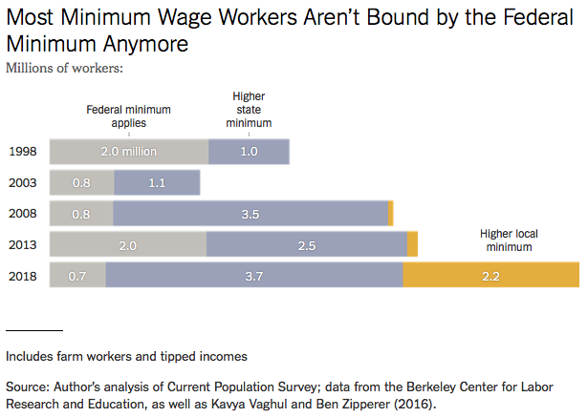
Notes:
https://www.nytimes.com/2019/04/24/upshot/why-america-may-already-have-its-highest-minimum-wage.html?action=click&module=RelatedLinks&pgtype=Article

Slide 42

Wealth Concentration Has Been Rising
2019 Overall Median: $121,700

Slide 43
What About Tax Rates?
400 Taxpayers with highest incomes
1992-2007
+
392%
Tax and inheritance laws (reduced rates on high income groups)
1992-2014
Average
Tax Rate
+310%
Average
Income
-12%
-
37%
Source: IRS
Source: IRS, Statistics of Income Division, December 2016.

Slide 44
Technology Benefits Ownership over Labor

Slide 45
Sources of Inequality Through Late 1990s

Slide 46

Wealth is More and More Concentrated
99th Percentile
2016 = 7x 1963
Source: Urban Institute

Slide 47
A Modern Example: Uber & Lyft
Technology:
  Facilitates market power for owners.
  Reduces bargaining power for labor.
  Shifts costs of doing business onto labor.
Modern day Robber Barons?
  Ruthlessly absorbing as much income as they can.
  Lack of regard for labor.

Slide 48
Income Changes from Growing Inequality
Bottom 90%
of Households

Slide 49
An International Perspective: Comparables
U.S.: 17-18
Canada, UK, Germany: 12-13
Italy, France, Japan: 7-9

Slide 50
Tension in Policy Solutions
Is it possible to increase growth at the same time that you reduce income inequality?
  Common refrain among some that government intervention in the economy is always and everywhere bad for growth.
Possibly: expanding equality of access promotes the full utilization of resources.
  Expanding equality of access requires resources likely from the well-to-do.

Slide 51
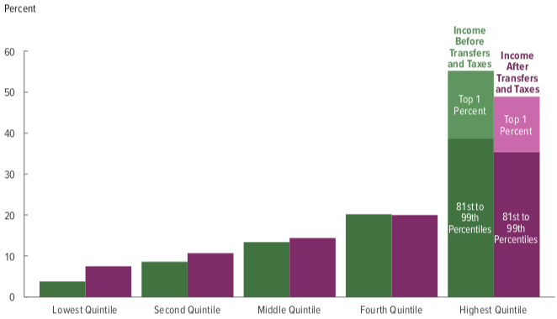
Tax and Transfer Programs: Income Shares
2018
Source: U.S. Congressional Budget Office, “The Distribution of Household Income, 2016”, Average Income Before and After Means-Tested Transfers and
Federal Taxes, by Income Group, 2016.

Slide 52
Different Ways of Thinking About Inequality
Income inequality
  Before taxes and transfers
  After taxes and transfers
Wealth inequality
How does wealth differ from income?
Income is measured over a period of time, say one year.
Wealth is one’s accumulated savings, including physical and financial assets (net worth).

Slide 53
Wealth Inequality Exceeds Income Inequality
Source: Chad Stone, Danilo Trisi, Arloc Sherman, and Roderick Taylor, “A Guide to Statistics on Historical Trends in Income Inequality,”
Center on Budget and Policy Priorities, Policy Futures, Dec. 11, 2018.

Slide 54
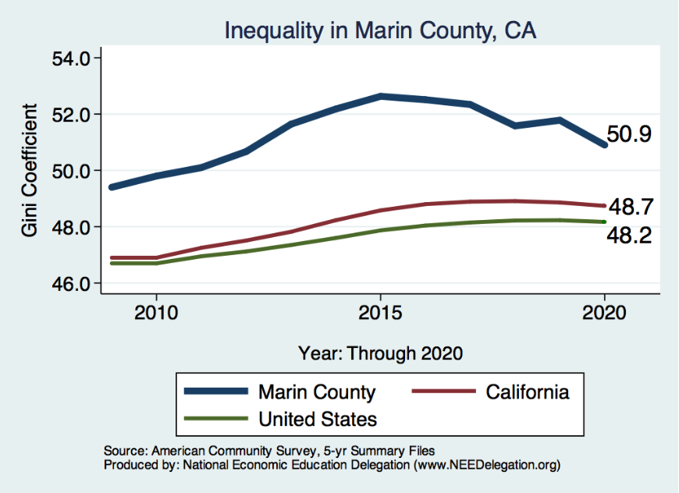
Inequality in Marin
Source: https://needelegation.org/LocalGraphs

