Slide 1


Economic Inequality
Stephanie Seguino, Ph.D.
Professor of Economics
University of Vermont
Randolph Rotary Club
December 16, 2021

Slide 2
National Economic Education Delegation
Vision
  One day, the public discussion of policy issues will be grounded in an accurate perception of the underlying economic principles and data.
Mission
  NEED unites the skills and knowledge of a vast network of professional economists to promote understanding of the economics of policy issues in the United States.
NEED Presentations
  Are nonpartisan and intended to reflect the consensus of the economics profession.

Slide 3
Economic Inequality
Definition:
  The economic distance from the poorest to the richest.
  The dispersion of income/wealth throughout the economy.

Slide 4
Different Ways of Thinking About Inequality
Income Inequality
  Before taxes and transfers
  After taxes and transfers
Wealth Inequality
Racial inequality
Gender inequality
How does wealth differ from income?
Income is measured over a period of time, say one year.
Wealth is one’s accumulated savings, including physical and financial assets.

Slide 5
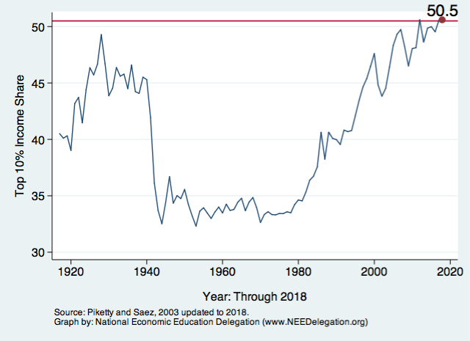
National Income Inequality: Share of Top 10%
Stock Market Crash
WWII
Housing Bubble
Dot-com Bubble

Slide 6
An International Perspective: Comparables
U.S.
Canada, UK, Germany
Italy, France, Japan

Slide 7
Wealth Inequality Exceeds Income Inequality
Source: Chad Stone, Danilo Trisi, Arloc Sherman, and Roderick Taylor, “A Guide to Statistics on Historical Trends in Income Inequality,”
Center on Budget and Policy Priorities, Policy Futures, Dec. 11, 2018.

Slide 8
REASONS INEQUALITY INCREASING?

Slide 9
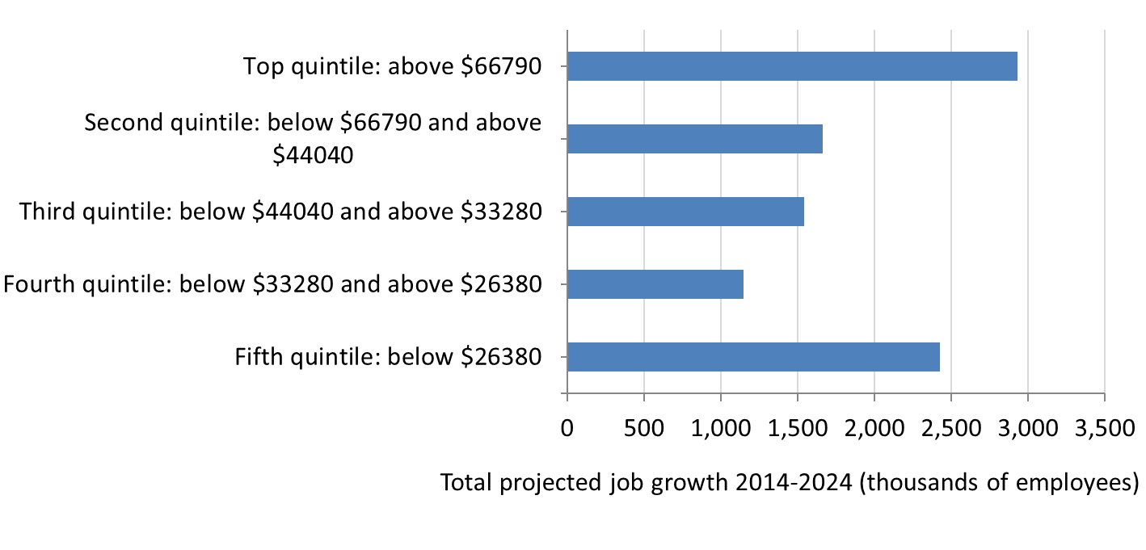
1. Changing economic structure and bargaining power
Increasing inequality associated with the changing distribution of jobs.
‘Missing middle’ - Low-paying and high-paying jobs are increasing in number while middle-income jobs are becoming scarcer.

Slide 10

Labor Income is Unhinged from Productivity
Why?
Declining unionization
Globalization
Increased monopolies
Technology
Declining value of min wage

Slide 11
2. Government Tax Policy
Tax and inheritance laws (reduced rates on high income groups)

Slide 12
3. Government policy: Declining value of minimum wage
In 1975, in real terms, $10.15/hr

Slide 13
4. Government Social Safety Net: Declining Support

Slide 14
Good news recently on social safety net spending
American Rescue Plan offered a child allowance which provides cash benefits to most households with children, about $3000 a year.
Stanford University Study found that child poverty will fall by 35% as a result.
Previous research indicates this will lead to increases in student learning.

Slide 15
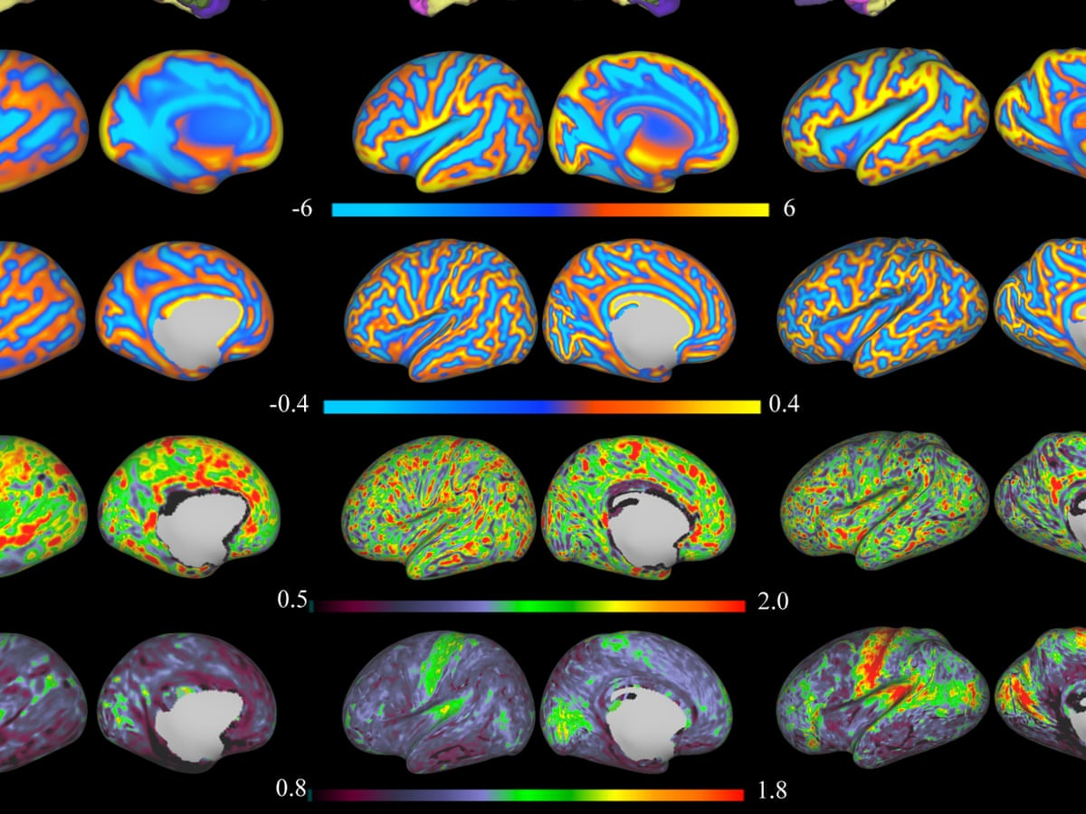
Intergenerational inequality: Does poverty show up in children’s brains?

Slide 16
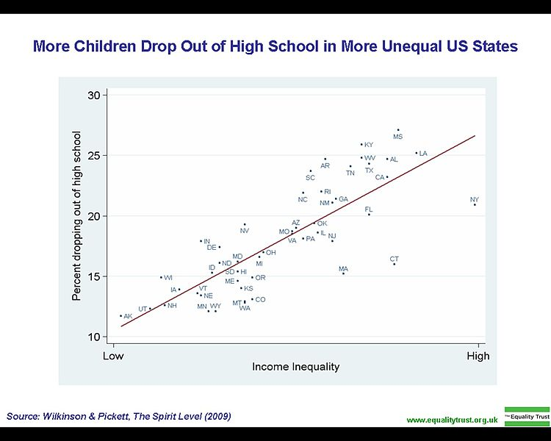
Wilkinson & Pickett, The Spirit Level (2009)

Slide 17
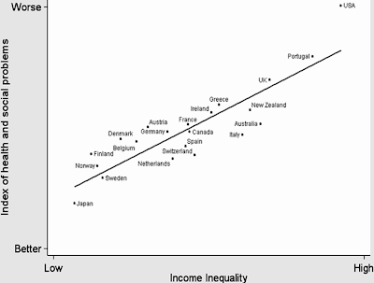

Slide 18
Addressing Inequality: Is It A Problem?
Why it might be a problem.
  Economic issues (Efficiency)
    There is evidence that at some level, increased inequality slows economic growth.
    Or, inequality concentrates resources among investors.
  Noneconomic issues (Equity)
    Values, ethics and morals will drive individual evaluations of the level of inequality.
      E.g., inequality is primarily a function of market outcomes, so should be left alone.
      Or, a solid middle class is important for maintaining a civil society, which runs contrary to a high degree of inequality.
Suppose you think it’s a problem. How might it be addressed?

Slide 19

Addressing Inequality:
Immediately Available Policy Solutions (1/2)
RE-distribution
  Tax and transfer programs
  Child allowances
  Subsidized child care
PRE-distribution
  Strengthen labor unions
  Support collective bargaining
  Other policies to increase working bargaining power
  Minimum wages

Slide 20
Racial Inequality

Slide 21
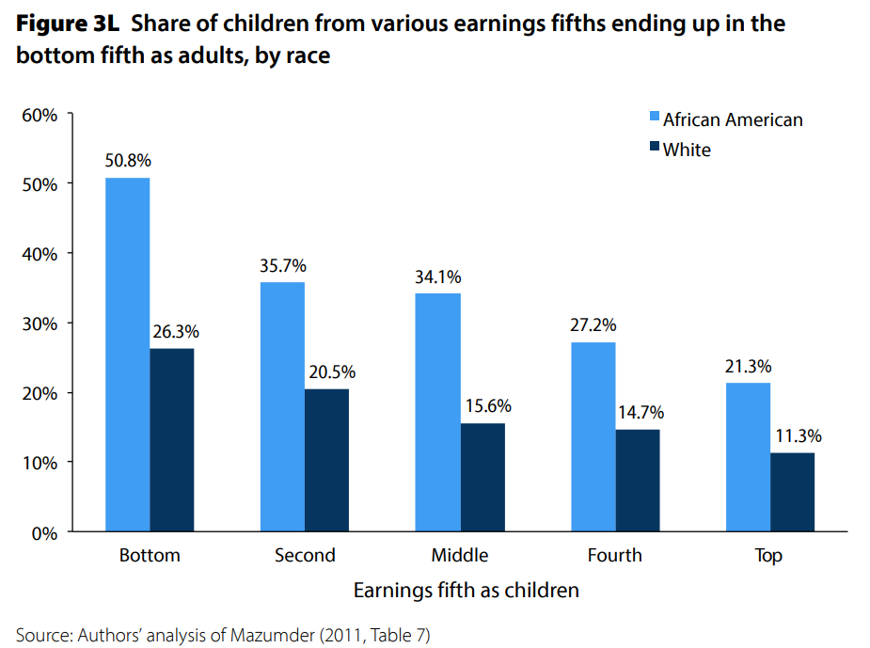
U.S. – Racial Differences
Odds of staying poor, if born poor
Odds of becoming poor, if born rich
Economic Policy Institute, State of Working America, 2012

Slide 22
Notes:
https://www.brookings.edu/blog/up-front/2020/02/27/examining-the-black-white-wealth-gap/

Slide 24
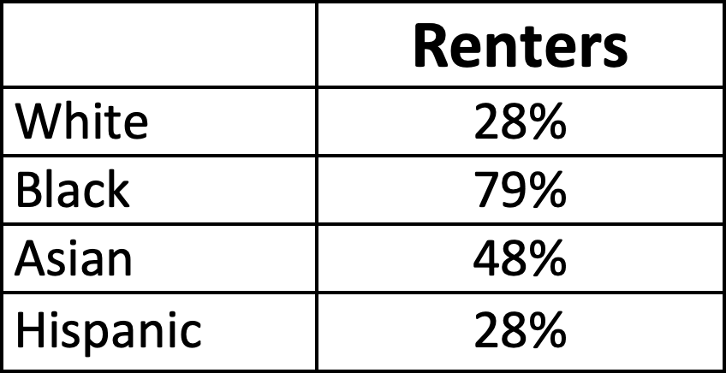
Is racial inequality a problem in Vermont?
There are 30,000 people of color in Vermont.

Slide 25
Summary
Income inequality is clearly increasing.
  The economy is clearly favoring owners of productive resources over labor.
Inequality is costly to all of us
The level of inequality is a policy choice.

