Slide 1
Osher Lifelong Learning Institute, Spring 2023
Contemporary Economic Policy Issues
Olli – Washington University, St. Louis
May, 2023
Host: Jon Haveman
National Economic Education Delegation

Slide 2
Available NEED Topics Include:
US Economy
Healthcare Economics
Climate Change
Economic Inequality
Economic Mobility
Trade and Globalization
Minimum Wages
Immigration Economics
Housing Policy
Federal Budgets
Federal Debt
Black-White Wealth Gap
Autonomous Vehicles
Healthcare Economics

Slide 3
Course Outline
Contemporary Economic Policy
  Week 1 (5/5): US Economic Update (Geoffrey Woglom, Amherst College)
  Week 2 (5/12): Economic Inequality (Adina Ardelean)
  Week 3 (5/19): Economic Mobility (Kathryn Wilson, Kent State Univ.)
  Week 4 (5/26): The Black-White Wealth Gap (Jon Haveman, NEED)

Slide 4
Submitting Questions
Please submit questions of clarification in the chat or raise your “digital” hand.
  I will try to handle them as they come up.
We will do a verbal Q&A once the material has been presented.
Slides will be available from the at the course web site later today.
https://sites.google.com/view/macro-current-issues/home

Slide 5


Economic Inequality
Adina Ardelean, Ph.D.
Senior Lecturer, Santa Clara University
OLLI, Washington University, St. Louis
May 12, 2023

Slide 6
Credits and Disclaimer
This slide deck was authored by:
  Jon Haveman, Executive Director of NEED
This slide deck was reviewed by:
  Timothy Smeeding, University of Wisconsin
  Robert Wright, Augustana University
Disclaimer
  NEED presentations are designed to be nonpartisan
  It is, however, inevitable that the presenter will be asked for and will provide their own views
  Such views are those of the presenter and not necessarily those of the National Economic Education Delegation (NEED)

Slide 7
Outline
Definition
What happened?
Does it matter?
Is it a problem?
What to do about it

Slide 8

Income Inequality
Definition:
  The extent to which the distribution of income deviates from complete equality
  The dispersion of income throughout the economy

Slide 9
Different Ways of Thinking About Inequality
Income Inequality
  Before taxes and transfers
  After taxes and transfers
Wealth Inequality
Consumption Inequality

Slide 10
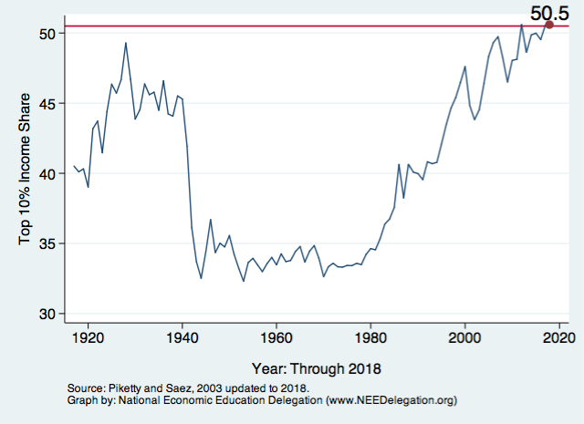
National Income Inequality: Share of Top 10%
Stock Market Crash
WWII
Housing Bubble
Dot-com Bubble

Slide 11

The Abrupt Increase in Inequality
Source: Chad Stone, Danilo Trisi, Arloc Sherman, and Roderick Taylor, “A Guide to Statistics on Historical Trends in Income Inequality,”
Center on Budget and Policy Priorities, Policy Futures, Dec. 11, 2018.
Notes:
Slide taken from page 10, Chad Stone, Danilo Trisi, Arloc Sherman, and Roderick Taylor, “A Guide to Statistics on Historical Trends in Income Inequality,” May 15, 2018

Slide 12

Most of the Action Is at the Top: Pre-Tax
Projected 2021
CBO: Projected Changes in the Distribution of Household Income, 2016 to 2021
Notes:
…
Bottom line: in 2014, 0.03% of all households receive 1.3% of all income in the United States.

Slide 13
Inequality is rising in advanced economies
Source: Peterson Institute of International Economics, “How to fix economic inequality”, based on OECD “Under Pressure: The Squeezed Middle Class”

Slide 14
The bottom half of workers: the U.S. vs. Europe
Source: Peterson Institute of International Economics, “How to fix economic inequality”

Slide 15
Gini Coefficient
Another way to describe income inequality is by using a Gini coefficient.
Gini coefficient – a numerical measure of the overall dispersion of income
  Ranges from 0 – 1
  0= perfect equality – everyone has same income
  1=perfect inequality – one person makes all income
  In practice:
  0.5 – 0.7 – highly unequal
  0.2 – 0.35 – relatively equal

Slide 16
The Gini Coefficient
100%
A
Gini =
x 100
A + B
% of
All Income
50%
Equality (45 degrees)
A
Bigger A: More inequality
Smaller A: Less inequality
Inequality
B
Extreme
50%
100%
% of Population

Slide 17
Forming the GINI Curve: 2015
Quintile Shares of Income
CUMULATIVE Quintile Shares of Income
Income Quintiles
Income Quintiles
Source: 2015 1-year American Community Survey, based on pre-tax household income.

Slide 18
Income Share Changes Between 1970 and 2015
1970: Dark Blue
2015: Light Blue
Share of All Income
% of Population
Income Quintiles
Source: U.S. Census Bureau, Current Population Survey, Annual Social and Economic Supplements.

Slide 19
The Gini Coefficient, 1985-2013
Source: Peterson Institute of International Economics, “How to fix economic inequality”

Slide 20
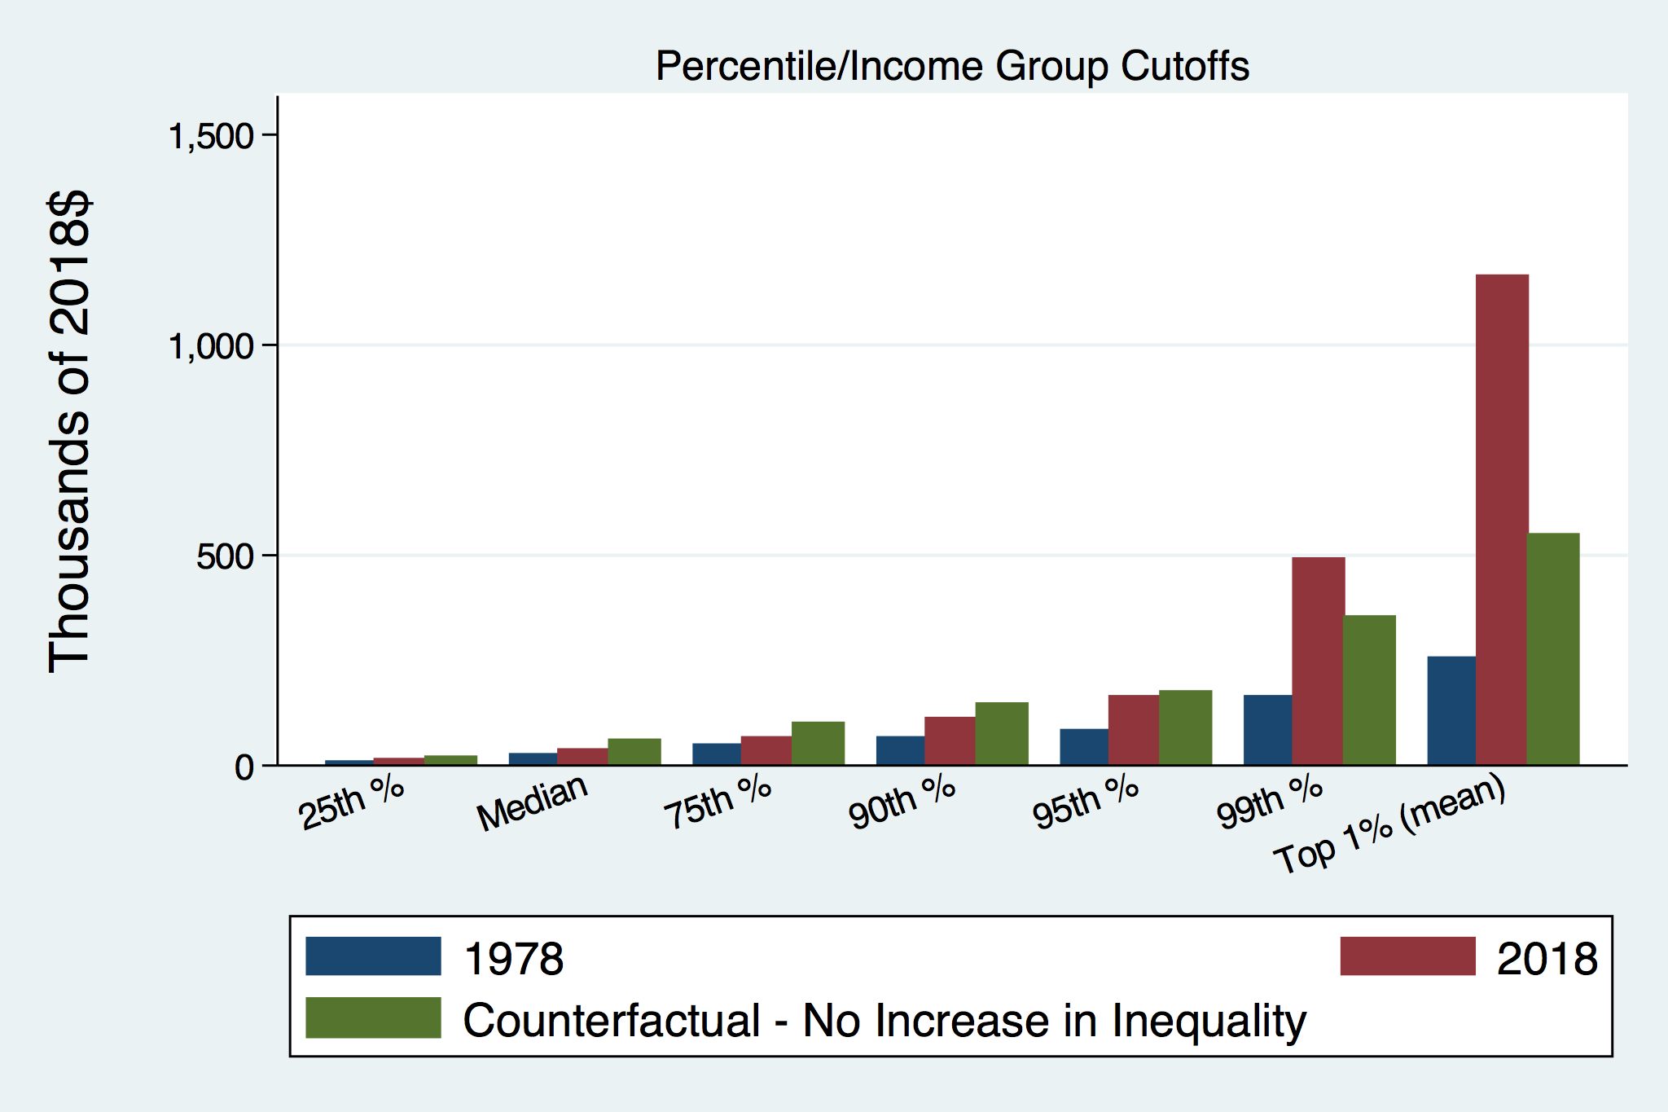
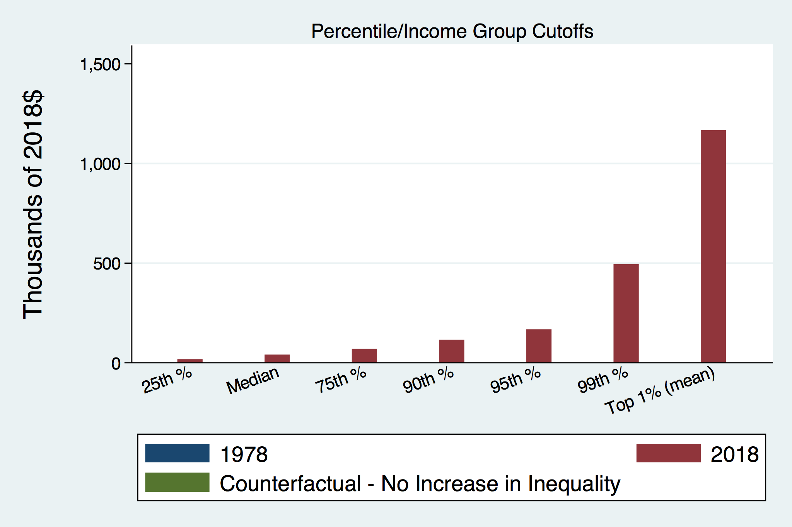
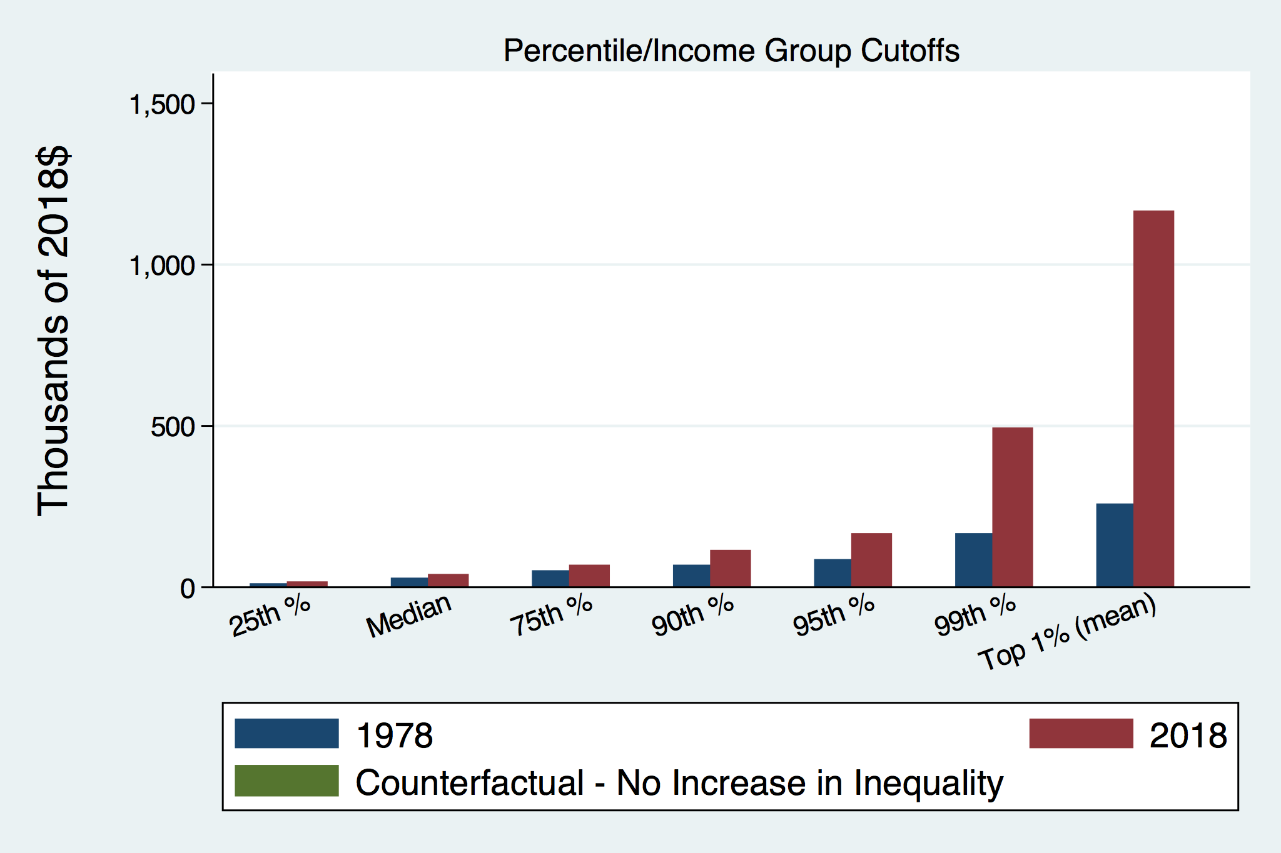
How Has Inequality Influenced Incomes?

Slide 21
Wealth Inequality Exceeds Income Inequality
Source: Chad Stone, Danilo Trisi, Arloc Sherman, and Roderick Taylor, “A Guide to Statistics on Historical Trends in Income Inequality,”
Center on Budget and Policy Priorities, Policy Futures, May 15, 2018, page 15, Figure 4.

Slide 22
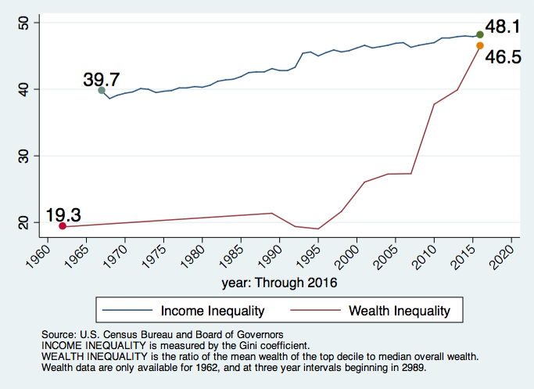
Income and Wealth Inequality
Income Inequality (Gini)
US: 48.1%

Slide 23
Outline
Definition
What happened?
Does it matter?
Is it a problem?
What to do about it

Slide 24
Where Does Inequality Come From?
Labor Characteristics
  Demographics
    Age distribution
  Personal Choices
    Educational attainment
    Household composition
  Immigration
Market Forces
  Technology
  Globalization
  Competition for labor
Government Policy
  Market influence
  Redistribution

Slide 25
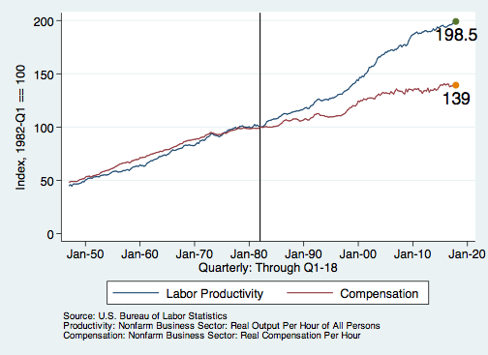
Labor Income is Unhinged from Productivity
Why?
Declining unionization
Competition policy
Immigration
Globalization
Cheap technology

Slide 26

Declining Unionization
Unionization Rates
1983: 20.1%
2020: 10.8%
Unionization Rates
Public: 34.8%
Private: 6.3%
Source: https://inequality.org/facts/income-inequality/, Bureau of Labor Statistics and Emmanueul Saez, University of Califonria, Berkeley

Slide 27
Competition in the Economy
Return on invested capital excluding goodwill –
US publicly-traded nonfinancial firms, 1965-2014
Source: Jason Furman, ”Forms and sources of inequality in the United States”, VOX, March 17, 2016, Figure 6.

Slide 28


CEO Pay Has Been Growing Rapidly

Slide 29
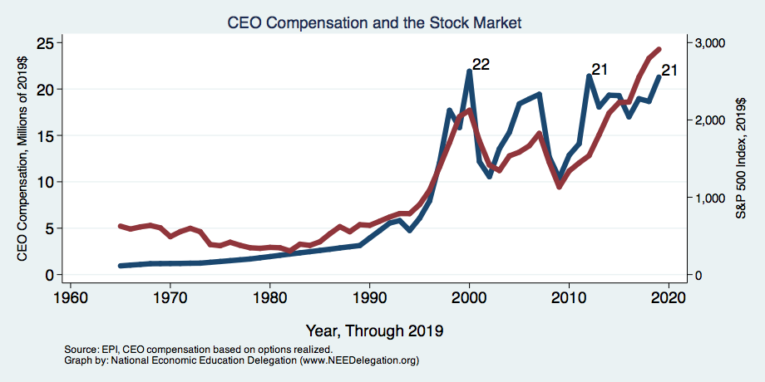
CEO Compensation – Tied to Stock Prices

Slide 30
Immigration and Inequality
Source: Ping Xu, James C. Garand, and Ling Zhu, “How immigration makes income inequality worse in the U.S.”, October, 2015, Figure 1.

Slide 31
Globalization
What is globalization?
  Flow of goods, services, capital, and labor across international borders
How does it affect inequality?
  Through a differential impact on low skilled workers and hence their wages
  For the United States, globalization is thought to lower the wages of low skilled and hence low wage workers relative to those of high skilled workers

Slide 32
Technological Change and Inequality
Much of the technology adopted in the last 30 years has eliminated low-skill or low-wage jobs.
  Computers, advanced manufacturing equipment, steel mini-mills, automation
There is a “winner take all” aspect of the technology-driven economy.
  This potentially favors a small group of individuals.
Both aspects increase inequality by increasing the rewards to:
  Those with significant labor market skills
  Owners over workers

Slide 33


Technology can Hurt Low Income Workers
Early on, technology was good to low income workers
Until it was bad for them….

Slide 34
A Modern Example: Uber & Lyft
Technology:
  Facilitates market power for owners.
  Reduces bargaining power for labor.
  Shifts costs of doing business onto labor.
Modern day Robber Barons?
  Ruthlessly absorbing as much income as they can.
  Lack of regard for labor.

Slide 35
What is driving increasing inequality?
Primary drivers:
  Technology
  Globalization
  Institutions
These drivers can also influence personal choices in ways that affect measured income inequality.
  For example, educational choices or labor force participation

Slide 36
Sources of Inequality Through Late 1990s

Slide 37
Government Policy and Inequality
Market Influence: PRE-distribution
  Characteristics of labor
    Access to education
  Effects on labor demand
    Market regulation
      Competition policy
    Labor regulations
      Minimum wage, overtime, health insurance, etc.
RE-distribution
  Tax Rates
  Income support
    Direct aid
    Food stamps

Slide 38
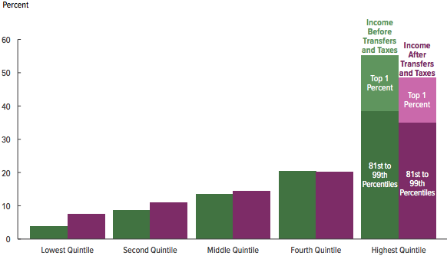
Tax and Transfer Programs: Income Shares
2017
Source: U.S. Congressional Budget Office, “The Distribution of Household Income, 2016”, Average Income Before and After Means-Tested Transfers and
Federal Taxes, by Income Group, 2016.

Slide 39
Tax and Transfer Programs help low-income Americans
US poverty levels with and without tax relief and government assistance, 1967-2015
Source: Peterson Institute of International Economics, “How to fix economic inequality”

Slide 40
Tax and Transfer Programs help low-income Americans
Change in the number of people in poverty in the US after transfer programs by age group
Source: Peterson Institute of International Economics, “How to fix economic inequality”

Slide 41

Dramatically Less Progressivity in the Tax Code
1961 to 2011
Source: New York Times, from Thomas Piketty, Emmanuel Saez and Gabriel Zucman, “
Distributional National Accounts: Methods and Estimates for the United States”

Slide 42
What About Tax Rates?
400 Taxpayers with highest incomes
1992-2007
+
392%
1992-2014
Average
Tax Rate
+310%
Average
Income
-12%
-
37%
Source: IRS
Source: IRS, Statistics of Income Division, December 2016.

Slide 43
Where Does Inequality Come From? Summary
Labor characteristics
  What do workers bring to the market?
Market forces
  How does the market value the labor characteristics?
Government policies
  PRE-distribution – affecting markets
  Redistribution – affecting incomes
Notes:
There are three broad categories of forces that ultimately determine the level of inequality in an economy. It’s important to keep these sources in mind when thinking about inequality and whether it is a problem, because an understanding of these sources will inform potential policy actions. It is also important to recognize that some of these determinants of inequality may well depend on or be influenced by the level of inequality.
Education and motivation are influenced by inequality
Regular and usual compensation, rewards for innovative ideas, rewards to education

Slide 44
Outline
Definition
What happened?
Does it matter?
Is it a problem?
What to do about it

Slide 45

Why Does Inequality Matter?
Too little inequality can:
  Reduce individual motivation
  Slow economic growth
Too much inequality can:
  Slow growth
  Reduce individual motivation
Too much inequality may also:
  Divide society
  Distort political environment
  Reduce political participation
  Reduce investments in public goods
    Education
    Environmental protections

Slide 46
How Much Inequality Is too Much?
?
?
Equity
Efficiency
Efficiency
Equity
Efficiency
Equity
0
100
Z’’
Z
Z’
X
Gini Coefficient

Slide 47

Peru
China
Brazil
Germany
U.S.
Canada
https://equitablegrowth.org/research-paper/are-todays-inequalities-limiting-tomorrows-opportunities

Slide 48
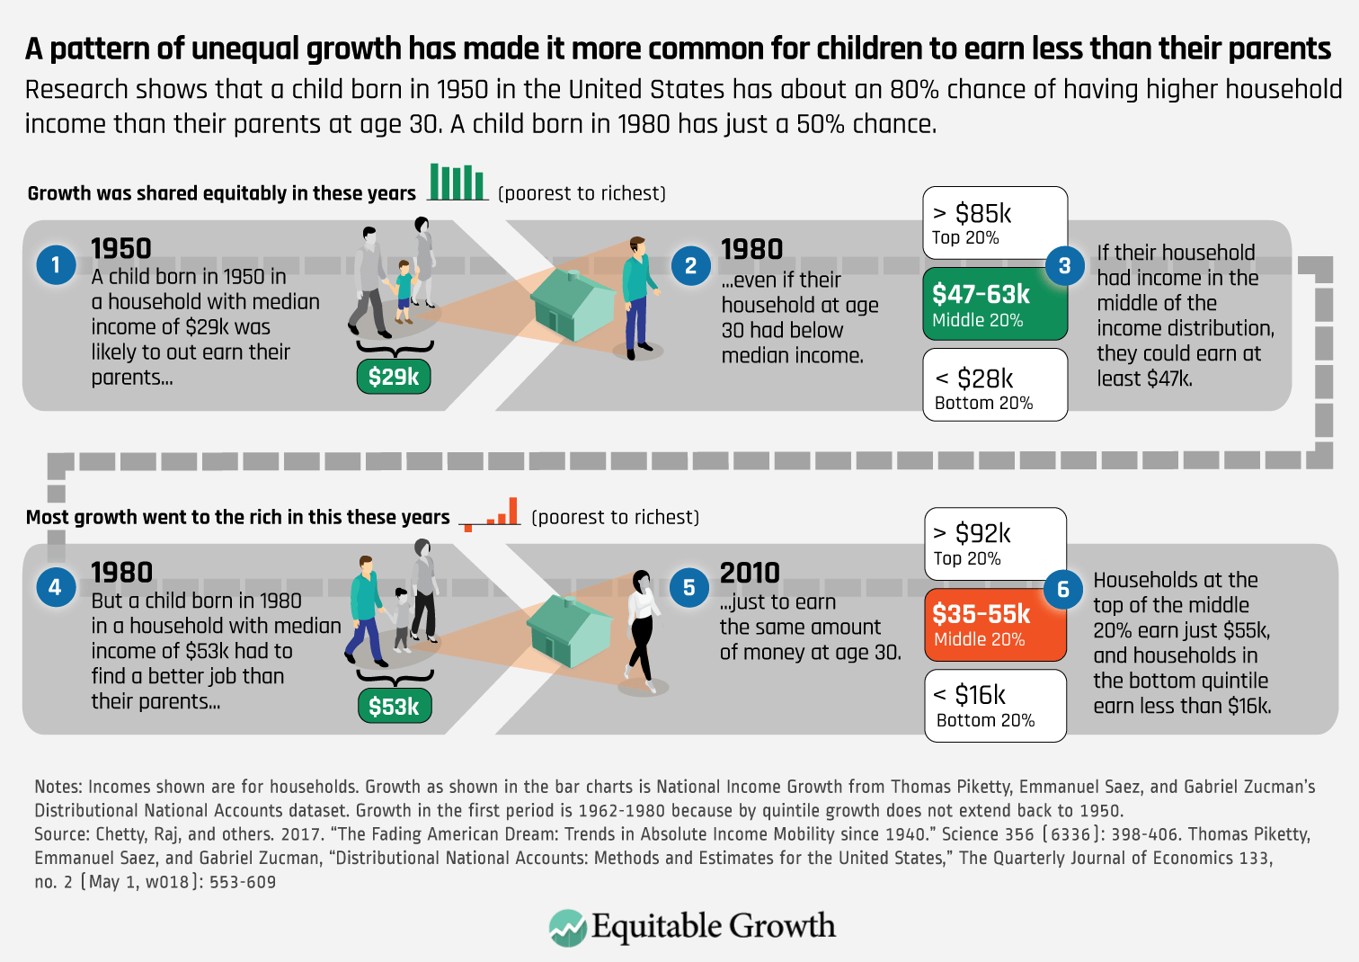

Slide 49
An International Perspective: Trends
U.S.: 17-18
Canada, UK, Germany: 12-13
Italy, France, Japan: 7-9

Slide 50
An International Perspective: Gini
Gini Coefficient, OECD countries, 2019 or latest year available
Source: OECD https://data.oecd.org/inequality/income-inequality.htm#indicator-chart

Slide 51
Outline
Definition
What happened?
Does it matter?
Is it a problem?
What to do about it

Slide 52
Addressing Inequality: Is It A Problem?
Why it might be a problem.
  Economic issues (Efficiency)
    There is evidence that at some level, increased inequality slows economic growth.
    Or, inequality concentrates resources among investors.
  Noneconomic issues (Equity)
    Values, ethics and morals will drive individual evaluations of the level of inequality.
      E.g., inequality is primarily a function of market outcomes, so should be left alone.
      Or, a solid middle class is important for maintaining a civil society, which runs contrary to a high degree of inequality.
Suppose you think it’s a problem. How might it be addressed?

Slide 53

Addressing Inequality:
Immediately Available Policy Solutions (1/2)
RE-distribution
  Tax and transfer programs
PRE-distribution
  Access to healthcare and education
  Strengthen labor unions
  Collective bargaining
  Other policies that favor labor over business owners
  Minimum wages

Slide 54
Addressing Inequality:
Immediately Available Policy Solutions (2/2)
Corporate Regulation Policies
  Reverse trends in market power
Locally
  Employment services: job training, interview skills, or assistance with day-to-day issues, such as child care
  Cognizance of the potential for technologies to affect worker/employer power dynamics
    Uber, Lyft, etc.
Notes:
Reference your own experience at FTC

Slide 55
Addressing Inequality:
Long Term
It’s all about access to resources:
  Education, in particular
    Improve public education
    Reduce disparities in quality of public education
    Improve counseling in low-income schools
      With respect to college – paths to success and funding
    Investments are needed in early education, not later (e.g. universal pre-k)
  Opportunities for wealth-building
  Housing
Initiatives whose impacts cross neighborhood and class lines and increase upward mobility specifically for black men
  Mentoring programs for black boys, efforts to reduce racial bias among whites, interventions to reduce discrimination in criminal justice, and efforts to facilitate greater interaction across racial groups.

Slide 56
The College Premium

Slide 57
Early Child Education
High-quality birth-five programs for disadvantaged kids can deliver a 13% per year return on investment improving education, employment, health outcomes and savings on later remediation costs.
Early education has tremendous benefits for kids. Research shows that kids who experience quality early learning:
  Are 25% more likely to graduate high school (Perry School Project)
  Are four times more likely to have completed a bachelor’s degree or higher (The Abecedarian Project)
  Earn up to 25% more in wages as an adult (The Jamaican Study)
Government-provided universal preschool education and childcare could financially benefit low-skilled and low-income workers and keep women in the workforce.
Source: https://heckmanequation.org/ and Start Early website

Slide 58
Early Education – International Perspective
Source: OECD Public Spending on childcare and early education

Slide 59

What to do About Inequality?
Nothing?
Redistribution?
PRE-distribution?
Access to resources?

Slide 60
Tension in Policy Solutions
Is it possible to increase growth at the same time that you reduce income inequality?
  Common refrain among some that government intervention in the economy is always and everywhere bad for growth.
Possibly: expanding equality of access promotes the full utilization of resources.
  Expanding equality of access requires resources likely from the well-to-do.

Slide 61
Summary
Income inequality is clearly increasing.
  The economy is clearly favoring owners of productive resources over labor.
The causes appear to be largely driven by:
  The market – technology, competition, and trade
  Changing institutions.
Open questions are:
  To act or not to act?
  If so, how?
The level of inequality is a policy choice.

Slide 62
Mobility
9 out of 10 of those born in the early 1940s could expect to earn more than their parents
  1 in 2 Millennials (born after 1980) earn more than their parents.
Kathy Wilson, Kent State University

Slide 63
Thank you!
Any Questions?
www.NEEDelegation.org
Adina Ardelean, Ph.D.
atardelean@scu.edu
Contact NEED: info@needelegation.org
Submit a testimonial: www.NEEDelegation.org/testimonials.php
Become a Friend of NEED: www.NEEDelegation.org/friend.php

