Slide 1
Osher Lifelong Learning Institute, Fall 2023
Contemporary Economic Policy
University of New Hampshire
Fall, 2023
Jon Haveman, Ph.D.
National Economic Education Delegation

Slide 2
National Economic Education Delegation
Vision
  One day, the public discussion of policy issues will be grounded in an accurate perception of the underlying economic principles and data.
Mission
  NEED unites the skills and knowledge of a vast network of professional economists to promote understanding of the economics of policy issues in the United States.
NEED Presentations
  Are nonpartisan and intended to reflect the consensus of the economics profession.

Slide 3
Who Are We?
Honorary Board: 54 members
  2 Fed Chairs: Janet Yellen, Ben Bernanke
  6 Chairs Council of Economic Advisers
    Furman (D), Rosen (R), Bernanke (R), Yellen (D), Tyson (D), Goolsbee (D)
  3 Nobel Prize Winners
    Akerlof, Smith, Maskin, Bernanke
Delegates: 652+ members
  At all levels of academia and some in government service
  All have a Ph.D. in economics
  Crowdsource slide decks
  Give presentations
Global Partners: 48 Ph.D. Economists
  Aid in slide deck development

Slide 4


Where Are We?

Slide 5
Available NEED Topics Include:
US Economy
Healthcare Economics
Climate Change
Economic Inequality
Economic Mobility
Trade and Globalization
Minimum Wages
Immigration Economics
Housing Policy
Federal Budgets
Federal Debt
Black-White Wealth Gap
Autonomous Vehicles
US Social Policy

Slide 6
Course Outline
Contemporary Economic Policy
  Week 1 (10/24): Economic Inequality (Jon Haveman, NEED)
  Week 2 (10/31): Economic Update (Geoffrey Woglom, Amherst College)
  Week 3 (11/7): Monetary Policy (Geoffrey Woglom)
  Week 4 (11/14): Crypto Currencies (Joan Nix, CUNY)
  Week 5 (11/21): International Institutions (Alan Deardorff, U of Michigan)
  Week 6 (11/28): Federal Debt (Brian Peterson Lagrange College)

Slide 7
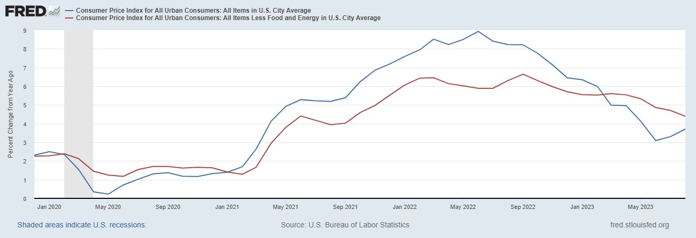
Inflation during the Recovery (CPI)
Notes:
August CPI yoy 8.3% down from 8.5 and Core 6.3 up from 6.3 in JUly

Slide 8
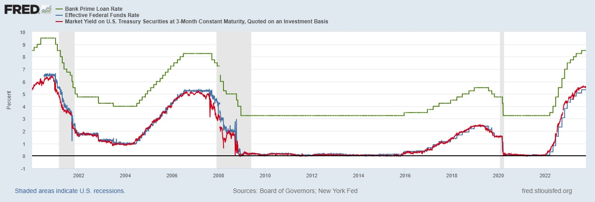
The Fed and Short-term Interest Rates
Blue is the fed funds rate.
Red is the rate on 3 month Treasuries.
Green is the prime bank lending rate
Notes:
Take note over the redline peeking above the others

Slide 9
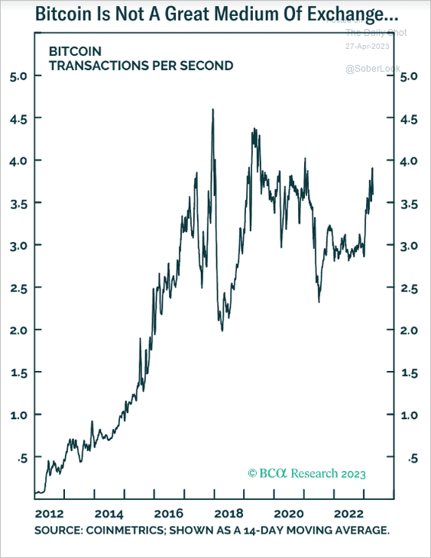
Question #1: Is Bitcoin serving an economic role
Bitcoin is not and cannot be widely used to make transactions
Scalability?
Price Instability.
Transactions costs
And, the network is costly
  Resources used in mining
  Environmental Costs
BIS, Annual Report 2018, Chapter V
Notes:
Presently, Bitcoin mining requires 150-200 terawatt-hours per year, more than Thailand with a carbon footprinttof the Czech Republicenergy consumption (although less than is used in gold mining). (Note there are other consensus mechanisms that do not use as much energy.)
In addition, computer hardware quickly becomes obsolete and is dumped.

Slide 10


International Institutions: Alan Deardorff

Slide 11
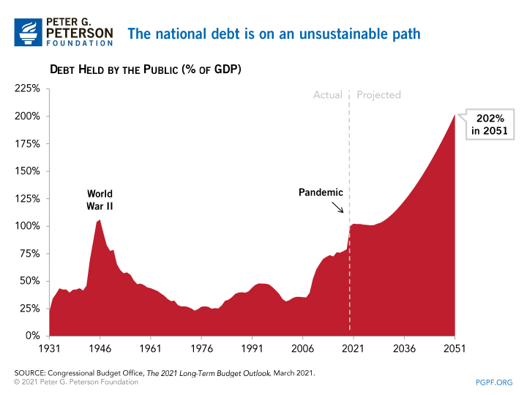
The Federal Debt is Becoming A Problem

Slide 12
Submitting Questions
Please submit questions of clarification in the chat.
  I will try to handle them as they come up.
We will do a verbal Q&A once the material has been presented.
Slides will be available from the NEED website shortly (https://NEEDEcon.org/delivered_presentations.php)

Slide 13


Economic Inequality
Jon Haveman, Ph.D.
NEED
October 24, 2023

Slide 14
Credits and Disclaimer
This slide deck was authored by:
  Jon Haveman, Executive Director of NEED
This slide deck was reviewed by:
  Timothy Smeeding, University of Wisconsin
  Robert Wright, Augustana University
Disclaimer
  NEED presentations are designed to be nonpartisan
  It is, however, inevitable that the presenter will be asked for and will provide their own views
  Such views are those of the presenter and not necessarily those of the National Economic Education Delegation (NEED)

Slide 15
Outline
Definition
Measurement
How does it happen?
Does it matter?
Is it a problem?
What to do about it

Slide 16

Economic Inequality: Income
Definition:
  The extent to which the distribution of income deviates from complete equality.
  The dispersion of income throughout the economy.

Slide 17
Different Ways of Thinking About Inequality
Income Inequality
  Before taxes and transfers
  After taxes and transfers
Wealth Inequality
How does wealth differ from income?
Income is measured over a period of time, say one year.
Wealth is one’s accumulated savings, including physical and financial assets (net worth).

Slide 18
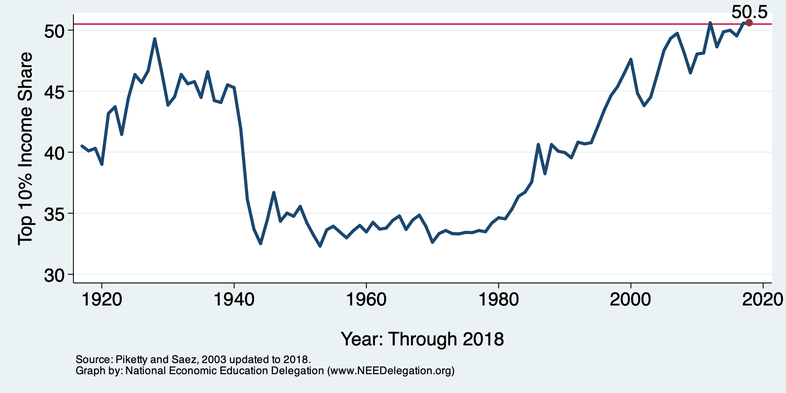
National Income Inequality: Share of Top 10%
Stock Market Crash
WWII
Housing Bubble
Dot-com Bubble

Slide 19
Recent Facts on Income Inequality
Beginning in the 1970s, income gaps widened.
  Income growth in the middle and lower parts of the distribution slowed.
  Incomes at the top continued to grow strongly.
Source: Chad Stone, Danilo Trisi, Arloc Sherman, and Roderick Taylor, “A Guide to Statistics on Historical Trends in Income Inequality,”
Center on Budget and Policy Priorities, Policy Futures, May 15, 2018.

Slide 20

The Abrupt Increase in Inequality
Source: Chad Stone, Danilo Trisi, Arloc Sherman, and Roderick Taylor, “A Guide to Statistics on Historical Trends in Income Inequality,”
Center on Budget and Policy Priorities, Policy Futures, Dec. 11, 2018.
Notes:
Slide taken from page 10, Chad Stone, Danilo Trisi, Arloc Sherman, and Roderick Taylor, “A Guide to Statistics on Historical Trends in Income Inequality,” May 15, 2018

Slide 21
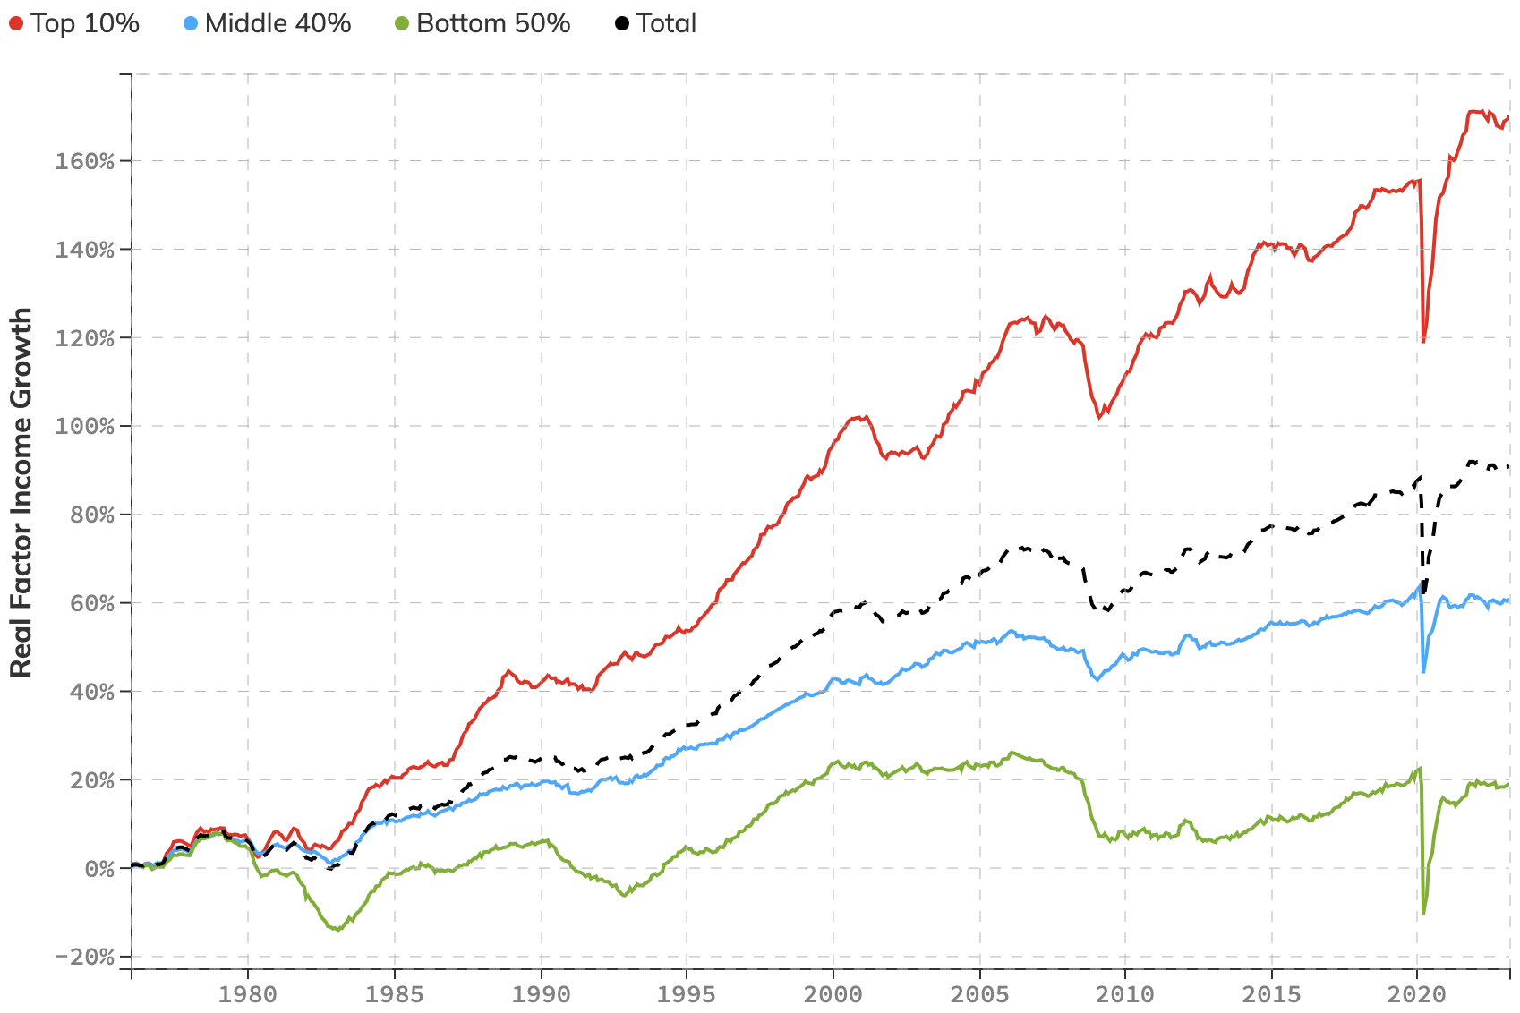
The Abrupt Increase in Inequality
Inflation Adjusted Income Growth
COVID
Source: https://realtimeinequality.org

Slide 22
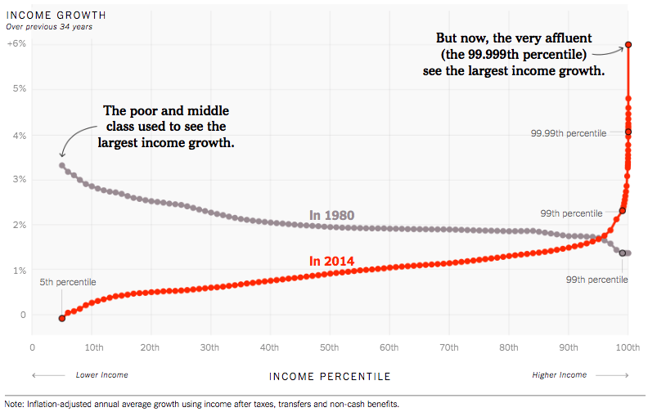
Income Growth Patterns Have Changed!
Source: https://www.nytimes.com/interactive/2017/08/07/opinion/leonhardt-income-inequality.html

Slide 23
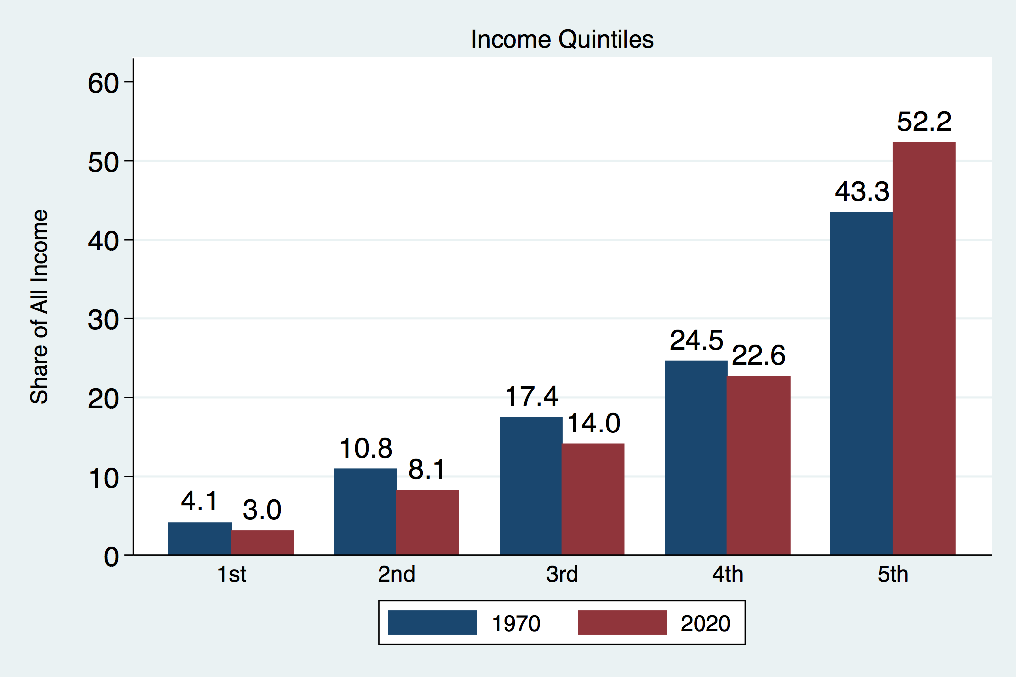
Income Share Changes Between 1970 and 2020
Source: U.S. Census Bureau, Current Population Survey, Annual Social and Economic Supplements.

Slide 24
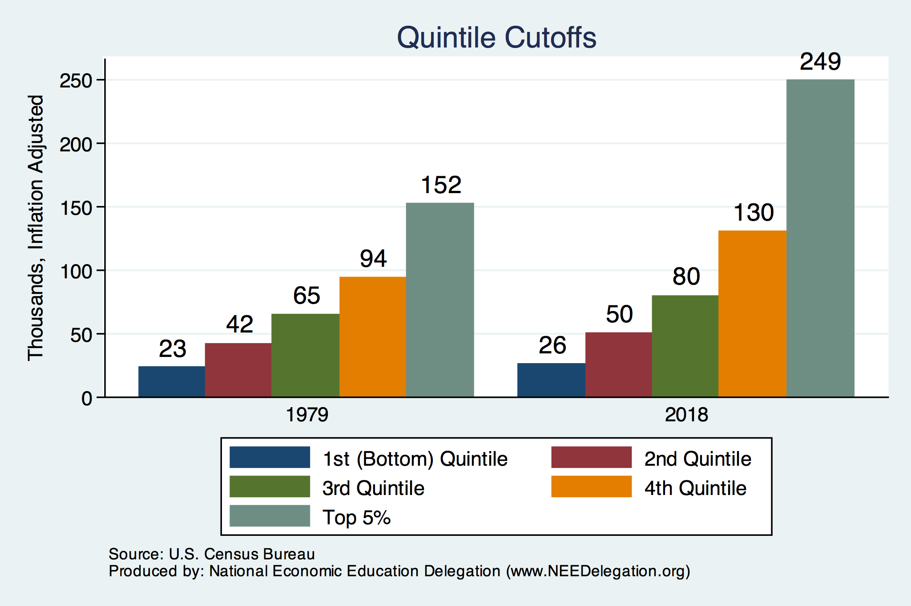
Quintile Income Cutoffs
Top 5%

Slide 25
Income Changes from Growing Inequality
Bottom 90%
of Households

Slide 26
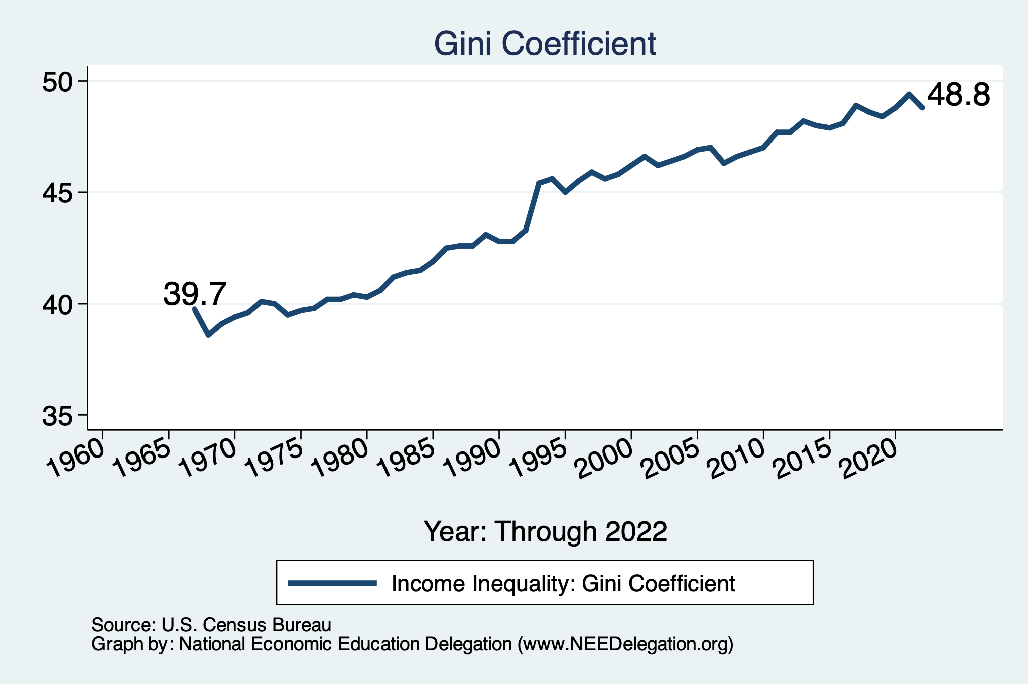
Income Inequality: Gini Coefficient Over Time

Slide 27
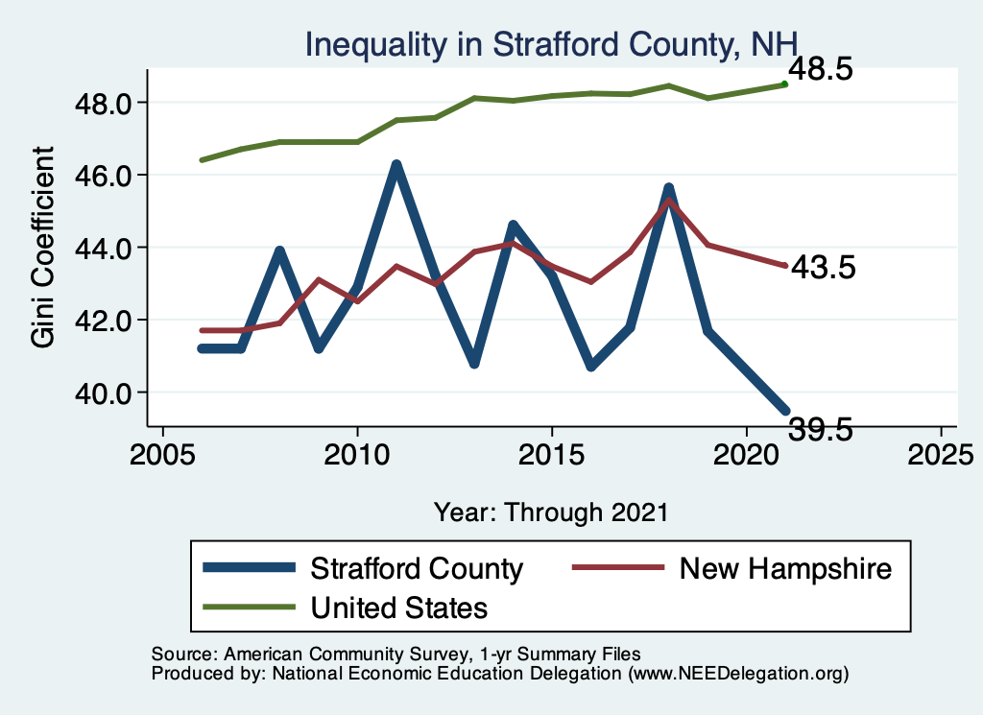
Your Local Inequality Trend

Slide 28
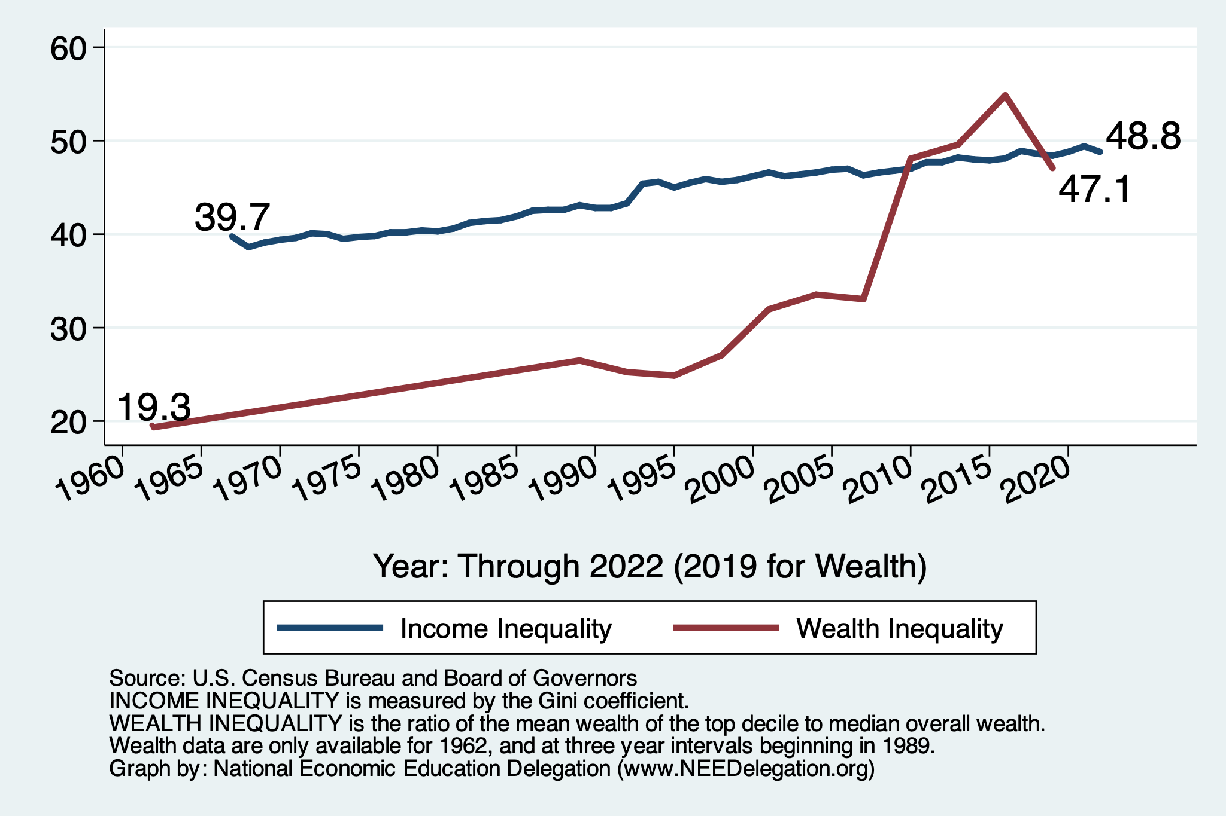
Income and Wealth Inequality Measures

Slide 29

Wealth Concentration Has Been Rising
2019 Overall Median: $121,700

Slide 30
Wealth Inequality Exceeds Income Inequality
Source: Chad Stone, Danilo Trisi, Arloc Sherman, and Roderick Taylor, “A Guide to Statistics on Historical Trends in Income Inequality,”
Center on Budget and Policy Priorities, Policy Futures, Dec. 11, 2018.

Slide 31
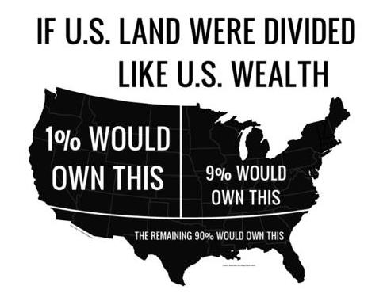
Wealth inequality in America

Slide 32
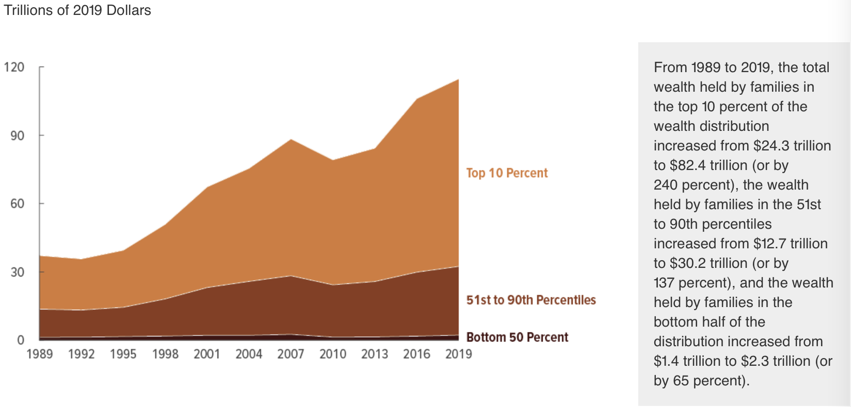
Total Family Wealth, by Wealth Group
Notes:
Tremendous growth in wealth between 1989 and 2019.
It all went to the top half of the wealth distribution and
most of it went to the very top.

Slide 33
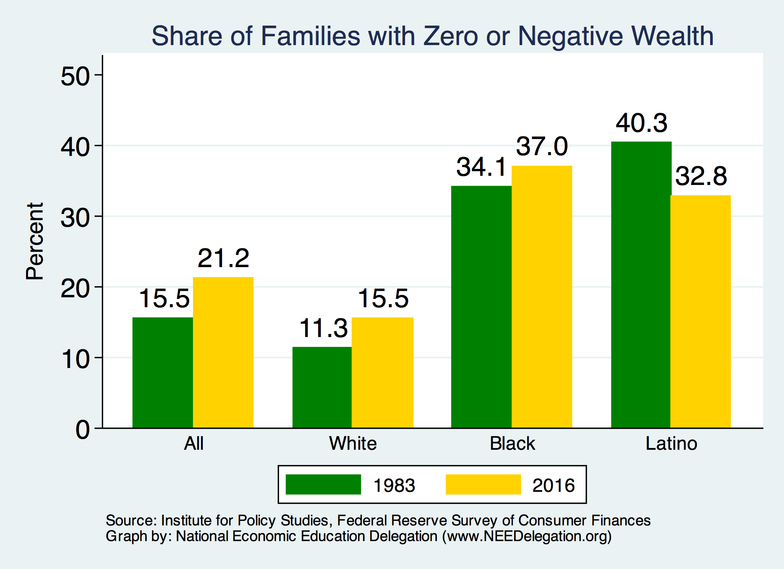
Evidence of Disparities: Zero Wealth

Slide 34

The Black-White Wealth Gap
Mean is
7x Greater
Median is 8x Greater

Slide 35
Where Does Income Inequality Come From?
Labor Characteristics
  Demographics
    Age distribution
  Personal Choices
    Educational attainment
    Effort & Priorities
  Immigration and Emigration
Market Forces
  Technology
  Changing demand patterns
  Competition for labor
Government Policy
  Market influence
  Redistribution

Slide 36
Government Policy and Inequality
Market Influence: PRE-distribution
  Characteristics of labor
    Access to education
  Effects on labor demand
    Market regulation
      Competition policy
    Labor regulations
      Minimum wage, overtime, health insurance, union regulations, etc.
RE-distribution
  Tax Rates
  Income support
    Direct aid
    Food stamps

Slide 37
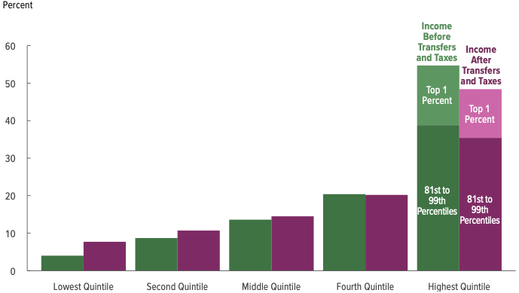
Tax and Transfer Programs and Inequality
2019
Source: U.S. Congressional Budget Office, “The Distribution of Household Income, 2014”, Average Income Before and After Means-Tested Transfers and
Federal Taxes, by Income Group, 2014.

Slide 38
What About Tax Rates?
400 Taxpayers with highest incomes
1992-2007
+
392%
1992-2014
Average
Tax Rate
+310%
Average
Income
-12%
-
37%
Source: IRS
Source: IRS, Statistics of Income Division, December 2016.

Slide 39

Dramatically Less Progressivity in the Tax Code
1961 to 2011
Source: New York Times, from Thomas Piketty, Emmanuel Saez and Gabriel Zucman, “
Distributional National Accounts: Methods and Estimates for the United States”

Slide 40
Market Forces and Inequality
Changing demand patterns
  Technology and “skill-biased technological change”
  Increased Trade and Globalization
  Industry composition
    PCs instead of typewriters
    Services instead of goods
    Professional services instead of personal services
Competition in labor markets
  Unionization
  Market concentration

Slide 41

Labor Income is Unhinged from Productivity
Why? Some theories:
Declining unionization
Competition policy
Technological change
Globalization

Slide 42

Declining Unionization
Unionization Rates
1983: 20.1%
2022: 10.1%
Unionization Rates
Public: 33.1%
Private: 6.0%
Source: https://inequality.org/facts/income-inequality/, Bureau of Labor Statistics and Emmanueul Saez, University of Califonria, Berkeley
Notes:
https://voxeu.org/article/forms-and-sources-inequality-united-states

Slide 43

CEO Pay Has Been Growing Rapidly

Slide 44

CEO Pay Has Been Growing Rapidly

Slide 45
Technological Change and Inequality
Much of the technology adopted in the last 30 years has eliminated low-skill or low-wage jobs.
  Computers, advanced manufacturing equipment, steel mini-mills, automation
Technological change may result in “winner take all” outcomes.
  This likely favors a small group of individuals.
  But of course the relative winners can change rapidly.
Both aspects increase inequality by increasing the rewards to:
  Those with significant labor market skills.
  Owners over workers

Slide 46


Technology Effects on Low Income Workers
Technology can improve worker productivity and create jobs
But technology can also displace jobs

Slide 47
Globalization
What is globalization?
  Flow of goods, services, capital, and labor across international borders.
How does it affect inequality?
  Through a differential impact on low-skilled workers and hence their wages.
  For the United States, globalization is thought to lower the wages of low skilled and hence low-wage workers relative to those of high-skilled workers.

Slide 48
What is driving increasing inequality?
Primary drivers:
  Technological change
  Increased globalization and trade
  Institutions and policy choices
These drivers can also influence personal choices in ways that affect measured income inequality.
  For example, educational choices or labor force participation.

Slide 49

Why Does Inequality Matter?
Too little inequality can:
  Reduce individual motivation
  Slow economic growth
Too much inequality can:
  Reduce individual motivation
  Slow economic growth
Too much inequality may also:
  Divide society
  Distort political environment
  Reduce political participation
  Affect public goods spending and distribution
    Education
    Environmental protections

Slide 50

Peru
China
Brazil
Less Economic Mobility
Germany
U.S.
Canada
https://equitablegrowth.org/research-paper/are-todays-inequalities-limiting-tomorrows-opportunities

Slide 51
Addressing Inequality: Is It A Problem?
Why might it be a problem?
  Economic issues (Efficiency)
    Inequality can misallocate resources and slow economic growth.
    Maybe not a problem? Inequality can concentrate resources with investors.
  Noneconomic issues (Equity)
    Values, ethics, and morals will drive individual evaluations of inequality.
    Depends on personal beliefs about origins and consequences of inequality.
Suppose you think it’s a problem. How might it be addressed?

Slide 52

Addressing Inequality:
Immediately Available Policy Solutions
RE-distribution
  Tax and transfer programs
PRE-distribution
  Reduce market power
  Unionization
  Collective bargaining
  Minimum wages
  Job training and interview skills
  Family care policies

Slide 53
Addressing Inequality:
Long Term
It’s all about access to resources:
  Improve public education and reduce quality disparities across schools.
  Improve counseling - paths to higher ed and funding for low-income students.
  Invest in early childhood education, not later (e.g. universal pre-k).
  Promote opportunities for wealth-building.
  Increase housing supply, especially in high-price, high-opportunity cities.
Focus on most affected groups:
  Mentoring programs for minority youth.
  Programs to address racial bias and discrimination in work and criminal justice.
  Efforts to desegregate and facilitate greater interaction across racial groups.

Slide 54
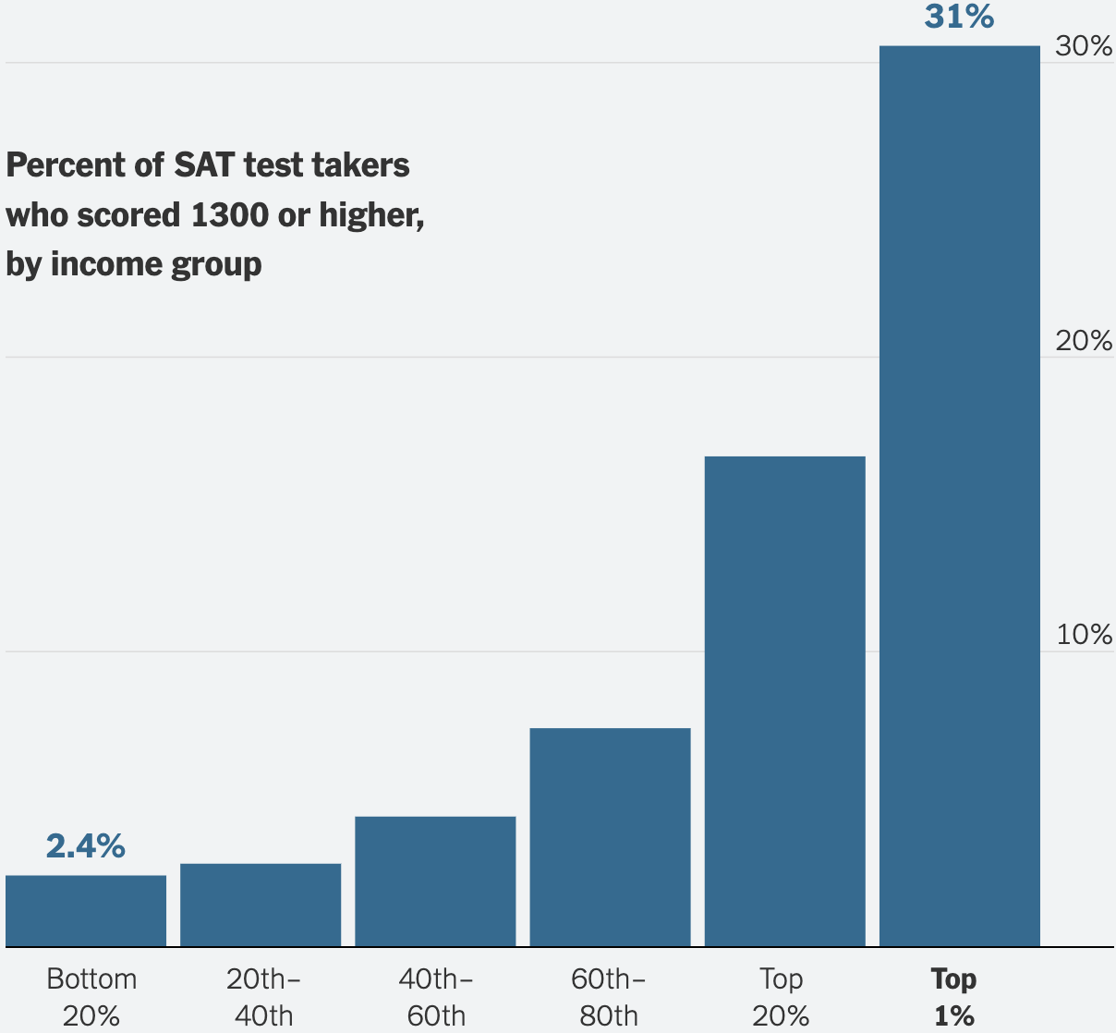
To Emphasize the Access Issue

Slide 55
An International Perspective: Comparables
U.S.: 17-18
Canada, UK, Germany: 12-13
Italy, France, Japan: 7-9

Slide 56

What to do About Inequality?
Nothing?
Redistribution?
PRE-distribution?
Access to resources?

Slide 57
Summary
Income inequality is clearly increasing.
  Owners of productive resources seeing greater income growth than workers reliant on labor income only.
The causes appear to be largely driven by:
  Technology, competition, and trade
  Institutions and public policies
Open questions are:
  To act or not to act?
  If so, how?
The level of inequality is a policy choice necessarily involving complex tradeoffs.

Slide 58
Inflation during the Recovery (CPI)
Notes:
August CPI yoy 8.3% down from 8.5 and Core 6.3 up from 6.3 in JUly

Slide 59
Thank you!
Any Questions?
www.NEEDEcon.org
Jon Haveman, Ph.D.
Jon@NEEDEcon.org
Contact NEED: info@NEEDEcon.org
Submit a testimonial: www.NEEDEcon.org/testimonials.php
Become a Friend of NEED: www.NEEDEcon.org/friend.php

