Slide 1
Osher Lifelong Learning Institute, Fall 2023
Contemporary Economic Policy
University of North Florida
December 5, 2023
Jon Haveman, Ph.D.
National Economic Education Delegation

Slide 2
Course Outline
Contemporary Economic Policy
  Week 1 (10/24): Economic Update (Geoffrey Woglom, Amherst College)
  Week 2 (10/31): Trade and Globalization (Alan Deardorff, U of Michigan)
  Week 3 (11/07): International Institutions (Alan Deardorff, U of Michigan)
  Week 4 (11/28): Economics of Immigration (Roger White, Whittier College)
  Week 5 (12/05): Economic Inequality (Geoffrey Woglom, Amherst College)
  Week 6 (12/12): Monetary Policy (Geoffrey Woglom, Amherst College)

Slide 3
Available NEED Topics Include:
US Economy
Healthcare Economics
Climate Change
Economic Inequality
Economic Mobility
Trade and Globalization
Minimum Wages
Immigration Economics
Housing Policy
Federal Budgets
Federal Debt
Black-White Wealth Gap
Autonomous Vehicles
US Social Policy

Slide 4
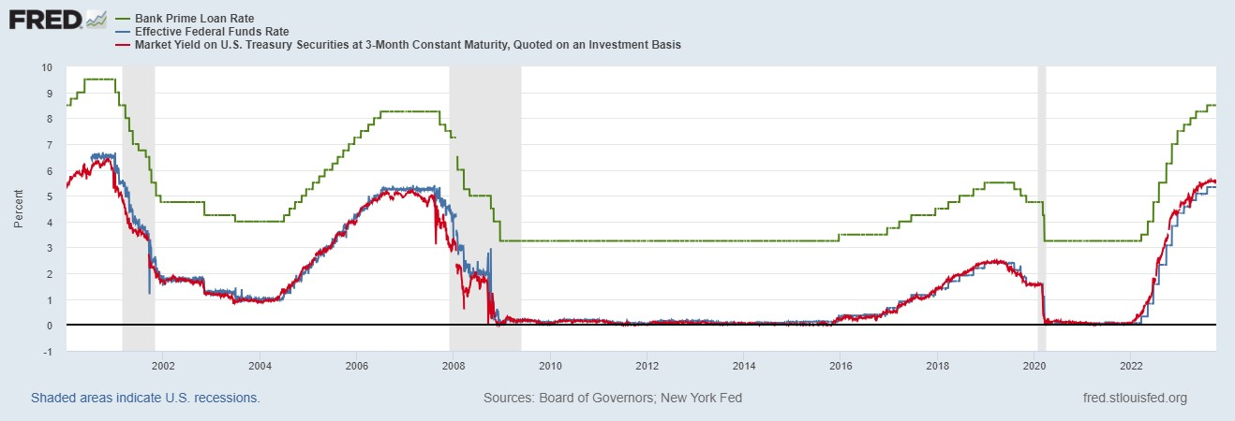
The Fed and Short-term Interest Rates
Blue is the fed funds rate.
Red is the rate on 3 month Treasuries.
Green is the prime bank lending rate
For Next week:
https://sites.google.com/view/macro-current-issues/monetary-policy
Notes:
Take note over the redline peeking above the others

Slide 5
Submitting Questions
Please submit questions of clarification in the chat.
  I will try to handle them as they come up.
We will do a verbal Q&A once the material has been presented.
Slides will be available from the NEED website shortly (https://NEEDEcon.org/delivered_presentations.php)

Slide 6


Economic Inequality
Geoffrey Woglom
Amherst College (emeritus)
December 5, 2023

Slide 7
Credits and Disclaimer
This slide deck was authored by:
  Jon Haveman, Executive Director of NEED
  Geoffrey Woglom, Amherst College
This slide deck was reviewed by:
  Timothy Smeeding, University of Wisconsin
  Robert Wright, Augustana University
Disclaimer
  NEED presentations are designed to be nonpartisan
  It is, however, inevitable that the presenter will be asked for and will provide their own views
  Such views are those of the presenter and not necessarily those of the National Economic Education Delegation (NEED)

Slide 8
Outline
Definition
Snapshots of US Inequality
Inequality over time
Does it matter?
The New Inequality?
What to do about it

Slide 9

Economic Inequality: Income
Definition:
  The extent to which the distribution of income deviates from complete equality.
  The dispersion of income throughout the economy.

Slide 10
Different Ways of Thinking About Material Inequality
Income Inequality
  Before taxes and transfers
  After taxes and transfers
Wealth Inequality
How does wealth differ from income?
Income is measured over a period of time, say one year and measures ability to consume today.
Wealth is one’s accumulated savings, including physical and financial assets (net worth), and measures the ability to consume now and in the future.

Slide 11
Measuring Material Inequality
median: $70,260
top 10% 52.3% of total
Top 10% comprise 73% of total
Federal Reserve Board “Survey of Consumer Finances”

Slide 12
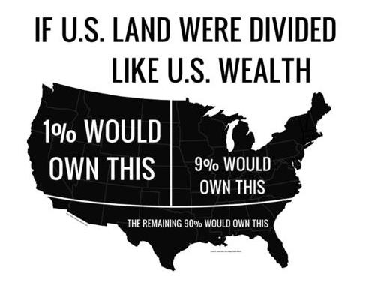
Wealth inequality in America

Slide 13
Income Inequality by Location

Slide 14
How We Compare to the Rest of the World
https://files.stlouisfed.org/files/htdocs/publications/page1-econ/2022/09/01/income-and-wealth-inequality_SE.pdf

Slide 15
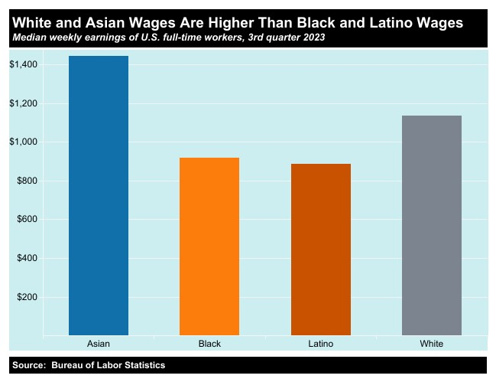
Racial Wage Gaps

Slide 16
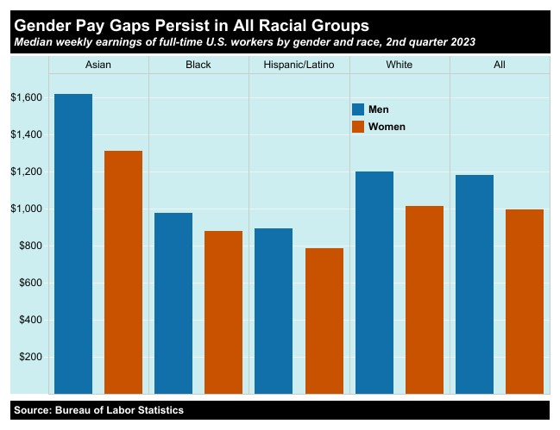
Gender Pay Gaps

Slide 17
Racial and Gender Wealth Inequality

Slide 18
Household Wealth by Education, 2023, Q2

Slide 19
Education Matters for Broader Measures of Inequality
Ratio of indicators of well being
OECD, “How’s Life in the United States?” https://www.oecd.org/wise/Better-Life-Initiative-country-note-United-States.pdf \

Slide 20
Case and Deaton’s Astounding Findings
Opioids were involved in more than 80,000 overdose deaths in 2021, which was 10 times the number of opioid overdose deaths in 1999. http://wonder.cdc.gov/

Slide 21
Summary of Snapshot
Top 1% earns over 50% of total income and 70% of total wealth
US is one of the more unequal countries in the industrialized world.
Within the US., substantial dimensions of inequality by geography, race, gender and educational attainment.
Earning a BA is important for
  Earnings.
  Life Satisfaction.
  Life Expectancy

Slide 22
How Did We Get Here: The Long View
T. Piketty and E. Saez, available at :https://gabriel-zucman.eu/usdina/

Slide 23
Long View of Wealth Inequality
Material Inequality was higher in the 1920s, but fell in the post WWII era
T. Piketty and E. Saez, available at :https://gabriel-zucman.eu/usdina/

Slide 24
Recent Facts on Income Inequality
Beginning in the late 1970s, income gaps widened.
  Income growth in the middle and lower parts of the distribution slowed.
  Incomes at the top continued to grow strongly.
Source: Chad Stone, Danilo Trisi, Arloc Sherman, and Roderick Taylor, “A Guide to Statistics on Historical Trends in Income Inequality,”
Center on Budget and Policy Priorities, Policy Futures, May 15, 2018.

Slide 25

The Abrupt Increase in Inequality
Source: Chad Stone, Danilo Trisi, Arloc Sherman, and Roderick Taylor, “A Guide to Statistics on Historical Trends in Income Inequality,”
Center on Budget and Policy Priorities, Policy Futures, Dec. 11, 2018.
Notes:
Slide taken from page 10, Chad Stone, Danilo Trisi, Arloc Sherman, and Roderick Taylor, “A Guide to Statistics on Historical Trends in Income Inequality,” May 15, 2018

Slide 26
Income Changes from Growing Inequality
Bottom 90%
of Households

Slide 27
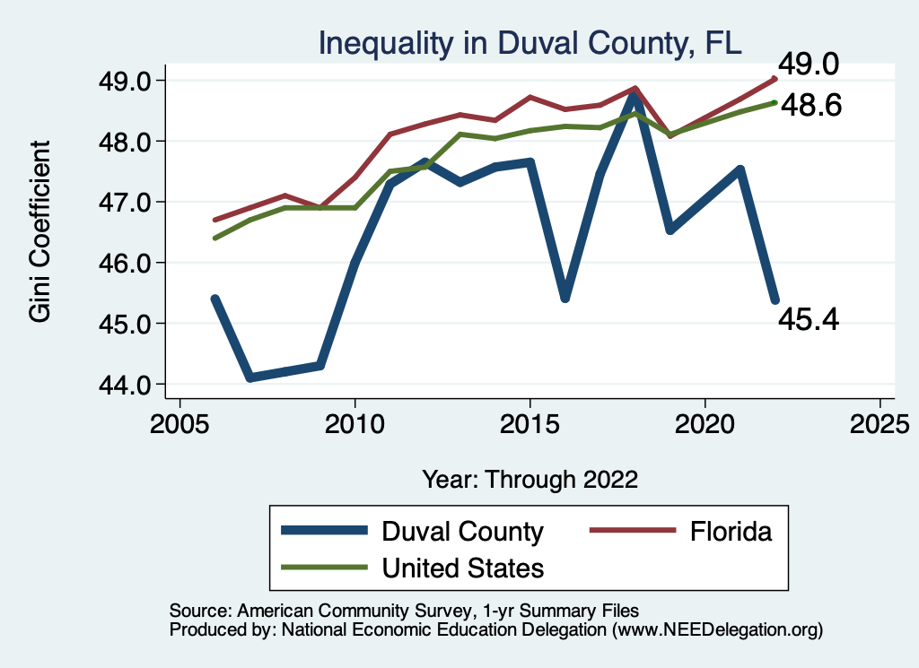
Your Local Inequality Trend

Slide 28
Increasing Inequality is Not Just US Phenomenon

Slide 29
But Global Inequality is Falling!

Slide 30
“Inequality Doesn’t Matter; Poverty Does” (?)

Slide 31
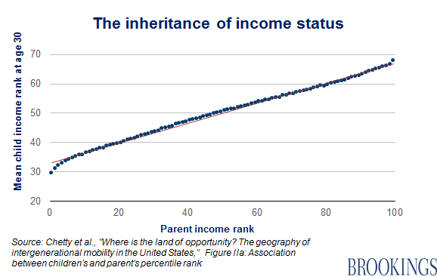
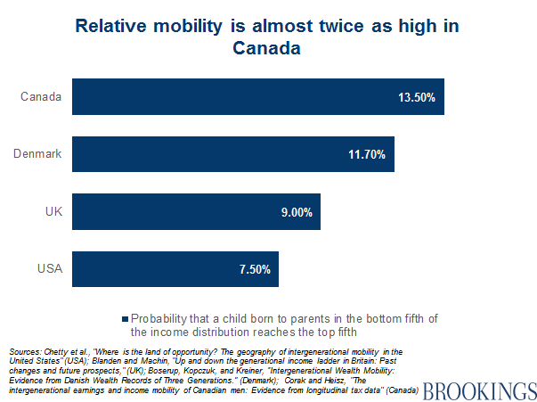
“Inequality Doesn’t Matter with Intergenerational Mobility (Horatio Alger)” (?)

Slide 32
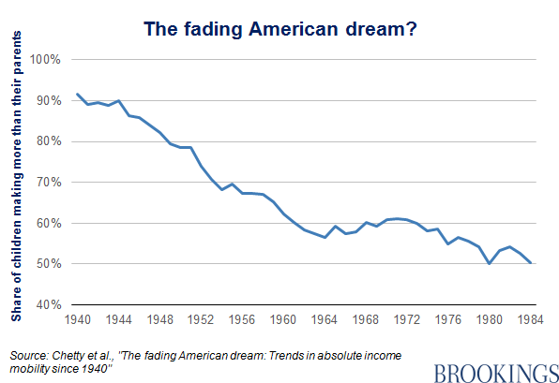
Inequality Doesn’t Matter because Children
Are Better Off Than Their Parents (?)

Slide 33
Where Does Income Inequality Come From?
Labor Characteristics
  Personal Choices
    Educational attainment
    Effort & Priorities
Market Forces
  Technology
  Globalization
  Immigration
Government Policy
  Market influence
  Redistribution

Slide 34
Government Policy and Inequality
Market Influence: PRE-distribution
  Characteristics of labor
    Access to education
  Effects on labor demand
    Market regulation
      Competition policy
    Labor regulations
      Minimum wage, overtime, health insurance, union regulations, etc.
RE-distribution
  Tax Rates
  Income support
    Direct aid
    Food stamps
  Medicare & SSA rules

Slide 35
Tax and Transfer Programs and Inequality

Slide 36
What About Tax Rates?
400 Taxpayers with highest incomes
1992-2007
+
392%
1992-2014
Average
Tax Rate
+310%
Average
Income
-12%
-
37%
Source: IRS
Source: IRS, Statistics of Income Division, December 2016.

Slide 37

Dramatically Less Progressivity in the Tax Code
1961 to 2011
Source: New York Times, from Thomas Piketty, Emmanuel Saez and Gabriel Zucman, “
Distributional National Accounts: Methods and Estimates for the United States”

Slide 38
Market Forces and Inequality
Changing demand patterns
  Technology and “skill-biased technological change”
  Increased Trade and Globalization
  Industry composition
    PCs instead of typewriters
    Services instead of goods
    Professional services instead of personal services
Competition in labor markets
  Unionization
  Market concentration

Slide 39
Technological Change and Inequality
Much of the technology adopted in the last 30 years has eliminated low-skill or low-wage jobs.
  Computers, advanced manufacturing equipment, steel mini-mills, automation
Technological change may result in “winner take all” outcomes.
  This likely favors a small group of individuals.
  But of course the relative winners can change rapidly.
Both aspects increase inequality by increasing the rewards to:
  Those with significant labor market skills and college degrees.
  Owners over workers.
What will AI do to this story?

Slide 40
Globalization
What is globalization?
  Flow of goods, services, capital, and labor across international borders.
How does it affect inequality?
  Through a differential impact on low-skilled workers and hence their wages.
  For the United States, globalization is thought to lower the wages of low skilled and hence low-wage workers relative to those of high-skilled workers.
  But Globalization lifted 300 million Chinese out of poverty.

Slide 41
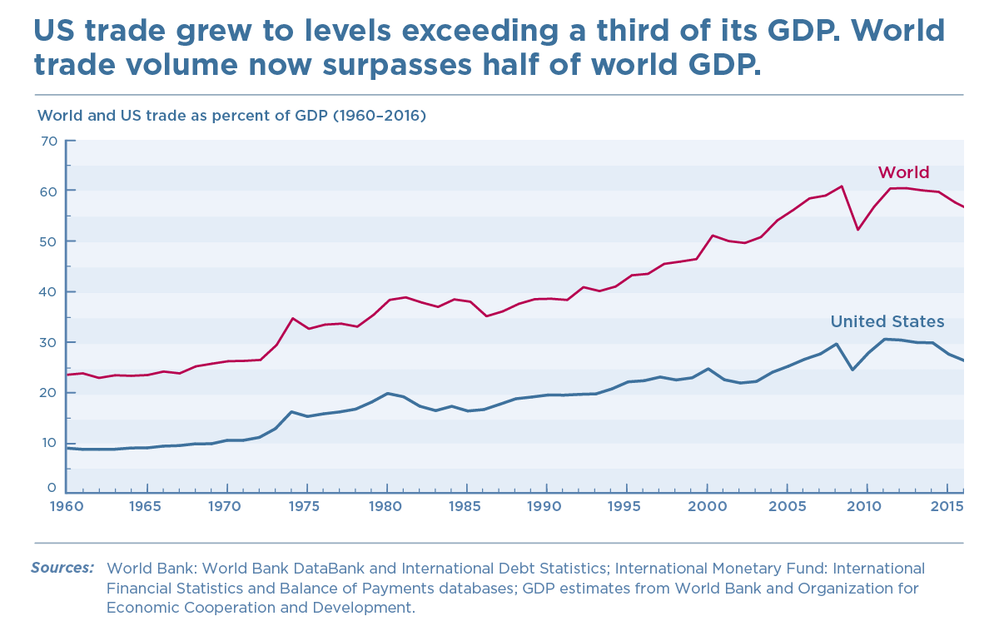
History of Globalization

Slide 42

Declining Unionization
Unionization Rates
1983: 20.1%
2022: 10.1%
Unionization Rates
Public: 33.1%
Private: 6.0%
Source: https://inequality.org/facts/income-inequality/, Bureau of Labor Statistics and Emmanueul Saez, University of Califonria, Berkeley
Notes:
https://voxeu.org/article/forms-and-sources-inequality-united-states

Slide 43
Why Does Inequality Matter?
Economic Reason: too much inequality slows economic growth.
Ethical Reasons: concern for our neighbors.
Political Reasons: political polarization leads to government paralysis and an inability to take needed action.

Slide 44
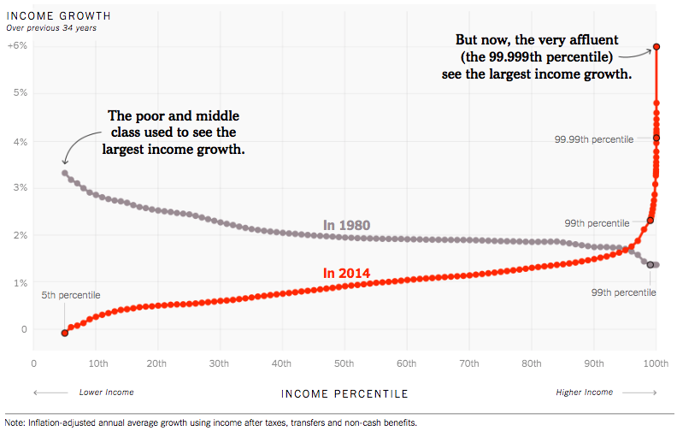
How Has Income Inequality Changed?
Source: https://www.nytimes.com/interactive/2017/08/07/opinion/leonhardt-income-inequality.html

Slide 45
Average Income Growth by Generation
Generation | Bottom 50% | Middle 40% | Top 10% | Top 1%
Greatest (46-70) | 2.85 | 2.57 | 2.03 | 1.27
Boomer (70-94) | 0.15 | 1.20 | 1.86 | 2.28
Gen X (94-15) | 0.61 | 0.93 | 1.94 | 2.56
Distributional National Accounts: Methods and Estimates for the United States (with T. Piketty and E. Saez,
Accessed from: https://gabriel-zucman.eu/usdina/ and my calculations.
Something changed in the nature of our economy and society somewhere at about the same time as the rise in inequality.

Slide 46
New Inequality due to Meritocracy
Greatest Generation and Meritocracy
  GI Bill.
  High paying, unionized manufacturing jobs.
Boomers
  1960s: SATs become more important and legacy status less for college.
  Economy is more competitive which tended to lessen prejudices against Catholics and Jews.
  The rise of suburbs
    Less socioeconomic and racial diversity.
    Investments in high quality public schools.
Gen X
  Affluent, college educated boomers invest heavily in children’s education.
  Globalization and the related decline in unionization eliminates high-paying blue collar jobs.

Slide 47
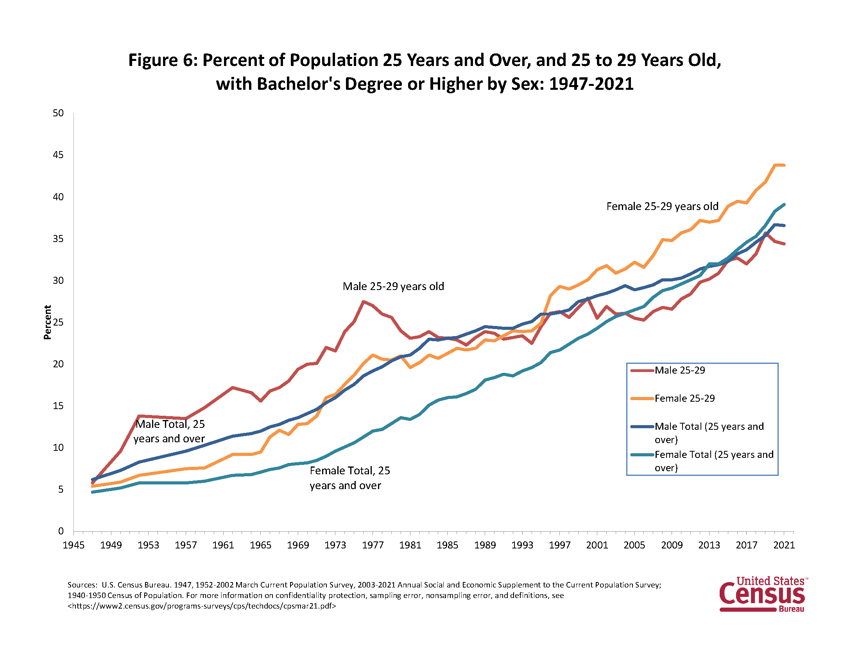
The Growing Importance of Education
David Deming, “Why Do Wages Grow Faster for Educated Workers,” NBER Workinmg Paper 31373, 6/23

Slide 48
Is it Still a “Meritocracy?”
The key question is whether there is equal opportunity for a college education.
Without equal access, the meritocracy based on educational attainment becomes an aristocracy.

Slide 49
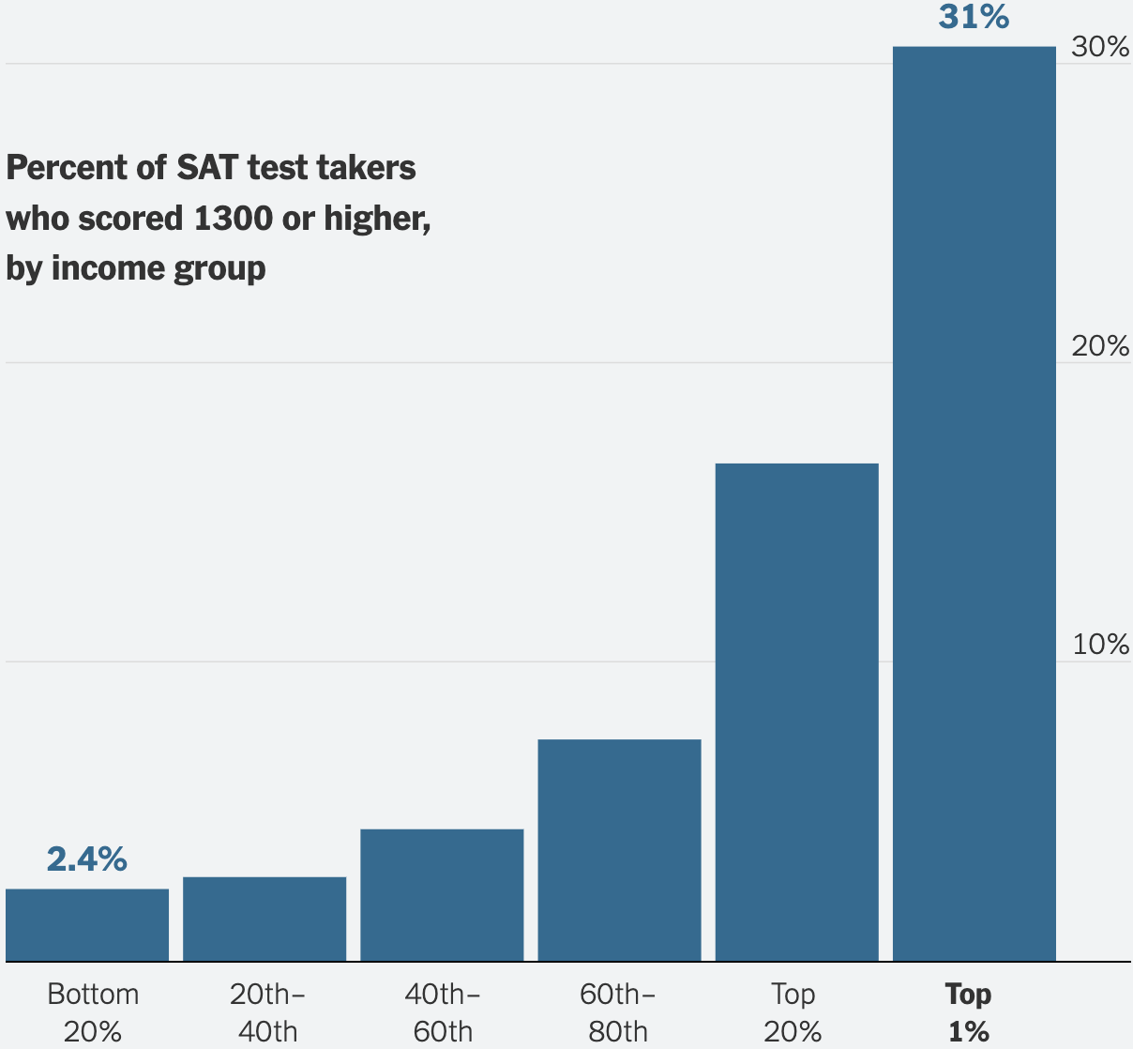
To Emphasize Educational Access Issue
What do these numbers reflect?
It gets worse. With “All Students” instead of “test takers” in the bottom 20% scoring above 1300 falls to 0.6%
And worse(er?)…
Elite schools twice as likely to admit student from a high income family as a low to middle income family
Higher admission rates for the high income is due to: 1) “Legacies; 2) higher “non-academic” rankings; 3) Athletic recruitment
https://www.nytimes.com/interactive/2023/10/23/upshot/sat-inequality.html

Slide 50
Meritocracy Hurts Rich and Poor
Poor are hurt because there is less equality of opportunity
Poor are hurt because in a meritocracy your lack of success is due your failings.
Rich are hurt because they have to work harder to confirm their status (remember long hours).
Rich are hurt because they make their children compete at an earlier age (Tiger Moms, SAT prep courses).
We are all hurt because of the growing segregation between the rich and poor and increasing polarization

Slide 51
What to do About Inequality?
Government policies to reduce material inequality:
  Greater Progressivity of Tax/Transfer System.
  Fix Social Security and Medicare Funding, but NOT by raising age of eligibility.
  Encourage re-unionization of industry. (?)
  Put limits on low-skilled immigration. (?)
  Industrial policies to provide meaningful work to non-BAs. (?)

Slide 52
What To Do about the “New Inequality”
Research shows that high-quality birth-to-five programs for disadvantaged children can deliver a 13% return on the investment. (James Heckman)
Somehow improve public schools.
Encourage students from low-income families to apply to quality colleges (Carolyn Hoxby)
Encourage colleges to practice affirmative action based on socioeconomic status (William Bowen).
Reinstitute National Service to lessen socioeconomic and racial segregation. (?)

Slide 53
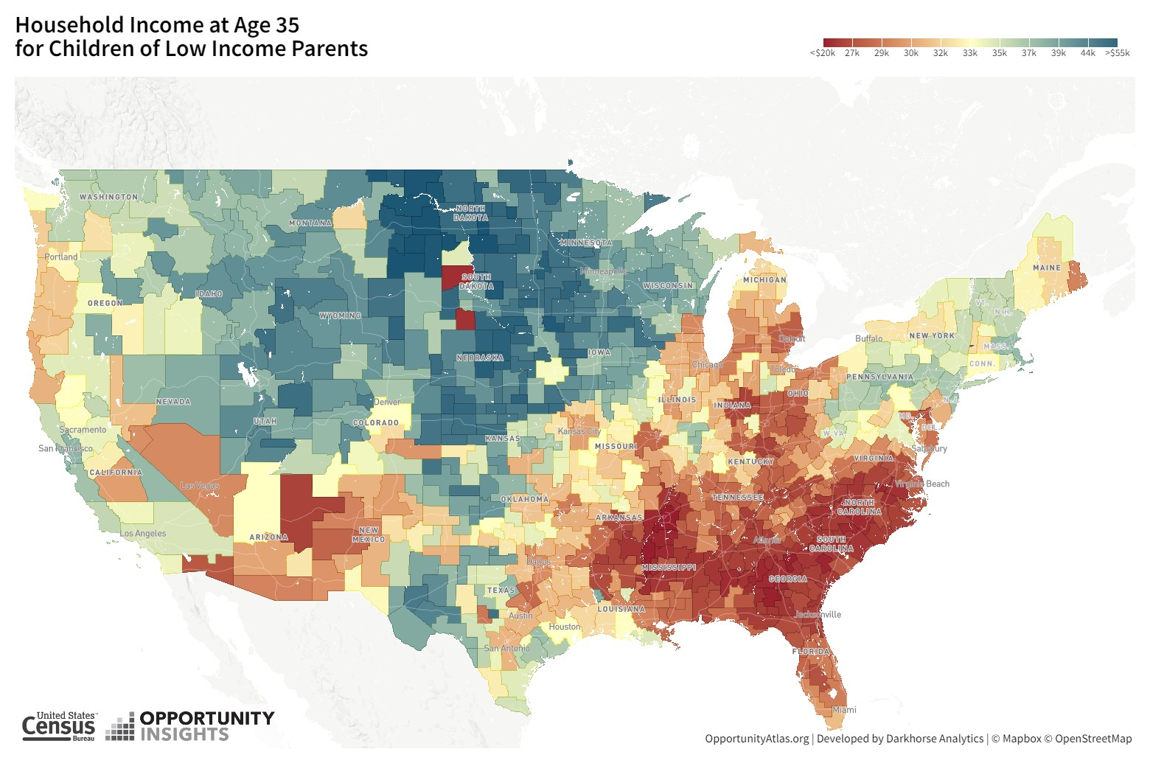
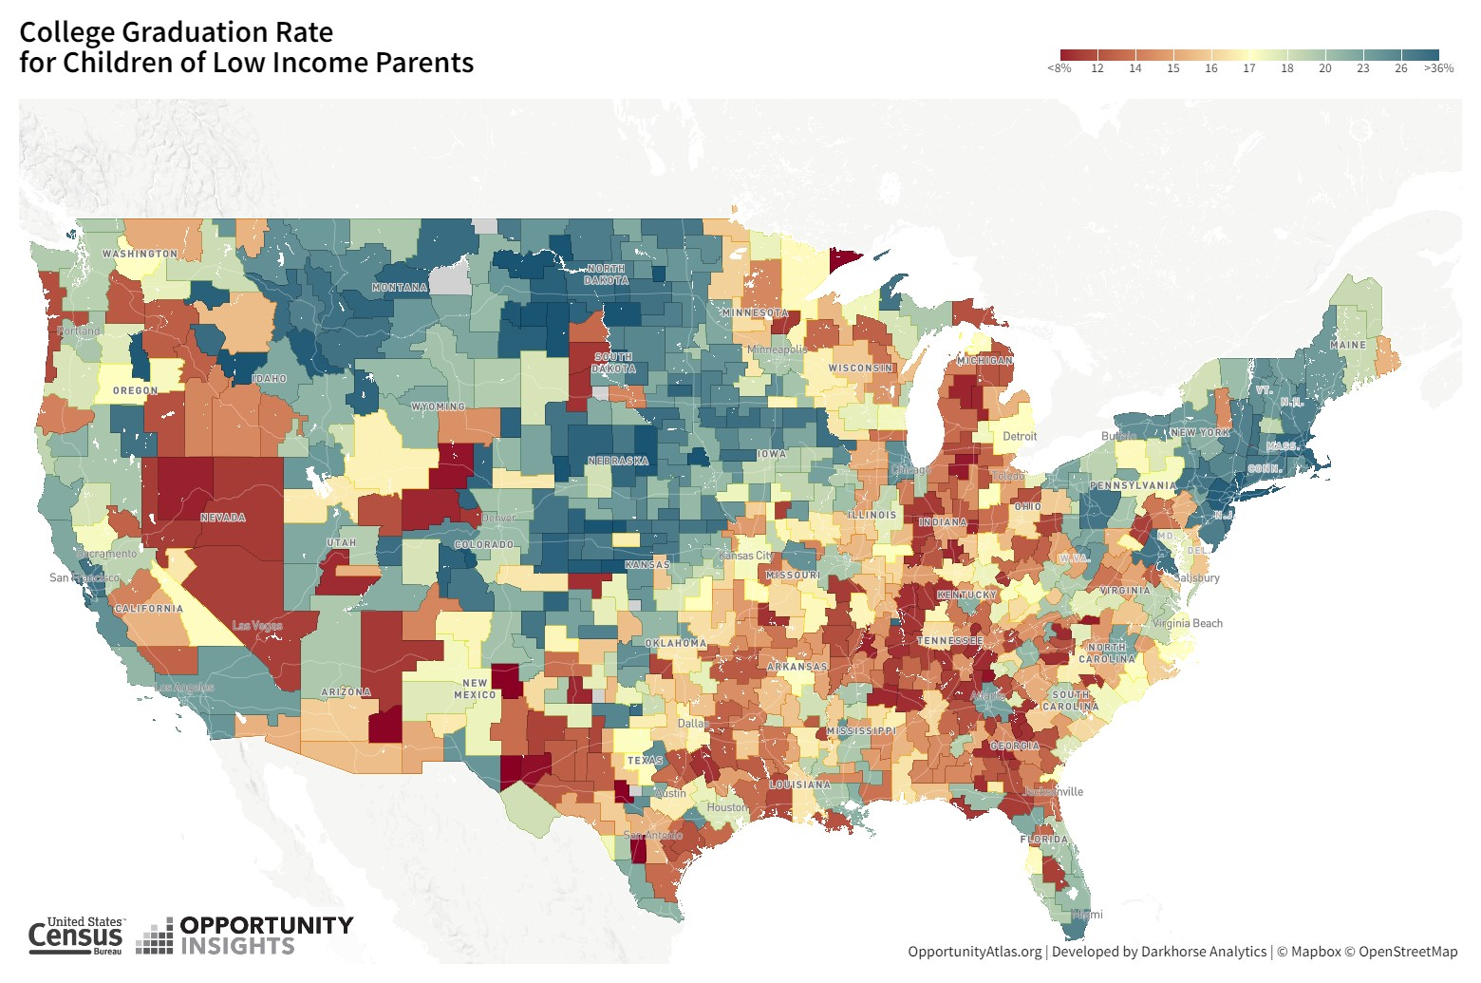
More Research on the Causes and Cures
Raj Chetty “Big Data” and Opportunity Insights
Try it yourself: https://www.opportunityatlas.org/

Slide 54
Readings on the New Ineqaulity
Roge Kama, “’The Meritocracy Trap’ Explained,”
https://www.vox.com/policy-and-politics/2019/10/24/20919030/meritocracy-book-daniel-markovits-inequality-rich
David Brooks, “What if We’re the Bad Guys,” https://www.nytimes.com/2023/08/02/opinion/trump-meritocracy-educated.html
Mathew Stewart, “The Birth of the New American Aristocracy, “The Atlantic, June 2018
Michael Sandel, “The Dark Side of Meritocracy,” https://www.noemamag.com/the-dark-side-of-meritocracy/

Slide 55
Let’s Hear from You!
Geoffrey Woglom
grwoglom@amherst.edu
Contact NEED: Info@NEEDEcon.org
Submit a testimonial: www.NEEDEcon.org/testimonials.php
Support NEED: www.NEEDEcon.org/donate.php

