Slide 1
Osher Lifelong Learning Institute, Spring 2023
Contemporary Economic Policy
University of California, Santa Cruz
May, 2023
Host: Jon Haveman, Ph.D.
National Economic Education Delegation

Slide 2
National Economic Education Delegation
Vision
  One day, the public discussion of policy issues will be grounded in an accurate perception of the underlying economic principles and data.
Mission
  NEED unites the skills and knowledge of a vast network of professional economists to promote understanding of the economics of policy issues in the United States.
NEED Presentations
  Are nonpartisan and intended to reflect the consensus of the economics profession.

Slide 3
Who Are We?
Honorary Board: 54 members
  2 Fed Chairs: Janet Yellen, Ben Bernanke
  6 Chairs Council of Economic Advisers
    Furman (D), Rosen (R), Bernanke (R), Yellen (D), Tyson (D), Goolsbee (D)
  3 Nobel Prize Winners
    Akerlof, Smith, Maskin
Delegates: 652+ members
  At all levels of academia and some in government service
  All have a Ph.D. in economics
  Crowdsource slide decks
  Give presentations
Global Partners: 48 Ph.D. Economists
  Aid in slide deck development

Slide 4
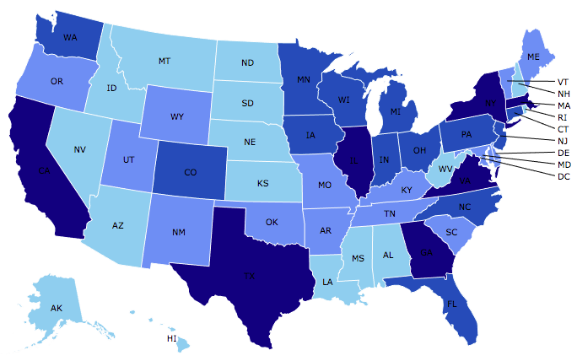

Where Are We?

Slide 5
Available NEED Topics Include:
US Economy
Healthcare Economics
Climate Change
Economic Inequality
Economic Mobility
Trade and Globalization
Minimum Wages
Immigration Economics
Housing Policy
Federal Budgets
Federal Debt
Black-White Wealth Gap
Autonomous Vehicles
Healthcare Economics

Slide 6
Course Outline
Contemporary Economic Policy
  Week 1 (5/2): Economic Inequality
  Week 2 (5/7): Economic Mobility
  Week 3 (5/16): Discriminatory Policies in U.S. History
  Week 4 (5/23): The Black-White Wealth Gap

Slide 7
Mobility
9 out of 10 of those born in the early 1940s could expect to earn more than their parents
  1 in 2 Millennials (born after 1980) earn more than their parents.

Slide 8
Misguided Past Policies: Redlining
Red areas were largely
Black communities,
and considered to be too risky
for new home loans.
Yellow areas also suffered from discrimination resulting from FHA guidelines.

Slide 9

Evidence of the B-W Wealth Gap
Mean is
7x Greater
Median is 8x Greater

Slide 10
Submitting Questions
Please submit questions of clarification in the chat.
  I will try to handle them as they come up.
We will do a verbal Q&A once the material has been presented.
Slides will be available from the NEED website shortly (https://NEEDEcon.org/delivered_presentations.php)

Slide 11


Economic Inequality
Jon Haveman, Ph.D.
NEED
May 2, 2023

Slide 12
Credits and Disclaimer
This slide deck was authored by:
  Jon Haveman, Executive Director of NEED
This slide deck was reviewed by:
  Timothy Smeeding, University of Wisconsin
  Robert Wright, Augustana University
Disclaimer
  NEED presentations are designed to be nonpartisan
  It is, however, inevitable that the presenter will be asked for and will provide their own views
  Such views are those of the presenter and not necessarily those of the National Economic Education Delegation (NEED)

Slide 13
Outline
Definition
Measurement
How does it happen?
Does it matter?
Is it a problem?
What to do about it

Slide 14

Economic Inequality: Income
Definition:
  The extent to which the distribution of income deviates from complete equality.
  The dispersion of income throughout the economy.

Slide 15
Different Ways of Thinking About Inequality
Income Inequality
  Before taxes and transfers
  After taxes and transfers
Wealth Inequality
Consumption Inequality
How does wealth differ from income?
Income is measured over a period of time, say one year.
Wealth is one’s accumulated savings, including physical and financial assets (net worth).

Slide 16

National Income Inequality: Share of Top 10%
Stock Market Crash
WWII
Housing Bubble
Dot-com Bubble

Slide 17
Recent Facts on Income Inequality
Beginning in the 1970s, income gaps widened.
  Income growth in the middle and lower parts of the distribution slowed.
  Incomes at the top continued to grow strongly.
Source: Chad Stone, Danilo Trisi, Arloc Sherman, and Roderick Taylor, “A Guide to Statistics on Historical Trends in Income Inequality,”
Center on Budget and Policy Priorities, Policy Futures, May 15, 2018.

Slide 18

The Abrupt Increase in Inequality
Source: Chad Stone, Danilo Trisi, Arloc Sherman, and Roderick Taylor, “A Guide to Statistics on Historical Trends in Income Inequality,”
Center on Budget and Policy Priorities, Policy Futures, Dec. 11, 2018.
Notes:
Slide taken from page 10, Chad Stone, Danilo Trisi, Arloc Sherman, and Roderick Taylor, “A Guide to Statistics on Historical Trends in Income Inequality,” May 15, 2018

Slide 19
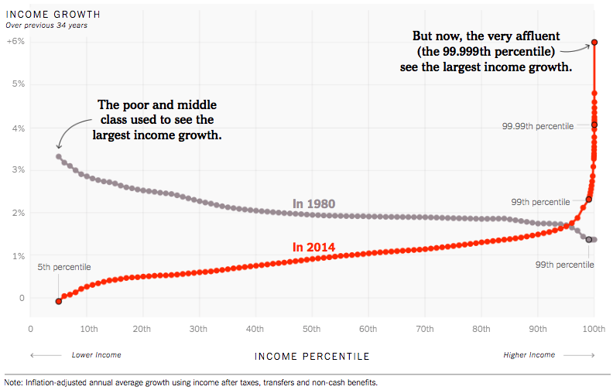
Wage Growth Patterns Have Changed!
Source: https://www.nytimes.com/interactive/2017/08/07/opinion/leonhardt-income-inequality.html

Slide 20
Gini Coefficient – Measuring Inequality
Gini coefficient – a numerical measure that summarizes the overall dispersion of income
  Ranges from 0 – 1
    0 = perfect equality – everyone has the same income
    1 = perfect inequality – one person has all the income
  In practice:
    0.5 – 0.7 – highly unequal
    0.2 – 0.35 – relatively equal
  Sometimes measured between 0 and 100.

Slide 21
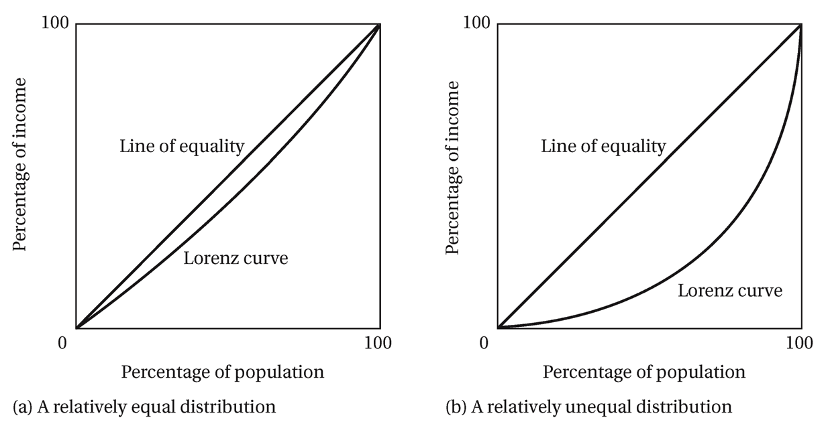
Lorenz Curve of Income Distribution
The greater the curvature of the Lorenz Curve, the greater is the degree of income inequality

Slide 22
US Income Distribution: 2015
Quintile Shares of Income
CUMULATIVE Quintile Shares of Income
Income Quintiles
Income Quintiles
Source: 2015 1-year American Community Survey, based on pre-tax household income.

Slide 23
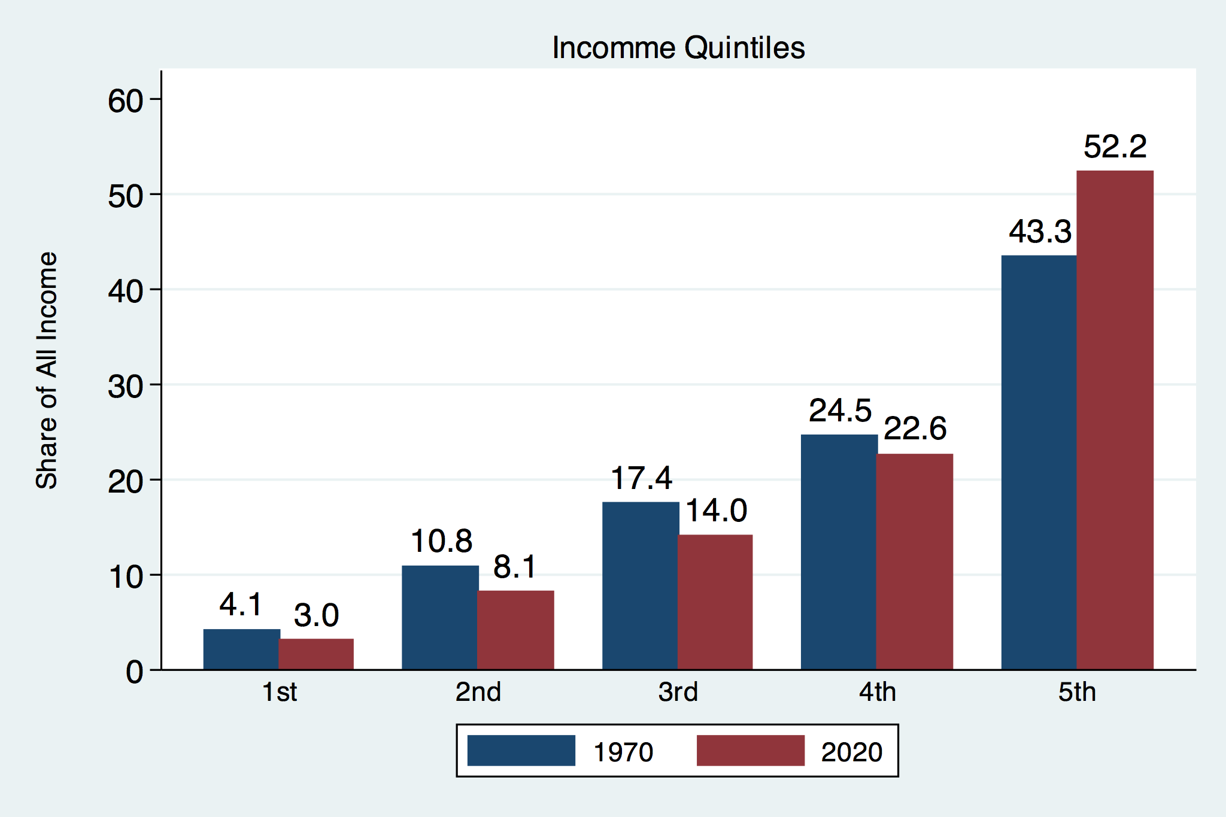
Income Share Changes Between 1970 and 2020
Source: U.S. Census Bureau, Current Population Survey, Annual Social and Economic Supplements.

Slide 24
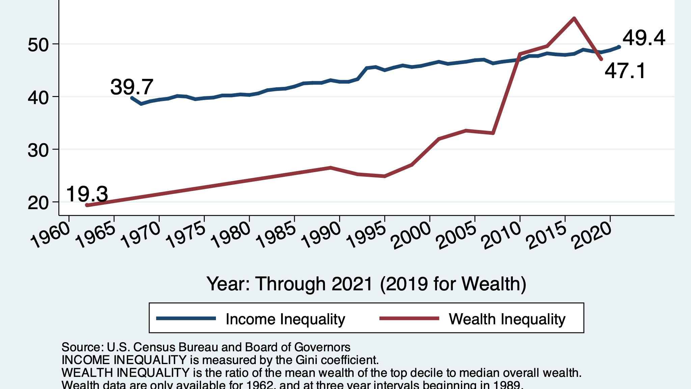
Income and Wealth Gini Coefficients

Slide 25
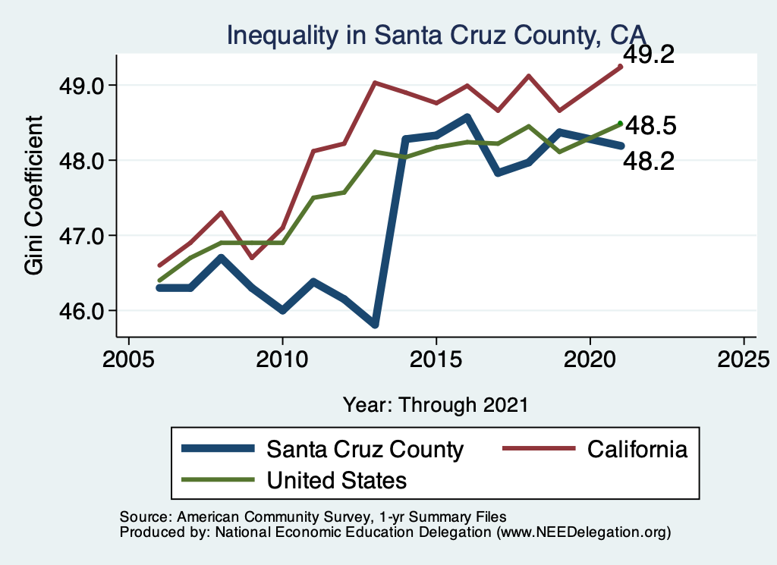
Your Local Inequality Trend

Slide 26
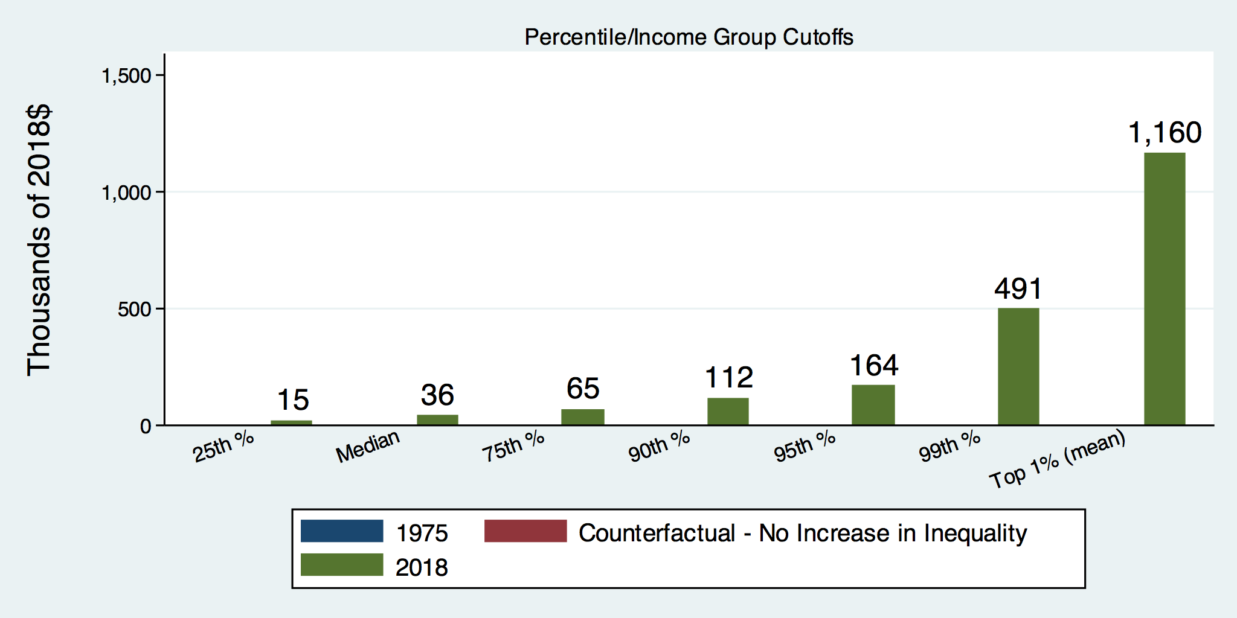
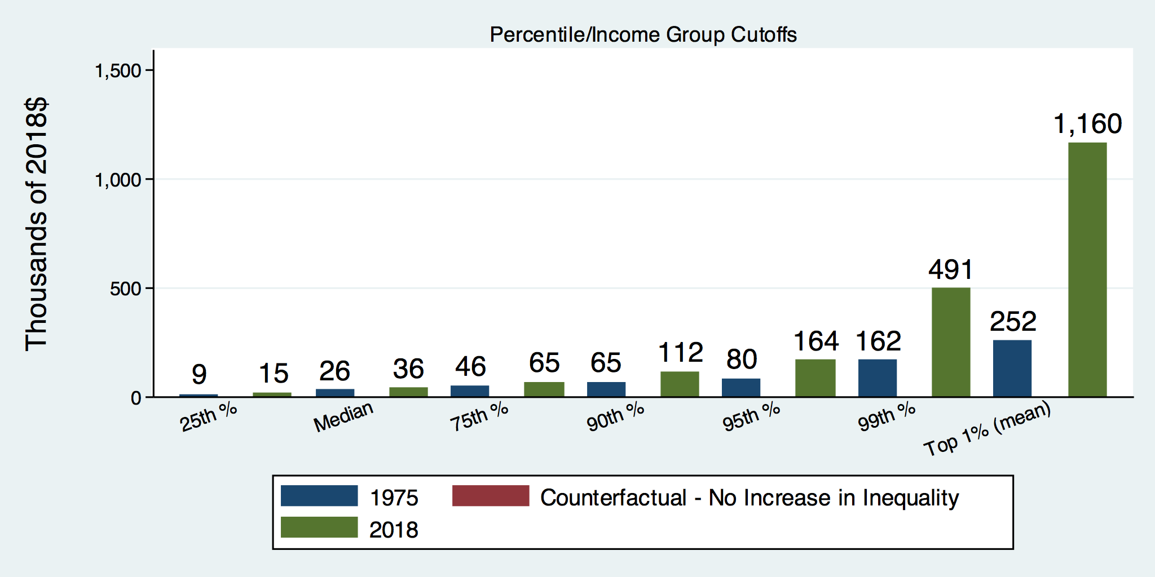
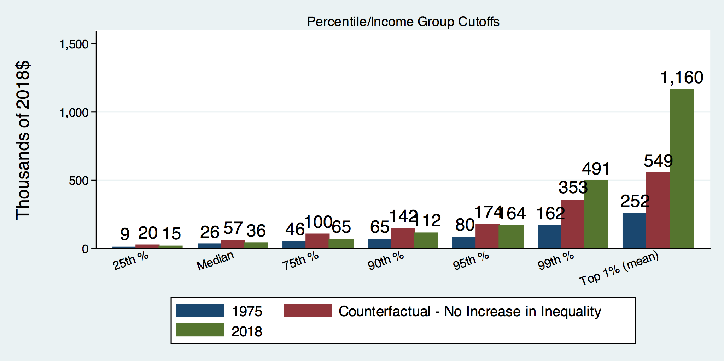
How Has Inequality Influenced Incomes?

Slide 27

Wealth Concentration Has Been Rising
2019 Overall Median: $121,700

Slide 28

Wealth is More and More Concentrated
99th Percentile
2016 = 7x 1963
Source: Urban Institute

Slide 29
Wealth Inequality Exceeds Income Inequality
Source: Chad Stone, Danilo Trisi, Arloc Sherman, and Roderick Taylor, “A Guide to Statistics on Historical Trends in Income Inequality,”
Center on Budget and Policy Priorities, Policy Futures, Dec. 11, 2018.

Slide 30
Where Does Income Inequality Come From?
Labor Characteristics
  Demographics
    Age distribution
  Personal Choices
    Educational attainment
    Effort
    Priorities
    Household composition
  Immigration and Emigration
Market Forces
  Technology
  Changing demand patterns
  Competition for labor
Government Policy
  Market influence
  Redistribution

Slide 31
Government Policy and Inequality
Market Influence: PRE-distribution
  Characteristics of labor
    Access to education
  Effects on labor demand
    Market regulation
      Competition policy
    Labor regulations
      Minimum wage, overtime, health insurance, union regulations, etc.
RE-distribution
  Tax Rates
  Income support
    Direct aid
    Food stamps

Slide 32
Tax and Transfer Programs and Inequality
2014
Source: U.S. Congressional Budget Office, “The Distribution of Household Income, 2014”, Average Income Before and After Means-Tested Transfers and
Federal Taxes, by Income Group, 2014.

Slide 33
What About Tax Rates?
400 Taxpayers with highest incomes
1992-2007
+
392%
1992-2014
Average
Tax Rate
+310%
Average
Income
-12%
-
37%
Source: IRS
Source: IRS, Statistics of Income Division, December 2016.

Slide 34

Tax Rates Over Time

Slide 35

The Top Tax Rate and Income Cutoff
Income tax rates have decreased.
But so have the income cutoffs.
So lower rates, but now applied
to broader tax base (more people)

Slide 36

Dramatically Less Progressivity in the Tax Code
1961 to 2011
Source: New York Times, from Thomas Piketty, Emmanuel Saez and Gabriel Zucman, “
Distributional National Accounts: Methods and Estimates for the United States”

Slide 37
Market Forces and Inequality
Changing demand patterns
  Technology and “skill-biased technological change”
  Increased Trade and Globalization
  Industry composition
    PCs instead of typewriters
    Services instead of goods
    Professional services instead of personal services
Competition in labor markets
  Unionization
  Market concentration

Slide 38

Labor Income is Unhinged from Productivity
Why? Some theories:
Declining unionization
Competition policy
Technological change
Globalization

Slide 39

Declining Unionization
Unionization Rates
1983: 20.1%
2021: 10.3%
Unionization Rates
Public: 33.9%
Private: 6.1%
Source: https://inequality.org/facts/income-inequality/, Bureau of Labor Statistics and Emmanueul Saez, University of Califonria, Berkeley
Notes:
https://voxeu.org/article/forms-and-sources-inequality-united-states

Slide 40

Growing Concentration within Industries
Source: The Hamilton Project, Brookings: The State of Competition and dynamism.

Slide 41
Growing Dispersion in Capital Returns
Return on invested capital excluding goodwill –
US publicly-traded nonfinancial firms, 1965-2014
Source: Jason Furman, ”Forms and sources of inequality in the United States”, VOX, March 17, 2016, Figure 6.
Notes:
Note: The return on invested capital definition is based on Koller et al (2015), and the data presented here are updated and augmented versions of the figures presented in Chapter 6 of that volume. The McKinsey data includes McKinsey analysis of Standard & Poor’s data and exclude financial firms from the analysis because of the practical complexities of computing returns on invested capital for such firms. ​
Source: Koller et al. (2015); McKinsey & Company; Furman and Orszag (2015). , by way of https://voxeu.org/article/forms-and-sources-inequality-united-states
Furman, J and P Orszag (2015), “A Firm-Level Perspective on the Role of Rents in the Rise in Inequality”, Presentation at “A Just Society” Centennial Event in Honor of Joseph Stiglitz Columbia University, October 16, 2015.

Slide 42

CEO Pay Has Been Growing Rapidly

Slide 43

CEO Pay Has Been Growing Rapidly

Slide 44
Immigration and Inequality
Beginning in about 1970, the immigrant share of the U.S.
Population increased dramatically.
  5% in 1970 and 14% in 2016
Immigration tends to happen most often among:
  Low-skilled low-wage workers
  High-skilled high-wage workers
Immigration has likely increased income inequality.
Its effect has likely been SMALL.
  ~5% between 1980 and 2000
  No reason to think it has been bigger since.

Slide 45
Immigration and Inequality
Source: Ping Xu, James C. Garand, and Ling Zhu, “How immigration makes income inequality worse in the U.S.”, October, 2015, Figure 1.

Slide 46
Technological Change and Inequality
Much of the technology adopted in the last 30 years has eliminated low-skill or low-wage jobs.
  Computers, advanced manufacturing equipment, steel mini-mills, automation
Technological change may result in “winner take all” outcomes.
  This likely favors a small group of individuals.
  But of course the relative winners can change rapidly.
Both aspects increase inequality by increasing the rewards to:
  Those with significant labor market skills.
  Owners over workers

Slide 47


Technology Effects on Low Income Workers
Technology can improve worker productivity and create jobs
But technology can also displace jobs

Slide 48
Globalization
What is globalization?
  Flow of goods, services, capital, and labor across international borders.
How does it affect inequality?
  Through a differential impact on low-skilled workers and hence their wages.
  For the United States, globalization is thought to lower the wages of low skilled and hence low-wage workers relative to those of high-skilled workers.

Slide 49
What is driving increasing inequality?
Primary drivers:
  Technological change
  Increased globalization and trade
  Institutions and policy choices
These drivers can also influence personal choices in ways that affect measured income inequality.
  For example, educational choices or labor force participation.

Slide 50

Why Does Inequality Matter?
Too little inequality can:
  Reduce individual motivation
  Slow economic growth
Too much inequality can:
  Reduce individual motivation
  Slow economic growth
Too much inequality may also:
  Divide society
  Distort political environment
  Reduce political participation
  Affect public goods spending and distribution
    Education
    Environmental protections

Slide 51

Peru
China
Brazil
Less Economic Mobility
Germany
U.S.
Canada
https://equitablegrowth.org/research-paper/are-todays-inequalities-limiting-tomorrows-opportunities

Slide 52
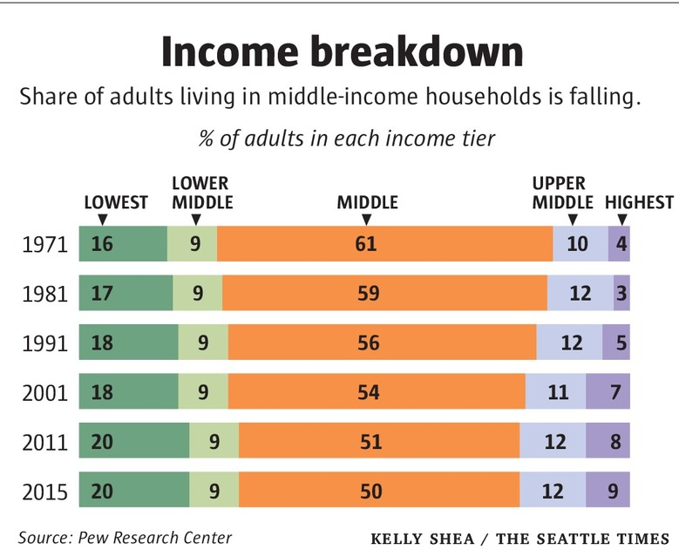
Inequality Can Also Directly Affect GDP
The US Economy is driven by consumption (67% of GDP).
  Middle class are the big consumers.
  They have less money.
  Consumption is lower.
  GDP is lower.

Slide 53
Addressing Inequality: Is It A Problem?
Why it might be a problem.
  Economic issues (Efficiency)
    Inequality can misallocate resources and slow economic growth.
    Or inequality can concentrate resources with investors.
  Noneconomic issues (Equity)
    Values, ethics, and morals will drive individual evaluations of inequality.
    Depends on personal beliefs about origins and consequences of inequality.
Suppose you think it’s a problem. How might it be addressed?

Slide 54

Addressing Inequality:
Immediately Available Policy Solutions
RE-distribution
  Tax and transfer programs
PRE-distribution
  Reduce market power
  Unionization
  Collective bargaining
  Minimum wages
  Job training and interview skills
  Family care policies

Slide 55
Addressing Inequality:
Long Term
It’s all about access to resources:
  Improve public education and reduce quality disparities across schools.
  Improve counseling - paths to higher ed and funding for low-income students.
  Invest in early childhood education, not later (e.g. universal pre-k).
  Promote opportunities for wealth-building.
  Increase housing supply, especially in high-price, high-opportunity cities.
Focus on most affected groups:
  Mentoring programs for minority youth.
  Programs to address racial bias and discrimination in work and criminal justice.
  Efforts to desegregate and facilitate greater interaction across racial groups.

Slide 56
Tension in Policy Solutions
Is it possible to increase growth at the same time that you reduce income inequality?
  Common refrain among some that government intervention in the economy is always and everywhere bad for growth.
Possibly: expanding equality of access promotes the full utilization of resources.

Slide 57
An International Perspective: Comparables
U.S.: 17-18
Canada, UK, Germany: 12-13
Italy, France, Japan: 7-9

Slide 58

What to do About Inequality?
Nothing?
Redistribution?
PRE-distribution?
Access to resources?

Slide 59
Summary
Income inequality is clearly increasing.
  Owners of productive resources seeing greater income growth than workers reliant on labor income only.
The causes appear to be largely driven by:
  Technology, competition, and trade
  Institutions and public policies
Open questions are:
  To act or not to act?
  If so, how?
The level of inequality is a policy choice necessarily involving complex tradeoffs.

Slide 60
Mobility
9 out of 10 of those born in the early 1940s could expect to earn more than their parents
  1 in 2 Millennials (born after 1980) earn more than their parents.

Slide 61
Thank you!
Any Questions?
www.NEEDelegation.org
Jon D. Haveman
Jon@NEEDelegation.org
Contact NEED: info@NEEDelegation.org
Submit a testimonial: www.NEEDelegation.org/testimonials.php
Become a Friend of NEED: www.NEEDelegation.org/friend.php

