Slide 1


Income Inequality in the U.S. and Globally
Adina Ardelean, Ph.D.
Lecturer, Santa Clara University
OLLI, Santa Clara University
May 3, 2021

Slide 2
National Economic Education Delegation
Vision
  One day, the public discussion of policy issues will be grounded in an accurate perception of the underlying economic principles and data.
Mission
  NEED unites the skills and knowledge of a vast network of professional economists to promote understanding of the economics of policy issues in the United States.
NEED Presentations
  Are nonpartisan and intended to reflect the consensus of the economics profession.

Slide 3
Who Are We?
Honorary Board: 53 members
  2 Fed Chairs: Janet Yellen, Ben Bernanke
  6 Chairs Council of Economic Advisers
    Furman (D), Rosen (R), Bernanke (R), Yellen (D), Tyson (D), Goolsbee (D)
  3 Nobel Prize Winners
    Akerlof, Smith, Maskin
Delegates: 585+ members
  At all levels of academia and some in government service
  All have a Ph.D. in economics
  Crowdsource slide decks
  Give presentations
Global Partners: 44 Ph.D. Economists
  Aid in slide deck development

Slide 4
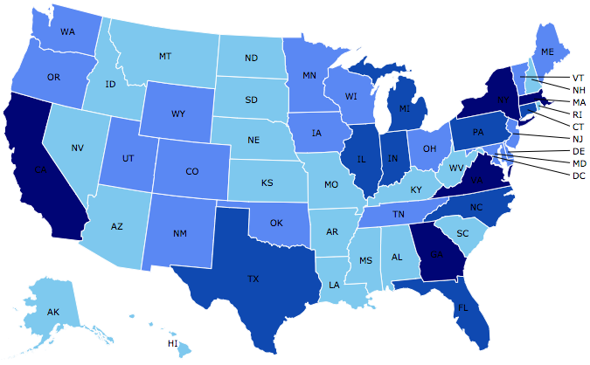
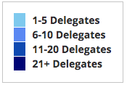
Where Are We?

Slide 5
Credits and Disclaimer
This slide deck was authored by:
  Jon Haveman, Executive Director of NEED
This slide deck was reviewed by:
  Timothy Smeeding, University of Wisconsin
  Robert Wright, Augustana University
Disclaimer
  NEED presentations are designed to be nonpartisan
  It is, however, inevitable that the presenter will be asked for and will provide their own views
  Such views are those of the presenter and not necessarily those of the National Economic Education Delegation (NEED)

Slide 6
Notes:
https://fivethirtyeight.com/features/many-americans-think-economic-inequality-is-a-problem-just-not-the-most-pressing-one/

Slide 7
Outline
Definition
Measurement
How does it happen?
Does it matter?
Is it a problem?
What to do about it

Slide 8
What you’ll hear today
Definition
Measurement
  Income Inequality
  Wealth Inequality
  Consumption Inequality

Slide 9

Economic Inequality: Income
Definition:
  The extent to which the distribution of income deviates from complete equality
  The dispersion of income throughout the economy

Slide 10
Different Ways of Thinking About Inequality
Income Inequality
  Before taxes and transfers
  After taxes and transfers
Wealth Inequality
Consumption Inequality

Slide 11
What you’ll hear today
Definition
Measurement
  Income Inequality
  Wealth Inequality
  Consumption Inequality

Slide 12
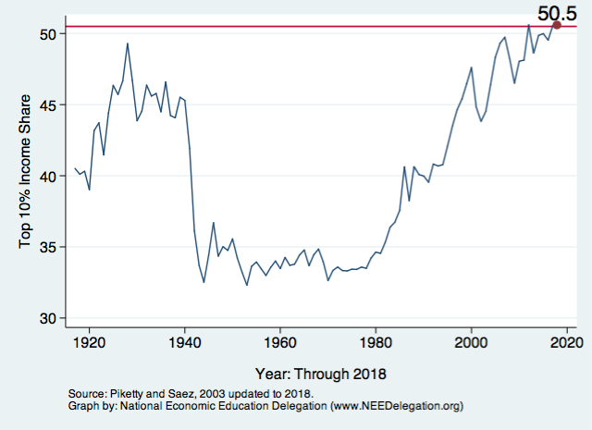
National Income Inequality: Share of Top 10%
Stock Market Crash
WWII
Housing Bubble
Dot-com Bubble

Slide 13
Recent Facts on Income Inequality
Beginning in the 1970s, the income gap widened.
  Income in the middle and lower parts of the distribution slowed
  Incomes at the top continued to grow strongly
  Income shares at the very top of the distribution rose to levels last seen more than 80 years ago
Source: Chad Stone, Danilo Trisi, Arloc Sherman, and Roderick Taylor, “A Guide to Statistics on Historical Trends in Income Inequality,”
Center on Budget and Policy Priorities, Policy Futures, May 15, 2018.

Slide 14

The Abrupt Increase in Inequality
Source: Chad Stone, Danilo Trisi, Arloc Sherman, and Roderick Taylor, “A Guide to Statistics on Historical Trends in Income Inequality,”
Center on Budget and Policy Priorities, Policy Futures, Dec. 11, 2018.
Notes:
Slide taken from page 10, Chad Stone, Danilo Trisi, Arloc Sherman, and Roderick Taylor, “A Guide to Statistics on Historical Trends in Income Inequality,” May 15, 2018

Slide 15

Most of the Action Is at the Top: Pre-Tax
Projected 2021
CBO: Projected Changes in the Distribution of Household Income, 2016 to 2021

Slide 16
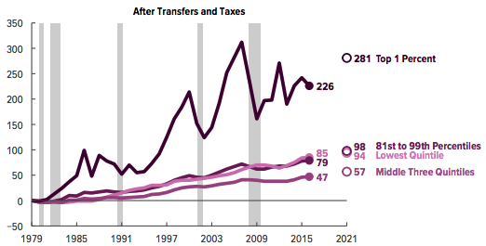
Most of the Action Is at the Top: After-Tax
Projected
CBO: Projected Changes in the Distribution of Household Income, 2016 to 2021

Slide 17
Inequality is rising in advanced economies
Source: Peterson Institute of International Economics, “How to fix economic inequality”, based on OECD “Under Pressure: The Squeezed Middle Class”

Slide 18
An International Perspective (Year: 2019)
Source: Data taken from www.wid.world.

Slide 19
The bottom half of workers: the U.S. vs. Europe
Source: Peterson Institute of International Economics, “How to fix economic inequality”

Slide 20
An International Perspective (Year: 2019)
Source: Data taken from www.wid.world.

Slide 21
Gini Coefficient
Another way to describe income inequality is by using a Gini coefficient.
Gini coefficient – a numerical measure of the overall dispersion of income
  Ranges from 0 – 1
  0= perfect equality – everyone has same income
  1=perfect inequality – one person makes all income
  In practice:
  0.5 – 0.7 – highly unequal
  0.2 – 0.35 – relatively equal

Slide 22
The Gini Coefficient
100%
A
Gini =
x 100
A + B
% of
All Income
50%
Equality (45 degrees)
A
Bigger A: More inequality
Smaller A: Less inequality
Inequality
B
Extreme
50%
100%
% of Population

Slide 23
Forming the GINI Coefficient: 2015
Quintile Shares of Income
CUMULATIVE Quintile Shares of Income
Income Quintiles
Income Quintiles
Source: 2015 1-year American Community Survey, based on pre-tax household income.

Slide 24
Income Share Changes Between 1970 and 2017
1970
2017
Share of All Income
% of Population
Income Quintiles
Source: U.S. Census Bureau, Current Population Survey, Annual Social and Economic Supplements.

Slide 25
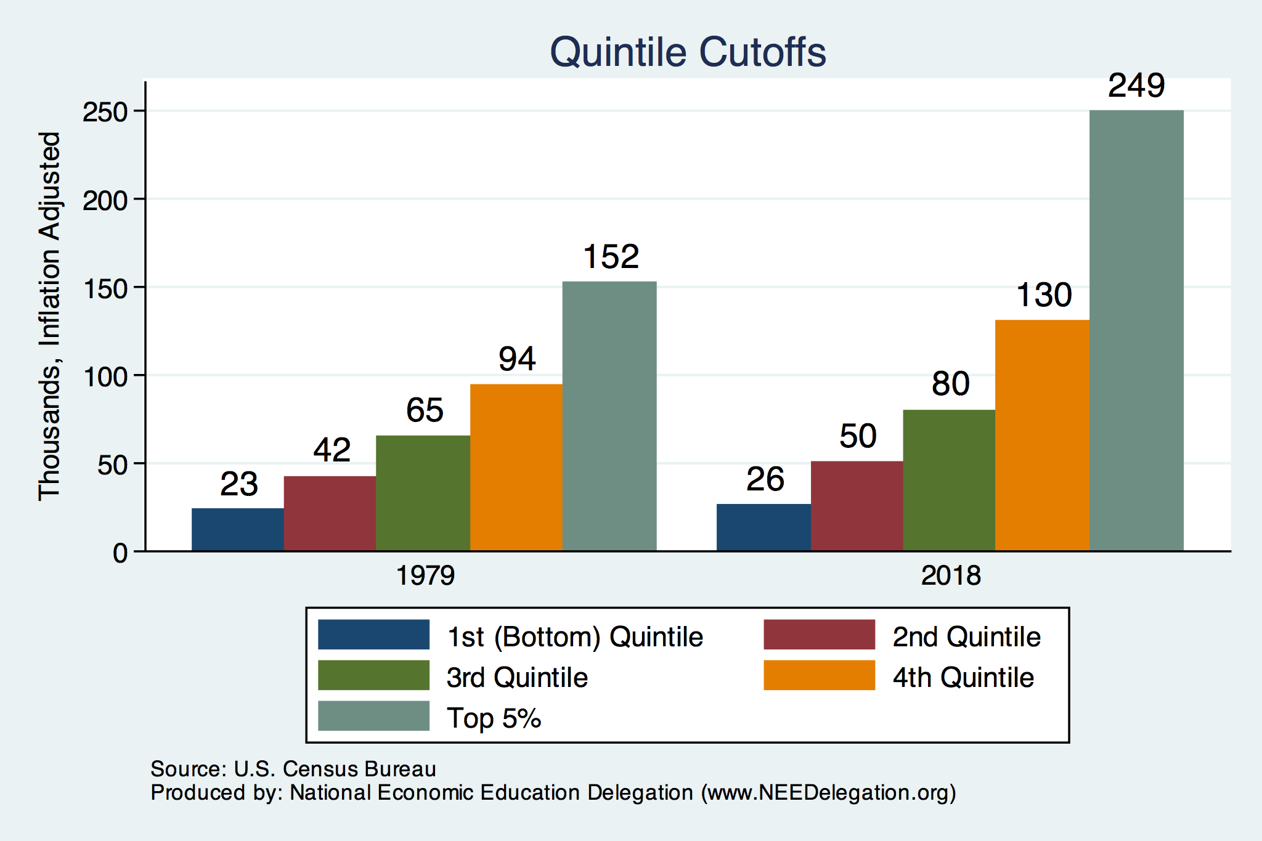
Quintile Income Cutoffs
Top 5%

Slide 26
The Gini Coefficient, 1985-2013
Source: Peterson Institute of International Economics, “How to fix economic inequality”

Slide 27
An International Perspective
Source: Data taken from the 2014 CIA World Factbook.

Slide 28
Income Changes from Growing Inequality
Bottom 90%
of Households

Slide 29
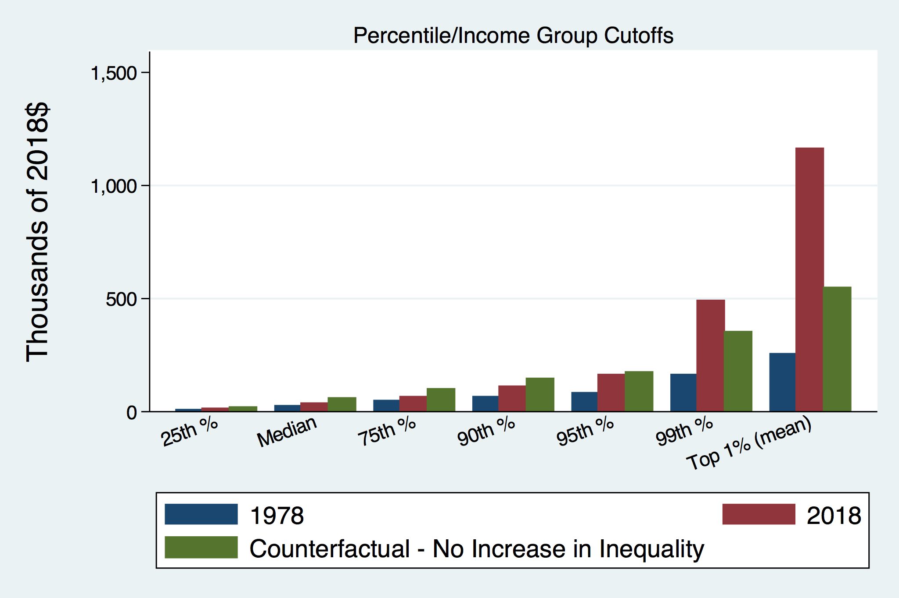
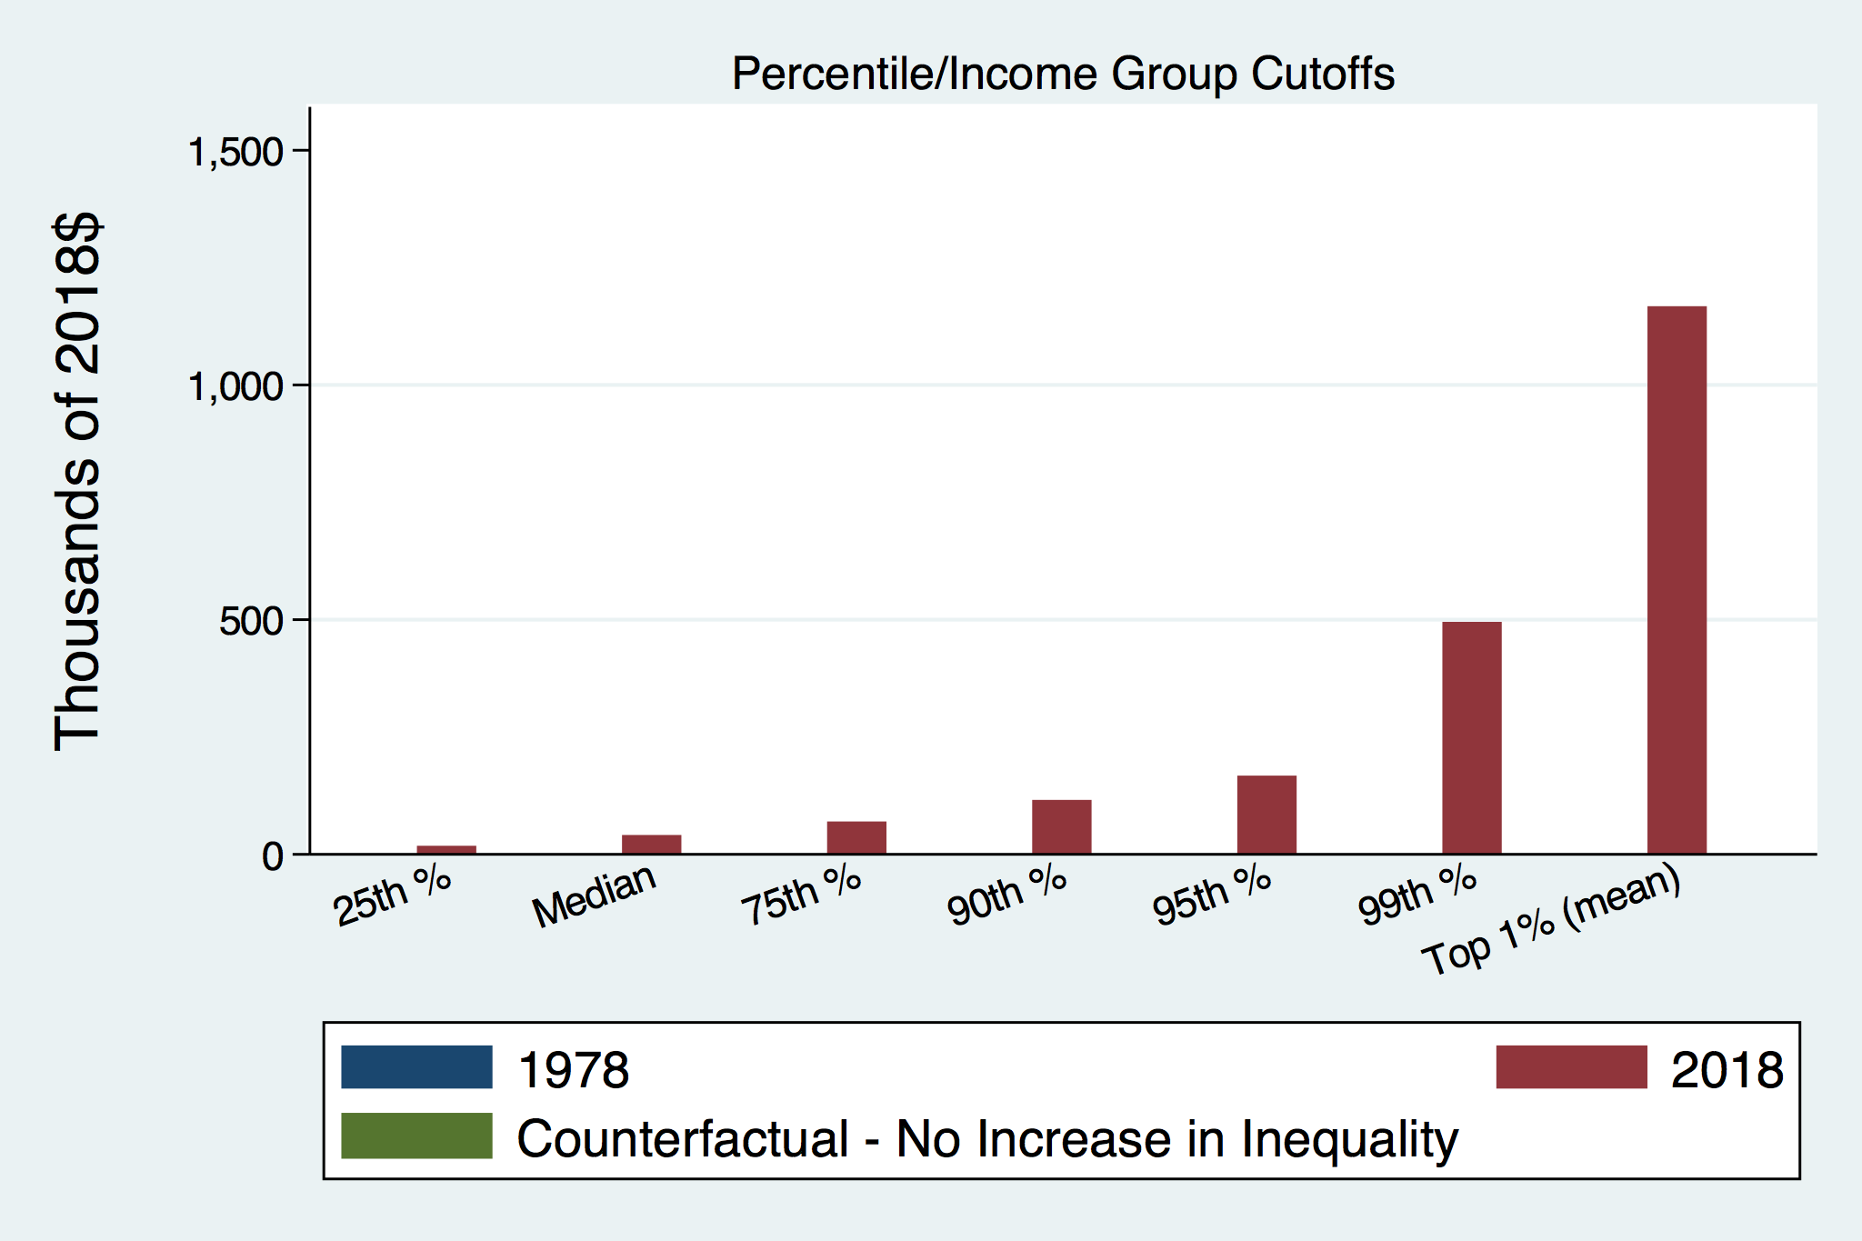
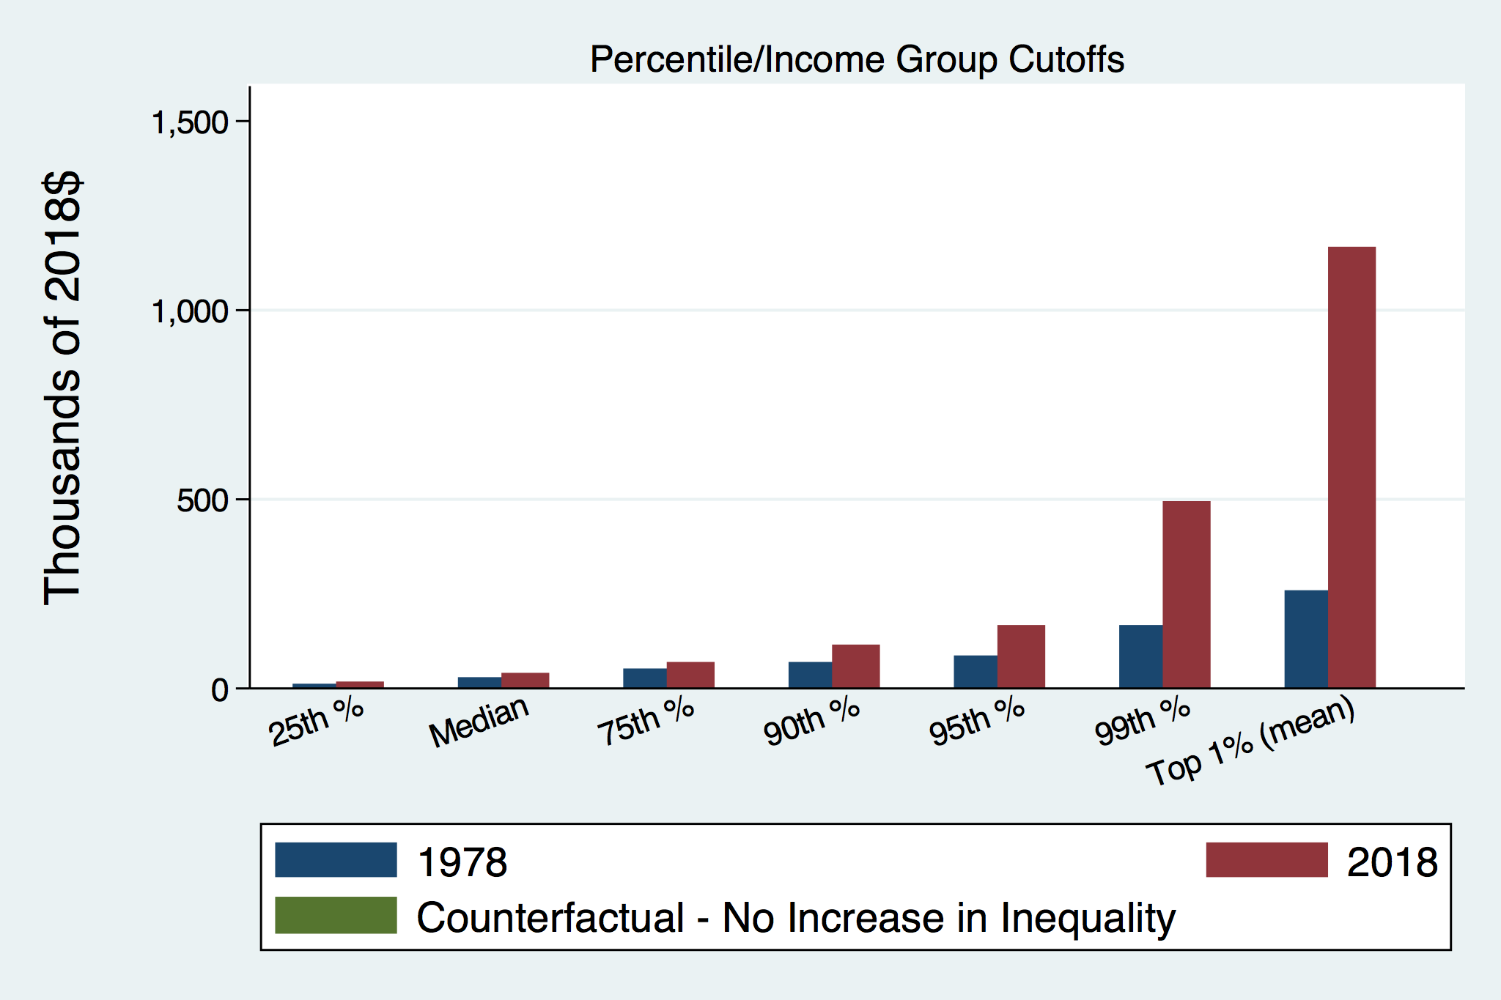
How Has Inequality Influenced Incomes?

Slide 30
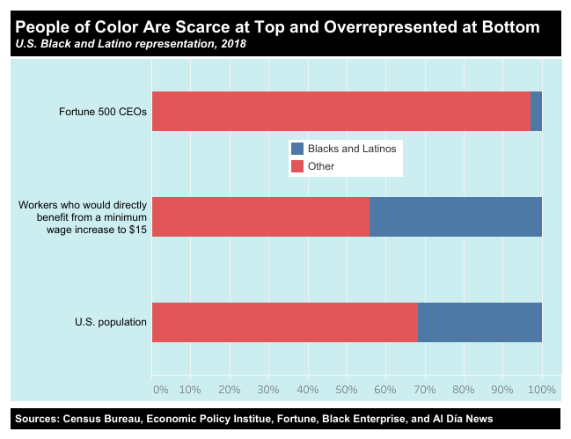
https://inequality.org/facts/racial-inequality/#racial-income-inequality
Notes:
https://inequality.org/facts/racial-inequality/#racial-income-inequality

Slide 31
Disappearing Middle Class
In this report, “middle‐income”
households are defined as those with an income that is 67% to 200% (two‐thirds to double) of the overall median household income, after incomes have been adjusted for household size.
Notes:
The hollowing of the American middle class has proceeded steadily for more than four decades. Since 1971, each decade has ended with a smaller share of adults living in middle-income households than at the beginning of the decade, and no single decade stands out as having triggered or hastened the decline in the middle.
https://www.pewsocialtrends.org/2015/12/09/the-american-middle-class-is-losing-ground/#:~:text=Based%20on%20the%20definition%20used,from%2025%25%20to%2029%25.

Slide 32
The American Dream is fading
Percent of US children earning more than their parents at age 30 by year of birth, 1940-1984
Source: How to fix Economic Inequality?, Peterson Institute of International Economics, 2020

Slide 33
Social Mobility across countries
Percent of men in bottom and top earnings quartiles with fathers in the bottom quartile
Source: How to fix Economic Inequality?, Peterson Institute of International Economics, 2020

Slide 34
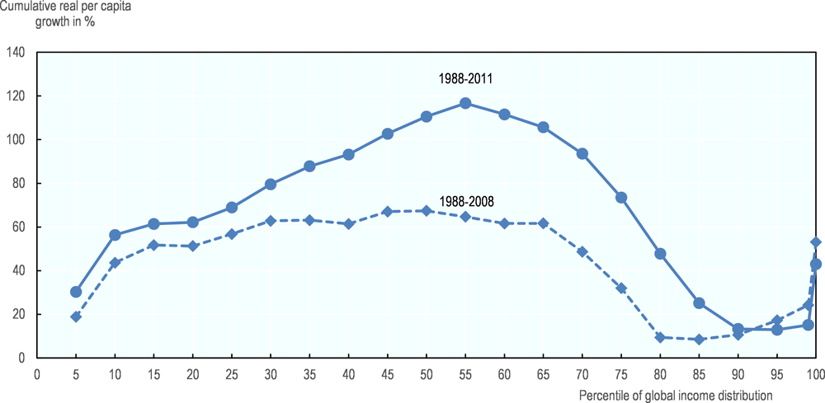
The Elephant Curve
Real income growth (population-weighted) over 1988-2008 and 1988-2011
Source: OECD “Under Pressure: The Squeezed Middle Class”

Slide 35
Gender Wage Gap has narrowed
Difference between median earnings of men and women relative to the median earnings of men
Source: How to fix Economic Inequality?, Peterson Institute of International Economics, 2020

Slide 36
What you’ll hear today
Definition
Measurement
  Income Inequality
  Wealth Inequality
  Consumption Inequality

Slide 37
Wealth Inequality Exceeds Income Inequality
Source: Chad Stone, Danilo Trisi, Arloc Sherman, and Roderick Taylor, “A Guide to Statistics on Historical Trends in Income Inequality,”
Center on Budget and Policy Priorities, Policy Futures, Dec. 11, 2018.

Slide 38
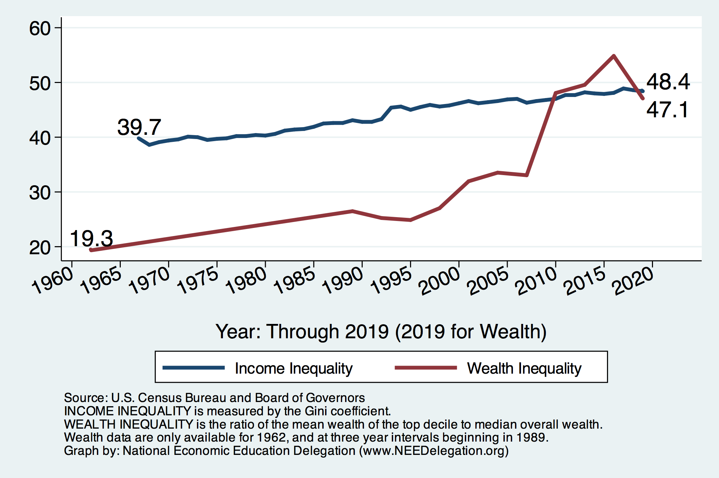
Income and Wealth Inequality
Income Inequality (Gini)
US: 48.1%
CA: 48.7%
Marin: 53.2% - all time high

Slide 39
Income and Wealth Inequality across countries
Share of total households disposable income and total household net wealth held by the top 10% in 2015
Source: How to fix Economic Inequality?, Peterson Institute of International Economics, 2020

Slide 40
Notes:
https://www.brookings.edu/blog/up-front/2020/02/27/examining-the-black-white-wealth-gap/

Slide 41
What you’ll hear today
Definition
Measurement
  Income Inequality
  Wealth Inequality
  Consumption Inequality

Slide 42
A Third Measure of Inequality: Consumption

Slide 43
Consumption Inequality
Consumption is another important metric for judging inequality
Arguably a better indicator of “well-being”
Extremely difficult to measure
Growing evidence that consumption inequality has also increased

Slide 44
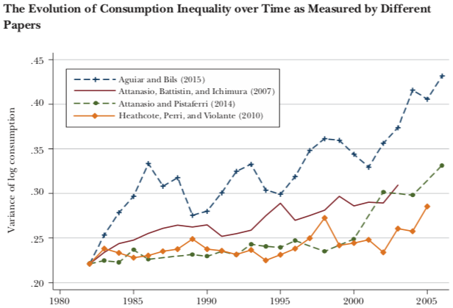
Growing Evidence: Consumption Inequality
Source: Orazio P. Attanasio and Luigi Pistaferri, “Consumption Inequality,” Journal of Economic Perspectives, Volume 30, #2, Spring 2016, page 11, Figure 1.

Slide 45
Case Study: Economic Research
Early, controversial result is published
Flurry of effort to understand the result
Growing body of evidence
Consensus reached
  Not always
  Sometimes data continue to conflict
  Often merely a preponderance of evidence drives understanding
Why has this happened with consumption inequality?
  Inadequacy of data and methods

Slide 46
Summary: Consumption Inequality
Early research indicated that although income inequality may be increasing, consumption inequality may not be.
  How is this possible? Borrowing, or otherwise smoothing consumption.
Mounting evidence that it is increasing along with income and wealth inequality.
Consensus reached? No.

Slide 47
Summary
Income inequality is clearly increasing in the U.S. and in other advanced countries.
Wealth inequality is higher than income inequality in advanced countries

Slide 48
Next Lecture …
  Where does inequality comes from?

Slide 49
Thank you!
Any Questions?
www.NEEDelegation.org
Adina Ardelean
<atardelean@scu.edu>
Contact NEED: info@needelegation.org
Submit a testimonial: www.NEEDelegation.org/testimonials.php
Become a Friend of NEED: www.NEEDelegation.org/friend.php

