Slide 1
Osher Lifelong Learning Institute, Summer 2022
Contemporary Economic Policy
Rochester Institute of Technology
July-Aug, 2022
Host: Jon Haveman, Ph.D.
National Economic Education Delegation

Slide 2
Available NEED Topics Include:
Healthcare Economics
US Economy
Climate Change
Economic Inequality
Economic Mobility
Trade and Globalization
Minimum Wages
Immigration Economics
Housing Policy
Federal Budgets
Federal Debt
Black-White Wealth Gap
Autonomous Vehicles
Healthcare Economics

Slide 3
Course Outline
Contemporary Economic Policy
  Week 1 (7/11): Economic Update (Jon Haveman, NEED)
  Week 2 (7/18): Economic Inequality (Christopher Herrington, VCU)
  Week 3 (7/25): Trade and Globalization (Alan Deardorff, University of Michigan)
  Week 4 (8/1): Economic Mobility (Jon Haveman, NEED)
  Week 5 (8/8): The Black-White Wealth Gap (Jon Haveman, NEED)
  Week 6 (8/15): Climate Change Economics (Jon Haveman, NEED)
  Week 7 (8/22): Autonomous Vehicles (Jon Haveman, NEED)

Slide 4
Submitting Questions
Please submit questions of clarification in the chat.
  I will try to handle them as they come up.
We will do a verbal Q&A once the material has been presented.
Slides will be available on Need website( www.NEEDelegation.org)

Slide 5


Economic Inequality
Christopher Herrington, Ph.D.
Virginia Commonwealth University
July 18, 2022

Slide 6
Credits and Disclaimer
This slide deck was authored by:
  Jon Haveman, Executive Director of NEED
This slide deck was reviewed by:
  Timothy Smeeding, University of Wisconsin
  Robert Wright, Augustana University
Disclaimer
  NEED presentations are designed to be nonpartisan
  It is, however, inevitable that the presenter will be asked for and will provide their own views
  Such views are those of the presenter and not necessarily those of the National Economic Education Delegation (NEED)

Slide 7
Outline
Definition
Measurement
How does it happen?
Does it matter?
Is it a problem?
What to do about it

Slide 8

Economic Inequality: Income
Definition:
  The extent to which the distribution of income deviates from complete equality
  The dispersion of income throughout the economy

Slide 9
Different Ways of Thinking About Inequality
Inequality
Inequality between groups
How evenly income/wealth is divided across a population
It is about the distribution of some measure and not a comparison between sub-groups.
Are there differences between different groups of people?
Are observable outcomes different based on group characteristics?
Ex: racial inequality or gender pay gap

Slide 10
Different Ways of Thinking About Inequality
Income Inequality
  Before taxes and transfers
  After taxes and transfers
Wealth Inequality
Consumption Inequality
How does wealth differ from income?
Income is measured over a period of time, say one year.
Wealth is one’s accumulated savings, including physical and financial assets (net worth).

Slide 11

National Income Inequality: Share of Top 10%
Stock Market Crash
WWII
Housing Bubble
Dot-com Bubble

Slide 12
Recent Facts on Income Inequality
Beginning in the 1970s, the income gap widened.
  Income in the middle and lower parts of the distribution slowed.
  Incomes at the top continued to grow strongly.
  Income shares at the very top of the distribution rose to levels last seen more than 80 years ago.
Source: Chad Stone, Danilo Trisi, Arloc Sherman, and Roderick Taylor, “A Guide to Statistics on Historical Trends in Income Inequality,”
Center on Budget and Policy Priorities, Policy Futures, May 15, 2018.

Slide 13

The Abrupt Increase in Inequality
Source: Chad Stone, Danilo Trisi, Arloc Sherman, and Roderick Taylor, “A Guide to Statistics on Historical Trends in Income Inequality,”
Center on Budget and Policy Priorities, Policy Futures, Dec. 11, 2018.
Notes:
Slide taken from page 10, Chad Stone, Danilo Trisi, Arloc Sherman, and Roderick Taylor, “A Guide to Statistics on Historical Trends in Income Inequality,” May 15, 2018

Slide 14

Most of the Action Is at the Top: Pre-Tax
Projected 2021
CBO: Projected Changes in the Distribution of Household Income, 2016 to 2021

Slide 15
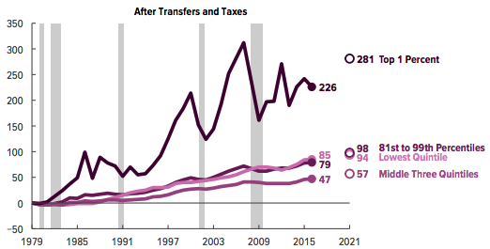
Most of the Action Is at the Top: Post-Tax
Projected
CBO: Projected Changes in the Distribution of Household Income, 2016 to 2021

Slide 16
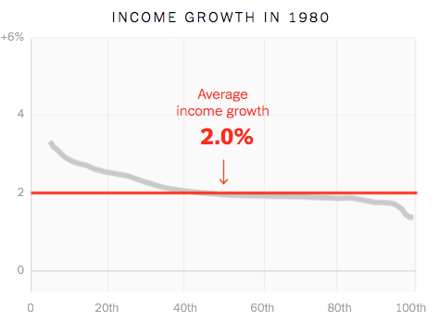
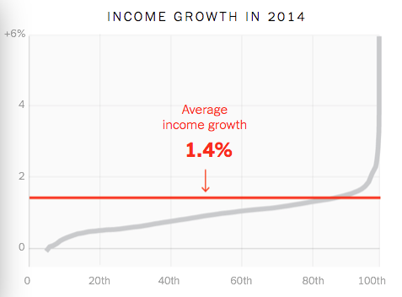
Income Growth Pattern – Has Changed

Slide 17
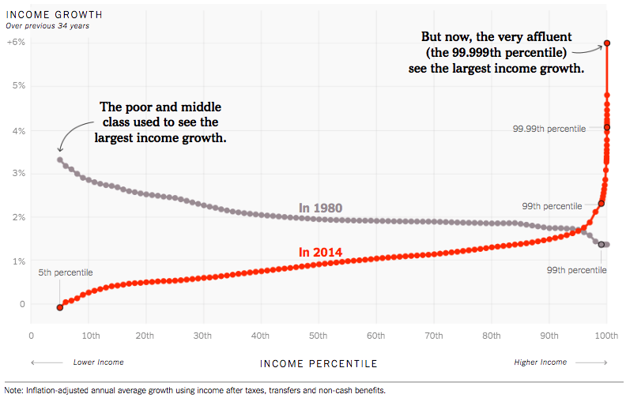
Wage Growth Patterns Have Changed!
Source: https://www.nytimes.com/interactive/2017/08/07/opinion/leonhardt-income-inequality.html

Slide 18
US Income Distribution: 2015
Quintile Shares of Income
CUMULATIVE Quintile Shares of Income
Income Quintiles
Income Quintiles
Source: 2015 1-year American Community Survey, based on pre-tax household income.

Slide 19
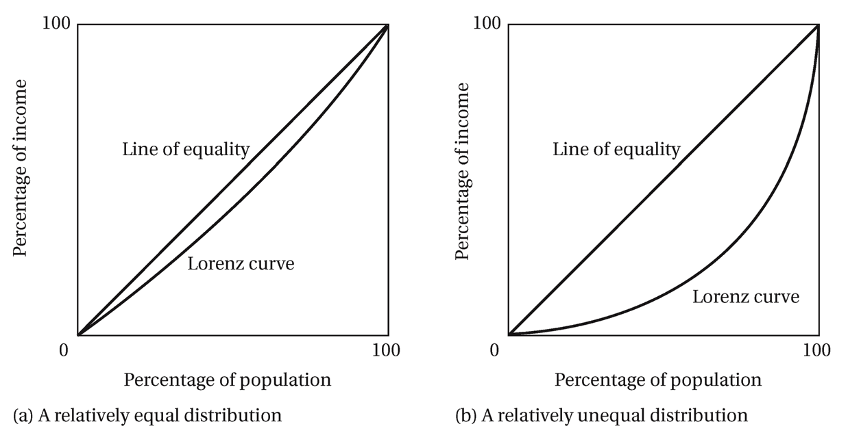
Lorenz Curve of Income Distribution
The greater the curvature of the Lorenz Curve, the greater is the degree of income inequality

Slide 20
Gini Coefficient
Gini coefficient – a numerical measure that summarizes the overall dispersion of income
  Ranges from 0 – 1
    0 = perfect equality – everyone has the same income
    1 = perfect inequality – one person has all the income
  In practice:
    0.5 – 0.7 – highly unequal
    0.2 – 0.35 – relatively equal

Slide 21
Calculating the Gini Coefficient
100%
A
Gini =
A + B
% of
All Income
50%
Equality (45 degrees)
A
Bigger A: More inequality
Smaller A: Less inequality
B
50%
100%
% of Population

Slide 22
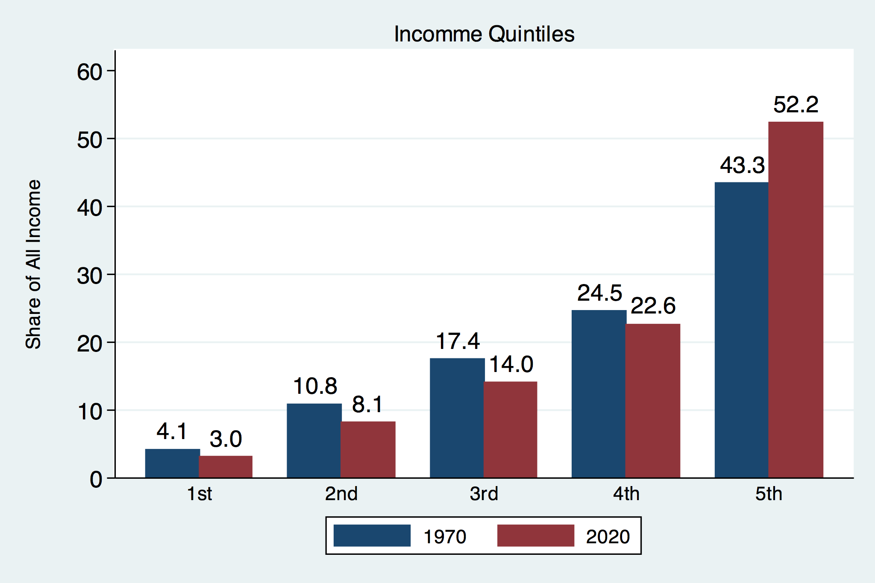
Income Share Changes Between 1970 and 2020
Source: U.S. Census Bureau, Current Population Survey, Annual Social and Economic Supplements.

Slide 23
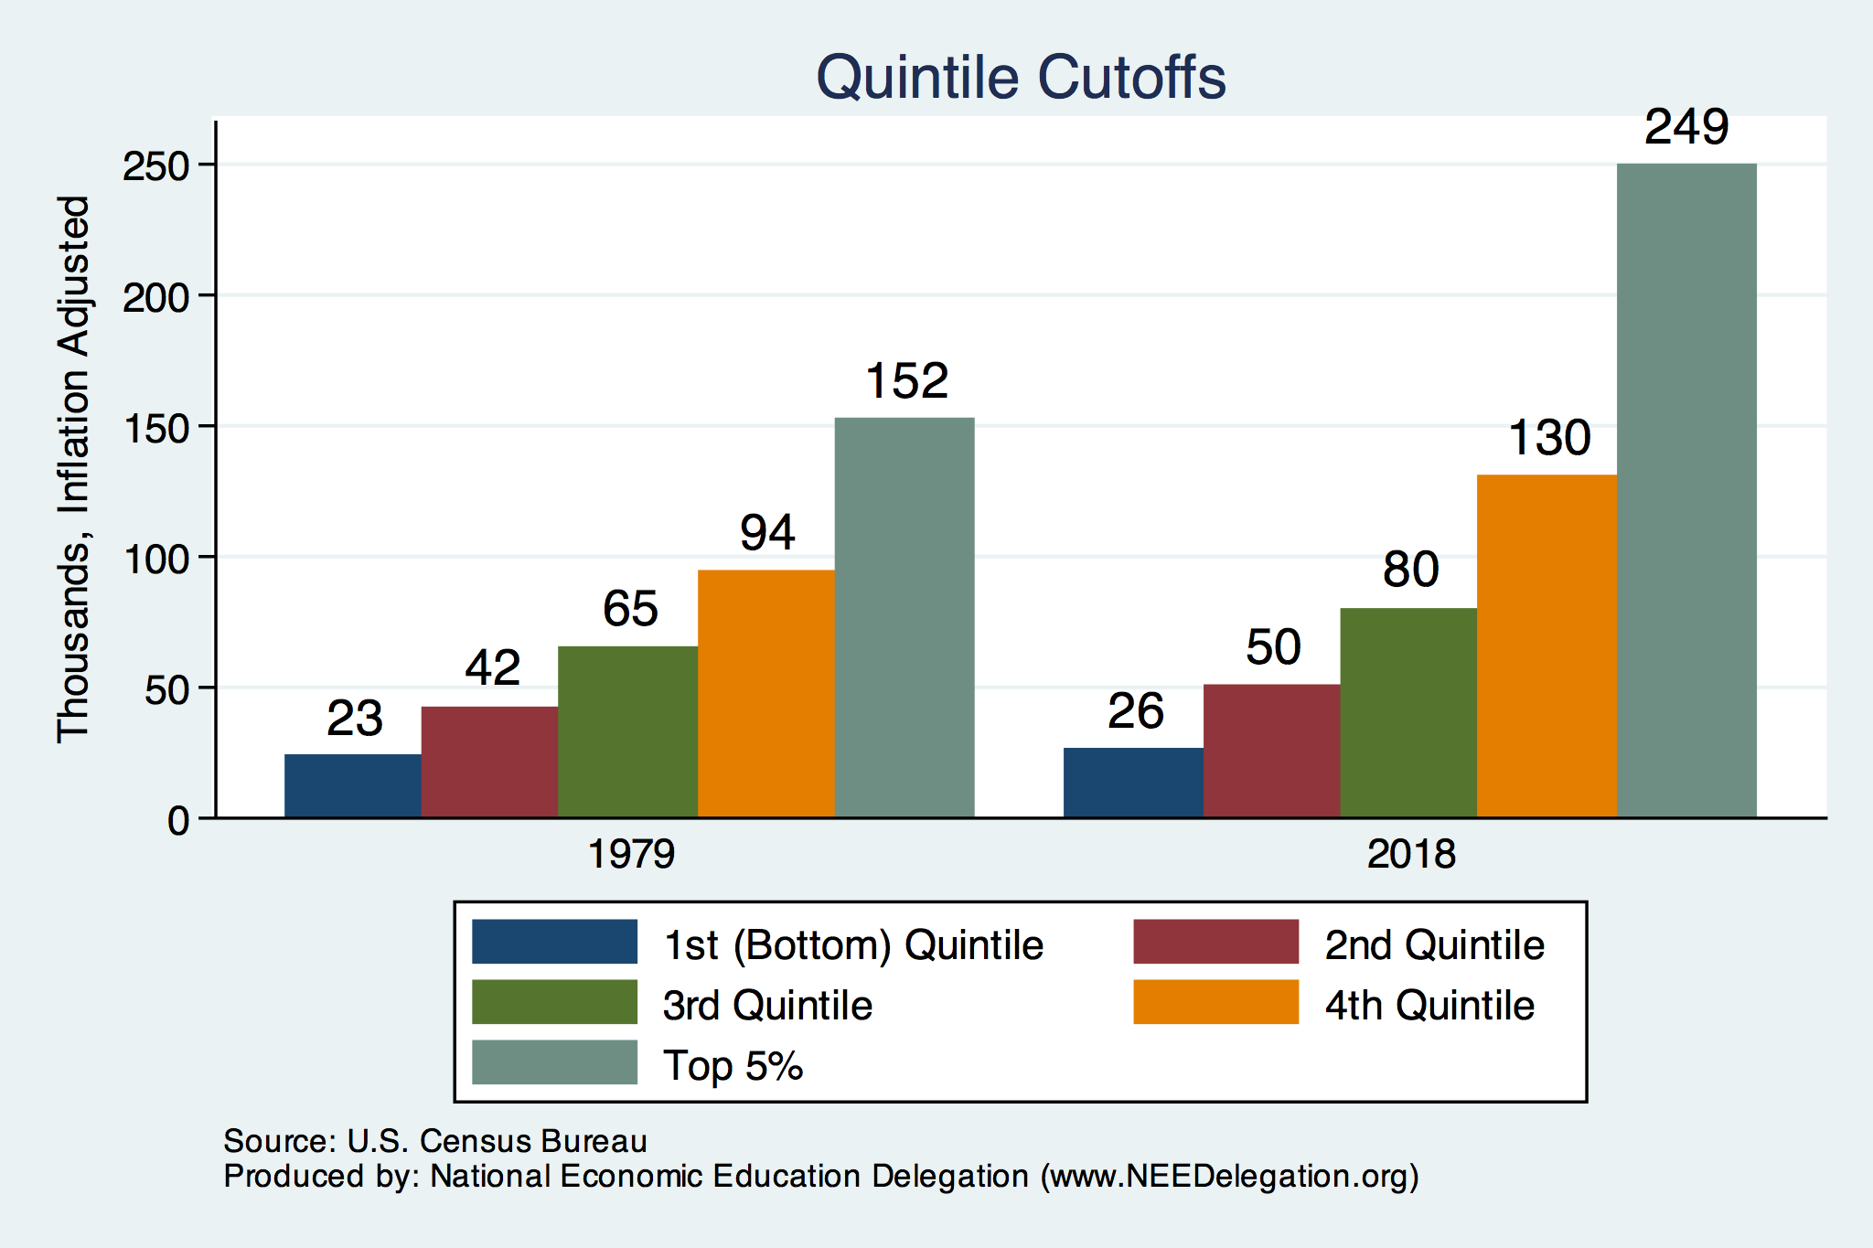
Quintile Income Cutoffs
Top 5%

Slide 24
Income Changes from Growing Inequality
Bottom 90%
of Households
Middle Class

Slide 25
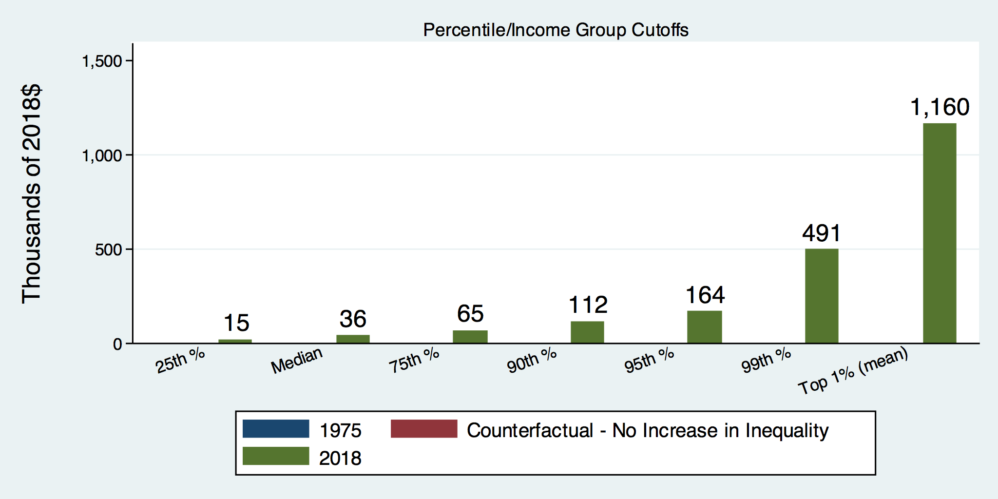
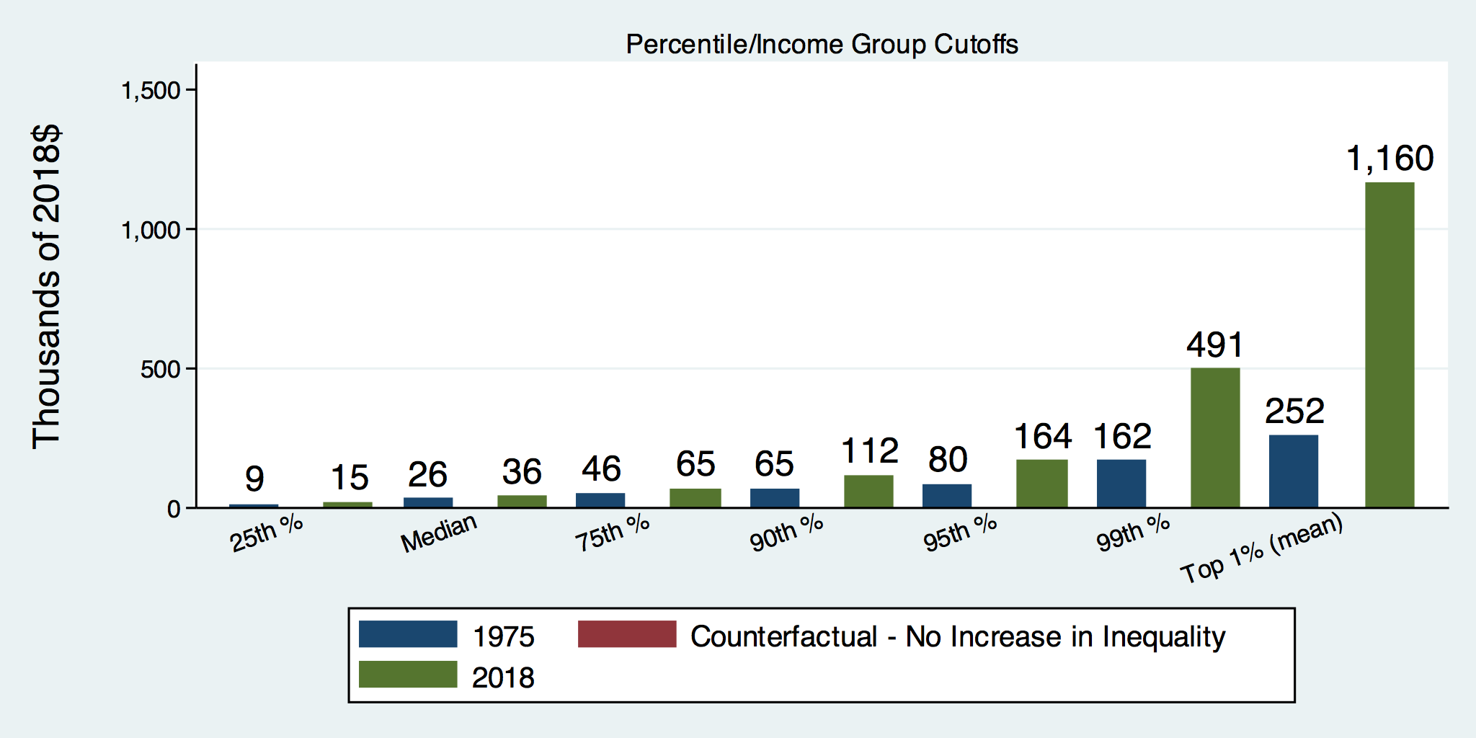
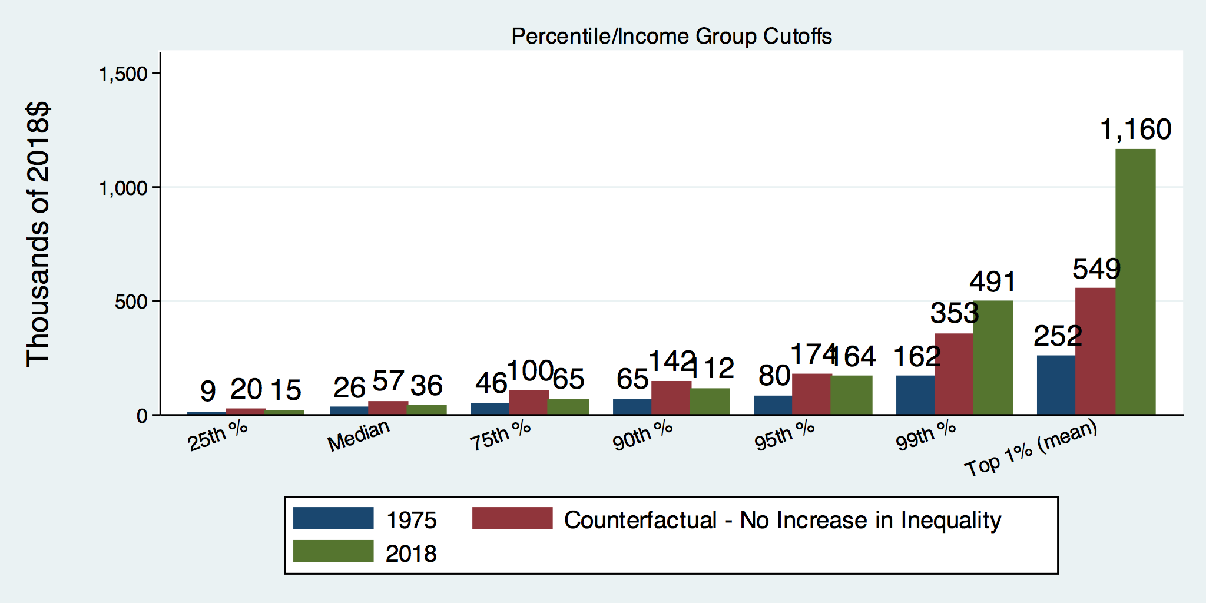
How Has Inequality Influenced Incomes?

Slide 26
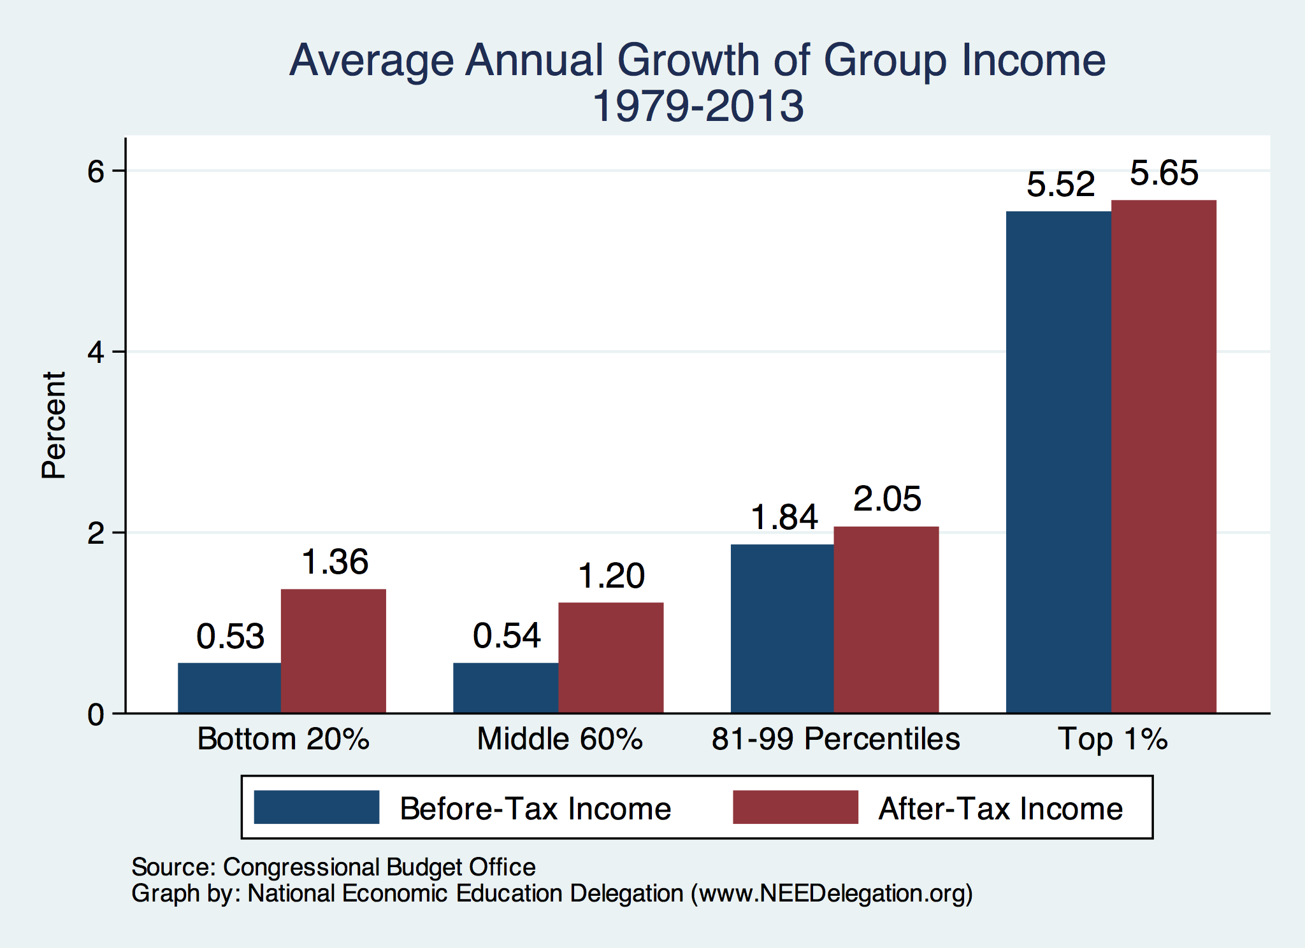
Growth Has Been Primarily at the Very Top

Slide 27
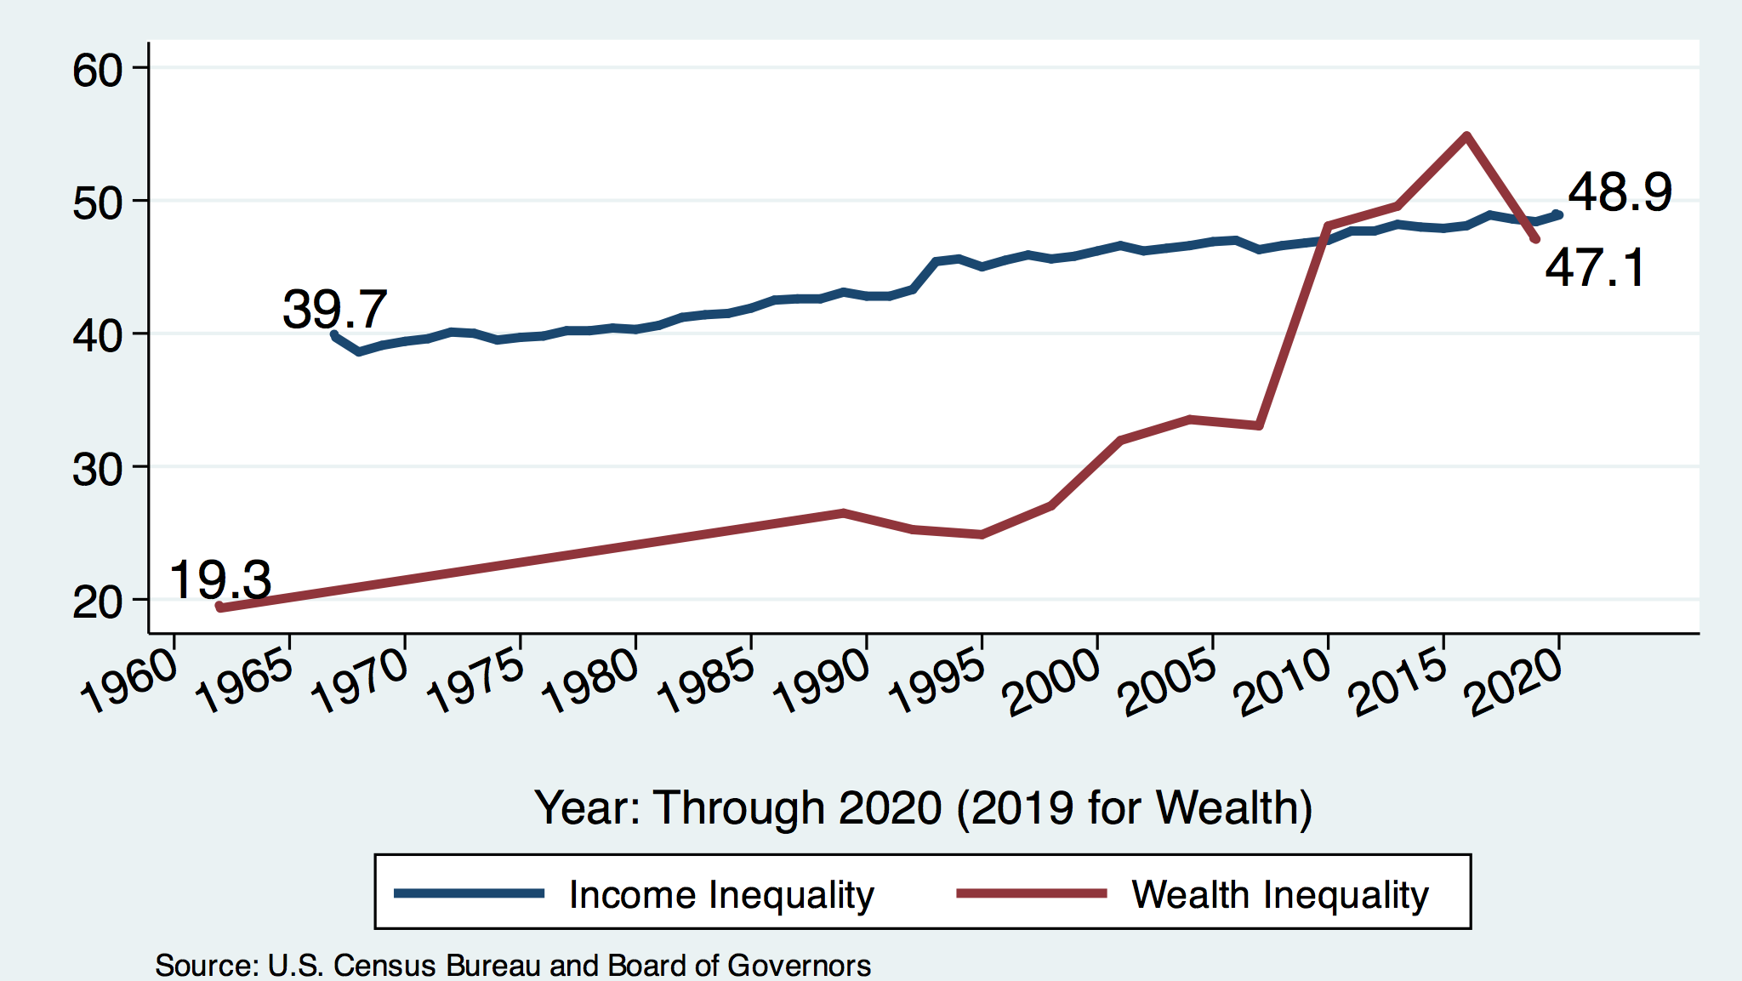
Income and Wealth Gini Coefficients

Slide 28
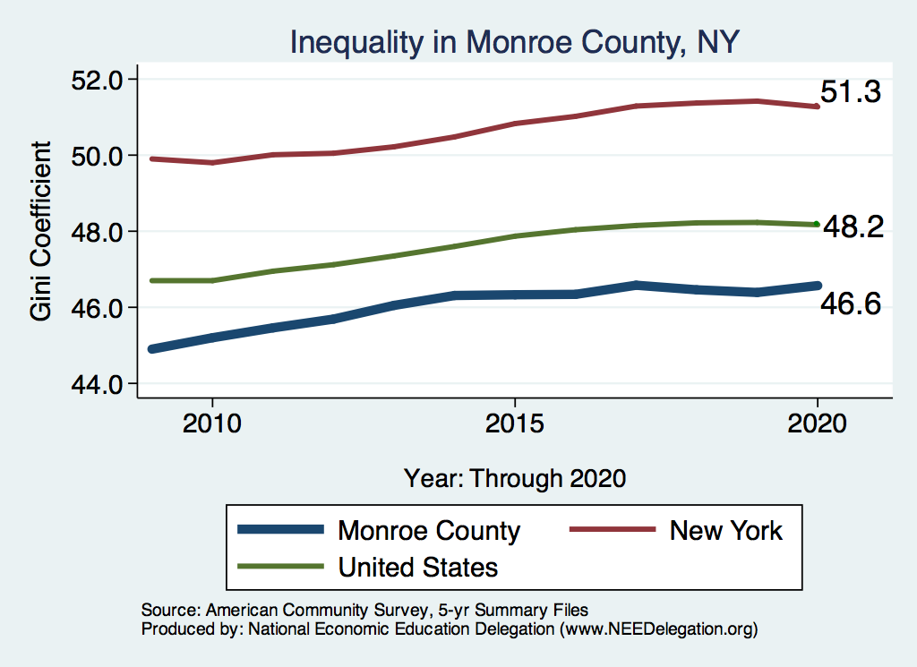
Your Local Inequality Trend

Slide 29

Wealth Concentration Has Been Rising
2019 Overall Median: $121,700

Slide 30

Wealth is More and More Concentrated
99th Percentile
2016 = 7x 1963
Source: Urban Institute

Slide 31
Wealth Inequality Exceeds Income Inequality
Source: Chad Stone, Danilo Trisi, Arloc Sherman, and Roderick Taylor, “A Guide to Statistics on Historical Trends in Income Inequality,”
Center on Budget and Policy Priorities, Policy Futures, Dec. 11, 2018.

Slide 32
Where Does Income Inequality Come From?
Labor Characteristics
  Demographics
    Age distribution
  Personal Choices
    Educational attainment
    Effort
    Priorities
    Household composition
  Immigration and Emigration
Market Forces
  Technology
  Changing demand patterns
  Competition for labor
Government Policy
  Market influence
  Redistribution

Slide 33
Government Policy and Inequality
Market Influence: PRE-distribution
  Characteristics of labor
    Access to education
  Effects on labor demand
    Market regulation
      Competition policy
    Labor regulations
      Minimum wage, overtime, health insurance, union regulations, etc.
RE-distribution
  Tax Rates
  Income support
    Direct aid
    Food stamps

Slide 34
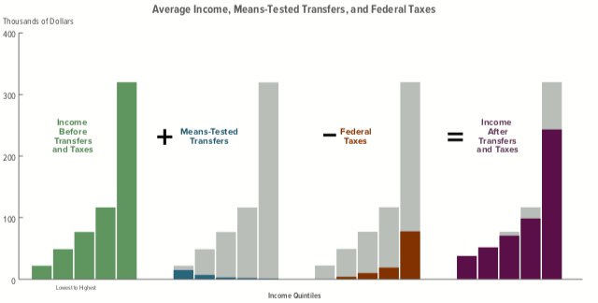
Taxes, Transfers, and Income
Source: U.S. Congressional Budget Office, “The Distribution of Household Income, 2016”.

Slide 35
Tax and Transfer Programs and Inequality
2014
Source: U.S. Congressional Budget Office, “The Distribution of Household Income, 2014”, Average Income Before and After Means-Tested Transfers and
Federal Taxes, by Income Group, 2014.

Slide 36
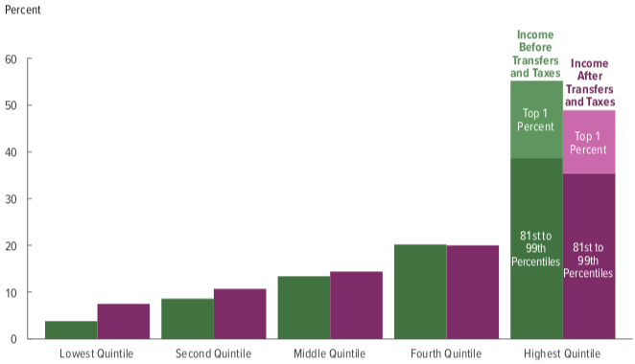
Tax and Transfer Programs: Income Shares
2018
Source: U.S. Congressional Budget Office, “The Distribution of Household Income, 2016”, Average Income Before and After Means-Tested Transfers and
Federal Taxes, by Income Group, 2016.

Slide 37
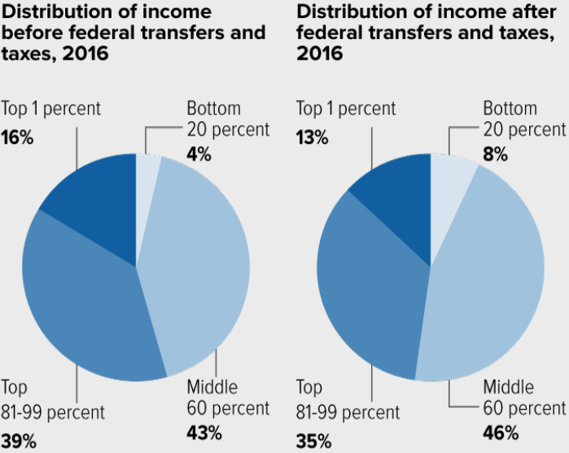
Tax and Transfer Programs: Income Shares

Slide 38
What About Tax Rates?
400 Taxpayers with highest incomes
1992-2007
+
392%
1992-2014
Average
Tax Rate
+310%
Average
Income
-12%
-
37%
Source: IRS
Source: IRS, Statistics of Income Division, December 2016.

Slide 39

Tax Rates Over Time

Slide 40

The Top Tax Rate and Income Cutoff
Income tax rates have decreased.
But so have the income cutoffs.
So lower rates, but now applied
to broader tax base (more people)

Slide 41

Dramatically Less Progressivity in the Tax Code
1961 to 2011
Source: New York Times, from Thomas Piketty, Emmanuel Saez and Gabriel Zucman, “
Distributional National Accounts: Methods and Estimates for the United States”

Slide 42
Market Forces and Inequality
Changing demand patterns
  Technology and “skill-biased technological change”
  Increased Trade and Globalization
  Industry composition
    PCs instead of typewriters
    Services instead of goods
    Professional services instead of personal services
Competition in labor markets
  Unionization
  Market concentration

Slide 43
Where Does Inequality Come From? Summary
Labor characteristics
  What do workers bring to the market?
Market forces
  How does the market value the labor characteristics?
Government policies
  PRE-distribution – affecting markets
  Redistribution – affecting incomes

Slide 44

Labor Income is Unhinged from Productivity
Why? Some theories:
Declining unionization
Competition policy
Immigration
Technological change
Globalization

Slide 45

Declining Unionization
Unionization Rates
1983: 20.1%
2021: 10.3%
Unionization Rates
Public: 33.9%
Private: 6.1%
Source: https://inequality.org/facts/income-inequality/, Bureau of Labor Statistics and Emmanueul Saez, University of Califonria, Berkeley
Notes:
https://voxeu.org/article/forms-and-sources-inequality-united-states

Slide 46
Competition in the Economy
Return on invested capital excluding goodwill –
US publicly-traded nonfinancial firms, 1965-2014
Source: Jason Furman, ”Forms and sources of inequality in the United States”, VOX, March 17, 2016, Figure 6.
Notes:
Note: The return on invested capital definition is based on Koller et al (2015), and the data presented here are updated and augmented versions of the figures presented in Chapter 6 of that volume. The McKinsey data includes McKinsey analysis of Standard & Poor’s data and exclude financial firms from the analysis because of the practical complexities of computing returns on invested capital for such firms. ​
Source: Koller et al. (2015); McKinsey & Company; Furman and Orszag (2015). , by way of https://voxeu.org/article/forms-and-sources-inequality-united-states
Furman, J and P Orszag (2015), “A Firm-Level Perspective on the Role of Rents in the Rise in Inequality”, Presentation at “A Just Society” Centennial Event in Honor of Joseph Stiglitz Columbia University, October 16, 2015.

Slide 47

Growing Revenue Concentration
Source: The Hamilton Project, Brookings: The State of Competition and dynamism.

Slide 48

CEO Pay Has Been Growing Rapidly

Slide 49

CEO-to-Worker Ratios Across Countries

Slide 50
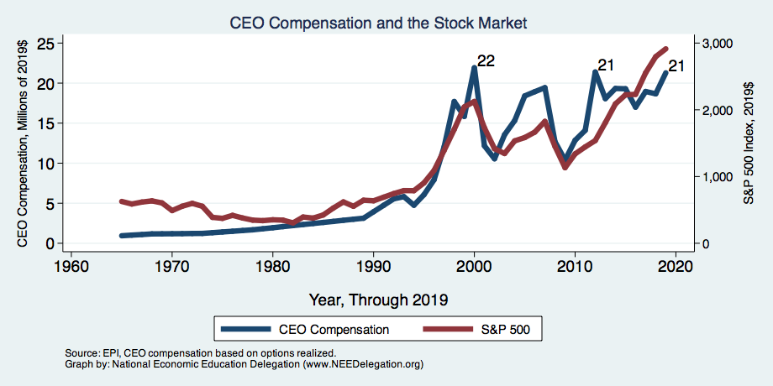
CEO Compensation – Tied to Stock Prices

Slide 51
Immigration and Inequality
Source: Ping Xu, James C. Garand, and Ling Zhu, “How immigration makes income inequality worse in the U.S.”, October, 2015, Figure 1.

Slide 52
Immigration and Inequality- Summary
Beginning in about 1970, the immigrant share of the U.S.
Population increased dramatically.
  5% in 1970 and 14% in 2016
Immigration tends to happen most often among:
  Low-skilled low-wage workers
  High-skilled high-wage workers
Immigration has likely increased income inequality.
Its effect has likely been small.
  ~5% between 1980 and 2000
  No reason to think it has been bigger since

Slide 53
Technological Change and Inequality
Much of the technology adopted in the last 30 years has eliminated low-skill or low-wage jobs.
  Computers, advanced manufacturing equipment, steel mini-mills, automation
Technological change may result in “winner take all” outcomes.
  This likely favors a small group of individuals.
  But of course the relative winners can change rapidly.
Both aspects increase inequality by increasing the rewards to:
  Those with significant labor market skills.
  Owners over workers

Slide 54


Technology Effects on Low Income Workers
Technology can improve worker productivity and create jobs
But technology can also displace jobs

Slide 55
A Modern Example: Uber & Lyft
Ride-Share Technology:
  May be more efficient: less idle time, supplying drivers to meet rider demand
  But may also reduce labor’s bargaining power and shift more costs to drivers
Other trade-offs and considerations:
  Increased flexibility for drivers (of course, difficult to value)
  Cost and convenience improvements for riders

Slide 56
Globalization
What is globalization?
  Flow of goods, services, capital, and labor across international borders
How does it affect inequality?
  Through a differential impact on low-skilled workers and hence their wages
  For the United States, globalization is thought to lower the wages of low skilled and hence low-wage workers relative to those of high-skilled workers
  But high-skill workers not immune to effects of globalization

Slide 57
Mechanisms for the Effects of Globalization
Merchandise trade
  Importing goods that are made with low-skilled workers and exporting goods that are made with high-skilled workers
    Lowers the wages of unskilled relative to skilled
      making the distribution of income less equal
Outsourcing
  Similar channel as with merchandise trade
Trade in services
  US imports of middle-skill services: business and some professional services
Intuitively: The same as if we were to move the actual workers.

Slide 58
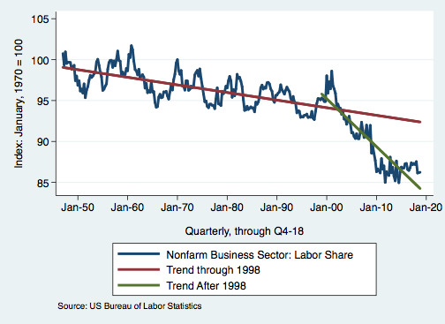
Effects of the Unhinging?
Labor’s Share of Income
1960: 66%
2011: 56%
2016: 58%
Source: Bureau of Labor Statistics

Slide 59
What is driving increasing inequality?
Primary drivers:
  Technology
  Globalization
  Institutions
These drivers can also influence personal choices in ways that affect measured income inequality.
  For example, educational choices or labor force participation

Slide 60
Sources of Inequality Through Late 1990s

Slide 61

Why Does Inequality Matter?
Too little inequality can:
  Reduce individual motivation
  Slow economic growth
Too much inequality can:
  Reduce individual motivation
  Slow economic growth
Too much inequality may also:
  Divide society
  Distort political environment
  Reduce political participation
  Affect public goods spending and distribution
    Education
    Environmental protections

Slide 62

Peru
China
Brazil
Less Economic Mobility
Germany
U.S.
Canada
https://equitablegrowth.org/research-paper/are-todays-inequalities-limiting-tomorrows-opportunities

Slide 63
How Much Inequality Is too Much?
Sweet
Spot
?
?
Equity
Efficiency/GDP
Efficiency/GDP
Equity
Efficiency/GDP
Equity
0
100
Z
X
Gini Coefficient

Slide 64
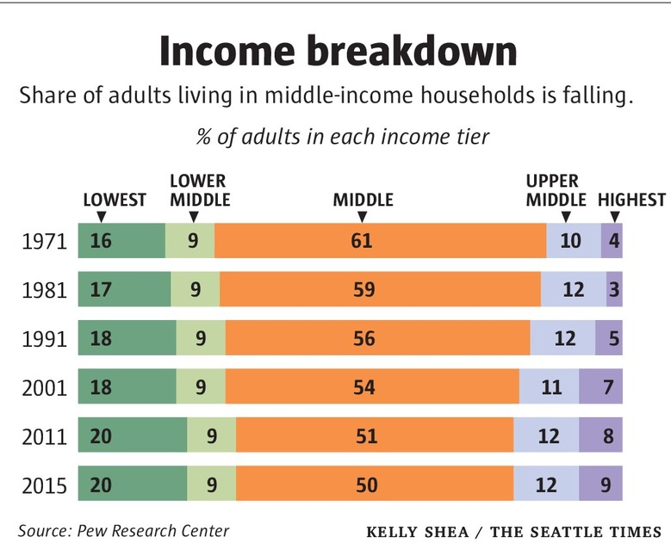
Inequality Can Also Directly Affect GDP
The US Economy is driven by consumption (67% of GDP).
  Middle class are the big consumers.
  They have less money.
  Consumption is lower.
  GDP is lower.

Slide 65
Too Much Inequality Can:
Reduce work effort, which reduces GDP.
Reduce purchasing power of the middle class, which reduces GDP.
Reduce the ability of people to get ahead, which reduces mobility.
  Puts the American Dream at risk.
Increase the share of the population living on low incomes.
  Offending our sense of equity? Desire for shared prosperity?
Concentrate political power.

Slide 66
An International Perspective
Source: Data taken from the 2014 CIA World Factbook.

Slide 67
An International Perspective: Comparables
U.S.: 17-18
Canada, UK, Germany: 12-13
Italy, France, Japan: 7-9

Slide 68
Addressing Inequality: Is It A Problem?
Why it might be a problem.
  Economic issues (Efficiency)
    There is evidence that increased inequality can slow economic growth.
    Or, inequality concentrates resources among investors.
  Noneconomic issues (Equity)
    Values, ethics and morals will drive individual evaluations inequality.
      E.g., inequality is primarily a function of market outcomes, so should be left alone.
      Or, a solid middle class is important for maintaining a civil society, which runs contrary to a high degree of inequality.
Suppose you think it’s a problem. How might it be addressed?

Slide 69

Addressing Inequality:
Immediately Available Policy Solutions (1/2)
RE-distribution
  Tax and transfer programs
PRE-distribution
  Strengthen labor unions
  Collective bargaining
  Other policies that favor labor over business owners
  Minimum wages

Slide 70
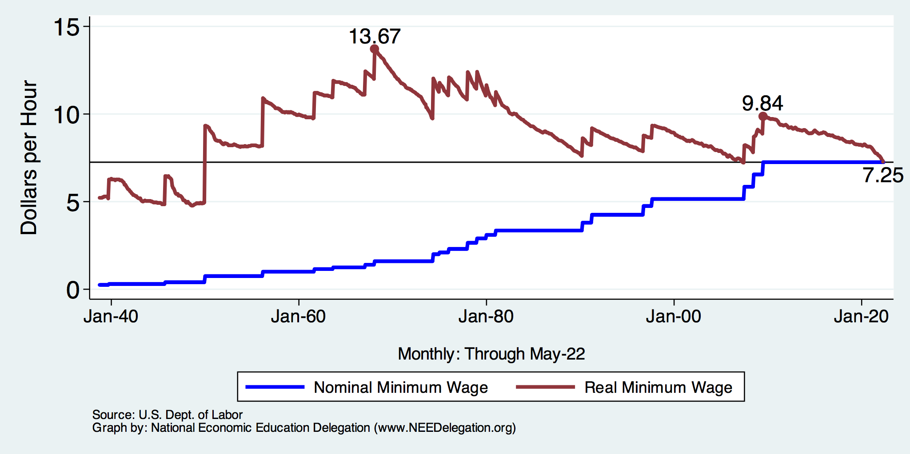
Historical Values of Minimum Wages

Slide 71
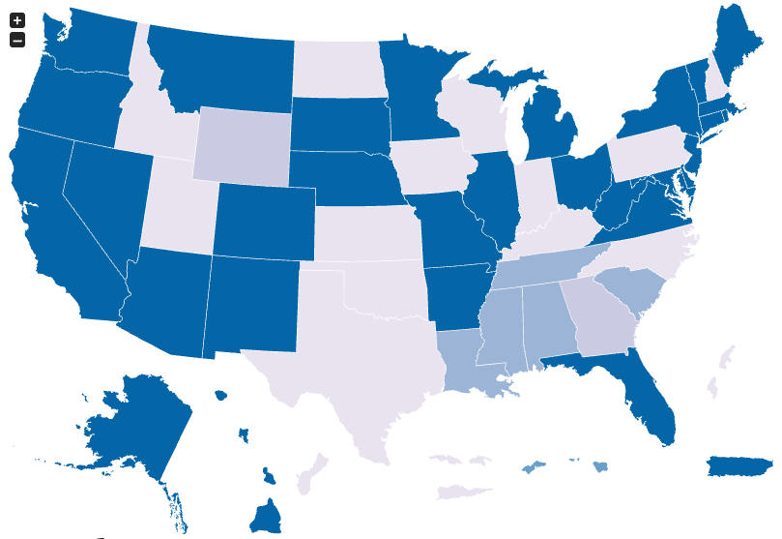
Many States Have A Higher Min Wage
NY: $13.20/hour
CA: $15/hour
States with Higher
Minimum Wage
than Federal
FL: $10/hour
As of July 1, 2022
Source: U.S. Department of Labor

Slide 72
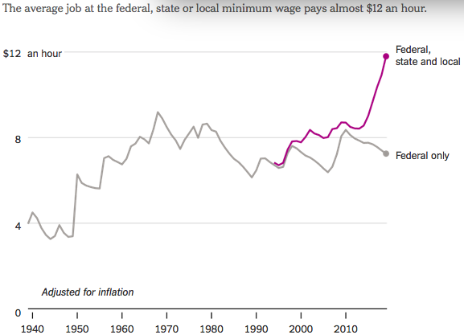
States and Local Gov’ts are Raising Min Wages
Notes:
https://www.nytimes.com/2019/04/24/upshot/why-america-may-already-have-its-highest-minimum-wage.html?action=click&module=RelatedLinks&pgtype=Article

Slide 73
Addressing Inequality:
Immediately Available Policy Solutions (2/2)
Other
  Reverse trends in market power
Locally
  Employment services: job training, interview skills, or assistance with day-to-day issues, such as child care
  Cognizance of the potential for technologies to affect worker/employer power dynamics
    Uber, Lyft, etc.
Notes:
Reference your own experience at FTC

Slide 74
Addressing Inequality:
Long Term
It’s all about access to resources:
  Education, in particular
    Improve public education
    Reduce disparities in quality of public education
    Improve counseling - paths to higher ed and funding for low-income students
    Investments are needed in early education, not later (e.g. universal pre-k)
  Opportunities for wealth-building
  Housing
Initiatives whose impacts cross neighborhood and class lines and increase upward mobility specifically for black men
  Mentoring programs for black boys, efforts to reduce racial bias among whites, interventions to reduce discrimination in criminal justice, and efforts to facilitate greater interaction across racial groups.

Slide 75

What to do About Inequality?
Nothing?
Redistribution?
PRE-distribution?
Access to resources?

Slide 76
Tension in Policy Solutions
Is it possible to increase growth at the same time that you reduce income inequality?
  Common refrain among some that government intervention in the economy is always and everywhere bad for growth.
Possibly: expanding equality of access promotes the full utilization of resources.
  Expanding equality of access requires resources likely from the well-to-do.
Possibly: encouraging competition promotes a more efficient economy
  Companies with market power (monopolies) can stagnate economies

Slide 77
Summary
Income inequality is clearly increasing.
  The economy is clearly favoring owners of productive resources over labor.
The causes appear to be largely driven by:
  The market – technology, competition, and trade
  Changing institutions.
Open questions are:
  To act or not to act?
  If so, how?
The level of inequality is a policy choice.

Slide 78
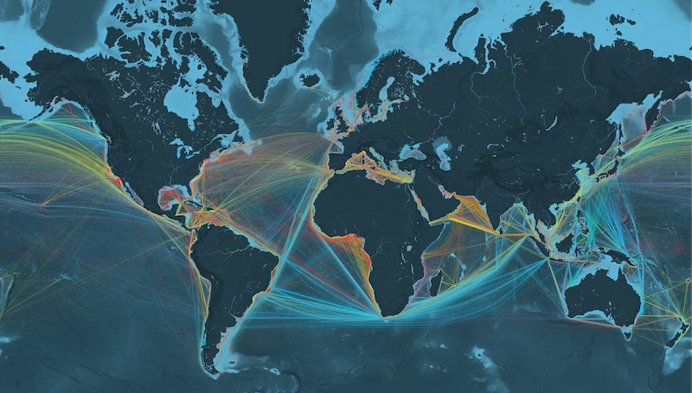
Next Week: Trade & Globalization
Source: www.shipmap.org

Slide 79
Thank you!
Any Questions?
www.NEEDelegation.org
Christopher Herrington, Ph.D.
cmherrington@gmail.com
Contact NEED: info@NEEDelegation.org
Submit a testimonial: www.NEEDelegation.org/testimonials.php
Become a Friend of NEED: www.NEEDelegation.org/friend.php

