Slide 1
Osher Lifelong Learning Institute, Fall 2025
Inequality and Economics
Northwestern University
Host: Geoffrey Woglom, Director
National Economic Education Delegation

Slide 2
Course Schedule
Inequality and Public Policy
  Week 1 (10/14): The New Inequality, Geoffrey Woglom, Amherst College
  Week 2 (10/21): Economics of Immigration, Robert Gitter, Ohio Wesleyan University
  Week 3 (10/28): Trade and Inequality Geoffrey Woglom, Amherst College
  Week 4 (11/04): The Black-White Wealth Gap, Jon Haveman, Exec. Director, NEED
  Week 5 (11/11): Climate Change Economics Sarah Jacobson, Williams College
  Week 6 (11/18): AI and Inequality Geoffrey Woglom, Amherst College

Slide 3
Characteristics of Native and Latin Amer. Born Population (Age 16 & up)
 | Native Born | Lat. Amer. Born
Labor Force | 130 Mil. | 13 Mil
< H.S. Educ | 5.8% | 37.1.%
Poor English | 1.9% | 77%
Employed | 59.2% | 64.9%
Unemployed | 3.0% | 3.5%
Med. Wk. Earn | $1,087 | $758
Poverty Rate | 13% | 17%

Slide 4
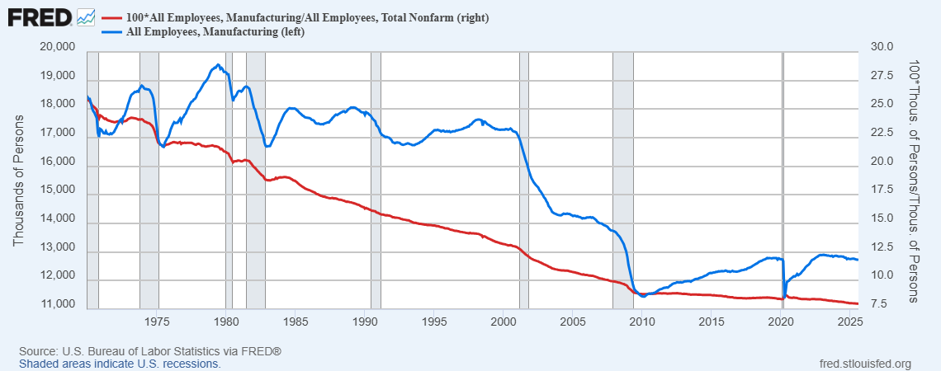
Employment in Manufacturing

Slide 5
Net Worth by Age and Race
Source: https://www.brookings.edu/blog/up-front/2020/02/27/examining-the-black-white-wealth-gap/

Slide 6
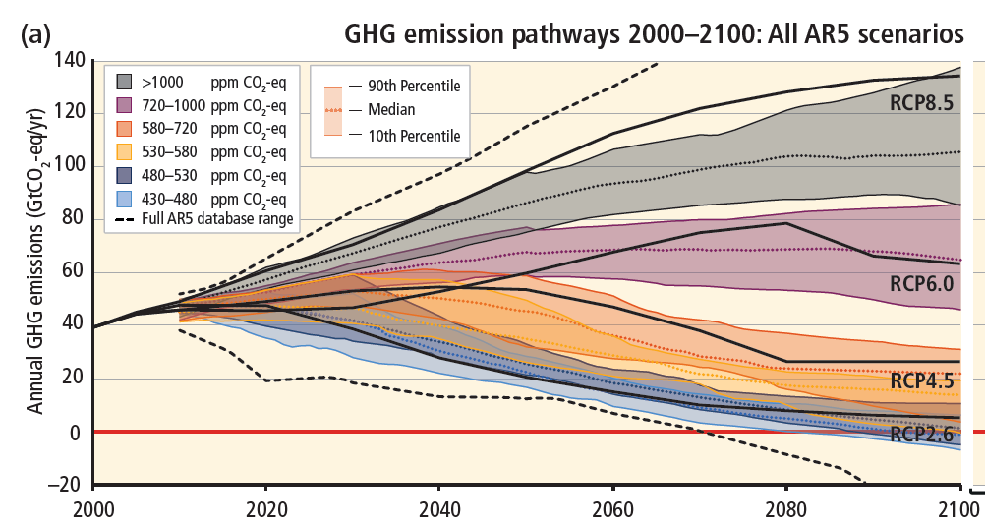
Emissions Trajectories into the Future
Source: IPCC Assessment Report 5
Notes:
Figure SPM.11 from the Summary for Policymakers of AR5

Slide 7
AI Is Getting “Smarter”
Eloundo, Manning, Mishkin, Rock (2023) https://ar5iv.labs.arxiv.org/html/2303.10130

Slide 8
Submitting Questions
Submit questions in the chat. I will try to address questions after 5 are in the chat.
We will do a verbal Q&A once the material has been presented.
Slides will be available from the NEED website tonight or tomorrow https://needecon.org/delivered_presentations.php.

Slide 9
Outline
Definitions.
Snapshots of US Inequality.
Inequality over time.
Does inequality matter?
The New Inequality?
What to do about it.

Slide 10

Economic Inequality: Material Inequality
Definition:
  The extent to which the distribution of goods and services deviates from complete equality.
  Material inequality is highly correlated with other kinds of inequality. E.g., life satisfaction, life expectancy.

Slide 11
Different Ways of Thinking About Material Inequality
Income Inequality
  Before taxes and transfers
  After taxes and transfers
Wealth Inequality
How does wealth differ from income?
Income is measured over a period of time, say one year and measures ability to consume today.
Wealth is one’s accumulated savings, including physical and financial assets (net worth), and measures the ability to consume now and in the future.

Slide 12
Measuring Material Inequality
median: $70,260
top 10% 52.3% of total
Top 10% comprise 73% of total
Federal Reserve Board “Survey of Consumer Finances”

Slide 13
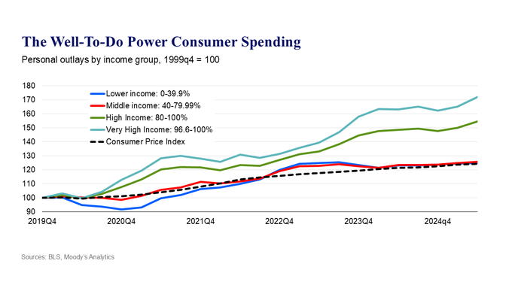
Shares of Consumption Are Similarly Unequal

Slide 14
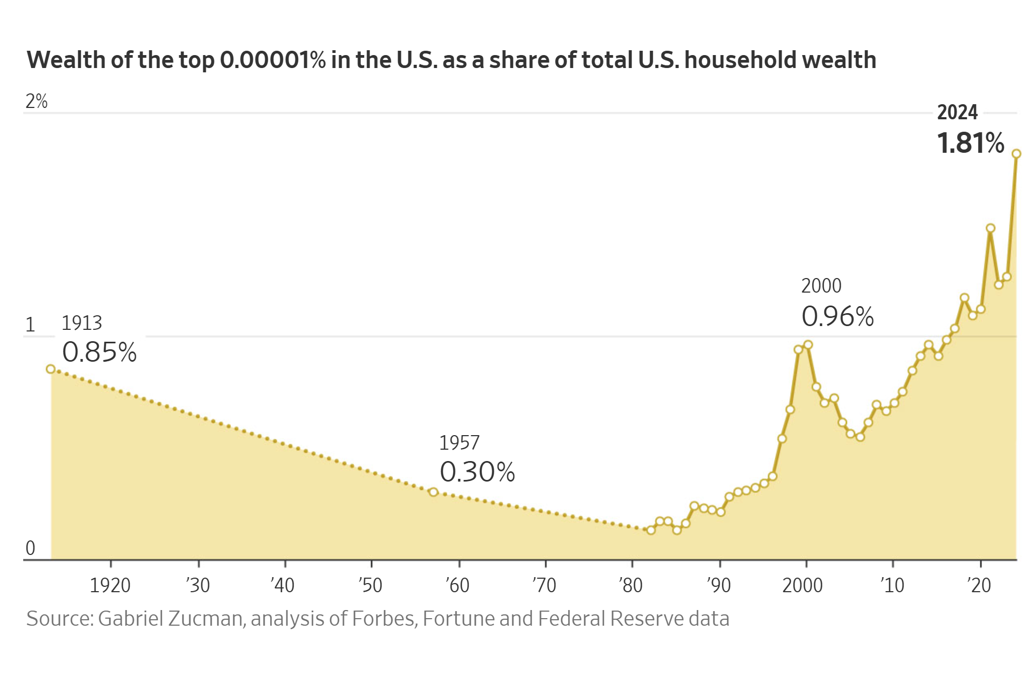
TheWSJ April 24th
19 Households
$2.6 trillion

Slide 15
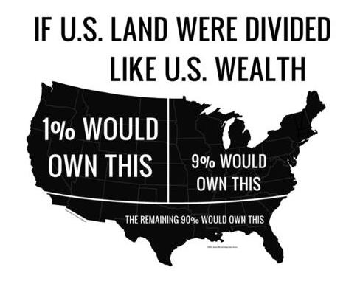
Wealth inequality in America

Slide 16
How We Compare to the Rest of the World
https://files.stlouisfed.org/files/htdocs/publications/page1-econ/2022/09/01/income-and-wealth-inequality_SE.pdf

Slide 17
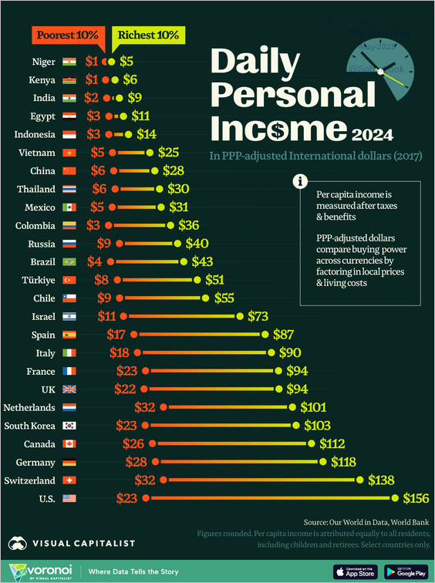
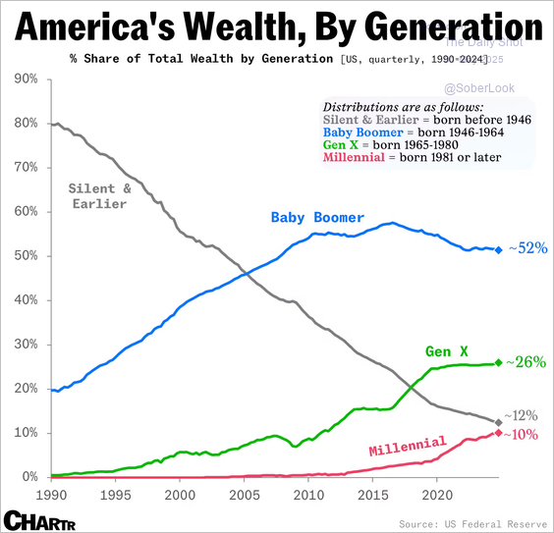
Living Standards Across the Globe

Slide 18
Racial Wage and Wealth Gaps
Source: Arloc Sherman, Danilo Trisi, and Joseph Cureton, “A Guide to Statistics on Historical Trends in Income Inequality,”
Center on Budget and Policy Priorities, Policy Futures, Dec. 11, 2024.

Slide 19
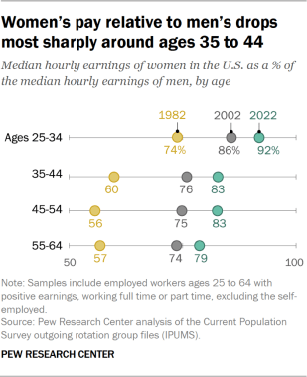
Gender Pay Gaps
https://www.pewresearch.org/social-trends/2023/03/01/the-enduring-grip-of-the-gender-pay-gap/

Slide 20
Household Wealth by Education, 2023, Q2

Slide 21
Case and Deaton’s Astounding Findings
Opioids were involved in more than 80,000 overdose deaths in 2021, which was 10 times the number of opioid overdose deaths in 1999. http://wonder.cdc.gov/

Slide 22
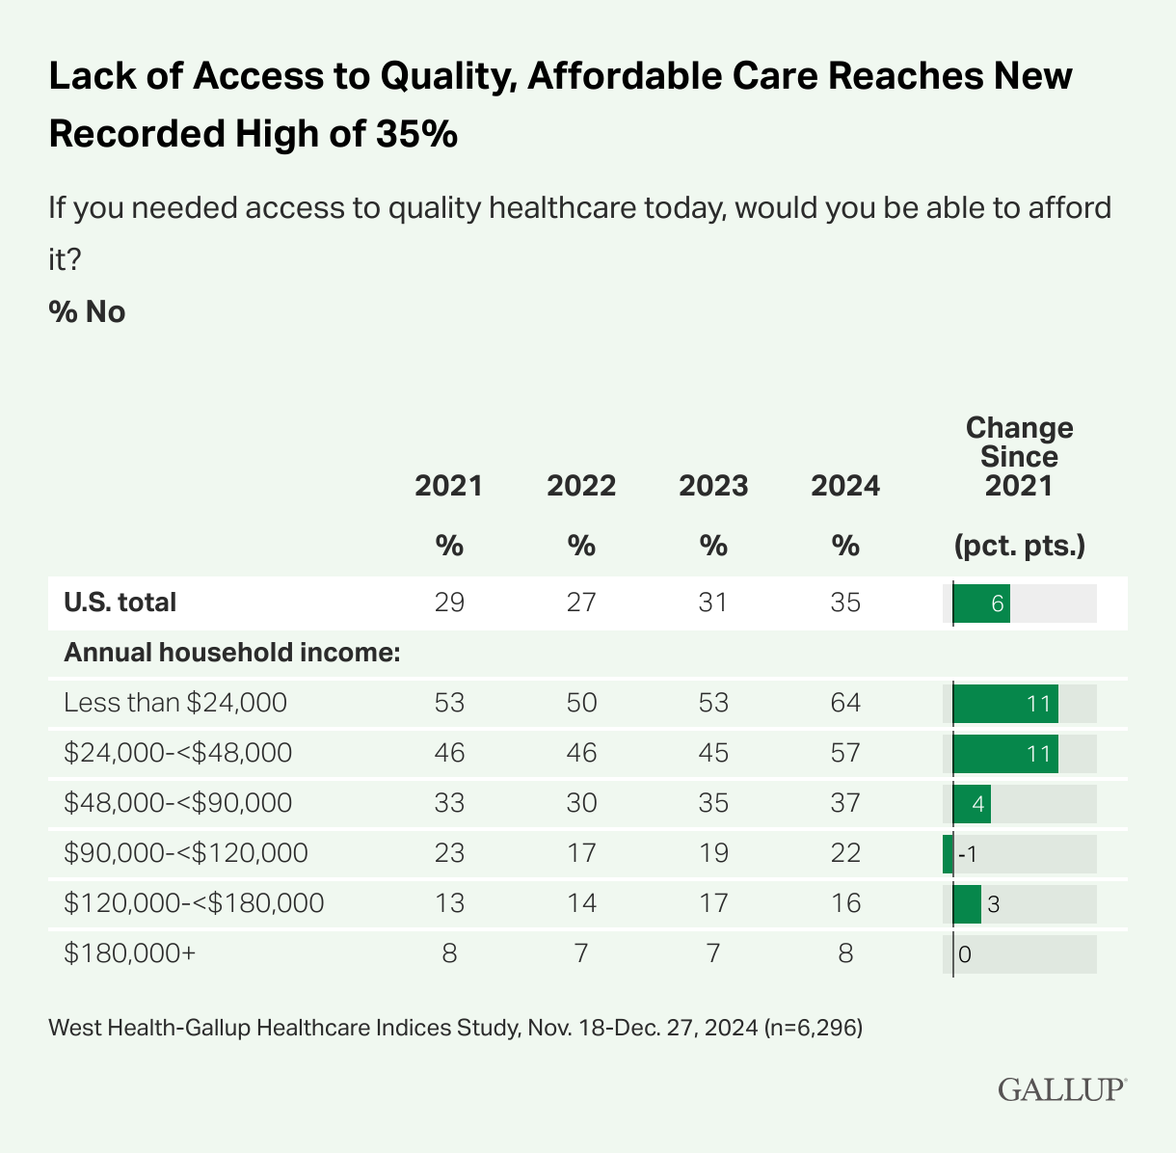
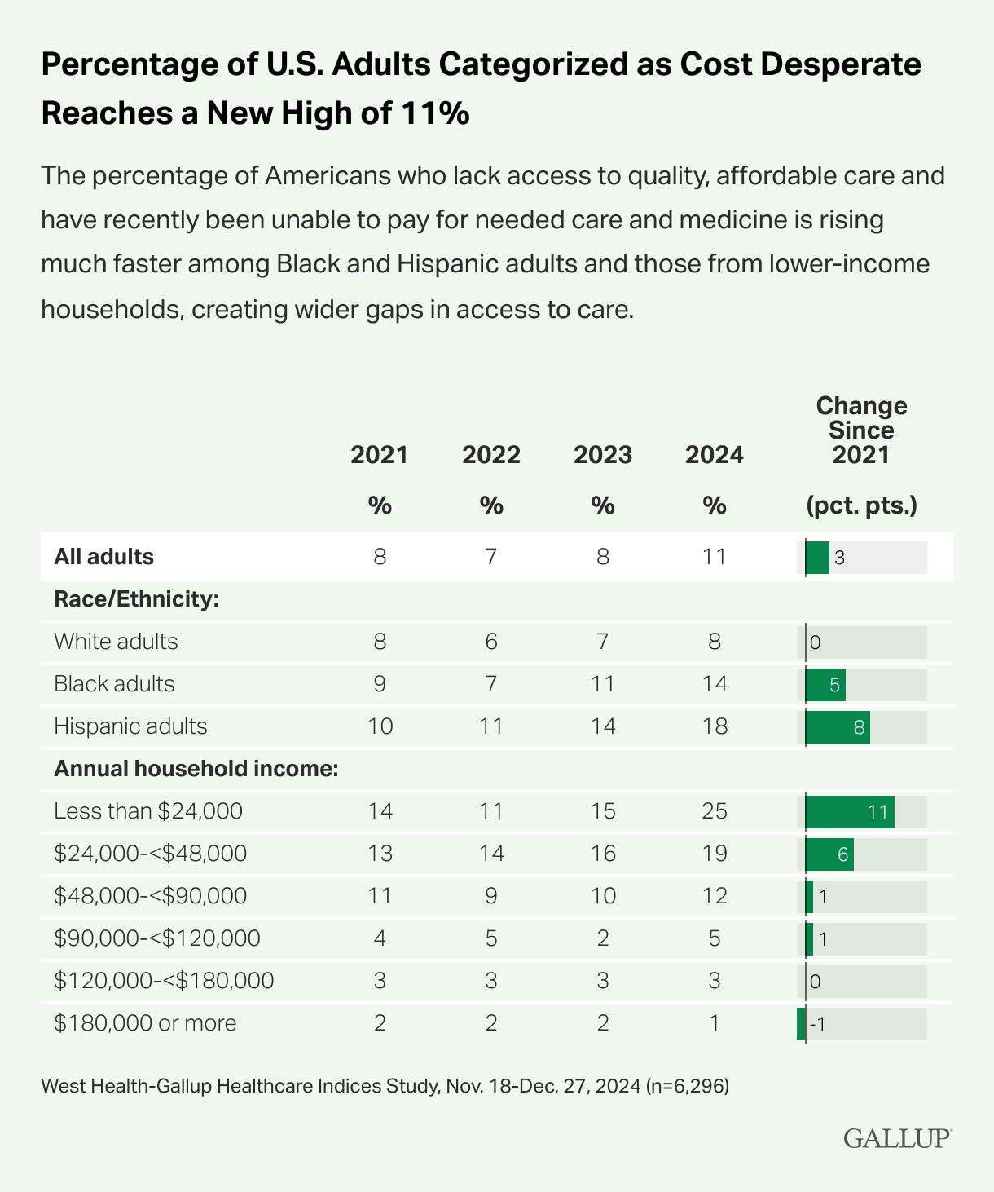
Health Care Access And Income

Slide 23
Education Matters for Broader Measures of Inequality
Ratio of indicators of well being
OECD, “How’s Life in the United States?” https://www.oecd.org/wise/Better-Life-Initiative-country-note-United-States.pdf \

Slide 24
Summary of Snapshot
Top 10% earns over 50% of total income and 70% of total wealth
US is one of the more unequal countries in the industrialized world.
Earning a BA is important for
  Earnings.
  Life Satisfaction.
  Life Expectancy.
Trends appear to be getting worse.

Slide 25
How Did We Get Here: The Long View
Source: Arloc Sherman, Danilo Trisi, and Joseph Cureton, “A Guide to Statistics on Historical Trends in Income Inequality,”
Center on Budget and Policy Priorities, Policy Futures, Dec. 11, 2024.
Notes:
Material Inequality was higher in the 1920s, but fell in the post WWII era

Slide 26
Historical Trends in Material Inequality
The “Great Convergence”: 1935-1978
The “Great Divergence:” 1979-?
  Income growth in the middle and lower parts of the distribution slowed.
  Incomes at the top continued to grow strongly.
Source: Chad Stone, Danilo Trisi, Arloc Sherman, and Roderick Taylor, “A Guide to Statistics on Historical Trends in Income Inequality,”
Center on Budget and Policy Priorities, Policy Futures, May 15, 2018.

Slide 27
The Abrupt Increase in Inequality
Source: Arloc Sherman, Danilo Trisi, and Joseph Cureton, “A Guide to Statistics on Historical Trends in Income Inequality,”
Center on Budget and Policy Priorities, Policy Futures, Dec. 11, 2024.
Notes:
Slide taken from page 10, Chad Stone, Danilo Trisi, Arloc Sherman, and Roderick Taylor, “A Guide to Statistics on Historical Trends in Income Inequality,” May 15, 2018

Slide 28
Increasing Inequality is Not Just US Phenomenon

Slide 29
But Global Inequality is Falling!

Slide 30
“Inequality Doesn’t Matter; Poverty Does” (?)

Slide 31
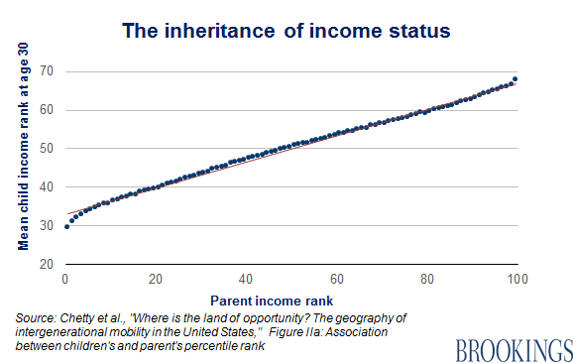
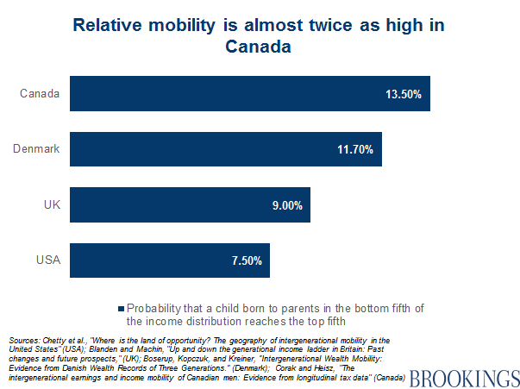
“Inequality Doesn’t Matter with Intergenerational Mobility (Horatio Alger)” (?)

Slide 32
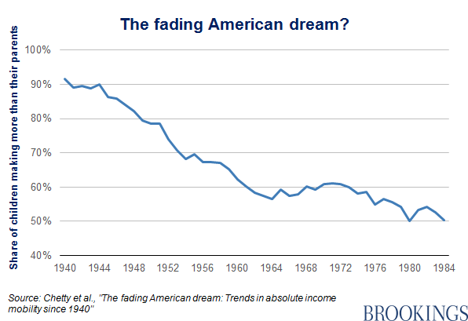
Inequality Doesn’t Matter because Children
Are Better Off Than Their Parents (?)

Slide 33
Tax and Transfer Programs and Inequality
https://www.cbo.gov/system/files/2023-11/59509-household-income_2019-2020.pdf

Slide 34
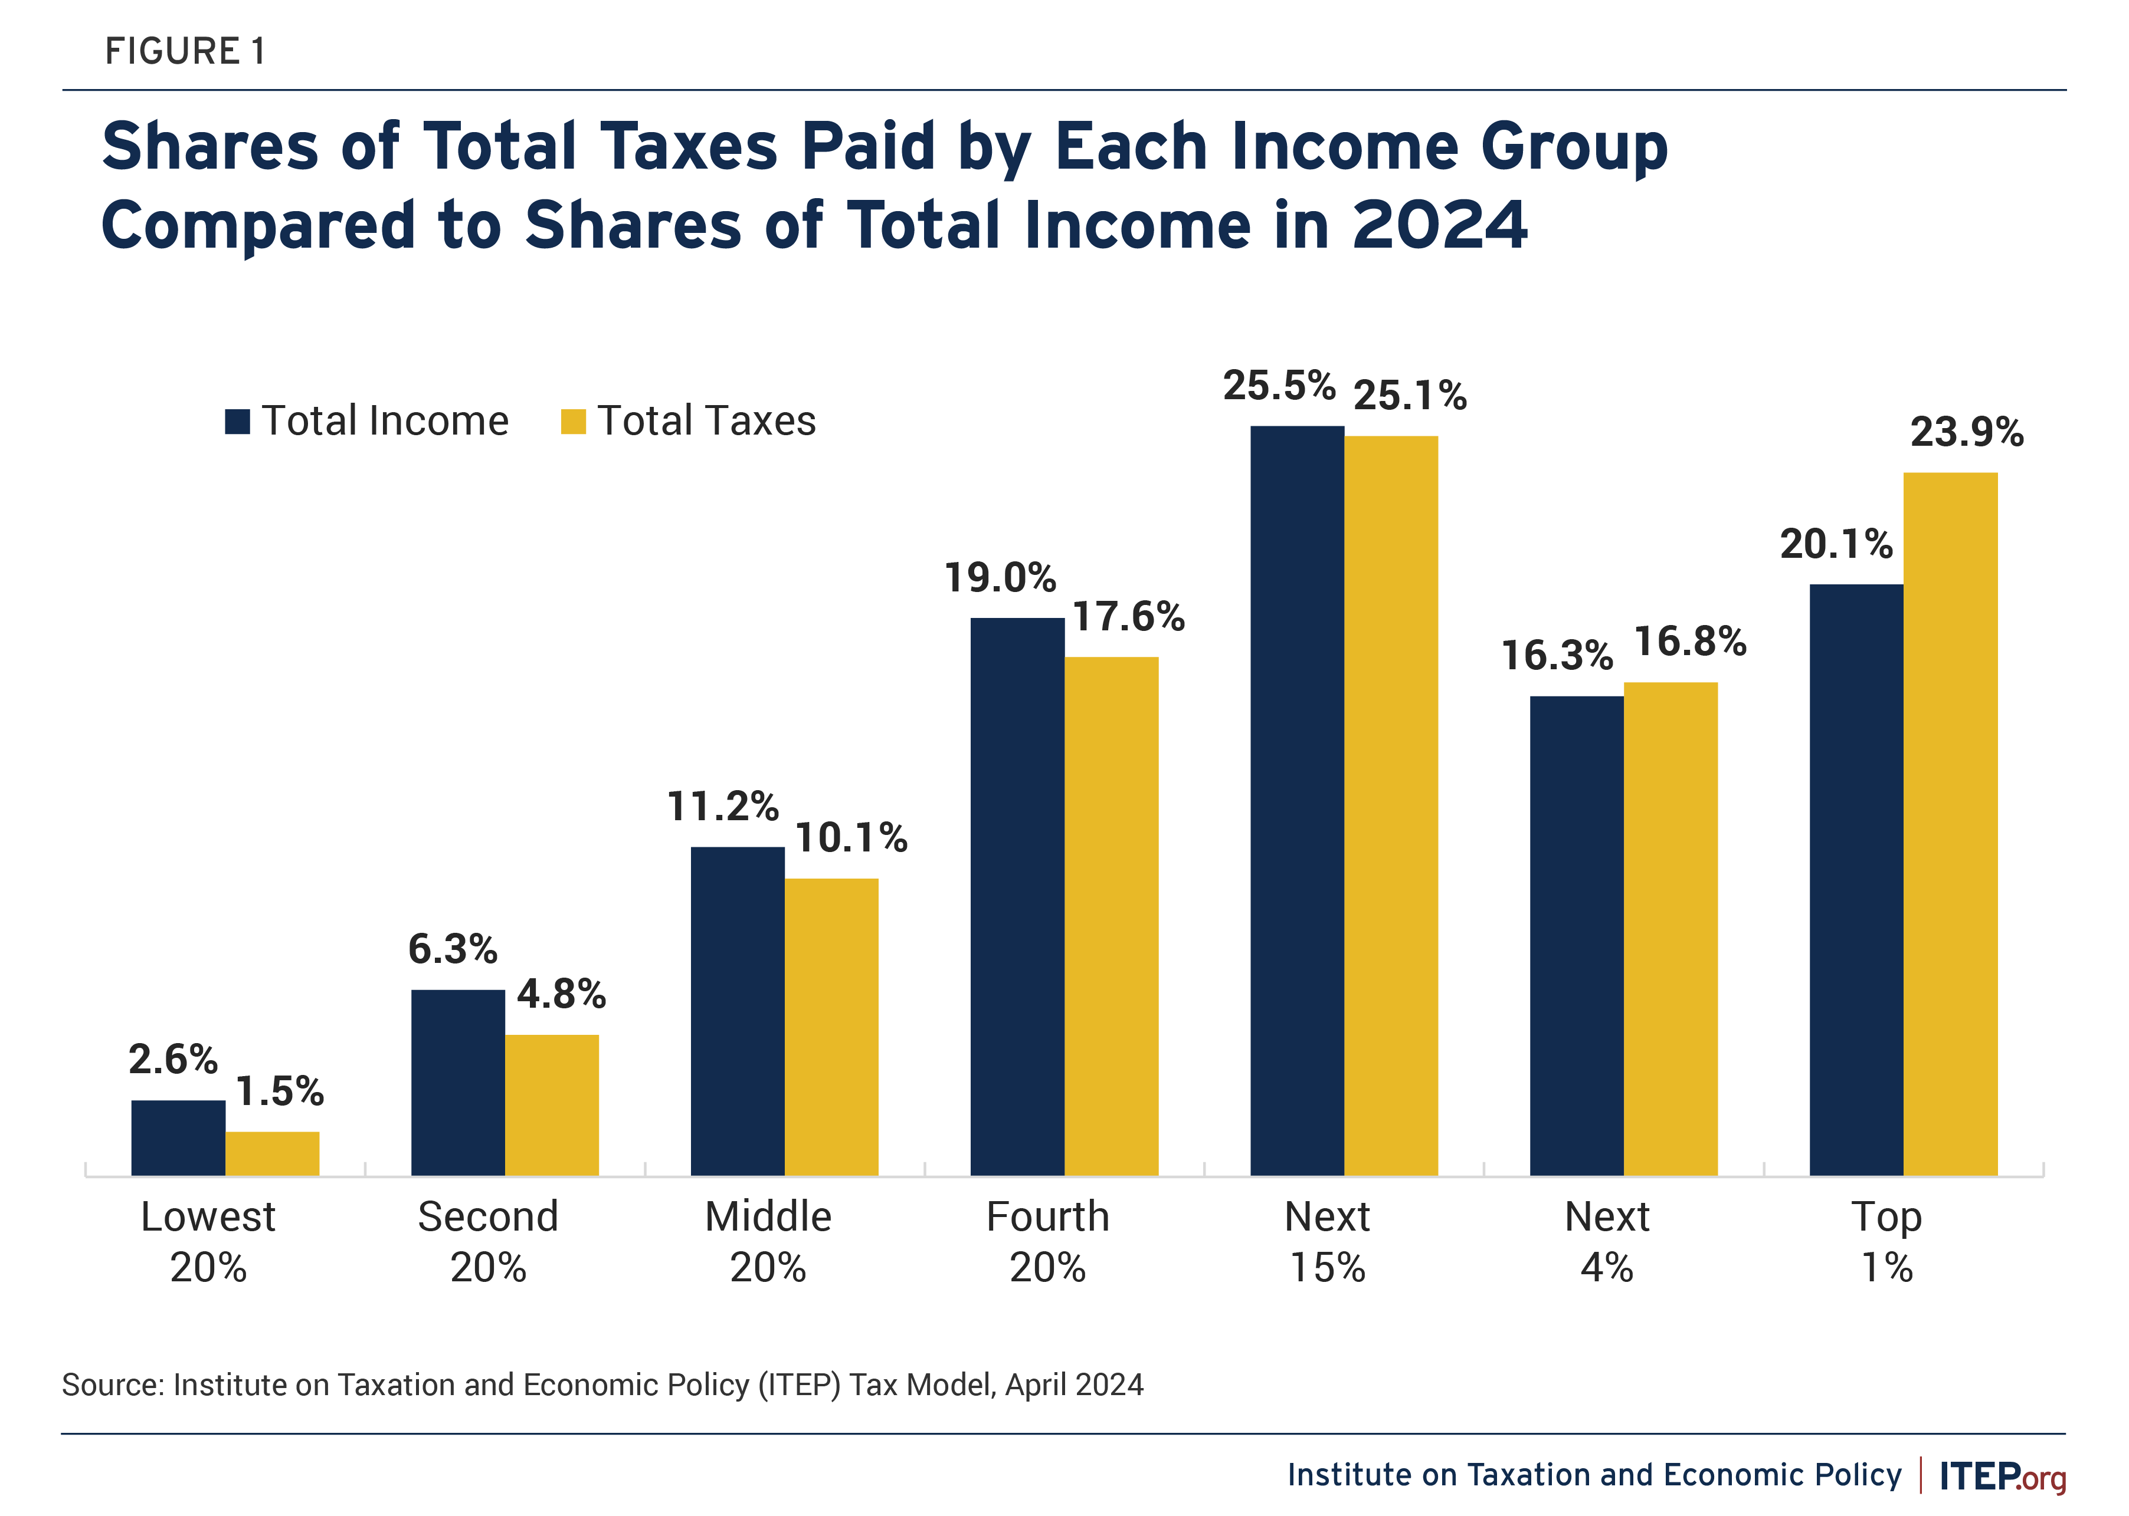
What about State Taxes?
But, this analysisis ignores transfers like Food stamp and Medicaid.
Most recently, a more comprehensive analysis was done. No pretty pictures, but here is the conclusion:
“We…found that the federal tax and transfer system is progressive, while state systems are close to
proportional, on average.”
https://www.minneapolisfed.org/research/staff-reports/fiscal-progressivity-of-the-us-federal-and-state-governments

Slide 35
Big Beautiful Bill & Tariffs
Source: https://budgetlab.yale.edu/

Slide 36
Market Forces and Inequality
Changing demand patterns
  Technology and “skill-biased technological change”
  Increased Trade and Globalization
  Industry composition
    PCs instead of typewriters
    Services instead of goods
    Professional services instead of personal services
Competition in labor markets
  Unionization
  Market concentration
  Immigration (?)

Slide 37
Technological Change and Inequality
Much of the technology adopted in the last 30 years has eliminated low-skill or low-wage jobs.
  Computers, advanced manufacturing equipment, steel mini-mills, automation
Technological change may result in “winner take all” outcomes.
  This likely favors a small group of individuals.
  But of course the relative winners can change rapidly.
Both aspects increase inequality by increasing the rewards to:
  Those with significant labor market skills and college degrees.
  Owners over workers.
What will AI do to this story?

Slide 38
Globalization
What is globalization?
  Flow of goods, services, capital, and labor across international borders.
How does it affect inequality?
  Through a differential impact on low-skilled workers and hence their wages.
  For the United States, globalization is thought to lower the wages of low skilled and hence low-wage workers relative to those of high-skilled workers.
  But Globalization lifted 300 million Chinese out of poverty.

Slide 39
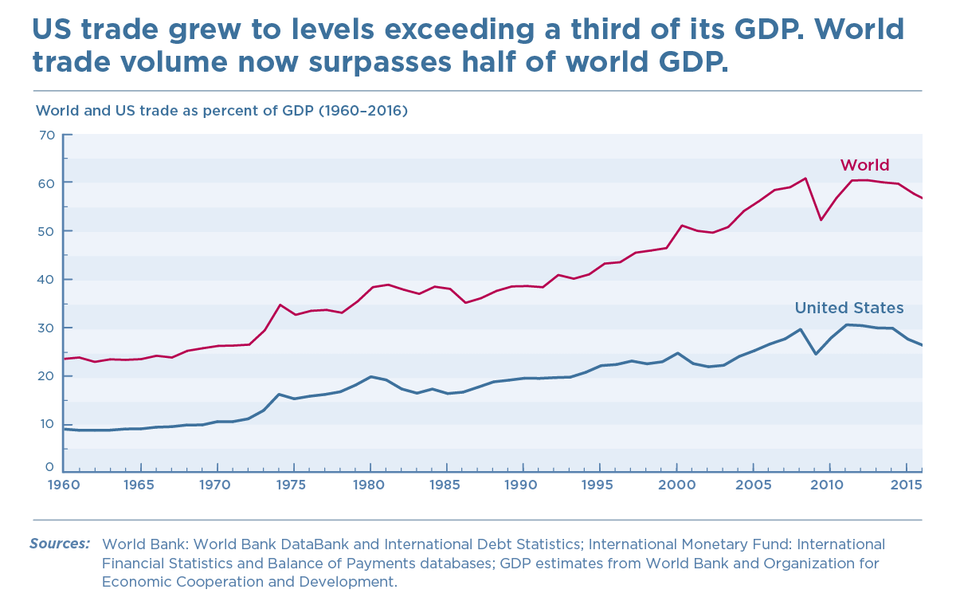
History of Globalization

Slide 40
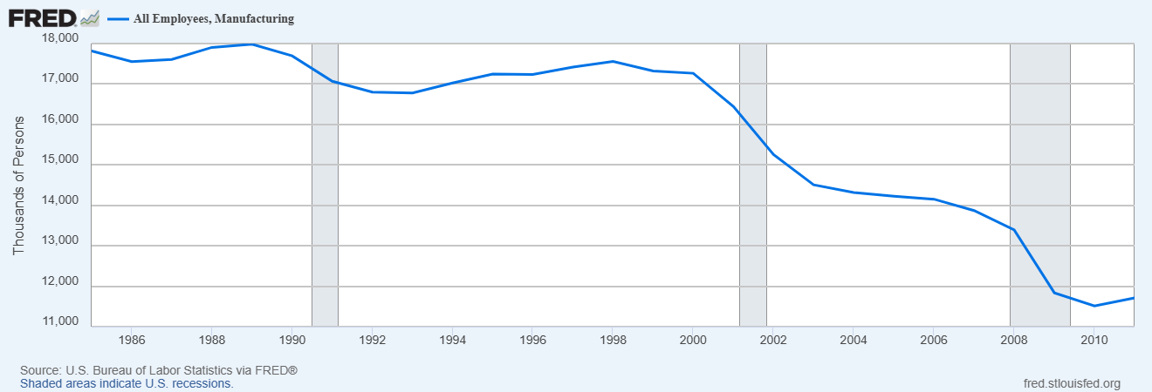
The China Shock
Reminder: China Joins WTO in December of 2001

Slide 41
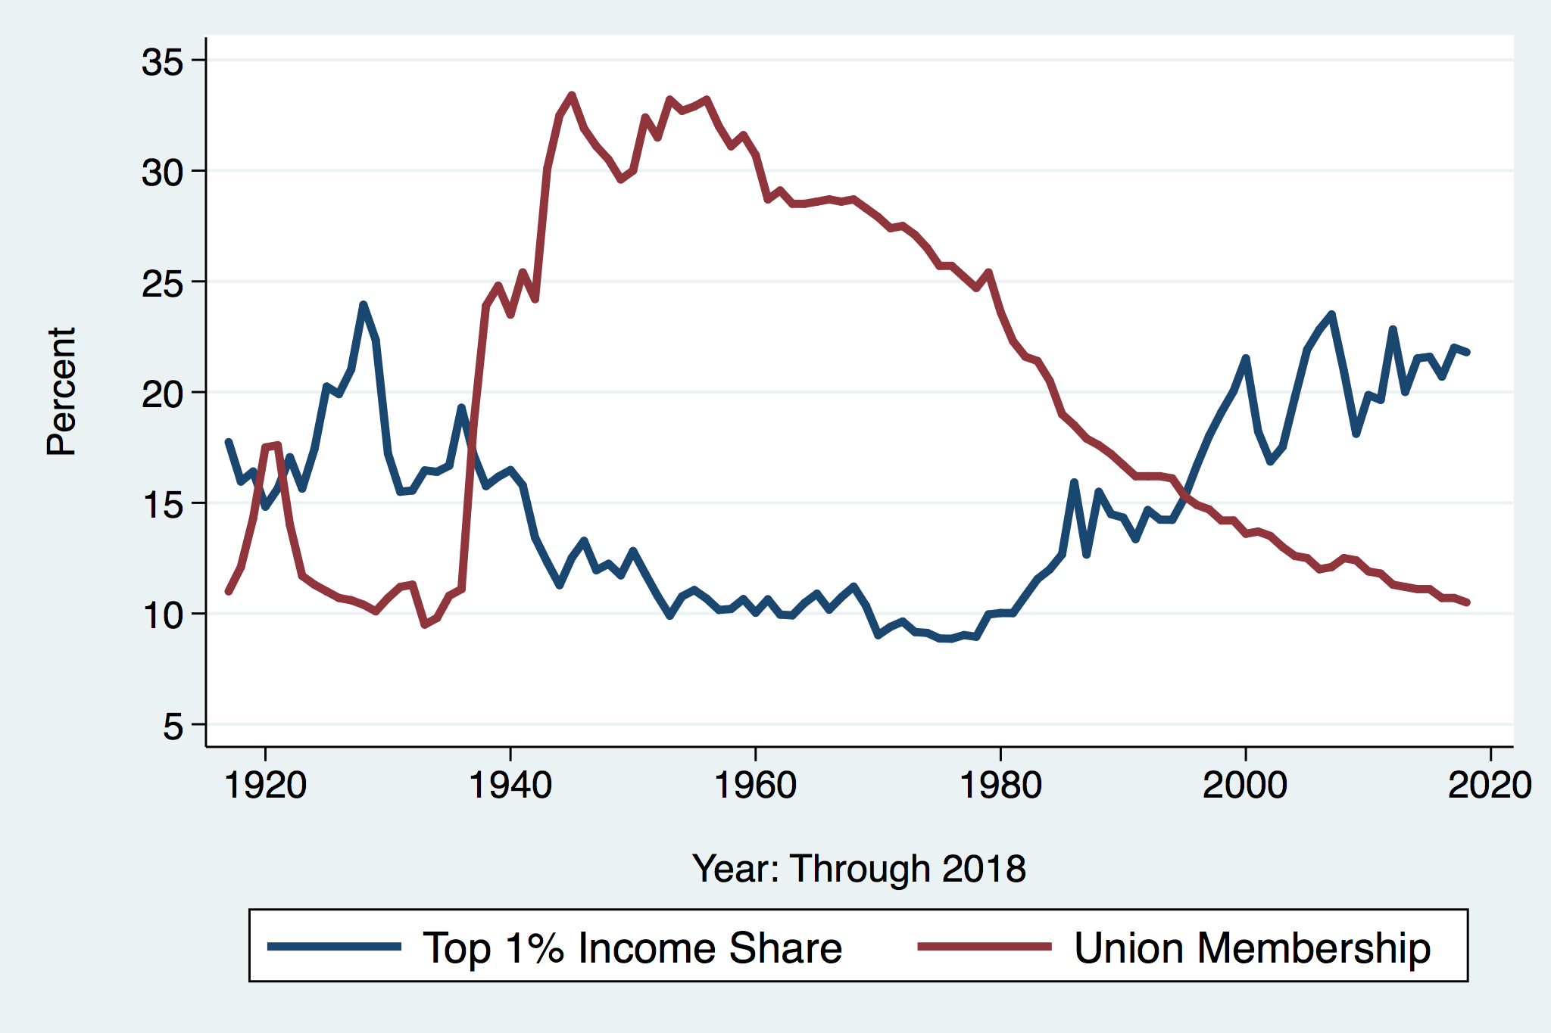
Declining Unionization
Unionization Rates
1983: 20.1%
2022: 10.1%
Unionization Rates
Public: 33.1%
Private: 6.0%
Source: https://inequality.org/facts/income-inequality/, Bureau of Labor Statistics and Emmanueul Saez, University of Califonria, Berkeley
Notes:
https://voxeu.org/article/forms-and-sources-inequality-united-states

Slide 42
Why Does Inequality Matter?
Economic Reason: too much inequality slows economic growth.
Ethical Reasons: concern for our neighbors. (What makes a Good Society?)
Political Reasons: political polarization leads to government paralysis and an inability to take needed action.

Slide 43
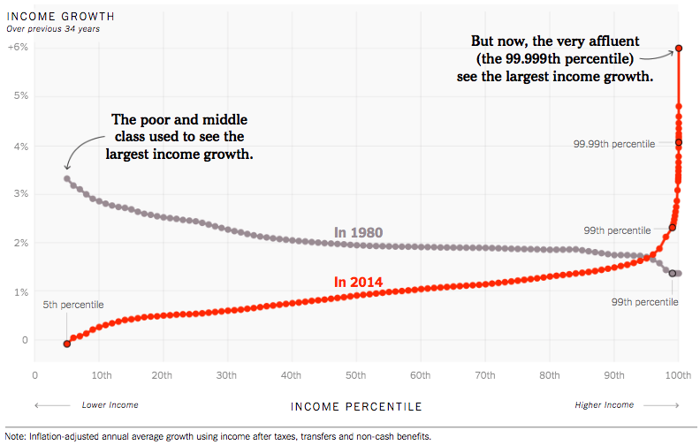
How Has Income Inequality Changed?
Source: https://www.nytimes.com/interactive/2017/08/07/opinion/leonhardt-income-inequality.html

Slide 44
Average Income Growth by Generation
Generation | Bottom 50% | Middle 40% | Top 10% | Top 1%
Greatest (46-70) | 2.85 | 2.57 | 2.03 | 1.27
Boomer (70-94) | 0.15 | 1.20 | 1.86 | 2.28
Gen X (94-15) | 0.61 | 0.93 | 1.94 | 2.56
Distributional National Accounts: Methods and Estimates for the United States (with T. Piketty and E. Saez,
Accessed from: https://gabriel-zucman.eu/usdina/ and my calculations.
Something changed in the nature of our economy and society somewhere at about the same time as the rise in inequality.

Slide 45
New Inequality due to Meritocracy
Greatest Generation and Meritocracy
  GI Bill.
  High-paying, unionized manufacturing jobs.
Boomers
  1960s: SATs become more important and legacy status less for college.
  Economy is more competitive which tended to lessen prejudices against Catholics and Jews.
  Society is more “meritocratic?”
  The rise of suburbs
    Less socioeconomic and racial diversity.
    Investments in high quality public schools.
Gen X
  Affluent, college educated boomers invest heavily in children’s education.
  Globalization, automation and the related decline in unionization eliminates high-paying blue collar jobs.

Slide 46
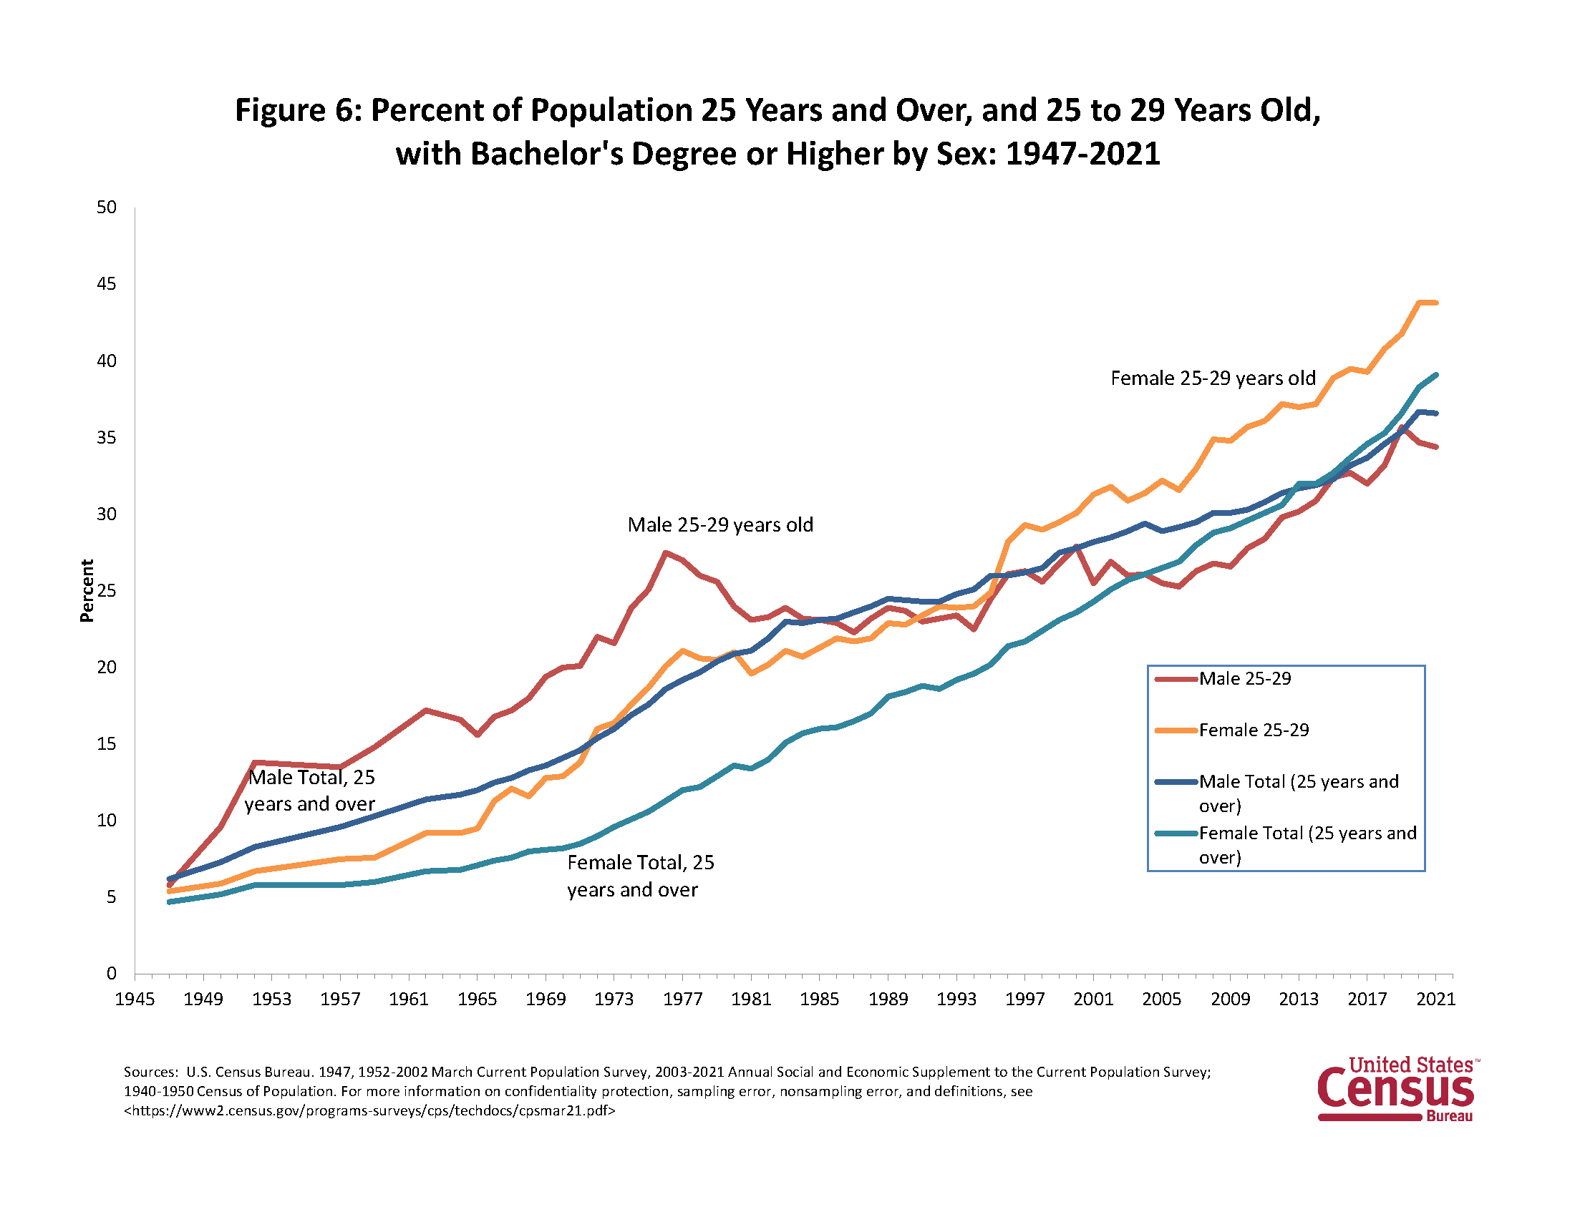
The Continuing Importance of Education
David Deming, “Why Do Wages Grow Faster for Educated Workers,” NBER Working Paper 31373, 6/23

Slide 47
Is it Still a “Meritocracy?”
The key question is whether there is equal opportunity for a college education.
Without equal access, the meritocracy based on educational attainment becomes an aristocracy.

Slide 48
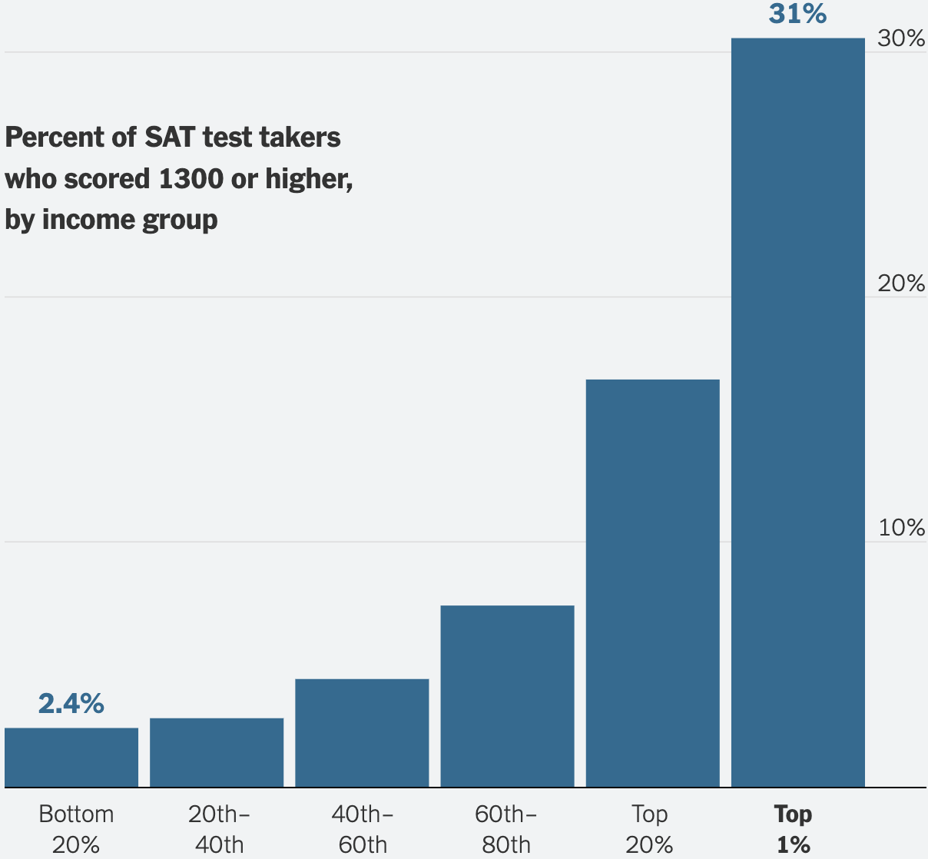
To Emphasize Educational Access Issue
What do these numbers reflect?
It gets worse. With “All Students” instead of “test takers,” the bottom 20% scoring above 1300 falls to 0.6%
And worse(er?)…
Elite schools twice as likely to admit student from a high income family as a low to middle income family with the same test scores.
Higher admission rates for the high income is due to: 1) “Legacies; 2) higher “non-academic” rankings; 3) Athletic recruitment
https://www.nytimes.com/interactive/2023/10/23/upshot/sat-inequality.html

Slide 49
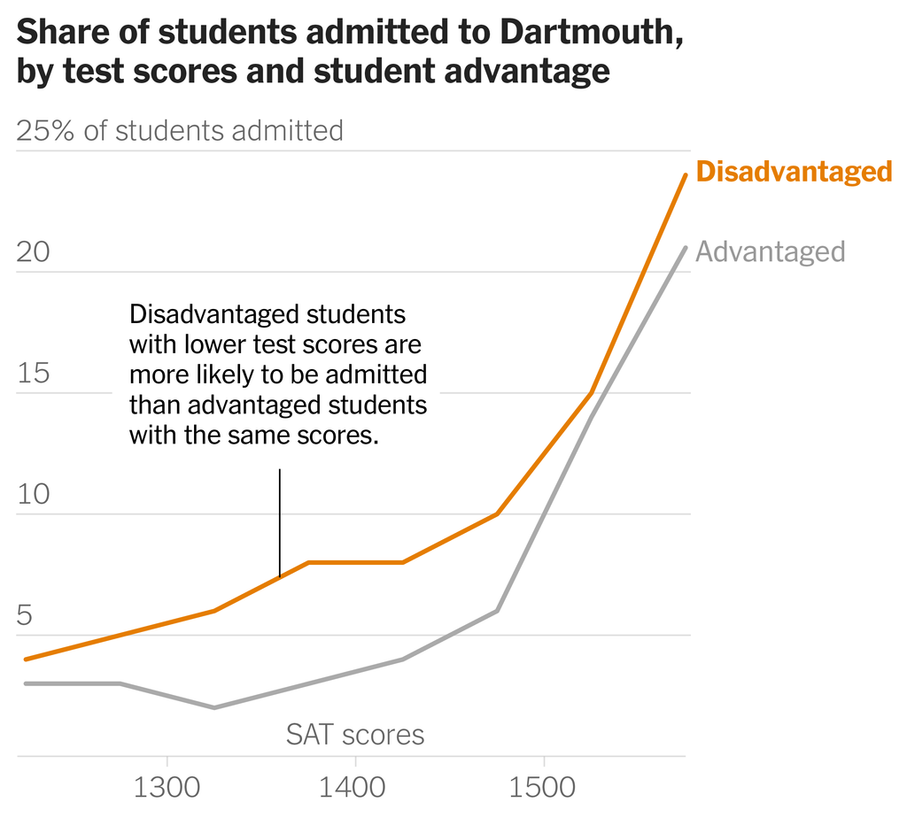
Reinstate the SAT!
Don’t Let the Bad be the Enemy of the Better!
Harvard
Yale
Dartmouth
Brown
Cornell
Caltech
Georgetown
MIT
Vanderbilt

Slide 50
Our Imperfect Meritocracy Hurts Rich and Poor
Poor are hurt because there is less equality of opportunity
Poor are hurt because in a “meritocracy” your lack of success is due to your failings.
Rich are hurt because they have to work harder to confirm their status.
Rich are hurt because they make their children compete at an earlier age (Tiger Moms, SAT prep courses).
We are all hurt because of the growing segregation between the rich and poor and increasing polarization

Slide 51
What to do About Inequality?
Government policies to reduce material inequality:
  Greater Progressivity of Tax/Transfer System.
  Fix Social Security and Medicare Funding, but NOT by raising age of eligibility. (https://www.brookings.edu/articles/fixing-social-security-blueprint-for-a-bipartisan-solution/)
  Tax capital gains at death.
  Encourage re-unionization of industry. (?)
  Put limits on low-skilled immigration. (?)
  Raise Minimum Wage (?)
  Industrial policies to provide meaningful work for non-BAs. (?)
  Tariffs to bring back manufacturing?

Slide 52
What To Do about the “New Inequality”
Research shows that high-quality birth-to-five programs for disadvantaged children can deliver a 13% return on the investment. (James Heckman)
Somehow improve public schools.
Encourage students from low-income families to apply to quality colleges (Carolyn Hoxby)
Encourage colleges to practice affirmative action based on socioeconomic status (William Bowen).
Invest in community colleges.
Reinstitute National Service to lessen socioeconomic and racial segregation. (?)

Slide 53
A Bigger Thinker: Michael Sandel
Reducing material inequality is insufficient; we need to raise social recognition and esteem for all people.
“Broad democratic equality of condition,” that goes beyond equal opportunity.
Renewing the dignity of work.
Rethinking merit: educating the elite about the role of luck and family background.
Ongoing public discussion about moral questions.
Promote solidarity and a shared vision; e.g., how should we regulate AI?

Slide 54
Readings on the New Inequality
https://sites.google.com/view/macro-current-issues/new-inequality

Slide 55
Next Week: Immigration
 | Native Born | Lat. Amer. Born
Labor Force | 130 Mil. | 13 Mil
< H.S. Educ | 5.8% | 37.1.%
Poor English | 1.9% | 77%
Employed | 59.2% | 64.9%
Unemployed | 3.0% | 3.5%
Med. Wk. Earn | $1,087 | $758
Poverty Rate | 13% | 17%

Slide 56
Let’s Hear from You!
Geoffrey Woglom
grwoglom@amherst.edu
My Google site:
https://sites.google.com/view/macro-current-issues/new-inequality
Contact NEED: Info@NEEDEcon.org

