Slide 1
Osher Lifelong Learning Institute, Winter 2022
Contemporary Economic Policy
Dominican University
Fall, 2022
National Economic Education Delegation

Slide 2
National Economic Education Delegation
Vision
  One day, the public discussion of policy issues will be grounded in an accurate perception of the underlying economic principles and data.
Mission
  NEED unites the skills and knowledge of a vast network of professional economists to promote understanding of the economics of policy issues in the United States.
NEED Presentations
  Are nonpartisan and intended to reflect the consensus of the economics profession.

Slide 3
Who Are We?
Honorary Board: 54 members
  2 Fed Chairs: Janet Yellen, Ben Bernanke
  6 Chairs Council of Economic Advisers
    Furman (D), Rosen (R), Bernanke (R), Yellen (D), Tyson (D), Goolsbee (D)
  4 Nobel Prize Winners
    Akerlof, Bernanke, Smith, Maskin
Delegates: 652+ members
  At all levels of academia and some in government service
  All have a Ph.D. in economics
  Crowdsource slide decks
  Give presentations
Global Partners: 48 Ph.D. Economists
  Aid in slide deck development

Slide 4


Where Are We?

Slide 5
Available NEED Topics Include:
US Economy
Healthcare Economics
Climate Change
Economic Inequality
Economic Mobility
Trade and Globalization
Minimum Wages
Immigration Economics
Housing Policy
Federal Budgets
Federal Debt
Black-White Wealth Gap
Autonomous Vehicles
US Social Policy

Slide 6
Course Outline
Contemporary Economic Policy
  Week 1 (10/13): Economic Inequality (Jennifer Alix-Garcia, Oregon St. Univ.)
  Week 2 (10/20): Economic Mobility (Jon Haveman, NEED)
  Week 3 (10/27): The Black-White Wealth Gap (Jon Haveman, NEED)
  Week 4 (11/3): The Gender Wage Gap (Mallika Pung, University of New Mexico)

Slide 7


Economic Inequality
Jennifer Alix-Garcia, Ph.D.
Professor, Oregon State University
OLLI Lifetime Learning, Dominican
October 13, 2022

Slide 8
Notes:
https://fivethirtyeight.com/features/many-americans-think-economic-inequality-is-a-problem-just-not-the-most-pressing-one/

Slide 9
Outline
Definition
Measurement
How does it happen?
Does it matter?
Is it a problem?
What to do about it

Slide 10

Economic Inequality: Income
Definition:
  The extent to which the distribution of income deviates from complete equality
  The dispersion of income throughout the economy

Slide 11
Different Ways of Thinking About Inequality
Income Inequality
  Before taxes and transfers
  After taxes and transfers
Wealth Inequality
Consumption Inequality
How does wealth differ from income?
Income is measured over a period of time, say one year.
Wealth is one’s accumulated savings, including physical and financial assets (net worth).

Slide 12
Different Ways of Thinking About Inequality
Inequality
Inequality between groups
How evenly income/wealth is divided across a population.
It is about the distribution of some measure and not a comparison between sub-groups.
Are there differences between different groups of people?
Are observable outcomes different based on group characteristics?
Ex: racial inequality or gender pay gap.

Slide 13

National Income Inequality: Share of Top 10%
Stock Market Crash
WWII
Housing Bubble
Dot-com Bubble

Slide 14
Recent Facts on Income Inequality
Beginning in the 1970s, the income gap widened.
  Income in the middle and lower parts of the distribution slowed
  Incomes at the top continued to grow strongly
  Income shares at the very top of the distribution rose to levels last seen more than 80 years ago
Source: Chad Stone, Danilo Trisi, Arloc Sherman, and Roderick Taylor, “A Guide to Statistics on Historical Trends in Income Inequality,”
Center on Budget and Policy Priorities, Policy Futures, May 15, 2018.

Slide 15

An Abrupt Increase in Inequality
Source: Chad Stone, Danilo Trisi, Arloc Sherman, and Roderick Taylor, “A Guide to Statistics on Historical Trends in Income Inequality,”
Center on Budget and Policy Priorities, Policy Futures, Dec. 11, 2018.

Slide 16

Most of the Action Is at the Top: Pre-Tax
Projected 2021
CBO: Projected Changes in the Distribution of Household Income, 2016 to 2021

Slide 17
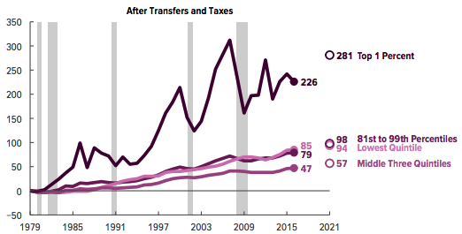
Most of the Action Is at the Top: Post-Tax
Projected
CBO: Projected Changes in the Distribution of Household Income, 2016 to 2021

Slide 18
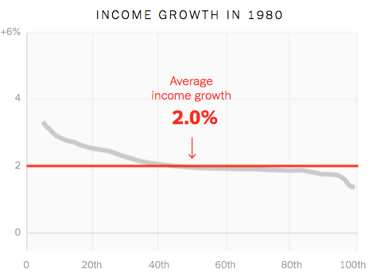
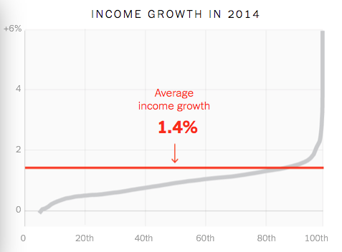
Income Growth Pattern – Has Changed

Slide 19
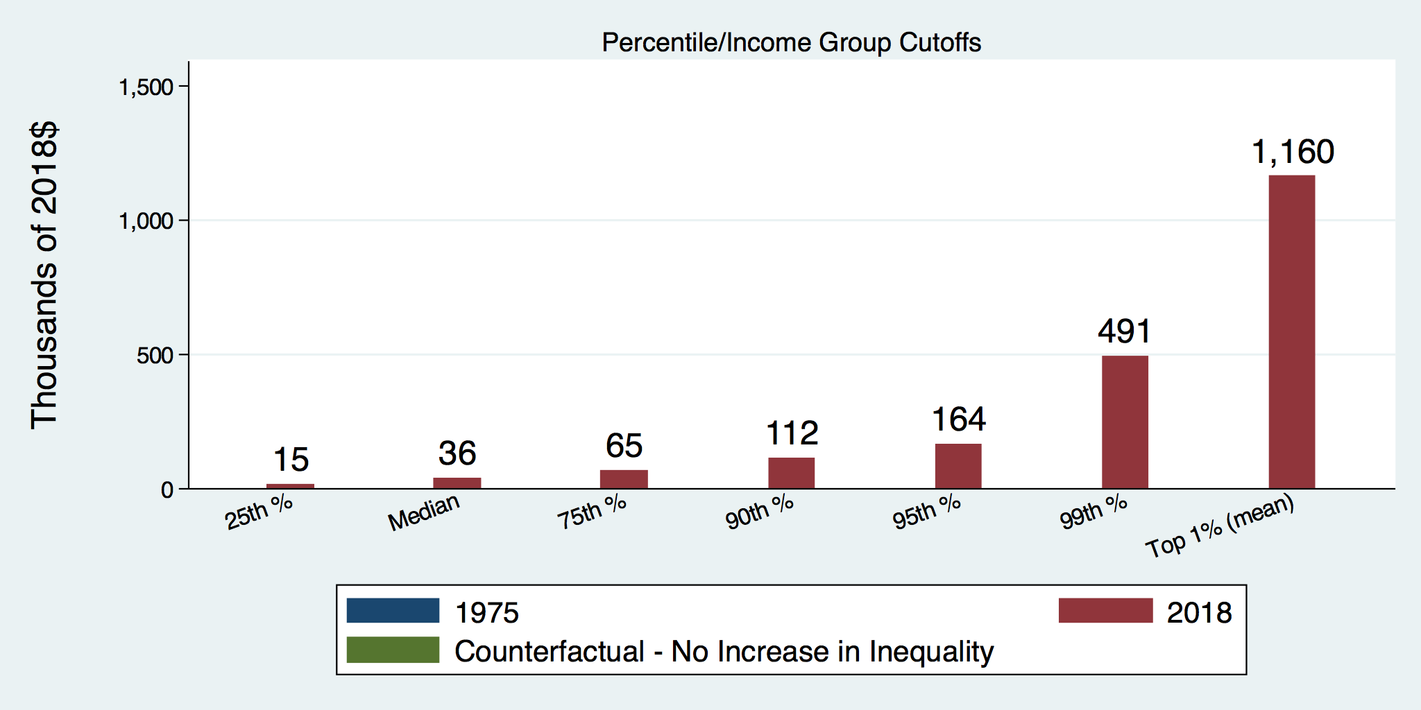
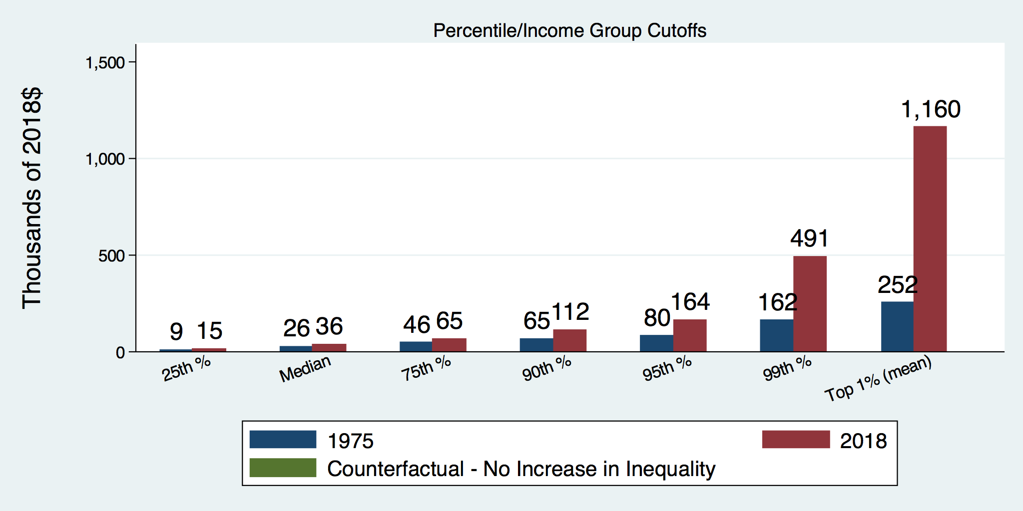
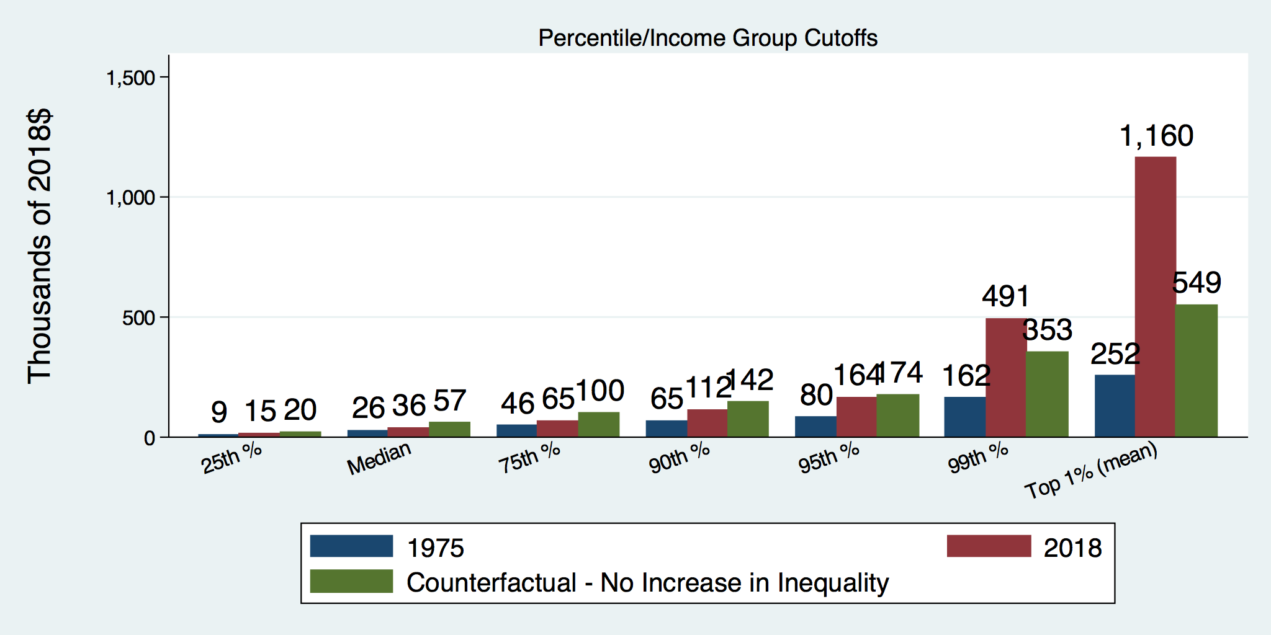
How Has Inequality Influenced Incomes?

Slide 20
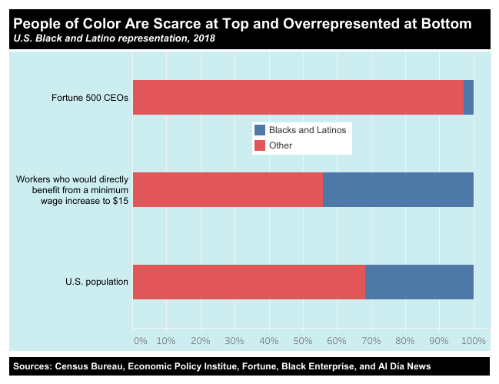
https://inequality.org/facts/racial-inequality/#racial-income-inequality

Slide 21
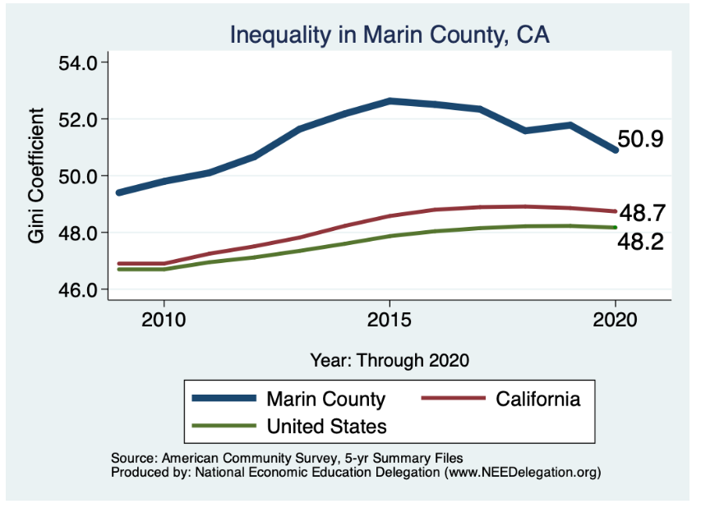
Your Local Inequality Trend
See: www.needelegation.org/LocalGraphs
for the graph for whatever county you’re presenting to.
Notes:
.

Slide 22
Where Does Inequality Come From?
Labor Characteristics
  Demographics
    Age distribution
  Personal Choices
    Educational attainment
    Effort
    Priorities
    Household composition
  Immigration
Market Forces
  Technology
  Changing demand patterns
  Competition for labor
Government Policy
  Market influence
  Redistribution

Slide 23
Government Policy and Inequality
Market Influence: PRE-distribution
  Characteristics of labor
    Access to education
  Effects on labor demand
    Market regulation
      Competition policy
    Labor regulations
      Minimum wage, overtime, health insurance, etc.
RE-distribution
  Tax Rates
  Income support
    Direct aid
    Food stamps

Slide 24
Tax and Transfer Programs and Inequality
2014
Source: U.S. Congressional Budget Office, “The Distribution of Household Income, 2014”, Average Income Before and After Means-Tested Transfers and
Federal Taxes, by Income Group, 2014.

Slide 25
What About Tax Rates?
400 Taxpayers with highest incomes
1992-2007
+
392%
1992-2014
Average
Tax Rate
+310%
Average
Income
-12%
-
37%
Source: IRS
Source: IRS, Statistics of Income Division, December 2016.

Slide 26

Dramatically Less Progressivity in the Tax Code
1961 to 2011
Source: New York Times, from Thomas Piketty, Emmanuel Saez and Gabriel Zucman, “
Distributional National Accounts: Methods and Estimates for the United States”

Slide 27
Market Forces and Inequality
Changing demand patterns
  Technology
  Globalization
  Industry composition
    PCs instead of typewriters
    Services instead of goods
    Professional services instead of personal services
Competition in labor markets
  Unionization
  Market concentration

Slide 28
Where Does Inequality Come From? Summary
Labor characteristics
  What do workers bring to the market?
Market forces
  How does the market value the labor characteristics?
Government policies
  PRE-distribution – affecting markets
  Redistribution – affecting incomes

Slide 29

Labor Income is Unhinged from Productivity
Why?
Declining unionization
Globalization
Immigration
Competition policy
Cheap technology

Slide 30

Declining Unionization
Unionization Rates
1983: 20.1%
2021: 10.3%
Unionization Rates
Public: 33.9%
Private: 6.1%
Source: https://inequality.org/facts/income-inequality/, Bureau of Labor Statistics and Emmanueul Saez, University of Califonria, Berkeley

Slide 31
Competition in the Economy
Return on invested capital excluding goodwill –
US publicly-traded nonfinancial firms, 1965-2014
Source: Jason Furman, ”Forms and sources of inequality in the United States”, VOX, March 17, 2016, Figure 6.

Slide 32

Growing Revenue Concentration
Source: The Hamilton Project, Brookings: The State of Competition and dynamism.

Slide 33
Technological Change and Inequality
Much of the technology adopted in the last 30 years has eliminated low-skill or low-wage jobs.
  Computers, advanced manufacturing equipment, steel mini-mills, automation
There is a “winner take all” aspect of the technology-driven economy.
  This likely favors a small group of individuals.
Both aspects increase inequality by increasing the rewards to:
  Those with significant labor market skills.
  Owners over workers

Slide 34
A Modern Example: Uber & Lyft
Technology:
  Facilitates market power for owners.
  Reduces bargaining power for labor.
  Shifts costs of doing business onto labor.
Modern day Robber Barons?
  Ruthlessly absorbing as much income as they can.
  Lack of regard for labor.

Slide 35
Globalization
What is globalization?
  Flow of goods, services, capital, and labor across international borders
How does it affect inequality?
  Through a differential impact on low-skilled workers and hence their wages
  For the United States, globalization is thought to lower the wages of low skilled and hence low-wage workers relative to those of high-skilled workers

Slide 36
Mechanisms for the Effects of Globalization
Merchandise trade
  Importing goods that are made with low-skilled workers and exporting goods that are made with high-skilled workers
    Lowers the wages of unskilled relative to skilled
      making the distribution of income less equal
Outsourcing
  Similar channel as with merchandise trade
Trade in services
  US imports of middle-skill services: business and some professional services
Intuitively: The same as if we were to move the actual workers.

Slide 37
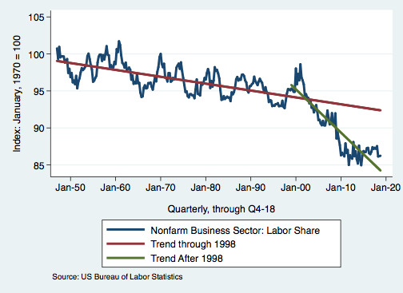
Effects of the Unhinging?
Labor’s Share of Income
1960: 66%
2011: 56%
2016: 58%
Source: Bureau of Labor Statistics

Slide 38

Why Does Inequality Matter?
Too little inequality can:
  Reduce individual motivation
  Slow economic growth
Too much inequality can:
  Reduce individual motivation
  Slow economic growth
Too much inequality may also:
  Divide society
  Distort political environment
  Reduce political participation
  Reduce investments in public goods
    Education
    Environmental protections

Slide 39

Peru
China
Brazil
Germany
U.S.
Canada
https://equitablegrowth.org/research-paper/are-todays-inequalities-limiting-tomorrows-opportunities

Slide 40
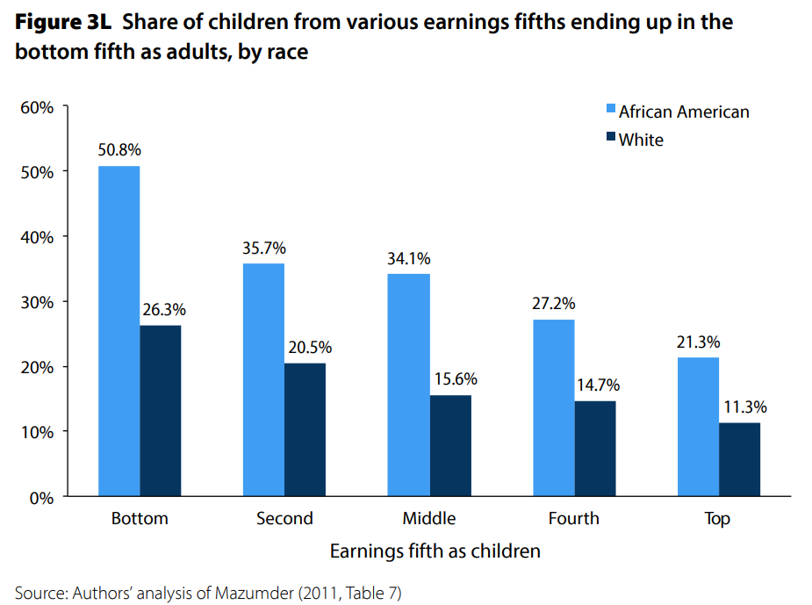
U.S. – Racial Differences
Odds of staying poor, if born poor
Odds of becoming poor, if born rich
Economic Policy Institute, State of Working America, 2012

Slide 41
Government Policy and Racial Inequality
Product of a long historical process of discrimination with at least two reinforcing sets of policies.
  Policies that govern the spatial distribution of the Black population.
    Restrictive covenants, redlining, and general housing and lending discrimination
  Policies that have a disparate impact on Black individuals because of their locations.
    The original version of Michigan Senate Bill 897 exempted individuals from this work requirement conditional on residing in a county with an unemployment rate above 8.5 percent. The higher unemployment rates in rural counties would disproportionately exempt white Medicaid recipients from the work requirement within the bill.

Slide 42
How Much Inequality Is too Much?
Sweet
Spot
?
?
Equity
Efficiency/GDP
Efficiency/GDP
Equity
Efficiency/GDP
Equity
0
100
Z
X
Gini Coefficient

Slide 43
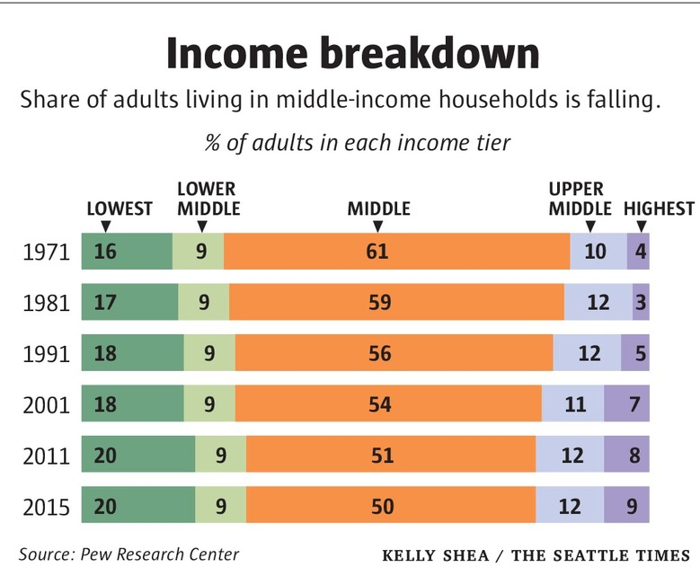
Inequality Can Also Directly Affect GDP
The US Economy is driven by consumption (67% of GDP).
  Middle class are the big consumers.
  They have less money.
  Consumption is lower.
  GDP is lower.

Slide 44
Too Much Inequality Can:
Reduce work effort, which reduces GDP.
Reduce purchasing power of the middle class, which reduces GDP.
Reduce the ability of people to get ahead, which reduces mobility.
  Puts the American Dream at risk.
Increase the share of the population living on low incomes.
  Offending our sense of equity? Desire for shared prosperity?
Concentrate political power.

Slide 45
An International Perspective
Source: Data taken from the 2014 CIA World Factbook.

Slide 46
Addressing Inequality: Is It A Problem?
Why it might be a problem.
  Economic issues (Efficiency)
    There is evidence that at some level, increased inequality slows economic growth.
    Or, inequality concentrates resources among investors.
  Noneconomic issues (Equity)
    Values, ethics and morals will drive individual evaluations of the level of inequality.
      E.g., inequality is primarily a function of market outcomes, so should be left alone.
      Or, a solid middle class is important for maintaining a civil society, which runs contrary to a high degree of inequality.
Suppose you think it’s a problem. How might it be addressed?

Slide 47

Addressing Inequality:
Immediately Available Policy Solutions (1/2)
RE-distribution
  Tax and transfer programs
PRE-distribution
  Strengthen labor unions
  Collective bargaining
  Other policies that favor labor over business owners
  Minimum wages

Slide 48
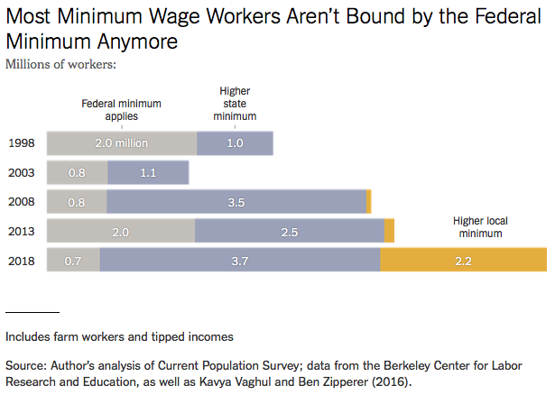

Slide 49
Addressing Inequality:
Immediately Available Policy Solutions (2/2)
Other
  Reverse trends in market power
Locally
  Employment services: job training, interview skills, or assistance with day-to-day issues, such as child care
  Cognizance of the potential for technologies to affect worker/employer power dynamics
    Uber, Lyft, etc.

Slide 50
Addressing Inequality:
Long Term
It’s all about access to resources:
  Education, in particular
    Improve public education
    Reduce disparities in quality of public education
    Improve counseling in low-income schools
      With respect to college – paths to success and funding
    Investments are needed in early education, not later (e.g. universal pre-k)
  Opportunities for wealth-building
  Housing
Initiatives whose impacts cross neighborhood and class lines and increase upward mobility specifically for Black men
  Mentoring programs for Black boys, efforts to reduce racial bias among whites, interventions to reduce discrimination in criminal justice, and efforts to facilitate greater interaction across racial groups.

Slide 51
Tension in Policy Solutions
Is it possible to increase growth at the same time that you reduce income inequality?
  Common refrain among some that government intervention in the economy is always and everywhere bad for growth.
Possibly: expanding equality of access promotes the full utilization of resources.
  Expanding equality of access requires resources likely from the well-to-do.

Slide 52
Summary
Income inequality is clearly increasing.
  The economy is clearly favoring owners of productive resources over labor.
The causes appear to be largely driven by:
  The market – technology, competition, and trade
  Changing institutions.
Open questions are:
  To act or not to act?
  If so, how?
The level of inequality is a policy choice.

Slide 53
Mobility: Jon Haveman
9 out of 10 of those born in the early 1940s could expect to earn more than their parents
  1 in 2 Millennials (born after 1980) earn more than their parents.

Slide 54
Thank you!
Any Questions?
www.NEEDelegation.org
Jennifer Alix-Garcia, Ph.D.
Jennifer.Alix-Garcia@oregonstate.edu
Contact NEED: info@needelegation.org
Submit a testimonial: www.NEEDelegation.org/testimonials.php
Become a Friend of NEED: www.NEEDelegation.org/friend.php

Slide 55
Available NEED Topics Include:
Coronavirus Economics
Climate Change
Economic Inequality
Economic Mobility
US Social Policy
Trade and Globalization
Minimum Wages
The U.S. Economy
Immigration Economics
Housing Policy
Federal Budgets
Federal Debt
Black-White Wealth Gap
Autonomous Vehicles

Slide 56
Additional Slides

Slide 57
Measuring inequality: The Lorenz Curve
Shows the distribution of income in a region
Ex: U.S. Income Distribution - 2008
 | Quintile (2008) | % of total income | Cumulative % of total income
A | Lowest 20% | 3.4 | 3.4
B | Second 20% | 8.6 | 12
C | Middle 20% | 14.7 | 26.7
D | Fourth 20% | 23.3 | 50
E | Highest 20% | 50 | 100

Slide 58
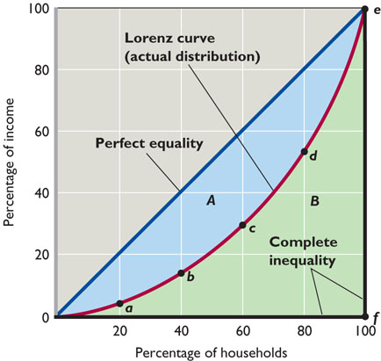

Slide 59
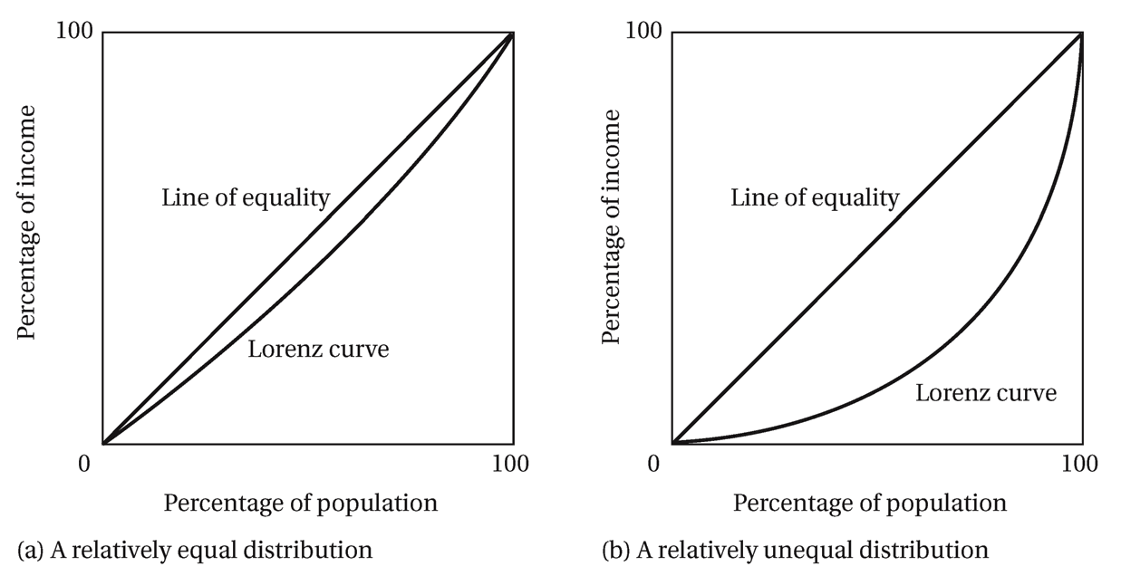
Lorenz Curve of Income Distribution
The greater the curvature of the Lorenz Curve, the greater is the degree of income inequality

Slide 60
Gini Coefficient
Another way to describe income inequality is by using a Gini coefficient.
Gini coefficient – a numerical measure of the overall dispersion of income
  Ranges from 0 – 1
  0= perfect equality – everyone has same income
  1=perfect inequality – one person makes all income
  In practice:
  0.5 – 0.7 – highly unequal
  0.2 – 0.35 – relatively equal

Slide 61
Using the Lorenz curve to calculate a Gini Coefficient
Gini coefficient = A /(A + B)
A higher Gini coefficient means greater inequality
Perfect equality: A=0, Gini=0
Perfect inequality: B=0, Gini = 1
A
B

Slide 62
The Gini Coefficient
100%
A
Gini =
x 100
A + B
% of
All Income
50%
Equality (45 degrees)
A
Bigger A: More inequality
Smaller A: Less inequality
Inequality
B
Extreme
50%
100%
% of Population
Notes:
The Gini coefficient is a commonly used measure of inequality, but what is it exactly? The Gini coefficient, as discussed earlier, is a measure that runs from zero (equality) to 100 (complete inequality). (The scale is sometimes reported as running from 0 to 1.) On a graph with the proportion or share of income on the vertical axis and the proportion or share of the population on the horizontal axis, where the population is lined up from the lowest to highest income (or wealth), the Gini coefficient is calculated as the share of the triangle beneath the 45-degree line, representing equality, and the other two legs of the triangle below that line. The greater the area “A,” the higher the inequality. A larger A indicates that a relatively higher share of income (or wealth) is possessed by richer households than it would if the area were smaller. The line delineating A is just the line that maps out the share of income (or wealth) possessed by the poorest, or bottom, X% of the households.
Because the households are lined up from poorest to richest on the horizontal axis, it will always be the case that the line between A and B will be below the 45% line.
The way to think about the Gini Coefficient is to interpret it is as how far between perfect inequality and complete inequality are we. So, a Gini of 50 roughly indicates that income is distributed as roughly halfway between the two. 33 is roughly one third of the way.
It is important to note that there is no clear consensus on exactly what is the right level of the Gini. Should it be 25, mostly equal, or 75, mostly unequal. We will talk more about this later, but although it is easy to say that 75 seems like a lot of inequality, there isn’t appropriate evidence to say that it is, from an economic perspective.

Slide 63
Forming the GINI Coefficient: 2015
Quintile Shares of Income
CUMULATIVE Quintile Shares of Income
Income Quintiles
Income Quintiles
Source: 2015 1-year American Community Survey, based on pre-tax household income.
Notes:
The calculation of the Gini curve can be seen with data from 2015. You could imagine doing this with an economy of five households, lining them up from poorest to richest. Instead, we will do it with even groupings of households in the economy. The Gini is normally calculated with data on individual households, of which there were 124.6 million in 2015.
The graph on the left depicts the shares of total income that are received by the different quintiles of households. Quintiles just represent one-fifth of all households, where the lowest quintile contains the poorest one-fifth, or 20%, of all households and the highest, or top, quintile contains the richest one-fifth of all households.
The graph on the right has the same income shares as on the left, but they are stacked on top of each other. The first bar is the same as on the left. The second bar is the second quintile with the height of the first quintile added on top. These bars represent the cumulative shares of income held by the quintiles. The first three quintiles receive about 25% of all income and the first four about 50%. All five quintiles, of course, receive 100% of all income.
The Gini is then calculated as the share of the triangle between the 45-degree line and the bottom and right-hand side of the graph that is above the curve that connects the tops of the bars. As more income is transferred to higher-income households, this curve gets pushed down toward the lower right-hand corner of the graph and the Gini coefficient gets bigger.

Slide 64
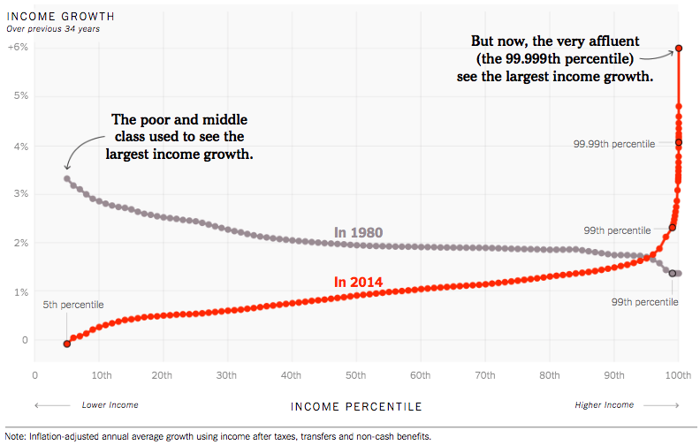
Income Growth Patterns Have Reversed!
Source: https://www.nytimes.com/interactive/2017/08/07/opinion/leonhardt-income-inequality.html
Notes:
It is often argued that so what if high income households are getting richer relative to the rest. Well, this graphic suggests that income growth at the top has come at the expense of income growth at the bottom.

Slide 65
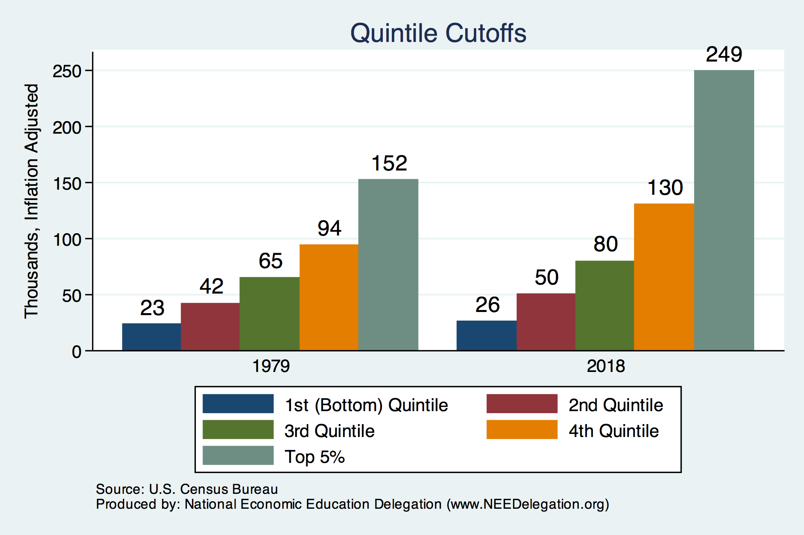
Quintile Income Cutoffs
Top 5%
Notes:
Although the income shares have changed at different levels of income, it is true that absolute levels of income, in inflation adjusted terms have also grow. At the 20th percentile, incomes grew from $23,000 to $26,000. This is an increase of a little over 10%. At the same time, the income cutoff for the 75% percentile, incomes grew from $94,000 to $130,000. An increase of a little more than a third. The cutoff for the top 5%, the 95th percentile, increased from $152,000 to $249,000 – an increase of nearly two-thirds (64%).

Slide 66
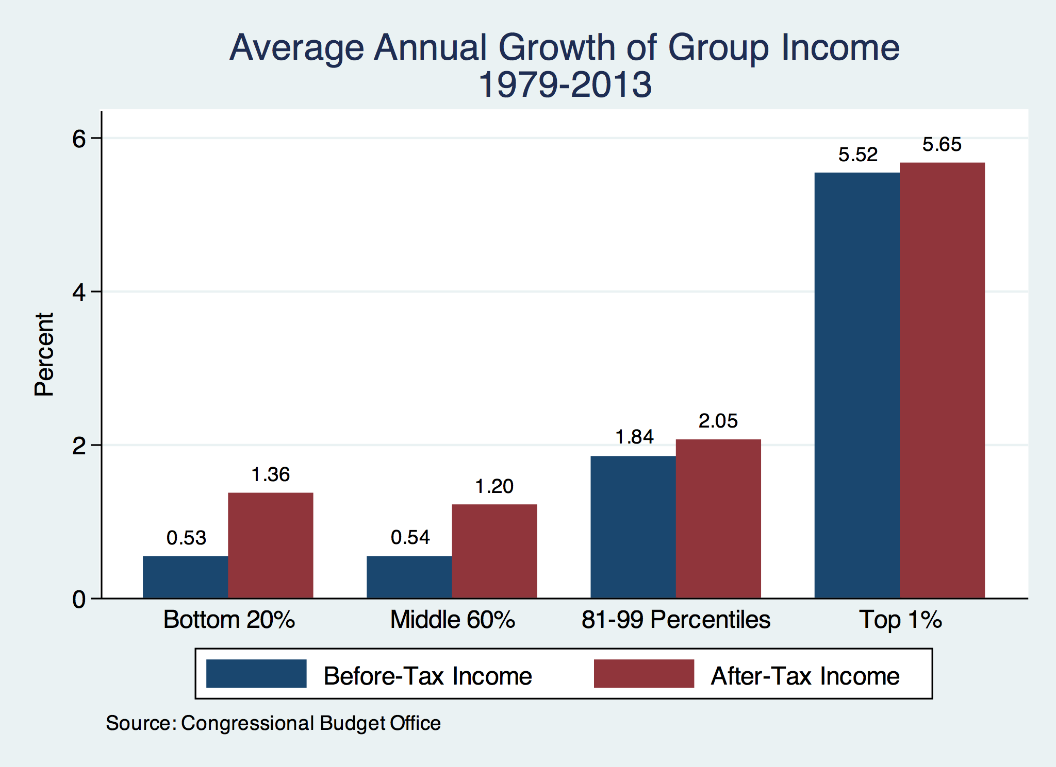
Growth Has Been Primarily at the Very Top
Notes:
The previous slide indicated the extent to which income has been redistributed as a result of increases in the income distribution. What the image made clear is that the gains were primarily at the very top of the income distribution.
Lest we give the impression that gains in income were only at the very top, this graph illustrates how quickly household incomes grew between 1979 and 2013. Over the course of this period, incomes at all levels grew, but they grew more than 10 times faster for those in the top 1% than they did for those in the bottom 80% of the income distribution.
The economy experienced growth throughout this period and incomes at all levels grew as well, but households at the very top accumulated the vast majority of the income gains. Average household income of those at the top grew in inflation-adjusted terms from $546,000 in 1979 to $1.6 million in 2013. They actually peaked at $2.1 million in 2007, just before the Great Recession.
If the data were available, we would find that the income gains for the very, very top of the income distribution were even greater. If we look at the top 400 households, their share of adjusted gross income in the United States increased from 0.52% in 1992 to 1.3% in 2014, the last year for which data are available. They represent just 0.0003% of households (three ten -thousandths of one percent), and they received 1.3% of all income. Their income share is 4,830 times their share of households.
The story is not one of the rich getting richer, though they certainly are, it is one of the super-rich getting much richer.
The graph indicates both pre-tax and post-tax rates of income growth. All groups grow faster in terms of after-tax income, which is interesting. Transfers benefit those in lower-income groups (at the bottom two quintiles) and tend to reduce income for those in higher-income groups (in the top three quintiles).
That pre-tax incomes grow faster for all groups indicates that despite the growing benefits that accrue to the bottom 40% during this period (post-tax incomes are rising faster than pre-tax incomes) the burden on the higher-income groups was lower in 2013 than it was in 1979. Their pre-tax incomes grew so fast that they were able to fund increased benefits for lower-income groups and experience increased income gains at the same time.
Congressional Budget Office, “The Distribution of Household Income and Federal Taxes, 2013,” https://www.cbo.gov/publication/51361, Figures 8 and 13.
Internal Revenue Service, “SOI Tax Stats: Top 400 Individual Income Tax Returns with the Largest Adjusted Gross Incomes,” https://www.irs.gov/statistics/soi-tax-stats-top-400-individual-income-tax-returns-with-the-largest-adjusted-gross-incomes.

Slide 67

Wealth Concentration Has Been Rising
2019 Overall Median: $121,700

Slide 68
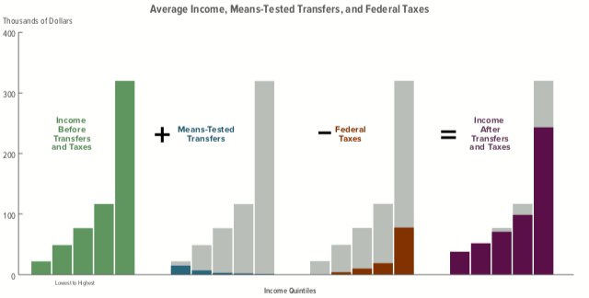
Taxes, Transfers, and Income: 2018
Source: U.S. Congressional Budget Office, “The Distribution of Household Income, 2016”.
Notes:
This graph gives an impression of the impact of taxes and transfers on incomes in each of the 5 quintiles. A couple of things that are worthy of note:
Means tested transfers are very small.
Federal tax receipts are skewed heavily towards the top quintile, as is income, both before and after taxes.

Slide 69
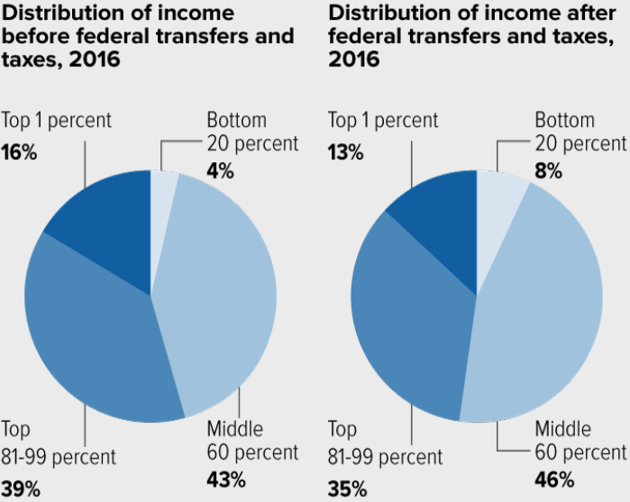
Tax and Transfer Programs: Income Shares
Notes:
Here is a glance at the distribution just for 2016. Clearly, tax and transfer programs have disproportionately benefited those in the bottom 80% of the distribution, with those in the bottom 20% benefiting the most.

Slide 70

Wealth is More and More Concentrated
99th Percentile
2016 = 7x 1963
Source: Urban Institute
Notes:
Here is another illustration just how much wealth inequality has changed over the years. The graph depicts average wealth in each percentile for 1963 and for 2016. As you move from left to right on the graph, you are examining wealth in households with more and more wealth. Several observations are worth highlighting:
Wealth has increased dramatically at the top of the distribution.
Wealth is inflation adjusted, so we can make comparisons across years.
The top percentile, the richest 1% of households, experienced a 7-fold increase in wealth over the 53 year period.
Wealth at the bottom decreased. If you look very closely, you can see that wealth has fallen negative for those in the lowest percentiles, at the right of the graph.

Slide 71
Wealth Inequality Exceeds Income Inequality
Source: Chad Stone, Danilo Trisi, Arloc Sherman, and Roderick Taylor, “A Guide to Statistics on Historical Trends in Income Inequality,”
Center on Budget and Policy Priorities, Policy Futures, Dec. 11, 2018.
Notes:
Also remarkable are increases in wealth inequality in the United States. Wealth is different from income in that it reflects the total financial holdings of households rather than the flow of money into a household. Wealth includes stocks, bonds, homes, cars, businesses, retirement savings, and the ownership of other financial instruments.
Wealth inequality is in fact much greater than income inequality. The richest 1% of households in the United States control 39% of all wealth, while the highest income households, also 1%, receive 24% of all income.
The richest 10% of households control 78% of all wealth, while the bottom 90% control just 23%. By contrast, the bottom 90% of households receive approximately 50% of all income.
Source: Center for Budget and Policy Priorities, “A Guide to Statistics on Historical Trends in Income Inequality,” 02/16/18. Produced from the Survey of Consumer Finances, 2017.

Slide 72
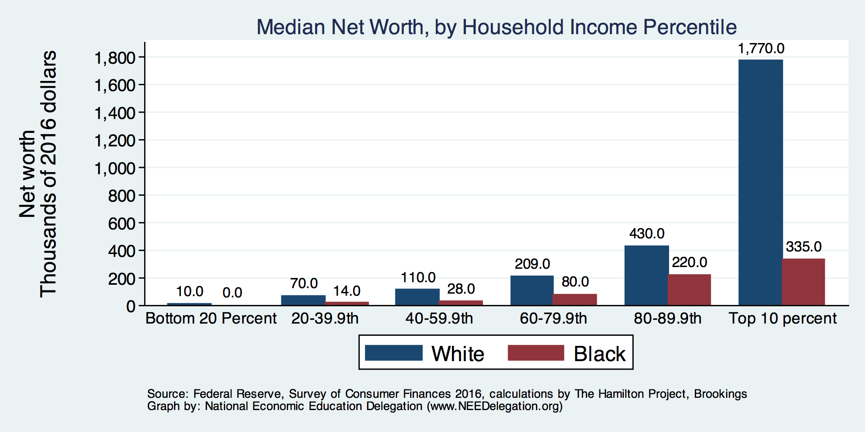
By Household Income
Notes:
NEED as another talk that focuses on the Black-White wealth gap in the United States. It focuses on the fact that both mean and median wealth of White households was between 7 and 8 times the wealth of Black households in 2019. This gap is anticipated to increase significantly in the wake of the pandemic.
The image here provides an indication of just how big the gap is. At every level of the income distribution, White wealth is significantly bigger than Black wealth. For the top 10%, it is 5 times higher for White households than for Black.
Our other talk goes into great detail about how the gap is not explained by any or all of income, education, savings rates, or other things that are important determinants of wealth creation. In other words, the story is very complicated and nuanced.

Slide 73
Consumption Inequality
Consumption is another important metric for judging inequality
Arguably a better indicator of “well-being”
Extremely difficult to measure
Growing evidence that consumption inequality has also increased
Notes:
At some level, we don’t really care about income inequality. It is arguably more important to measure how much people are consuming and whether or not there is growing disparity in the ability of people in society to consume. After all, changes in income can be transitory – job losses, sudden unexpected capital gains. These changes may cause measured income inequality to change, but may not lead to a change in consumption patterns.
It may not lead to consumption changes because people tend to consume out of what they believe to be their lifetime earnings capacity. In other words, they will find ways to smooth out their consumption when income fluctuates unexpectedly. They can borrow against their home, from family members, or simply draw down savings. So, although we are in an era of significantly increasing income inequality. It may well be that perceptions of lifetime income have not changed and consumption inequality may not increase accordingly.
At the same time, it is extremely difficult to measure consumption inequality. There are many surveys that are designed to measure income, and these surveys arguably do a pretty good job. There are relatively few surveys that measure consumption patterns and none of these surveys were developed with the express purpose of measuring consumption with an eye towards making comparisons across groups of people.
Several shortcomings of these surveys include a failure to cover all expenditure categories and a inability to adequately collect information from all levels of income; in particular, from high income individuals. Another problem is the difficulty in measuring the quality of goods and services purchases versus the quantity – some surveys focus on spending while others focus on quantity. If there are changes in demand for quality at different levels of income, it is possible that these changes will be omitted in quantity-based surveys.
So, what do we think we know about consumption inequality? At this point, there is no consensus, but it appears as though consumption inequality is also increasing.

Slide 74
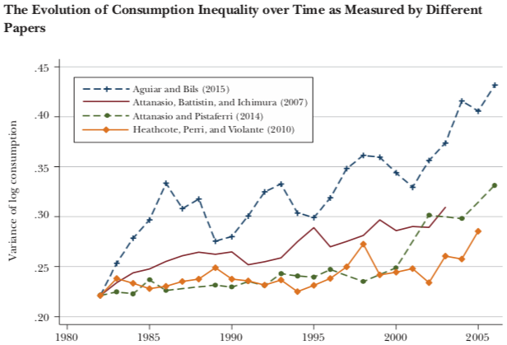
Growing Evidence: Consumption Inequality
Source: Orazio P. Attanasio and Luigi Pistaferri, “Consumption Inequality,” Journal of Economic Perspectives, Volume 30, #2, Spring 2016, page 11, Figure 1.
Notes:
Early research on consumption inequality found that although income and wealth inequality have been increasing, consumption inequality may well not have been increasing.
This set off a bit of a firestorm among inequality researchers who found this extremely difficult to believe. As more and more studies were produced, each attempting to correct for perceived inadequacies in the studies that show no increase in inequality, it has become evident that consumption inequality may well be increasing as well.

Slide 75
Case Study: Economic Research
Early, controversial result is published.
Flurry of effort to understand the result.
Growing body of evidence.
Consensus reached…
  Not always.
  Sometimes data continue to conflict.
  Often merely a preponderance of evidence drives understanding.
Why has this happened with consumption inequality?
  Inadequacy of data and methods.
Notes:
At this point, the profession is in a place where there is no complete consensus on consumption inequality, whether it is remaining constant or increasing.
At this point, this area of research, as are many areas of economic research, is still in search mode. Searching for clear evidence of one result or another.
This is a very common aspect of economic research, and of research more generally. An early result is published that seems to contradict conventional wisdom. There is then a flurry of research all of which probes the data and basic assumptions that underpin the early result.
Some of these studies will confirm the early result and some will dispute it. Over time, a general sense of the issue will evolve as more and more research supports one result over another.
There is no guarantee that a consensus will arise. Sometimes the necessary data do not exist to convincingly pin down one result or the other. Instead, it is merely a preponderance of the evidence that will drive our understand.
It’s important to recognize that this phenomena is not unique to economics. The same type of process occurs in almost all disciplines, from food research (Are eggs good or bad for you?) to physics (there remains no unifying theory of our physical environment).
As with so many issues, the study of consumption inequality is confounded by both the perfect set of data as well as the perfect toolbox or set of methods with which to evaluate it.

Slide 76
Summary: Consumption Inequality
Early research indicated that although income inequality may be increasing, consumption inequality may not be.
  How is this possible? Borrowing, or otherwise smoothing consumption.
Mounting evidence that it is increasing along with income and wealth inequality.
Consensus reached? No.
Notes:
As the graph suggests, there is mounting evidence that consumption inequality is also increasing, there is no concrete consensus among economists. Will a consensus be reached? It’s unclear.

Slide 77

Tax Rates Over Time
Notes:
The progressivity of the U.S. federal tax system at the top of the income distribution has declined dramatically since the 1960s. This decline continued through the early 2000s.
The top marginal tax rate has come down substantially, from 90% to just 37%. At the same time, however, it is worth noting that the income cutoff has come down as well.
At the same time, tax rates for the bottom have also come down, from about 20% to 10%.

Slide 78

The Top Tax Rate and Income Cutoff
Massive tax cut for those with
More than $4 million in income.
And for those with more than
About $200,000 in income.
Notes:
It would be disingenuous to leave the previous graph without some further elaboration. Although the top marginal tax rate has come down significantly, so, too, has the income level at which the top tax rate kicks in.
Yes, the top marginal tax rate in 1950 was 90%, but only incomes above the equivalent of $4 million were taxed at that rate. By way of contrast, although the top tax rate today is 37%, it applies to incomes in excess of $600,000.
So, although much lower, the top marginal tax rate applies to much more income today than it did when it was 90% 60 years ago.

Slide 79

CEO Pay Has Been Growing Rapidly
Notes:
Perhaps as a result of less competition in the economy and hence greater returns to some of the economy’s largest companies, the ratio of CEO pay to the pay of an average worker in the same company has skyrocketed since the late 1980s.
Prior to 1985, CEO compensation had been consistently below 50 times the compensation of the average worker at the same company. By 2000, at the peak of the dot-com bubble, the ratio had grown to 343.5 times greater than average worker compensation.
Lawrence Mishel and Jessica Scheider, “CEO compensation surged in 2017”, Economic Policy Institute, August 16, 2018.

Slide 80

CEO Pay Has Been Growing Rapidly
Notes:
This is to some extent a reflection of the “winner take all” nature of today’s economy. Earnings at many firms are being increasingly concentrated in the hands of just a few, or perhaps just the one, the CEO.
A reasonable argument can be made that these outsized compensation packages merely reflect the value that the CEO brings to the company. CEO compensation among S&P companies is highly correlated with the S&P.
Although this may be true, it is nonetheless true that this phenomenon is adding significantly to income inequality in the United States
https://www.epi.org/publication/ceo-pay-remains-high-relative-to-the-pay-of-typical-workers-and-high-wage-earners/, on August 21, 2018.

Slide 81
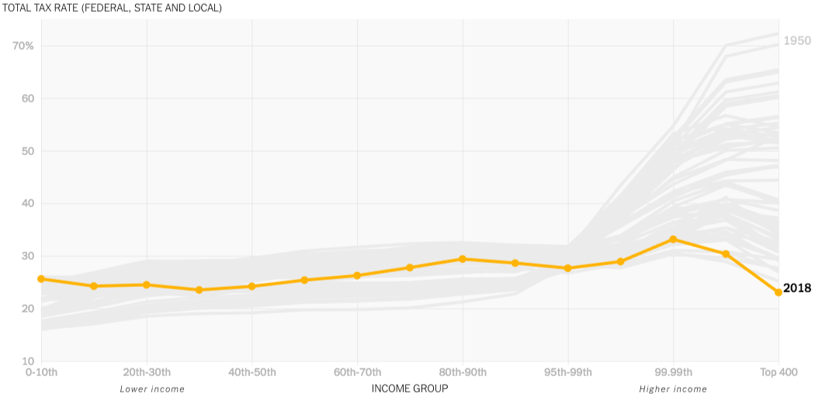
The Rich Really do Pay Lower Taxes
1950
Top 400
Lower Income
Higher Income
Notes:
Over the last 70 years, the tax rates being imposed on the top income households – factoring in state, local as well as federal taxes – has declined very significantly. At the same time tax rates at the bottom have been increasing, to the point where average tax rates are higher at the very bottom than at the very top.
This is a reflection of the taxes alone. The picture is different when transfers are taken into account – primarily because net tax rates at the bottom will go down significantly.

Slide 82
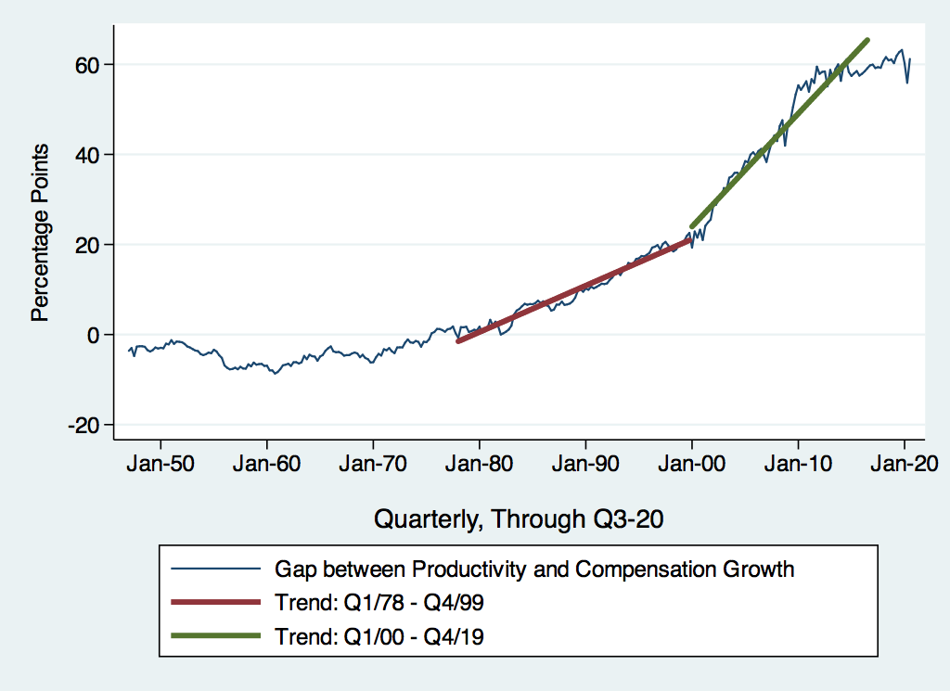
Labor Share Gap Acceleration

Slide 83
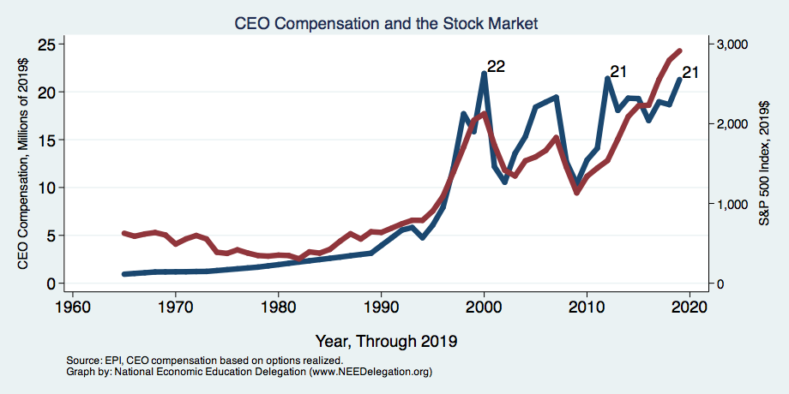
CEO Compensation – Tied to Stock Prices

Slide 84
Sources of Inequality Through Late 1990s

Slide 85
Immigration and Inequality
Source: Ping Xu, James C. Garand, and Ling Zhu, “How immigration makes income inequality worse in the U.S.”, October, 2015, Figure 1.
Notes:
Immigration has received a lot of attention, and many believe that immigrant workers contribute to an increase in income inequality. The notion is relatively intuitive. Most immigrants, or at least those receiving most of the attention, are low-income workers. As more low-income workers come into the economy, they compete with low-skilled Americans, driving down their wages. There is a flip side to this argument that also suggests that immigrant workers contribute to income inequality—many immigrants are high skilled and therefore receive high wages. Thus, immigration adds workers at both tails of the distribution, which suggests that it increases income inequality. The figure on the slide backs this up. If you look at the distribution of income without immigrants, it is more equal than with them, but not by very much.
It is important to notice from the graph that the trends of the two lines are very similar. Immigration may well add to inequality, but there is little evidence that it is adding significantly to the trend in income inequality when we consider the number of immigrants and the pattern of immigration.
Things are a little bit different once the influence on wages of an increase in immigration is taken into account.
See http://blogs.lse.ac.uk/usappblog/2015/10/14/how-immigration-makes-income-inequality-worse-in-the-us/.

Slide 86
Technology Benefits Ownership over Labor
Notes:
The technological advances of the past have served to increase the productivity of the U.S. economy. During much of the latest technological revolution, jobs have been created. Beginning in about 2000, productivity continued to increase throughout the economy, but employment began to stagnate. The graph illustrates this. Although employment grew a little bit more slowly than did productivity through 2000, this coupling failed in 2000.
We may have entered an era in which digital labor substitutes for human labor. A broad range of jobs could be lost, from those that rely on routine tasks, the loss of which will suppress the wages of less-educated workers, to those requiring more sophisticated skills, such as writing prose. Digital labor is slowly displacing more and more workers with higher skill levels. This compresses income, favoring those who own equipment over those who provide labor services.
Erik Brynjolfsson and Andrew McAfee, “Jobs, Productivity, and the Great Decoupling,” New York Times, December 11, 2012, https://www.nytimes.com/2012/12/12/opinion/global/jobs-productivity-and-the-great-decoupling.html.

Slide 87
What is driving increasing inequality?
Primary drivers:
  Technology
  Globalization
  Institutions
These drivers can also influence personal choices in ways that affect measured income inequality.
  For example, educational choices or labor force participation
Notes:
As discussed above, there can be multiple causes of growing inequality. If growing inequality is driven by demographics, then it might very well not be an issue to be addressed by policy considerations. If, however, the increase is being driven by declining access to resources, such as education, so that the overall productive capacity of the economy isn’t what it might be, then that is another matter, and arguably one to be addressed by policy decisions.
There seems to be a general consensus that globalization (trade and offshoring), technology, and institutions are the primary drivers of increasing inequality in the United States. Of these three, there is little consensus as to which is a primary driver. Also, the rising practice of basing executive compensation on stock options has pushed top incomes well above historical norms. In the late 1990s, the Federal Reserve assembled a group of experts and established their version of a consensus view of the causes of increasing income inequality up to that point. The graph on the slide illustrates their consensus view. That view is that by far the largest contributor to rising income inequality is skill-biased technological change, accounting for nearly 45% of the increase. That still leaves most of the change unaccounted for. Globalization is the second largest contributor to rising inequality.
These two sources were likely the largest contributors to inequality and it is reasonable to expect that they have remained so. There is also likely to have been very little change in the contribution of the other factors. Though individual states and jurisdictions have raised the minimum wage, this surely does little to offset the nationwide decline in the minimum wage (in real terms). The decline in unionization has continued since the late 1990s and shows no sign of slowing. Immigration has slowed in the wake of the Great Recession, so if anything, its contribution has declined since the 1990s.
To the extent that the decline in unionization reflects the declining bargaining position of labor more generally, it is possible that this phenomenon has grown in importance. The growing prevalence of the gig economy and the increased reliance on contractors both have the effect of separating labor from prescribed benefits (including health care, unemployment compensation, and disability), discouraging collective bargaining, and undercutting any influence over the determination of wages. It is possible that labor’s declining bargaining power has grown as a source of income inequality.
The second largest source of increased inequality is rather vaguely labelled “Other.” Standing out among these other sources are the reductions in competition that were discussed earlier in the presentation. This and other rent-seeking behavior—efforts to tilt the economic table in one direction or another—are likely significant contributors to overall inequality. Again, it is reasonable to expect that this has remained unchanged since the 1990s.
Era Dabla-Norris, Kalpana Kochhar, Nujin Suphaphiphat, Frantisek Ricka, and Evridiki Tsounta, “Causes and Consequences of Income Inequality: A Global Perspective,” International Monetary Fund Staff Discussion Note 15/13, June 2015, https://www.imf.org/external/pubs/ft/sdn/2015/sdn1513.pdf.
Thomas Piketty, Emanuel Saez, and Stefanie Stantcheva, “Optimal Taxation of Top Labor Incomes: A Tale of Three Elasticities,” American Economic Journal: Economic Policy 6(1), pp. 230–271, 2014, https://www.aeaweb.org/articles?id=10.1257/pol.6.1.230.

Slide 88
An International Perspective: Comparables
U.S.: 17-18
Canada, UK, Germany: 12-13
Italy, France, Japan: 7-9
Notes:
When considering how much inequality is too much, it is worthwhile comparing inequality in the United States with inequality in other developed countries. The figure presented does just that. When compared to six countries that are arguably the closest peer countries to the United States, the share of income earned by the top 1% is significantly higher in the United States and has been growing much more quickly than in any of the other countries. In 2015, the share of income going to the top 1% was in excess of 17%. In none of the other countries has this share been much higher than 15%, and then only briefly in the United Kingdom just prior to the Great Recession.
These six countries are all very similar to the United States. Their economies are based on very similar capitalist systems and their cultures are also similar. There is nothing inherently different in the United States that would dictate a higher share of income going to the top 1%. Indeed, in the 1970s and through the mid-1980s, the United States did not stand out in this regard. Although the share of income earned by the top 1% has increased in many countries since that time, it has increased significantly faster in the United States.
This observation strongly suggests that the amount of income inequality in a country is a matter of policy, not something inherent in the makeup of the economy. That is, there is something inherently different in the policies of the United States that have led to this dramatic increase in income inequality. Therefore, there are policy prescriptions that could be reasonably applied to reduce the level of income inequality.
This graphic is from the CEA 2017 Economic Report of the President, by way of Wikipedia.

Slide 89

What to do About Inequality?
Nothing?
Redistribution?
PRE-distribution?
Access to resources?
Notes:
There are a variety of policy options available to reduce poverty. Applying one of these policy instruments to the issue of inequality presumes that it is a problem worthy of rectification. It is not an unreasonable position to assert that inequality at its current levels is not a problem. It has not been well established how to determine the point at which both equity and efficiency (the effects on GDP) begin to decline. With this perspective, the appropriate policy response is to do nothing.
It is also perfectly reasonable to have concerns about the level of inequality that the U.S. economy is currently experiencing. The policy tools for addressing these concerns fall into several buckets. These buckets include redistribution policies—policies that tax higher-income households and transfer income to lower-income households. There are policies that involve what here has been dubbed PRE-distribution; that is, policies that change the marketplace to the advantage of lower-income workers. Finally, there are policies that seek to level the playing field. These policies facilitate access to resources that are key to future economic success. For example, they seek to improve access to education, health care, and adequate housing.
Addressing economic inequality requires thoughtful debate. Reasonable people can disagree on the extent to which income inequality is a problem, and there can also be disagreements regarding the best policy solutions. The entanglement between inequality and an individual’s incentives to improve his or her situation make inequality a very challenging policy issue.

