Slide 1
Osher Lifelong Learning Institute, Fall 2022
Contemporary Economic Policy Issues
California State University, Dominguez Hills
Fall, 2022
Ryan Herzog, Ph.D.
National Economic Education Delegation

Slide 2
Available NEED Topics Include:
US Economy
Healthcare Economics
Climate Change
Economic Inequality
Economic Mobility
Trade and Globalization
Minimum Wages
Immigration Economics
Housing Policy
Federal Budgets
Federal Debt
Black-White Wealth Gap
Autonomous Vehicles
US Social Policy

Slide 3
Course Outline
Contemporary Economic Policy
  Week 1 (9/19): Economic Update (Jon Haveman, NEED)
  Week 2 (9/26): Trade and Globalization (Alan Deardorff, University of Michigan)
  Week 3 (10/3): Cryptocurrencies (Geoffrey Woglom, Amherst College)
  Week 4 (10/10): The Federal Debt (Ryan Herzog, Gonzaga University)
  Week 5 (10/17): Economic Inequality (Ryan Herzog, Gonzaga University)
  Week 6 (10/24): Trade Deficit and Exchange Rates (Alan Deardorff, Univ. of Michigan)

Slide 4
Submitting Questions
Please submit questions of clarification in the chat.
  I will try to handle them as they come up.
We will do a verbal Q&A once the material has been presented.
Slides will be available on NEED’s website( www.NEEDelegation.org)

Slide 5


Economic Inequality
Ryan Herzog, Ph.D.
Gonzaga University
OLLI-CSUDH
October 17, 2022

Slide 6

Economic Inequality: Income
Definition:
  The extent to which the distribution of income deviates from complete equality
  The dispersion of income throughout the economy

Slide 7
Different Ways of Thinking About Inequality
Income Inequality
  Before taxes and transfers
  After taxes and transfers
Wealth Inequality
Consumption Inequality
How does wealth differ from income?
Income is measured over a period of time, say one year.
Wealth is one’s accumulated savings, including physical and financial assets (net worth).

Slide 8
Different Ways of Thinking About Inequality
Inequality
Inequality between groups
How evenly income/wealth is divided across a population.
It is about the distribution of some measure and not a comparison between sub-groups.
Are there differences between different groups of people?
Are observable outcomes different based on group characteristics?
Ex: racial inequality or gender pay gap.

Slide 9

National Income Inequality: Share of Top 10%
Stock Market Crash
WWII
Housing Bubble
Dot-com Bubble

Slide 10
Recent Facts on Income Inequality
Beginning in the 1970s, the income gap widened.
  Income in the middle and lower parts of the distribution slowed
  Incomes at the top continued to grow strongly
  Income shares at the very top of the distribution rose to levels last seen more than 80 years ago
Source: Chad Stone, Danilo Trisi, Arloc Sherman, and Roderick Taylor, “A Guide to Statistics on Historical Trends in Income Inequality,”
Center on Budget and Policy Priorities, Policy Futures, May 15, 2018.

Slide 11

An Abrupt Increase in Inequality
Source: Chad Stone, Danilo Trisi, Arloc Sherman, and Roderick Taylor, “A Guide to Statistics on Historical Trends in Income Inequality,”
Center on Budget and Policy Priorities, Policy Futures, Dec. 11, 2018.

Slide 12
Gini Coefficient
Gini coefficient – a numerical measure that summarizes the overall dispersion of income
  Ranges from 0 – 1
    0 = perfect equality – everyone has the same income
    1 = perfect inequality – one person has all the income
  In practice:
    0.5 – 0.7 – highly unequal
    0.2 – 0.35 – relatively equal

Slide 13
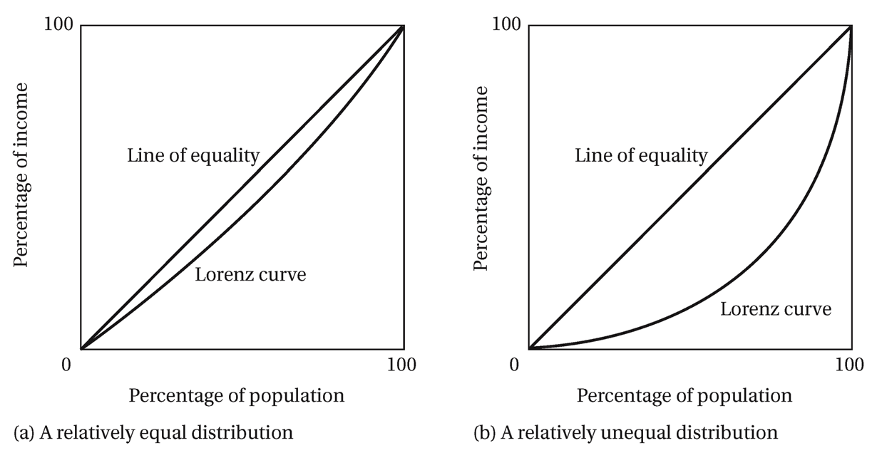
Lorenz Curve of Income Distribution
The greater the curvature of the Lorenz Curve, the greater is the degree of income inequality

Slide 14
US Income Distribution: 2015
Quintile Shares of Income
CUMULATIVE Quintile Shares of Income
Income Quintiles
Income Quintiles
Source: 2015 1-year American Community Survey, based on pre-tax household income.

Slide 15
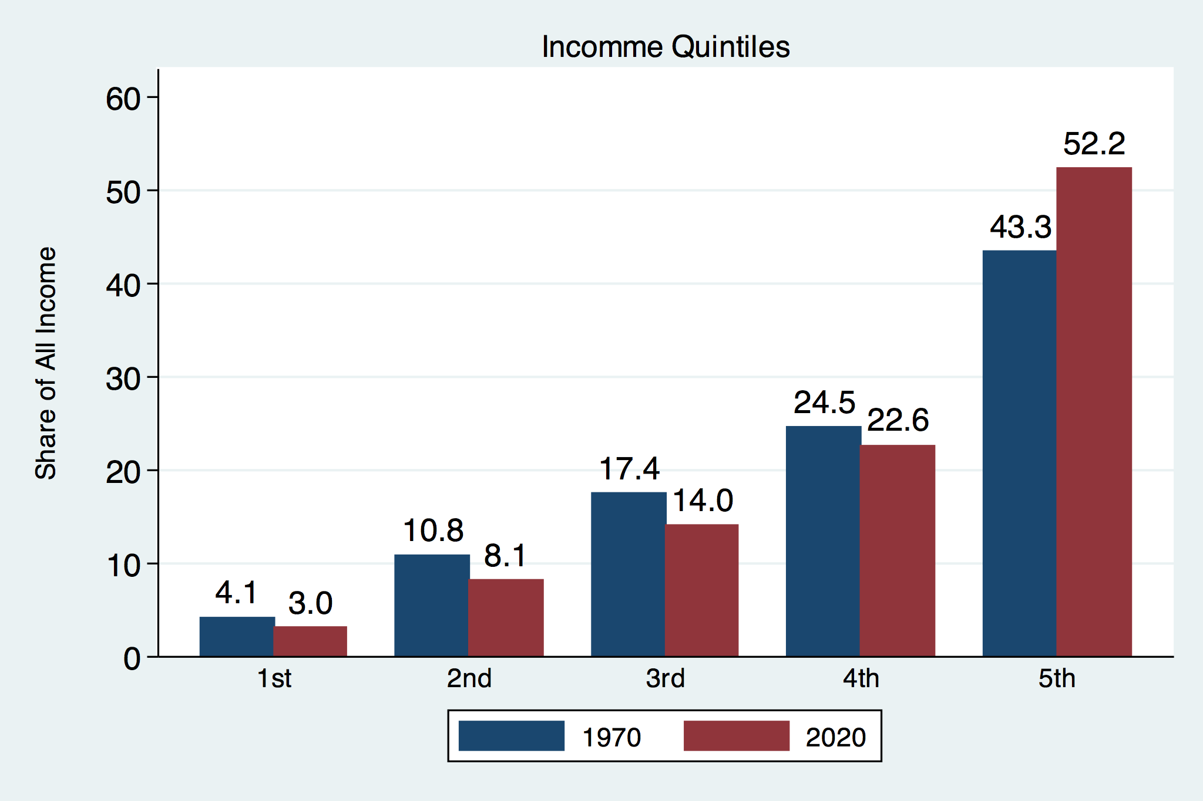
Income Share Changes Between 1970 and 2020
Source: U.S. Census Bureau, Current Population Survey, Annual Social and Economic Supplements.

Slide 16
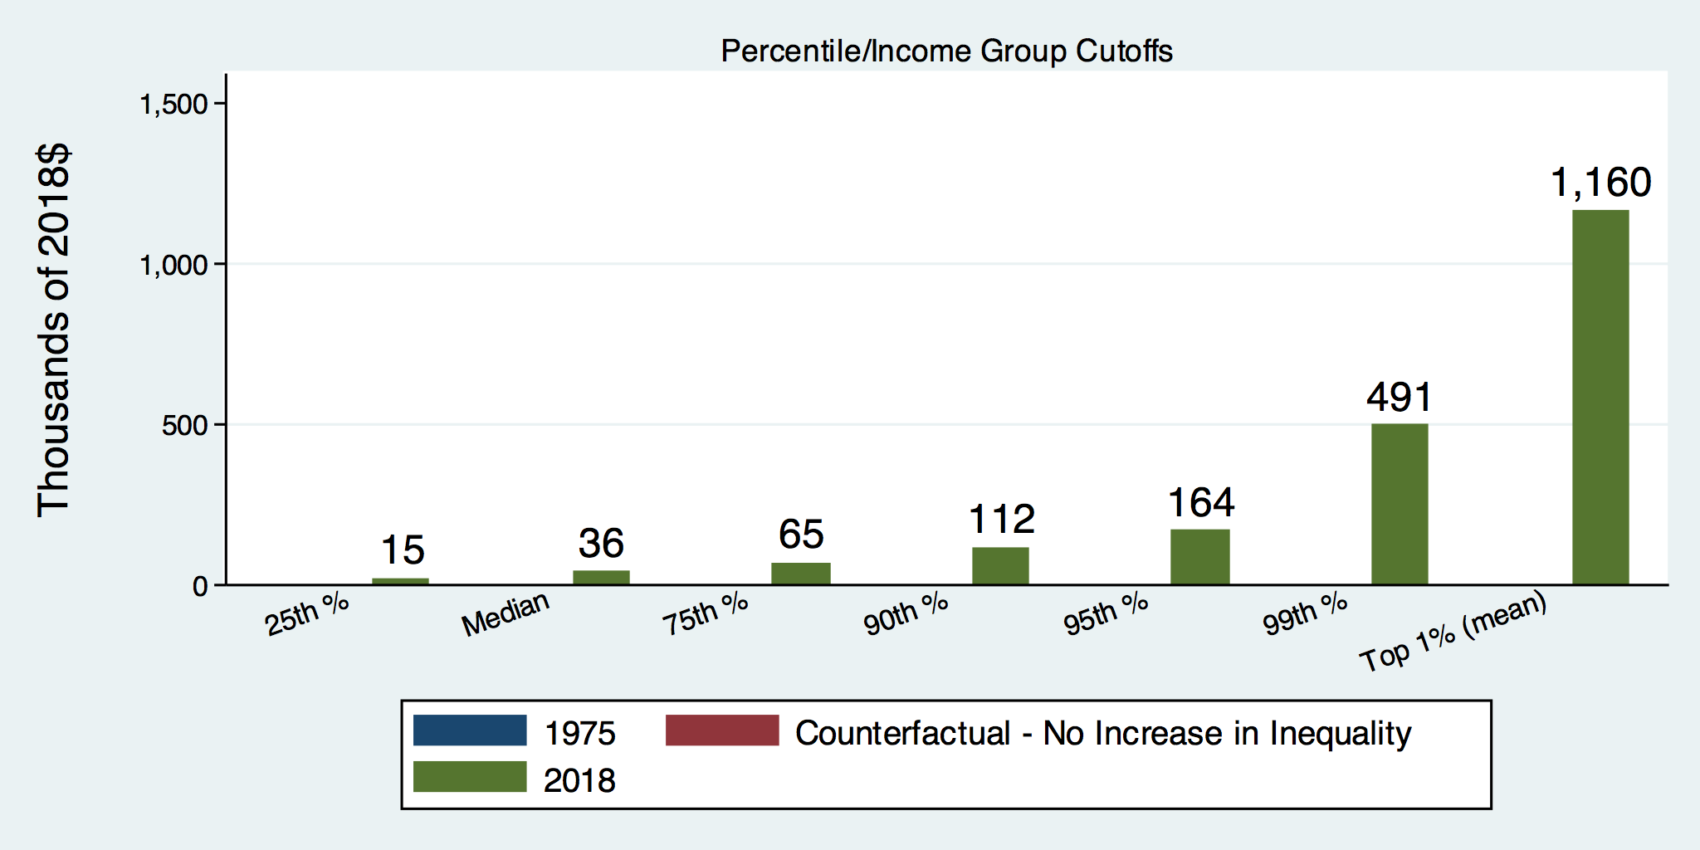
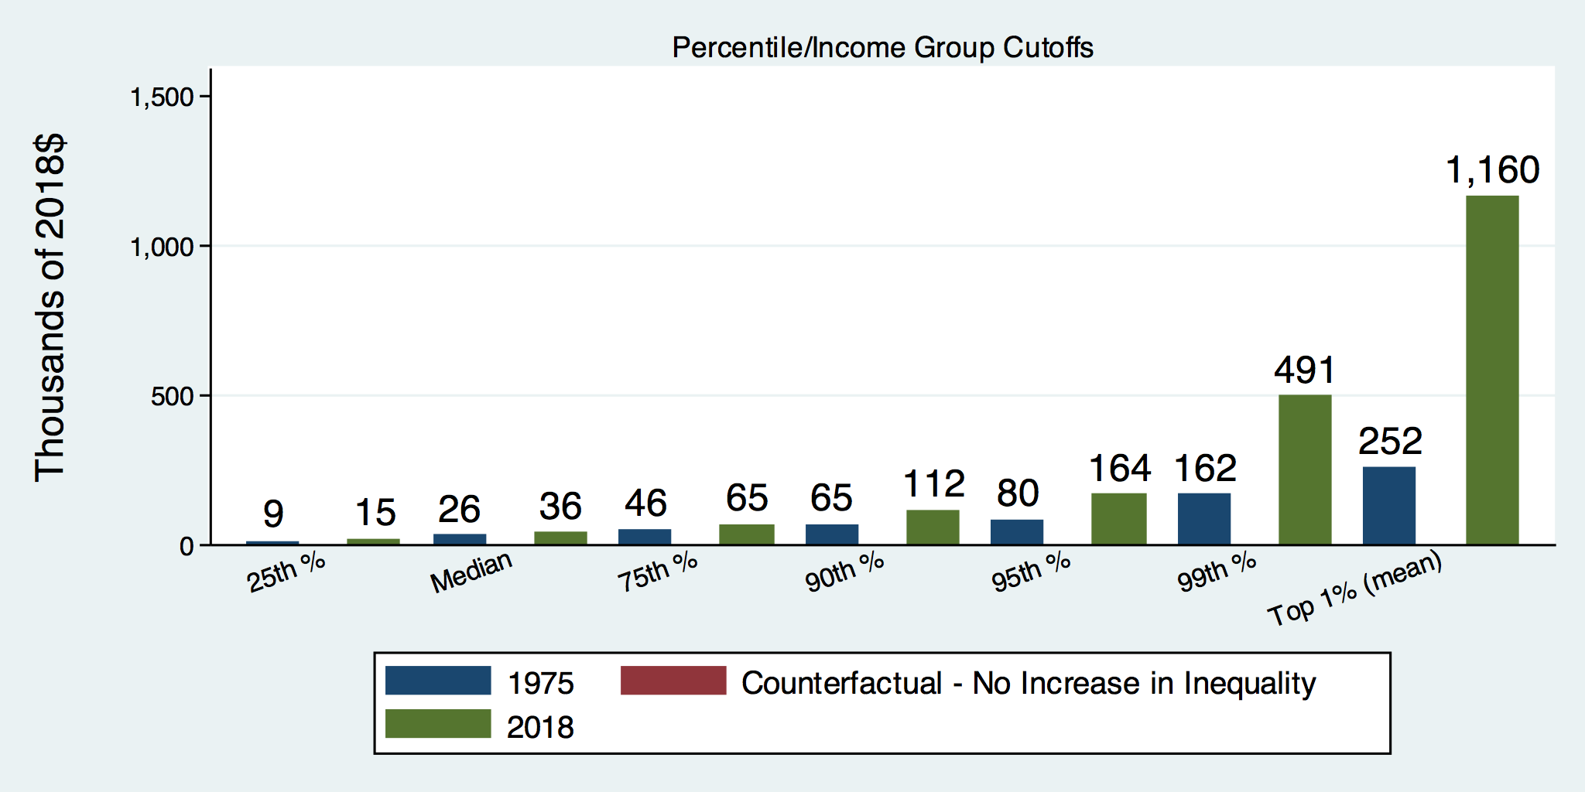
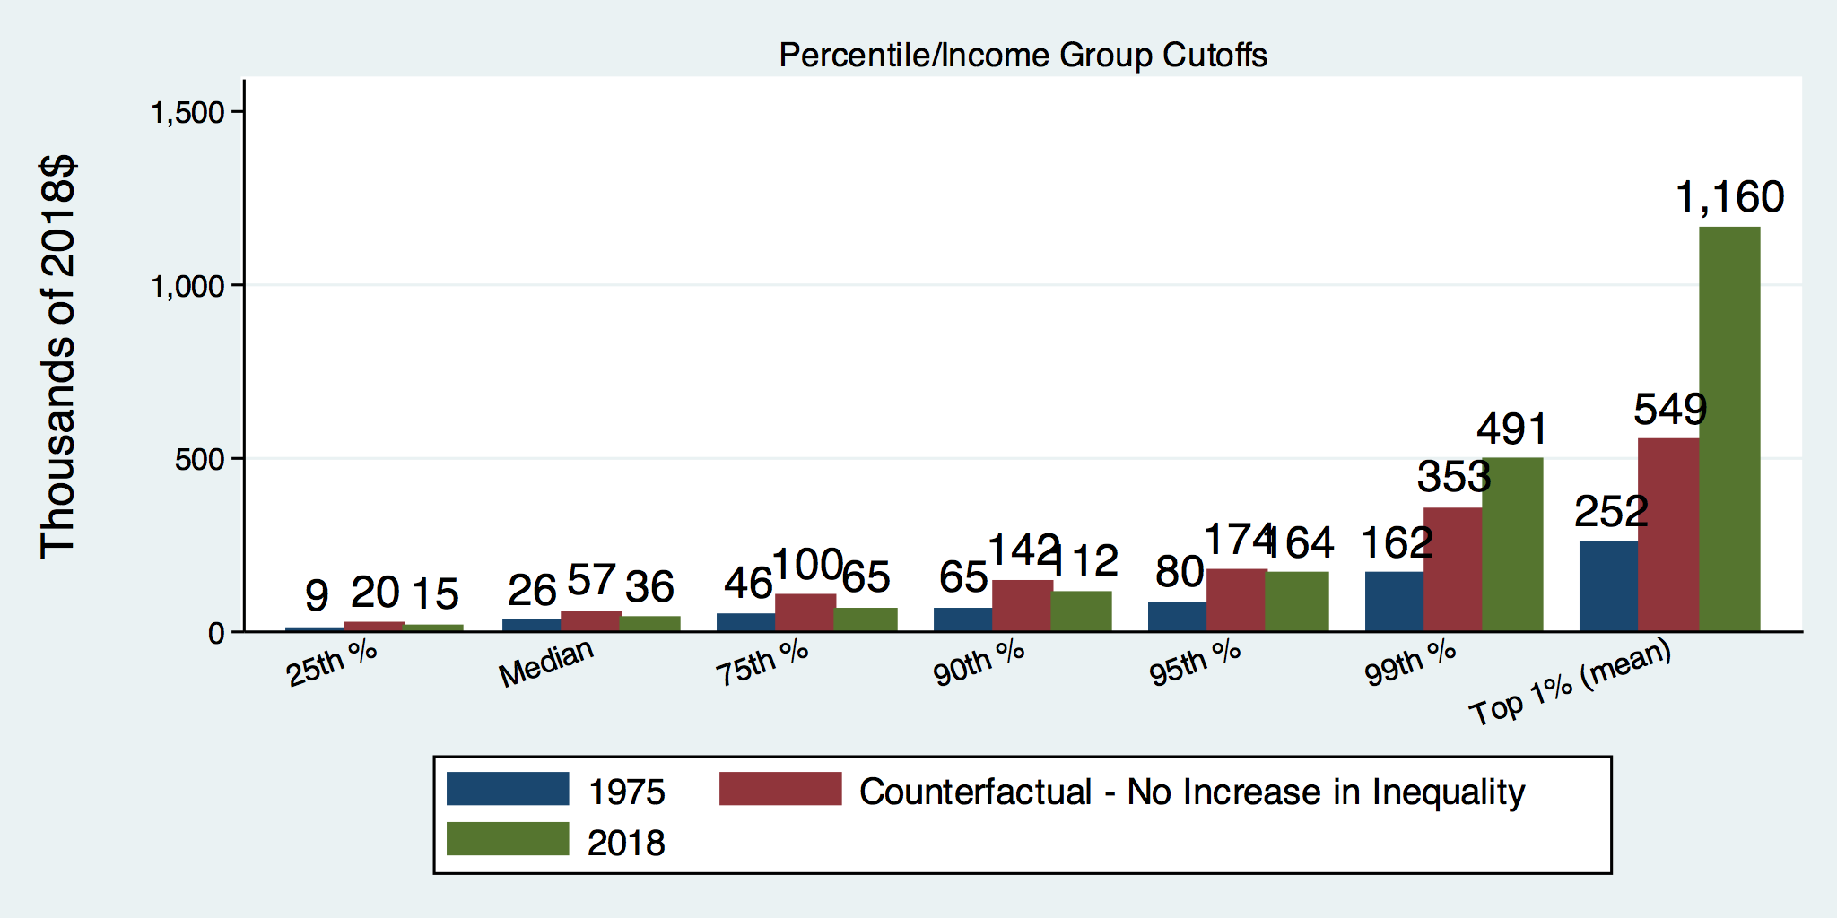
How Has Inequality Influenced Incomes?

Slide 17
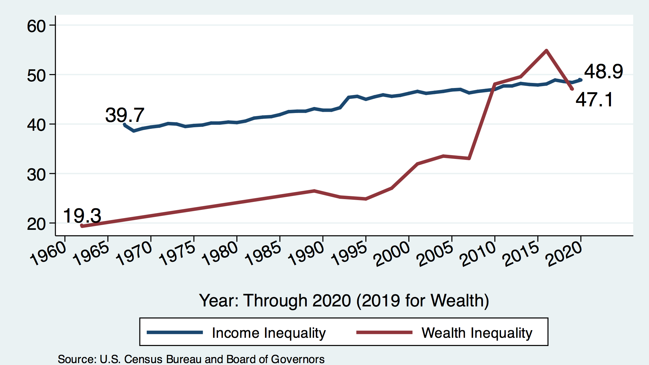
Income and Wealth Gini Coefficients

Slide 18

Wealth Concentration Has Been Rising
2019 Overall Median: $121,700

Slide 19

Wealth is More and More Concentrated
99th Percentile
2016 = 7x 1963
Source: Urban Institute

Slide 20
Wealth Inequality Exceeds Income Inequality
Source: Chad Stone, Danilo Trisi, Arloc Sherman, and Roderick Taylor, “A Guide to Statistics on Historical Trends in Income Inequality,”
Center on Budget and Policy Priorities, Policy Futures, Dec. 11, 2018.

Slide 21

Most of the Action Is at the Top: Pre-Tax
Projected 2021
CBO: Projected Changes in the Distribution of Household Income, 2016 to 2021

Slide 22
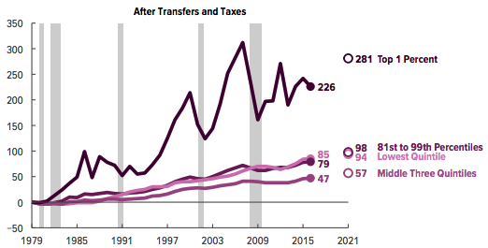
Most of the Action Is at the Top: Post-Tax
Projected
CBO: Projected Changes in the Distribution of Household Income, 2016 to 2021

Slide 23
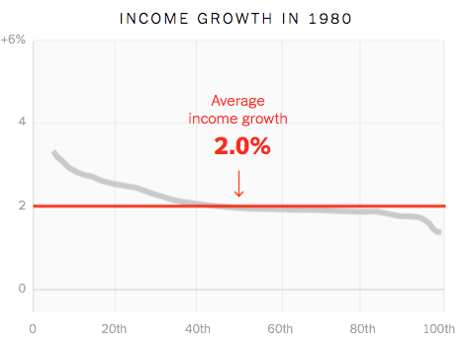
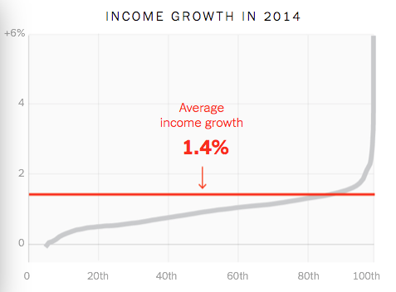
Income Growth Pattern – Has Changed

Slide 24
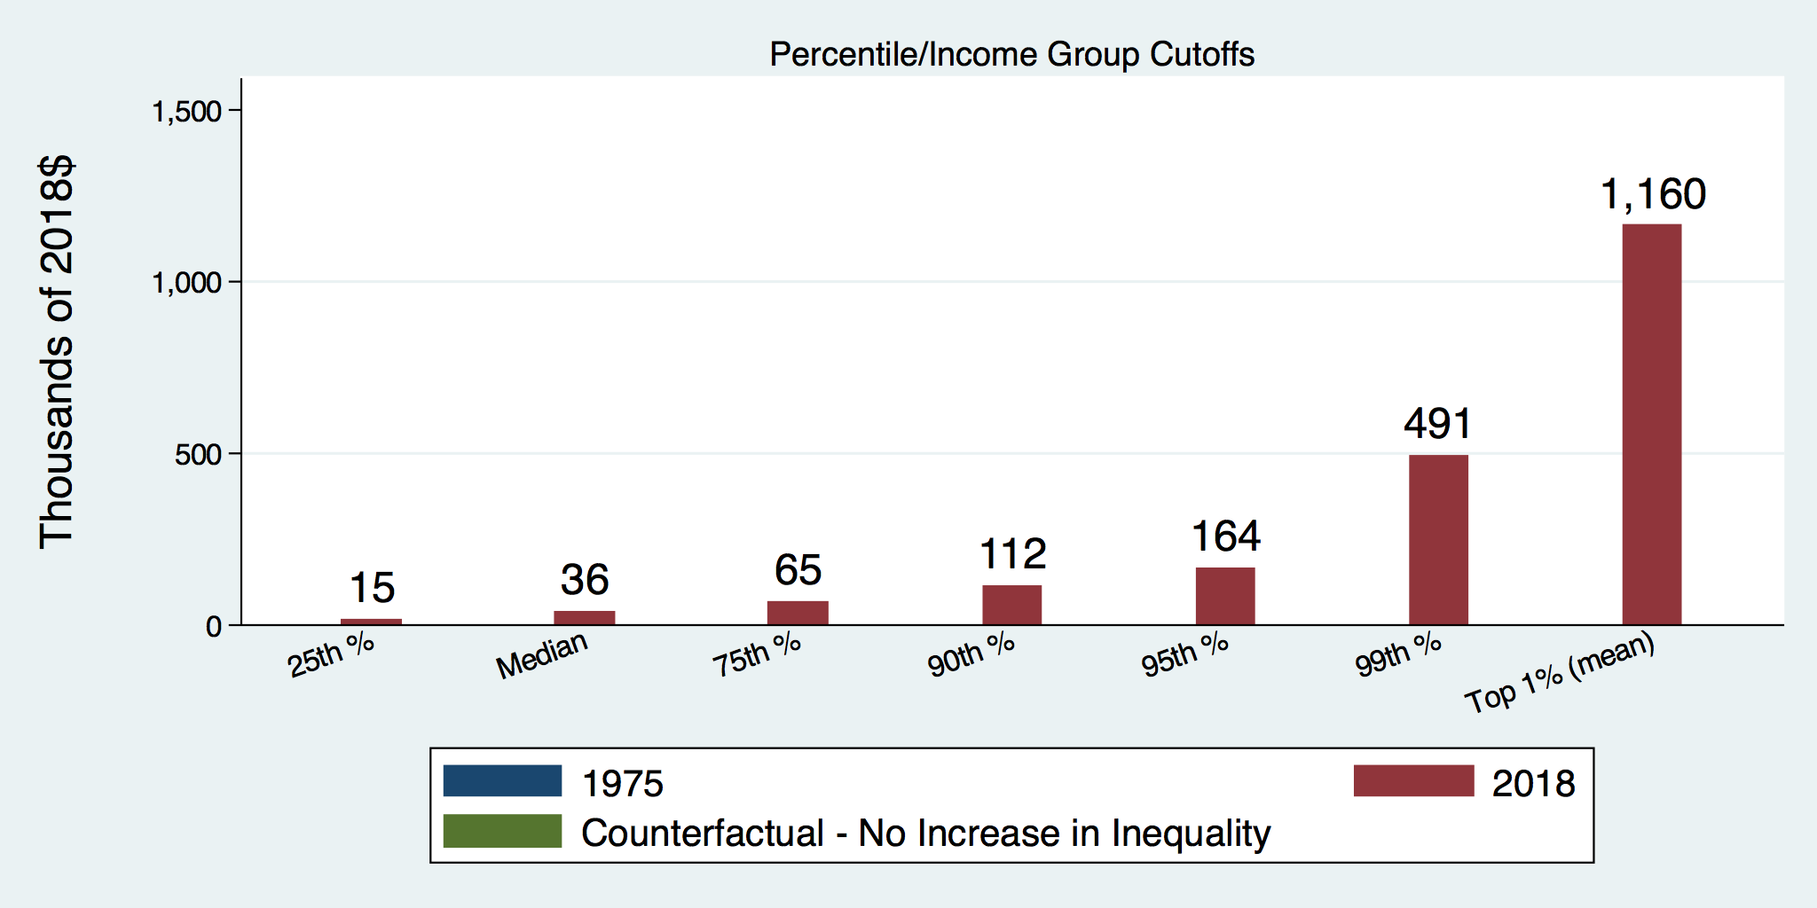
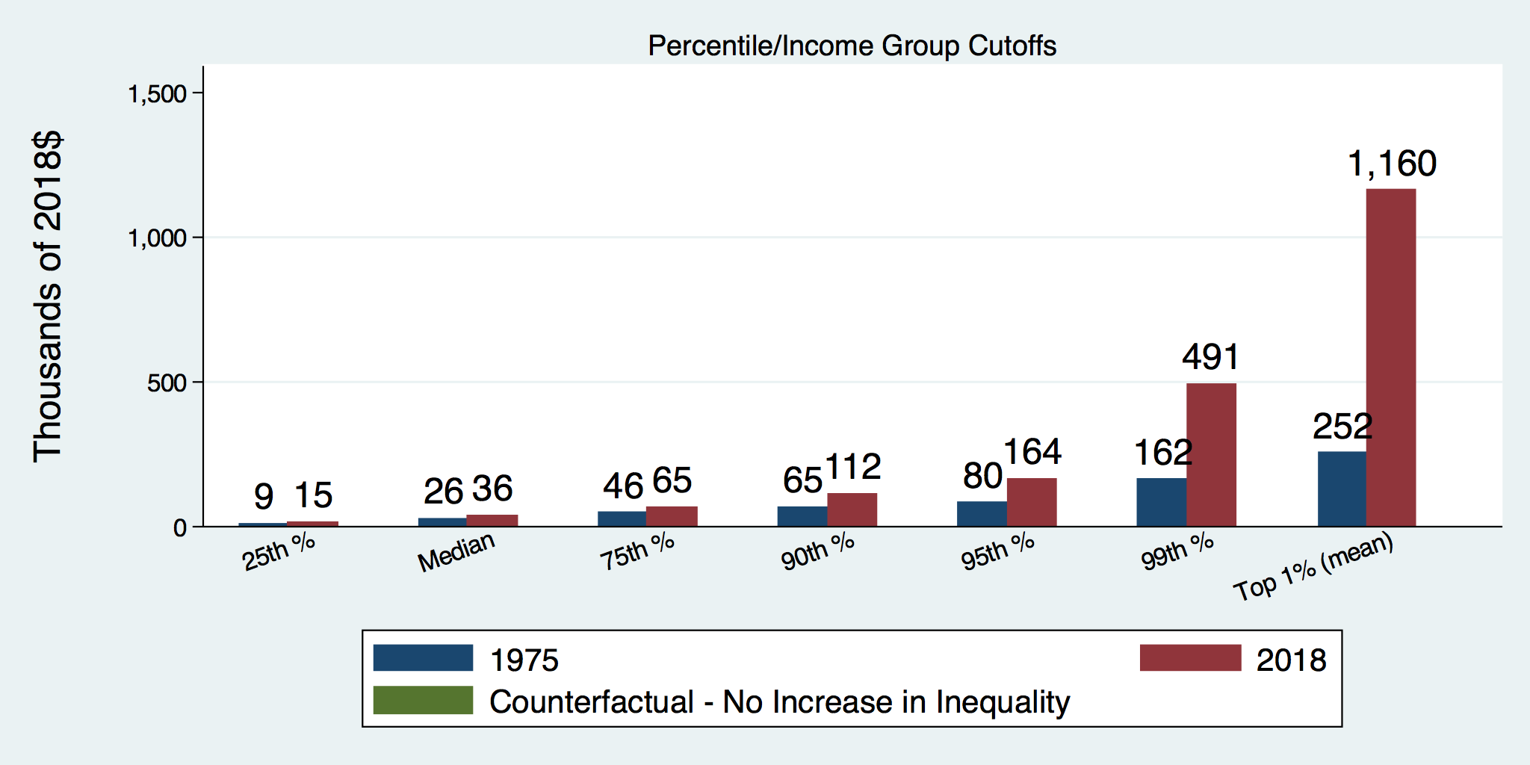
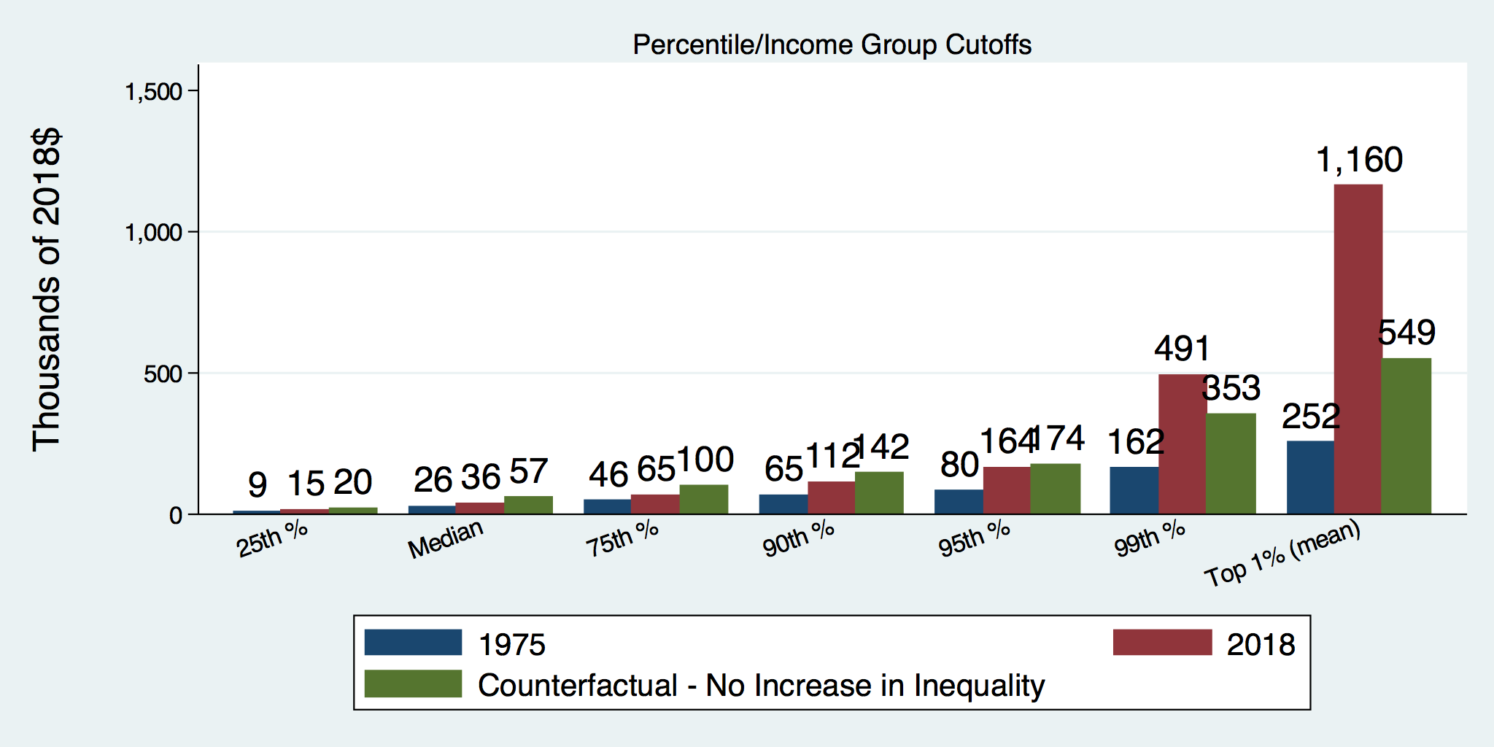
How Has Inequality Influenced Incomes?

Slide 25
Where Does Inequality Come From?
Labor Characteristics
  Demographics
    Age distribution
  Personal Choices
    Educational attainment
    Effort
    Priorities
    Household composition
  Immigration
Market Forces
  Technology
  Changing demand patterns
  Competition for labor
Government Policy
  Market influence
  Redistribution

Slide 26
Government Policy and Inequality
Market Influence: PRE-distribution
  Characteristics of labor
    Access to education
  Effects on labor demand
    Market regulation
      Competition policy
    Labor regulations
      Minimum wage, overtime, health insurance, etc.
RE-distribution
  Tax Rates
  Income support
    Direct aid
    Food stamps

Slide 27
Tax and Transfer Programs and Inequality
2014
Source: U.S. Congressional Budget Office, “The Distribution of Household Income, 2014”, Average Income Before and After Means-Tested Transfers and
Federal Taxes, by Income Group, 2014.

Slide 28
What About Tax Rates?
400 Taxpayers with highest incomes
1992-2007
+
392%
1992-2014
Average
Tax Rate
+310%
Average
Income
-12%
-
37%
Source: IRS
Source: IRS, Statistics of Income Division, December 2016.

Slide 29

Dramatically Less Progressivity in the Tax Code
1961 to 2011
Source: New York Times, from Thomas Piketty, Emmanuel Saez and Gabriel Zucman, “
Distributional National Accounts: Methods and Estimates for the United States”

Slide 30
Market Forces and Inequality
Changing demand patterns
  Technology
  Globalization
  Industry composition
    PCs instead of typewriters
    Services instead of goods
    Professional services instead of personal services
Competition in labor markets
  Unionization
  Market concentration

Slide 31
Where Does Inequality Come From? Summary
Labor characteristics
  What do workers bring to the market?
Market forces
  How does the market value the labor characteristics?
Government policies
  PRE-distribution – affecting markets
  Redistribution – affecting incomes

Slide 32

Labor Income is Unhinged from Productivity
Why?
Declining unionization
Globalization
Immigration
Competition policy
Cheap technology

Slide 33

Declining Unionization
Unionization Rates
1983: 20.1%
2021: 10.3%
Unionization Rates
Public: 33.9%
Private: 6.1%
Source: https://inequality.org/facts/income-inequality/, Bureau of Labor Statistics and Emmanueul Saez, University of Califonria, Berkeley

Slide 34
Competition in the Economy
Return on invested capital excluding goodwill –
US publicly-traded nonfinancial firms, 1965-2014
Source: Jason Furman, ”Forms and sources of inequality in the United States”, VOX, March 17, 2016, Figure 6.

Slide 35

Growing Revenue Concentration
Source: The Hamilton Project, Brookings: The State of Competition and dynamism.

Slide 36
Technological Change and Inequality
Much of the technology adopted in the last 30 years has eliminated low-skill or low-wage jobs.
  Computers, advanced manufacturing equipment, steel mini-mills, automation
There is a “winner take all” aspect of the technology-driven economy.
  This likely favors a small group of individuals.
Both aspects increase inequality by increasing the rewards to:
  Those with significant labor market skills.
  Owners over workers

Slide 37
Globalization
What is globalization?
  Flow of goods, services, capital, and labor across international borders
How does it affect inequality?
  Through a differential impact on low-skilled workers and hence their wages
  For the United States, globalization is thought to lower the wages of low skilled and hence low-wage workers relative to those of high-skilled workers

Slide 38
Mechanisms for the Effects of Globalization
Merchandise trade
  Importing goods that are made with low-skilled workers and exporting goods that are made with high-skilled workers
    Lowers the wages of unskilled relative to skilled
      making the distribution of income less equal
Outsourcing
  Similar channel as with merchandise trade
Trade in services
  US imports of middle-skill services: business and some professional services
Intuitively: The same as if we were to move the actual workers.

Slide 39
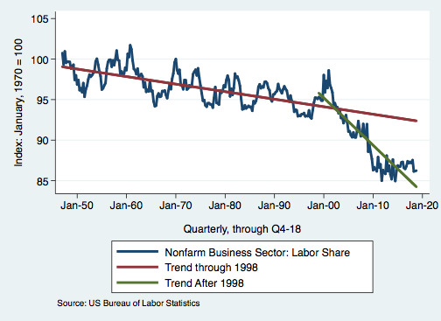
Effects of the Unhinging?
Labor’s Share of Income
1960: 66%
2011: 56%
2016: 58%
Source: Bureau of Labor Statistics

Slide 40

Why Does Inequality Matter?
Too little inequality can:
  Reduce individual motivation
  Slow economic growth
Too much inequality can:
  Reduce individual motivation
  Slow economic growth
Too much inequality may also:
  Divide society
  Distort political environment
  Reduce political participation
  Reduce investments in public goods
    Education
    Environmental protections

Slide 41
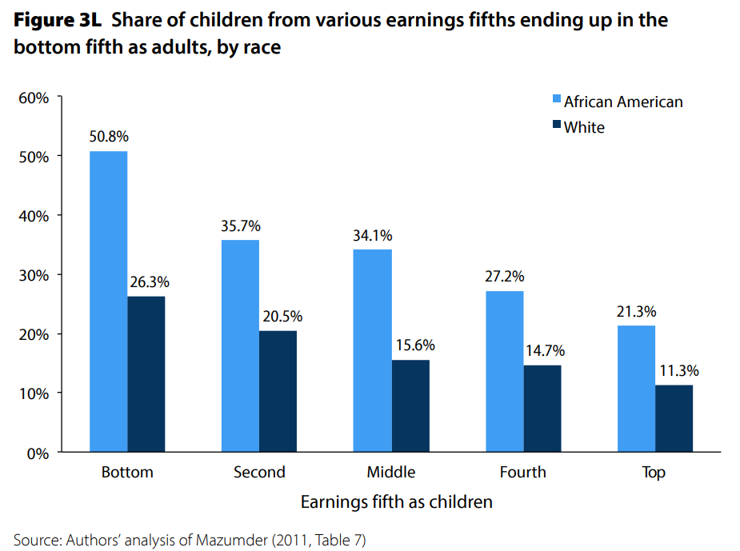
U.S. – Racial Differences
Odds of staying poor, if born poor
Odds of becoming poor, if born rich
Economic Policy Institute, State of Working America, 2012

Slide 42
Government Policy and Racial Inequality
Product of a long historical process of discrimination with at least two reinforcing sets of policies.
  Policies that govern the spatial distribution of the Black population.
    Restrictive covenants, redlining, and general housing and lending discrimination
  Policies that have a disparate impact on Black individuals because of their locations.
    The original version of Michigan Senate Bill 897 exempted individuals from this work requirement conditional on residing in a county with an unemployment rate above 8.5 percent. The higher unemployment rates in rural counties would disproportionately exempt white Medicaid recipients from the work requirement within the bill.

Slide 43
How Much Inequality Is too Much?
Sweet
Spot
?
?
Equity
Efficiency/GDP
Efficiency/GDP
Equity
Efficiency/GDP
Equity
0
100
Z
X
Gini Coefficient

Slide 44
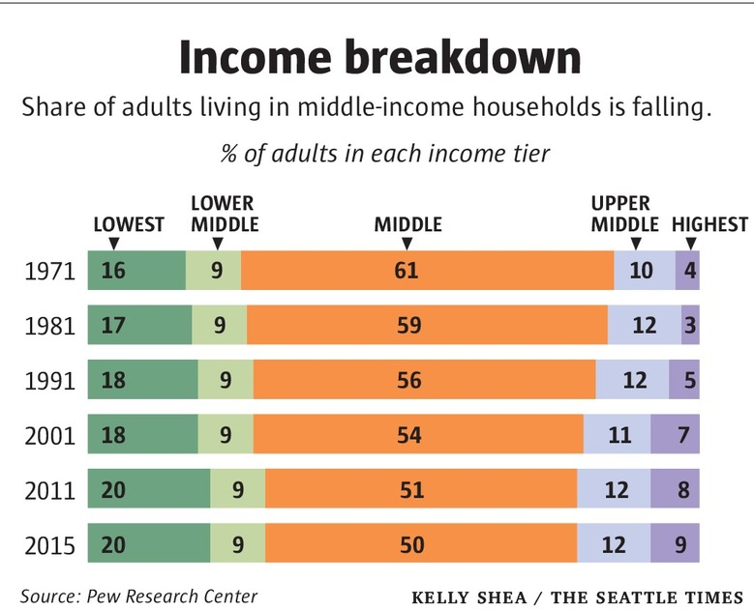
Inequality Can Also Directly Affect GDP
The US Economy is driven by consumption (67% of GDP).
  Middle class are the big consumers.
  They have less money.
  Consumption is lower.
  GDP is lower.

Slide 45
Too Much Inequality Can:
Reduce work effort, which reduces GDP.
Reduce purchasing power of the middle class, which reduces GDP.
Reduce the ability of people to get ahead, which reduces mobility.
  Puts the American Dream at risk.
Increase the share of the population living on low incomes.
  Offending our sense of equity? Desire for shared prosperity?
Concentrate political power.

Slide 46
An International Perspective
Source: Data taken from the 2014 CIA World Factbook.

Slide 47
Addressing Inequality: Is It A Problem?
Why it might be a problem.
  Economic issues (Efficiency)
    There is evidence that at some level, increased inequality slows economic growth.
    Or, inequality concentrates resources among investors.
  Noneconomic issues (Equity)
    Values, ethics and morals will drive individual evaluations of the level of inequality.
      E.g., inequality is primarily a function of market outcomes, so should be left alone.
      Or, a solid middle class is important for maintaining a civil society, which runs contrary to a high degree of inequality.
Suppose you think it’s a problem. How might it be addressed?

Slide 48

Addressing Inequality:
Immediately Available Policy Solutions (1/2)
RE-distribution
  Tax and transfer programs
PRE-distribution
  Strengthen labor unions
  Collective bargaining
  Other policies that favor labor over business owners
  Minimum wages

Slide 49
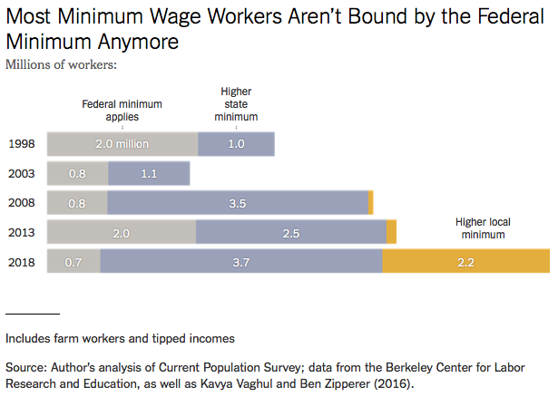

Slide 50
Addressing Inequality:
Immediately Available Policy Solutions (2/2)
Other
  Reverse trends in market power
Locally
  Employment services: job training, interview skills, or assistance with day-to-day issues, such as child care
  Cognizance of the potential for technologies to affect worker/employer power dynamics
    Uber, Lyft, etc.

Slide 51
Addressing Inequality:
Long Term
It’s all about access to resources:
  Education, in particular
    Improve public education
    Reduce disparities in quality of public education
    Improve counseling in low-income schools
      With respect to college – paths to success and funding
    Investments are needed in early education, not later (e.g. universal pre-k)
  Opportunities for wealth-building
  Housing
Initiatives whose impacts cross neighborhood and class lines and increase upward mobility specifically for Black men
  Mentoring programs for Black boys, efforts to reduce racial bias among whites, interventions to reduce discrimination in criminal justice, and efforts to facilitate greater interaction across racial groups.

Slide 52
Tension in Policy Solutions
Is it possible to increase growth at the same time that you reduce income inequality?
  Common refrain among some that government intervention in the economy is always and everywhere bad for growth.
Possibly: expanding equality of access promotes the full utilization of resources.
  Expanding equality of access requires resources likely from the well-to-do.

Slide 53
Summary
Income inequality is clearly increasing.
  The economy is clearly favoring owners of productive resources over labor.
The causes appear to be largely driven by:
  The market – technology, competition, and trade
  Changing institutions.
Open questions are:
  To act or not to act?
  If so, how?
The level of inequality is a policy choice.

Slide 54
Thank you!
Any Questions?
www.NEEDelegation.org
Ryan Herzog, Ph.D.
herzogr@gonzaga.edu
Contact NEED: info@NEEDelegation.org
Submit a testimonial: www.NEEDelegation.org/testimonials.php
Become a Friend of NEED: www.NEEDelegation.org/friend.php

