Slide 1


Economic Inequality
Jon Haveman, Ph.D.
NEED
October 1, 2026

Slide 2
Outline
Definition
Measurement
How does it happen?
Does it matter?
Is it a problem?
What to do about it

Slide 3

Economic Inequality: Income
Definition:
  The extent to which the distribution of income deviates from complete equality.
  The dispersion of income throughout the economy.

Slide 4
Different Ways of Thinking About Inequality
Income Inequality
  Before taxes and transfers
  After taxes and transfers
Wealth Inequality
How does wealth differ from income?
Income is measured over a period of time, say one year.
Wealth is one’s accumulated savings, including physical and financial assets (net worth).

Slide 5
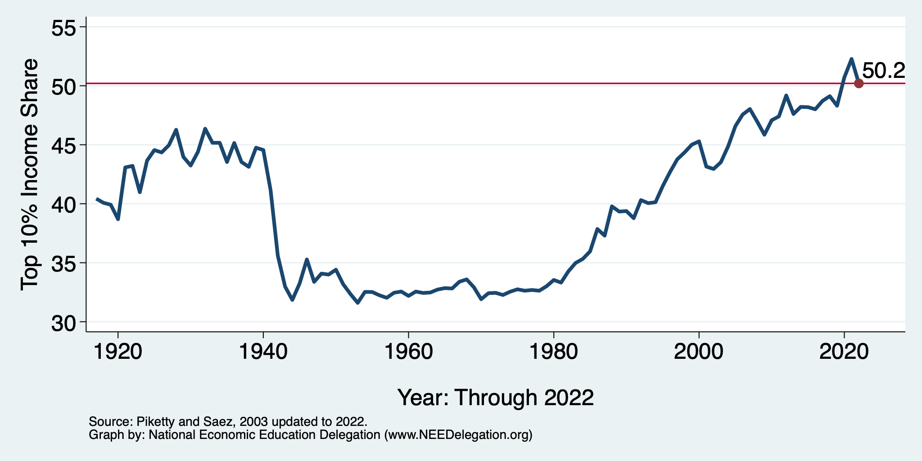
National Income Inequality: Share of Top 10%
Stock Market Crash
WWII
Housing Bubble
Dot-com Bubble

Slide 6
Recent Facts on Income Inequality
Beginning in the 1970s, income gaps widened.
  Income growth in the middle and lower parts of the distribution slowed.
  Incomes at the top continued to grow strongly.
Source: Chad Stone, Danilo Trisi, Arloc Sherman, and Roderick Taylor, “A Guide to Statistics on Historical Trends in Income Inequality,”
Center on Budget and Policy Priorities, Policy Futures, May 15, 2018.

Slide 7
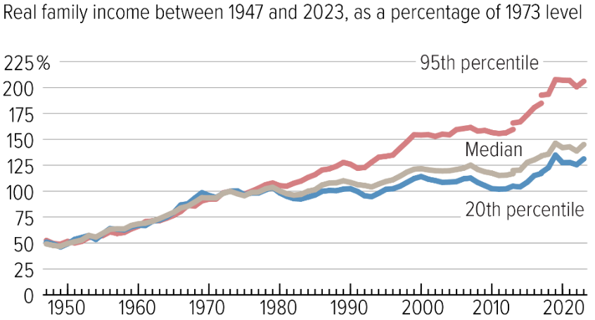
The Abrupt Increase in Income Inequality
Source: Chad Stone, Danilo Trisi, Arloc Sherman, and Roderick Taylor, “A Guide to Statistics on Historical Trends in Income Inequality,”
Center on Budget and Policy Priorities, Policy Futures, Dec. 11, 2018.
Notes:
Slide taken from page 10, Chad Stone, Danilo Trisi, Arloc Sherman, and Roderick Taylor, “A Guide to Statistics on Historical Trends in Income Inequality,” May 15, 2018

Slide 8
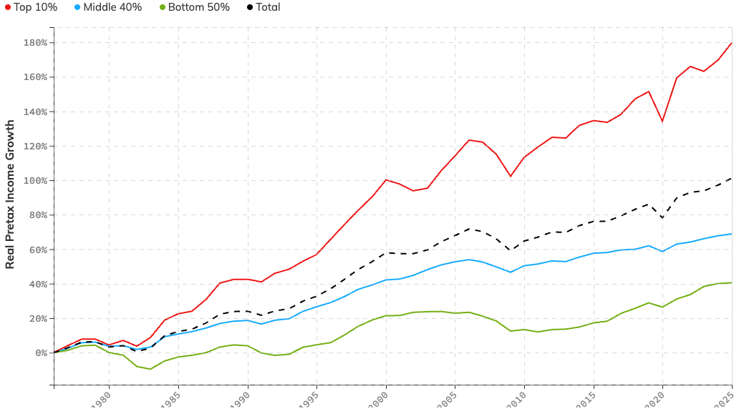
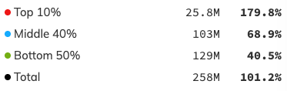
The Abrupt Increase in Income Inequality
Gain ($) Growth (%)
Inflation Adjusted Income Growth
1976 to 2025
Source: https://realtimeinequality.org

Slide 9
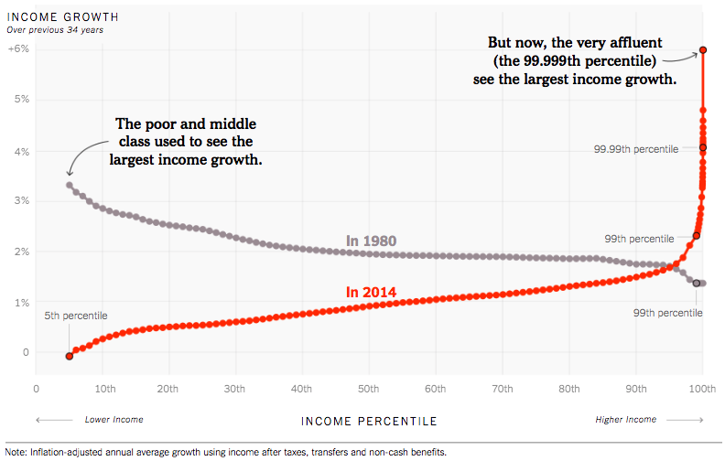
Income Growth Patterns Have Changed!
Source: https://www.nytimes.com/interactive/2017/08/07/opinion/leonhardt-income-inequality.html

Slide 10
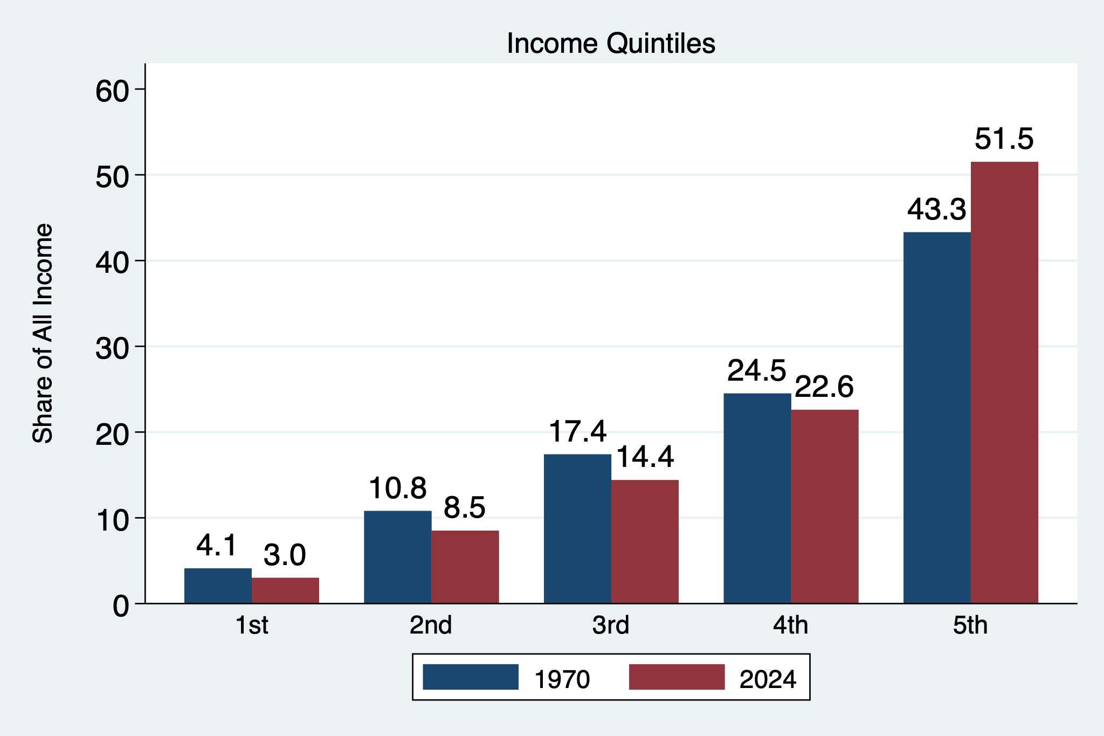
Income Share Changes Between 1970 and 2024
Source: U.S. Census Bureau, Current Population Survey, Annual Social and Economic Supplements.

Slide 11
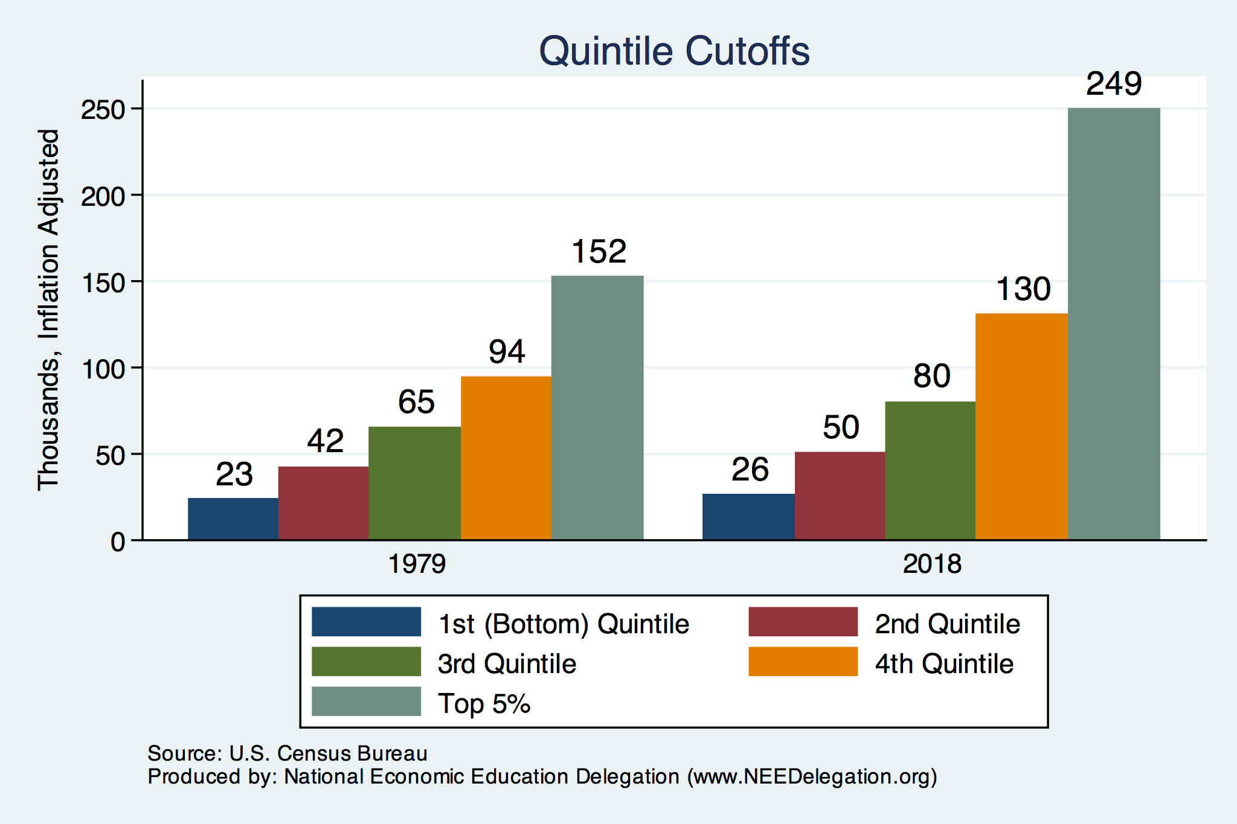
Quintile Income Cutoffs
Top 5%

Slide 12
Income Changes from Growing Inequality
Bottom 90%
of Households

Slide 13
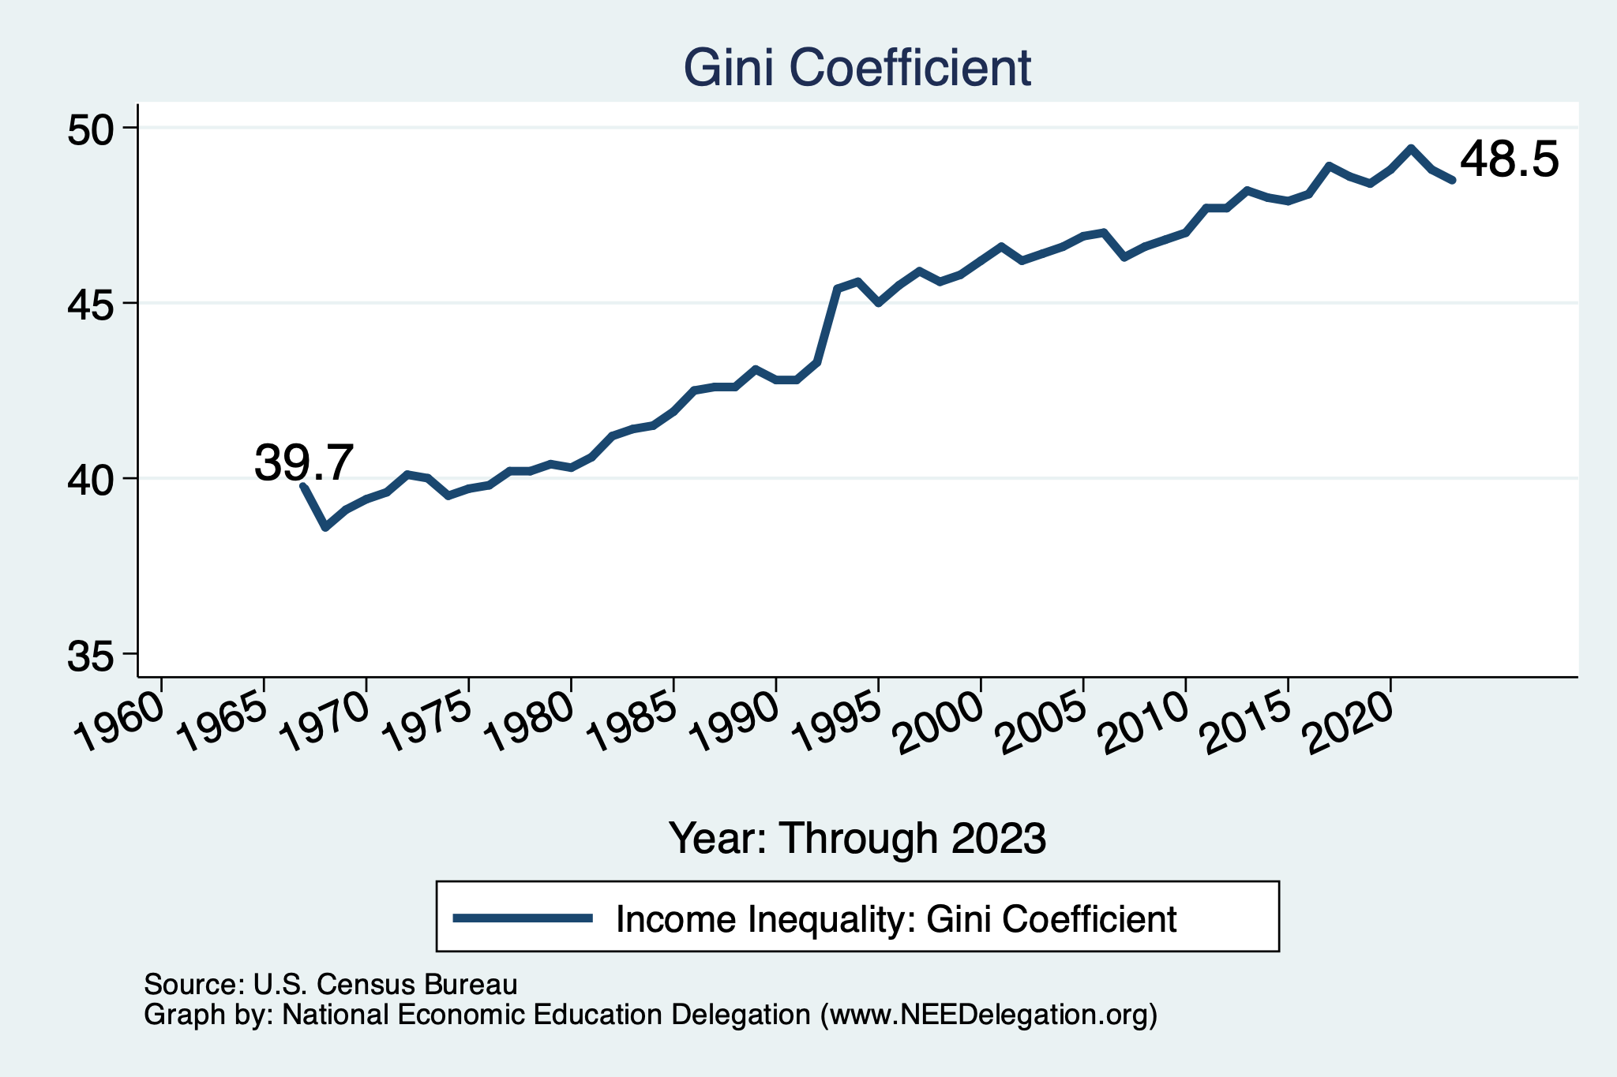
Income Inequality: Gini Coefficient Over Time

Slide 14
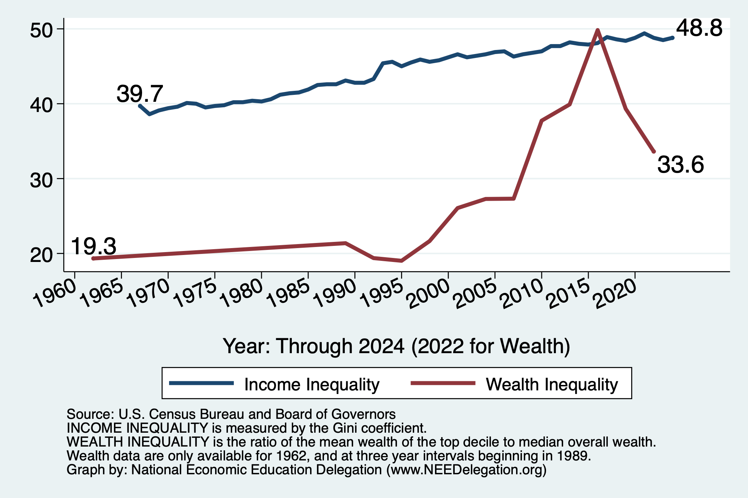
Income and Wealth Inequality Measures

Slide 15
Wealth Inequality Exceeds Income Inequality
Source: Chad Stone, Danilo Trisi, Arloc Sherman, and Roderick Taylor, “A Guide to Statistics on Historical Trends in Income Inequality,”
Center on Budget and Policy Priorities, Policy Futures, Dec. 11, 2018.

Slide 16
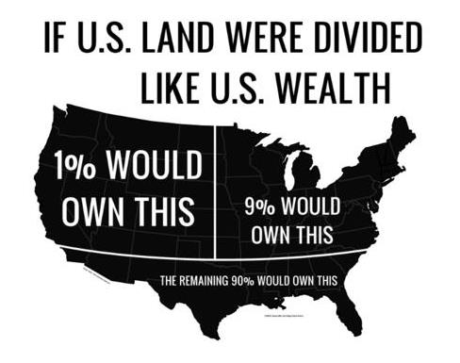
Wealth inequality in America

Slide 17
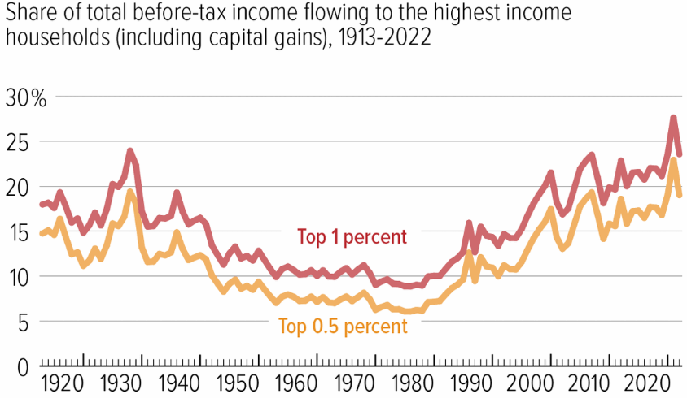
Wealth Concentration Has Been Rising
2019 Overall Median: $121,700

Slide 18
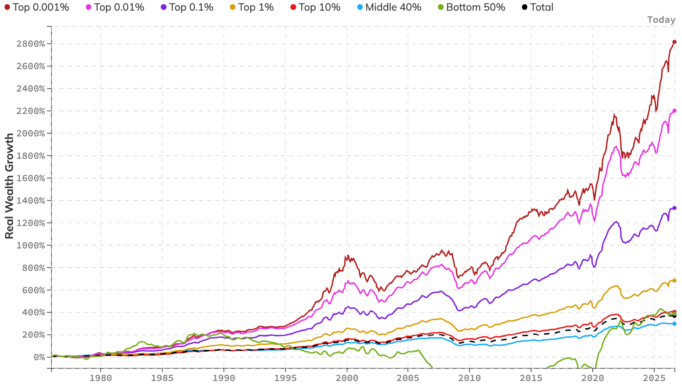
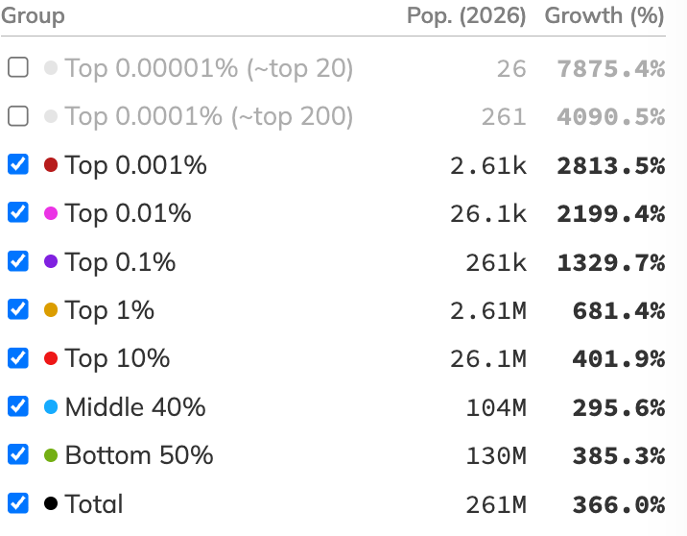
The Abrupt Increase in Wealth Inequality
Inflation Adjusted Income Growth
January 1979 to June 2026
Source: https://realtimeinequality.org

Slide 19
Where Does Income Inequality Come From?
Labor Characteristics
  Demographics
    Age distribution
  Personal Choices
    Educational attainment
    Effort & Priorities
  Immigration and Emigration
Market Forces
  Technology
  Changing demand patterns
  Competition for labor
Government Policy
  Market influence
  Redistribution

Slide 20
Government Policy and Inequality
Market Influence: PRE-distribution
  Characteristics of labor
    Access to education
  Effects on labor demand
    Market regulation
      Competition policy
    Labor regulations
      Minimum wage, overtime, health insurance, union regulations, etc.
RE-distribution
  Tax Rates
  Income support
    Direct aid
    Food stamps

Slide 21
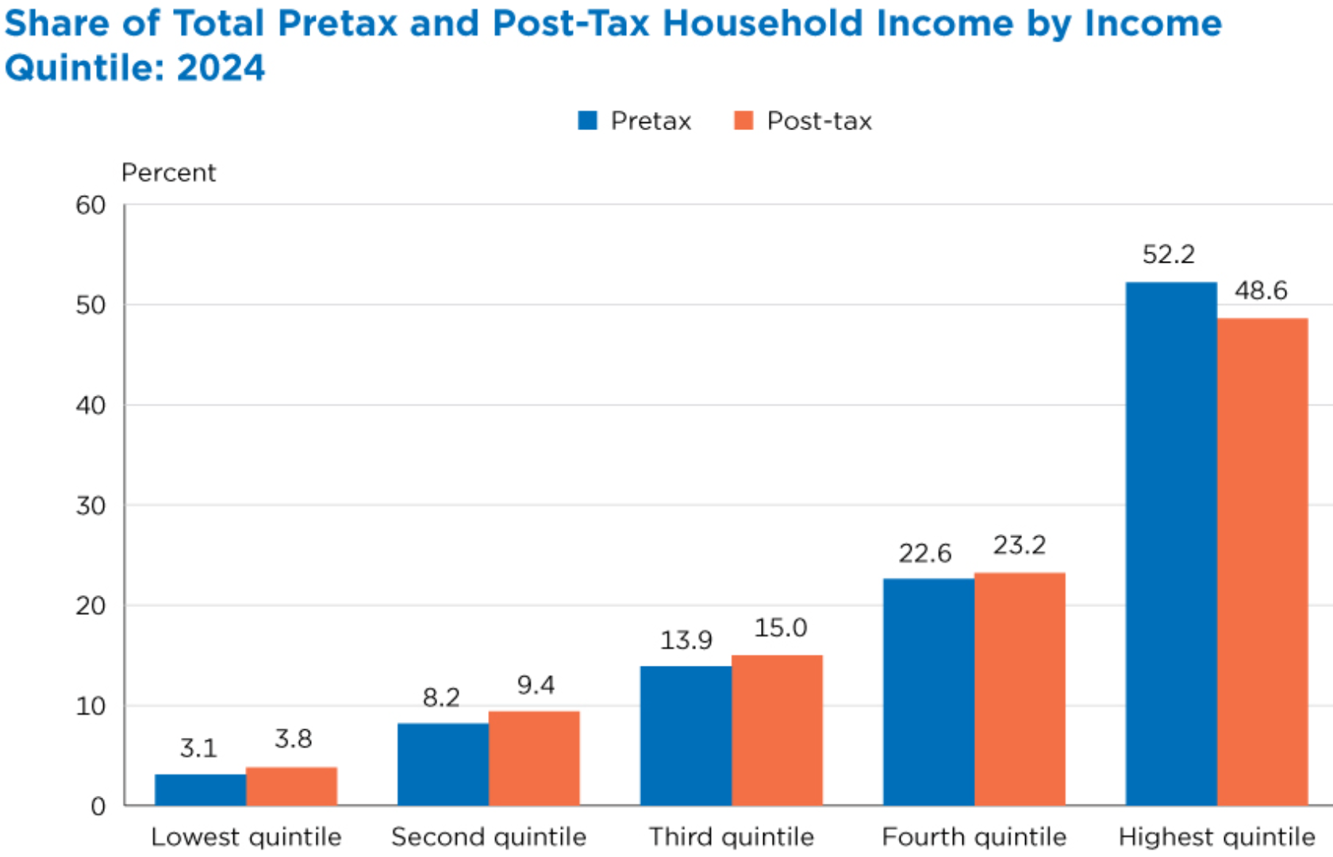
Tax and Transfer Programs and Inequality
Source: U.S. Congressional Budget Office, “The Distribution of Household Income, 2014”, Average Income Before and After Means-Tested Transfers and
Federal Taxes, by Income Group, 2014.

Slide 22
Market Forces and Inequality
Changing demand patterns
  Technology and “skill-biased technological change”
  Increased Trade and Globalization
  Industry composition
    PCs instead of typewriters
    Services instead of goods
    Professional services instead of personal services
Competition in labor markets
  Unionization
  Market concentration

Slide 23
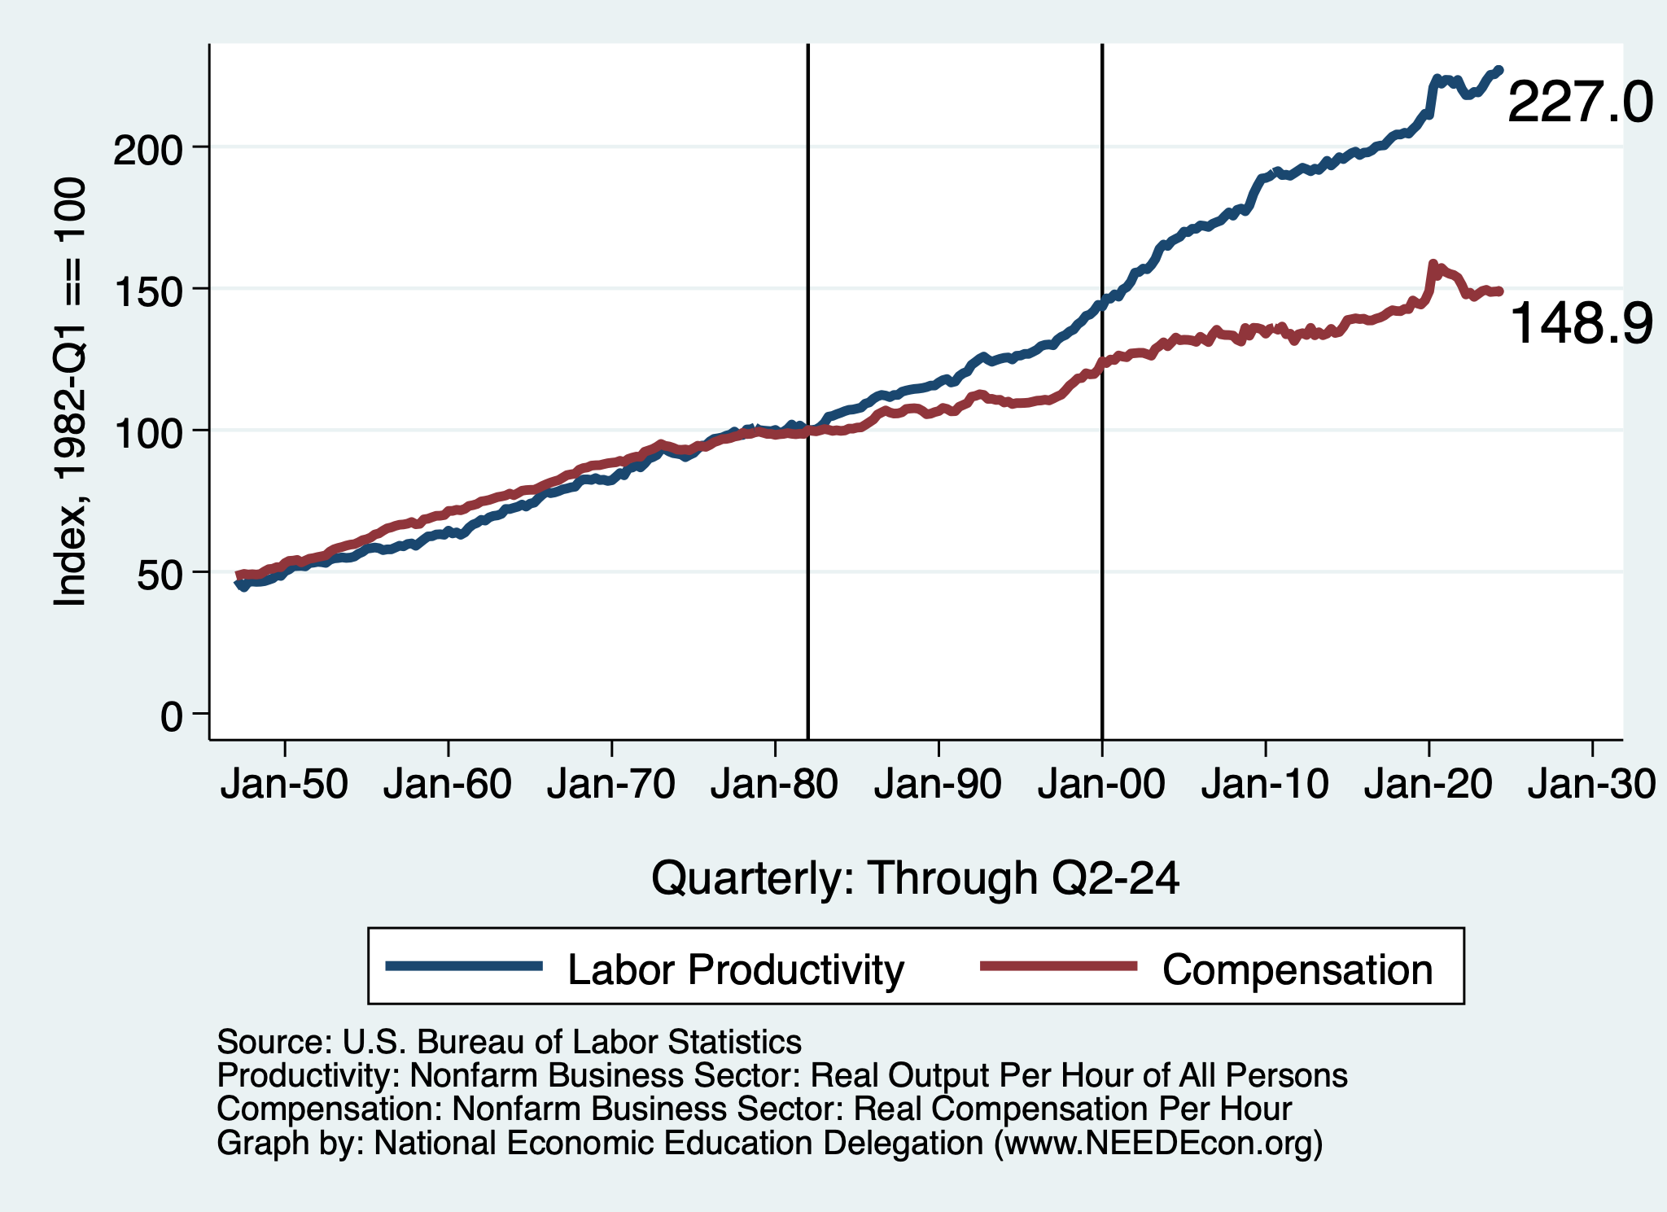
Labor Income is Unhinged from Productivity
Why? Some theories:
Declining unionization
Competition policy
Technological change
Globalization

Slide 24
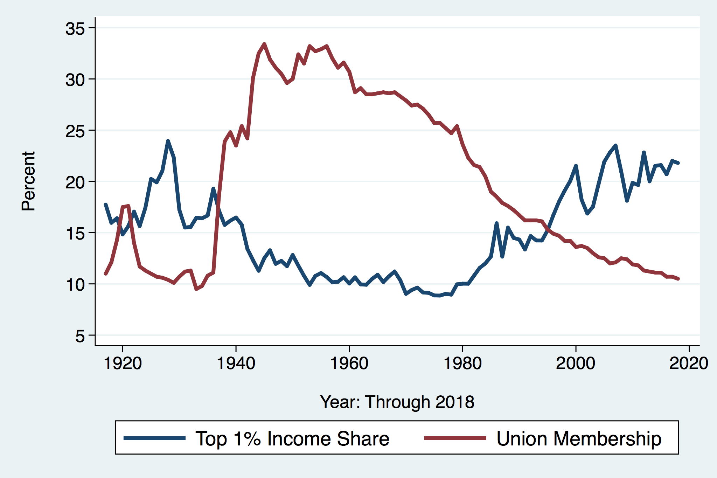
Declining Unionization
Unionization Rates
1983: 20.1%
2025: 10.0%
Unionization Rates
Public: 32.9%
Private: 5.9%
Source: https://inequality.org/facts/income-inequality/, Bureau of Labor Statistics and Emmanueul Saez, University of Califonria, Berkeley
Notes:
https://voxeu.org/article/forms-and-sources-inequality-united-states

Slide 25
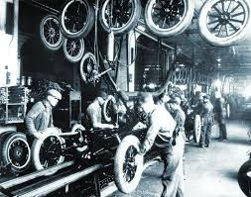
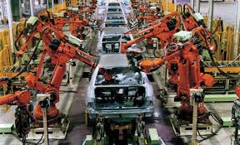
Technology Effects on Low Income Workers
Technology can improve worker productivity and create jobs
But technology can also displace jobs

Slide 26
Globalization
What is globalization?
  Flow of goods, services, capital, and labor across international borders.
How does it affect inequality?
  Through a differential impact on low-skilled workers and hence their wages.
  For the United States, globalization is thought to lower the wages of low skilled and hence low-wage workers relative to those of high-skilled workers.

Slide 27
What is driving increasing inequality?
Primary drivers:
  Technological change
  Increased globalization and trade
  Institutions and policy choices
These drivers can also influence personal choices in ways that affect measured income inequality.
  For example, educational choices or labor force participation.

Slide 28

Why Does Inequality Matter?
Too little inequality can:
  Reduce individual motivation
  Slow economic growth
Too much inequality can:
  Reduce individual motivation
  Slow economic growth
Too much inequality may also:
  Divide society
  Distort political environment
  Reduce political participation
  Affect public goods spending and distribution
    Education
    Environmental protections

Slide 29
Addressing Inequality: Is It A Problem?
Why might it be a problem?
  Economic issues (Efficiency)
    Inequality can misallocate resources and slow economic growth.
    Maybe not a problem? Inequality can concentrate resources with investors.
  Noneconomic issues (Equity)
    Values, ethics, and morals will drive individual evaluations of inequality.
    Depends on personal beliefs about origins and consequences of inequality.
Suppose you think it’s a problem. How might it be addressed?

Slide 30

Addressing Inequality:
Immediately Available Policy Solutions
RE-distribution
  Tax and transfer programs
PRE-distribution
  Reduce market power
  Unionization
  Collective bargaining
  Minimum wages
  Job training and interview skills
  Family care policies

Slide 31
Addressing Inequality:
Long Term
It’s all about access to resources:
  Improve public education and reduce quality disparities across schools.
  Improve counseling - paths to higher ed and funding for low-income students.
  Invest in early childhood education, not later (e.g. universal pre-k).
  Promote opportunities for wealth-building.
  Increase housing supply, especially in high-price, high-opportunity cities.
Focus on most affected groups:
  Mentoring programs for minority youth.
  Programs to address racial bias and discrimination in work and criminal justice.
  Efforts to desegregate and facilitate greater interaction across racial groups.

Slide 32
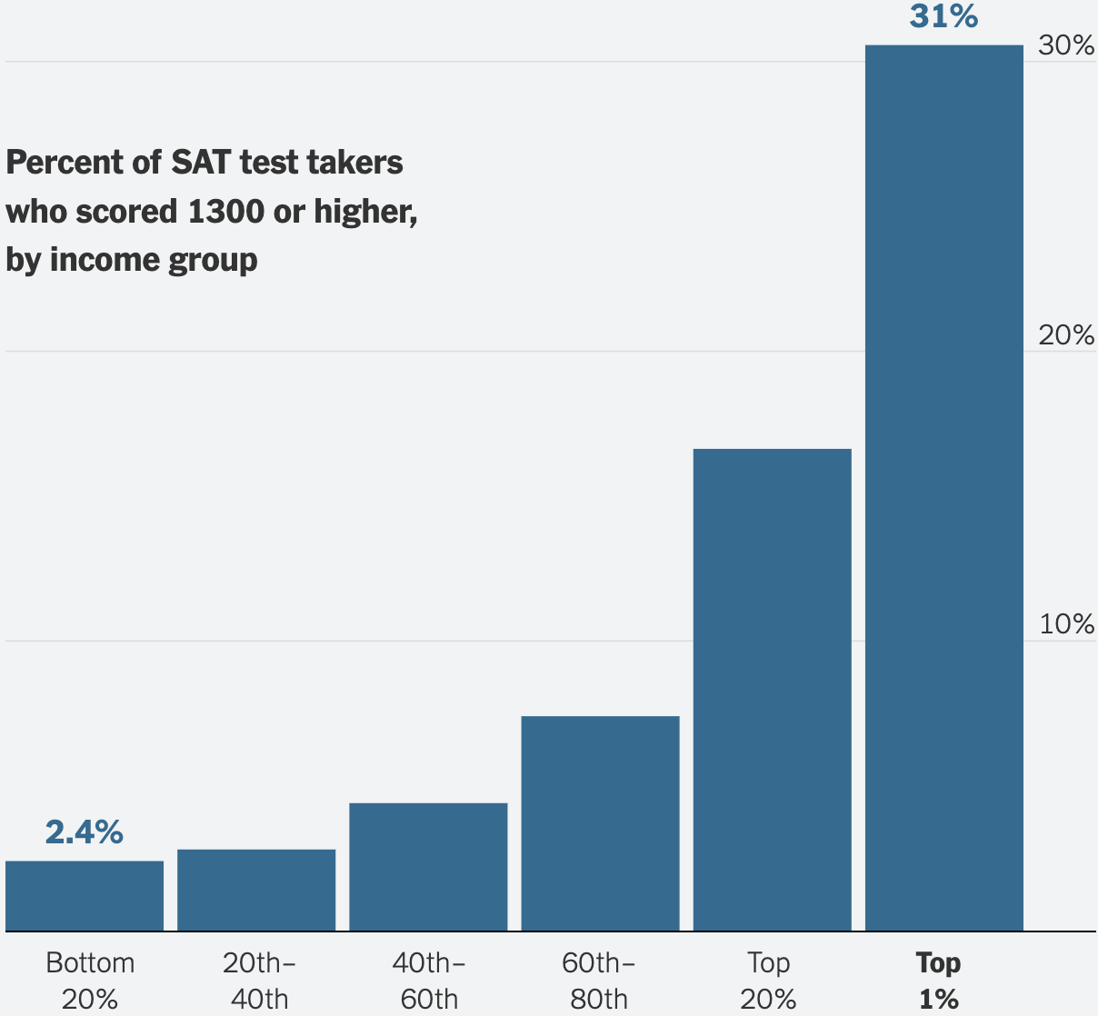
To Emphasize the Access Issue

Slide 33
An International Perspective: Comparables
U.S.: 17-18
Canada, UK, Germany: 12-13
Italy, France, Japan: 7-9

Slide 34
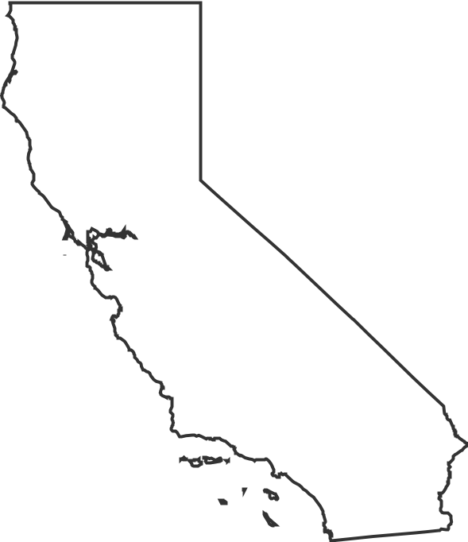

Summary
Income inequality is clearly increasing.
  Owners of productive resources seeing greater income growth than workers reliant on labor income only.
The causes appear to be largely driven by:
  Technology, competition, and trade
  Institutions and public policies
Open questions are:
  To act or not to act?
  If so, how?
The level of inequality is a policy choice necessarily involving complex tradeoffs.

Slide 35
Thank you!
Any Questions?
www.NEEDEcon.org
Jon Haveman, Ph.D.
Jon@NEEDEcon.org
Contact NEED: info@NEEDEcon.org
Submit a testimonial: www.NEEDEcon.org/testimonials.php
Become a Friend of NEED: www.NEEDEcon.org/friend.php

