Slide 1
Osher Lifelong Learning Institute, Winter 2022
Contemporary Economic Policy
Clemson University
National Economic Education Delegation

Slide 2


Economic Inequality
Brian Peterson, Ph.D.
Senior Associate Academic Dean and Professor of Economics
Central College, Pella, Iowa
Osher Lifelong Learning Institute, Clemson University
7 March 2022

Slide 3
Course Outline
Contemporary Economic Policy
  Week 1 (2/28): US Economy & Coronavirus Economics
  Week 2 (3/7): Economic Inequality (Brian Peterson, Central College)
  Week 3 (3/14): Cryptocurrencies (Geoffrey Woglom, Amherst College)
  Week 4 (3/21): Autonomous Vehicles (Jon Haveman, NEED)

Slide 4
Submitting Questions
Please submit questions in the chat.
  I will try to handle them as they come up but may take them in a bunch as time permits.
I will try to leave a few minutes for a verbal Q&A once the material has been presented.
  (and the questions in the chat have been addressed)

Slide 5
National Economic Education Delegation
Vision
  One day, the public discussion of policy issues will be grounded in an accurate perception of the underlying economic principles and data.
Mission
  NEED unites the skills and knowledge of a vast network of professional economists to promote understanding of the economics of policy issues in the United States.
NEED Presentations
  Are nonpartisan and intended to reflect the consensus of the economics profession.

Slide 6
Who Are We?
Honorary Board: 54 members
  2 Fed Chairs: Janet Yellen, Ben Bernanke
  6 Chairs Council of Economic Advisers
    Furman (D), Rosen (R), Bernanke (R), Yellen (D), Tyson (D), Goolsbee (D)
  3 Nobel Prize Winners
    Akerlof, Smith, Maskin
Delegates: 650 members
  At all levels of academia and some in government service
  All have a Ph.D. in economics
  Crowdsource slide decks
  Give presentations
Global Partners: 48 Ph.D. Economists
  Aid in slide deck development

Slide 7
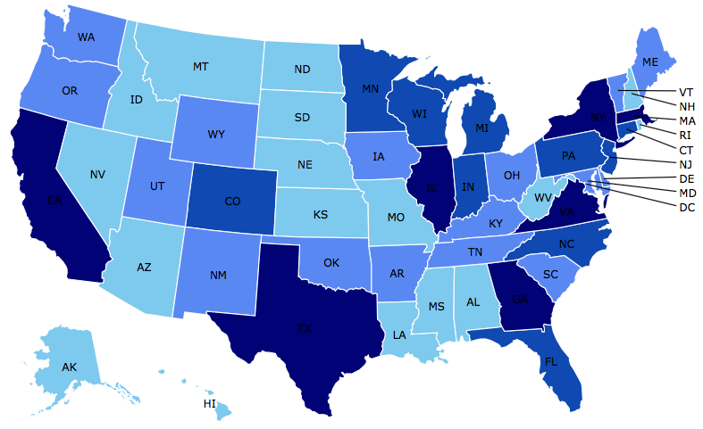

Where Are We?

Slide 8
Available NEED Topics Include:
Coronavirus Economics
US Economy
Climate Change
Economic Inequality
Economic Mobility
Trade and Globalization
Minimum Wages
Immigration Economics
Housing Policy
Federal Budgets
Federal Debt
Black-White Wealth Gap
Autonomous Vehicles
US Social Policy

Slide 9
Credits and Disclaimer
This slide deck was authored by:
  Jon Haveman, Executive Director of NEED
This slide deck was reviewed by:
  Timothy Smeeding, University of Wisconsin
  Robert Wright, Augustana University
Disclaimer
  NEED presentations are designed to be nonpartisan
  It is, however, inevitable that the presenter will be asked for and will provide their own views
  Such views are those of the presenter and not necessarily those of the National Economic Education Delegation (NEED)

Slide 10
Economic Inequality
Brian Peterson, Ph.D.
Senior Associate Academic Dean and Professor of Economics
Central College, Pella, Iowa
Osher Lifelong Learning Institute, Clemson University
7 March 2022

Slide 11
Notes:
https://fivethirtyeight.com/features/many-americans-think-economic-inequality-is-a-problem-just-not-the-most-pressing-one/

Slide 12
Outline
Definition
Measurement
How does it happen?
Does it matter?
Is it a problem?
What do we do about it?

Slide 13

Economic Inequality: Income
Definition:
  The extent to which the distribution of income deviates from complete equality
  The dispersion of income throughout the economy

Slide 14
Different Ways of Thinking About Inequality
Income Inequality
  Before taxes and transfers
  After taxes and transfers
Wealth Inequality
Consumption Inequality

Slide 15

National Income Inequality: Share of Top 10%
Stock Market Crash
WWII
Housing Bubble
Dot-com Bubble

Slide 16
Recent Facts on Income Inequality
Beginning in the 1970s, the income gap widened.
  Income in the middle and lower parts of the distribution slowed
  Incomes at the top continued to grow strongly
  Income shares at the very top of the distribution rose to levels last seen more than 80 years ago
Source: Chad Stone, Danilo Trisi, Arloc Sherman, and Roderick Taylor, “A Guide to Statistics on Historical Trends in Income Inequality,”
Center on Budget and Policy Priorities, Policy Futures, May 15, 2018.

Slide 17

The Abrupt Increase in Inequality
Source: Chad Stone, Danilo Trisi, Arloc Sherman, and Roderick Taylor, “A Guide to Statistics on Historical Trends in Income Inequality,”
Center on Budget and Policy Priorities, Policy Futures, Dec. 11, 2018.
Notes:
Slide taken from page 10, Chad Stone, Danilo Trisi, Arloc Sherman, and Roderick Taylor, “A Guide to Statistics on Historical Trends in Income Inequality,” May 15, 2018

Slide 18
The Gini Coefficient
A common way to describe income inequality is by using a Gini coefficient.
Gini coefficient – a numerical measure of the overall dispersion of income
  Ranges from 0 – 1
  0= perfect equality – everyone has same income
  1=perfect inequality – one person makes all income, no one else has any
  In practice:
    0.5 – 0.7 – highly unequal
    0.2 – 0.35 – relatively equal

Slide 19
The Gini Coefficient
100%
A
Gini =
x 100
A + B
% of
All Income
50%
Equality (45 degrees)
A
Bigger A: More inequality
Smaller A: Less inequality
Inequality
B
Extreme
50%
100%
% of Population

Slide 20
Forming the GINI Coefficient: 2015
Quintile Shares of Income
CUMULATIVE Quintile Shares of Income
Income Quintiles
Income Quintiles
Source: 2015 1-year American Community Survey, based on pre-tax household income.

Slide 21
Income Share Changes Between 1970 and 2017
1970
2017
Share of All Income
% of Population
Income Quintiles
Source: U.S. Census Bureau, Current Population Survey, Annual Social and Economic Supplements.

Slide 22
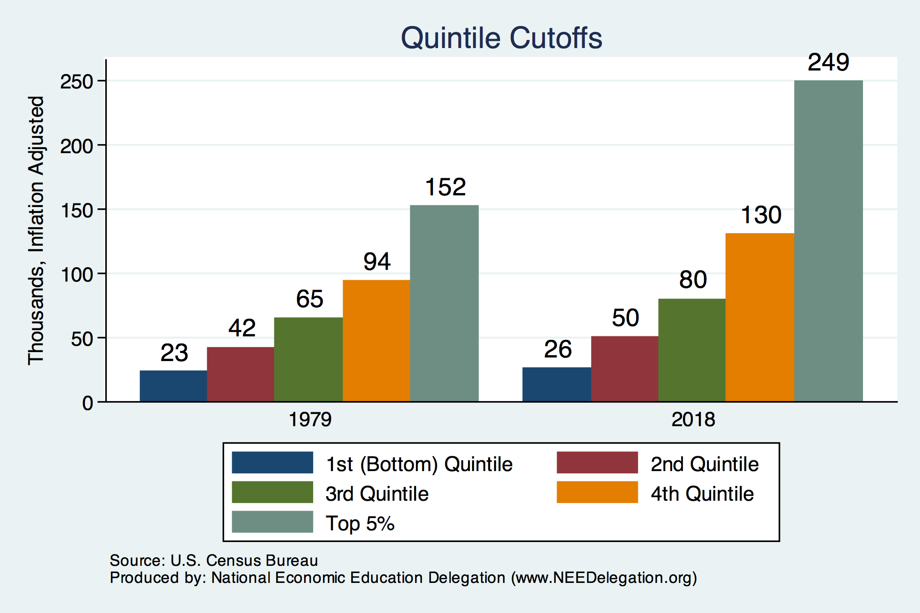
Quintile Income Cutoffs
Top 5%

Slide 23
Income Changes from Growing Inequality
Bottom 90%
of Households

Slide 24
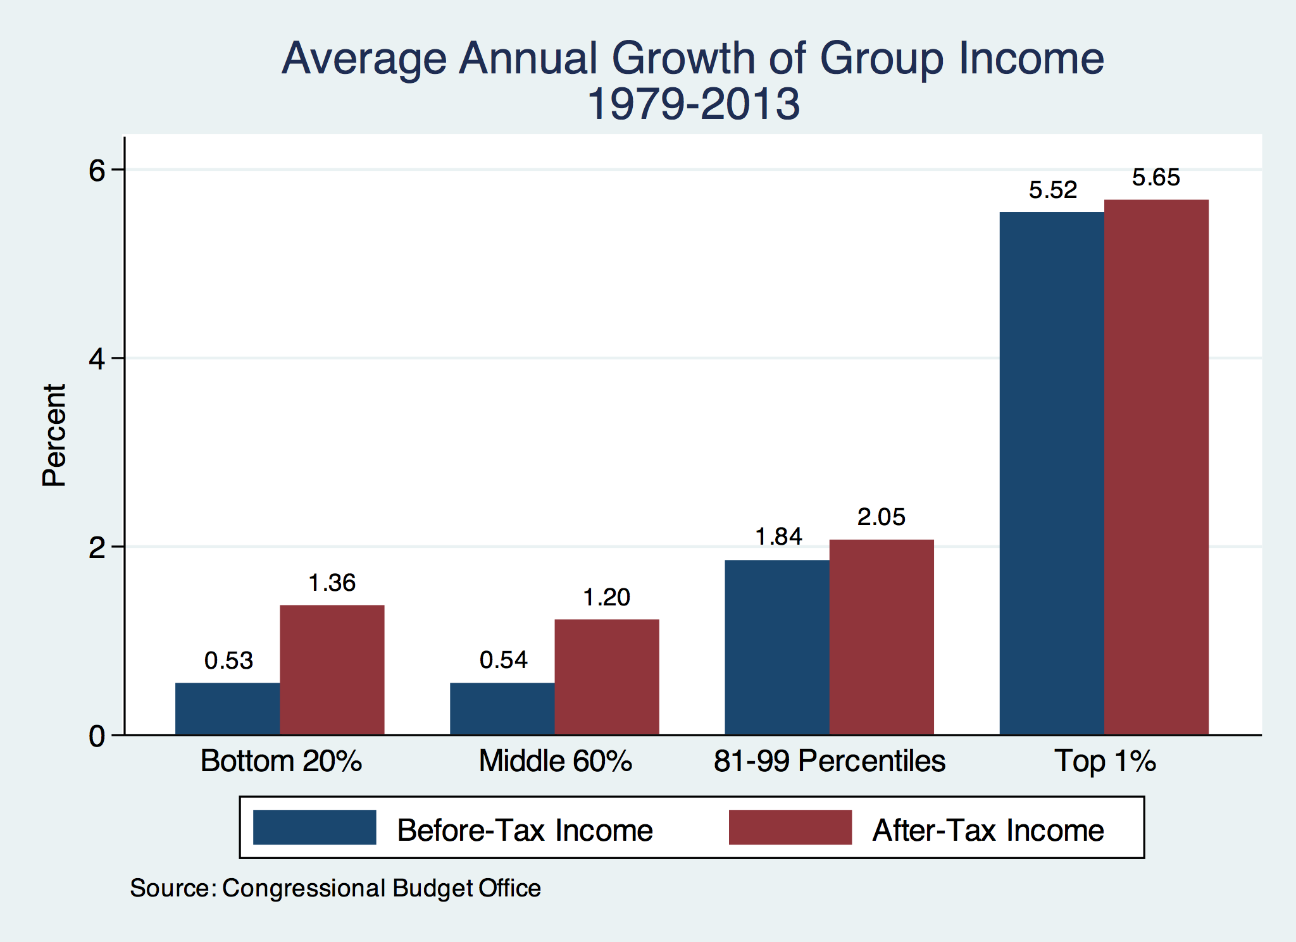
Growth Has Been Primarily at the Very Top

Slide 25
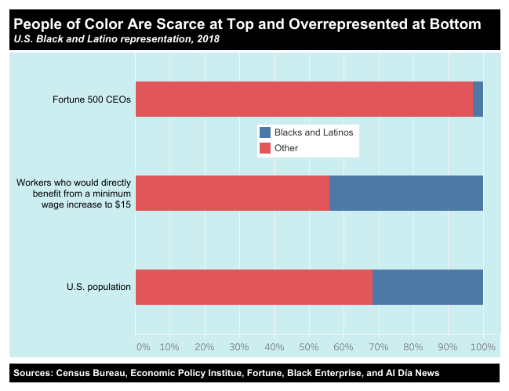
https://inequality.org/facts/racial-inequality/#racial-income-inequality
Notes:
https://inequality.org/facts/racial-inequality/#racial-income-inequality

Slide 26
Income Inequality Varies by Location
Gini Coefficients in 2019
US: 48.1
SC: 47.5
Anderson County, SC: 46.8 - (increasing since 2014)
Pickens County, SC: 43.9 (falling since 2016)

Slide 27
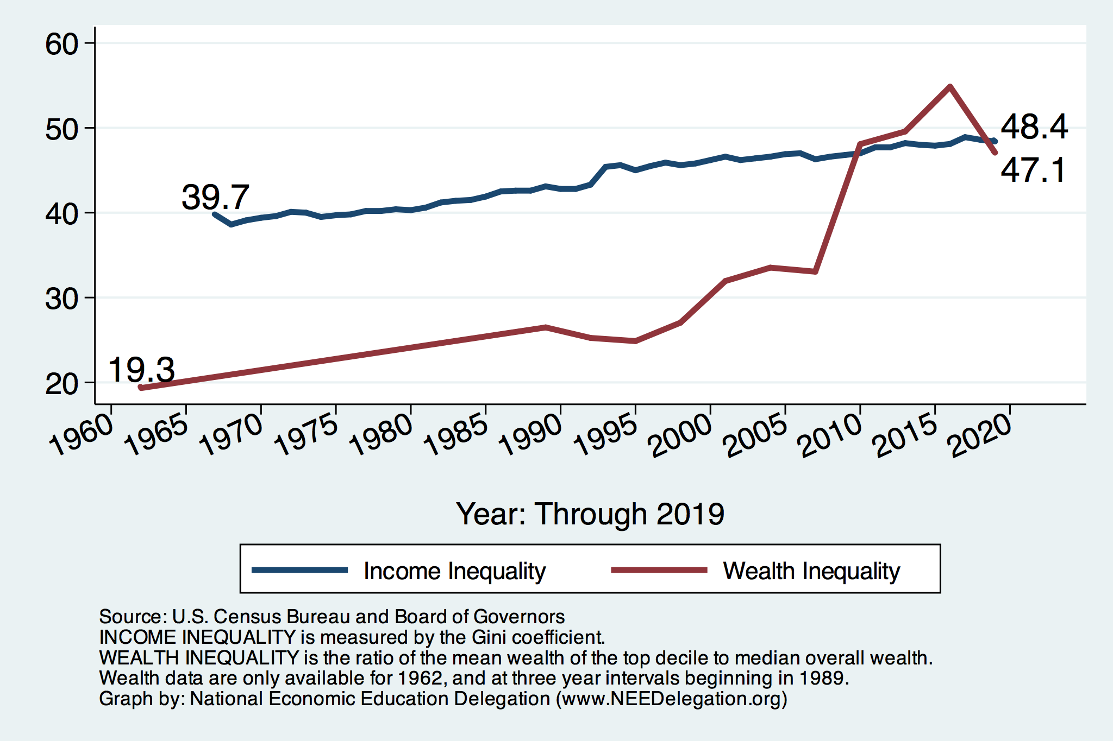
Income and Wealth Inequality

Slide 28
Wealth Inequality Exceeds Income Inequality
Source: Chad Stone, Danilo Trisi, Arloc Sherman, and Roderick Taylor, “A Guide to Statistics on Historical Trends in Income Inequality,”
Center on Budget and Policy Priorities, Policy Futures, Dec. 11, 2018.

Slide 29
Notes:
https://www.brookings.edu/blog/up-front/2020/02/27/examining-the-black-white-wealth-gap/

Slide 30
A Third Measure of Inequality: Consumption

Slide 31
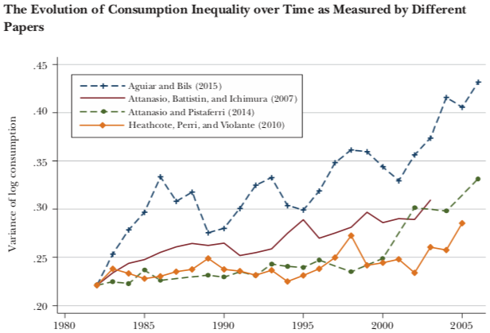
Growing Evidence: Consumption Inequality
Source: Orazio P. Attanasio and Luigi Pistaferri, “Consumption Inequality,” Journal of Economic Perspectives, Volume 30, #2, Spring 2016, page 11, Figure 1.

Slide 32
Case Study: Economic Research
Early, controversial result is published
Flurry of effort to understand the result
Growing body of evidence
Consensus reached
  Not always
  Sometimes data continue to conflict
  Often merely a preponderance of evidence drives understanding
Why has this happened with consumption inequality?
  Inadequacy of data and methods

Slide 33
Where Does Inequality Come From?
Labor Characteristics
  Demographics
    Age distribution
  Personal Choices
    Educational attainment
    Effort
    Priorities
    Household composition
  Immigration
Market Forces
  Technology
  Changing demand patterns
  Competition for labor
Government Policy
  Market influence
  Redistribution

Slide 34
Government Policy and Inequality
Market Influence: PRE-distribution
  Characteristics of labor
    Access to education
  Effects on labor demand
    Market regulation
      Competition policy
    Labor regulations
      Minimum wage, overtime, health insurance, etc.
RE-distribution
  Tax Rates
  Income support
    Direct aid
    Food stamps

Slide 35
Tax and Transfer Programs and Inequality
2014
Source: U.S. Congressional Budget Office, “The Distribution of Household Income, 2014”, Average Income Before and After Means-Tested Transfers and
Federal Taxes, by Income Group, 2014.

Slide 36
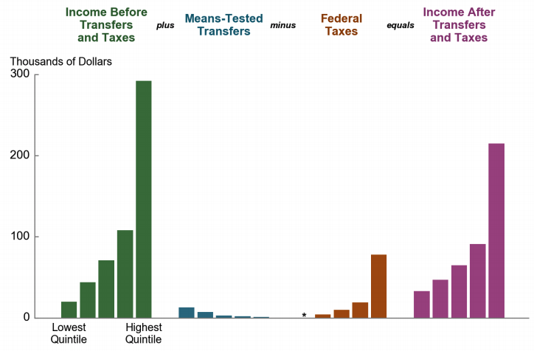
Taxes, Transfers, and Income: 2016
Source: U.S. Congressional Budget Office, “The Distribution of Household Income, 2016”.

Slide 37
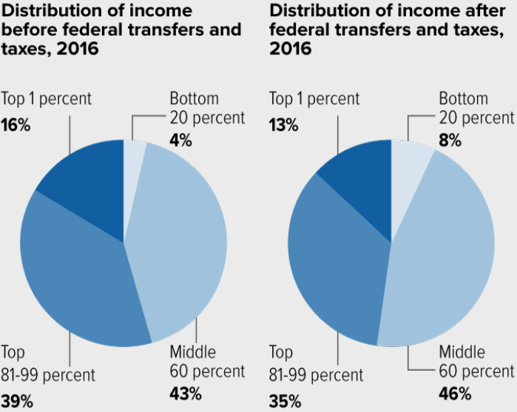
Tax and Transfer Programs: Income Shares

Slide 38
What About Tax Rates?
400 Taxpayers with highest incomes
1992-2007
+
392%
1992-2014
Average
Tax Rate
+310%
Average
Income
-12%
-
37%
Source: IRS
Source: IRS, Statistics of Income Division, December 2016.

Slide 39

The Top Tax Rate and Income Cutoff

Slide 40
Market Forces and Inequality
Changing demand patterns
  Technology
  Globalization
  Industry composition
    PCs instead of typewriters
    Services instead of goods
    Professional services instead of personal services
Competition in labor markets
  Unionization
  Market concentration

Slide 41
Where Does Inequality Come From? Summary
Labor characteristics
  What do workers bring to the market?
Market forces
  How does the market value the labor characteristics?
Government policies
  PRE-distribution – affecting markets
  Redistribution – affecting incomes

Slide 42

Labor Income is Unhinged from Productivity
Why?
Declining unionization
Globalization
Immigration
Competition policy
Cheap technology

Slide 43
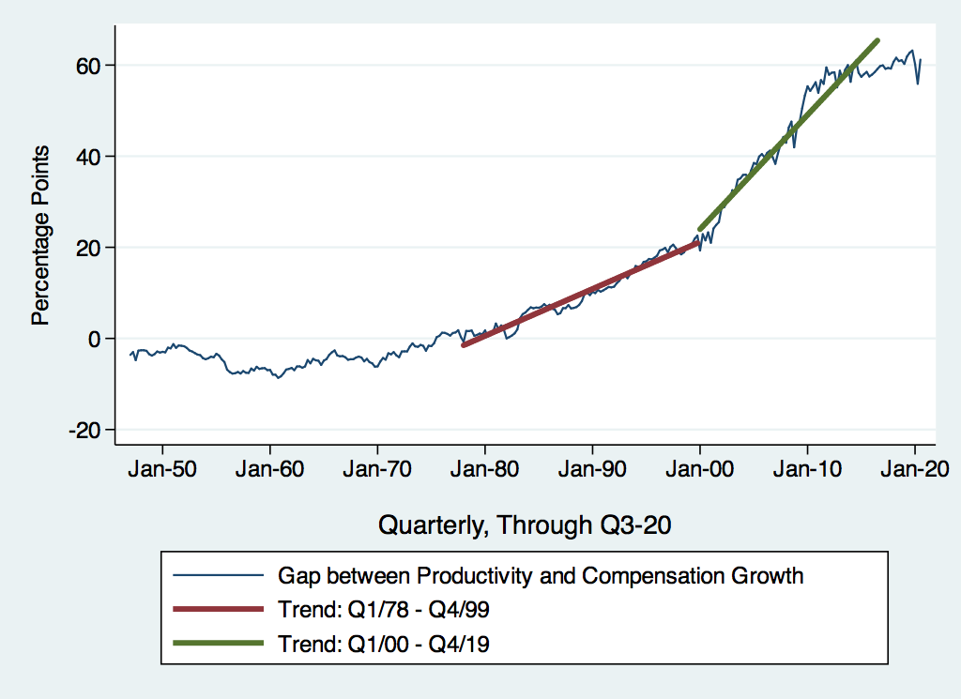
Labor Share Gap Acceleration

Slide 44

Declining Unionization
Unionization Rates
1983: 20.1%
2018: 10.5%
Unionization Rates
Public: 33.9%
Private: 6.4%
Source: https://inequality.org/facts/income-inequality/, Bureau of Labor Statistics and Emmanueul Saez, University of Califonria, Berkeley
Notes:
https://voxeu.org/article/forms-and-sources-inequality-united-states

Slide 45
Competition in the Economy
Return on invested capital excluding goodwill –
US publicly-traded nonfinancial firms, 1965-2014
Source: Jason Furman, ”Forms and sources of inequality in the United States”, VOX, March 17, 2016, Figure 6.
Notes:
Note: The return on invested capital definition is based on Koller et al (2015), and the data presented here are updated and augmented versions of the figures presented in Chapter 6 of that volume. The McKinsey data includes McKinsey analysis of Standard & Poor’s data and exclude financial firms from the analysis because of the practical complexities of computing returns on invested capital for such firms. ​
Source: Koller et al. (2015); McKinsey & Company; Furman and Orszag (2015). , by way of https://voxeu.org/article/forms-and-sources-inequality-united-states
Furman, J and P Orszag (2015), “A Firm-Level Perspective on the Role of Rents in the Rise in Inequality”, Presentation at “A Just Society” Centennial Event in Honor of Joseph Stiglitz Columbia University, October 16, 2015.

Slide 46

CEO Pay Has Been Growing Rapidly

Slide 47

CEO Pay Has Been Growing Rapidly

Slide 48
Immigration and Inequality
Source: Ping Xu, James C. Garand, and Ling Zhu, “How immigration makes income inequality worse in the U.S.”, October, 2015, Figure 1.

Slide 49
Immigration and Inequality- Summary
Beginning in about 1970, the immigrant share of the U.S.
Population increased dramatically.
  5% in 1970 and 14% in 2016
Immigration tends to happen most often among:
  Low-skilled low-wage workers
  High-skilled high-wage workers
Immigration has likely increased income inequality.
Its effect has likely been small.
  ~5% between 1980 and 2000
  No reason to think it has been bigger since

Slide 50
Technological Change and Inequality
Much of the technology adopted in the last 30 years has eliminated low-skill or low-wage jobs.
  Computers, advanced manufacturing equipment, steel mini-mills, automation
There is a “winner take all” aspect of the technology-driven economy.
  This likely favors a small group of individuals.
Both aspects increase inequality by increasing the rewards to:
  Those with significant labor market skills.
  Owners over workers

Slide 51
Technology Benefits Ownership over Labor

Slide 52


Technology can Hurt Low Income Workers
Early on, technology was good to low income workers
Until it was bad for them….

Slide 53
A Modern Example: Uber & Lyft
Technology:
  Facilitates market power for owners.
  Reduces bargaining power for labor.
  Shifts costs of doing business onto labor.
Modern day Robber Barons?
  Ruthlessly absorbing as much income as they can.
  Lack of regard for labor.

Slide 54
Globalization
What is globalization?
  Flow of goods, services, capital, and labor across international borders
How does it affect inequality?
  Through a differential impact on low-skilled workers and hence their wages
  For the United States, globalization is thought to lower the wages of low skilled and hence low-wage workers relative to those of high-skilled workers

Slide 55
Mechanisms for the Effects of Globalization
Merchandise trade
  Importing goods that are made with low-skilled workers and exporting goods that are made with high-skilled workers
    Lowers the wages of unskilled relative to skilled
      making the distribution of income less equal
Outsourcing
  Similar channel as with merchandise trade
Trade in services
  US imports of middle-skill services: business and some professional services
Intuitively: The same as if we were to move the actual workers.

Slide 56
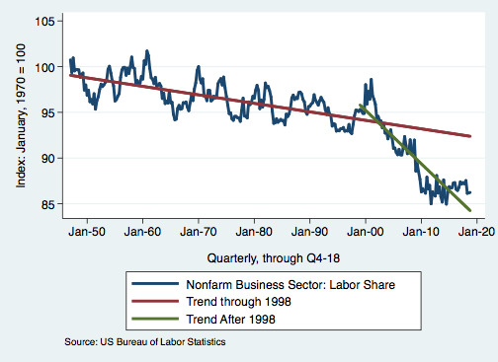
Effects of the Unhinging?
Labor’s Share of Income
1960: 66%
2011: 56%
2016: 58%
Source: Bureau of Labor Statistics

Slide 57

Why Does Inequality Matter?
Too little inequality can:
  Reduce individual motivation
  Slow economic growth
Too much inequality can:
  Reduce individual motivation
  Slow economic growth
Too much inequality may also:
  Divide society
  Distort political environment
  Reduce political participation
  Reduce investments in public goods
    Education
    Environmental protections

Slide 58

Peru
China
Brazil
Germany
U.S.
Canada
https://equitablegrowth.org/research-paper/are-todays-inequalities-limiting-tomorrows-opportunities

Slide 59
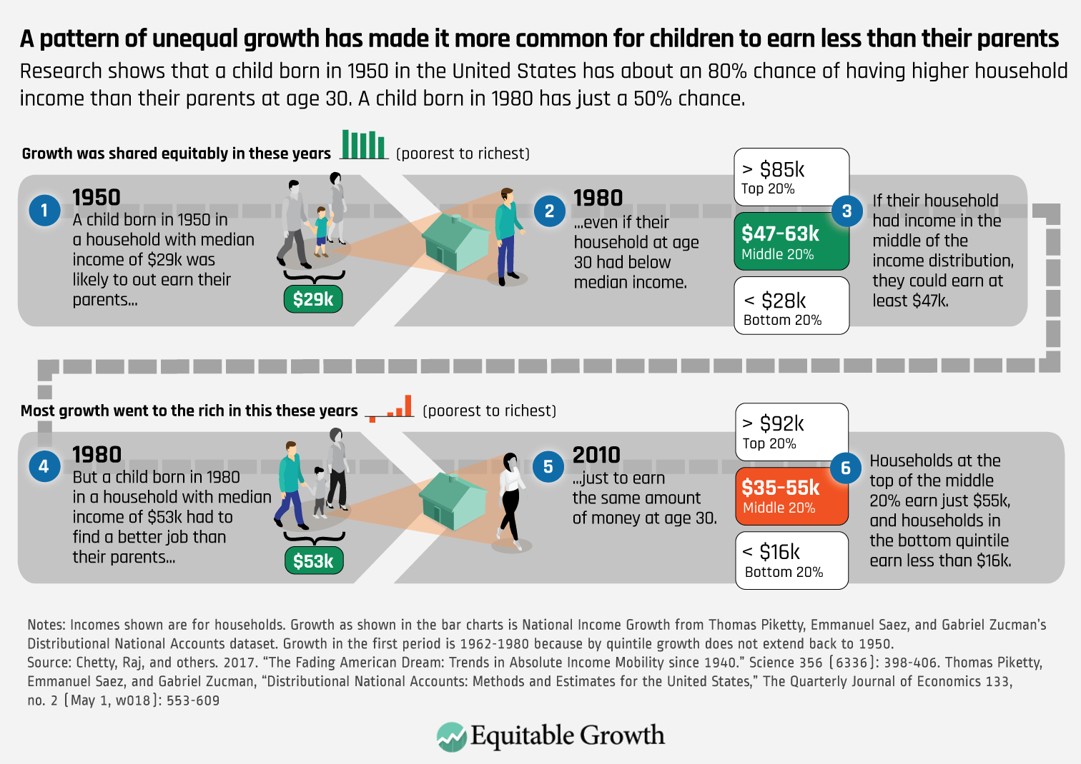
Notes:
https://equitablegrowth.org/rising-income-inequality-exacerbates-downward-economic-mobility/

Slide 60
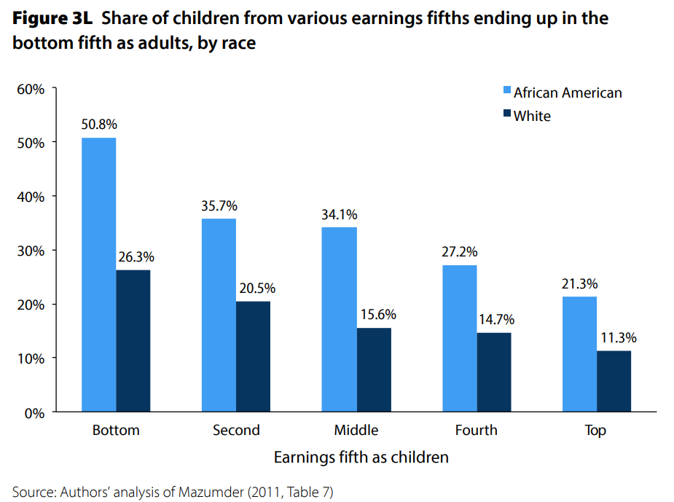
U.S. – Racial Differences
Odds of staying poor, if born poor
Odds of becoming poor, if born rich
Economic Policy Institute, State of Working America, 2012

Slide 61
How Much Inequality Is too Much?
?
?
Equity
Efficiency
Efficiency
Equity
Efficiency
Equity
0
100
Z’’
Z
Z’
X
Gini Coefficient

Slide 62
Addressing Inequality: Is It A Problem?
Why it might be a problem.
  Economic issues (Efficiency)
    There is evidence that at some level, increased inequality slows economic growth.
    Or, inequality concentrates resources among investors.
  Noneconomic issues (Equity)
    Values, ethics and morals will drive individual evaluations of the level of inequality.
      E.g., inequality is primarily a function of market outcomes, so should be left alone.
      Or, a solid middle class is important for maintaining a civil society, which runs contrary to a high degree of inequality.
Suppose you think it’s a problem. How might it be addressed?

Slide 63

Addressing Inequality:
Immediately Available Policy Solutions (1/2)
RE-distribution
  Tax and transfer programs
PRE-distribution
  Strengthen labor unions
  Collective bargaining
  Other policies that favor labor over business owners
  Minimum wages

Slide 64
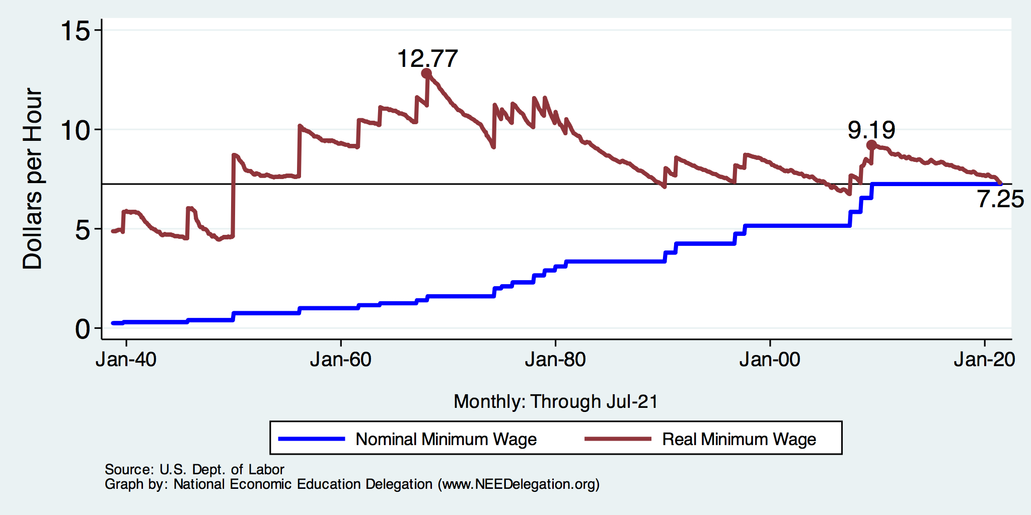
Historical Values of Minimum Wages

Slide 65
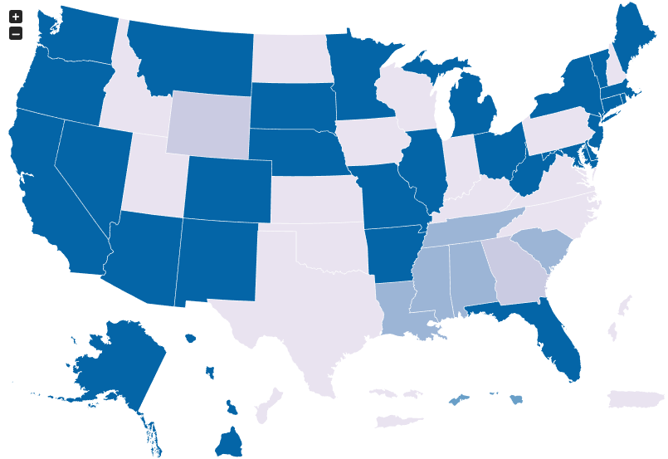
Many States Have A Higher Min Wage
NY: $12.50/hour
CA: $13/hour
States with Higher
Minimum Wage
than Federal
As of Jan 1, 2021
Source: U.S. Department of Labor

Slide 66
Addressing Inequality:
Immediately Available Policy Solutions (2/2)
Other
  Reverse trends in market power
Locally
  Employment services: job training, interview skills, or assistance with day-to-day issues, such as child care
  Cognizance of the potential for technologies to affect worker/employer power dynamics
    Uber, Lyft, etc.
Notes:
Reference your own experience at FTC

Slide 67
Addressing Inequality:
Long Term
It’s all about access to resources:
  Education, in particular
    Improve public education
    Reduce disparities in quality of public education
    Improve counseling in low-income schools
      With respect to college – paths to success and funding
    Investments are needed in early education, not later (e.g. universal pre-k)
  Opportunities for wealth-building
  Housing
Initiatives whose impacts cross neighborhood and class lines and increase upward mobility specifically for black men
  Mentoring programs for black boys, efforts to reduce racial bias among whites, interventions to reduce discrimination in criminal justice, and efforts to facilitate greater interaction across racial groups.

Slide 68

What to do About Inequality?
Nothing?
Redistribution?
PRE-distribution?
Access to resources?

Slide 69
Tension in Policy Solutions
Is it possible to increase growth at the same time that you reduce income inequality?
  Common refrain among some that government intervention in the economy is always and everywhere bad for growth.
Possibly: expanding equality of access promotes the full utilization of resources.
  Expanding equality of access requires resources likely from the well-to-do.

Slide 70
Summary
Income inequality is clearly increasing.
  The economy is clearly favoring owners of productive resources over labor.
The causes appear to be largely driven by:
  The market – technology, competition, and trade
  Changing institutions.
Open questions are:
  To act or not to act?
  If so, how?
The level of inequality is a policy choice.

Slide 71
Thank you!
Any Questions?
www.NEEDelegation.org
Brian Peterson
petersonbj@central.edu
Contact NEED: info@needelegation.org
Submit a testimonial: www.NEEDelegation.org/testimonials.php
Become a Friend of NEED: www.NEEDelegation.org/friend.php

Slide 72
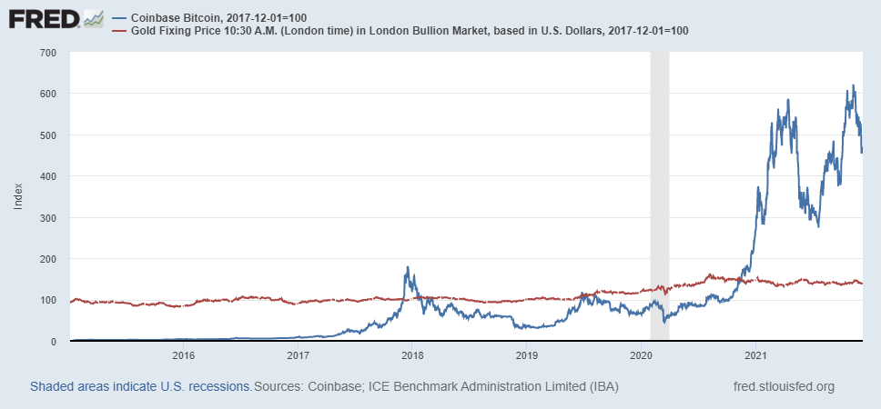
Bitcoins: Geoffrey Woglom
Almost 500% increase in 6 months
Blue Line Price of Bitcoin
Red Line: Price of Gold
On, 12/9, 1PM
1 bitcoin = $48k
Notes:
Bitcoin today was trading at $56,850

