Slide 1


Economic Inequality
Jon D. Haveman, Ph.D.
Executive Director, NEED
April 5, 2022
OLLI – Aquinas College

Slide 2
National Economic Education Delegation
Vision
  One day, the public discussion of policy issues will be grounded in an accurate perception of the underlying economic principles and data.
Mission
  NEED unites the skills and knowledge of a vast network of professional economists to promote understanding of the economics of policy issues in the United States.
NEED Presentations
  Are nonpartisan and are intended to reflect the consensus of the economics profession.

Slide 3
Who Are We?
Honorary Board: 54 members
  2 Fed Chairs: Janet Yellen, Ben Bernanke
  6 Chairs Council of Economic Advisers
    Furman (D), Rosen (R), Bernanke (R), Yellen (D), Tyson (D), Goolsbee (D)
  3 Nobel Prize Winners
    Akerlof, Smith, Maskin
Delegates: 651+ members
  At all levels of academia and some in government service
  All have a Ph.D. in economics
  Crowdsource slide decks
  Give presentations
Global Partners: 49 Ph.D. Economists
  Aid in slide deck development

Slide 4


Where Are We?

Slide 5
Available NEED Topics Include:
Coronavirus Economics
US Economy
Climate Change
Economic Inequality
Economic Mobility
Trade and Globalization
Minimum Wages
Immigration Economics
Housing Policy
Federal Budgets
Federal Debt
Black-White Wealth Gap
Autonomous Vehicles
US Social Policy

Slide 6
Submitting Questions
Please submit questions in the chat.
  I will try to handle them as they come up, but may take them in a bunch as time permits.
We will do a verbal Q&A once the material has been presented.
  And the questions in the chat have been addressed.

Slide 7
Credits and Disclaimer
This slide deck was authored by:
  Jon Haveman, Executive Director of NEED
This slide deck was reviewed by:
  Timothy Smeeding, University of Wisconsin
  Robert Wright, Augustana University
Disclaimer
  NEED presentations are designed to be nonpartisan
  It is, however, inevitable that the presenter will be asked for and will provide their own views
  Such views are those of the presenter and not necessarily those of the National Economic Education Delegation (NEED)

Slide 8
Outline
Definition
Measurement
How does it happen?
Does it matter?
Is it a problem?
What to do about it

Slide 9

Economic Inequality: Income
Definition:
  The extent to which the distribution of income deviates from complete equality
  The dispersion of income/wealth throughout the economy

Slide 10
Different Ways of Thinking About Inequality
Income inequality
  Before taxes and transfers
  After taxes and transfers
Wealth inequality
Racial inequality
How does wealth differ from income?
Income is measured over a period of time, say one year.
Wealth is one’s accumulated savings, including physical and financial assets (net worth).

Slide 11

National Income Inequality: Share of Top 10%
Stock Market Crash
WWII
Housing Bubble
Dot-com Bubble

Slide 12
Recent Facts on Income Inequality
Beginning in the 1970s, the income gap widened.
  Income in the middle and lower parts of the distribution slowed
  Incomes at the top continued to grow strongly
  Income shares at the very top of the distribution rose to levels last seen more than 80 years ago
Source: Chad Stone, Danilo Trisi, Arloc Sherman, and Roderick Taylor, “A Guide to Statistics on Historical Trends in Income Inequality,”
Center on Budget and Policy Priorities, Policy Futures, May 15, 2018.

Slide 13

The Abrupt Increase in Inequality
Source: Chad Stone, Danilo Trisi, Arloc Sherman, and Roderick Taylor, “A Guide to Statistics on Historical Trends in Income Inequality,”
Center on Budget and Policy Priorities, Policy Futures, Dec. 11, 2018.
Notes:
Slide taken from page 10, Chad Stone, Danilo Trisi, Arloc Sherman, and Roderick Taylor, “A Guide to Statistics on Historical Trends in Income Inequality,” May 15, 2018

Slide 14

Most of the Action Is at the Top: Pre-Tax
Projected 2021
CBO: Projected Changes in the Distribution of Household Income, 2016 to 2021

Slide 15
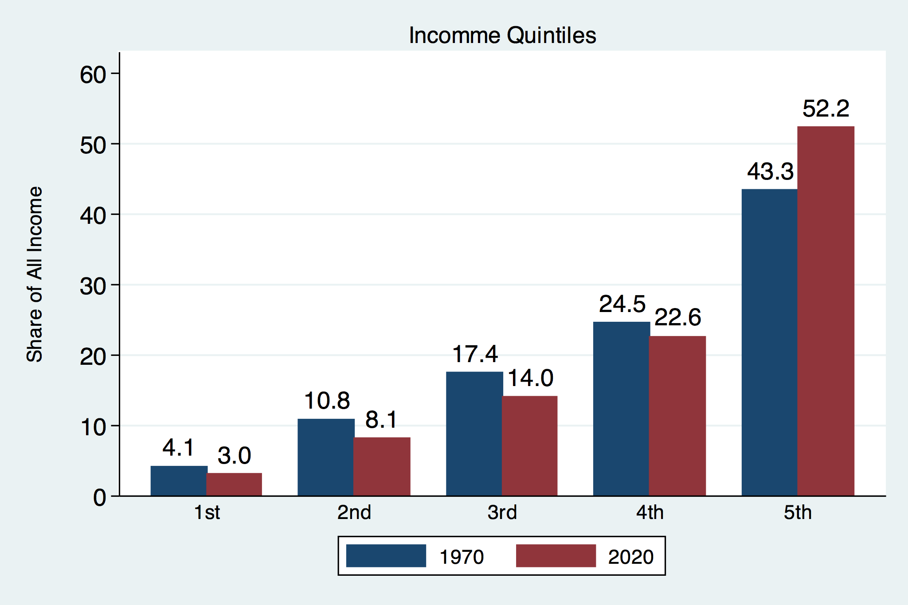
Income Share Changes Between 1970 and 2020
Source: U.S. Census Bureau, Current Population Survey, Annual Social and Economic Supplements.

Slide 16
Income Changes from Growing Inequality
Bottom 90%
of Households

Slide 17
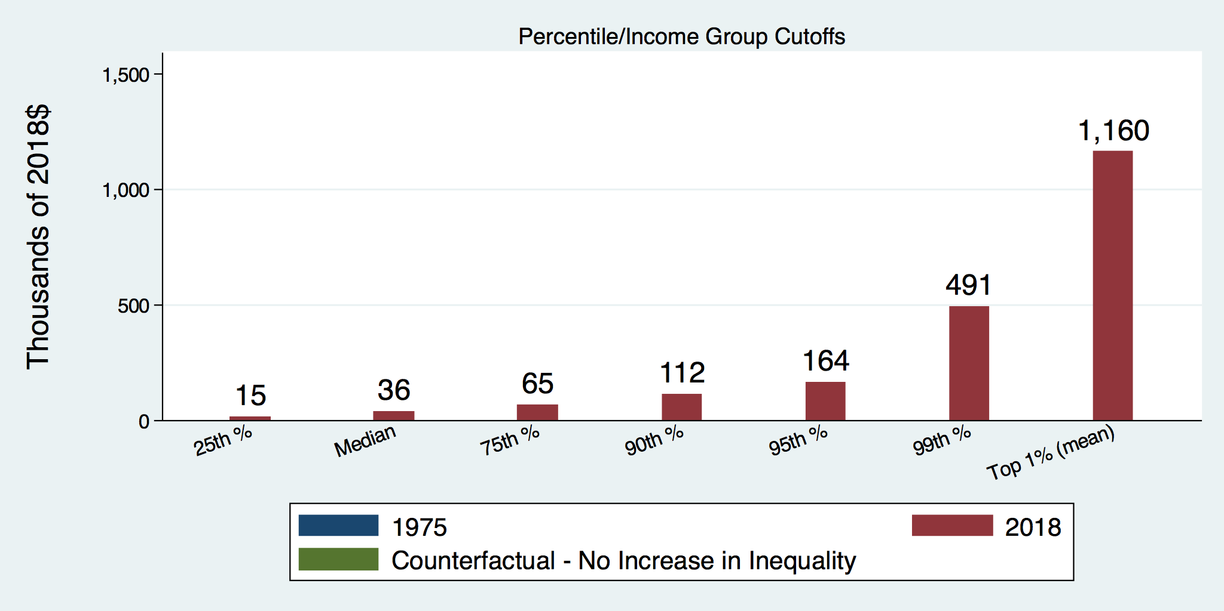
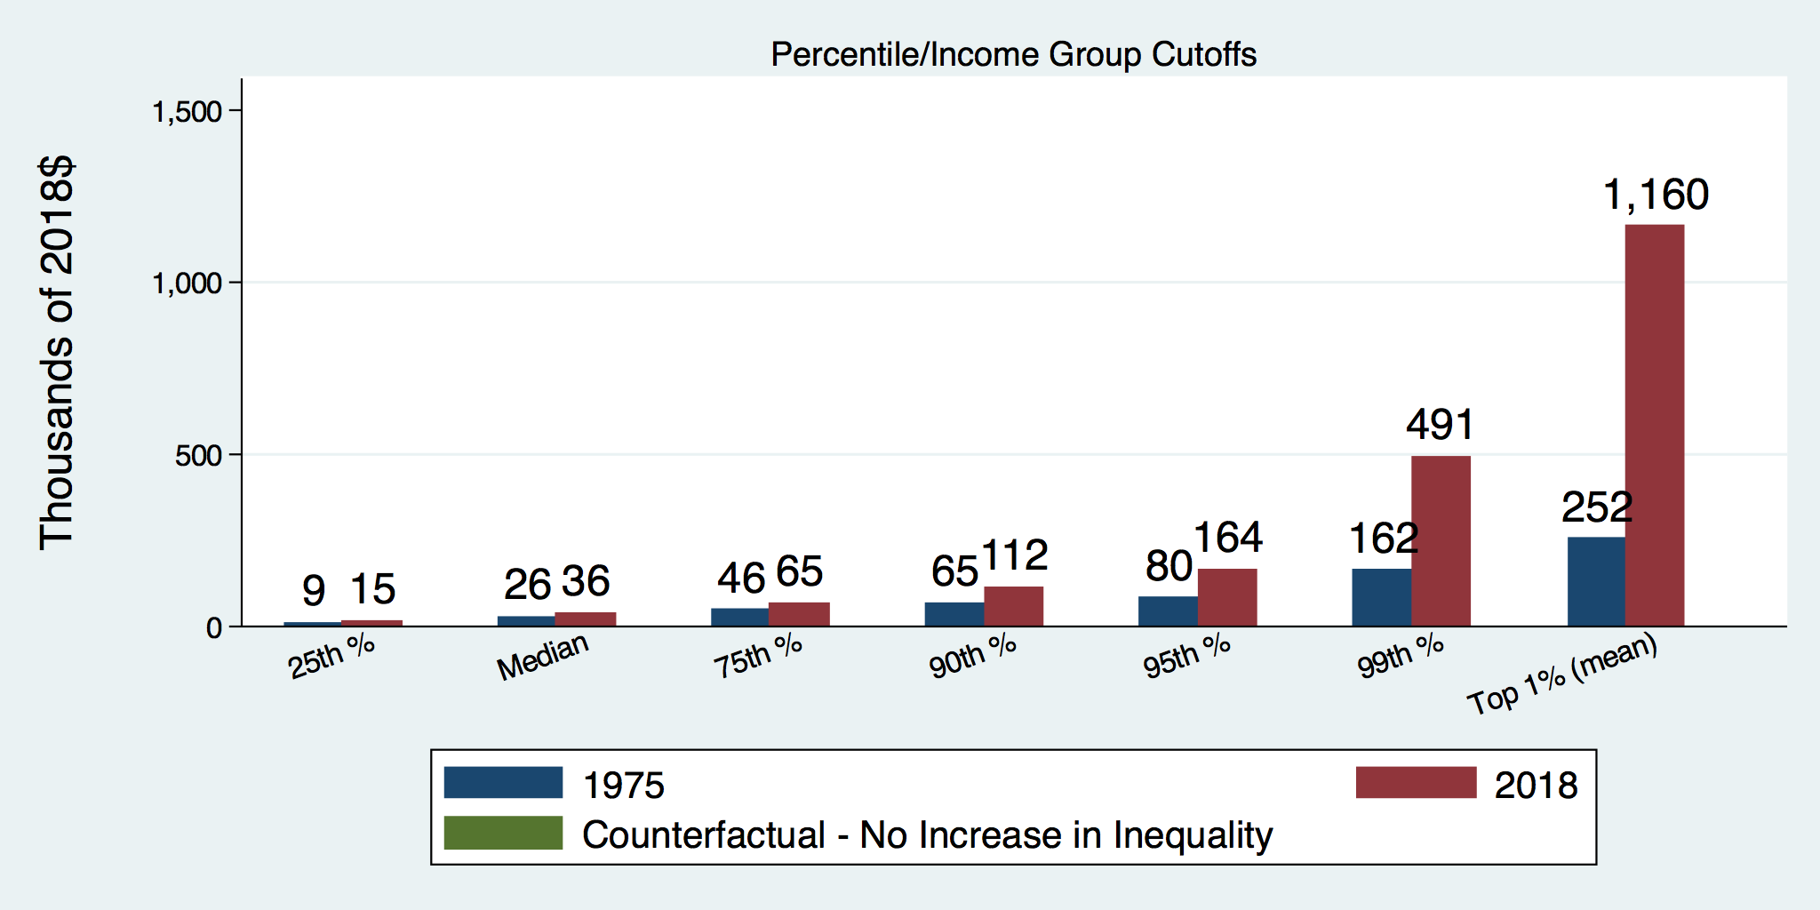
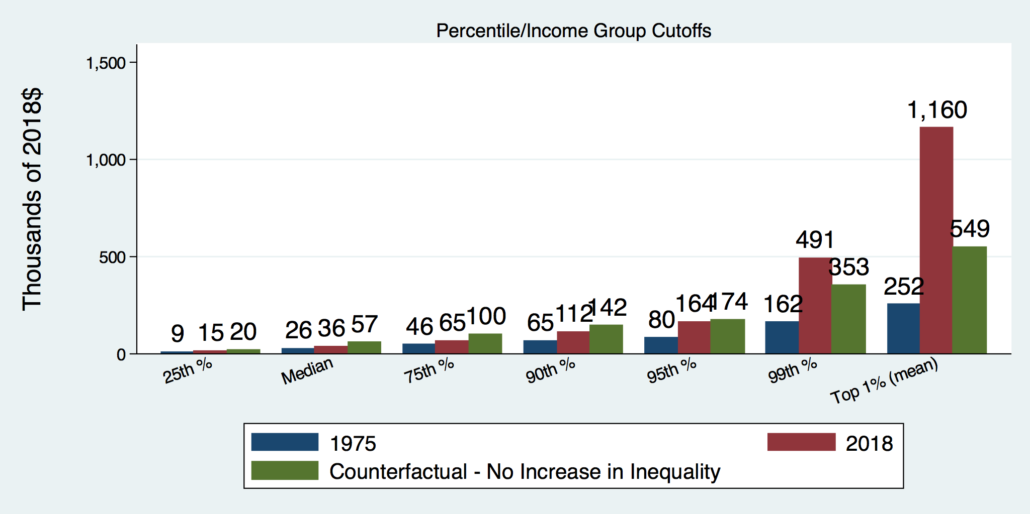
How Has Inequality Influenced Incomes?

Slide 18
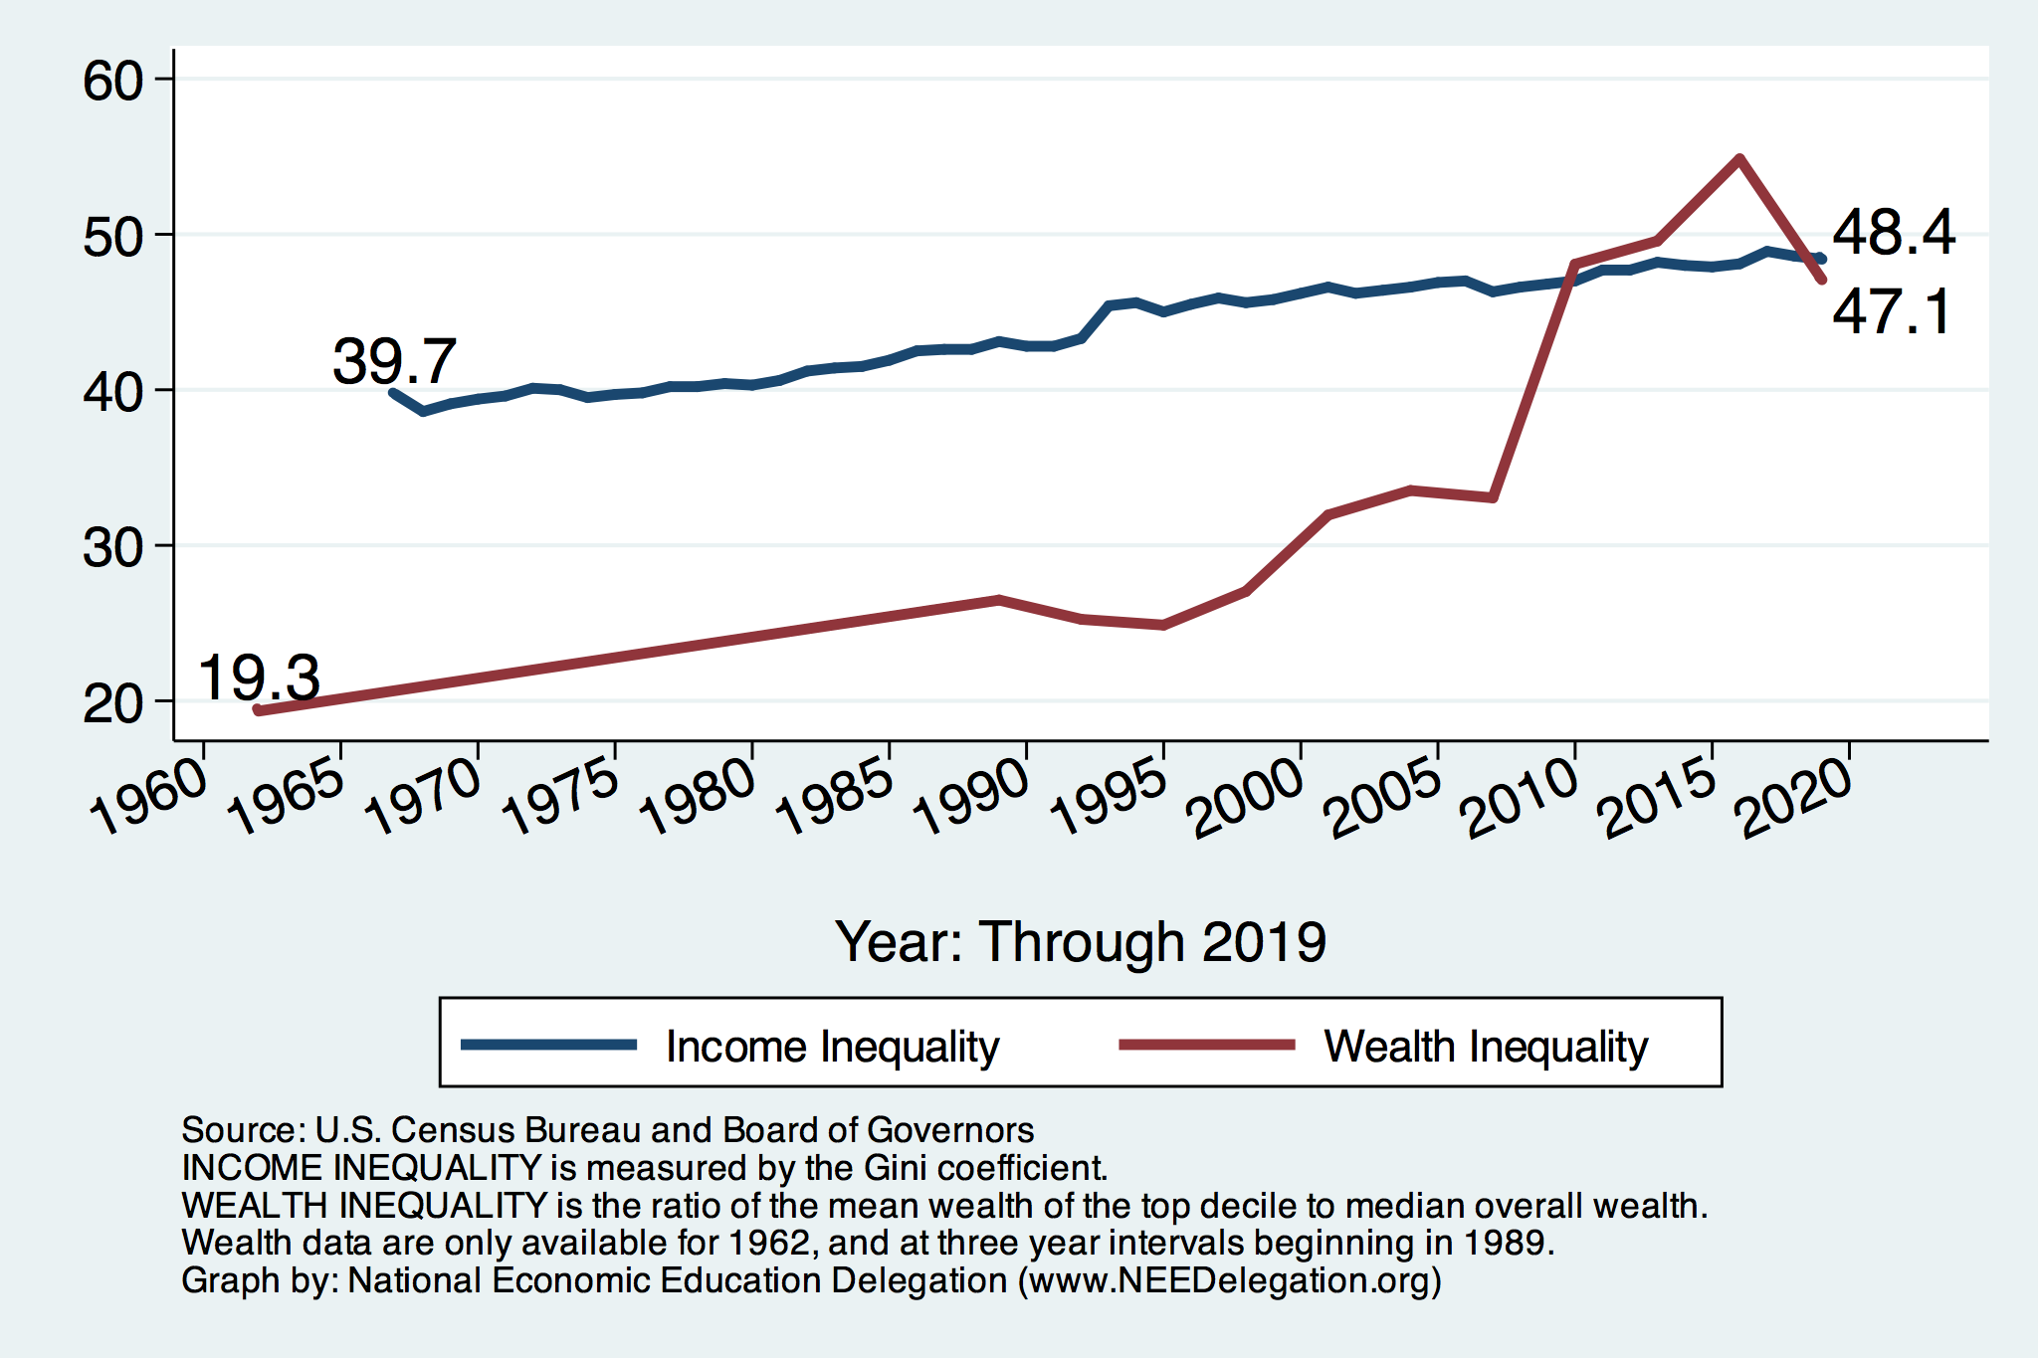
Income and Wealth Inequality
Income Inequality (Gini)
US: 48.4%
MI: 46.5%
Kent County: 45.5%

Slide 19
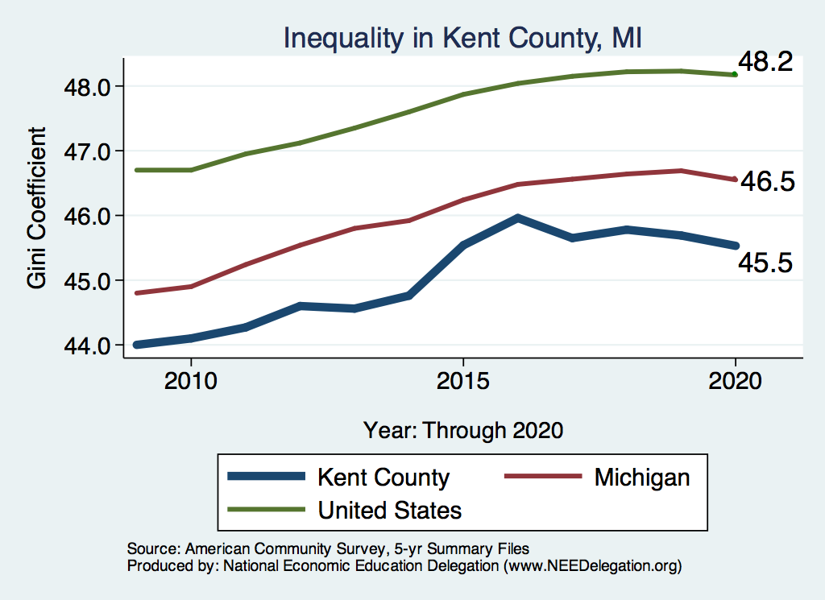
Inequality in Kent County, MI
Source: https://needelegation.org/LocalGraphs

Slide 20
Wealth Inequality Exceeds Income Inequality
Source: Chad Stone, Danilo Trisi, Arloc Sherman, and Roderick Taylor, “A Guide to Statistics on Historical Trends in Income Inequality,”
Center on Budget and Policy Priorities, Policy Futures, Dec. 11, 2018.

Slide 21

Wealth Concentration Has Been Rising
2019 Overall Median: $121,700

Slide 22

Wealth is More and More Concentrated
99th Percentile
2016 = 7x 1963
Source: Urban Institute

Slide 23
Where Does Inequality Come From?
Labor Characteristics
  Demographics
    Age distribution
  Personal Choices
    Educational attainment
    Effort
    Priorities
  Immigration
Market Forces
  Technology
  Changing demand patterns
  Competition for labor
Government Policy
  Market influence
  Redistribution

Slide 24
Government Policy and Inequality
Market Influence: PRE-distribution
  Characteristics of labor
    Access to education
  Effects on labor demand
    Market regulation
      Competition policy
    Labor regulations
      Minimum wage, overtime, health insurance, etc.
RE-distribution
  Tax Rates
  Income support
    Direct aid
    Food stamps

Slide 25
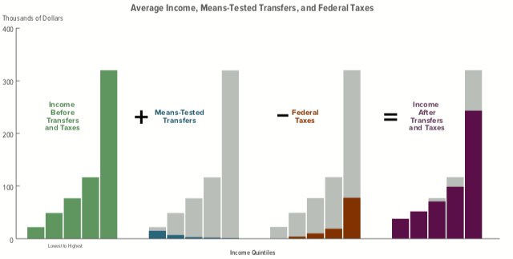
Taxes, Transfers, and Income: 2018
Source: U.S. Congressional Budget Office, “The Distribution of Household Income, 2016”.

Slide 26
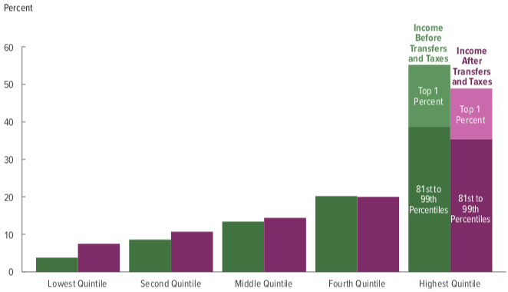
Tax and Transfer Programs: Income Shares
2018
Source: U.S. Congressional Budget Office, “The Distribution of Household Income, 2016”, Average Income Before and After Means-Tested Transfers and
Federal Taxes, by Income Group, 2016.

Slide 27
What About Tax Rates?
400 Taxpayers with highest incomes
1992-2007
+
392%
Tax and inheritance laws (reduced rates on high income groups)
1992-2014
Average
Tax Rate
+310%
Average
Income
-12%
-
37%
Source: IRS
Source: IRS, Statistics of Income Division, December 2016.

Slide 28

Tax Rates Over Time

Slide 29

The Top Tax Rate and Income Cutoff
Massive tax cut for those with
More than $4 million in income.
And for those with more than
About $200,000 in income.

Slide 30

Dramatically Less Progressivity in the Tax Code
1961 to 2011
Source: New York Times, from Thomas Piketty, Emmanuel Saez and Gabriel Zucman, “
Distributional National Accounts: Methods and Estimates for the United States”

Slide 31
Market Forces and Inequality
Changing demand patterns
  Technology
  Globalization
  Industry composition
    PCs instead of typewriters
    Services instead of goods
    Professional services instead of personal services
Competition in labor markets
  Unionization
  Market concentration

Slide 32
Where Does Inequality Come From? Summary
Labor characteristics
  What do workers bring to the market?
Market forces
  How does the market value the labor characteristics?
Government policies
  PRE-distribution – affecting markets
  Redistribution – affecting incomes

Slide 33
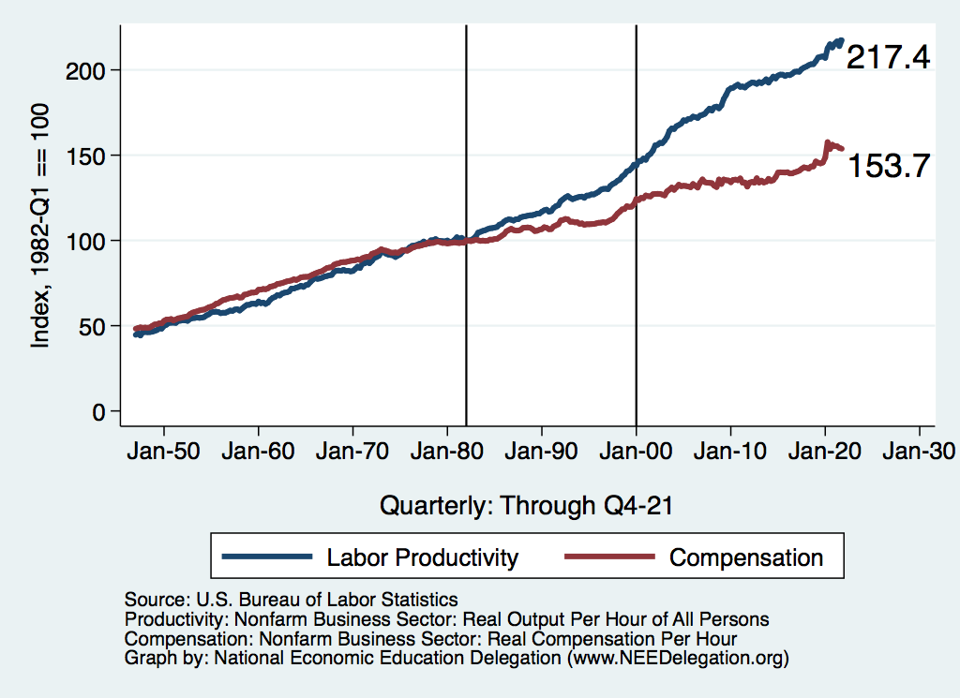
Labor Income is Unhinged from Productivity
Why?
Declining unionization
Globalization
Immigration
Competition policy
Cheap technology

Slide 34

Declining Unionization
Unionization Rates
1983: 20.1%
2021: 10.3%
Unionization Rates
Public: 33.9%
Private: 6.1%
Source: https://inequality.org/facts/income-inequality/, Bureau of Labor Statistics and Emmanueul Saez, University of Califonria, Berkeley
Notes:
https://voxeu.org/article/forms-and-sources-inequality-united-states

Slide 35
Competition in the Economy
Return on invested capital excluding goodwill –
US publicly-traded nonfinancial firms, 1965-2014
Source: Jason Furman, ”Forms and sources of inequality in the United States”, VOX, March 17, 2016, Figure 6.
Notes:
Note: The return on invested capital definition is based on Koller et al (2015), and the data presented here are updated and augmented versions of the figures presented in Chapter 6 of that volume. The McKinsey data includes McKinsey analysis of Standard & Poor’s data and exclude financial firms from the analysis because of the practical complexities of computing returns on invested capital for such firms. ​
Source: Koller et al. (2015); McKinsey & Company; Furman and Orszag (2015). , by way of https://voxeu.org/article/forms-and-sources-inequality-united-states
Furman, J and P Orszag (2015), “A Firm-Level Perspective on the Role of Rents in the Rise in Inequality”, Presentation at “A Just Society” Centennial Event in Honor of Joseph Stiglitz Columbia University, October 16, 2015.

Slide 36

Growing Revenue Concentration
Source: The Hamilton Project, Brookings: The State of Competition and dynamism.

Slide 37

CEO Pay Has Been Growing Rapidly

Slide 38

CEO Pay Has Been Growing Rapidly

Slide 39
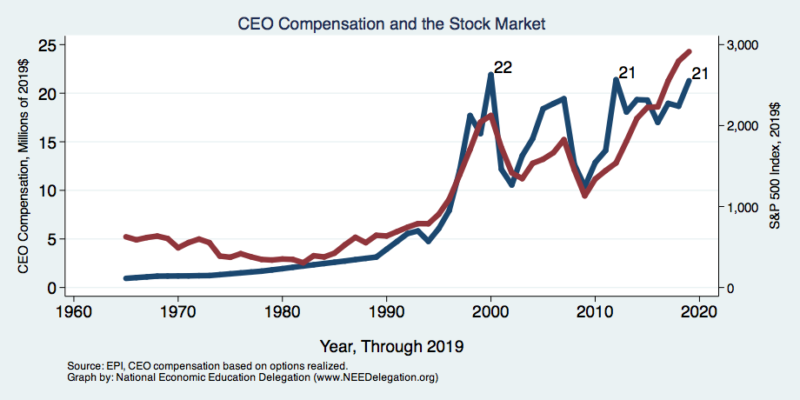
CEO Compensation – Tied to Stock Prices

Slide 40
Immigration and Inequality
Source: Ping Xu, James C. Garand, and Ling Zhu, “How immigration makes income inequality worse in the U.S.”, October, 2015, Figure 1.

Slide 41
Technological Change and Inequality
Much of the technology adopted in the last 30 years has eliminated low-skill or low-wage jobs.
  Computers, advanced manufacturing equipment, steel mini-mills, automation
There is a “winner take all” aspect of the technology-driven economy.
  This likely favors a small group of individuals.
Both aspects increase inequality by increasing the rewards to:
  Those with significant labor market skills.
  Owners over workers

Slide 42
Technology Benefits Ownership over Labor

Slide 43


Technology can Hurt Low Income Workers
Early on, technology was good to low income workers
Until it was bad for them….

Slide 44
A Modern Example: Uber & Lyft
Technology:
  Facilitates market power for owners.
  Reduces bargaining power for labor.
  Shifts costs of doing business onto labor.
Modern day Robber Barons?
  Ruthlessly absorbing as much income as they can.
  Lack of regard for labor.

Slide 45
Globalization
What is globalization?
  Flow of goods, services, capital, and labor across international borders
How does it affect inequality?
  Through a differential impact on low-skilled workers and hence their wages
  For the United States, globalization is thought to lower the wages of low skilled and hence low-wage workers relative to those of high-skilled workers

Slide 46
Mechanisms for the Effects of Globalization
Merchandise trade
  Importing goods that are made with low-skilled workers and exporting goods that are made with high-skilled workers
    Lowers the wages of unskilled relative to skilled
      making the distribution of income less equal
Outsourcing
  Similar channel as with merchandise trade
Trade in services
  US imports of middle-skill services: business and some professional services
Intuitively: The same as if we were to move the actual workers.

Slide 47
What is driving increasing inequality?
Primary drivers:
  Technology
  Globalization
  Institutions
These drivers can also influence personal choices in ways that affect measured income inequality.
  For example, educational choices or labor force participation

Slide 48
Sources of Inequality Through Late 1990s

Slide 49

Why Does Inequality Matter?
Too little inequality can:
  Reduce individual motivation
  Slow economic growth
Too much inequality can:
  Reduce individual motivation
  Slow economic growth
Too much inequality may also:
  Divide society
  Distort political environment
  Reduce political participation
  Reduce investments in public goods
    Education
    Environmental protections

Slide 50
How Much Inequality Is too Much?
?
?
Equity
Efficiency
Efficiency
Equity
Efficiency
Equity
0
100
Z’’
Z
Z’
X
Gini Coefficient

Slide 51

Peru
China
Brazil
Germany
U.S.
Canada
https://equitablegrowth.org/research-paper/are-todays-inequalities-limiting-tomorrows-opportunities

Slide 52
An International Perspective: Comparables
U.S.: 17-18
Canada, UK, Germany: 12-13
Italy, France, Japan: 7-9

Slide 53
Addressing Inequality: Is It A Problem?
Why it might be a problem.
  Economic issues (Efficiency)
    There is evidence that at some level, increased inequality slows economic growth.
    Or, inequality concentrates resources among investors.
  Noneconomic issues (Equity)
    Values, ethics and morals will drive individual evaluations of the level of inequality.
      E.g., inequality is primarily a function of market outcomes, so should be left alone.
      Or, a solid middle class is important for maintaining a civil society, which runs contrary to a high degree of inequality.
Suppose you think it’s a problem. How might it be addressed?

Slide 54

Addressing Inequality:
Immediately Available Policy Solutions (1/2)
RE-distribution
  Tax and transfer programs
PRE-distribution
  Strengthen labor unions
  Collective bargaining
  Other policies that favor labor over business owners
  Minimum wages

Slide 55
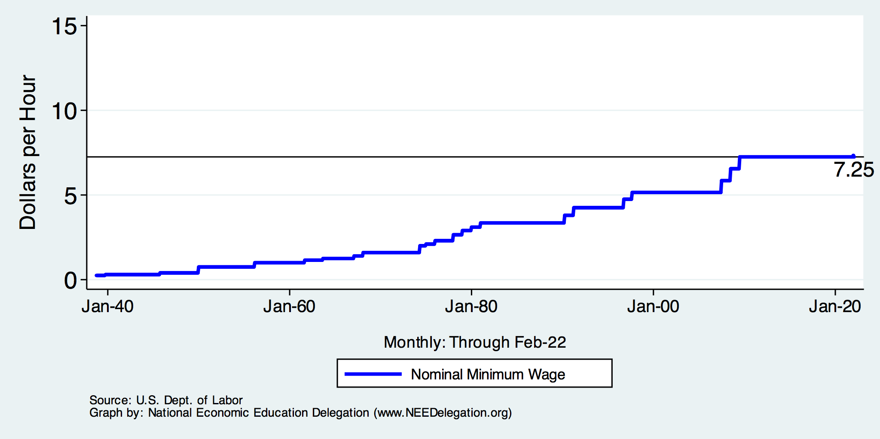
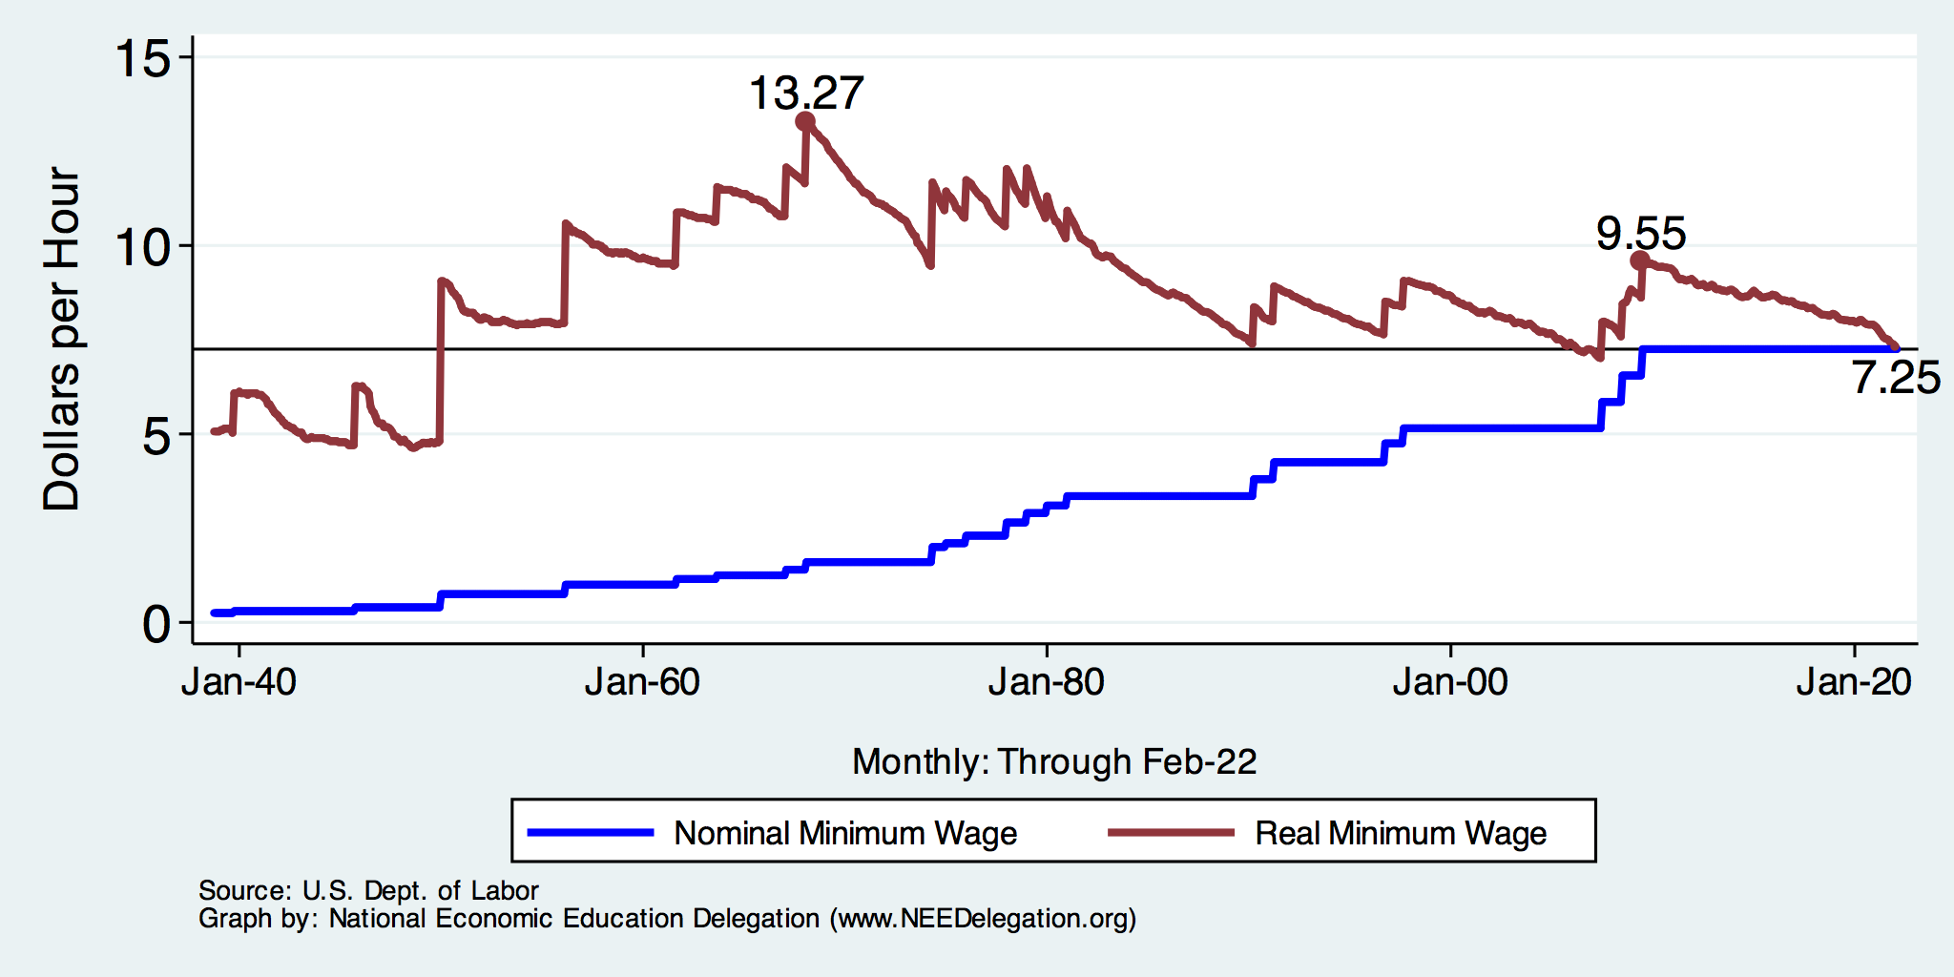
History of the Federal Minimum Wage

Slide 56
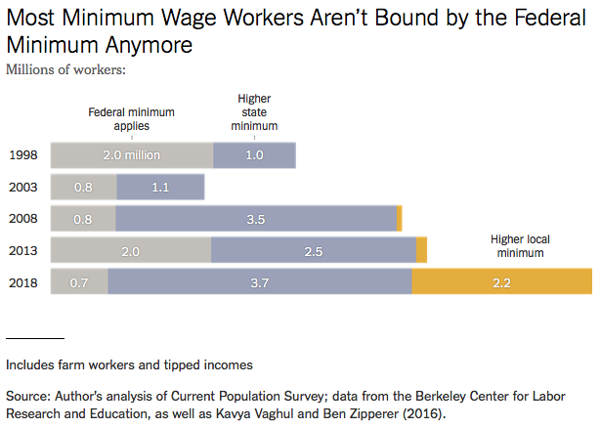
Notes:
https://www.nytimes.com/2019/04/24/upshot/why-america-may-already-have-its-highest-minimum-wage.html?action=click&module=RelatedLinks&pgtype=Article

Slide 57
Addressing Inequality:
Immediately Available Policy Solutions (2/2)
Other
  Reverse trends in market power
Locally
  Employment services: job training, interview skills, or assistance with day-to-day issues, such as child care
  Cognizance of the potential for technologies to affect worker/employer power dynamics
    Uber, Lyft, etc.
Notes:
Reference your own experience at FTC

Slide 58
Addressing Inequality:
Long Term
It’s all about access to resources:
  Education, in particular
    Improve public education
    Reduce disparities in quality of public education
    Improve counseling in low-income schools
      With respect to college – paths to success and funding
    Investments are needed in early education, not later (e.g. universal pre-k)
  Opportunities for wealth-building
  Housing
Initiatives whose impacts cross neighborhood and class lines can increase upward mobility

Slide 59

What to do About Inequality?
Nothing?
Redistribution?
PRE-distribution?
Access to resources?

Slide 60
Tension in Policy Solutions
Is it possible to increase growth at the same time that you reduce income inequality?
  Common refrain among some that government intervention in the economy is always and everywhere bad for growth.
Possibly: expanding equality of access promotes the full utilization of resources.
  Expanding equality of access requires resources likely from the well-to-do.

Slide 61
Summary
Income inequality is clearly increasing.
  The economy is clearly favoring owners of productive resources over labor.
The causes appear to be largely driven by:
  The market – technology, competition, and trade
  Changing institutions.
Open questions are:
  To act or not to act?
  If so, how?
The level of inequality is a policy choice.

Slide 62
Thank you!
Any Questions?
www.NEEDelegation.org
Jon D. Haveman
Jon@NEEDelegation.org
Contact NEED: info@NEEDelegation.org
Submit a testimonial: www.NEEDelegation.org/testimonials.php
Become a Friend of NEED: www.NEEDelegation.org/friend.php

