Slide 1
Osher Lifelong Learning Institute, Winter 2022
Contemporary Economic Policy
University of Alaska, Anchorage
February-March, 2022
National Economic Education Delegation

Slide 2
Economic Inequality
Cliff Nowell, Ph.D.
Professor,
Shanghai Normal University
and
Professor Emeritus
Weber State University
University of Alaska, Anchorage
February, 24 2022

Slide 3
National Economic Education Delegation
Vision
One day, the public discussion of policy issues will be grounded in an accurate perception of the underlying economic principles and data.
Mission
NEED unites the skills and knowledge of a vast network of professional economists to promote understanding of the economics of policy issues in the United States.
NEED Presentations
Are nonpartisan and intended to reflect the consensus of the economics profession.

Slide 4
Available NEED Topics Include:
Coronavirus Economics
US Economy
Climate Change
Economic Inequality
Economic Mobility
Trade and Globalization
Minimum Wages
Immigration Economics
Housing Policy
Federal Budgets
Federal Debt
Black-White Wealth Gap
Autonomous Vehicles
US Social Policy

Slide 5
Submitting Questions
Please submit questions in the chat.
I will try to handle them as they come up, but may take them in a bunch as time permits.
We will do a verbal Q&A once the material has been presented.
And the questions in the chat have been addressed.
OLLI allowing, we can stay beyond the end of class to have further discussion.

Slide 6
Outline
Definition
Measurement
How does it happen?
Does it matter?
Is it a problem?
What to do about it

Slide 7
Economic Inequality: Income
Definition:
The extent to which the distribution of income deviates from complete equality
The dispersion of income throughout the economy

Slide 8
Different Ways of Thinking About Inequality
Income Inequality
Before taxes and transfers
After taxes and transfers
Wealth Inequality
Consumption Inequality

Slide 9
National Income Inequality: Share of Top 10%
Stock Market Crash
WWII
Housing Bubble
Dot-com Bubble

Slide 10
Recent Facts on Income Inequality
Beginning in the 1970s, the income gap widened.
Income in the middle and lower parts of the distribution slowed
Incomes at the top continued to grow strongly
Income shares at the very top of the distribution rose to levels last seen more than 80 years ago
Source: Chad Stone, Danilo Trisi, Arloc Sherman, and Roderick Taylor, “A Guide to Statistics on Historical Trends in Income Inequality,”
Center on Budget and Policy Priorities, Policy Futures, May 15, 2018.

Slide 11
The Abrupt Increase in Inequality
Source: Chad Stone, Danilo Trisi, Arloc Sherman, and Roderick Taylor, “A Guide to Statistics on Historical Trends in Income Inequality,”
Center on Budget and Policy Priorities, Policy Futures, Dec. 11, 2018.
Notes:
Slide taken from page 10, Chad Stone, Danilo Trisi, Arloc Sherman, and Roderick Taylor, “A Guide to Statistics on Historical Trends in Income Inequality,” May 15, 2018

Slide 12
Most of the Action Is at the Top: Pre-Tax
Projected 2021
CBO: Projected Changes in the Distribution of Household Income, 2016 to 2021

Slide 13
Most of the Action Is at the Top: Post-Tax
Projected
CBO: Projected Changes in the Distribution of Household Income, 2016 to 2021

Slide 14
The Gini Coefficient
100%
A
Gini =
x 100
A + B
% of
All Income
50%
Equality (45 degrees)
A
Bigger A: More inequality
Smaller A: Less inequality
Inequality
B
Extreme
50%
100%
% of Population

Slide 15
Income Share Changes Between 1970 and 2017
1970
2017
Share of All Income
% of Population
Income Quintiles
Source: U.S. Census Bureau, Current Population Survey, Annual Social and Economic Supplements.

Slide 16
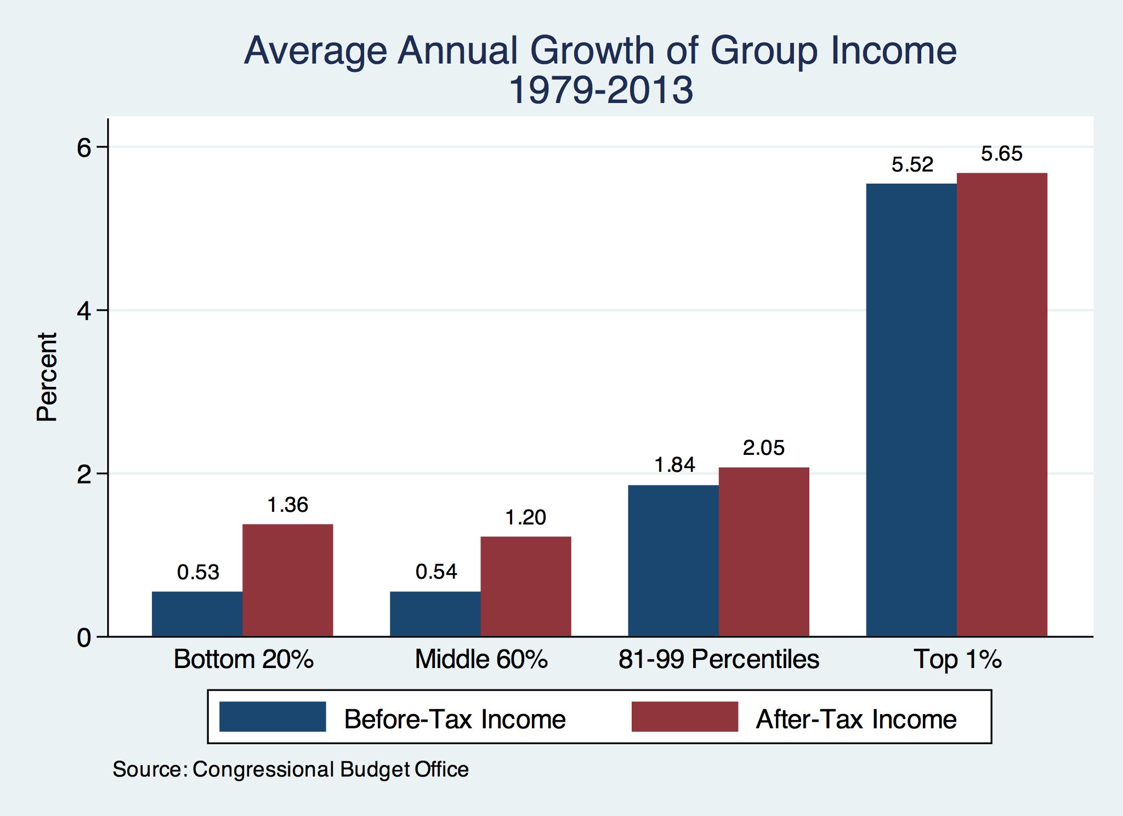
Growth Has Been Primarily at the Very Top

Slide 17
Wealth Inequality Exceeds Income Inequality
Source: Chad Stone, Danilo Trisi, Arloc Sherman, and Roderick Taylor, “A Guide to Statistics on Historical Trends in Income Inequality,”
Center on Budget and Policy Priorities, Policy Futures, Dec. 11, 2018.

Slide 18
A Third Measure of Inequality: Consumption

Slide 19
Consumption Inequality
Consumption is another important metric for judging inequality
Arguably a better indicator of “well-being”
Extremely difficult to measure
Growing evidence that consumption inequality has also increased

Slide 20
Government Policy and Inequality
Market Influence: PRE-distribution
Characteristics of labor
Access to education
Effects on labor demand
Market regulation
Competition policy
Labor regulations
Minimum wage, overtime, health insurance, etc.
RE-distribution
Tax Rates
Income support
Direct aid
Food stamps

Slide 21
Tax Rates Over Time

Slide 22
Dramatically Less Progressivity in the Tax Code
1961 to 2011
Source: New York Times, from Thomas Piketty, Emmanuel Saez and Gabriel Zucman, “
Distributional National Accounts: Methods and Estimates for the United States”

Slide 23
Market Forces and Inequality
Changing demand patterns
Technology
Globalization
Industry composition
PCs instead of typewriters
Services instead of goods
Professional services instead of personal services
Competition in labor markets
Unionization
Market concentration

Slide 24
Technological Change and Inequality
Much of the technology adopted in the last 30 years has eliminated low-skill or low-wage jobs.
Computers, advanced manufacturing equipment, steel mini-mills, automation
There is a “winner take all” aspect of the technology-driven economy.
This likely favors a small group of individuals.
Both aspects increase inequality by increasing the rewards to:
Those with significant labor market skills.
Owners over workers

Slide 25
Globalization
What is globalization?
Flow of goods, services, capital, and labor across international borders
How does it affect inequality?
Through a differential impact on low-skilled workers and hence their wages
For the United States, globalization is thought to lower the wages of low skilled and hence low-wage workers relative to those of high-skilled workers

Slide 26
Sources of Inequality Through Late 1990s

Slide 27
Why Does Inequality Matter?
Too little inequality can:
Reduce individual motivation
Slow economic growth
Too much inequality can:
Reduce individual motivation
Slow economic growth
Too much inequality may also:
Divide society
Distort political environment
Reduce political participation
Reduce investments in public goods
Education
Environmental protections

Slide 28
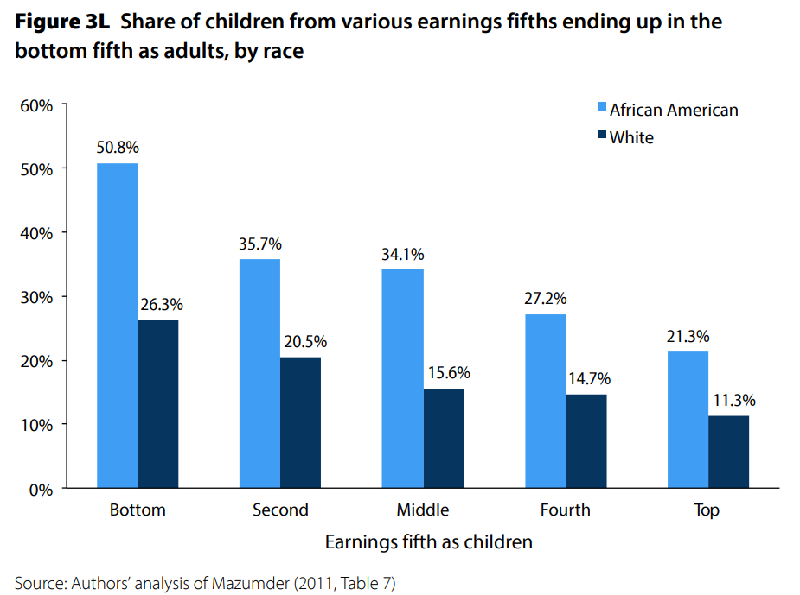
U.S. – Racial Differences
Odds of staying poor, if born poor
Odds of becoming poor, if born rich
Economic Policy Institute, State of Working America, 2012

Slide 29
An International Perspective: Comparables
U.S.: 17-18
Canada, UK, Germany: 12-13
Italy, France, Japan: 7-9

Slide 30
Addressing Inequality: Immediately Available Policy Solutions (1/2)
RE-distribution
Tax and transfer programs
PRE-distribution
Strengthen labor unions
Collective bargaining
Other policies that favor labor over business owners
Minimum wages

Slide 31
Addressing Inequality: Immediately Available Policy Solutions (2/2)
Other
Reverse trends in market power
Locally
Employment services: job training, interview skills, or assistance with day-to-day issues, such as child care
Cognizance of the potential for technologies to affect worker/employer power dynamics
Uber, Lyft, etc.
Notes:
Reference your own experience at FTC

Slide 32
Thank you!
Any Questions?
www.NEEDelegation.org
Cliff Nowell>
cnowell@weber.edu
Contact NEED: info@needelegation.org
Submit a testimonial: www.NEEDelegation.org/testimonials.php
Become a Friend of NEED: www.NEEDelegation.org/friend.php

Slide 33
Cryptocurrencies: Geoffrey Woglom
Almost 500% increase in 6 months
Blue Line Price of Bitcoin
Red Line: Price of Gold
On, 12/9, 1PM 1 bitcoin = $48k
Notes:
Bitcoin today was trading at $56,850

