Slide 1


Economic Inequality
Adina Ardelean, Ph.D.
Lecturer, Santa Clara University
OLLI, Santa Clara University
May 17, 2021

Slide 2
National Economic Education Delegation
Vision
  One day, the public discussion of policy issues will be grounded in an accurate perception of the underlying economic principles and data.
Mission
  NEED unites the skills and knowledge of a vast network of professional economists to promote understanding of the economics of policy issues in the United States.
NEED Presentations
  Are nonpartisan and intended to reflect the consensus of the economics profession.

Slide 3
Who Are We?
Honorary Board: 53 members
  2 Fed Chairs: Janet Yellen, Ben Bernanke
  6 Chairs Council of Economic Advisers
    Furman (D), Rosen (R), Bernanke (R), Yellen (D), Tyson (D), Goolsbee (D)
  3 Nobel Prize Winners
    Akerlof, Smith, Maskin
Delegates: 585+ members
  At all levels of academia and some in government service
  All have a Ph.D. in economics
  Crowdsource slide decks
  Give presentations
Global Partners: 44 Ph.D. Economists
  Aid in slide deck development

Slide 4
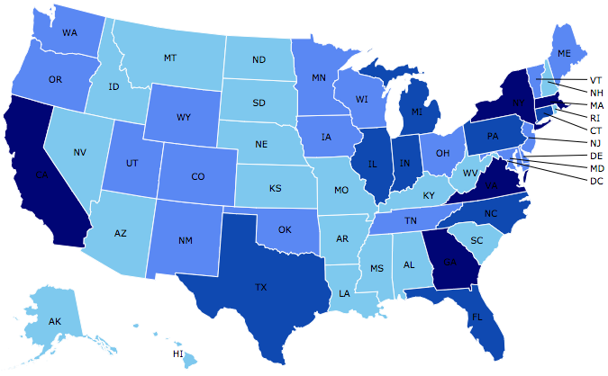
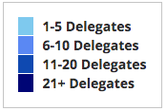
Where Are We?

Slide 5
Credits and Disclaimer
This slide deck was authored by:
  Jon Haveman, Executive Director of NEED
This slide deck was reviewed by:
  Timothy Smeeding, University of Wisconsin
  Robert Wright, Augustana University
Disclaimer
  NEED presentations are designed to be nonpartisan
  It is, however, inevitable that the presenter will be asked for and will provide their own views
  Such views are those of the presenter and not necessarily those of the National Economic Education Delegation (NEED)

Slide 6
Outline
Definition
Measurement
How does it happen?
Does it matter?
Is it a problem?
What to do about it

Slide 7
Previous Lectures …
Income inequality is clearly increasing in the U.S. and in other advanced countries.
Wealth inequality is higher than income inequality in advanced countries
The causes of growing Income Inequality appear to be largely driven by:
  The market – technology, competition, and trade
  Changing institutions.

Slide 8
What you’ll hear today
Does inequality matter?
How much inequality is too much?
Addressing inequality:
  Redistribution: Tax and transfer programs
  Pre-distribution programs

Slide 9

Why Does Inequality Matter?
Too little inequality can:
  Reduce individual motivation
  Slow economic growth
Too much inequality can:
  Reduce individual motivation
  Slow economic growth
Too much inequality may also:
  Divide society
  Distort political environment
  Reduce political participation
  Reduce investments in public goods
    Education
    Environmental protections

Slide 10

Peru
China
Brazil
Germany
U.S.
Canada
https://equitablegrowth.org/research-paper/are-todays-inequalities-limiting-tomorrows-opportunities

Slide 11
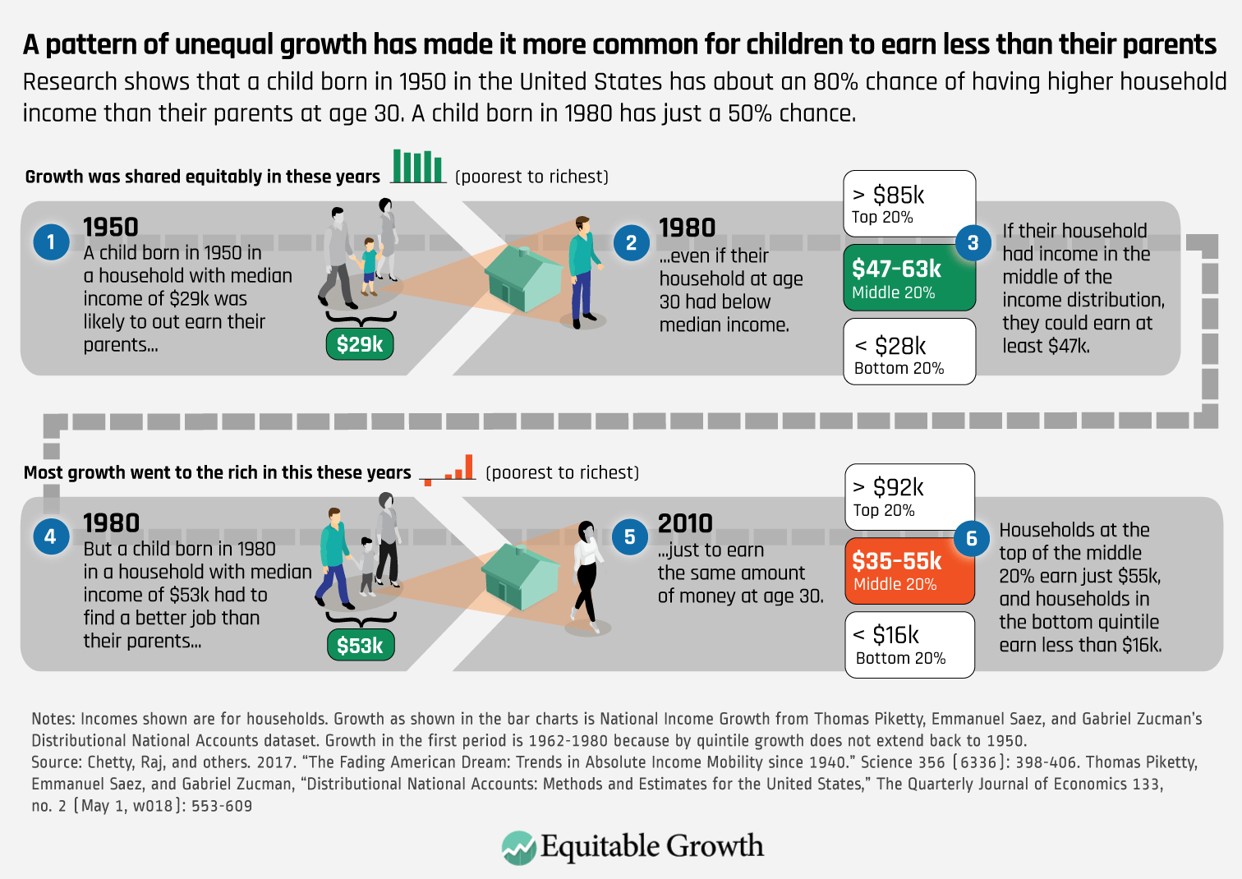
Notes:
https://equitablegrowth.org/rising-income-inequality-exacerbates-downward-economic-mobility/

Slide 12
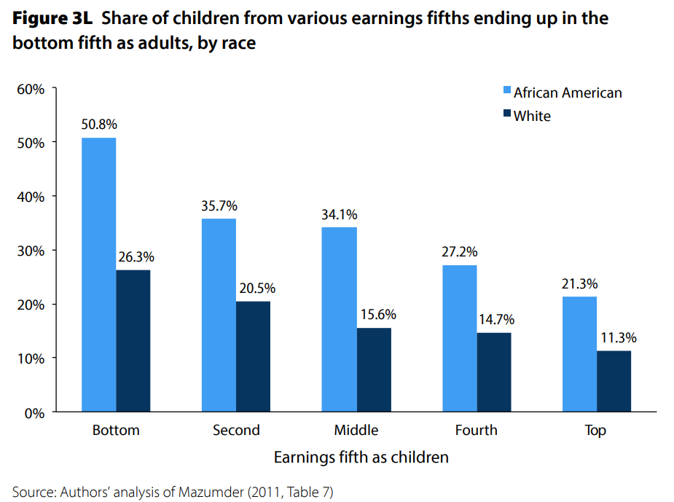
U.S. – Racial Differences
Odds of staying poor, if born poor
Odds of becoming poor, if born rich
Economic Policy Institute, State of Working America, 2012

Slide 13
Government Policy and Racial Inequality
Product of a long historical process of discrimination with at least two reinforcing sets of policies.
  Policies that govern the spatial distribution of the black population.
    Restrictive covenants, redlining, and general housing and lending discrimination
  Policies that have a disparate impact on black individuals because of their locations.
    The original version of Michigan Senate Bill 897 exempted individuals from this work requirement conditional on residing in a county with an unemployment rate above 8.5 percent. The higher unemployment rates in rural counties would disproportionately exempt white Medicaid recipients from the work requirement within the bill.

Slide 14
What you’ll hear today
Does inequality matter?
How much inequality is too much?
Addressing inequality:
  Redistribution: Tax and transfer programs
  Pre-distribution programs

Slide 15
How Much Inequality Is too Much?
?
?
Equity
Efficiency
Efficiency
Equity
Efficiency
Equity
0
100
Z’’
Z
Z’
X
Gini Coefficient

Slide 16
An International Perspective: Trends
U.S.: 17-18
Canada, UK, Germany: 12-13
Italy, France, Japan: 7-9

Slide 17
An International Perspective: Gini
Gini Coefficient, OECD countries, 2019 or latest year available
Source: OECD https://data.oecd.org/inequality/income-inequality.htm#indicator-chart

Slide 18
An International Perspective: Poverty rate
Poverty Rate by age group, OECD countries, 2019 or latest year available
Source: OECD https://data.oecd.org/inequality/poverty-gap.htm#indicator-chart

Slide 19
But the High-Income Households Save More
Facilitates the Consumption of:
Wealth
Which facilitates the consumption of:
Leisure

Slide 20
What you’ll hear today
Does inequality matter?
How much inequality is too much?
Addressing inequality:
  Redistribution: Tax and transfer programs
  Pre-distribution programs

Slide 21
Addressing Inequality: Is It A Problem?
Why it might be a problem.
  Economic issues (Efficiency)
    There is evidence that at some level, increased inequality slows economic growth.
    Or, inequality concentrates resources among investors.
  Noneconomic issues (Equity)
    Values, ethics and morals will drive individual evaluations of the level of inequality.
      E.g., inequality is primarily a function of market outcomes, so should be left alone.
      Or, a solid middle class is important for maintaining a civil society, which runs contrary to a high degree of inequality.
Suppose you think it’s a problem. How might it be addressed?

Slide 22

Addressing Inequality:
Immediately Available Policy Solutions (1/2)
RE-distribution
  Tax and transfer programs
PRE-distribution
  Access to healthcare and education
  Strengthen labor unions
  Collective bargaining
  Other policies that favor labor over business owners
  Minimum wages

Slide 23
Tax and Transfer Potential Policies
Government transfers
  Full employment policies: unemployment benefits, Trade-Adjustment Assistance
  Earned Income Tax Credit (EITC)
  Child Tax Credit (CTC)
Social safety nets
  Expand access to health care
  Relax eligibility conditions for SNAP
  Housing vouchers, Supplemental Security Income, Social Security Disability Insurance
  Universal Basic Income
Tax Policies
  Reduce payroll tax, introduce wealth tax, keep estate tax, introduce value-added tax

Slide 24
Current Programs and Child Poverty
Source: A Roadmap to Reducing Child Poverty, National Academy of Sciences, 2019

Slide 25
Public Spending on Families and Children
Source: A Roadmap to Reducing Child Poverty, National Academy of Sciences, 2019

Slide 26
Addressing Inequality:
Immediately Available Policy Solutions (1/2)
RE-distribution
  Tax and transfer programs
PRE-distribution
  Access to healthcare and education
  Strengthen labor unions
  Collective bargaining
  Other policies that favor labor over business owners
  Minimum wages

Slide 27
Health Insurance Coverage

Slide 28
The College Premium

Slide 29
Early Child Education
High-quality birth-five programs for disadvantaged kids can deliver a 13% per year return on investment improving education, employment, health outcomes and savings on later remediation costs.
Early education has tremendous benefits for kids. Research shows that kids who experience quality early learning:
  Are 25% more likely to graduate high school (Perry School Project)
  Are four times more likely to have completed a bachelor’s degree or higher (The Abecedarian Project)
  Earn up to 25% more in wages as an adult (The Jamaican Study)
Government-provided universal preschool education and childcare could financially benefit low-skilled and low-income workers and keep women in the workforce.
Source: https://heckmanequation.org/ and Start Early website

Slide 30
Early Education – International Perspective
Source: OECD Public Spending on childcare and early education

Slide 31
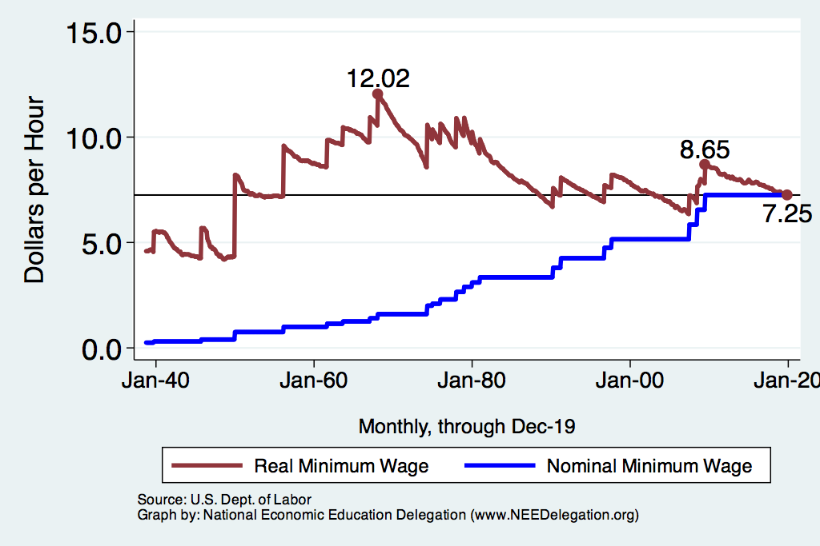
Historical Values of Minimum Wages

Slide 32
Minimum Wages and Productivity

Slide 33
Historical Share of Workers paid Minimum Wage

Slide 34
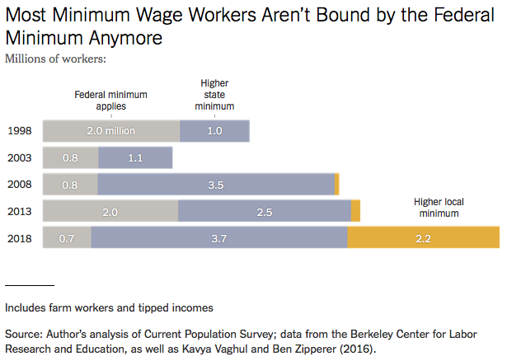
Notes:
https://www.nytimes.com/2019/04/24/upshot/why-america-may-already-have-its-highest-minimum-wage.html?action=click&module=RelatedLinks&pgtype=Article

Slide 35
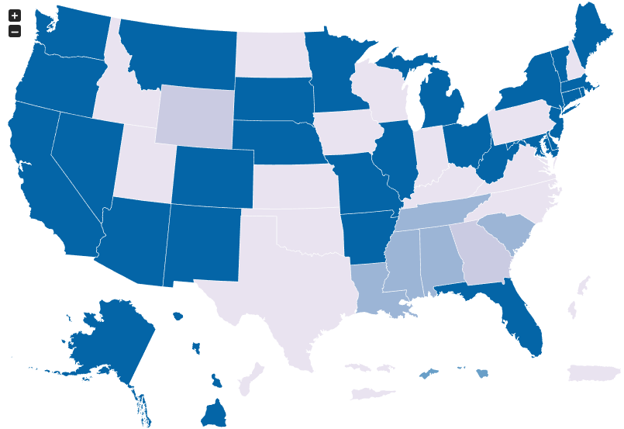
Many States Have A Higher Min Wage
NY: $12.50/hour
CA: $13/hour
States with Higher
Minimum Wage
than Federal
As of Jan 1, 2021
Source: U.S. Department of Labor

Slide 36
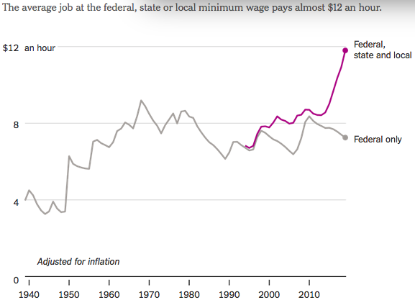
States and Local Gov’ts are Raising Min Wages
Notes:
https://www.nytimes.com/2019/04/24/upshot/why-america-may-already-have-its-highest-minimum-wage.html?action=click&module=RelatedLinks&pgtype=Article

Slide 37
Industries with Workers paid Min Wage

Slide 38
Minimum Wage – International Comparison
Source: Statista
Notes:
https://www.nytimes.com/2019/04/24/upshot/why-america-may-already-have-its-highest-minimum-wage.html?action=click&module=RelatedLinks&pgtype=Article

Slide 39
Addressing Inequality:
Immediately Available Policy Solutions (2/2)
Other
  Reverse trends in market power
Locally
  Employment services: job training, interview skills, or assistance with day-to-day issues, such as child care
  Cognizance of the potential for technologies to affect worker/employer power dynamics
    Uber, Lyft, etc.
Notes:
Reference your own experience at FTC

Slide 40
Addressing Inequality:
Long Term
It’s all about access to resources:
  Education, in particular
    Improve public education
    Reduce disparities in quality of public education
    Improve counseling in low-income schools
      With respect to college – paths to success and funding
    Investments are needed in early education, not later (e.g. universal pre-k)
  Opportunities for wealth-building
  Housing
Initiatives whose impacts cross neighborhood and class lines and increase upward mobility specifically for black men
  Mentoring programs for black boys, efforts to reduce racial bias among whites, interventions to reduce discrimination in criminal justice, and efforts to facilitate greater interaction across racial groups.

Slide 41

What to do About Inequality?
Nothing?
Redistribution?
PRE-distribution?
Access to resources?

Slide 42
Tension in Policy Solutions
Is it possible to increase growth at the same time that you reduce income inequality?
  Common refrain among some that government intervention in the economy is always and everywhere bad for growth.
Possibly: expanding equality of access promotes the full utilization of resources.
  Expanding equality of access requires resources likely from the well-to-do.

Slide 43
Summary
Income inequality is clearly increasing.
  The economy is clearly favoring owners of productive resources over labor.
The causes appear to be largely driven by:
  The market – technology, competition, and trade
  Changing institutions.
Open questions are:
  To act or not to act?
  If so, how?
The level of inequality is a policy choice.

Slide 44
Thank you!
Any Questions?
www.NEEDelegation.org
Adina Ardelean
<atardelean@scu.edu>
Contact NEED: info@needelegation.org
Submit a testimonial: www.NEEDelegation.org/testimonials.php
Become a Friend of NEED: www.NEEDelegation.org/friend.php

Slide 45
Child poverty across U.S. States
Source: A Roadmap to Reducing Child Poverty, National Academy of Sciences, 2019

