Slide 1
Economic Inequality
Areendam Chanda, Ph.D.
Associate Professor
Louisiana State University
Sunrise Rotary Club of Baton Rouge
June 10th, 2021

Slide 2
National Economic Education Delegation
Vision
One day, the public discussion of policy issues will be grounded in an accurate perception of the underlying economic principles and data.
Mission
NEED unites the skills and knowledge of a vast network of professional economists to promote understanding of the economics of policy issues in the United States.
NEED Presentations
Are nonpartisan and intended to reflect the consensus of the economics profession.

Slide 3
Who Are We?
Honorary Board: 53 members
2 Fed Chairs: Janet Yellen, Ben Bernanke
6 Chairs Council of Economic Advisers
Furman (D), Rosen (R), Bernanke (R), Yellen (D), Tyson (D), Goolsbee (D)
3 Nobel Prize Winners
Akerlof, Smith, Maskin
Delegates: 585+ members
At all levels of academia and some in government service
All have a Ph.D. in economics
Crowdsource slide decks
Give presentations
Global Partners: 44 Ph.D. Economists
Aid in slide deck development

Slide 4
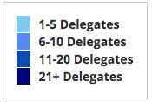
Where Are We?

Slide 5
Credits and Disclaimer
This slide deck was authored by:
Jon Haveman, Executive Director of NEED
This slide deck was reviewed by:
Timothy Smeeding, University of Wisconsin
Robert Wright, Augustana University
Disclaimer
NEED presentations are designed to be nonpartisan
It is, however, inevitable that the presenter will be asked for and will provide their own views
Such views are those of the presenter and not necessarily those of the National Economic Education Delegation (NEED)

Slide 6
Outline
Definition
Measurement
How does it happen?
Does it matter?
Is it a problem?
What to do about it

Slide 7
Economic Inequality: Income
Definition:
The extent to which the distribution of income deviates from complete equality
The dispersion of income throughout the economy

Slide 8
Different Ways of Thinking About Inequality
Income Inequality
Before taxes and transfers
After taxes and transfers
Wealth Inequality
Consumption Inequality

Slide 9
Recent Facts on Income Inequality
Beginning in the 1970s, the income gap widened.
Income in the middle and lower parts of the distribution slowed
Incomes at the top continued to grow strongly
Income shares at the very top of the distribution rose to levels last seen more than 80 years ago
Source: Chad Stone, Danilo Trisi, Arloc Sherman, and Roderick Taylor, “A Guide to Statistics on Historical Trends in Income Inequality,”
Center on Budget and Policy Priorities, Policy Futures, May 15, 2018.

Slide 10
National Income Inequality: Share of Top 10%
Stock Market Crash
WWII
Housing Bubble
Dot-com Bubble

Slide 11
The Abrupt Increase in Inequality
Source: Chad Stone, Danilo Trisi, Arloc Sherman, and Roderick Taylor, “A Guide to Statistics on Historical Trends in Income Inequality,”
Center on Budget and Policy Priorities, Policy Futures, Dec. 11, 2018.
Notes:
Slide taken from page 10, Chad Stone, Danilo Trisi, Arloc Sherman, and Roderick Taylor, “A Guide to Statistics on Historical Trends in Income Inequality,” May 15, 2018

Slide 12
Most of the Action Is at the Top: Pre-Tax
Projected 2021
CBO: Projected Changes in the Distribution of Household Income, 2016 to 2021

Slide 13
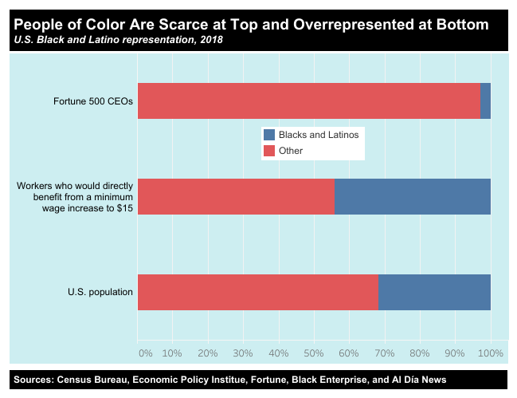
https://inequality.org/facts/racial-inequality/#racial-income-inequality
Notes:
https://inequality.org/facts/racial-inequality/#racial-income-inequality

Slide 14
Wealth Inequality Exceeds Income Inequality
Source: Chad Stone, Danilo Trisi, Arloc Sherman, and Roderick Taylor, “A Guide to Statistics on Historical Trends in Income Inequality,”
Center on Budget and Policy Priorities, Policy Futures, Dec. 11, 2018.

Slide 15
Consumption Inequality
Consumption is another important metric for judging inequality
Arguably a better indicator of “well-being”
Extremely difficult to measure
Growing evidence that consumption inequality has also increased

Slide 16
Growing Evidence: Consumption Inequality
Source: Orazio P. Attanasio and Luigi Pistaferri, “Consumption Inequality,” Journal of Economic Perspectives, Volume 30, #2, Spring 2016, page 11, Figure 1.

Slide 17
Where Does Inequality Come From?
Labor Characteristics
Demographics
Age distribution
Personal Choices
Educational attainment
Effort
Priorities
Household composition
Immigration
Market Forces
Technology
Changing demand patterns
Competition for labor
Government Policy
Market influence
Redistribution

Slide 18
Government Policy and Inequality
Market Influence: PRE-distribution
Characteristics of labor
Access to education
Effects on labor demand
Market regulation
Competition policy
Labor regulations
Minimum wage, overtime, health insurance, etc.
RE-distribution
Tax Rates
Income support
Direct aid
Food stamps

Slide 19
Tax and Transfer Programs and Inequality
2014
Source: U.S. Congressional Budget Office, “The Distribution of Household Income, 2014”, Average Income Before and After Means-Tested Transfers and
Federal Taxes, by Income Group, 2014.

Slide 20
Tax and Transfer Programs: Income Shares
2017
Source: U.S. Congressional Budget Office, “The Distribution of Household Income, 2016”, Average Income Before and After Means-Tested Transfers and
Federal Taxes, by Income Group, 2016.

Slide 21
The Rich Really do Pay Lower Taxes
1950
Top 400
Lower Income
Higher Income

Slide 22
What About Tax Rates?
400 Taxpayers with highest incomes
1992-2007
+
392%
1992-2014
Average
Tax Rate
+310%
Average
Income
-12%
-
37%
Source: IRS
Source: IRS, Statistics of Income Division, December 2016.

Slide 23
Market Forces and Inequality
Changing demand patterns
Technology
Globalization
Industry composition
PCs instead of typewriters
Services instead of goods
Professional services instead of personal services
Competition in labor or product markets
Unionization
Market concentration

Slide 24
Technological Change and Inequality
Much of the technology adopted in the last 30 years has eliminated low-skill or low-wage jobs.
Computers, advanced manufacturing equipment, steel mini-mills, automation
There is a “winner take all” aspect of the technology-driven economy.
This likely favors a small group of individuals.
Both aspects increase inequality by increasing the rewards to:
Those with significant labor market skills.
Owners over workers

Slide 25
Mechanisms for the Effects of Globalization
Merchandise trade
Importing goods that are made with low-skilled workers and exporting goods that are made with high-skilled workers
Lowers the wages of unskilled relative to skilled
making the distribution of income less equal
Outsourcing
Similar channel as with merchandise trade
Trade in services
US imports of middle-skill services: business and some professional services
Intuitively: The same as if we were to move the actual workers.

Slide 26
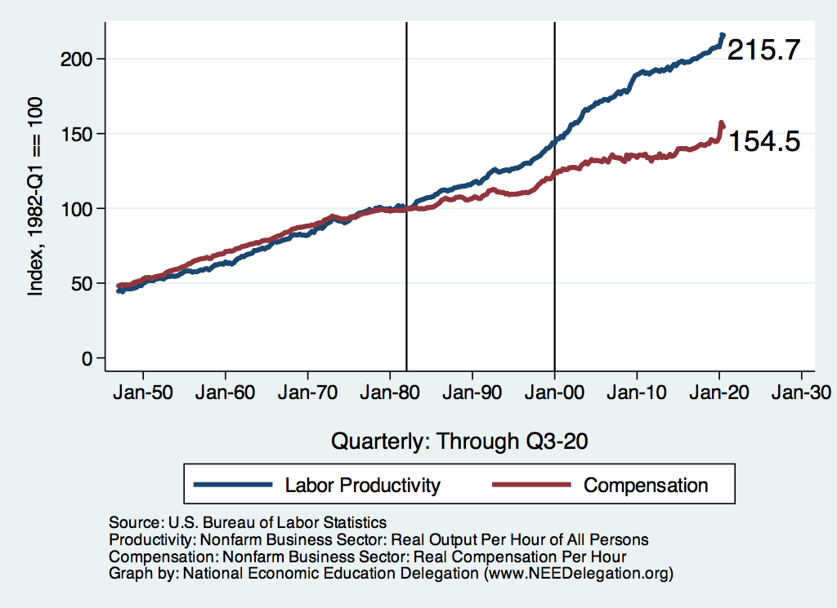
Labor Income is Unhinged from Productivity
Why?
Declining unionization
Globalization
Immigration
Competition policy
Cheap technology

Slide 27
Competition in the Economy
Return on invested capital excluding goodwill –
US publicly-traded nonfinancial firms, 1965-2014
Source: Jason Furman, ”Forms and sources of inequality in the United States”, VOX, March 17, 2016, Figure 6.
Notes:
Note: The return on invested capital definition is based on Koller et al (2015), and the data presented here are updated and augmented versions of the figures presented in Chapter 6 of that volume. The McKinsey data includes McKinsey analysis of Standard & Poor’s data and exclude financial firms from the analysis because of the practical complexities of computing returns on invested capital for such firms. ​ Source: Koller et al. (2015); McKinsey & Company; Furman and Orszag (2015). , by way of https://voxeu.org/article/forms-and-sources-inequality-united-states
Furman, J and P Orszag (2015), “A Firm-Level Perspective on the Role of Rents in the Rise in Inequality”, Presentation at “A Just Society” Centennial Event in Honor of Joseph Stiglitz Columbia University, October 16, 2015.

Slide 28
Growing Revenue Concentration
Source: The Hamilton Project, Brookings: The State of Competition and dynamism.

Slide 29
CEO Pay Has Been Growing Rapidly

Slide 30
CEO Compensation – Tied to Stock Prices

Slide 31
Why Does Inequality Matter?
Too little inequality can:
Reduce individual motivation
Slow economic growth
Too much inequality can:
Reduce individual motivation
Slow economic growth
Too much inequality may also:
Divide society
Distort political environment
Reduce political participation
Reduce investments in public goods
Education
Environmental protections

Slide 32
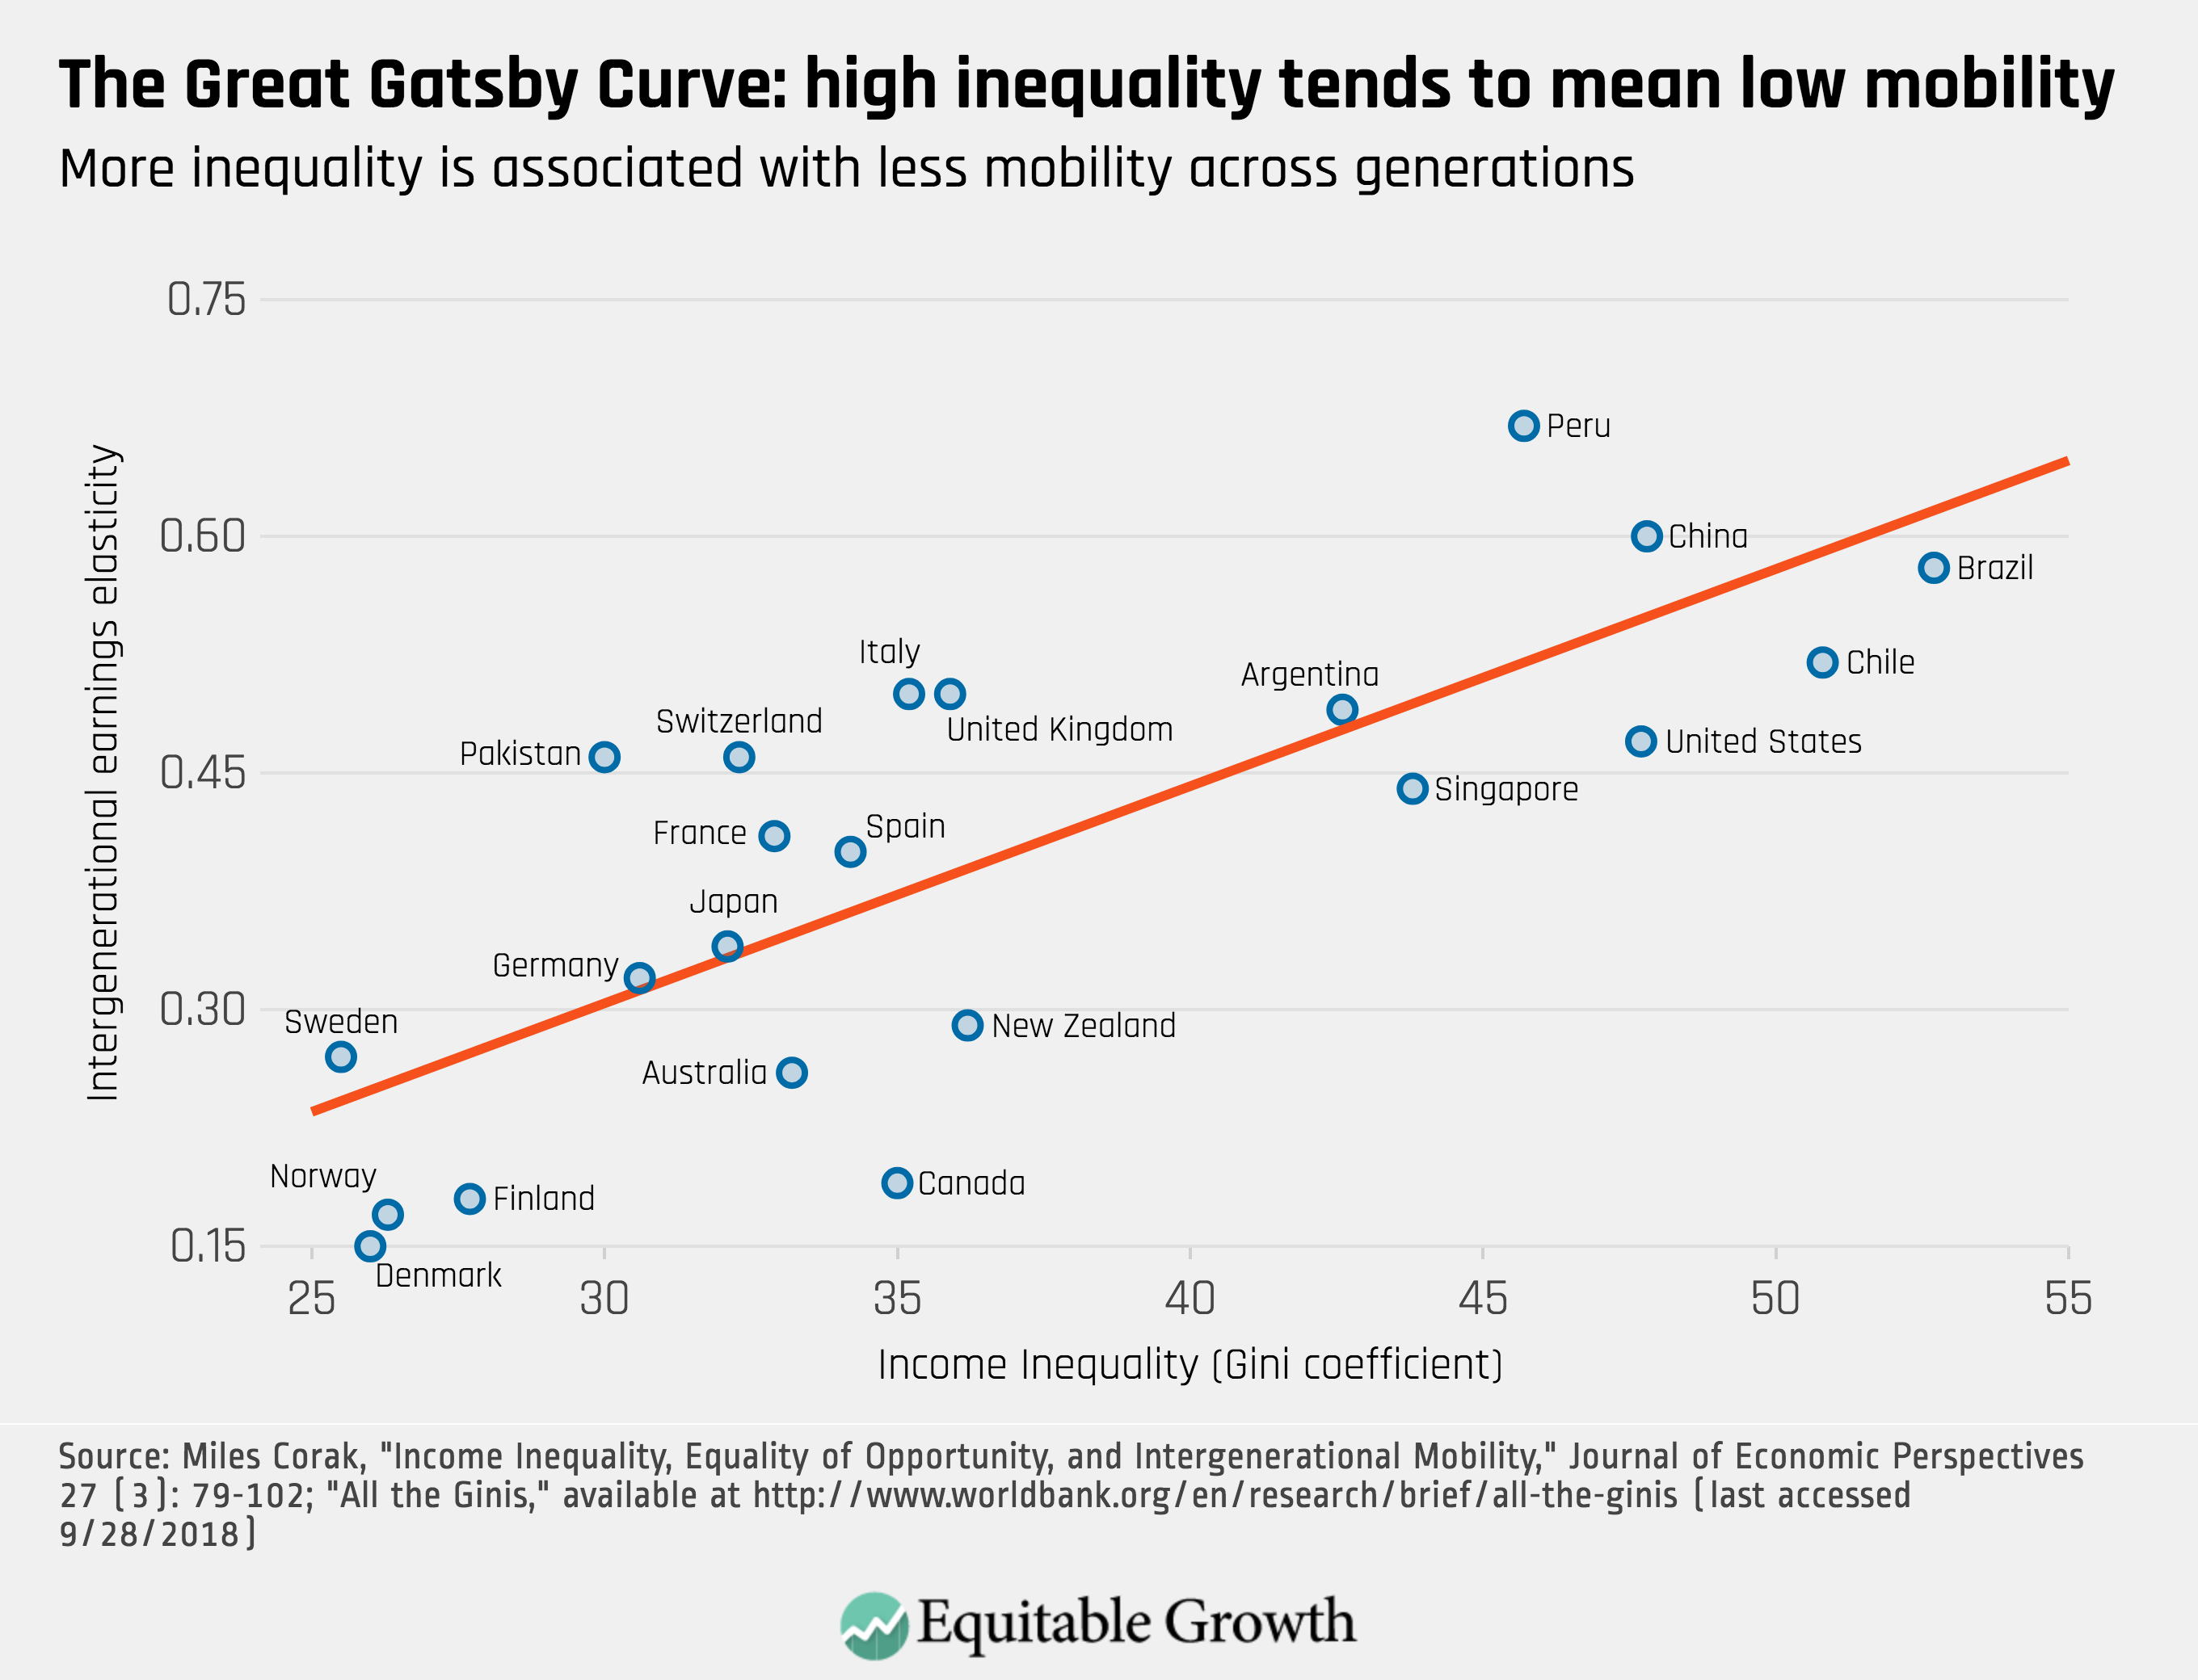
Peru
China
Brazil
Germany
U.S.
Canada
https://equitablegrowth.org/research-paper/are-todays-inequalities-limiting-tomorrows-opportunities

Slide 33
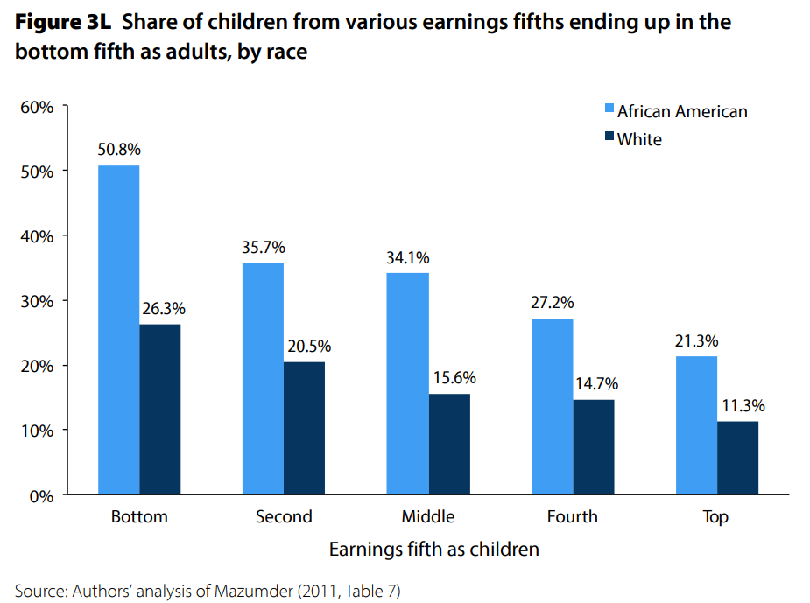
U.S. – Racial Differences
Odds of staying poor, if born poor
Odds of becoming poor, if born rich
Economic Policy Institute, State of Working America, 2012

Slide 34
Government Policy and Racial Inequality
Product of a long historical process of discrimination with at least two reinforcing sets of policies.
Policies that govern the spatial distribution of the black population.
Restrictive covenants, redlining, and general housing and lending discrimination
Policies that have a disparate impact on black individuals because of their locations.
The original version of Michigan Senate Bill 897 exempted individuals from this work requirement conditional on residing in a county with an unemployment rate above 8.5 percent. The higher unemployment rates in rural counties would disproportionately exempt white Medicaid recipients from the work requirement within the bill.

Slide 35
Addressing Inequality: Is It A Problem?
Why it might be a problem.
Economic issues (Efficiency)
There is evidence that at some level, increased inequality slows economic growth.
Or, inequality concentrates resources among investors.
Noneconomic issues (Equity)
Values, ethics and morals will drive individual evaluations of the level of inequality.
E.g., inequality is primarily a function of market outcomes, so should be left alone.
Or, a solid middle class is important for maintaining a civil society, which runs contrary to a high degree of inequality.
Suppose you think it’s a problem. How might it be addressed?

Slide 36
Addressing Inequality: Immediately Available Policy Solutions (1/2)
RE-distribution
Tax and transfer programs
PRE-distribution
Strengthen labor unions
Collective bargaining
Other policies that favor labor over business owners
Minimum wages

Slide 37
Addressing Inequality: Immediately Available Policy Solutions (2/2)
Other
Reverse trends in market power
Locally
Employment services: job training, interview skills, or assistance with day-to-day issues, such as child care
Cognizance of the potential for technologies to affect worker/employer power dynamics
Uber, Lyft, etc.
Notes:
Reference your own experience at FTC

Slide 38
Addressing Inequality: Long Term
It’s all about access to resources:
Education, in particular
Improve public education
Reduce disparities in quality of public education
Improve counseling in low-income schools
With respect to college – paths to success and funding
Investments are needed in early education, not later (e.g. universal pre-k)
Opportunities for wealth-building
Housing
Initiatives whose impacts cross neighborhood and class lines and increase upward mobility specifically for black men
Mentoring programs for black boys, efforts to reduce racial bias among whites, interventions to reduce discrimination in criminal justice, and efforts to facilitate greater interaction across racial groups.

Slide 39
Thank you!
Any Questions?
www.NEEDelegation.org
<presenter name>
<presenter email>
Contact NEED: info@needelegation.org
Submit a testimonial: www.NEEDelegation.org/testimonials.php
Become a Friend of NEED: www.NEEDelegation.org/friend.php

Slide 40
Available NEED Topics Include:
US Economy
Economic Inequality
Climate Change
US Social Policy
Trade and Globalization
Economic Mobility
Trade Wars
Housing Policy
Federal Budgets
Federal Debt
2017 Tax Law
Autonomous Vehicles

Slide 41
Additional Slides

Slide 42
Measuring inequality: The Lorenz Curve
Shows the distribution of income in a region
Ex: U.S. Income Distribution - 2008
 | Quintile (2008) | % of total income | Cumulative % of total income
A | Lowest 20% | 3.4 | 3.4
B | Second 20% | 8.6 | 12
C | Middle 20% | 14.7 | 26.7
D | Fourth 20% | 23.3 | 50
E | Highest 20% | 50 | 100

Slide 44
Lorenz Curve of Income Distribution
The greater the curvature of the Lorenz Curve, the greater is the degree of income inequality

Slide 45
Gini Coefficient
Another way to describe income inequality is by using a Gini coefficient.
Gini coefficient – a numerical measure of the overall dispersion of income
Ranges from 0 – 1
0= perfect equality – everyone has same income
1=perfect inequality – one person makes all income
In practice:
0.5 – 0.7 – highly unequal
0.2 – 0.35 – relatively equal

Slide 46
Using the Lorenz curve to calculate a Gini Coefficient
Gini coefficient = A /(A + B)
A higher Gini coefficient means greater inequality
Perfect equality: A=0, Gini=0
Perfect inequality: B=0, Gini = 1
A
B

