Slide 1


Current Issues in
Economic Policy
Mina Kim, Ph.D.
NEED
American University OLLI
July 12-14, 2021

Slide 2
National Economic Education Delegation
Vision
  One day, the public discussion of policy issues will be grounded in an accurate perception of the underlying economic principles and data.
Mission
  NEED unites the skills and knowledge of a vast network of professional economists to promote understanding of the economics of policy issues in the United States.
NEED Presentations
  Are nonpartisan and intended to reflect the consensus of the economics profession.

Slide 3
Who Are We?
Honorary Board: 47 members
  2 Fed Chairs: Janet Yellen, Ben Bernanke
  6 Chairs Council of Economic Advisers
    Furman (D), Rosen (R), Bernanke (R), Yellen (D), Tyson (D), Goolsbee (D)
  3 Nobel Prize Winners
    Akerlof, Smith, Maskin
Delegates: 500+ members
  At all levels of academia and some in government service
  All have a Ph.D. in economics
  Crowdsource slide decks
  Give presentations
Global Partners: 45 Ph.D. Economists
  Aid in slide deck development

Slide 4
Economic Inequality

Slide 5
Credits and Disclaimer
This slide deck was authored by:
  Jon Haveman, Executive Director of NEED
This slide deck was reviewed by:
  Timothy Smeeding, University of Wisconsin
  Robert Wright, Augustana University
Disclaimer
  NEED presentations are designed to be nonpartisan
  It is, however, inevitable that the presenter will be asked for and will provide their own views
  Such views are those of the presenter and not necessarily those of the National Economic Education Delegation (NEED)

Slide 6
Notes:
https://fivethirtyeight.com/features/many-americans-think-economic-inequality-is-a-problem-just-not-the-most-pressing-one/

Slide 7
Poll
There is economic inequality in the country these days.
Too much
The right amount
Too little
If you answered that there is too much economic inequality, of economic inequality is acceptable.
Some amount
No amount
Notes:
https://www.pewsocialtrends.org/2020/01/09/views-on-reducing-economic-inequality/

Slide 8
Outline
Definition
Measurement
How does it happen?
Does it matter?
Is it a problem?
What to do about it

Slide 9

Economic Inequality
Definition:
  The extent to which the distribution of people’s economic position deviates from complete equality
  The dispersion of people’s economic positions.

Slide 10
Different Ways of Thinking About Inequality
Income Inequality
  Before taxes and transfers
  After taxes and transfers
Wealth Inequality
Consumption Inequality

Slide 11
Different Ways of Thinking About Inequality
Income Inequality
  Before taxes and transfers
  After taxes and transfers
Wealth Inequality
Consumption Inequality
Inequality of Opportunity

Slide 12
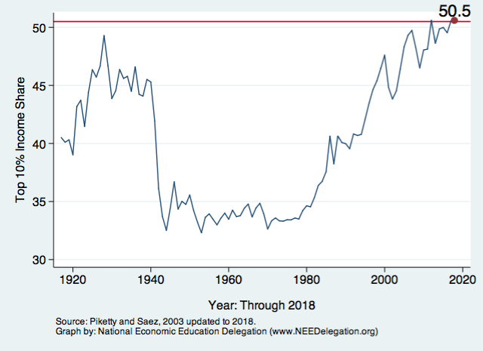
National Income Inequality: Share of Top 10%
Stock Market Crash
WWII
Housing Bubble
Dot-com Bubble
Notes:
Income concept here is market income before individual income taxes for each tax unit. Market income is the sum of all income sources reported on tax returns, including unrealized capital gains and taxable unemployment compensation. Income of non-filers is estimated. Household size is not corrected for. Steep drop coincides with start of WWII (1940).

Slide 13
Notes:
Capital incomes were hit by major shocks in the first part of the century. The post-WW I depression and the Great Depression destroyed many businesses and thus significantly reduced top capital incomes. The wars generated large fiscal shocks, especially in the corporate sector that mechanically reduced distributions to stockholders. Top capital incomes were never able to fully recover from these shocks, probably because of the dynamic effects of progressive taxation on capital accumulation and wealth inequality.

Slide 14
Notes:
Top wage shares have started to recover from the WW II shock in the late 1960s, and they are now higher than before WW II. Thus the increase in top income shares in the last three decades is the direct consequence of the surge in top wages.
Downturn and upturn of top wage shares seem too sudden to be accounted for by technical change alone. Our series suggest that other factors, such as changes in labor market institutions, fiscal policy, or more generally social norms regarding pay inequality may have played important roles in the determinational of the wage structure.

Slide 15
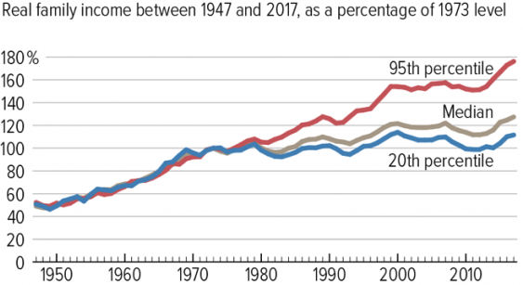
The Abrupt Increase in Inequality
Source: Chad Stone, Danilo Trisi, Arloc Sherman, and Roderick Taylor, “A Guide to Statistics on Historical Trends in Income Inequality,”
Center on Budget and Policy Priorities, Policy Futures, Dec. 11, 2018.
Notes:
Slide taken from page 10, Chad Stone, Danilo Trisi, Arloc Sherman, and Roderick Taylor, “A Guide to Statistics on Historical Trends in Income Inequality,” May 15, 2018

Slide 16
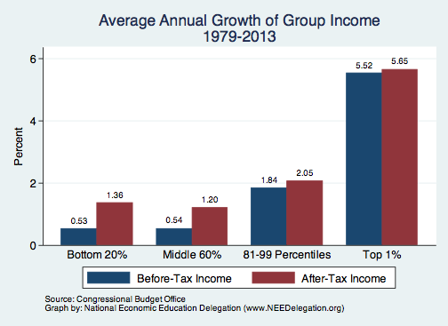
Growth Has Been Primarily at the Very Top
Notes:
Household income

Slide 17
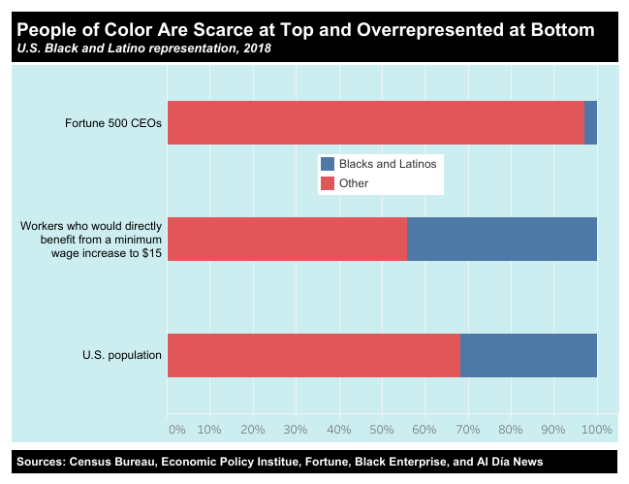
Notes:
https://inequality.org/facts/racial-inequality/#racial-income-inequality

Slide 18
Disappearing Middle Class
In this report, “middle‐income”
households are defined as those with an income that is 67% to 200% (two‐thirds to double) of the overall median household income, after incomes have been adjusted for household size.
Notes:
The hollowing of the American middle class has proceeded steadily for more than four decades. Since 1971, each decade has ended with a smaller share of adults living in middle-income households than at the beginning of the decade, and no single decade stands out as having triggered or hastened the decline in the middle.
https://www.pewsocialtrends.org/2015/12/09/the-american-middle-class-is-losing-ground/#:~:text=Based%20on%20the%20definition%20used,from%2025%25%20to%2029%25.

Slide 19
Wealth Inequality Exceeds Income Inequality
Source: Chad Stone, Danilo Trisi, Arloc Sherman, and Roderick Taylor, “A Guide to Statistics on Historical Trends in Income Inequality,”
Center on Budget and Policy Priorities, Policy Futures, Dec. 11, 2018.
Notes:
Based on family-level survey of consumer finance. Wealth = total stock of assets, less any liabilities

Slide 20
Notes:
https://www.brookings.edu/blog/up-front/2020/02/27/examining-the-black-white-wealth-gap/

Slide 21
A Third Measure of Inequality: Consumption Inequality
Consumption is another important metric for judging inequality
Arguably a better indicator of “well-being”
Extremely difficult to measure
Growing evidence that consumption inequality has also increased

Slide 22
Consumption Inequality

Slide 23
Summary: Consumption Inequality
Early research indicated that although income inequality may be increasing, consumption inequality may not be.
  How is this possible? Borrowing, or otherwise smoothing consumption.
Mounting evidence that it is increasing along with income and wealth inequality.
Consensus reached? No.

Slide 24

U.S.
https://equitablegrowth.org/research-paper/are-todays-inequalities-limiting-tomorrows-opportunities

Slide 25
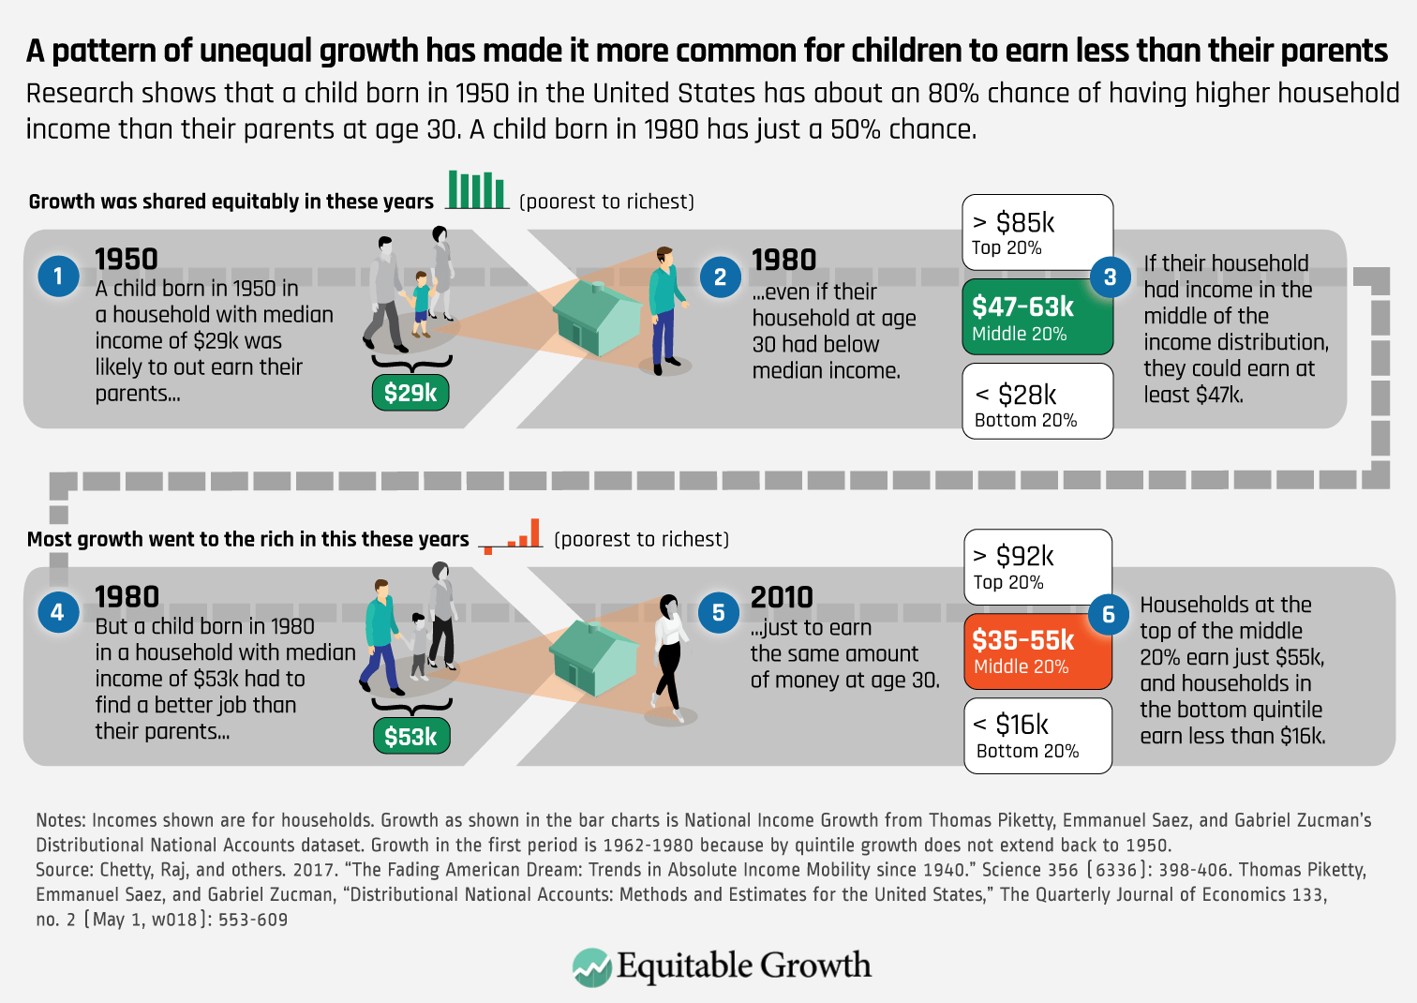
Notes:
https://equitablegrowth.org/rising-income-inequality-exacerbates-downward-economic-mobility/

Slide 26
Poll
Which factors are essential for being economically successful in the US today?
Hard work
Knowing the right people
Graduating from college
Graduating from a highly ranked college
Graduating from professional school
Having well-educated parents
Coming from an upper-income family
Growing up in an upper-income neighborhood
A person’s racial/ethnic background
Notes:
https://apps.npr.org/dailygraphics/graphics/poll-inequality-success-20200109/

Slide 27
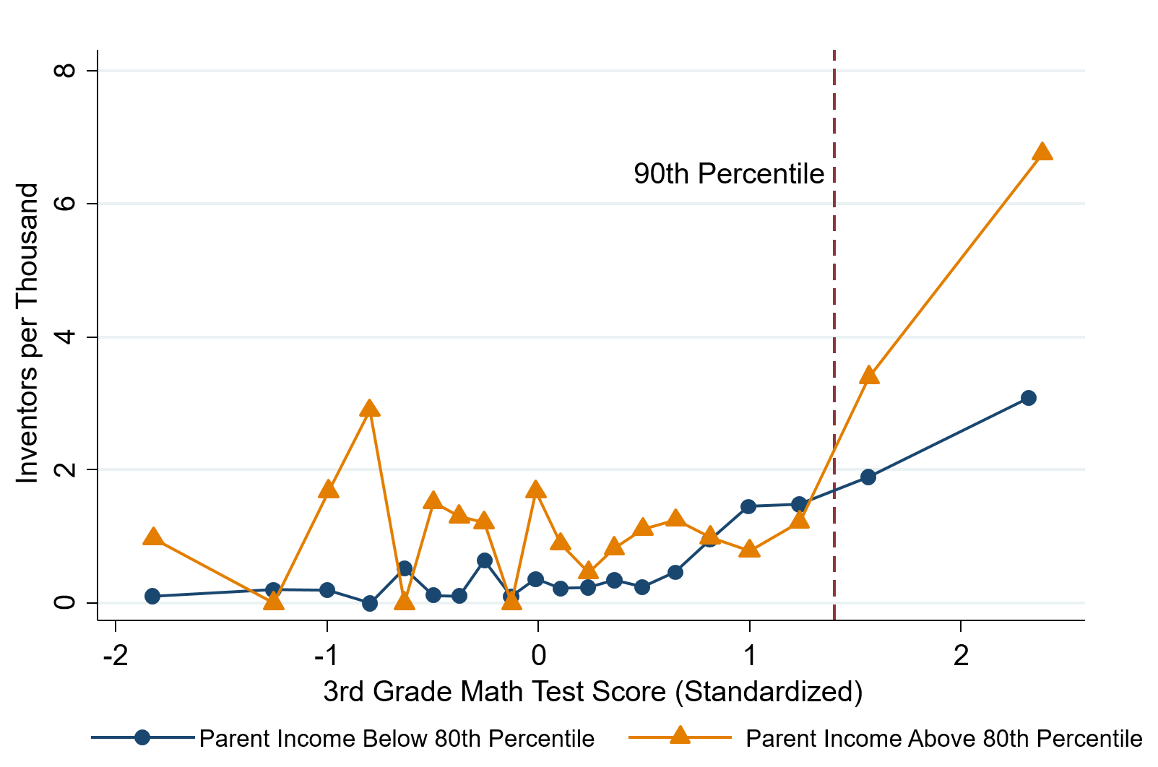
Upward Mobility: Finances Matter
High math-ability 3rd graders much more likely to become inventors if their family is well-off.
(Also if they grow up in high-innovation areas)

Slide 28
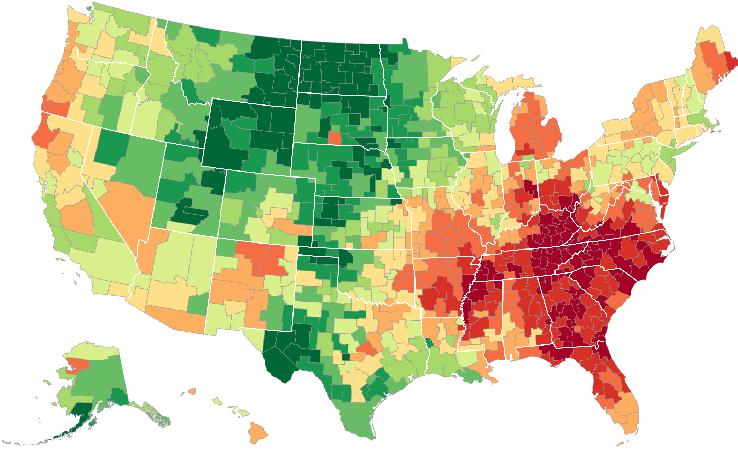
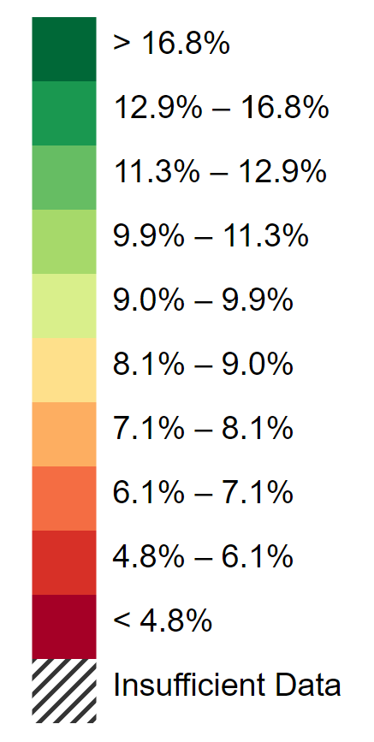
The Geography of Upward Mobility in the United States
Average Individual Income for Males with Parents Earning $25,000 (25th percentile)
Newark $30.1k
San Francisco
Bay Area
$28.8k
56.9 ($34.5k)
Atlanta
$23.1k
49.0 ($27.6k)
Source: Chetty et al.
42.9 ($22.8k)
Note: Green = More Upward Mobility, Red = Less Upward Mobility
Notes:
The differences in upward mobility across areas are caused by differences in childhood environment. Studying the experiences of seven million children who moved across areas while growing up, we document that every year of exposure to a better environment improves a child’s chances of success.

Slide 29
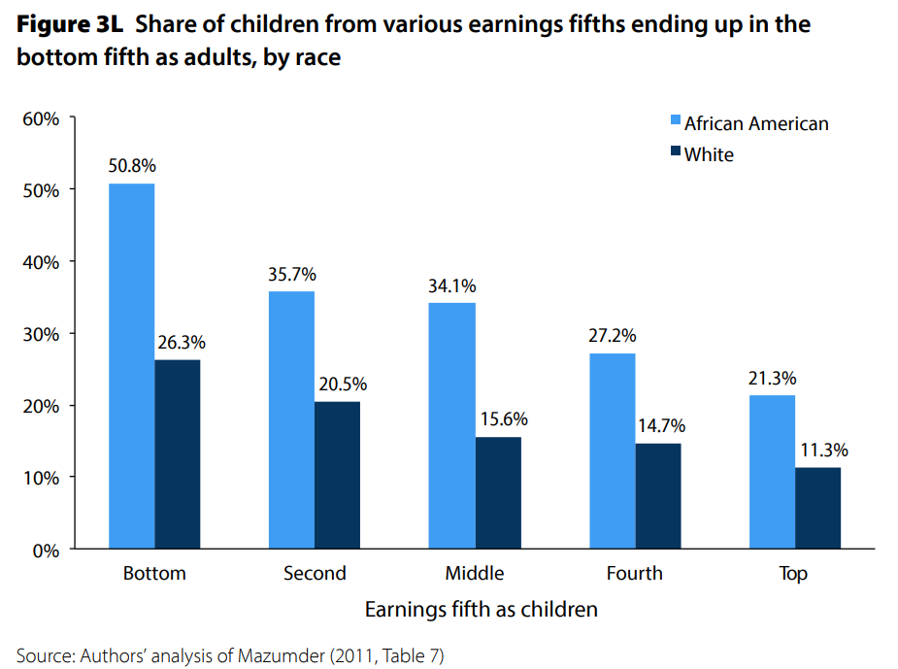
U.S. – racial differences
Odds of staying poor, if born poor
Odds of becoming poor, if born rich
Economic Policy Institute, State of Working America, 2012

Slide 30
Inequality of Opportunity
It occurs when people living in the same society do not have access to the same opportunities.
Outcomes that are valued by all or most members of society (such as income, wealth, health status, etc.) are determined by two types of factors: those for which the individual can be held responsible, and those for which they cannot (e.g. gender, place of birth, ethnicity, or parental background).
Inequality of opportunity is thus widely regarded as the unfair part of inequality

Slide 31
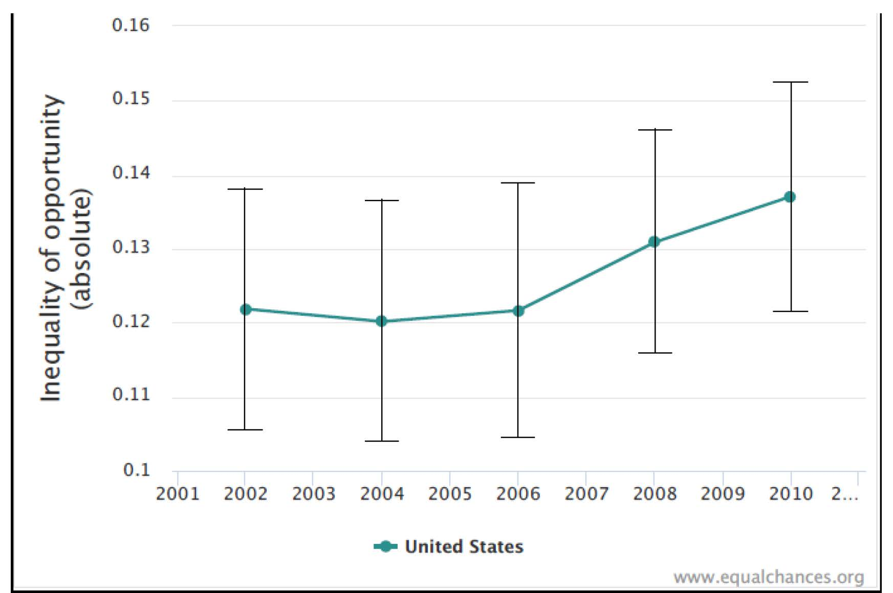
An example from the Equalchances database

Slide 32
Poll
What do you think are the top three contributors to economic inequality?
Outsourcing of jobs to other countries
The tax system
Problems with the education system
The different life choices people make
Some people start out with more opportunities than others
Not enough regulation of major corporations
Some people work harder than others
Discrimination against racial and ethnic minorities
The automation of jobs
Current US trade policies
Immigration
Too much regulation of major corporations
Notes:
https://apps.npr.org/dailygraphics/graphics/poll-inequality-success-20200109/

Slide 33
Where Does Inequality Come From?
Labor Characteristics
  Demographics
    Age distribution
  Personal Choices
    Educational attainment
    Effort
    Priorities
    Household composition
  Immigration
Market Forces
  Technology
  Changing demand patterns
  Competition for labor
Government Policy
  Market influence
  Redistribution

Slide 34
Government Policy and Inequality
Market Influence: PRE-distribution
  Characteristics of labor
    Access to education
  Effects on labor demand
    Market regulation
      Competition policy
    Labor regulations
      Minimum wage, overtime, health insurance, etc.
RE-distribution
  Tax Rates
  Income support
    Direct aid
    Food stamps

Slide 35
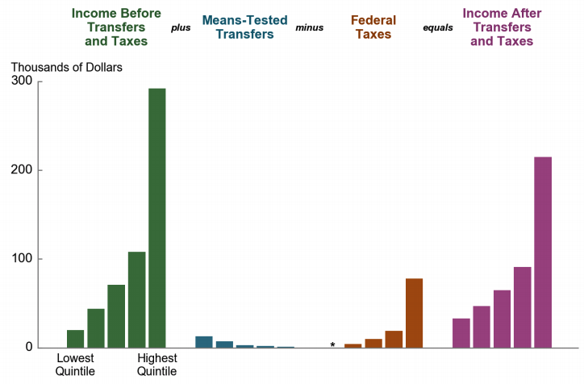
Taxes, Transfers, and Income: 2016
Source: U.S. Congressional Budget Office, “The Distribution of Household Income, 2016”.
Notes:
Household Income

Slide 36
Government Policy and Racial Inequality
Product of a long historical process of discrimination with at least two reinforcing sets of policies.
  Policies that govern the spatial distribution of the black population.
    Restrictive covenants, redlining, and general housing and lending discrimination
  Policies that have a disparate impact on black individuals because of their locations.
    The original version of Michigan Senate Bill 897 exempted individuals from this work requirement conditional on residing in a county with an unemployment rate above 8.5 percent. The higher unemployment rates in rural counties would disproportionately exempt white Medicaid recipients from the work requirement within the bill.

Slide 37
Market Forces and Inequality
Changing demand patterns
  Technology
  Globalization
  Industry composition
    PCs instead of typewriters
    Services instead of goods
    Professional services instead of personal services
Competition in labor markets
  Unionization
  Market concentration

Slide 38
Technological Change and Inequality
Much of the technology adopted in the last 30 years has eliminated low-skill or low-wage jobs.
  Computers, advanced manufacturing equipment, steel mini-mills, automation
There is a “winner take all” aspect of the technology-driven economy.
  This likely favors a small group of individuals.
Both aspects increase inequality by increasing the rewards to:
  Those with significant labor market skills.
  Owners over workers

Slide 39


Technology can Hurt Low Income Workers
Early on, technology was good to low income workers
Until it was bad for them….

Slide 40
Globalization
What is globalization?
  Flow of goods, services, capital, and labor across international borders
How does it affect inequality?
  Through a differential impact on low-skilled workers and hence their wages
  For the United States, globalization is thought to lower the wages of low skilled and hence low-wage workers relative to those of high-skilled workers

Slide 41
Mechanisms for the Effects of Globalization
Merchandise trade
  Importing goods that are made with low-skilled workers and exporting goods that are made with high-skilled workers
    Lowers the wages of unskilled relative to skilled
      making the distribution of income less equal
Outsourcing
  Similar channel as with merchandise trade
Trade in services
  US imports of middle-skill services: business and some professional services
Intuitively: The same as if we were to move the actual workers.

Slide 42
Immigration and Inequality- Summary
Beginning in about 1970, the immigrant share of the U.S.
Population increased dramatically.
  5% in 1970 and 14% in 2016
Immigration tends to happen most often among:
  Low-skilled low-wage workers
  High-skilled high-wage workers
Immigration has likely increased income inequality.
Its effect has likely been small.
  ~5% between 1980 and 2000
  No reason to think it has been bigger since

Slide 43
Declining Unionization
Unionization Rates
1983: 20.1%
2018: 10.5%
Unionization Rates
Public: 33.9%
Private: 6.4%
Source: Jason Furman, ”Forms and sources of inequality in the United States”, VOX, March 17, 2016, Figure 4.
Notes:
https://voxeu.org/article/forms-and-sources-inequality-united-states

Slide 44
Competition in the Economy
Return on invested capital excluding goodwill –
US publicly-traded nonfinancial firms, 1965-2014
Source: Jason Furman, ”Forms and sources of inequality in the United States”, VOX, March 17, 2016, Figure 6.
Notes:
Note: The return on invested capital definition is based on Koller et al (2015), and the data presented here are updated and augmented versions of the figures presented in Chapter 6 of that volume. The McKinsey data includes McKinsey analysis of Standard & Poor’s data and exclude financial firms from the analysis because of the practical complexities of computing returns on invested capital for such firms. ​
Source: Koller et al. (2015); McKinsey & Company; Furman and Orszag (2015). , by way of https://voxeu.org/article/forms-and-sources-inequality-united-states
Furman, J and P Orszag (2015), “A Firm-Level Perspective on the Role of Rents in the Rise in Inequality”, Presentation at “A Just Society” Centennial Event in Honor of Joseph Stiglitz Columbia University, October 16, 2015.

Slide 45
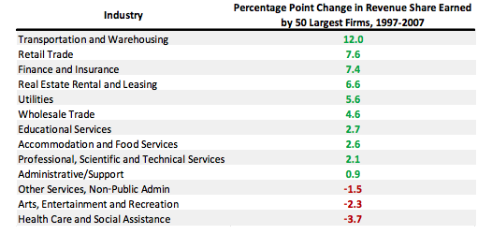
Growing Revenue Concentration
Source: Furman and Orszag, “A Firm-Level Perspective on the Role of Rents in the Rise in Inequality”, 2015.

Slide 46
Addressing Inequality: Is It A Problem?
Why it might be a problem.
  Economic issues (Efficiency)
    There is evidence that at some level, increased inequality slows economic growth.
    Or, inequality concentrates resources among investors.
  Noneconomic issues (Equity)
    Values, ethics and morals will drive individual evaluations of the level of inequality.
      E.g., inequality is primarily a function of market outcomes, so should be left alone.
      Or, a solid middle class is important for maintaining a civil society, which runs contrary to a high degree of inequality.
Suppose you think it’s a problem. How might it be addressed?

Slide 47

Addressing Inequality:
Immediately Available Policy Solutions (1/2)
RE-distribution
  Tax and transfer programs
PRE-distribution
  Strengthen labor unions
  Collective bargaining
  Other policies that favor labor over business owners
  Minimum wages
  Anti-discrimination

Slide 48
Addressing Inequality:
Immediately Available Policy Solutions (2/2)
Other
  Reverse trends in market power
Locally
  Employment services: job training, interview skills, or assistance with day-to-day issues, such as child care
  Cognizance of the potential for technologies to affect worker/employer power dynamics
    Uber, Lyft, etc.
Notes:
Reference your own experience at FTC

Slide 49
Addressing Inequality:
Long Term
It’s all about access to resources:
  Education, in particular
    Improve public education
    Reduce disparities in quality of public education
    Improve counseling in low-income schools
      With respect to college – paths to success and funding
    Investments are needed in early education, not later (e.g. universal pre-k)
  Opportunities for wealth-building
  Housing
Initiatives whose impacts cross neighborhood and class lines and increase upward mobility specifically for black men
  Mentoring programs for black boys, efforts to reduce racial bias among whites, interventions to reduce discrimination in criminal justice, and efforts to facilitate greater interaction across racial groups.

Slide 50
Tension in Policy Solutions
Is it possible to increase growth at the same time that you reduce income inequality?
  Common refrain among some that government intervention in the economy is always and everywhere bad for growth.
Possibly: expanding equality of access promotes the full utilization of resources.
  Expanding equality of access requires resources likely from the well-to-do.

Slide 51
Summary
Income inequality is clearly increasing.
  The economy is clearly favoring owners of productive resources over labor.
The causes appear to be largely driven by:
  The market – technology, competition, and trade
  Changing institutions.
Open questions are:
  To act or not to act?
  If so, how?
The level of inequality is a policy choice.

Slide 52
Thank you!
Any Questions?
www.NEEDelegation.org
Mina Kim
minakim@mkecon.com
Contact NEED: info@needelegation.org
Submit a testimonial: www.NEEDelegation.org/testimonials.php
Become a Friend of NEED: www.NEEDelegation.org/friend.php

