Slide 1


Economic Inequality
Dmitriy Stolyarov, Ph.D.
Department of Economics,
University of Michigan
Adult Learning Institute
Oct 13, 2020

Slide 2
National Economic Education Delegation
Vision
  One day, the public discussion of policy issues will be grounded in an accurate perception of the underlying economic principles and data.
Mission
  NEED unites the skills and knowledge of a vast network of professional economists to promote understanding of the economics of policy issues in the United States.
NEED Presentations
  Are nonpartisan and intended to reflect the consensus of the economics profession.

Slide 3
Who Are We?
Honorary Board: 52 members
  2 Fed Chairs: Janet Yellen, Ben Bernanke
  6 Chairs Council of Economic Advisers
    Furman (D), Rosen (R), Bernanke (R), Yellen (D), Tyson (D), Goolsbee (D)
  3 Nobel Prize Winners
    Akerlof, Smith, Maskin
Delegates: 522 members
  At all levels of academia and some in government service
  All have a Ph.D. in economics
  Crowdsource slide decks
  Give presentations
Global Partners: 45 Ph.D. Economists
  Aid in slide deck development

Slide 4
Credits and Disclaimer
This slide deck was authored by:
  Jon Haveman, Executive Director of NEED
  Dmitriy Stolyarov, University of Michigan
This slide deck was reviewed by:
  Timothy Smeeding, University of Wisconsin
  Robert Wright, Augustana University
Disclaimer
  NEED presentations are designed to be nonpartisan
  It is, however, inevitable that the presenter will be asked for and will provide their own views
  Such views are those of the presenter and not necessarily those of the National Economic Education Delegation (NEED)

Slide 5
Outline
Measurement of economic inequality
Some facts: Inequality measures over time and across countries
Why does it happen? Some key drivers of economic inequality
Does it matter and is it a problem?
What should/can be done about inequality?

Slide 6
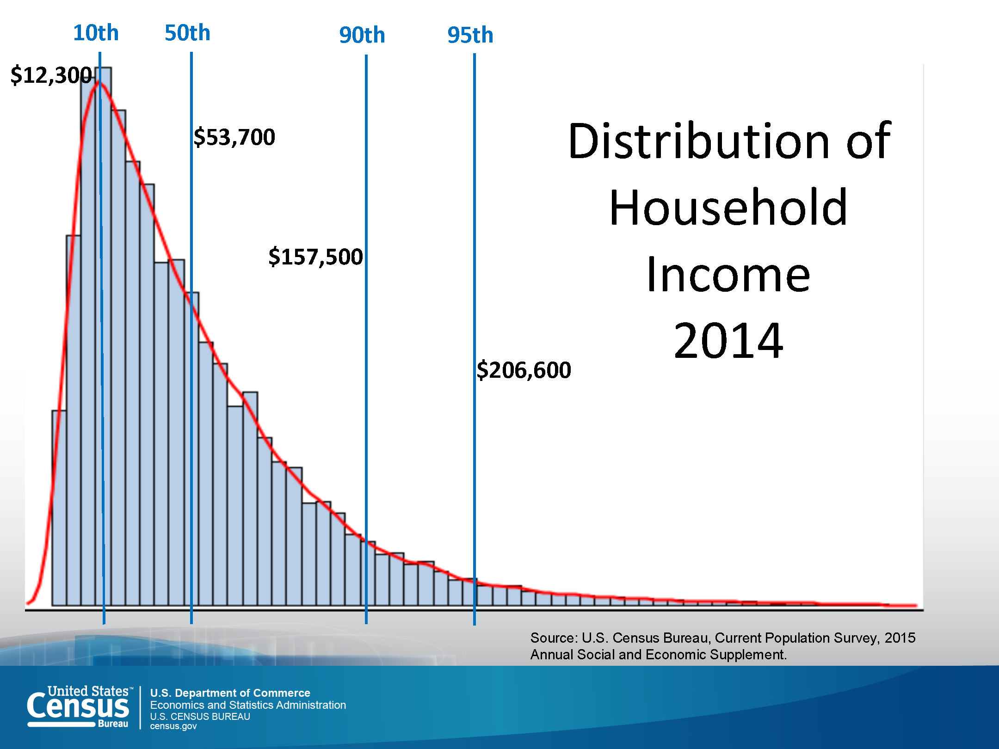
Income distribution in the US
Number of people
Income level
Notes:
Давайте сначала поговорим о распределении дохода семей (т.н. домохозяйств) в США
Перед вами – гистограмма распределения дохода построенная на основании общенационального опроса проведенного в 2014 г.
По горизонтали – уровень дохода до налогов и перераспределения, а высота столбиков показывает, сколько семей располагает доходом такого уровня.

Slide 7
Income distribution in the US
Number of people
Top 5% income share
Income level
Notes:
Интересно отметить, что для того чтобы войти в 5 % семей с самым высоким доходом – в верхние 5% - необходим годовой доход примерно в 206000 долларов. Для того, чтобы войти в верхние 10 процентов – 157,000 итд.

Slide 8
Income distribution in the US
Number of people
Top 10% income share
Income level
Notes:
Мы также видим огромную разницу в доходах между верхними и нижними скобками. Например, верхние 10% располагают в 13 раз большим доходом чем нижние 10%.

Slide 9

A convenient summary of inequality:
The Gini Coefficient (since 1912)
100%
A
Gini =
x 100
A + B
% of
All Income
50%
Equality (45 degrees)
A
Bigger A: More inequality
Smaller A: Less inequality
Inequality
B
Extreme
50%
100%
% of Population
Notes:
The Gini coefficient conveniently summarizes dispersion in a distribution using just one number. This graph uses income inequality as an example. The red line plots income shares held by various population groups. The shape of the income distribution will determine the shape of the red line. A completely equal income distribution corresponds to each person holding an equal share of income, as depicted by a 45 degree dashed orange line. A completely unequal income distribution where one person at the top has all the income and the rest have nothing looks like an L-shape depicted in dark blue.
The average distance between the actual income distribution and completely equal income distribution can be summarized by area A. The larger is area A, the more unequal is the income distribution.

Slide 10
Forming the GINI Coefficient: 2015
Quintile Shares of Income
CUMULATIVE Quintile Shares of Income
Btm 20% 20-40% 40-60% 60-80% Top 20%
20% 40% 60% 80% 100%
Source: 2015 1-year American Community Survey, based on pre-tax household income.
Notes:
Давайте попробуем построить коэффициент Джини для США, опираясь на гистограмму распределения доходов. Мы получаем коэффициент около 0.4.
Надо сказать, что в США неравенство доходов – самое высокое среди развитых стран

Slide 11
Gini Coefficient around the world, 2014
Source: Data taken from the 2014 CIA World Factbook.
Notes:
Страны с наибольшим равенством находятся в западной Европе, а страны с экстремальным неравенством – в Африке и средней Азии: Узбекистан, Таджикистан, Гватемала, Южная Африка. По степени неравенства США сравнимы с Китаем, Аргентиной, Малайзией, Морокко, Мозамбиком, Мадагаскаром, Танзанией итд
Страны с самым равным распределением доходов это Швеция и Чехия

Slide 12
Different Ways of Thinking About Inequality
Income Inequality
  Before taxes and transfers
  After taxes and transfers
Wealth Inequality
Consumption Inequality
Notes:
Доход – это не единственный признак неравенства. Мы получаем гораздо больше информации когда сравниваем неравенство доходов до и после налогов и перераспределения, а также неравенство богатства и потребления.

Slide 13
Consumption is more equal than income
Notes:
Compared to the bottom 10 percent, the top 10 percent have 10 times more pre-tax income. When progressive taxes are imposed, this difference shrinks to 7 times. And yet, they spend only 3.5 times more than the bottom 10th percent.
Again, consumption is more equal than income because high-income households save a larger fraction of their income, and the households at the bottom decile might resort to borrowing in order to finance consumption.
On this graph, there seems to be no trend in consumption inequality, as measured by 90-10 ratio. Other studies find increases in consumption inequality to varying degrees which is not surprising given the trends in income and wealth inequality.

Slide 14
Tax and Transfer Programs and Inequality
2014
Source: U.S. Congressional Budget Office, “The Distribution of Household Income, 2014”, Average Income Before and After Means-Tested Transfers and
Federal Taxes, by Income Group, 2014.
Notes:
The US government collects about 27 cents on every dollar of national income and redistributes 15 cents in the form of transfers

Slide 15
Tax and Transfer Programs across countries
US tax system is less redistributive than that of most developed countries
Source: OECD
Notes:
На графике показаны коэффициенты Джини до и после налогов по разным странам. Страны ранжированы по коэффициенту Джини после налога и соцпрограмм. В США, как видно, гораздо меньше перераспределения дохода чем в других развитых странах.

Slide 16
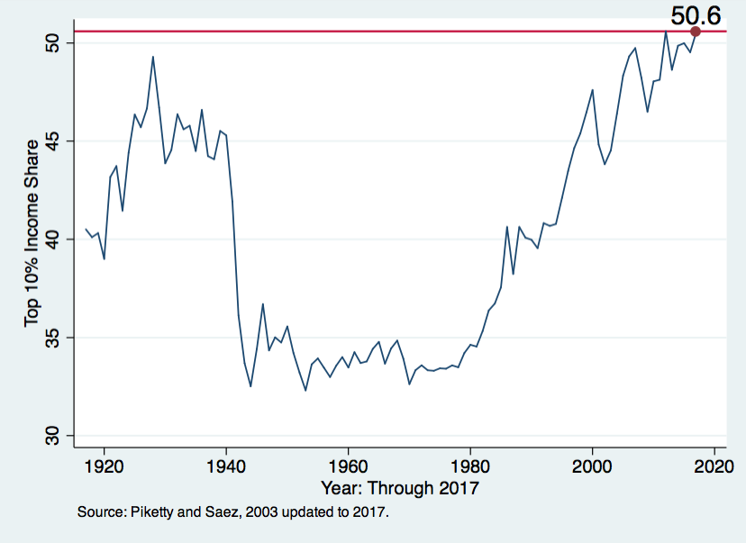
Income inequality over time: Share of Top 10%
1929 Market Crash
2008 Crash
WWII
Dot-com Crash
Notes:
This shows a comprehensive measure of income that includes both labor income and capital income. Notice declines in income inequality during market crashes: this happens because assets bring negative income during market crashes – they experience capital losses.

Slide 17
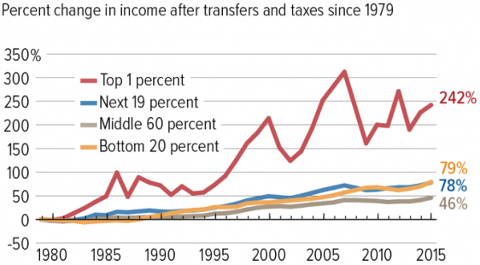
Income inequality trends: winners and losers
Source: Chad Stone, Danilo Trisi, Arloc Sherman, and Roderick Taylor, “A Guide to Statistics on Historical Trends in Income Inequality,”
Center on Budget and Policy Priorities, Policy Futures, Dec. 11, 2018.

Slide 18
Recent Facts on Income Inequality
Beginning in the 1970s, the income gap widened.
  Biggest winners: top 5 %
  Biggest losers: middle-income families
Source: Chad Stone, Danilo Trisi, Arloc Sherman, and Roderick Taylor, “A Guide to Statistics on Historical Trends in Income Inequality,”
Center on Budget and Policy Priorities, Policy Futures, May 15, 2018.

Slide 19
Wealth is distributed more unequally compared to income
Source: Chad Stone, Danilo Trisi, Arloc Sherman, and Roderick Taylor, “A Guide to Statistics on Historical Trends in Income Inequality,”
Center on Budget and Policy Priorities, Policy Futures, Dec. 11, 2018.
Notes:
Top 1% gets about a quarter of national income, but it has about 40 percent of wealth
Bottom 90% have about half the income but only a quarter of wealth.

Slide 20
Wealth group | Number of families | Wealth threshold | Average wealth | Wealth share
Bottom 90% | 144,600,000 |  | $84,000 | 23%
Top 10-1% | 14,463,000 | $660,000 | $1,310,000 | 35%
Top 1-0.1% | 1,446,300 | $3,960,000 | $7,290,000 | 20%
Top 0.1-0.01% | 144,600 | $20,600,000 | $39,700,000 | 11%
Top .01% | 16,070 | $111,000,000 | $371,000,000 | 11%
https://academic.oup.com/view-large/173462481
1/1

Slide 21
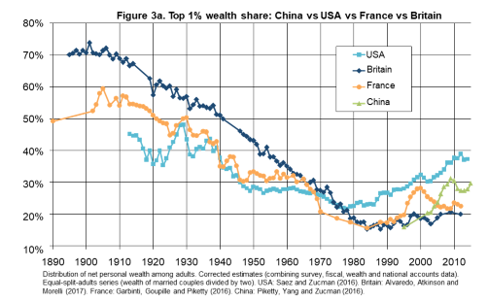
Wealth share of the top 1%: US, UK,
France and China
Notes:
France and china also experienced recent rises in the top 1 percent wealth share. Among the four countries, this share is the highest in the US. In the UK, the top 1% share has been falling for about 100 years, and it became largely stable after 2000
Alvaredo, Facundo, Lucas Chancel, Thomas Piketty, Emmanuel Saez, and Gabriel Zucman. “Global Inequality Dynamics: New Findings from WID.World.” Working Paper. National Bureau of Economic Research, February 2017. https://doi.org/10.3386/w23119.

Slide 22
Why might wealth be distributed more unequally compared to income?
Differences in saving behavior
Wealthy households save a larger fraction of their income; thus, they accumulate more wealth
Differences in rate of return on saving
Wealthy households hold riskier assets (e.g. stocks and private businesses) and receive higher average returns

Slide 23
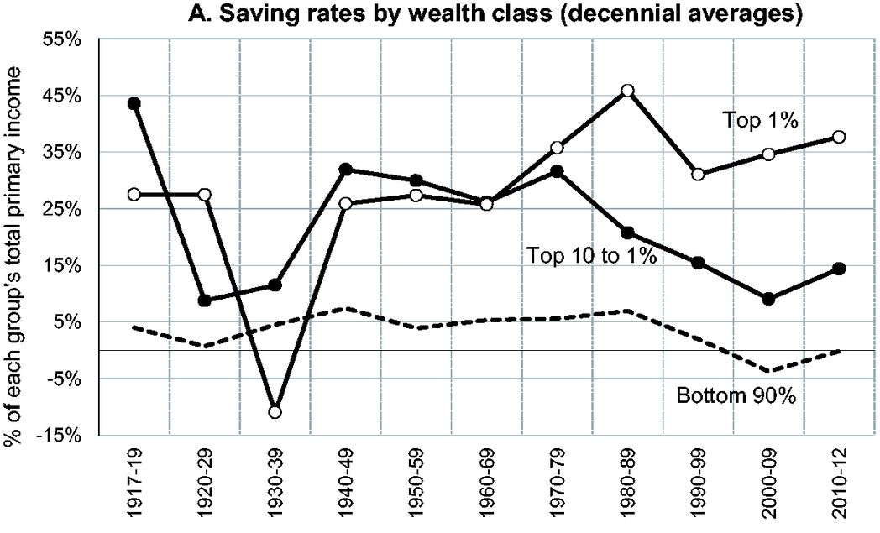
Saving rates by wealth group
Top 1% save over a third of their income
Bottom 90% save little
Source: Saez and Zuchman, Quarterly Journal of Economics, 2016
Notes:
Why do income sources matter for inequality? Return on capital is 6%, adjusted for inflation. So if all capital income is saved, wealth would grow by 6 percent. By way of comparison, a raise is about 2 percent.

Slide 24
Where Does Inequality Come From?
Market Forces
  Technological change
  Job polarization
  Globalization
Government Policy
  Regulation
  Taxation and redistribution of income
Labor Characteristics
  Population composition
    Aging
    Immigration
  Personal Choices
    Educational attainment
    Effort
    Priorities
    Household composition

Slide 25
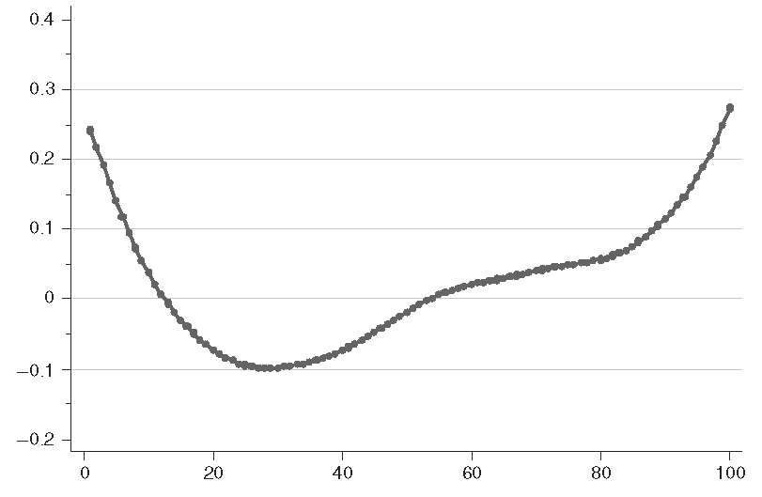
Job polarization: decline of middle-skill occupations
Share of middle-skill jobs has declined
Employment share growth, 1980-2005
Low paying Occupation rank High paying
Source: Autor and Dorn, 2013
Notes:
On the horizontal axis, all jobs are ranked from lowest paying to highest paying. On the vertical axis, we show how many jobs were added in the 25 years since 1980

Slide 26
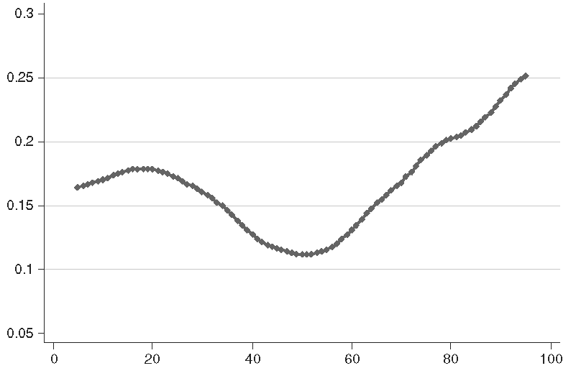
Job polarization: tepid wage growth in the middle
Hourly wage growth, 1980-2005
Low paying Occupation rank High paying
Source: Autor and Dorn, 2013

Slide 27
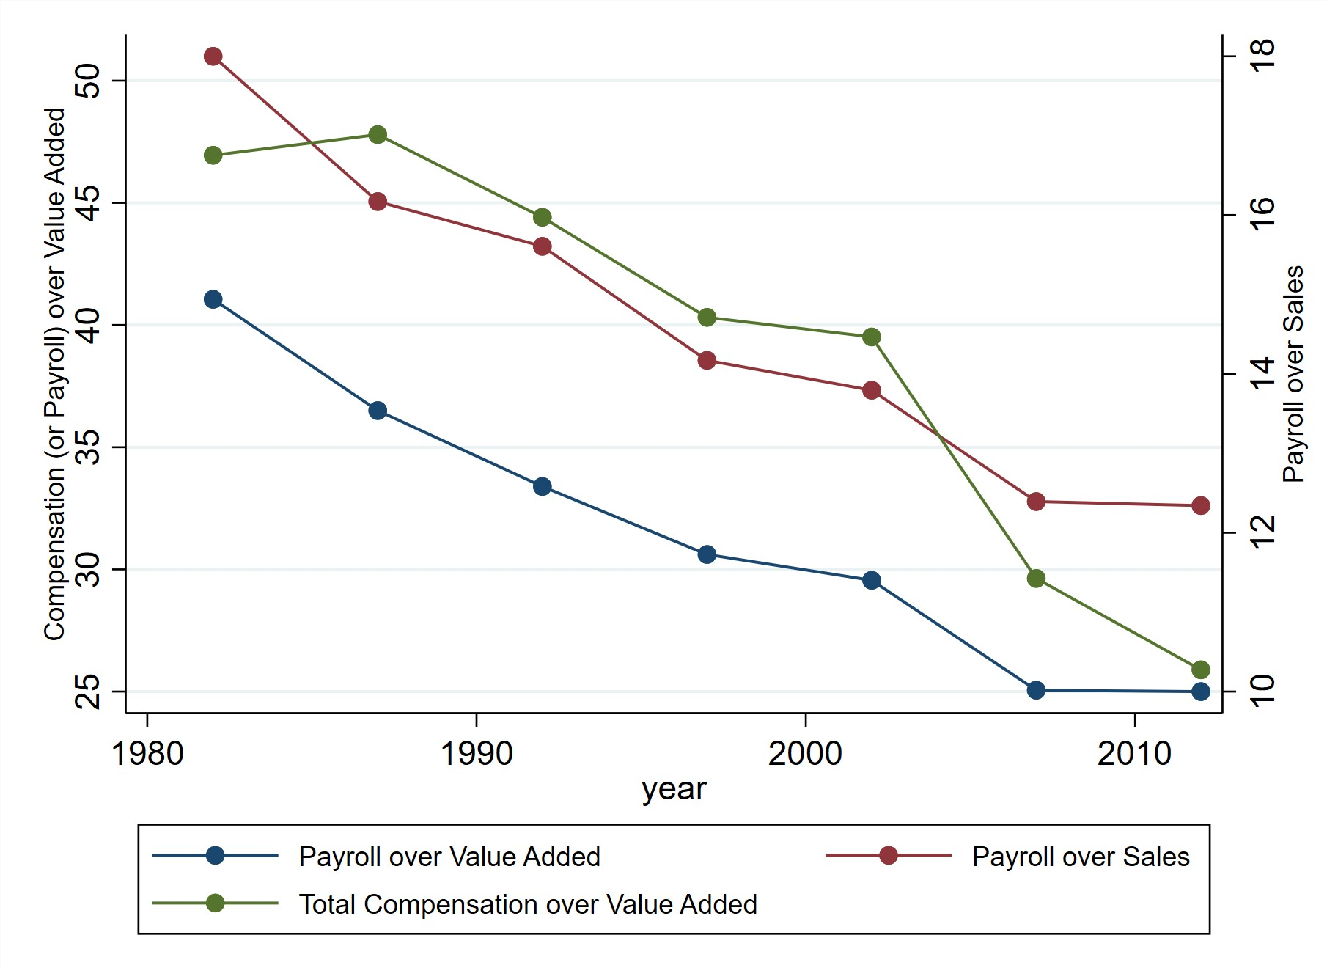
Share of income paid to labor has been falling
Labor income share in manufacturing
Notes:
Производство все больше автоматизируется. В сфере производства товаров, доля труда в добавленной стоимости упала в 2 раза: с 50 % на доллар до 25 %. .
Production is becoming more and more automated. Accordingly, the share of income paid to labor is declining, and the share of income paid to owners of capital is increasing.

Slide 28
Technological Change and Inequality
Much of the technology adopted in the last 30 years has eliminated middle-skill jobs.
  Computers, advanced manufacturing equipment, automation
There is a “winner take all” aspect of the technology-driven economy.
  This likely favors a small group of individuals.
Both aspects increase inequality by increasing the rewards to:
  Those with significant labor market skills
  Owners of assets and intellectual property over workers
Notes:
Современные технологии увеличили вес и значимость компаний-победителей, которые доминируют на своем рынке.
рынков на которых победитель забирает весь выигрыш, то есть компания-победитель доминирует на рынке.
В связи с этим, увеличилось вознаграждение работников, которые обладают исключительными способностями с своей области, а также наметилась тенденция к перераспределению дохода от наемных работников в пользу владельцев бизнеса или интеллектуальной собственности
Modern technologies allow firms with a competitive advantage to easily scale up their production of goods and services. have increased the importance of firms that dominate their markets

Slide 29
Why does economic inequality matter?

Slide 30
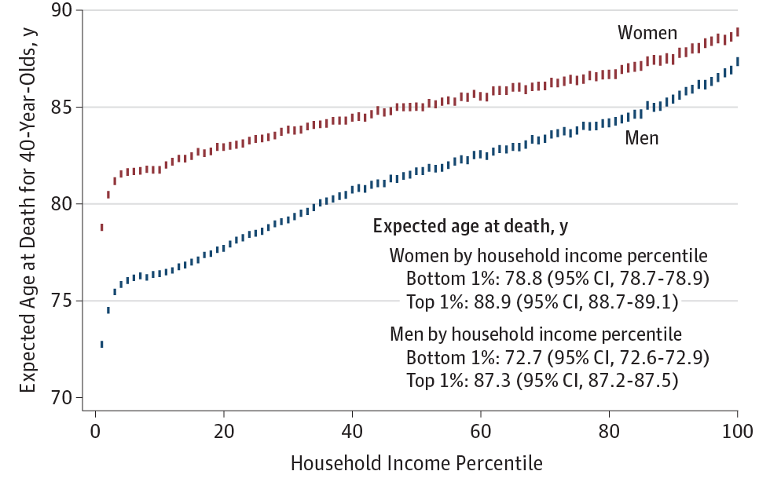
Life expectancy by income group
Top 1% can expect to live about 10 years longer than bottom 10%
Source: Chetty et al., 2016
Notes:
Разница в продолжительности жизни между верхним 1% и нижним 10% составляет 10 лет

Slide 31
Pay grade and health: the Whitehall Study
More than 6000 British civil servants were followed for over a decade
All have identical access to health care
No differences in “long-standing illness” prevalence by pay grade
Compared to the highest pay grade, the lowest pay grade executives are:
      About 2X as likely to have symptoms of depression
      3X as likely to be smokers
      Have significantly higher BMI and blood pressure
Problematic alcohol consumption is associated with higher pay grade
Source: Chetty et al., 2016

Slide 32
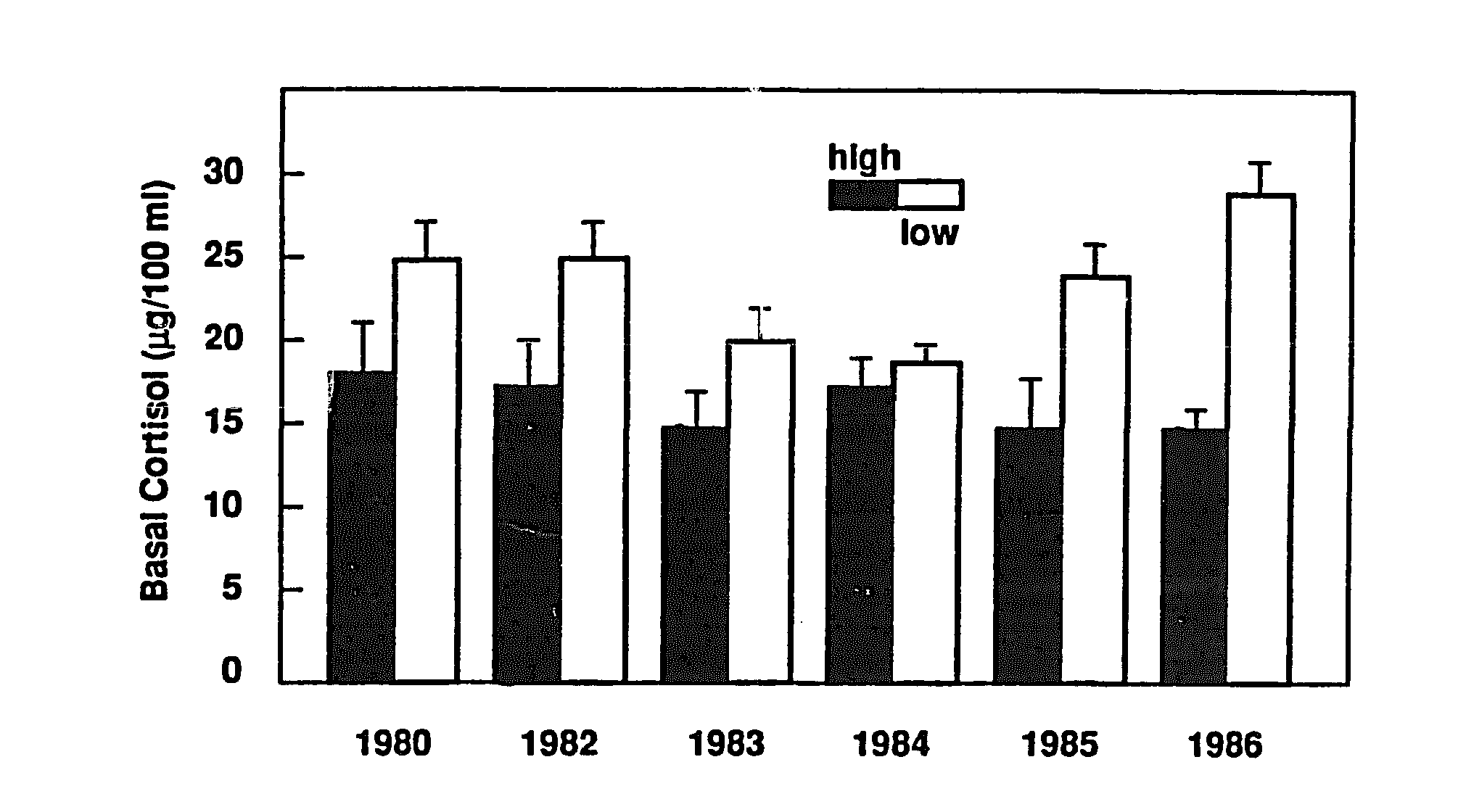
Inequality and toxic stress
Differences in stress hormone levels between high-status and low-status baboons
status
status
Source: Sapolsky (Biol. Psychiatry, 1990)
Notes:
The association between status in a hierarchy and stress can be tested only in a very strict hierarchy which modern humans rarely have. Therefore, the cleanest experiment comes from the animal kingdom – the primates.
Male baboon were tracked for 6 years. Those that rank low in the hierarchy showed elevated levels of stress hormone cortisol compared to high-status baboons.
Sapolsky, Robert M. “Adrenocortical Function, Social Rank, and Personality among Wild Baboons.” Biological Psychiatry 28, no. 10 (November 15, 1990): 862–78. https://doi.org/10.1016/0006-3223(90)90568-M.

Slide 33
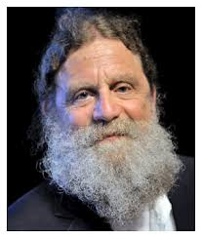
Inequality and lack of social cohesion
“For the poor, more inequality means more anger at what they don’t have and more cognitive load from the worry about how to keep up. For the wealthy, it’s more fear about the menace of the have-nots and more effort put into walling themselves off from them. For everyone, there’s less social support - by definition, the more widely-spread and unequal a hierarchy, the fewer peers one has, and true social support requires the symmetry of peers.”
  Robert Sapolsky, Professor of Biology and Neurology, Stanford University
Notes:
A society with high inequality experiences a deficit of social support, people feel less alike and this makes them care about one another less. Unequal sociaeties have difficulties agreeing on common policy goals, so they are more fragmented and divided.

Slide 34
Inequality and intergenerational income mobility
Higher income mobility
Source: Corak (2011), OECD, CEA estimates
Notes:
This is so-called great Gatsby curve. On the horizontal is the Gini coefficient for developed countries as of 1985. On the vertical axis is a chance that the children will not overtake their parents in the income ranking. This is based on the intergenerational data comparing income rank of parents to income rank of their children. It seems that countries that are initially more unequal have a more difficult time with children doing better than their parents in terms of the income rank.

Slide 35
Inequality and intergenerational income mobility
.
United States
(2010 Gini)
Higher income mobility
Source: Corak (2011), OECD, CEA estimates
Notes:
This is the projection of a slowdown in the US income mobility

Slide 36
What can/should be done about inequality?

Slide 37
Government policy tools
RE-distribution
  Tax system
  Transfers
    Direct aid
    Food stamps
    Medicaid
Market Influence: PRE-distribution
  Characteristics of labor
    Access to education
  Effects on labor demand
    Market regulation
      Antitrust policy
      Intellectual property policy
    Labor regulations
      Minimum wage, overtime, health insurance, etc.
      Occupational licensing

Slide 38
Addressing Inequality: Long Term
Focus on education
  Public education, in particular
    Reduce disparities in quality of public education
    Improve counseling in low-income schools
      With respect to college – paths to success and funding
  Investments are needed in early education, not later
    Universal pre-K
    Upgrade quality of elementary schools in low-income areas
Focus on childhood poverty
    Childhood poverty was shown to have long-lasting adverse effects
Notes:
Funding public education from property taxes creates inequalities. Nationally, house prices vary by a factor of at least 10.
Intergenerational poverty:
McEwen, Craig A., and Bruce S. McEwen. “Social Structure, Adversity, Toxic Stress, and Intergenerational Poverty: An Early Childhood Model.” Annual Review of Sociology 43, no. 1 (2017): 445–72. https://doi.org/10.1146/annurev-soc-060116-053252.

Slide 39
What to do About Inequality?
Nothing?
Redistribution?
PRE-distribution?
Early access to resources?

Slide 40
Summary
Income inequality is clearly increasing.
  The economy is favoring owners of assets and intellectual property over labor.
The causes appear to be largely driven by:
  The market – technology, competition, and trade
  Changing institutions/regulation.
Open questions are:
  To act or not to act?
  If so, how?
The level of inequality is a policy choice.

Slide 41
Thank you!
Any Questions?
www.NEEDelegation.org
Dmitriy Stolyarov, Ph.D.
stolyar@umich.edu
Contact NEED: info@needelegation.org
Submit a testimonial: www.NEEDelegation.org/testimonials.php
Become a Friend of NEED: www.NEEDelegation.org/friend.php

