Slide 1


Economic Inequality
Jon Haveman, Ph.D.
Executive Director, NEED
Redwood High School Economics
April 22-23, 2021

Slide 2
Credits and Disclaimer
This slide deck was authored by:
  Jon Haveman, Executive Director of NEED
This slide deck was reviewed by:
  Timothy Smeeding, University of Wisconsin
  Robert Wright, Augustana University
Disclaimer
  NEED presentations are designed to be nonpartisan
  It is, however, inevitable that the presenter will be asked for and will provide their own views
  Such views are those of the presenter and not necessarily those of the National Economic Education Delegation (NEED)

Slide 3
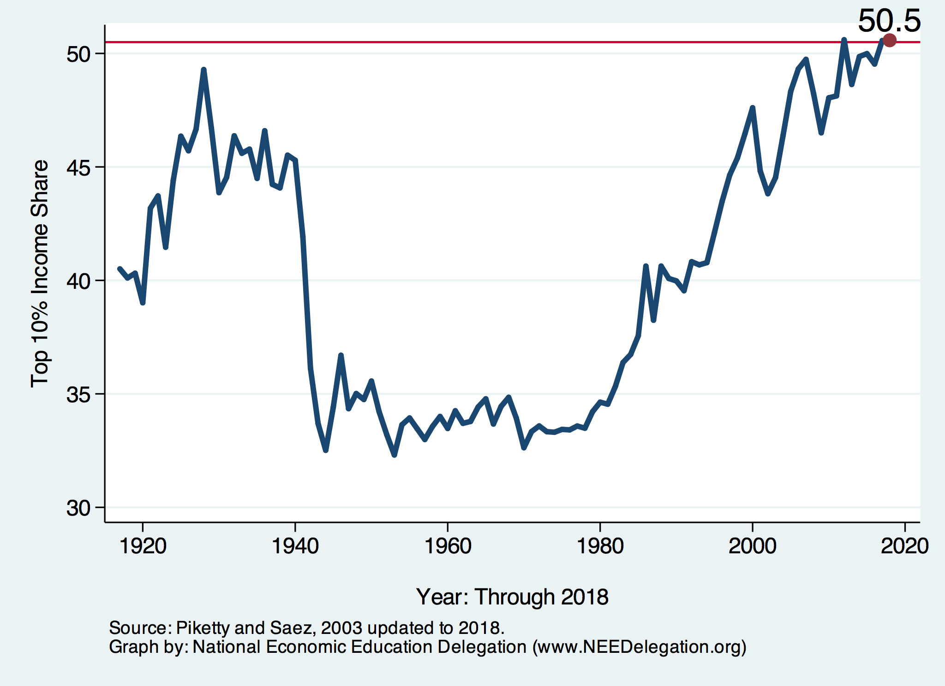
National Income Inequality: Share of Top 10%
Stock Market Crash
WWII
Housing Bubble
Dot-com Bubble

Slide 4

The Abrupt Increase in Inequality
Source: Chad Stone, Danilo Trisi, Arloc Sherman, and Roderick Taylor, “A Guide to Statistics on Historical Trends in Income Inequality,”
Center on Budget and Policy Priorities, Policy Futures, Dec. 11, 2018.
Notes:
Slide taken from page 10, Chad Stone, Danilo Trisi, Arloc Sherman, and Roderick Taylor, “A Guide to Statistics on Historical Trends in Income Inequality,” May 15, 2018

Slide 5
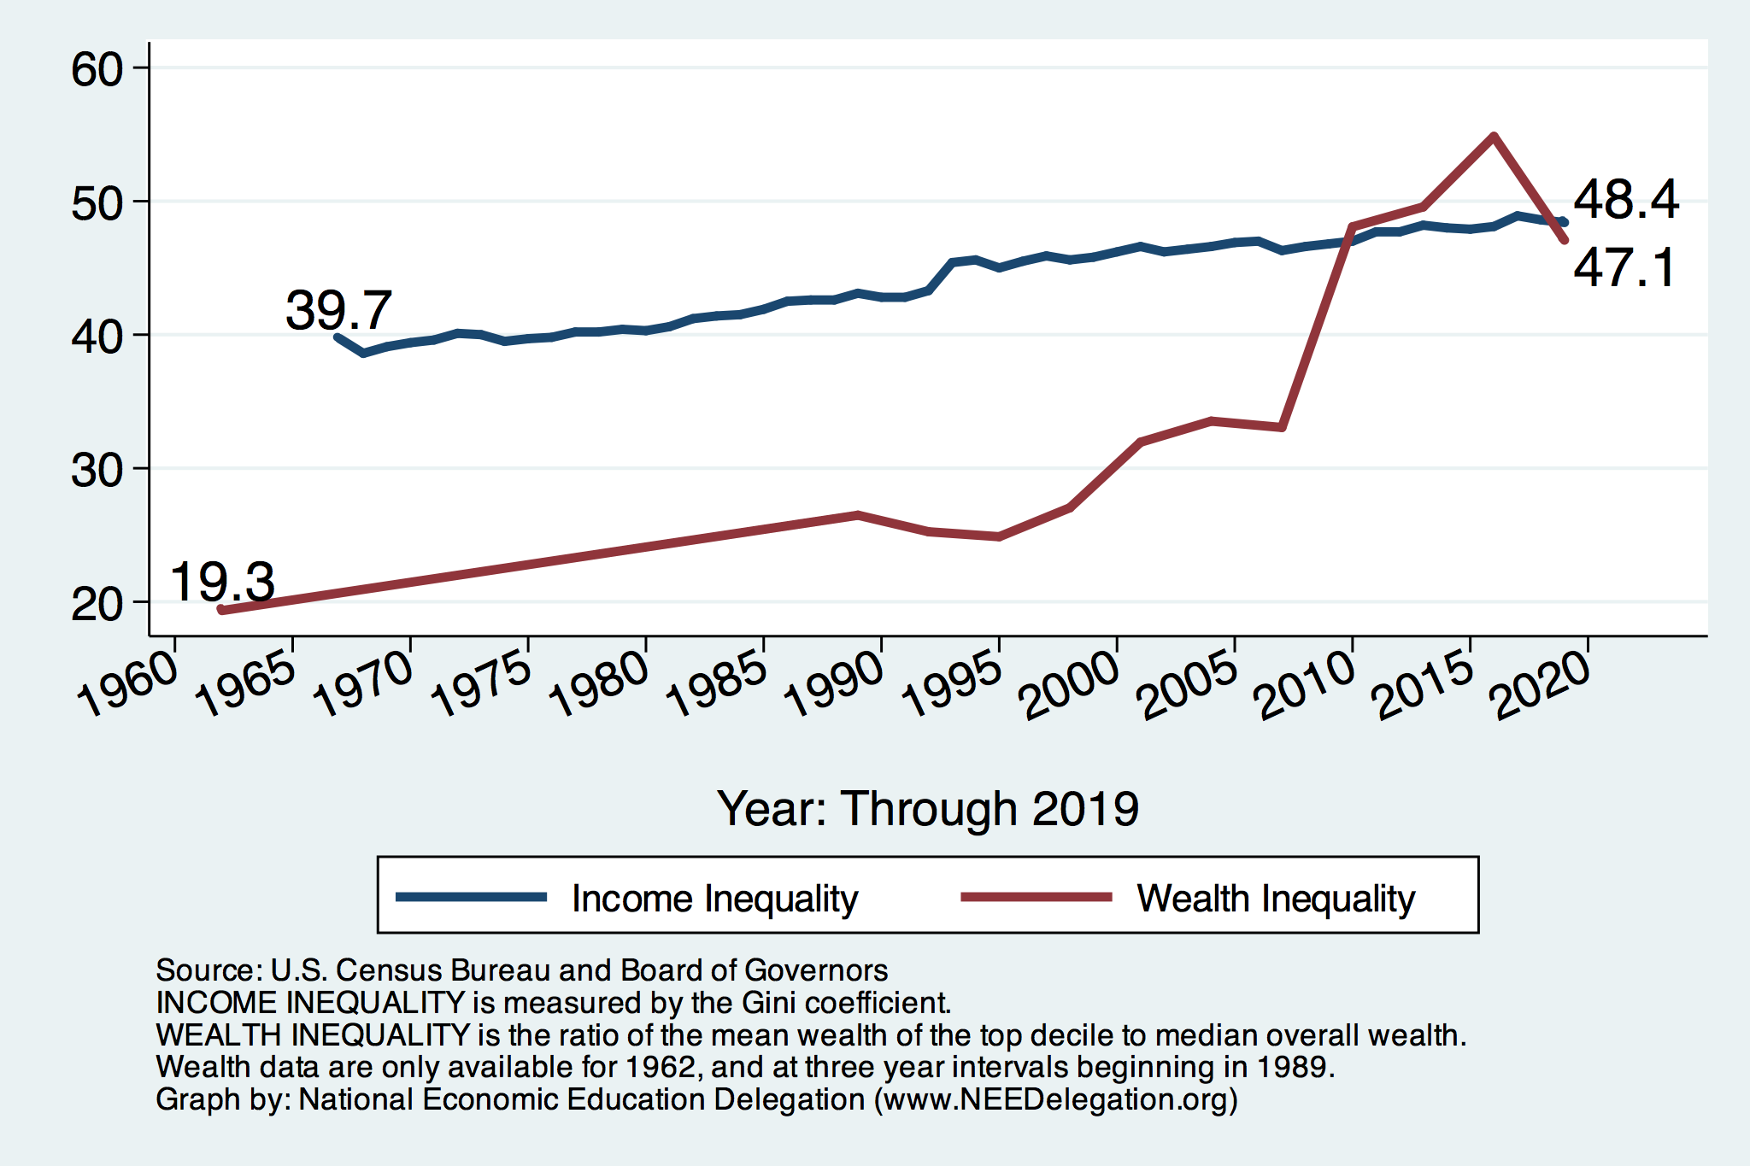
Income and Wealth Inequality
Income Inequality (Gini)
US: 48.1%
CA: 48.7%
Marin: 53.2% - all time high

Slide 6
Wealth Inequality Exceeds Income Inequality
Source: Chad Stone, Danilo Trisi, Arloc Sherman, and Roderick Taylor, “A Guide to Statistics on Historical Trends in Income Inequality,”
Center on Budget and Policy Priorities, Policy Futures, Dec. 11, 2018.

Slide 7
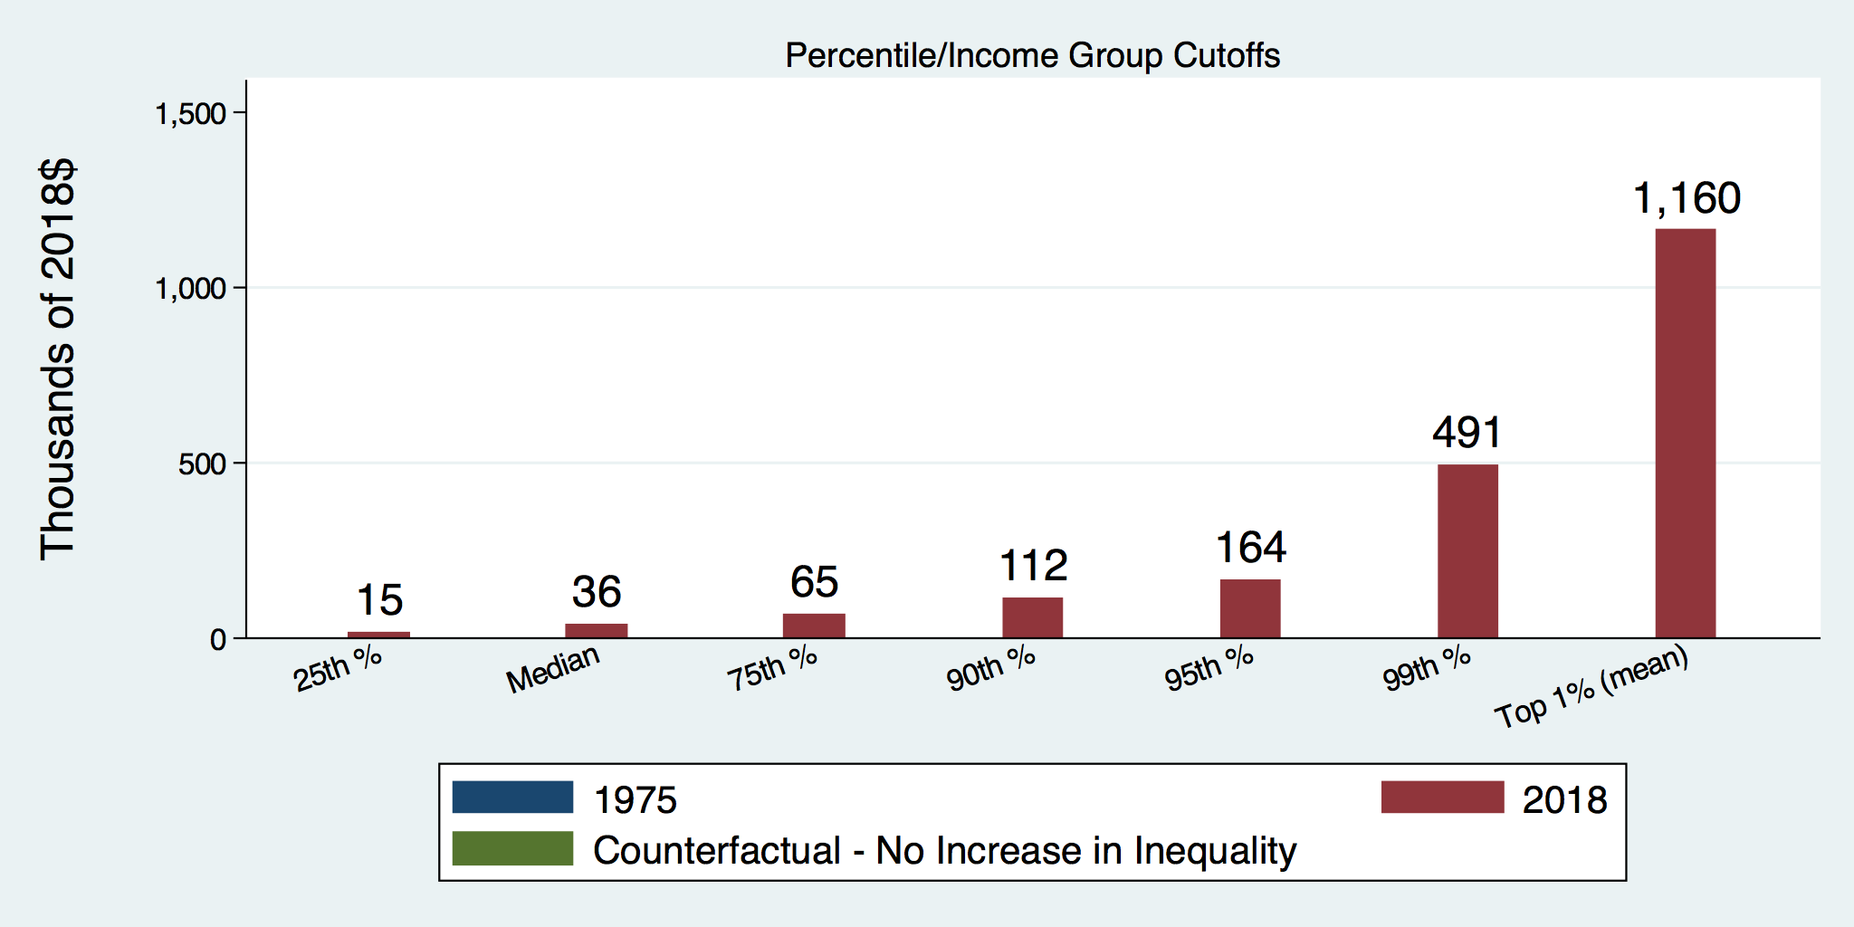
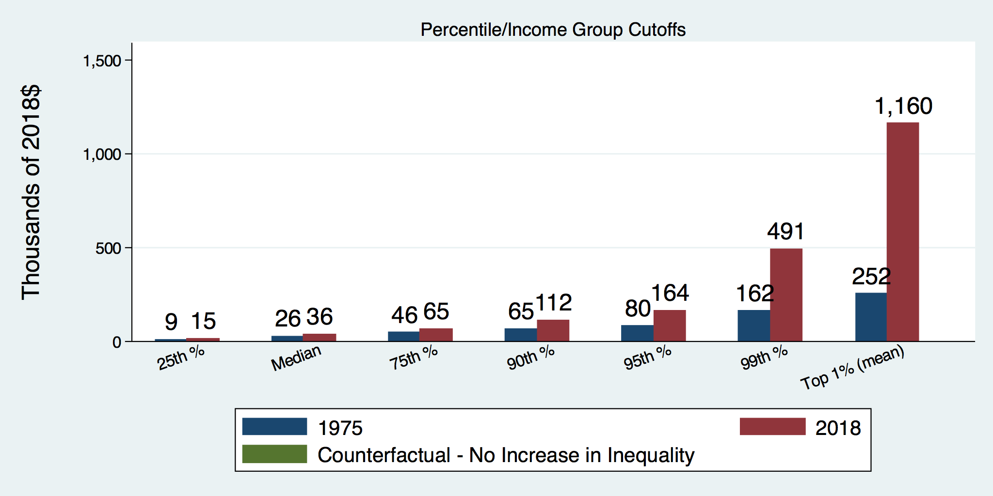
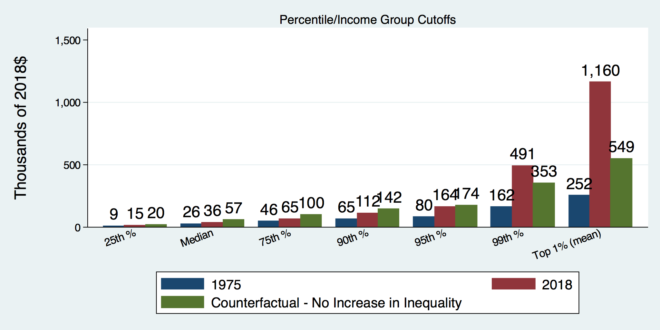
How Has Inequality Influenced Incomes?

Slide 8
Where Does Inequality Come From?
Labor characteristics
  What do workers bring to the market?
Market forces
  How does the market value the labor characteristics?
Government policies
  PRE-distribution – affecting markets
  Redistribution – affecting incomes

Slide 9

Why Does Inequality Matter?
Too little inequality can:
  Reduce individual motivation
  Slow economic growth
Too much inequality can:
  Reduce individual motivation
  Slow economic growth
Too much inequality may also:
  Divide society
  Distort political environment
  Reduce political participation
  Reduce investments in public goods
    Education
    Environmental protections

Slide 10
How Much Inequality Is too Much?
GDP Sweet Spot
?
?
Equity
Efficiency
Efficiency
Equity
Efficiency
Equity
0
100
Z’’
Z
Z’
X
Gini Coefficient

Slide 11
Addressing Inequality: Is It A Problem?
Why it might be a problem.
  Economic issues (Efficiency)
    There is evidence that at some level, increased inequality slows economic growth.
    Or, inequality concentrates resources among investors.
  Noneconomic issues (Equity)
    Values, ethics and morals will drive individual evaluations of the level of inequality.
      E.g., inequality is primarily a function of market outcomes, so should be left alone.
      Or, a solid middle class is important for maintaining a civil society, which runs contrary to a high degree of inequality.
Suppose you think it’s a problem. It can be addressed through policy.

Slide 12
An International Perspective
U.S.: 17-18
Canada, UK, Germany: 12-13
Italy, France, Japan: 7-9

Slide 13
Tension in Policy Solutions
Is it possible to increase growth at the same time that you reduce income inequality?
  Common refrain among some that government intervention in the economy is always and everywhere bad for growth.
Possibly: expanding equality of access promotes the full utilization of resources.
  Expanding equality of access requires resources likely from the well-to-do.

Slide 14
Summary
Income inequality is clearly increasing.
  The economy is clearly favoring owners of productive resources over labor.
The causes appear to be largely driven by:
  The market – technology, competition, and trade
  Changing institutions.
Open questions are:
  To act or not to act?
  If so, how?
The level of inequality is a policy choice.

Slide 15
Thank you!
Any Questions?
www.NEEDelegation.org
Jon Haveman, Ph.D.
Jon@NEEDelegation.org
Contact NEED: info@needelegation.org
Submit a testimonial: www.NEEDelegation.org/testimonials.php
Become a Friend of NEED: www.NEEDelegation.org/friend.php

