Slide 1


Economic Inequality
Jon D. Haveman, Ph.D.
Executive Director, NEED
Science & Society, Woodland, CA
February 25, 2021

Slide 2
National Economic Education Delegation
Vision
  One day, the public discussion of policy issues will be grounded in an accurate perception of the underlying economic principles and data.
Mission
  NEED unites the skills and knowledge of a vast network of professional economists to promote understanding of the economics of policy issues in the United States.
NEED Presentations
  Are nonpartisan and intended to reflect the consensus of the economics profession.

Slide 3
Credits and Disclaimer
This slide deck was authored by:
  Jon Haveman, Executive Director of NEED
This slide deck was reviewed by:
  Timothy Smeeding, University of Wisconsin
  Robert Wright, Augustana University
Disclaimer
  NEED presentations are designed to be nonpartisan
  It is, however, inevitable that the presenter will be asked for and will provide their own views
  Such views are those of the presenter and not necessarily those of the National Economic Education Delegation (NEED)

Slide 4
Outline: Economic Inequality
Recent Changes
How does it happen?
Does it matter?
What to do about it
Inequality & Coronavirus

Slide 5
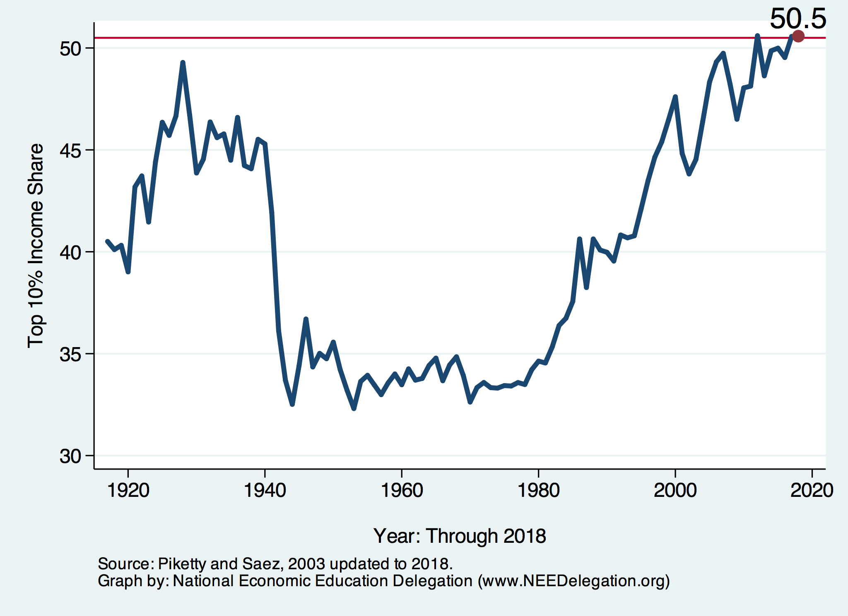
National Income Inequality: Share of Top 10%
Stock Market Crash
WWII
Housing Bubble
Dot-com Bubble

Slide 6

The Abrupt Increase in Inequality
Source: Chad Stone, Danilo Trisi, Arloc Sherman, and Roderick Taylor, “A Guide to Statistics on Historical Trends in Income Inequality,”
Center on Budget and Policy Priorities, Policy Futures, Dec. 11, 2018.
Notes:
Slide taken from page 10, Chad Stone, Danilo Trisi, Arloc Sherman, and Roderick Taylor, “A Guide to Statistics on Historical Trends in Income Inequality,” May 15, 2018

Slide 7
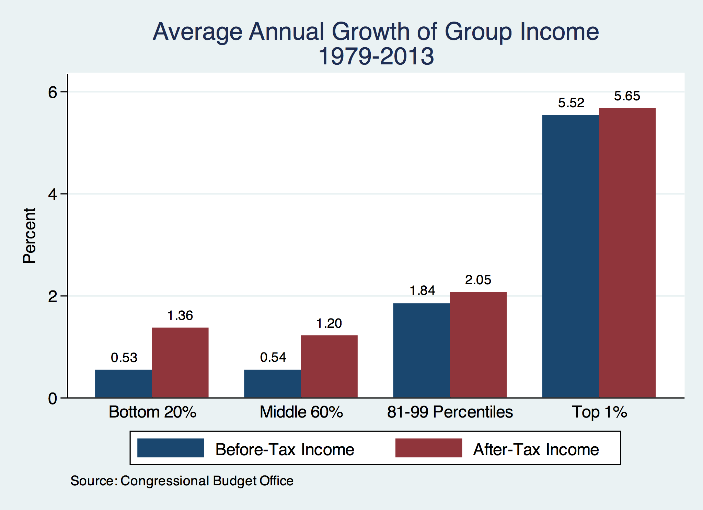
Growth Has Been Primarily at the Very Top

Slide 8
Tale of Two Periods
Increases in inequality have been consistent since late 1970s.
Causes have not:
  1980-2000 - Changing returns to education.
  2000-ongoing - Shifting income from workers to owners.

Slide 9
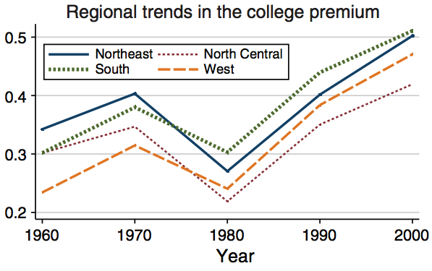
Returns to Education
College grads make almost
50% more than those
with only a HS diploma.
Source: https://pubs.aeaweb.org/doi/pdfplus/10.1257/aer.101.6.2309

Slide 10

Labor Income is Unhinged from Productivity
Why?
Declining unionization
Globalization
Competition policy
Cheap technology

Slide 11
Income Share Changes Between 1970 and 2017
1970
2017
Share of All Income
% of Population
Income Quintiles
Source: U.S. Census Bureau, Current Population Survey, Annual Social and Economic Supplements.

Slide 12
Income Changes from Growing Inequality
Bottom 90%
of Households

Slide 13
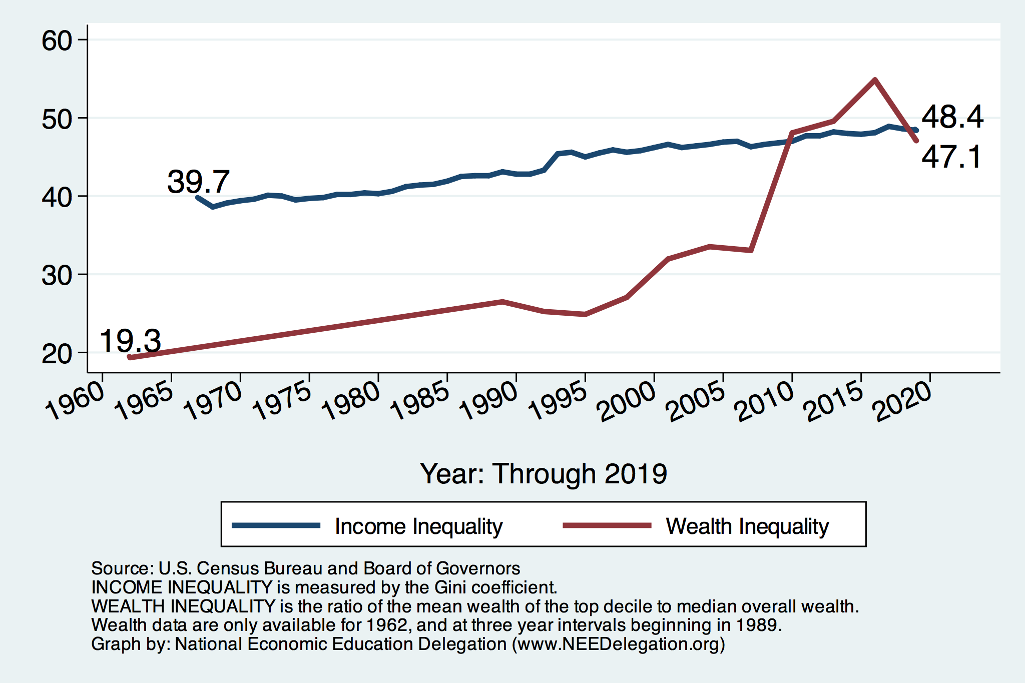
Income and Wealth Inequality
Income Inequality (Gini)
US: 48.4%
CA: 48.7%
Yolo County: 50.9%

Slide 14
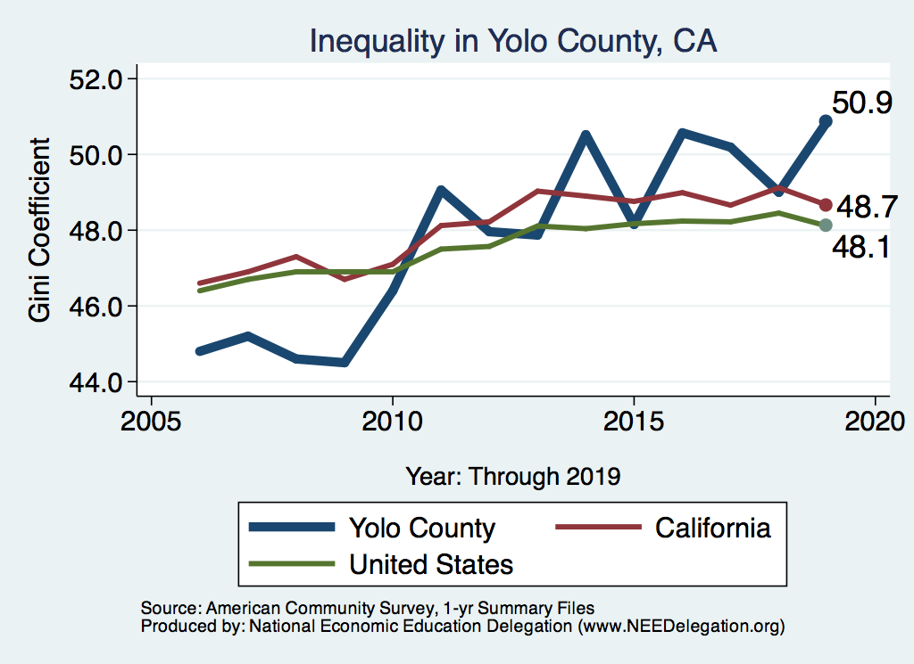
Your Local Income Inequality

Slide 15
Wealth Inequality Exceeds Income Inequality
Source: Chad Stone, Danilo Trisi, Arloc Sherman, and Roderick Taylor, “A Guide to Statistics on Historical Trends in Income Inequality,”
Center on Budget and Policy Priorities, Policy Futures, Dec. 11, 2018.

Slide 16
Where Does Inequality Come From?
Labor Characteristics
  Demographics
    Age distribution
  Personal Choices
    Educational attainment
    Effort
    Priorities
Market Forces
  Technology
  Changing demand patterns
  Competition for labor
Government Policy
  Market influence
  Redistribution

Slide 17
Tax and Transfer Programs: Income Shares
2016
Source: U.S. Congressional Budget Office, “The Distribution of Household Income, 2016”, Average Income Before and After Means-Tested Transfers and
Federal Taxes, by Income Group, 2016.

Slide 18
Market Forces and Inequality
Changing demand patterns
  Technology
  Globalization
  Industry composition
    PCs instead of typewriters
    Services instead of goods
    Professional services instead of personal services
Competition in labor markets
  Unionization
  Market concentration

Slide 19

Declining Unionization
Unionization Rates
1983: 20.1%
2020: 10.8%
Unionization Rates
Public: 34.8%
Private: 6.3%
Source: https://inequality.org/facts/income-inequality/, Bureau of Labor Statistics and Emmanueul Saez, University of Califonria, Berkeley
Notes:
https://voxeu.org/article/forms-and-sources-inequality-united-states

Slide 20
Competition in the Economy
Return on invested capital excluding goodwill –
US publicly-traded nonfinancial firms, 1965-2014
Source: Jason Furman, ”Forms and sources of inequality in the United States”, VOX, March 17, 2016, Figure 6.
Notes:
Note: The return on invested capital definition is based on Koller et al (2015), and the data presented here are updated and augmented versions of the figures presented in Chapter 6 of that volume. The McKinsey data includes McKinsey analysis of Standard & Poor’s data and exclude financial firms from the analysis because of the practical complexities of computing returns on invested capital for such firms. ​
Source: Koller et al. (2015); McKinsey & Company; Furman and Orszag (2015). , by way of https://voxeu.org/article/forms-and-sources-inequality-united-states
Furman, J and P Orszag (2015), “A Firm-Level Perspective on the Role of Rents in the Rise in Inequality”, Presentation at “A Just Society” Centennial Event in Honor of Joseph Stiglitz Columbia University, October 16, 2015.

Slide 21
Technological Change and Inequality
Much of the technology adopted in the last 30 years has eliminated low-skill or low-wage jobs.
  Computers, advanced manufacturing equipment, steel mini-mills, automation
There is a “winner take all” aspect of the tech-driven economy.
  This likely favors a small group of individuals.
Both aspects increase inequality by increasing the rewards to:
  Those with significant labor market skills.
  Owners over workers

Slide 22


Technology can Hurt Low Income Workers
Early on, technology was good to low income workers
Until it was bad for them….

Slide 23
Globalization
What is globalization?
  Flow of goods, services, capital, and labor across international borders.
How does it affect inequality?
  Through a differential impact on low-skilled workers and hence their wages
  For the United States, globalization is thought to lower the wages of low skilled and hence low-wage workers relative to those of high-skilled workers

Slide 24

CEO Pay Has Been Growing Rapidly

Slide 25

CEO Pay Has Been Growing Rapidly

Slide 26
What is driving increasing inequality?
Primary drivers:
  Technology
  Institutions
  Globalization
These drivers can also influence personal choices in ways that affect measured income inequality.
  For example, educational choices or labor force participation.
    Returns to education go down, people get less education.

Slide 27

Why Does Inequality Matter?
Too little inequality can:
  Reduce individual motivation
  Slow economic growth
Too much inequality can:
  Reduce individual motivation
  Slow economic growth
Too much inequality may also:
  Divide society
  Distort political environment
  Reduce political participation
  Reduce investments in public goods
    Education
    Environmental protections

Slide 28
An International Perspective: Comparables
U.S.: 17-18
Canada, UK, Germany: 12-13
Italy, France, Japan: 7-9

Slide 29
Addressing Inequality: Is It A Problem?
Why it might be a problem.
  Economic issues (Efficiency)
    Increased inequality may slow economic growth.
    Or, inequality concentrates resources among investors.
  Noneconomic issues (Equity)
    Values, ethics and morals will drive individual evaluations of the level of inequality.
      Is GDP the best measure of well being?
Suppose you think it IS a problem. How might it be addressed?

Slide 30

Addressing Inequality:
Immediately Available Policy Solutions (1/2)
RE-distribution
  Tax and transfer programs
PRE-distribution
  Strengthen labor unions
  Collective bargaining
  Other policies that favor labor over business owners
  Minimum wages

Slide 31
Addressing Inequality:
Immediately Available Policy Solutions (2/2)
Other
  Reverse trends in market power
Locally
  Employment services: job training, interview skills, or assistance with day-to-day issues, such as child care
  Cognizance of the potential for technologies to affect worker/employer power dynamics
    Uber, Lyft, etc.
Notes:
Reference your own experience at FTC

Slide 32
Addressing Inequality:
Long Term
It’s all about access to resources:
  Education, in particular
    Improve public education.
    Reduce disparities in quality of public education.
    Improve counseling in low-income schools.
      With respect to college – paths to success and funding.
  Investments are needed in early education, not later.
    Universal pre-K.
    Upgrade quality of elementary schools in low-income areas.

Slide 33
Summary
Income inequality is clearly increasing.
  The economy is clearly favoring owners of productive resources over labor.
The causes appear to be largely driven by:
  The market – technology, competition, and trade
  Changing institutions.
Open questions are:
  To act or not to act?
  If so, how?
The level of inequality is a policy choice.

Slide 34
Coronavirus and Inequality
Job losses primarily among low-wage workers.
Resources to weather the storm.
Racial inequities.
Educational inequities.
Rich are getting richer.

Slide 35
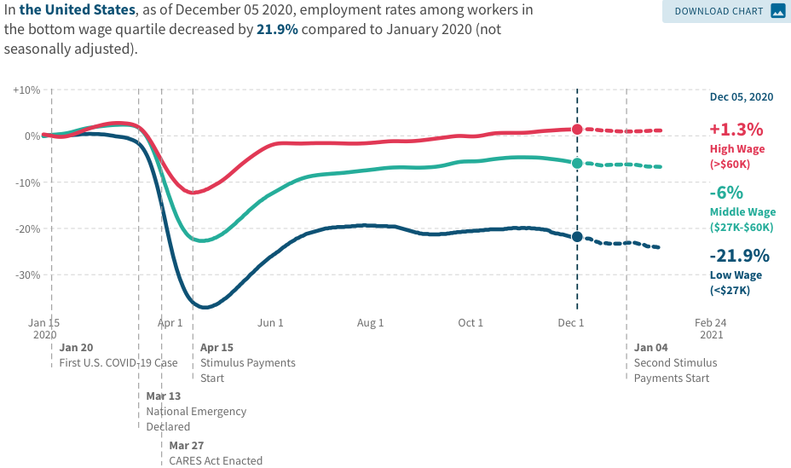
Spending Patterns Since First US Case
Source: https://tracktherecovery.org/

Slide 36
Financial Insecurity Before Coronavirus
40% of Americans don’t have the cash to pay for a $400 emergency expense
25% have no retirement or pension savings
Less than 60% can answer at least three basic financial literacy questions correctly.
1 in 5 of adults knows someone impacted by the opioid crisis.
About 25% of borrowers who attended a for-profit college are behind on student loan payments compared with about 10% who attended a public or private college
Source: The Federal Reserve, Survey of Household Economics and Decisionmaking,

Slide 37
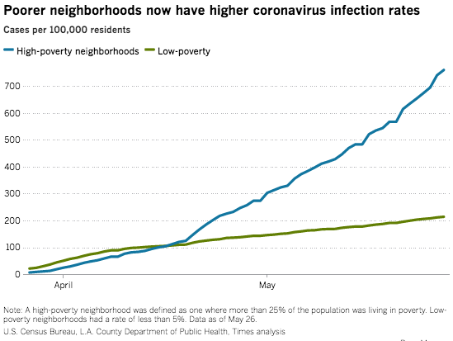
Los Angeles County

Slide 38
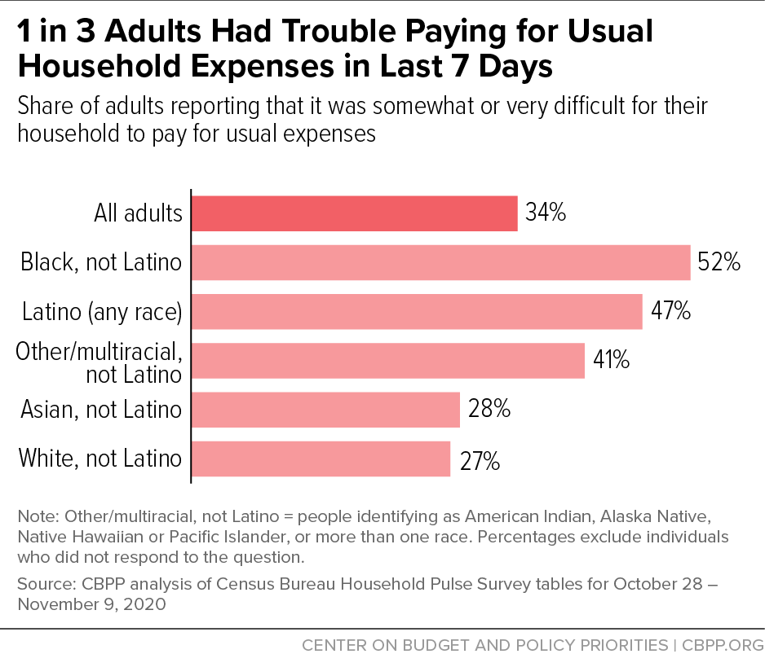
Low Income Troubles

Slide 39
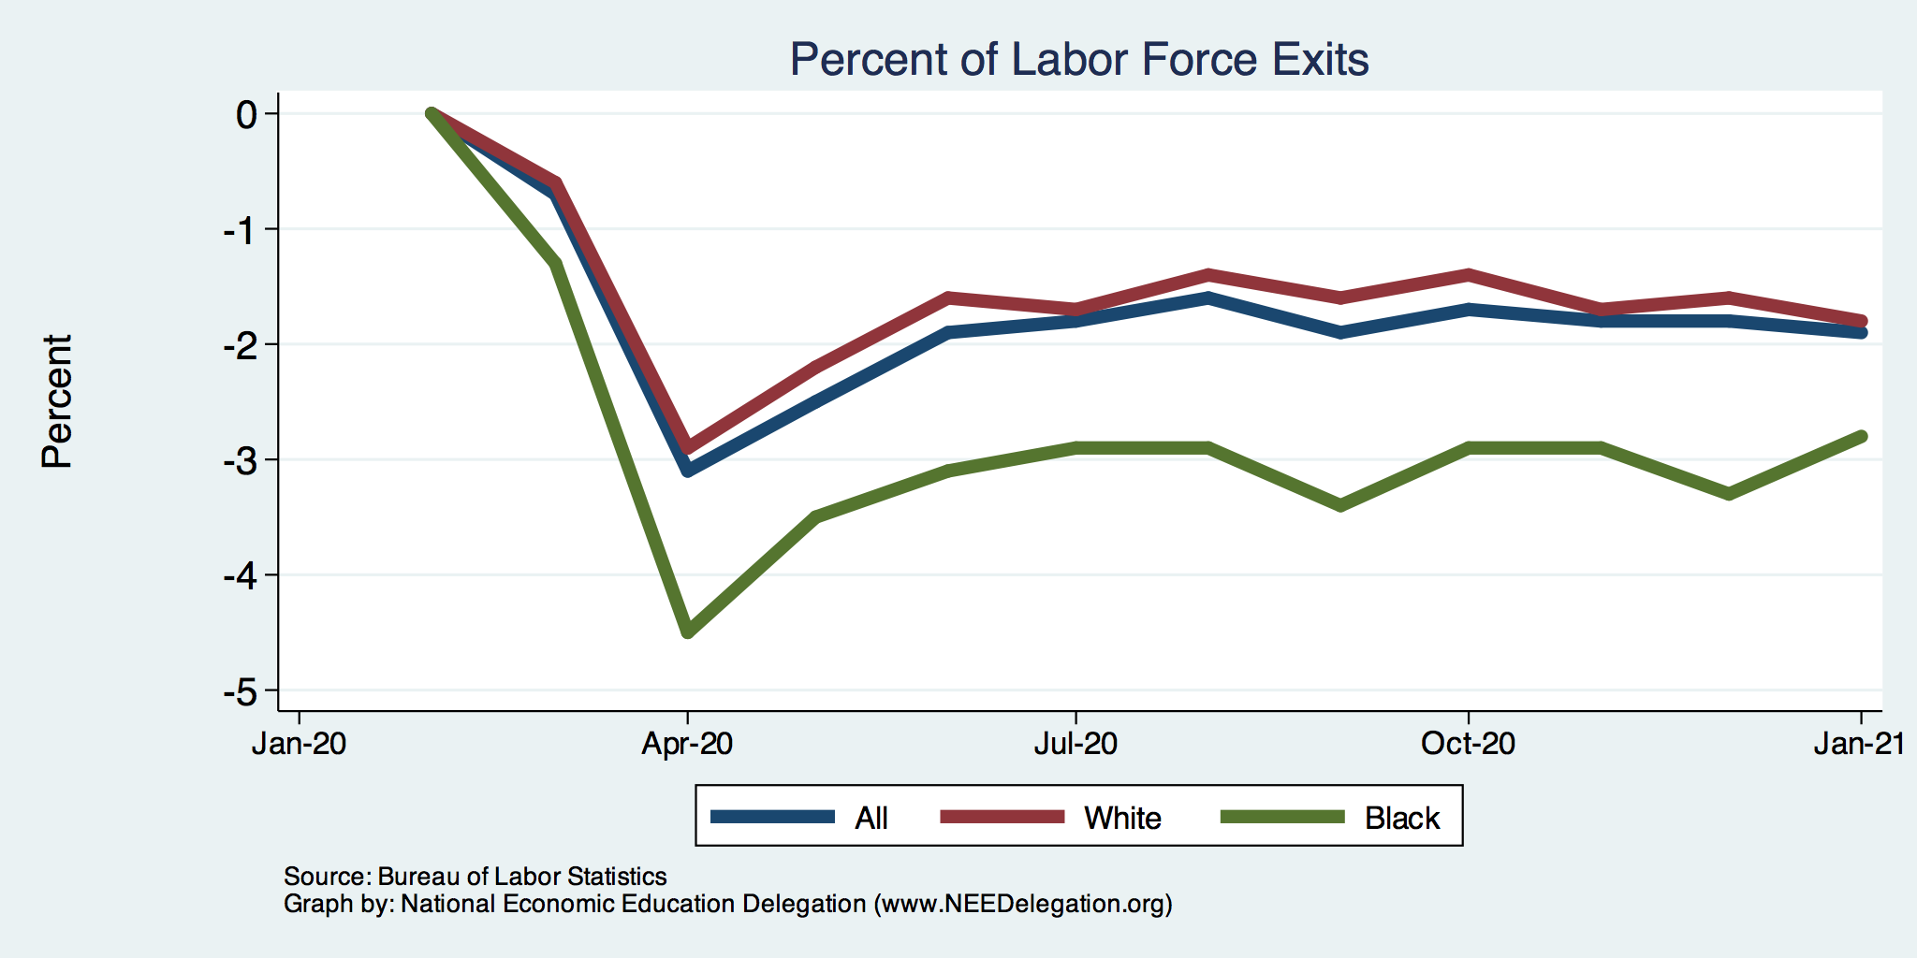
Affecting Black Workers More than White
White
Black

Slide 40
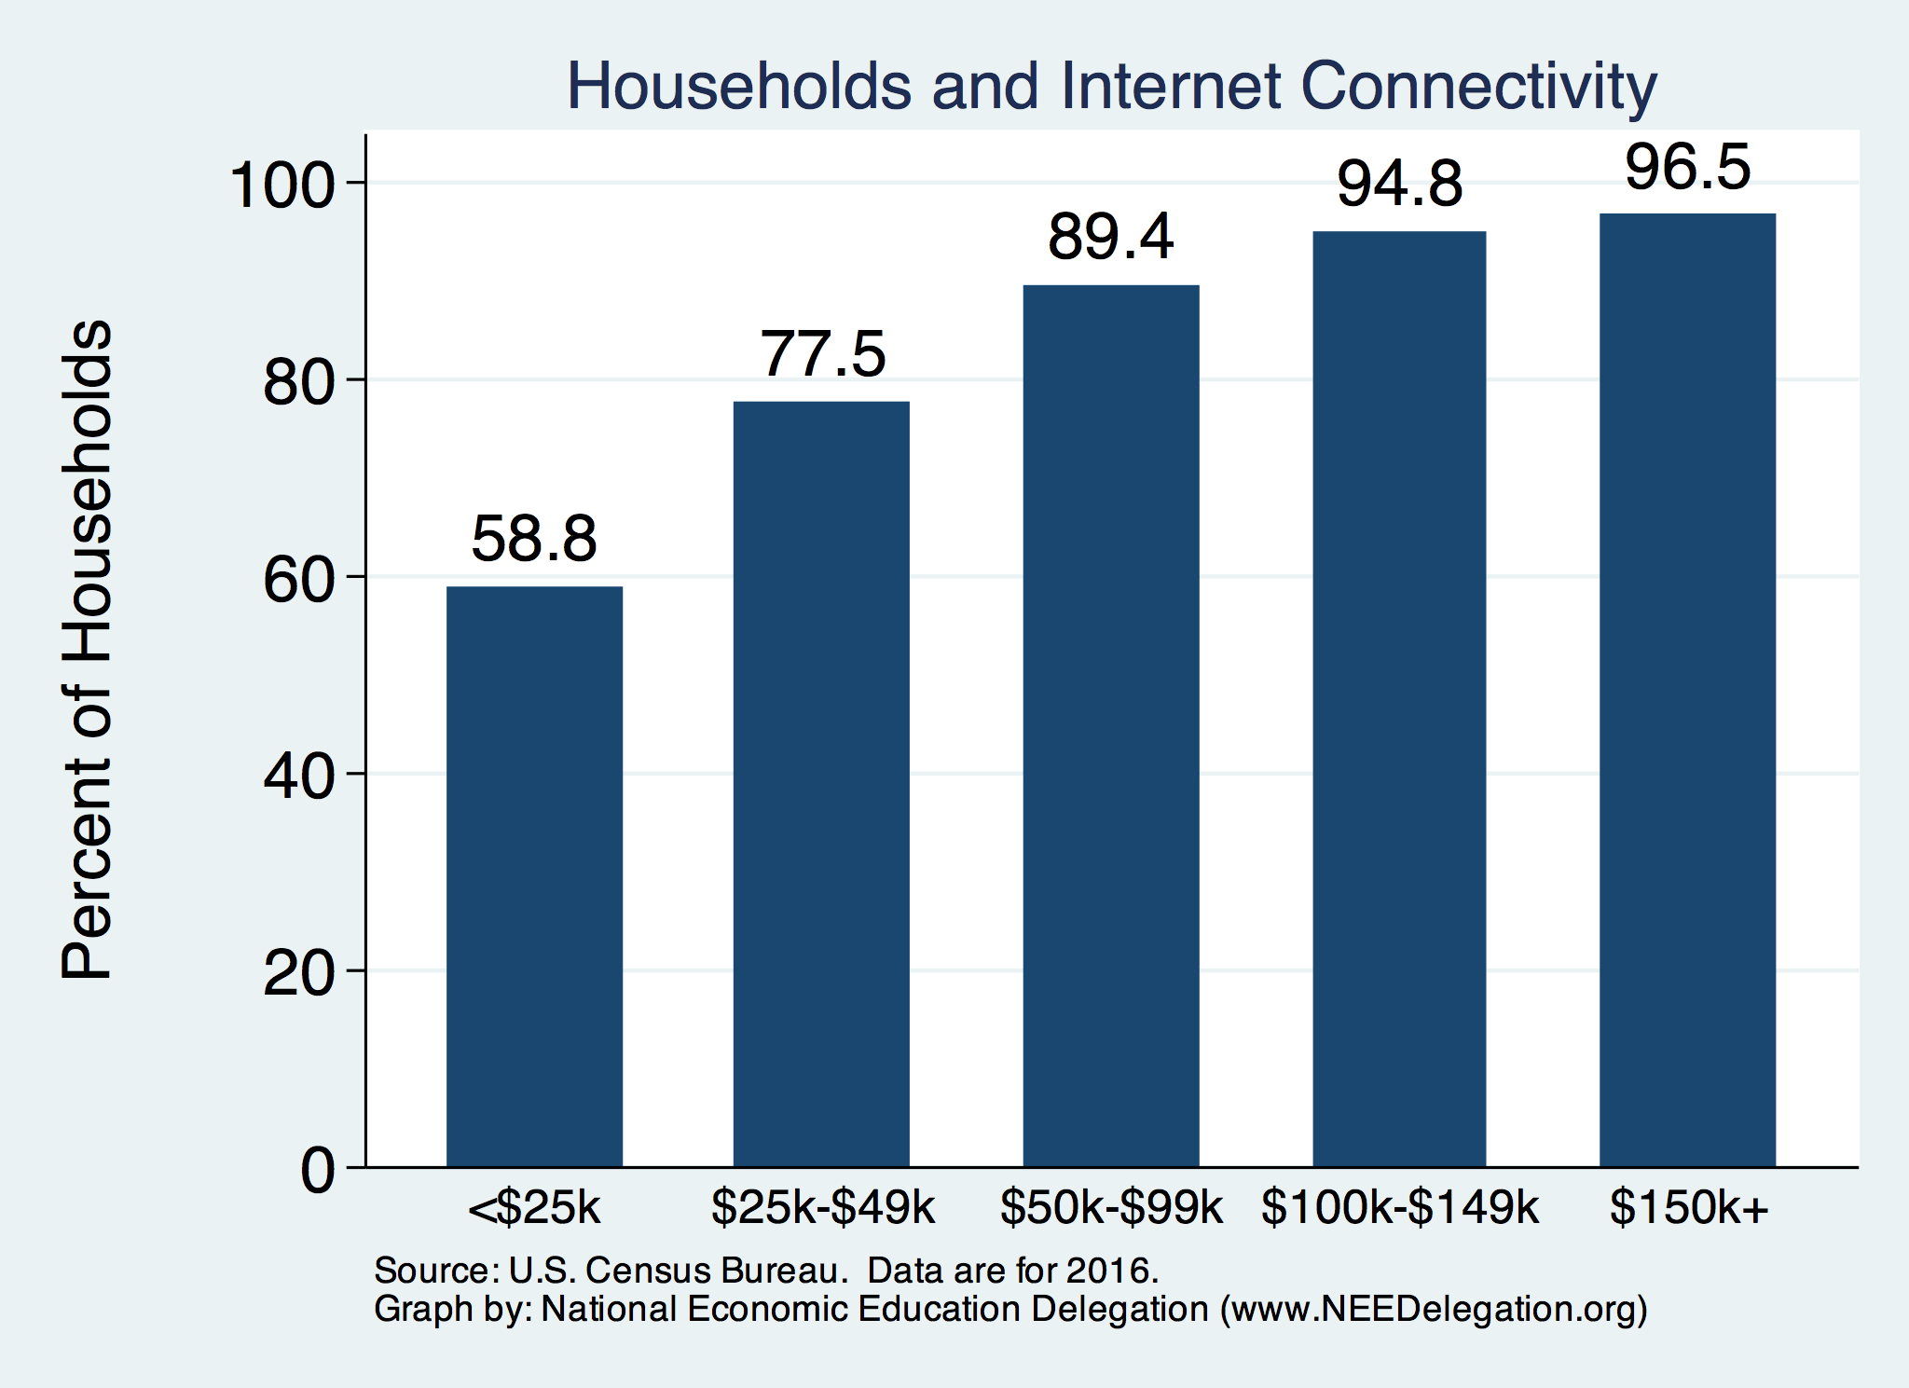
Home Schooling - Access to the Internet

Slide 41
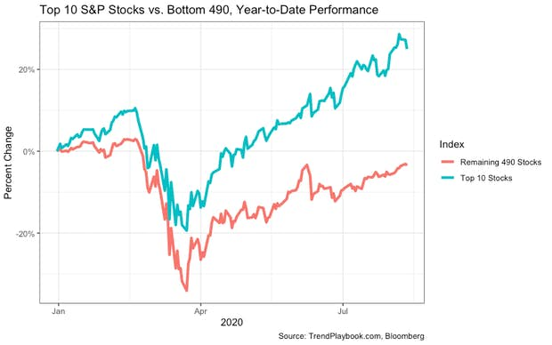
Recovery/Recession for Whom?
Top 10 S&P Stocks:
Apple
Microsoft
Amazon
Facebook
Alphabet Class A shares
Alphabet Class C shares
Berkshire Hathaway
Johnson & Johnson
Visa
Procter & Gamble

Slide 42
Rich Getting Richer
As of November 17, the combined wealth of 647 U.S. billionaires increased by almost $960 billion since mid-March, the beginning of the pandemic lockdown.
Since March, there are 33 new billionaires in the U.S.
Driving this exploding inequality are 12 companies whose profits are coming at the expense of workers and communities.
They include retailers like Walmart, Amazon, Target, and Dollar Tree and Dollar Store, gig economy companies like Instacart, and food producers like Tyson Foods and private equity firms like BlackRock.
Source: Inequality.org

Slide 43
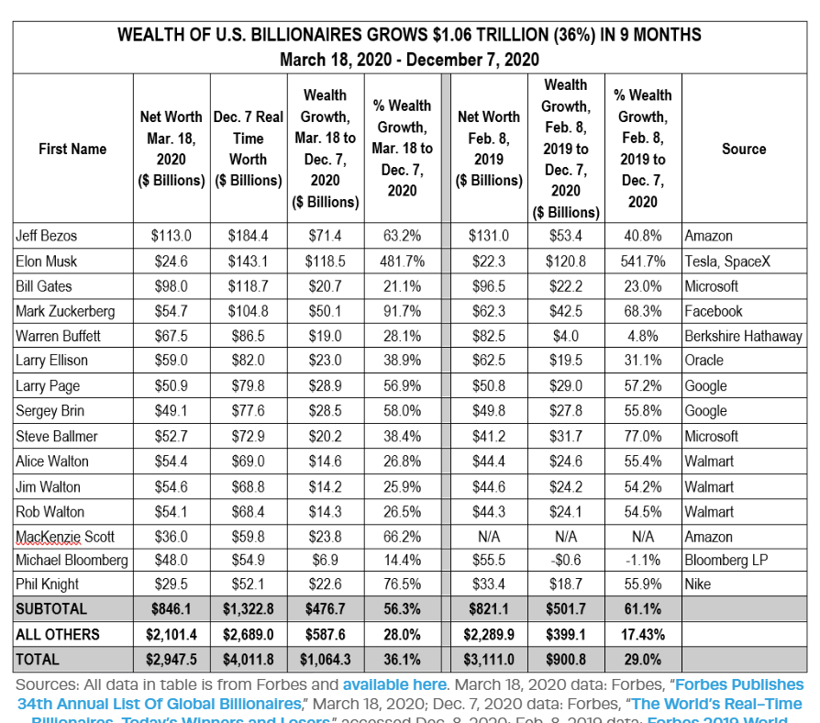
Gains by American Billionaires

Slide 44
Income and Wealth Inequality
Because of the pandemic.
Income Inequality (Gini)
US: 48.4%
CA: 48.7%
Yolo County: 50.9%

Slide 45
Thank you!
Any Questions?
www.NEEDelegation.org
Jon D. Haveman, Ph.D.
Jon@NEEDelegation.org
Contact NEED: info@needelegation.org
Submit a testimonial: www.NEEDelegation.org/testimonials.php
Become a Friend of NEED: www.NEEDelegation.org/friend.php

Slide 46
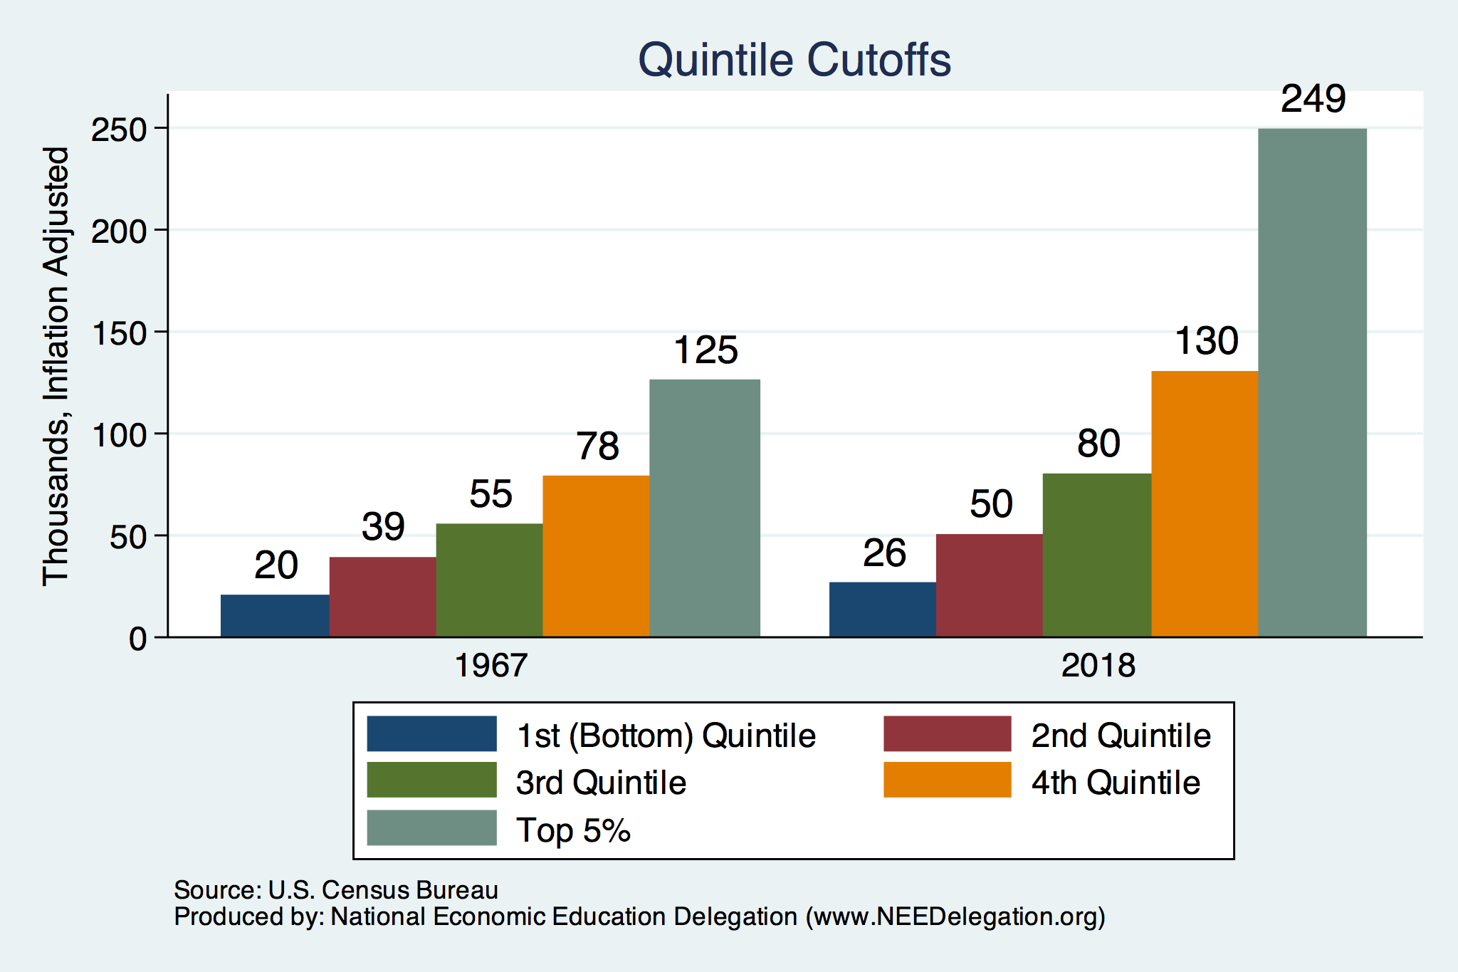
Quintile Income Cutoffs
Top 5%

