Slide 1
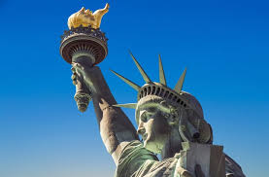
The Economics of Immigration
Tiger 21
Vancouver, BC, Canada
June 9, 2022
Jo Beth Mertens, PhD

Slide 2
National Economic Education Delegation
Vision
One day, the public discussion of policy issues will be grounded in an accurate perception of the underlying economic principles and data.
Mission
NEED unites the skills and knowledge of a vast network of professional economists to promote understanding of the economics of policy issues in the United States.
NEED Presentations
Are nonpartisan and intended to reflect the consensus of the economics profession.

Slide 3
Credits and Disclaimer
This slide deck was authored by:
Anna Maria Mayda, Georgetown University
Robert Gitter, Ohio Wesleyan University
Roger White, Whittier College
This slide deck was reviewed by:
Kirk Doran, Notre Dame
Ethan Lewis, Dartmouth College
Disclaimer
NEED presentations are designed to be nonpartisan.
It is, however, inevitable that presenters will be asked for and will provide their own views.
Such views are those of the presenter and not necessarily those of the National Economic Education Delegation (NEED).

Slide 4
Outline
Why do people migrate?
Brief history of immigration to the US
How does immigration affect the economy?
Economic effects of immigration in the US– what do the data tell us?

Slide 5
Why Do People Migrate?
Push factors:
Economic dislocation, violence, population pressures, religious persecution, or denial of political rights.
Pull factors:
Potential for higher wages, job opportunities, and political or religious liberty.
Uneven development helps create push and pull factors:
Disparities in income, standards of living, and the availability of jobs within and across societies.
Source: Gilder Lehrman Institute of American History.

Slide 6
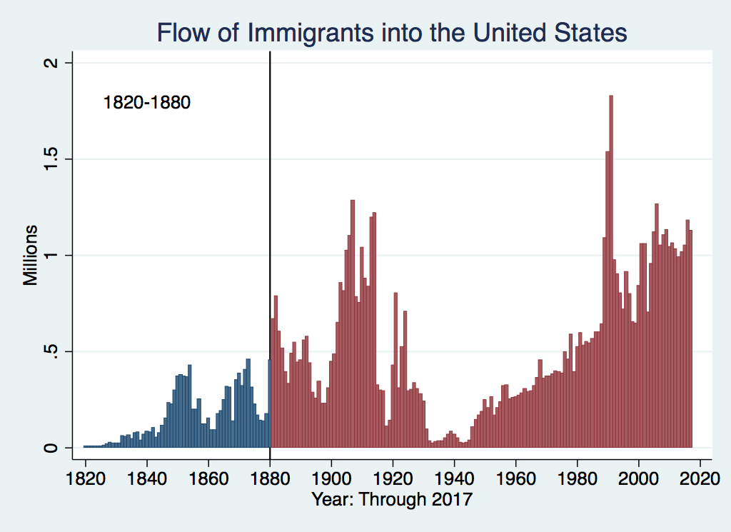
History of US Immigration
Source Countries | 1820-1880
Germany | 3,000,000
Ireland | 2,800,000
Britain | 2,000,000
Austro-Hungarian empire | 1,000,000
Canada | 750,000
China | 230,000
African countries | 50,000
Potato Famine
https://www.libertyellisfoundation.org/immigration-timeline

Slide 7
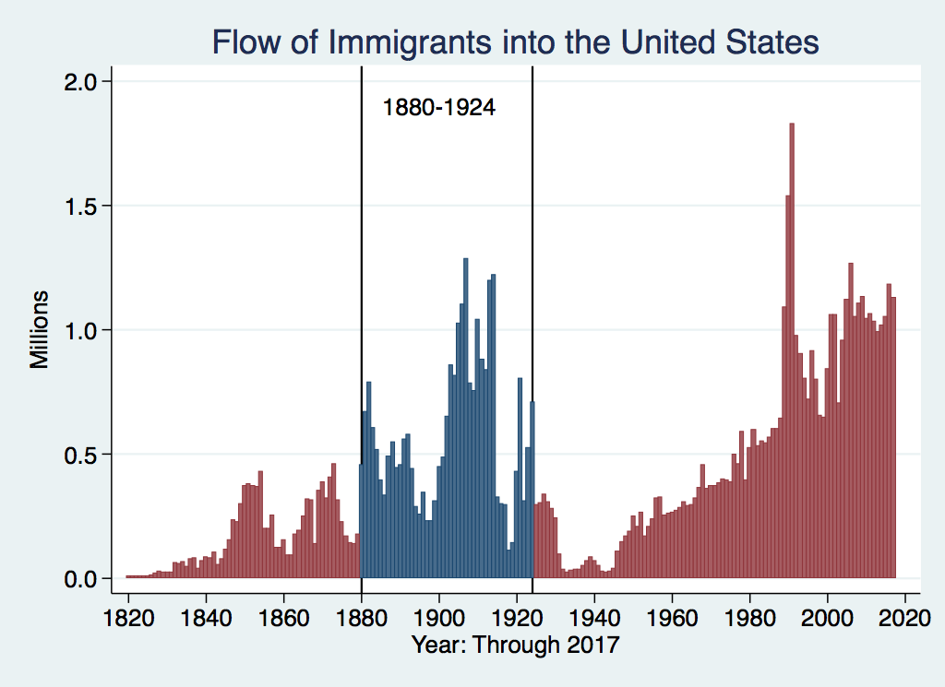
History of US Immigration
Source Country | 1880-1930
Italy | 4,600,000
Austro-Hungarian empire | 4,000,000
Russian empire | 3,300,000
German empire | 2,800,000
Britain | 2,300,000
Canada | 2,300,000
Ireland | 1,700,000

Slide 8
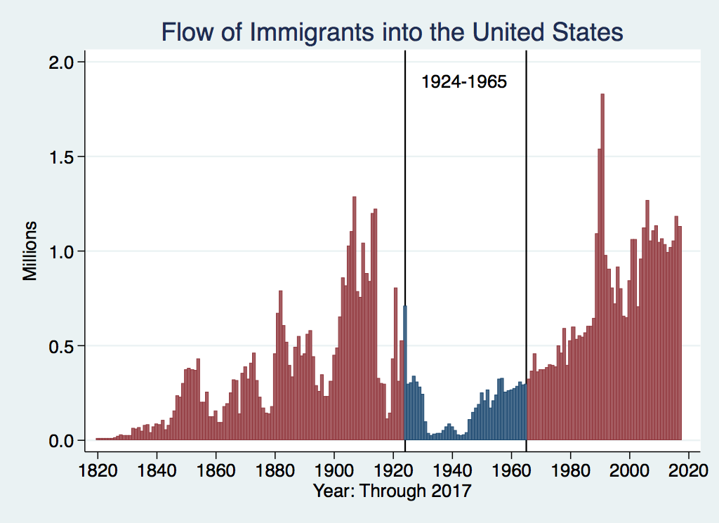
History of US Immigration
Source Countries | 1930-1965
Germany | 940,000
Canada | 900,000
Mexico | 610,000
Britain | 480,000
Italy | 390,000
Caribbean/ West Indies | 310,000
Source: https://www.libertyellisfoundation.org/immigration-timeline/.

Slide 9
Authorized Immigration by Region, 2000-17
37%

Slide 10
Authorized Immigration from the Americas, 2000-17
78%

Slide 11
Immigrant Population in 2017
Categories of the total number
of immigrants in the United States.
59%
6%
35%
https://www.pewresearch.org/fact-tank/2019/07/12/how-pew-research-center-counts-unauthorized-immigrants-in-us/

Slide 12
U.S. Unauthorized Immigration Totals
Pew Research Center, 5 facts about illegal immigration in the U.S., June 12, 2019

Slide 13
U.S. Unauthorized Immigration: Labor Force
Pew Research Center, 5 facts about illegal immigration in the U.S., June 12, 2019

Slide 14
Unauthorized Immigration: Education
Pew Research Center, U.S. unauthorized immigrants are more proficient in English, more educated than a decade ago, May 23, 2019

Slide 15
US Unauthorized Immigration: Duration
Pew Research Center, 5 facts about illegal immigration in the U.S., June 12, 2019

Slide 16
Unauthorized Immigration: Where They Live
27%
14%

Slide 17
Unauthorized Immigration: Mode of Entry
Entry w/o Inspection
Notes:
62% authorized entry

Slide 18
Why Do We Care? Economic Implications
GDP (Economic growth)
Labor markets
Government revenue and spending

Slide 19
GDP: How Does This Work?
What determines the size of an economy?
Technology/productivity
Physical capital
The number of workers
Immigration adds to the number of workers.
Number of immigrants in the labor force is high
28.2 million foreign-born persons ages 16+ in the labor force in 2018.
17.4% of the total US workforce.
Evidence
Immigrants added 11% to GDP ($2 trillion) in 2016.

Slide 20
Immigration and Labor Markets

Slide 21
Labor Market Implications: Complicated
Depends on the type of immigrant: Skills/education
Similar to native-born population?
Low-skilled?
Highly skilled?
Brings capital market implications
Low-skilled – substitutes for capital
Highly skilled – capital complementing
Source: Hong & McLaren (2015).

Slide 22
Labor Market Implications: General Principles
Short run
Harm likely to native-born workers who are similar to immigrants.
Benefit likely for other workers and owners of capital.
Long run
Lower prices will restore some of the purchasing power of those harmed.
Expanded opportunities may restore wages of harmed native-born workers.
Whether there are winners or losers in long-run depends on capital inflows, could be a wash

Slide 23
Summary of Labor Market Effects
Immigration CAN lead to negative wage effects for competing native-born workers
Particularly high school dropouts and those in vulnerable communities.
Other workers will likely benefit
Through increased wages.
Through increased opportunity.
Owners of capital will benefit
Existing capital will earn greater returns.
More if immigrant labor complements existing capital.
Source: Hong & McLaren (2015).

Slide 24
Pattern of Immigration wrt Education
Educational Attainment of Recent Immigrants – Last 5 Years
Source: Blau & Mackie (2017), p. 88.

Slide 25
Recent Immigrants Are Less and More Educated

Slide 26
Skilled Immigrants and Innovation
1% increase in the share of the immigrant college graduate population
9-18% increase in patenting per capita
Increased immigration increases patenting by native-born population
In the 1990s
Increased skilled immigration can account for one-third of increased patenting in that decade.
This translates into a 1.4-2.5% increase in GDP per capita by the end of the decade.

Slide 27
Immigrants and Entrepreneurship
Self-Employment Rates by Nativity
Source: Magnus Lofstrom from Current Population Survey Data.

Slide 29
Fortune 500: First- and Second-Generation Founders

Slide 30
Government Revenues and Expenditures

Slide 31
Taxes and Benefits
Basic Question:
What are taxes (income, sales, and other) immigrants pay vs. government expenditures on public benefits and services they receive.
More complicated:
Immigrants also affect the taxes paid and benefits received for many native-born residents.
Changes in wages and the return to capital.

Slide 32
Age-Specific Taxes and Benefits
By Immigrant Generation, United States, 2012
Source: Blau & Mackie (2017), p. 325.
Notes:
This graph shows an estimate of the taxes paid and the value of the benefits received by first-, second-, and third-generation immigrants at various ages. The blue lines reflect the value of benefits, and the red lines reflect the amount of taxes paid in.
Immigrants between the ages of roughly 25 and 65 on average pay more into the system than they receive in benefits. The children of immigrants are relatively expensive because they go to school. Older immigrants are also expensive, because they might receive Medicare and Social Security benefits.
In terms of lifetime benefits, it depends on the age at which they arrive and whether they stay. Many immigrants are in the country only temporarily and are of prime working age. These people clearly contribute more to government revenue than they receive.
For others, it isn’t so clear.

Slide 33
What Do We Know?
Immigrants who arrive while of working age:
Are, on average, net contributors.
21-year-old with a high school diploma: +$126,000 over a lifetime
Though this value gradually declines with age at arrival.
Turns negative for arrivals of age 35+
Net contribution crucially depends on characteristics
Age distribution, family composition, health status, fertility patterns
Temporary or permanent relocation
Employment in the legal labor market
Authorized or unauthorized

Slide 34
Bottom Line/Consensus of Estimates
Federal level: fiscal impact is generally positive.
State and local level: typically negative fiscal impact.

Slide 35
Implications for Major Federal Programs
Documented immigrants are less likely to use Social Security and Medicare.
Unauthorized immigrants are ineligible.
They will pay into the system but cannot receive benefits.
Medicaid: not available to legal residents for the first five years
Provide a source of revenue for an aging population.

Slide 36
Other Implications of Immigration

Slide 37
The Big Misconception:
Immigration and Crime
By the 3rd generation, immigrants look very much like US born citizens– with respect to education, occupation, employment and earnings, health, poverty, and language. The once difference is crime.
Source: The Integration of Immigrants into American Society (2015).

Slide 38
Immigrants and Crime Rates
Conventional wisdom:
Immigrants commit crimes more frequently than do native-born residents.
Rising immigration leads to rising crime.
What do the data say?
Rates of incarceration are lower for foreign-born than U.S.-born.
Neighborhoods with more immigrants have lower crime rates.

Slide 39
Crime: Incarceration Rates in California
Source: Butcher & Piehl (2008).

Slide 40
Crime: Incarceration Rates in California
California Institutionalization Rate
U.S.-Born and Foreign-Born Men Ages 18-40, by Place of Birth
Source: Butcher & Piehl (2008).

Slide 41
MSAs: Growing Immigration and Crime
No Relationship
Source: Butcher & Piehl (1998b).

Slide 42
Immigrants and Crime Rates
Conventional wisdom:
Immigrants commit crimes more frequently than do native born residents.
Rising immigration leads to rising crime.
What do the data say?
Rates of incarceration are lower for the foreign born than US born.
Neighborhoods with more immigrants have lower crime rates.
There is no evidence that deporting noncitizen immigrants affects crime rates.

Slide 43
Summary
Immigration should be thought of as increasing the population of the United States.
This brings economic growth and opportunity, just as does increasing the native-born population.
Including unauthorized immigrants, the supply of low-skilled workers is increased
This lowers the wages of low-skilled workers.
But also increases labor force participation among highly skilled workers.

Slide 44
At the Same Time….
Immigrants are often a select group:
Willing to incur an enormous personal or familial cost to better their lives.
As a result:
Immigrants tend to commit crimes at low rates.
Immigrants tend to be entrepreneurial and to add significantly to economic growth.
Although there are distributional issues:
Immigration is an important contributor to economic growth.
Immigration helps to sustain vital government programs.

Slide 45
About Conventional Wisdom
Native-born unskilled workers
There is some negative impact on their wages.
But who wins and loses depend on the skill mix of immigrants;
when this skill mix changes, so do its effects.
Crime
Immigrants, both authorized and unauthorized, commit crimes at much lower rates than do native-born residents.
Government programs
Federal: immigrants are a source of revenue and stability for some important programs.
State and local: because education is funded at the local level, this can be a drain on local government coffers.

Slide 46
Thank you!
Any Questions?
www.NEEDelegation.org
Jo Beth Mertens, PhD
mertens@hws.edu
Contact NEED: info@needelegation.org
Submit a testimonial: www.NEEDelegation.org/testimonials.php
Become a Friend of NEED: www.NEEDelegation.org/friend.php

Slide 47
Available NEED Topics Include:
US Economy
Economic Inequality
Climate Change
US Social Policy
Trade and Globalization
Economic Mobility
Trade Wars
Housing Policy
Federal Budgets
Federal Debt
2017 Tax Law
Autonomous Vehicles

