Slide 1
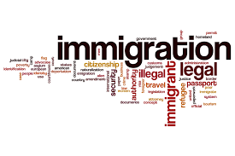
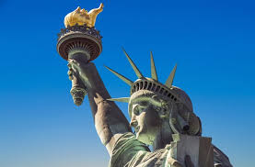
The Economics of
Unauthorized Immigration
Rotary Club of Ross Valley
May 1, 2024
Jon Haveman, Ph.D.
National Economic Education Delegation

Slide 2
Credits and Disclaimer
This slide deck was authored by:
Anna Maria Mayda, Georgetown University
Robert Gitter, Ohio Wesleyan University
Roger White, Whittier College
This slide deck was reviewed by:
Kirk Doran, Notre Dame
Ethan Lewis, Dartmouth College
Disclaimer
NEED presentations are designed to be nonpartisan.
It is, however, inevitable that presenters will be asked for and will provide their own views.
Such views are those of the presenter and not necessarily those of the National Economic Education Delegation (NEED).

Slide 3
Immigration Quiz
What % of the U.S. population are immigrants?
14%
What % of the world’s population are immigrants?
3.6%
How long has the average undocumented immigrant lived in the United States?
A. 3 months
B. 2 years
C. 10 years
D. 25 years
21% of children born to native parents are high-income earners (above the middle class).
What % of kids born to immigrants are high-income earners?
A. 15%
B. 21%
C. 28%
D. 35%
In 2021, 8% of Americans lived in poverty. What percent of immigrants lived in poverty?
13%
Source: Freakonomics – How Much Do You Know About Immigration?

Slide 4
Immigration Quiz
Immigrants are responsible for what % of patents in the United States?
36%
23% of inventors on record
13% from increase in native born patenting
What % of green cards go to family and employment-based immigration?
66% go to family-based
What % of the U.S. workforce are immigrants?
18% (7.8% are unauthorized)
Native-born Americans receive $8k on average in benefits. What is it for immigrants?
$6,000
100 years ago, most immigrants were from Europe. Today, Latin America and Asia. Is the rate of assimilation:
Faster? Slower? About the same?
Source: Freakonomics – How Much Do You Know About Immigration?

Slide 5
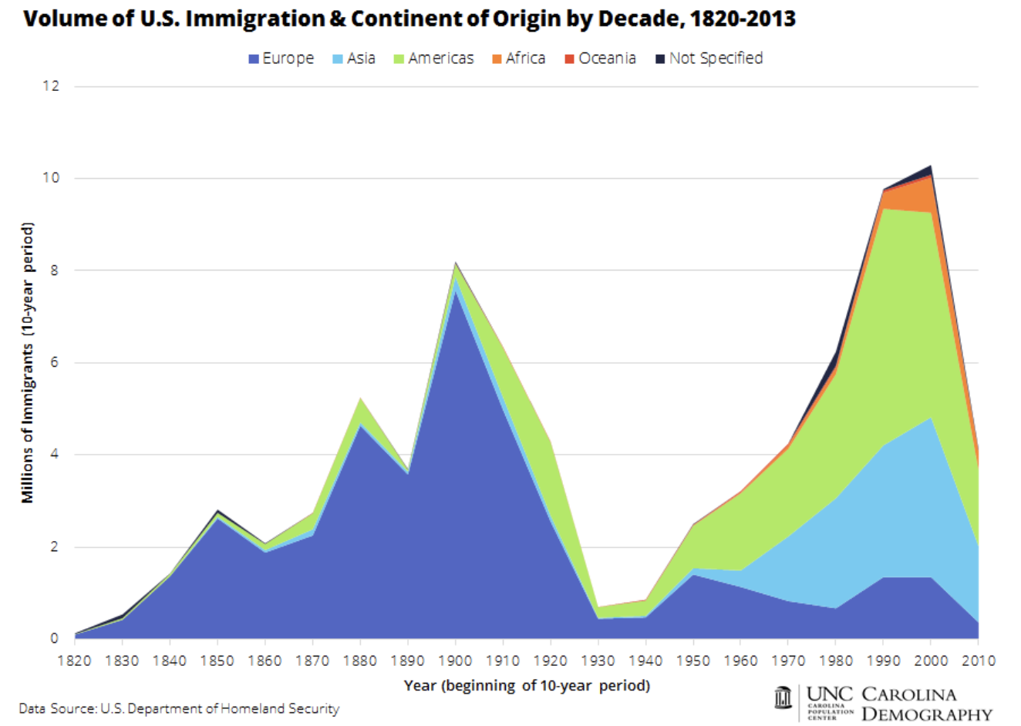

Slide 6
Why Do People Migrate?
Push factors:
Disparities in income/standards of living, and the availability of jobs, violence/war, climate change, natural disasters, population pressures, economic dislocation, religious persecution, and denial of political rights.
Pull factors:
Potential for economic prosperity (higher wages, job opportunities), physical security, political freedom, and religious liberty.
Source: Gilder Lehrman Institute of American History.

Slide 7
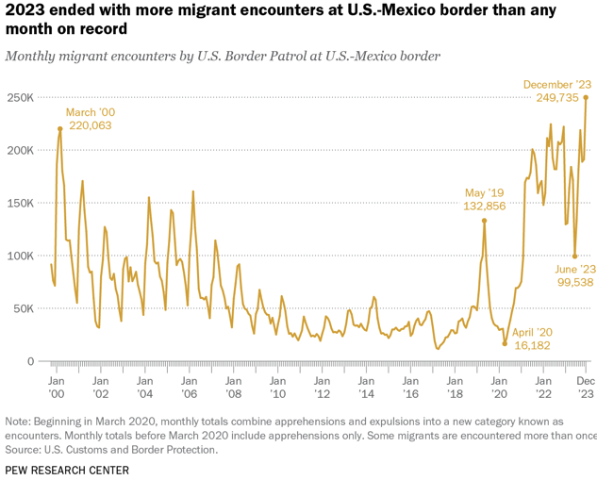

Slide 8
Most Are Single Adults
Evidence suggests:
Most unaccompanied minors
are coming to join family members
who are already here.
The population of minors in the
U.S. without a parent has not increased.
Source: Pew Research Center, US Customs and Border Protection

Slide 9
U.S. Unauthorized Immigration Totals
Source: Pew Research Center, What we know about unauthorized immigrants living in the U.S., Nov. 16, 2023

Slide 10
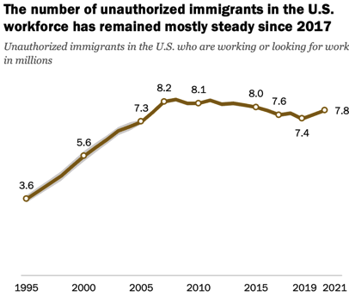
U.S. Unauthorized Immigration: Labor Force
5% of labor force
3% of population
Source: Pew Research Center, What we know about unauthorized immigrants living in the U.S., Nov. 16, 2023

Slide 11
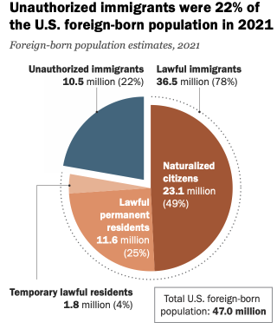
Source: Pew Research Center, What we know about unauthorized immigrants living in the U.S., Nov. 16, 2023

Slide 12
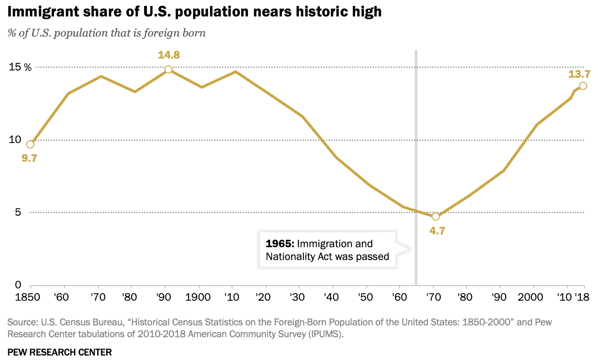
Source: Pew Research Center, What we know about unauthorized immigrants living in the U.S., Nov. 16, 2023

Slide 13
Why Do We Care? Economic Implications
Conventional Wisdom Issues:
Labor markets: Wages and Jobs
Government Revenue and Spending
Crime
Other issues (that don’t get talked about much):
Gross Domestic Product (GDP)
Innovation and Entrepreneurship

Slide 14
Is Immigration Saving the Day?
The vast majority of additions to the
Population in the last several years
Has been from immigration.
Source: CBO – The Demographic Outlook, 2023-2053

Slide 15
Recent Immigrants Are Less and More Educated

Slide 16
Labor Market Implications
Provides net benefits to the receiving economy
Larger labor supply.
Changes in labor prices increase production of goods and services that use the type of labor offered by immigrants.
Short run: there are winners and losers
Changes in wage structure and returns to capital affect native-born workers differently.
Long run: could be no winners, but also no losers
The economy might adjust to pre-immigration wage structure and returns to capital. No change for native-born individuals.

Slide 17
Pathway of Wage and Employment Effects
}
Inflows of Low-Skilled Immigrants
Order of Impact
Impact is negative,
But is smaller
at each step.
Previous Immigrants
Disadvantaged Minorities
Native-born HS Dropouts
Positive influence on wages and employment of other workers.

Slide 18
Fortune 500: First- and Second-Generation Founders

Slide 19
Government Revenues and Expenditures

Slide 20
Age-Specific Taxes and Benefits
By Immigrant Generation, United States, 2012
Source: Blau & Mackie (2017), p. 325.

Slide 21
Bottom Line/Consensus of Estimates
Federal level: fiscal impact is generally positive.
State and local level: typically negative fiscal impact.

Slide 22
Non - Economic Implications
Patterns of Integration
Education
Employment and Earnings
Occupations
Poverty
Residential Integration
Language
Health
Family Patterns
The Big Misconception: Crime
Source: The Integration of Immigrants into American Society (2015).

Slide 23
Incarceration by Immigration Status, 2018
Unauthorized Immigrants
Authorized Immigrants
Source: Cato Institute, Illegal Immigrant Incarceration Rates, 2010–2018: Demographics and Policy Implications, April 2020.

Slide 24
Crime: Incarceration Rates in California
California Institutionalization Rate
U.S.-Born and Foreign-Born Men Ages 18-40, by Place of Birth
Source: Butcher & Piehl (2008).

Slide 25
About Conventional Wisdom
Native-born unskilled workers
There is some negative impact on their wages.
But who wins and loses depend on the skill mix of immigrants;
when this skill mix changes, so do its effects.
Crime
Immigrants, both authorized and unauthorized, commit crimes at much lower rates than do native-born residents.
Government programs
Federal: immigrants are a source of revenue and stability for some important programs.
State and local: because education is funded at the local level, this can be a drain on local government coffers.

Slide 26
Potential Solution?
Trends in Authorized Immigration
Expand Authorized Immigration
Currently just 1 million/year on average.
This would reduce the volume of people on the southern border.
Not 1-1, but significantly.
2022
1.0 Million

Slide 27
Thank you!
Any Questions?
www.NEEDEcon.org
Jon D. Haveman, Ph.D.
Jon@NEEDEcon.org
Contact NEED: info@needecon.org
Submit a testimonial: www.NEEDEcon.org/testimonials.php
Become a Friend of NEED: www.NEEDEcon.org/friend.php

