Slide 1
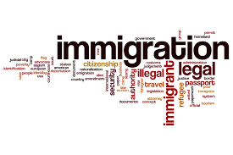
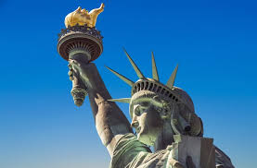
The Economics of Immigration
Parkway United Church of Christ
October 5, 2025
Jon Haveman, Ph.D.
National Economic Education Delegation

Slide 2
Available NEED Topics Include:
US Economy
Healthcare Economics
Climate Change
Economic Inequality
Economic Mobility
Trade and Globalization
Minimum Wages
Immigration Economics
Housing Policy
Federal Budgets
Saving Social Security
Black-White Wealth Gap
Autonomous Vehicles
US Social Policy

Slide 3
Credits and Disclaimer
This slide deck was authored by:
Anna Maria Mayda, Georgetown University
Robert Gitter, Ohio Wesleyan University
Roger White, Whittier College
This slide deck was reviewed by:
Kirk Doran, Notre Dame
Ethan Lewis, Dartmouth College
Disclaimer
NEED presentations are designed to be nonpartisan.
It is, however, inevitable that presenters will be asked for and will provide their own views.
Such views are those of the presenter and not necessarily those of the National Economic Education Delegation (NEED).

Slide 4
Outline
Why do people migrate?
The nature of immigration to the U.S.
Economics of immigration
Recent immigration issues

Slide 5
Why Do People Migrate?
Push factors:
Disparities in income/standards of living, and the availability of jobs, violence/war, climate change, natural disasters, population pressures, economic dislocation, religious persecution, and denial of political rights.
Pull factors:
Potential for economic prosperity (higher wages, job opportunities), physical security, political freedom, and religious liberty.
Source: Gilder Lehrman Institute of American History.

Slide 6
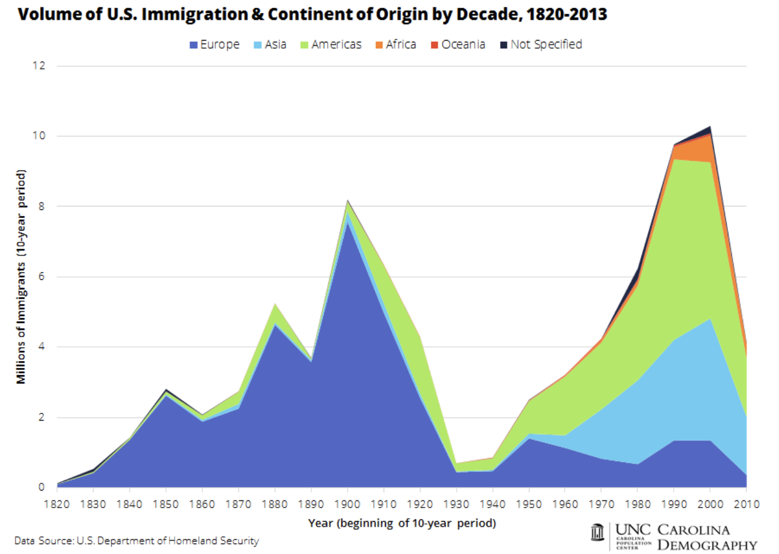
Source: https://carolinademography.cpc.unc.edu/2015/04/27/u-s-immigration-flows-1820-2013/

Slide 7
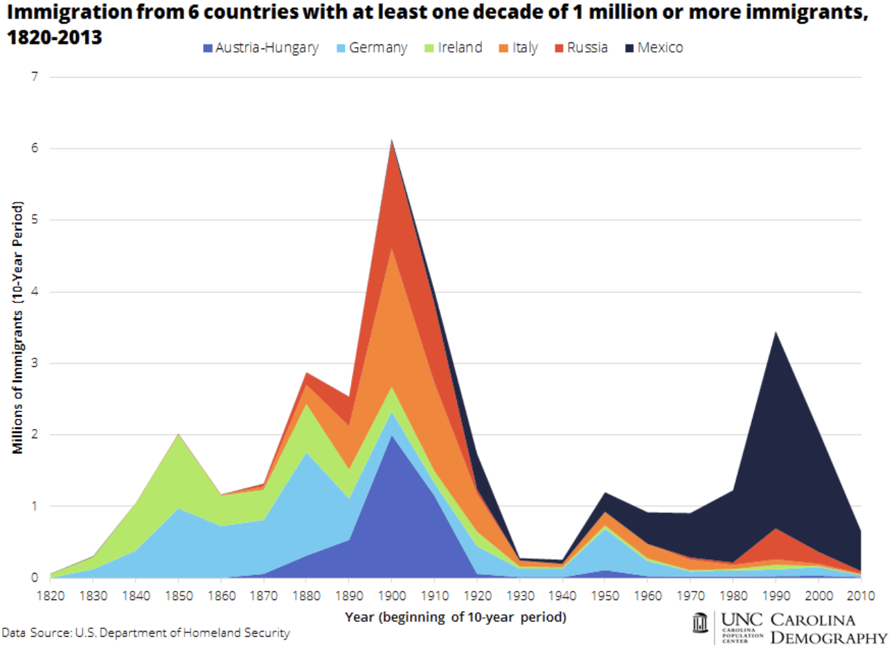
Source: https://carolinademography.cpc.unc.edu/2015/04/27/u-s-immigration-flows-1820-2013/

Slide 8
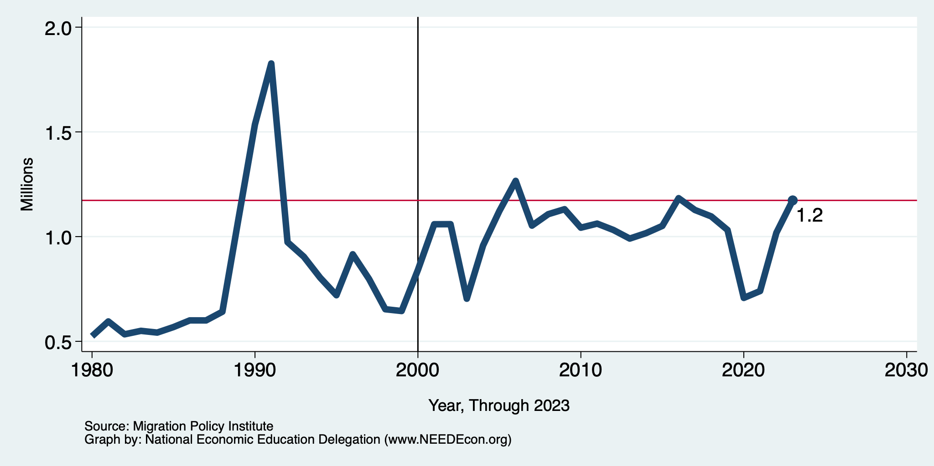
Recent Trends in Authorized Immigration
2023
1.2 Million

Slide 9
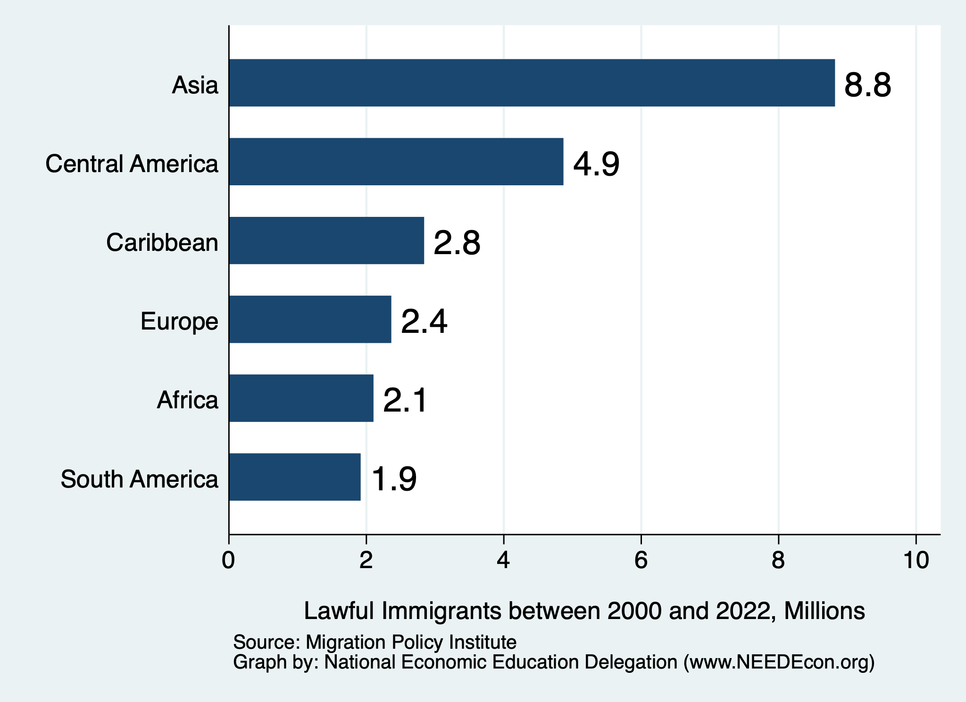
Authorized Immigration by Region (2000-2022)

Slide 10
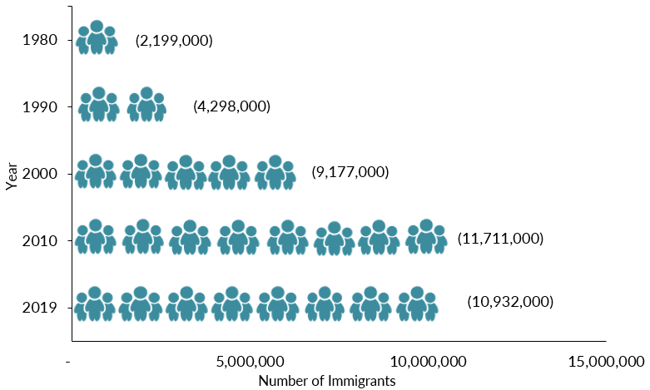
Mexican-Born People in the US
About 11 million in mid-2023 (Latest data)
1 in 14 people born in Mexico currently lives in the US

Slide 11
Distribution of Income
Mexico
United States
Number of People
Income

Slide 12
UNauthorized Immigration

Slide 13
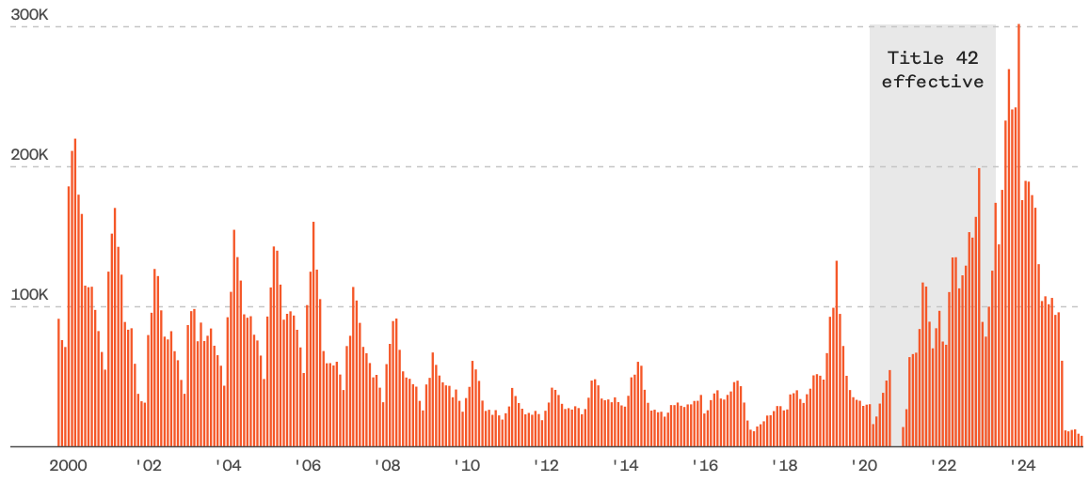
Encounters w/Migrants at the U.S.-Mexico Border
Dec. `23
249,741
Aug. `24
58,038
July `25
7,832
Source: https://www.nbcnews.com/data-graphics/us-immigration-tracker-follow-arrests-detentions-border-crossings-rcna189148

Slide 14
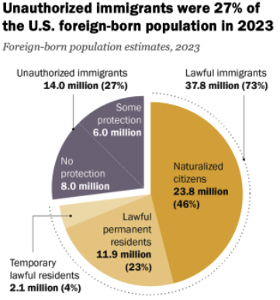
Total Foreign-Born (2023)
Population: 51.8 million
Total Foreign-Born (Aug/25)
Population: 48.5 million
(This seems too low.)
Source: Pew Research Center, U.S. Unauthorized Immigrant Population Reached a Record 14 Million in 2023, August 21, 2025

Slide 15
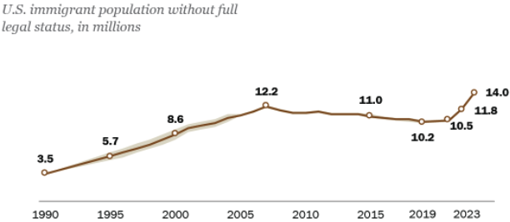
U.S. Unauthorized Immigration Totals, to 2023
Source: Pew Research Center, What we know about unauthorized immigrants living in the U.S., July 22, 2024

Slide 16
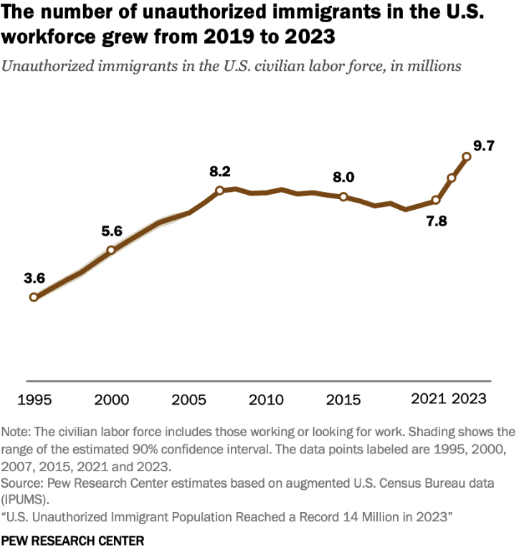
U.S. Unauthorized Immigration: Labor Force
5% of labor force
3% of population
Source: Pew Research Center, What we know about unauthorized immigrants living in the U.S., July 22, 2024

Slide 17
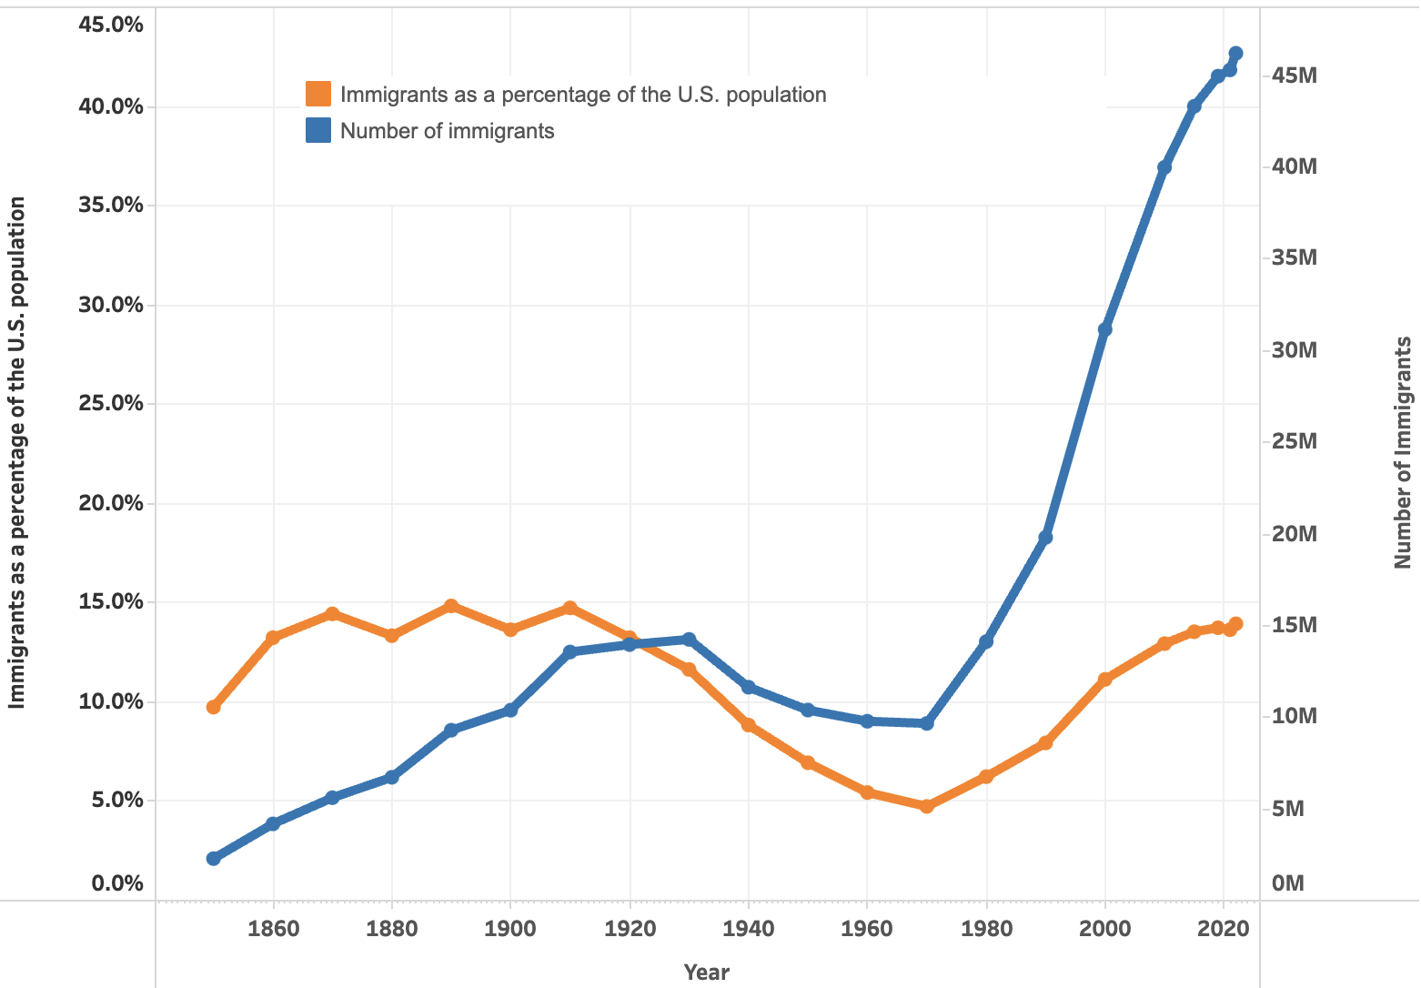

U.S. Immigrant Population and Share over Time
1850-2022
60 YEARS

Slide 18
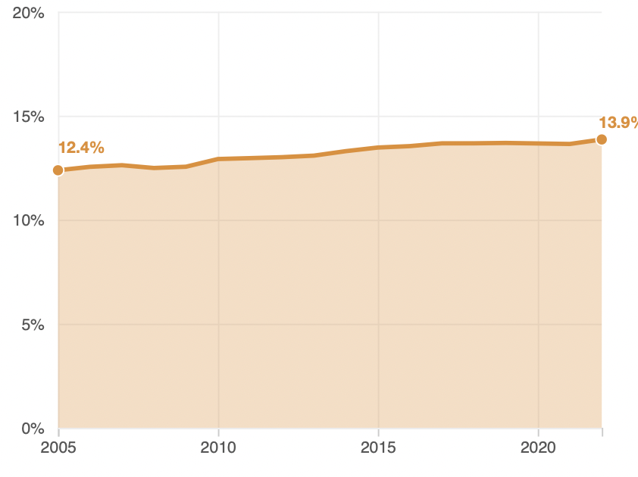
Immigrant Share of US Population
13.9 %
12.4 %

Slide 19
Economics

Slide 20
Why Do We Care? Economic Implications
Conventional Wisdom Issues:
Labor markets: Wages and Jobs
Government Revenue and Spending
Crime
Other issues (that don’t get talked about much):
Gross Domestic Product (GDP)
Innovation and Entrepreneurship

Slide 21
GDP: How Does This Work?
What determines the size of an economy?
Physical capital
Technology/productivity
The number of workers
Immigration adds to the number of workers.
Number of immigrants in the labor force is high
32.2 million foreign-born persons ages 16+ in the labor force in Aug/25.
18.8% of the total US workforce.
Evidence
Immigrants added 11% to GDP ($2 trillion) in 2016.
Federal Reserve Bank of St. Louis (https://fred.stlouisfed.org/)
National Academies of Sciences, Engineering, and Medicine (2017) “The Economic and Fiscal Consequences of Immigration”.

Slide 22
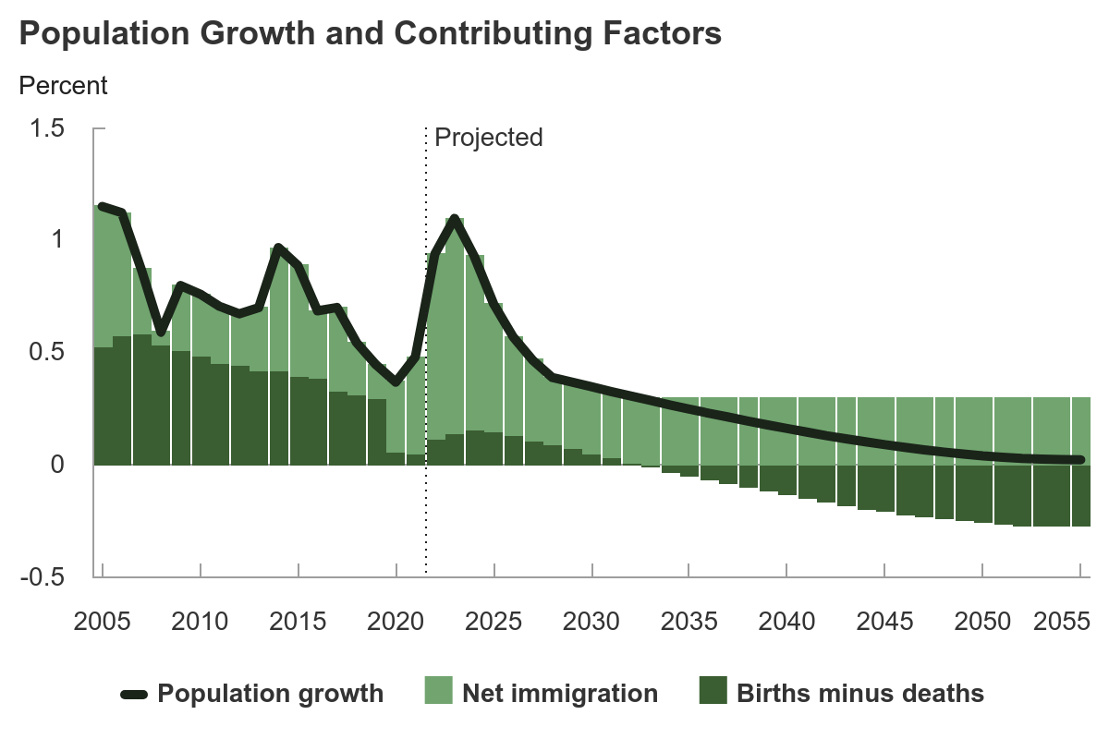
Is Immigration Saving the Day?
The vast majority of additions to the
Population in the last several years
Have been from immigration.
Source: https://carolinademography.cpc.unc.edu/2015/04/27/u-s-immigration-flows-1820-2013/
Source: CBO – The Demographic Outlook, 2025-2055

Slide 23
Jobs: Conventional Wisdom…Upended
What is the conventional wisdom?
Low-skilled immigrants come in and take jobs from low-skilled native-born individuals.
1-1 tradeoff.
What does new research show?
Low-skilled immigrants contribute positively to the economy.
Every 100 low-skilled immigrants: create 9 jobs for low-skilled native-born.
They create opportunities for low-skilled native-born workers.
Low-skilled immigrants take jobs that native-born don’t want.

Slide 24
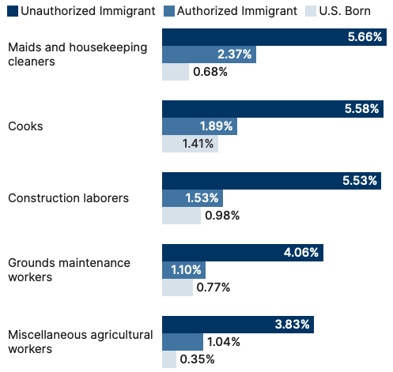
Share of Workers in Each Occupations

Slide 25
Pathway of Wage and Employment Effects
}
Inflows of Low-Skilled Immigrants
Order of Impact
Impact is negative,
But is smaller
at each step.
Previous Immigrants
Disadvantaged Minorities
Native-born HS Dropouts
Positive influence on wages and employment of other workers.

Slide 26
Skilled Immigrants and Innovation
1% increase in the share of the immigrant college graduate population
9-18% increase in patenting per capita
Increased immigration increases patenting by native-born population.
In the 1990s
Increased skilled immigration can account for one-third of increased patenting in that decade.
This translates into a 1.4-2.5% increase in GDP per capita by the end of the decade.
Source: Hunt and Gauthier-Loiselle (2008).

Slide 27
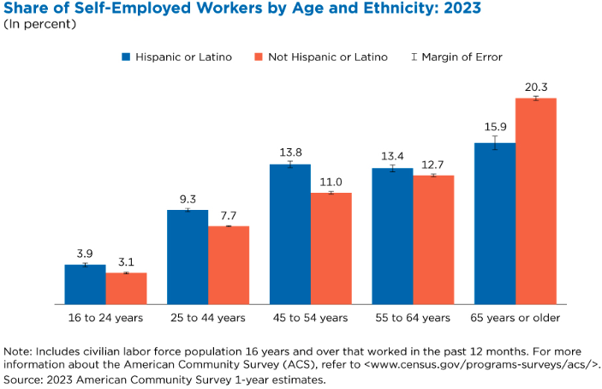
Immigrants and Entrepreneurship
Source: Magnus Lofstrom from Current Population Survey Data.

Slide 28
Fortune 500: First- and Second-Generation Founders

Slide 29
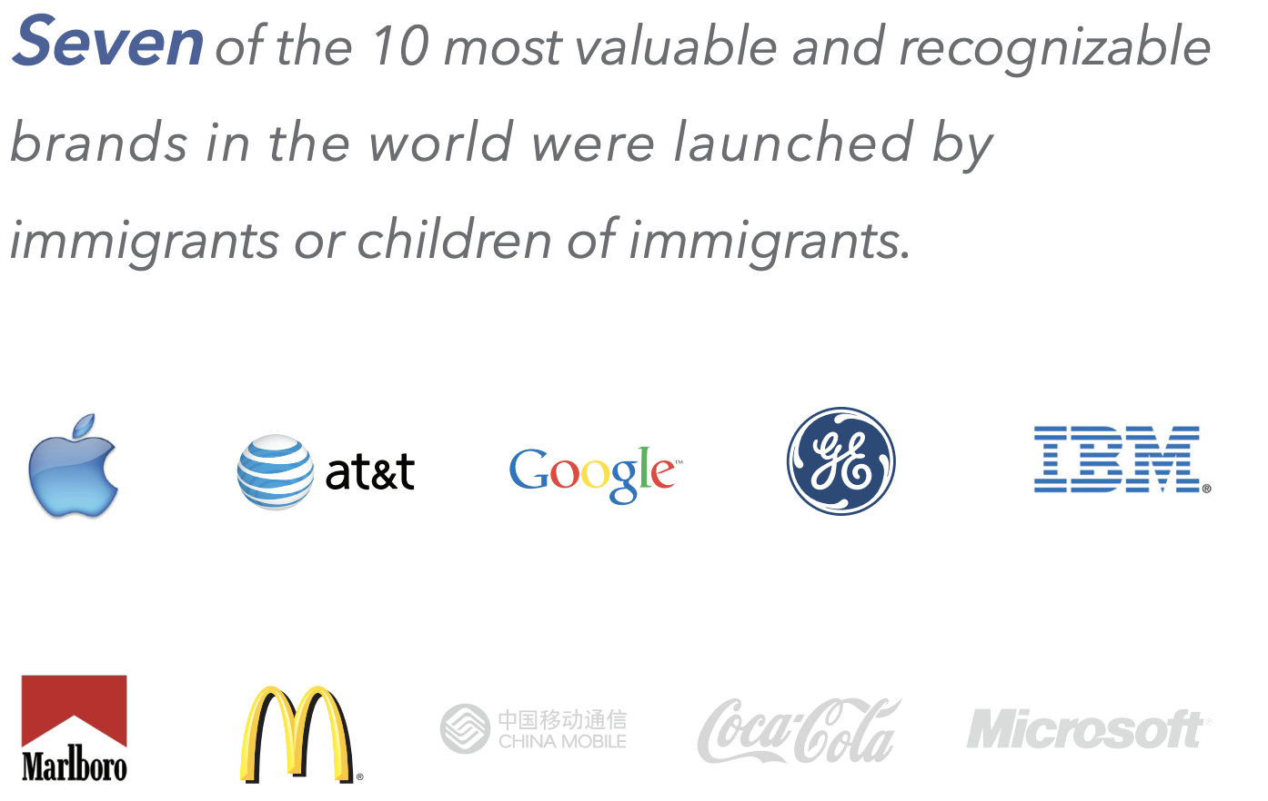

Slide 30
Government Revenues and Expenditures

Slide 31
Topics?
Basic Question:
Taxes (income, sales, and other) immigrants pay vs. government expenditures on public benefits and services they receive.
More complicated:
Immigrants also affect the fiscal equation for many native-born residents.
Indirectly through labor and capital markets.
Changes in wages and the return to capital.

Slide 32
Age-Specific Taxes and Benefits
By Immigrant Generation, United States, 2012
Source: Blau & Mackie (2017), p. 325.

Slide 33
What Do We Know?
Immigrants who arrive while of working age:
Are, on average, net contributors.
21-year-old with a high school diploma: +$126,000 over a lifetime
Though this value gradually declines with age at arrival.
Turns negative for arrivals of age 35+
Net contribution crucially depends on characteristics
Age distribution, family composition, health status, fertility patterns
Temporary or permanent relocation
Employment in the legal labor market
Authorized or unauthorized

Slide 34
Bottom Line/Consensus of Estimates
Federal level: fiscal impact is generally positive.
State and local level: typically negative fiscal impact.

Slide 35
Implications for Major Federal Programs
Documented immigrants are less likely to use Social Security and Medicare.
Unauthorized immigrants are ineligible.
They will pay into the system but cannot receive benefits.
Medicaid: not available to legal residents for the first five years.
Provide a source of revenue for an aging population.

Slide 36
The Aging US Population
Source: Blau & Mackie (2017), p. 63.

Slide 37
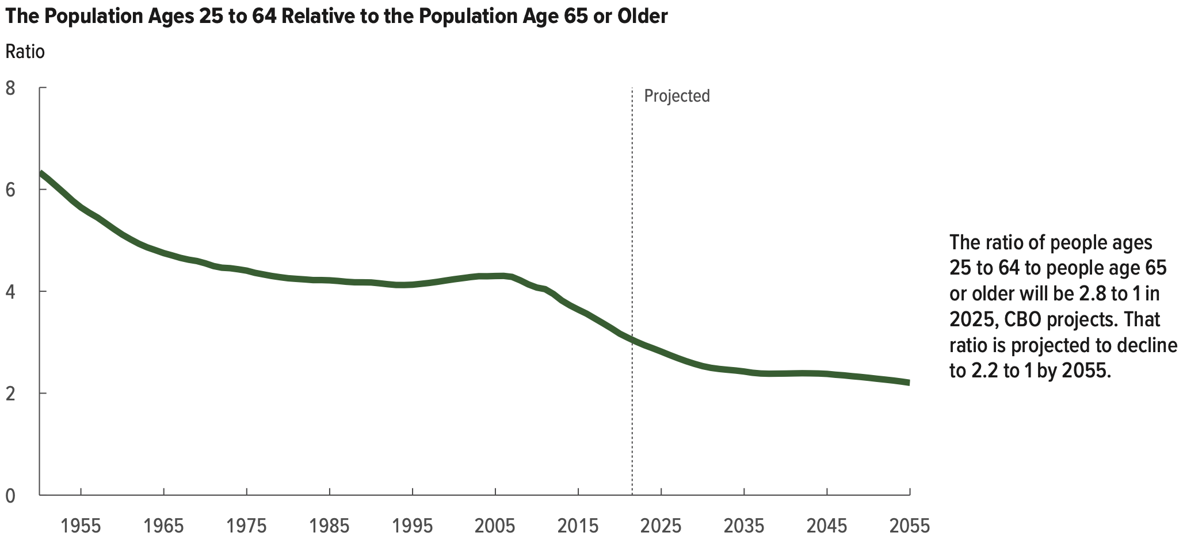
Implications for Social Security
Source: Blau & Mackie (2017).

Slide 38
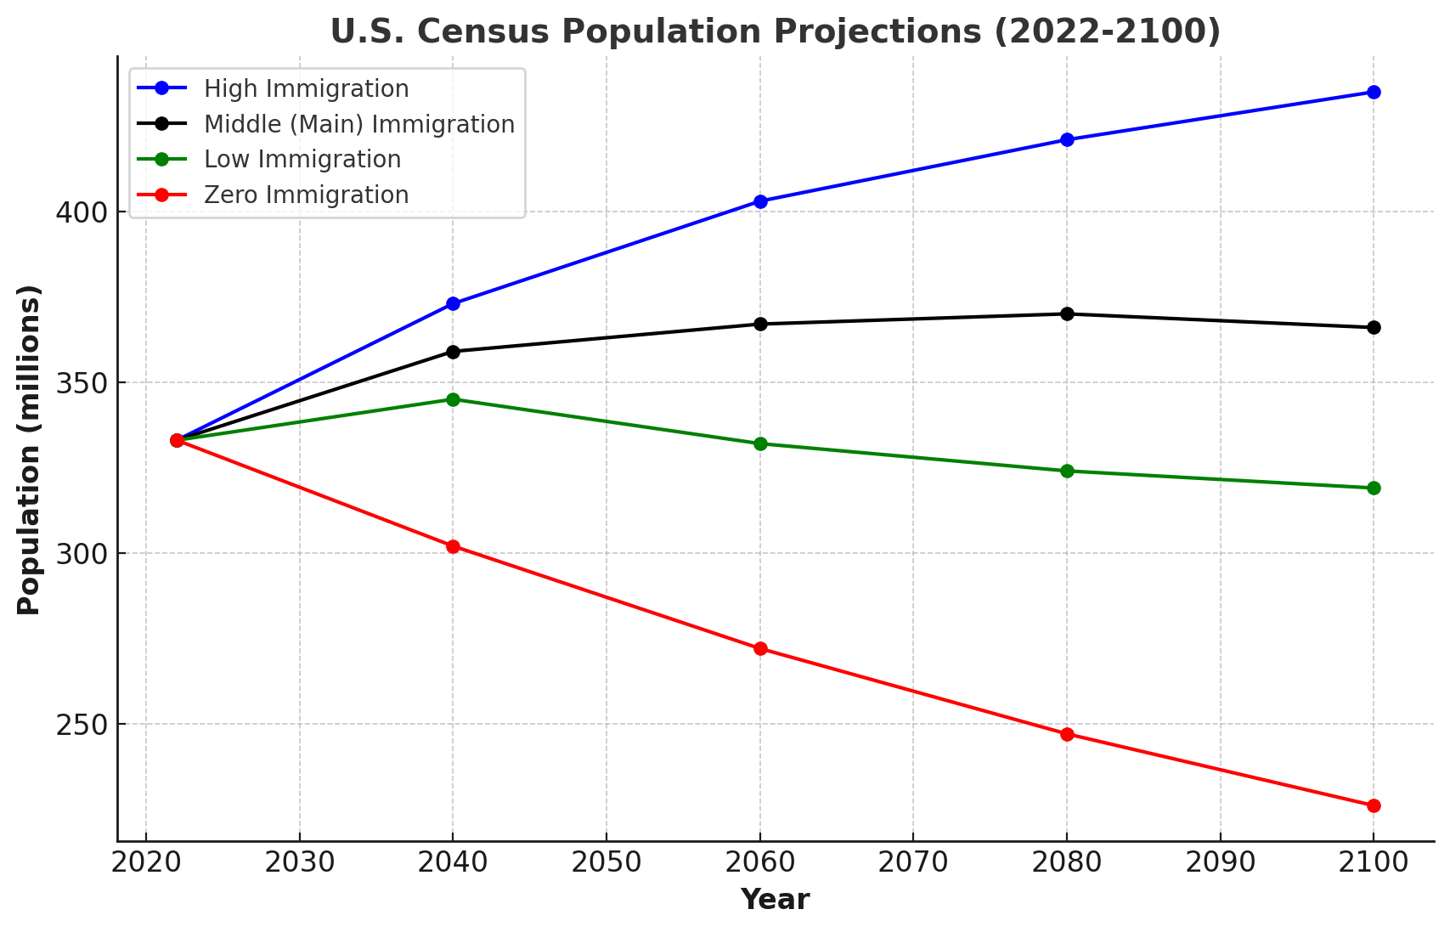
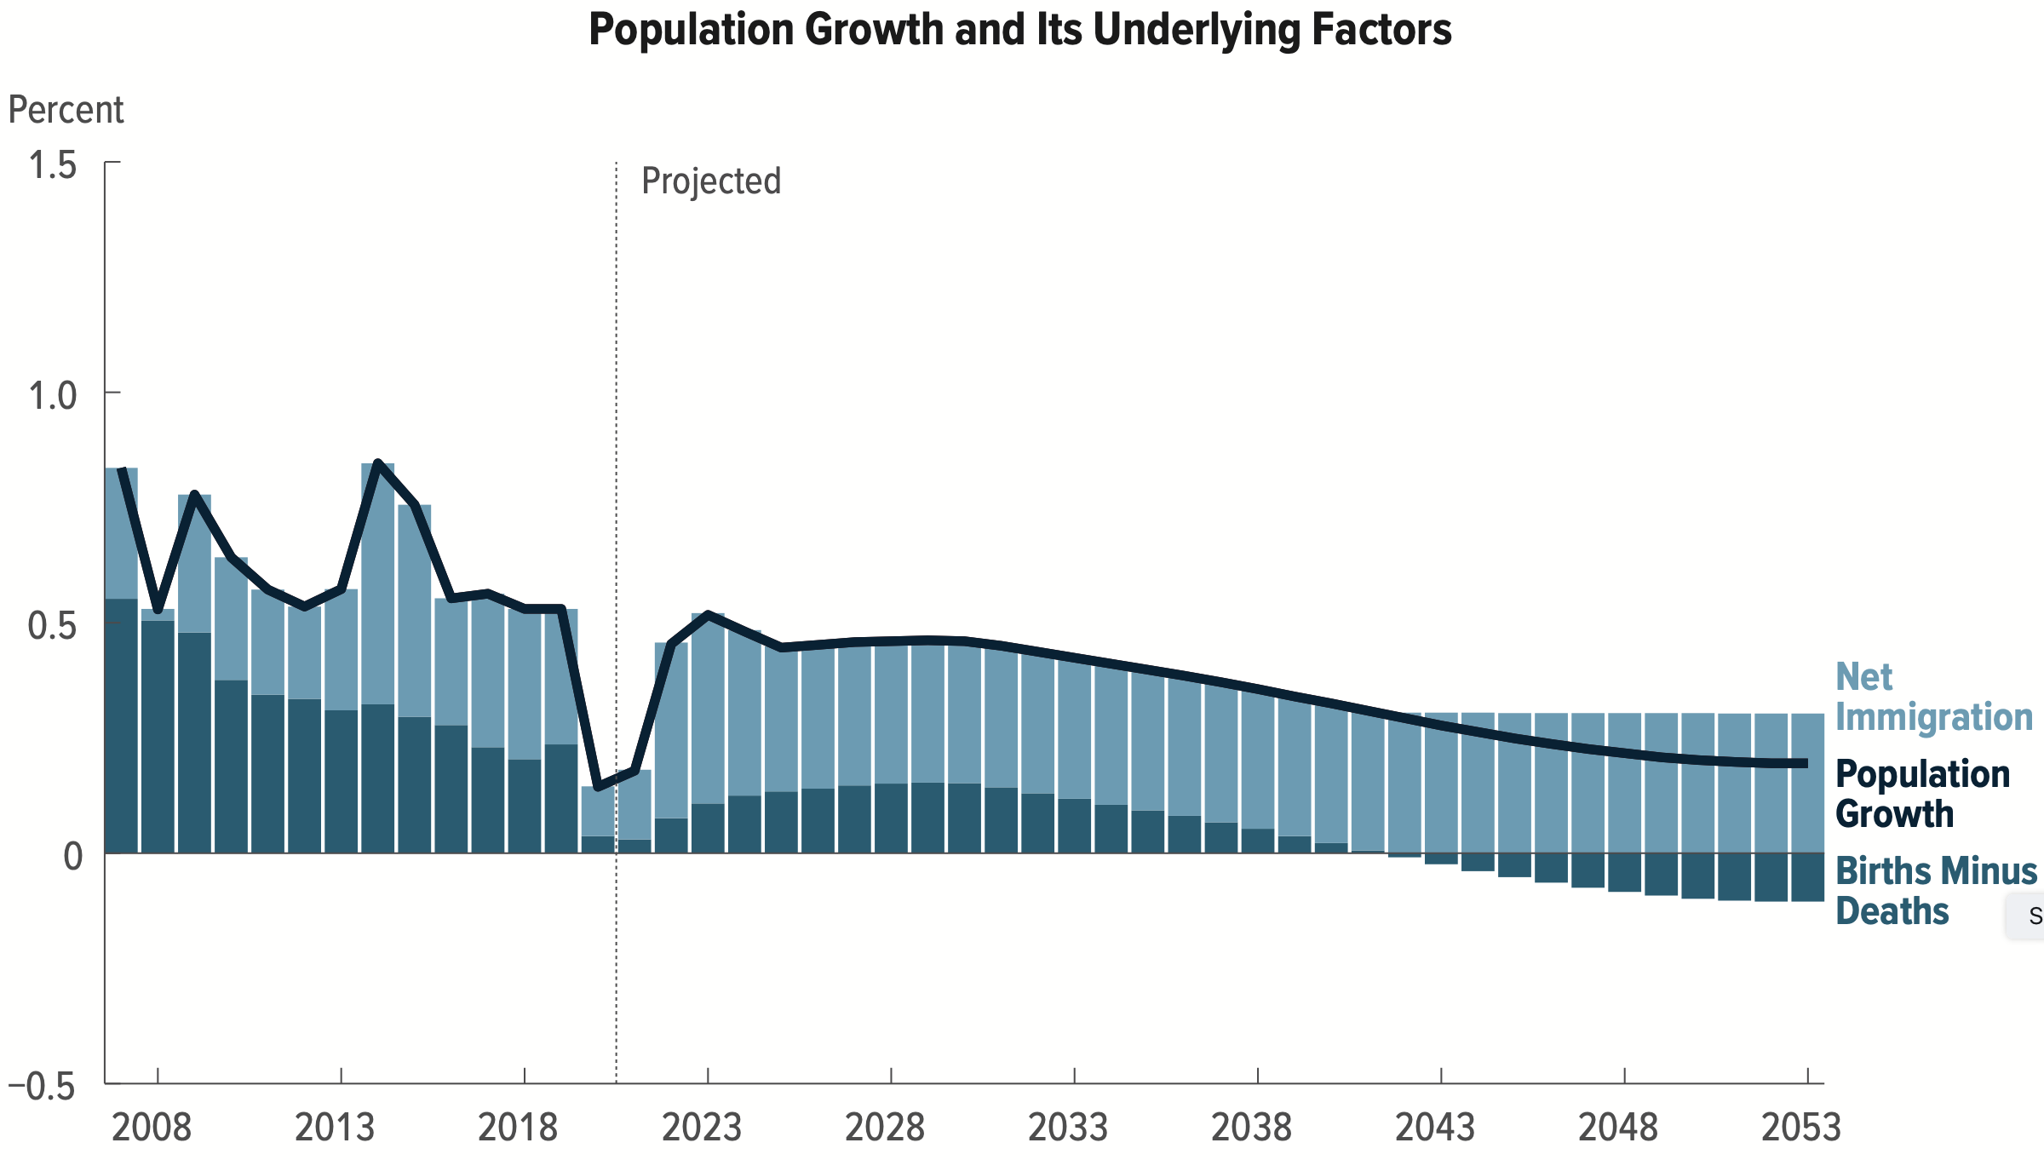
Is Immigration Saving the Day?
100 Million
Lower in 2100
Source: CBO – The Demographic Outlook, 2023-2053

Slide 39
Immigrants and Crime Rates
Conventional wisdom:
Immigrants commit crimes more frequently than do native-born residents.
Rising immigration leads to rising crime.
What do the data say?
Rates of incarceration are lower for foreign-born than U.S.-born.
Neighborhoods with more immigrants have lower crime rates.
Let’s Have a Look!

Slide 40
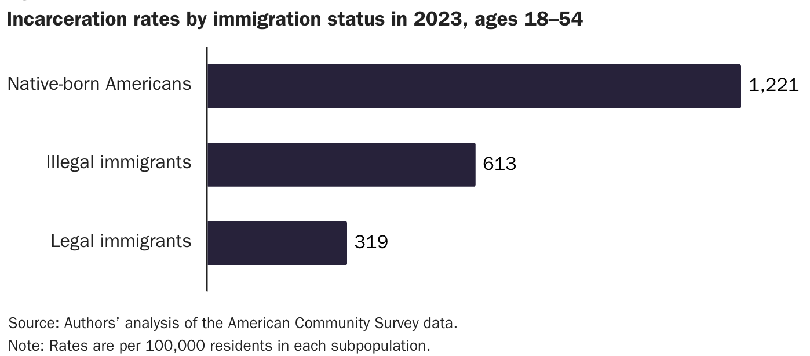
Incarceration by Immigration Status, 2023
Unauthorized Immigrants
Authorized Immigrants
Source: Cato Institute, https://www.cato.org/policy-analysis/illegal-immigrant-incarceration-rates-2010-2023#incarcerations

Slide 41
Immigrants and Crime Rates
Conventional wisdom:
Immigrants commit crimes more frequently than do native-born residents.
Rising immigration leads to rising crime.
What do the data say?
Rates of incarceration are lower for the foreign born than US born.
Neighborhoods with more immigrants have lower crime rates.
There is no evidence that deporting noncitizen immigrants affects crime rates.

Slide 42
Summary
Immigration can be thought of as increasing the population of the United States.
But they are a select group.
This brings economic growth and opportunity, just as does increasing the native-born population.
But not crime.
Unauthorized immigrants do increase the supply of low-skilled workers.
This may lower the wages of SOME low-skilled workers.
But also increases labor force participation among highly skilled workers.

Slide 43
At the Same Time….
Immigrants are often a select group:
Willing to incur an enormous personal or familial cost to better their lives.
As a result:
Immigrants tend to be entrepreneurial and to add significantly to economic growth.
Although there are distributional issues:
Immigration is an important contributor to economic growth.
Immigration helps to sustain vital government programs.

Slide 44
About Conventional Wisdom
Native-born unskilled workers
There may be some negative impact on their wages.
But who wins and loses depends on the skill mix of immigrants.
Crime
Immigrants, both authorized and unauthorized, commit crimes at much lower rates than do native-born residents.
Government programs
Federal: immigrants are a source of revenue and stability for some important programs.
State and local: Because education is funded at the local level, this can be a drain on local government coffers.

Slide 45
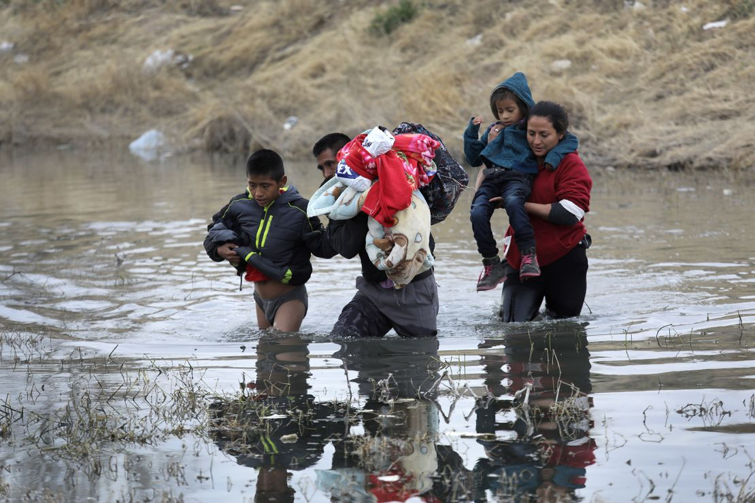
Recent Immigration Issues
The Northern Triangle
Mass Deportations
H1B Visas

Slide 46
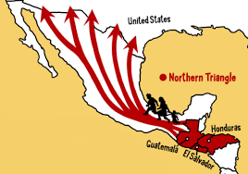
The Northern Triangle

Slide 47
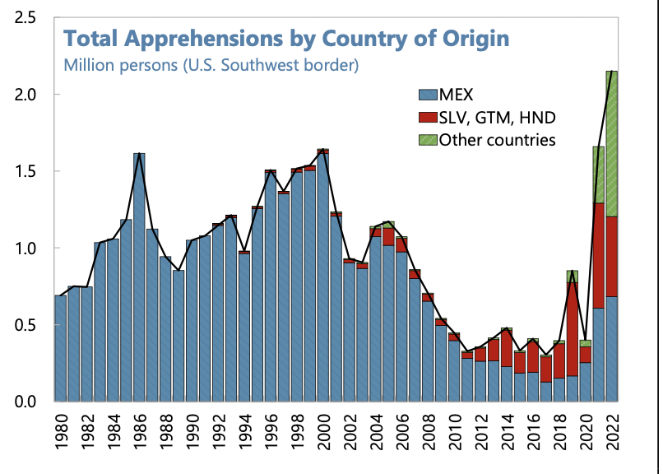
Northern Triangle Apprehensions (Northern Triangle Countries in Red)
Also:
Venezuela
Haiti
Cuba

Slide 48
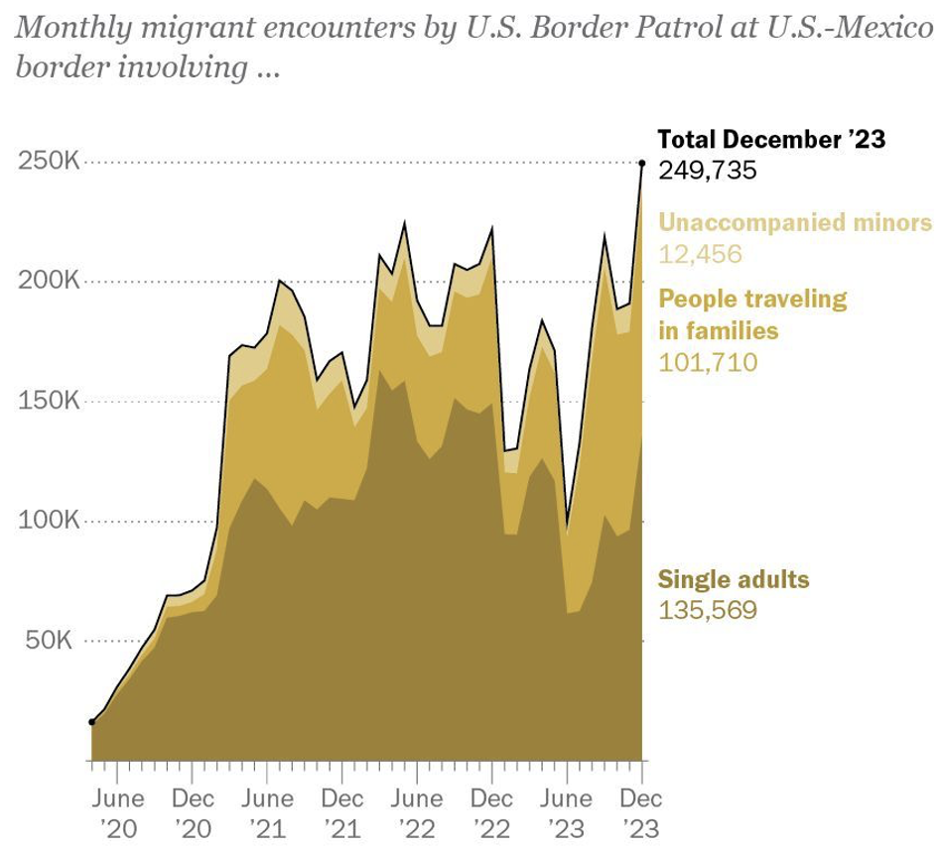
Growing #s of People Traveling in Families
Source: Pew Research Center, US Customs and Border Protection

Slide 49
Mass Deportations
Immigrants work different jobs than do native-born workers.
Immigrants contribute to the local economy.
GDP losses of up to $1.7 trillion annually.
Immigrants keep prices low: in particular, food!
Deportations impact tax revenues.
$1,300 more in on average than out, annually.
Unauthorized immigrants: $22.6 billion in social security and $5.7 billion in Medicare payments.
Deportations are expensive ($13,000 each).
Total cost $315 billion.
They rob people of their dignity.

Slide 50
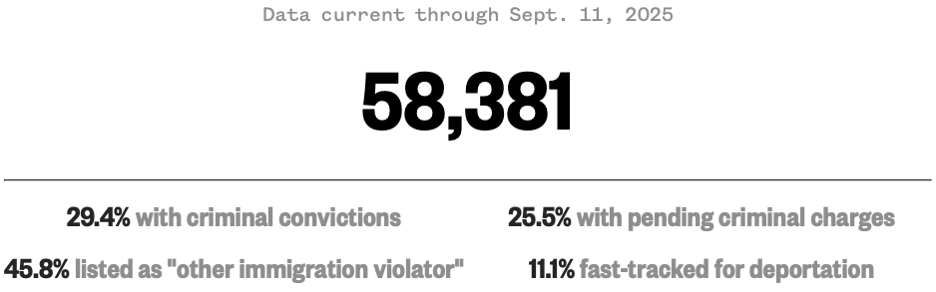
Migrants in ICE Detention
Source: https://www.nbcnews.com/data-graphics/us-immigration-tracker-follow-arrests-detentions-border-crossings-rcna189148

Slide 51
H1B Visas
What are they?
Visas for immigrants with specialized labor:
65,000 per year.
Visas for immigrants with a master’s degree from a U.S. university:
20,000 per year.
Details
They are valid for 3 years, with extension possible up to 6 years.
There is almost always more demand for visas than there is supply.
Lottery is then used to allocate the visas.

Slide 52
H1B Visas
Pros
Companies have an easier time finding appropriate workers.
Immigrants are sometimes complementary to U.S. workers.
Creating job opportunities for U.S. workers.
Immigrants spend in the U.S., stimulating the economy.
Cons
Immigrant H1B holders sometimes take jobs from skilled American workers.
Overall: the program expands the number of immigrants that are here in an authorized way. This may be helpful to the economy.

Slide 53
H1B Visas: $100,000 fee? (Was: $2,000 to $5,000)
Pros
Perhaps less use of H1B visas to exploit foreign workers.
May benefit U.S. workers.
Prioritized the highest-skilled immigrants.
Source of funds for immigration services.
Cons
Many fewer applications, which will lower U.S. economic activity.
Inaccessible to many small businesses.
Economic disruption.
Overall: That depends.

Slide 54
Thank you!
Any Questions?
www.NEEDEcon.org
Jon D. Haveman, Ph.D.
Jon@NEEDEcon.org
Contact NEED: info@needecon.org
Submit a testimonial: www.NEEDEcon.org/testimonials.php
Become a Friend of NEED: www.NEEDEcon.org/friend.php

