Slide 1
Osher Lifelong Learning Institute, Fall 2023
Contemporary Economic Policy
Eckerd College
November 7, 2023
Roger White, Ph.D.
National Economic Education Delegation

Slide 2
Course Outline
Contemporary Economic Policy
  Week 1 (10/10): Economic Update (Geoffrey Woglom, Amherst College)
  Week 2 (10/17): International Institutions (Alan Deardorff, U of Michigan)
  Week 3 (10/24): Economics Inequality (Roger White, Whittier College)
  Week 4 (10/31): Trade and Globalization (Avik Chakrabarti, U Wisconsin Milwaukee)
  Week 5 (11/07): Economics of Immigration (Roger White, Whittier College)
  Week 6 (11/10): Federal Debt (Brian Peterson, Lagrange College)

Slide 3
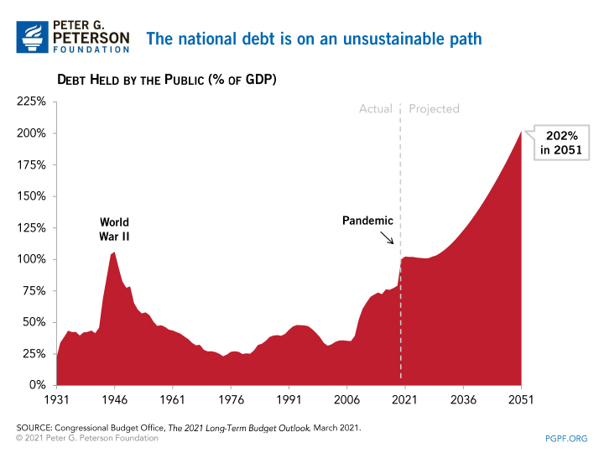
The Federal Debt is Becoming A Problem

Slide 4
Submitting Questions
Please submit questions in the chat.
  I will try to handle them as they come up but may take them in a bunch as time permits.
We will do a verbal Q&A once the material has been presented.
  And the questions in the chat have been addressed.

Slide 5

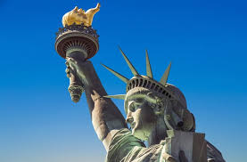
The Economics of Immigration
Roger White, Ph.D.
Douglas W. Ferguson Professor of International Economics, Whittier College

Slide 6
Outline
What is immigration?
Why do people migrate?
History of immigration to the US
Economics of immigration

Slide 7
What Is Immigration?
Immigration
  The action of coming to live in another country.
Emigration
  The act of leaving one’s own country and going to live in another country.

Slide 8
Why Do People Migrate?
Push factors:
  Disparities in income/standards of living, and the availability of jobs, violence/war, climate change, natural disasters, population pressures, economic dislocation, religious persecution, and denial of political rights.
Pull factors:
  Potential for economic prosperity (higher wages, job opportunities), physical security, political freedom, and religious liberty.
Source: Gilder Lehrman Institute of American History.

Slide 9
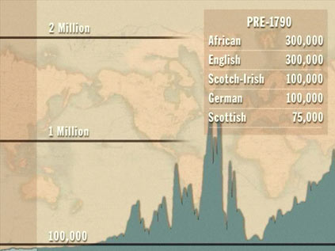
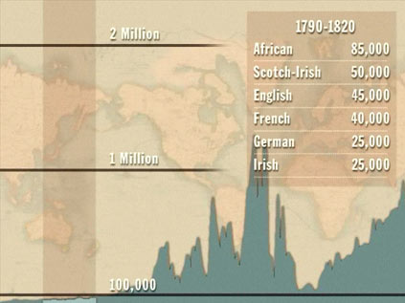
History of US Immigration
Source Countries | Pre-1790
African countries* | 300,000
England | 300,000
Scotland-Ireland | 100,000
Germany | 100,000
Scotland | 75,000
Source Countries | 1790-1820
African countries* | 85,000
Scotland-Ireland | 50,000
England | 45,000
France | 40,000
Germany | 25,000
* Slave trade and clearly not voluntary or reflective of standard motivations for immigration.
Source: https://www.libertyellisfoundation.org/immigration-timeline/.

Slide 10
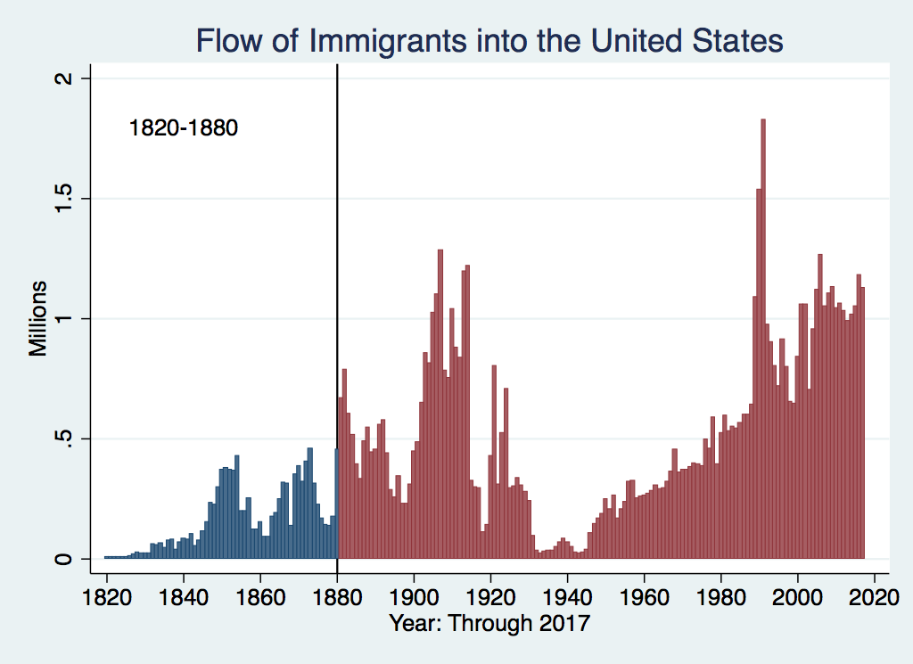
History of US Immigration
Source Countries | 1820-1880
Germany | 3,000,000
Ireland | 2,800,000
Britain | 2,000,000
Austro-Hungarian empire | 1,000,000
Canada | 750,000
China | 230,000
African countries | 50,000
https://www.libertyellisfoundation.org/immigration-timeline

Slide 11
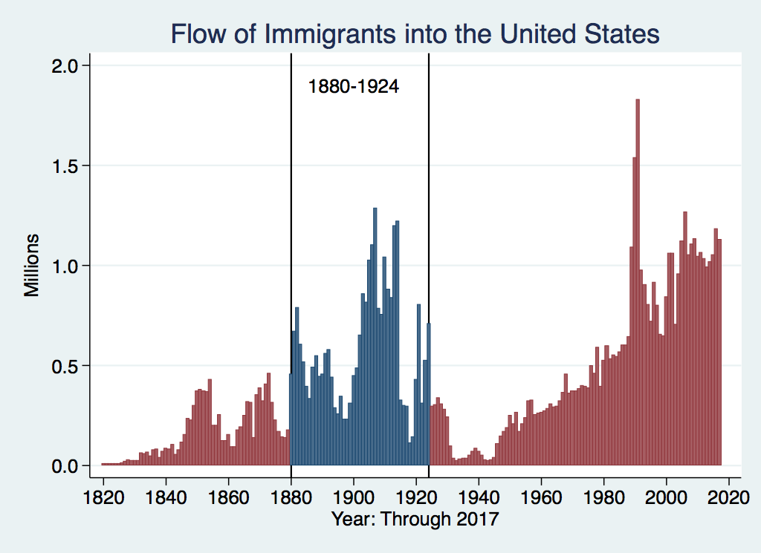
History of US Immigration
Source Countries | 1880-1930
Italy | 4,600,000
Austro-Hungarian empire | 4,000,000
Russian empire | 3,300,000
German empire | 2,800,000
Britain | 2,300,000
Canada | 2,300,000
Ireland | 1,700,000
https://www.libertyellisfoundation.org/immigration-timeline

Slide 12
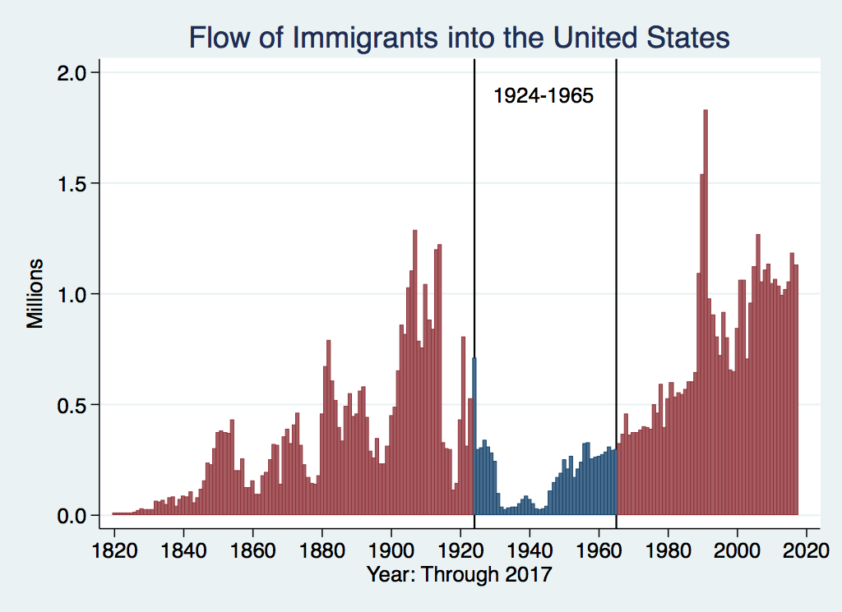
History of US Immigration
Source Countries | 1930-1965
Germany | 940,000
Canada | 900,000
Mexico | 610,000
Britain | 480,000
Italy | 390,000
Caribbean/ West Indies | 310,000
Source: https://www.libertyellisfoundation.org/immigration-timeline/.

Slide 13
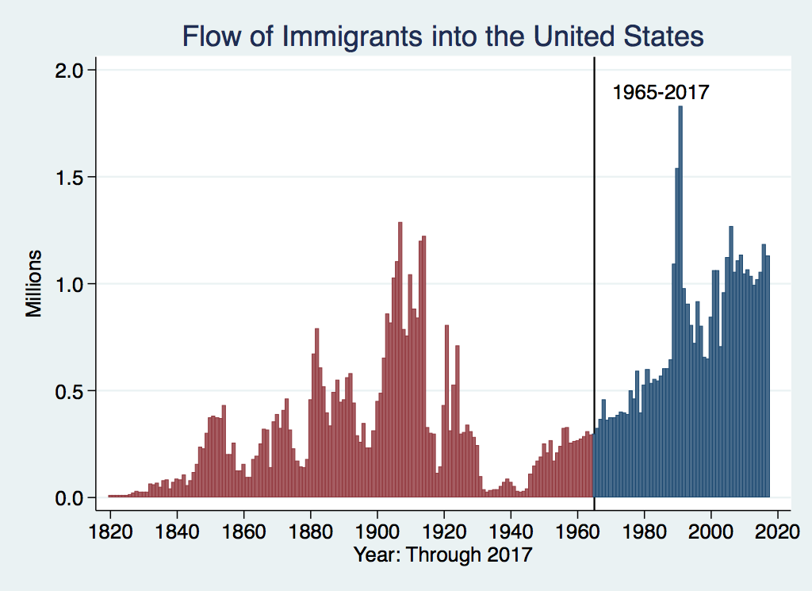
History of US Immigration: 1965-2017
Source Country | 1965-2017
Mexico | 4,300,000
Philippines | 1,400,000
South Korea | 760,000
Dominican Republic | 750,000
India | 740,000
Cuba | 700,000
Vietnam | 700,000
Canada | 650,000
Source: https://www.libertyellisfoundation.org/immigration-timeline/.

Slide 14
History of US Immigration: 2011-2020
Sources (top 9) | 2011-2020
Mexico | 1,491,000
China | 721,000
India | 637,000
Philippines | 505,000
Dominican Rep. | 487,000
Cuba | 473,000
Vietnam | 334,000
El Salvador | 215,000
South Korea | 199,000
Jamaica | 198,000
Total immigrant inflow, 2011-2020 = 10,125,000
US population growth, 2011-2020 = 22,700,000
Typical year during decade…
US population increased by 2.27 million (0.74%)
Native births contributed approx. 1.35 million (0.44%)
Immigration contributed approx. 920,000 (0.30%)
Sources: UN Population Division (2010 and 2020 immigrant stocks), US DHS (2010-2020 immigrant inflows), US Census (population values).

Slide 15
Total and Average Annual Immigrant Arrivals, 1820-2015
Sources: US Statistical Abstract (various years), US INS (various years), and US DHS (various years)

Slide 16
Immigrant Inflow Shares, 1820-2015
Sources: US Statistical Abstract (various years), US INS (various years), and US DHS (various years)

Slide 17
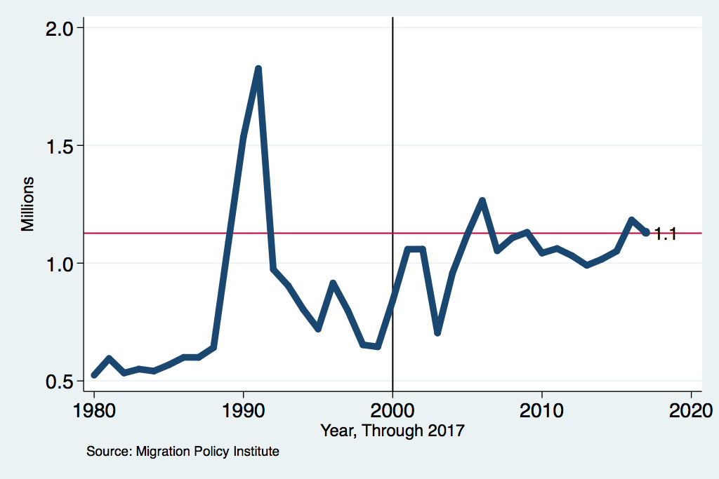
Recent Trends in Authorized Immigration

Slide 18
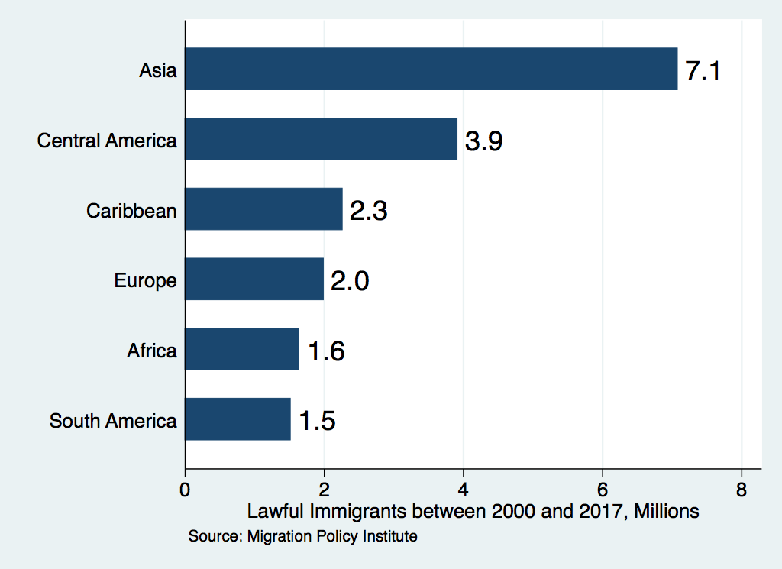
Authorized Immigration by Region

Slide 19
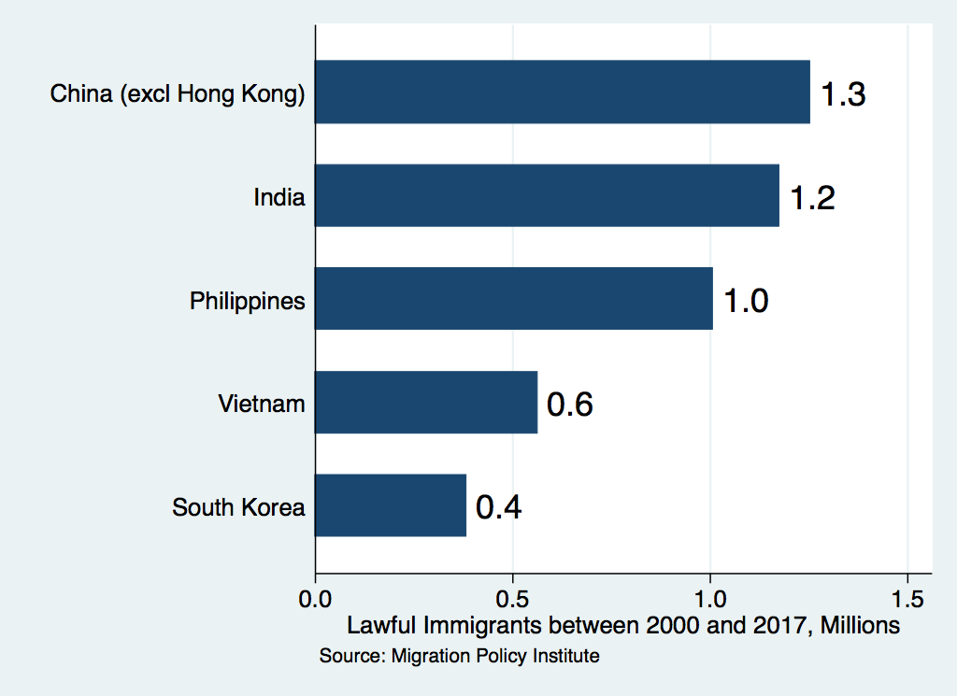
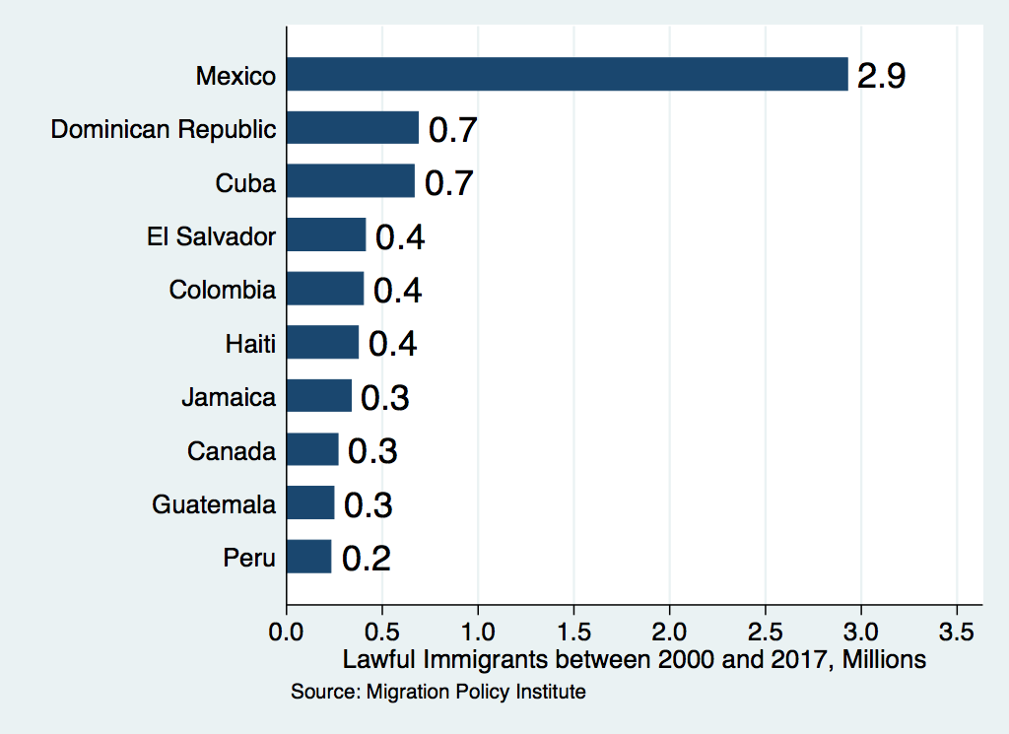
Authorized Immigration by Source

Slide 20
U.S. Unauthorized Immigration Totals
2018: 11.4 million (US DHS).
Pew Research Center, 5 facts about illegal immigration in the U.S., June 12, 2019
US DHS (Dept. of Homeland Security) (2021) “Estimates of the Unauthorized Immigrant Population Residing in the United States:
January 2015–January 2018”.

Slide 21
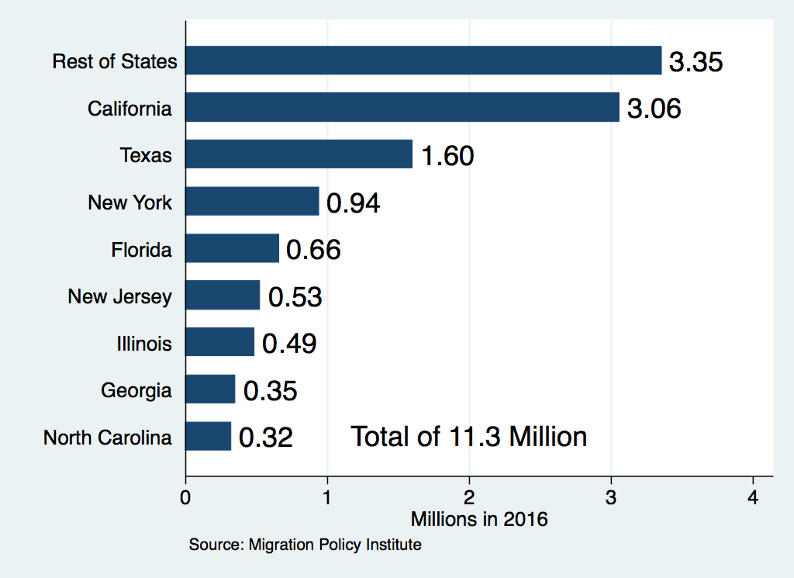
Unauthorized Immigration: Where They Live

Slide 22
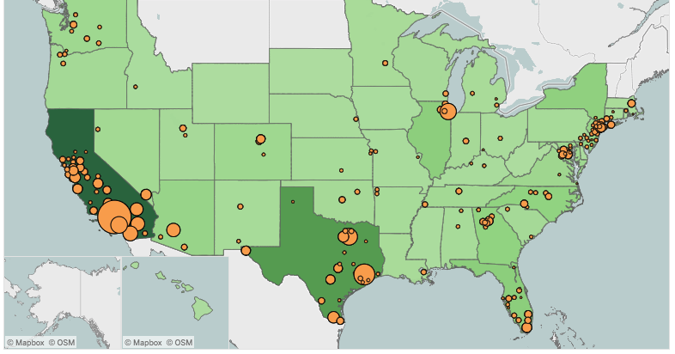
Unauthorized Immigration: 2012-2016
https://www.migrationpolicy.org/programs/data-hub/charts/unauthorized-immigrant-populations-country-and-region-top-state-and-county

Slide 23
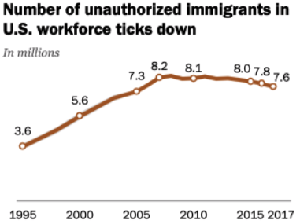
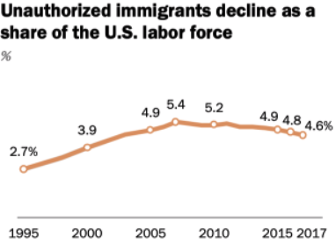
U.S. Unauthorized Immigration: Labor Force
Pew Research Center, 5 facts about illegal immigration in the U.S., June 12, 2019

Slide 24
GDP, Labor markets, Trade, FDI, Innovation, Entrepreneurship, Inequality, Government Revenues and Expenditures

Slide 25
Two Sets of Implications
Aggregate effects: The size of the pie
Income distribution: The size of slices of the pie

Slide 26
GDP: How Does This Work?
What determines the size of an economy?
  Physical capital
  Technology/productivity
  The number of workers
    Immigration adds to the number of workers.
Number of immigrants in the labor force is high
  28.2 million foreign-born persons ages 16+ in the labor force in 2018.
  17.4% of the total US workforce (US Census Bureau, 2019).
Evidence
  Immigrants added 11% to GDP ($2 trillion) in 2016.
US Census Bureau (2019) American Community Survey.
National Academies of Sciences, Engineering, and Medicine (2017) “The Economic and Fiscal Consequences of Immigration”.

Slide 27
Labor Market Implications: Complicated
Depends on the type of immigrant: Skills/education
  Similar to native-born population?
  Low-skilled?
  Highly skilled?
Brings capital market implications
  Low-skilled immigrants – capital supplementing
  Highly skilled immigrants – capital complementing
Source: Hong & McLaren (2015).

Slide 28
Pattern of Immigration
Educational Attainment of Recent Immigrants – Last 5 Decades
Source: Blau & Mackie (2017), p. 88.

Slide 29
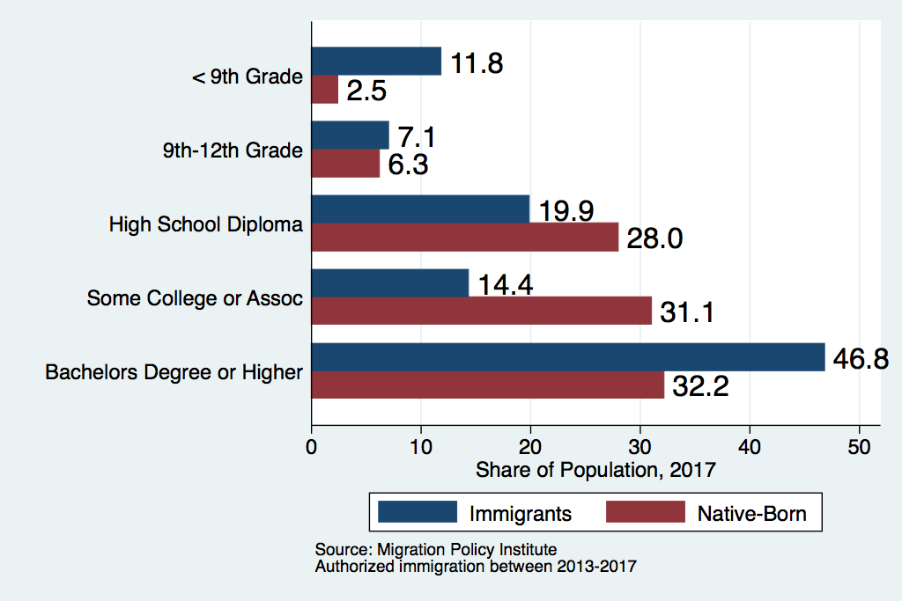
Recent Immigrants Are Less and More Educated

Slide 30
Labor Market Implications
Provides net benefits to the receiving economy
  Larger labor supply.
  Changes in labor prices increase production of goods and services that use the type of labor offered by immigrants.
Short run: there are winners and losers
  Changes in wage structure and returns to capital affect native-born workers differently.
Long run: could be no winners, but also no losers
  The economy might adjust to pre-immigration wage structure and returns to capital. No change for native-born individuals.

Slide 31
Exports, Imports, and FDI
Flows of goods, services, and investments internationally rely heavily:
  Information
  Contacts abroad
Immigrants bring both information and networks.
A variety of studies show that increased immigration from a particular country leads to
  Increased exports to the source country.
  Increased imports from the source country.
  Increased flows of investment to/from the source country.
Migrant networks do indeed complement both trade and FDI.
Sources: Gould (1994), Hatzigeorgiou and Lodefalk (2015).

Slide 32
Skilled Immigrants and Innovation
1% increase in the share of the immigrant college graduate population
  9-18% increase in patenting per capita
  Increased immigration increases patenting by native-born population
  Nonetheless, the effect is positive
In the 1990s
  Increased skilled immigration can account for one-third of increased patenting in that decade.
  This translates into a 1.4-2.5% increase in GDP per capita by the end of the decade.
Source: Hunt and Gauthier-Loiselle (2008).

Slide 33
Immigrants and Entrepreneurship
Self-Employment Rates by Nativity
Source: Magnus Lofstrom from Current Population Survey Data.

Slide 34
Immigration and Inequality
  Source: Ping Xu, James C. Garand, and Ling Zhu, “How immigration makes income inequality worse in the U.S.” (October 2015), Figure 1.

Slide 35
Immigration and Inequality: Summary
Beginning in about 1970, the immigrant share of the US
population increased dramatically.
  5% in 1970 and 14% in 2016
Compared to the native born, immigrants:
  Comprise a larger share of less-educated workers (less than HS diploma)
  Comprise a larger share of highly educated workers (advanced degree)
Immigration has likely increased income inequality.
Its effect has likely been small.
  ~5% between 1980 and 2000
  No reason to think it has been bigger since then

Slide 36
Government Revenues and Expenditures

Slide 37
Why Is This Important?
Important for understanding whether immigrants will be net contributors to the economy.
Two additional reasons:
  Taxpayer inequity geographically
  Necessary to understand the full consequences of admitting additional immigrants into the country

Slide 38
Topics?
Basic Question:
  Taxes (income, sales, and other) immigrants pay vs. government expenditures on public benefits and services they receive.
More complicated:
  Immigrants also affect the fiscal equation for many native-born residents.
    Indirectly through labor and capital markets.
    Changes in wages and the return to capital.

Slide 39
What Do We Know?
Immigrants who arrive while of working age:
  Are, on average, net contributors.
  21-year-old with a high school diploma: +$126,000 over a lifetime
    Though this value gradually declines with age at arrival.
    Turns negative for arrivals of age 35+
Net contribution crucially depends on characteristics
  Age distribution, family composition, health status, fertility patterns
  Temporary or permanent relocation
  Employment in the legal labor market
  Authorized or unauthorized

Slide 40
Bottom Line/Consensus of Estimates
Federal level: fiscal impact is generally positive.
State and local level: typically negative fiscal impact.

Slide 41
Implications for Major Federal Programs
Documented immigrants are less likely to use Social Security and Medicare.
Unauthorized immigrants are ineligible.
  They will pay into the system but cannot receive benefits.
Medicaid: not available to legal residents for the first five years.
Provide a source of revenue for an aging population.

Slide 42
The Aging US Population
Source: Blau & Mackie (2017), p. 63.

Slide 43
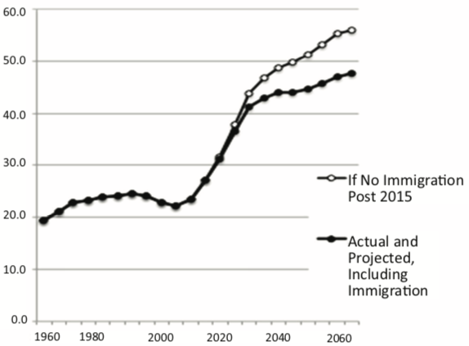
Implications for Social Security
Population Age 65+ per 100 of Working Age (25-64)
Source: Blau & Mackie (2017).

Slide 44
Summary
Immigration can be thought of as increasing the population of the United States.
This brings economic growth and opportunity, just as does increasing the native-born population.
Including unauthorized immigrants, the supply of low-skilled workers is increased
  This lowers the wages of low-skilled workers.
  But also increases labor force participation among highly skilled workers.

Slide 45
At the Same Time….
Immigrants are often a select group:
  Willing to incur an enormous personal or familial cost to better their lives.
As a result:
  Immigrants tend to be entrepreneurial and to add significantly to economic growth.
Although there are distributional issues:
  Immigration is an important contributor to economic growth.
  Immigration helps to sustain vital government programs.

Slide 46
Credits and Disclaimer
This slide deck was authored by:
  Anna Maria Mayda, Georgetown University
  Robert Gitter, Ohio Wesleyan University
  Roger White, Whittier College
This slide deck was reviewed by:
  Kirk Doran, Notre Dame
  Ethan Lewis, Dartmouth College
Disclaimer
  NEED presentations are designed to be nonpartisan.
  It is, however, inevitable that presenters will be asked for and will provide their own views.
  Such views are those of the presenter and not necessarily those of the National Economic Education Delegation (NEED).

Slide 47
Thank you!
Any Questions?
www.NEEDelegation.org
Roger White, Ph.D.
rwhite1@whittier.edu
Contact NEED: info@NEEDelegation.org
Submit a testimonial: www.NEEDelegation.org/testimonials.php
Become a Friend of NEED: www.NEEDelegation.org/friend.php

