Slide 1
Osher Lifelong Learning Institute, Spring 2025
Contemporary Economic Policy Issues
Washington University in St. Louis
Host: Jon Haveman, Ph.D.
National Economic Education Delegation

Slide 2
Available NEED Topics Include:
US Economy
Healthcare Economics
Climate Change
Economic Inequality
Economic Mobility
Trade and Globalization
Minimum Wages
Immigration Economics
Housing Policy
Federal Budgets
Federal Debt
Black-White Wealth Gap
Autonomous Vehicles
US Social Policy

Slide 3
Course Outline
Contemporary Economic Policy
  Week 1 (4/29): US Economic Update & Tariffs (Geoffrey Woglom, NEED)
  Week 2 (5/6): Federal Debt (Geoffrey Woglom, NEED)
  Week 3 (5/13): Economics of Immigration (Jon Haveman)
  Week 4 (5/20): Autonomous Vehicles (Jon Haveman)

Slide 4
Submitting Questions
Please submit questions in the chat.
  I will try to handle them at the break.
We will do a verbal Q&A once the material has been presented.
Slides will be available from the NEED website after the talk. (https://www.needecon.org/delivered_presentations.php).

Slide 5
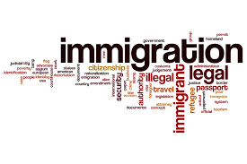
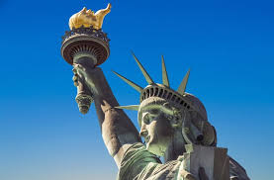
The Economics of Immigration
Jon Haveman, Ph.D.
National Economic Education Delegation

Slide 6
Credits and Disclaimer
This slide deck was authored by:
  Anna Maria Mayda, Georgetown University
  Robert Gitter, Ohio Wesleyan University
  Roger White, Whittier College
This slide deck was reviewed by:
  Kirk Doran, Notre Dame
  Ethan Lewis, Dartmouth College
Disclaimer
  NEED presentations are designed to be nonpartisan.
  It is, however, inevitable that presenters will be asked for and will provide their own views.
  Such views are those of the presenter and not necessarily those of the National Economic Education Delegation (NEED).

Slide 7
Outline
Quiz!
Why do people migrate?
The nature of immigration to the U.S.
Economics of immigration
Recent immigration issues

Slide 8
Immigration Quiz
What % of the U.S. population are not native-born?
  14%
What % of the world’s population are not native-born?
  3.6%
How long has the average undocumented immigrant lived in the United States?
  A. 3 months
  B. 2 years
  C. 10 years
  D. 25 years
21% of children born to native parents are high-income earners (above the middle class).
What % of kids born to immigrants are high-income earners?
  A. 15%
  B. 21%
  C. 28%
  D. 35%
In 2021, 8% of Americans lived in poverty. What percent of immigrants lived in poverty?
  13%
Source: Freakonomics – How Much Do You Know About Immigration?

Slide 9
Immigration Quiz
Immigrants are responsible for what % of patents in the United States?
  36%
    23% of inventors on record
    13% from increase in native born patenting
What % of green cards go to family rather than employment-based immigration?
  66% go to family-based
What % of the U.S. workforce are immigrants?
  18%
Native-born Americans receive $8k on average in benefits. What is it for immigrants?
  $6,000
100 years ago, most immigrants were from Europe. Today, Latin America and Asia. Is the rate of assimilation:
  Faster? Slower? About the same?
Source: Freakonomics – How Much Do You Know About Immigration?

Slide 10
Why Do People Migrate?
Push factors:
  Disparities in income/standards of living, and the availability of jobs, violence/war, climate change, natural disasters, population pressures, economic dislocation, religious persecution, and denial of political rights.
Pull factors:
  Potential for economic prosperity (higher wages, job opportunities), physical security, political freedom, and religious liberty.
Source: Gilder Lehrman Institute of American History.

Slide 11
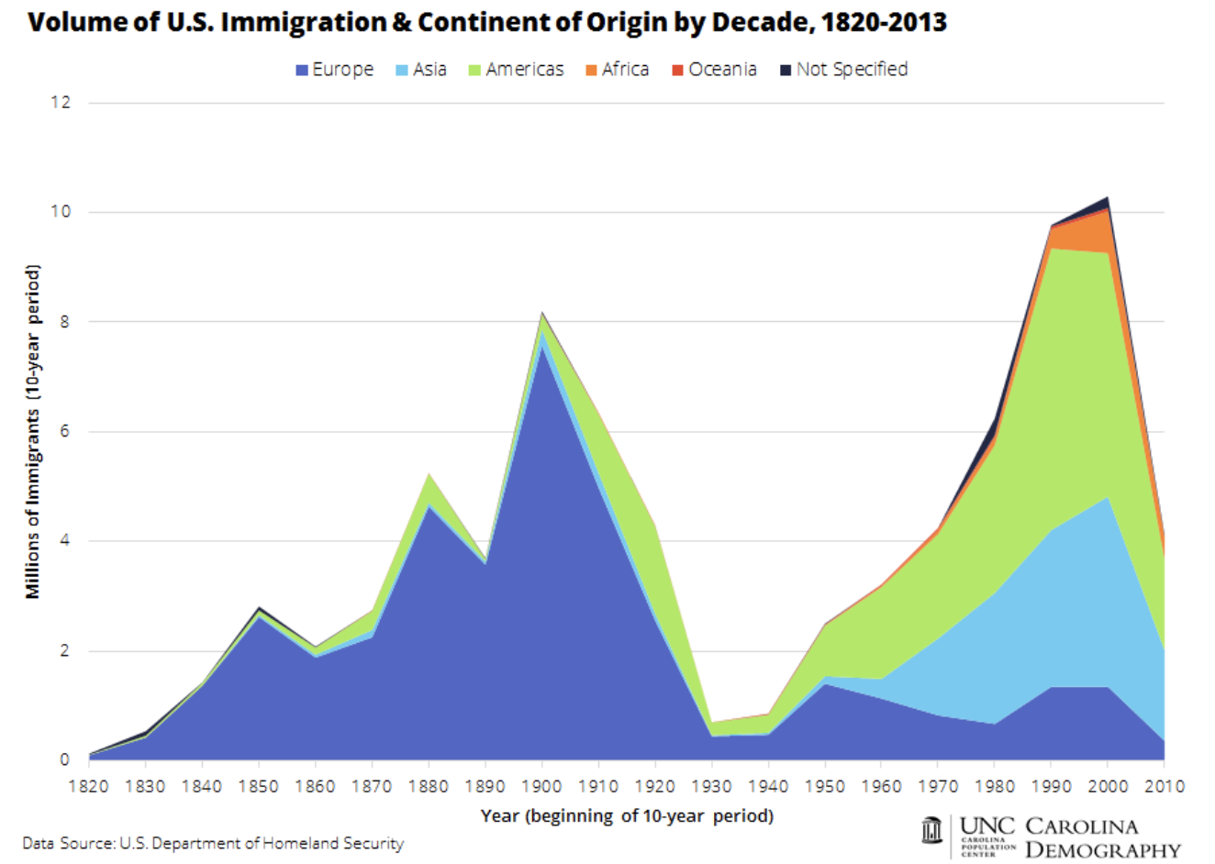

Slide 12
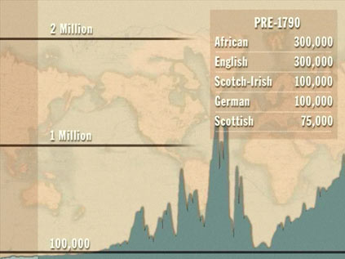
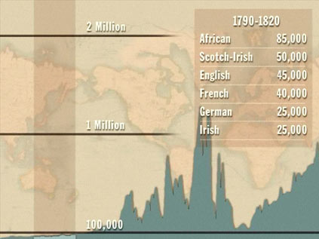
History of US Immigration
Source Countries | Pre-1790
African countries* | 300,000
England | 300,000
Scotland-Ireland | 100,000
Germany | 100,000
Scotland | 75,000
Source Countries | 1790-1820
African countries* | 85,000
Scotland-Ireland | 50,000
England | 45,000
France | 40,000
Germany | 25,000
* Slave trade and clearly not voluntary or reflective of standard motivations for immigration.
Source: https://www.libertyellisfoundation.org/immigration-timeline/.

Slide 13
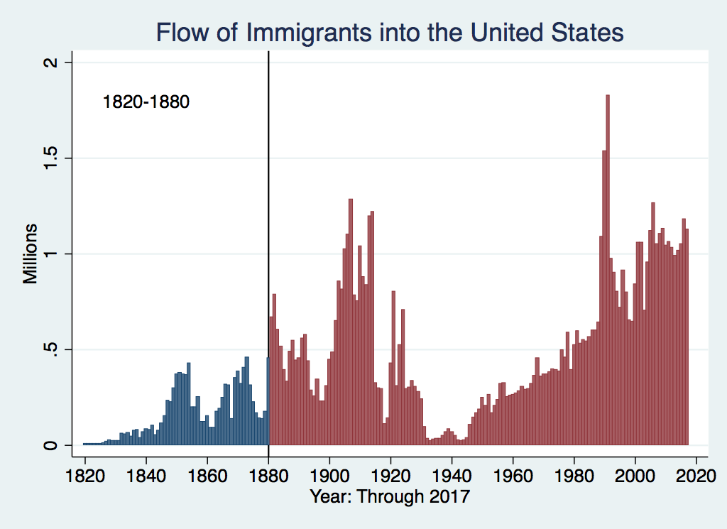
History of US Immigration
Source Countries | 1820-1880
Germany | 3,000,000
Ireland | 2,800,000
Britain | 2,000,000
Austro-Hungarian empire | 1,000,000
Canada | 750,000
China | 230,000
African countries | 50,000
https://www.libertyellisfoundation.org/immigration-timeline

Slide 14
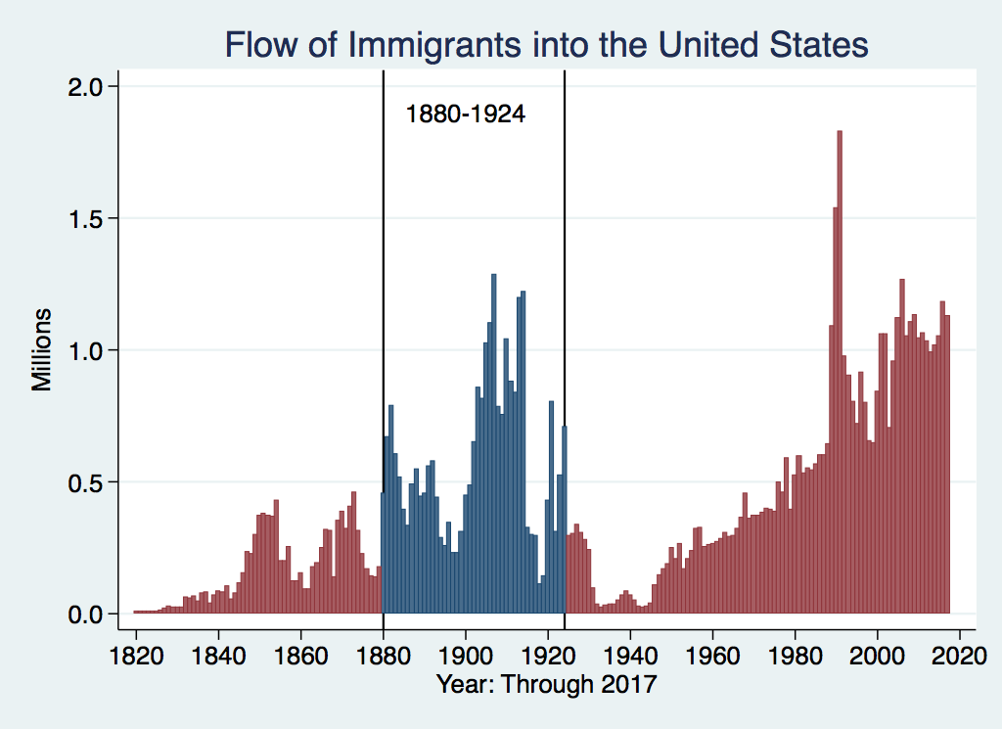
History of US Immigration
Source Countries | 1880-1930
Italy | 4,600,000
Austro-Hungarian empire | 4,000,000
Russian empire | 3,300,000
German empire | 2,800,000
Britain | 2,300,000
Canada | 2,300,000
Ireland | 1,700,000
https://www.libertyellisfoundation.org/immigration-timeline

Slide 15
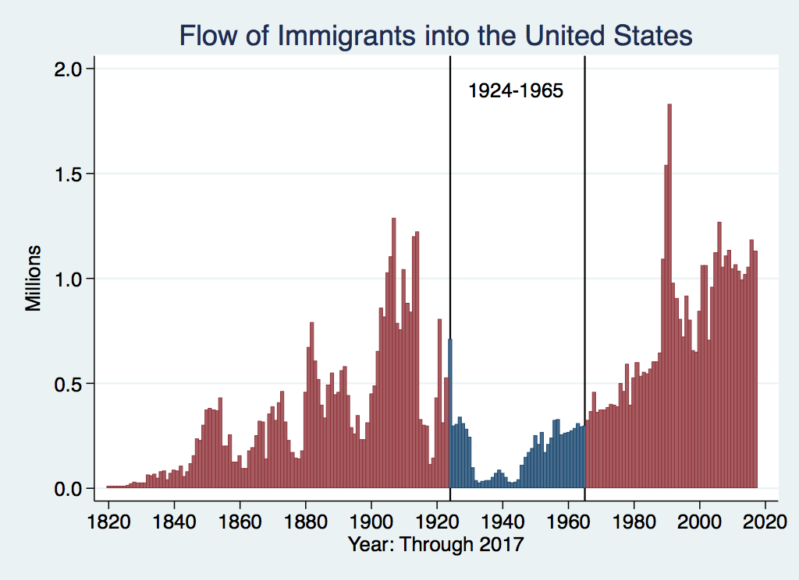
History of US Immigration
Source Countries | 1930-1965
Germany | 940,000
Canada | 900,000
Mexico | 610,000
Britain | 480,000
Italy | 390,000
Caribbean/ West Indies | 310,000
Source: https://www.libertyellisfoundation.org/immigration-timeline/.

Slide 16
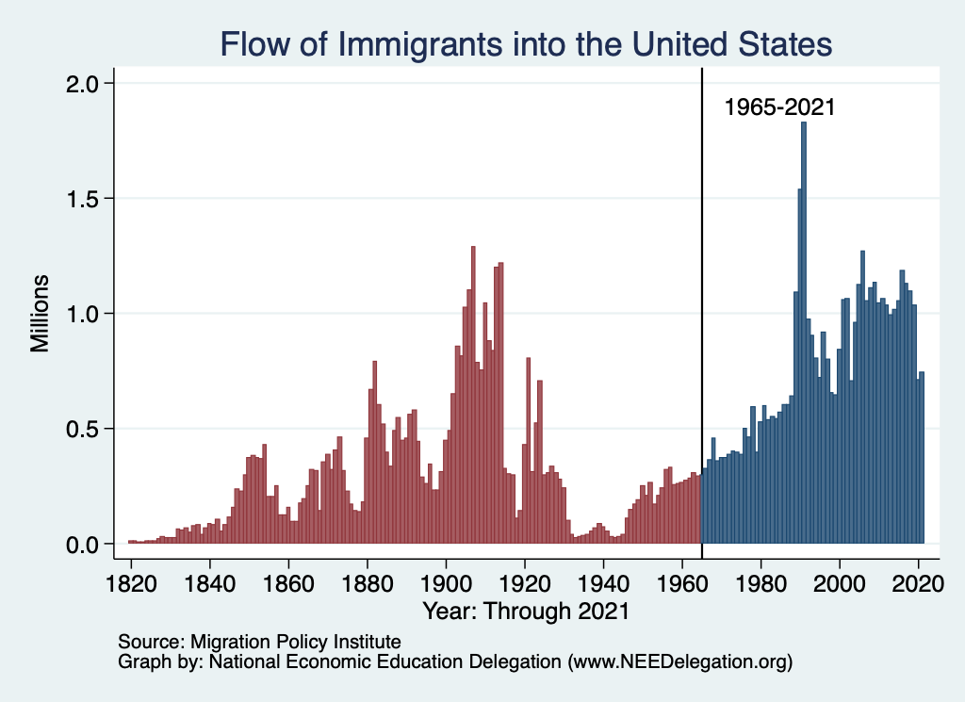
History of US Immigration: 1965-2017
Source Country | 1965-2017
Mexico | 4,300,000
Philippines | 1,400,000
South Korea | 760,000
Dominican Republic | 750,000
India | 740,000
Cuba | 700,000
Vietnam | 700,000
Canada | 650,000
Source: https://www.libertyellisfoundation.org/immigration-timeline/.

Slide 17
History of US Immigration: 2011-2020
Sources (top 10) | 2011-2020
Mexico | 1,491,000
China | 721,000
India | 637,000
Philippines | 505,000
Dominican Rep. | 487,000
Cuba | 473,000
Vietnam | 334,000
El Salvador | 215,000
South Korea | 199,000
Jamaica | 198,000
Total immigrant inflow, 2011-2020 = 10,125,000
US population growth, 2011-2020 = 22,700,000
Typical year during decade…
US population increased by 2.27 million (0.74%)
Native births contributed approx. 1.35 million (0.44%)
Immigration contributed approx. 920,000 (0.30%)
Sources: UN Population Division (2010 and 2020 immigrant stocks), US DHS (2010-2020 immigrant inflows), US Census (population values).

Slide 18
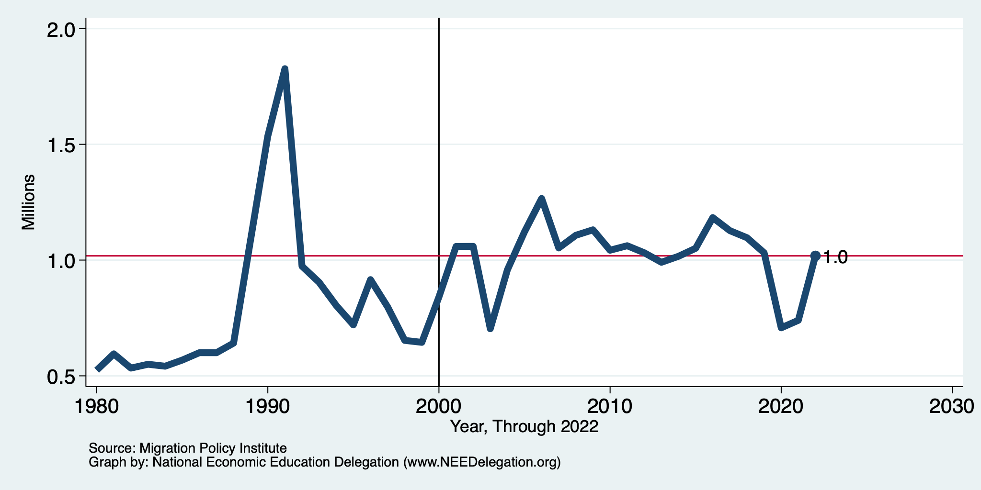
Recent Trends in Authorized Immigration
2022
1.0 Million

Slide 19
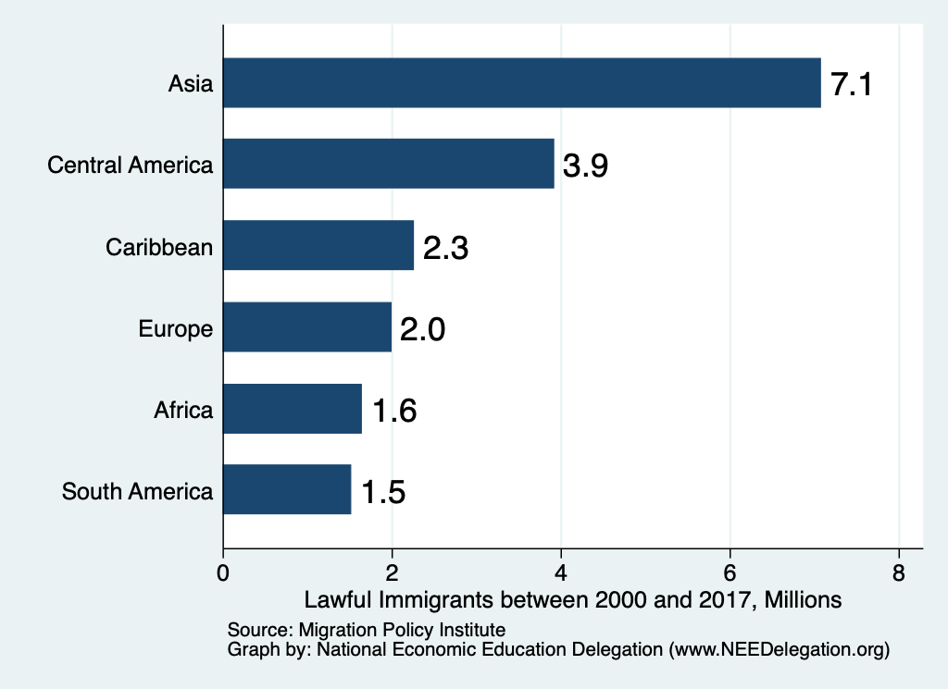
Authorized Immigration by Region (2000-2017)

Slide 20
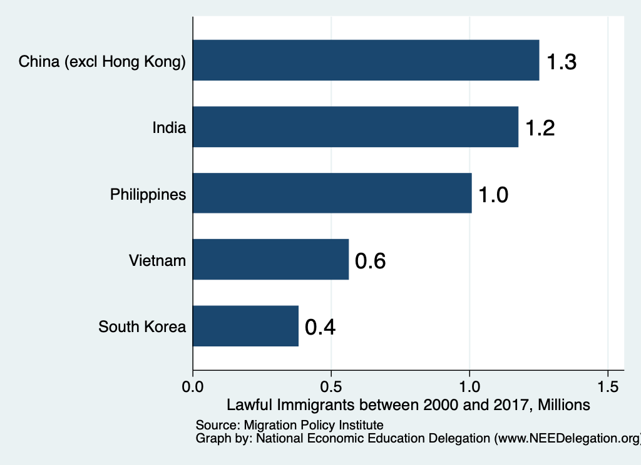
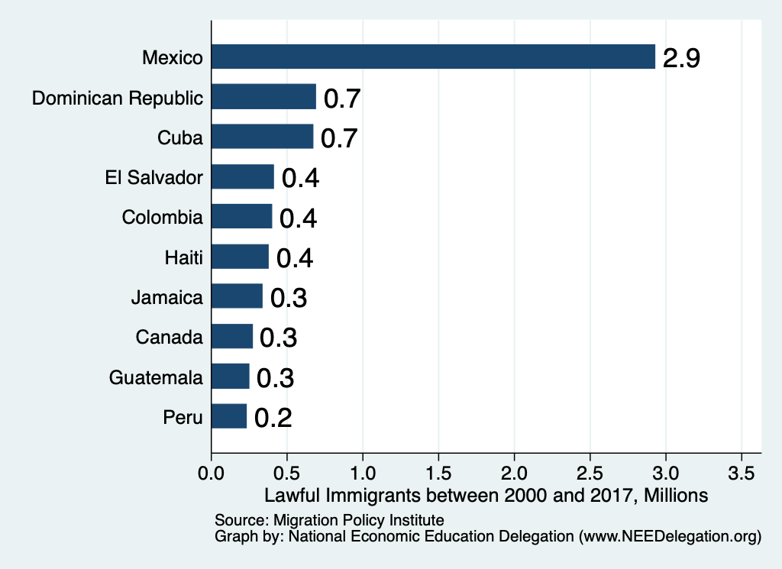
Authorized Immigration by Source

Slide 21
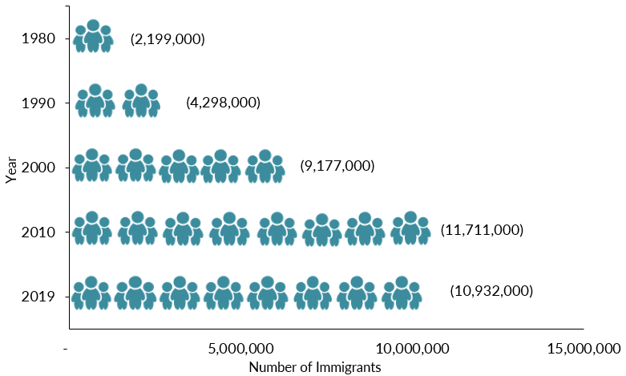
Mexican-Born People in the US
About 10.6 million in 2022 (Latest data)
1 in 14 people born in Mexico currently lives in the US

Slide 22
Distribution of Income
Mexico
United States
Number of People
Income

Slide 23
Pattern of Immigration
Educational Attainment of Recent Immigrants – Last 5 Decades
Source: Blau & Mackie (2017), p. 88.

Slide 24
UNauthorized Immigration

Slide 25
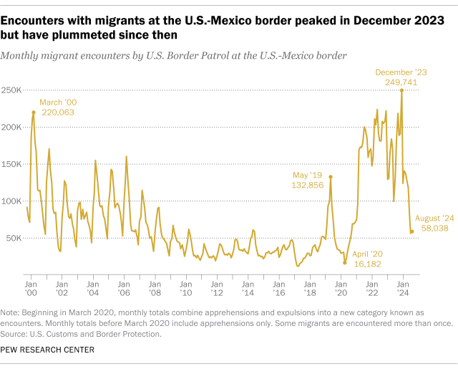
Source: Customs and Border Patrol
https://usafacts.org/articles/what-can-the-data-tell-us-about-unauthorized-immigration

Slide 26
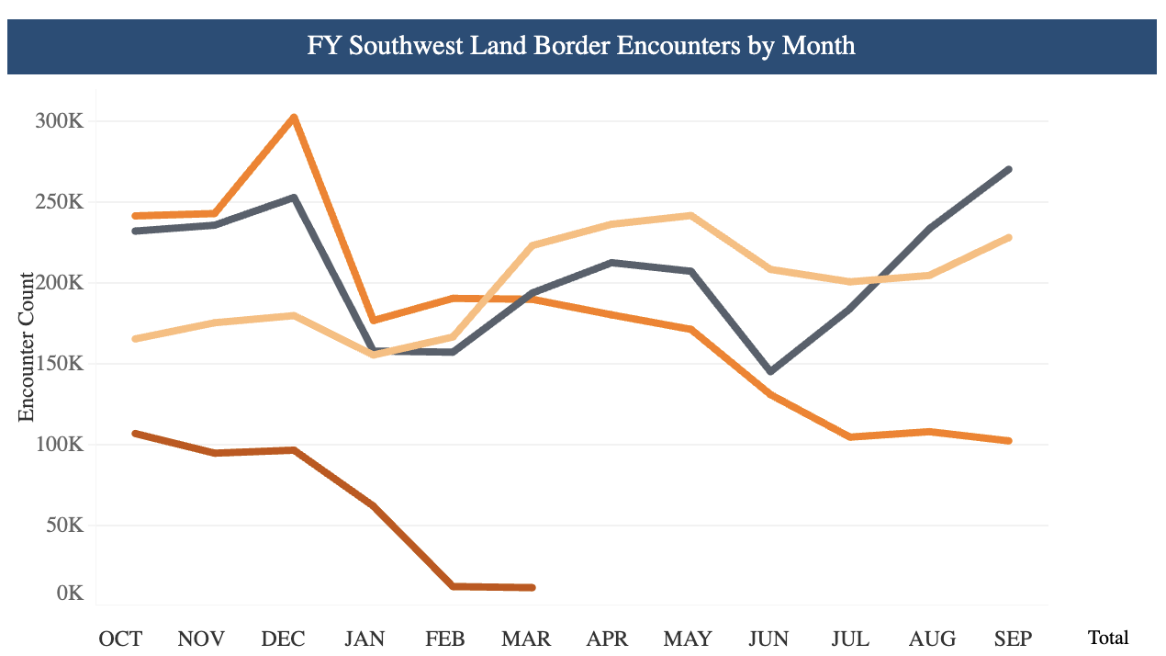
Recent Border Encounters
2023
2022
2024
2025

Slide 27
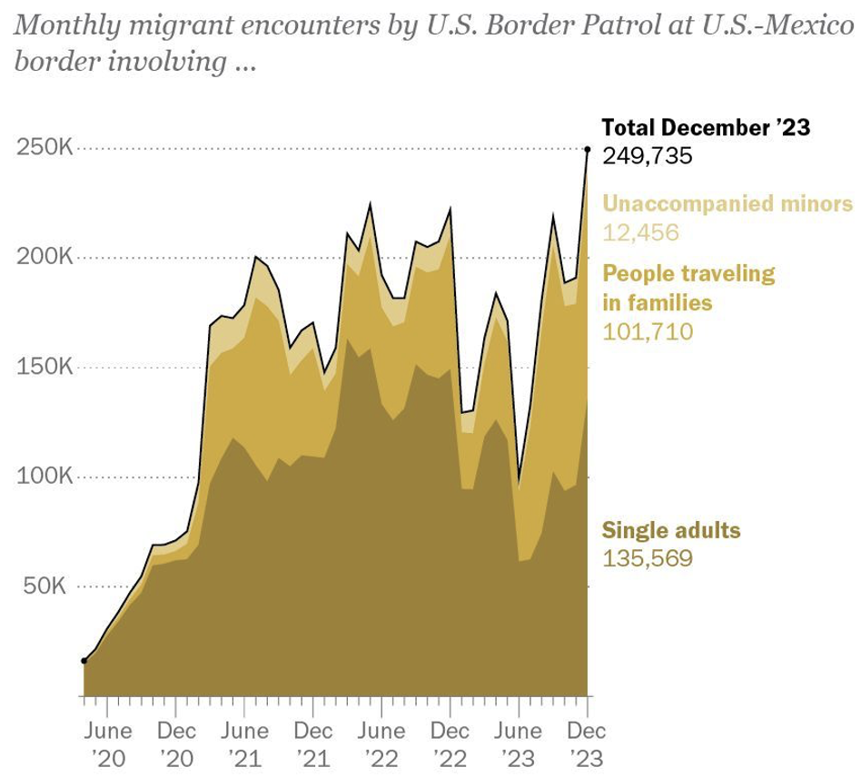
Growing #s of People Traveling in Families
Evidence suggests:
Most unaccompanied minors
are coming to join family members
who are already here.
The population of minors in the
U.S. without a parent has not increased.
Big Story:
- Many more people coming as families.
Source: Pew Research Center, US Customs and Border Protection

Slide 28
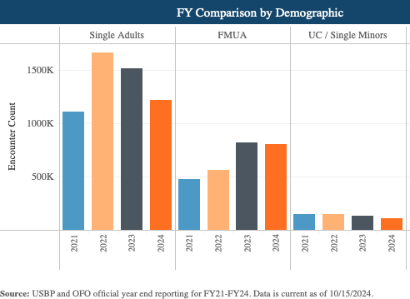
Most Are Single Adults

Slide 29
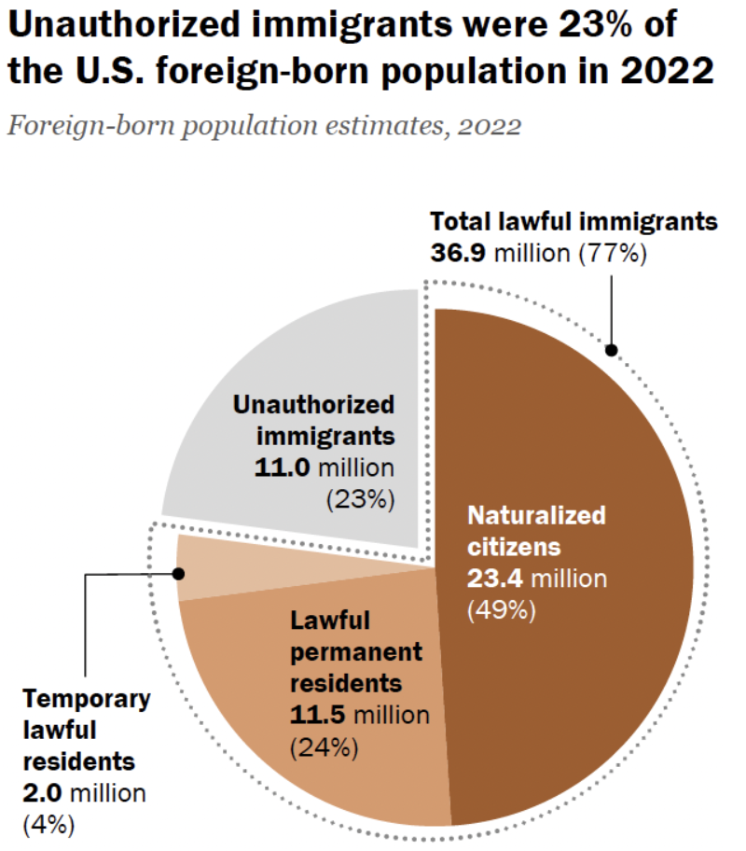
Total Foreign-Born (2022)
Population: 47.9 million
Total Foreign-Born (Current)
Population: 49.7 million
Source: Pew Research Center, What we know about unauthorized immigrants living in the U.S., July 22, 2024

Slide 30
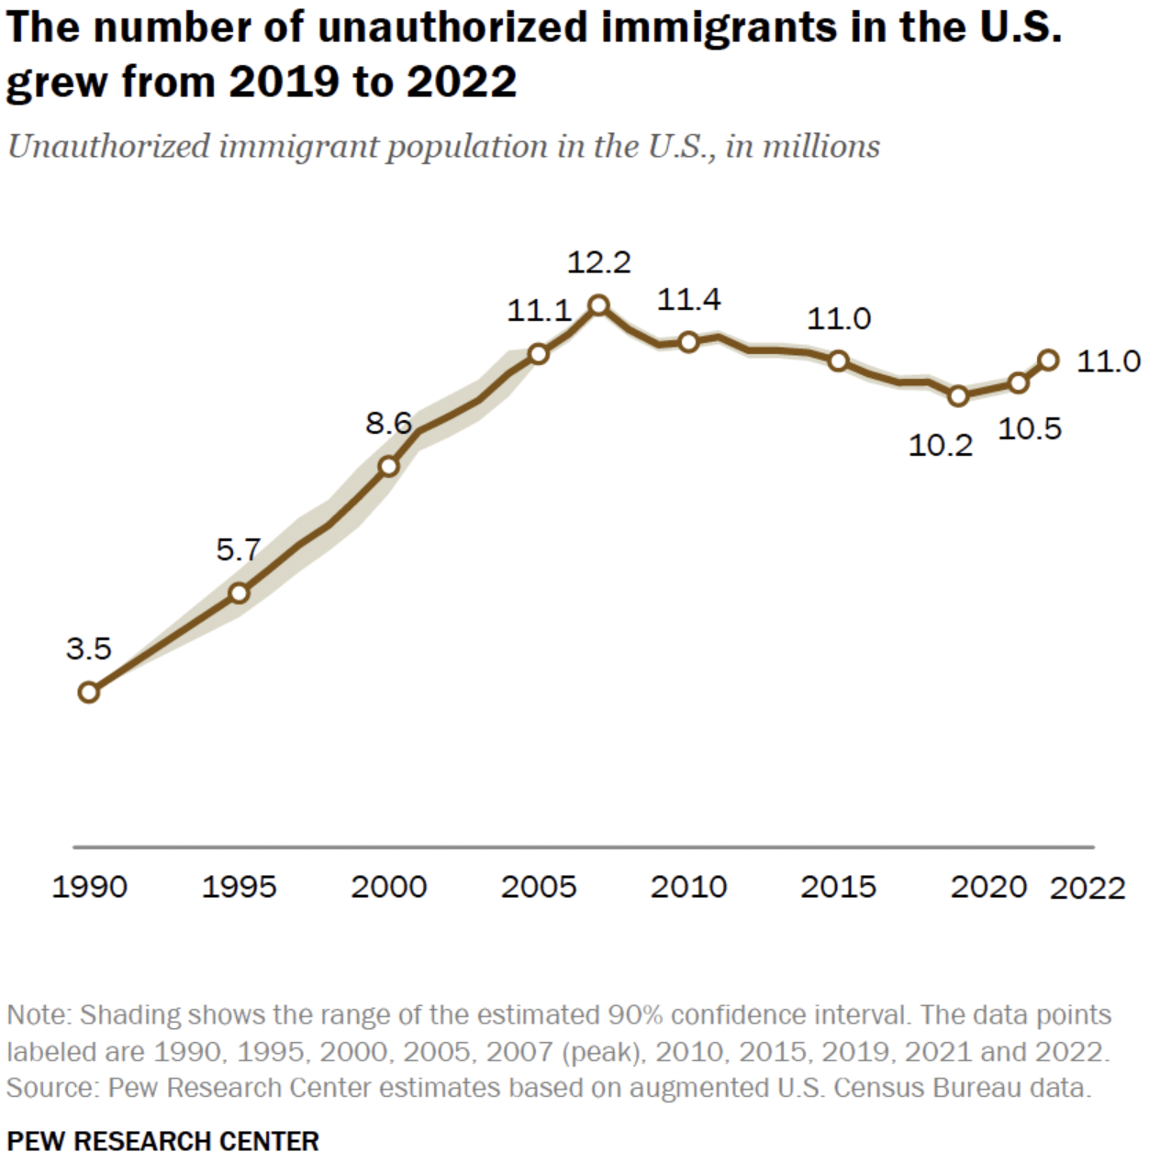
U.S. Unauthorized Immigration Totals
And is about the same
As in 2015.
Data suggest:
- 11.7 in 2023.
Less than 13 million
currently
Source: Pew Research Center, What we know about unauthorized immigrants living in the U.S., July 22, 2024

Slide 31
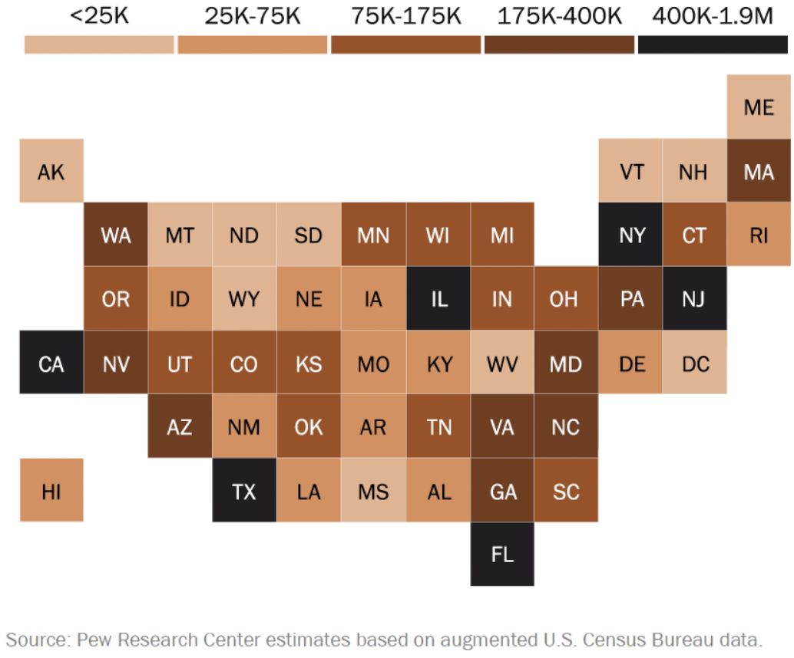
Unauthorized Immigrants by State, 2022

Slide 32
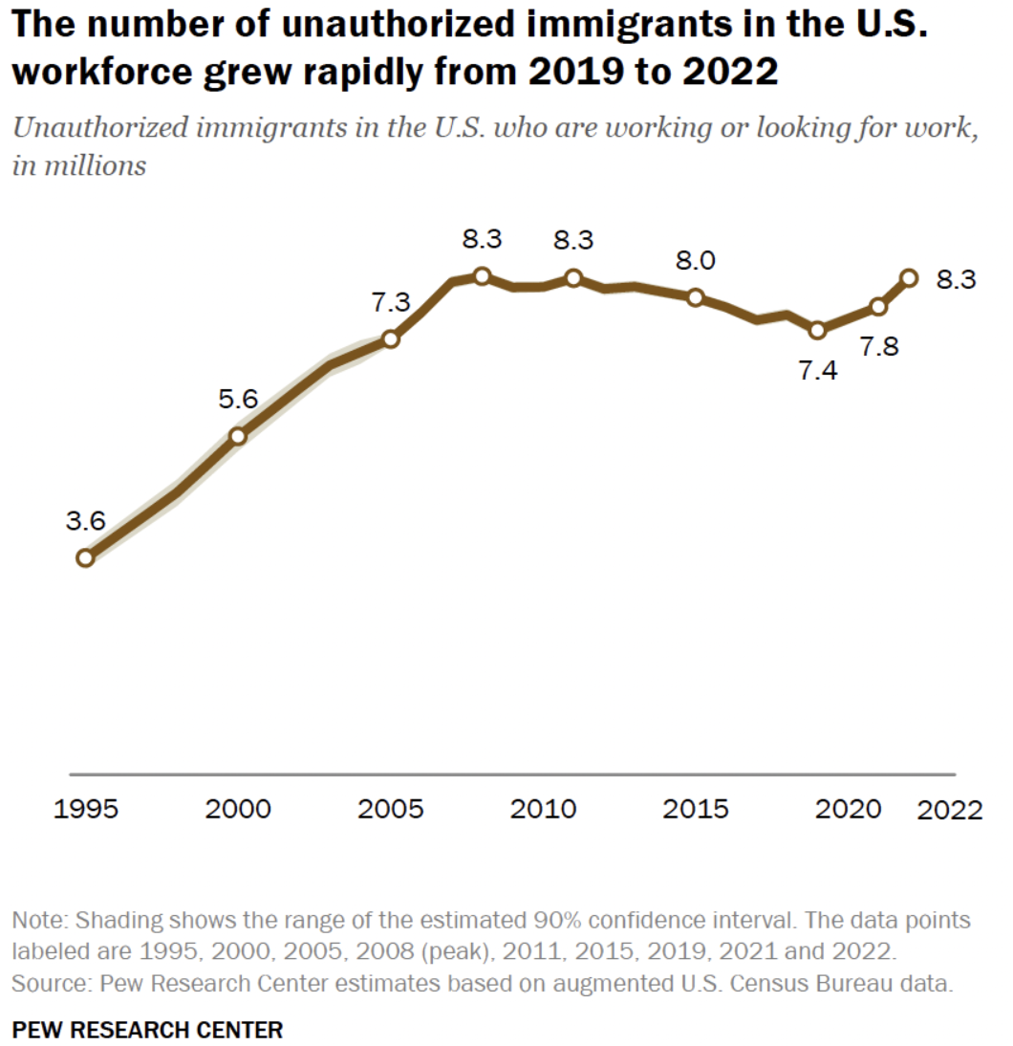
U.S. Unauthorized Immigration: Labor Force
And is about the same
As in 2006-2010.
5% of labor force
3% of population
Source: Pew Research Center, What we know about unauthorized immigrants living in the U.S., July 22, 2024

Slide 33
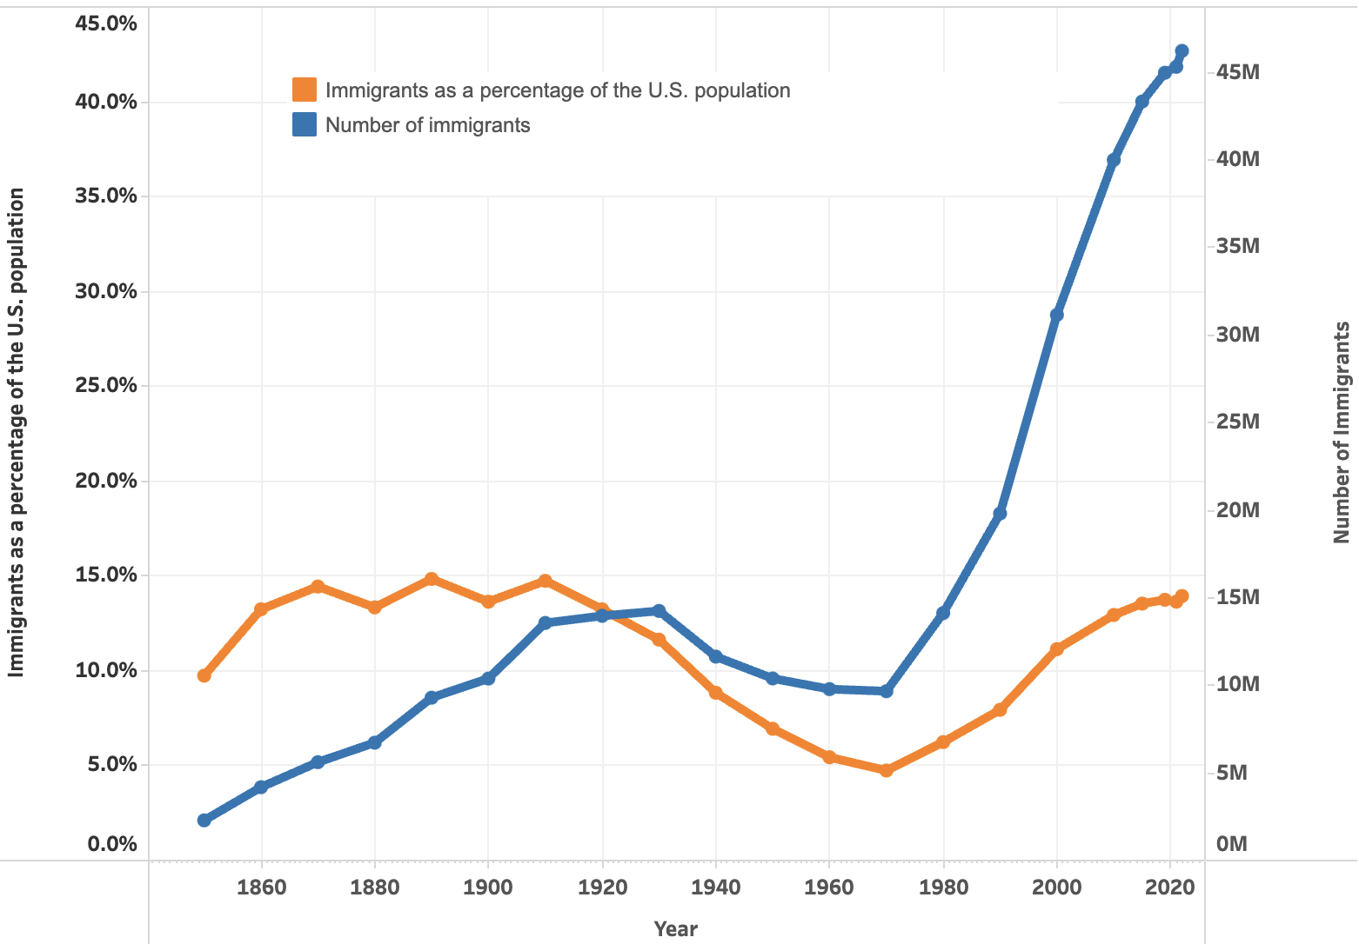

U.S. Immigrant Population and Share over Time
1850-2022
60 YEARS

Slide 34
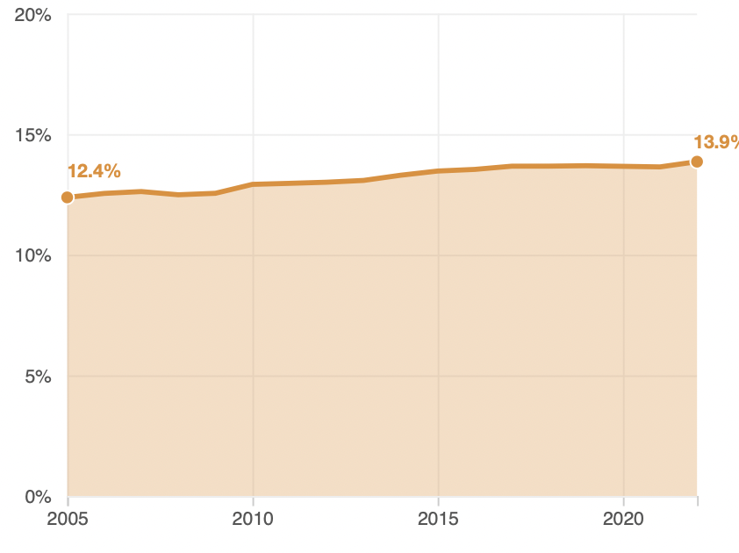
Immigrant Share of US Population
13.9 %
12.4 %

Slide 35
Economics

Slide 36
Why Do We Care? Economic Implications
Conventional Wisdom Issues:
  Labor markets: Wages and Jobs
  Government Revenue and Spending
  Crime
Other issues (that don’t get talked about much):
  Gross Domestic Product (GDP)
  Innovation and Entrepreneurship

Slide 37
GDP: How Does This Work?
What determines the size of an economy?
  Physical capital
  Technology/productivity
  The number of workers
    Immigration adds to the number of workers.
Number of immigrants in the labor force is high
  33.0 million foreign-born persons ages 16+ in the labor force in April/25.
  19.3% of the total US workforce.
Evidence
  Immigrants added 11% to GDP ($2 trillion) in 2016.
Federal Reserve Bank of St. Louis (https://fred.stlouisfed.org/)
National Academies of Sciences, Engineering, and Medicine (2017) “The Economic and Fiscal Consequences of Immigration”.

Slide 38
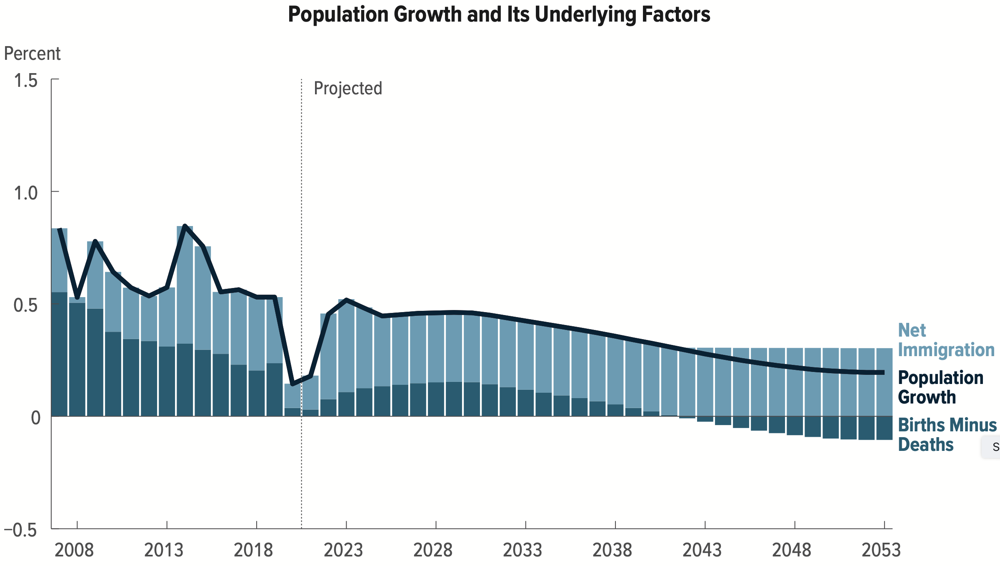
Is Immigration Saving the Day?
The vast majority of additions to the
Population in the last several years
Have been from immigration.
Source: CBO – The Demographic Outlook, 2023-2053

Slide 39
Jobs: Conventional Wisdom…Upended
What is the conventional wisdom?
  Low-skilled immigrants come in and take jobs from low-skilled native-born individuals.
    1-1 tradeoff.
What does new research show?
  Low-skilled immigrants contribute positively to the economy.
    Every 100 low-skilled immigrants: create 9 jobs for low-skilled native-born.
    They create opportunities for low-skilled native-born workers.
  Low-skilled immigrants take jobs that native-born don’t want.

Slide 40
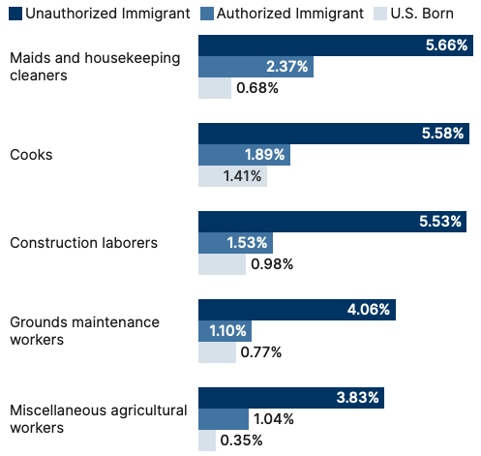
Share of Workers in Each Occupations

Slide 41
Pathway of Wage and Employment Effects
}
Inflows of Low-Skilled Immigrants
Order of Impact
Impact is negative,
But is smaller
at each step.
Previous Immigrants
Disadvantaged Minorities
Native-born HS Dropouts
Positive influence on wages and employment of other workers.

Slide 42
Skilled Immigrants and Innovation
1% increase in the share of the immigrant college graduate population
  9-18% increase in patenting per capita
  Increased immigration increases patenting by native-born population
  Nonetheless, the effect is positive
In the 1990s
  Increased skilled immigration can account for one-third of increased patenting in that decade.
  This translates into a 1.4-2.5% increase in GDP per capita by the end of the decade.
Source: Hunt and Gauthier-Loiselle (2008).

Slide 43
Immigrants and Entrepreneurship
Self-Employment Rates by Nativity
Source: Magnus Lofstrom from Current Population Survey Data.

Slide 44
Fortune 500: First- and Second-Generation Founders

Slide 45
Government Revenues and Expenditures

Slide 46
Topics?
Basic Question:
  Taxes (income, sales, and other) immigrants pay vs. government expenditures on public benefits and services they receive.
More complicated:
  Immigrants also affect the fiscal equation for many native-born residents.
    Indirectly through labor and capital markets.
    Changes in wages and the return to capital.

Slide 47
Age-Specific Taxes and Benefits
By Immigrant Generation, United States, 2012
Source: Blau & Mackie (2017), p. 325.

Slide 48
What Do We Know?
Immigrants who arrive while of working age:
  Are, on average, net contributors.
  21-year-old with a high school diploma: +$126,000 over a lifetime
    Though this value gradually declines with age at arrival.
    Turns negative for arrivals of age 35+
Net contribution crucially depends on characteristics
  Age distribution, family composition, health status, fertility patterns
  Temporary or permanent relocation
  Employment in the legal labor market
  Authorized or unauthorized

Slide 49
Bottom Line/Consensus of Estimates
Federal level: fiscal impact is generally positive.
State and local level: typically negative fiscal impact.

Slide 50
Implications for Major Federal Programs
Documented immigrants are less likely to use Social Security and Medicare.
Unauthorized immigrants are ineligible.
  They will pay into the system but cannot receive benefits.
Medicaid: not available to legal residents for the first five years.
Provide a source of revenue for an aging population.

Slide 51
The Aging US Population
Source: Blau & Mackie (2017), p. 63.

Slide 52
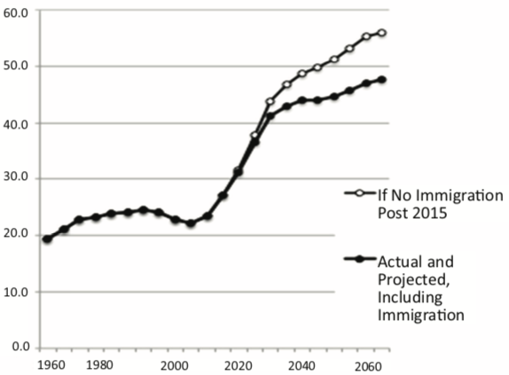
Implications for Social Security
Population Age 65+ per 100 of Working Age (25-64)
Source: Blau & Mackie (2017).

Slide 53
Is Immigration Saving the Day?
Source: CBO – The Demographic Outlook, 2023-2053

Slide 54
Non - Economic Implications
Patterns of Integration
Education
Employment and Earnings
Occupations
Poverty
Residential Integration
Language
Health
Family Patterns
The Big Misconception: Crime
Source: The Integration of Immigrants into American Society (2015).

Slide 55
Immigrants and Crime Rates
Conventional wisdom:
  Immigrants commit crimes more frequently than do native-born residents.
  Rising immigration leads to rising crime.
What do the data say?
  Rates of incarceration are lower for foreign-born than U.S.-born.
  Neighborhoods with more immigrants have lower crime rates.
Let’s Have a Look!

Slide 56
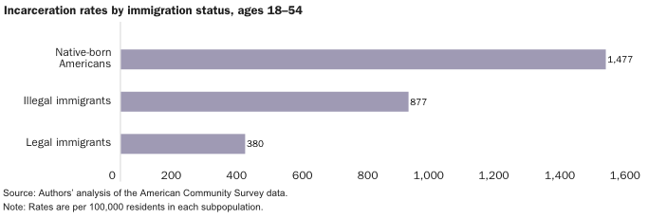
Incarceration by Immigration Status, 2018
Source: Cato Institute, Illegal Immigrant Incarceration Rates, 2010–2018: Demographics and Policy Implications, April 2020.

Slide 57
Immigrants and Crime Rates
Conventional wisdom:
  Immigrants commit crimes more frequently than do native-born residents.
  Rising immigration leads to rising crime.
What do the data say?
  Rates of incarceration are lower for the foreign born than US born.
  Neighborhoods with more immigrants have lower crime rates.
  There is no evidence that deporting noncitizen immigrants affects crime rates.

Slide 58
Summary
Immigration can be thought of as increasing the population of the United States.
  But they are a select group.
This brings economic growth and opportunity, just as does increasing the native-born population.
  But not crime.
Including unauthorized immigrants, the supply of low-skilled workers is increased.
  This lowers the wages of low-skilled workers.
  But also increases labor force participation among highly skilled workers.

Slide 59
At the Same Time….
Immigrants are often a select group:
  Willing to incur an enormous personal or familial cost to better their lives.
As a result:
  Immigrants tend to be entrepreneurial and to add significantly to economic growth.
Although there are distributional issues:
  Immigration is an important contributor to economic growth.
  Immigration helps to sustain vital government programs.

Slide 60
About Conventional Wisdom
Native-born unskilled workers
  There is some negative impact on their wages.
  But who wins and loses depend on the skill mix of immigrants;
    when this skill mix changes, so do its effects.
Crime
  Immigrants, both authorized and unauthorized, commit crimes at much lower rates than do native-born residents.
Government programs
  Federal: immigrants are a source of revenue and stability for some important programs.
  State and local: because education is funded at the local level, this can be a drain on local government coffers.

Slide 61
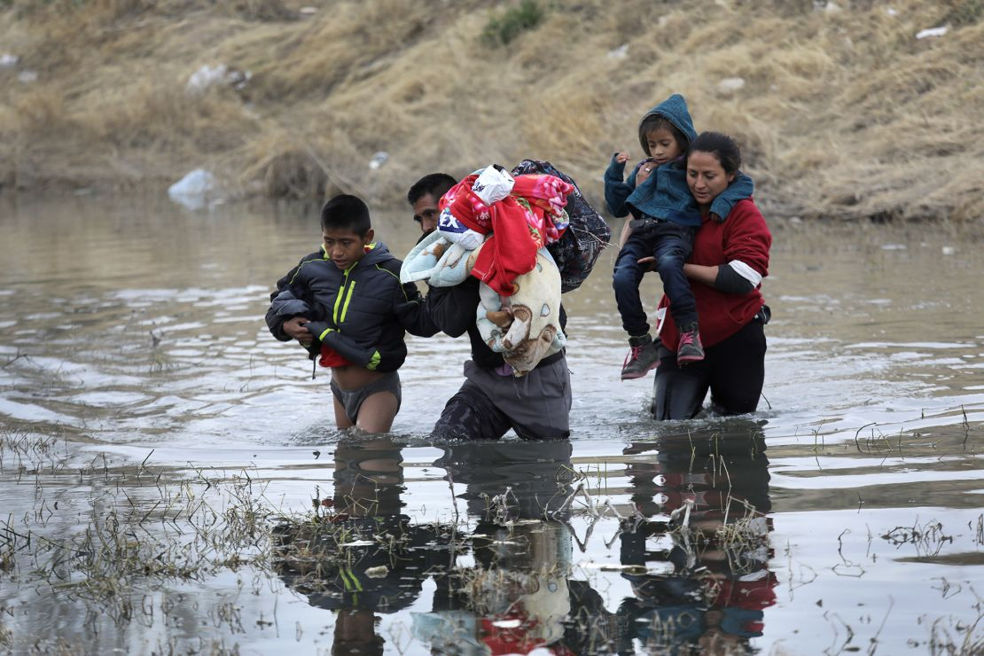
Recent Immigration Issues
DACA
The Northern Triangle
The Venezuelan Wave
Haitians in Springfield, Ohio
Mass Deportations

Slide 62
DACA (Deferred Action for Childhood Arrivals)
Entered U.S. before age 16, now in U.S.
Entered before June 2007.
Currently in school, high school grad or honorable discharge from military.
No felony conviction or threat to security.
Renewable every 2 years.
Executive Order by Obama, Trump ended, Biden restored.

Slide 63
DACA Statistics
825,000 of them. Arrived prior to June 15, 2007
  343,000 employed in essential jobs. (According to DHS: health/education)
  168,000 in California
1/3 arrived before the age of 5.
Average is now 26 years old.
1.3 million live with a DACA individual
  300,000 dependent children.
Tax revenues:
  $6.2 billion federal, $3.3 billion state

Slide 64
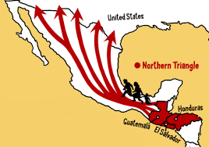
The Northern Triangle

Slide 65
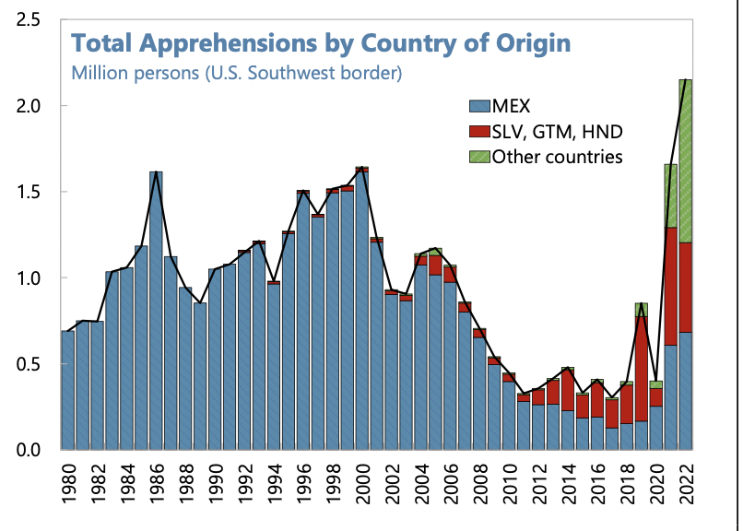
Northern Triangle Apprehensions
(Northern Triangle Countries in Red)

Slide 66
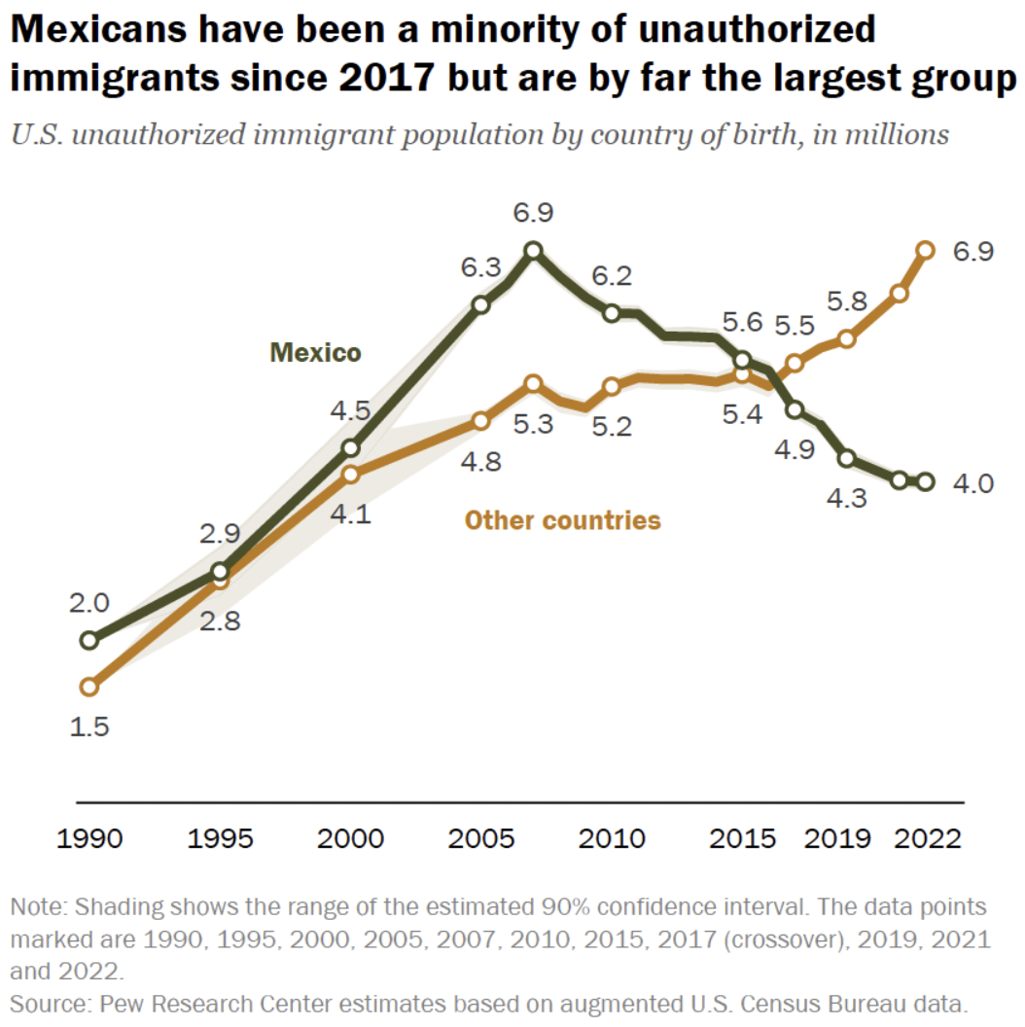

Slide 67
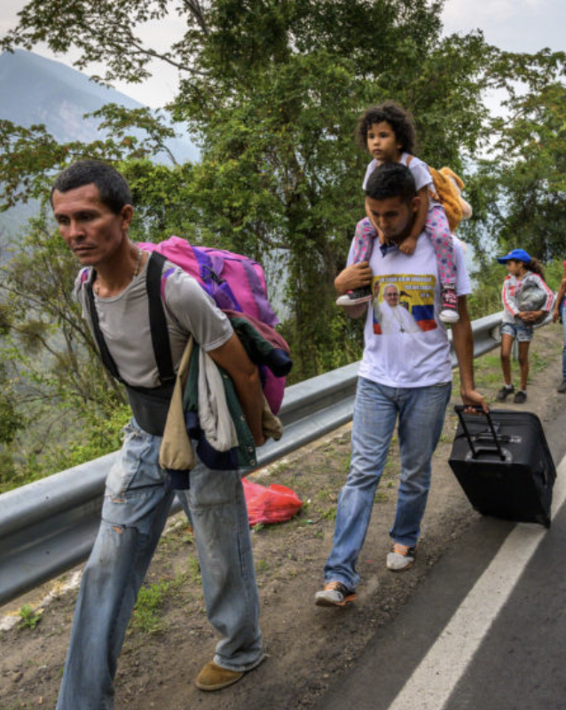
The Surge of Venezuelans
Almost 8 million Venezuelans have left
Caused by economic mismanagement, hyperinflation, unrest, violence
Largest national group arrested for entering U.S.
Temporary Protected Status
  Venezuela, Nicaragua, Haiti, and Cuba
Increasingly stuck in Mexico

Slide 68
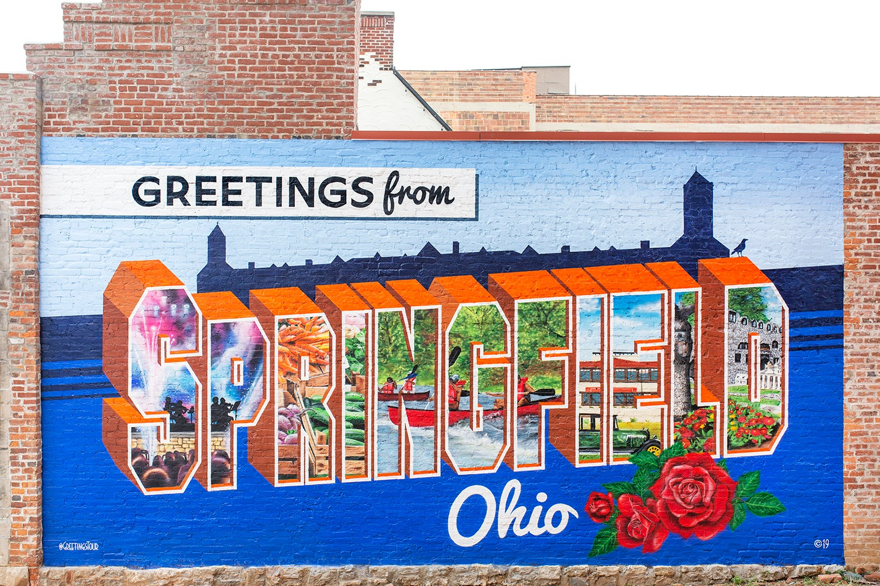
What’s Going on in Springfield, Ohio?

Slide 69
Temporary Protected Status (TPS)
The Secretary of Homeland Security can grant.
Can be granted to foreign-born persons who can’t return to home country safely due to their country unable to handle their return.
Acceptable reasons:
  Conflict - epidemic
  Hurricane or earthquake - Other temporary conditions
Temporary status but can be extended.
Can work and travel within the United States.
May be eligible for welfare such as TANF, SNAP, Medicaid.

Slide 70
Mass Deportations
Immigrants work different jobs than do native-born workers.
Immigrants contribute to the local economy.
  GDP losses of up to $1.7 trillion annually.
Immigrants keep prices low: in particular, food!
Deportations impact tax revenues.
  $1,300 more in on average than out, annually.
  Unauthorized immigrants: $22.6 billion in social security and $5.7 billion in Medicare payments.
Deportations are expensive ($13,000 each).
  Total cost $315 billion.
They rob people of their dignity.

Slide 71
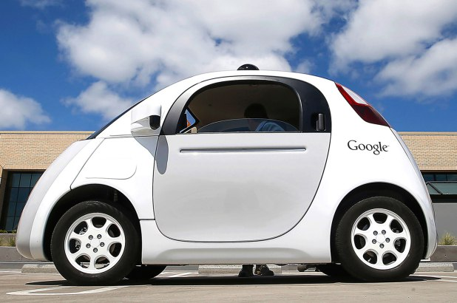
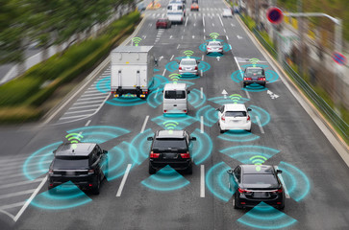
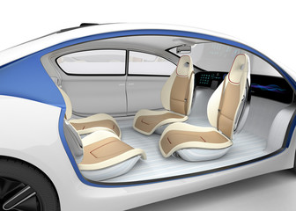

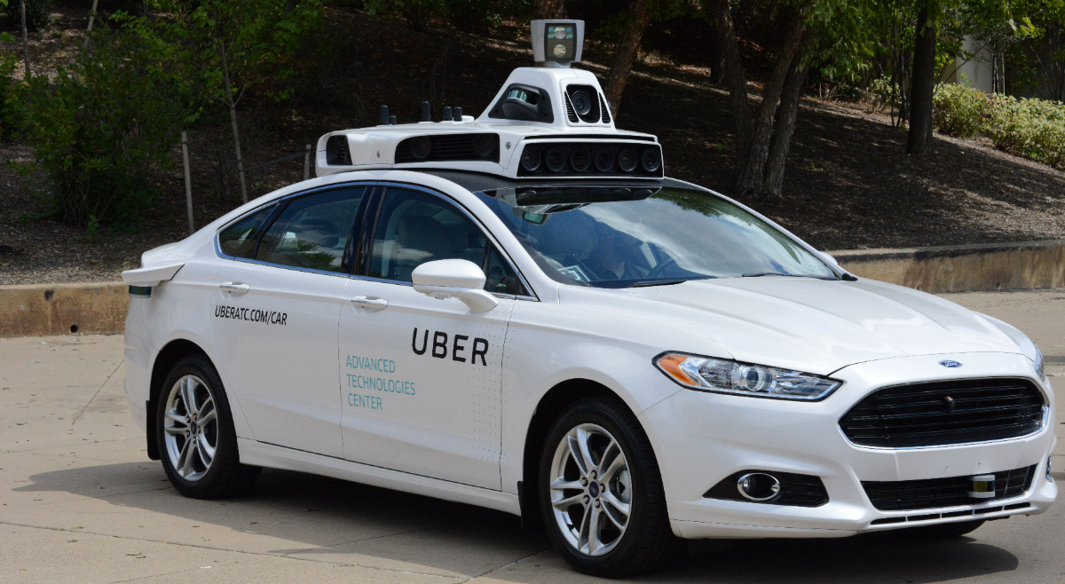
Autonomous Vehicles Next Week

Slide 72
Thank you!
Any Questions?
www.NEEDEcon.org
Jon D. Haveman, Ph.D.
Jon@NEEDEcon.org
Contact NEED: info@needecon.org
Submit a testimonial: www.NEEDEcon.org/testimonials.php
Become a Friend of NEED: www.NEEDEcon.org/friend.php

Slide 73
Total and Average Annual Immigrant Arrivals, 1820-2015
Sources: US Statistical Abstract (various years), US INS (various years), and US DHS (various years)

Slide 74
Immigration and Inequality
  Source: Ping Xu, James C. Garand, and Ling Zhu, “How immigration makes income inequality worse in the U.S.” (October 2015), Figure 1.

Slide 75
Immigration and Inequality: Summary
Beginning in about 1970, the immigrant share of the US
population increased dramatically.
  5% in 1970 and 14% in 2016
Compared to the native born, immigrants:
  Comprise a larger share of less-educated workers (less than HS diploma)
  Comprise a larger share of highly educated workers (advanced degree)
Immigration has likely increased income inequality.
Its effect has likely been small.
  ~5% between 1980 and 2000
  No reason to think it has been bigger since then

Slide 76
Crime: Incarceration Rates in California
Source: Butcher & Piehl (2008).

Slide 77

Immigrant Inflow Shares,1820-2015
Sources: US Statistical Abstract (various years), US INS (various years), and US DHS (various years)

