Slide 1
Osher Lifelong Learning Institute, Summer 2022
Contemporary Economic Policy
University of Georgia
Aug-Sep, 2022
Jon Haveman, Ph.D.
National Economic Education Delegation

Slide 2
Available NEED Topics Include:
Coronavirus Economics
US Economy
Climate Change
Economic Inequality
Economic Mobility
Trade and Globalization
Minimum Wages
Immigration Economics
Housing Policy
Federal Budgets
Federal Debt
Black-White Wealth Gap
Autonomous Vehicles
US Social Policy

Slide 3
Course Outline
Contemporary Economic Policy
Week 1 (8/23): Climate Change Economics (Sarah Jacobson, Williams College)
Week 2 (8/30): Economics of Immigration (Jennifer Alix-Garcia, Oregon St. Univ.)
Week 3 (9/6): Economic Inequality (Kelley Cullen, E. Washington University)
Week 4 (9/13): Federal Debt (Brian Peterson, Central College)

Slide 4
Submitting Questions
Please submit questions in the chat.
I will try to handle them as they come up, but may take them in a bunch as time permits.
I will catch up on the questions in the chat before starting up again after the break.
We will do a verbal Q&A once the material has been presented.
And the questions in the chat have been addressed.

Slide 5
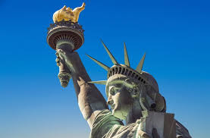
The Economics of Immigration
OLLI – University of Georgia
August, 2022
Jennifer Alix-Garcia, PhD

Slide 6
Outline
What is immigration?
Why do people migrate?
History of immigration to the US
Economics of immigration

Slide 7
What Is Immigration?
Immigration
The action of coming to live in another country.
Emigration
The act of leaving one’s own country and going to live in another country.

Slide 8
Why Do People Migrate?
Push factors:
Economic dislocation, violence, population pressures, religious persecution, or denial of political rights.
Pull factors:
Potential for higher wages, job opportunities, and political or religious liberty.
Uneven development:
Disparities in income, standards of living, and the availability of jobs within and across societies.
Source: Gilder Lehrman Institute of American History.

Slide 9
Why Do People Migrate?
Levels of Decision-Making
Individual level:
Economic opportunity, escape social turmoil.
Family level:
Desire of the family to improve its security or level of economic well-being.
“Remittances”
Structural or Institutional:
War, better information about opportunities, easier transportation, income differentials between countries.
Changes in immigration policies.
Source: Gilder Lehrman Institute of American History.

Slide 10
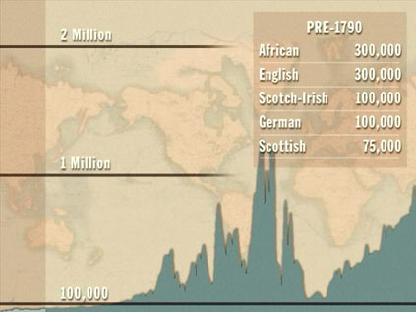
History of US Immigration
Source Countries | Pre-1790
African countries* | 300,000
England | 300,000
Scotland-Ireland | 100,000
Germany | 100,000
Scotland | 75,000
Source Countries | 1790-1820
African countries* | 85,000
Scotland-Ireland | 50,000
England | 45,000
France | 40,000
Germany | 25,000
* Slave trade and clearly not voluntary or reflective of standard motivations for immigration.
Source: https://www.libertyellisfoundation.org/immigration-timeline/.

Slide 11
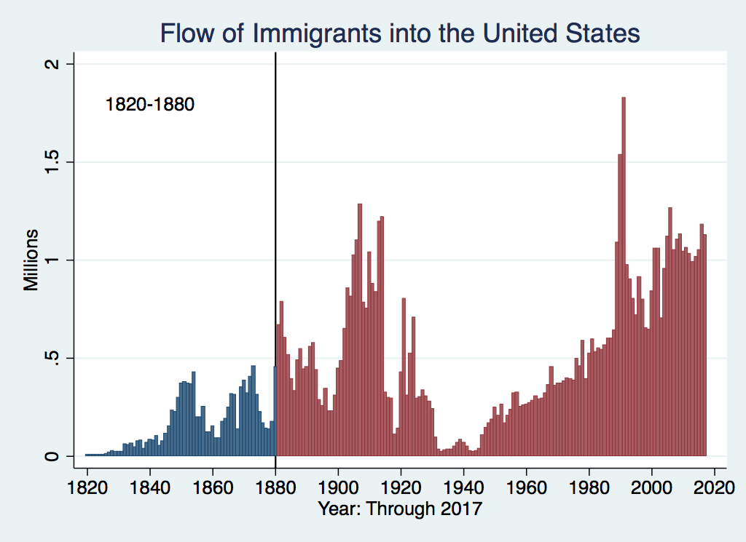
History of US Immigration
Source Countries | 1820-1880
Germany | 3,000,000
Ireland | 2,800,000
Britain | 2,000,000
Austro-Hungarian empire | 1,000,000
Canada | 750,000
China | 230,000
African countries | 50,000
https://www.libertyellisfoundation.org/immigration-timeline

Slide 12
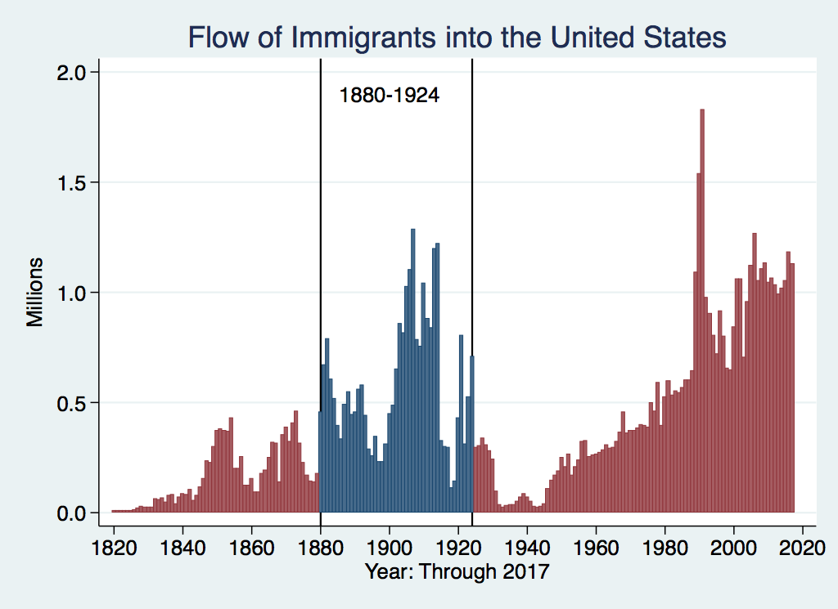
History of US Immigration
Source Country | 1880-1930
Italy | 4,600,000
Austro-Hungarian empire | 4,000,000
Russian empire | 3,300,000
German empire | 2,800,000
Britain | 2,300,000
Canada | 2,300,000
Ireland | 1,700,000

Slide 13
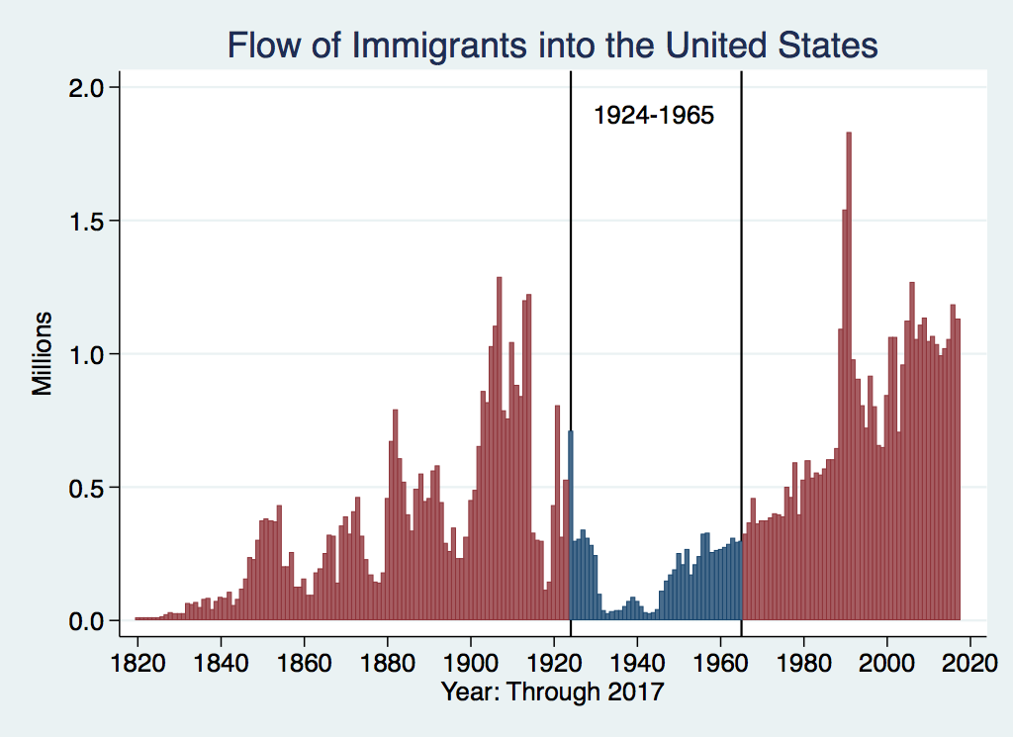
History of US Immigration
Source Countries | 1930-1965
Germany | 940,000
Canada | 900,000
Mexico | 610,000
Britain | 480,000
Italy | 390,000
Caribbean/ West Indies | 310,000
Source: https://www.libertyellisfoundation.org/immigration-timeline/.

Slide 14
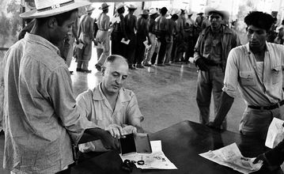
Signing up for Bracero Program

Slide 15
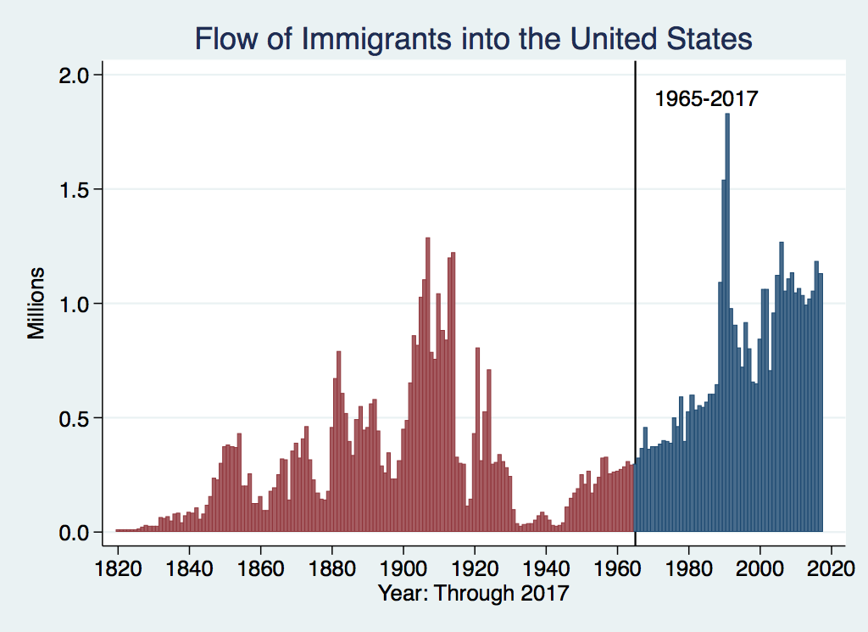
History of US Immigration: 1965-Today
Source Country | 1965-2017
Mexico | 4,300,000
Philippines | 1,400,000
South Korea | 760,000
Dominican Republic | 750,000
India | 740,000
Cuba | 700,000
Vietnam | 700,000
Canada | 650,000
Source: https://www.libertyellisfoundation.org/immigration-timeline/.

Slide 16
Authorized Immigration during the pandemic**
***These figures have been added to the NEED slide deck by the presenter.

Slide 17
Authorized Immigration by Region

Slide 18
Authorized Immigration from Asia

Slide 19
Authorized Immigration from the Americas

Slide 20
Immigrant Population in 2017
Categories of the total number
of immigrants in the United States.
https://www.pewresearch.org/fact-tank/2019/07/12/how-pew-research-center-counts-unauthorized-immigrants-in-us/

Slide 21
U.S. Unauthorized Immigration Totals
Pew Research Center, 5 facts about illegal immigration in the U.S., June 12, 2019

Slide 22
Unauthorized Population: Source Countries

Slide 23
Unauthorized Immigration: Education
Pew Research Center, U.S. unauthorized immigrants are more proficient in English, more educated than a decade ago, May 23, 2019

Slide 24
Unauthorized Immigration: Where They Live

Slide 25
Why Do We Care? Economic Implications
GDP
Labor markets
Government revenue and spending
Prices
Exports and FDI

Slide 26
Two Sets of Implications
Aggregate effects: The size of the pie
Income distribution: The size of slices of the pie

Slide 27
GDP: How Does This Work?
What determines the size of an economy?
Technology/productivity
Physical capital
The number of workers
Immigration adds to the number of workers.
Number of immigrants in the labor force is high
28.2 million foreign-born persons ages 16+ in the labor force in 2018.
17.4% of the total US workforce.
Evidence
Immigrants added 11% to GDP ($2 trillion) in 2016.

Slide 28
Immigration and Labor Markets

Slide 29
Labor Market Implications: Complicated
Depends on the type of immigrant: Skills/education
Similar to native-born population?
Low-skilled?
Highly skilled?
Brings capital market implications
Low-skilled – capital supplementing
Highly skilled – capital complementing
Source: Hong & McLaren (2015).

Slide 30
Labor Market Implications
Provides net benefits to the receiving economy
Larger labor supply.
Changes in labor prices increase production of goods and services that use the type of labor offered by immigrants.
Short run: there are winners and losers
Changes in wage structure and returns to capital affect native-born workers differently depending upon skill level.
Long run: could be no winners, but also no losers
The economy might adjust to pre-immigration wage structure and returns to capital. No change for native-born individuals.

Slide 31
Summary of Labor Market Effects
Immigration CAN lead to negative wage effects for competing native-born workers in the short run
Particularly high school dropouts and those in vulnerable communities.
Other workers will likely benefit
Through increased wages.
Through increased opportunity (each immigrant creates ~1.2 local jobs).
Owners of capital will benefit
Existing capital will earn greater returns.
More if immigrant labor complements existing capital.
Source: Hong & McLaren (2015).

Slide 32
Pattern of Immigration
Educational Attainment of Recent Immigrants – Last 5 Years
Source: Blau & Mackie (2017), p. 88.

Slide 33
Recent Immigrants Are Less and More Educated

Slide 34
Skilled Immigrants and Innovation
1% increase in the share of the immigrant college graduate population
9-18% increase in patenting per capita
Increased immigration increases patenting by native-born population
Nonetheless, the effect is positive
In the 1990s
Increased skilled immigration can account for one-third of increased patenting in that decade.
This translates into a 1.4-2.5% increase in GDP per capita by the end of the decade.

Slide 35
Immigrants and Entrepreneurship
Self-Employment Rates by Nativity
Source: Magnus Lofstrom from Current Population Survey Data.

Slide 37
Fortune 500: First- and Second-Generation Founders

Slide 38
Immigration and Prices
How do immigrants lower prices?
Demand side
A higher proportion of immigrants tends to make markets more price sensitive.
Accordingly, stores are reluctant to raise prices.
Supply side
By providing labor services at lower cost.
Input prices are lowered, so final goods prices are also likely to be lower.
Primarily in nontraded sectors
Household services, construction, hospitality, agriculture.

Slide 39
Prices: Distributional Consequences
A 10% increase in the share of low-skilled immigrants in a city:
Lowers prices of immigrant-intensive sectors by 2%.
E.g., housekeeping, gardening, babysitting, dry cleaning
Immigration between 1980 and 2000 immigration affected the cost of living:
-0.32% for highly skilled workers
… but not for everybody:
+1% for native high school dropouts
+4.2% for low-skilled native-born Hispanics
Conclusion:
Positive net benefits for the country as a whole.
But not all benefit.
Cortes (2008)

Slide 40
Prices and Economic Expansion
Economic Expansion
Increases the labor supply.
Lowers the prices of immigration-intensive products.
Frees up highly skilled labor to provide more market services.
Primarily through provision of household services.
Evidence of an expansion of labor provided by highly skilled women.
Particularly where long hours are required: law, medicine, and women with PhDs
Source: Cortes & Tesada (2011).

Slide 41
Government Revenues and Expenditures

Slide 42
Why Is This Important?
Important factor for understanding whether immigrants will be net contributors to the economy.
Two additional reasons:
Taxpayer inequity geographically
Necessary to understand the full consequences of admitting additional immigrants into the country

Slide 43
Topics?
Basic Question:
Taxes (income, sales, and other) immigrants pay vs. government expenditures on public benefits and services they receive.
More complicated:
Immigrants also affect the fiscal equation for many native-born residents.
Indirectly through labor and capital markets.
Changes in wages and the return to capital.

Slide 44
Age-Specific Taxes and Benefits
By Immigrant Generation, United States, 2012
Source: Blau & Mackie (2017), p. 325.

Slide 45
What Do We Know?
Immigrants who arrive while of working age:
Are, on average, net contributors.
21-year-old with a high school diploma: +$126,000 over a lifetime
Though this value gradually declines with age at arrival.
Turns negative for arrivals of age 35+
Net contribution crucially depends on characteristics
Age distribution, family composition, health status, fertility patterns
Temporary or permanent relocation
Employment in the legal labor market
Authorized or unauthorized

Slide 46
Bottom Line/Consensus of Estimates
Federal level: fiscal impact is generally positive.
State and local level: typically negative fiscal impact.

Slide 47
Implications for Major Federal Programs
Documented immigrants are less likely to use Social Security and Medicare.
Unauthorized immigrants are ineligible.
They will pay into the system but cannot receive benefits.
Medicaid: not available to legal residents for the first five years.
Provide a source of revenue for an aging population.

Slide 48
The Aging US Population
Source: Blau & Mackie (2017), p. 63.

Slide 49
Implications for Social Security
Population Age 65+ per 100 of Working Age (25-64)
Source: Blau & Mackie (2017).

Slide 50
Other Implications of Immigration

Slide 51
Non-Economic Implications
Patterns of Integration
Education
Employment and Earnings
Occupations
Poverty
Residential Integration
Language
Health
Family Patterns
The Big Misconception: Crime
Source: The Integration of Immigrants into American Society (2015).

Slide 52
Immigrants and Crime Rates
Conventional wisdom:
Immigrants commit crimes more frequently than do native-born residents.
Rising immigration leads to rising crime.
What do the data say?
Rates of incarceration are lower for foreign-born than U.S.-born.
Neighborhoods with more immigrants have lower crime rates.
Let’s Have a Look!

Slide 53
Crime: Incarceration Rates in California
Source: Butcher & Piehl (2008).

Slide 54
MSAs: Growing Immigration and Crime
No Relationship
Source: Butcher & Piehl (1998b).

Slide 55
Immigrants and Crime Rates
Conventional wisdom:
Immigrants commit crimes more frequently than do native born residents.
Rising immigration leads to rising crime.
What do the data say?
Rates of incarceration are lower for the foreign born than US born.
Neighborhoods with more immigrants have lower crime rates.
There is no evidence that deporting noncitizen immigrants affects crime rates.

Slide 56
Summary
Immigration should be thought of as increasing the population of the United States.
This brings economic growth and opportunity, just as does increasing the native-born population.
Including unauthorized immigrants, the supply of low-skilled workers is increased
This lowers the wages of low-skilled workers.
But also increases labor force participation among highly skilled workers.

Slide 57
At the Same Time….
Immigrants are often a select group:
Willing to incur an enormous personal or familial cost to better their lives.
As a result:
Immigrants tend to commit crimes at low rates.
Immigrants tend to be entrepreneurial and to add significantly to economic growth.
Although there are distributional issues:
Immigration is an important contributor to economic growth.
Immigration helps to sustain vital government programs.

Slide 58
About Conventional Wisdom
Native-born unskilled workers
There is some negative impact on their wages.
But who wins and loses depend on the skill mix of immigrants;
when this skill mix changes, so do its effects.
Crime
Immigrants, both authorized and unauthorized, commit crimes at much lower rates than do native-born residents.
Government programs
Federal: immigrants are a source of revenue and stability for some important programs.
State and local: because education is funded at the local level, this can be a drain on local government coffers.

Slide 59
Economic Inequality: Kelley Cullen
Stock Market Crash
WWII
Housing Bubble
Dot-com Bubble

Slide 60
Thank you!
Any Questions?
www.NEEDelegation.org
Jennifer Alix-Garcia, Ph.D.
Jennifer.Alix-Garcia@oregonstate.edu
Contact NEED: info@needelegation.org
Submit a testimonial: www.NEEDelegation.org/testimonials.php
Become a Friend of NEED: www.NEEDelegation.org/friend.php

