Slide 1
Osher Lifelong Learning Institute, Fall 2022
Contemporary Economic Policy
University of Connecticut
October, 2022
Jon Haveman, Ph.D.
National Economic Education Delegation

Slide 2
National Economic Education Delegation
Vision
One day, the public discussion of policy issues will be grounded in an accurate perception of the underlying economic principles and data.
Mission
NEED unites the skills and knowledge of a vast network of professional economists to promote understanding of the economics of policy issues in the United States.
NEED Presentations
Are nonpartisan and intended to reflect the consensus of the economics profession.

Slide 3
Who Are We?
Honorary Board: 54 members
2 Fed Chairs: Janet Yellen, Ben Bernanke
6 Chairs Council of Economic Advisers
Furman (D), Rosen (R), Bernanke (R), Yellen (D), Tyson (D), Goolsbee (D)
3 Nobel Prize Winners
Akerlof, Smith, Maskin
Delegates: 652+ members
At all levels of academia and some in government service
All have a Ph.D. in economics
Crowdsource slide decks
Give presentations
Global Partners: 48 Ph.D. Economists
Aid in slide deck development

Slide 4
Available NEED Topics Include:
Healthcare Economics
US Economy
Climate Change
Economic Inequality
Economic Mobility
Trade and Globalization
Minimum Wages
Immigration Economics
Housing Policy
Federal Budgets
Federal Debt
Black-White Wealth Gap
Autonomous Vehicles
US Social Policy

Slide 5
Course Outline
Contemporary Economic Policy
Week 1 (10/3): Economics of Immigration (Roger White, Whittier College)
Week 2 (10/10): US Economic Update (Geof Woglom, Amherst College)
Week 3 (10/17): Cryptocurrencies (Geof Woglom, Amherst College)
Week 4 (10/14): Trade and Globalization (Avik Chakrabarti, UW-Milwaukee)

Slide 6
Submitting Questions
Please submit questions of clarification in the chat.
I will try to handle them as they come up.
We will do a verbal Q&A once the material has been presented.
OLLI allowing, we can stay beyond the end of class to have further discussion.
Slides will be available from the NEED website tomorrow (https://needelegation.org/delivered_presentations.php)

Slide 7
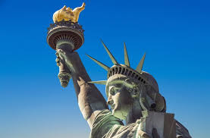
The Economics of Immigration
Roger White, Ph.D.
Whittier College

Slide 8
Outline
What is immigration?
Why do people migrate?
History of immigration to the US
…Break (~10 minutes)…
Economics of immigration

Slide 9
What Is Immigration?
Immigration
The action of coming to live in another country.
Emigration
The act of leaving one’s own country and going to live in another country.

Slide 10
Why Do People Migrate?
Push factors:
Economic dislocation, violence, population pressures, religious persecution, or denial of political rights.
Pull factors:
Potential for higher wages, job opportunities, and political or religious liberty.
Uneven development:
Disparities in income, standards of living, and the availability of jobs within and across societies.
Source: Gilder Lehrman Institute of American History.

Slide 11
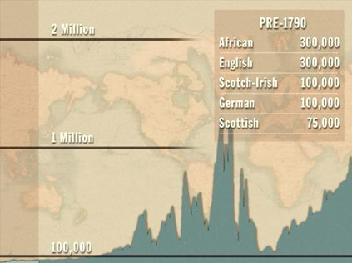
History of US Immigration
Source Countries | Pre-1790
African countries* | 300,000
England | 300,000
Scotland-Ireland | 100,000
Germany | 100,000
Scotland | 75,000
Source Countries | 1790-1820
African countries* | 85,000
Scotland-Ireland | 50,000
England | 45,000
France | 40,000
Germany | 25,000
* Slave trade and clearly not voluntary or reflective of standard motivations for immigration.
Source: https://www.libertyellisfoundation.org/immigration-timeline/.

Slide 12
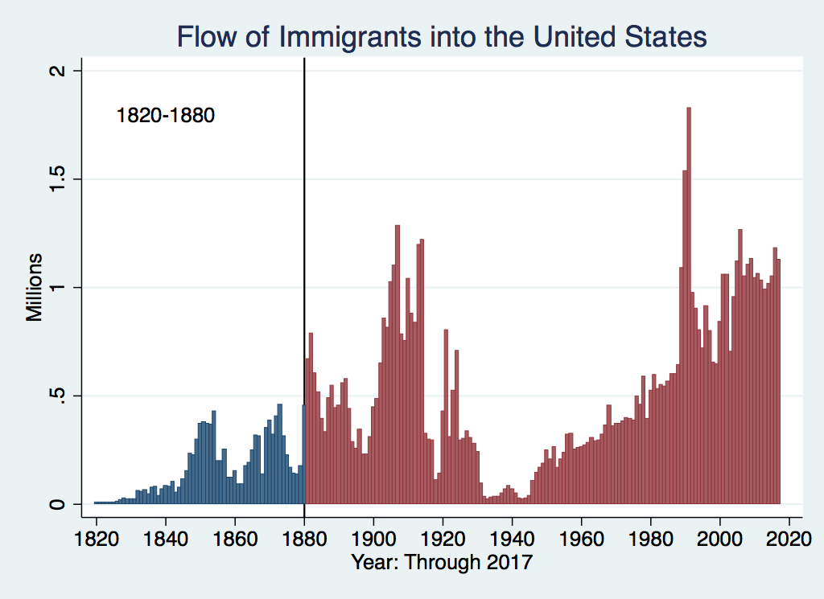
History of US Immigration
Source Countries | 1820-1880
Germany | 3,000,000
Ireland | 2,800,000
Britain | 2,000,000
Austro-Hungarian empire | 1,000,000
Canada | 750,000
China | 230,000
African countries | 50,000
https://www.libertyellisfoundation.org/immigration-timeline

Slide 13
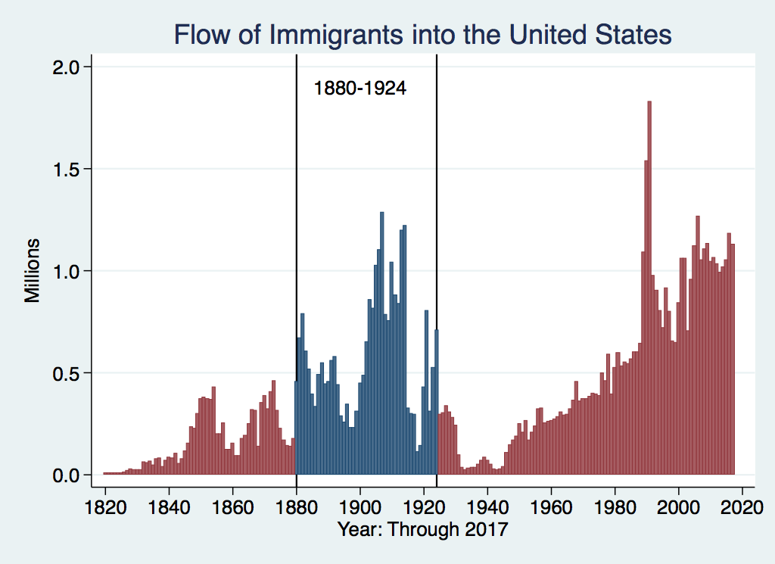
History of US Immigration
Source Countries | 1880-1930
Italy | 4,600,000
Austro-Hungarian empire | 4,000,000
Russian empire | 3,300,000
German empire | 2,800,000
Britain | 2,300,000
Canada | 2,300,000
Ireland | 1,700,000

Slide 14
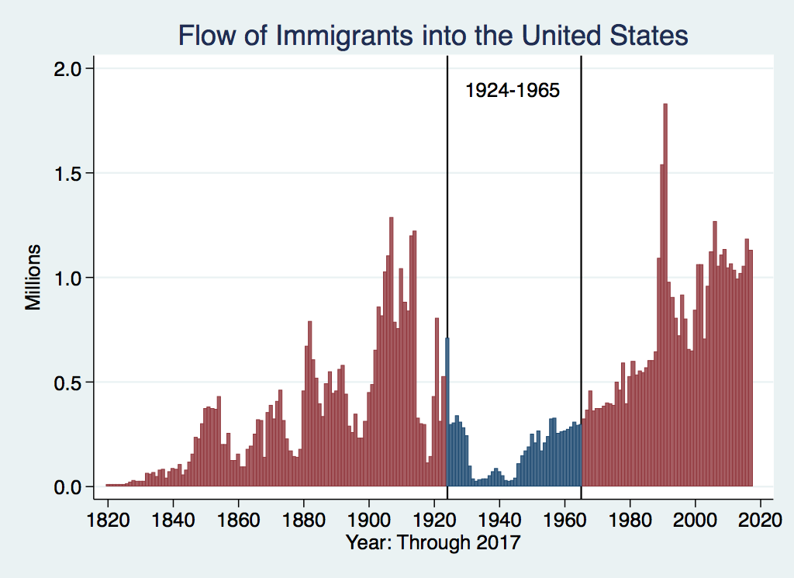
History of US Immigration
Source Countries | 1930-1965
Germany | 940,000
Canada | 900,000
Mexico | 610,000
Britain | 480,000
Italy | 390,000
Caribbean/ West Indies | 310,000
Source: https://www.libertyellisfoundation.org/immigration-timeline/.

Slide 15
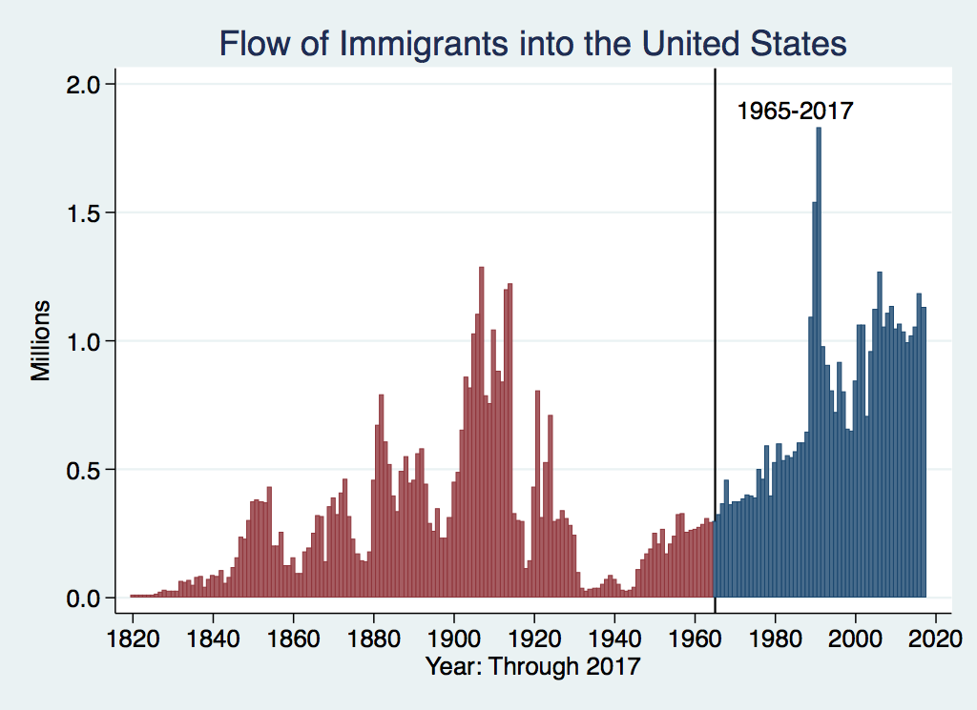
History of US Immigration: 1965-Today
Source Country | 1965-2017
Mexico | 4,300,000
Philippines | 1,400,000
South Korea | 760,000
Dominican Republic | 750,000
India | 740,000
Cuba | 700,000
Vietnam | 700,000
Canada | 650,000
Source: https://www.libertyellisfoundation.org/immigration-timeline/.

Slide 16
Historical Trends in Authorized Immigration
https://www.libertyellisfoundation.org/immigration-timeline

Slide 17
Recent Trends in Authorized Immigration

Slide 18
Authorized Immigration by Region

Slide 19
Authorized Immigration from Asia

Slide 20
Authorized Immigration from the Americas

Slide 21
Persons Obtaining Lawful Permanent Residency by Region of Birth, 2017
Region of Birth | Number
Total | 1,127,167
Africa | 118,824
Asia | 424,743
Europe | 84,335
North America | 413,650
Oceania | 5,071
South America | 79,076
Unknown | 1,468

Slide 22
Immigrant Population in 2017
Categories of the total number
of immigrants in the United States.
https://www.pewresearch.org/fact-tank/2019/07/12/how-pew-research-center-counts-unauthorized-immigrants-in-us/

Slide 23
U.S. Unauthorized Immigration Totals
Pew Research Center, 5 facts about illegal immigration in the U.S., June 12, 2019

Slide 24
U.S. Unauthorized Immigration: Labor Force
Pew Research Center, 5 facts about illegal immigration in the U.S., June 12, 2019

Slide 25
Unauthorized Immigration: Education
Pew Research Center, U.S. unauthorized immigrants are more proficient in English, more educated than a decade ago, May 23, 2019

Slide 26
Unauthorized Population: Source Countries

Slide 27
Unauthorized Immigration: 2012-2016
https://www.migrationpolicy.org/programs/data-hub/charts/unauthorized-immigrant-populations-country-and-region-top-state-and-county

Slide 28
Unauthorized Immigration: Where They Live

Slide 29
Unauthorized Immigration: Mode of Entry
Entry w/o Inspection

Slide 30
Why Do We Care? Economic Implications
GDP
Labor markets
Government revenue and spending
Exports and FDI
Crime

Slide 31
GDP and Labor Markets

Slide 32
Two Sets of Implications
Aggregate effects: The size of the pie
Income distribution: The size of slices of the pie

Slide 33
GDP: How Does This Work?
What determines the size of an economy?
Technology/productivity
Physical capital
The number of workers
Immigration adds to the number of workers.
Number of immigrants in the labor force is high
28.2 million foreign-born persons ages 16+ in the labor force in 2018.
17.4% of the total US workforce.
Evidence
Immigrants added 11% to GDP ($2 trillion) in 2016.

Slide 34
Labor Market Implications: Complicated
Depends on the type of immigrant: Skills/education
Similar to native-born population?
Low-skilled?
Highly skilled?
Brings capital market implications
Low-skilled – capital supplementing
Highly skilled – capital complementing
Source: Hong & McLaren (2015).

Slide 35
Labor Market Implications
Provides net benefits to the receiving economy
Larger labor supply.
Changes in labor prices increase production of goods and services that use the type of labor offered by immigrants.
Short run: there are winners and losers
Changes in wage structure and returns to capital affect native-born workers differently.
Long run: could be no winners, but also no losers
The economy might adjust to pre-immigration wage structure and returns to capital. No change for native-born individuals.

Slide 36
Labor Market Implications: Basic Case
Suppose the immigrants have the same skills as the native-born population in a city
Short run: workers lose and owners of capital win
Higher ratio of labor to capital.
Wages decline, and the returns to capital rise.
Long run: there are no losers or winners
Capital flows into the city
Because the returns are now higher here than elsewhere
The original ratio of labor to capital is restored.

Slide 37
Labor Market Implications: Low-Skill Immigrants
Suppose the immigrants are less skilled than the native-born population in a city
Short run: low-skilled workers are losers
Supply of low-skilled workers goes up, so their wages go down.
Long run: there need not be any losers, but there may still be
Prices adjust
Purchasing power of low-skilled workers need not be lower.
Subtlety: Opportunities for low-skilled native-born workers expand as the economy expands.
Greater demand for English-proficient workers.

Slide 38
Labor Market Implications: General Principles
Short run
Harm likely to native-born workers who are similar to immigrants.
Benefit likely for other workers and owners of capital.
Long run
Lower prices will restore some of the purchasing power of those harmed.
Expanded opportunities may restore wages of harmed native-born workers.
Inflows of other types of labor and capital may return the economy to its pre-immigration wage structure and production patterns.

Slide 39
Pattern of Immigration
Educational Attainment of Recent Immigrants – Last 5 Decades
Source: Blau & Mackie (2017), p. 88.

Slide 40
Recent Immigrants Are Less and More Educated

Slide 41
Skilled Immigrants and Innovation
1% increase in the share of the immigrant college graduate population
9-18% increase in patenting per capita
Increased immigration increases patenting by native-born population
Nonetheless, the effect is positive
In the 1990s
Increased skilled immigration can account for one-third of increased patenting in that decade.
This translates into a 1.4-2.5% increase in GDP per capita by the end of the decade.

Slide 42
Immigrants and Entrepreneurship
Self-Employment Rates by Nativity
Source: Magnus Lofstrom from Current Population Survey Data.

Slide 43
Immigration and Inequality
Source: Ping Xu, James C. Garand, and Ling Zhu, “How immigration makes income inequality worse in the U.S.” (October 2015), Figure 1.

Slide 44
Immigration and Inequality: Summary
Beginning in about 1970, the immigrant share of the US population increased dramatically.
5% in 1970 and 14% in 2016
Compared to the native born, immigrants:
Comprise a larger share of less-educated workers (less than HS diploma)
Comprise a larger share of highly educated workers (advanced degree)
Immigration has likely increased income inequality.
Its effect has likely been small.
~5% between 1980 and 2000
No reason to think it has been bigger since then

Slide 45
Government Revenues and Expenditures

Slide 46
Why Is This Important?
Important for understanding whether immigrants will be net contributors to the economy.
Two additional reasons:
Taxpayer inequity geographically
Necessary to understand the full consequences of admitting additional immigrants into the country

Slide 47
Topics?
Basic Question:
Taxes (income, sales, and other) immigrants pay vs. government expenditures on public benefits and services they receive.
More complicated:
Immigrants also affect the fiscal equation for many native-born residents.
Indirectly through labor and capital markets.
Changes in wages and the return to capital.

Slide 48
Age-Specific Taxes and Benefits
By Immigrant Generation, United States, 2012
Source: Blau & Mackie (2017), p. 325.

Slide 49
What Do We Know?
Immigrants who arrive while of working age:
Are, on average, net contributors.
21-year-old with a high school diploma: +$126,000 over a lifetime
Though this value gradually declines with age at arrival.
Turns negative for arrivals of age 35+
Net contribution crucially depends on characteristics
Age distribution, family composition, health status, fertility patterns
Temporary or permanent relocation
Employment in the legal labor market
Authorized or unauthorized

Slide 50
Bottom Line/Consensus of Estimates
Federal level: fiscal impact is generally positive.
State and local level: typically negative fiscal impact.

Slide 51
Implications for Major Federal Programs
Documented immigrants are less likely to use Social Security and Medicare.
Unauthorized immigrants are ineligible.
They will pay into the system but cannot receive benefits.
Medicaid: not available to legal residents for the first five years.
Provide a source of revenue for an aging population.

Slide 52
The Aging US Population
Source: Blau & Mackie (2017), p. 63.

Slide 53
Implications for Social Security
Population Age 65+ per 100 of Working Age (25-64)
Source: Blau & Mackie (2017).

Slide 54
Other Implications of Immigration

Slide 55
Exports and FDI
Flows of goods, services, and investments internationally rely heavily:
Information
Contacts abroad
Immigrants bring both information and networks.
A variety of studies show that increased immigration from a particular country leads to
Increased exports to that country.
Increased flows of investment to that country.
Migrant networks do indeed complement both trade and FDI.

Slide 56
Immigrants and Crime Rates
Conventional wisdom:
Immigrants commit crimes more frequently than do native-born residents.
Rising immigration leads to rising crime.
What do the data say?
Rates of incarceration are lower for foreign-born than U.S.-born.
Neighborhoods with more immigrants have lower crime rates.
Let’s Have a Look!

Slide 57
Crime: Incarceration Rates in California
Source: Butcher & Piehl (2008).

Slide 58
Crime: Incarceration Rates in California
California Institutionalization Rate
U.S.-Born and Foreign-Born Men Ages 18-40, by Place of Birth
Source: Butcher & Piehl (2008).

Slide 59
MSAs: Growing Immigration and Crime
No Relationship
Source: Butcher & Piehl (1998b).

Slide 60
Immigrants and Crime Rates
Conventional wisdom:
Immigrants commit crimes more frequently than do native born residents.
Rising immigration leads to rising crime.
What do the data say?
Rates of incarceration are lower for the foreign born than US born.
Neighborhoods with more immigrants have lower crime rates.
There is no evidence that deporting noncitizen immigrants affects crime rates.

Slide 61
Summary
Immigration should be thought of as increasing the population of the United States.
This brings economic growth and opportunity, just as does increasing the native-born population.
Including unauthorized immigrants, the supply of low-skilled workers is increased
This lowers the wages of low-skilled workers.
But also increases labor force participation among highly skilled workers.

Slide 62
At the Same Time….
Immigrants are often a select group:
Willing to incur an enormous personal or familial cost to better their lives.
As a result:
Immigrants tend to commit crimes at low rates.
Immigrants tend to be entrepreneurial and to add significantly to economic growth.
Although there are distributional issues:
Immigration is an important contributor to economic growth.
Immigration helps to sustain vital government programs.

Slide 63
About Conventional Wisdom
Native-born unskilled workers
There is some negative impact on their wages.
But who wins and loses depend on the skill mix of immigrants;
when this skill mix changes, so do its effects.
Crime
Immigrants, both authorized and unauthorized, commit crimes at much lower rates than do native-born residents.
Government programs
Federal: immigrants are a source of revenue and stability for some important programs.
State and local: because education is funded at the local level, this can be a drain on local government coffers.

Slide 64
Credits and Disclaimer
This slide deck was authored by:
Anna Maria Mayda, Georgetown University
Robert Gitter, Ohio Wesleyan University
Roger White, Whittier College
This slide deck was reviewed by:
Kirk Doran, Notre Dame
Ethan Lewis, Dartmouth College
Disclaimer
NEED presentations are designed to be nonpartisan.
It is, however, inevitable that presenters will be asked for and will provide their own views.
Such views are those of the presenter and not necessarily those of the National Economic Education Delegation (NEED).

Slide 65
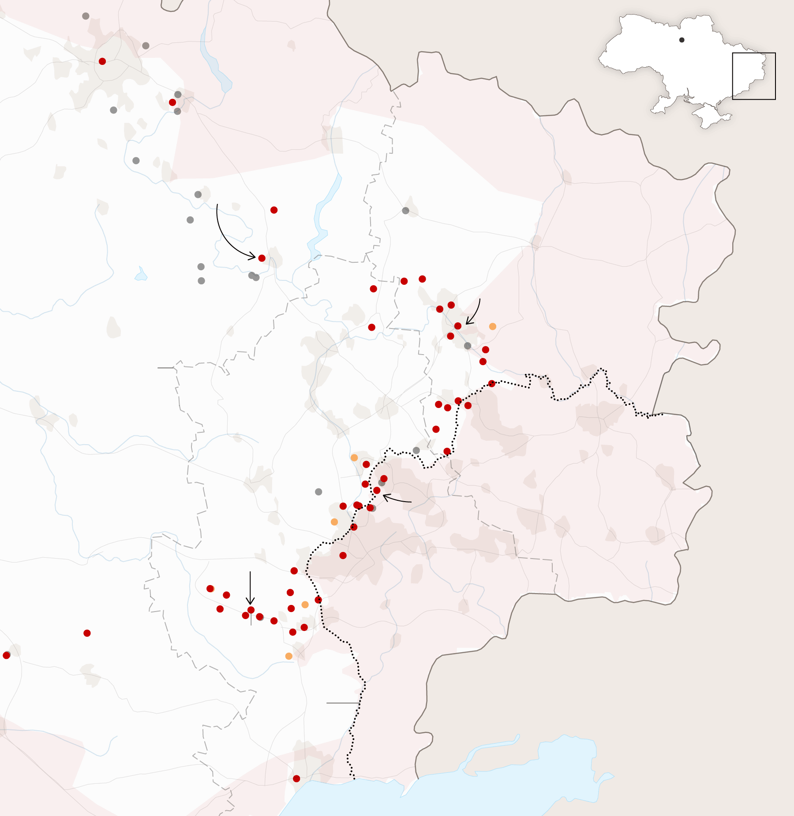
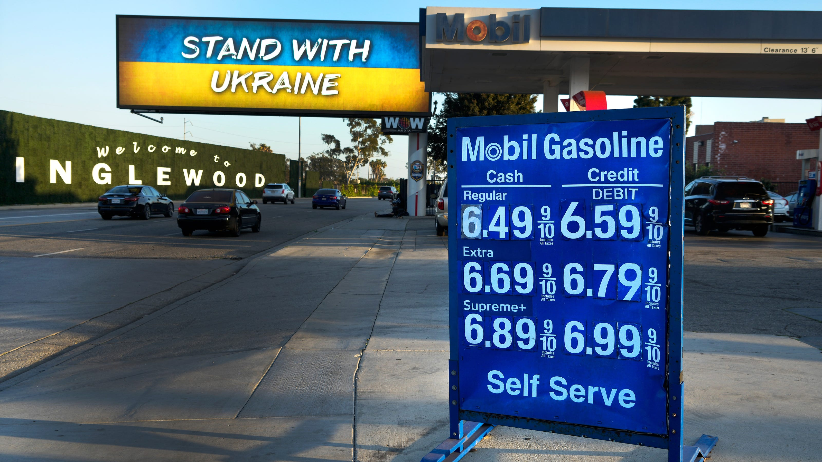
US Economy: Update
Geoffrey Woglom,
Professor of Economics
Amherst College, emeritus
October 10, 2022

Slide 66
Thank you!
Any Questions?
www.NEEDelegation.org
Roger White, Ph.D.
rwhite1@whittier.edu
Contact NEED: info@NEEDelegation.org
Submit a testimonial: www.NEEDelegation.org/testimonials.php
Become a Friend of NEED: www.NEEDelegation.org/friend.php

