Slide 1
Osher Lifelong Learning Institute, Summer 2023
Contemporary Economic Policy
University of Pittsburgh
May-June, 2023
Host: Jon Haveman, Ph.D.
National Economic Education Delegation

Slide 2
Available NEED Topics Include:
US Economy
Healthcare Economics
Climate Change
Economic Inequality
Economic Mobility
Trade and Globalization
Minimum Wages
Immigration Economics
Housing Policy
Federal Budgets
Federal Debt
Black-White Wealth Gap
Autonomous Vehicles
Healthcare Economics

Slide 3
Course Outline
Contemporary Economic Policy
Week 1 (5/17): US Economic Update (Jon Haveman, NEED)
Week 1 (5/24): US Economic Update (Geoffrey Woglom, Amherst College)
Week 2 (5/31): Federal Debt (Brian Peterson, Lagrange College)
Week 3 (6/7): Economics of Immigration (Jon Haveman, NEED)
Week 4 (6/14): Economic Mobility (Jon Haveman)
Week 5 (6/21): The Gender Wage Gap (Jon Haveman)

Slide 4
Submitting Questions
Please submit questions of clarification in the chat.
I will try to handle them as they come up.
We will do a verbal Q&A once the material has been presented.
Slides will be available from the NEED website tomorrow (https://needecon.org/delivered_presentations.php)

Slide 5
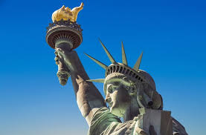
The Economics of Immigration
Jon Haveman, Ph.D.
NEED

Slide 6
Outline
What is immigration?
Why do people migrate?
History of immigration to the US
Economics of immigration

Slide 7
What Is Immigration?
Immigration
The action of coming to live in another country.
Emigration
The act of leaving one’s own country and going to live in another country.

Slide 8
Why Do People Migrate?
Push factors:
Disparities in income/standards of living, and the availability of jobs, violence, climate change, population pressures, economic dislocation, religious persecution, or denial of political rights.
Pull factors:
Potential for prosperity (higher wages, job opportunities), physical security, and political or religious liberty.
Source: Gilder Lehrman Institute of American History.

Slide 9
Recent Push Factors from Central America
Hurricane Mitch in Honduras and Nicaragua in 1998.
Two massive earthquakes in El Salvador in 2001.
Prolonged droughts in El Salvador and Guatemala in 2013-14.
Very high level of violence and crime and continued political instability — especially in El Salvador, Guatemala and Honduras.
All have contributed to large emigration from the region.

Slide 10
Why Do People Migrate?
Levels of Decision-Making
Individual level:
Economic opportunity, escape social turmoil.
Family level:
Desire of the family to improve its security or level of economic well-being.
“Remittances”
Structural or Institutional:
War, better information about opportunities, easier transportation, income differentials between countries.
Changes in immigration policies.
Source: Gilder Lehrman Institute of American History.

Slide 11
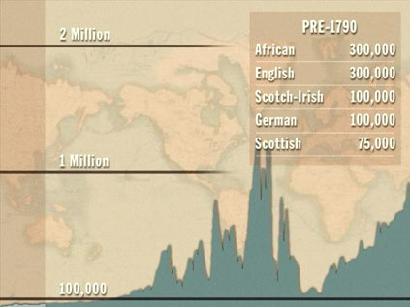
History of US Immigration
Source Regions | Pre-1790
African countries* | 300,000
England | 300,000
Scotland-Ireland | 100,000
Germany | 100,000
Scotland | 75,000
Source Regions | 1790-1820
African countries* | 85,000
Scotland-Ireland | 50,000
England | 45,000
France | 40,000
Germany | 25,000
* Slave trade and clearly not voluntary or reflective of standard motivations for immigration.
Source: https://www.libertyellisfoundation.org/immigration-timeline/.

Slide 12
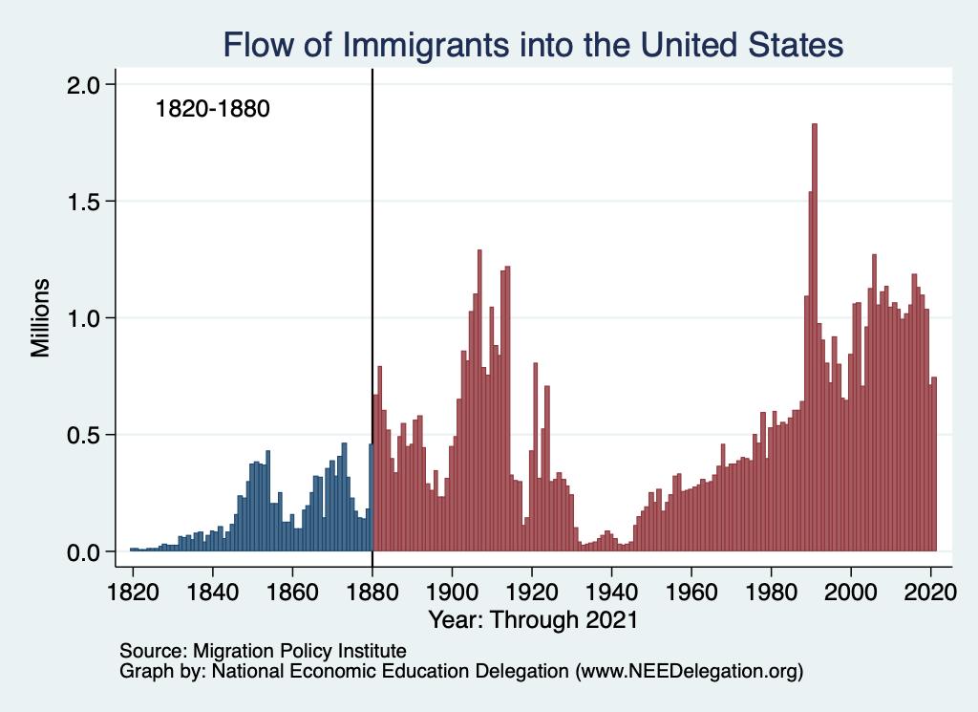
History of US Immigration
Source Countries | 1820-1880
Germany | 3,000,000
Ireland | 2,800,000
Britain | 2,000,000
Austro-Hungarian empire | 1,000,000
Canada | 750,000
China | 230,000
African countries | 50,000
https://www.libertyellisfoundation.org/immigration-timeline

Slide 13
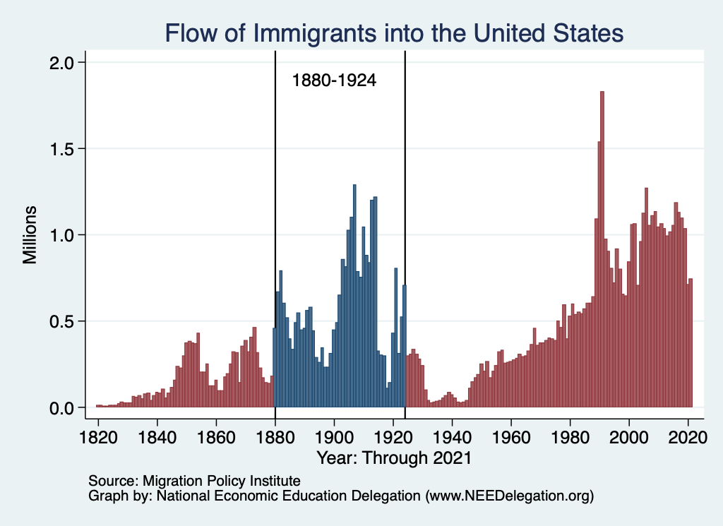
History of US Immigration
Source Countries | 1880-1930
Italy | 4,600,000
Austro-Hungarian empire | 4,000,000
Russian empire | 3,300,000
German empire | 2,800,000
Britain | 2,300,000
Canada | 2,300,000
Ireland | 1,700,000
https://www.libertyellisfoundation.org/immigration-timeline

Slide 14
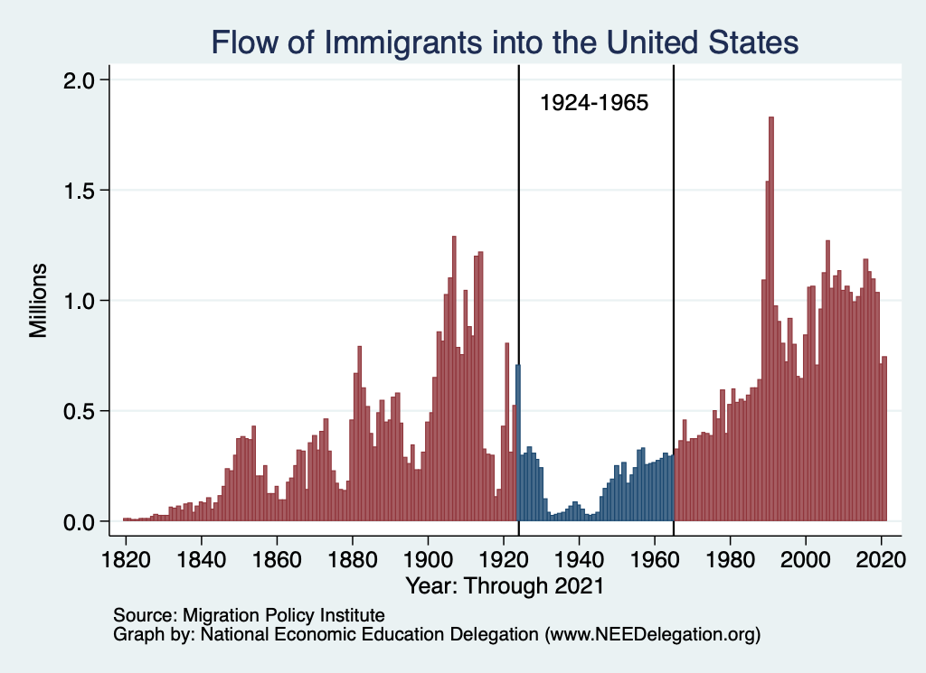
History of US Immigration
Source Countries | 1930-1965
Germany | 940,000
Canada | 900,000
Mexico | 610,000
Britain | 480,000
Italy | 390,000
Caribbean/ West Indies | 310,000
Source: https://www.libertyellisfoundation.org/immigration-timeline/.

Slide 15
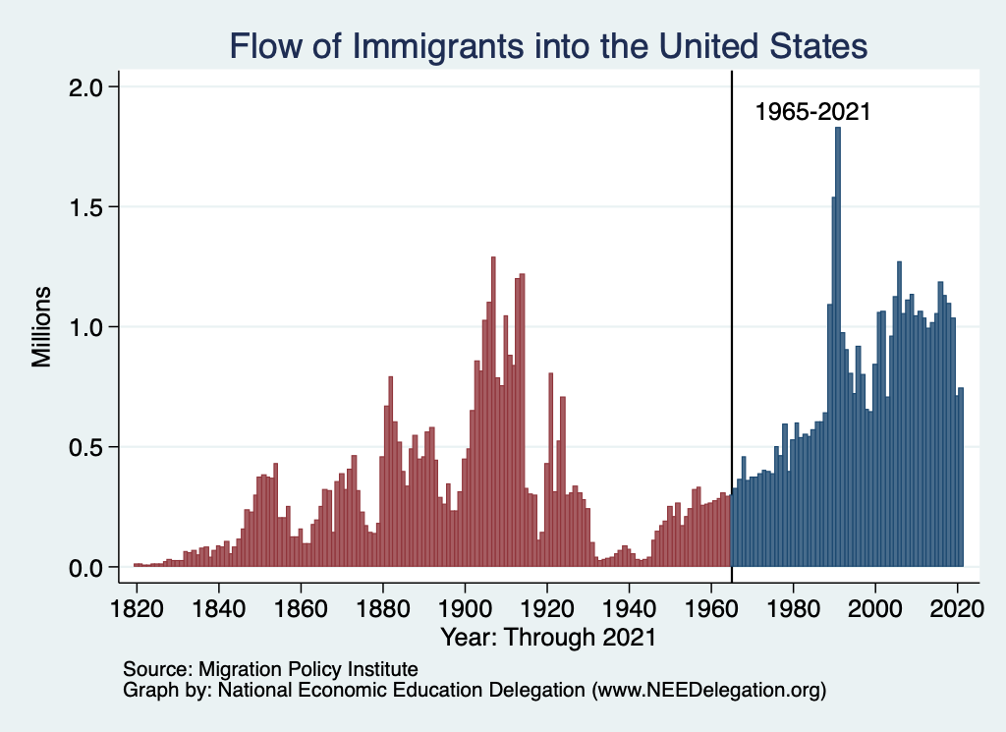
History of US Immigration: 1965-2021
Source Country | 1965-2017
Mexico | 4,300,000
Philippines | 1,400,000
South Korea | 760,000
Dominican Republic | 750,000
India | 740,000
Cuba | 700,000
Vietnam | 700,000
Canada | 650,000
Immigration Reform and Control Act, 1986
- Amnesty program, 3 million
Source: https://www.libertyellisfoundation.org/immigration-timeline/.

Slide 16
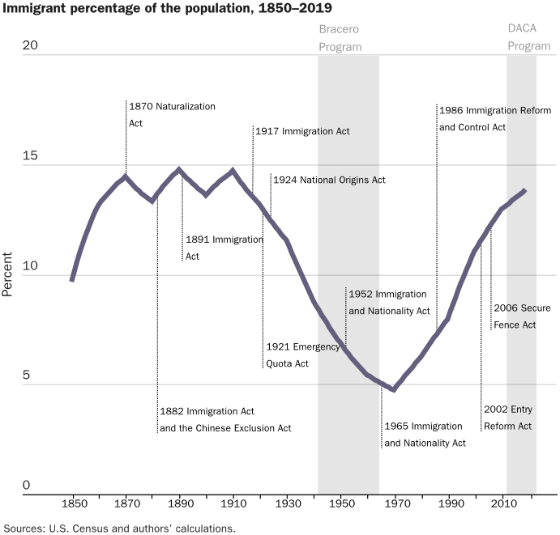
Immigration policy had a big impact on:
Volumes of immigrants
Source countries
Source: Cato Institute, A Brief History of U.S. Immigration Policy from the Colonial Period to the Present Day, August 3, 2021.

Slide 17
History of US Immigration: 2011-2020
Sources (top 9) | 2011-2020
Mexico | 1,491,000
China | 721,000
India | 637,000
Philippines | 505,000
Dominican Rep. | 487,000
Cuba | 473,000
Vietnam | 334,000
El Salvador | 215,000
South Korea | 199,000
Jamaica | 198,000
Total immigrant inflow, 2011-2020 = 10,125,000
US population growth, 2011-2020 = 22,700,000
Typical year during decade…
US population increased by 2.27 million (0.74%)
Native births contributed approx. 1.35 million (0.44%)
Immigration contributed approx. 920,000 (0.30%)
Sources: UN Population Division (2010 and 2020 immigrant stocks), US DHS (2010-2020 immigrant inflows), US Census (population values).

Slide 18
Authorized Immigration by Region

Slide 19
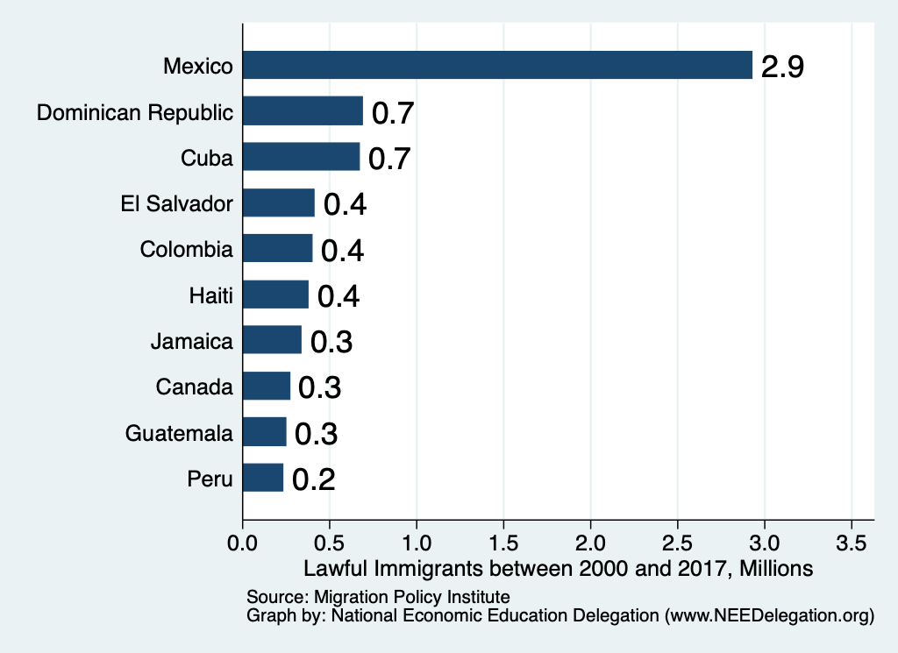
Authorized Immigration by Source Country

Slide 20
Immigrant Population in 2017
Categories of the total number
of immigrants in the United States.
https://www.pewresearch.org/fact-tank/2019/07/12/how-pew-research-center-counts-unauthorized-immigrants-in-us/

Slide 21
U.S. Unauthorized Immigration Totals
Source: Pew Research Center, 5 facts about illegal immigration in the U.S., June 12, 2019

Slide 22
Recent Declines in the Unauthorized Population
Source: Pew Research Center, 5 facts about illegal immigration in the U.S., April 13, 2021

Slide 23
U.S. Unauthorized Immigration: Labor Force
Pew Research Center, 5 facts about illegal immigration in the U.S., June 12, 2019

Slide 24
US Unauthorized Immigration: Duration
Pew Research Center, 5 facts about illegal immigration in the U.S., June 12, 2019

Slide 25
Unauthorized Immigration: Education
Pew Research Center, U.S. unauthorized immigrants are more proficient in English, more educated than a decade ago, May 23, 2019

Slide 26
Unauthorized Immigration: Where They Live

Slide 27
Unauthorized Immigration: 2012-2016
https://www.migrationpolicy.org/programs/data-hub/charts/unauthorized-immigrant-populations-country-and-region-top-state-and-county

Slide 28
Unauthorized Immigration: Mode of Entry
Entry w/o Inspection

Slide 29
What’s Happening at the Border?

Slide 30
Most Are Single Adults
Evidence suggests:
Most unaccompanied minors
are coming to join family members
who are already here.
The population of minors in the
U.S. without a parent has not increased.
Source: Pew Research Center, US Customs and Border Protection

Slide 31
Mexico: No Longer the Primary Source
Northern Triangle:
El Salvador
Guatemala
Honduras
Source: Pew Research Center, US Customs and Border Protection

Slide 32
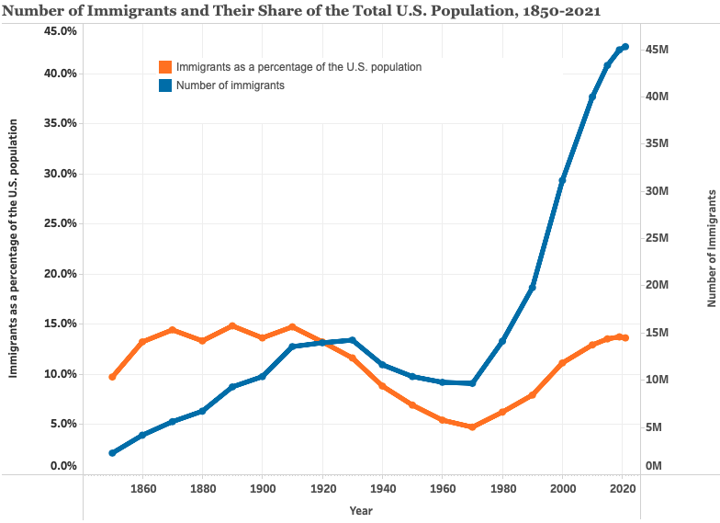
14%
https://www.migrationpolicy.org/programs/data-hub/us-immigration-trends#history

Slide 33
Why Do We Care? Economic Implications
Gross Domestic Product (GDP)
Labor markets: Wages and Jobs
Innovation, Entrepreneurship, and Inequality
Government Revenue and Spending
Exports, Imports, and Foreign Direct Investment (FDI)
Crime

Slide 34
GDP, Labor Markets, and Innovation, Entrepreneurship, and Inequality

Slide 35
Two Sets of Implications
Aggregate effects: The size of the pie
Income distribution: The size of slices of the pie

Slide 36
GDP: How Does This Work?
What determines the size of an economy?
Technology/productivity
Physical capital
The number of workers
Immigration adds to the number of workers.
Number of immigrants in the labor force is high
28.2 million foreign-born persons ages 16+ in the labor force in 2018.
17.4% of the total US workforce.
Evidence
Immigrants added 11% to GDP ($2 trillion) in 2016.

Slide 37
Immigration Is Similar to Trade
Trade
Allows production to be brought to where the low-wage workers are.
Immigration
Allows workers to move to where high-wage jobs are.
Both:
Equalize wages geographically
Lower prices
Increase overall economic activity

Slide 38
Labor Market Implications: Complicated
Depends on the type of immigrant: Skills/education
Similar to native-born population?
Low-skilled?
Highly skilled?
Brings capital market implications
Low-skilled immigrants – capital supplementing
Highly skilled immigrants – capital complementing
Source: Hong & McLaren (2015).

Slide 39
Pattern of Immigration
Educational Attainment of Recent Immigrants – Last 5 Decades
Source: Blau & Mackie (2017), p. 88.

Slide 40
Recent Immigrants Are Less and More Educated

Slide 41
Labor Market Implications
Provides net benefits to the receiving economy
Larger labor supply.
Changes in labor prices increase production of goods and services that use the type of labor offered by immigrants.
Short run: there are winners and losers
Changes in wage structure and returns to capital affect native-born workers differently.
Long run: could be no winners, but also no losers
The economy might adjust to pre-immigration wage structure and returns to capital. No change for native-born individuals.

Slide 42
Potential Benefits for Low-Skilled Native Workers
Immigration can increase native-born worker wages:
More demand for jobs where English is necessary.
Increased demand for goods and services
Increases wages in those industries.
Each immigrant creates 1.2 local jobs – mostly for native-born workers.
Source: Hong & McLaren (2015).

Slide 43
Pathway of Wage and Employment Effects
}
Inflows of Low-Skilled Immigrants
Order of Impact
Impact is negative,
but smaller at
each step.
Previous Immigrants
Disadvantaged Minorities
Native-born HS Dropouts
Positive influence on wages and employment of other workers.

Slide 44
Skilled Immigrants and Innovation
1% increase in the share of the immigrant college graduate population.
9-18% increase in patenting per capita.
Increased immigration increases patenting by native-born population.
Nonetheless, the effect is positive.
In the 1990s:
Increased skilled immigration can account for one-third of increased patenting in that decade.
This translates into a 1.4-2.5% increase in GDP per capita by the end of the decade.

Slide 45
Immigrants and Entrepreneurship
Self-Employment Rates by Nativity
Source: Magnus Lofstrom from Current Population Survey Data.

Slide 47
Fortune 500: First- and Second-Generation Founders

Slide 48
Immigration and Inequality
Beginning in about 1970, the immigrant share of the US population increased dramatically.
5% in 1970 and 14% in 2016
Compared to the native born, immigrants:
Comprise a larger share of less-educated workers (less than HS diploma)
Comprise a larger share of highly educated workers (advanced degree)
Immigration has likely increased income inequality.
Its effect has likely been small.
~5% between 1980 and 2000
No reason to think it has been bigger since then

Slide 49
Immigration and Inequality
Source: Ping Xu, James C. Garand, and Ling Zhu, “How immigration makes income inequality worse in the U.S.” (October 2015), Figure 1.

Slide 50
Immigration and Prices
How do immigrants lower prices?
Demand side
A higher proportion of immigrants tends to make markets more price sensitive.
Accordingly, stores are reluctant to raise prices.
Supply side
By providing labor services at lower cost.
Input prices are lowered, so final goods prices are also likely to be lower.
Primarily in nontraded sectors
Household services, construction, hospitality, agriculture.

Slide 51
Prices: Distributional Consequences
A 10% increase in the share of low-skilled immigrants in a city:
Lowers prices of immigrant-intensive sectors by 2%.
E.g., housekeeping, gardening, babysitting, dry cleaning
Between 1980 and 2000 immigration affected the cost of living:
-0.32% for highly skilled workers
… but not for everybody:
+1% for native high school dropouts
+4.2% for low-skilled native-born Hispanics
Conclusion:
Positive net benefits for the country as a whole.
But not all benefit.
Cortes (2008)

Slide 52
Price Declines Facilitate Economic Expansion
Economic expansion comes from:
Increases in the labor supply.
Lowers the prices of immigration-intensive products.
Frees up highly skilled labor to provide more market services.
Primarily through provision of household services.
Evidence of an expansion of labor provided by highly skilled women.
Particularly where long hours are required: law, medicine, and women with PhDs.
Source: Cortes & Tesada (2011).

Slide 53
Government Revenues and Expenditures

Slide 54
Why Is This Important?
Important for understanding whether immigrants will be net contributors to the economy.
Two additional reasons:
Taxpayer inequity geographically
Necessary to understand the full consequences of admitting additional immigrants into the country

Slide 55
Topics?
Basic Question:
Taxes (income, sales, and other) immigrants pay vs. government expenditures on public benefits and services they receive.
More complicated:
Immigrants also affect the fiscal equation for many native-born residents.
Indirectly through labor and capital markets.
Changes in wages and the return to capital.

Slide 56
Age-Specific Taxes and Benefits
By Immigrant Generation, United States, 2012
Source: Blau & Mackie (2017), p. 325.

Slide 57
What Do We Know?
Immigrants who arrive while of working age:
Are, on average, net contributors.
21-year-old with a high school diploma: +$126,000 over a lifetime
This value gradually declines with age at arrival.
Turns negative for arrivals of age 35+
Net contribution crucially depends on characteristics
Age distribution, family composition, health status, fertility patterns
Temporary or permanent relocation
Employment in the legal labor market
Authorized or unauthorized

Slide 58
Bottom Line/Consensus of Estimates
FEDERAL level: fiscal impact is generally positive.
STATE AND LOCAL level: typically negative fiscal impact.
Primarily because of the cost of education.

Slide 59
Implications for Major Federal Programs
Documented immigrants are less likely to use Social Security and Medicare.
Unauthorized immigrants are ineligible.
They will pay into the system but cannot receive benefits.
Medicaid: not available to legal residents for the first five years.
Provide a source of revenue for an aging population.

Slide 60
The Aging US Population
Source: Blau & Mackie (2017), p. 63.

Slide 61
Implications for Social Security
Population Age 65+ per 100 of Working Age (25-64)
Source: Blau & Mackie (2017).

Slide 62
Other Implications of Immigration

Slide 63
Exports and FDI
Flows of goods, services, and investments internationally rely heavily on:
Information
Contacts abroad
Immigrants bring both information and networks.
A variety of studies show that increased immigration from a particular country leads to:
Increased exports to that country.
Increased flows of investment to that country.
Migrant networks do indeed complement both trade and FDI.

Slide 64
Immigrants and Crime Rates
Conventional wisdom:
Immigrants commit crimes more frequently than do native-born residents.
Rising immigration leads to rising crime.
What do the data say?
Rates of incarceration are lower for the foreign born than US born.
Neighborhoods with more immigrants have lower crime rates.
There is no evidence that deporting noncitizen immigrants affects crime rates.

Slide 65
Incarceration by Immigration Status, 2018
Source: Cato Institute, Illegal Immigrant Incarceration Rates, 2010–2018: Demographics and Policy Implications, April 2020.

Slide 66
Crime: Incarceration Rates in California
Source: Butcher & Piehl (2008).

Slide 67
Crime: Incarceration Rates in California
California Institutionalization Rate
U.S.-Born and Foreign-Born Men Ages 18-40, by Place of Birth
Source: Butcher & Piehl (2008).

Slide 68
MSAs: Growing Immigration and Crime
No Relationship
Source: Butcher & Piehl (1998b).

Slide 69
Immigrants and Crime Rates
Conventional wisdom:
Immigrants commit crimes more frequently than do native-born residents.
Rising immigration leads to rising crime.
What do the data say?
Rates of incarceration are lower for the foreign born than US born.
Neighborhoods with more immigrants have lower crime rates.
There is no evidence that deporting noncitizen immigrants affects crime rates.

Slide 70
Summary
Immigration should be thought of as increasing the population of the United States.
This brings economic growth and opportunity, just as does increasing the native-born population.
Including unauthorized immigrants, the supply of low-skilled workers is increased
This lowers the wages of low-skilled workers.
But also increases labor force participation among highly skilled workers.

Slide 71
At the Same Time….
Immigrants are often a select group:
Willing to incur an enormous personal or familial cost to better their lives.
As a result:
Immigrants tend to commit crimes at low rates.
Immigrants tend to be entrepreneurial and to add significantly to economic growth.
Although there are distributional issues:
Immigration is an important contributor to economic growth.
Immigration helps to sustain vital government programs.

Slide 72
About Conventional Wisdom
Native-born unskilled workers
There is some negative impact on their wages.
But who wins and loses depend on the skill mix of immigrants;
when this skill mix changes, so do its effects.
Government programs
Federal: immigrants are a source of revenue and stability for some important programs.
State and local: because education is funded at the local level, this can be a drain on local government coffers.
Crime
Immigrants, both authorized and unauthorized, commit crimes at much lower rates than do native-born residents.

Slide 73
Mobility
9 out of 10 of those born in the early 1940s could expect to earn more than their parents
1 in 2 Millennials (born after 1980) earn more than their parents.

Slide 74
Thank you!
Any Questions?
www.NEEDEcon.org
Jon Haveman, Ph.D.
Jon@NEEDEcon.org
Contact NEED: info@NEEDEcon.org
Submit a testimonial: www.NEEDEcon.org/testimonials.php
Become a Friend of NEED: www.NEEDEcon.org/friend.php

