Slide 1
Osher Lifelong Learning Institute, Summer 2026
Contemporary Economic Policy Issues
OLLI – Dominican University, San Rafael
July, 2026
Host: Jon Haveman
National Economic Education Delegation

Slide 2
Available NEED Topics Include:
US Economy
Healthcare Economics
Climate Change
Economic Inequality
Economic Mobility
Trade and Globalization
Minimum Wages
Immigration Economics
Saving Social Security
Federal Budgets
Federal Debt
Black-White Wealth Gap
Autonomous Vehicles
Healthcare Economics

Slide 3
Course Outline
Contemporary Economic Policy
  Week 1 (7/8): US Economic Update
  Week 2 (7/15): The Economics of Immigration
  Week 3 (7/22): Saving Social Security (Geof Woglom, Amherst University)
  Week 4 (7/29): Tariff Economics (Jon Haveman, NEED)

Slide 4
Submitting Questions
Submit questions in the chat.
  I will try to handle them as they come up.
We will do a verbal Q&A once the material has been presented.
Slides will be available from the NEED website shortly. (https://needecon.org/delivered_presentations.php).
Also: Break at 10:55 for 5 minutes.

Slide 5
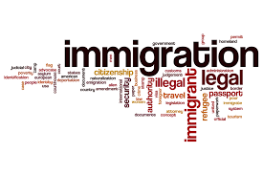
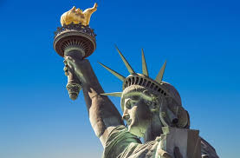
The Economics of Immigration
OLLI – Dominican University
July 15, 2026
Jon Haveman, Ph.D.
National Economic Education Delegation

Slide 6
Outline
Quiz!
Why do people migrate?
The nature of immigration to the U.S.
Economics of immigration
Recent immigration issues

Slide 7
Immigration Quiz
What % of the U.S. population are not native-born?
  14.5%
What % of the world’s population are not native-born?
  3.6%
How long has the average undocumented immigrant lived in the United States?
  A. 3 months
  B. 2 years
  C. 10 years
  D. 25 years
21% of children born to native parents are high-income earners (above the middle class).
What % of kids born to immigrants are high-income earners?
  A. 15%
  B. 21%
  C. 28%
  D. 35%
In 2024, 12% of Americans lived in poverty. What percent of immigrants lived in poverty?
  14%
Source: Freakonomics – How Much Do You Know About Immigration?

Slide 8
Immigration Quiz
Immigrants are responsible for what % of patents in the United States?
  36%
    23% of inventors on record
    13% from increase in native-born patenting
What % of green cards go to family rather than employment-based immigration?
  66% go to family-based
What % of the U.S. workforce are immigrants?
  19.3%
Native-born Americans receive $8k on average in government benefits. What is it for immigrants?
  $6,000
100 years ago, most immigrants were from Europe. Today, Latin America and Asia. Is the rate of assimilation:
  Faster? Slower? About the same?
Source: Freakonomics – How Much Do You Know About Immigration?

Slide 9
Why Do People Migrate?
Push factors:
  Disparities in income/standards of living, and the availability of jobs, violence/war, climate change, natural disasters, population pressures, economic dislocation, religious persecution, and denial of political rights.
Pull factors:
  Potential for economic prosperity (higher wages, job opportunities), physical security, political freedom, and religious liberty.
Source: Gilder Lehrman Institute of American History.

Slide 10
The Migration Decision
Benefit of Migrating
Benefit of Staying
Cost of Migrating

Slide 11

The Dangers of Border Crossing

Slide 12
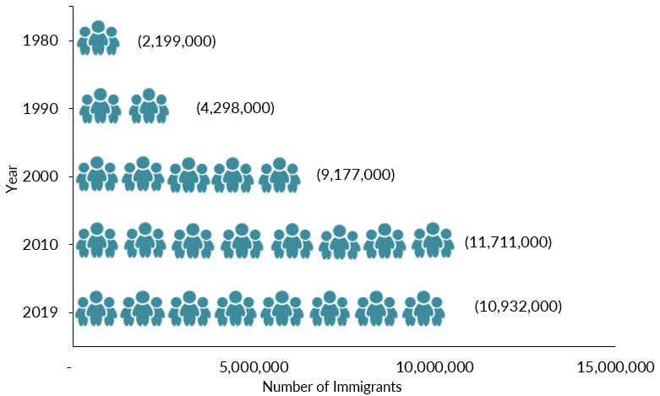
Mexican-Born People in the US
About 11 million in mid-2023 (Latest data)
1 in 14 people born in Mexico currently lives in the US

Slide 13
Distribution of Income
Mexico
United States
Number of People
Income

Slide 14
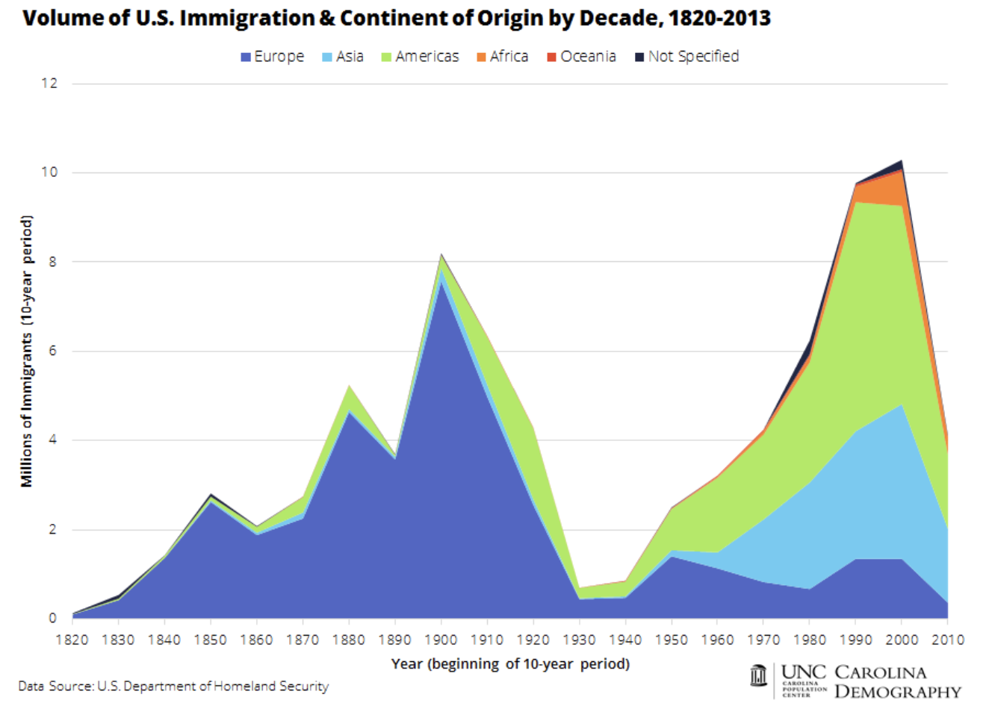

Slide 15
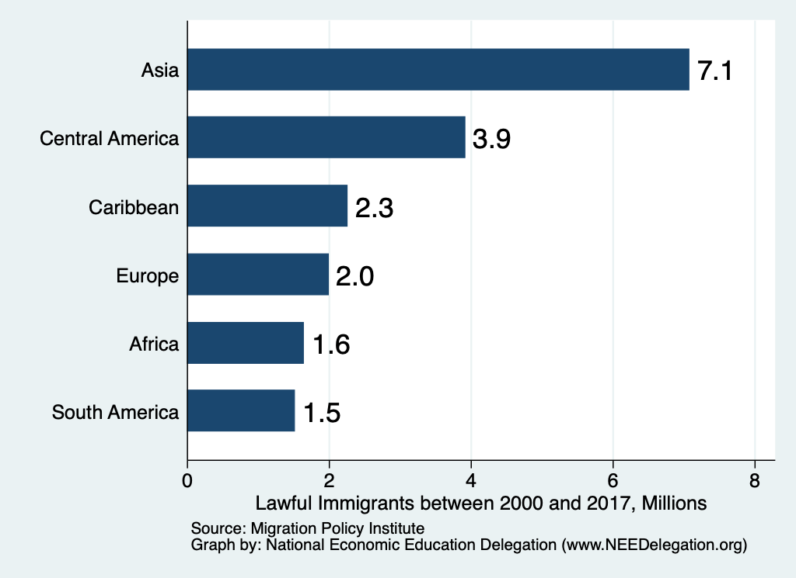
Authorized Immigration by Region (2000-2022)

Slide 16
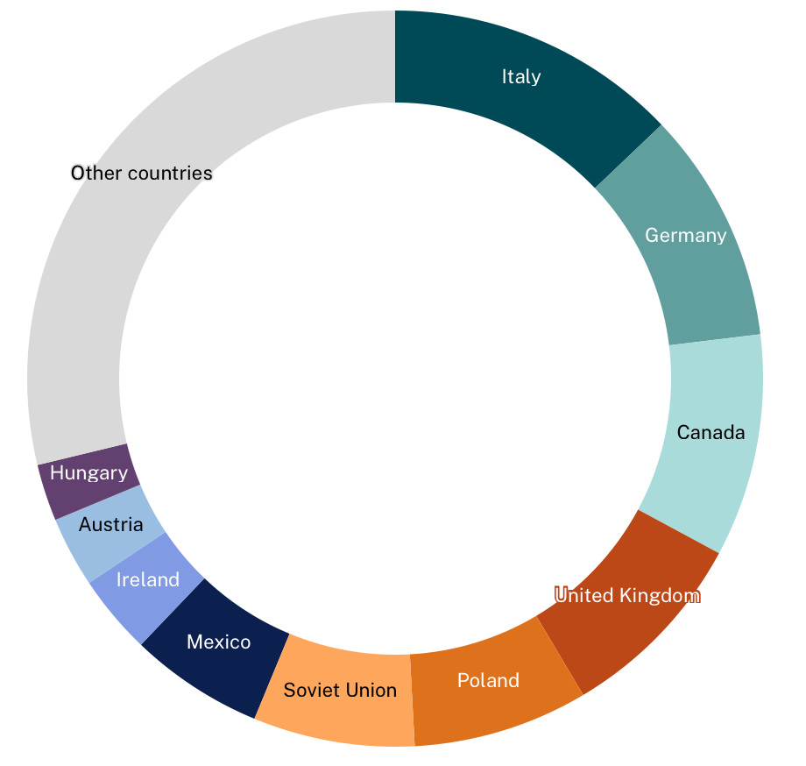
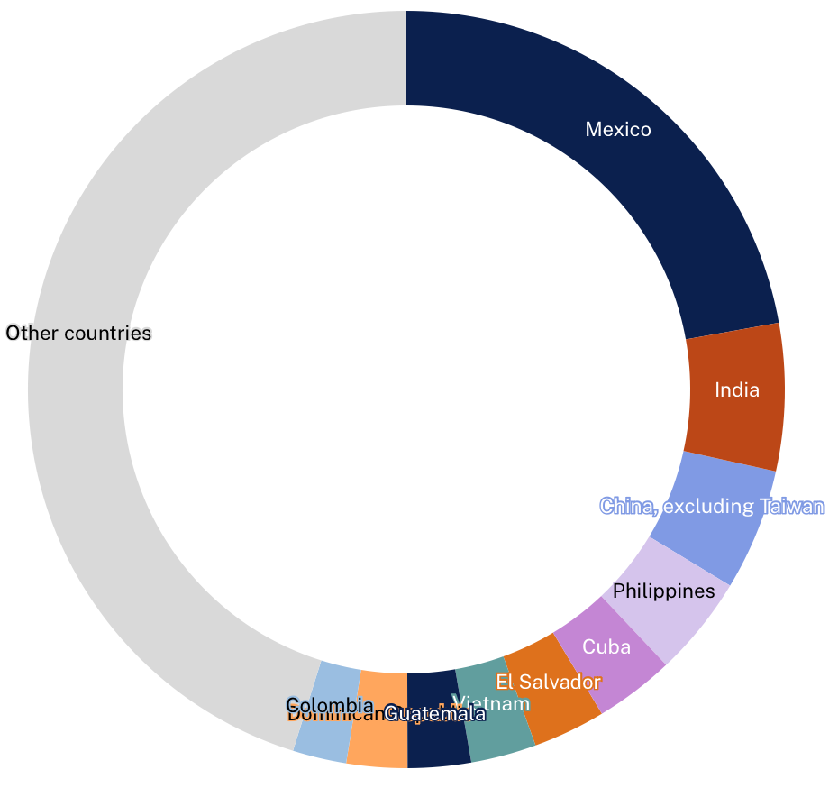
Dramatic Change in Immigration Composition
1960
2024

Slide 17
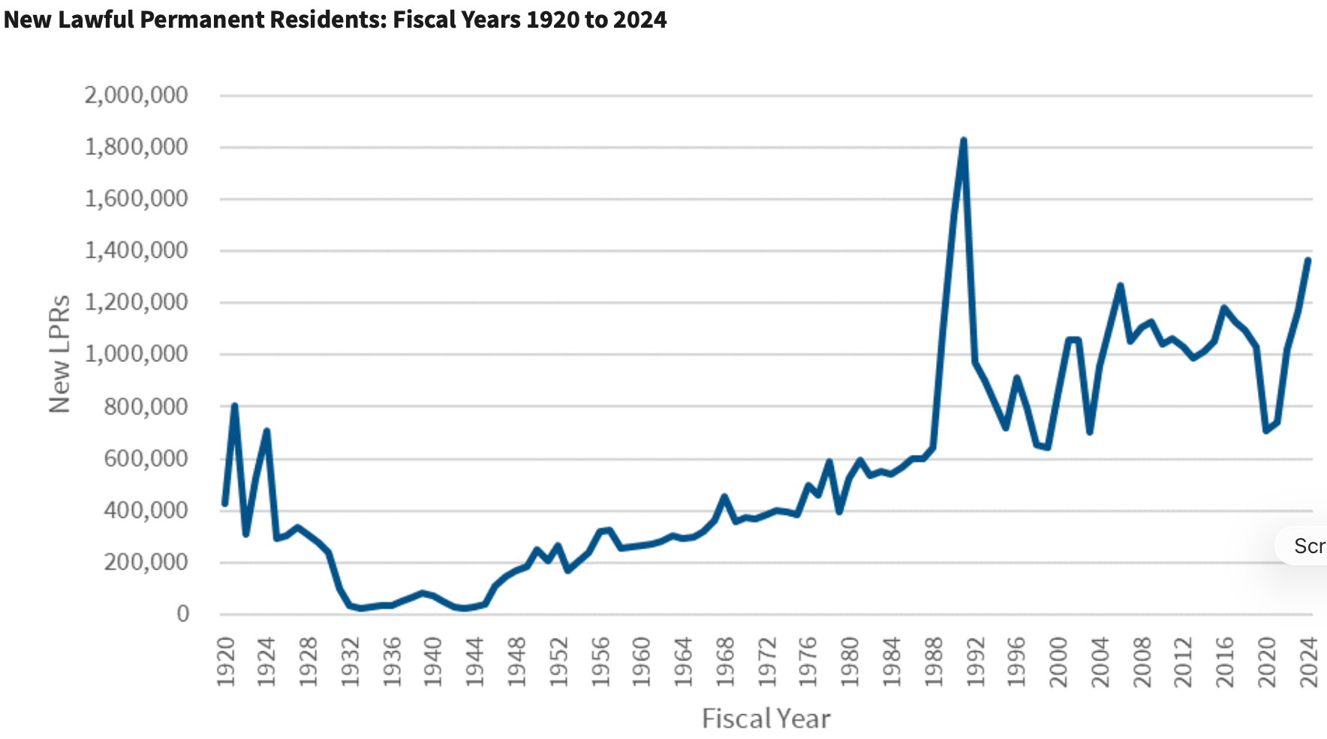
Trends in Authorized Immigration
2024
1.4 Million
Source: https://ohss.dhs.gov/topics/immigration/lawful-permanent-residents/annual-flow-report/fy-24-lpr-flow-report

Slide 18
NUMBER OF IMMIGRANTS BY TYPE OF ADMISSION: FISCAL YEAR 2024
Family-sponsored preferences | 188,190
Immediate relatives of U.S. citizens | 672,240
Employment-based preferences | 171,120
Refugees | 178,200
Diversity | 49,890
Asylees | 41,650
Other | 62,810
TOTAL | 1,364,090
{
860,430
Source: https://ohss.dhs.gov/topics/immigration/lawful-permanent-residents/annual-flow-report/fy-24-lpr-flow-report

Slide 19
History of US Immigration: 2011-2020
Sources (top 10) | 2011-2020
Mexico | 1,491,000
China | 721,000
India | 637,000
Philippines | 505,000
Dominican Rep. | 487,000
Cuba | 473,000
Vietnam | 334,000
El Salvador | 215,000
South Korea | 199,000
Jamaica | 198,000
Total immigrant inflow, 2011-2020 = 10,125,000
US population growth, 2011-2020 = 22,700,000
Immigration was 45% of population growth.
Sources: US DHS (2011-2020 immigrant inflows), US Census (population values)

Slide 20
UNauthorized Immigration

Slide 21
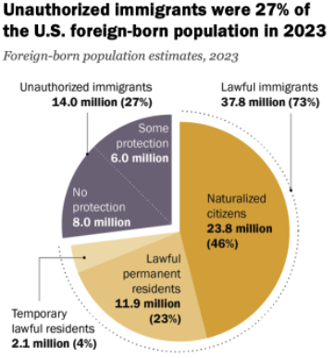
Total Foreign-Born (2023)
Population: 51.8 million
Total Foreign-Born (June/26)
Population: 48.6 million
(This seems too low.)
Source: Pew Research Center, U.S. Unauthorized Immigrant Population Reached a Record 14 Million in 2023, August 21, 2025

Slide 22
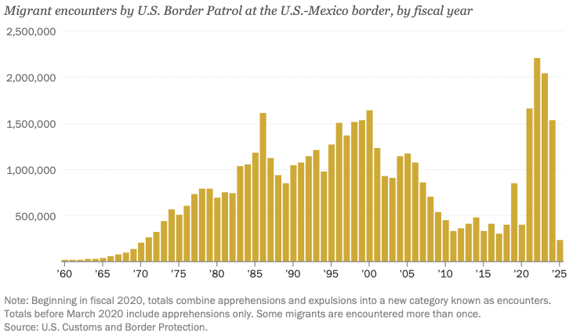
Encounters w/Migrants at the U.S.-Mexico Border
2025: Lowest
Level in more
Than 50 years.
Source: https://www.nbcnews.com/data-graphics/us-immigration-tracker-follow-arrests-detentions-border-crossings-rcna189148

Slide 23
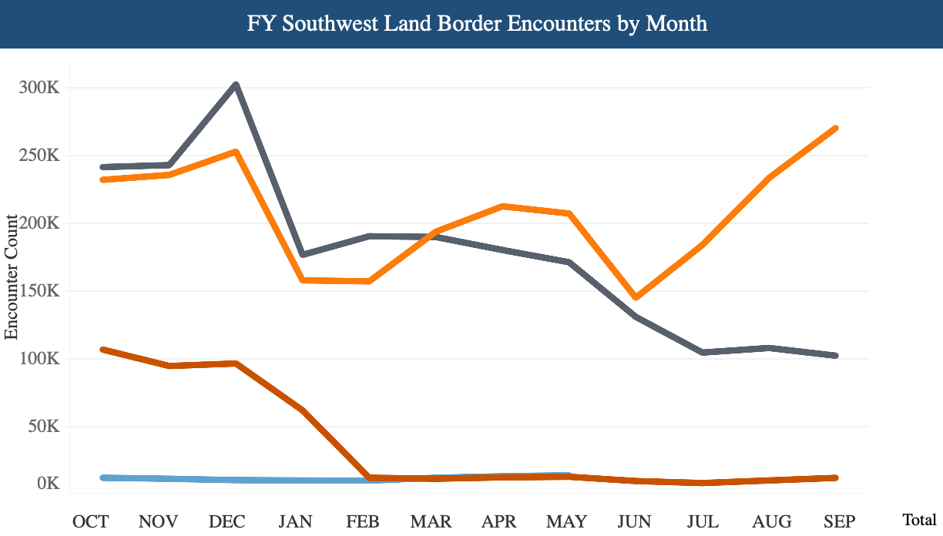
Recent Border Encounters
Dec/23 Peak
2023
2024
2025 & 2026
Source: https://www.cbp.gov/newsroom/stats/southwest-land-border-encounters

Slide 24
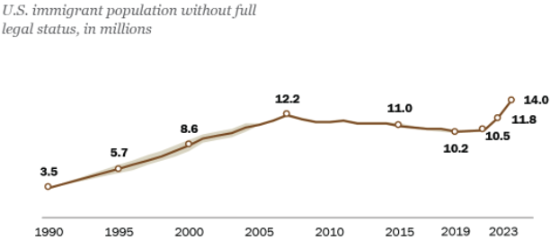
U.S. Unauthorized Immigration Totals, to 2023
Source: Pew Research Center, What we know about unauthorized immigrants living in the U.S., July 22, 2024

Slide 25
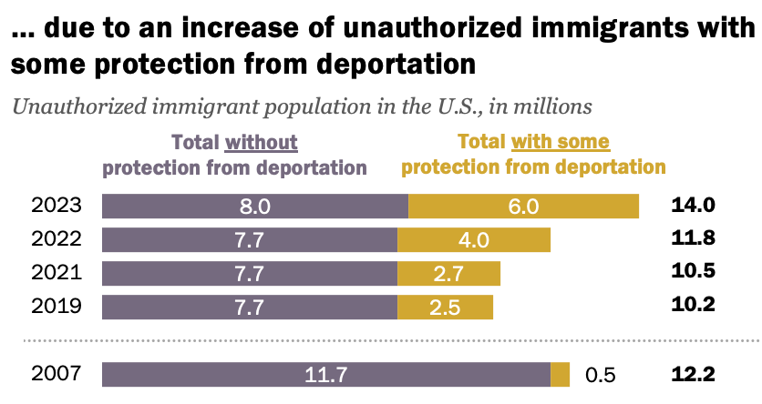
The Growth is Largely…
https://www.pewresearch.org/race-and-ethnicity/2025/08/21/u-s-unauthorized-immigrant-population-reached-a-record-14-million-in-2023/

Slide 26
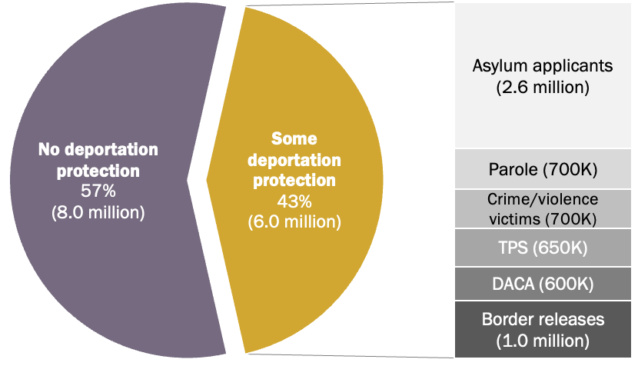
Types of Protected Status, 2023
https://www.pewresearch.org/race-and-ethnicity/2025/08/21/u-s-unauthorized-immigrant-population-reached-a-record-14-million-in-2023/

Slide 27
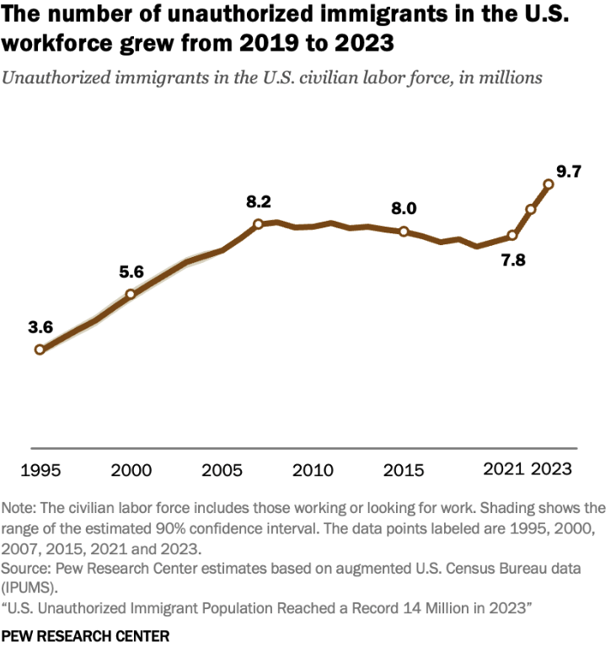
U.S. Unauthorized Immigration: Labor Force
6% of labor force
4% of population
Source: Pew Research Center, What we know about unauthorized immigrants living in the U.S., July 22, 2024

Slide 28
Economics

Slide 29
Why Do We Care? Economic Implications
Conventional Wisdom Issues:
  Labor markets: Wages and Jobs
  Government Revenue and Spending
  Crime
Other issues (that don’t get talked about much):
  Gross Domestic Product (GDP)
  Innovation and Entrepreneurship

Slide 30
GDP: How Does This Work?
What determines the size of an economy?
  Physical capital
  Technology/productivity
  The number of workers
    Immigration adds to the number of workers.
Number of immigrants in the labor force is high
  31.9 million foreign-born persons ages 16+ in the labor force in June/26.
    Down from 33.7 million in March/25.
  18.8% of the total US workforce.
    Down from 19.7 in March/25.
Evidence
  Immigrants added 11% to GDP ($2 trillion) in 2016.
Federal Reserve Bank of St. Louis (https://fred.stlouisfed.org/)
National Academies of Sciences, Engineering, and Medicine (2017) “The Economic and Fiscal Consequences of Immigration”.

Slide 31
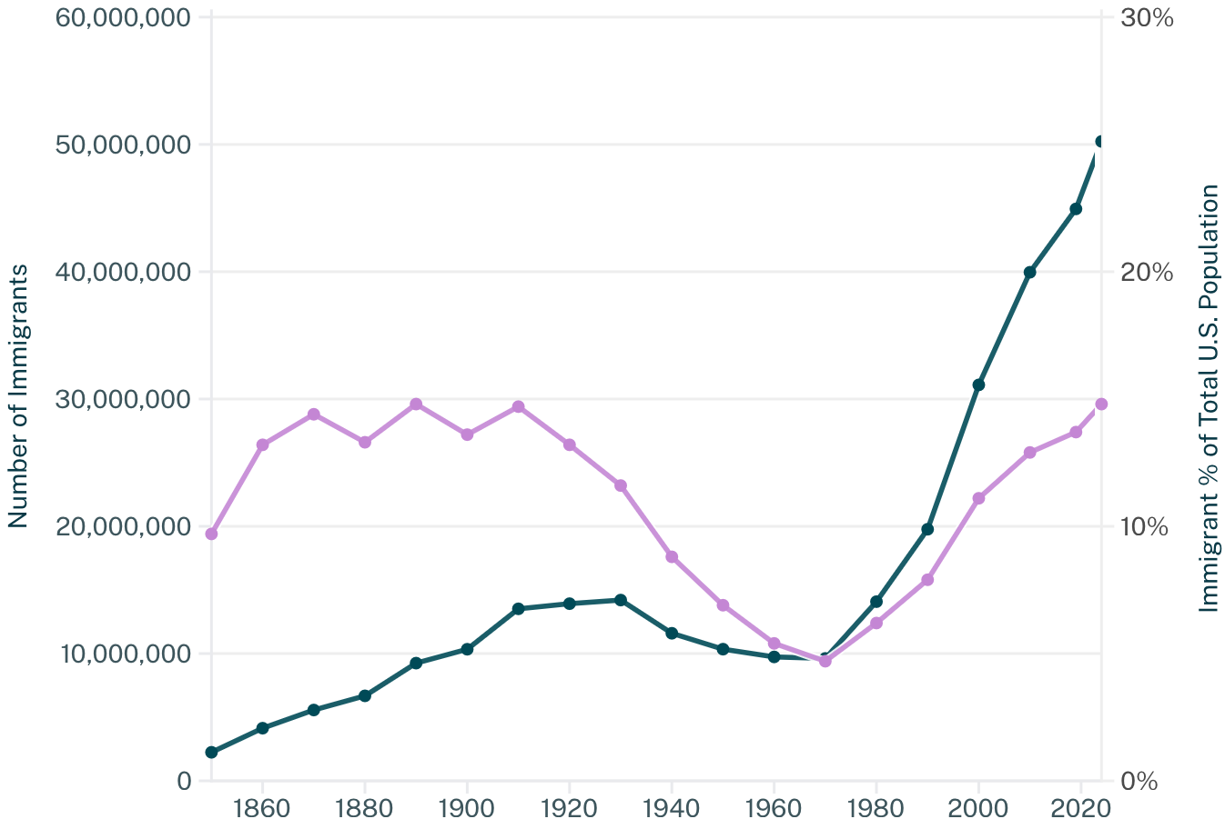


U.S. Immigrant Population and Share over Time
1850-2024
60 YEARS
Source: https://www.migrationpolicy.org/data-tool/us-immigrant-population-share

Slide 32
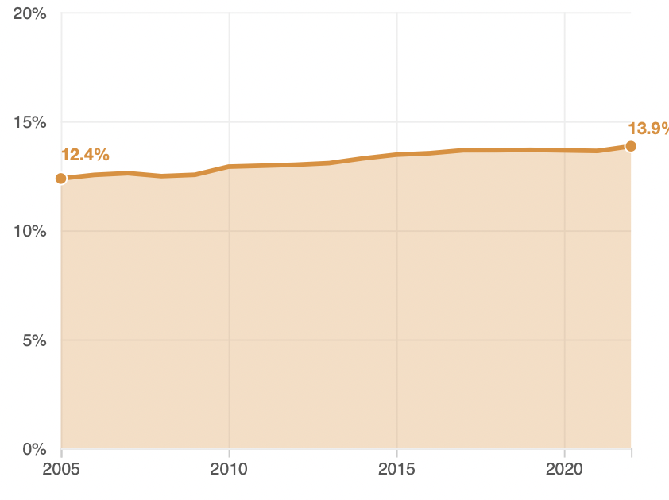
Immigrant Share of US Population
13.9 %
12.4 %

Slide 33
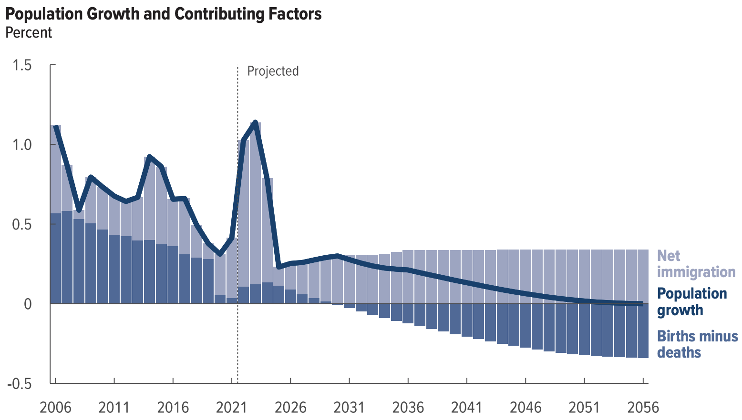
Is Immigration Saving the Day?
The majority of additions to the
Population in recent years
Have come from immigration.
Source: CBO – The Demographic Outlook, 2026-2056

Slide 34
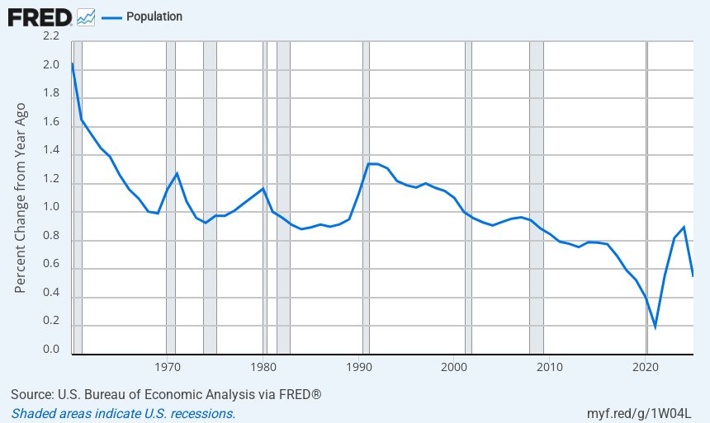
Not A Whopping Big Increase in Population

Slide 35
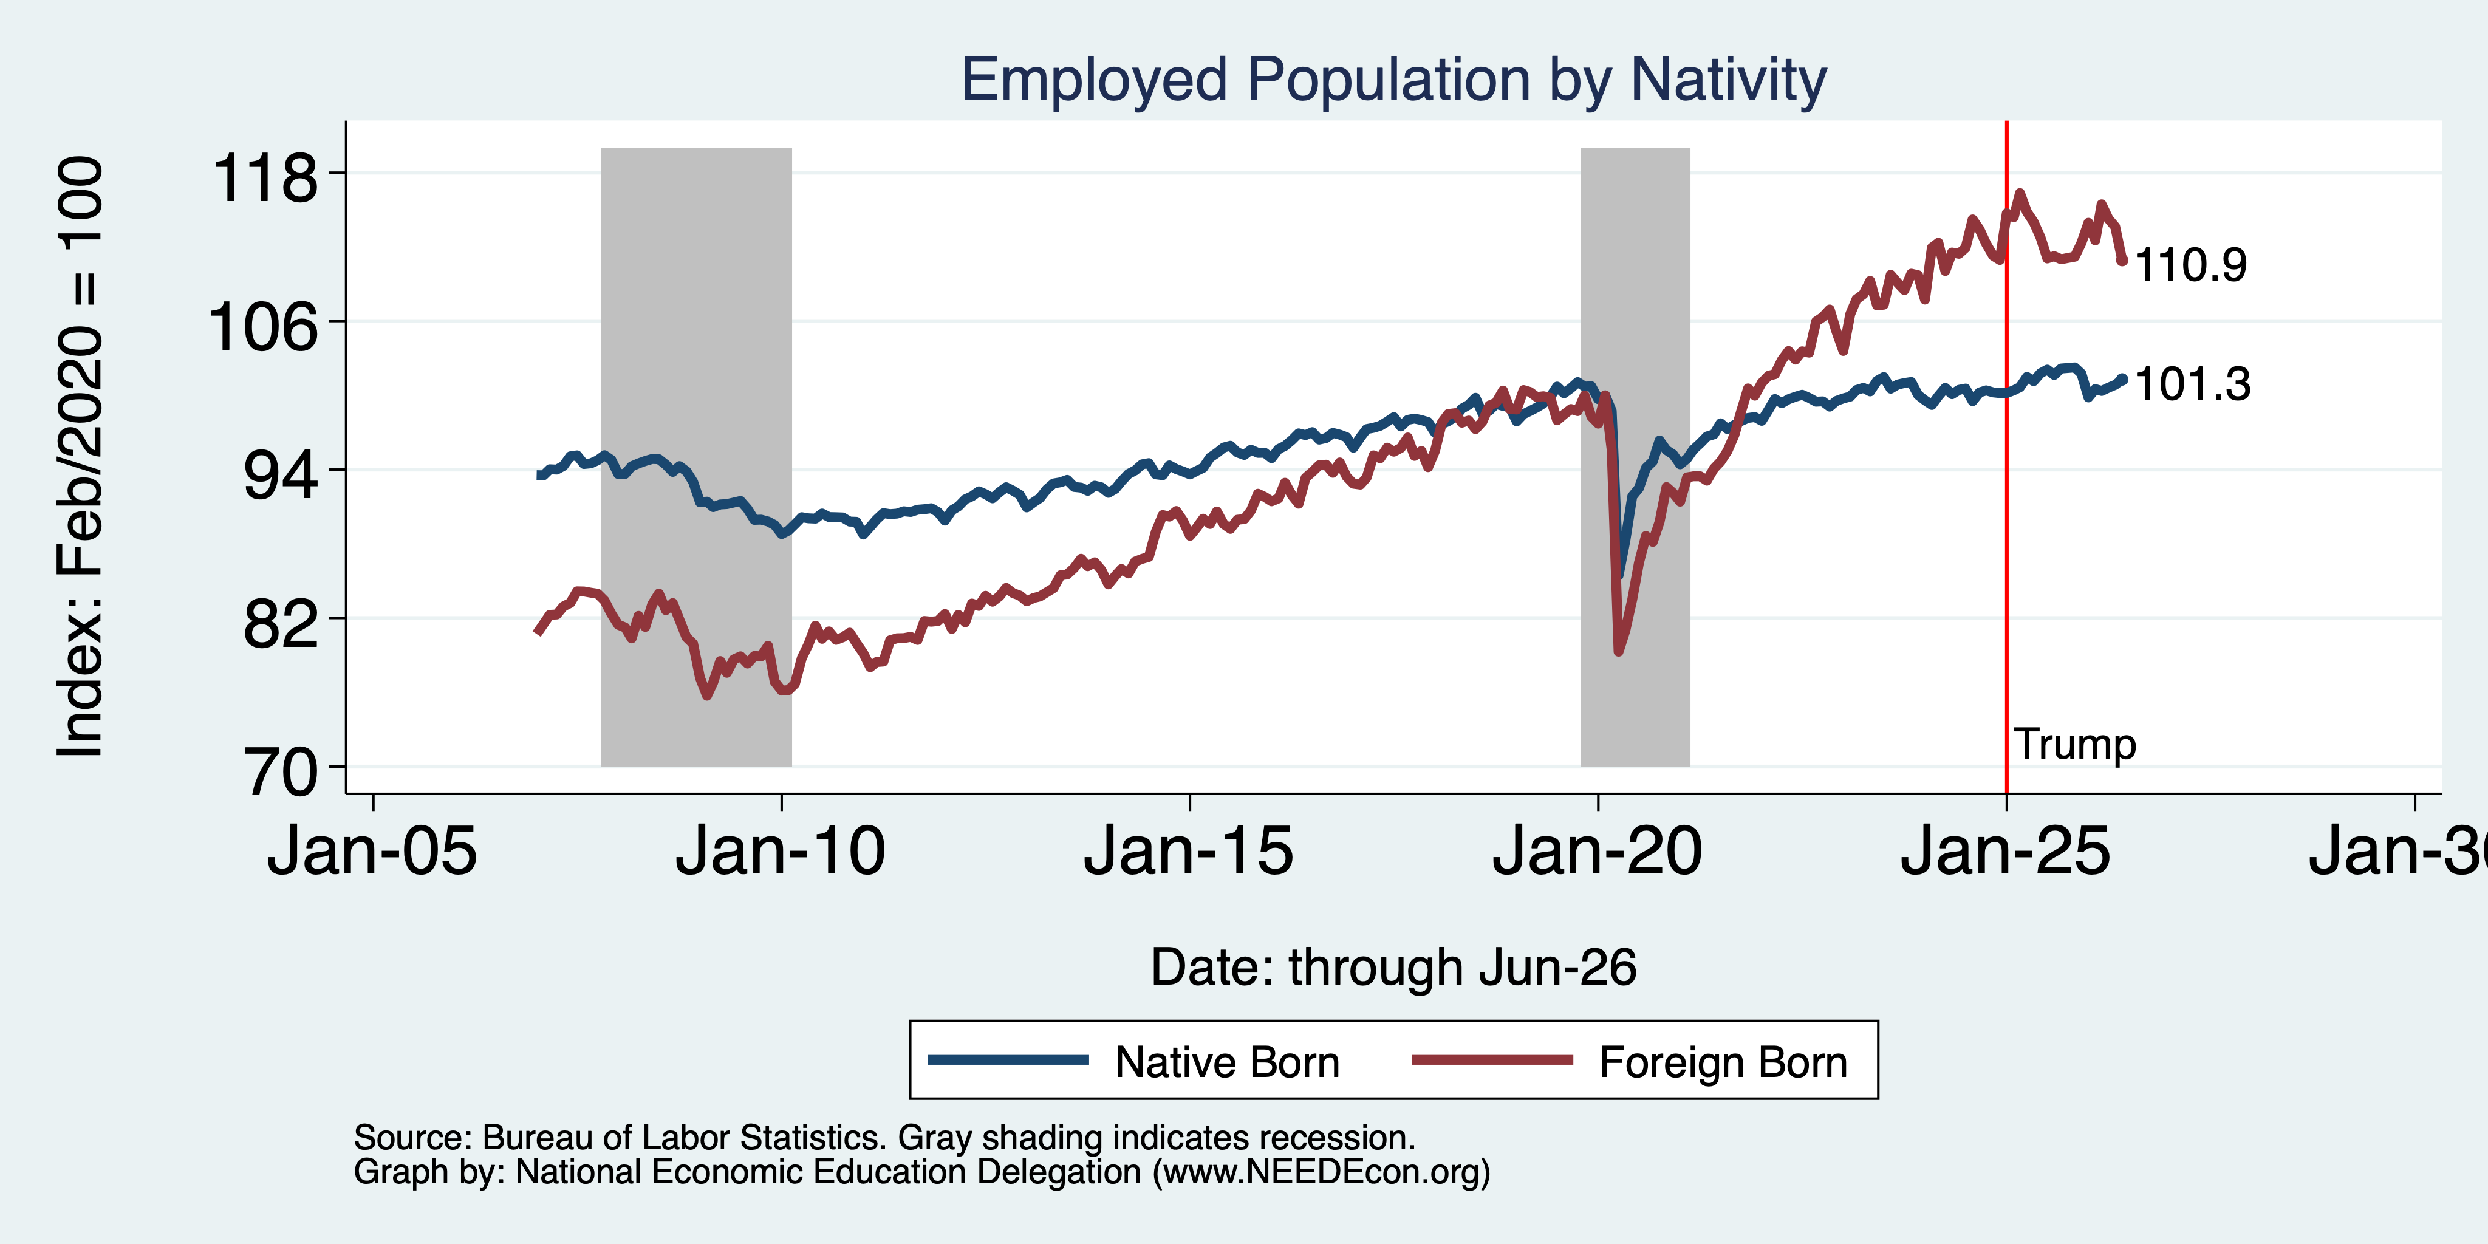
Immigrants to the Rescue!

Slide 36
Jobs: Conventional Wisdom…Upended
What is the conventional wisdom?
  Low-skilled immigrants come in and take jobs from low-skilled native-born individuals.
    1-1 tradeoff.
What does new research show?
  Low-skilled immigrants contribute positively to the economy.
    Every 100 low-skilled immigrants: create 9 jobs for low-skilled native-born.
    They create opportunities for low-skilled native-born workers.
    They create opportunities for high-skilled native-born workers.
  Low-skilled immigrants take jobs that native-born don’t want.

Slide 37
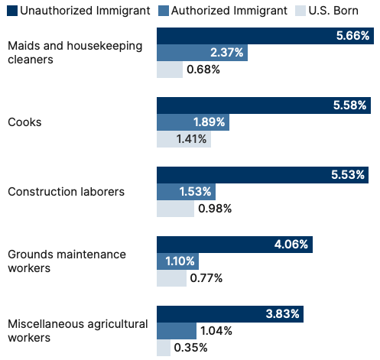
Share of Workers in Each Occupations

Slide 38
Pathway of Wage and Employment Effects
}
Inflows of Low-Skilled Immigrants
Order of Impact
Impact is negative,
But is smaller
at each step.
Previous Immigrants
Disadvantaged Minorities
Native-born HS Dropouts
Positive influence on wages and employment of other workers.

Slide 39
Skilled Immigrants and Innovation
1% increase in the share of the immigrant college graduate population:
  9-18% increase in patenting per capita
  Increased immigration increases patenting by native-born population.
In the 1990s:
  Increased skilled immigration accounts for one-third of increased patenting in that decade.
  This translates into a 1.4-2.5% increase in GDP per capita by the end of the decade.
Source: Hunt and Gauthier-Loiselle (2008).

Slide 40
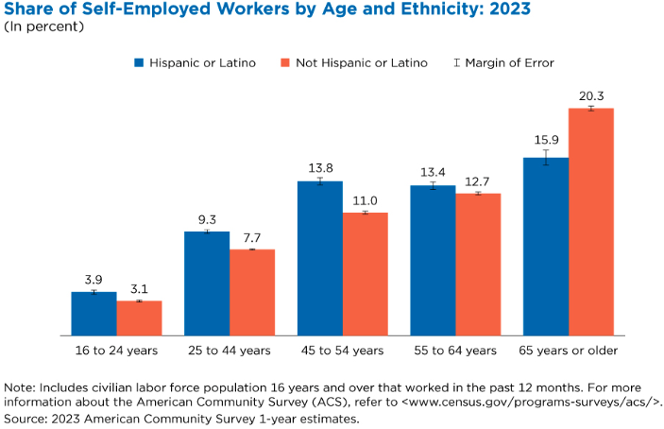
Immigrants and Entrepreneurship
Source: Magnus Lofstrom from Current Population Survey Data.

Slide 41
Fortune 500: First- and Second-Generation Founders

Slide 42
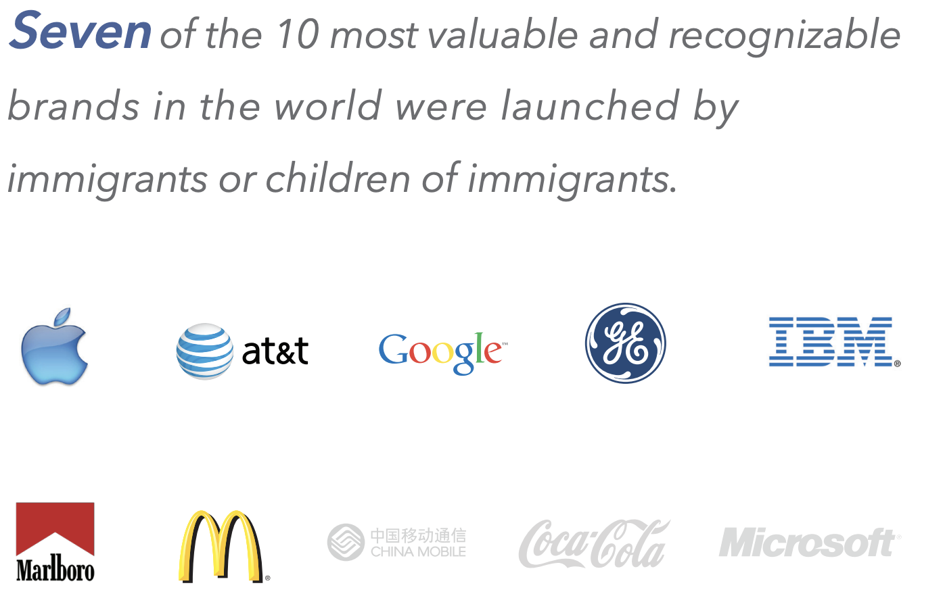

Slide 43
Government Revenues and Expenditures

Slide 44
Topics?
Basic Question:
  Taxes (income, sales, and other) immigrants pay vs. government expenditures on public benefits and services they receive.
More complicated:
  Immigrants also affect the fiscal equation for many native-born residents.
    Indirectly through labor and capital markets.
    Changes in wages and the return to capital.

Slide 45
Age-Specific Taxes and Benefits
By Immigrant Generation, United States, 2012
Source: Blau & Mackie (2017), p. 325.

Slide 46
What Do We Know?
Immigrants who arrive while of working age:
  Are, on average, net contributors.
  21-year-old with a high school diploma: +$126,000 over a lifetime.
    Though this value gradually declines with age at arrival.
    Turns negative for arrivals of age 35+.
Net contribution crucially depends on characteristics
  Age distribution, family composition, health status, fertility patterns
  Temporary or permanent relocation
  Employment in the legal labor market
  Authorized or unauthorized

Slide 47
Bottom Line/Consensus of Estimates
Federal level: fiscal impact is generally positive.
State and local level: typically negative fiscal impact.

Slide 48
Implications for Major Federal Programs
Documented immigrants are less likely to use Social Security and Medicare.
Unauthorized immigrants are ineligible.
  They will pay into the system but cannot receive benefits.
Medicaid: not available to legal residents for the first five years.
Provide a source of revenue for an aging population.

Slide 49
The Aging US Population
Source: Blau & Mackie (2017), p. 63.

Slide 50
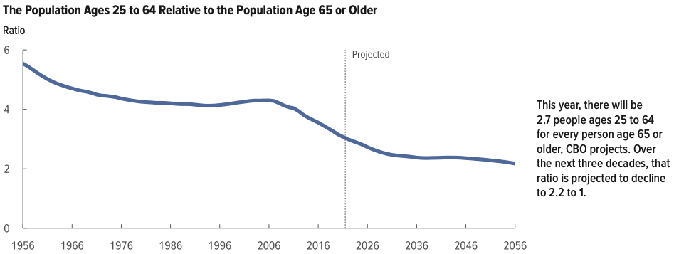
Implications for Social Security
Worker to Beneficiary Ratio
Source: CBO – The Demographic Outlook, 2026-2056

Slide 51
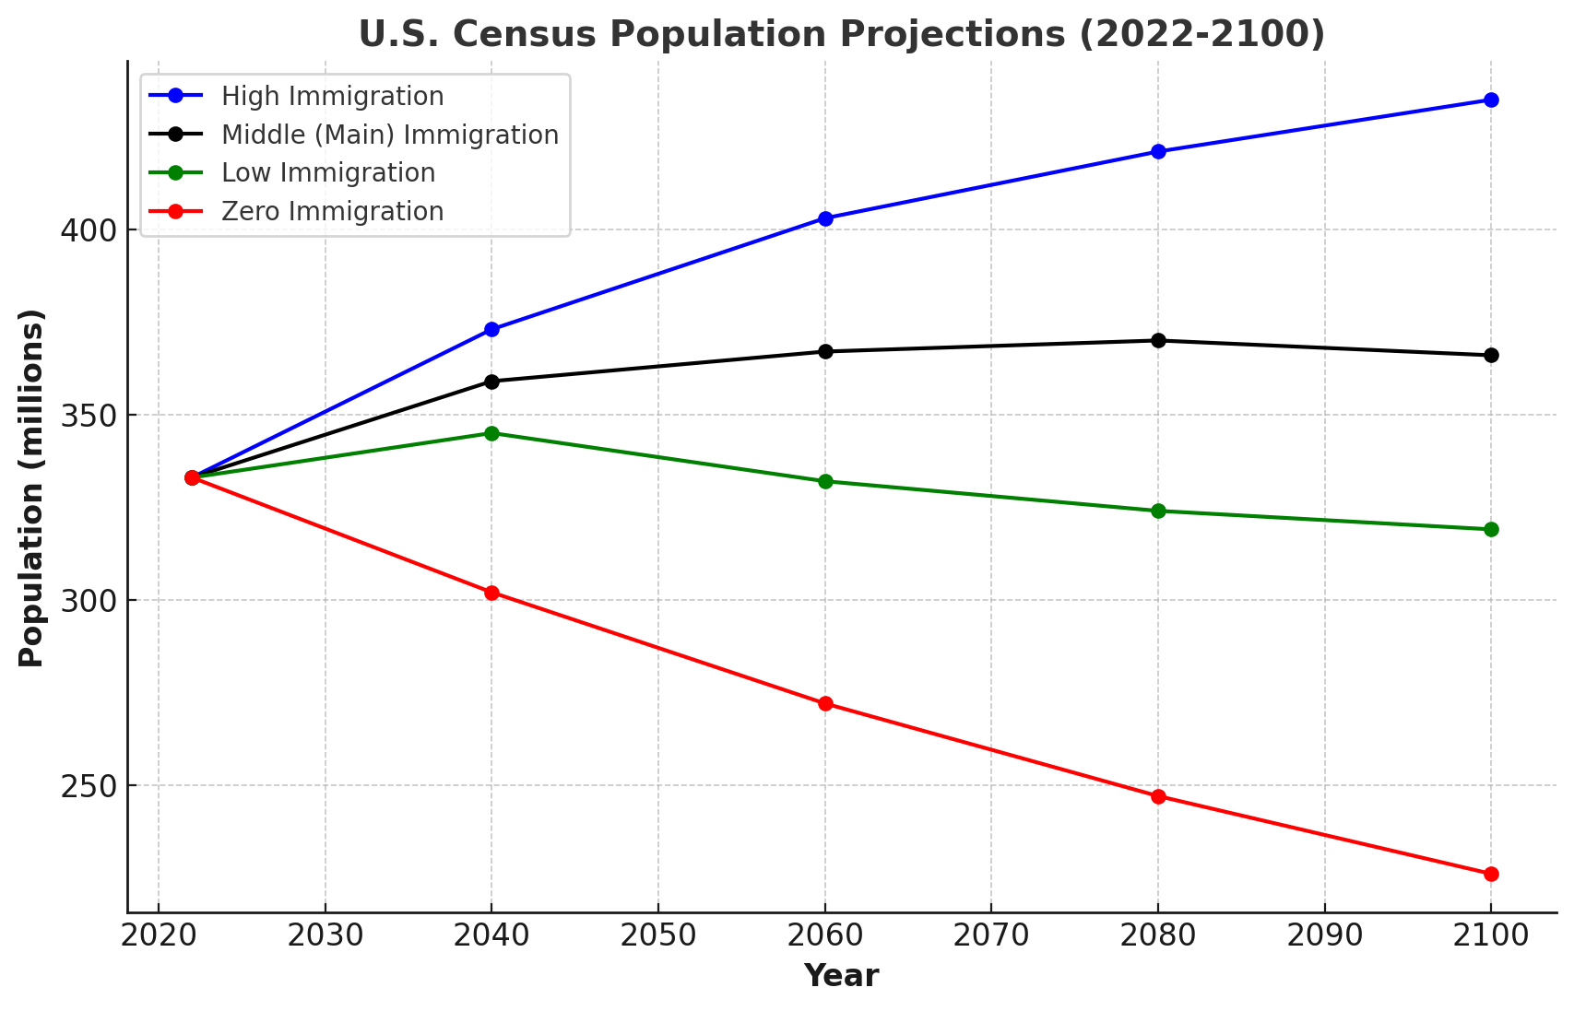
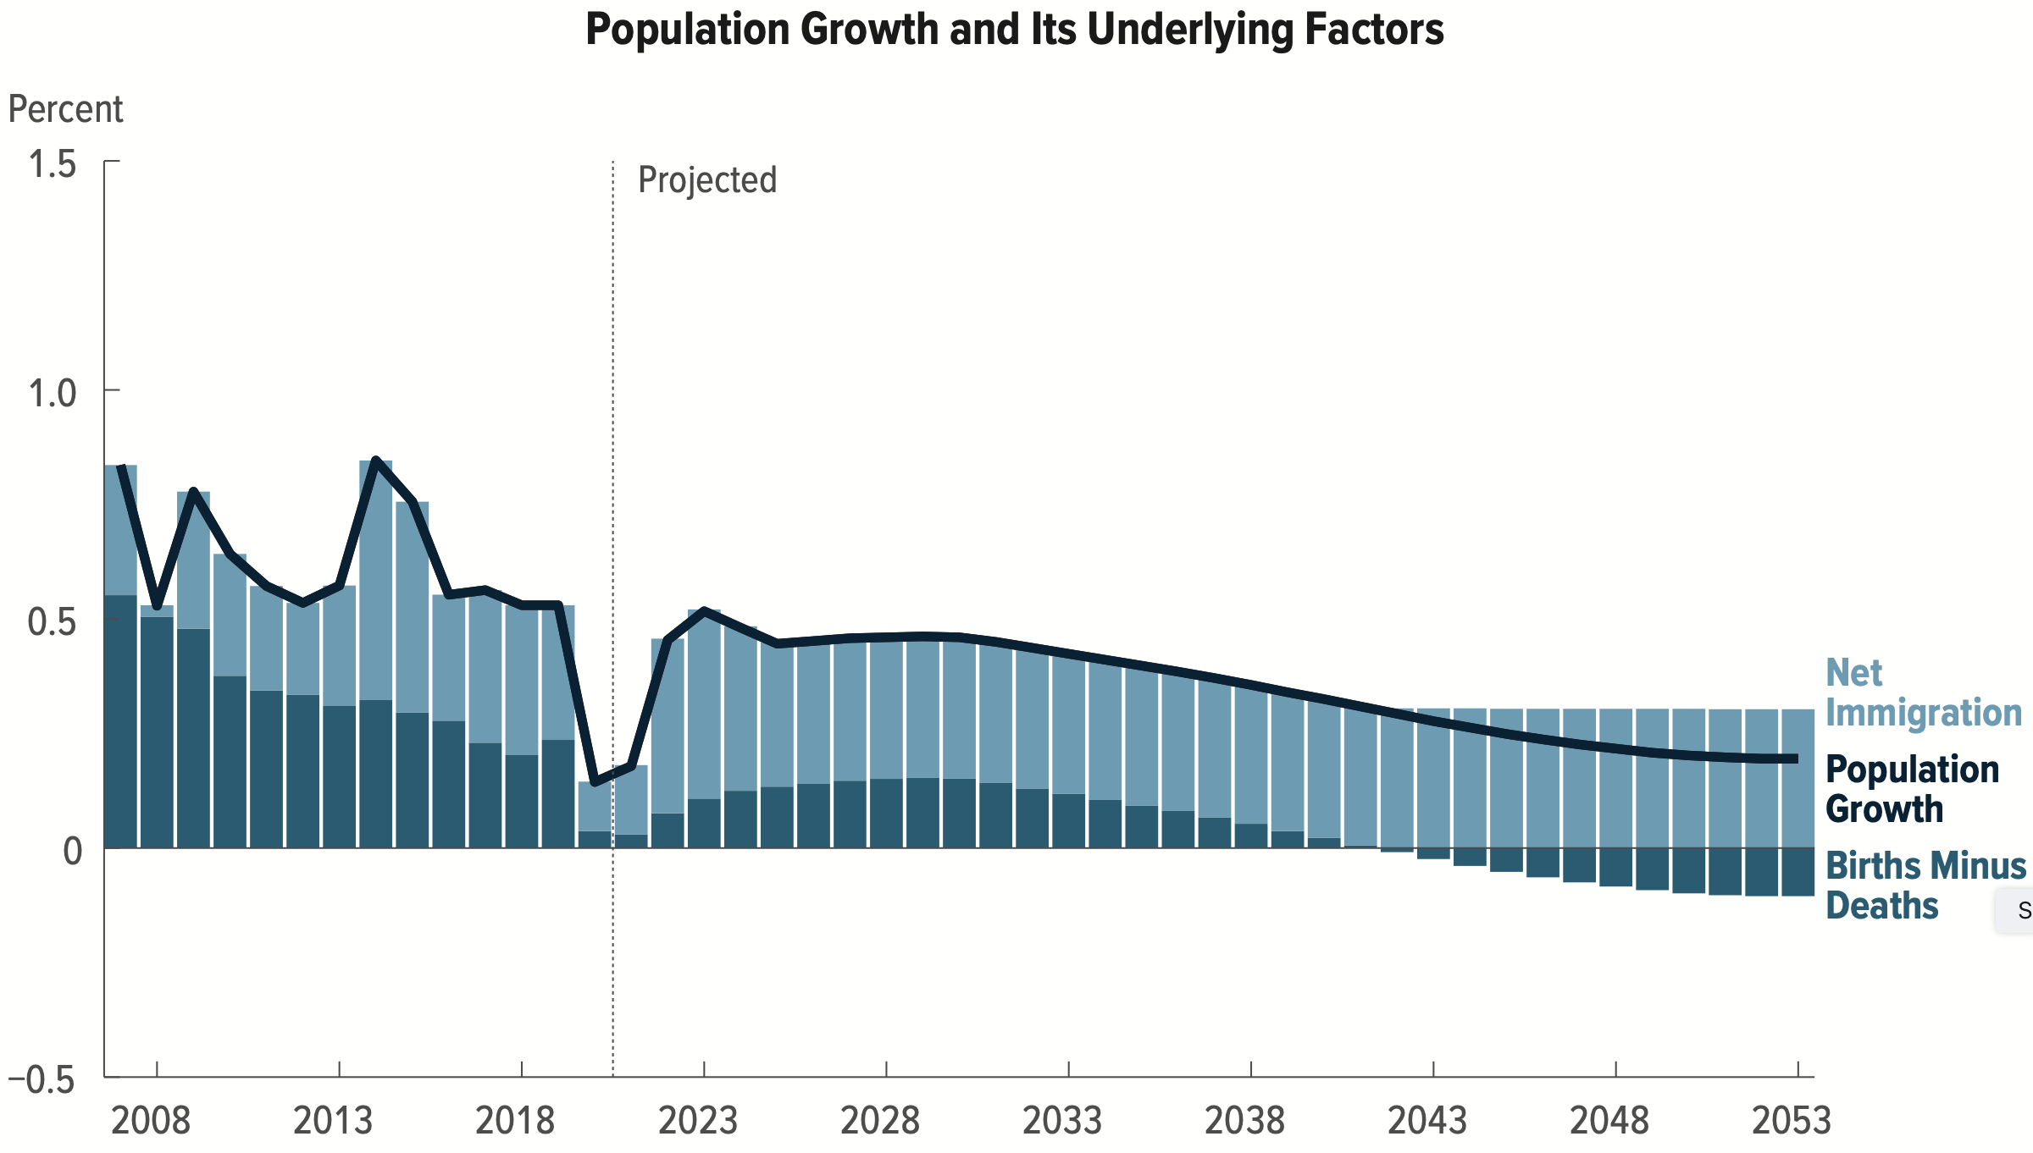
Is Immigration Saving the Day?
Source: CBO – The Demographic Outlook, 2023-2053

Slide 52
Non - Economic Implications
Patterns of Integration
Education
Employment and Earnings
Occupations
Poverty
Residential Integration
Language
Health
Family Patterns
The Big Misconception: Crime
Source: The Integration of Immigrants into American Society (2015).

Slide 53
Immigrants and Crime Rates
Conventional wisdom:
  Immigrants commit crimes more frequently than do native-born residents.
  Rising immigration leads to rising crime.
What do the data say?
  Rates of incarceration are lower for foreign-born than U.S.-born.
  Neighborhoods with more immigrants have lower crime rates.
Let’s Have a Look!

Slide 54
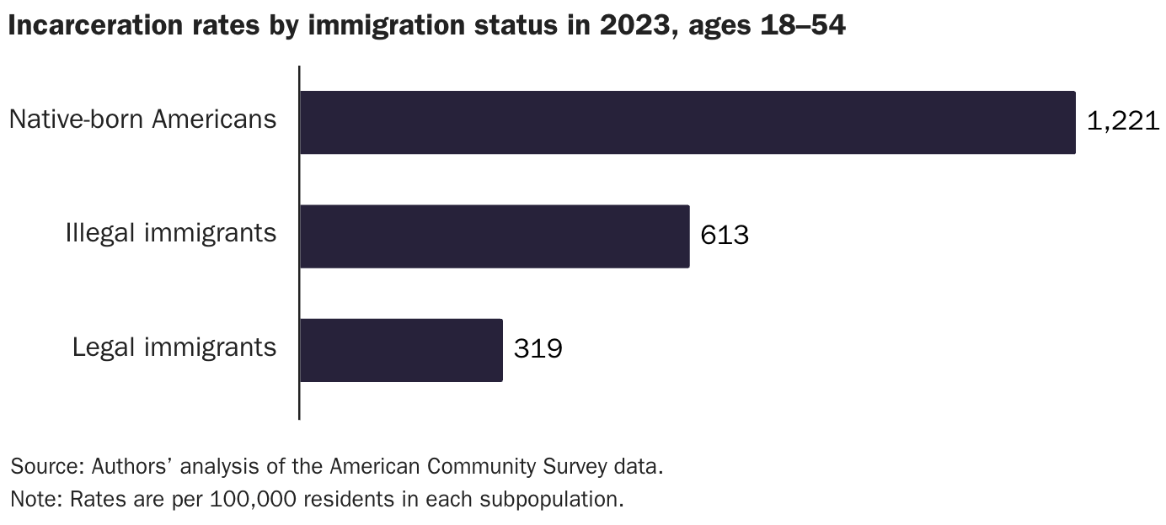
Incarceration by Immigration Status, 2023
Unauthorized immigrants
Authorized immigrants
Source: Cato Institute, Illegal Immigrant Incarceration Rates, 2010–2023

Slide 55
Immigrants and Crime Rates
Conventional wisdom:
  Immigrants commit crimes more frequently than do native-born residents.
  Rising immigration leads to rising crime.
What do the data say?
  Rates of incarceration are lower for the foreign born than US born.
  Neighborhoods with more immigrants have lower crime rates.
  There is no evidence that deporting noncitizen immigrants affects crime rates.

Slide 56
About Conventional Wisdom
Native-born unskilled workers
  There is some negative impact on their wages.
  But who wins and loses depend on the skill mix of immigrants;
    when this skill mix changes, so do its effects.
Crime
  Immigrants, both authorized and unauthorized, commit crimes at much lower rates than do native-born residents.
Government programs
  Federal: immigrants are a source of revenue and stability for some important programs.
  State and local: because education is funded at the local level, this can be a drain on local government coffers.

Slide 57
At the Same Time….
Immigrants are often a select group:
  Willing to incur an enormous personal or familial cost to better their lives.
As a result:
  Immigrants tend to be entrepreneurial and to add significantly to economic growth.
Although there are distributional issues:
  Immigration is an important contributor to economic growth.
  Immigration helps to sustain vital government programs.

Slide 58
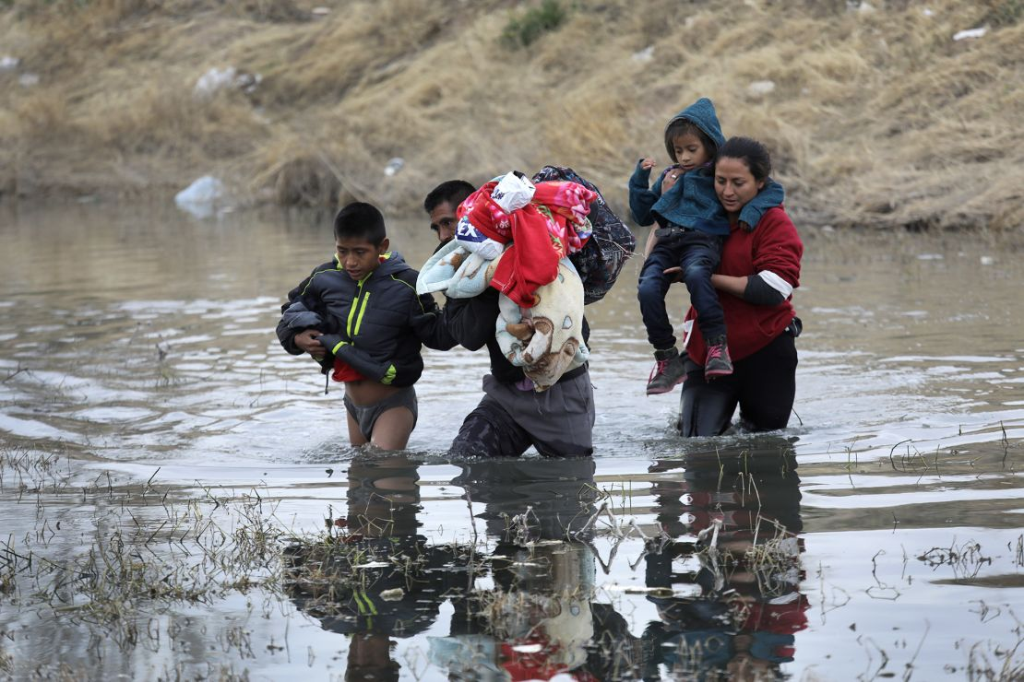
Recent Immigration Issues
DACA
The Northern Triangle
Temporary Protected Status
Mass Deportations

Slide 59
DACA (Deferred Action for Childhood Arrivals)
Entered U.S. before age 16, now in U.S.
Entered before June 2007.
Currently in school, high school grad or honorable discharge from military.
No felony conviction or threat to security.
Renewable every 2 years.
Executive Order by Obama, Trump ended, Biden restored.

Slide 60
DACA Statistics
There have been 825,000 of them. Arrived prior to June 15, 2007
  343,000 employed in essential jobs. (According to DHS: health/education)
  168,000 in California
1/3 arrived before the age of 5.
Average is now 26 years old.
1.3 million people live with a DACA individual.
  300,000 dependent children.
Tax revenues:
  $6.2 billion federal, $3.3 billion state.

Slide 61
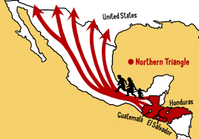
The Northern Triangle

Slide 62
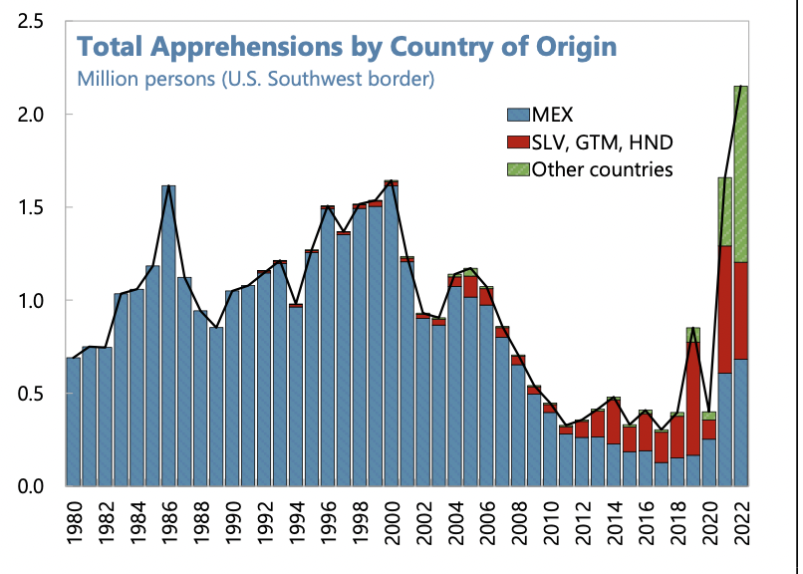
Northern Triangle Apprehensions
(Northern Triangle Countries in Red)

Slide 63
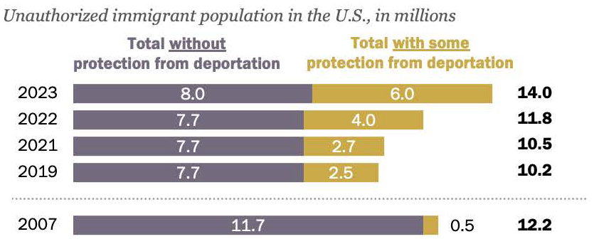
Undocumented Immigrants and TPS
Source: Pew Foundation

Slide 64
Asylees and Refugees
Refugees are usually outside the United States when they are screened for resettlement in US.
Asylum seekers submit their applications while physically present in the United States or at a U.S. port of entry.
Both groups have a pathway to permanent status.
Reason to grant – (US & UNCOR) unable to return because of persecution or a well-founded fear of persecution based on: race, religion, nationality, membership in a particular social group, or political opinion. (Not economic hardship!)

Slide 65
Temporary Protected Status (TPS)
The Secretary of Homeland Security can grant.
Can be granted to foreign-born persons who can’t return to home country safely due to their country unable to handle their return.
Acceptable reasons:
  Conflict - Epidemic
  Hurricane or earthquake - Other temporary conditions
Temporary status but can be extended.
Can work and travel within the United States.
May be eligible for welfare such as TANF, SNAP, Medicaid.
No pathway to permanent status.

Slide 66
TPS As of March 31, 2025
Country | Individuals
Venezuela | 605,015
Haiti | 330,735
El Salvador | 170,125
Ukraine | 101,150
Honduras | 51,225
Other | 39,150
Total | 1,297,635
Source: https://forumtogether.org/article/temporary-protected-status-fact-sheet/

Slide 67
TPS As of March 2026
Country | Individuals - 2025 Totals
Venezuela | 605,015
Haiti ??? | 330,735
El Salvador | 170,125
Ukraine | 101,150
Honduras | 51,225
Other | 39,150
Total | 1,297,635 ~600,000
Source: https://forumtogether.org/article/temporary-protected-status-fact-sheet/

Slide 68
Current TPS Status
In Effect | Ended but Suspended by Court Order
El Salvador | Burma
Lebanon | Ethiopia
Sudan | Haiti
Ukraine | Somalia
 | South Sudan
 | Syria
 | Yemen

Slide 69
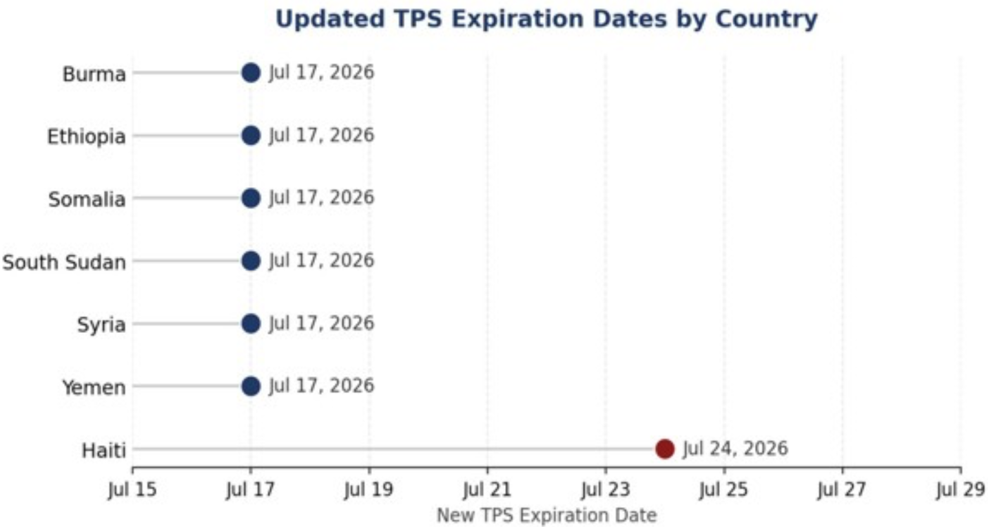
(Minimally) Extended Expiration Dates
Other Expiration Dates:
El Salvador: Sep. 9, 2026
Lebanon: Nov. 27,2026
Sudan: Oct. 19, 2026
Ukraine: Oct. 19, 2026
~300,000 people
Recall, there were
1.3 million on March 31, 2025
Source: https://www.jdsupra.com/legalnews/updated-tps-expiration-dates-announced-3831227/

Slide 70
Notes on TPS Individuals
Very high labor force participation.
Working in critical industries:
  830,000 TPS holders are working
    130,000 in construction,
    130,000 in wholesale and retail trade,
    120,000 in leisure and hospitality,
    110,000 in transportation, warehousing and utilities,
    110,000 in business services, and
    85,000 in manufacturing.
They contribute $29 Billion to the U.S. economy.
And they pay taxes:
  $7.8 billion in federal, state, and local income taxes.
  $690 million in social security taxes.

Slide 71
Mass Deportations
Immigrants work different jobs than do native-born workers.
Immigrants contribute to the local economy.
  GDP losses of up to $1.7 trillion annually.
Immigrants keep prices low: in particular, food!
Deportations impact tax revenues.
  $1,300 more in on average than out, annually.
  Unauthorized immigrants: $22.6 billion in social security and $5.7 billion in Medicare payments.
Deportations are expensive ($13,000 each).
  Total cost $315 billion.
They rob people of their dignity.

Slide 72
Summary
Immigration can be thought of as increasing the population of the United States.
  But they are a select group.
This brings economic growth and opportunity, just as does increasing the native-born population.
  But not crime.
Including unauthorized immigrants, the supply of low-skilled workers is increased.
  This may lower the wages of some low-skilled workers, but…
    also increases labor force participation among highly-skilled workers, and
    Increases economic opportunity for many low-skilled workers.

Slide 73
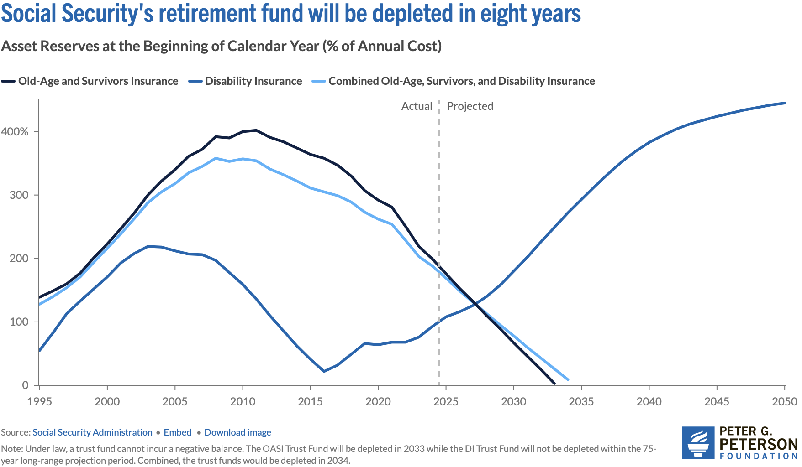
Saving Social Security: Geoffrey Woglom

Slide 74
Thank you!
Any Questions?
www.NEEDEcon.org
Jon D. Haveman, Ph.D.
Jon@NEEDEcon.org
Contact NEED: info@needecon.org
Submit a testimonial: www.NEEDEcon.org/testimonials.php
Become a Friend of NEED: www.NEEDEcon.org/friend.php

