Slide 1
Osher Lifelong Learning Institute, Summer 2024
Contemporary Economic Policy
OLLI – University of California
June, 2024
Jon Haveman, Ph.D.
National Economic Education Delegation

Slide 2
Course Outline
Contemporary Economic Policy
  Week 1 (6/4): US Economic Update (Jon Haveman, NEED)
  Week 2 (6/11): Economics of Immigration
  Week 3 (6/18): Federal Debt
  Week 4 (6/25): Taxes: Rebellion, Rascals, and Revenue

Slide 3

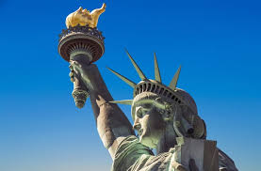
The Economics of Immigration
OLLI – University of California, Berkeley
June 11, 2024
Jon Haveman, Ph.D.
National Economic Education Delegation

Slide 4
Credits and Disclaimer
This slide deck was authored by:
  Anna Maria Mayda, Georgetown University
  Robert Gitter, Ohio Wesleyan University
  Roger White, Whittier College
This slide deck was reviewed by:
  Kirk Doran, Notre Dame
  Ethan Lewis, Dartmouth College
Disclaimer
  NEED presentations are designed to be nonpartisan.
  It is, however, inevitable that presenters will be asked for and will provide their own views.
  Such views are those of the presenter and not necessarily those of the National Economic Education Delegation (NEED).

Slide 5
Outline
Quiz!
History of immigration to the U.S.
Why do people migrate?
The nature of immigration to the U.S.
Economics of immigration
Recent policy issues

Slide 6
Immigration Quiz
What % of the U.S. population are immigrants?
  14%
What % of the world’s population are immigrants?
  3.6%
How long has the average undocumented immigrant lived in the United States?
  A. 3 months
  B. 2 years
  C. 10 years
  D. 25 years
21% of children born to native parents are high-income earners (above the middle class).
What % of kids born to immigrants are high-income earners?
  A. 15%
  B. 21%
  C. 28%
  D. 35%
In 2021, 8% of Americans lived in poverty. What percent of immigrants lived in poverty?
  13%
Source: Freakonomics – How Much Do You Know About Immigration?

Slide 7
Immigration Quiz
Immigrants are responsible for what % of patents in the United States?
  36%
    23% of inventors on record
    13% from increase in native born patenting
What % of green cards go to family and employment-based immigration?
  66% go to family-based
What % of the U.S. workforce are immigrants?
  18%
Native-born Americans receive $8k on average in benefits. What is it for immigrants?
  $6,000
100 years ago, most immigrants were from Europe. Today, Latin America and Asia. Is the rate of assimilation:
  Faster? Slower? About the same?
Source: Freakonomics – How Much Do You Know About Immigration?

Slide 8
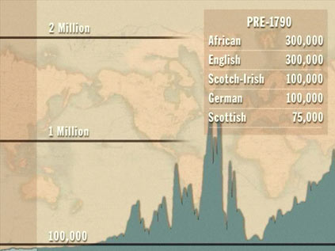
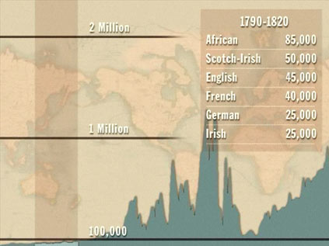
History of US Immigration
Source Countries | Pre-1790
African countries* | 300,000
England | 300,000
Scotland-Ireland | 100,000
Germany | 100,000
Scotland | 75,000
Source Countries | 1790-1820
African countries* | 85,000
Scotland-Ireland | 50,000
England | 45,000
France | 40,000
Germany | 25,000
* Slave trade and clearly not voluntary or reflective of standard motivations for immigration.
Source: https://www.libertyellisfoundation.org/immigration-timeline/.

Slide 9
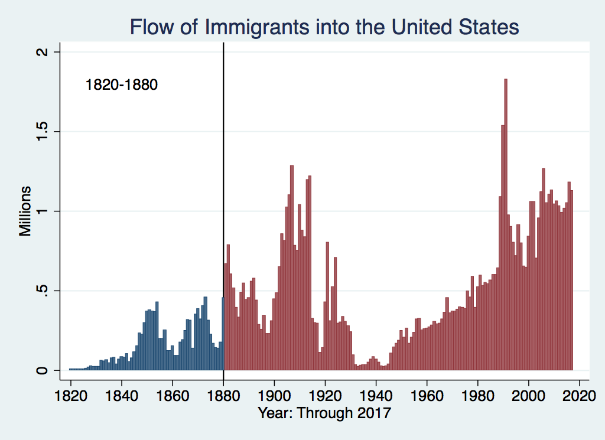
History of US Immigration
Source Countries | 1820-1880
Germany | 3,000,000
Ireland | 2,800,000
Britain | 2,000,000
Austro-Hungarian empire | 1,000,000
Canada | 750,000
China | 230,000
African countries | 50,000
https://www.libertyellisfoundation.org/immigration-timeline

Slide 10
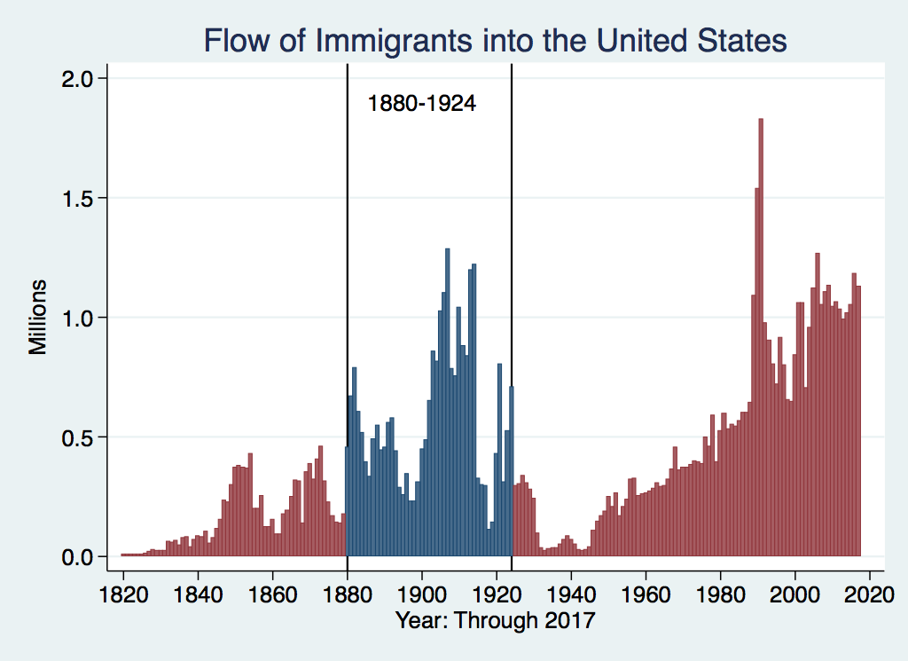
History of US Immigration
Source Countries | 1880-1930
Italy | 4,600,000
Austro-Hungarian empire | 4,000,000
Russian empire | 3,300,000
German empire | 2,800,000
Britain | 2,300,000
Canada | 2,300,000
Ireland | 1,700,000
https://www.libertyellisfoundation.org/immigration-timeline

Slide 11
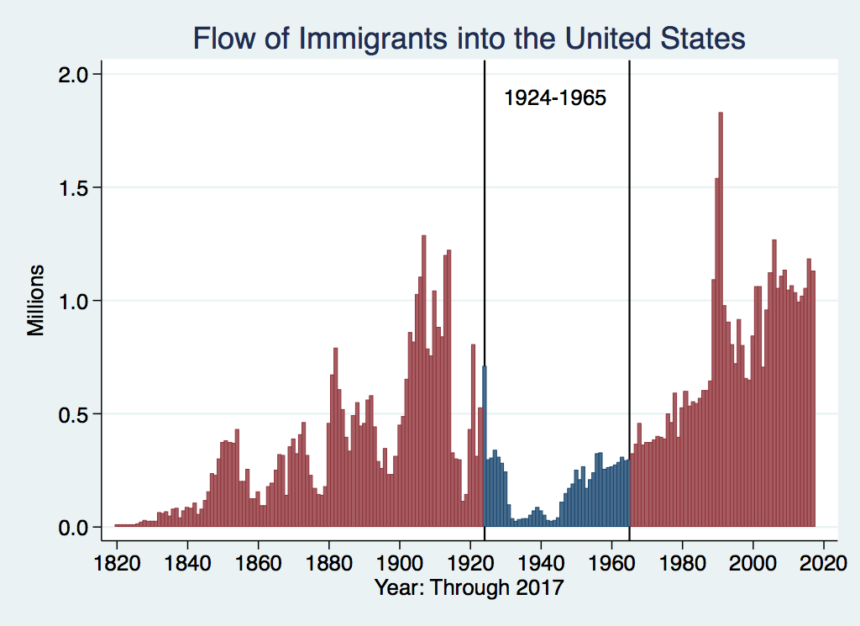
History of US Immigration
Source Countries | 1930-1965
Germany | 940,000
Canada | 900,000
Mexico | 610,000
Britain | 480,000
Italy | 390,000
Caribbean/ West Indies | 310,000
Source: https://www.libertyellisfoundation.org/immigration-timeline/.

Slide 12
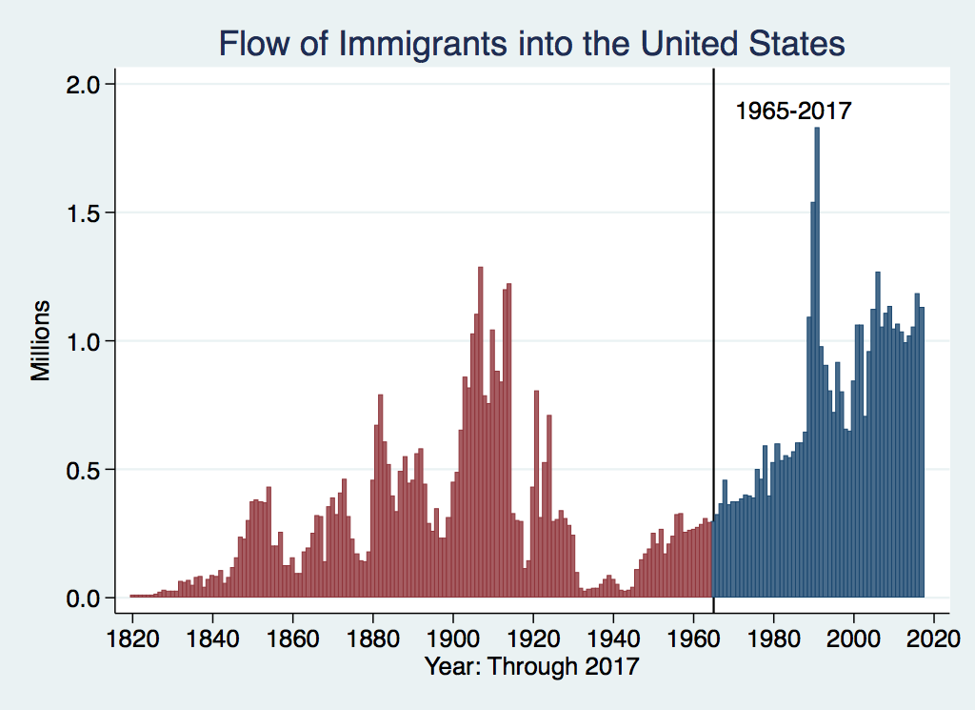
History of US Immigration: 1965-2017
Source Country | 1965-2017
Mexico | 4,300,000
Philippines | 1,400,000
South Korea | 760,000
Dominican Republic | 750,000
India | 740,000
Cuba | 700,000
Vietnam | 700,000
Canada | 650,000
Source: https://www.libertyellisfoundation.org/immigration-timeline/.

Slide 13
History of US Immigration: 2011-2020
Sources (top 9) | 2011-2020
Mexico | 1,491,000
China | 721,000
India | 637,000
Philippines | 505,000
Dominican Rep. | 487,000
Cuba | 473,000
Vietnam | 334,000
El Salvador | 215,000
South Korea | 199,000
Jamaica | 198,000
Total immigrant inflow, 2011-2020 = 10,125,000
US population growth, 2011-2020 = 22,700,000
Typical year during decade…
US population increased by 2.27 million (0.74%)
Native births contributed approx. 1.35 million (0.44%)
Immigration contributed approx. 920,000 (0.30%)
Sources: UN Population Division (2010 and 2020 immigrant stocks), US DHS (2010-2020 immigrant inflows), US Census (population values).

Slide 14
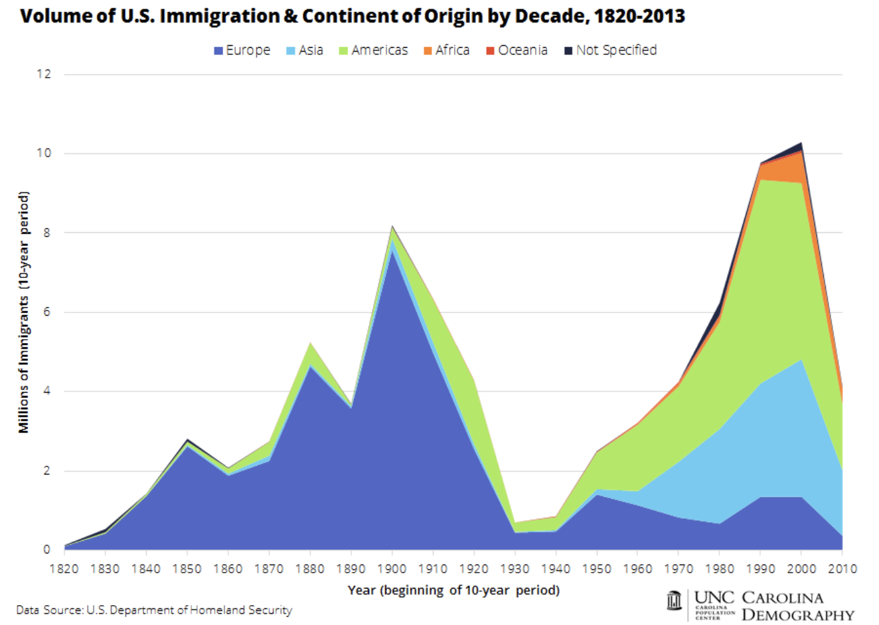
Authorized Immigration

Slide 15
Why Do People Migrate?
Push factors:
  Disparities in income/standards of living, and the availability of jobs, violence/war, climate change, natural disasters, population pressures, economic dislocation, religious persecution, and denial of political rights.
Pull factors:
  Potential for economic prosperity (higher wages, job opportunities), physical security, political freedom, and religious liberty.
Source: Gilder Lehrman Institute of American History.

Slide 16
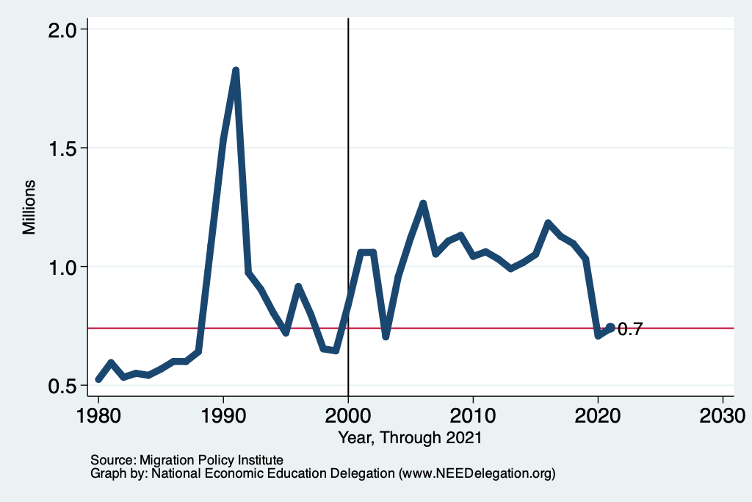
Recent Trends in Authorized Immigration
2022
1.0 Million

Slide 17
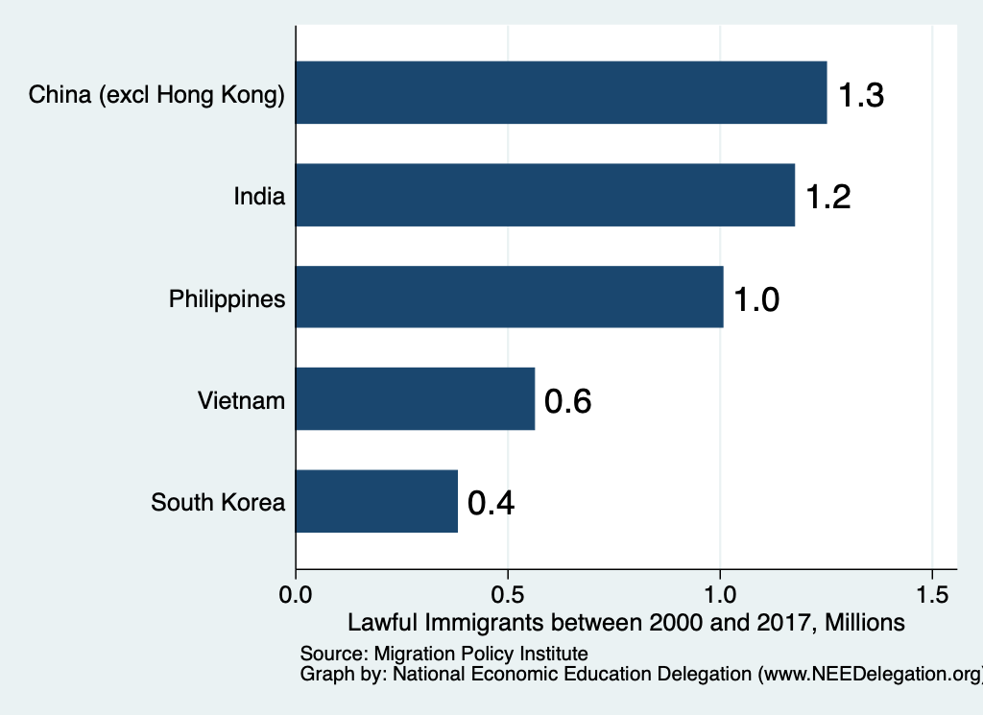
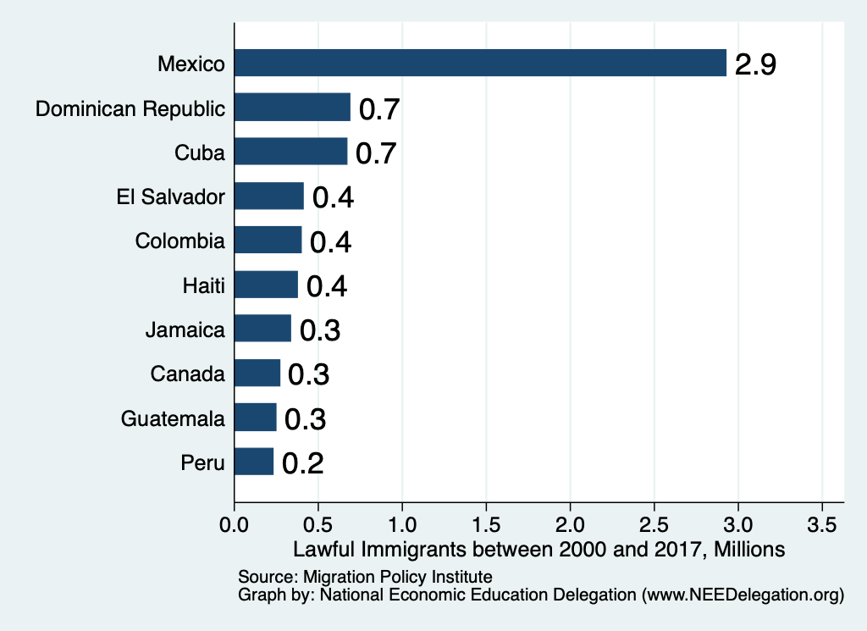
Authorized Immigration by Source

Slide 18
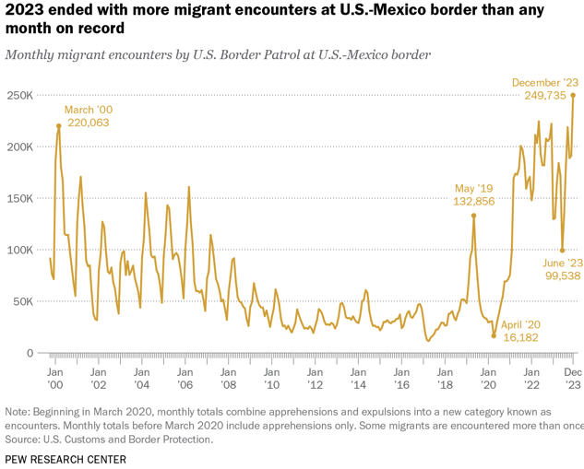

Slide 19
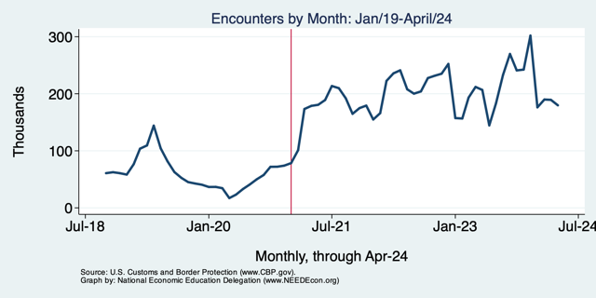
2024 Has Seen Reductions – But Still High

Slide 20
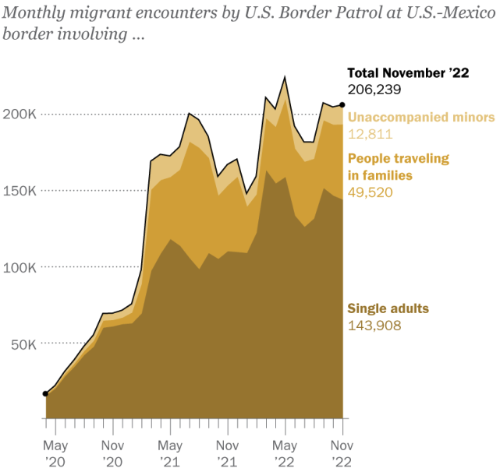
Most Are Single Adults
Evidence suggests:
Most unaccompanied minors
are coming to join family members
who are already here.
The population of minors in the
U.S. without a parent has not increased.
Source: Pew Research Center, US Customs and Border Protection

Slide 21
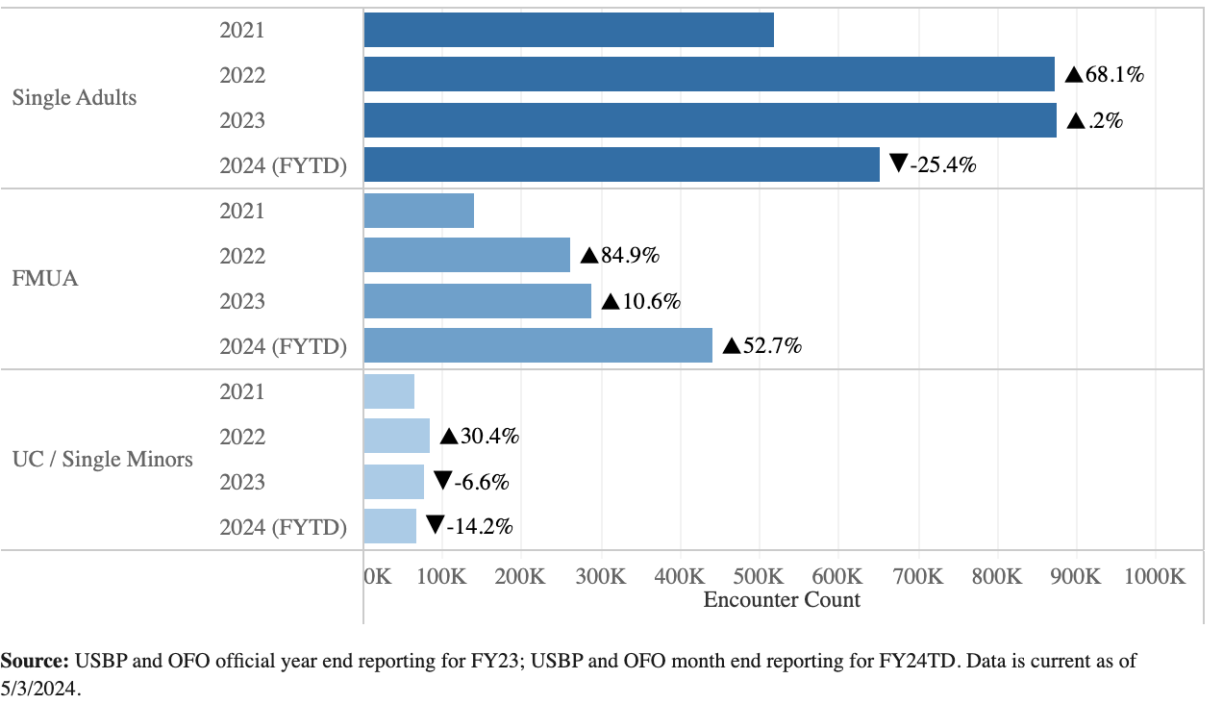
Demographic Trends
(Members of
Families)

Slide 22
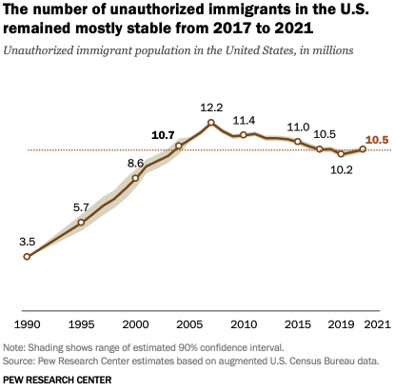
U.S. Unauthorized Immigration Totals
Source: Pew Research Center, What we know about unauthorized immigrants living in the U.S., Nov. 16, 2023

Slide 23
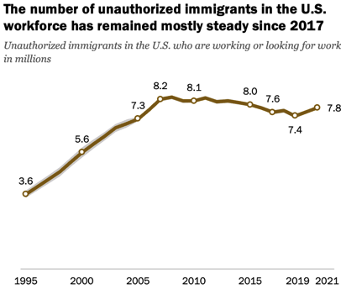
U.S. Unauthorized Immigration: Labor Force
5% of labor force
3% of population
Source: Pew Research Center, What we know about unauthorized immigrants living in the U.S., Nov. 16, 2023

Slide 24
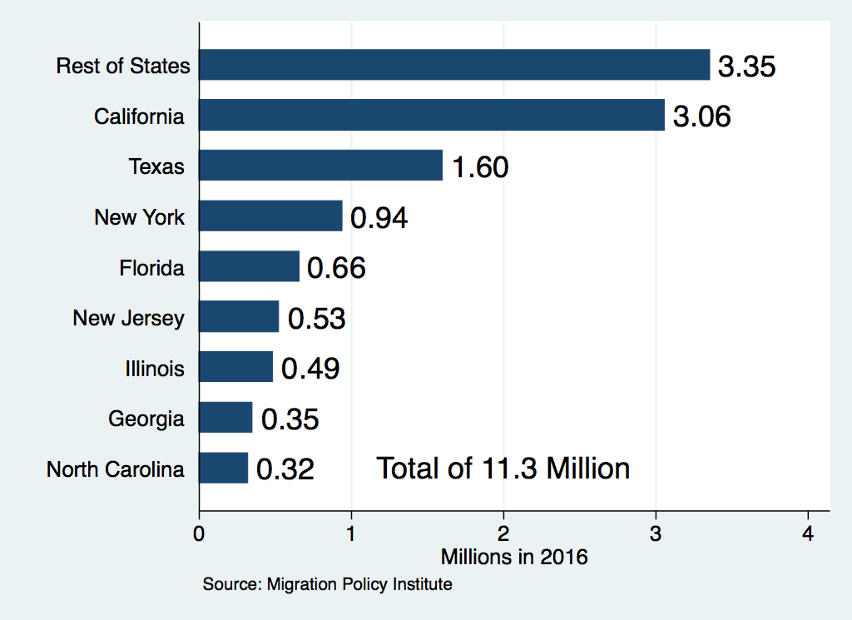
Unauthorized Immigration: Where They Live

Slide 25
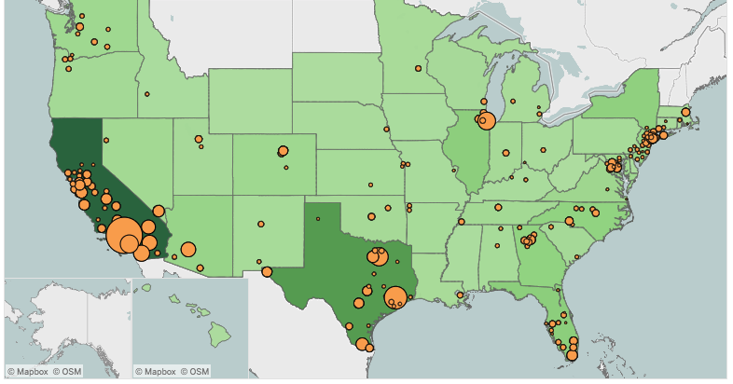
Unauthorized Immigration: 2012-2016
https://www.migrationpolicy.org/programs/data-hub/charts/unauthorized-immigrant-populations-country-and-region-top-state-and-county

Slide 26
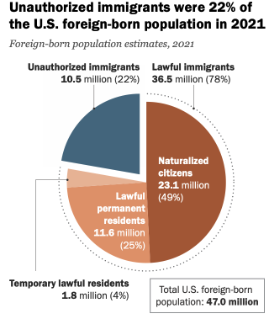
Source: Pew Research Center, What we know about unauthorized immigrants living in the U.S., Nov. 16, 2023

Slide 27
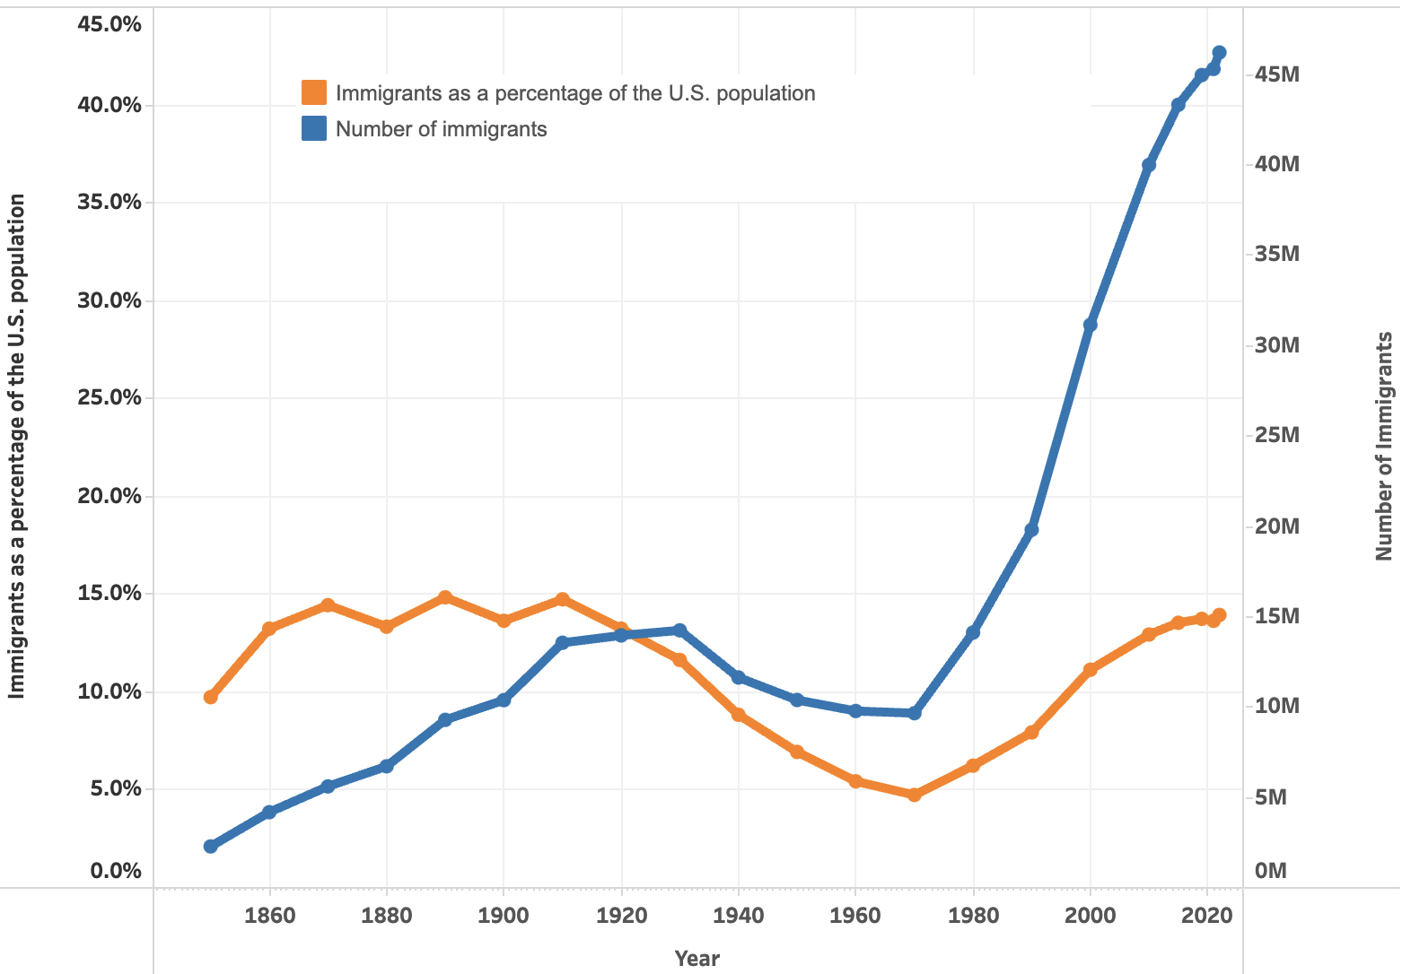
U.S. Immigrant Population and Share over Time
1850-2022

Slide 28
Why Do We Care? Economic Implications
Conventional Wisdom Issues:
  Labor markets: Wages and Jobs
  Government Revenue and Spending
  Crime
Other issues (that don’t get talked about much):
  Gross Domestic Product (GDP)
  Innovation and Entrepreneurship

Slide 29
GDP: How Does This Work?
What determines the size of an economy?
  Physical capital
  Technology/productivity
  The number of workers
    Immigration adds to the number of workers.
Number of immigrants in the labor force is high
  28.2 million foreign-born persons ages 16+ in the labor force in 2018.
  17.4% of the total US workforce.
Evidence
  Immigrants added 11% to GDP ($2 trillion) in 2016.
US Census Bureau (2019) American Community Survey.
National Academies of Sciences, Engineering, and Medicine (2017) “The Economic and Fiscal Consequences of Immigration”.

Slide 30
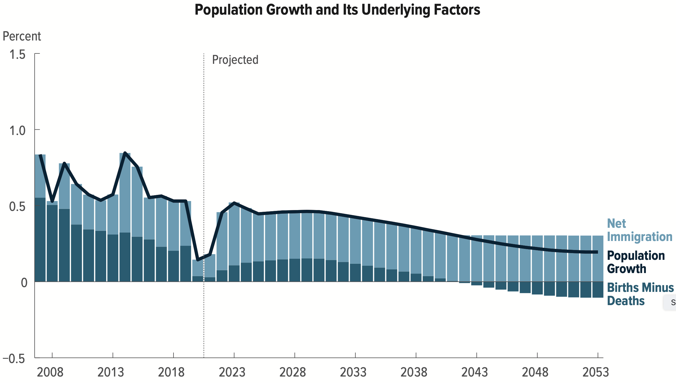
Is Immigration Saving the Day?
The vast majority of additions to the
Population in the last several years
Has been from immigration.
Source: CBO – The Demographic Outlook, 2023-2053

Slide 31
Labor Market Implications: Complicated
Depends on the type of immigrant: Skills/education
  Similar to native-born population?
  Low-skilled?
  Highly skilled?
Brings capital market implications
  Low-skilled immigrants – capital supplementing
    Competing
  Highly skilled immigrants – capital complementing
    Mutually beneficial.
Source: Hong & McLaren (2015).

Slide 32
Pattern of Immigration
Educational Attainment of Recent Immigrants – Last 5 Decades
Source: Blau & Mackie (2017), p. 88.

Slide 33
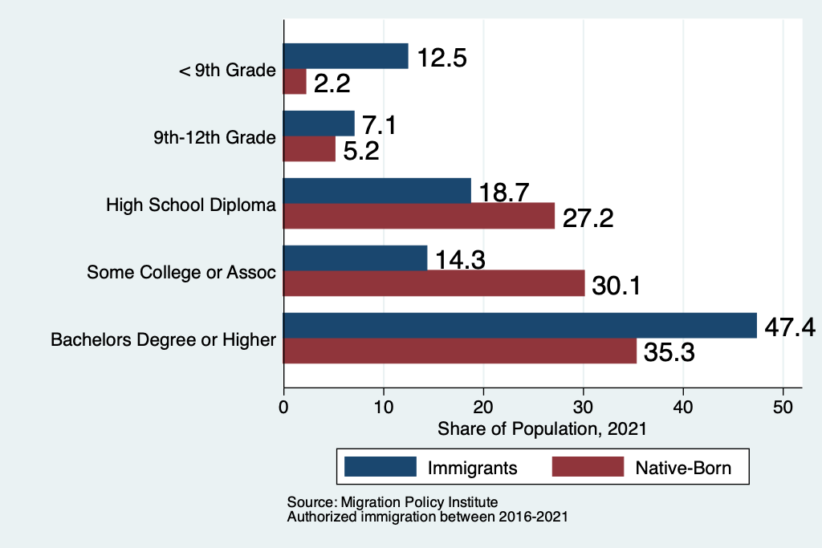
Recent Immigrants Are Less and More Educated

Slide 34
Labor Market Implications
Provides net benefits to the receiving economy
  Larger labor supply.
  Changes in labor prices increase production of goods and services that use the type of labor offered by immigrants.
Short run: there are winners and losers
  Changes in wage structure and returns to capital affect native-born workers differently.
Long run: could be no winners, but also no losers
  The economy might adjust to pre-immigration wage structure and returns to capital. No change for native-born individuals.

Slide 35
Pathway of Wage and Employment Effects
}
Inflows of Low-Skilled Immigrants
Order of Impact
Impact is negative,
But is smaller
at each step.
Previous Immigrants
Disadvantaged Minorities
Native-born HS Dropouts
Positive influence on wages and employment of other workers.

Slide 36
Skilled Immigrants and Innovation
1% increase in the share of the immigrant college graduate population
  9-18% increase in patenting per capita
  Increased immigration increases patenting by native-born population
  Nonetheless, the effect is positive
In the 1990s
  Increased skilled immigration can account for one-third of increased patenting in that decade.
  This translates into a 1.4-2.5% increase in GDP per capita by the end of the decade.
Source: Hunt and Gauthier-Loiselle (2008).

Slide 37
Immigrants and Entrepreneurship
Self-Employment Rates by Nativity
Source: Magnus Lofstrom from Current Population Survey Data.

Slide 38
Fortune 500: First- and Second-Generation Founders

Slide 39
Government Revenues and Expenditures

Slide 40
Why Is This Important?
Important for understanding whether immigrants will be net contributors to the economy.
Two additional reasons:
  Taxpayer inequity geographically
  Necessary to understand the full consequences of admitting additional immigrants into the country

Slide 41
Topics?
Basic Question:
  Taxes (income, sales, and other) immigrants pay vs. government expenditures on public benefits and services they receive.
More complicated:
  Immigrants also affect the fiscal equation for many native-born residents.
    Indirectly through labor and capital markets.
    Changes in wages and the return to capital.

Slide 42
Age-Specific Taxes and Benefits
By Immigrant Generation, United States, 2012
Source: Blau & Mackie (2017), p. 325.

Slide 43
What Do We Know?
Immigrants who arrive while of working age:
  Are, on average, net contributors.
  21-year-old with a high school diploma: +$126,000 over a lifetime
    Though this value gradually declines with age at arrival.
    Turns negative for arrivals of age 35+
Net contribution crucially depends on characteristics
  Age distribution, family composition, health status, fertility patterns
  Temporary or permanent relocation
  Employment in the legal labor market
  Authorized or unauthorized

Slide 44
Bottom Line/Consensus of Estimates
Federal level: fiscal impact is generally positive.
State and local level: typically negative fiscal impact.

Slide 45
Implications for Major Federal Programs
Documented immigrants are less likely to use Social Security and Medicare.
Unauthorized immigrants are ineligible.
  They will pay into the system but cannot receive benefits.
Medicaid: not available to legal residents for the first five years.
Provide a source of revenue for an aging population.

Slide 46
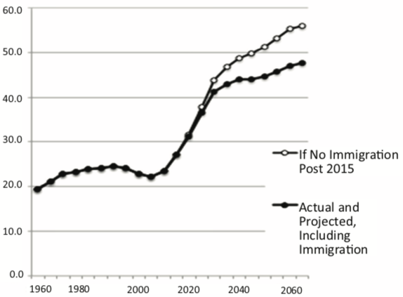
Implications for Social Security
Population Age 65+ per 100 of Working Age (25-64)
Source: Blau & Mackie (2017).

Slide 47
Is Immigration Saving the Day?
Source: CBO – The Demographic Outlook, 2023-2053

Slide 48
Non - Economic Implications
Patterns of Integration
Education
Employment and Earnings
Occupations
Poverty
Residential Integration
Language
Health
Family Patterns
The Big Misconception: Crime
Source: The Integration of Immigrants into American Society (2015).

Slide 49
Immigrants and Crime Rates
Conventional wisdom:
  Immigrants commit crimes more frequently than do native-born residents.
  Rising immigration leads to rising crime.
What do the data say?
  Rates of incarceration are lower for foreign-born than U.S.-born.
  Neighborhoods with more immigrants have lower crime rates.
Let’s Have a Look!

Slide 50
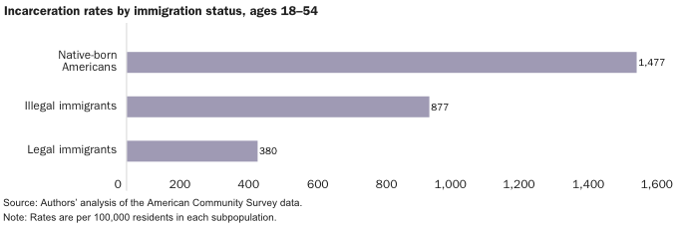
Incarceration by Immigration Status, 2018
Source: Cato Institute, Illegal Immigrant Incarceration Rates, 2010–2018: Demographics and Policy Implications, April 2020.

Slide 51
Crime: Incarceration Rates in California
California Institutionalization Rate
U.S.-Born and Foreign-Born Men Ages 18-40, by Place of Birth
Source: Butcher & Piehl (2008).

Slide 52
MSAs: Growing Immigration and Crime
No Relationship
Source: Butcher & Piehl (1998b).

Slide 53
Immigrants and Crime Rates
Conventional wisdom:
  Immigrants commit crimes more frequently than do native-born residents.
  Rising immigration leads to rising crime.
What do the data say?
  Rates of incarceration are lower for the foreign born than US born.
  Neighborhoods with more immigrants have lower crime rates.
  There is no evidence that deporting noncitizen immigrants affects crime rates.

Slide 54
Summary
Immigration can be thought of as increasing the population of the United States.
This brings economic growth and opportunity, just as does increasing the native-born population.
Including unauthorized immigrants, the supply of low-skilled workers is increased
  This lowers the wages of low-skilled workers.
  But also increases labor force participation among highly skilled workers.

Slide 55
At the Same Time….
Immigrants are often a select group:
  Willing to incur an enormous personal or familial cost to better their lives.
As a result:
  Immigrants tend to be entrepreneurial and to add significantly to economic growth.
Although there are distributional issues:
  Immigration is an important contributor to economic growth.
  Immigration helps to sustain vital government programs.

Slide 56
About Conventional Wisdom
Native-born unskilled workers
  There is some negative impact on their wages.
  But who wins and loses depend on the skill mix of immigrants;
    when this skill mix changes, so do its effects.
Crime
  Immigrants, both authorized and unauthorized, commit crimes at much lower rates than do native-born residents.
Government programs
  Federal: immigrants are a source of revenue and stability for some important programs.
  State and local: because education is funded at the local level, this can be a drain on local government coffers.

Slide 57
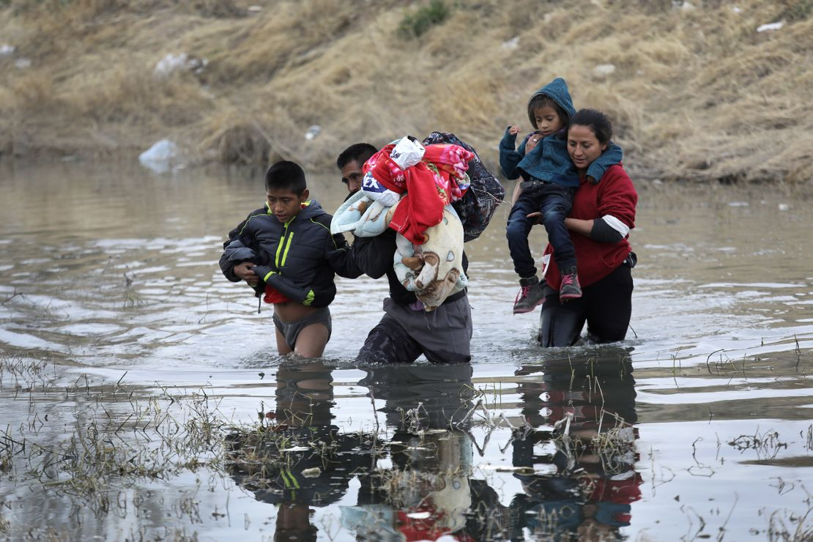
Recent Immigration Issues
DACA
The Northern Triangle
Unaccompanied Minors
Covid and Title 42
The Venezuelan Wave

Slide 58
DACA (Deferred Action for Childhood Arrivals)
Entered U.S. before age 16, now in U.S.
Entered before June 2007
Currently in school, high school grad or honorable discharge from military
No felony conviction or threat to security
Renewable every 2 years
Executive Order by Obama, Trump ended, Biden restored

Slide 59
DACA Statistics
825,000 of them. Arrived prior to June 15, 2007
  343,000 employed in essential jobs. (According to DHS: health/education)
  168,000 in California
1/3 arrived before the age of 5.
Average is now 26 years old.
1.3 million live with a DACA individual
  300,000 dependent children.
Tax revenues:
  $6.2 billion federal, $3.3 billion state

Slide 60
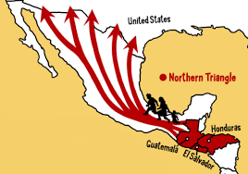
The Northern Triangle

Slide 61
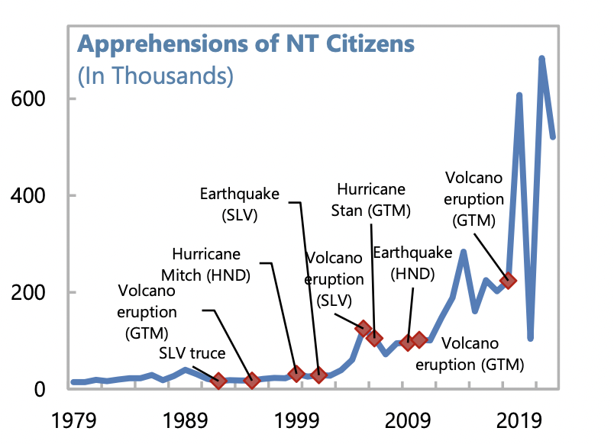
U.S. Border Apprehensions from the Northern Triangle

Slide 62
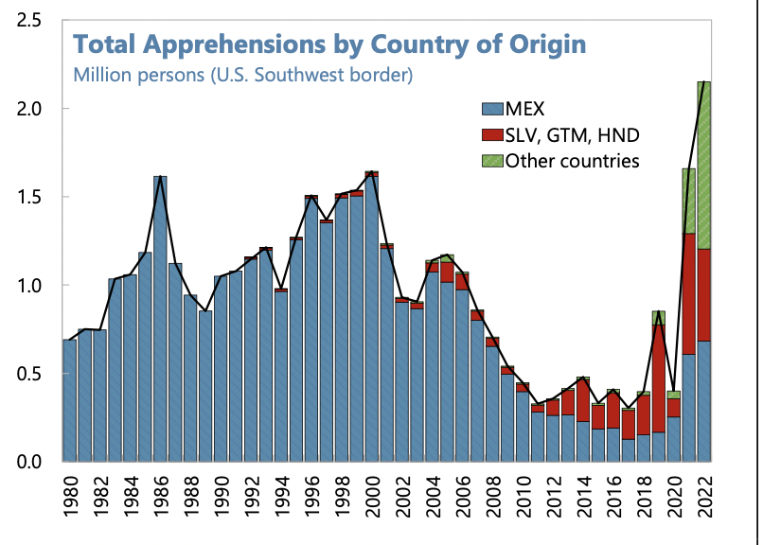
Northern Triangle Apprehensions
(Northern Triangle Countries in Red)

Slide 63
Asylees and Refugees
Refugees are usually outside the United States when they are screened for resettlement in U.S.
Asylum seekers submit their applications while physically present in the United States or at a U.S. port of entry
Reason to grant – (US & UNCOR) unable to return because of persecution or a well-founded fear of persecution based on: race, religion, nationality, membership in a particular social group, or political opinion. (Not economic hardship!)

Slide 64
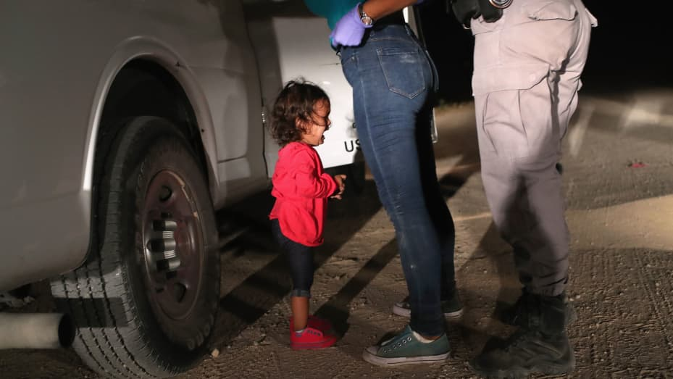
Separation of Children

Slide 65
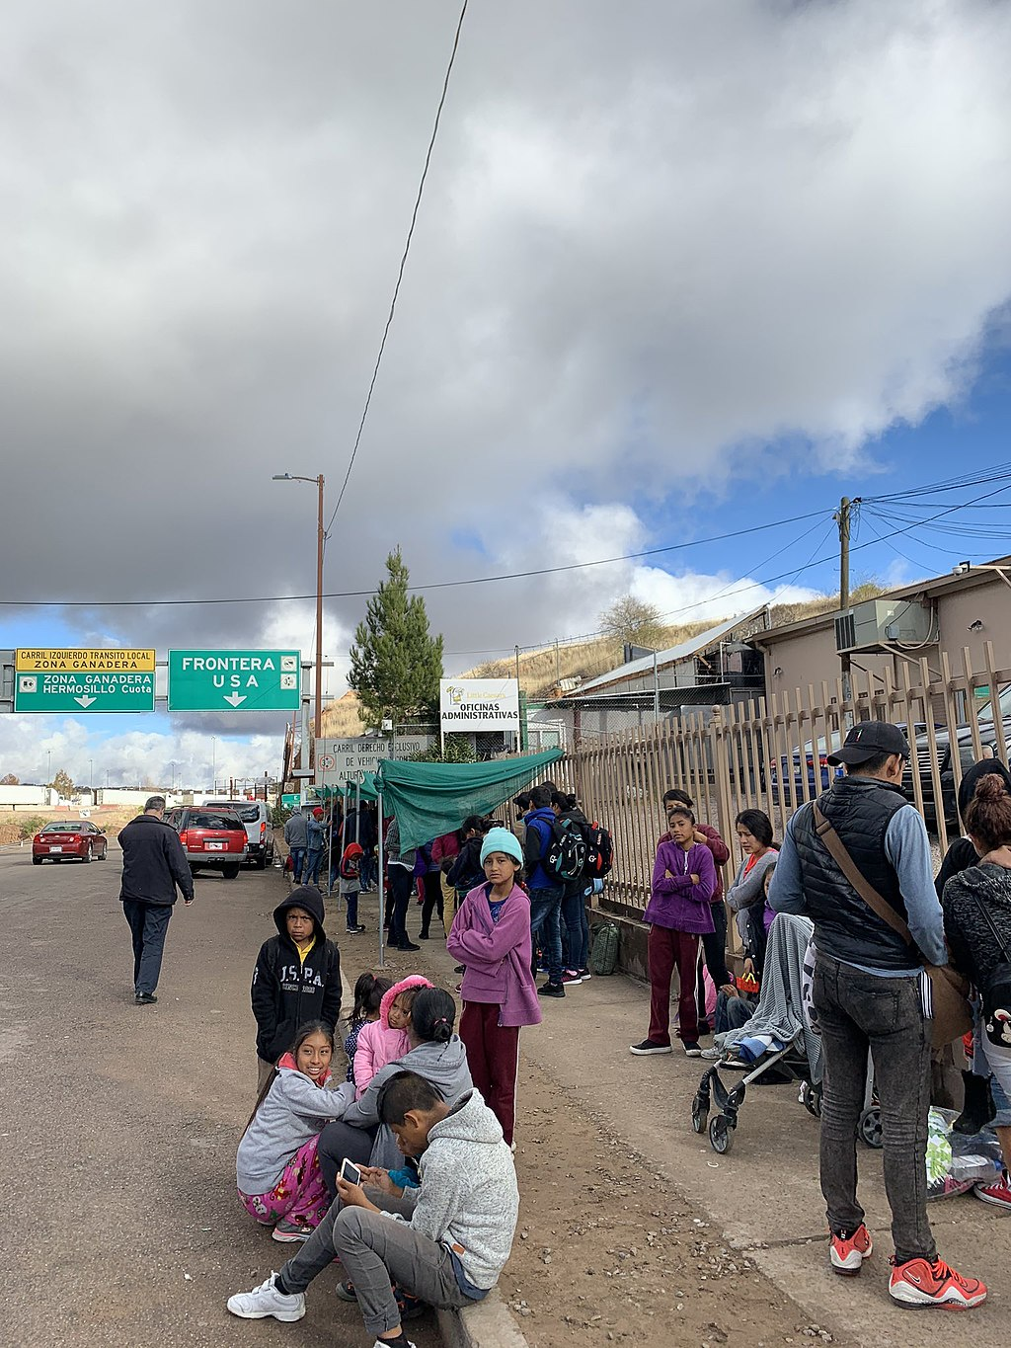
Remain in Mexico Policy
Applies to non-Mexicans asking for asylum
Must wait in Mexico while case being heard
Not applied to unaccompanied minors
Not eligible for asylum if passed through another nation on way.
Dangerous in Mexico
In the courts now

Slide 66
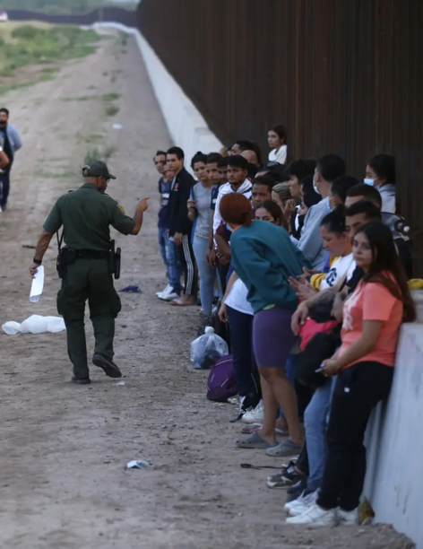
Covid and Title 42
Started in March 2020.
Used to limit Covid
Migrants who crossed into United States not allowed to ask for asylum
Returned to Mexico, not allowed a hearing
Ended May 2023

Slide 67
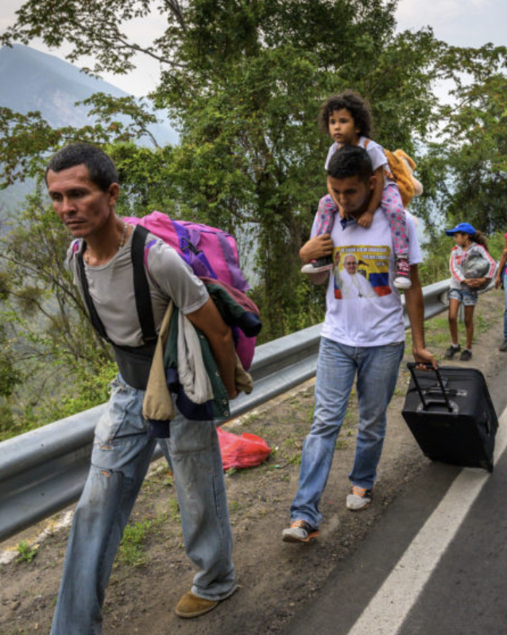
The Surge of Venezuelans
Almost 8 million Venezuelans have left
Caused by economic mismanagement, hyperinflation, unrest, violence
Largest national group arrested for entering U.S.
Temporary Protected Status
  Venezuela, Nicaragua, Haiti, and Cuba
Increasingly stuck in Mexico

Slide 68
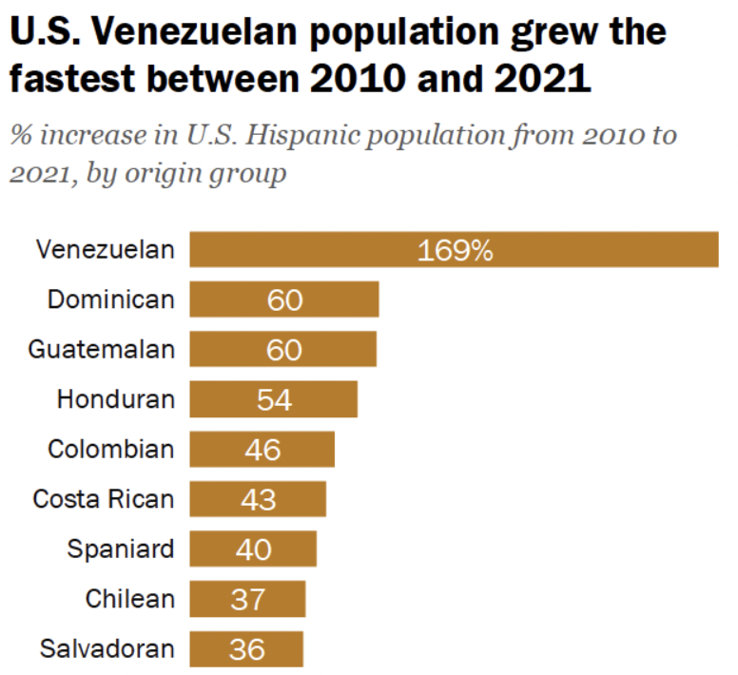
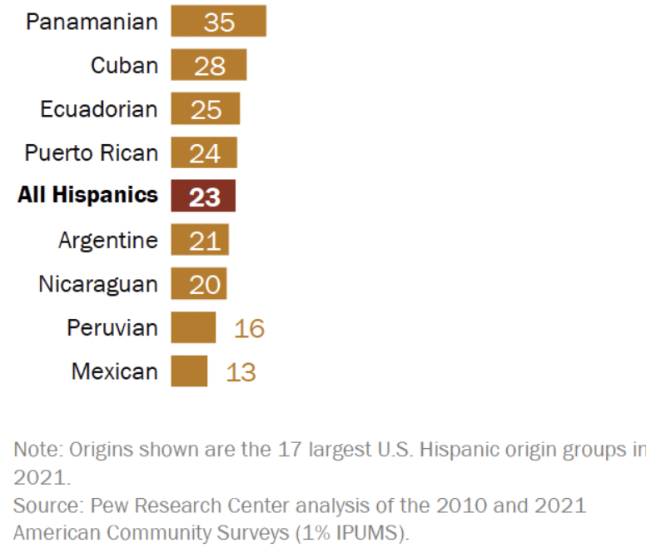
The Venezuelans are Coming….

Slide 69
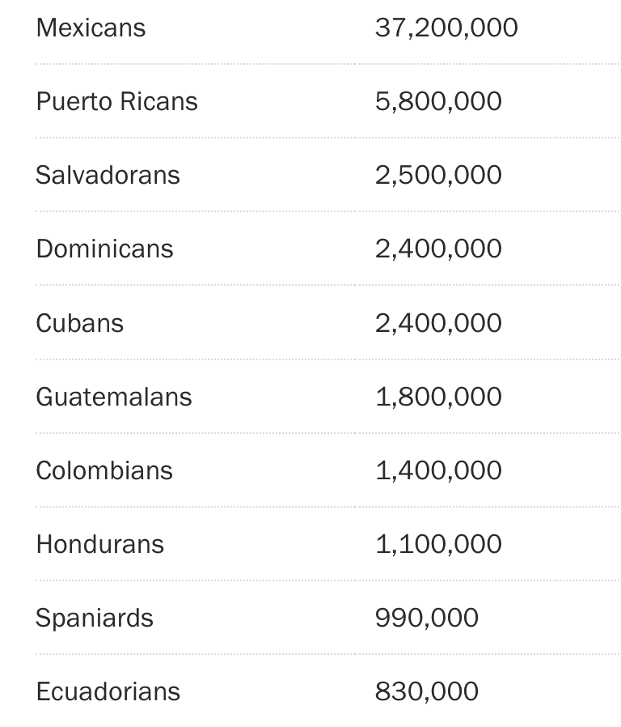
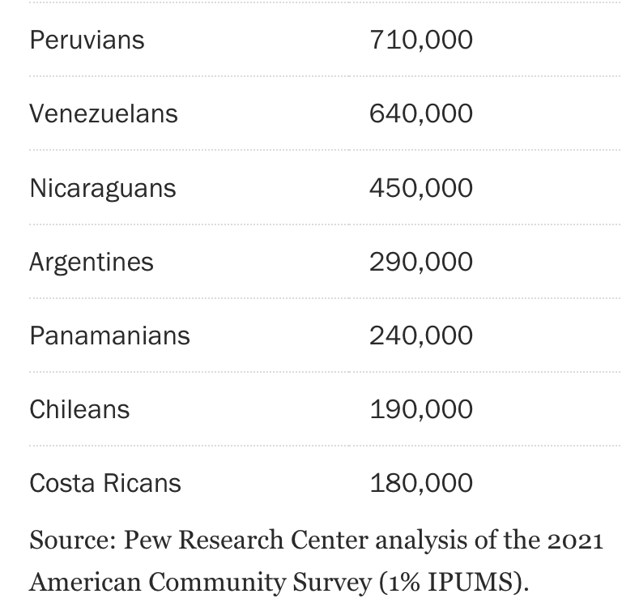
But Still a Small Overall Share (#s in U.S.)
But This
Is 2021

Slide 70
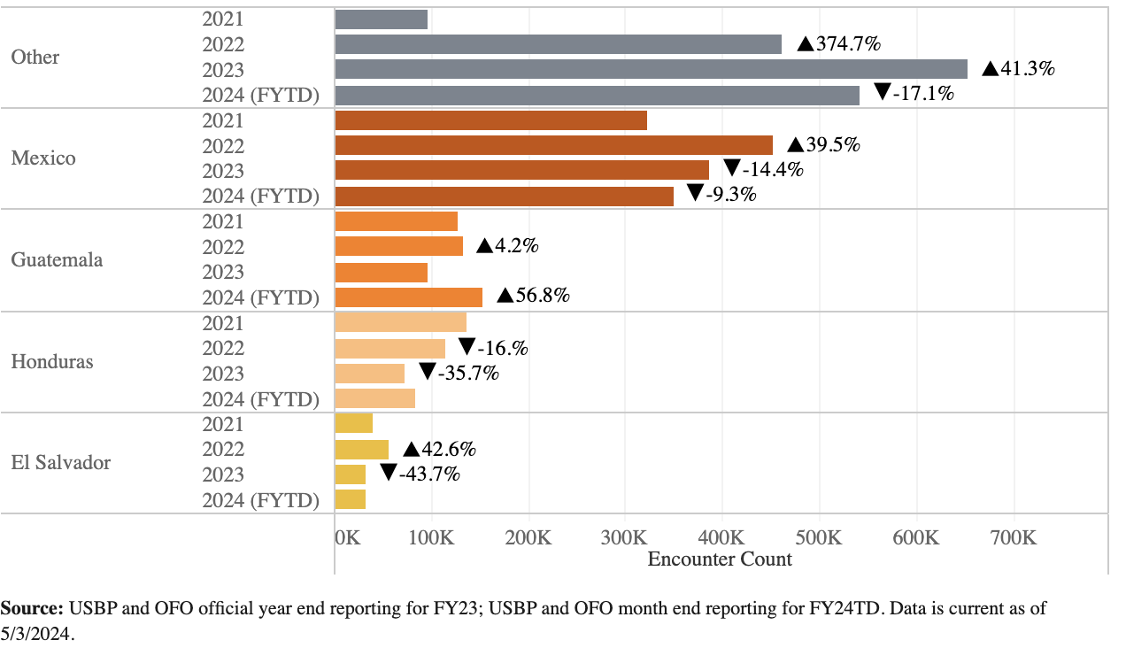
Surge of Southern Border Apprehensions

Slide 71
Thank you!
Any Questions?
www.NEEDEcon.org
Jon D. Haveman, Ph.D.
Jon@NEEDEcon.org
Contact NEED: info@needecon.org
Submit a testimonial: www.NEEDEcon.org/testimonials.php
Become a Friend of NEED: www.NEEDEcon.org/friend.php

Slide 72
Total and Average Annual Immigrant Arrivals, 1820-2015
Sources: US Statistical Abstract (various years), US INS (various years), and US DHS (various years)

Slide 73
Immigration and Inequality
  Source: Ping Xu, James C. Garand, and Ling Zhu, “How immigration makes income inequality worse in the U.S.” (October 2015), Figure 1.

Slide 74
Immigration and Inequality: Summary
Beginning in about 1970, the immigrant share of the US
population increased dramatically.
  5% in 1970 and 14% in 2016
Compared to the native born, immigrants:
  Comprise a larger share of less-educated workers (less than HS diploma)
  Comprise a larger share of highly educated workers (advanced degree)
Immigration has likely increased income inequality.
Its effect has likely been small.
  ~5% between 1980 and 2000
  No reason to think it has been bigger since then

Slide 75
Implications for Major Federal Programs
Documented immigrants are less likely to use Social Security and Medicare.
Unauthorized immigrants are ineligible.
  They will pay into the system but cannot receive benefits.
Medicaid: not available to legal residents for the first five years.
Provide a source of revenue for an aging population.

Slide 76
The Aging US Population
Source: Blau & Mackie (2017), p. 63.

Slide 77

Immigrant Inflow Shares,1820-2015
Sources: US Statistical Abstract (various years), US INS (various years), and US DHS (various years)

