Slide 1
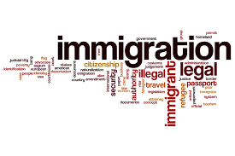
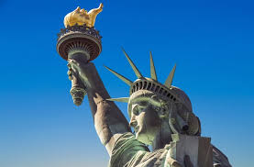
The Economics of Immigration
Marin Academy
March 12, 2026
Jon Haveman, Ph.D.
National Economic Education Delegation

Slide 2
Outline
Quiz
Why do people migrate?
The nature of immigration to the U.S.
Economics of immigration

Slide 3
Immigration Quiz
What % of the U.S. population are not native-born?
14%
What % of the world’s population are not native-born?
3.6%
How long has the average undocumented immigrant lived in the United States?
A. 3 months
B. 2 years
C. 10 years
D. 25 years
21% of children born to native parents are high-income earners (above the middle class).
What % of kids born to immigrants are high-income earners?
A. 15%
B. 21%
C. 28%
D. 35%
In 2021, 8% of Americans lived in poverty. What percent of immigrants lived in poverty?
13%
Source: Freakonomics – How Much Do You Know About Immigration?

Slide 4
Immigration Quiz
Immigrants are responsible for what % of patents in the United States?
36%
23% of inventors on record
13% from increase in native born patenting
What % of green cards go to family rather than employment-based immigration?
66% go to family-based
What % of the U.S. workforce are immigrants?
19%
Native-born Americans receive $8k on average in benefits. What is it for immigrants?
$6,000
100 years ago, most immigrants were from Europe. Today, Latin America and Asia. Is the rate of assimilation:
Faster? Slower? About the same?
Source: Freakonomics – How Much Do You Know About Immigration?

Slide 5
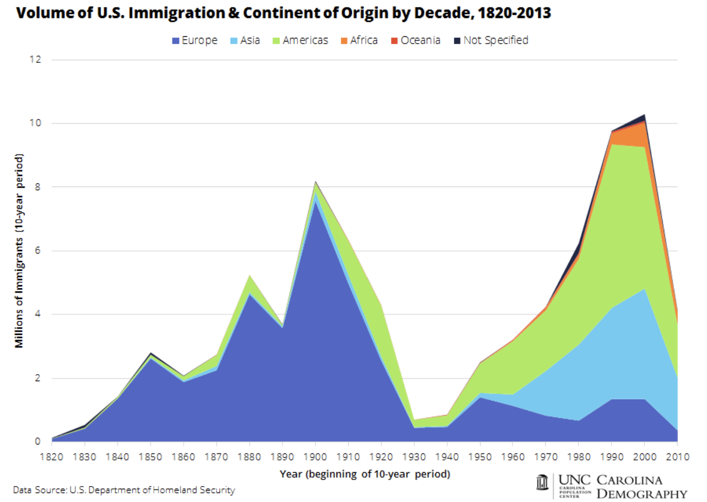
Americas
Great Depression
Asia
Europe

Slide 6
Why Do People Migrate?
Push factors:
Disparities in income/standards of living, and the availability of jobs, violence/war, climate change, natural disasters, population pressures, economic dislocation, religious persecution, and denial of political rights.
Pull factors:
Potential for economic prosperity (higher wages, job opportunities), physical security, political freedom, and religious liberty.
Family reunification
Source: Gilder Lehrman Institute of American History.

Slide 7
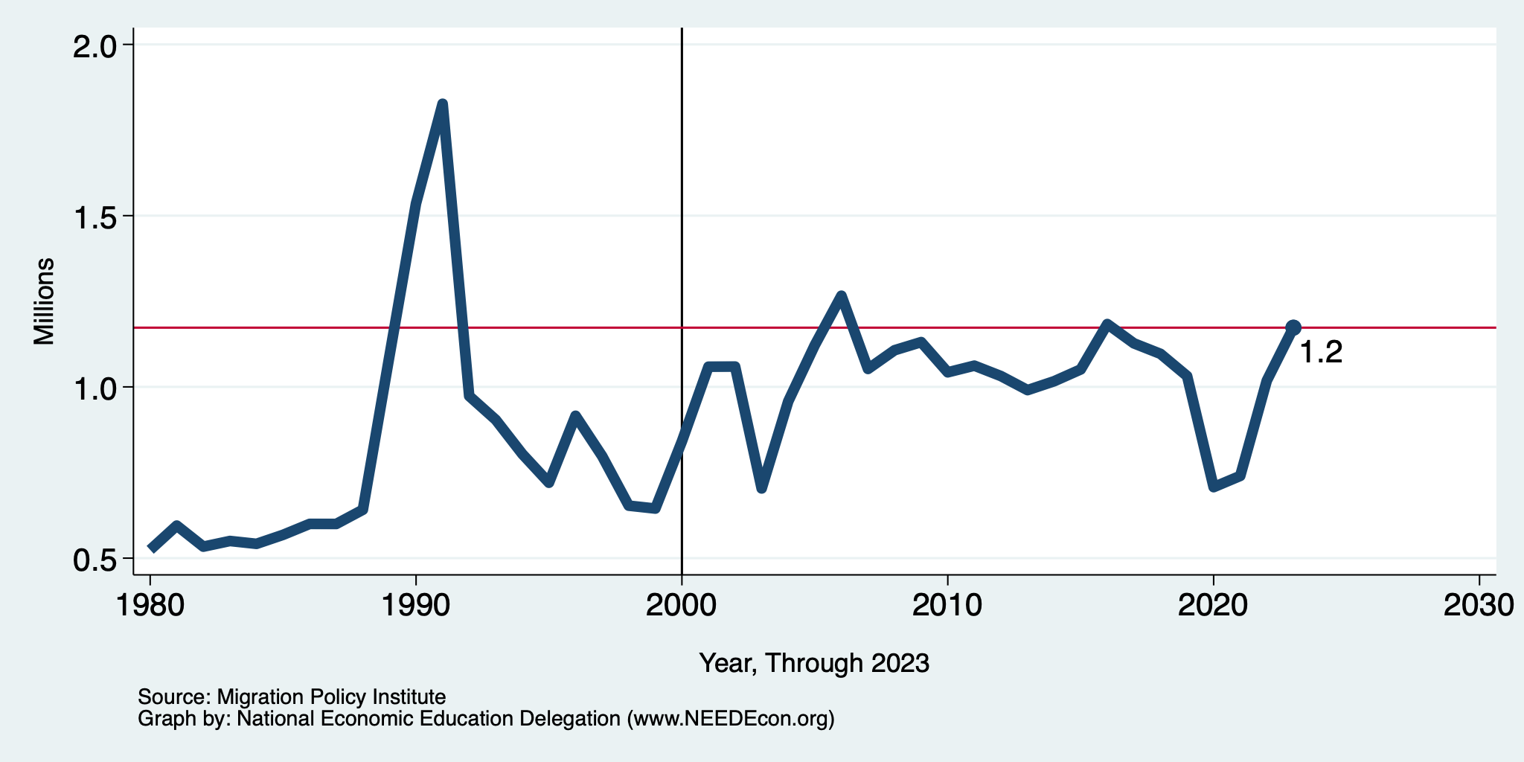
Recent Trends in Authorized Immigration
2023
1.2 Million

Slide 8
History of US Immigration: 2011-2020
Sources (top 10) | 2011-2020
Mexico | 1,491,000
China | 721,000
India | 637,000
Philippines | 505,000
Dominican Rep. | 487,000
Cuba | 473,000
Vietnam | 334,000
El Salvador | 215,000
South Korea | 199,000
Jamaica | 198,000
Total immigrant inflow, 2011-2020 = 10,125,000
US population growth, 2011-2020 = 22,700,000
Immigration was 45% of population growth.
Sources: US DHS (2011-2020 immigrant inflows), US Census (population values)

Slide 9
Distribution of Income: A Big Pull
Mexico
United States
Number of People
Income

Slide 10
UNauthorized Immigration

Slide 11
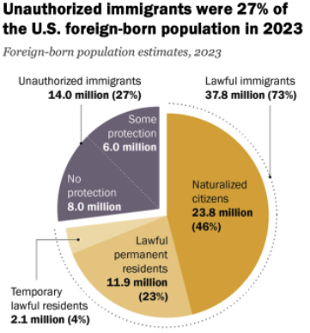
Total Foreign-Born (2023)
Population: 51.8 million
Total Foreign-Born (Feb/26)
Population: 49.3 million
(This seems too low.)
Source: Pew Research Center, U.S. Unauthorized Immigrant Population Reached a Record 14 Million in 2023, August 21, 2025

Slide 12
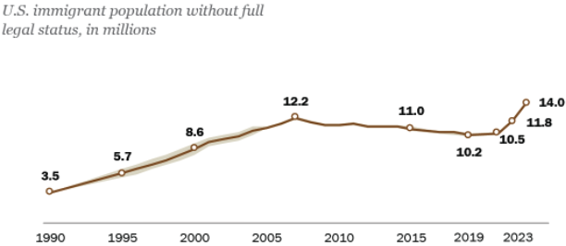
U.S. Unauthorized Immigration Totals, to 2023
Source: Pew Research Center, What we know about unauthorized immigrants living in the U.S., July 22, 2024

Slide 13
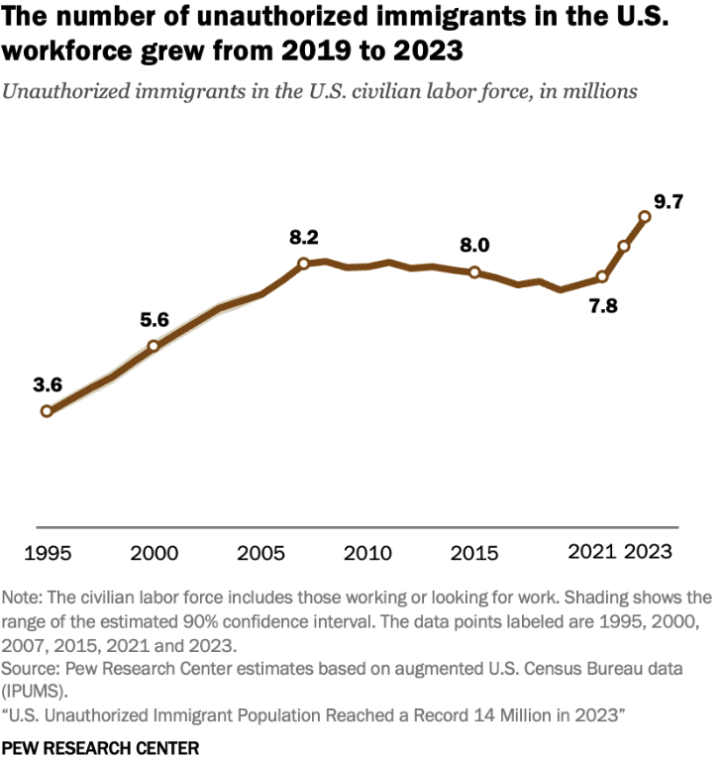
U.S. Unauthorized Immigration: Labor Force
5% of labor force
3% of population
Source: Pew Research Center, What we know about unauthorized immigrants living in the U.S., July 22, 2024

Slide 14
Economics

Slide 15
Why Do We Care? Economic Implications
Conventional Wisdom Issues:
Labor markets: Wages and Jobs
Government Revenue and Spending
Crime

Slide 16
Jobs: Conventional Wisdom…Upended
What is the conventional wisdom?
Low-skilled immigrants come in and take jobs from low-skilled native-born individuals.
1-1 tradeoff.
What does new research show?
Low-skilled immigrants contribute positively to the economy.
Every 100 low-skilled immigrants: create 9 jobs for low-skilled native-born.
They create opportunities for low-skilled native-born workers.
They ALSO create opportunities for high-skilled workers.
Low-skilled immigrants take jobs that native-born individuals don’t want.

Slide 17
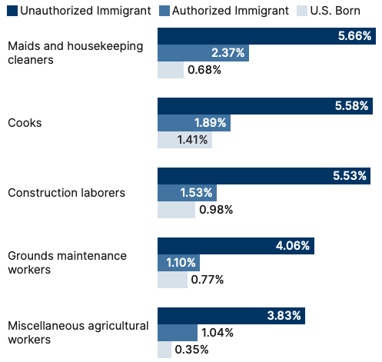
Share of Workers in Each Occupation

Slide 18
Pathway of Wage and Employment Effects
}
Inflows of Low-Skilled Immigrants
Order of Impact
Impact is negative,
But is smaller
at each step.
Previous Immigrants
Disadvantaged Minorities
Native-born HS Dropouts
Positive influence on wages and employment of other workers.

Slide 19
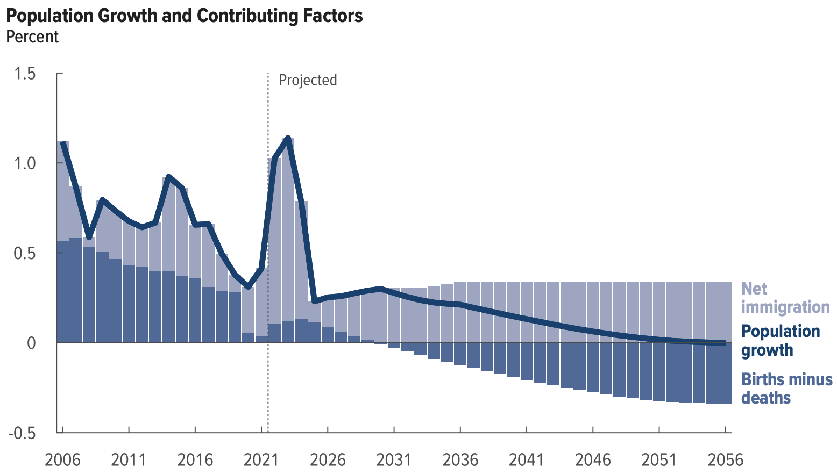
Is Immigration Saving the Day?
The majority of additions to the
Population in recent years
Have come from immigration.
Source: CBO – The Demographic Outlook, 2026-2056

Slide 20
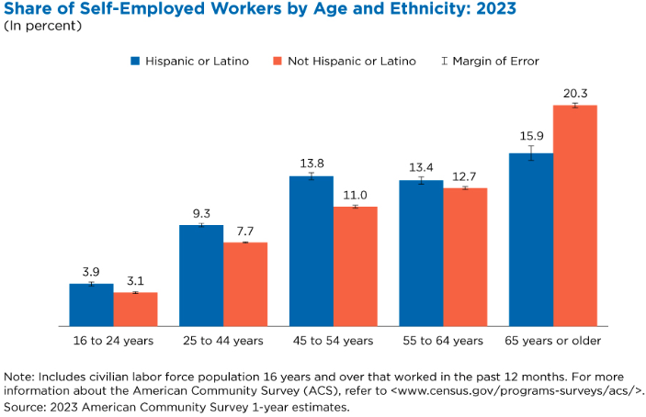
Immigrants and Entrepreneurship
Source: Magnus Lofstrom from Current Population Survey Data.

Slide 21
Fortune 500: First- and Second-Generation Founders

Slide 22
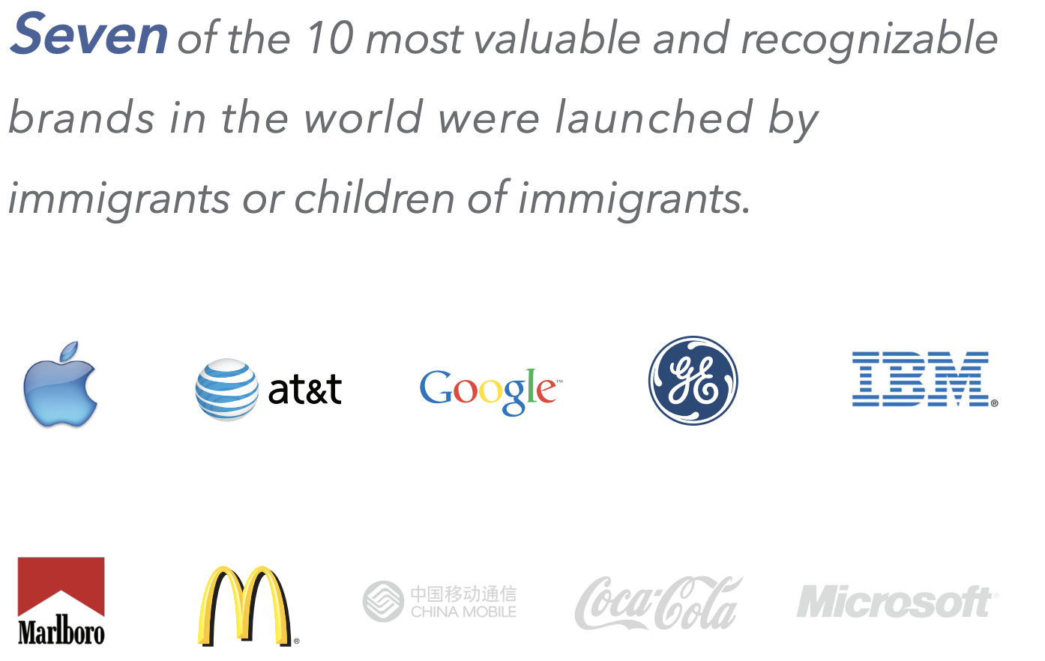

Slide 23
GDP: How Does This Work?
What determines the size of an economy?
Physical capital
Technology/productivity
The number of workers
Immigration adds to the number of workers.
Number of immigrants in the labor force is high
32.7 million foreign-born persons ages 16+ in the labor force in Feb/26.
19% of the total US workforce (14% of population).
Evidence
Immigrants added 11% to GDP ($2 trillion) in 2016.
Federal Reserve Bank of St. Louis (https://fred.stlouisfed.org/)
National Academies of Sciences, Engineering, and Medicine (2017) “The Economic and Fiscal Consequences of Immigration”.

Slide 24
Government Revenues and Expenditures

Slide 25
Questions?
Basic question:
Taxes (income, sales, and other) immigrants pay vs. government expenditures on public benefits and services they receive.
More complicated question:
Immigrants also affect the fiscal equation for many native-born residents.
Indirectly through labor and capital markets.
Changes in wages and the return to capital.

Slide 26
Age-Specific Taxes and Benefits
By Immigrant Generation, United States, 2012
21-year-old with a
high school diploma:
+$126,000 over a lifetime
Education
Source: Blau & Mackie (2017), p. 325.

Slide 27
Bottom Line/Consensus of Estimates
Federal level: fiscal impact is generally positive.
State and local level: typically negative fiscal impact.
Overall: $1,300 in more on average than out.

Slide 28
Implications for Major Federal Programs
DOCUMENTED immigrants are less likely to receive Social Security and Medicare benefits than are native-born individuals.
Unauthorized immigrants are ineligible.
They will pay into the system but cannot receive benefits.
Medicaid: not available to legal residents for the first five years.
Provide a source of revenue for an aging population.

Slide 29
Crime

Slide 30
Immigrants and Crime Rates
Conventional wisdom:
Immigrants commit crimes more frequently than do native-born residents.
Rising immigration leads to rising crime.
What do the data say?
Rates of incarceration are lower for foreign-born than U.S.-born.
Neighborhoods with more immigrants have lower crime rates.
Let’s Have a Look!

Slide 31
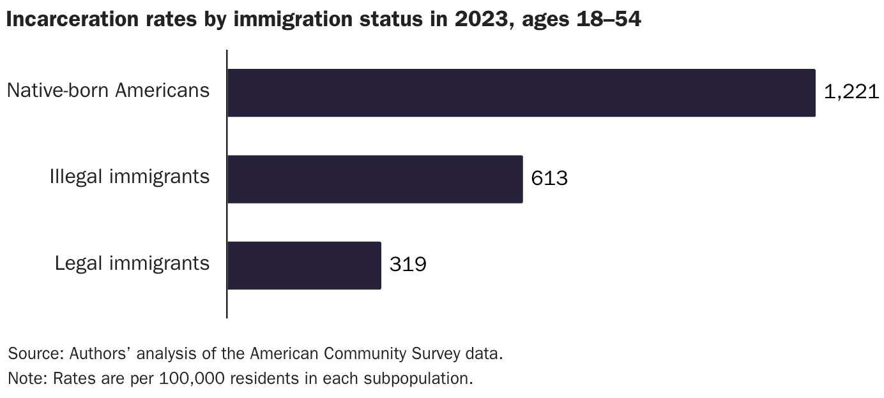
Incarceration by Immigration Status, 2023
Unauthorized immigrants
Authorized immigrants
Source: Cato Institute, Illegal Immigrant Incarceration Rates, 2010–2023

Slide 32
Immigrants and Crime Rates
Conventional wisdom:
Immigrants commit crimes more frequently than do native-born residents.
Rising immigration leads to rising crime.
What do the data say?
Rates of incarceration are lower for the foreign born than US born.
Neighborhoods with more immigrants have lower crime rates.
There is no evidence that deporting noncitizen immigrants affects crime rates.

Slide 33
About Conventional Wisdom
Native-born unskilled workers
Some may experience negative impact on their wages.
But opportunities are also created for many others.
Government programs
Federal: immigrants are a source of revenue and stability for some important programs.
State and local: because education is funded at the local level, this can be a drain on local government coffers.
Crime
Immigrants, both authorized and unauthorized, commit crimes at much lower rates than do native-born residents.

Slide 34
Summary
Immigration can be thought of as increasing the population of the United States.
But they are a select group.
This brings economic growth and opportunity, just as does increasing the native-born population.
But not crime.
Including unauthorized immigrants, the supply of low-skilled workers is increased.
This may lower the wages of some low-skilled workers.
But it creates opportunities for others.
Increases the availability and lowers prices of goods produced using low-skilled workers.
It also increases labor force participation among highly-skilled workers.

Slide 35
Mass Deportations
Immigrants work different jobs than do native-born workers.
Immigrants contribute to the local economy.
GDP losses of up to $1.7 trillion annually.
Immigrants keep prices low: in particular, food!
Deportations impact tax revenues.
$1,300 more in on average than out, annually.
Unauthorized immigrants: $22.6 billion in Social Security and $5.7 billion in Medicare payments.
Deportations are expensive ($13,000 each).
Total cost $315 billion.
They rob people of their dignity.

