Slide 1
Osher Lifelong Learning Institute, Summer 2026
Contemporary Economic Policy
University of Hawaii, Manoa
Host: Geoffrey Woglom, Director
National Economic Education Delegation

Slide 2
Course Schedule
Contemporary Economic Policy
  Week 1 (7/2): Saving Social Security, Geoffrey Woglom, Amherst College
  Week 2 (7/9): Trade & Globalization, Luisa R. Blanco, Pepperdine
  Week 3 (7/16): Crypto Currencies and the Future of Money, Geoffrey Woglom
  Week 4 (7/23): Economics of Immigration, Luisa R. Blanco, Pepperdine University
  Week 5 (7/30): Federal Debt and Deficits, Robert Rebelein, Vassar College
  Week 6 (8/6): Climate Change Economics, Gary Yohe, Wesleyan University

Slide 3
Submitting Questions
Submit questions in the chat. I will try to address questions after 10-15-minute intervals (at the different block stops noted in presentation). We will also do a verbal Q&A once the material has been presented.
Short break 5-10 min around 50 min mark
Slides will be available from the NEED website: https://needecon.org/delivered_presentations.php.

Slide 4
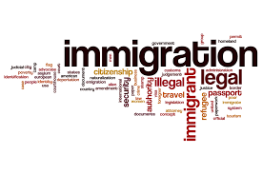
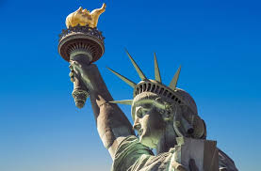
The Economics of Immigration
Luisa R. Blanco, Ph.D., MBA
Pepperdine University
School of Public Policy

Slide 5
Credits and Disclaimer
This slide deck was authored by:
  Anna Maria Mayda, Georgetown University
  Robert Gitter, Ohio Wesleyan University
  Roger White, Whittier College
This slide deck was reviewed by:
  Kirk Doran, Notre Dame
  Ethan Lewis, Dartmouth College
Disclaimer
  NEED presentations are designed to be nonpartisan.
  It is, however, inevitable that presenters will be asked for and will provide their own views.
  Such views are those of the presenter and not necessarily those of the National Economic Education Delegation (NEED).

Slide 6
Outline
Why do people migrate?
The nature of immigration to the U.S.
Economics of immigration
Recent immigration issues

Slide 7
Why do people migrate?
US immigration trends

Slide 8
Why Do People Migrate?
Push factors:
  Disparities in income/standards of living, and the availability of jobs, violence/war, climate change, natural disasters, population pressures, economic dislocation, religious persecution, and denial of political rights.
Pull factors:
  Potential for economic prosperity (higher wages, job opportunities), physical security, political freedom, and religious liberty.
Source: Gilder Lehrman Institute of American History.

Slide 9
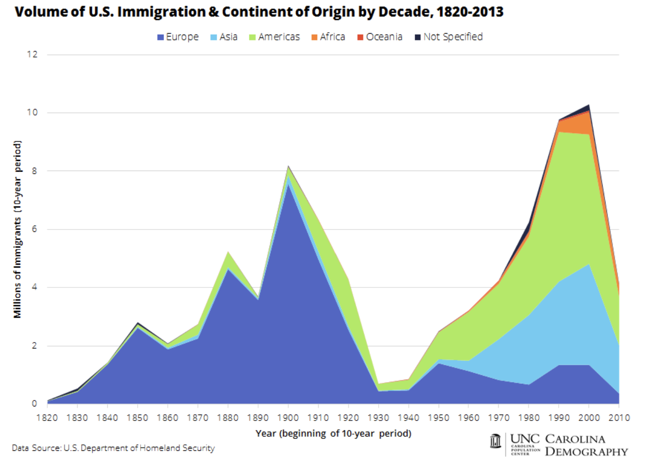
Source: https://carolinademography.cpc.unc.edu/2015/04/27/u-s-immigration-flows-1820-2013/

Slide 10
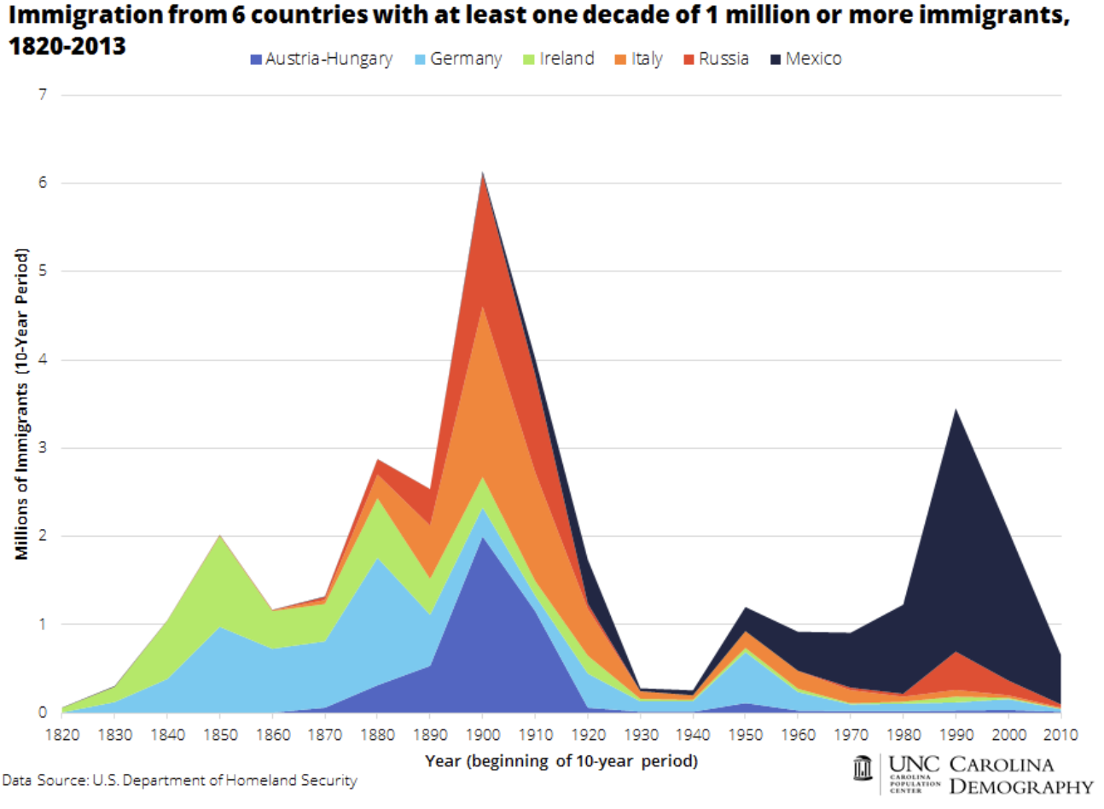
Source: https://carolinademography.cpc.unc.edu/2015/04/27/u-s-immigration-flows-1820-2013/

Slide 11
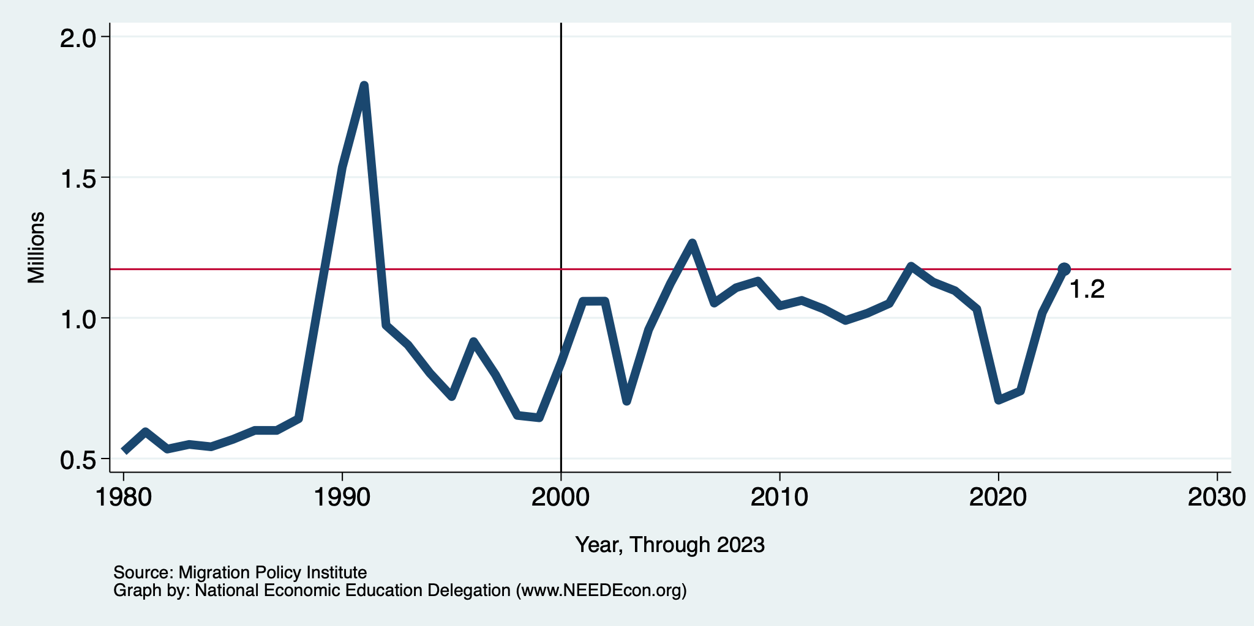
Recent Trends in Authorized Immigration
2023
1.2 Million

Slide 12
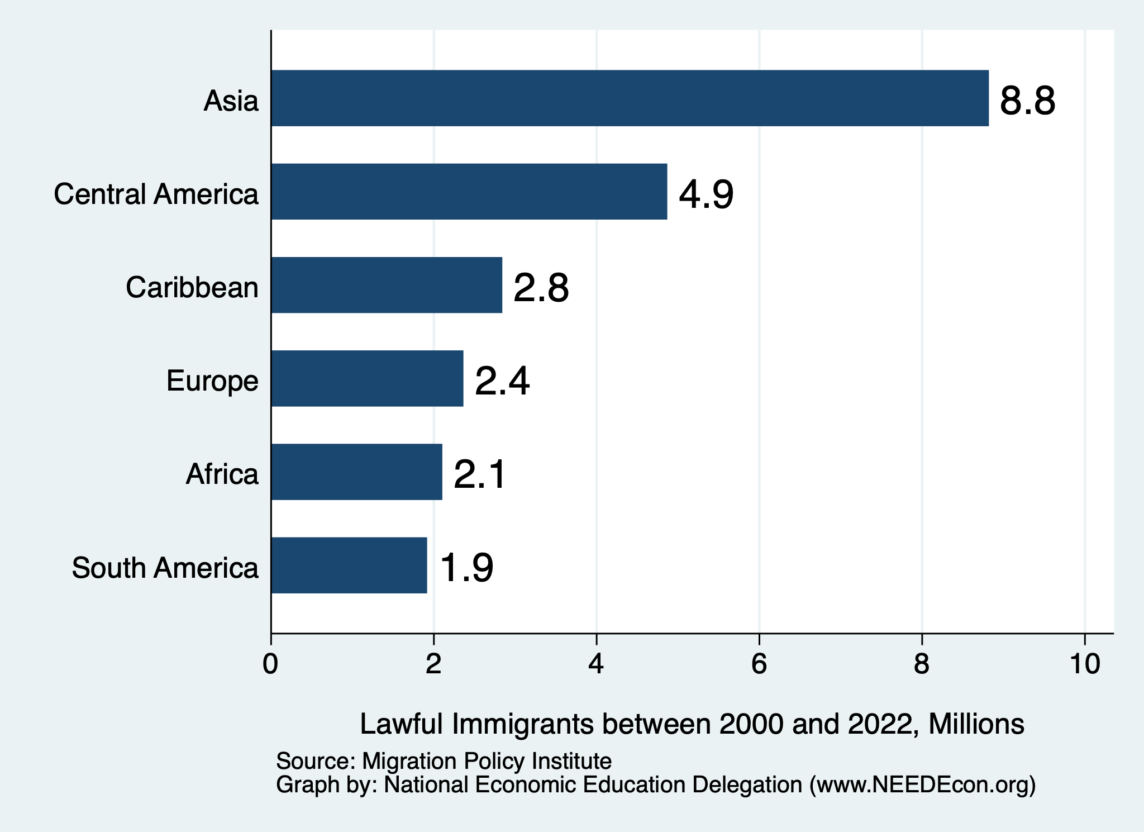
Authorized Immigration by Region (2000-2022)

Slide 13
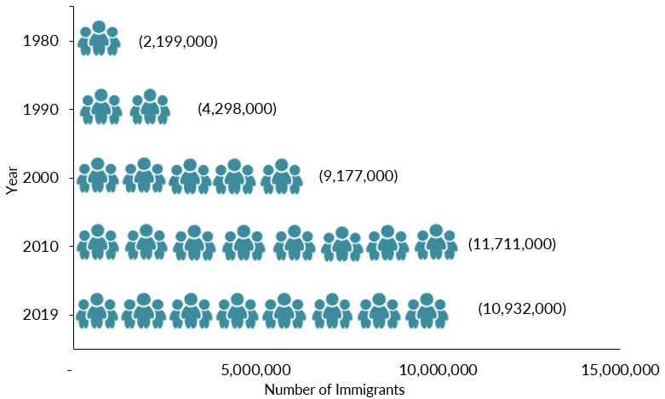
Mexican-Born People in the US
About 11 million in mid-2023 (Latest data)
1 in 14 people born in Mexico currently lives in the US

Slide 14
Distribution of Income
Mexico
United States
Number of People
Income

Slide 15
UNauthorized Immigration

Slide 16
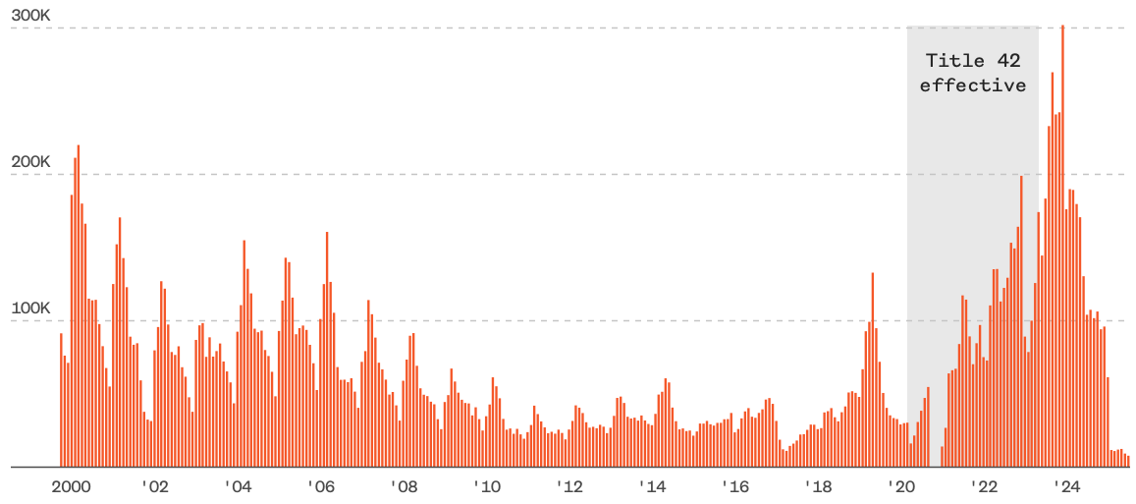
Encounters w/Migrants at the U.S.-Mexico Border
Dec. `23
249,741
Aug. `24
58,038
July `25
7,832
Source: https://www.nbcnews.com/data-graphics/us-immigration-tracker-follow-arrests-detentions-border-crossings-rcna189148

Slide 17
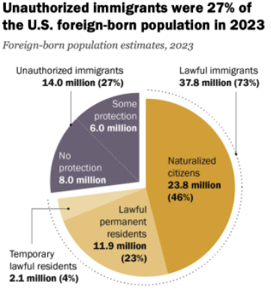
Total Foreign-Born (2023)
Population: 51.8 million
Total Foreign-Born (Aug/25)
Population: 48.5 million
(This seems too low.)
Source: Pew Research Center, U.S. Unauthorized Immigrant Population Reached a Record 14 Million in 2023, August 21, 2025

Slide 18
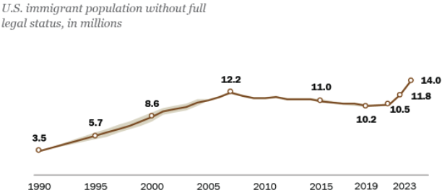
U.S. Unauthorized Immigration Totals, to 2023
Source: Pew Research Center, What we know about unauthorized immigrants living in the U.S., July 22, 2024

Slide 19
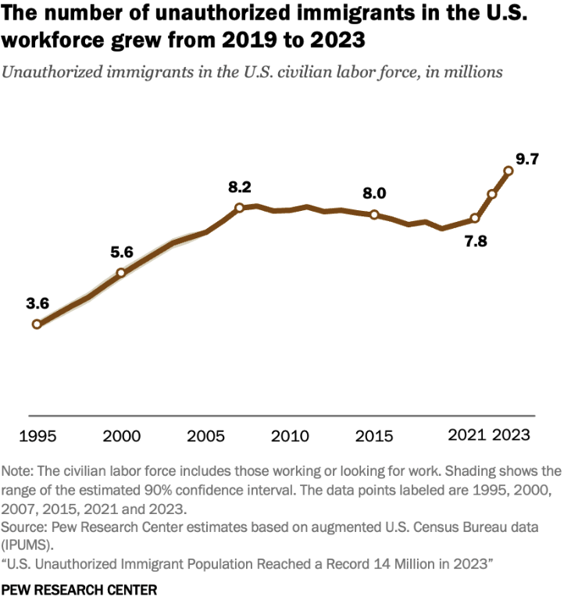
U.S. Unauthorized Immigration: Labor Force
5% of labor force
3% of population
Source: Pew Research Center, What we know about unauthorized immigrants living in the U.S., July 22, 2024

Slide 20
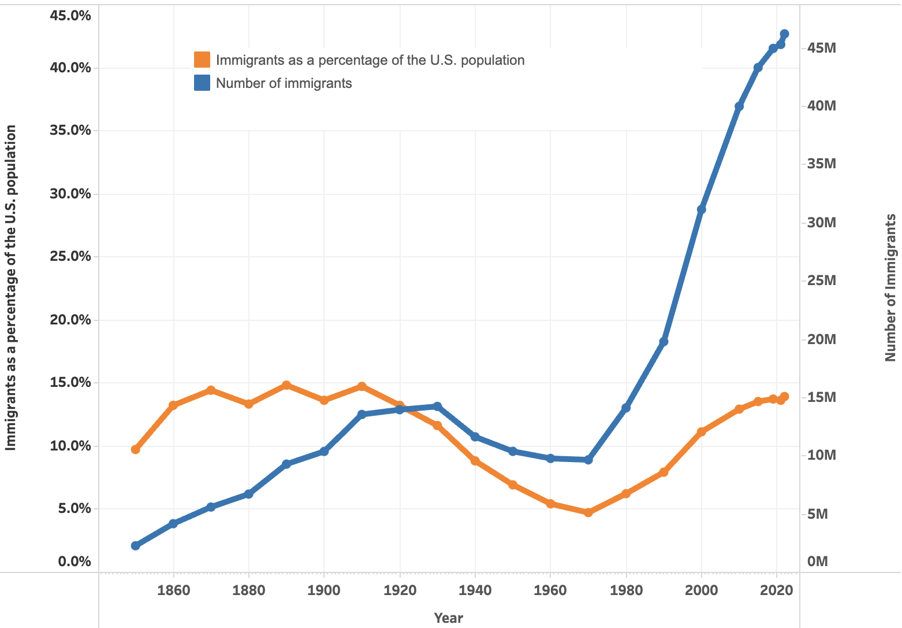

U.S. Immigrant Population and Share over Time
1850-2022
60 YEARS

Slide 21
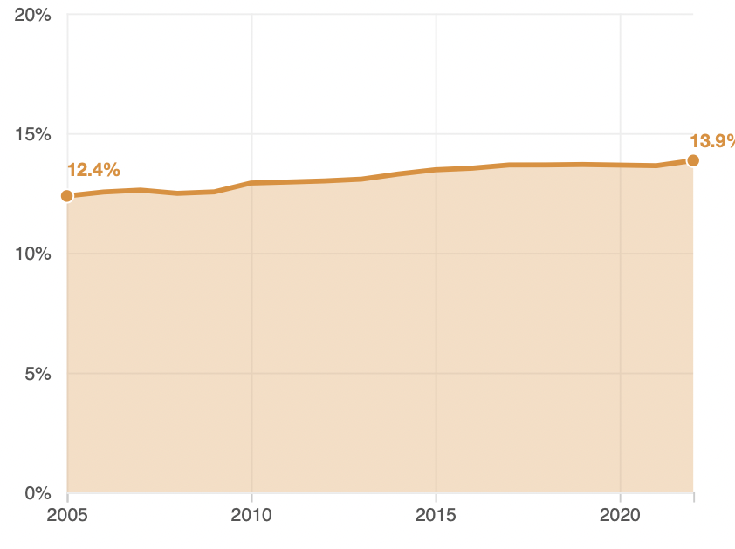
Immigrant Share of US Population
13.9 %
12.4 %

Slide 22
Economics of Immigration

Slide 23
Why Do We Care? Economic Implications
Conventional Wisdom Issues:
  Labor markets: Wages and Jobs
  Government Revenue and Spending
  Crime
Other issues (that don’t get talked about much):
  Gross Domestic Product (GDP)
  Innovation and Entrepreneurship

Slide 24
GDP: How Does This Work?
What determines the size of an economy?
  Physical capital
  Technology/productivity
  The number of workers
    Immigration adds to the number of workers.
Number of immigrants in the labor force is high
  32.2 million foreign-born persons ages 16+ in the labor force in Aug/25.
  18.8% of the total US workforce.
Evidence
  Immigrants added 11% to GDP ($2 trillion) in 2016.
Federal Reserve Bank of St. Louis (https://fred.stlouisfed.org/)
National Academies of Sciences, Engineering, and Medicine (2017) “The Economic and Fiscal Consequences of Immigration”.

Slide 25
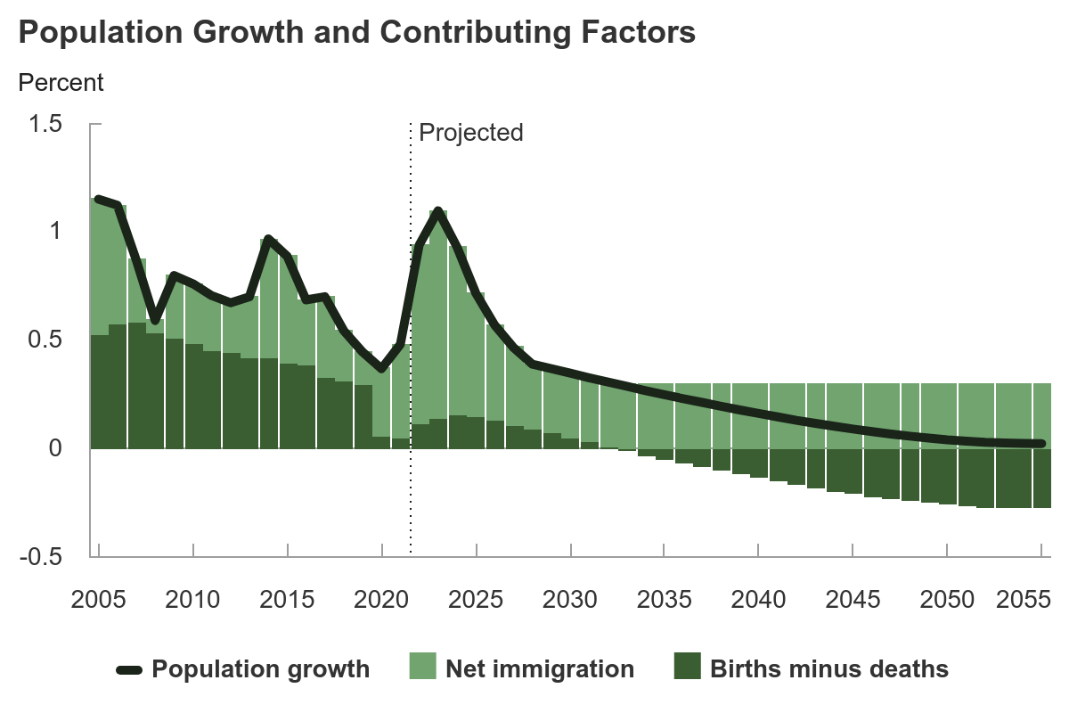
Is Immigration Saving the Day?
The vast majority of additions to the
Population in the last several years
Have been from immigration.
Source: https://carolinademography.cpc.unc.edu/2015/04/27/u-s-immigration-flows-1820-2013/
Source: CBO – The Demographic Outlook, 2025-2055

Slide 26
Jobs: Conventional Wisdom…Upended
What is the conventional wisdom?
  Low-skilled immigrants come in and take jobs from low-skilled native-born individuals.
    1-1 tradeoff.
What does new research show?
  Low-skilled immigrants contribute positively to the economy.
    Every 100 low-skilled immigrants: create 9 jobs for low-skilled native-born.
    They create opportunities for low-skilled native-born workers.
  Low-skilled immigrants take jobs that native-born don’t want.

Slide 27
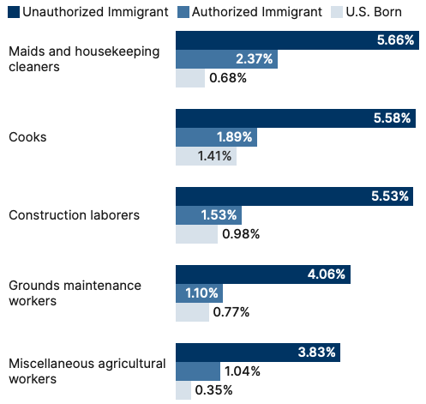
Share of Workers in Each Occupations

Slide 28
Pathway of Wage and Employment Effects
}
Inflows of Low-Skilled Immigrants
Order of Impact
Impact is negative,
But is smaller
at each step.
Previous Immigrants
Disadvantaged Minorities
Native-born HS Dropouts
Positive influence on wages and employment of other workers.

Slide 29
Skilled Immigrants and Innovation
1% increase in the share of the immigrant college graduate population
  9-18% increase in patenting per capita
  Increased immigration increases patenting by native-born population.
In the 1990s
  Increased skilled immigration can account for one-third of increased patenting in that decade.
  This translates into a 1.4-2.5% increase in GDP per capita by the end of the decade.
Source: Hunt and Gauthier-Loiselle (2008).

Slide 30
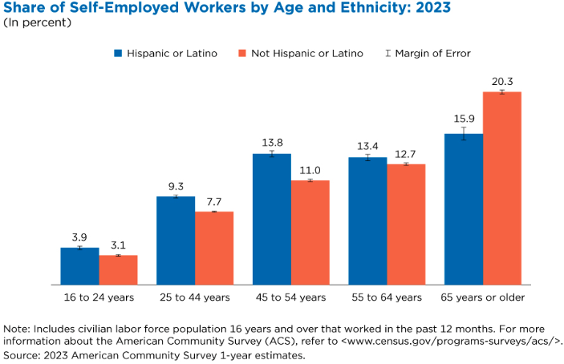
Immigrants and Entrepreneurship
Source: Magnus Lofstrom from Current Population Survey Data.

Slide 31
Fortune 500: First- and Second-Generation Founders

Slide 32
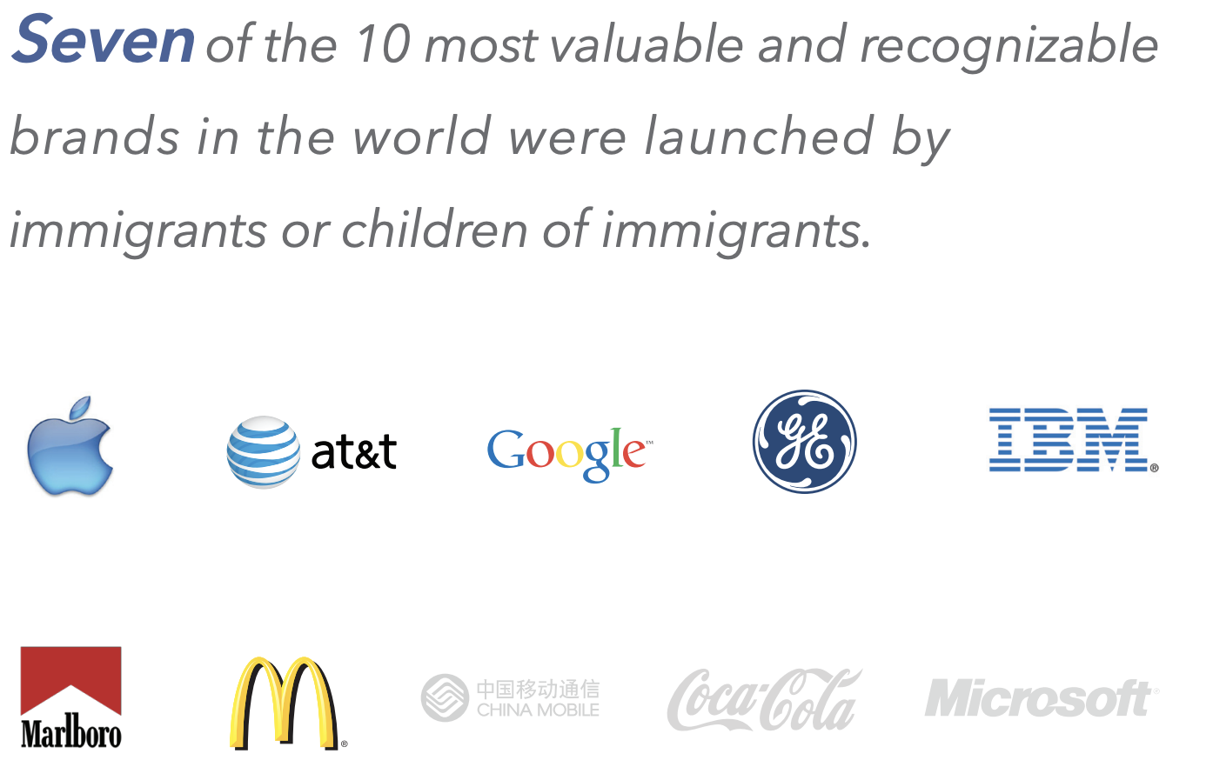

Slide 33
Government Revenues and Expenditures

Slide 34
Topics?
Basic Question:
  Taxes (income, sales, and other) immigrants pay vs. government expenditures on public benefits and services they receive.
More complicated:
  Immigrants also affect the fiscal equation for many native-born residents.
    Indirectly through labor and capital markets.
    Changes in wages and the return to capital.

Slide 35
Age-Specific Taxes and Benefits
By Immigrant Generation, United States, 2012
Source: Blau & Mackie (2017), p. 325.

Slide 36
What Do We Know?
Immigrants who arrive while of working age:
  Are, on average, net contributors.
  21-year-old with a high school diploma: +$126,000 over a lifetime
    Though this value gradually declines with age at arrival.
    Turns negative for arrivals of age 35+
Net contribution crucially depends on characteristics
  Age distribution, family composition, health status, fertility patterns
  Temporary or permanent relocation
  Employment in the legal labor market
  Authorized or unauthorized

Slide 37
Bottom Line/Consensus of Estimates
Federal level: fiscal impact is generally positive.
State and local level: typically negative fiscal impact.

Slide 38
Implications for Major Federal Programs
Documented immigrants are less likely to use Social Security and Medicare.
Unauthorized immigrants are ineligible.
  They will pay into the system but cannot receive benefits.
Medicaid: not available to legal residents for the first five years.
Provide a source of revenue for an aging population.

Slide 39
The Aging US Population
Source: Blau & Mackie (2017), p. 63.

Slide 40
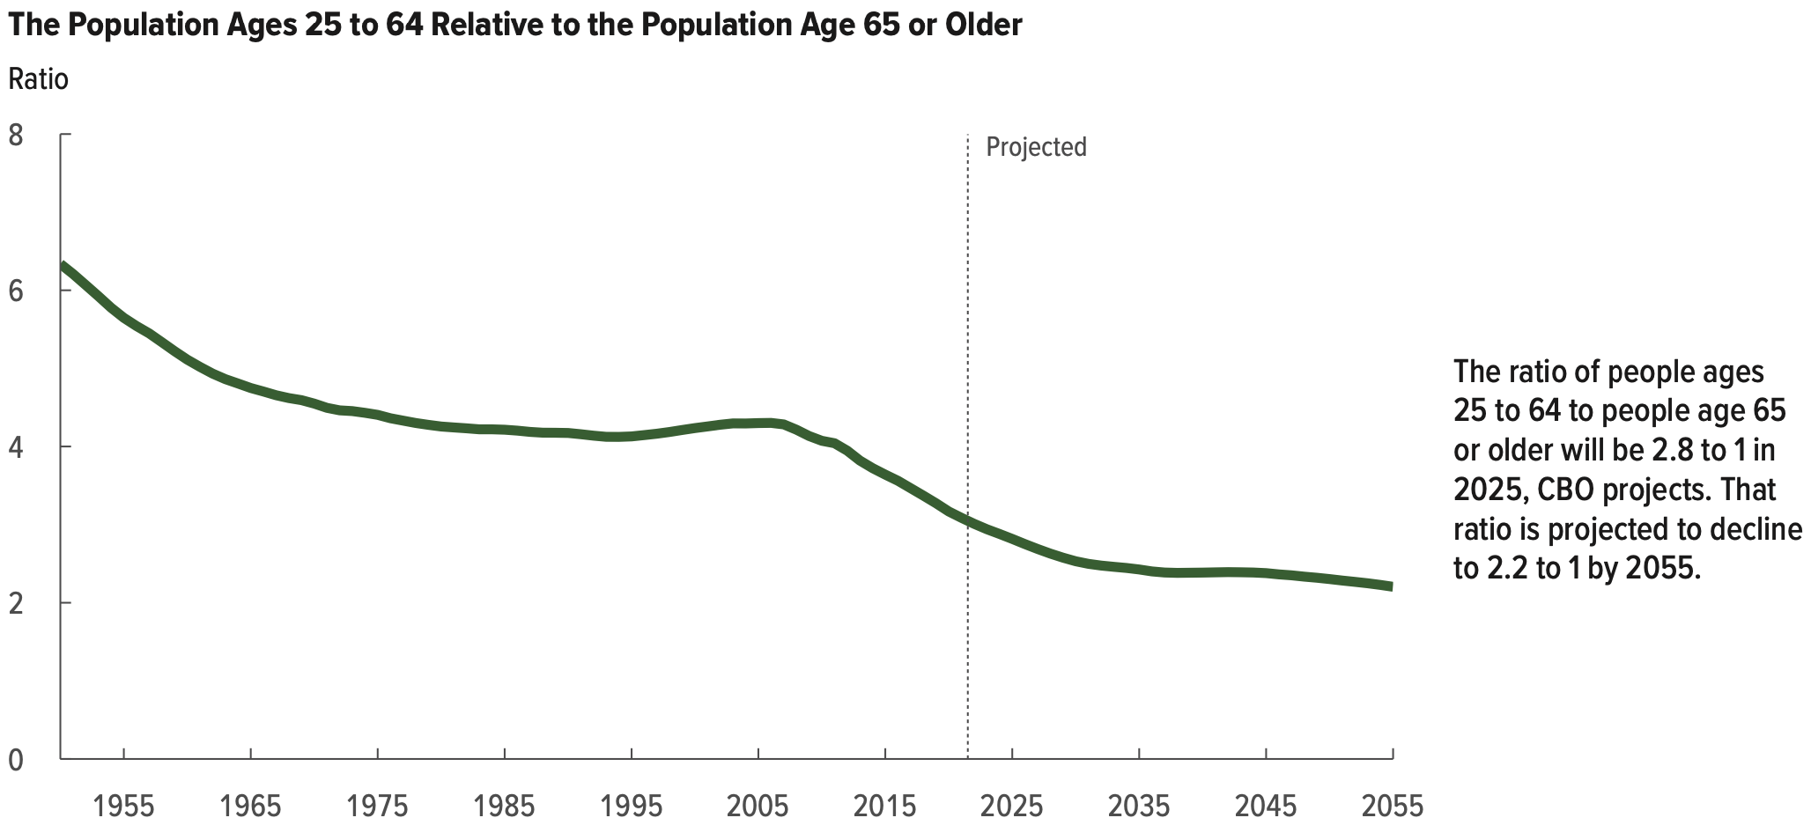
Implications for Social Security
Source: Blau & Mackie (2017).

Slide 41
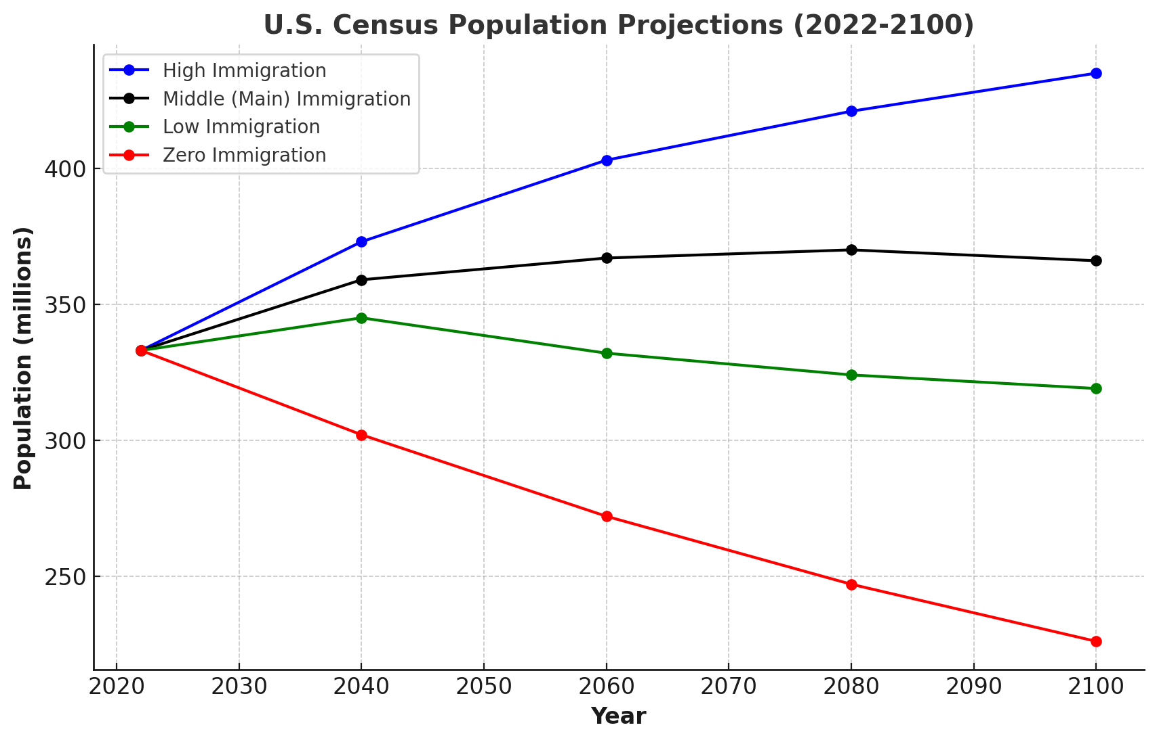
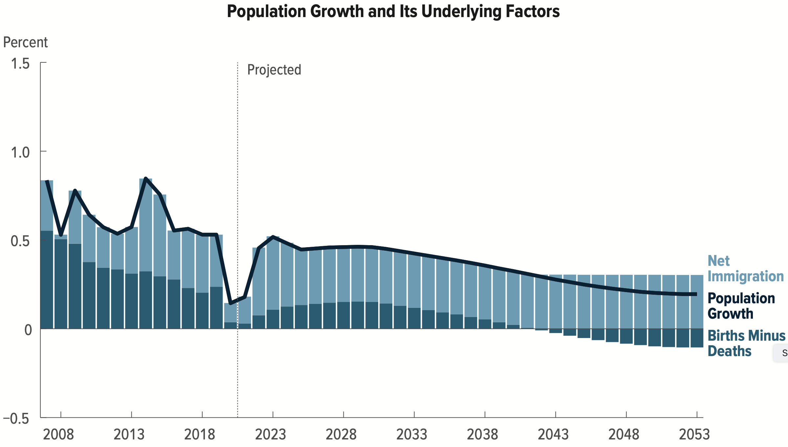
Is Immigration Saving the Day?
100 Million
Lower in 2100
Source: CBO – The Demographic Outlook, 2023-2053

Slide 42
Immigrants and Crime Rates
Conventional wisdom:
  Immigrants commit crimes more frequently than do native-born residents.
  Rising immigration leads to rising crime.
What do the data say?
  Rates of incarceration are lower for foreign-born than U.S.-born.
  Neighborhoods with more immigrants have lower crime rates.
Let’s Have a Look!

Slide 43
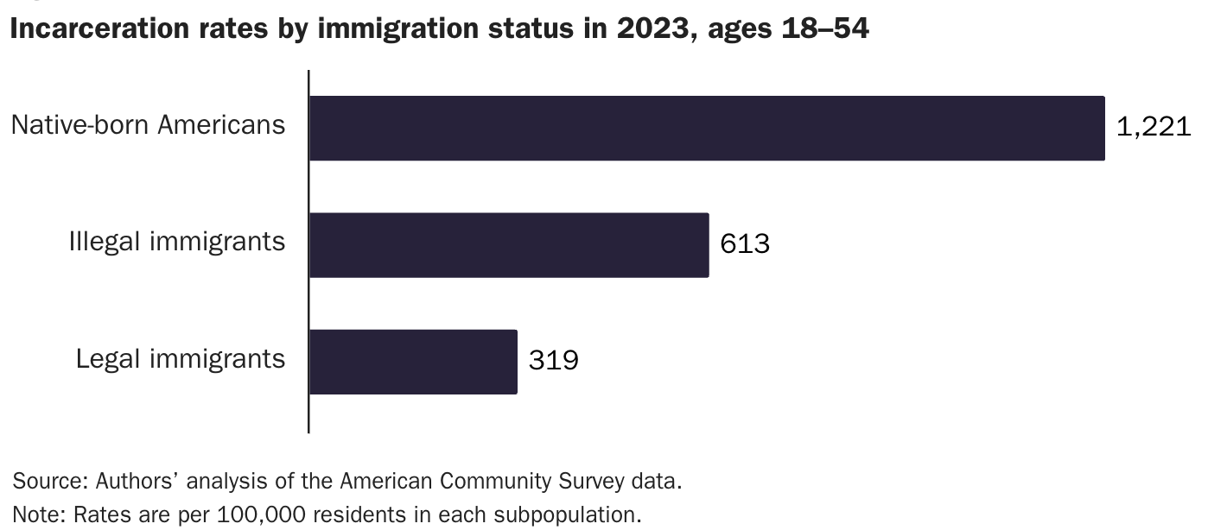
Incarceration by Immigration Status, 2023
Unauthorized Immigrants
Authorized Immigrants
Source: Cato Institute, https://www.cato.org/policy-analysis/illegal-immigrant-incarceration-rates-2010-2023#incarcerations

Slide 44
Immigrants and Crime Rates
Conventional wisdom:
  Immigrants commit crimes more frequently than do native-born residents.
  Rising immigration leads to rising crime.
What do the data say?
  Rates of incarceration are lower for the foreign born than US born.
  Neighborhoods with more immigrants have lower crime rates.
  There is no evidence that deporting noncitizen immigrants affects crime rates.

Slide 45
Summary
Immigration can be thought of as increasing the population of the United States.
  But they are a select group.
This brings economic growth and opportunity, just as does increasing the native-born population.
  But not crime.
Unauthorized immigrants do increase the supply of low-skilled workers.
  This may lower the wages of SOME low-skilled workers.
  But also increases labor force participation among highly skilled workers.

Slide 46
At the Same Time….
Immigrants are often a select group:
  Willing to incur an enormous personal or familial cost to better their lives.
As a result:
  Immigrants tend to be entrepreneurial and to add significantly to economic growth.
Although there are distributional issues:
  Immigration is an important contributor to economic growth.
  Immigration helps to sustain vital government programs.

Slide 47
About Conventional Wisdom
Native-born unskilled workers
  There may be some negative impact on their wages.
  But who wins and loses depends on the skill mix of immigrants.
Crime
  Immigrants, both authorized and unauthorized, commit crimes at much lower rates than do native-born residents.
Government programs
  Federal: immigrants are a source of revenue and stability for some important programs.
  State and local: Because education is funded at the local level, this can be a drain on local government coffers.

Slide 48
Recent Immigration Issues

Slide 49
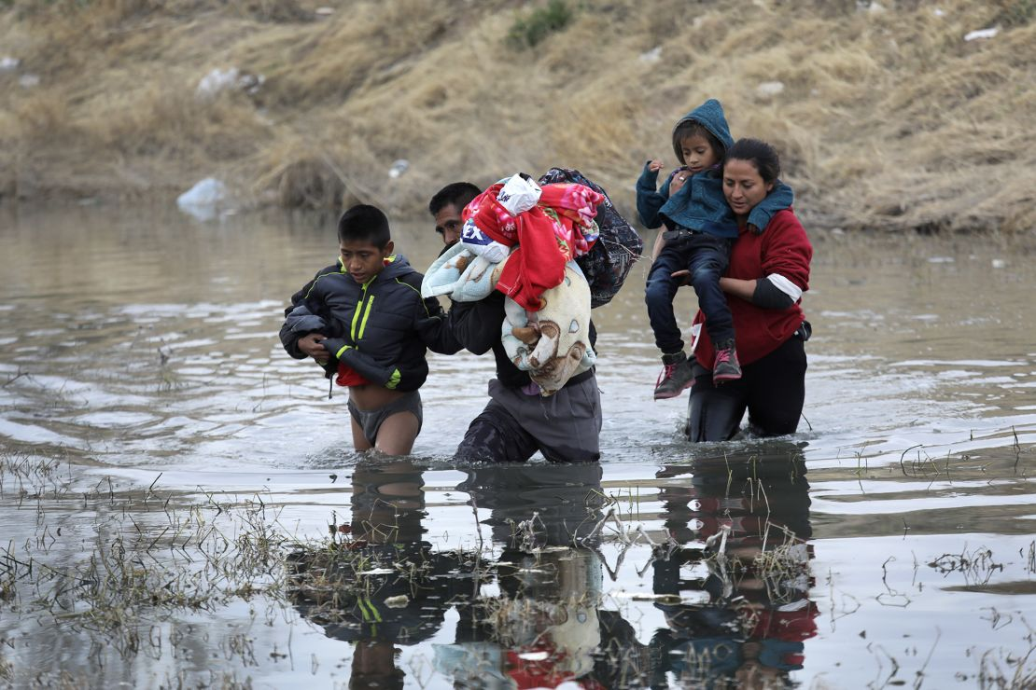
Recent Immigration Issues
The Northern Triangle
Mass Deportations
H1B Visas

Slide 50
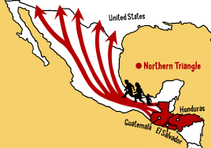
The Northern Triangle

Slide 51
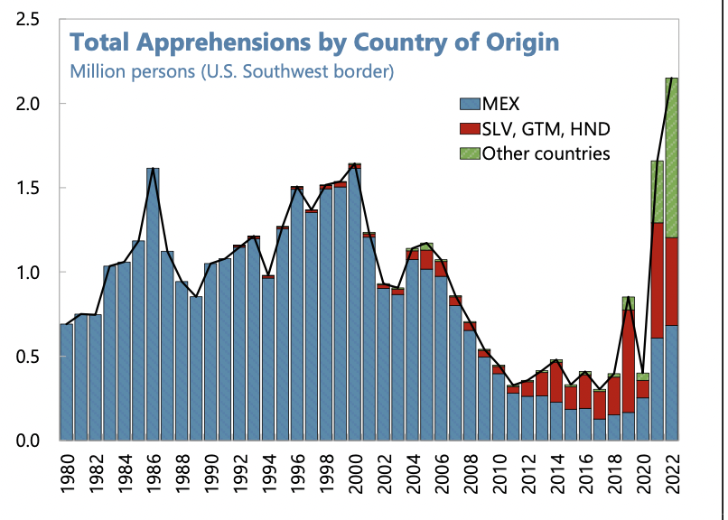
Northern Triangle Apprehensions
(Northern Triangle Countries in Red)
Also:
Venezuela
Haiti
Cuba

Slide 52
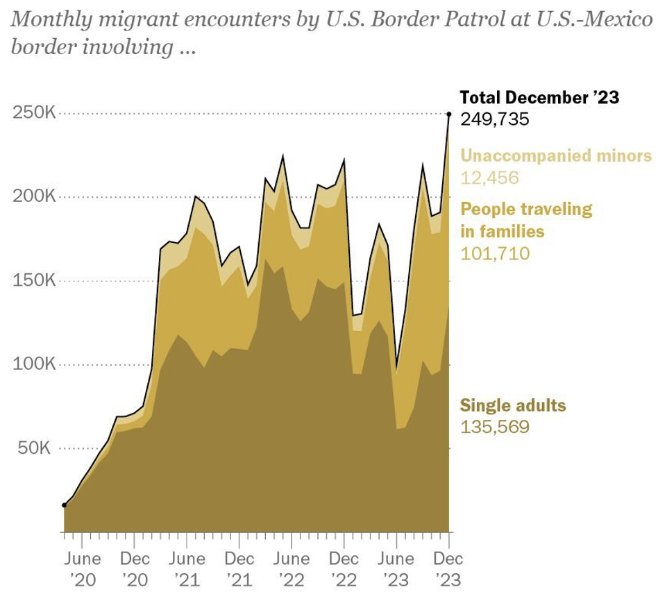
Growing #s of People Traveling in Families
Source: Pew Research Center, US Customs and Border Protection

Slide 53
Mass Deportations
Immigrants work different jobs than do native-born workers.
Immigrants contribute to the local economy.
  GDP losses of up to $1.7 trillion annually.
Immigrants keep prices low: in particular, food!
Deportations impact tax revenues.
  $1,300 more in on average than out, annually.
  Unauthorized immigrants: $22.6 billion in social security and $5.7 billion in Medicare payments.
Deportations are expensive ($13,000 each).
  Total cost $315 billion.
They rob people of their dignity.

Slide 54
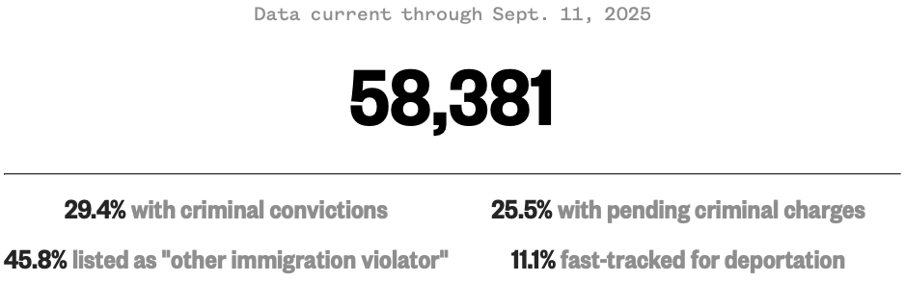
Migrants in ICE Detention
Source: https://www.nbcnews.com/data-graphics/us-immigration-tracker-follow-arrests-detentions-border-crossings-rcna189148

Slide 55
H1B Visas
What are they?
  Visas for immigrants with specialized labor:
    65,000 per year.
  Visas for immigrants with a master’s degree from a U.S. university:
    20,000 per year.
Details
  They are valid for 3 years, with extension possible up to 6 years.
  There is almost always more demand for visas than there is supply.
    Lottery is then used to allocate the visas.

Slide 56
H1B Visas
Pros
  Companies have an easier time finding appropriate workers.
  Immigrants are sometimes complementary to U.S. workers.
    Creating job opportunities for U.S. workers.
  Immigrants spend in the U.S., stimulating the economy.
Cons
  Immigrant H1B holders sometimes take jobs from skilled American workers.
Overall: the program expands the number of immigrants that are here in an authorized way. This may be helpful to the economy.

Slide 57
H1B Visas: $100,000 fee? (Was: $2,000 to $5,000)
Pros
  Perhaps less use of H1B visas to exploit foreign workers.
    May benefit U.S. workers.
  Prioritized the highest-skilled immigrants.
  Source of funds for immigration services.
Cons
  Many fewer applications, which will lower U.S. economic activity.
    Inaccessible to many small businesses.
  Economic disruption.
Overall: That depends.

Slide 58
Summer 2026 Update
*AI generated (Claude)

Slide 59
U.S. Immigration Policy Update
Where Things Stand — Summer 2026
An overview for a general audience | July 2026
ICE Detention
H-1B Visas
Birthright Citizenship
DACA
Asylum & Humanitarian

Slide 60
The Big Picture: A Year of Rapid Change
Since January 2025, the federal government has pursued the largest expansion of interior immigration enforcement in modern U.S. history — while federal courts have emerged as the principal check on many of these policies.
$45B
70,766
600%
Approved by Congress for ICE detention (July 2025), funding up to ~135,000 detention beds through FY 2029
People in ICE detention on Jan. 24, 2026 — the highest single-day total ever publicly recorded
Reported increase in “at-large” community arrests since the start of the current administration
Takeaway: nearly every major policy in this presentation is being contested in federal court — the status quo can shift quickly.
Immigration Policy Update — Summer 2026 | 2

Slide 61
ICE Detention & Enforcement: Record Levels
Detention population crossed 70,000 for the first time on record (Jan. 2026); it remains above any pre-2025 level even after a spring decline.
Roughly 7 in 10 people in ICE custody (April 2026) had no criminal conviction; growth has come mostly from non-criminal cases.
Removals are on a record pace: ~356,000 in the first 284 days of FY 2026, projected to reach ~460,000 for the year.
Fewer releases on bond (“no release” posture); discretionary releases fell 87% by late 2025.
New “mega-facilities” are expanding capacity; oversight groups report deaths in custody and conditions concerns.
70,766
record single-day detention (Jan. 24, 2026)
~71%
of detainees with no criminal conviction (Apr. 2026)
47
deaths in ICE custody since Jan. 2025
Immigration Policy Update — Summer 2026 | 3

Slide 62
H-1B Visas: The $100,000 Fee Fight
A September 2025 proclamation imposed a one-time $100,000 fee on certain new H-1B petitions — courts have since split, and the fee's fate is now on appeal.
Sept. 19, 2025
Dec. 24, 2025
June 8, 2026
June 12, 2026
Presidential proclamation: $100K fee on new H-1B petitions (consular processing)
D.C. federal court upholds the fee; 20 states file a separate challenge
Massachusetts court strikes fee down as an unconstitutional tax (APA violation)
Ruling stayed pending appeal — the fee still applies for now
Also new: DHS finalized a wage-weighted selection process for the FY 2027 H-1B lottery, favoring higher-paid positions — a significant shift from the random lottery.
Immigration Policy Update — Summer 2026 | 4

Slide 63
Birthright Citizenship: Settled — For Now
The Supreme Court struck down the Day-One 2025 executive order that sought to deny citizenship to U.S.-born children of undocumented or temporary-status parents.
The Court held such children are “subject to the jurisdiction” of the U.S. and are citizens at birth under the 14th Amendment.
The order never took effect — lower courts had blocked it since 2025, even after Trump v. CASA limited nationwide injunctions.
Three conservative justices dissented; the President has said he will pursue the issue through legislation, though scholars doubt a statute could override the constitutional ruling.
6–3
Trump v. Barbara
June 30, 2026
Majority opinion by
Chief Justice Roberts
Immigration Policy Update — Summer 2026 | 5

Slide 64
DACA: Alive, but in Limbo
≈525,000 people currently hold DACA — most have been in the U.S. since childhood.
Renewals: OPEN
New applications: FROZEN
USCIS is processing renewals and work permits nationwide, including Texas. Recommended filing window: 120–150 days before expiration.
First-time applications are accepted but cannot be approved under a court injunction in place since July 2021.
Litigation: PENDING
New risk (Apr. 2026)
The Fifth Circuit (Jan. 2025) found DACA unlawful but preserved renewals; the district court must still decide how to implement the ruling — including Texas work permits.
The Board of Immigration Appeals ruled DACA alone does not stop deportation proceedings from moving forward.
Bottom line: current recipients keep protection and work authorization for now, but no permanent fix exists without Congress.
Immigration Policy Update — Summer 2026 | 6

Slide 65
Asylum: The Right Exists, Access Has Narrowed
Decision pause: since December 2025, an indefinite pause has halted most final asylum decisions; it was partially relaxed in March 2026 for “non-high-risk” countries.
Border access: executive actions sharply restricted asylum at the southern border; in April 2026 a federal appeals court ruled that a blanket border asylum ban is unlawful — but access remains inconsistent.
Travel restrictions: nationals of ~39 fully or partially restricted countries face major barriers to entry and to having claims considered.
Daily life harder: new rules delay or limit work permits for applicants, and a March 2026 rule bars new commercial driver's licenses for asylum seekers.
Screening upstream: visa applicants abroad are now asked whether they fear harm at home — effectively filtering potential asylum seekers before arrival.
Key point for audiences: applying for asylum remains legal — but the process is slower, more restricted, and litigation-dependent.
Immigration Policy Update — Summer 2026 | 7

Slide 66
Also on the Radar: TPS & Travel Restrictions
Two related developments round out the summer 2026 picture — and directly affect hundreds of thousands of long-term U.S. residents.
Temporary Protected Status (TPS)
Travel Restrictions (“Travel Ban 2.0”)
On June 25, 2026, the Supreme Court ruled the government may end TPS for Haiti and Syria.
Terminations for several other countries (e.g., Venezuela) have moved forward since 2025.
Many losing TPS have lived and worked lawfully in the U.S. for years or decades.
Full or partial entry restrictions cover ~39 countries, including Afghanistan, Haiti, Iran, Cuba, and Venezuela.
In June 2026, a court set aside the policy of treating these nationalities as a “negative factor” in immigration applications.
Entry restrictions themselves remain in effect and continue to shape family, student, and work travel.
Immigration Policy Update — Summer 2026 | 8

Slide 67
Common Threads & What to Watch
1
Courts are the battleground
Nearly every policy — the H-1B fee, asylum limits, birthright citizenship, DACA — has been shaped or blocked by federal litigation. Expect more Supreme Court activity in the 2026–27 term.
2
Funding drives capacity
The July 2025 spending law transformed enforcement scale; detention and removal numbers reflect budget as much as policy.
3
Congress is the missing actor
Durable answers on DACA, legal immigration levels, and asylum reform require legislation — none has passed. Post-ruling, birthright citizenship debate may shift to Congress.
4
Local impacts are uneven
Enforcement intensity, state responses, and community effects (labor markets, schools, mixed-status families) vary widely across the country.
Immigration Policy Update — Summer 2026 | 9

Slide 68
Thank you!
Any Questions?
www.NEEDEcon.org
Luisa R. Blanco
luisa.blancoraynal@pepperdine.edu
Contact NEED: info@NEEDEcon.org
Submit a testimonial: www.NEEDEcon.org/testimonials.php
Become a Friend of NEED: www.NEEDEcon.org/friend.php

