Slide 1
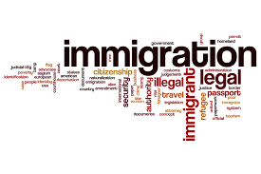
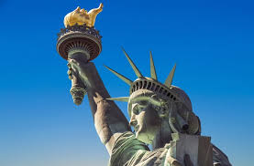
The Economics of Immigration
Belvedere Tiburon Library
September 22, 2025
Jon Haveman, Ph.D.
National Economic Education Delegation

Slide 2
Available NEED Topics Include:
US Economy
Healthcare Economics
Climate Change
Economic Inequality
Economic Mobility
Trade and Globalization
Minimum Wages
Immigration Economics
Housing Policy
Federal Budgets
Saving Social Security
Black-White Wealth Gap
Autonomous Vehicles
US Social Policy

Slide 3
Credits and Disclaimer
This slide deck was authored by:
  Anna Maria Mayda, Georgetown University
  Robert Gitter, Ohio Wesleyan University
  Roger White, Whittier College
This slide deck was reviewed by:
  Kirk Doran, Notre Dame
  Ethan Lewis, Dartmouth College
Disclaimer
  NEED presentations are designed to be nonpartisan.
  It is, however, inevitable that presenters will be asked for and will provide their own views.
  Such views are those of the presenter and not necessarily those of the National Economic Education Delegation (NEED).

Slide 4
Outline
Quiz!
Why do people migrate?
The nature of immigration to the U.S.
Economics of immigration
Recent immigration issues

Slide 5
Immigration Quiz
What % of the U.S. population are not native-born?
  14%
What % of the world’s population are not native-born?
  3.6%
How long has the average undocumented immigrant lived in the United States?
  A. 3 months
  B. 2 years
  C. 10 years
  D. 25 years
21% of children born to native parents are high-income earners (above the middle class).
What % of kids born to immigrants are high-income earners?
  A. 15%
  B. 21%
  C. 28%
  D. 35%
In 2021, 8% of Americans lived in poverty. What percent of immigrants lived in poverty?
  13%
Source: Freakonomics – How Much Do You Know About Immigration?

Slide 6
Immigration Quiz
Immigrants are responsible for what % of patents in the United States?
  36%
    23% of inventors on record
    13% from increase in native born patenting
What % of green cards go to family rather than employment-based immigration?
  66% go to family-based
What % of the U.S. workforce are immigrants?
  18%
Native-born Americans receive $8k on average in benefits. What is it for immigrants?
  $6,000
100 years ago, most immigrants were from Europe. Today, Latin America and Asia. Is the rate of assimilation:
  Faster? Slower? About the same?
Source: Freakonomics – How Much Do You Know About Immigration?

Slide 7
Why Do People Migrate?
Push factors:
  Disparities in income/standards of living, and the availability of jobs, violence/war, climate change, natural disasters, population pressures, economic dislocation, religious persecution, and denial of political rights.
Pull factors:
  Potential for economic prosperity (higher wages, job opportunities), physical security, political freedom, and religious liberty.
Source: Gilder Lehrman Institute of American History.

Slide 8
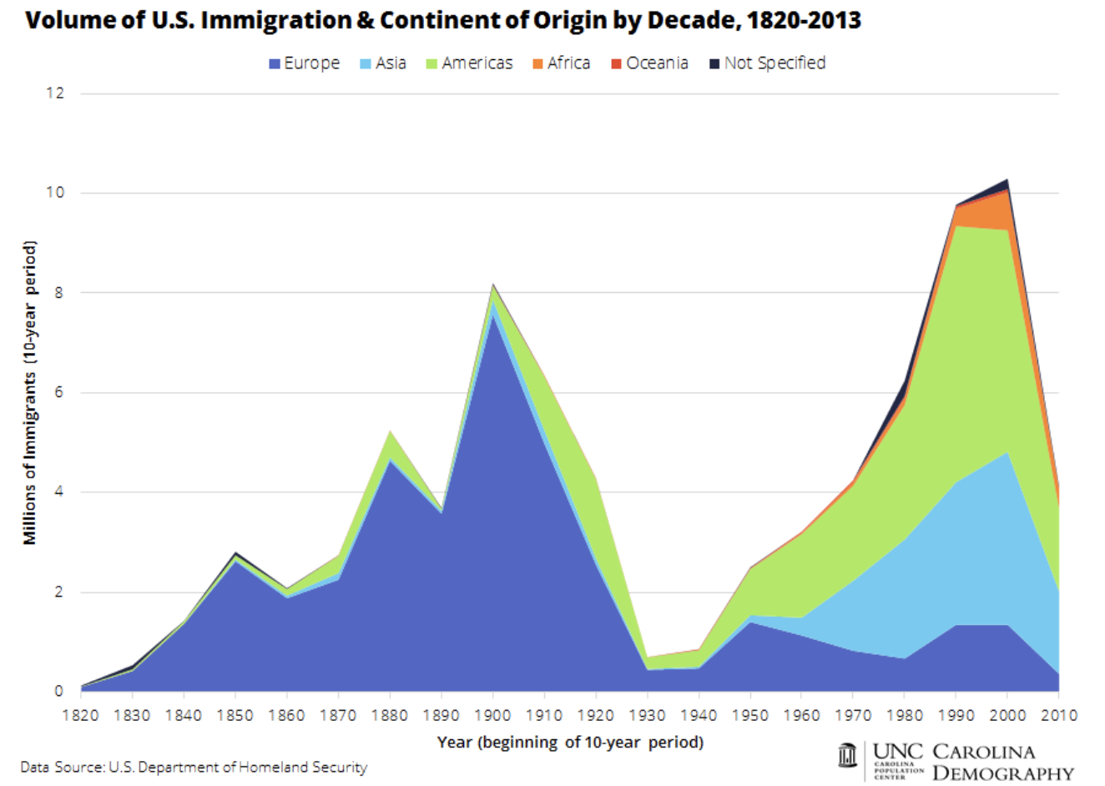

Slide 9
History of US Immigration: 2011-2020
Sources (top 10) | 2011-2020
Mexico | 1,491,000
China | 721,000
India | 637,000
Philippines | 505,000
Dominican Rep. | 487,000
Cuba | 473,000
Vietnam | 334,000
El Salvador | 215,000
South Korea | 199,000
Jamaica | 198,000
Total immigrant inflow, 2011-2020 = 10,125,000
US population growth, 2011-2020 = 22,700,000
Typical year during decade…
US population increased by 2.27 million (0.74%)
Native births contributed approx. 1.35 million (0.44%)
Immigration contributed approx. 920,000 (0.30%)
Sources: UN Population Division (2010 and 2020 immigrant stocks), US DHS (2010-2020 immigrant inflows), US Census (population values).

Slide 10
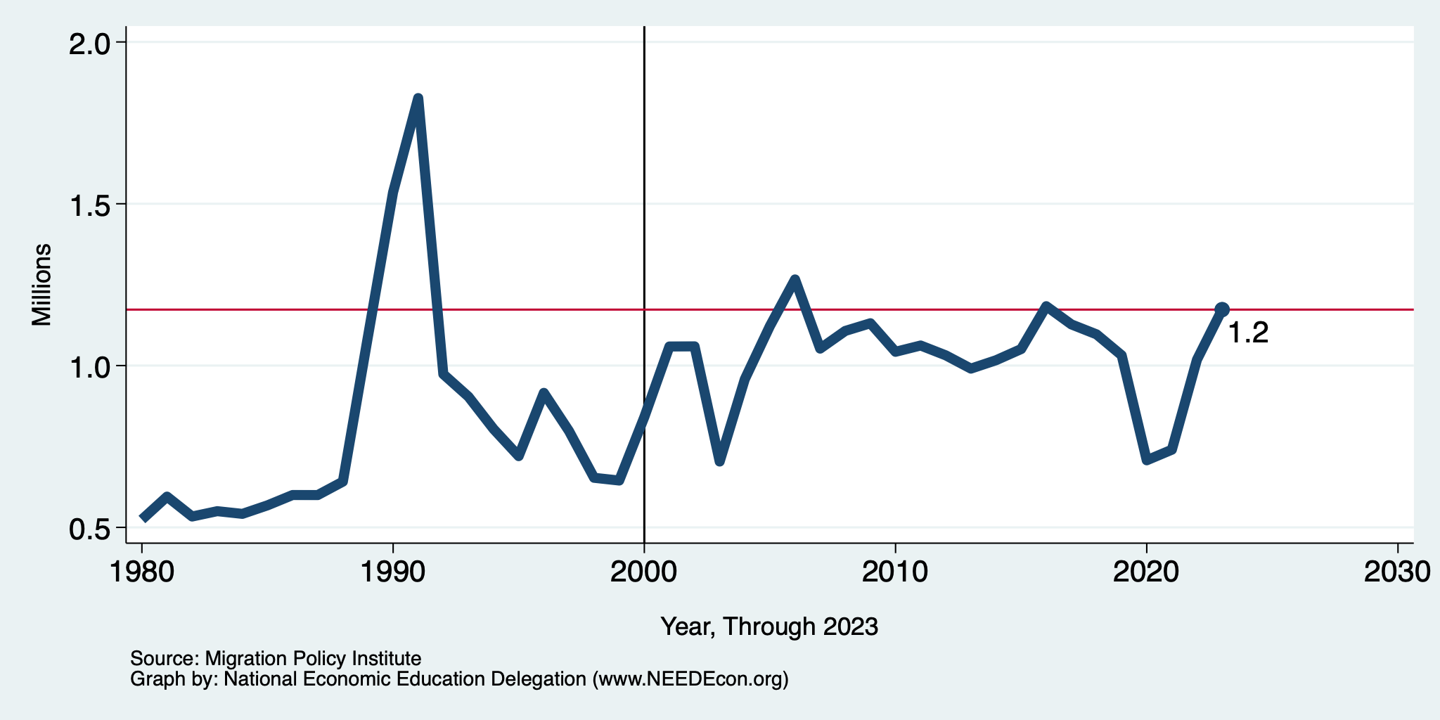
Recent Trends in Authorized Immigration
2023
1.2 Million

Slide 11
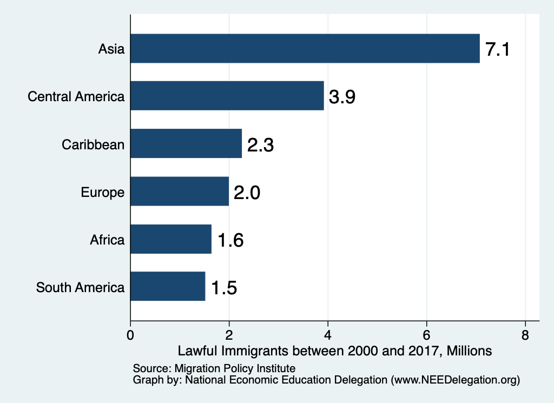
Authorized Immigration by Region (2000-2022)

Slide 12
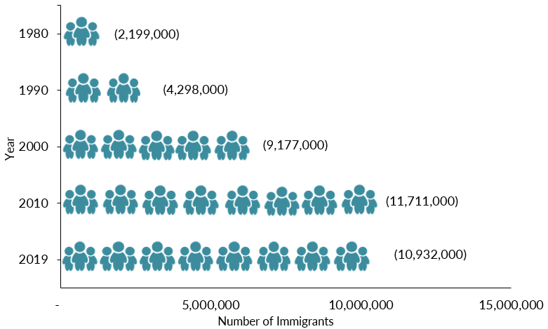
Mexican-Born People in the US
About 11 million in mid-2023 (Latest data)
1 in 14 people born in Mexico currently lives in the US

Slide 13
Distribution of Income
Mexico
United States
Number of People
Income

Slide 14
UNauthorized Immigration

Slide 15
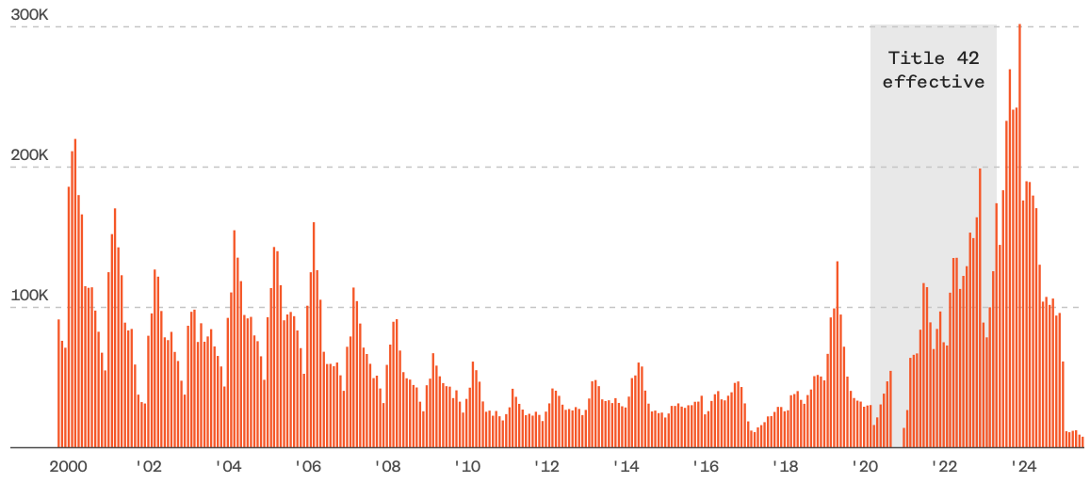
Encounters w/Migrants at the U.S.-Mexico Border
Dec. `23
249,741
Aug. `24
58,038
July `25
7,832
Source: https://www.nbcnews.com/data-graphics/us-immigration-tracker-follow-arrests-detentions-border-crossings-rcna189148

Slide 16
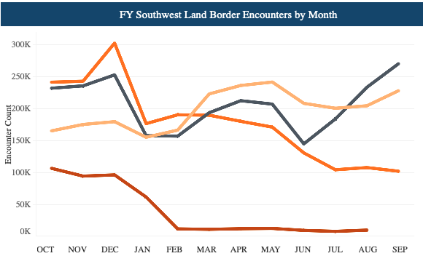
Recent Border Encounters
Dec/23 Peak
2023
2022
2024
2025
Source: https://www.cbp.gov/newsroom/stats/southwest-land-border-encounters

Slide 17
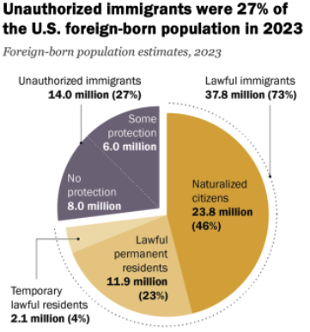
Total Foreign-Born (2023)
Population: 51.8 million
Total Foreign-Born (Aug/25)
Population: 48.5 million
(This seems too low.)
Source: Pew Research Center, U.S. Unauthorized Immigrant Population Reached a Record 14 Million in 2023, August 21, 2025

Slide 18
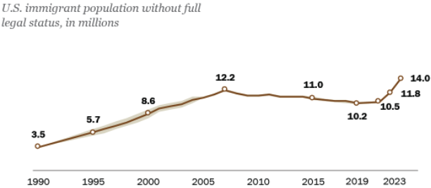
U.S. Unauthorized Immigration Totals, to 2023
Source: Pew Research Center, What we know about unauthorized immigrants living in the U.S., July 22, 2024

Slide 19
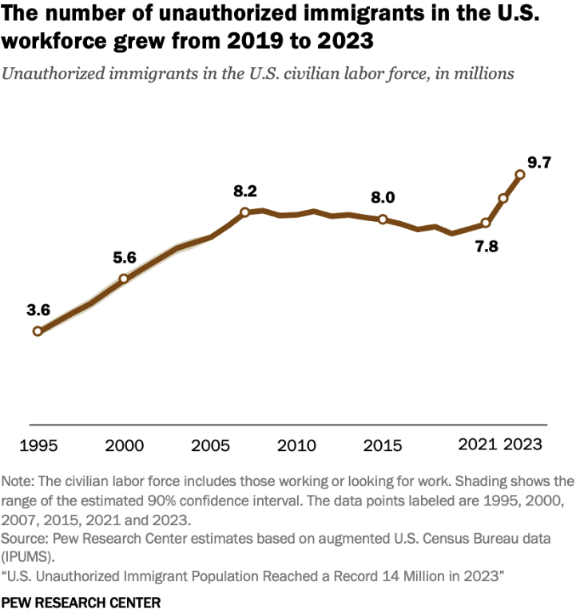
U.S. Unauthorized Immigration: Labor Force
5% of labor force
3% of population
Source: Pew Research Center, What we know about unauthorized immigrants living in the U.S., July 22, 2024

Slide 20
Economics

Slide 21
Why Do We Care? Economic Implications
Conventional Wisdom Issues:
  Labor markets: Wages and Jobs
  Government Revenue and Spending
  Crime
Other issues (that don’t get talked about much):
  Gross Domestic Product (GDP)
  Innovation and Entrepreneurship

Slide 22
GDP: How Does This Work?
What determines the size of an economy?
  Physical capital
  Technology/productivity
  The number of workers
    Immigration adds to the number of workers.
Number of immigrants in the labor force is high
  32.2 million foreign-born persons ages 16+ in the labor force in Aug/25.
  18.8% of the total US workforce.
Evidence
  Immigrants added 11% to GDP ($2 trillion) in 2016.
Federal Reserve Bank of St. Louis (https://fred.stlouisfed.org/)
National Academies of Sciences, Engineering, and Medicine (2017) “The Economic and Fiscal Consequences of Immigration”.

Slide 23
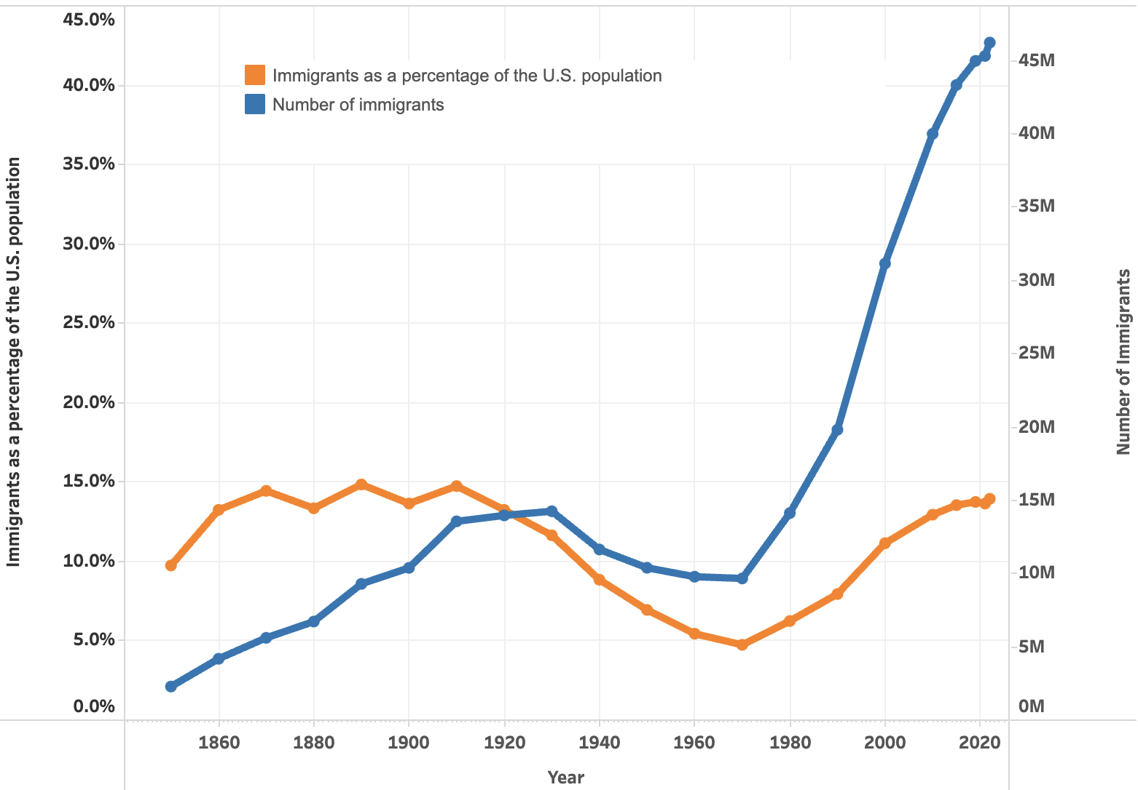

U.S. Immigrant Population and Share over Time
1850-2022
60 YEARS

Slide 24
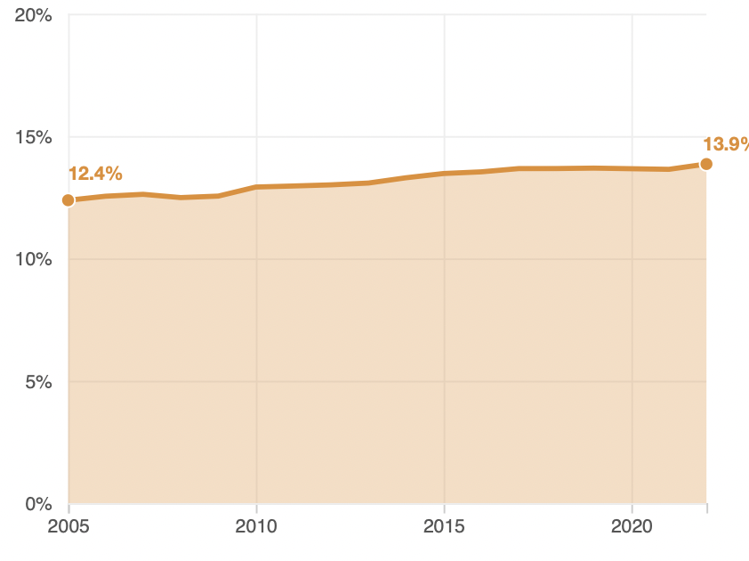
Immigrant Share of US Population
13.9 %
12.4 %

Slide 25
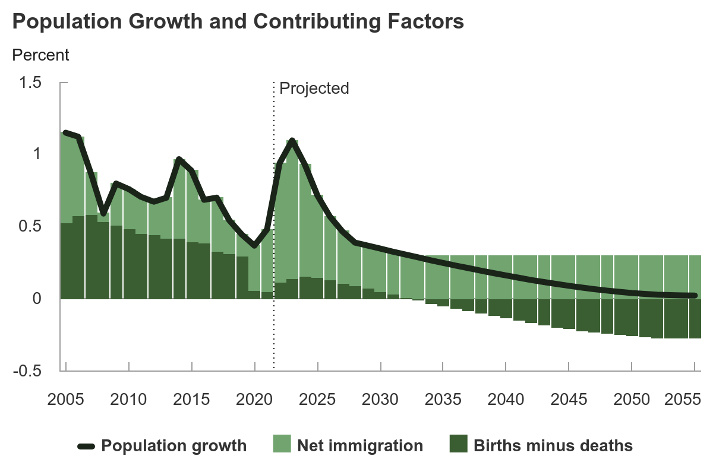
Is Immigration Saving the Day?
The vast majority of additions to the
Population in the last several years
Have been from immigration.
Source: CBO – The Demographic Outlook, 2025-2055

Slide 26
Jobs: Conventional Wisdom…Upended
What is the conventional wisdom?
  Low-skilled immigrants come in and take jobs from low-skilled native-born individuals.
    1-1 tradeoff.
What does new research show?
  Low-skilled immigrants contribute positively to the economy.
    Every 100 low-skilled immigrants: create 9 jobs for low-skilled native-born.
    They create opportunities for low-skilled native-born workers.
  Low-skilled immigrants take jobs that native-born don’t want.

Slide 27
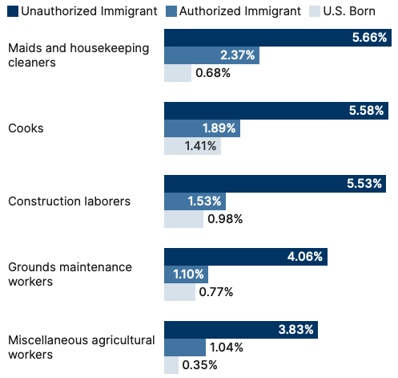
Share of Workers in Each Occupations

Slide 28
Pathway of Wage and Employment Effects
}
Inflows of Low-Skilled Immigrants
Order of Impact
Impact is negative,
But is smaller
at each step.
Previous Immigrants
Disadvantaged Minorities
Native-born HS Dropouts
Positive influence on wages and employment of other workers.

Slide 29
Skilled Immigrants and Innovation
1% increase in the share of the immigrant college graduate population
  9-18% increase in patenting per capita
  Increased immigration increases patenting by native-born population.
In the 1990s
  Increased skilled immigration can account for one-third of increased patenting in that decade.
  This translates into a 1.4-2.5% increase in GDP per capita by the end of the decade.
Source: Hunt and Gauthier-Loiselle (2008).

Slide 30
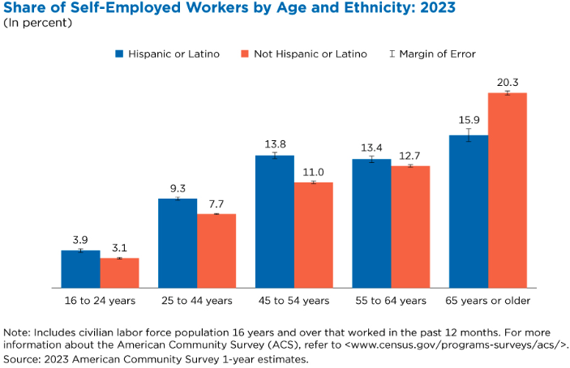
Immigrants and Entrepreneurship
Source: Magnus Lofstrom from Current Population Survey Data.

Slide 31
Fortune 500: First- and Second-Generation Founders

Slide 32
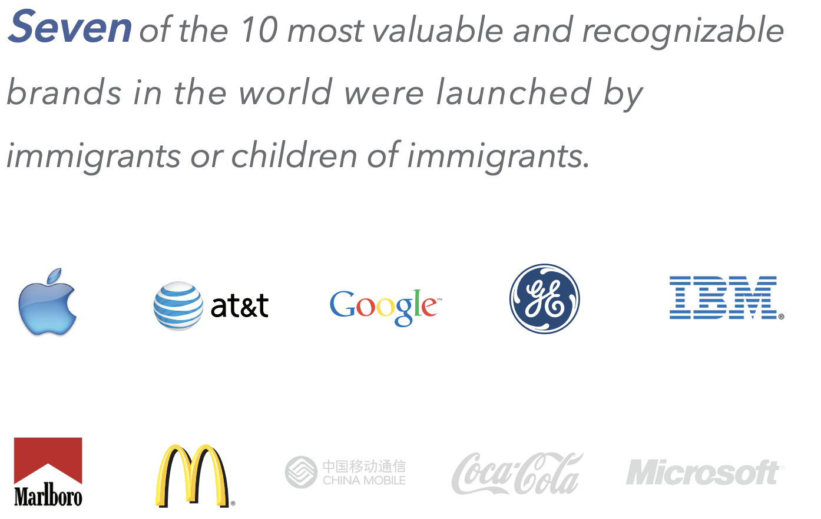

Slide 33
Government Revenues and Expenditures

Slide 34
Topics?
Basic Question:
  Taxes (income, sales, and other) immigrants pay vs. government expenditures on public benefits and services they receive.
More complicated:
  Immigrants also affect the fiscal equation for many native-born residents.
    Indirectly through labor and capital markets.
    Changes in wages and the return to capital.

Slide 35
Age-Specific Taxes and Benefits
By Immigrant Generation, United States, 2012
Source: Blau & Mackie (2017), p. 325.

Slide 36
What Do We Know?
Immigrants who arrive while of working age:
  Are, on average, net contributors.
  21-year-old with a high school diploma: +$126,000 over a lifetime
    Though this value gradually declines with age at arrival.
    Turns negative for arrivals of age 35+
Net contribution crucially depends on characteristics
  Age distribution, family composition, health status, fertility patterns
  Temporary or permanent relocation
  Employment in the legal labor market
  Authorized or unauthorized

Slide 37
Bottom Line/Consensus of Estimates
Federal level: fiscal impact is generally positive.
State and local level: typically negative fiscal impact.

Slide 38
Implications for Major Federal Programs
Documented immigrants are less likely to use Social Security and Medicare.
Unauthorized immigrants are ineligible.
  They will pay into the system but cannot receive benefits.
Medicaid: not available to legal residents for the first five years.
Provide a source of revenue for an aging population.

Slide 39
The Aging US Population
Source: Blau & Mackie (2017), p. 63.

Slide 40
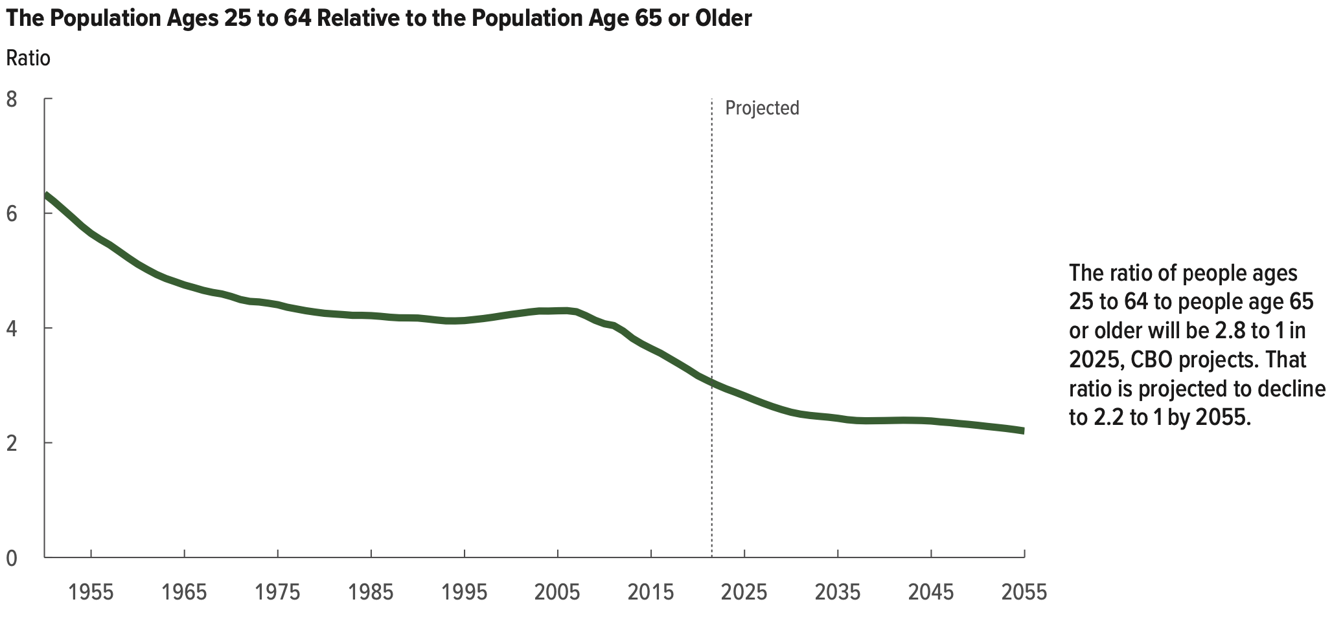
Implications for Social Security
Source: Blau & Mackie (2017).

Slide 41
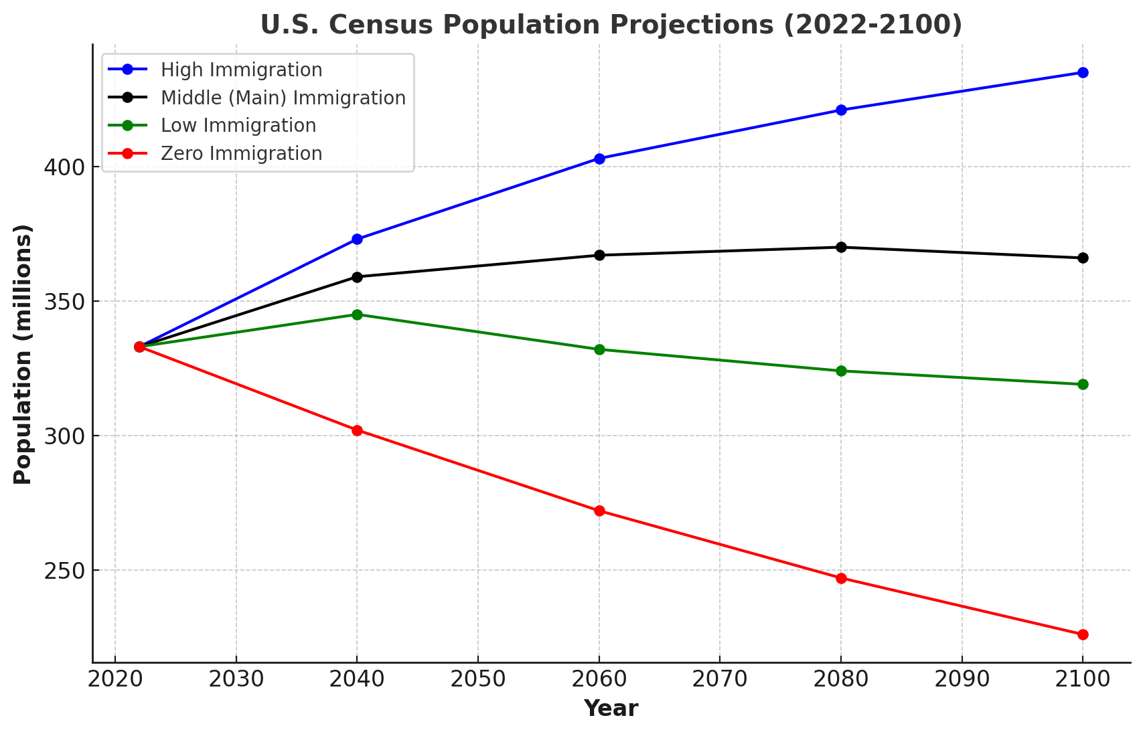
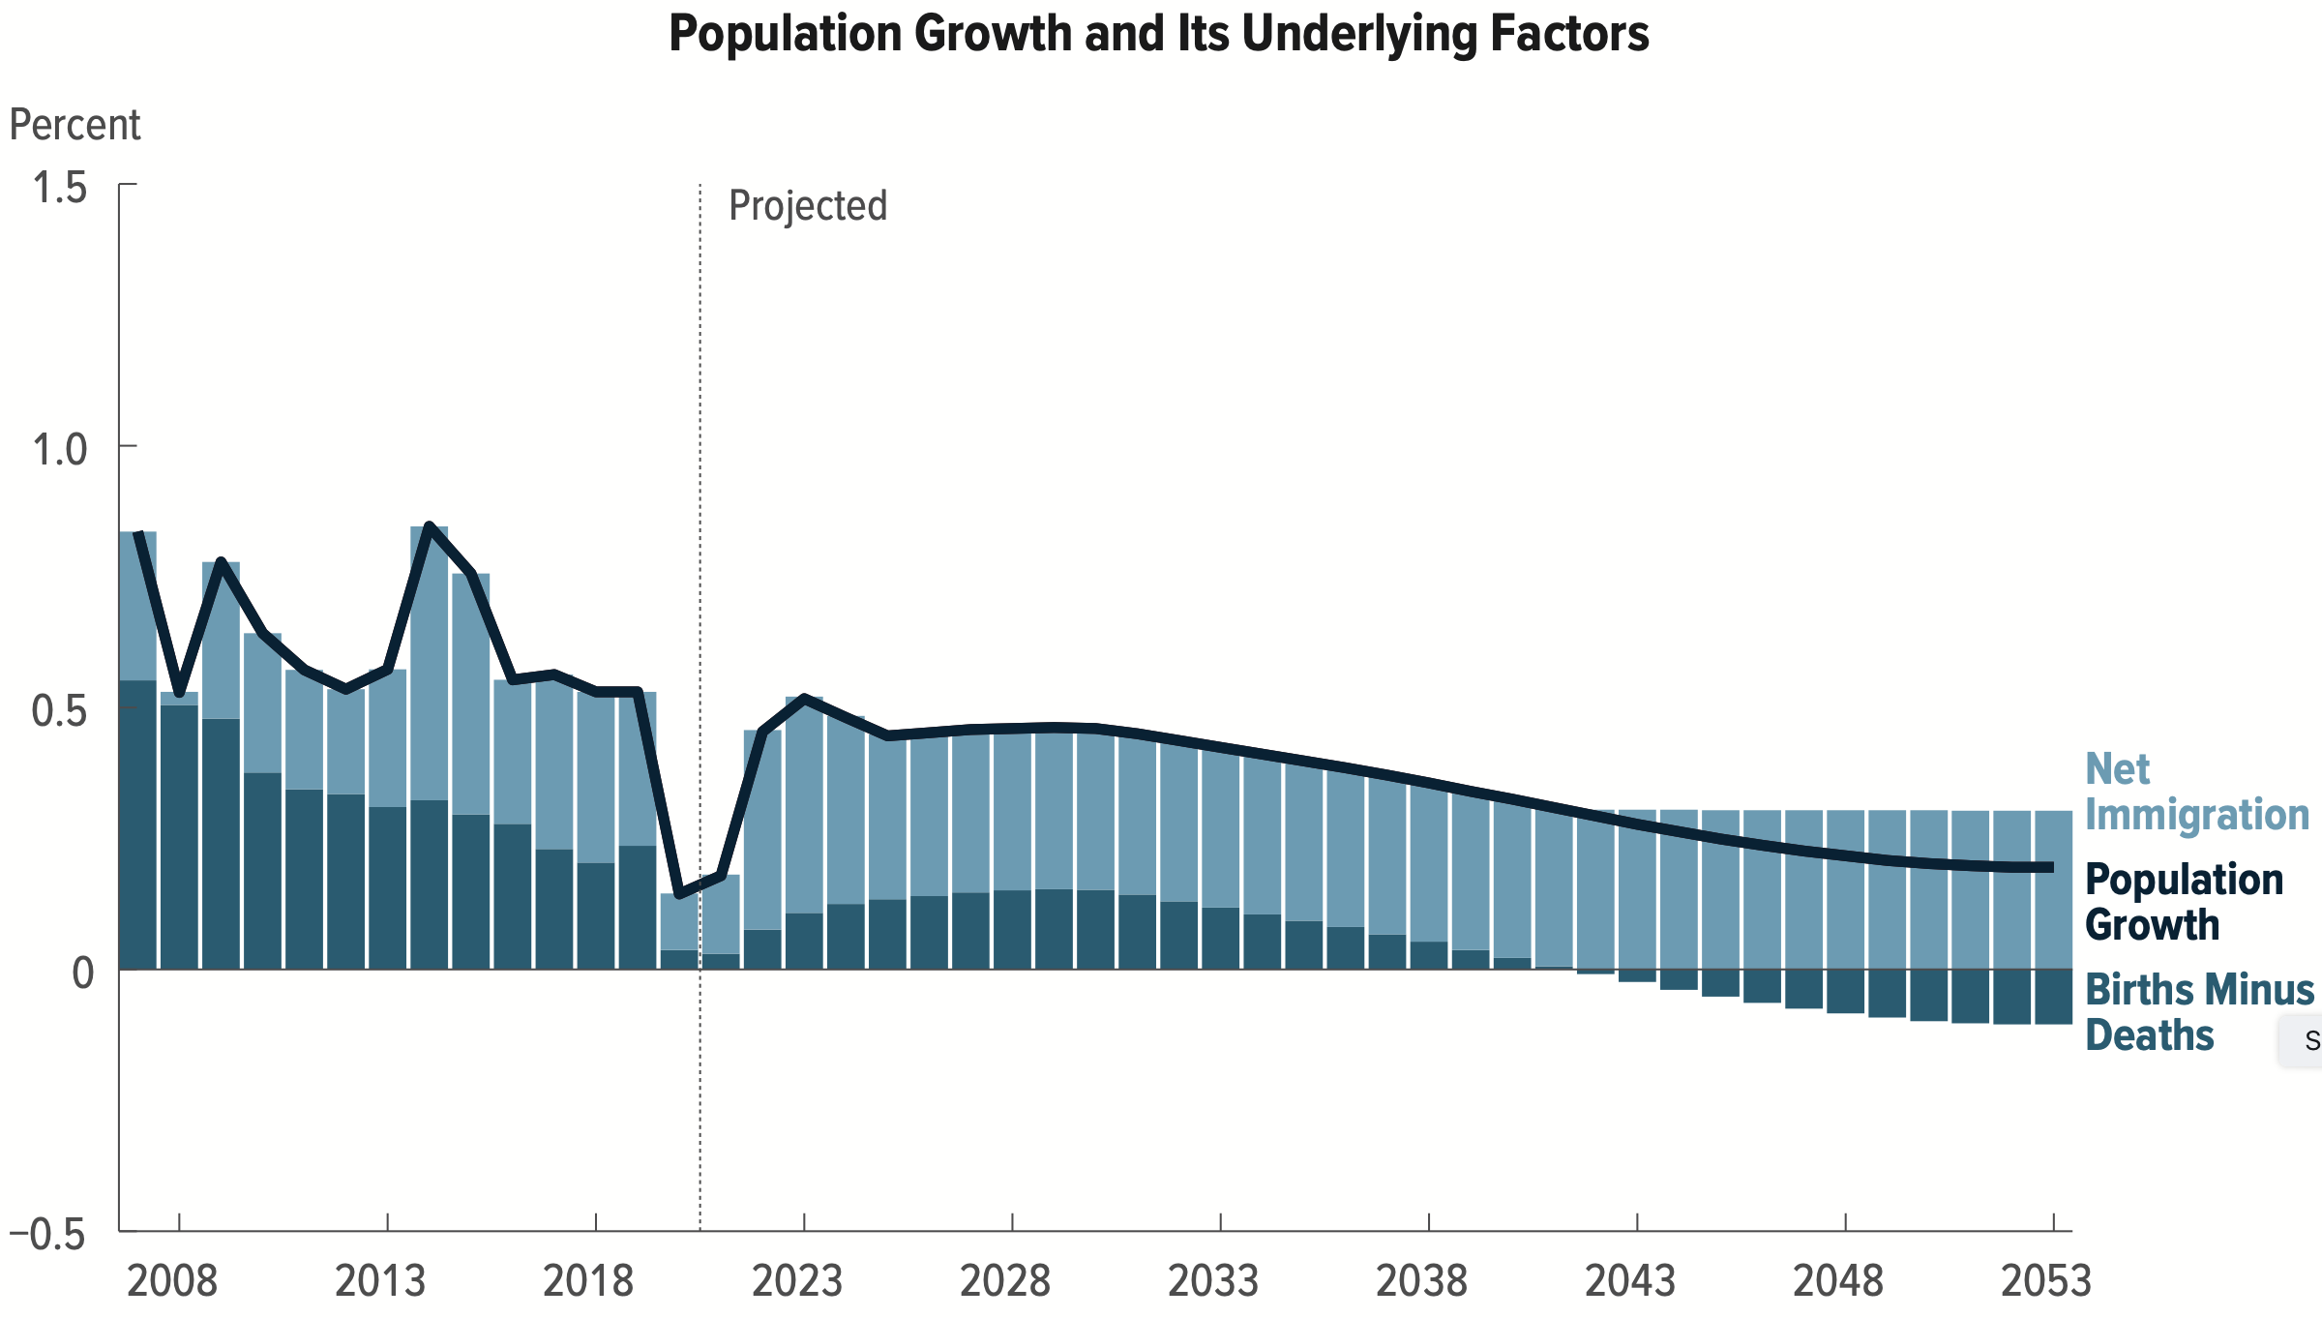
Is Immigration Saving the Day?
Source: CBO – The Demographic Outlook, 2023-2053

Slide 42
Non - Economic Implications
Patterns of Integration
Education
Employment and Earnings
Occupations
Poverty
Residential Integration
Language
Health
Family Patterns
The Big Misconception: Crime
Source: The Integration of Immigrants into American Society (2015).

Slide 43
Immigrants and Crime Rates
Conventional wisdom:
  Immigrants commit crimes more frequently than do native-born residents.
  Rising immigration leads to rising crime.
What do the data say?
  Rates of incarceration are lower for foreign-born than U.S.-born.
  Neighborhoods with more immigrants have lower crime rates.
Let’s Have a Look!

Slide 44
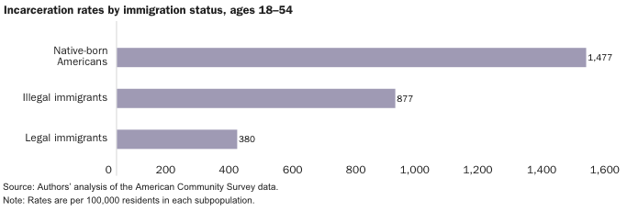
Incarceration by Immigration Status, 2018
Source: Cato Institute, Illegal Immigrant Incarceration Rates, 2010–2018: Demographics and Policy Implications, April 2020.

Slide 45
Immigrants and Crime Rates
Conventional wisdom:
  Immigrants commit crimes more frequently than do native-born residents.
  Rising immigration leads to rising crime.
What do the data say?
  Rates of incarceration are lower for the foreign born than US born.
  Neighborhoods with more immigrants have lower crime rates.
  There is no evidence that deporting noncitizen immigrants affects crime rates.

Slide 46
Summary
Immigration can be thought of as increasing the population of the United States.
  But they are a select group.
This brings economic growth and opportunity, just as does increasing the native-born population.
  But not crime.
Including unauthorized immigrants, the supply of low-skilled workers is increased.
  This lowers the wages of low-skilled workers.
  But also increases labor force participation among highly skilled workers.

Slide 47
At the Same Time….
Immigrants are often a select group:
  Willing to incur an enormous personal or familial cost to better their lives.
As a result:
  Immigrants tend to be entrepreneurial and to add significantly to economic growth.
Although there are distributional issues:
  Immigration is an important contributor to economic growth.
  Immigration helps to sustain vital government programs.

Slide 48
About Conventional Wisdom
Native-born unskilled workers
  There is some negative impact on their wages.
  But who wins and loses depend on the skill mix of immigrants;
    when this skill mix changes, so do its effects.
Crime
  Immigrants, both authorized and unauthorized, commit crimes at much lower rates than do native-born residents.
Government programs
  Federal: immigrants are a source of revenue and stability for some important programs.
  State and local: because education is funded at the local level, this can be a drain on local government coffers.

Slide 49

Recent Immigration Issues
The Northern Triangle
Mass Deportations
H1B Visas

Slide 50
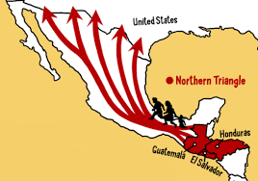
The Northern Triangle

Slide 51
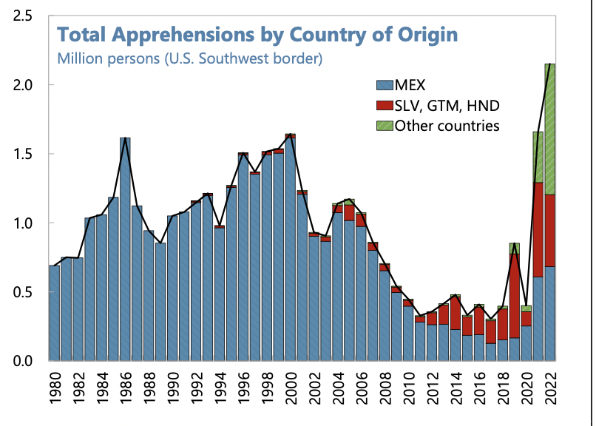
Northern Triangle Apprehensions
(Northern Triangle Countries in Red)

Slide 52
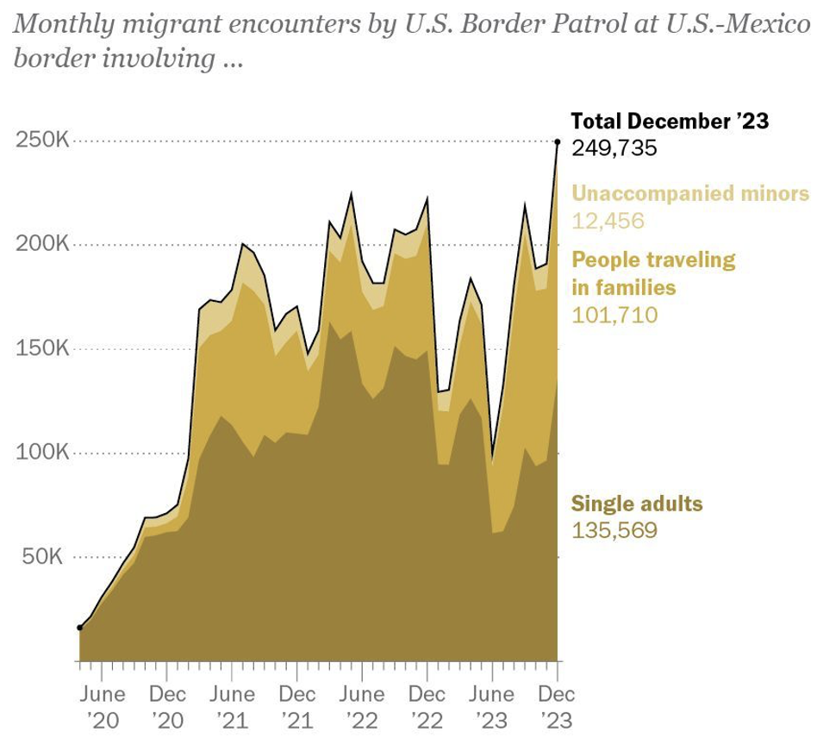
Growing #s of People Traveling in Families
Source: Pew Research Center, US Customs and Border Protection

Slide 53
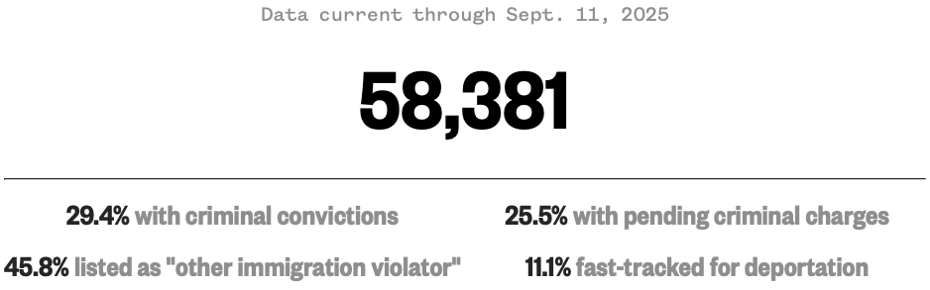
Migrants in ICE Detention
Source: https://www.nbcnews.com/data-graphics/us-immigration-tracker-follow-arrests-detentions-border-crossings-rcna189148

Slide 54
Mass Deportations
Immigrants work different jobs than do native-born workers.
Immigrants contribute to the local economy.
  GDP losses of up to $1.7 trillion annually.
Immigrants keep prices low: in particular, food!
Deportations impact tax revenues.
  $1,300 more in on average than out, annually.
  Unauthorized immigrants: $22.6 billion in social security and $5.7 billion in Medicare payments.
Deportations are expensive ($13,000 each).
  Total cost $315 billion.
They rob people of their dignity.

Slide 55
H1B Visas
What are they?
  Visas for immigrants with specialized labor:
    65,000 per year.
  Visas for immigrants with a master’s degree from a U.S. university:
    20,000 per year.
Details
  They are valid for 3 years, with extension possible up to 6 years.
  There is almost always more demand for visas than there is supply.
    Lottery is then used to allocate the visas.

Slide 56
H1B Visas
Pros
  Companies have an easier time finding appropriate workers.
  Immigrants are sometimes complementary to U.S. workers.
    Creating job opportunities for U.S. workers.
  Immigrants spend in the U.S., stimulating the economy.
Cons
  Immigrant H1B holders sometimes take jobs from skilled American workers.
Overall: the program expands the number of immigrants that are here in an authorized way. This may be helpful to the economy.

Slide 57
H1B Visas: $100,000 fee? (Was: $2,000 to $5,000)
Pros
  Perhaps less use of H1B visas to exploit foreign workers.
    May benefit U.S. workers.
  Prioritized the highest-skilled immigrants.
  Source of funds for immigration services.
Cons
  Many fewer applications, which will lower U.S. economic activity.
    Inaccessible to many small businesses.
  Economic disruption.
Overall: That depends.

Slide 58
Thank you!
Any Questions?
www.NEEDEcon.org
Jon D. Haveman, Ph.D.
Jon@NEEDEcon.org
Contact NEED: info@needecon.org
Submit a testimonial: www.NEEDEcon.org/testimonials.php
Become a Friend of NEED: www.NEEDEcon.org/friend.php

