Slide 1
Osher Lifelong Learning Institute, Winter 2022
Contemporary Economic Policy
University of Alaska, Fairbanks
February-March, 2022
National Economic Education Delegation

Slide 2
National Economic Education Delegation
Vision
One day, the public discussion of policy issues will be grounded in an accurate perception of the underlying economic principles and data.
Mission
NEED unites the skills and knowledge of a vast network of professional economists to promote understanding of the economics of policy issues in the United States.
NEED Presentations
Are nonpartisan and intended to reflect the consensus of the economics profession.

Slide 3
Who Are We?
Honorary Board: 54 members
2 Fed chairs: Janet Yellen, Ben Bernanke
6 chairs of the Council of Economic Advisers
Furman (D), Rosen (R), Bernanke (R), Yellen (D), Tyson (D), Goolsbee (D)
3 Nobel prize winners
Akerlof, Smith, Maskin
Delegates: 590+ members
At all levels of academia and some in government service
All have a PhD in economics
Crowdsource slide decks
Give presentations
Global Partners: 45 PhD Economists
Aid in slide deck development

Slide 4
Available NEED Topics Include:
Coronavirus Economics
US Economy
Climate Change
Economic Inequality
Economic Mobility
Trade and Globalization
Minimum Wages
Immigration Economics
Housing Policy
Federal Budgets
Federal Debt
Black-White Wealth Gap
Autonomous Vehicles
US Social Policy

Slide 5
Submitting Questions
Please submit questions in the chat
I will try to handle some of them at the end of each topic, and do my best to address them all as time permits.
We will do a verbal Q&A once the material has been presented.
OLLI allowing, we can stay beyond the end of class to have further discussion.

Slide 6
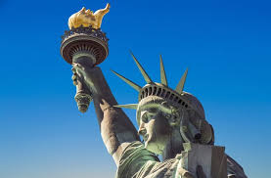
The Economics of Immigration
Jo Beth Mertens, Ph.D.
Hobart and William Smith
Colleges

Slide 7
Credits and Disclaimer
This slide deck was authored by:
Anna Maria Mayda, Georgetown University
Robert Gitter, Ohio Wesleyan University
Roger White, Whittier College
This slide deck was reviewed by:
Kirk Doran, Notre Dame
Ethan Lewis, Dartmouth College
Disclaimer
NEED presentations are designed to be nonpartisan.
It is, however, inevitable that presenters will be asked for and will provide their own views.
Such views are those of the presenter and not necessarily those of the National Economic Education Delegation (NEED).

Slide 8
Outline
Why do people migrate?
Brief history of immigration to the US
How does immigration affect the economy?
Immigration polices

Slide 9
What Is Immigration?
Immigration
The action of coming to live in another country.
Emigration
The act of leaving one’s own country and going to live in another country.

Slide 10
Why Do People Migrate?
Push factors:
Economic dislocation, violence, population pressures, religious persecution, or denial of political rights.
Pull factors:
Potential for higher wages, job opportunities, and political or religious liberty.
Uneven development helps create push and pull factors:
Disparities in income, standards of living, and the availability of jobs within and across societies.
Source: Gilder Lehrman Institute of American History.

Slide 11
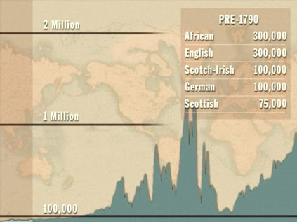
History of US Immigration
Source Countries | Pre-1790
African countries* | 300,000
England | 300,000
Scotland-Ireland | 100,000
Germany | 100,000
Scotland | 75,000
Source Countries | 1790-1820
African countries* | 85,000
Scotland-Ireland | 50,000
England | 45,000
France | 40,000
Germany | 25,000
* Slave trade and clearly not voluntary or reflective of standard motivations for immigration.
Source: https://www.libertyellisfoundation.org/immigration-timeline/.

Slide 12
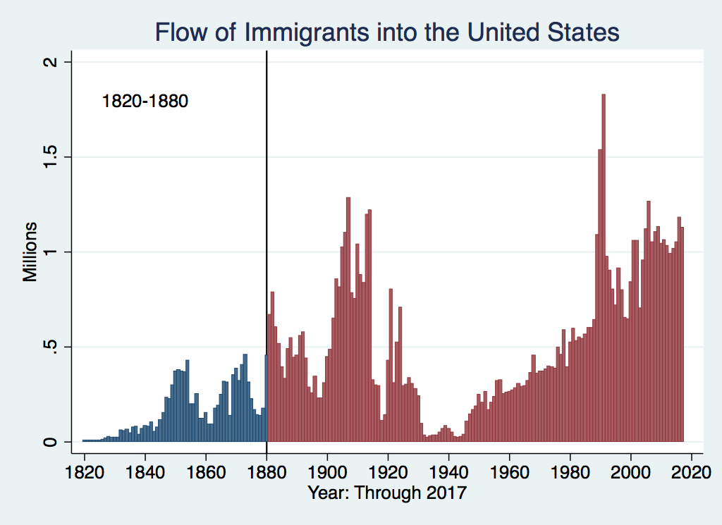
History of US Immigration
Source Countries | 1820-1880
Germany | 3,000,000
Ireland | 2,800,000
Britain | 2,000,000
Austro-Hungarian empire | 1,000,000
Canada | 750,000
China | 230,000
African countries | 50,000
Potato Famine
https://www.libertyellisfoundation.org/immigration-timeline

Slide 13
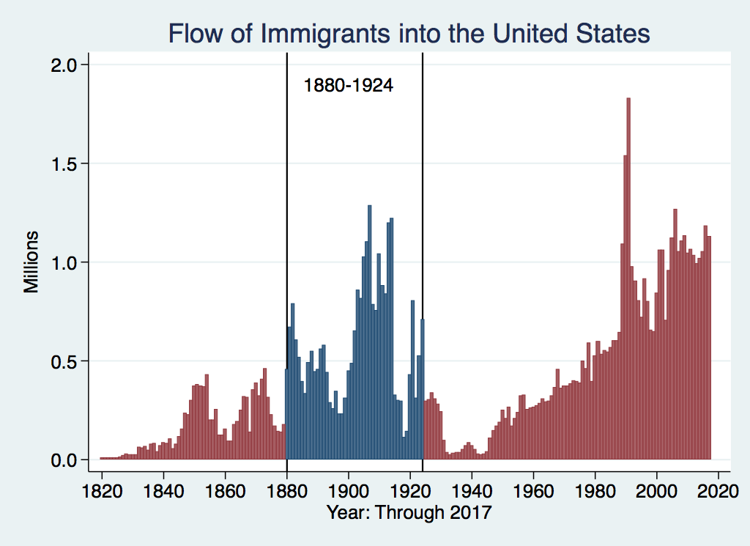
History of US Immigration
Source Country | 1880-1930
Italy | 4,600,000
Austro-Hungarian empire | 4,000,000
Russian empire | 3,300,000
German empire | 2,800,000
Britain | 2,300,000
Canada | 2,300,000
Ireland | 1,700,000

Slide 14
Nationality of US Immigrants
1830-1890 |  | 1890-1920
German |  | Austro-Hungarian
Irish |  | Italian
British |  | Russian and Soviet

Slide 15
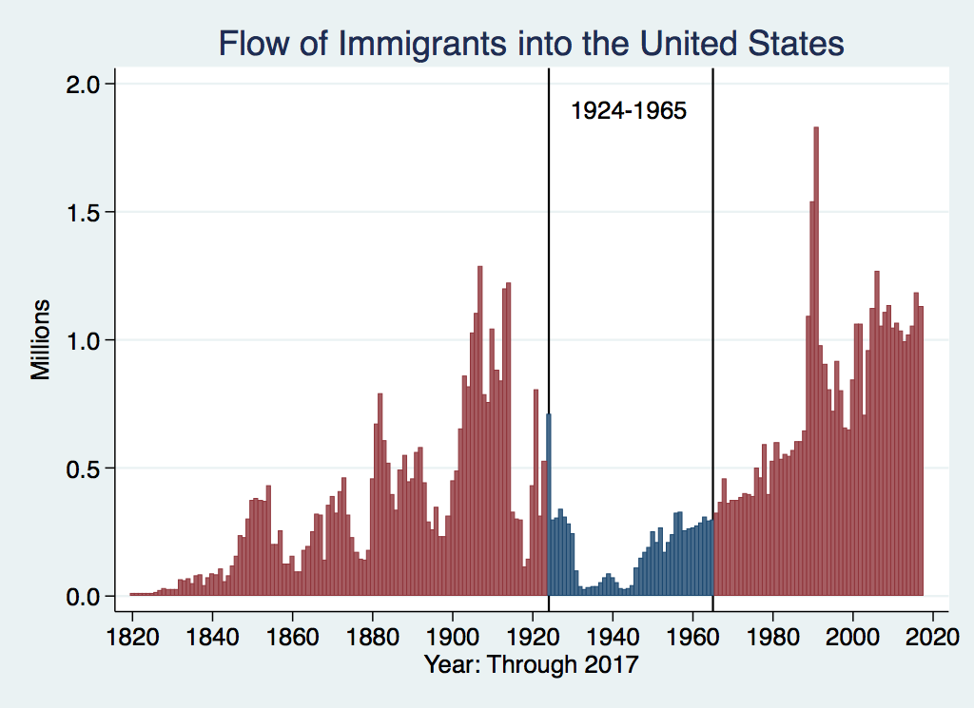
History of US Immigration
Source Countries | 1930-1965
Germany | 940,000
Canada | 900,000
Mexico | 610,000
Britain | 480,000
Italy | 390,000
Caribbean/ West Indies | 310,000
Source: https://www.libertyellisfoundation.org/immigration-timeline/.

Slide 16
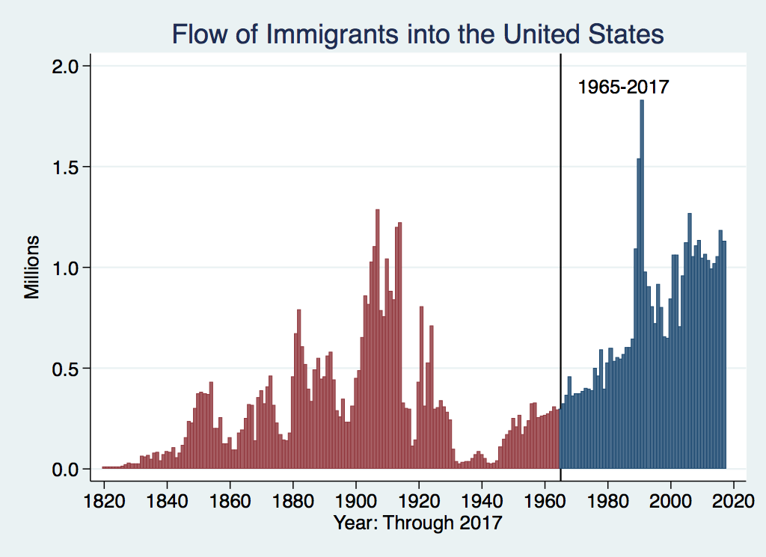
History of US Immigration: 1965-Today
Source Country | 1965-2017
Mexico | 4,300,000
Philippines | 1,400,000
South Korea | 760,000
Dominican Republic | 750,000
India | 740,000
Cuba | 700,000
Vietnam | 700,000
Canada | 650,000
1986 Immigration Reform Act gives legal status to millions
Source: https://www.libertyellisfoundation.org/immigration-timeline/.

Slide 17
Authorized Immigration by Region
37%

Slide 18
Authorized Immigration from Asia

Slide 19
Authorized Immigration from the Americas
78%

Slide 20
Immigrant Population in 2017
Categories of the total number
of immigrants in the United States.
https://www.pewresearch.org/fact-tank/2019/07/12/how-pew-research-center-counts-unauthorized-immigrants-in-us/

Slide 21
U.S. Unauthorized Immigration Totals
Pew Research Center, 5 facts about illegal immigration in the U.S., June 12, 2019

Slide 22
U.S. Unauthorized Immigration: Labor Force
Pew Research Center, 5 facts about illegal immigration in the U.S., June 12, 2019

Slide 23
Unauthorized Immigration: Education
Pew Research Center, U.S. unauthorized immigrants are more proficient in English, more educated than a decade ago, May 23, 2019

Slide 24
Unauthorized Population: Source Countries

Slide 25
Unauthorized Immigration: Where They Live
27%
14%

Slide 26
Unauthorized Immigration: Mode of Entry
Entry w/o Inspection

Slide 27
Why Do We Care? Economic Implications
GDP (Economic growth)
Labor markets
Government revenue and spending

Slide 28
Two Kinds of Economic Impacts from Immigration
Aggregate effects: The size of the pie
Income distribution: The size of slices of the pie

Slide 29
GDP: How Does This Work?
What determines the size of an economy?
Technology/productivity
Physical capital
The number of workers
Immigration adds to the number of workers.
Number of immigrants in the labor force is high
28.2 million foreign-born persons ages 16+ in the labor force in 2018.
17.4% of the total US workforce.
Evidence
Immigrants added 11% to GDP ($2 trillion) in 2016.

Slide 30
Immigration and Labor Markets

Slide 31
Labor Market Implications: Complicated
Depends on the type of immigrant: Skills/education
Similar to native-born population?
Lower-skilled?
More highly skilled?
Brings capital market implications
Low-skilled – substitutes for capital
Highly skilled – capital complementing
Source: Hong & McLaren (2015).

Slide 32
Labor Market Implications: General Principles
Short run
Harm likely to native-born workers who are similar to immigrants.
Benefit likely for other workers and owners of capital.
Long run
Lower prices will restore some of the purchasing power of those harmed.
Expanded opportunities may restore wages of harmed native-born workers.
Whether there are winners or losers in long-run depends on capital inflows, could be a wash

Slide 33
Labor Market Implications: The Surplus
The Surplus
Immigration CAN make all native-born workers and capital more productive.
This increases incomes of the native born.
In other words, the economy might not just get bigger, it might become more productive as well!
This will, on average, increase the living standards of all native-born workers and owners of capital.

Slide 34
Labor Market Implications: Evidence of Surplus
 | Surplus: % of GDP
Type of Immigrants | Short Run | Long Run
No Skill Bias | 0.24 to 0.50 | 0.02 to 0.03
Low skilled | 0.45 to 0.90 | 0.42 to 0.77
Highly skilled | 0.75 to 1.35 | 0.16 to 0.31
Source: Borjas (2014a).

Slide 35
Summary of Labor Market Effects
Immigration CAN lead to negative wage effects for competing native-born workers
Particularly high school dropouts and those in vulnerable communities.
Other workers will likely benefit
Through increased wages.
Through increased opportunity.
Owners of capital will benefit
Existing capital will earn greater returns.
More if immigrant labor complements existing capital.
Source: Hong & McLaren (2015).

Slide 36
Potential Benefits for Low-Skilled Native Workers
Immigration can increase native-born worker wages:
More demand for jobs where English is necessary
Increased demand for goods and services – increases wages in those industries.
Through money spent locally, each immigrant creates 1.2 local jobs – mostly for native-born workers.
Source: Hong & McLaren (2015).

Slide 37
Pattern of Immigration
Educational Attainment of Recent Immigrants – Last 5 Years
Source: Blau & Mackie (2017), p. 88.

Slide 38
Recent Immigrants Are Less and More Educated

Slide 39
Skilled Immigrants and Innovation
1% increase in the share of the immigrant college graduate population
9-18% increase in patenting per capita
Increased immigration increases patenting by native-born population
In the 1990s
Increased skilled immigration can account for one-third of increased patenting in that decade.
This translates into a 1.4-2.5% increase in GDP per capita by the end of the decade.

Slide 40
Immigrants and Entrepreneurship
Self-Employment Rates by Nativity
Source: Magnus Lofstrom from Current Population Survey Data.

Slide 42
Fortune 500: First- and Second-Generation Founders

Slide 43
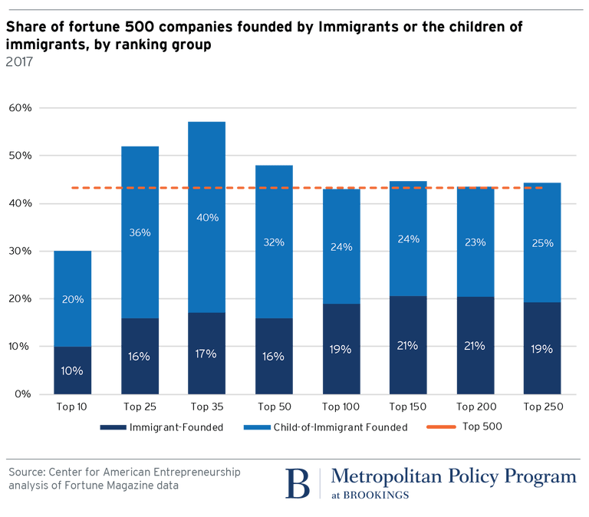

Slide 44
Government Revenues and Expenditures

Slide 45
Taxes and Benefits
Basic Question:
Taxes (income, sales, and other) immigrants pay vs. government expenditures on public benefits and services they receive.
More complicated:
Immigrants also affect the taxes paid and benefits received for many native-born residents.
Indirectly through labor and capital markets.
Changes in wages and the return to capital.

Slide 46
Age-Specific Taxes and Benefits
By Immigrant Generation, United States, 2012
Source: Blau & Mackie (2017), p. 325.

Slide 47
What Do We Know?
Immigrants who arrive while of working age:
Are, on average, net contributors.
21-year-old with a high school diploma: +$126,000 over a lifetime
Though this value gradually declines with age at arrival.
Turns negative for arrivals of age 35+
Net contribution crucially depends on characteristics
Age distribution, family composition, health status, fertility patterns
Temporary or permanent relocation
Employment in the legal labor market
Authorized or unauthorized

Slide 48
Bottom Line/Consensus of Estimates
Federal level: fiscal impact is generally positive.
State and local level: typically negative fiscal impact.

Slide 49
Implications for Major Federal Programs
Documented immigrants are less likely to use Social Security and Medicare.
Unauthorized immigrants are ineligible.
They will pay into the system but cannot receive benefits.
Medicaid: not available to legal residents for the first five years
Provide a source of revenue for an aging population.

Slide 50
Implications for Social Security
Population Age 65+ per 100 of Working Age (25-64)
Source: Blau & Mackie (2017).

Slide 51
Other Implications of Immigration

Slide 52
Other Implications
Patterns of Integration
Education
Employment and Earnings
Occupations
Poverty
Residential Integration
Language
Health
Family Patterns
The Big Misconception: Crime
Source: The Integration of Immigrants into American Society (2015).

Slide 53
Immigrants and Crime Rates
Conventional wisdom:
Immigrants commit crimes more frequently than do native-born residents.
Rising immigration leads to rising crime.
What do the data say?
Rates of incarceration are lower for foreign-born than U.S.-born.
Neighborhoods with more immigrants have lower crime rates.
Let’s Have a Look!

Slide 54
Crime: Incarceration Rates in California
Source: Butcher & Piehl (2008).

Slide 55
Crime: Incarceration Rates in California
California Institutionalization Rate
U.S.-Born and Foreign-Born Men Ages 18-40, by Place of Birth
Source: Butcher & Piehl (2008).

Slide 56
MSAs: Growing Immigration and Crime
No Relationship
Source: Butcher & Piehl (1998b).

Slide 57
Immigrants and Crime Rates
Conventional wisdom:
Immigrants commit crimes more frequently than do native born residents.
Rising immigration leads to rising crime.
What do the data say?
Rates of incarceration are lower for the foreign born than US born.
Neighborhoods with more immigrants do not have higher crime rates.
There is no evidence that deporting noncitizen immigrants affects crime rates.

Slide 58
Summary
Immigration should be thought of as increasing the population of the United States.
This brings economic growth and opportunity, just as does increasing the native-born population.
Including unauthorized immigrants, the supply of low-skilled workers is increased
This lowers the wages of low-skilled workers.
But also increases labor force participation among highly skilled workers.

Slide 59
At the Same Time….
Immigrants are often a select group:
Willing to incur an enormous personal or familial cost to better their lives.
As a result:
Immigrants tend to commit crimes at low rates.
Immigrants tend to be entrepreneurial and to add significantly to economic growth.
Although there are distributional issues:
Immigration is an important contributor to economic growth.
Immigration helps to sustain vital government programs.

Slide 60
About Conventional Wisdom
Native-born unskilled workers
There is some negative impact on their wages.
But who wins and loses depend on the skill mix of immigrants;
when this skill mix changes, so do its effects.
Crime
Immigrants, both authorized and unauthorized, commit crimes at much lower rates than do native-born residents.
Government programs
Federal: immigrants are a source of revenue and stability for some important programs.
State and local: because education is funded at the local level, this can be a drain on local government coffers.

Slide 61
Thank you!
Any Questions?
www.NEEDelegation.org
Jo Beth Mertens, PhD
mertens@hws.edu
Contact NEED: info@needelegation.org
Submit a testimonial: www.NEEDelegation.org/testimonials.php
Become a Friend of NEED: www.NEEDelegation.org/friend.php

