Slide 1
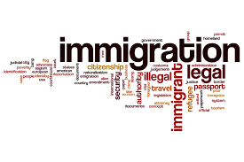
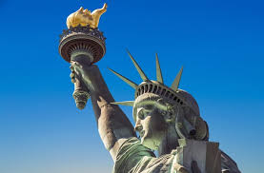
The Economics of Immigration
AAUW, Marin County
May 14, 2025
Jon Haveman, Ph.D.
National Economic Education Delegation

Slide 2
National Economic Education Delegation
Vision
  One day, the public discussion of policy issues will be grounded in an accurate perception of the underlying economic principles and data.
Mission
  NEED unites the skills and knowledge of a vast network of professional economists to promote understanding of the economics of policy issues in the United States.
NEED Presentations
  Are nonpartisan and intended to reflect the consensus of the economics profession.

Slide 3
Who Are We?
Honorary Board: 54 members
  2 Fed Chairs: Janet Yellen, Ben Bernanke
  6 Chairs Council of Economic Advisers
    Furman (D), Rosen (R), Bernanke (R), Yellen (D), Tyson (D), Goolsbee (D)
  4 Nobel Prize Winners
    Akerlof, Smith, Maskin, Bernanke
Delegates: 652+ members
  At all levels of academia and some in government service
  All have a Ph.D. in economics
  Crowdsource slide decks
  Give presentations
Global Partners: 49 Ph.D. Economists
  Aid in slide deck development

Slide 4
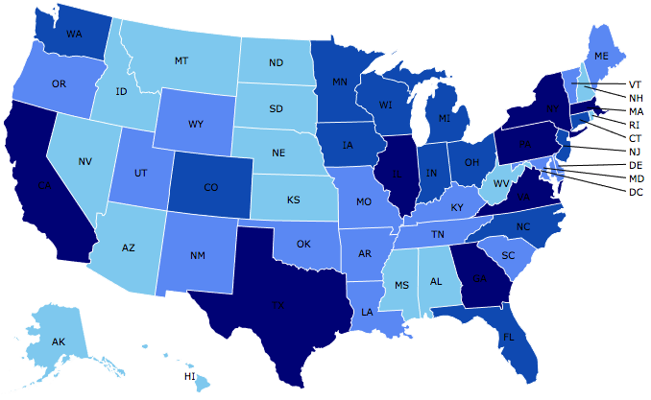
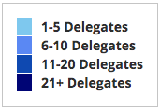
Where Are We?

Slide 5
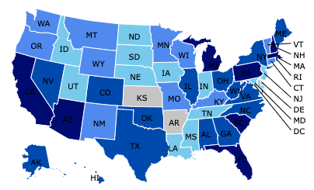
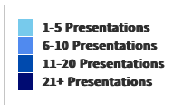
Where Have We Presented? (1,240 Talks)

Slide 6
Available NEED Topics Include:
US Economy
Healthcare Economics
Climate Change
Economic Inequality
Economic Mobility
Trade and Globalization
Minimum Wages
Immigration Economics
Housing Policy
Federal Budgets
Federal Debt
Black-White Wealth Gap
Autonomous Vehicles
US Social Policy

Slide 7
Credits and Disclaimer
This slide deck was authored by:
  Anna Maria Mayda, Georgetown University
  Robert Gitter, Ohio Wesleyan University
  Roger White, Whittier College
This slide deck was reviewed by:
  Kirk Doran, Notre Dame
  Ethan Lewis, Dartmouth College
Disclaimer
  NEED presentations are designed to be nonpartisan.
  It is, however, inevitable that presenters will be asked for and will provide their own views.
  Such views are those of the presenter and not necessarily those of the National Economic Education Delegation (NEED).

Slide 8
Outline
Quiz!
Why do people migrate?
The nature of immigration to the US
Economics of immigration
Recent immigration issues

Slide 9
Immigration Quiz
What % of the U.S. population are not native-born?
  14%
What % of the world’s population are not native-born?
  3.6%
How long has the average undocumented immigrant lived in the United States?
  A. 3 months
  B. 2 years
  C. 10 years
  D. 25 years
21% of children born to native parents are high-income earners (above the middle class).
What % of kids born to immigrants are high-income earners?
  A. 15%
  B. 21%
  C. 28%
  D. 35%
In 2021, 8% of Americans lived in poverty. What percent of immigrants lived in poverty?
  13%
Source: Freakonomics – How Much Do You Know About Immigration?

Slide 10
Immigration Quiz
Immigrants are responsible for what % of patents in the United States?
  36%
    23% of inventors on record
    13% from increase in native born patenting
What % of green cards go to family rather than employment-based immigration?
  66% go to family-based
What % of the U.S. workforce are immigrants?
  18%
Native-born Americans receive $8k on average in benefits. What is it for immigrants?
  $6,000
100 years ago, most immigrants were from Europe. Today, Latin America and Asia. Is the rate of assimilation:
  Faster? Slower? About the same?
Source: Freakonomics – How Much Do You Know About Immigration?

Slide 11
Why Do People Migrate?
Push factors:
  Disparities in income/standards of living, and the availability of jobs, violence/war, climate change, natural disasters, population pressures, economic dislocation, religious persecution, and denial of political rights.
Pull factors:
  Potential for economic prosperity (higher wages, job opportunities), physical security, political freedom, and religious liberty.
Source: Gilder Lehrman Institute of American History.

Slide 12
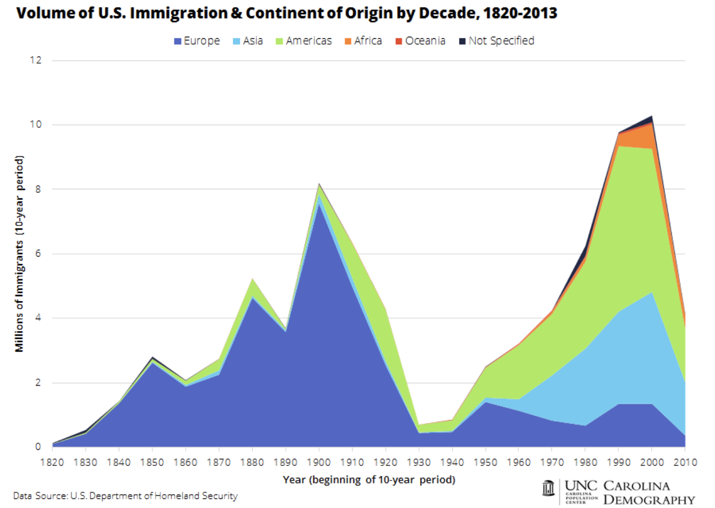

Slide 13
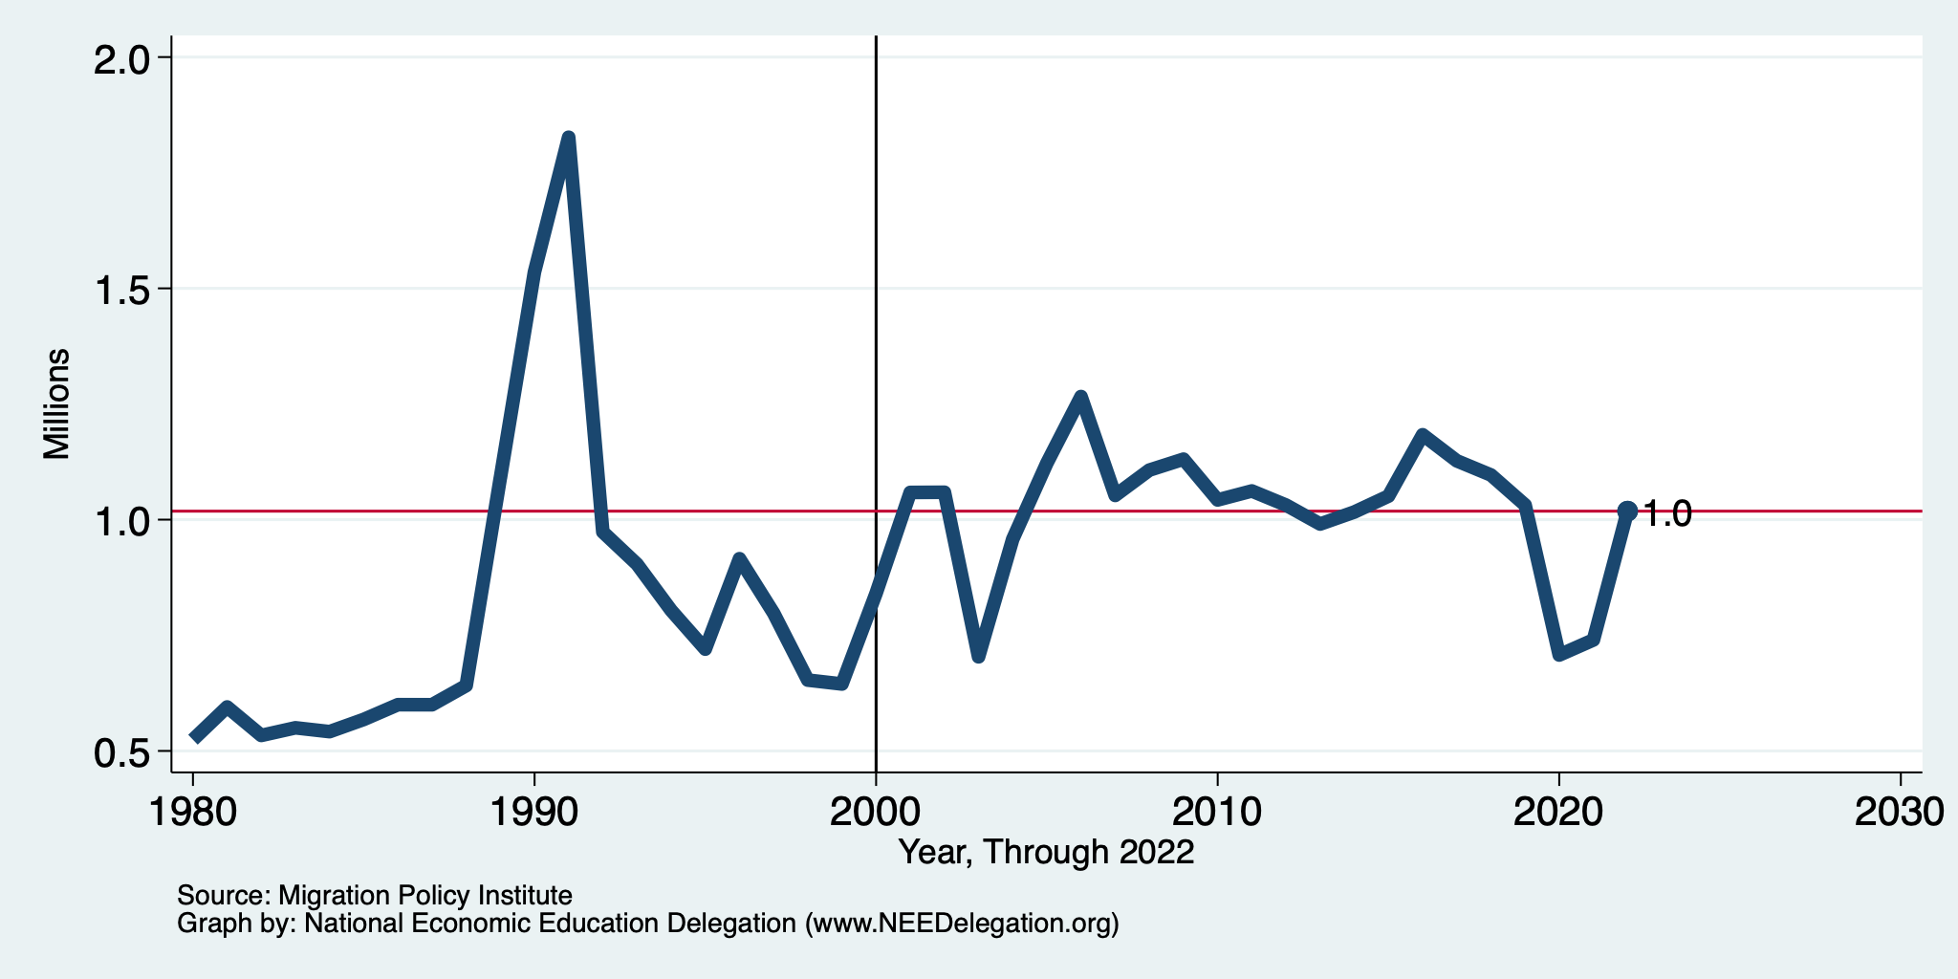
Recent Trends in Authorized Immigration
2022
1.0 Million

Slide 14
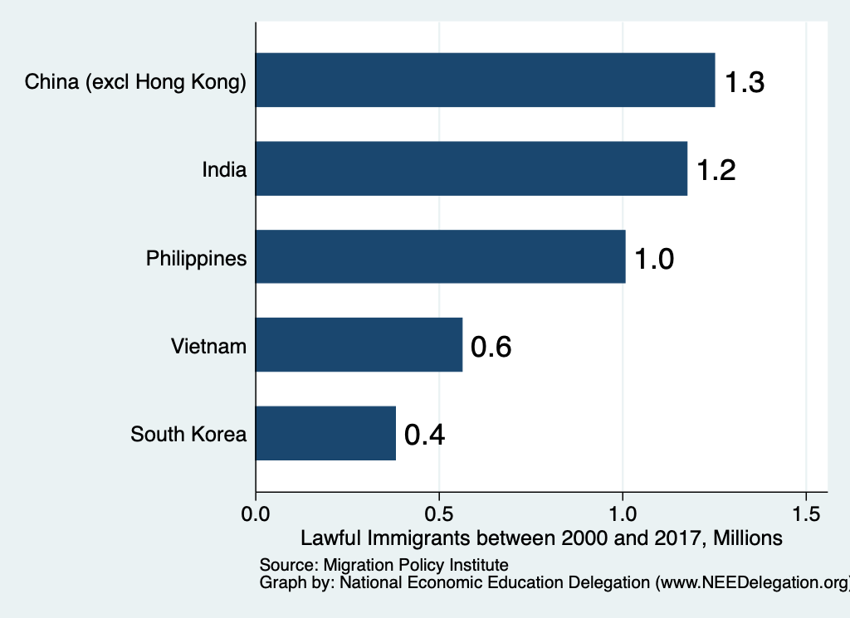
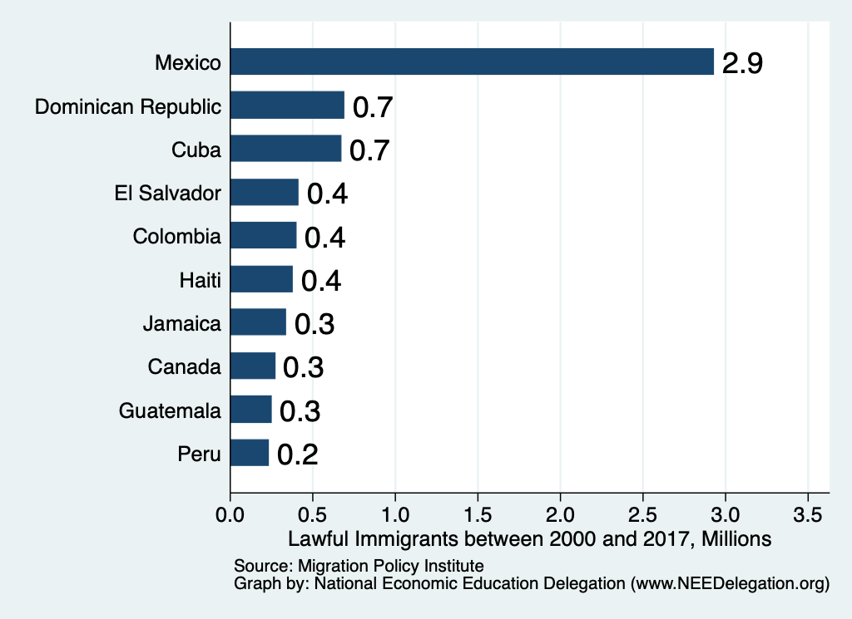
Authorized Immigration by Source

Slide 15
UNauthorized Immigration

Slide 16
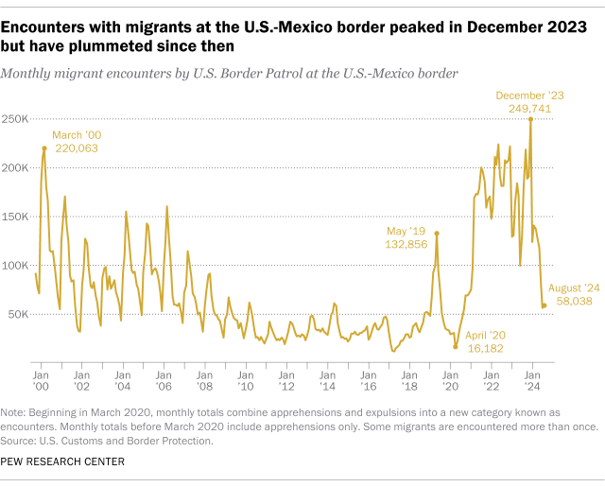
Source: Customs and Border Patrol
https://usafacts.org/articles/what-can-the-data-tell-us-about-unauthorized-immigration

Slide 17
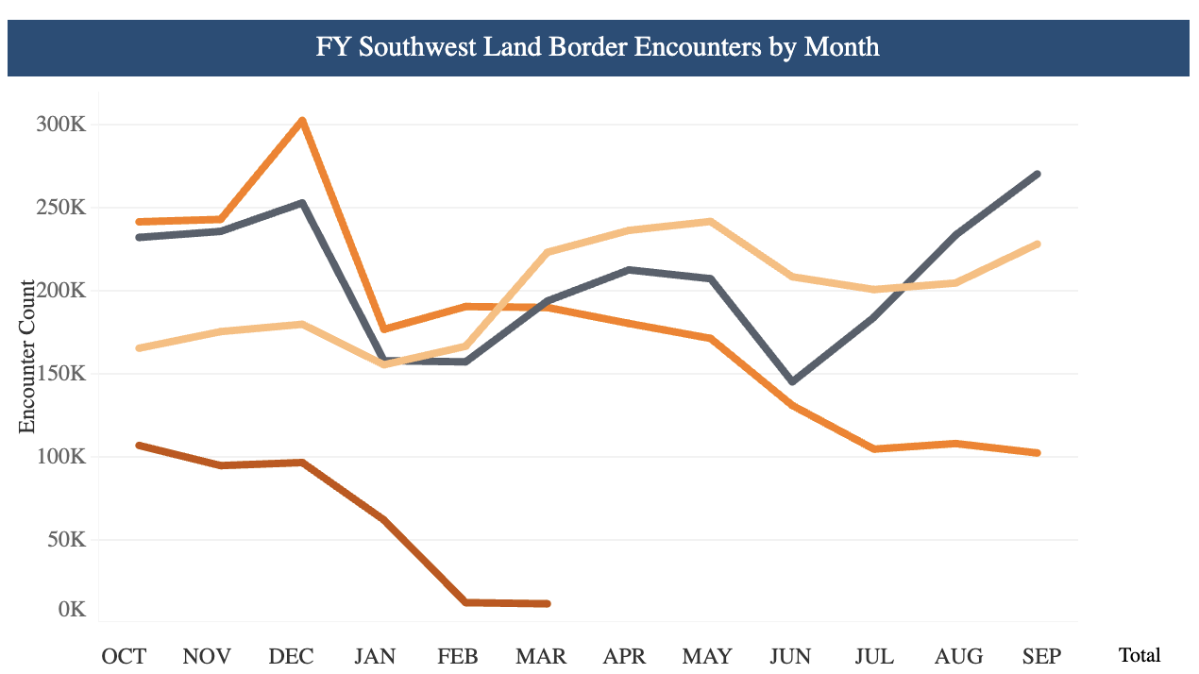
Recent Border Encounters
2023
2022
2024
2025

Slide 18
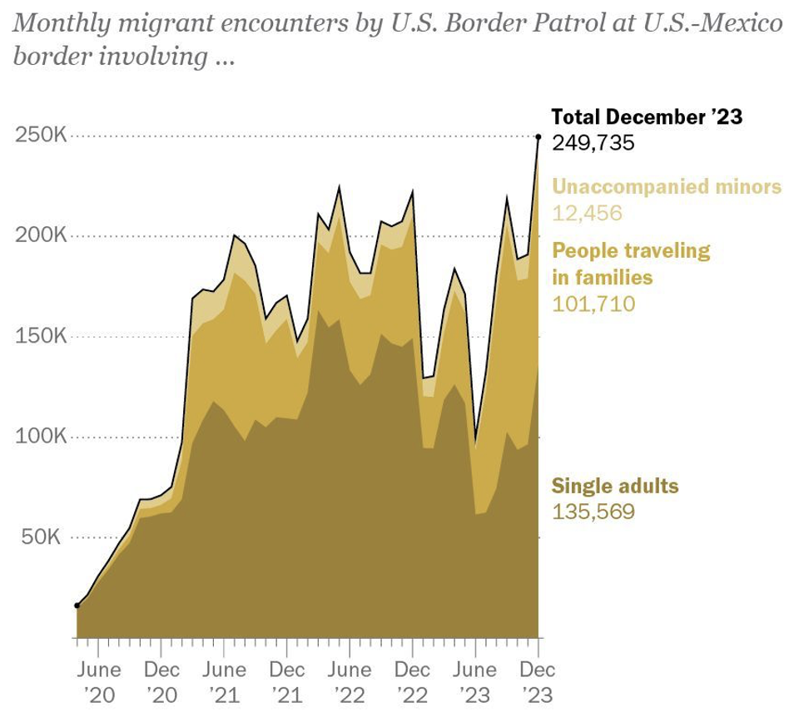
Growing #s of People Traveling in Families
Source: Pew Research Center, US Customs and Border Protection

Slide 19
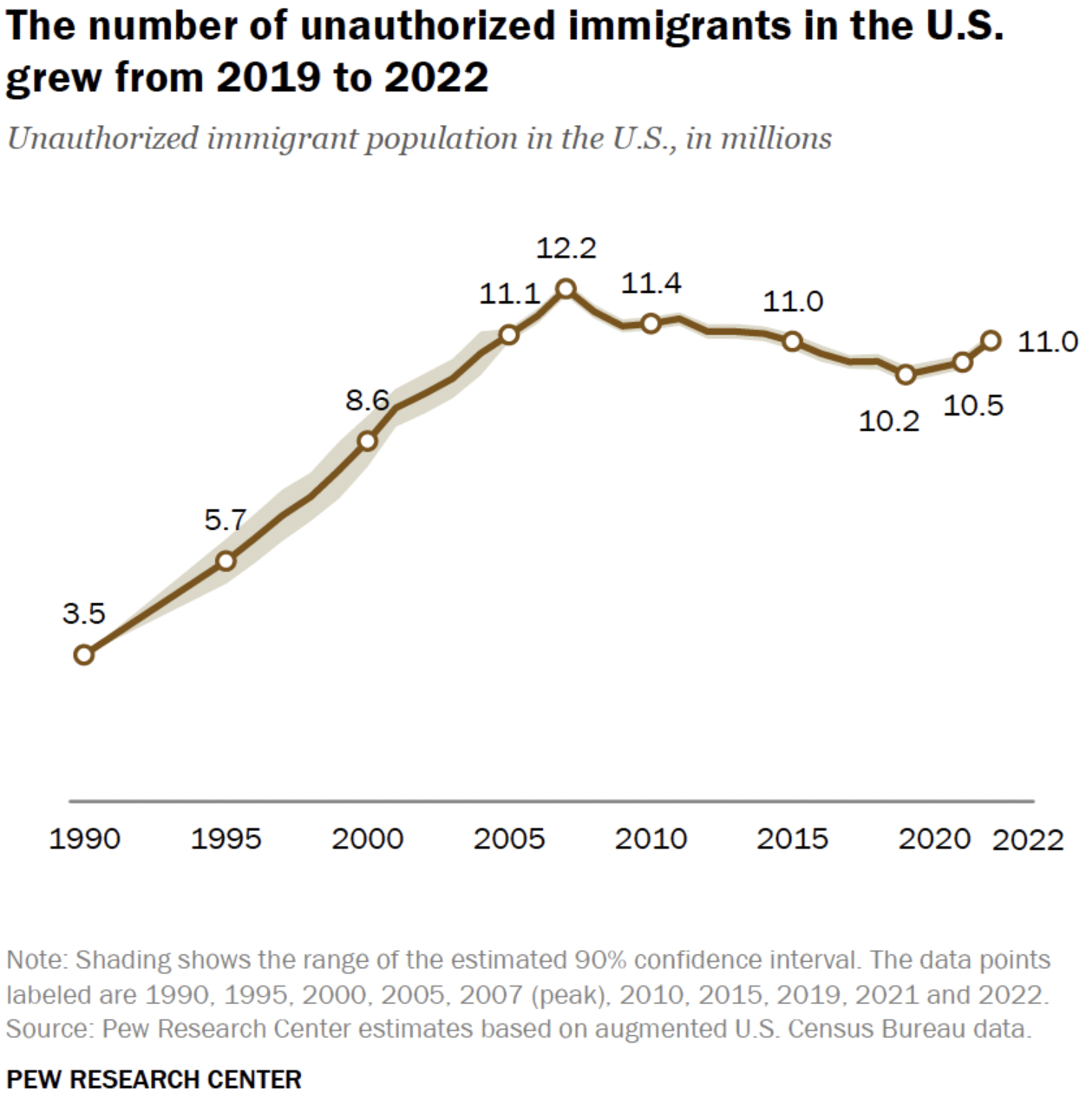
U.S. Unauthorized Immigration Totals
And is about the same
As in 2015.
Data suggest:
- 11.7 in 2023.
Less than 13 million
currently
Source: Pew Research Center, What we know about unauthorized immigrants living in the U.S., July 22, 2024

Slide 20
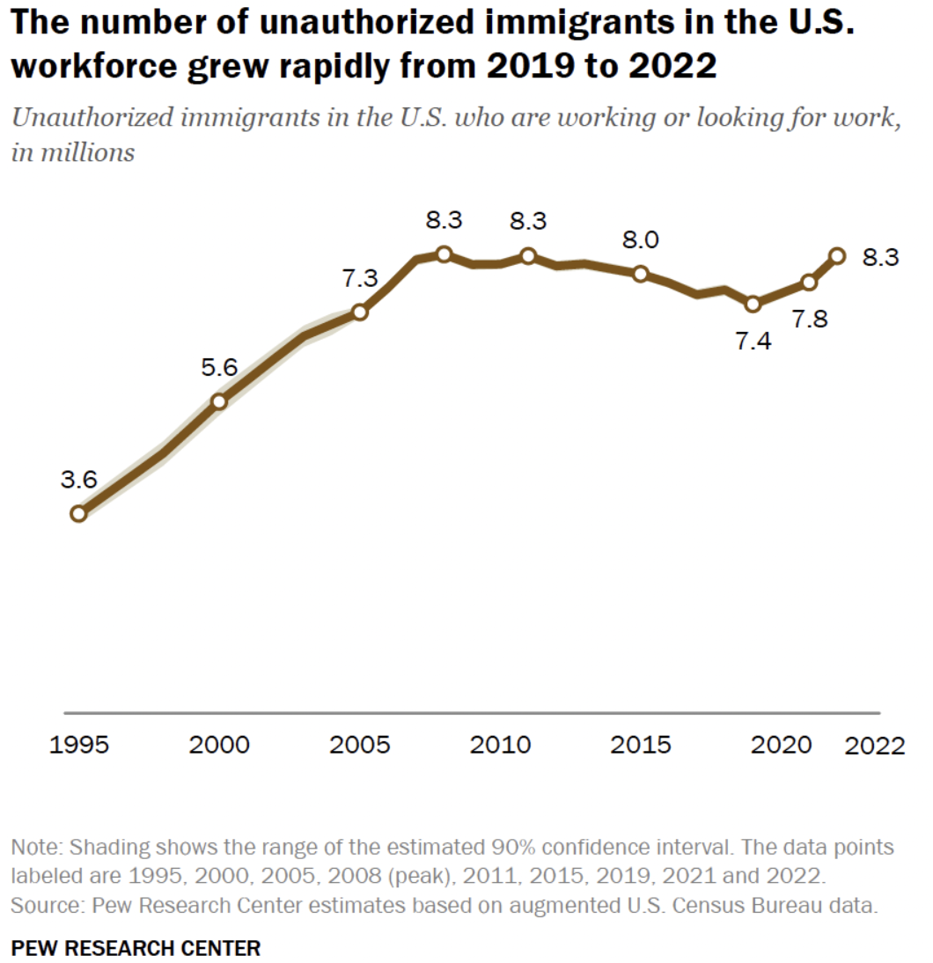
U.S. Unauthorized Immigration: Labor Force
And is about the same
As in 2006-2010.
5% of labor force
3% of population
Source: Pew Research Center, What we know about unauthorized immigrants living in the U.S., July 22, 2024

Slide 21
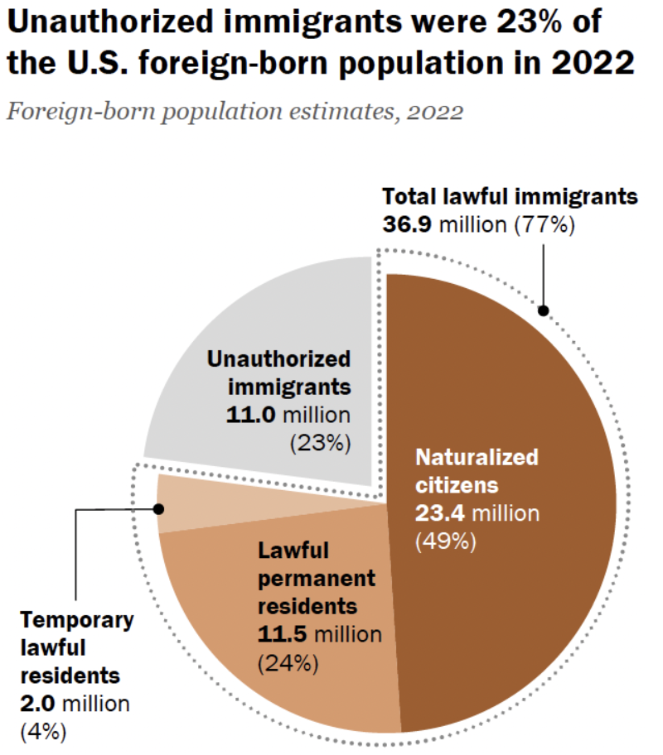
Total Foreign-Born (2022)
Population: 47.9 million
Total Foreign-Born (Current)
Population: 49.7 million
Source: Pew Research Center, What we know about unauthorized immigrants living in the U.S., July 22, 2024

Slide 22
Why Do We Care? Economic Implications
Conventional Wisdom Issues:
  Labor markets: Wages and Jobs
  Government Revenue and Spending
  Crime
Other issues (that don’t get talked about much):
  Gross Domestic Product (GDP)
  Innovation and Entrepreneurship

Slide 23
GDP: How Does This Work?
What determines the size of an economy?
  Physical capital
  Technology/productivity
  The number of workers
    Immigration adds to the number of workers.
Number of immigrants in the labor force is high
  33.0 million foreign-born persons ages 16+ in the labor force in August/24.
  19.6% of the total US workforce.
Evidence
  Immigrants added 11% to GDP ($2 trillion) in 2016.
Federal Reserve Bank of St. Louis (https://fred.stlouisfed.org/)
National Academies of Sciences, Engineering, and Medicine (2017) “The Economic and Fiscal Consequences of Immigration”.

Slide 24
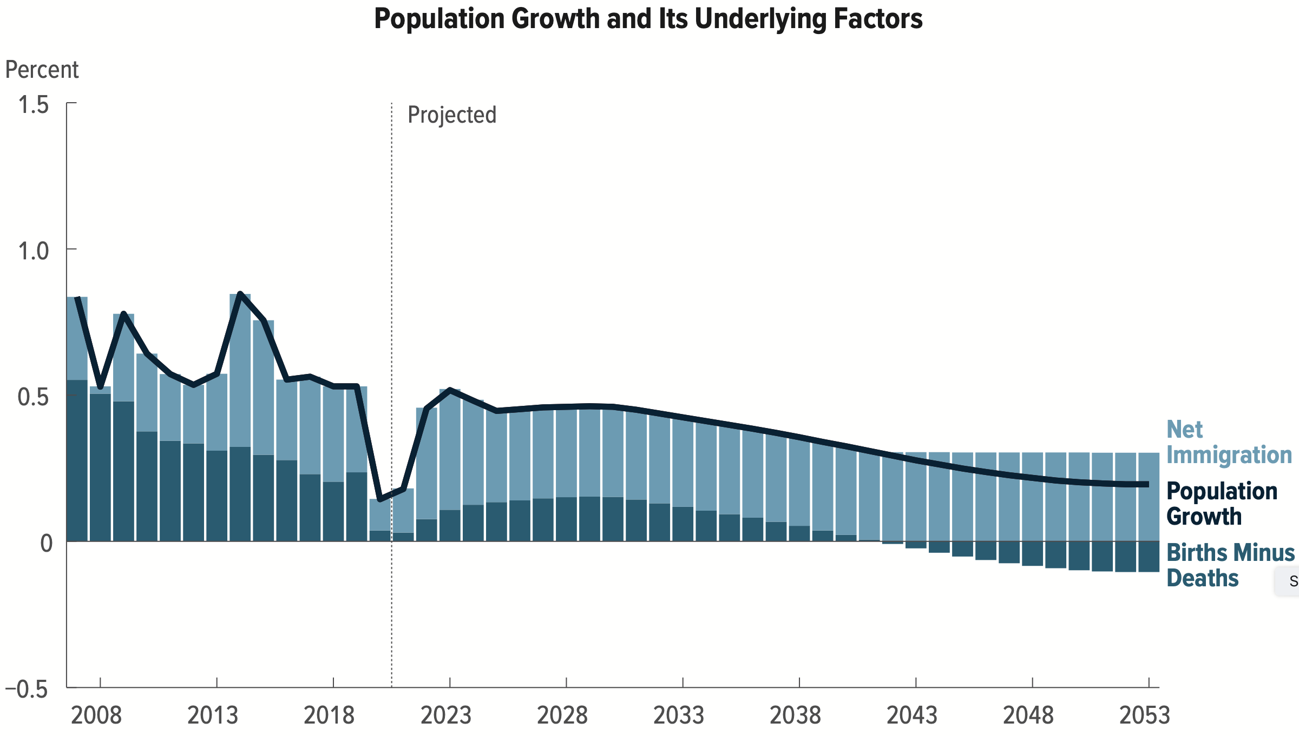
Is Immigration Saving the Day?
The vast majority of additions to the
Population in the last several years
Has been from immigration.
Source: CBO – The Demographic Outlook, 2023-2053

Slide 25
Jobs: Conventional Wisdom…Upended
What is the conventional wisdom?
  Low-skilled immigrants come in and take jobs from low-skilled native-born individuals.
    1-1 tradeoff.
What does new research show?
  Low-skilled immigrants contribute positively to the economy.
    Every 100 low-skilled immigrants: create 9 jobs for low-skilled native-born.
    They create opportunities for low-skilled native-born workers.
  Low-skilled immigrants take jobs that native-born don’t want.

Slide 26
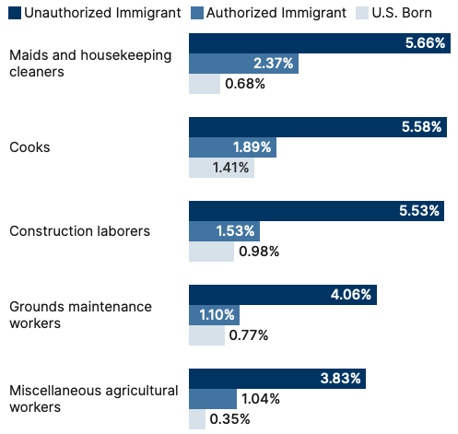
Share of Workers in Each Occupations

Slide 27
Fortune 500: First- and Second-Generation Founders

Slide 28
Government Revenues and Expenditures

Slide 29
Topics?
Basic Question:
  Taxes (income, sales, and other) immigrants pay vs. government expenditures on public benefits and services they receive.
More complicated:
  Immigrants also affect the fiscal equation for many native-born residents.
    Indirectly through labor and capital markets.
    Changes in wages and the return to capital.

Slide 30
Age-Specific Taxes and Benefits
By Immigrant Generation, United States, 2012
Source: Blau & Mackie (2017), p. 325.

Slide 31
Bottom Line/Consensus of Estimates
Federal level: fiscal impact is generally positive.
State and local level: typically negative fiscal impact.

Slide 32
Implications for Major Federal Programs
Documented immigrants are less likely to use Social Security and Medicare.
Unauthorized immigrants are ineligible.
  They will pay into the system but cannot receive benefits.
Medicaid: not available to legal residents for the first five years.
Provide a source of revenue for an aging population.

Slide 33
Immigrants and Crime Rates
Conventional wisdom:
  Immigrants commit crimes more frequently than do native-born residents.
  Rising immigration leads to rising crime.
What do the data say?
  Rates of incarceration are lower for foreign-born than U.S.-born.
  Neighborhoods with more immigrants have lower crime rates.
Let’s Have a Look!

Slide 34
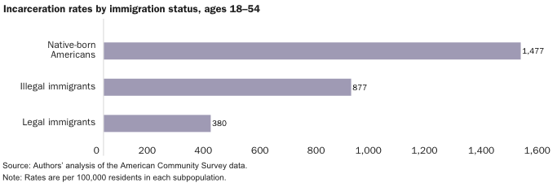
Incarceration by Immigration Status, 2018
Source: Cato Institute, Illegal Immigrant Incarceration Rates, 2010–2018: Demographics and Policy Implications, April 2020.

Slide 35
Immigrants and Crime Rates
Conventional wisdom:
  Immigrants commit crimes more frequently than do native-born residents.
  Rising immigration leads to rising crime.
What do the data say?
  Rates of incarceration are lower for the foreign born than US born.
  Neighborhoods with more immigrants have lower crime rates.
  There is no evidence that deporting noncitizen immigrants affects crime rates.

Slide 36
Summary
Immigration can be thought of as increasing the population of the United States.
  But they are a select group.
This brings economic growth and opportunity, just as does increasing the native-born population.
  But not crime.
Including unauthorized immigrants, the supply of low-skilled workers is increased.
  This lowers the wages of low-skilled workers.
  But also increases labor force participation among highly skilled workers.

Slide 37
At the Same Time….
Immigrants are often a select group:
  Willing to incur an enormous personal or familial cost to better their lives.
As a result:
  Immigrants tend to be entrepreneurial and to add significantly to economic growth.
Although there are distributional issues:
  Immigration is an important contributor to economic growth.
  Immigration helps to sustain vital government programs.

Slide 38
About Conventional Wisdom
Native-born unskilled workers
  There is some negative impact on their wages.
  But opportunities are also created.
Crime
  Immigrants, both authorized and unauthorized, commit crimes at much lower rates than do native-born residents.
Government programs
  Federal: immigrants are a source of revenue and stability for some important programs.
  State and local: because education is funded at the local level, this can be a drain on local government coffers.

Slide 39
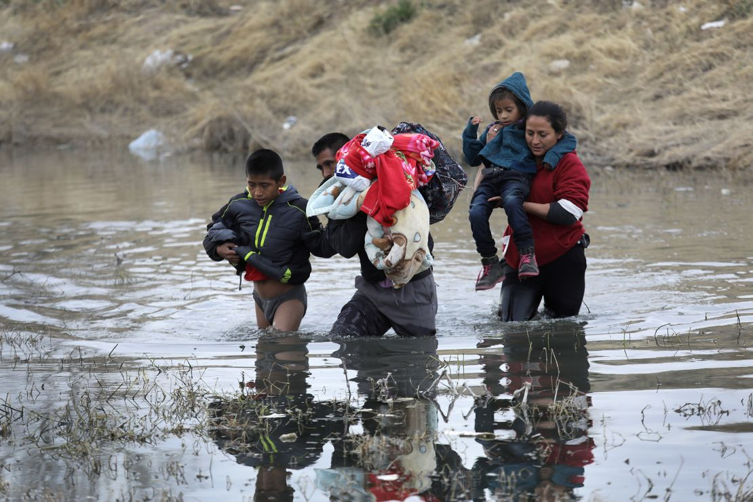
Recent Immigration Issues
DACA
The Northern Triangle
The Venezuelan Wave
Haitians in Springfield, Ohio
Mass Deportations

Slide 40
DACA (Deferred Action for Childhood Arrivals)
Entered U.S. before age 16, now in U.S.
Entered before June 2007.
Currently in school, high school grad or honorable discharge from military.
No felony conviction or threat to security.
Renewable every 2 years.
Executive Order by Obama, Trump ended, Biden restored.

Slide 41
DACA Statistics
825,000 of them. Arrived prior to June 15, 2007
  343,000 employed in essential jobs. (According to DHS: health/education)
  168,000 in California
1/3 arrived before the age of 5.
Average is now 26 years old.
1.3 million live with a DACA individual
  300,000 dependent children.
Tax revenues:
  $6.2 billion federal, $3.3 billion state

Slide 42
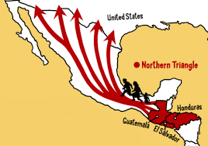
The Northern Triangle

Slide 43
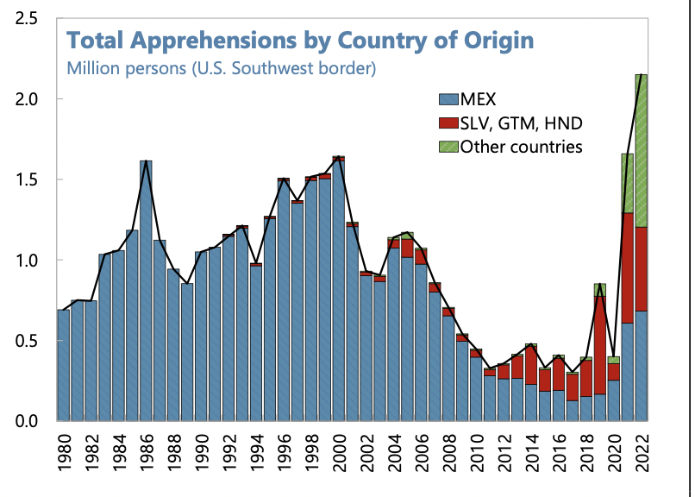
Northern Triangle Apprehensions
(Northern Triangle Countries in Red)

Slide 44
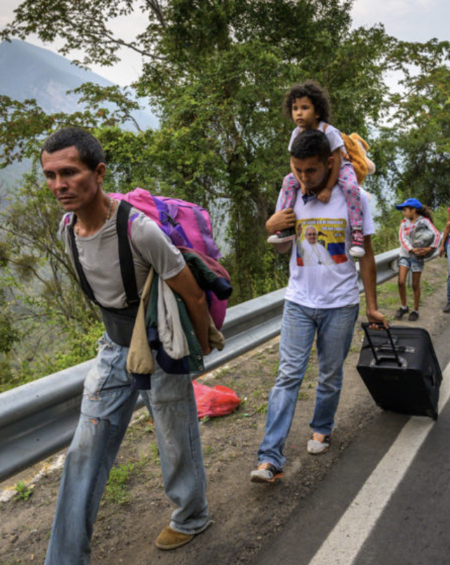
The Surge of Venezuelans
Almost 8 million Venezuelans have left
Caused by economic mismanagement, hyperinflation, unrest, violence
Largest national group arrested for entering U.S.
Temporary Protected Status
  Venezuela, Nicaragua, Haiti, and Cuba
Increasingly stuck in Mexico

Slide 45
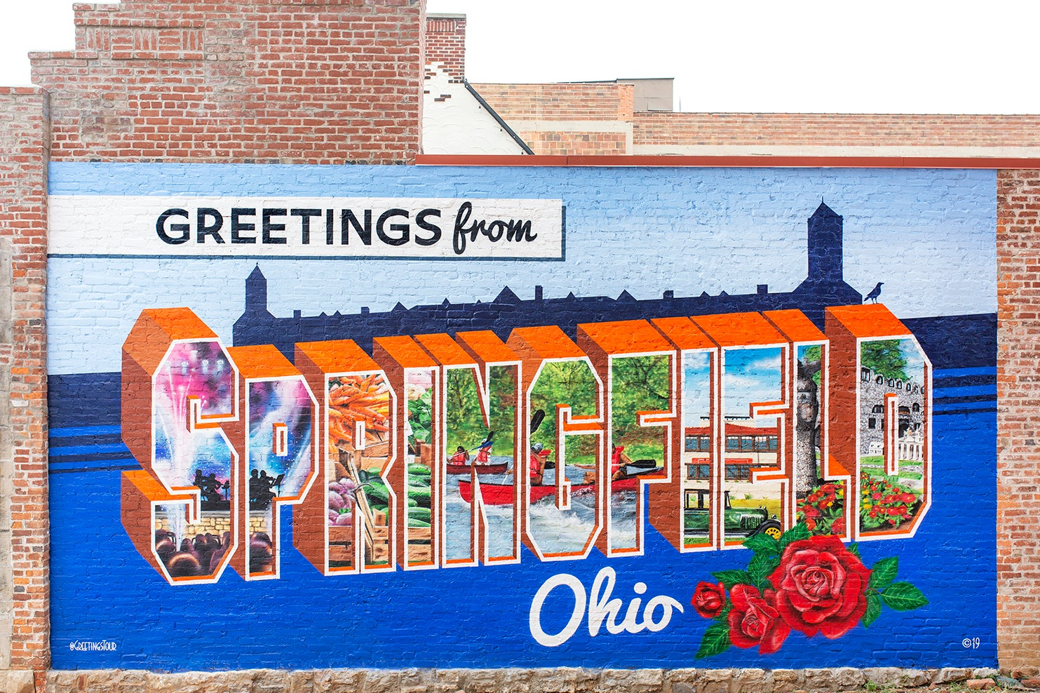
What’s Going on in Springfield, Ohio?

Slide 46
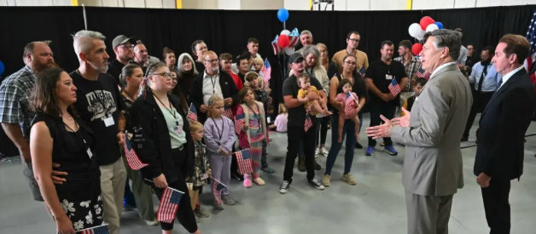
Only Currently Permissible Refugees: S. Africa

Slide 47
Mass Deportations
Immigrants work different jobs than do native-born workers.
Immigrants contribute to the local economy.
  GDP losses of up to $1.7 trillion annually.
Immigrants keep prices low: in particular, food!
Deportations impact tax revenues.
  $1,300 more in on average than out, annually.
  Unauthorized immigrants: $22.6 billion in social security and $5.7 billion in Medicare payments.
Deportations are expensive ($13,000 each).
  Total cost $315 billion.
They rob people of their dignity.

Slide 48
Thank you!
Any Questions?
www.NEEDEcon.org
Jon D. Haveman, Ph.D.
Jon@NEEDEcon.org
Contact NEED: info@needecon.org
Submit a testimonial: www.NEEDEcon.org/testimonials.php
Become a Friend of NEED: www.NEEDEcon.org/friend.php

